Slide 1

Istituto Nazionale di Fisica Nucleare
Positron source optimization
with GIOTTO and a sub-harmonic buncher
A. Bacci, M. Rossetti Conti
& I. Drebot (on ICS)
2nd FCC Italy & France Workshop, 4-6 November 2024, Venice, Italy
Notes:
Good, afternoon, I thank the organizers for this contribution to the INFN-Milano activities on FCC

Slide 2
  Index
2
INFN-MI activities on Positron Sources optimization
focusing more on the methods than on one the specific case
  GIOTTO AI code, the main tool applied to the source beam line optimization
  The most relevant results obtained in this activity
----- the latest news -----
The use of a low-frequency buncher to improve the e⁺ capture
Optimizations by “orchestrating” an array of solenoids on the AMD field profile
One-slide on Illya Drebot contribute about BD with ICS in the FCC main ring
Conclusions

Slide 3
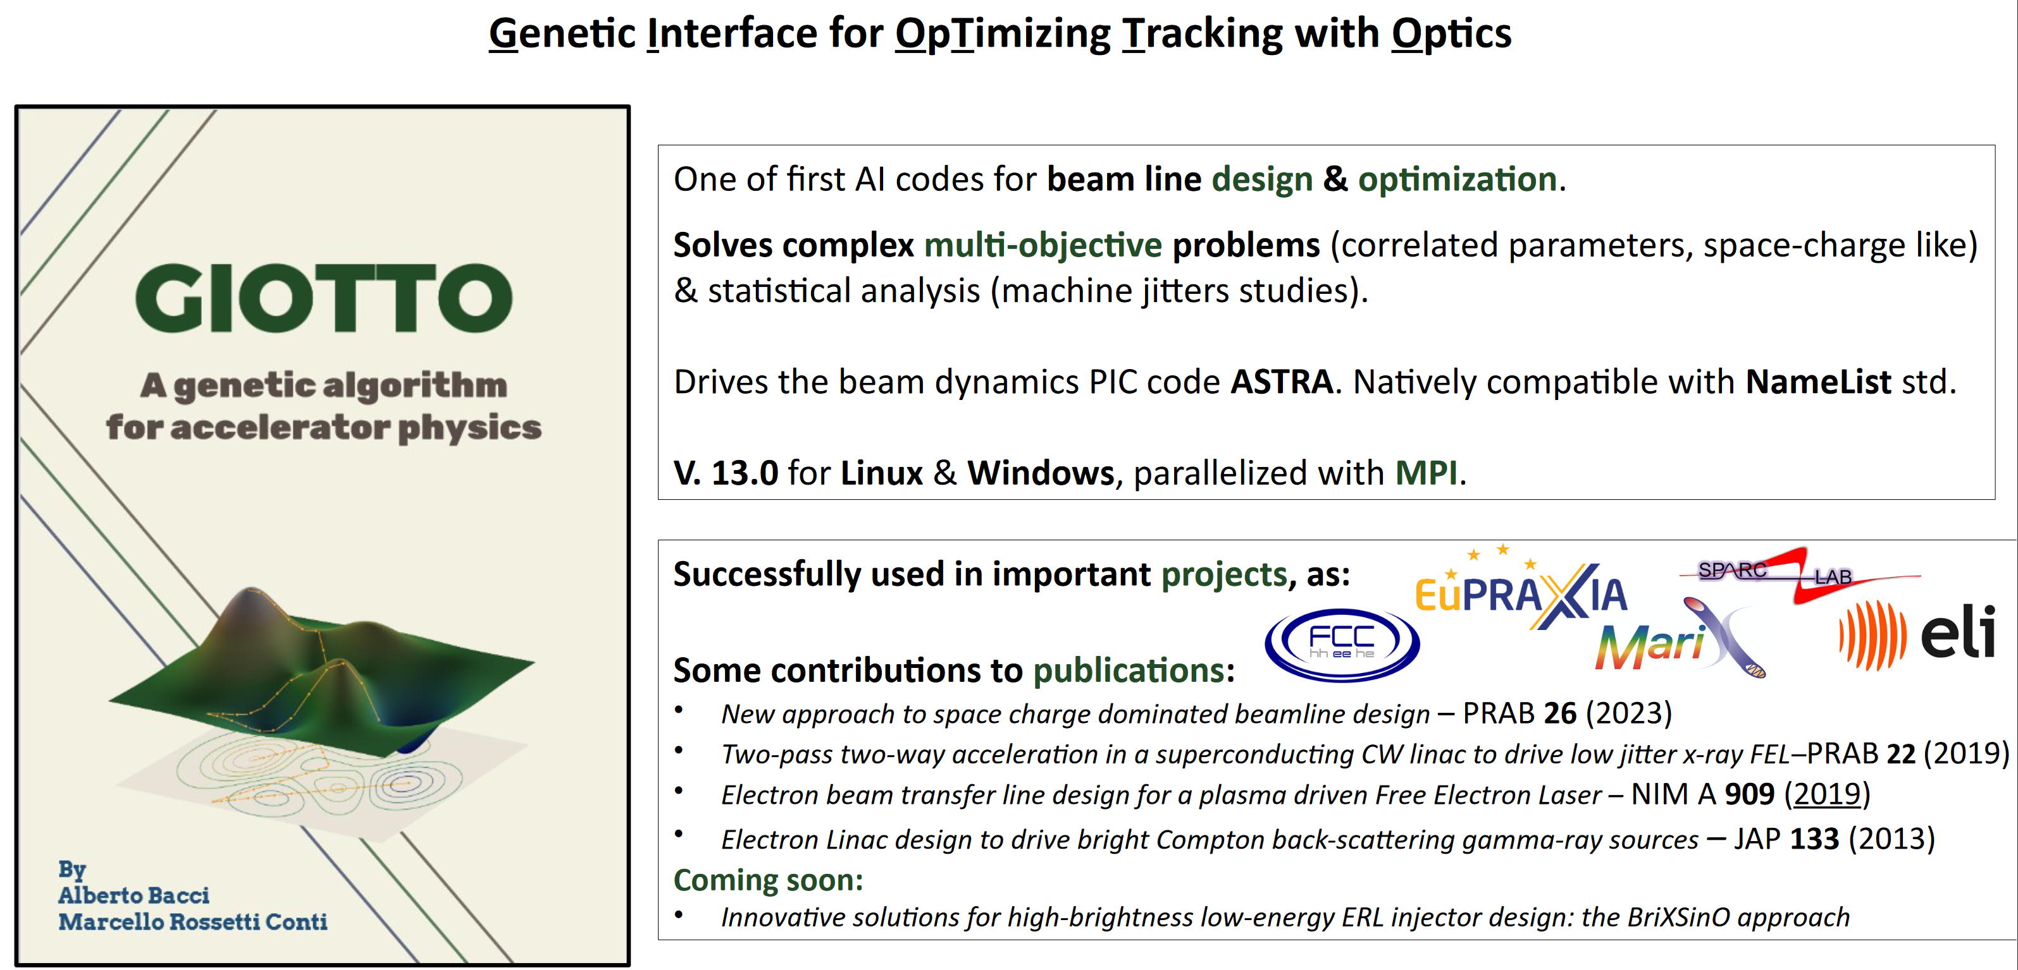
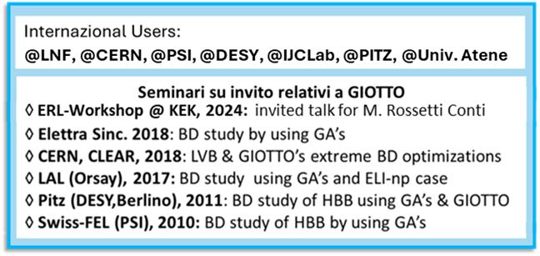
  GIOTTO AI code for beam line optimization
3
Genetic Interface for OpTimizing Tracking with Optics
from 2007
Notes:
Invited @ ERL UN MESE FA
In principle it can drive a generic code, or python script
keyikey

Slide 4
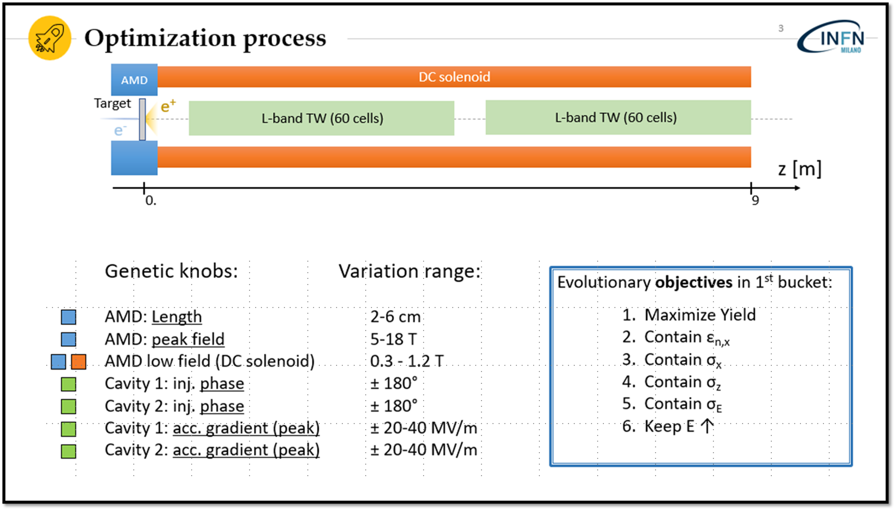
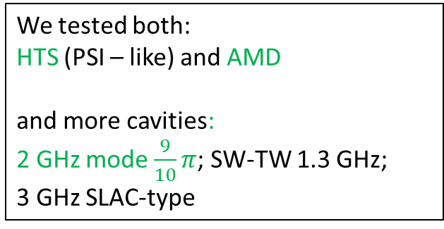
  2022/23 Collaboration with IJClab
4
Our activity main Goal:
start from IJClab SOTA layout and with GIOTTO & our BD expertise to push the optimization @ its maximum
We kept frozen initial positron distrib.:
“Amor5X0_E6GeV_Spot0.5mm_Emxy15um_OutputPositrons_Astra.ini”;
The only modification:
an Astra’s flag to consider the beam extraction from the target
Example of an of the optimization we performed
We tested both:
HTS (PSI – like) and AMD
and more cavities:
2 GHz mode $\frac{9}{10}π$; SW-TW 1.3 GHz;
3 GHz SLAC-type
1
2
3
4
5
6
7
M. Rossetti Conti
Notes:
Positron yeld

Slide 5
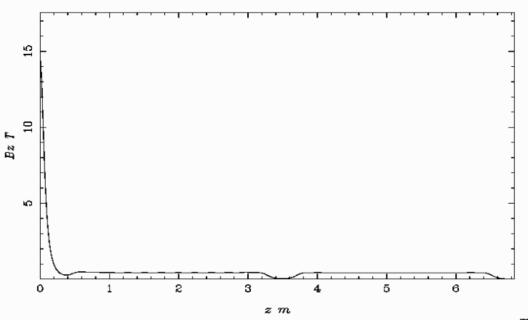
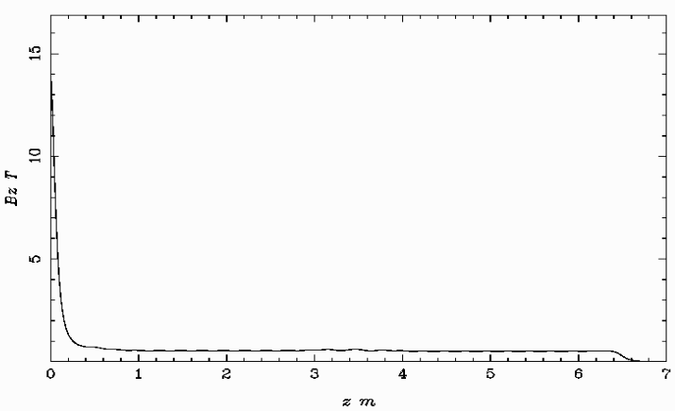
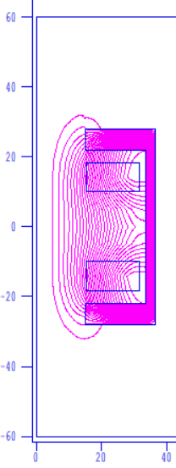

  GIOTTO bridge coils optimization test
5
HTS – Mag. Device field profile
Optimization magnetic field profile
Bz-Hyperbole completion
Bz-plateau= 0.55T
a bridge solenoid
Genetic knobs: +3
Bridge coil : position
Bridge coil 1: field
Bridge coil 2: field
Notes:
Two Helmholtz coils.
We built the field profile with superfish

Slide 6
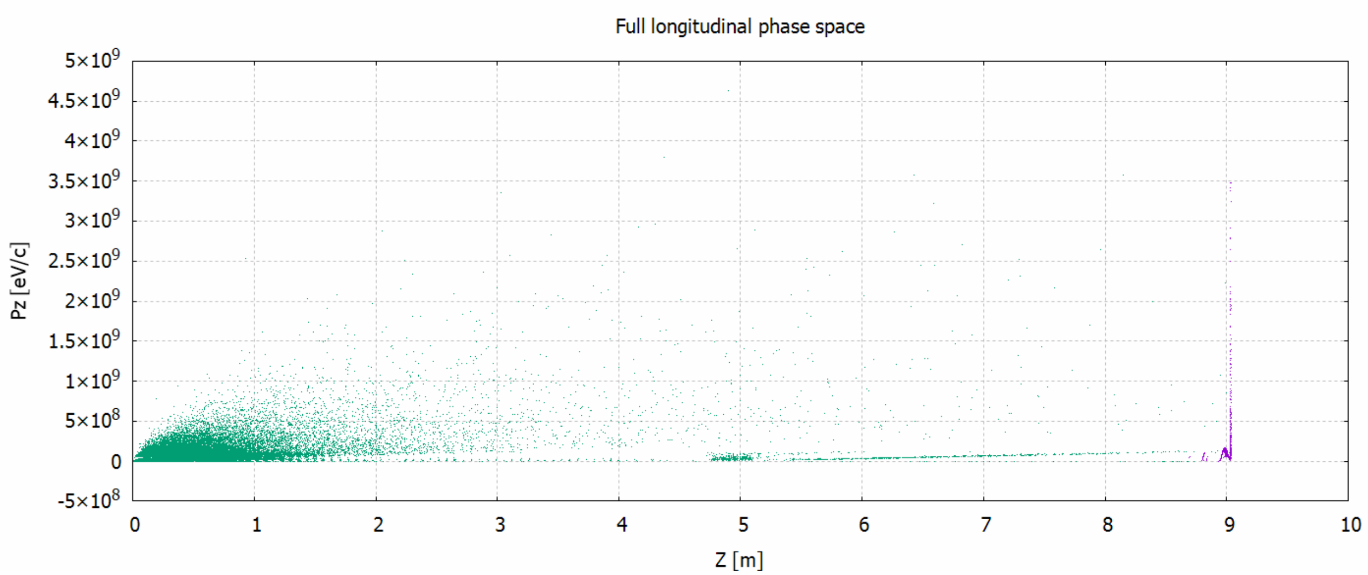
  A new GIOTTO feature: the window optimization
6
GIOTTO now optimizes particle distribution subsets within specific windows (6D)
here within the first bucket optimization (z-cut, pz-cut).
two RF buckets
Macroparticles: 136 k
In green, the dead particles; in violet, the live ones

Slide 7
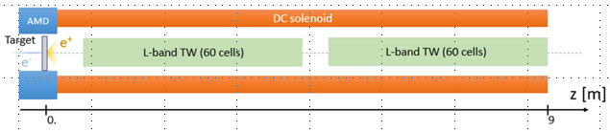


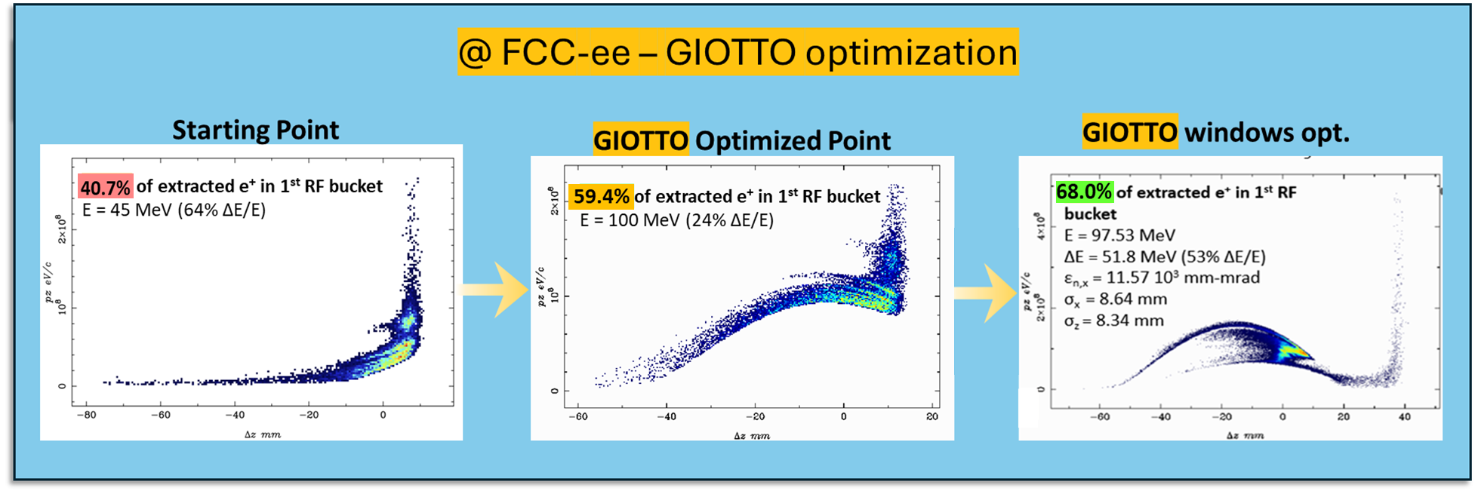
  GIOTTO window optimization results
7
+
+
22-end
meanwhile
few months ago

Slide 8
8
----- the latest news -----
Notes:
Last weeks news

Slide 9
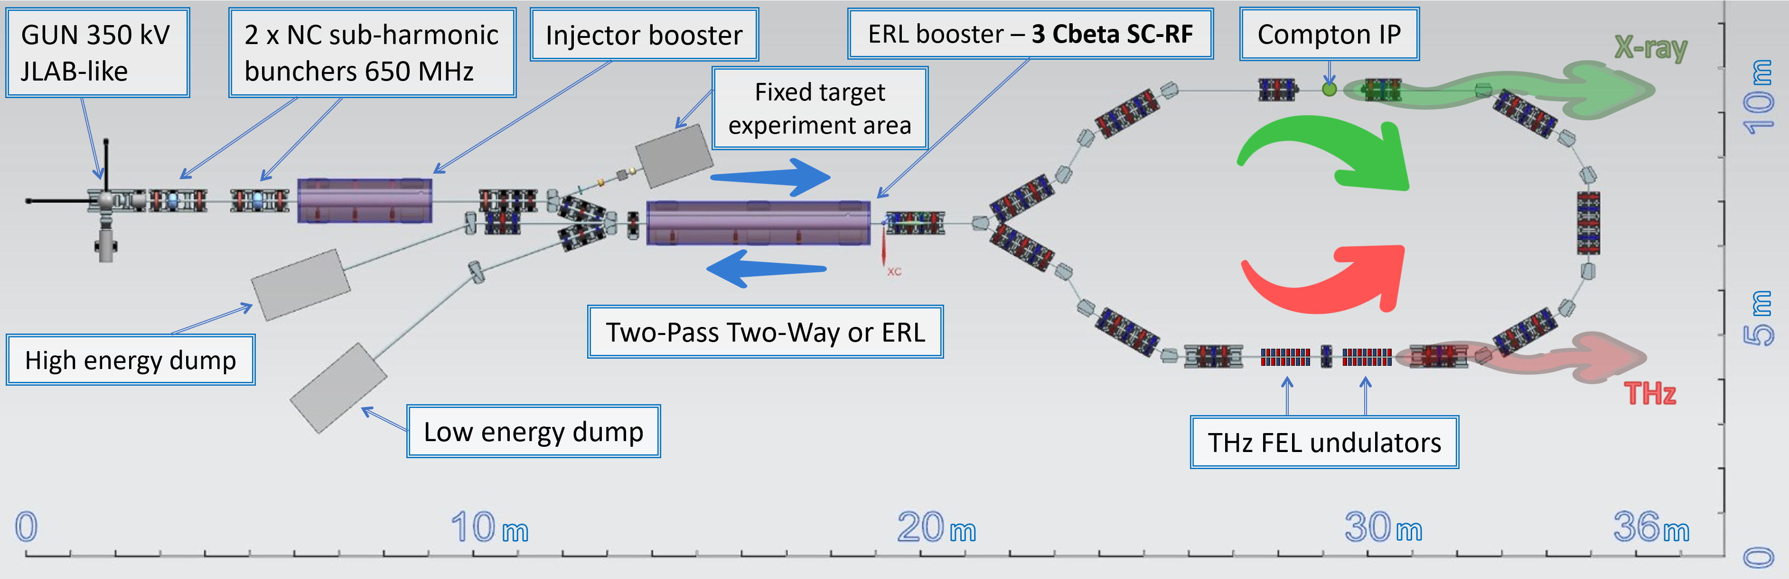
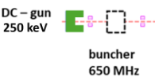
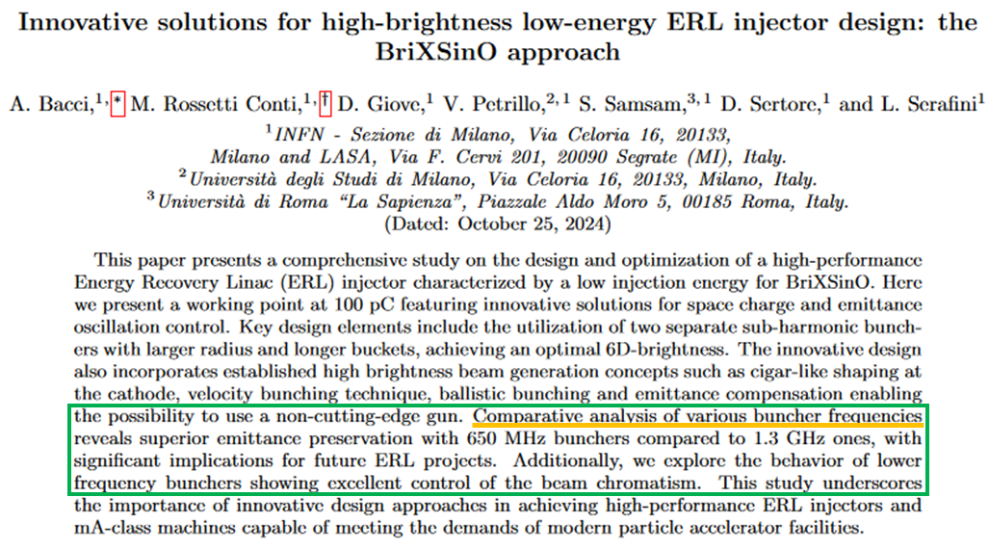
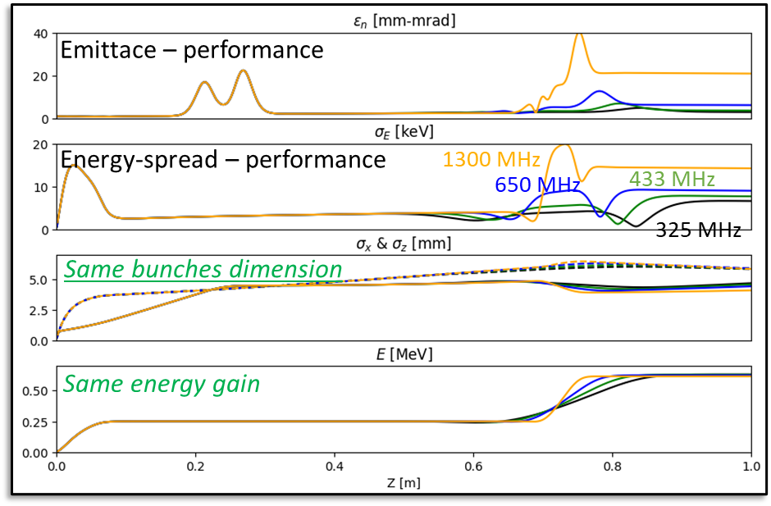
  The use of a low-frequency buncher to improve the e⁺ capture
9
The idea: in the frame of ERL-INFN BriXSinO project
Bunchers Comparison: Performance vs frequencies
1.3 GHz vs 650 MHz vs 433 MHz vs 325 MHz
Paper under submission
Notes:
The buncher has a lot of benefits on BD
Buncher under constructon in Milano

Slide 10
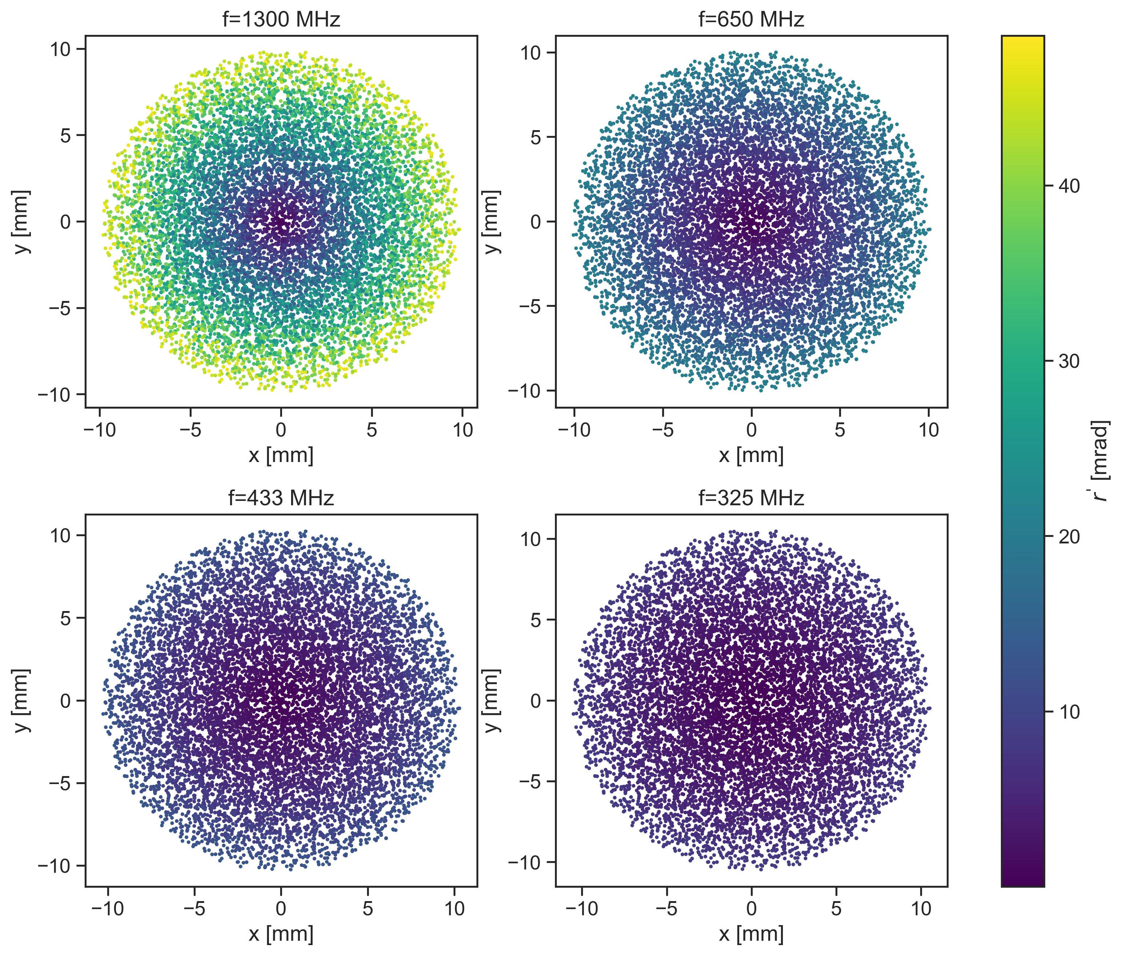
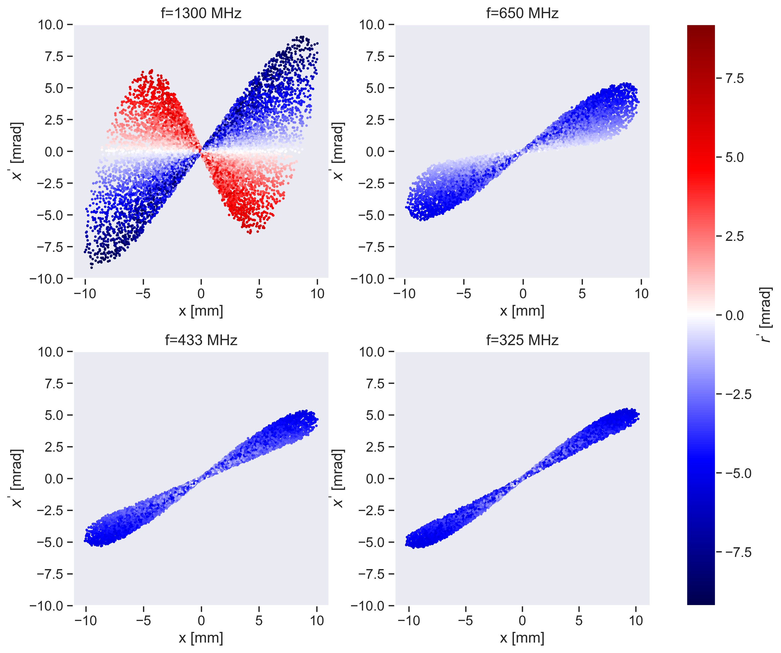
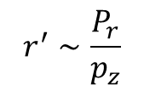
  Focus on the low-frequency buncher
10
Lower frequency buncher:
  a more linear field == a lower chromatism
  cavities with large irises == larger particles acceptance
$$r^{′}∼\frac{P_{r}}{p_{z}}$$
Notes:
Raccontare che è una comparazione tra 4 diversi piani trasversi al centro del buncher cambiando la frequeza del buncher
Le emittanze sono dopo il buncher

Slide 11
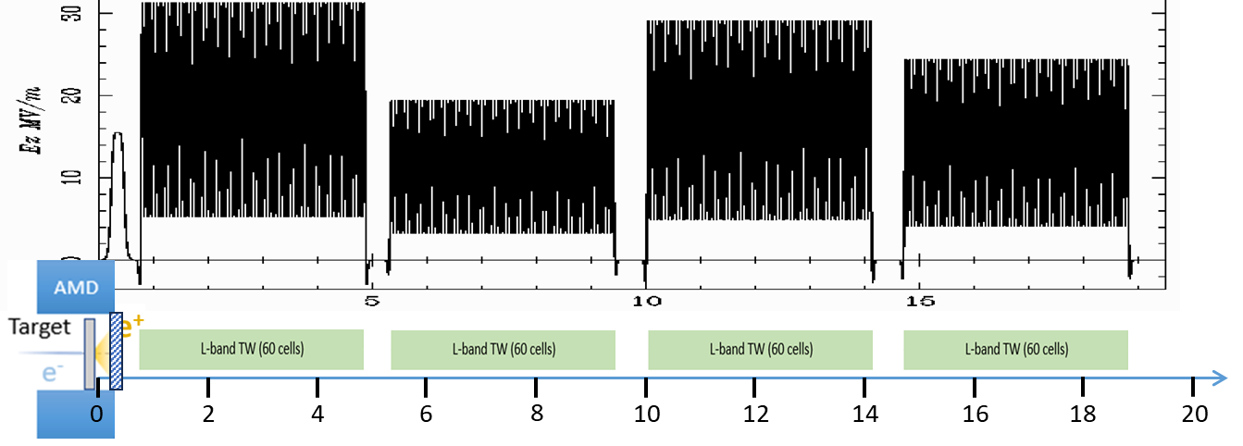
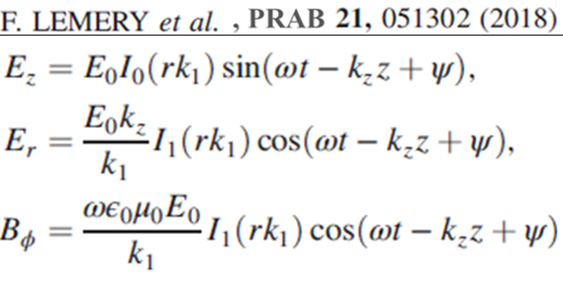
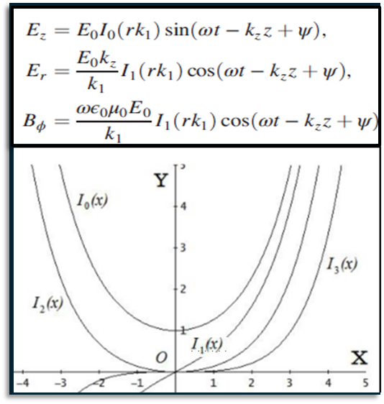
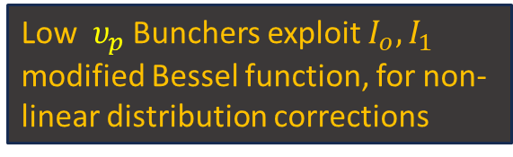

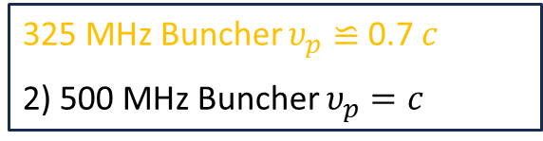
  Focus on the low-frequency buncher & low v_{ph}
11
Study of two cases for a buncher injecting an L-band LINAC 2GHz, $\frac{9}{10}π$cavities :
A low v_{ph} 325 MHz buncher cavity ~ 1/6 of 2 GHz
A 500 MHz buncher as first trapping device cavity for L-banc 2GHz acc. cavities
Low$υ_{p}$ Bunchers exploit $I_{o}, I_{1}$ modified Bessel function, for non-linear distribution corrections
325 MHz Buncher $υ_{p}≌$ 0.7 $c$
2) 500 MHz Buncher $υ_{p}=c$
1) 325 MHz Buncher $υ_{p}≌$ 0.7 $c$
Notes:
Light speed
Dire bene dove si piazza il buncher!!!

Slide 12
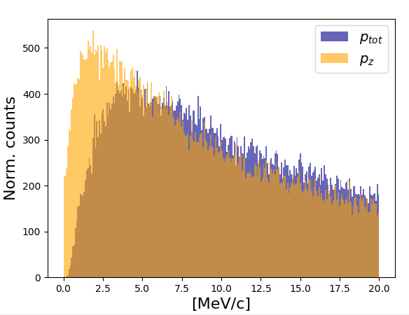
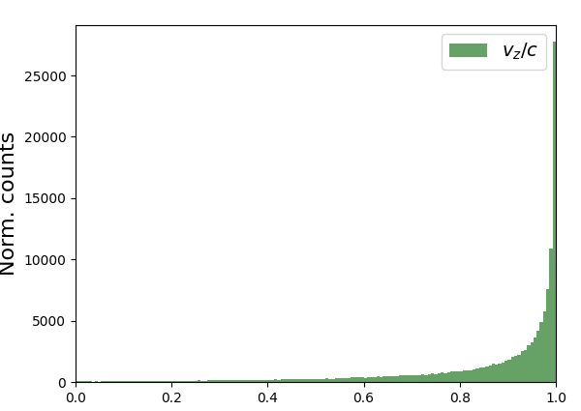

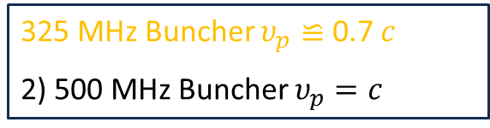
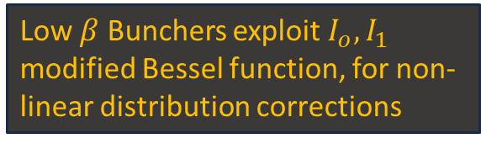
  Focus on low v_{ph} and β < 1 positron
12
325 MHz Buncher $υ_{p}≌$ 0.7 $c$
2) 500 MHz Buncher $υ_{p}=c$
Distribution leaving the target
1) 325 MHz Buncher $υ_{p}≌$ 0.7 $c$
Low $β$ Bunchers exploit $I_{o}, I_{1}$ modified Bessel function, for non-linear distribution corrections

Slide 13
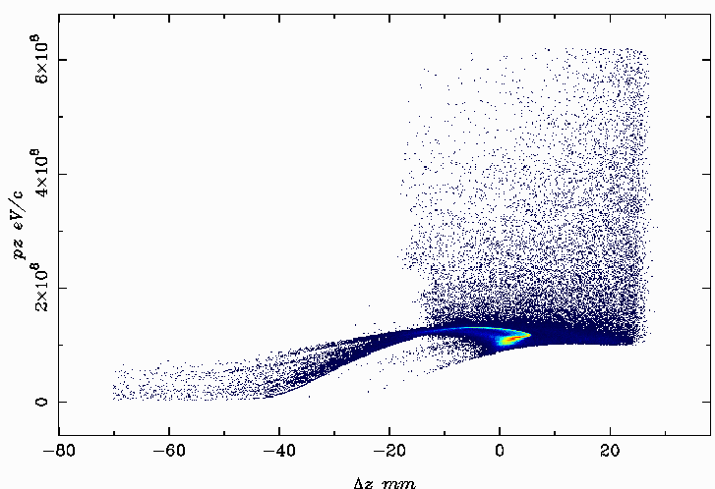
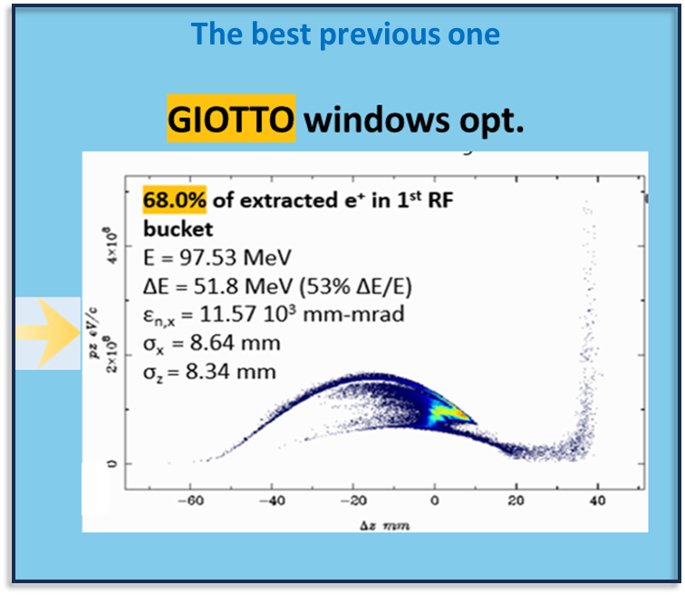
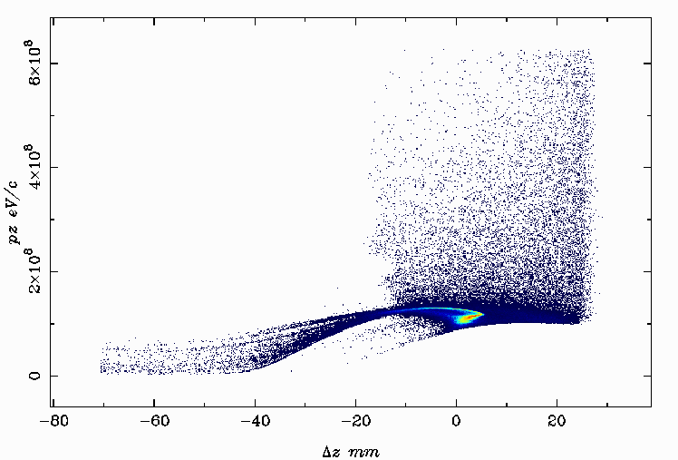
  Low-frequency buncher results 325 vs 500 MHz
13
89% of extracted e⁺ in 1st RF bucket
E=126 MeV
∆E = 56.7 MeV (45.0% ∆E/E)
ε_{n,x}=52 10³ mm-mrad
σ_{x}= 16 mm
σ_{z}= 11 mm
325 MHz Low-v_{p}
500 MHz
88.9% of extracted e⁺ in 1st RF bucket
E=126 MeV
∆E = 57.1 MeV (45.3% ∆E/E)
ε_{n,x}=53 10³ mm-mrad
σ_{x}= 16 mm
σ_{z}= 11 mm

Slide 14
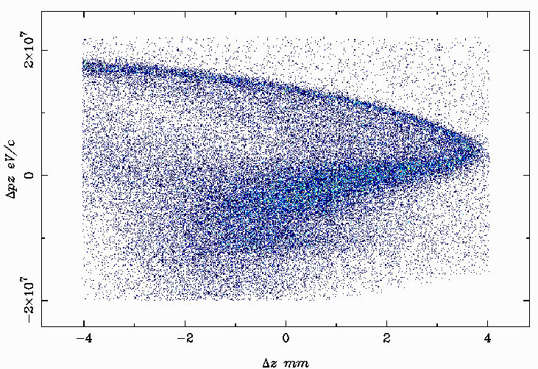
  Low-frequency buncher results 325 MHz
14
325 MHz
89% of extracted e+ in 1st RF bucket
E=126 MeV
∆E = 56.7 MeV (45% ∆E/E)
ε_{n,x}=52.0 10³ mm-mrad
σx= 16 mm
σz= 11 mm
45% of extracted e⁺ in 1st RF bucket
E=126 MeV
∆E = 8.9 MeV (7.9 % ∆E/E)
ε_{n,x}=12.4 10³ mm-mrad
σ_{x}= 8 mm
σ_{z}= 1.9 mm
to be boosted and
compared with the ring acceptance
Notes:
È stato un nostro esercizio,
ma chiarmaente ci dobbiamo confrontare con la parte che veramente entrerà nel Damping Ring
che è nota, ma non l’abbiamo ancora inserirla in questi conti

Slide 15
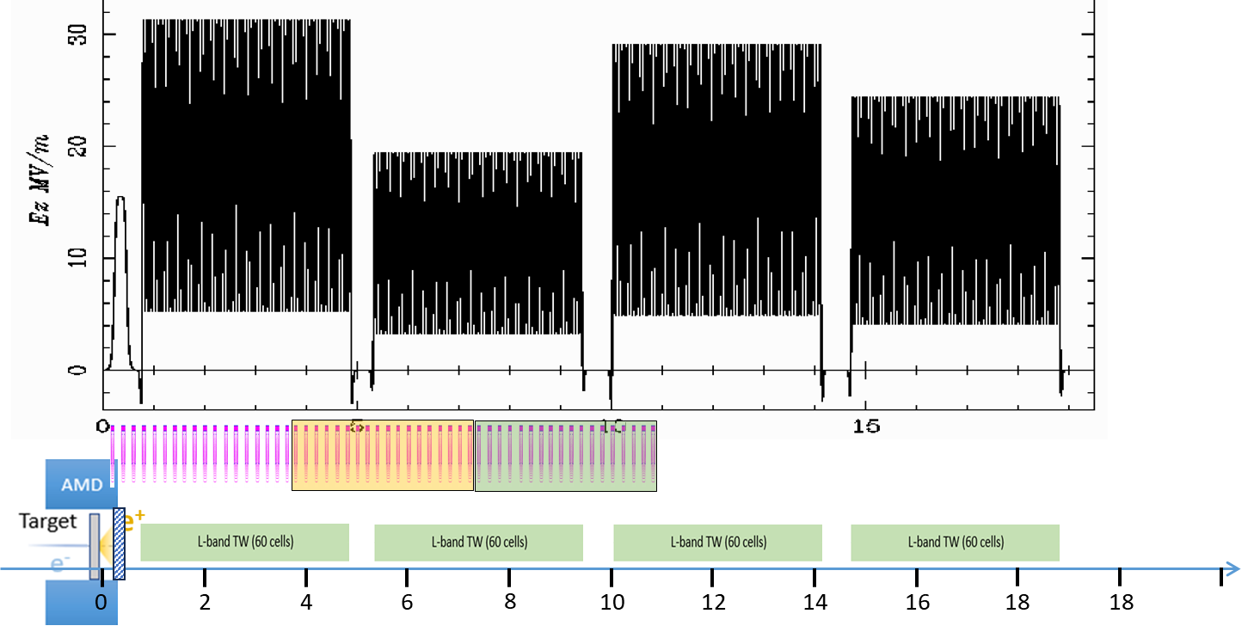
  The solenoids array used for the optimization
15
A GIOTTO peculiar multidimensional problem: 21 Knobs
  Two cases: -large windows optimization- & -narrow windows opt-
⓲
⓲
#21 Gens/knobs list
- 1x φ_{inj} 325 MHz Buncher
- 18x single coils Bz
- 2x array of coils ⓲ & ⓲ (each powered together) Bz

Slide 16
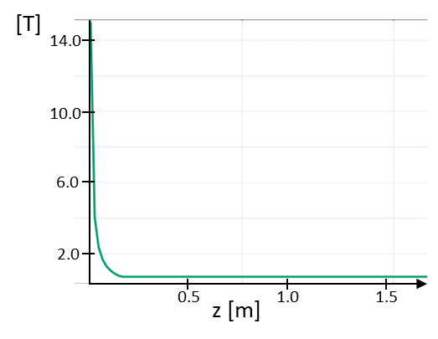
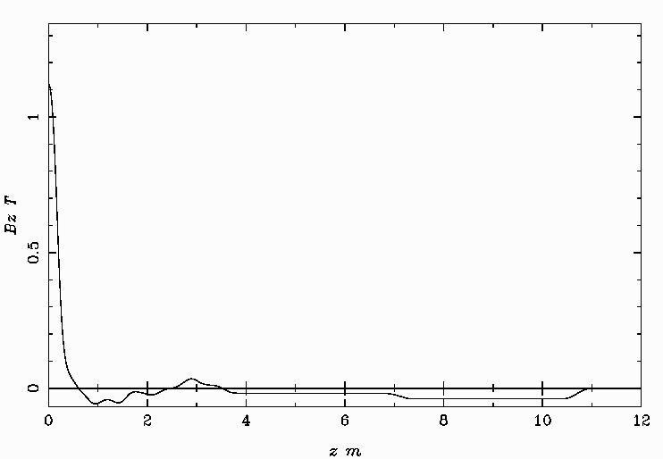
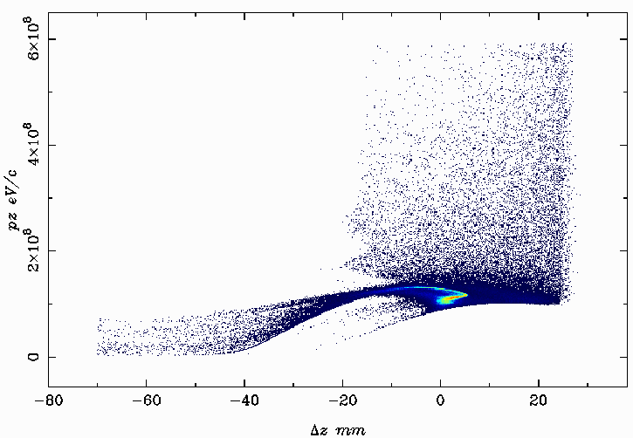
  As GIOTTO directed the solenoids -large window opt-
16
Previous: the only AMD
89% of extracted e⁺ in 1st RF bucket
E=126 MeV
∆E = 56.7 MeV (45% ∆E/E)
ε_{n,x}=52 10³ mm-mrad
σ_{x}= 16 mm
σ_{z}= 11 mm
The AMD
field map
90% of extracted e⁺ in 1st RF bucket
E=126 MeV
∆E = 54.6 MeV (43% ∆E/E)
ε_{n,x}=52 10³ mm-mrad
σ_{x}= 16 mm
σ_{z}= 11 mm
+

Slide 17
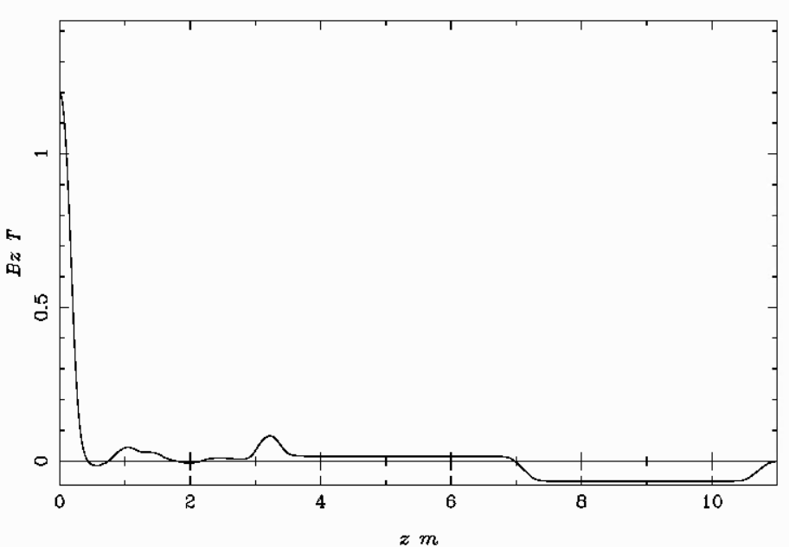
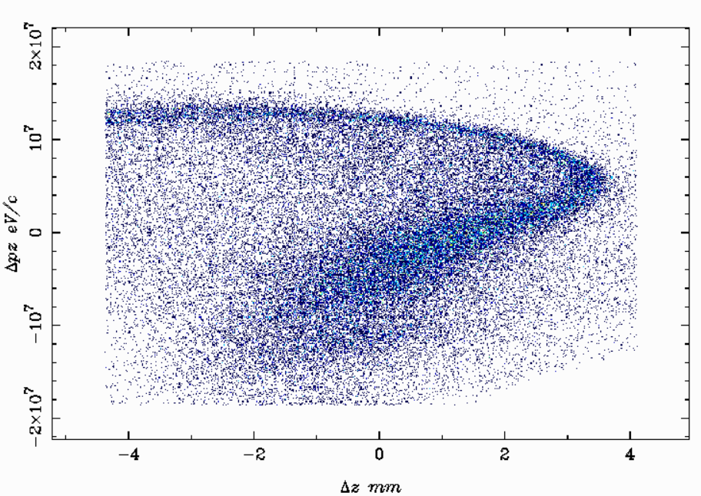
  As GIOTTO directed the solenoids -narrow window opt-
17
The previous slide one
45% of extracted e⁺ in 1st RF bucket
E=126 MeV
∆E = 8.9 MeV (7.9 % ∆E/E)
ε_{n,x}=12.4 10³ mm-mrad
σ_{x}= 8 mm
σ_{z}= 1.9 mm
44% of extracted e⁺ in 1st RF bucket
E=125.8 MeV
∆E = 8.0 MeV (6.3 % ∆E/E)
ε_{n,x}=10.0 10³ mm-mrad
σ_{x}= 7.7 mm
σ_{z}= 1.8 mm
The previous B_{z} profile
The new B_{z} profile

Slide 18
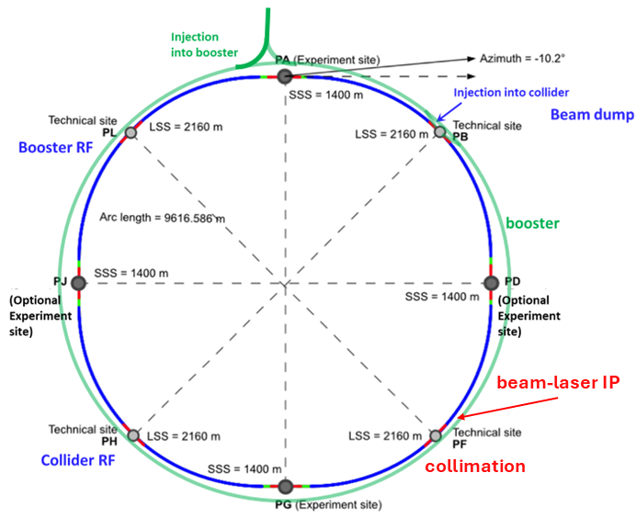
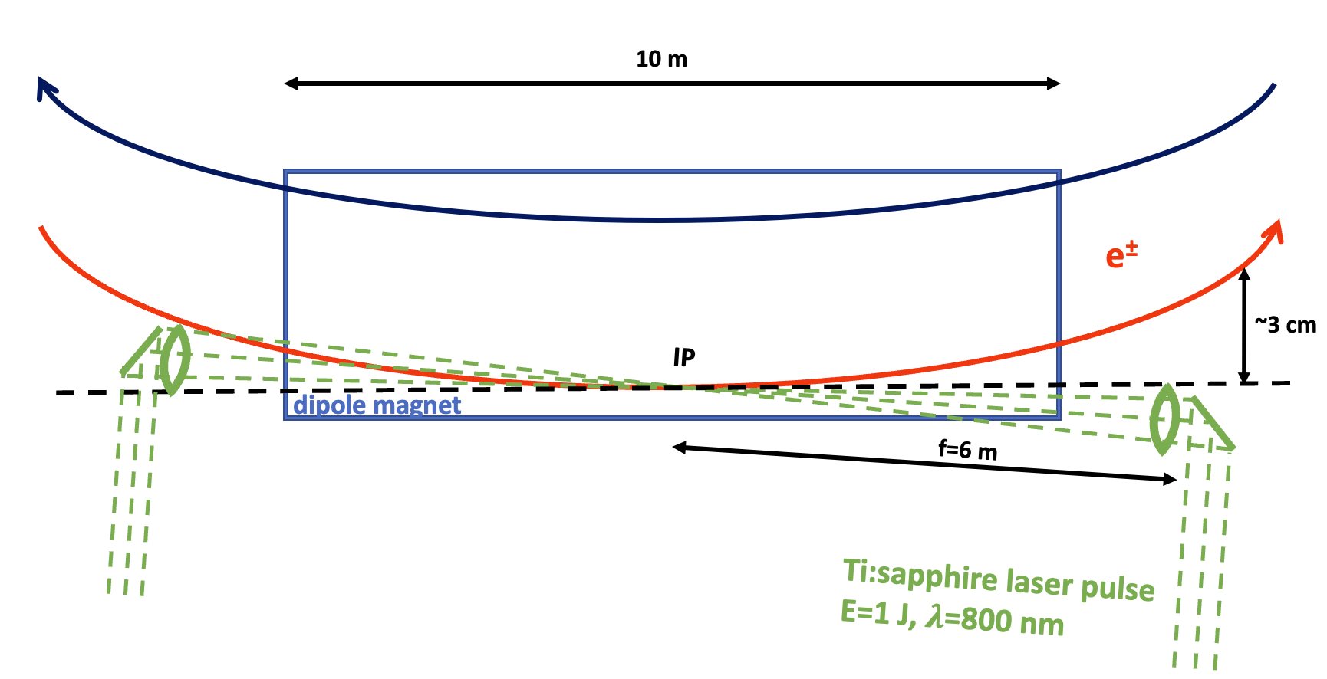
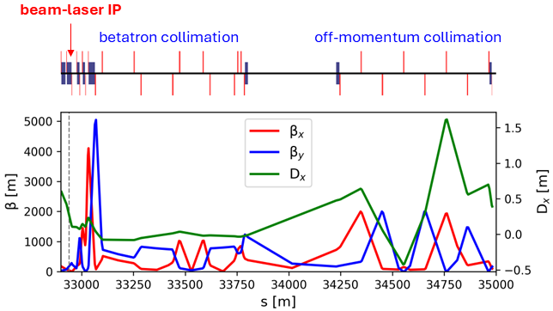
  Bunch intensity control & diagnostics via ICS in the FCC main ring
18
ICS = Inverse Compton Scattering
ICS can equalize the charge of colliding beams avoiding the Flip-Flop instability.
Several % of bunch charge can be removed in the first 400 beam ring loops.
Work in progress
﻿﻿ Improve the IP of LASER VS e⁻/e⁺ beams inside the bending magnet.
﻿﻿Find the optimum between bunch charge reduction VS emit. degradation.
﻿﻿ e⁻/e⁺ energy optimization exploiting the IP within a dispersion region
﻿﻿ Beam halo reducing exploiting Donuts-shaped laser beam. In proposal experiment @ FACET-II (SLAC)
Use high-energy scattered photons (25 & 150 GeV) paving the way for new discoveries as the Primakoff production of pseudoscalar particles,. Collaboration with FTX group, LUXE experiment @ DESY.
Illya Drebot

Slide 19
  Conclusions
19
Optimization achieved:
  We believe, we have pushed our optimizations close to the maximum achievable limits (FF saturated).
  The method can be still applied to different layouts.
  There is under study with IJCLab a comparison between AI GA methods with AI ML Bayesian methods.
The Buncher capability:
  The use of a buncher is promising to enhance the capture, still in the early stages. We used a 50 mm iris with a gradient of 15 MV/m. Still in realistic feasibility study, including integration with magnetic devices, are still missing.
Planning optimization test of the crystal target at P³ (PSI): crystal target conceptual design in an HTS-based configuration (within the FCC-ee injector collaboration and with Ferrara-INFN group)
Genetic Optimizer in Control System: A genetic optimizer will eventually be integrated directly into the control system for real-time machine optimization, as currently implemented in the STAR project at the University of Calabria.

