Slide 1

Nb₃Sn High Field Magnet (HFM) activities at Saclay
E. Rochepault, V. Calvelli, G. Campagna, M. Durante, H. Felice, J. Faucheux, T. Guillo, G. Lenoir, G. Minier, S. Perraud, Y. Perron, F. Rondeaux - CEA
J.C. Perez - CERN
2nd FCC Italy & France Workshop

Slide 2
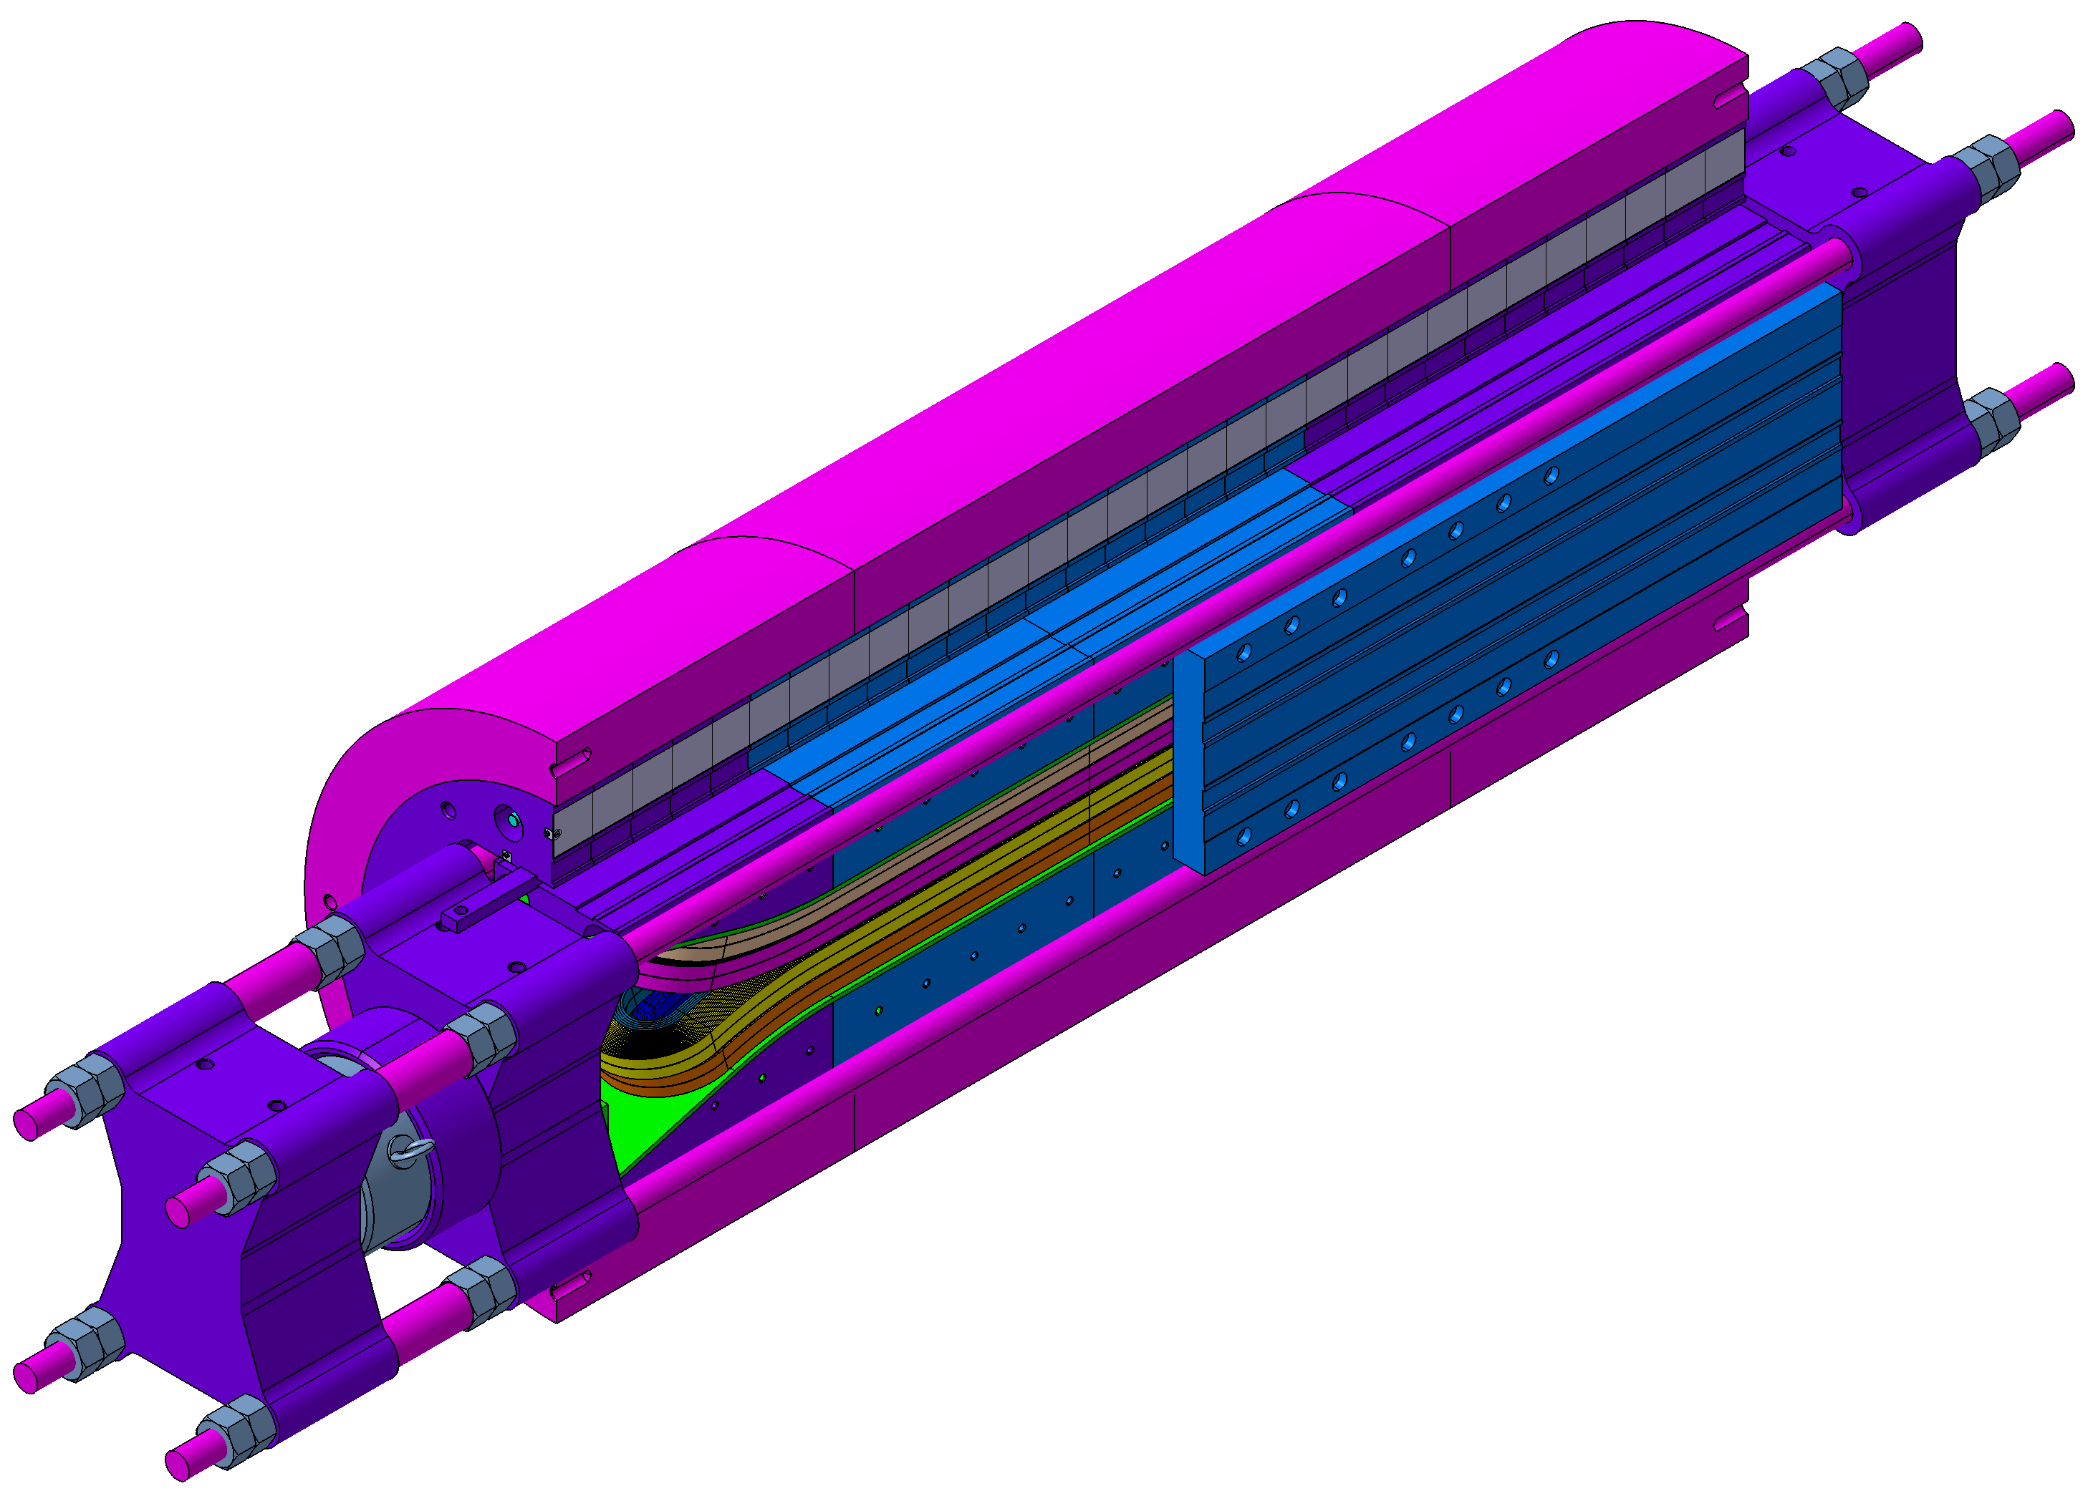
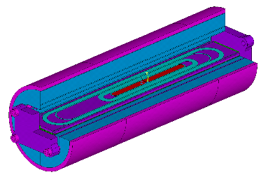
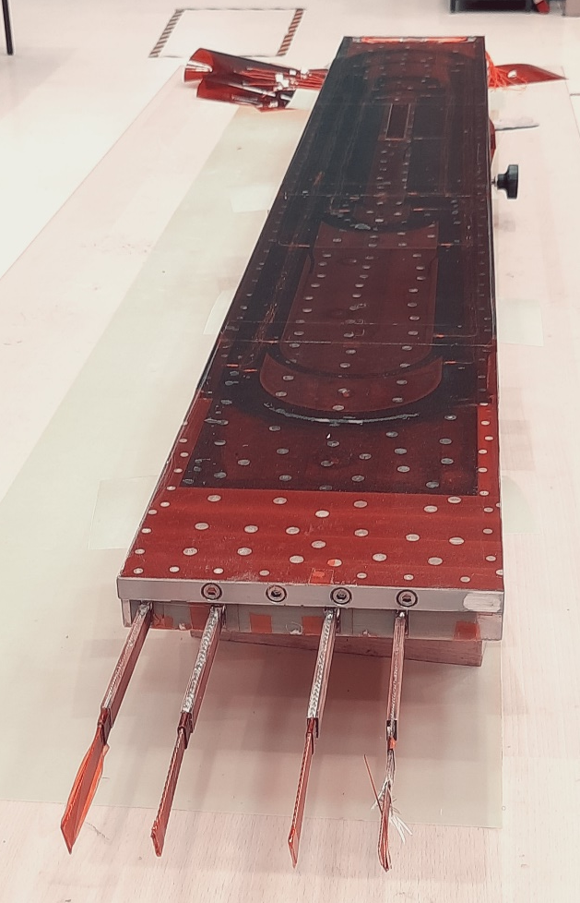
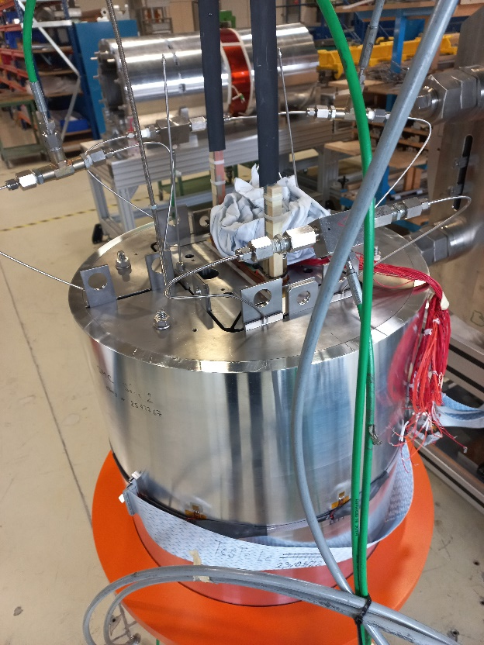
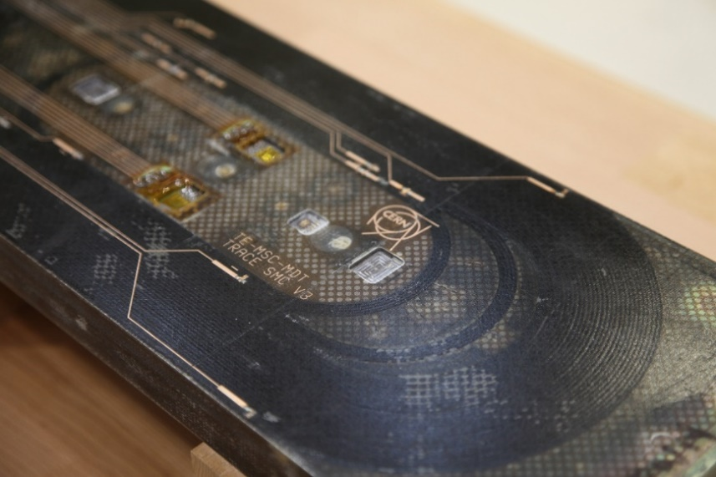
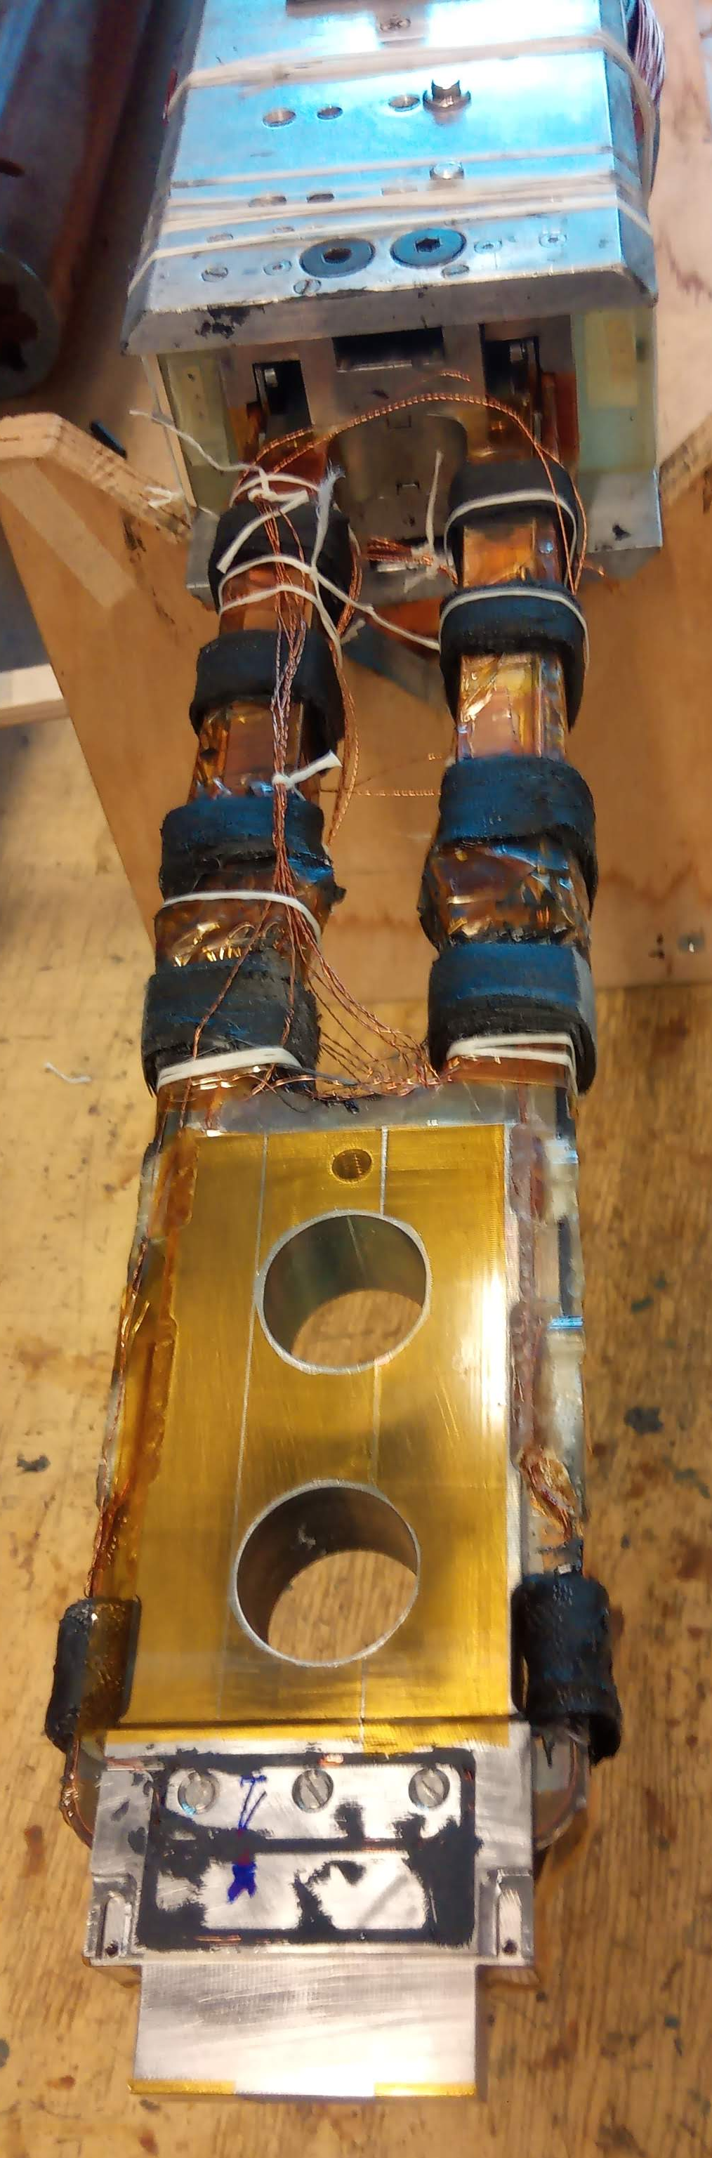
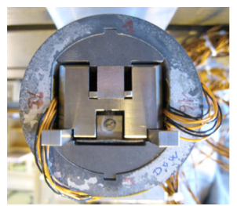
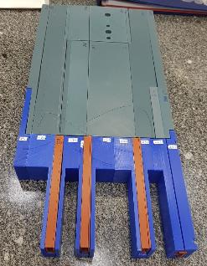
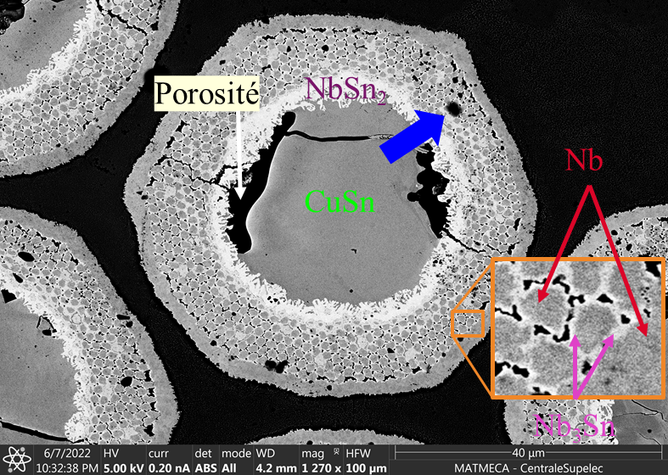
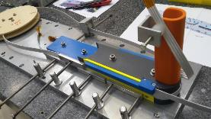
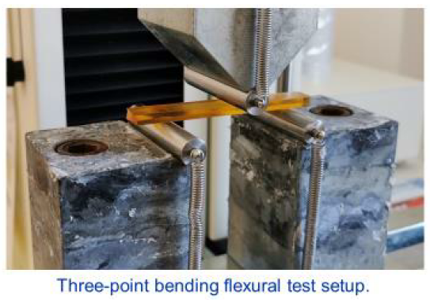
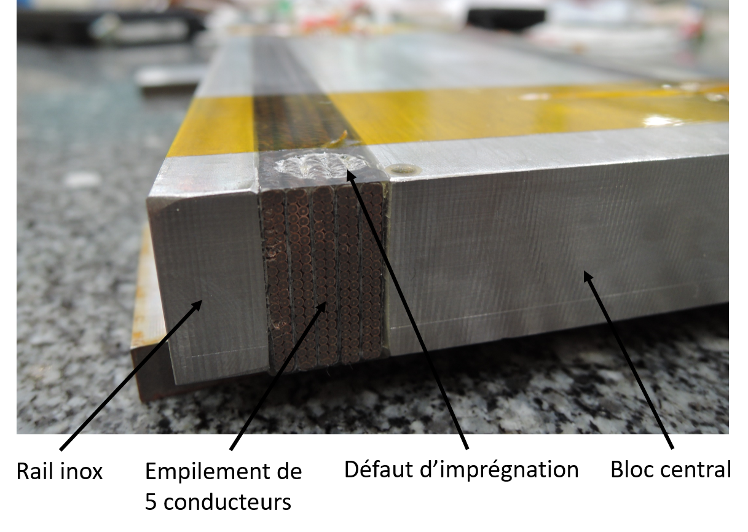
Development Plan towards 16 T Nb₃Sn Dipoles
16 T
demo
12-14 T demo
Subscales
Powered samples
Non-powered samples
F2D2
R2D2
SMC

Slide 3
Non-Powered samples
0

Slide 4
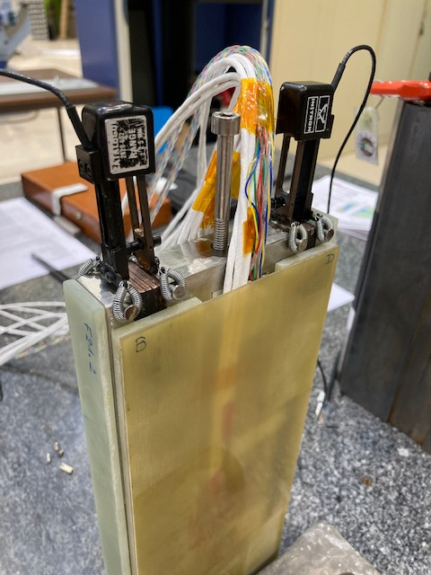
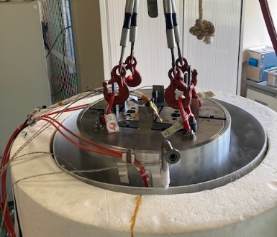
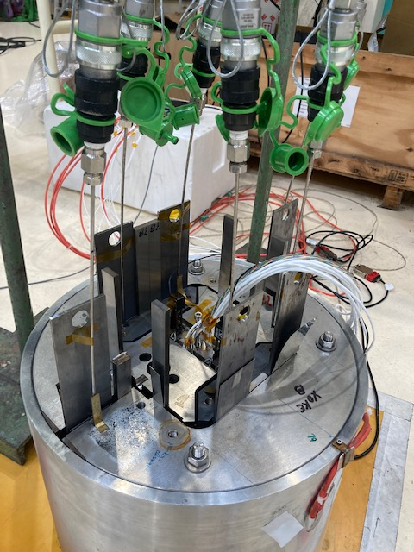
Magnet scale - Subscale dipole
Courtesy of E. Rochepault and G. Campagna
Characterize the mechanical behavior of Nb₃Sn coils in their structure
Instrumented coil segment
coil segment
Mechanical loading in a structure
Cool-down to 77K

Slide 5
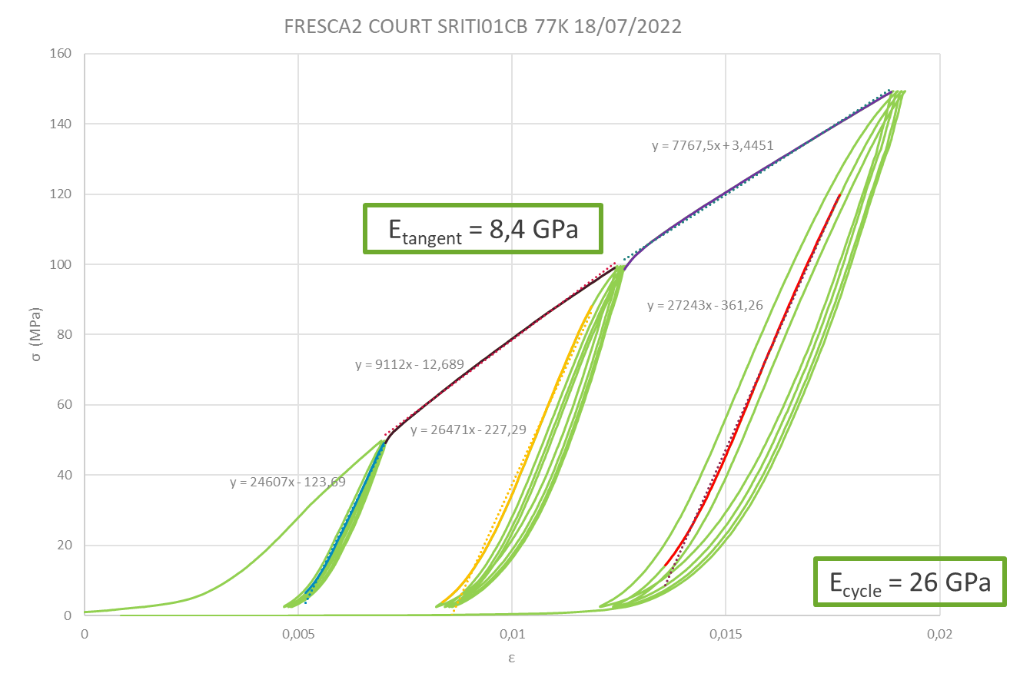
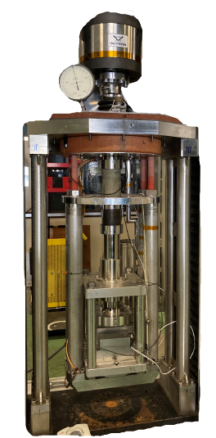
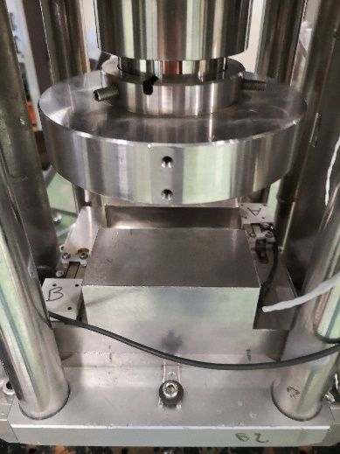
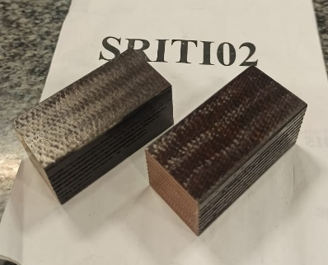
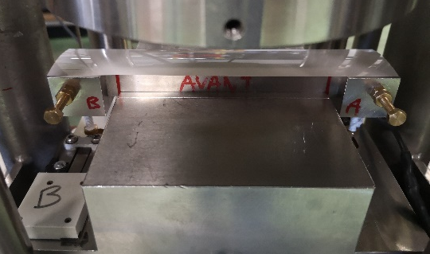
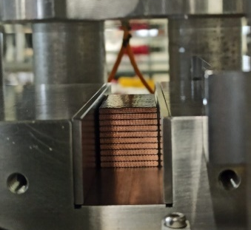
Cable scale - 10-stack campain
Adapted from S. Perraud
Campain performed by M. Durante in 2000
Restarted in 2022
Objective
  Independent test
  Validated on old conductor (FRESCA2)
  Test of all new conductor for HFM program
R&D investigation
  Characterization of mechanical behavior
  (strain rate, hold, unloadings and cyclic behavior)
  Investigation of damage
  (impregnation matrix and conductors)
  Validation of mechanical models

Slide 6
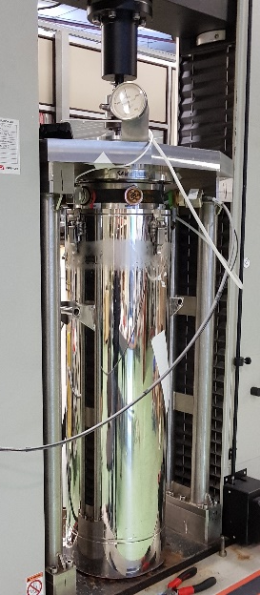
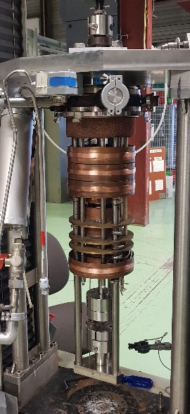
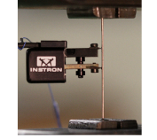
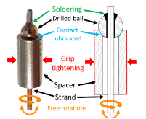
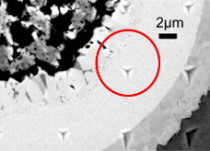
Strand and sub-element characterization
Tensile test on strands at RT and 77 K
  Data for the identification
  and the validation of mechanical models
  Investigation of mechanical behavior
  of strands (strain rate, hold, cyclic behavior)
Nano-indentation at RT
  Local elastic modulus and nano-hardness
Perspectives
  Transverse tests on strands
  Nano-indentation at cryogenic temperatures
  Micro and nano-mechanical testing
Test of a Nb₃Sn strand
Clamping setup
Outer part cryostat
Inner part cryostat
@CEA Paris-Saclay
Nano-indentation in Nb₃Sn phase of a PIT strand [Lenoir 17]

Slide 7
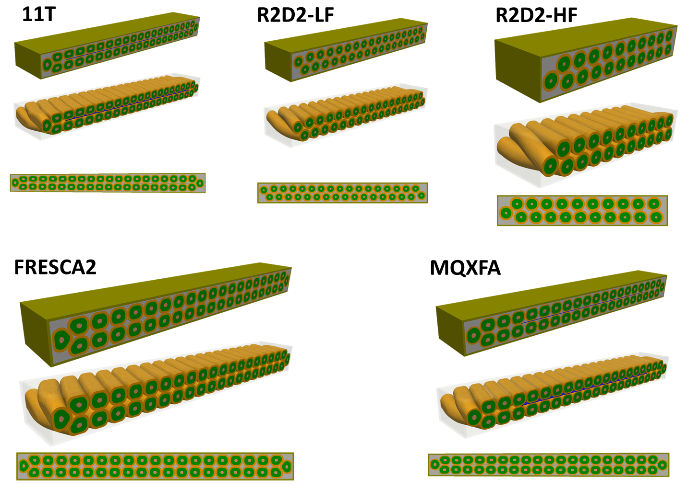
Cable scale - Mesh Generator

Slide 8
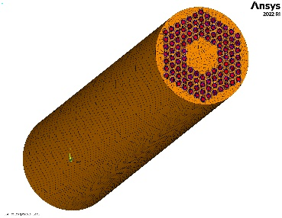
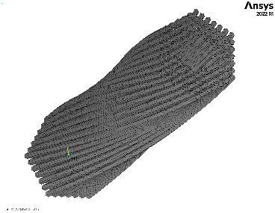
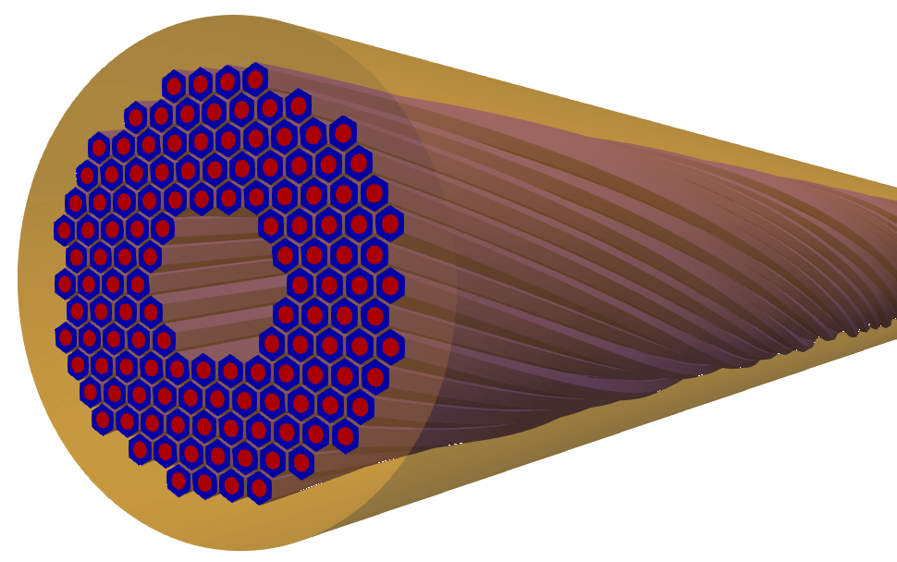
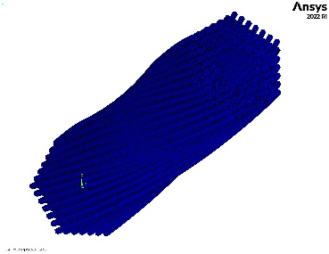
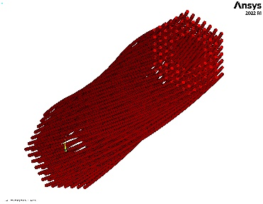
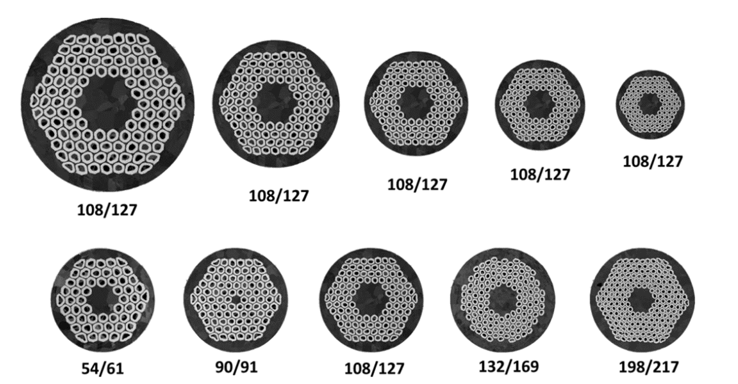
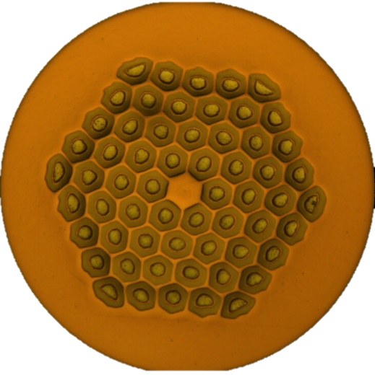
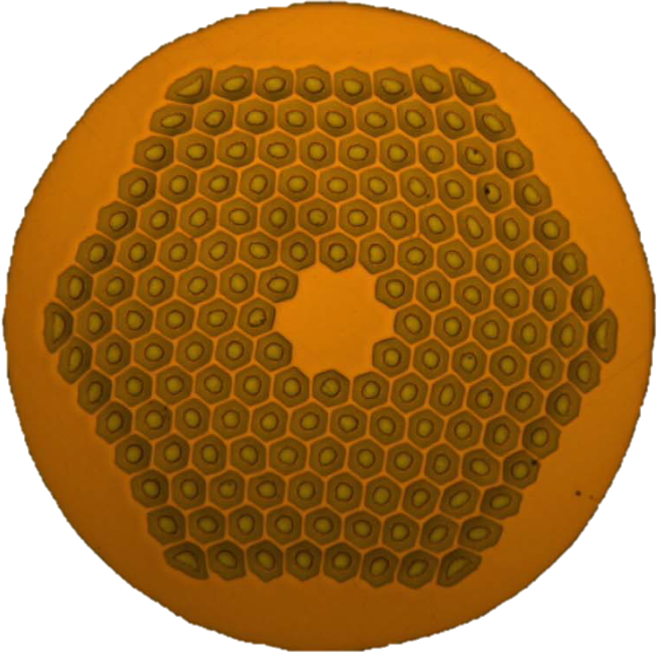
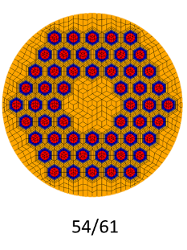
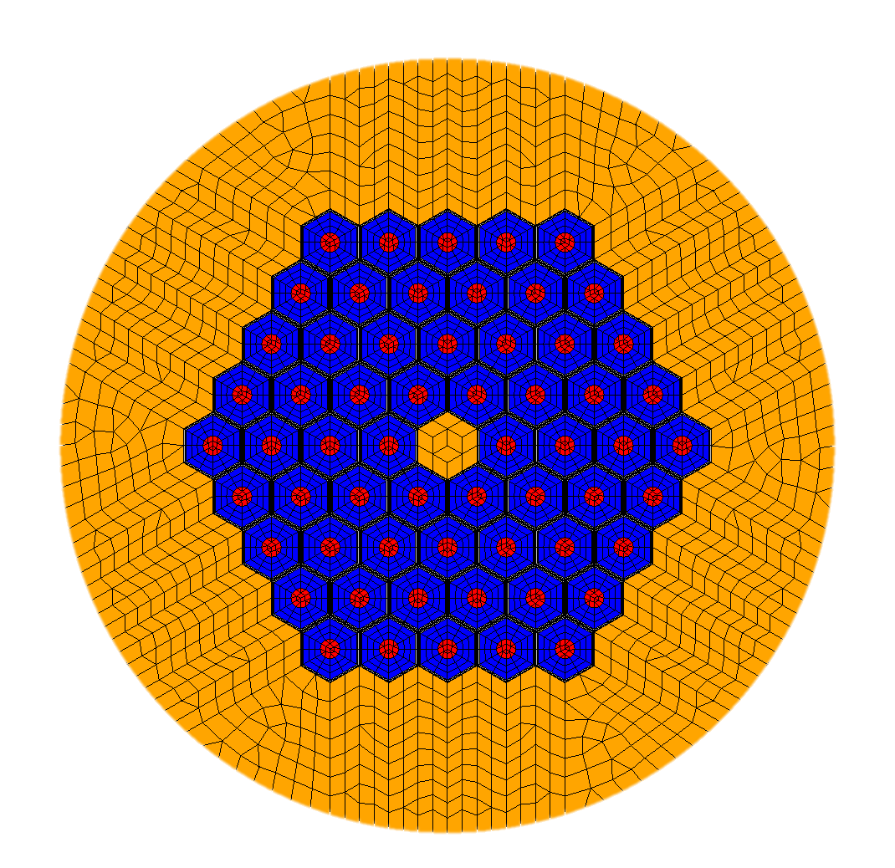
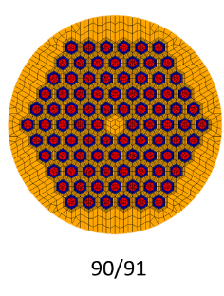
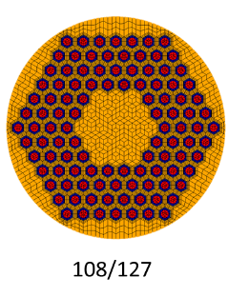

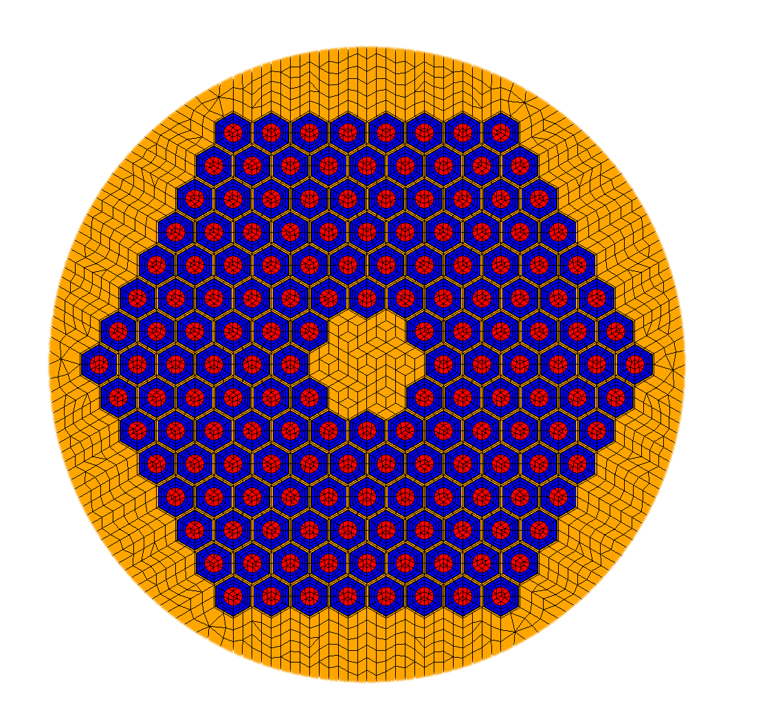

Strand scale - Mesh Generator
Numerical models from Y. Perron
Micrographies from S. Hopkins and C. Sanabria
60/91
162/169
60/91
162/169

Slide 9
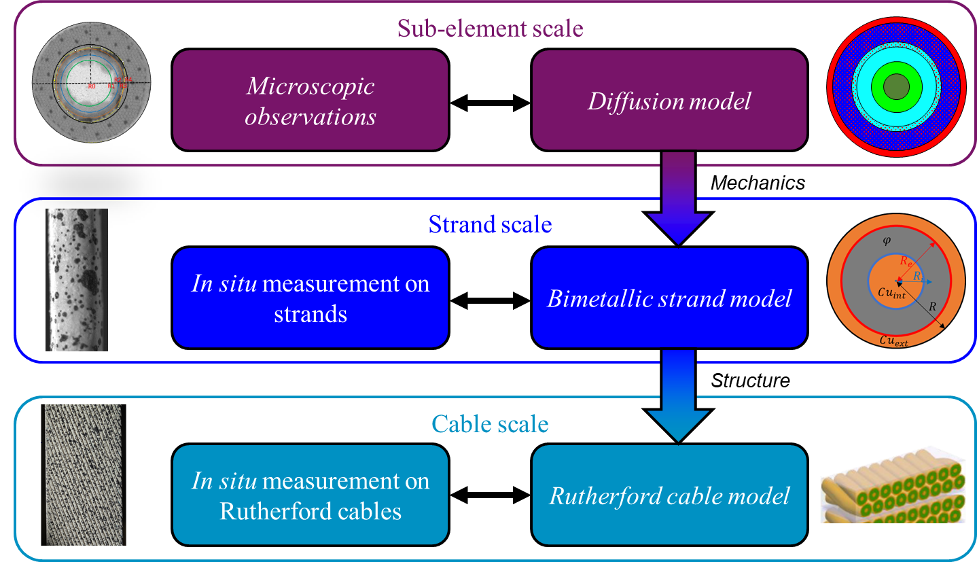
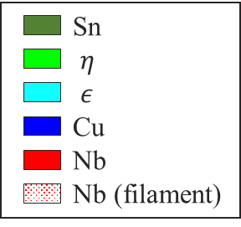
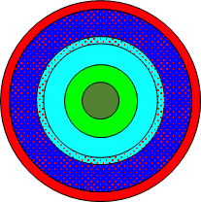
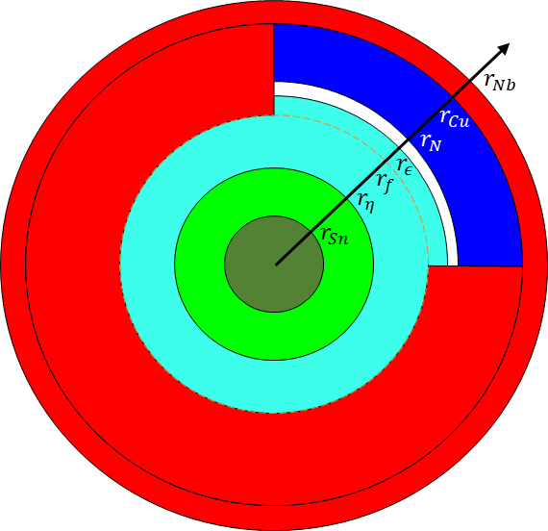
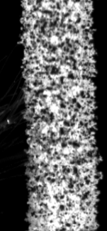
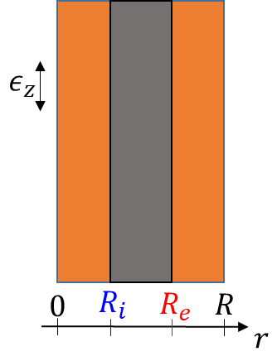

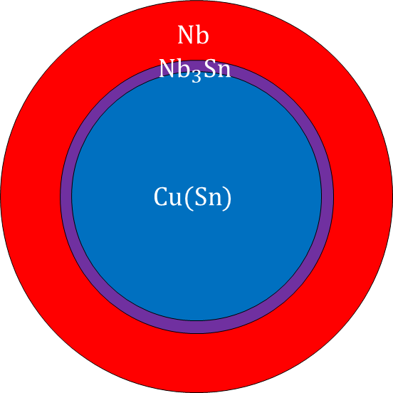
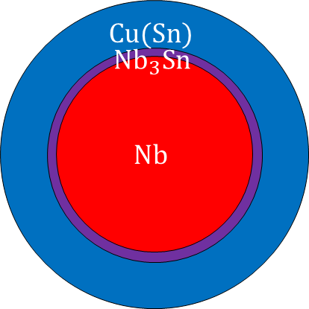
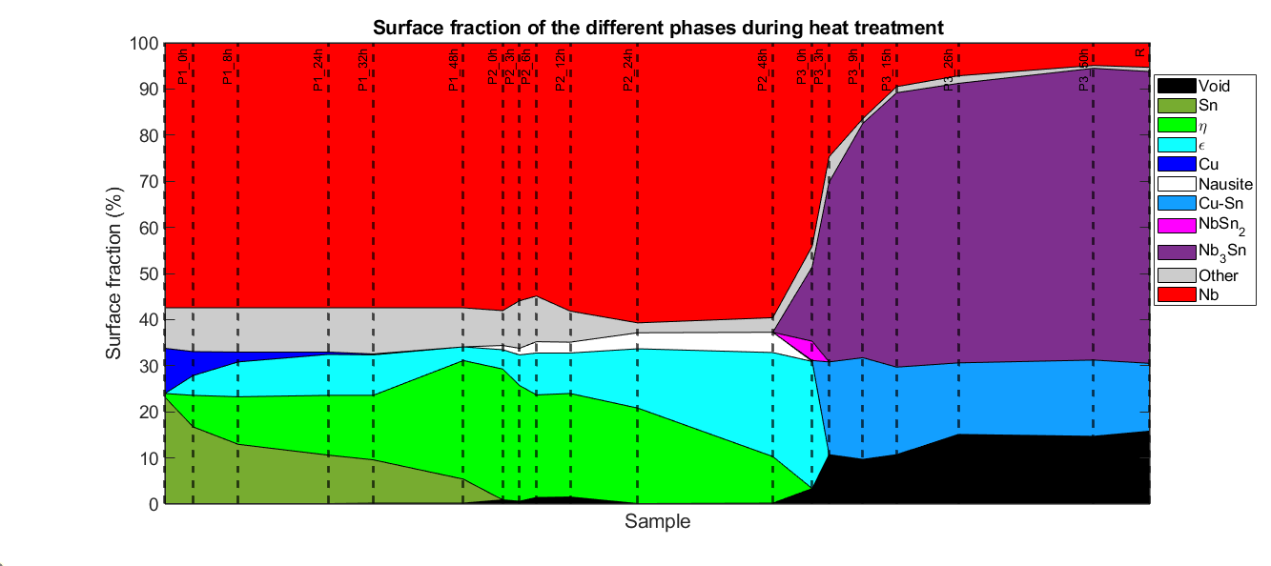
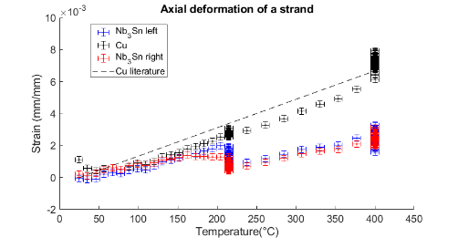






Thermomechanical behavior during HT
1st diffusion stage
Work performed during PhD of
M. Abdel-Hafiz @ CEA/LMPS, Univ. Paris-Saclay
Subelement
Filament
Filament
2nd diffusion stage
Subelement
Experiment
Model

Slide 10
Powered samples
1

Slide 11



deBOnding eXperiment n°1 - deBOX1
PhD Thesis Guillaume Campagna
New instrumentation: two pick-up coils and a 7 kN load cell for cryogenic use
Twente sample holder : 11 T background, 100 kA transformer, up to 200 MPa compression

Slide 12
SMC-11T
2

Slide 13




SMC-CEA#101
SMC-CEA #101 fabricated at Saclay in 2021
Assembled and tested at CERN in 2022
95 % SS @ 4.2 K
No sign of mechanical degradation or loss of pre-stress

Slide 14


SMC-CEA#102
Introduction of the CTD flexibilizer
2 shortcuts detected after impregnation
repaired, electrical tests passed !
Assembled and tested at CERN in 2024
99 % SS @ 4.2 K
No sign of mechanical degradation or loss of pre-stress

Slide 15
R2D2
3

Slide 16





Conductor production and qualification
2 Nb₃Sn RRP conductors for grading
Same cables for all magnets
Strand characterization @ CERN
Cable production @ CERN
Cable and strand characterization @ Saclay
HF
LF
Parameter | Unit | HF cable | LF cable
Strand type |  | DEM-1.1 | DEM-0.7
Strand layout |  | RRP® 162/169 | RRP® 60/91
Strand diameter | mm | 1.1 | 0.7
Number of strands |  | 21 | 34
Cable mid-thickness | mm | 1.969 ± 0.010 | 1.253 ± 0.010
Cable width | mm | 12.579 ± 0.050 | 12.579 ± 0.050
Pitch | mm | 84 ± 3 | 79 ± 3
Core |  | No core | No core
HF
LF
Cocascope 3D FEM

Slide 17
Overview of the R2D2 design
CEA conceptual design validated by an external committee
Fabrication, assembly and pre-stress at Saclay
Tests at cold at CERN
Main goal: demonstrate feasibility of grading
  Winding two cables on top of each other
  Heat treating two different cables together
  Jonctions of the 2 cables → 1st option: external Nb₃Sn-NbTi joints
R2D2 = Research Racetrack Dipole Demonstrator
Aperture | None
Outer diameter | 480 mm
Structure length | 2.0 m
Nominal central field | 11.1 T
Ultimate central field | 12.0 T
Nominal peak field | 12.7 T
Ultimate peak field | 13.7 T

Slide 18



Fabrication of R2D2 Nb₃Sn coil CR01
CR01:
Winding
Heat treatment
Junctions
Impregnation
Electrical shortcut, identified
CR02:
Winding
Heat treatment pending

Slide 19


R2D2 structure procurement
Shell segments received at CERN
Structure components (yoke, pads, rods, endplates)
Machining ongoing
Delivery expected ~November
Connection box:
    3D design finalized
    Mockup ongoing
Magnet schedule :
  Dummy assembly at Saclay to validate the mechanical behavior of the structure → Q4 2024
  Selection of the 2 best coils for assembly → Q1 2025
  Delivery at CERN for cold tests → mid-2025

Slide 20
FD/F2D2
4

Slide 21

F2D2 16T demonstrator magnet
Conceptual design stage
Fabrication, assembly and pre-stress at Saclay
Tests at cold at CERN
Main goal: demonstrate all technologies
  Representative of high field magnets: grading, joints, flared-ends, high field and high stress
  Representative of accelerator magnets: 50 mm bore, field quality
F2D2 = Future Flared Dipole Demonstrator
Aperture | 50 mm
Outer diameter | 650 mm
Structure length | 2.0 m
Nominal central field | 15.5 T
SS central field | 17.8 T
Nominal peak field | 16.2 T
SS peak field | 18.6 T

Slide 22

FD 14T demonstrator magnet
Conceptual design stage
Fabrication, assembly and pre-stress at Saclay
Tests at cold at CERN
Main goal: demonstrate key technologies
  Representative of high field magnets: grading, joints, flared-ends, high field and high stress
  Some simplifications: 1 type of coils, no bore
FD = Flared Dipole
Aperture | None
Outer diameter | 650 mm
Structure length | 2.0 m
Nominal central field | 14.0 T
SS central field | 17.2 T
Nominal peak field | 14.7 T
SS peak field | 17.9 T

Slide 23
Conclusion
Non-powered samples
Characterization of materials
Modelling activities
Powered samples
Behavior of Nb₃Sn cables at low or no pre-stress
Behavior of HFM Nb₃Sn cables under stress
Short Model coil SMC :
2 coils manufactured at Saclay: successful tests!
Development of fabrication processes, infrastructure, experience
Demonstrator magnet R2D2
→ Proof of concept of the grading technologies
Coil fabrication ongoing
Structure components being machined
Demonstrator magnet F2D2
→ Design of a 14+ T accelerator-type magnet
FD: 14+ T dipole as an intermediate assembly to validate the concepts

Slide 25
Backup slides

Slide 26




CEA plan towards 20 T HTS dipoles
Phase 3 :
« EuCARD V3 »
MI cold bore 16 T+
magnet
Courtesy T. Lécrevisse
Phase 2 :
magnet MI 16 T+
« EuCARD V2 »
Phase 1 2023-2025:
Racetrack MI
Ongoing Project
Phase one objectives :
Adapt and validate the numerical tools for electromagnetic + thermal + quench models
Characterize specific parameters of MI windings (Turn-to-turn thermal conduction…)
Develop the technologies from winding to assembly including electrical connections
Evaluate the options of conduction cooled dipole
Fabricate and test one racetrack coil for models benchmark

