Slide 1
IDEA detector concept paper
F. Bedeschi, INFN-Pisa
2nd FCC Italy – France workshop
November 2024, Venice, Italy
Why
How
Some decisions
Authors

Slide 2
WHY
Good up-to-date reference for IDEA
  To be used for EoI’s and inputs for next EU strategy update
Clearly define baseline configuration
  Many versions of geometry and detector components lately
  Define baseline and its geometry for EU strategy
    Not fixed forever, but a clear reference is a must

Slide 3
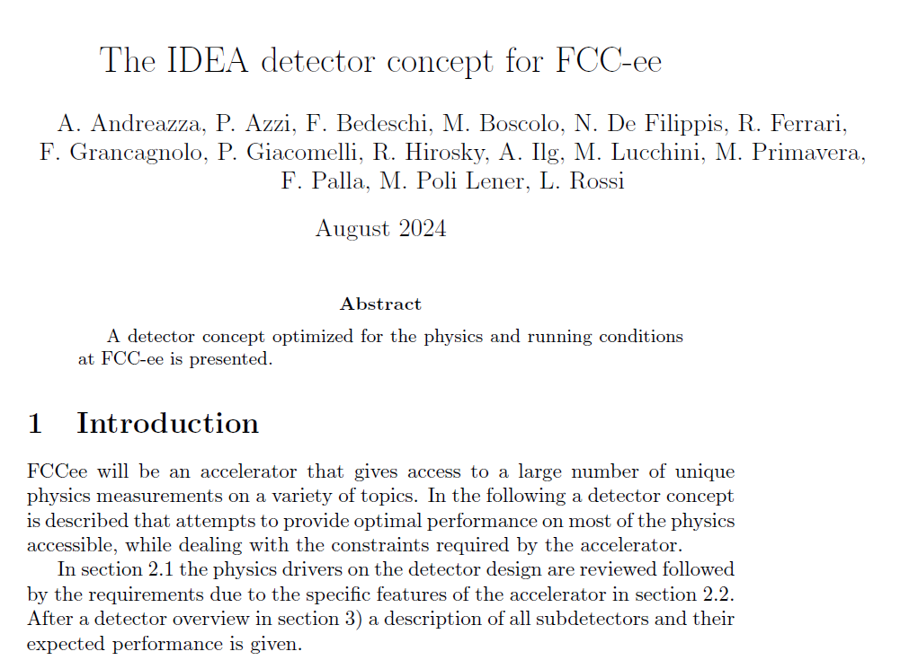
HOW
Overleaf document:
  https://www.overleaf.com/project/66bb6199fac6a0dddd45dd4c
Many authors
Structure defined
  Editors for each section
    Chair editor/section
Timeline
  1° draft before Christmas
  EoI deadline end Jan. ‘25
  EU deadline March ‘25

Slide 4
Decisions (1)
Where to publish
  arXiv document: no restrictions, but citable
  Later configure for NIM or other
Geometry:
  Baseline has an EM crystal calorimeter
  No change in DCH outer radius (2.0 m)
  Usage of pre-shower uncertain
    No dedicated section, but discuss in introduction
    Additional 10 cm radial space in front of EM calorimeter to allow for future implementation (else use for services)
      40 cm between Si wrapper and start of solenoid

Slide 5
Decisions (2)
Structure and current editors:
  Introduction and requirements - F. Bedeschi, P. Azzi, N. De Filippis
  Detector Overview - F. Bedeschi, P. Giacomelli
  MDI/Beam backgrounds - M. Boscolo, F. Palla
  Tracker introduction - A. Andreazza, N. De Filippis, A. Ilg, M. Primavera, F. Palla
  Vertex detector - A. Andreazza, A. Ilg, F. Palla
  Drift chamber - N. De Filippis, M. Primavera
  Si wrapper - A. Andreazza, A. Ilg, F. Palla
  Tracker performance - A. Andreazza, N. De Filippis, A. Ilg, M. Primavera, F. Palla
  Crystal calorimeter - R. Hirosky, M. Lucchini
  Solenoid - L. Rossi
  Fiber calorimeter - R. Ferrari
  Muon chambers - M. Poli Lener

Slide 6
Authors
Author list is still open to all willing to help
Seeking for additional editors from the wide international community
Full list of editors needs to be defined soon
  Sections with many editors need a chair

