Slide 1


Massive Black Hole formation in proto-stellar clusters via early gas accretion
Dr Zacharias Roupas
University of Milano-Bicocca Italy
ICNFP2025 Chania 24 July 2025

Slide 2


Stellar Black Holes $5−60M_{⊙}$
Core-collapse Supernova remnants $m_{BH}∼(5−20)M_{⊙}$ from progenitor stars $m_{ZAMS}∼\left(20−40\right)M_{⊙}$
Direct-collapse $m_{BH}∼(20−60)M_{⊙}$ from progenitor stars $m_{ZAMS}∼\left(40−70\right)M_{⊙}$ direct BH formation without significant mass ejection from the progenitor star
Pulsational Pair-Instability Supernova remnants $m_{BH}∼(5−50)M_{⊙}$ from progenitor stars $m_{ZAMS}∼\left(70−130\right)M_{⊙}$ mass loss through pulsations before final collapse
lower BH mass gap: NO BH with mass $∼(2.5−5)M_{⊙}$
upper BH mass gap: NO BH with mass $∼(60−130)M_{⊙}$
heavier $m_{ZAMS}$ $⇒$ earlier formed BH in a stellar cluster

Slide 3
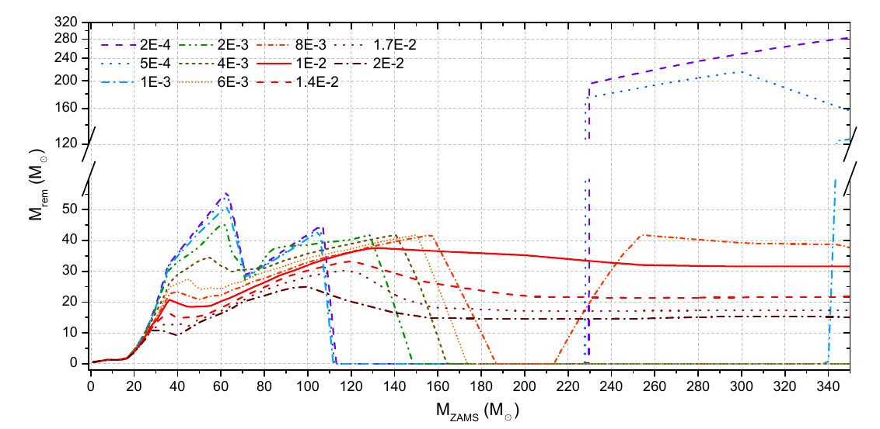
Pair-Instability-Supernova (PISN) BH mass gap
PISN BH mass gap $∼60−130M_{⊙}$
[Spera & Mapelli MNRAS (2017)]

Slide 4
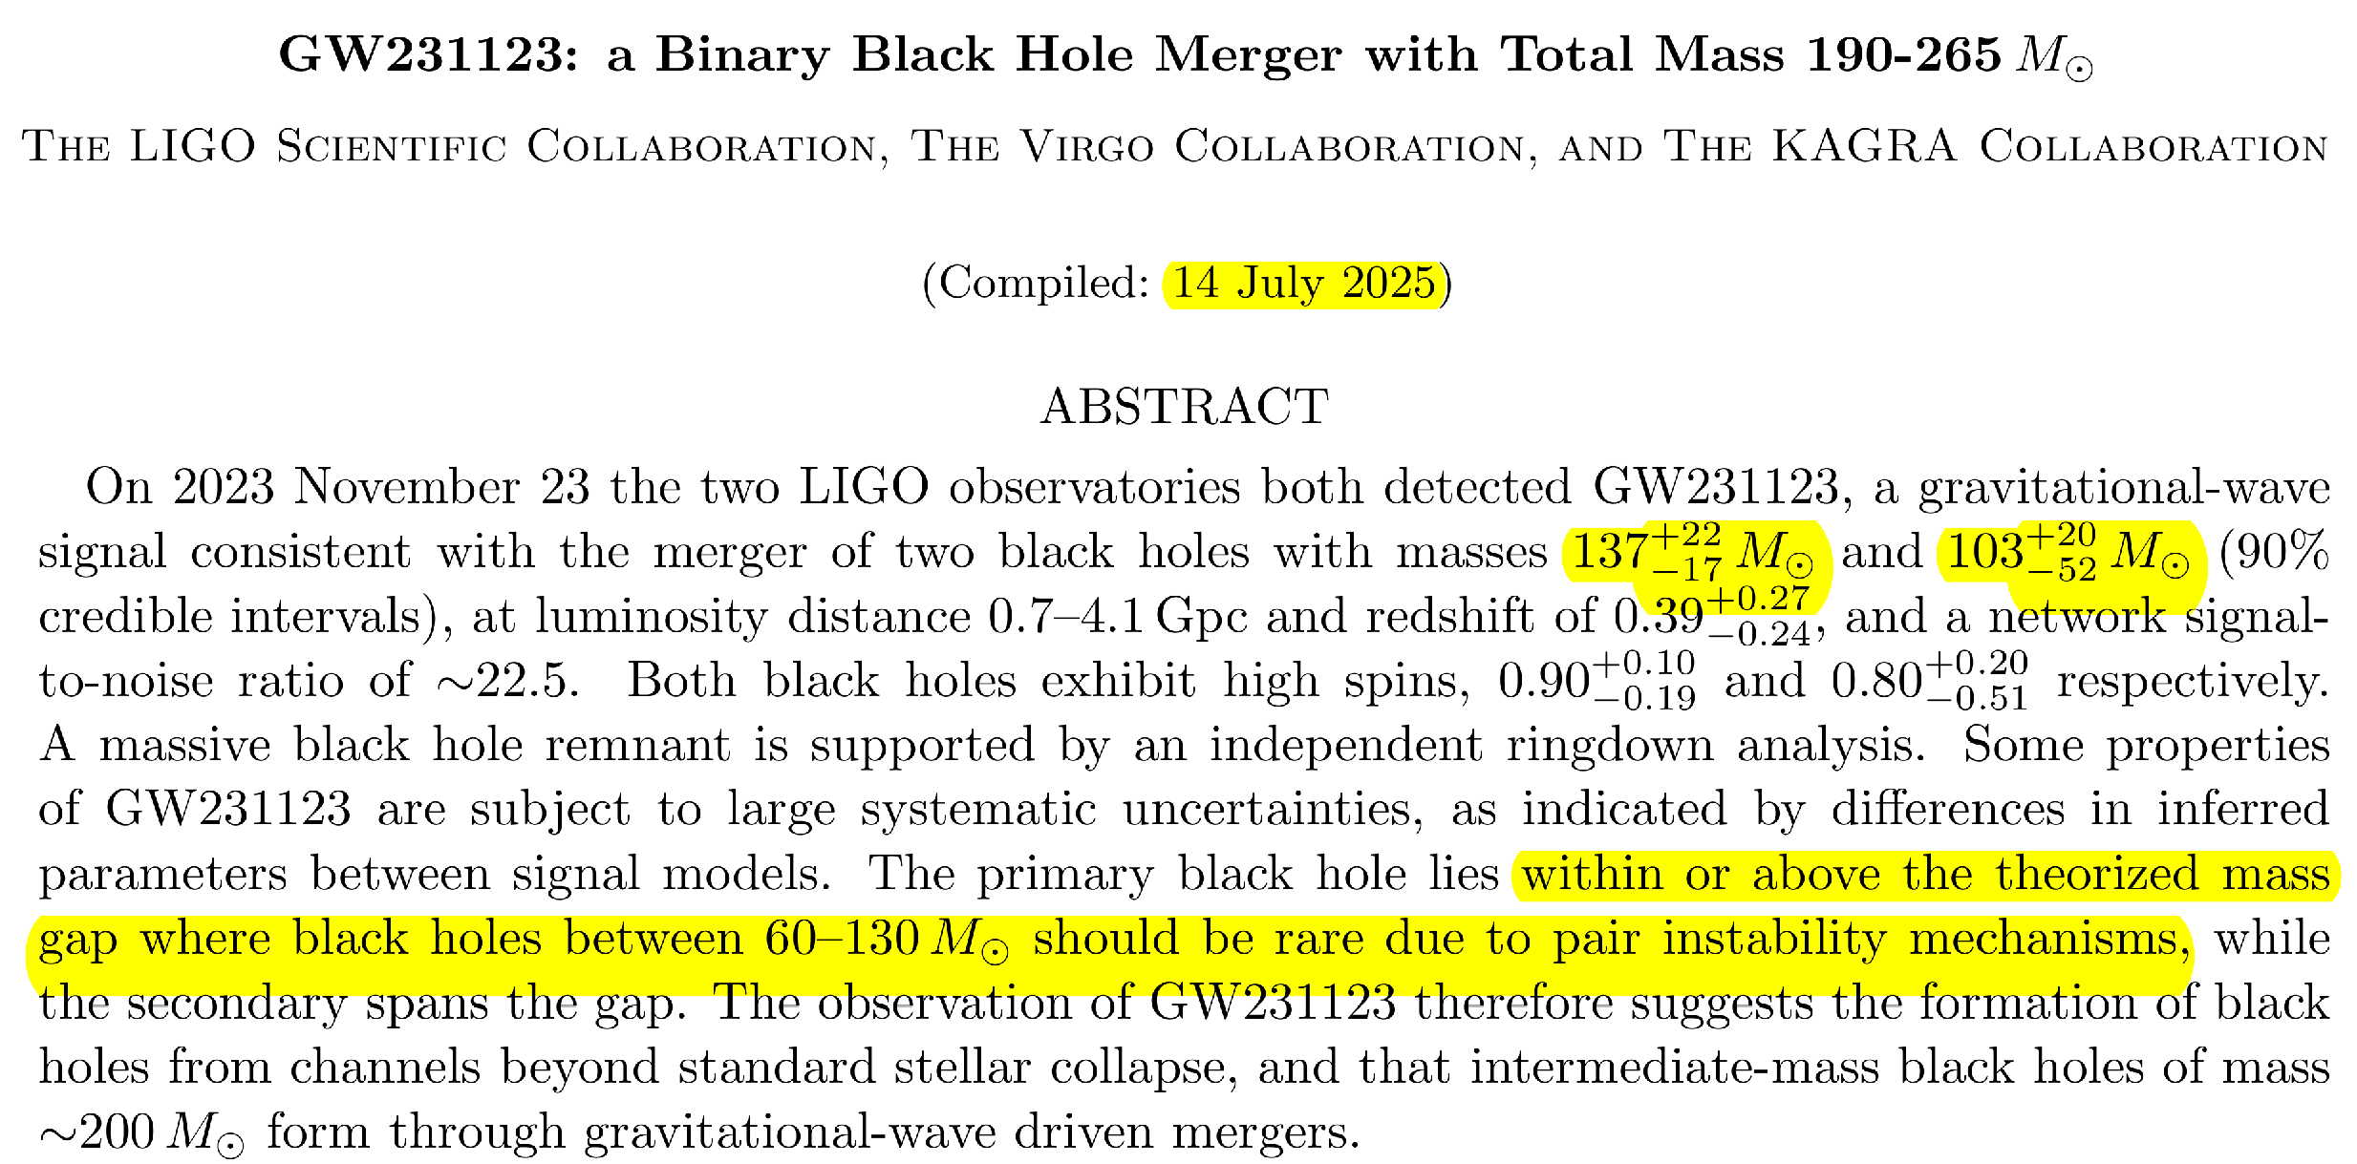

Slide 5
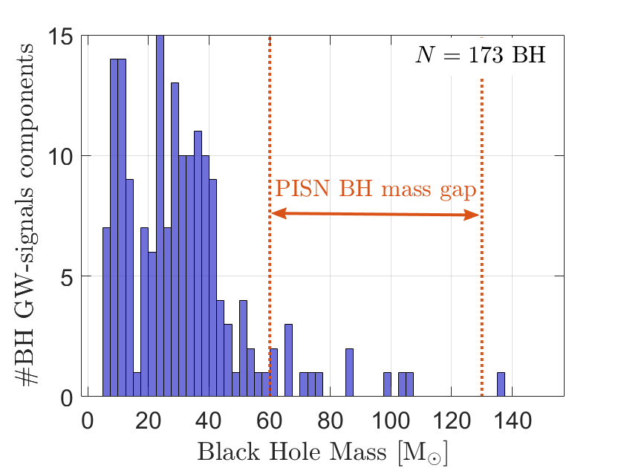
GWTC-DATA LIGO/Virgo/KAGRA collaborations [gwosc.org/eventapi/html/GWTC]
BH mass growth
mergers
gas accretion

Slide 6

Proto-stellar clusters
Massive, compact, high-redshift, stellar clusters, likely precursors of Globular Clusters
Stellar clusters initially formed from the collapse of dense gas cloud.
Stars form almost simultaneously within $Δt_{form}≈0.1Myr$
Initial total mass $M={10}^{5}−{10}^{7}M_{⊙}$
Star formation efficiency $ε∼0.1−0.3$
Compactness: $C≡\frac{M/{{10}^{5}M_{⊙}}}{r_{h}}$
Gas gets depleted because of injected energy by stellar winds and SN-explosions.
Gravitational binding energy $U∝\frac{M^{2}}{R}∼C⋅M$ grows linearly with $M$for fixed $C$
Stellar feedback energy on the other hand grows as $E_{feed}∝M$ regardless of $C$
$⇒$ the effectiveness of gas depletion (depletion timescale) depends on compactness $C$
but also $ε$ and metallicity

Slide 7
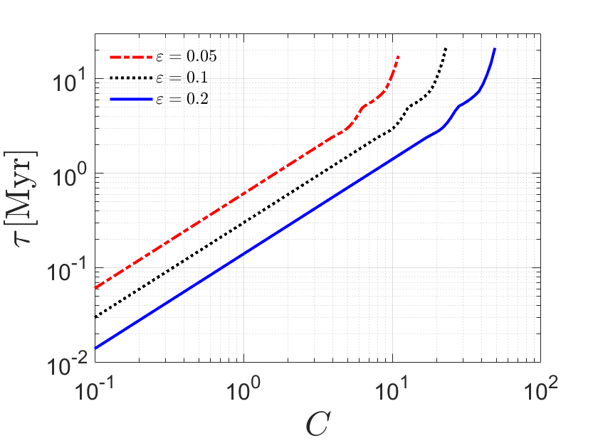
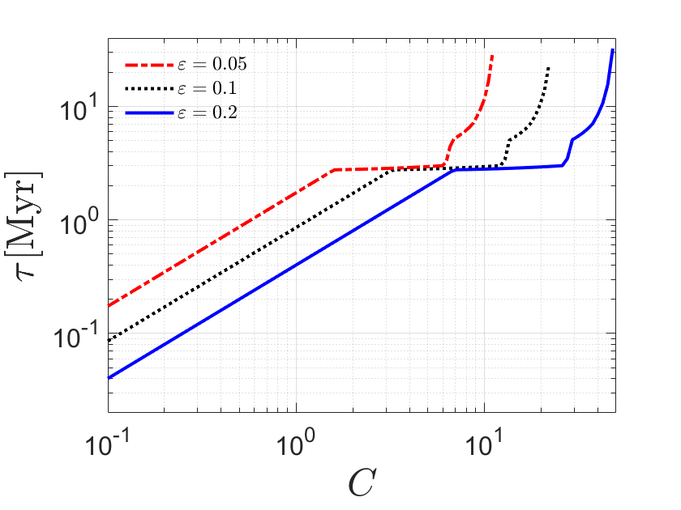
Gas depletion timescales in proto-stellar clusters [Roupas, to appear]
Subsolar metallicity
Low metallicity

Slide 8
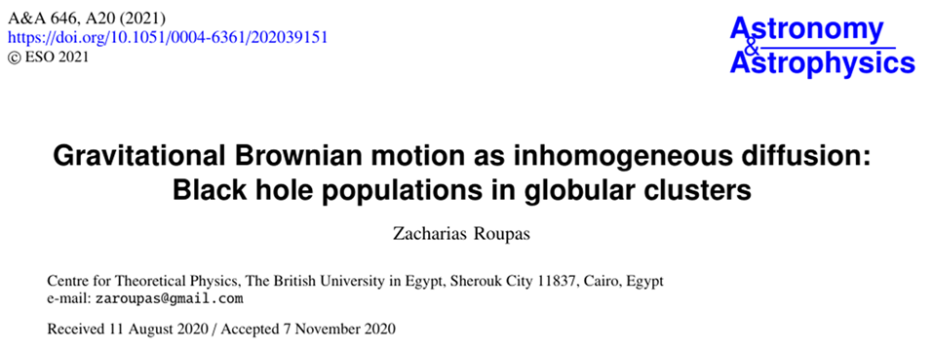
BH motion in stellar clusters
Dynamical friction & random fluctuations of the gravitational field $⇒$ “Brownian” equilibrium

Slide 9
BH motion in stellar clusters
Dynamical friction $a_{DF}=a_{DF,gas}+a_{DF,⋆ }∝−m_{BH}\frac{ρ}{v^{3}}\vec{v}$
Star-induced perturbations (white noise) $δ\vec{v}=\sqrt{2D_{⋆}Δt}\vec{ξ}$ for a diffusion coefficient $D_{⋆}=\frac{\left\langle m_{⋆}\right\rangle }{m_{BH}}η_{⋆}σ_{⋆}^{2}$
Gas-induced perturbations – turbulence: Ornstein-Uhlenbeck process $\vec{a}\left(t+Δt\right)=\vec{a}\left(t\right)e^{−\frac{Δt}{τ_{OU}}}+σ_{a}\sqrt{1−e^{−\frac{2Δt}{τ_{OU}}}} \vec{ξ}$
Isotropic mass accretion: ${\dot{m}}_{BH}=πρ_{gas}vR_{acc}^{2}$ and we assume $R_{acc}=R_{Bondi}=2Gm_{BH}/v^{2}$
protoBHMF code [Roupas, to appear]
calculations of gas depletion timescales incorporating stellar lifetimes, stellar winds, SN explosions
generation of realistic BH populations with assigned progenitor masses
time-dependent introduction of BHs into the simulation according to their formation times
modelling of stochastic perturbations from both gas and stellar components.

Slide 10
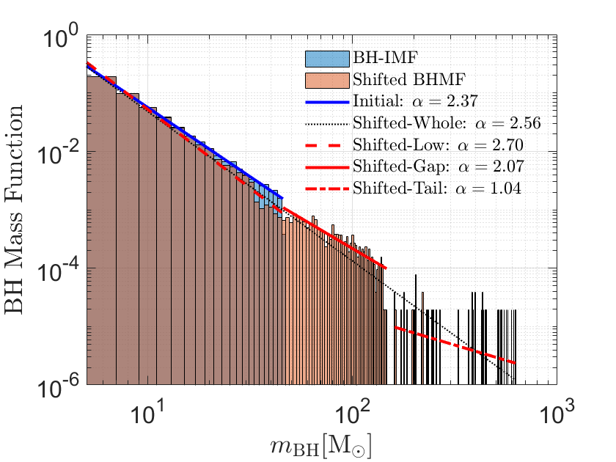
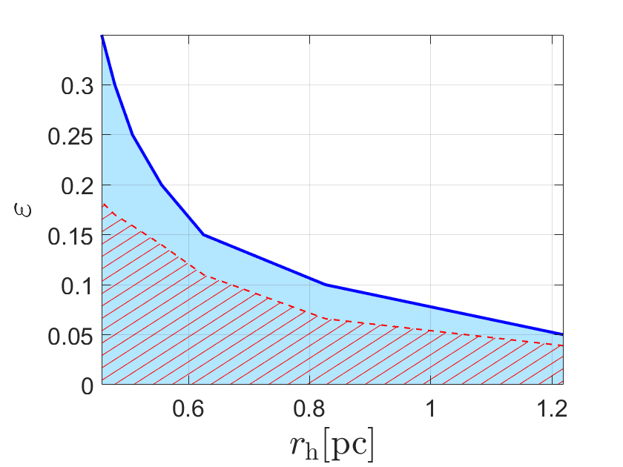

BHMF shift in proto-stellar clusters [Roupas, to appear]
Subsolar metallicity, ${M=10}^{6}M_{⊙}$, $r_{h}=0.7pc$

Slide 11
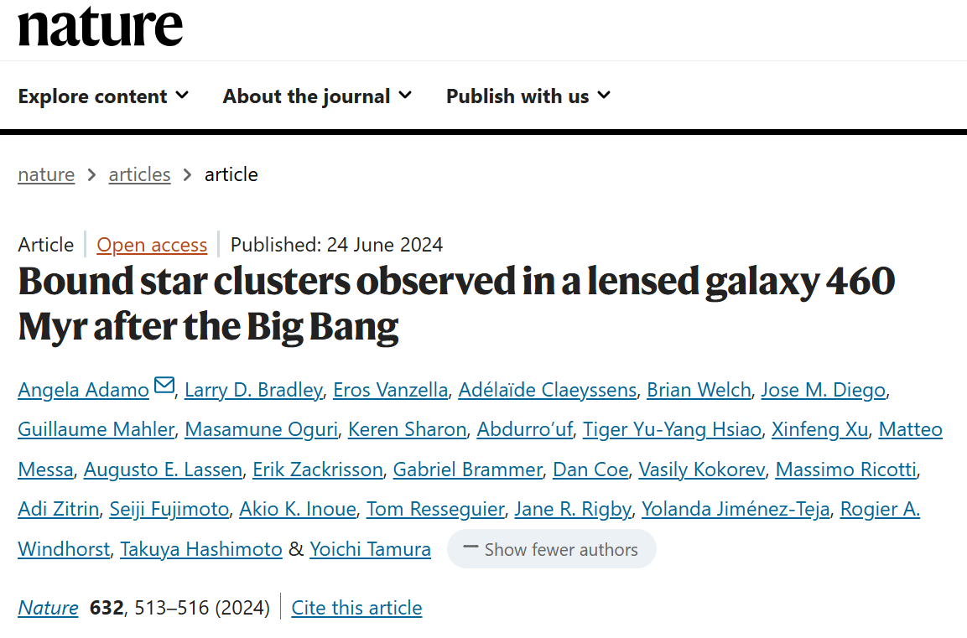
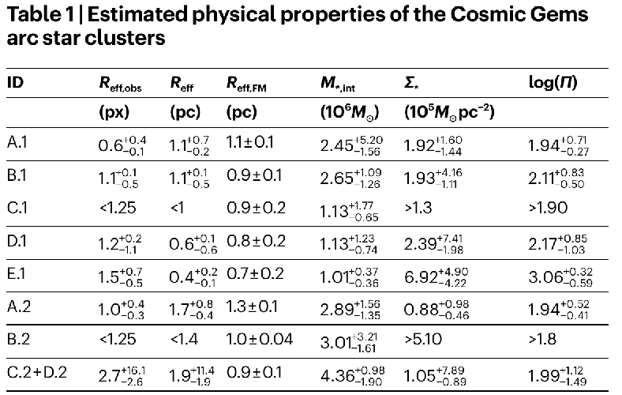
Proto-stellar clusters
Recently observed by JWST in the Cosmic Gems arc galaxy [Adamo et al. Nature (2024)]
Mass: $M≈{\left(1−5\right)⋅10}^{6}M_{⊙}$ , half-light radius: $R_{e}≈(0.7−1.3)pc$

Slide 12
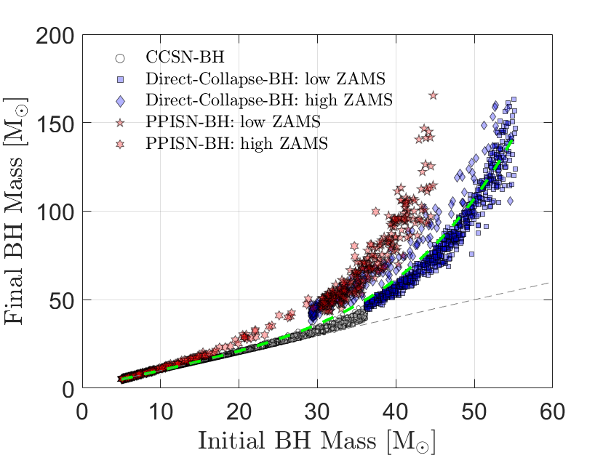
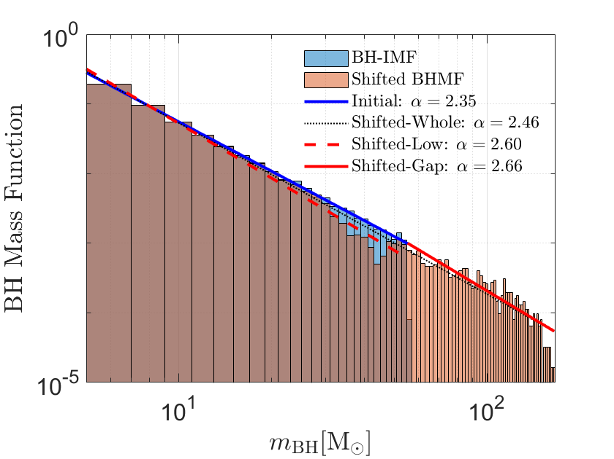
Theoretical Prediction for Cosmic Gems clusters [Roupas, to appear]
Results for: $M_{⋆}={10}^{6}M_{⊙}$, $ε=0.35$ and conservative size: $r_{c,⋆}=1.3pc$

Slide 13
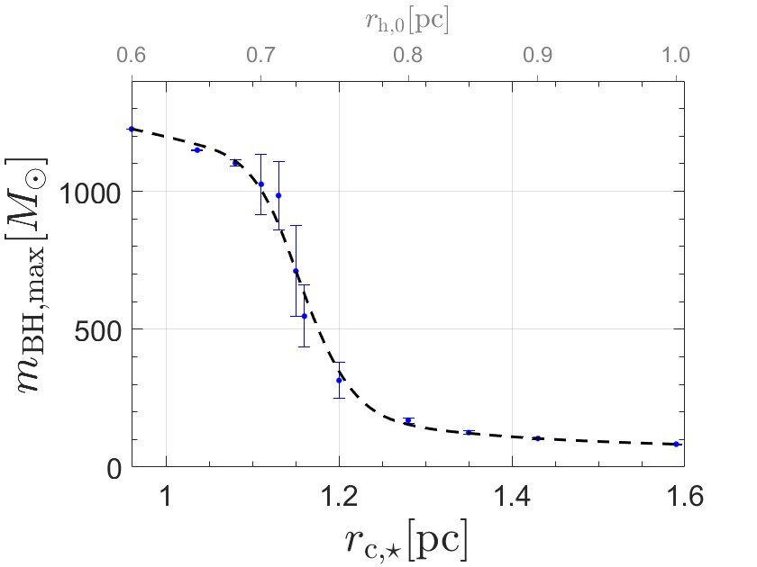
Theoretical Prediction for Cosmic Gems clusters [Roupas, to appear]
Results for: $M_{⋆}={10}^{6}M_{⊙}$, $ε=0.35$

Slide 14
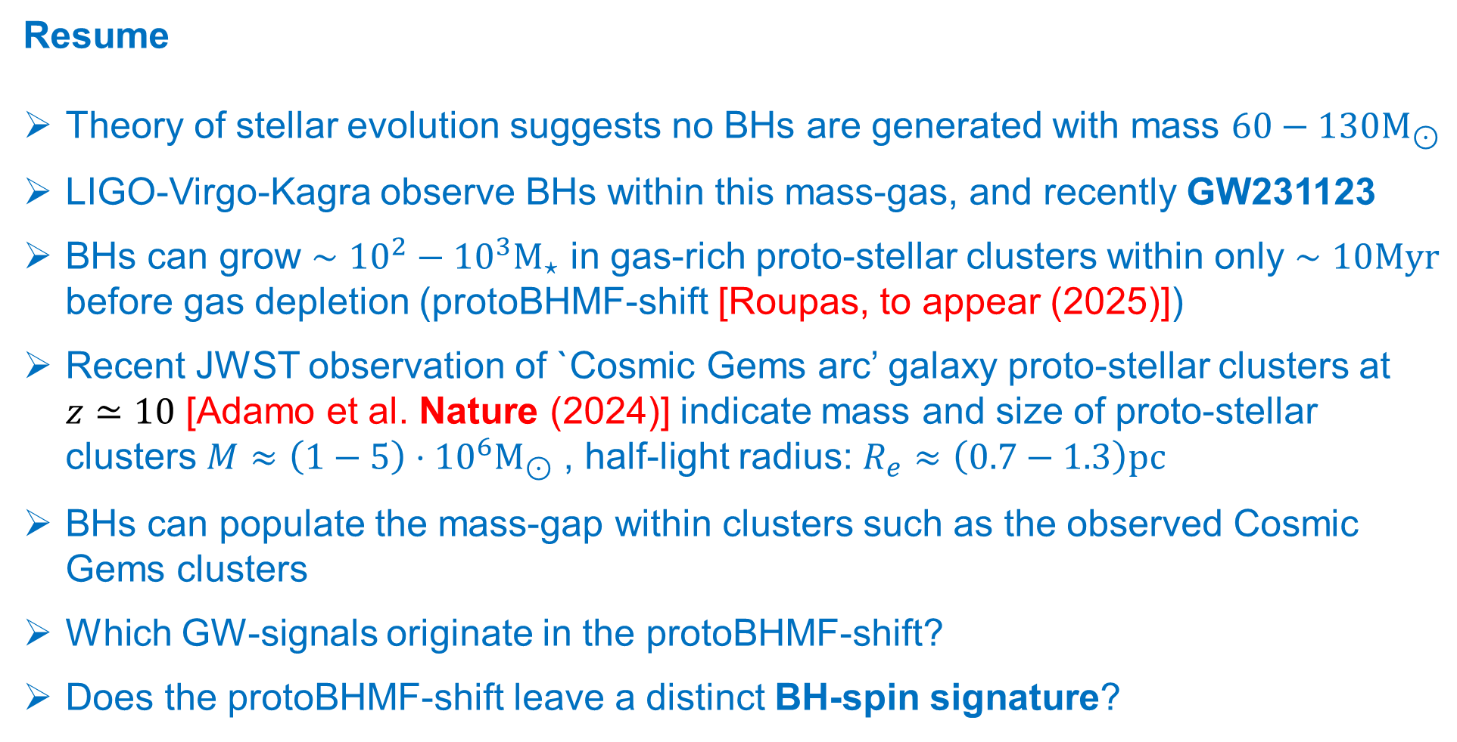
Resume
Theory of stellar evolution suggests no BHs are generated with mass $60−130M_{⊙}$
LIGO-Virgo-Kagra observe BHs within this mass-gas, and recently GW231123
BHs can grow $∼{10}^{2}−{10}^{3}M_{⋆}$ in gas-rich proto-stellar clusters within only $∼10Myr$ before gas depletion (protoBHMF-shift [Roupas, to appear (2025)])
Recent JWST observation of `Cosmic Gems arc’ galaxy proto-stellar clusters at $z≃10$ [Adamo et al. Nature (2024)] indicate mass and size of proto-stellar clusters $M≈{\left(1−5\right)⋅10}^{6}M_{⊙}$ , half-light radius: $R_{e}≈\left(0.7−1.3\right)pc$
BHs can populate the mass-gap within clusters such as the observed Cosmic Gems clusters
Which GW-signals originate in the protoBHMF-shift?
Does the protoBHMF-shift leave a distinct BH-spin signature?

Slide 15
Thank you!

