Slide 1

Laser Induced p+11B Fusion by
Resonant Nanoplasmonic Antennas
Laszlo P. Csernai
for the NAPLIFE and FUSENOW Collaborations
⁻ Department of Physics and Technology, Uiversity of Bergen, Bergen, Norway
- Csernai Consult Bergen, Ulset, Norway
XIV International Conference
on New Frontiers in Physics 2025
July 17-31, 2025, OAC, Kolimbary, Crete, Greece

Slide 2

The NAPLIFE & FUSENOW Collaborations
Nour Jalal Abdulameer, Tibor Ajtai, Márk Aladi, D. Alkhalil, L. Balázs, Balázs Bánhelyi, Á. Bélteki, Tamás S. Biró, Attila Bonyár, Alexandra Borók, Larissa Bravina, J.A. Burunkova, F.A. Casian-Plaza, N.Q. Chinh, István Csarnovics, T. Csendes, László Pál Csernai, Mária Csete, A. Csik, Tamás Csörgő, Odd Erik Garcia, Gábor Galbács, Z. Galbács, Zs. Geretovszky, Chris Grayson, Martin Greve, Olivér Fekete, Zsolt Fogarassy, J.P. Hansen, L. Himics, Román Holomb, P.M. Janovszky, L. Juhász, Gyula Kajner, Gábor Kasza, Judit Kámán, Miklós Kedves, Albert Kéri, A. Kohut, J. Kopniczky, Rebeka Kovács, Éva Kovács-Széles, S. Kökényesi, Norbert Kroó, Archana Kumari, Tomás Lednický, Bálint Leits, Péter József Lévai, Zs. Márton, Igor N. Mishustin, Dénes Molnár, Kolos Molnár, Anton Motornenko, Ágnes Nagyné Szokol, Károly Osvay, D.J. Palásti, István Papp, Petra Pál, Péter Petrik, Béla Ráczkevi, Péter Rácz, Johann Rafelski, István Rigó, Leonid M. Satarov, Horst Stöcker, Daniel D. Strottman, F. Schubert, DS. Svjazhina, G. Szabó, Melinda Szalóki, Géza Szántó, András Szenes, R. Szipőcs, Karolis Tamosiunas, Nóra Tarpataki, Bálint Ferenc Tóth, Emese Tóth, O. Urbán, P. Varmazyar, Dávid Vass, Miklós Veres, Lajos Villy, Shereen Zangana, Konstantin Zhukovsky, S. Zivkovic,
85 participants
Dujuan Wang, Wuhan University of Technology
Dieter D.D. Hoffmann, Xi'an Jiaotong University

Slide 3


















Csernai László
University of Bergen, Norway

Slide 4
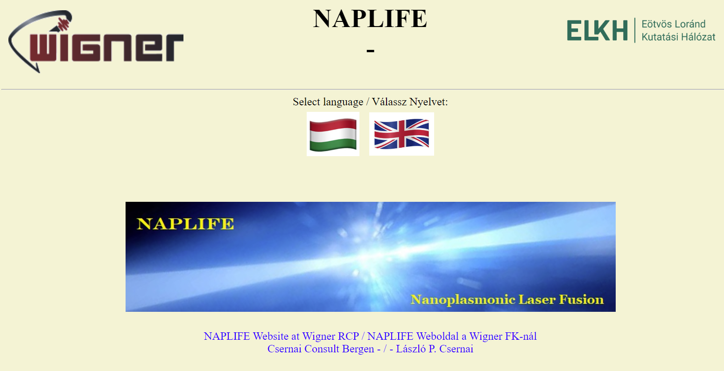
https://csernai.no/naplife/

Slide 5
Basic ideas
This is a Fundamentally New Laser Fusion Method
No slow compression, No thermalization, No central hot point ignition, No α- heating !!!
Instead:
Exploiting monochromatic, linearly polarized laser:
Simultaneous two-sided ignition of the whole fuel (=> H.E.H.I.Phys),
Direct generation of near equal energy, parallel directed, protons for fusion
HOW ??? >>> Resonant Nanotechnology
Let us start with simultaneous (time-like) ignition >>

Slide 6
[ A.H. Taub (1948) ]
Taub assumed that (physically) only slow
space-like shocks or discontinuities may occur (with space-like normal, λ₄=0).
This was then taken as standard, since then (e.g. LL 1954-)

Slide 7
[ L. P. Csernai, Zh. Eksp. Teor. Fiz. 92, 379-386 (1987) &
Sov. Phys. JETP 65, 216-220 (1987) ]
corrected the work of
[ A. Taub, Phys. Rev. 74, 328 (1948) ]
λ_{α} λ^{α} = ± 1
+1
-1

Slide 8
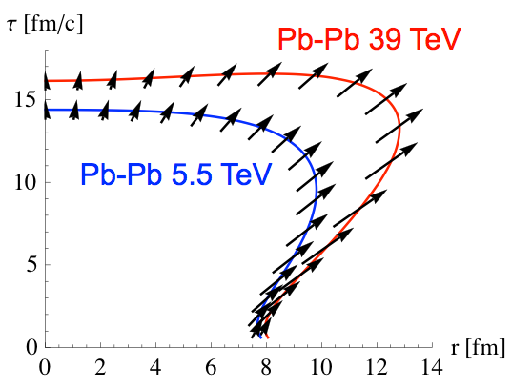
~[e-23s]
Light cone
Size and time extent of hadronization is measured by two particle correlations,
via Hanbury-Brown & Twiss effect.
[ N. Armesto, et al., Nucl.Phys. A931 (2014) 1163 ]
Simultaneous ignition: Verified in Rel. Heavy Ion reactions (CERN, BNL)

Slide 9
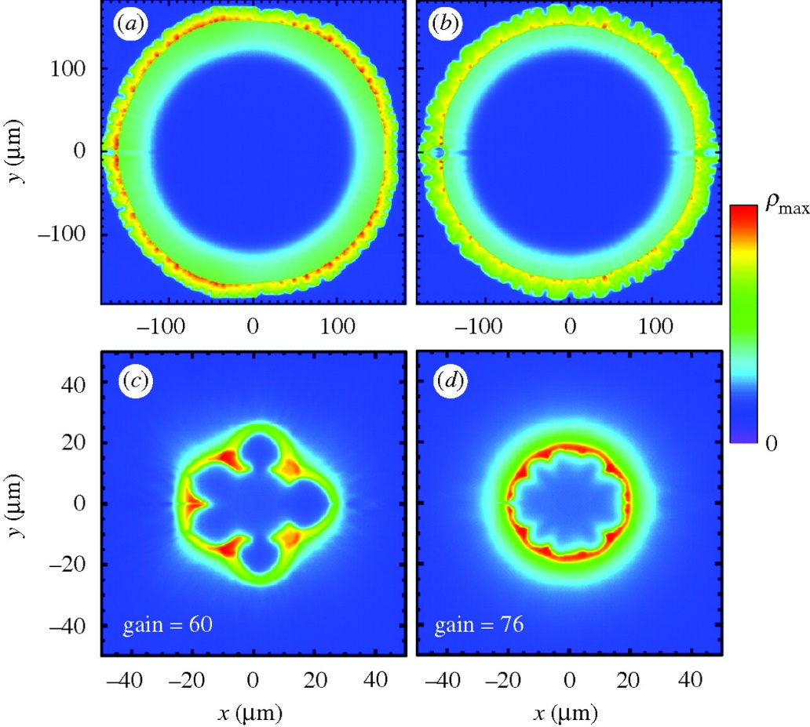
Fusion reaction:
D + T ➔ n(14.1 MeV) + 4He (3.5 MeV)
Constant absorptivity,
Spherical irradiation
Ignition temperature = T1 ➔
Simultaneous, volume ignition up to
0.5 R (i.e. 12% of the volume).
Not too good, but better than NIF:
[ L.P. Csernai & D.D. Strottman,
Laser and Particle Beams 33, 279 (2015).]

Slide 10
Thick, coin like target - New Developments
L.P. Csernai, N. Kroo, I. Papp
X
Thickness of the target is: h
h depends on pulse energy, ignition energy, target mass, …
[Patent (1987)]

Slide 11
How can we
achieve this ?
With nano-antennas !
Ignition is reached at contour line Q = 1.
[ L. P. Csernai, M. Csete, I. N. Mishustin, A. Motornenko, I. Papp, L. M. Satarov, H. Stöcker, N. Kroo, Physics of Wave Phenomena, 28 (3), 187-199 (2020).]

Slide 12
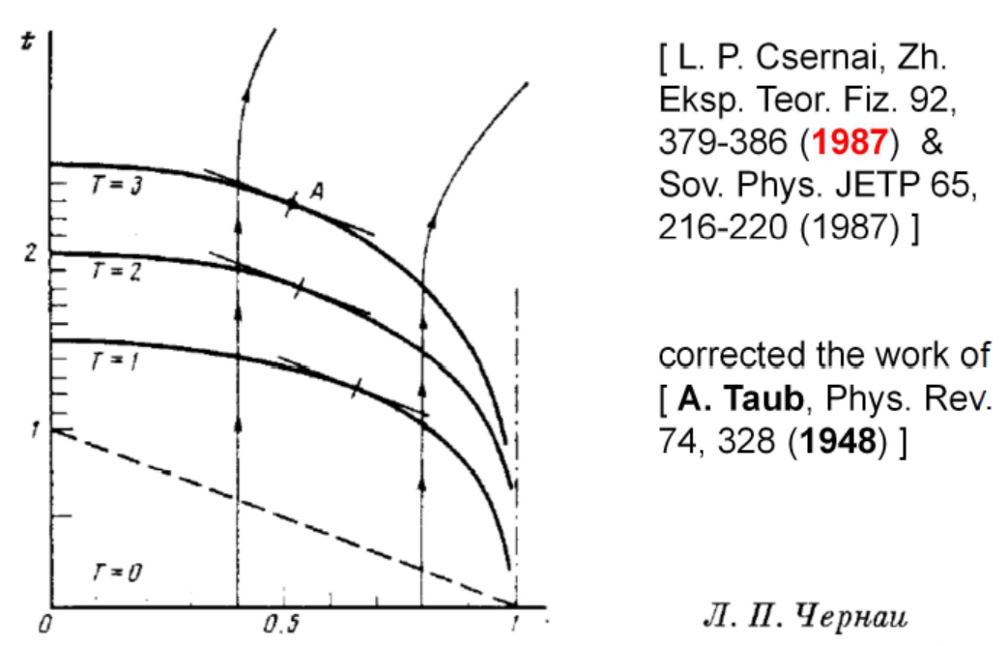
Simultaneous ignition – no instabilities
[ N. Kroo (2017) &
M. Csete et al., (2021) ]

Slide 13
Laser-induced proton acceleration
by a resonant nanoantenna
[arXiv:2306.13445v2, István Papp, Larissa Bravina, Mária Csete, Archana Kumari, Igor N. Mishustin, Anton Motornenko, Péter Rácz, Leonid M. Satarov, Horst Stöcker, András Szenes, Dávid Vass, Tamás S. Biró, László P. Csernai, Norbert Kroó; EPOCH – PIC ]

Slide 14
Nuclear transmutation ➔ Deuterium
[ I. Papp et al. PRX Energy 1, 023001 (2022)]

Slide 15
Industrial setup
[ L.P.. Cs., Eur. Phys. J. Spec. Top. (2025),
https://doi.org/10.1140/epjs/s11734-025-01466-6 ]

Slide 16

NAPLIFE: Three unique, new ideas
Simultaneous ignition by monochromatic, linearly polarized laser light to avoid instabilities. Short pulse length is needed
➔ Only ELI-ALPS ! (regular nonthermal) [Patented]
Using resonant nanorod antennas to increase and regulate light absorption, for whole target (regular nonthermal) [Patented]
Accelerating protons via LWFA & LWFC mechanisms in one direction, orthogonal to the two colliding laser beams to start nuclear reactions (regular nonthermal)
(i) Theory & ideas
Now: (ii) Exp. Validation

Slide 17
(ii) Validation Status

Slide 18
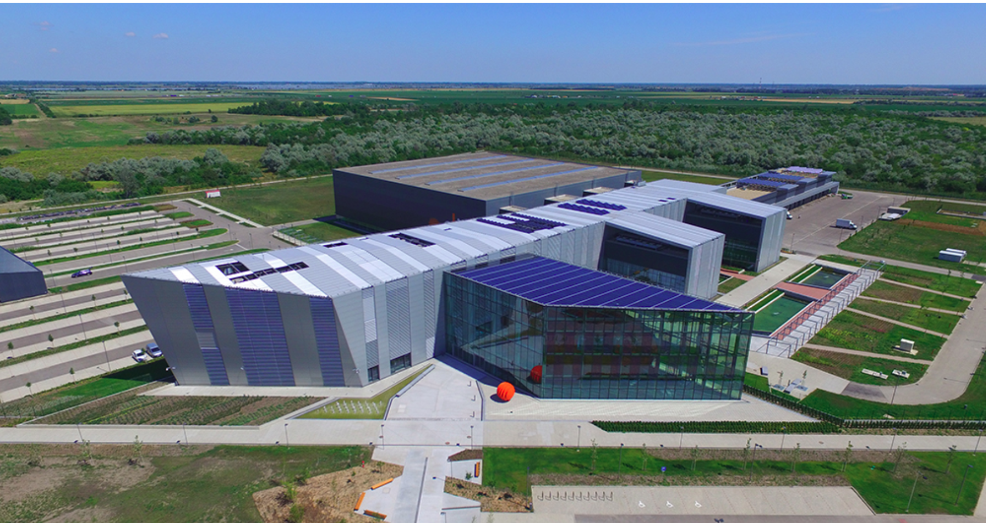
European Laser Infrastructure – Szeged, HU
Only @ ELI-ALPS Szeged: EU Extr. Light Infrastructure , Attosec. Light Pulse Source
2PW High Field laser, 10 Hz, <10fs, 20 J

Slide 19
ELI-ALPS
Target chamber
[K. Osvay et al.]

Slide 20
Validation status
Targets, Polymers, UDMA, TEGDMA, MMA, Deuterated MMA, resonant nano-rods random oriented and placed [BME, U. Debrecen] ordered & aligned nanorods [ELI – ALPS], directed nanorods […]
Laser irradiation one sided irradiation up to now,
Wigner RCP Budapest, 30 mJ Ti:Sa Hydra I= ~ 2 10¹⁷ W/cm²
ELI-ALPS Szeged, 30 mJ SYLOS I= ~ 2 10¹⁹ W/cm²
p + 11B fusion, Proton absorption by Boron containing target is observed with
α –particle production at ELI-ALPS

Slide 21
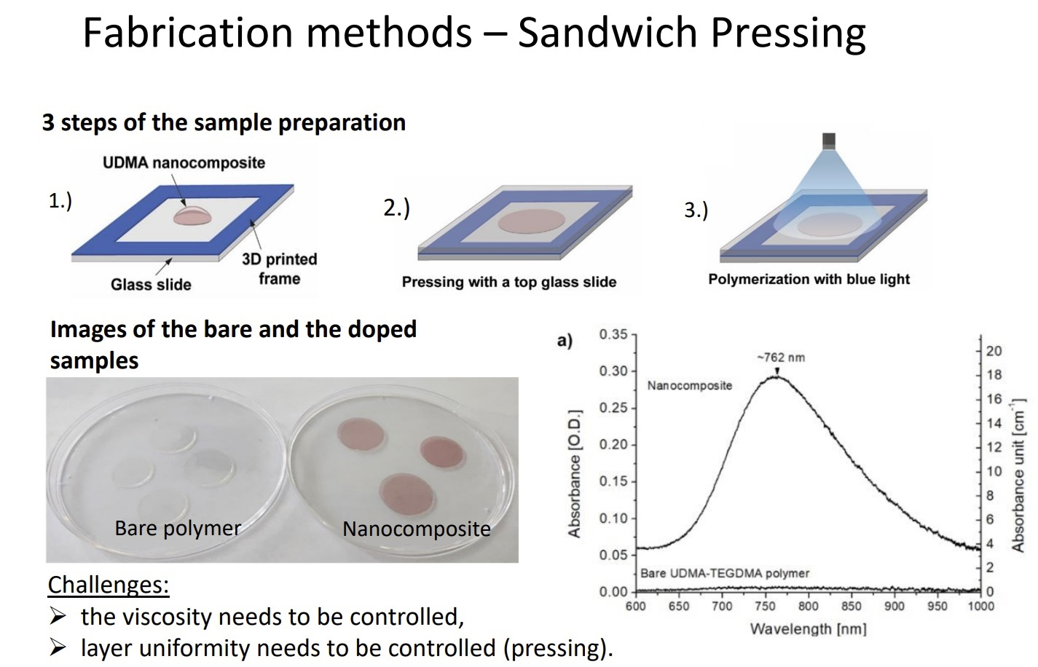
[ A. Bonyár et al. (2023) ]

Slide 22
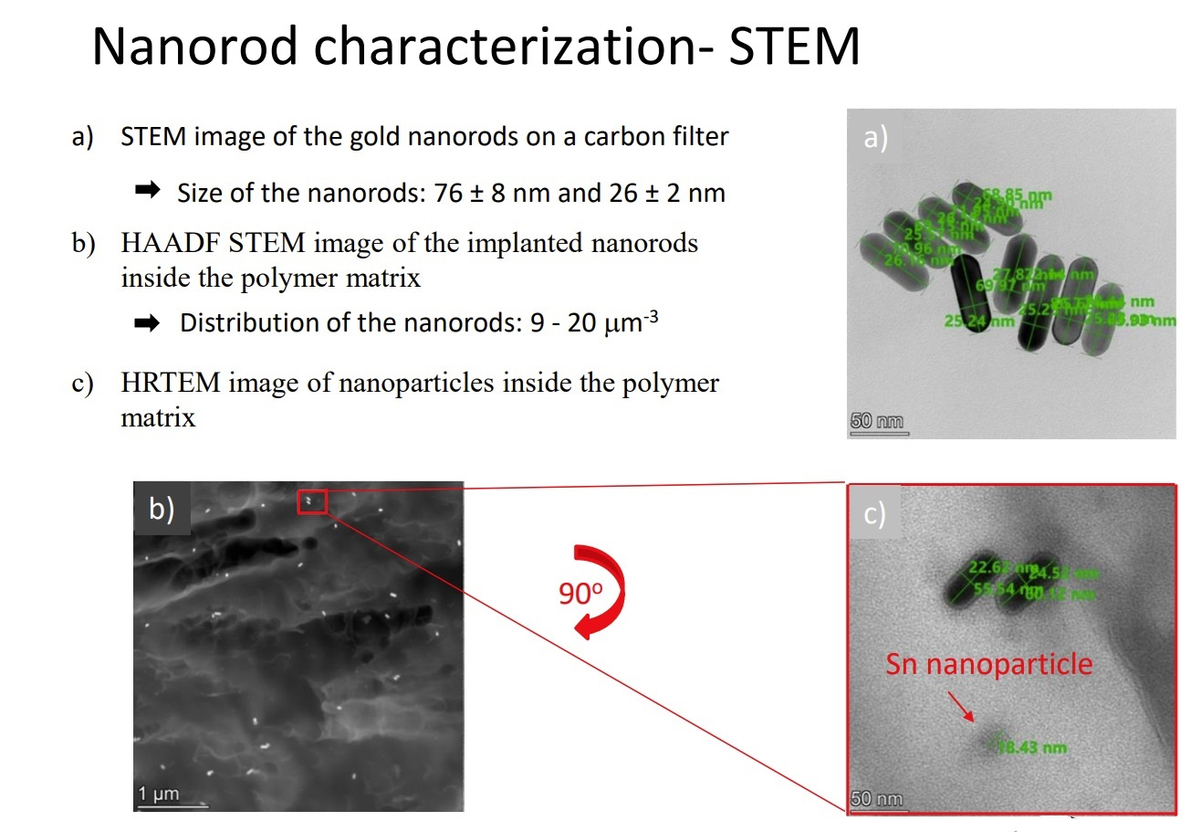
[ A. Bonyár et al. (2023) ]

Slide 23
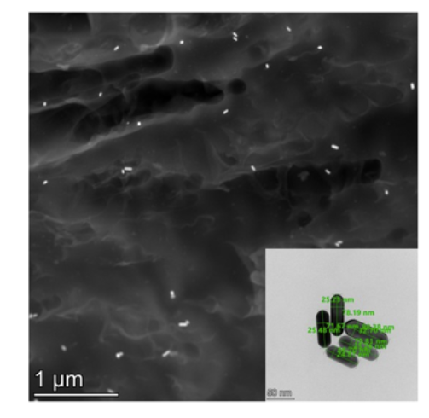
Resonant targets
Solid targets at room temperature → hard polymer: UDMA (470: H38, C23, O8, N2), TEGDMA, MMA - large hydrogen content (evt. deuterated) & 85x25 nm nanorod antennas (sort !)
1st random orientation, 85x25nm, Au0,
Au1 (0.1m%),
Au2 (0.2m%)
[A. Bonyár et al., (BME)] These targets are used up to now >>
2nd directed & ordered [in progress] [Zs. Márton, J. Budai, M. Csete et al., ELI-ALPS ]

Slide 24
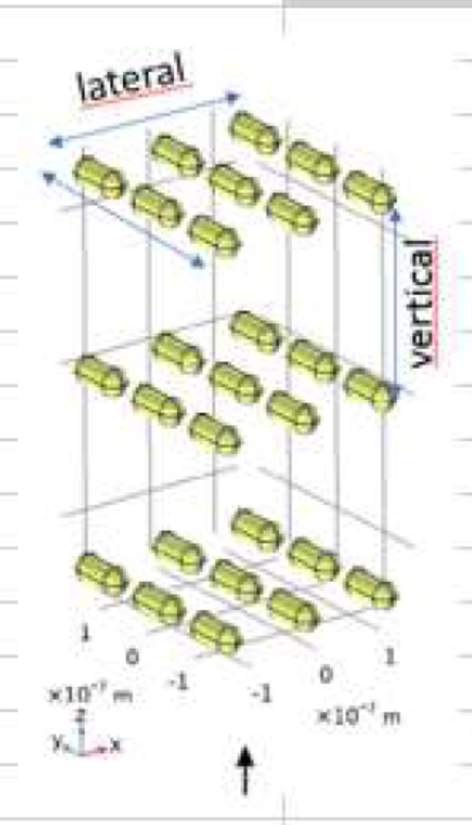
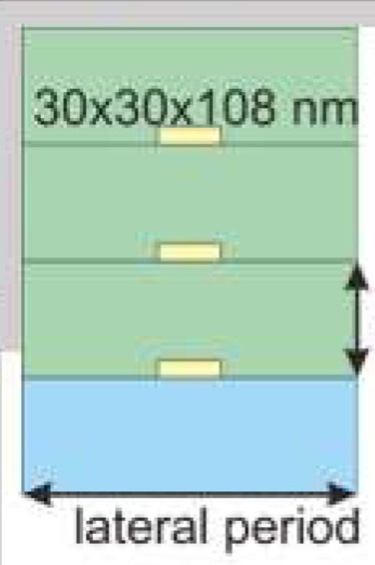
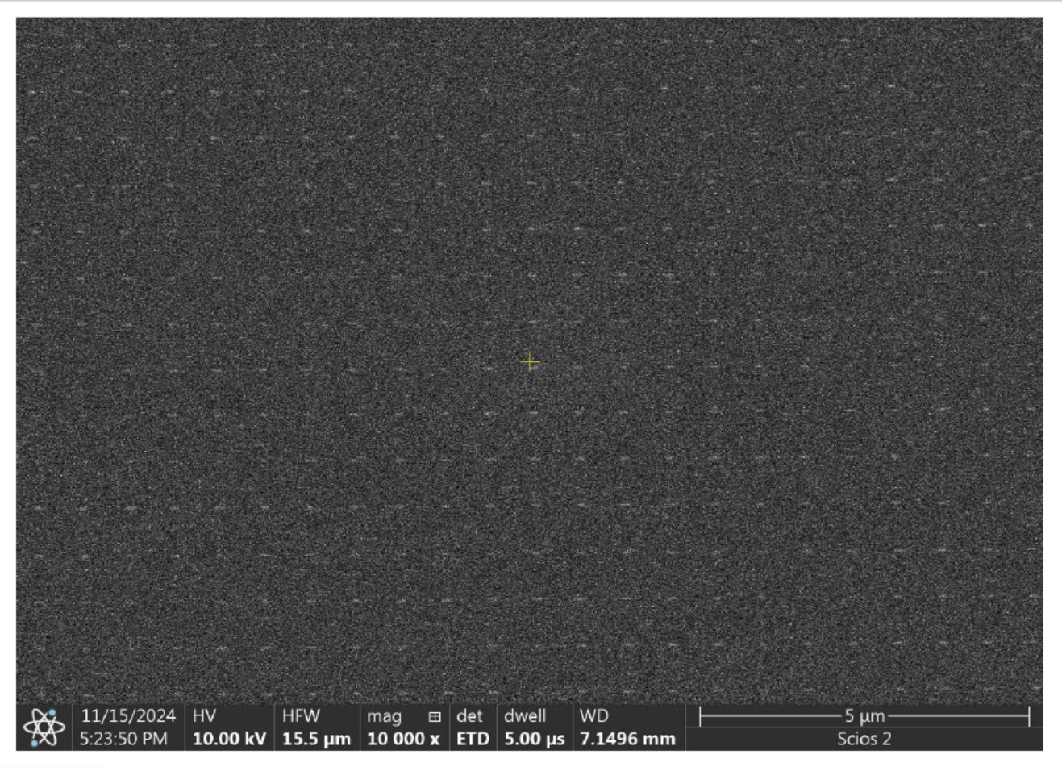
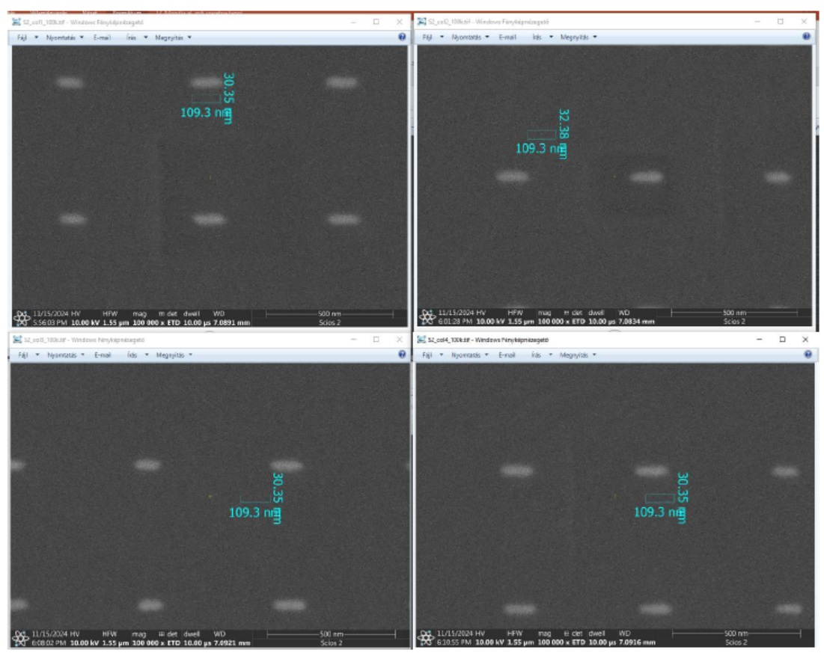

New directed multi-layer targets by ELI-APLS
HSQ
Vertical period: 410nm, 480 nm
Longitudinal p.: n x λ_{eff} , n > 2. λ_{eff} /2 = 108 nm in HSQ
HSQ
Directed proton emission ? Will be tested at ELI !!!
Si, SiO_{2,}
530nm, 570nm
500 nm
[Zs. Márton, J. Budai, M. Csete et al., ]
1.0 x 0.6 mm

Slide 25
ELI – ALPS
Target w/
Directed
nanorod
antennas
[Zs. Márton
et al.]

Slide 26
Laser
beam is
horizontally
polarized !!!
➔
Nanorod
antennas
accelerate
protons
horizontally
!!!
[ Imene Benabdelghani et al., (NAPLIFE Collaboration) @ ELI-ALPS: XIV ICNFP 2025 ]

Slide 27
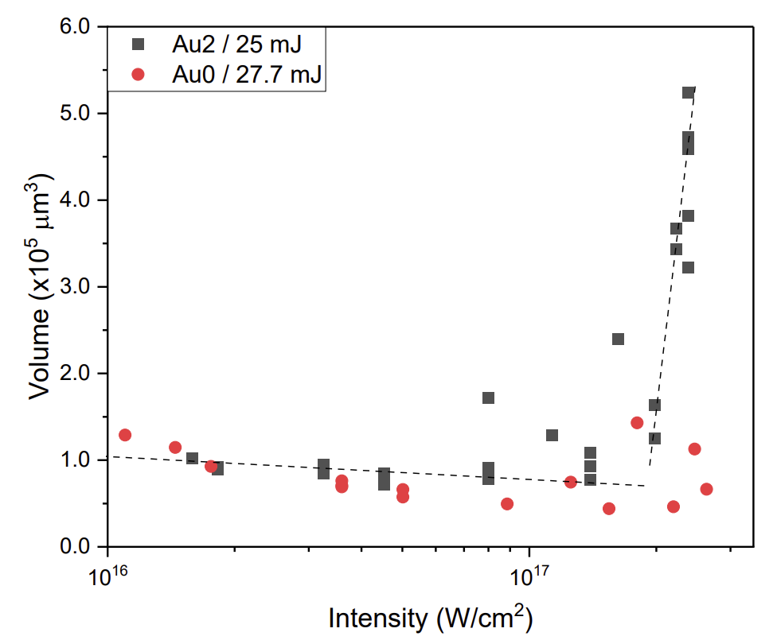
Crater Volume
[ Ágnes Nagyné Szokol et al., arxiv.org/pdf/2402.18138 ]
Q = ~ 6
Change of the crater volume with the amount of laser light reflected by the target (plasma mirror) for the laser irradiations of the undoped (Au0) and gold nanorod containing (Au2) targets

Slide 28
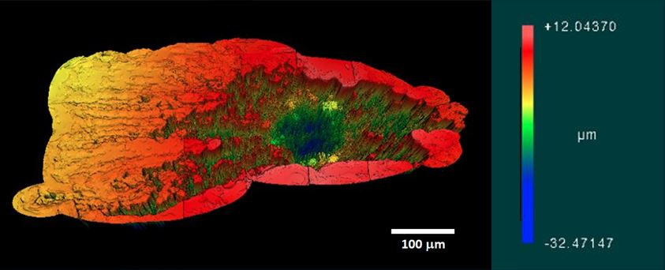
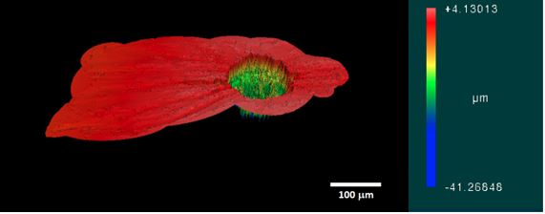
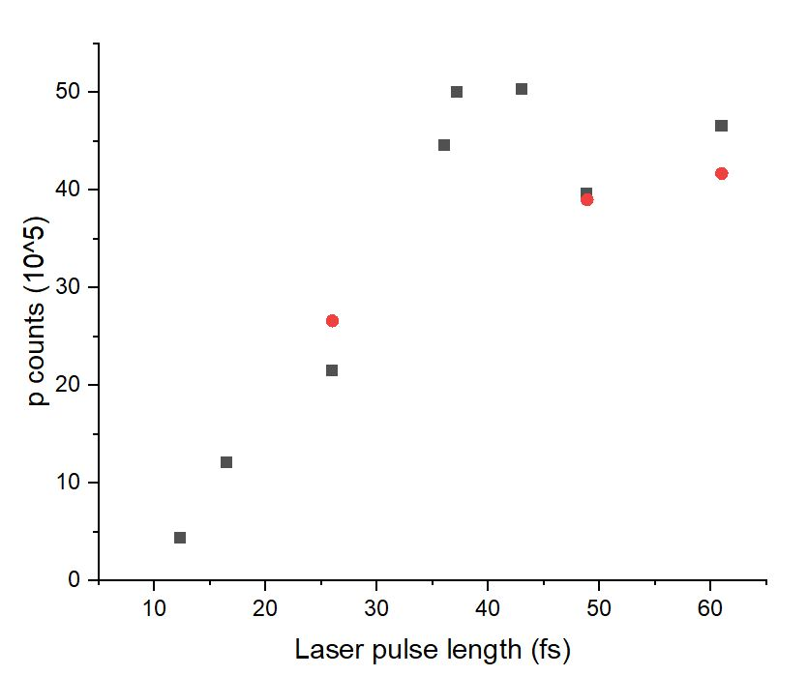
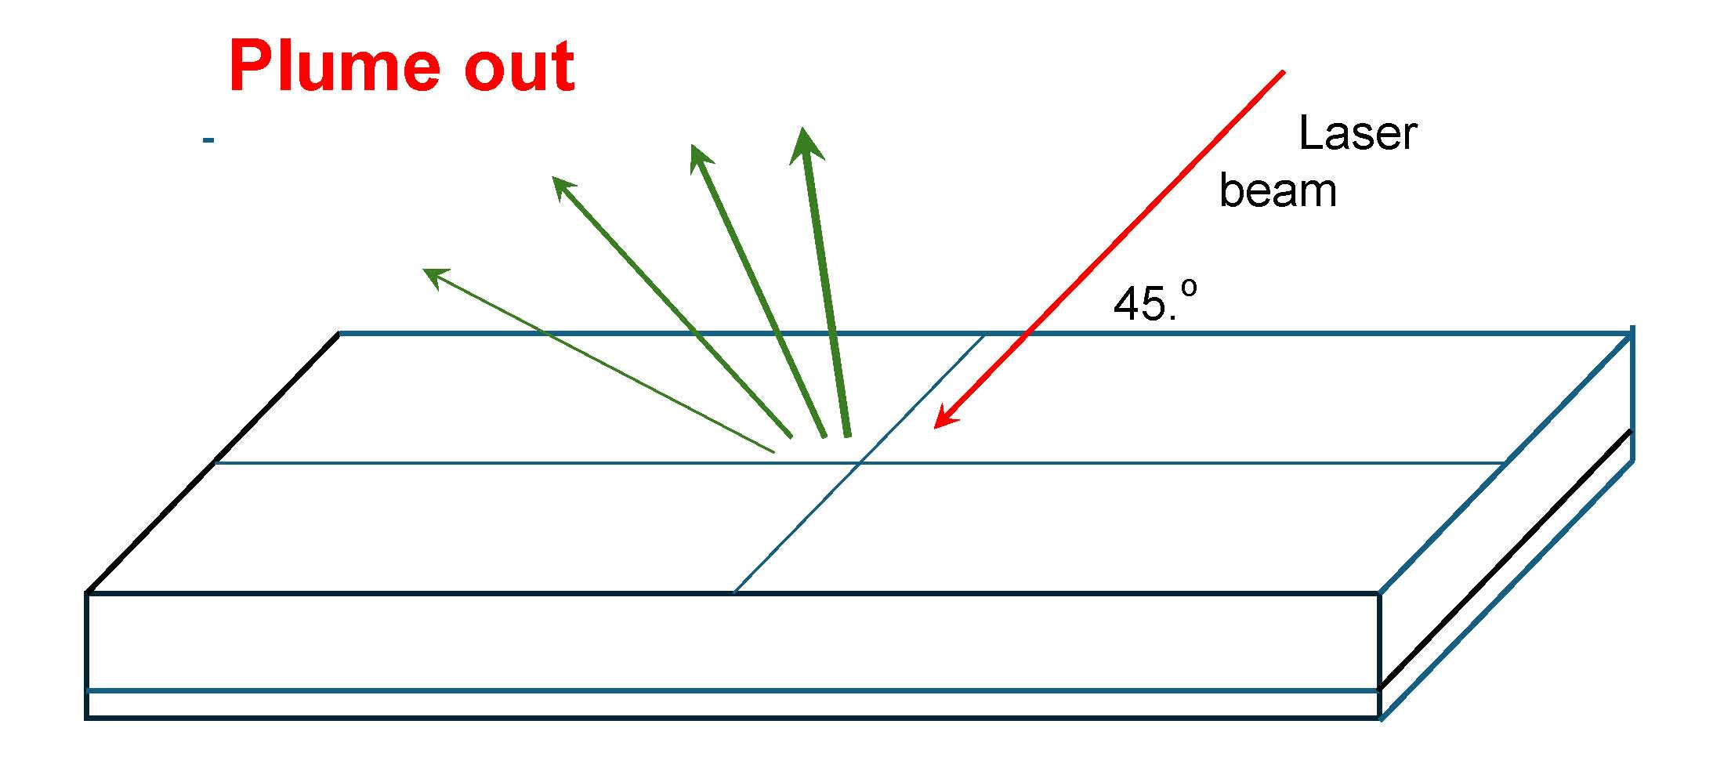
Au2
Au0
13,15.10⁵µ³
3,48.10⁵µ³
Images: Laser pulse length 43fs
3,48.10⁵µ³
Proton counts vs pulse length
[ Nagyné Szokol Ágnes for the NAPLIFE Collaboration
Simonyi Nap, Budapest, 2024.10.17. ]

Slide 29
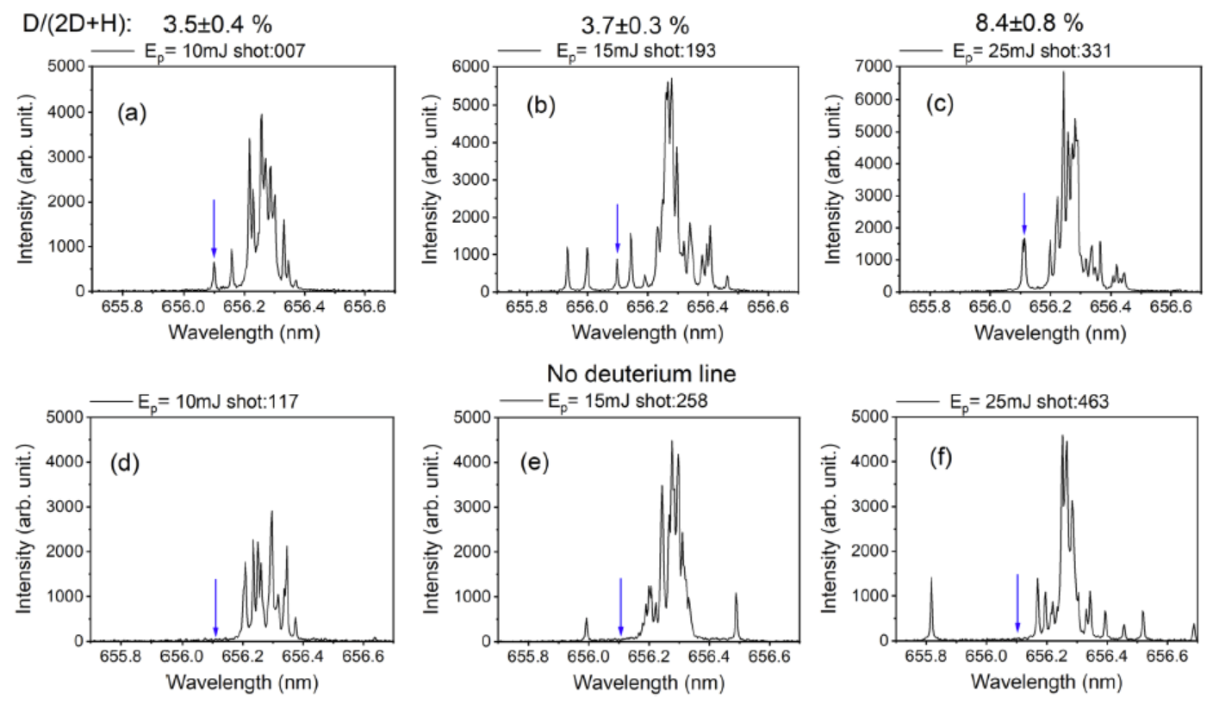
[ N. Kroó, M. Aladi, M. Kedves, B. Ráczkevi, A. Kumari, P. Rácz, M. Veres, G. Galbács, L.P. Csernai, T.S. Biró, for the NAPLIFE Collaboration, Monitoring of nanoplasmonics-assisted deuterium production in a polymer seeded with resonant Au nanorods using in situ femtosecond laser induced breakdown spectroscopy,
Scientific Reports (Nature) 14, 18288 (2024)., (arXiv:2312.16723)
https://doi.org/10.1038/s41598-024-69289-4 ]
Deuterium production

Slide 30
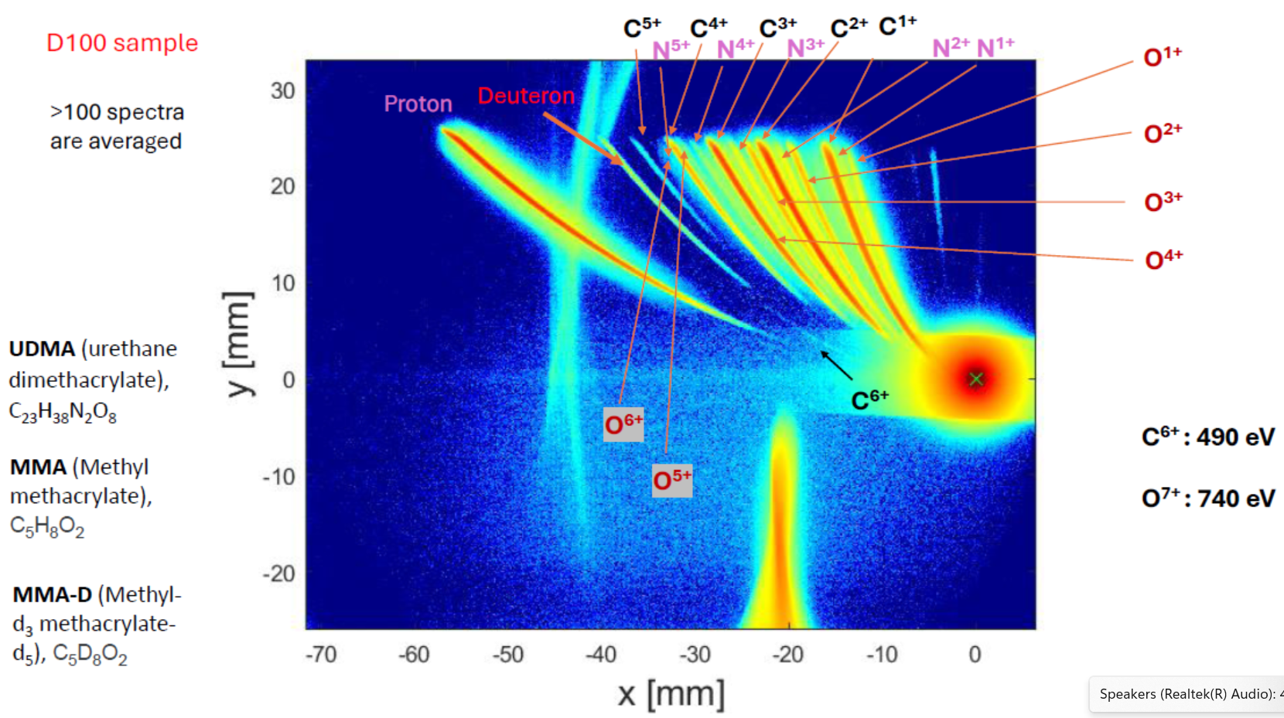
[NAPLIFE –ELI-ALPS 2024]
= D100
[M. Kedves, M. Aladi et al., (2024). ]

Slide 31
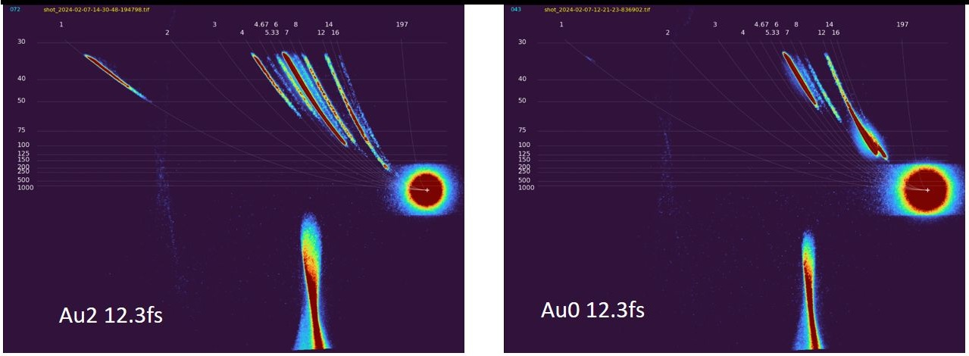
PROOF of Proton acceleration by nano-rod antennas (by Thompson Parabola)
With Au2 nano-antennas we observe accelerated, ~100+ keV protons, while without none!
[M. Kedves, M. Aladi et al., ELI-ALPS preliminary]

Slide 32
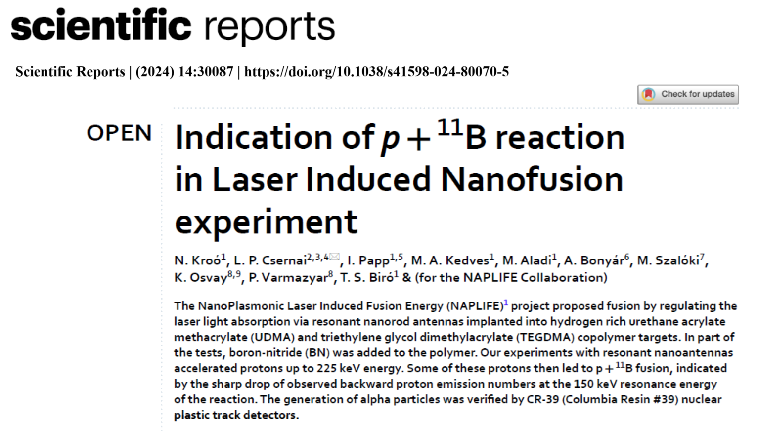
Only two other such measurements are reported up to now:
"First measurements of p11B fusion in a magnetically confined plasma“ R.M. Magee et al., Nature Communications (2023) 14:955, and
"A multi-MeV alpha particle source via proton boron fusion driven by a 10-GW tabletop laser" V. Istokskaia et al., (nature) Communications Physics (2023) 6:27.

Slide 33
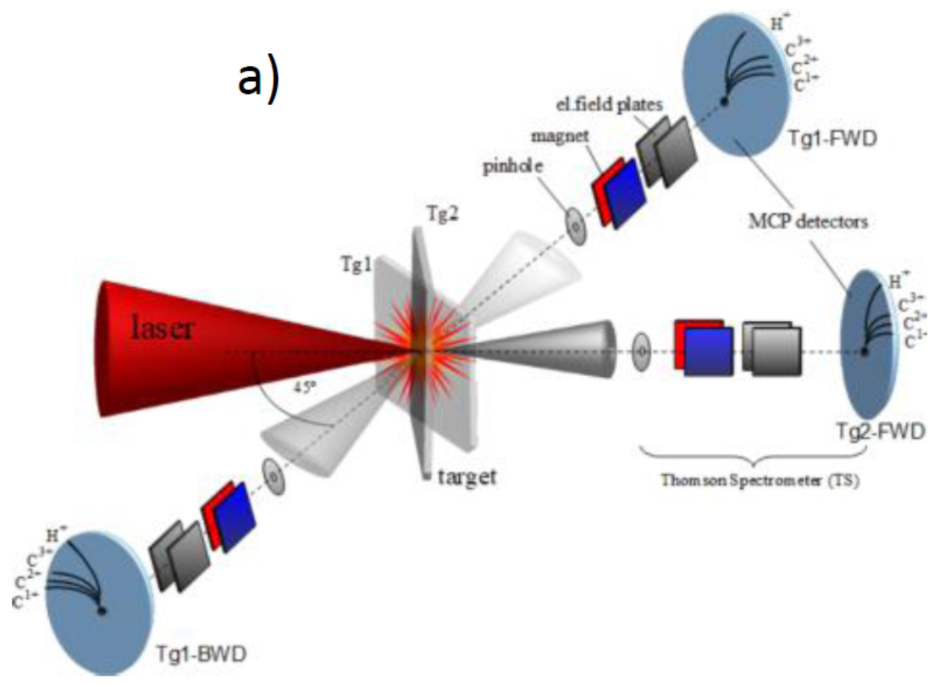
ELI-ALPS – High Intensity Tests 2024 –Thompson Parabola
Thick target
<
< [K. Osvay, M. Kedves, M. Aladi, et al., (2024). ]

Slide 34
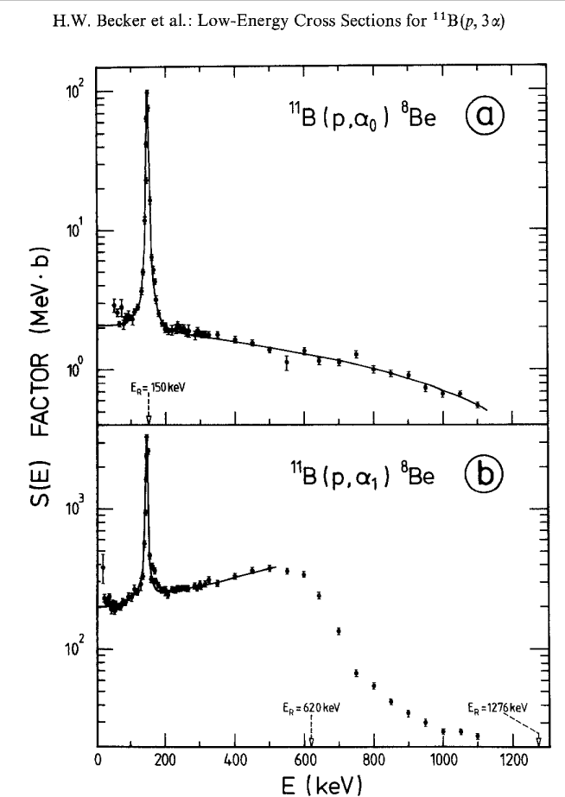
Indication of p + 11B Reaction
Cross section resonance
at 148 keV
[ N. Kroo, L.P. Csernai, I. Papp, M.´A. Kedves, M. Aladi, A. Bonyar, M. Szaloki, K. Osvay, P. Varmazyar, and T.S. Biro, (for the NAPLIFE Collaboration) Sci.Rep. 14, 30087 (2024)]

Slide 35
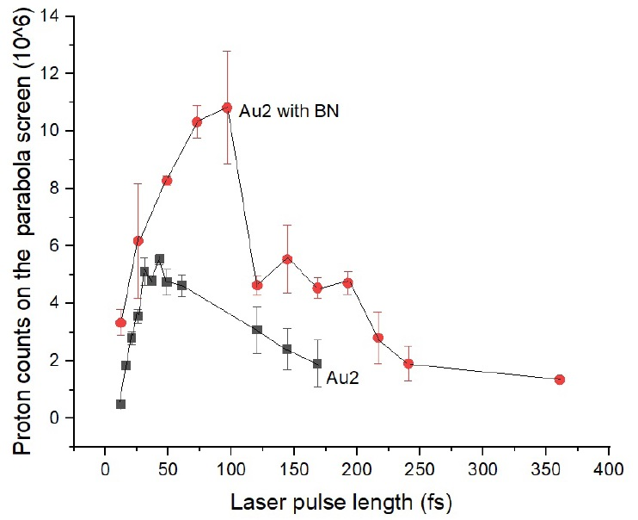
Indication of p + 11B Reaction
T=2.65 fs
The integral number of proton signal in a backward direction, measured at ELI-ALPS SEA laser with pulse energy 25 mJ, applying various pulse lengths from 12.3 to 360 fs.
The maximum beam intensity at 12.3 fs was I= 8.3×10¹⁸ W/cm2. The target was an UDMA-TEGDMA copolymer with embedded resonant gold nanorod antennas at the density Au2=0.182 m/m%, and boron-nitride (BN) with 2.5m/m% density. This BN number density corresponds to 43% of the number of UDMA-TEGDMA monomers. Averaged numbers are shown for 2-12 shots at each laser pulse length, with the corresponding root mean squares indicated by error bars.

Slide 36
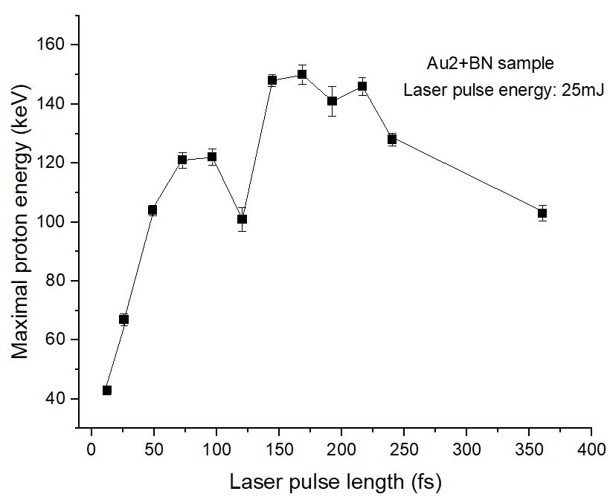
Indication of p + 11B Reaction
Maximum proton energy detected in the backward 45-degree direction with respect to the laser beam for different laser pulse lengths by Thomson parabola. As can be seen in
Fig. 1 at 100-125 fs, the resonant protons are absorbed by the Borons in the fusion reactions, and only lower than 150 keV energy protons remain. In the range 150-250 fs pulse length
protons above the 150 keV resonance energy are observed. These originate from those protons, which were already exceedingly well the resonance energy of the p+11B cross section.

Slide 37
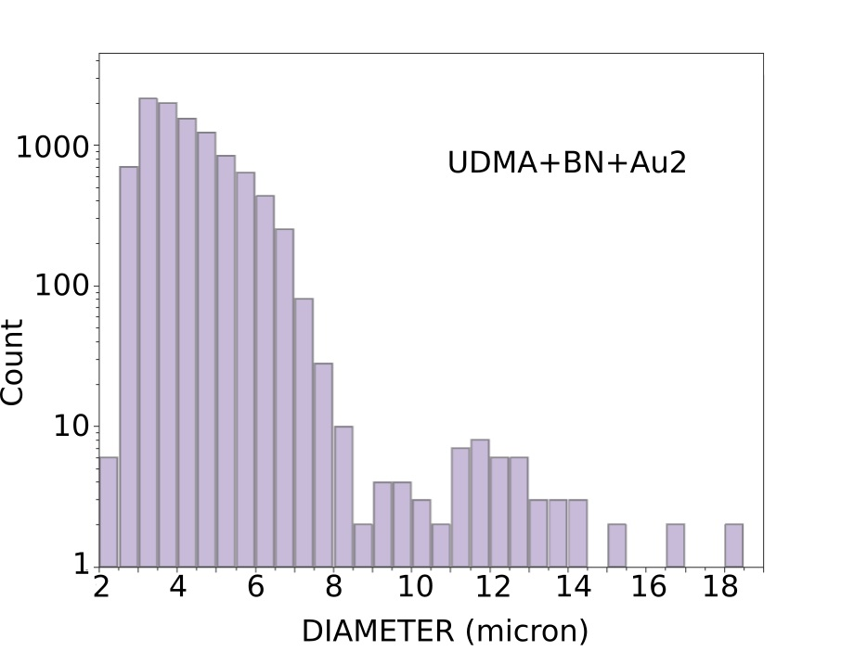
Indication of p + 11B Reaction
Number of impact traces versus the diameter of the trace spot in μm in CR-39 detections with boron-nitride in the target shows a second peak at diameter ∼12 μm, corresponding
to the emitted α particles.

Slide 38
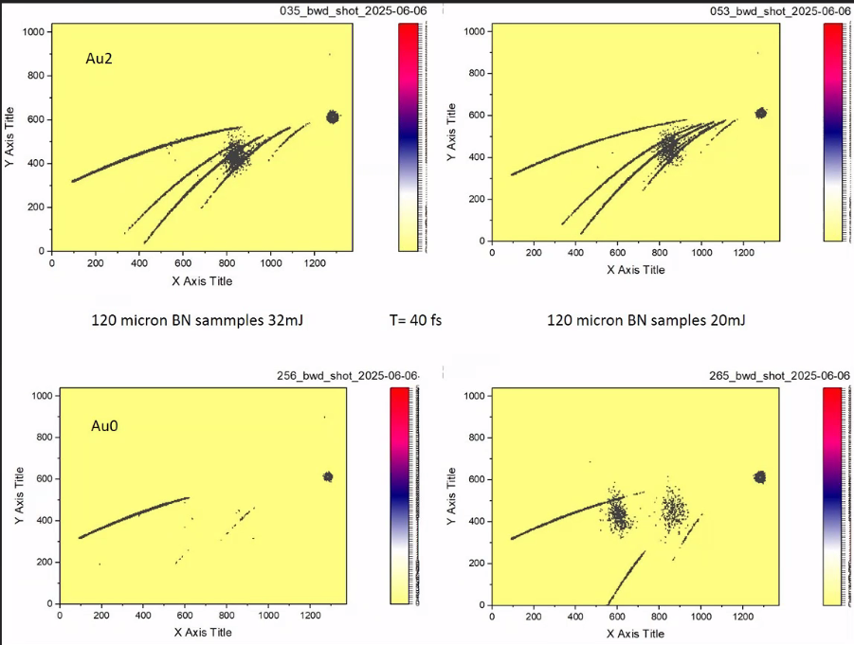
Verification at ELI-ALPS
2025 June
Nanorods (Au2) contribute
to Proton acceleration, up to
~ 500 keV (40mJ, 120 fs)
Nanorods (Au2) accelerate
other heavier ions also
α number and energy
measurements: 2025 July

Slide 39
CONCLUSIONS
Plasmonic amplification is verified
Proton acceleration is verified
Nuclear transmutation reactions are achieved
Formation of Deuteron nuclei is verified
p+¹¹B fusion reaction is detected
contrary to the fact that
Only 40 mJ laser pulse energy was used
Only one-sided laser irradiation was available
Nanorod antennas were randomly directed

Slide 40
Thanks for your attention

