Slide 1
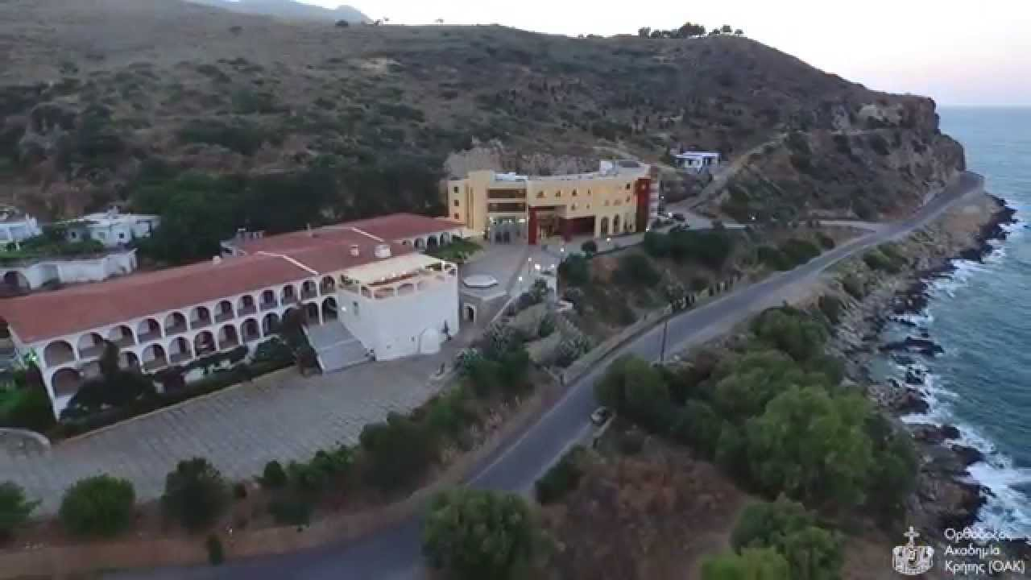
WELCOME TO THE ORTHODOX ACADEMY OF CRETE (OAC)

Slide 2
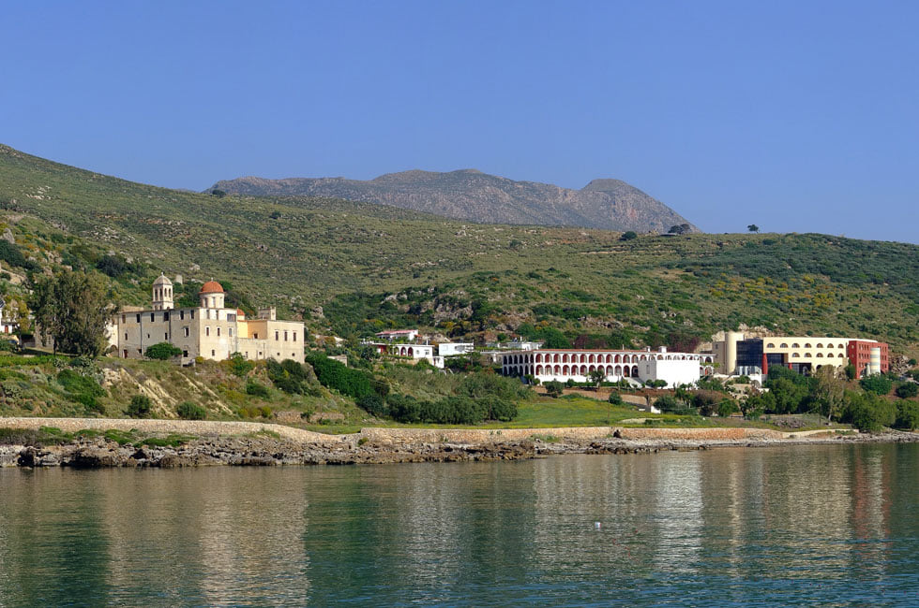

Slide 3
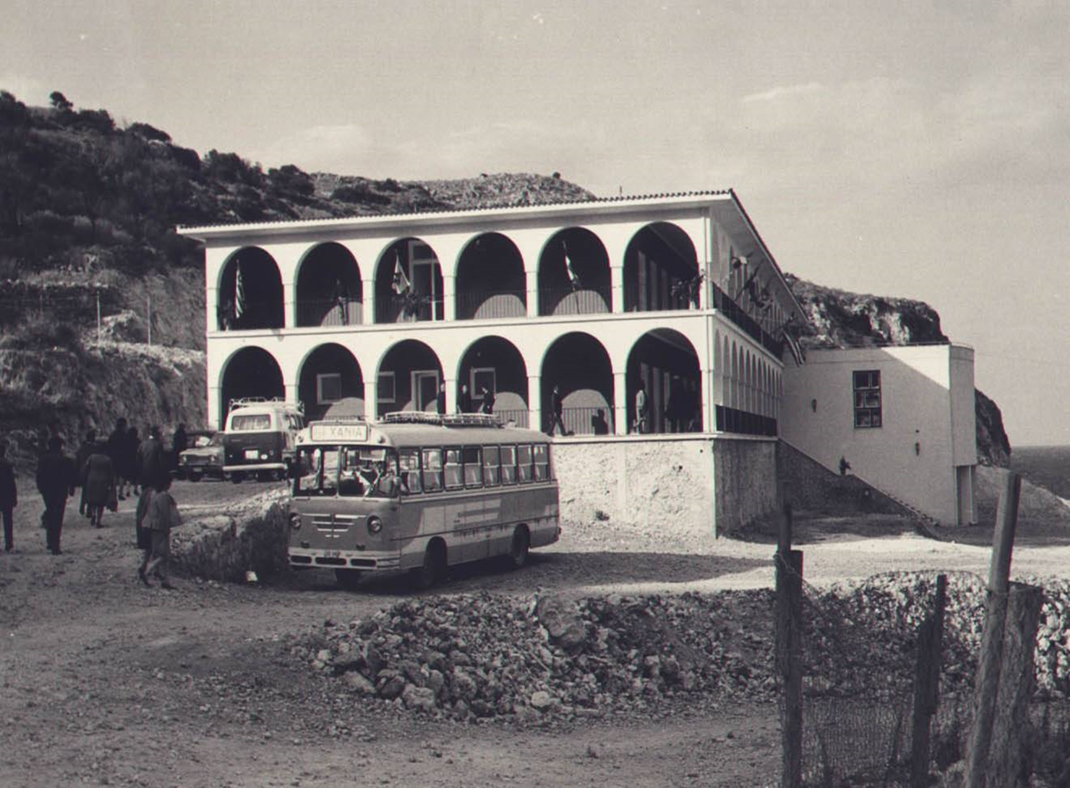
The idea 1958-1964

Slide 4
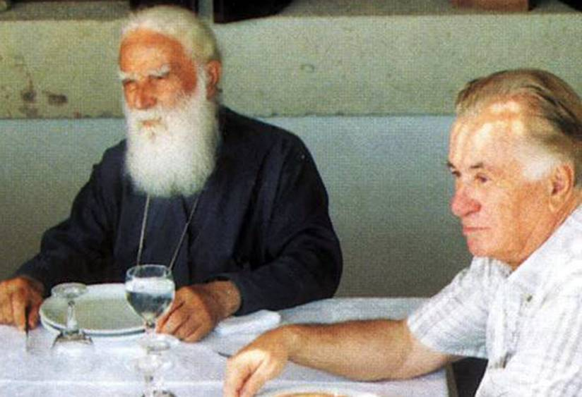

Slide 5
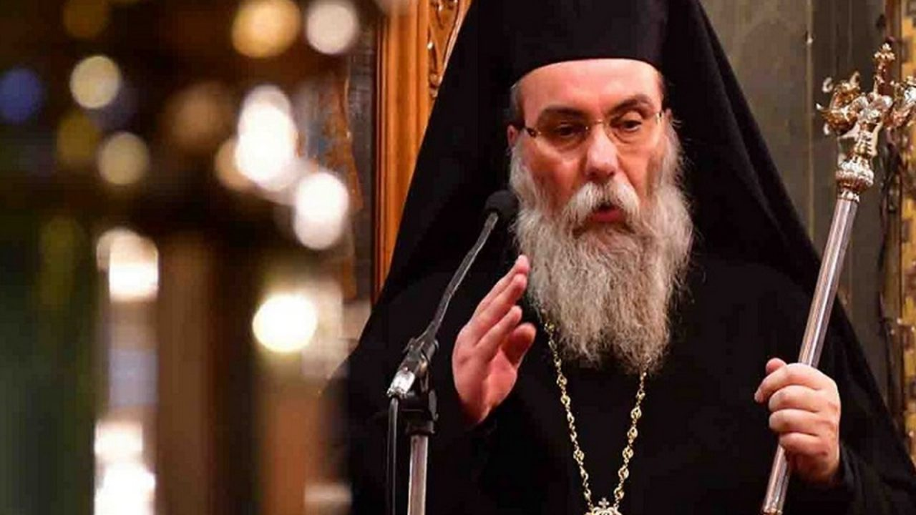
His Eminence the Metropolitan of Kissamos and Selinon, Amphilochios

Slide 6
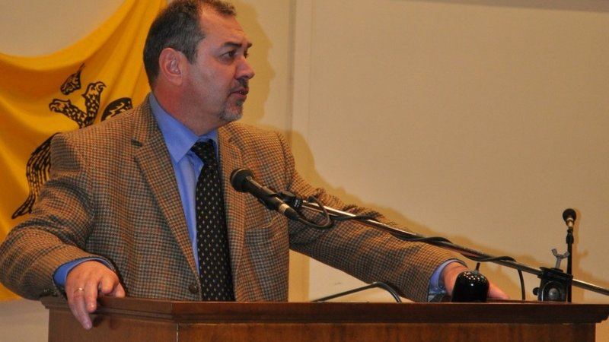
Dr. Konstantinos Zormpas, General Director

Slide 7
Main Activities
International Conferences
Educational Programs
Enviroment

Slide 8
From 1968 until today, 2.926 Conferences, Seminars and Workshops International 60% Local 40%

Slide 9
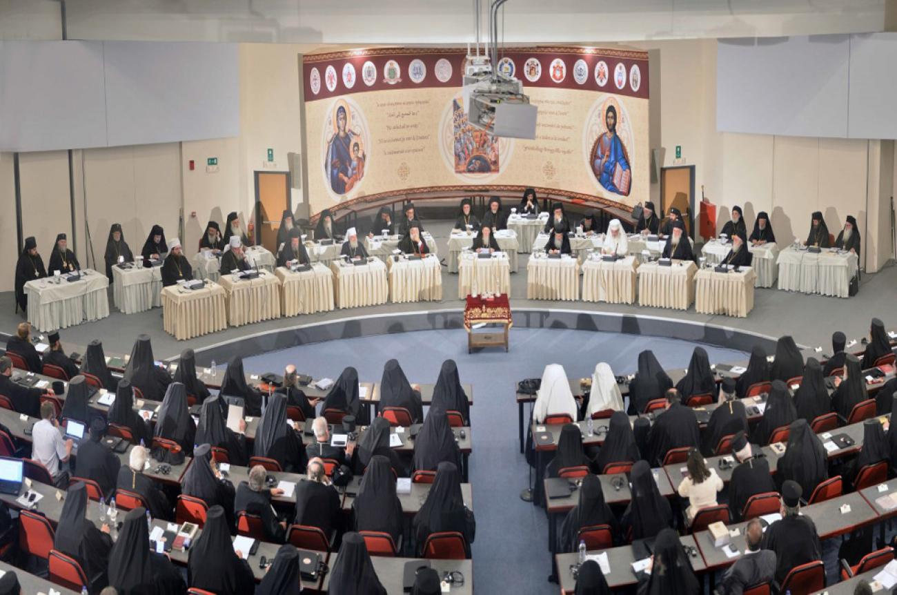
The Holy and Great Synod of the Orthodox Church 2016 at the OAC

Slide 10
Facilities

Slide 11
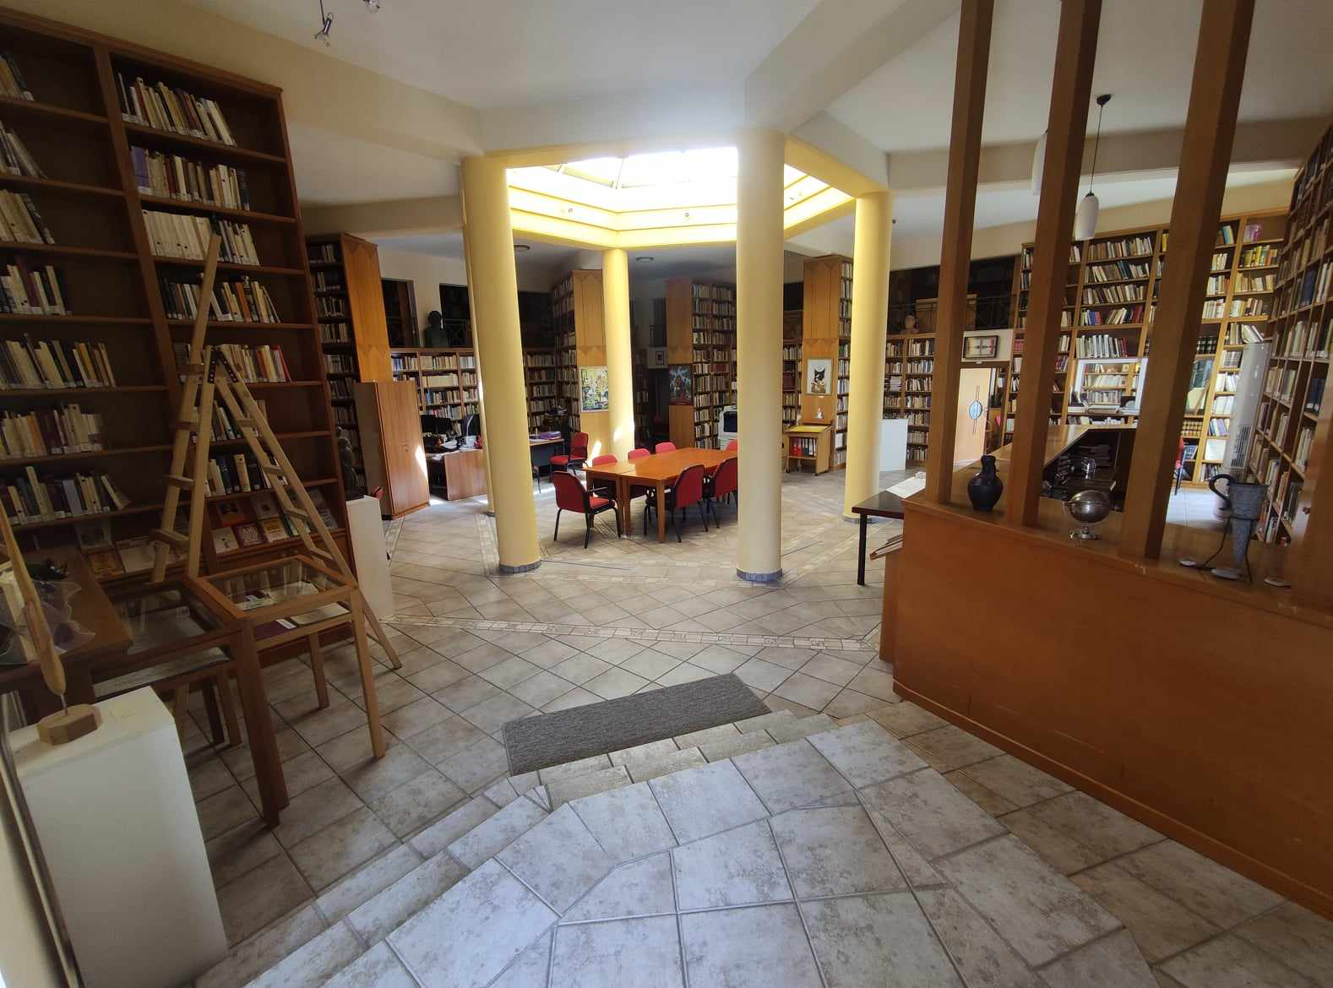
MAIN Library “The Light”

Slide 12
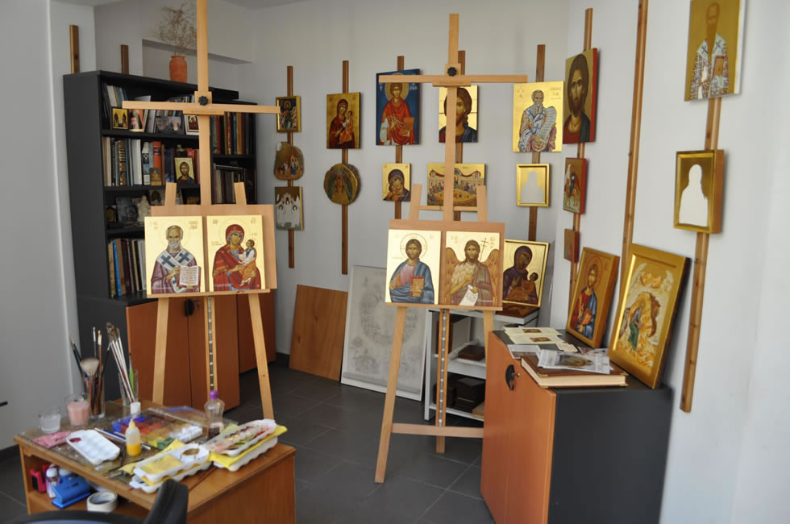
Iconography Workshop

Slide 13
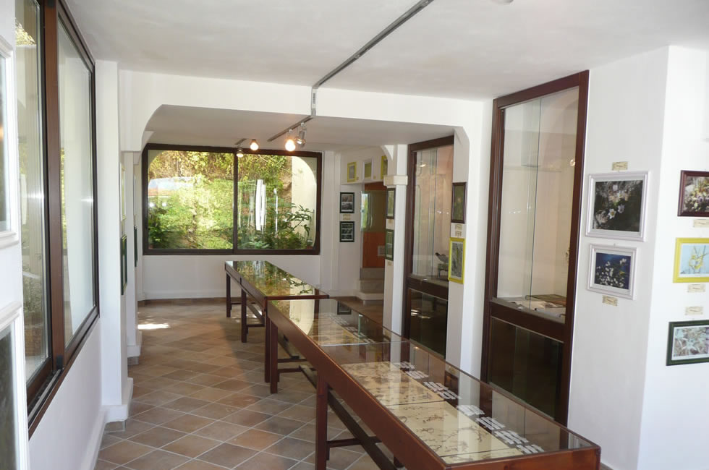
Museum of Cretan Herbs

Slide 14
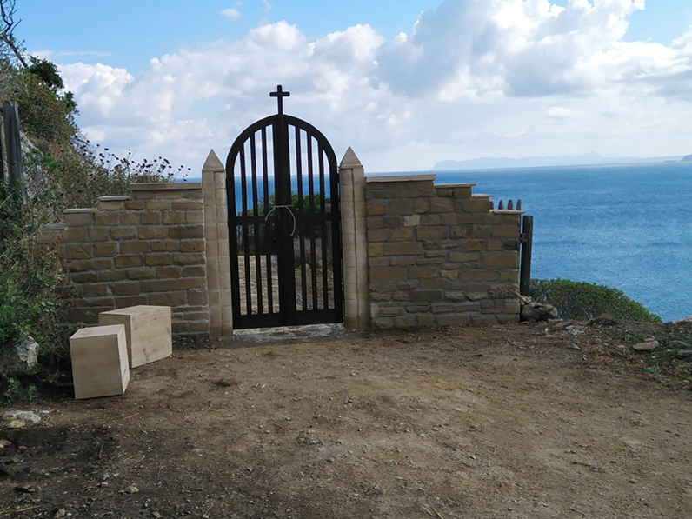
Walks on the OAC’s
Natural Stone Pathways

Slide 15
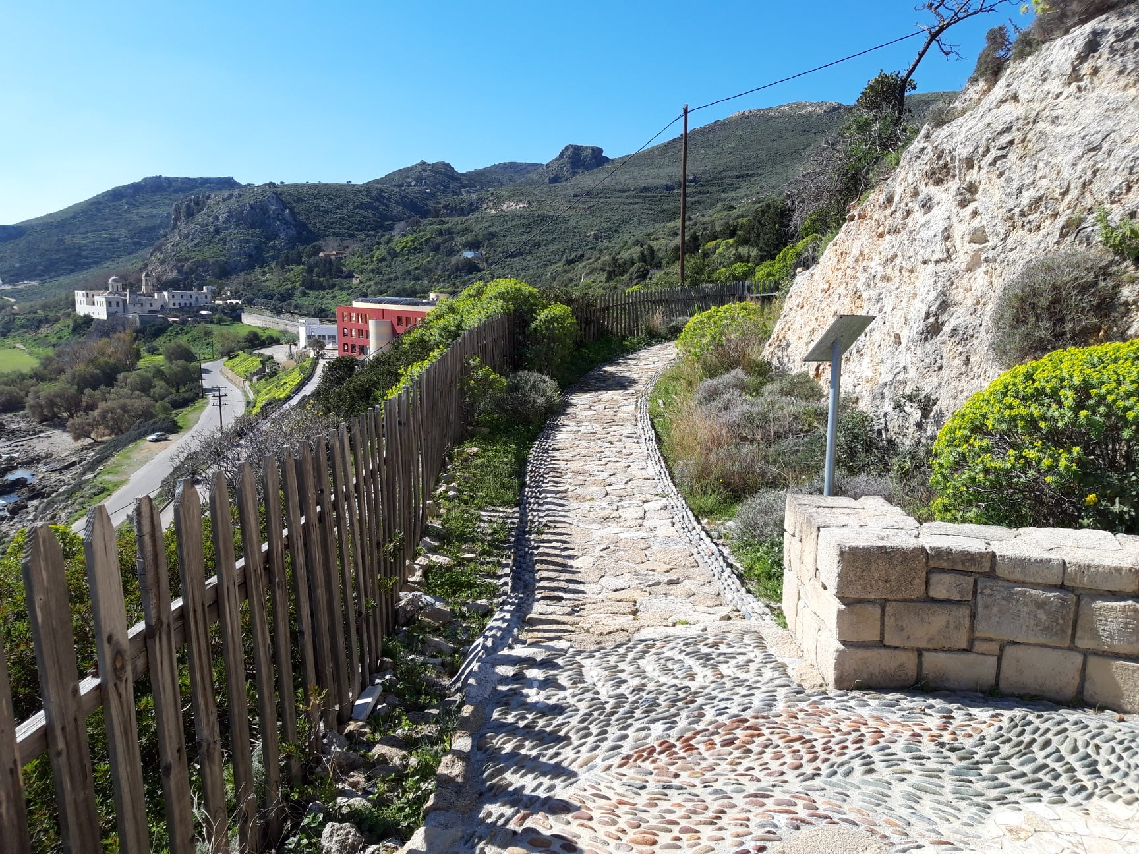
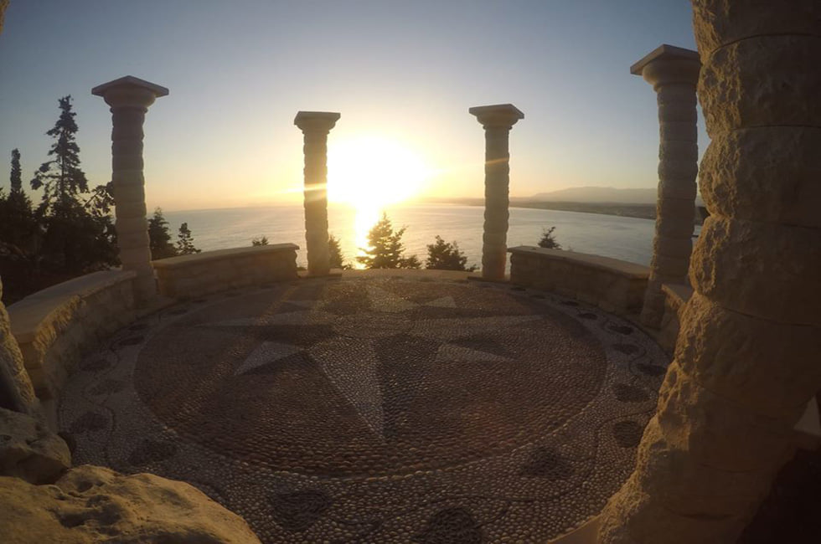
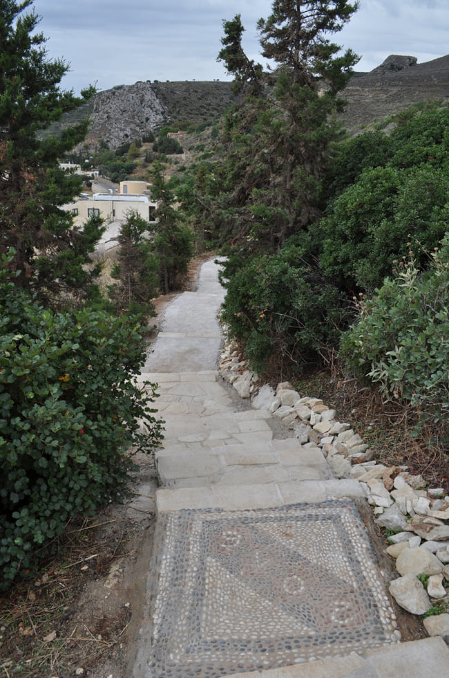
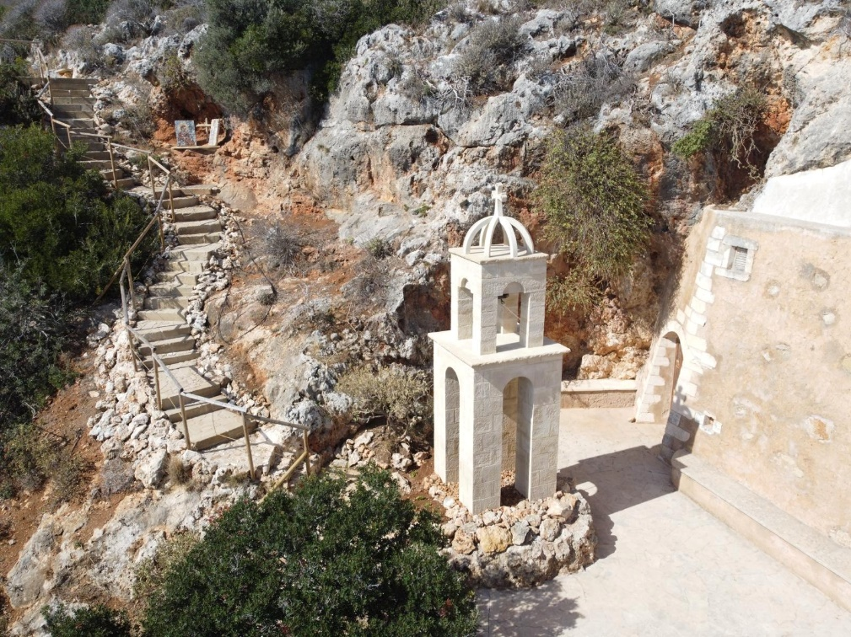

Slide 16

Important Days
Sunday, July 20th excursion to the Monastery
Tuesday, July 22nd Opera Gala Concert, OAC, Kalliopi Petrou (soprano), Tommaso Dorigo (Piano).
Friday, July 25th, Chania excursion
Sunday, July 27th, Conference excursion
Tuesday, July 29th 19:30 Cretan Evening

Slide 17
Practical Issues
At the Conference Halls please don’t bring drinks/food
Buffet Breakfast
Monday-Sunday 07:45-08:45,
Buffet Lunch
Monday-Sunday 13:00
→Buffet Dinner 20:00
Please keep the time schedule

Slide 18
Practical Issues
Please, contact our reception for any assistance you may need:
From 9:00am to 21:00pm

Slide 19

Practical Issues
Please do use the waste paper basket provided at the toilets for ALL disposed materials.

Slide 20
Towels
Towels on the floor means: Please replace them
Towels hanging means:
I will use them again
Blue towels are for swimming

Slide 21
Internet
Wifi
USERNAME: guest
PASSWORD: 2020
Wifi Networks: OAK1…OAK15

Slide 22
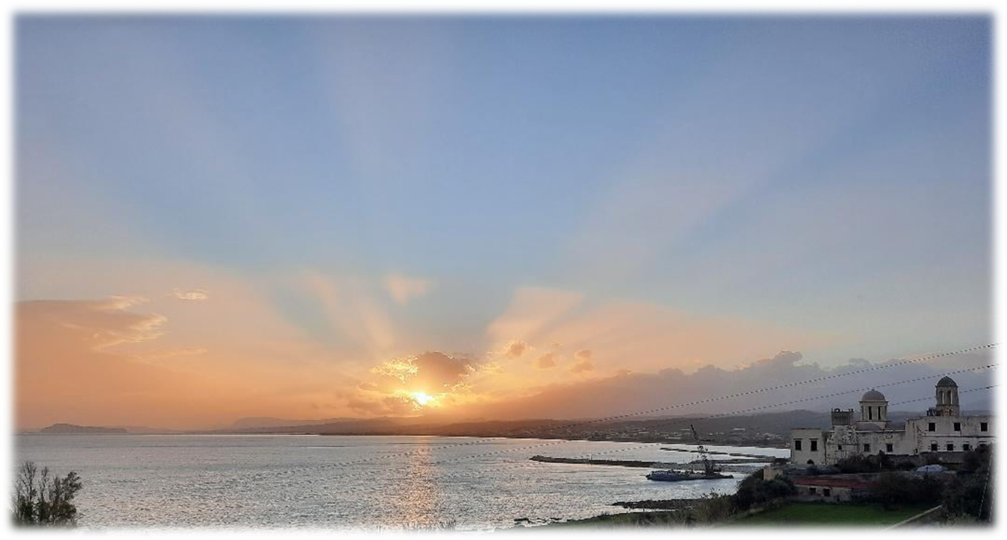
THANK YOU!

Slide 23





FOLLOW US
Orthodox Academy of Crete
orthodox_academy_of_crete
@orth_acad_crete
ORTHODOX ACADEMY OF CRETE
www.oac.gr

