Slide 1


Slide 2
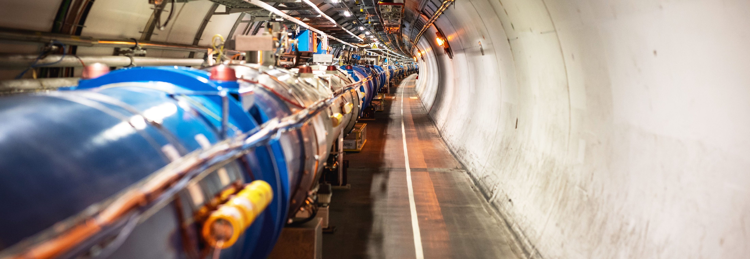
WELCOME TO CERN
FICSA @ CERN

Slide 3
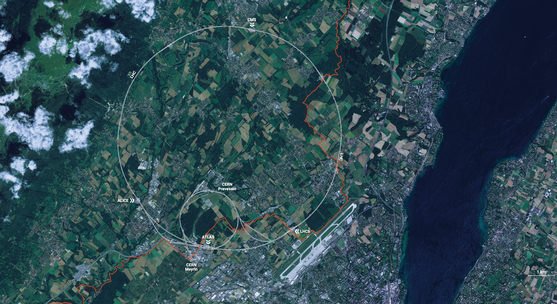
CERN is the world’s biggest laboratory
for particle physics.
Our goal is to understand the most fundamental particles and laws
of the universe.

Slide 4
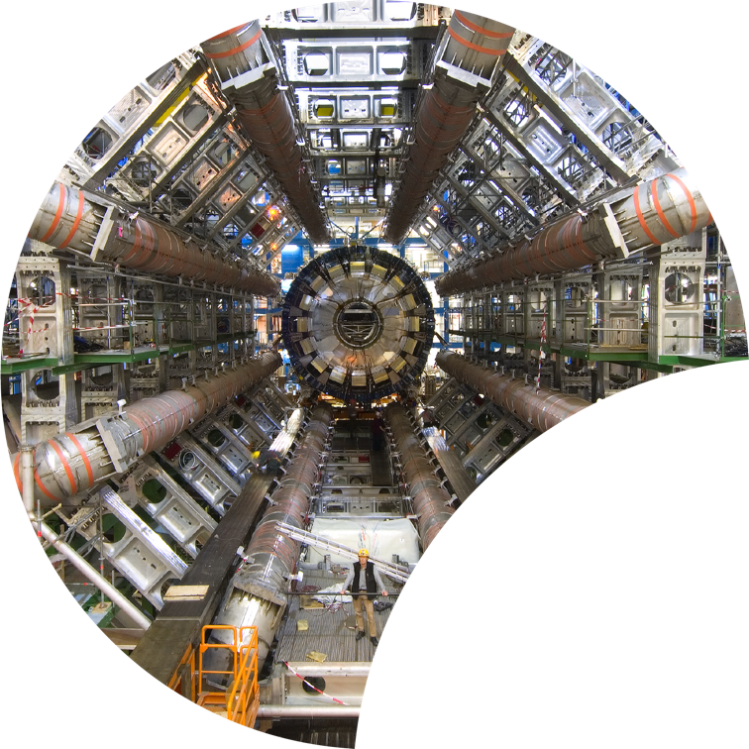
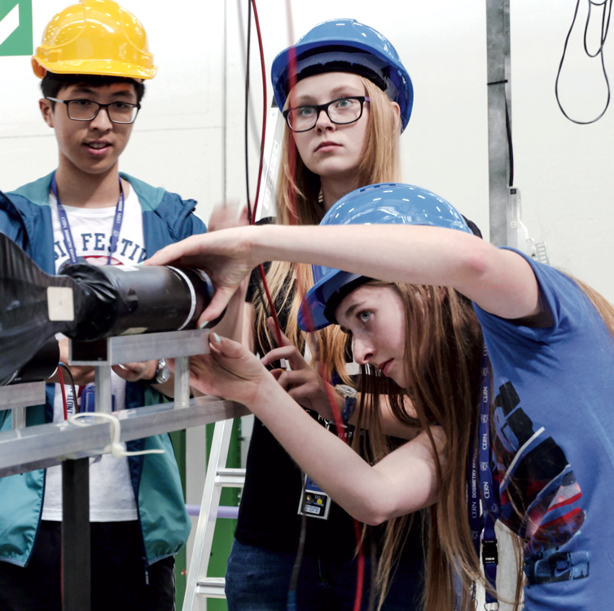
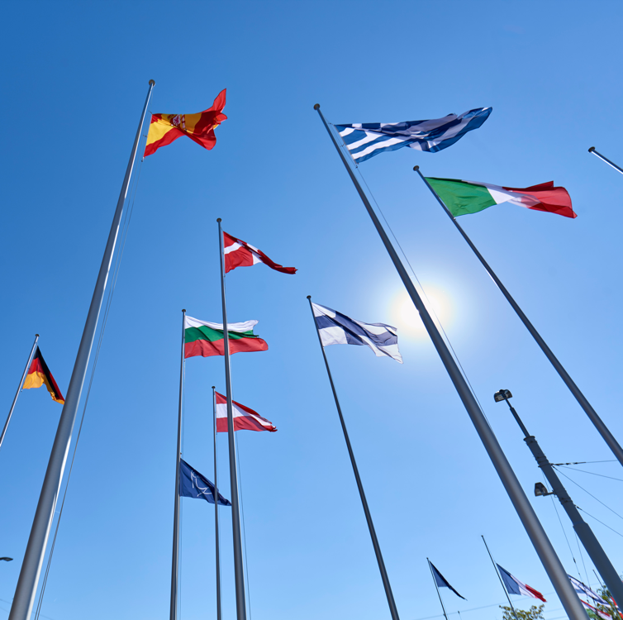
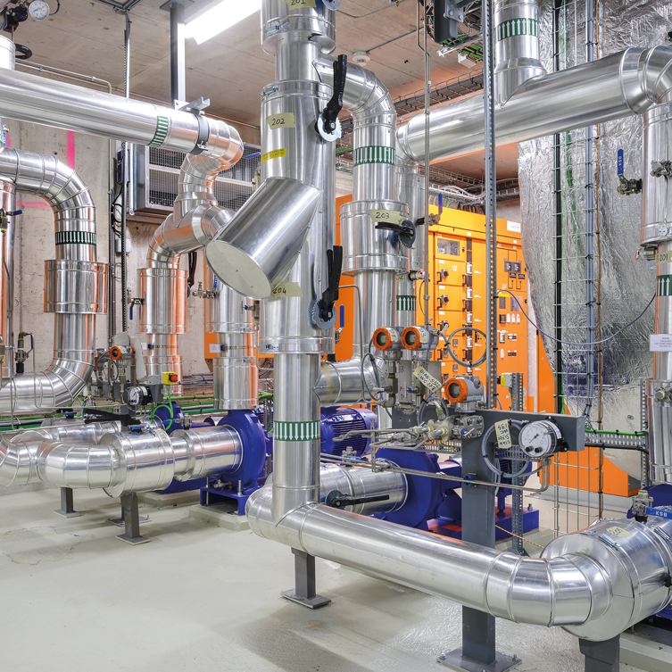

Four pillars underpin CERN’s mission
RESEARCH
EDUCATION
& TRAINING
COLLABORATION
TECHNOLOGY
& INNOVATION
FICSA @ CERN
30 January 2025

Slide 5
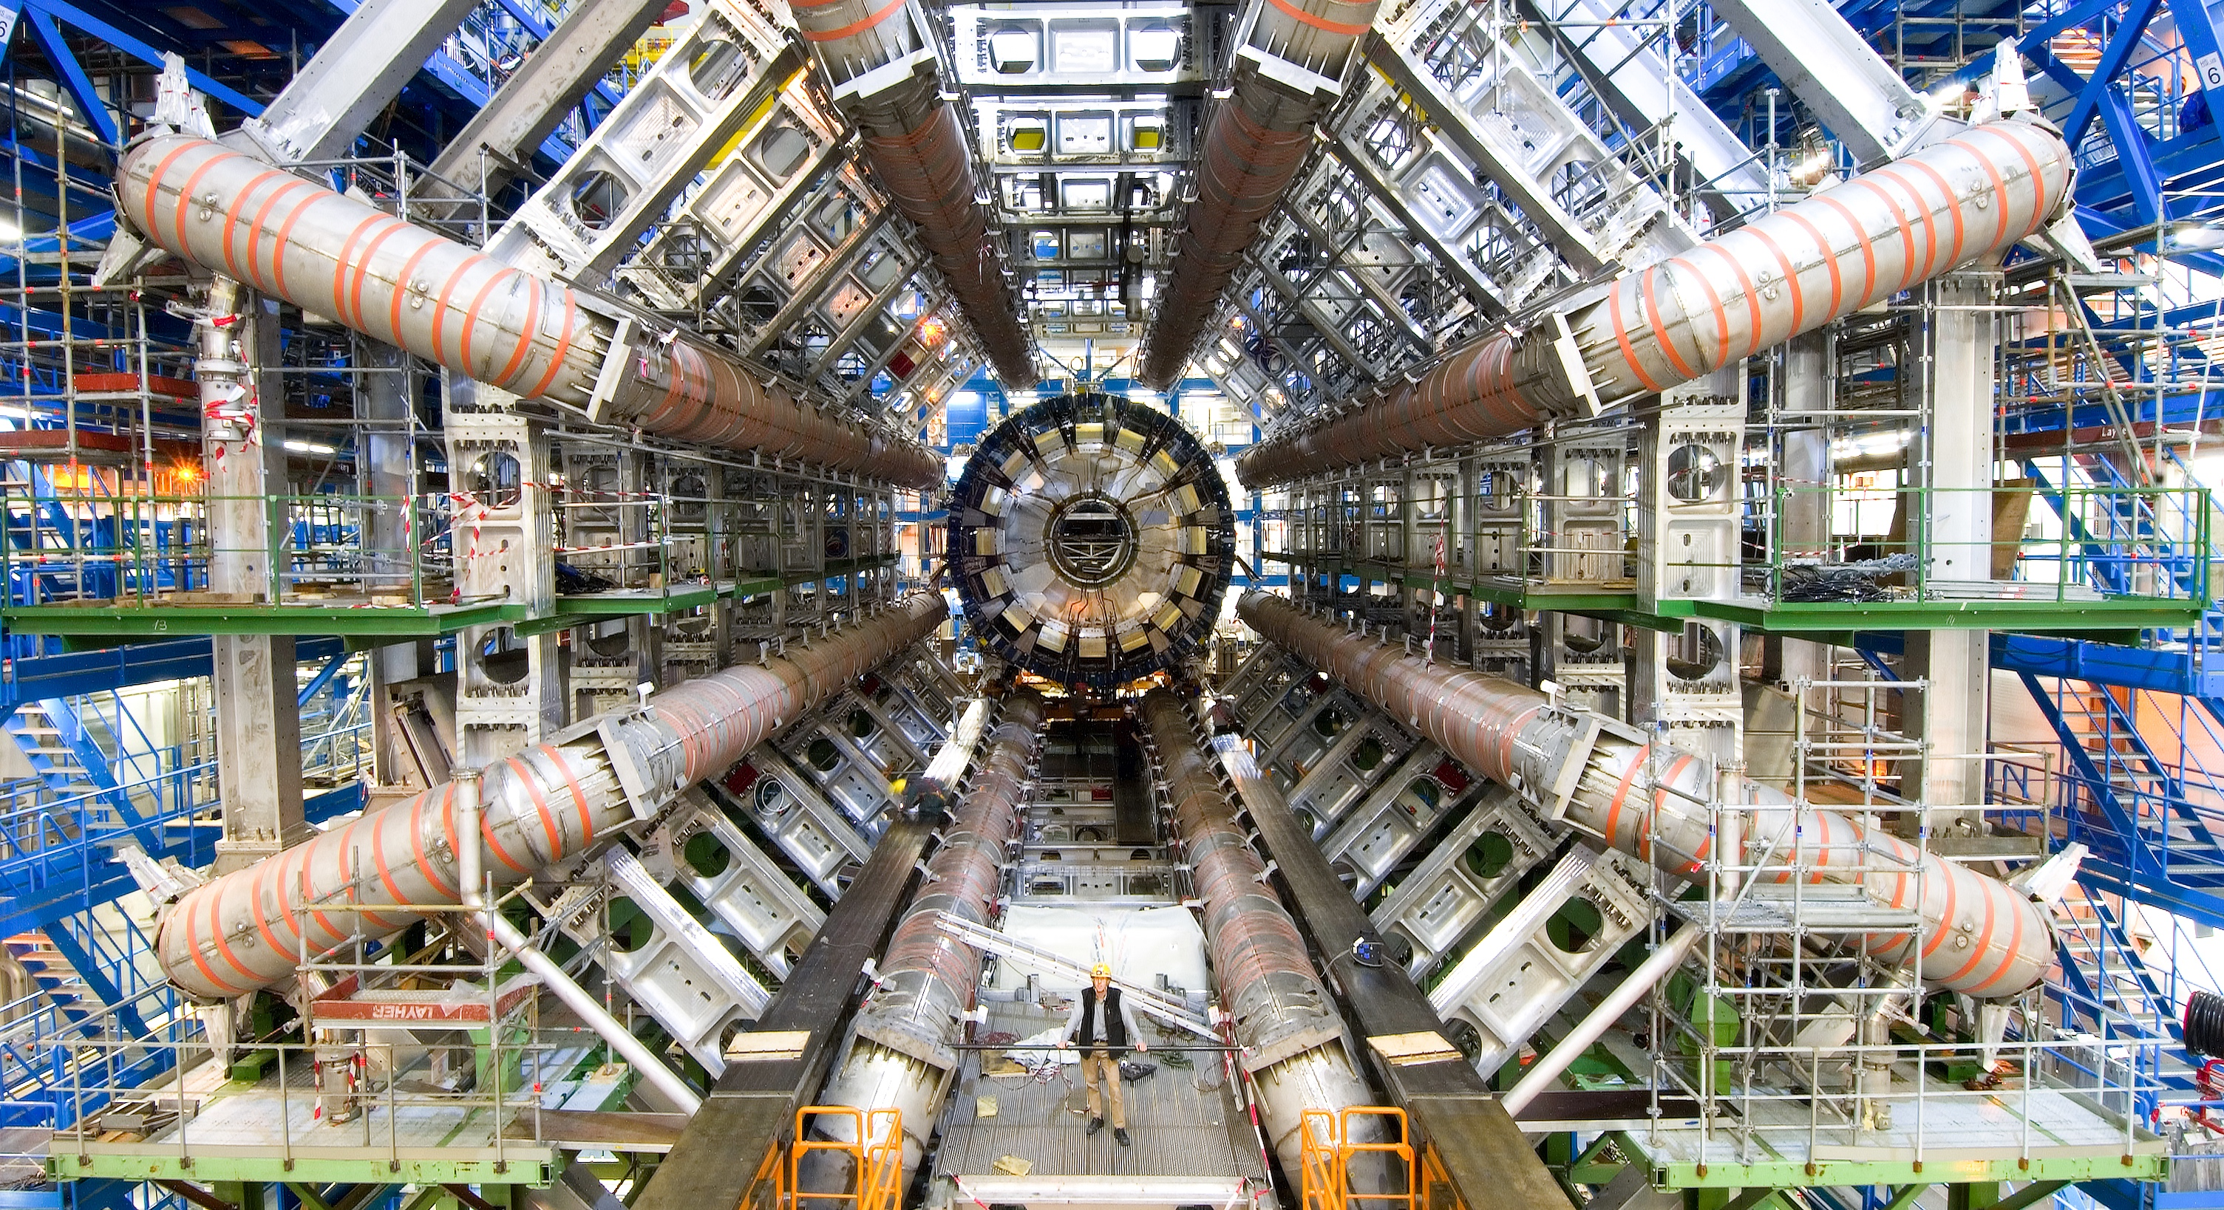
RESEARCH

Slide 6
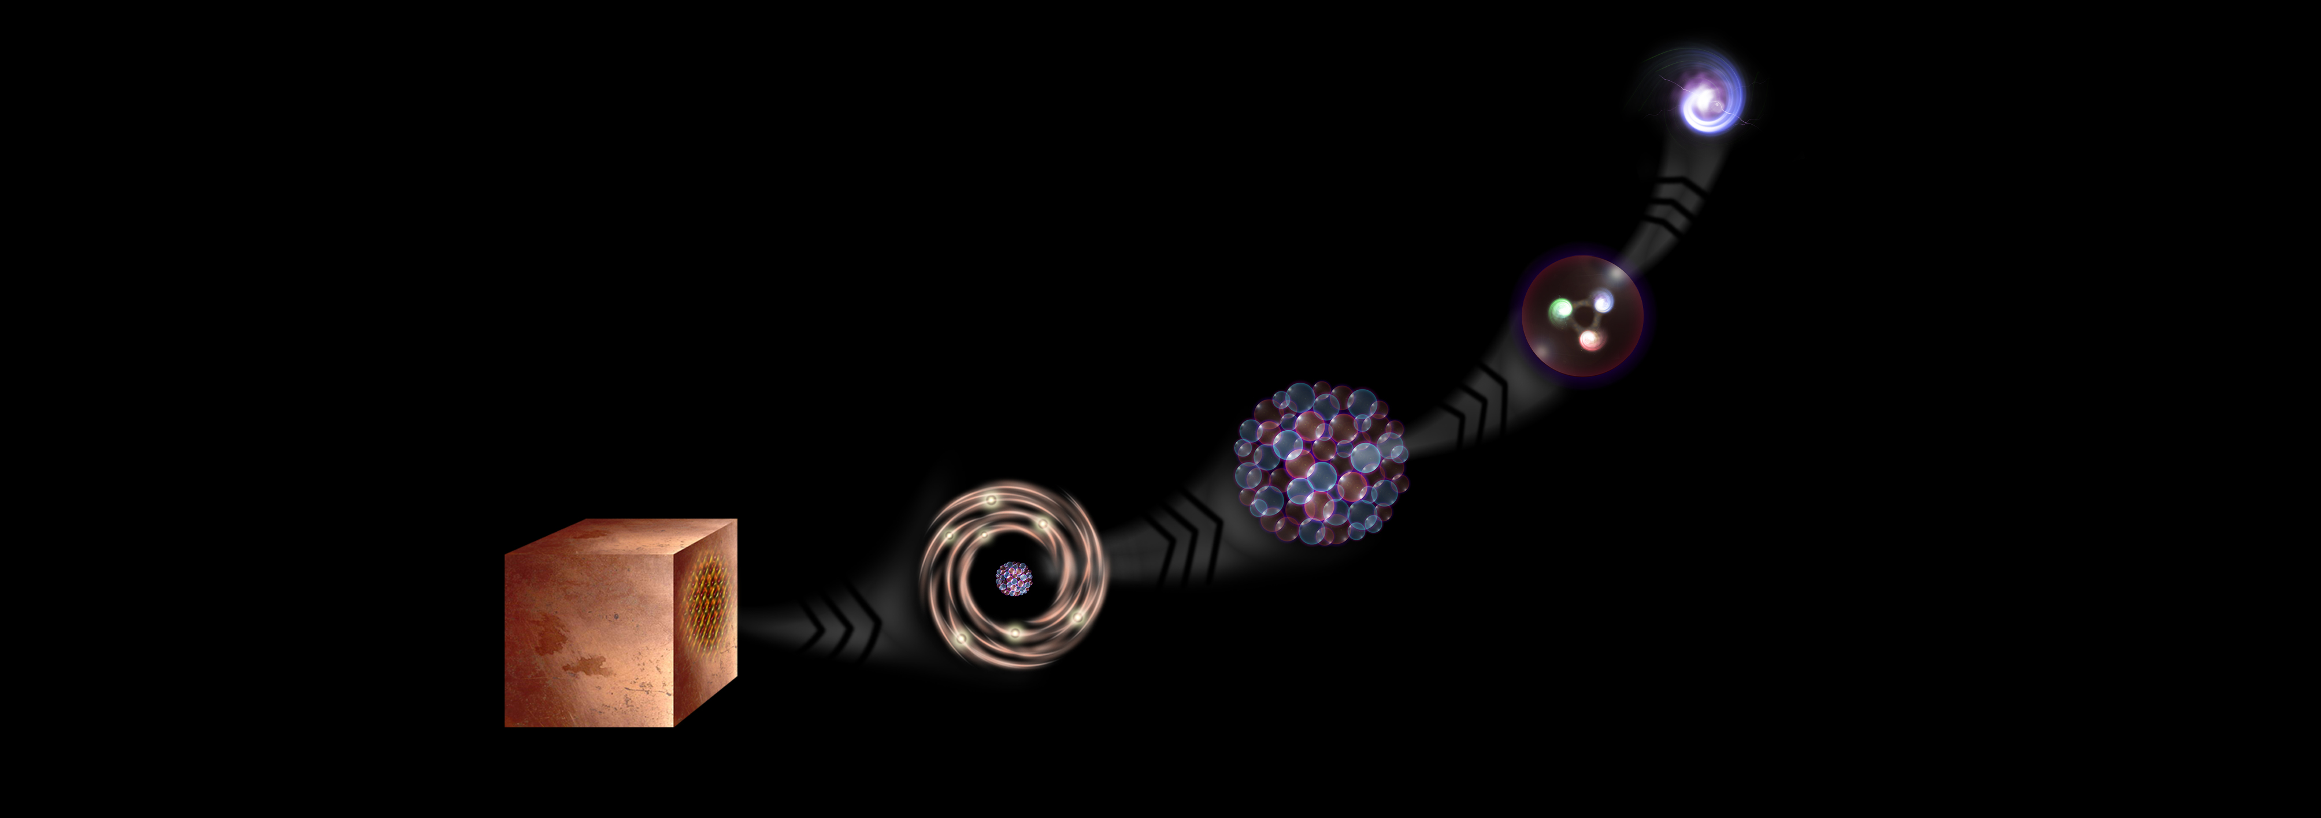
What is the universe made of?
We study the elementary building blocks of matter and the forces that control their behaviour
Quark
<10⁻¹⁸ m
Proton
~10⁻¹⁵ m
Nucleus
~10⁻¹⁴ m
Electron
Matter
0,1 m
Atom
~10⁻¹⁰ m
FICSA @ CERN
30 January 2025

Slide 7
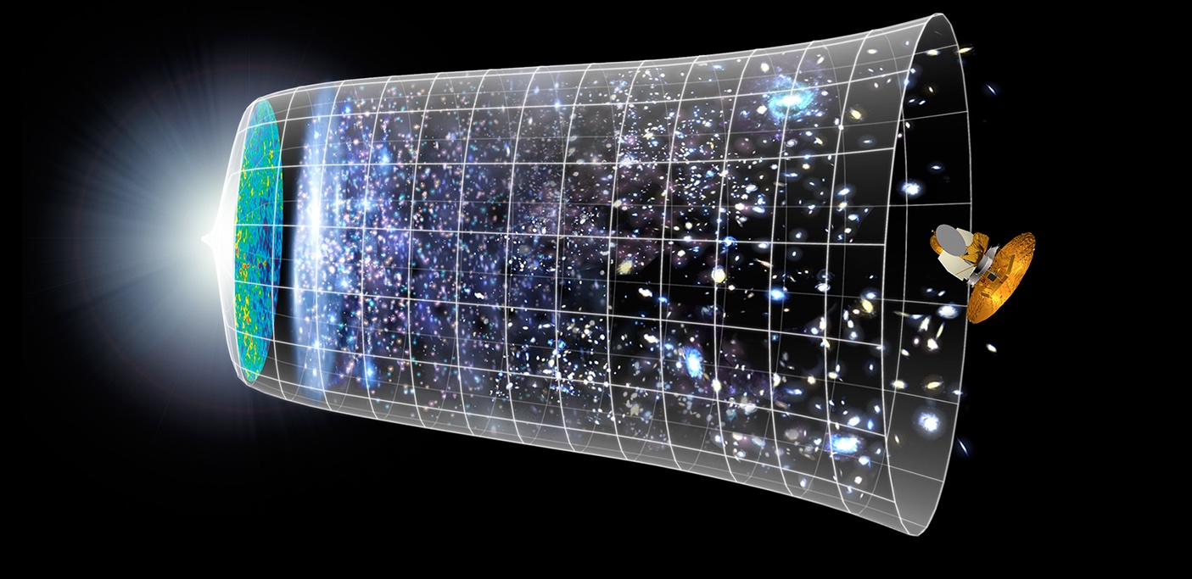

How did the universe begin?
Big Bang
We reproduce the conditions a fraction of
a second after the Big Bang, to gain insight into the structure and evolution
of the universe.
Telescopes
Accelerators
380 000 years
13.8 Billion Years
Today
10²⁸ cm

Slide 8
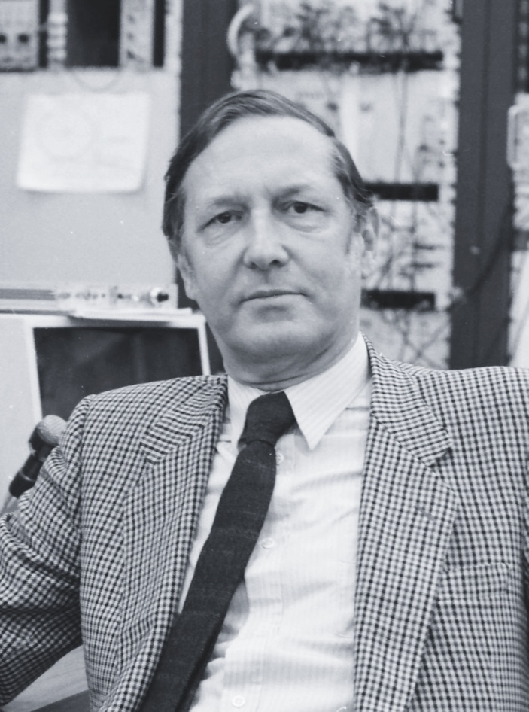
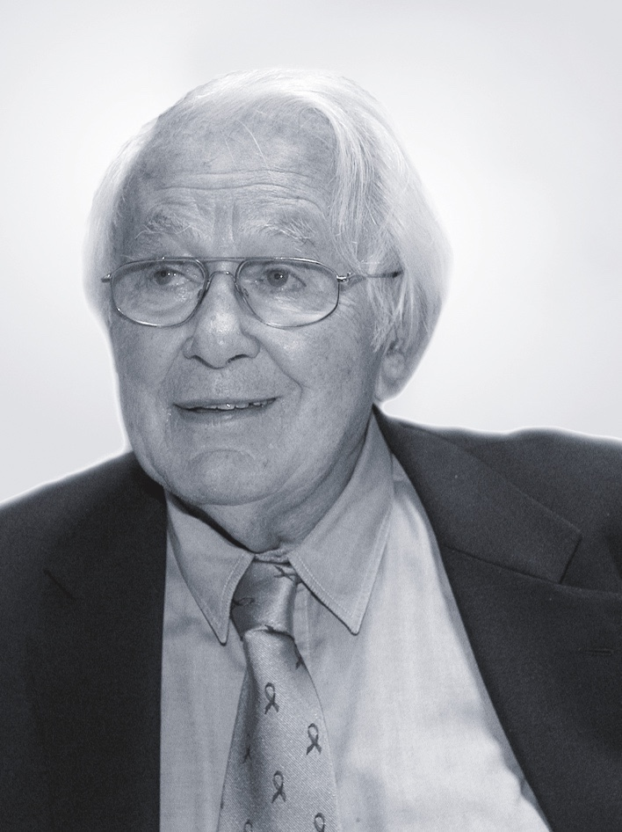
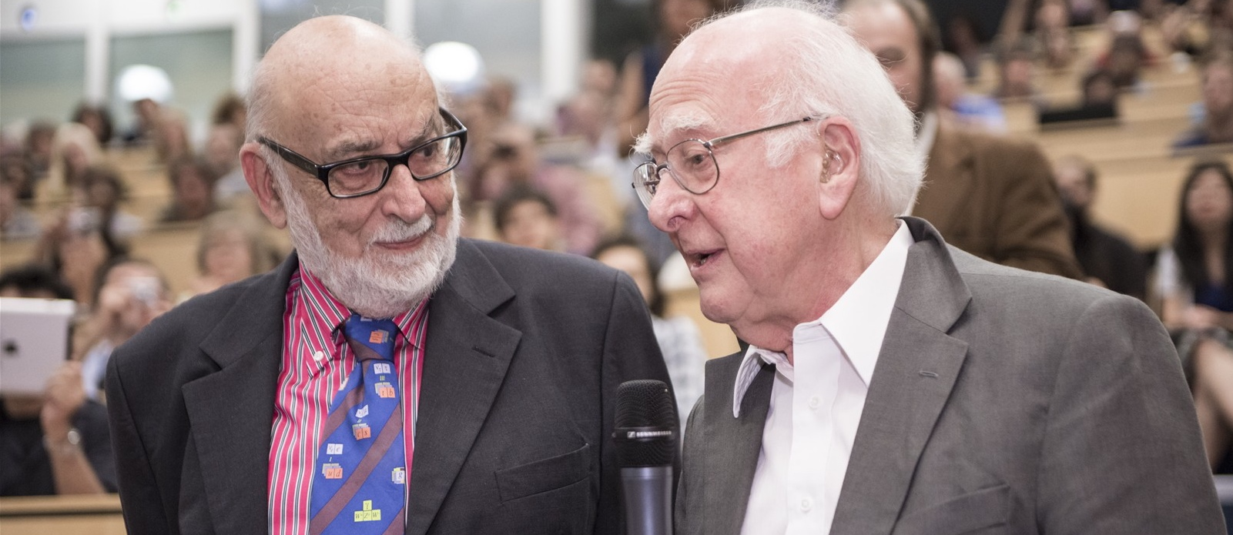
At CERN we help to answer these questions
The Higgs boson was discovered in 2012; without it fundamental particles would be massless
and atoms could not form.
Carlo Rubbia
Simon Van der Meer
Georges Charpak
Several CERN scientists have received
Nobel Prizes for key discoveries
in particle physics.
François Englert and Peter Higgs. With Robert Brout, they proposed the mechanism in 1964.
FICSA @ CERN
30 January 2025

Slide 9
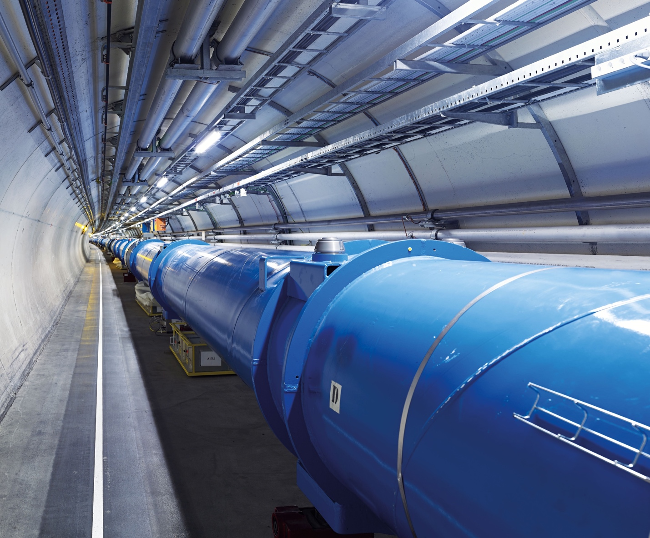
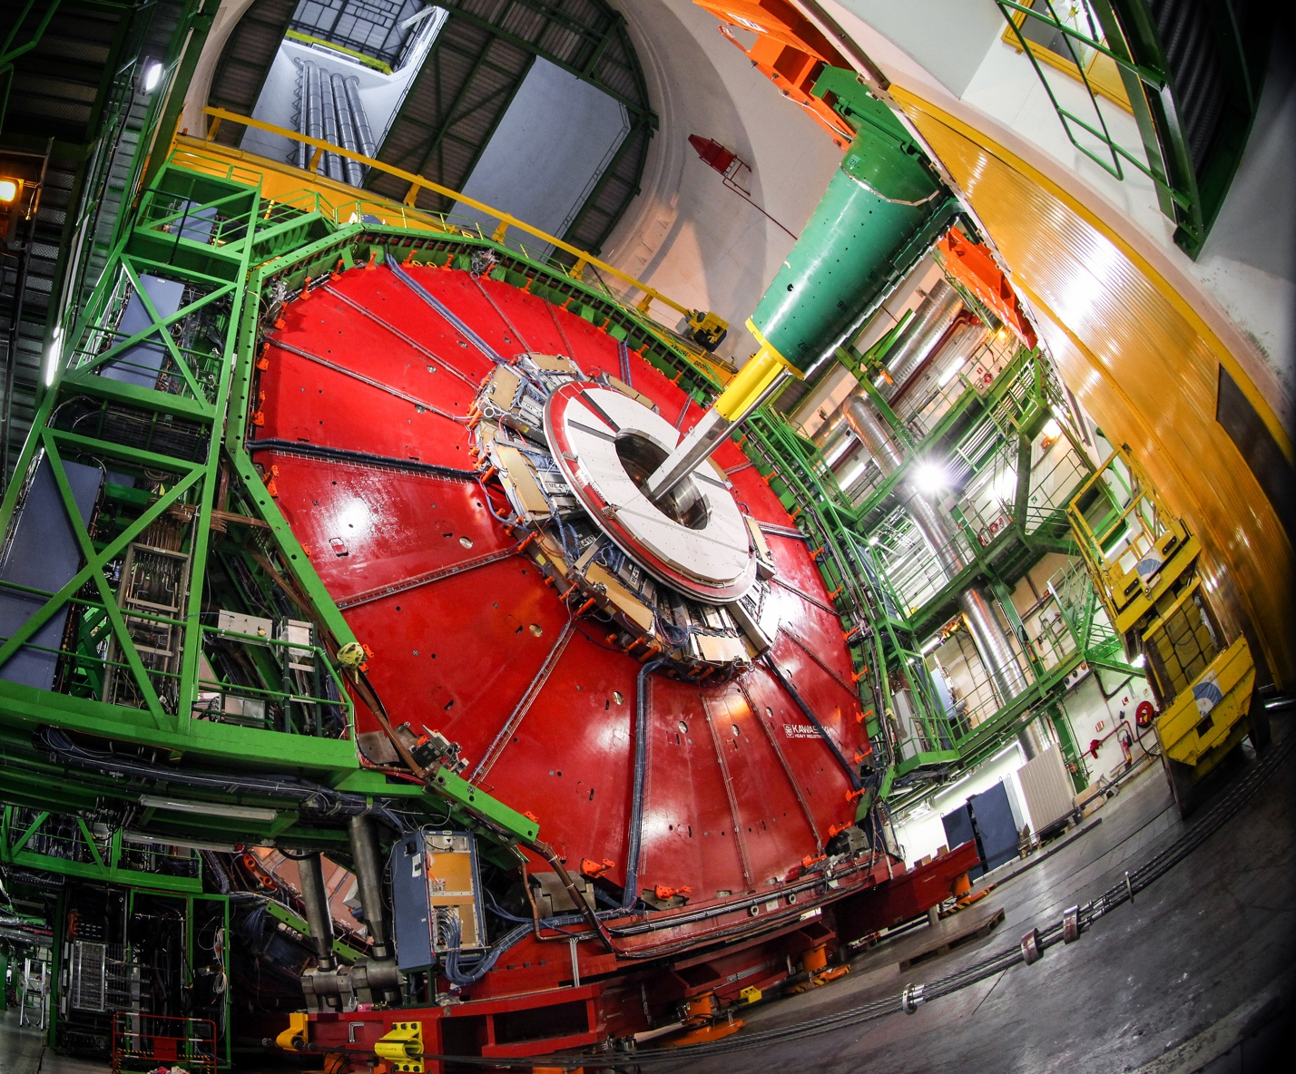
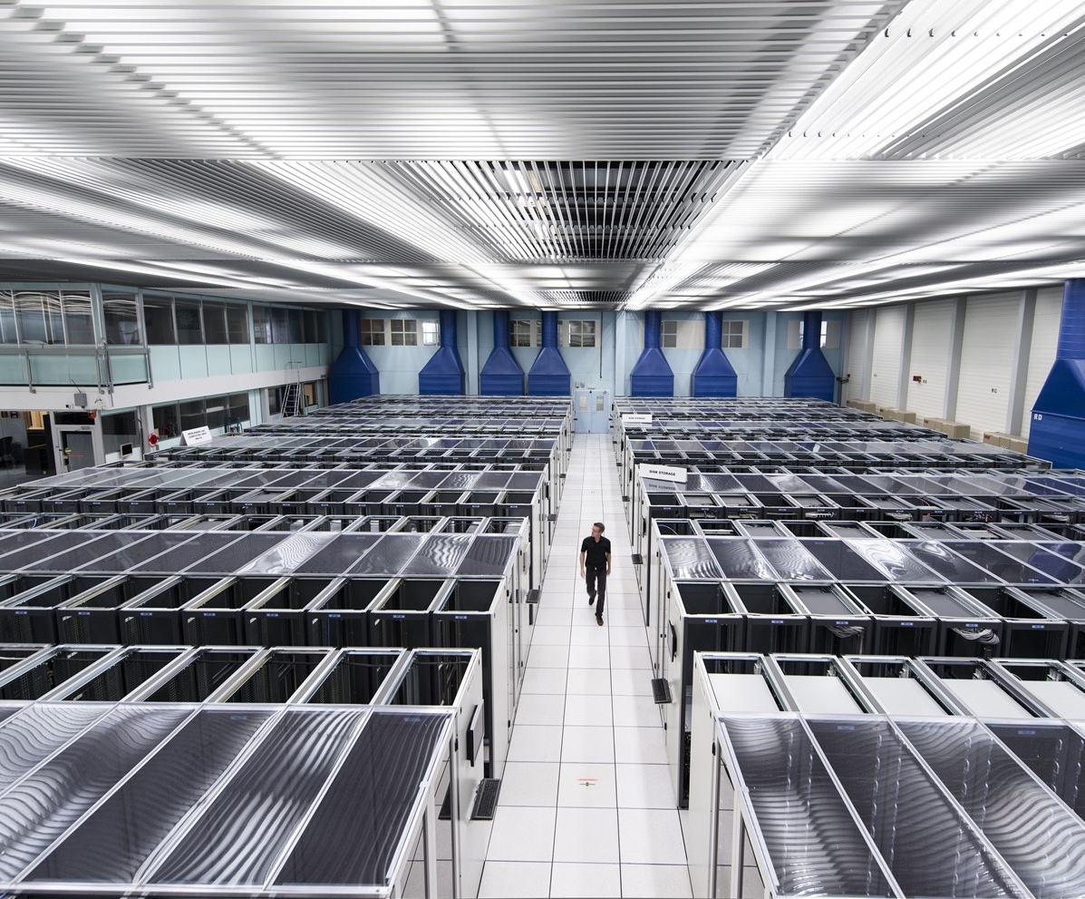
We develop technologies in three key areas
ACCELERATORS
DETECTORS
COMPUTING
FICSA @ CERN
30 January 2025

Slide 10
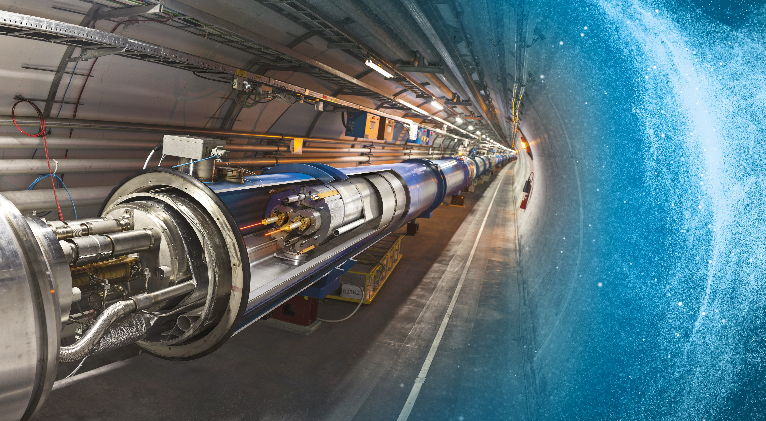
Large Hadron Collider (LHC)
27 km in circumference
About 100 m underground
Superconducting magnets steer the particles around the ring
Particles are accelerated
to close to the speed
of light

Slide 11
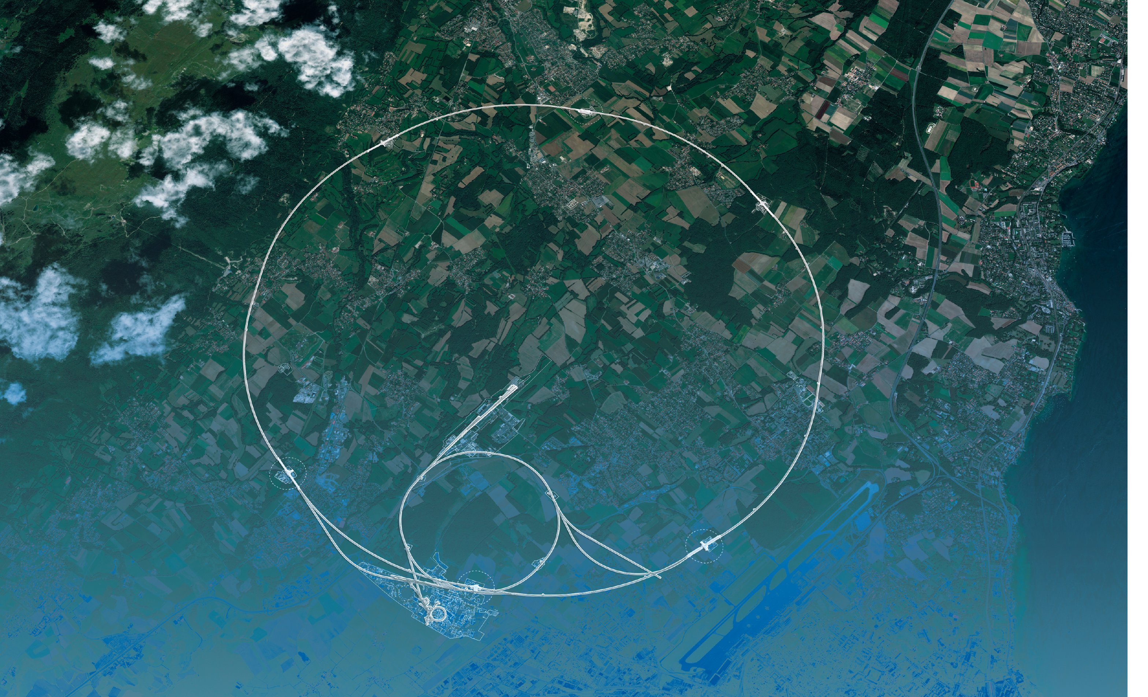
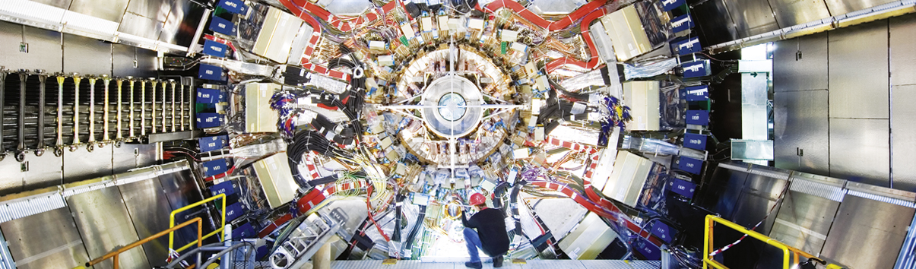
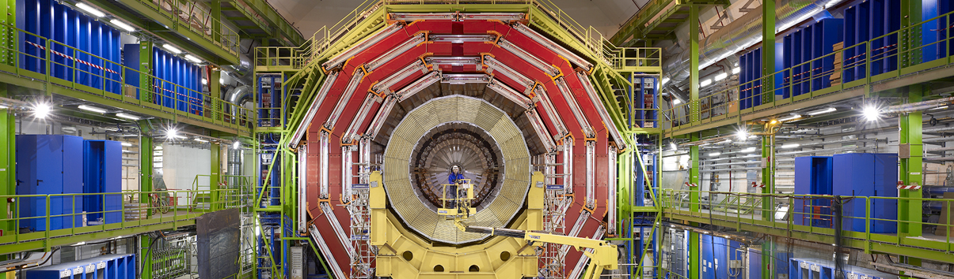
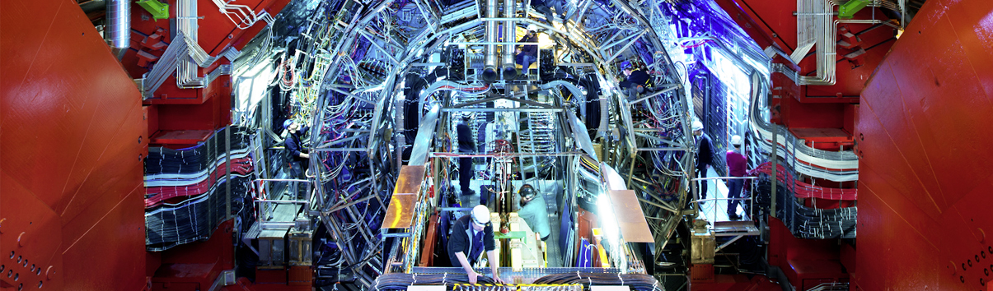
Giant detectors record the particles formed at the four collision points
ATLAS
CMS
CMS
ALICE
ALICE
ATLAS
LHCb
LHCb

Slide 12
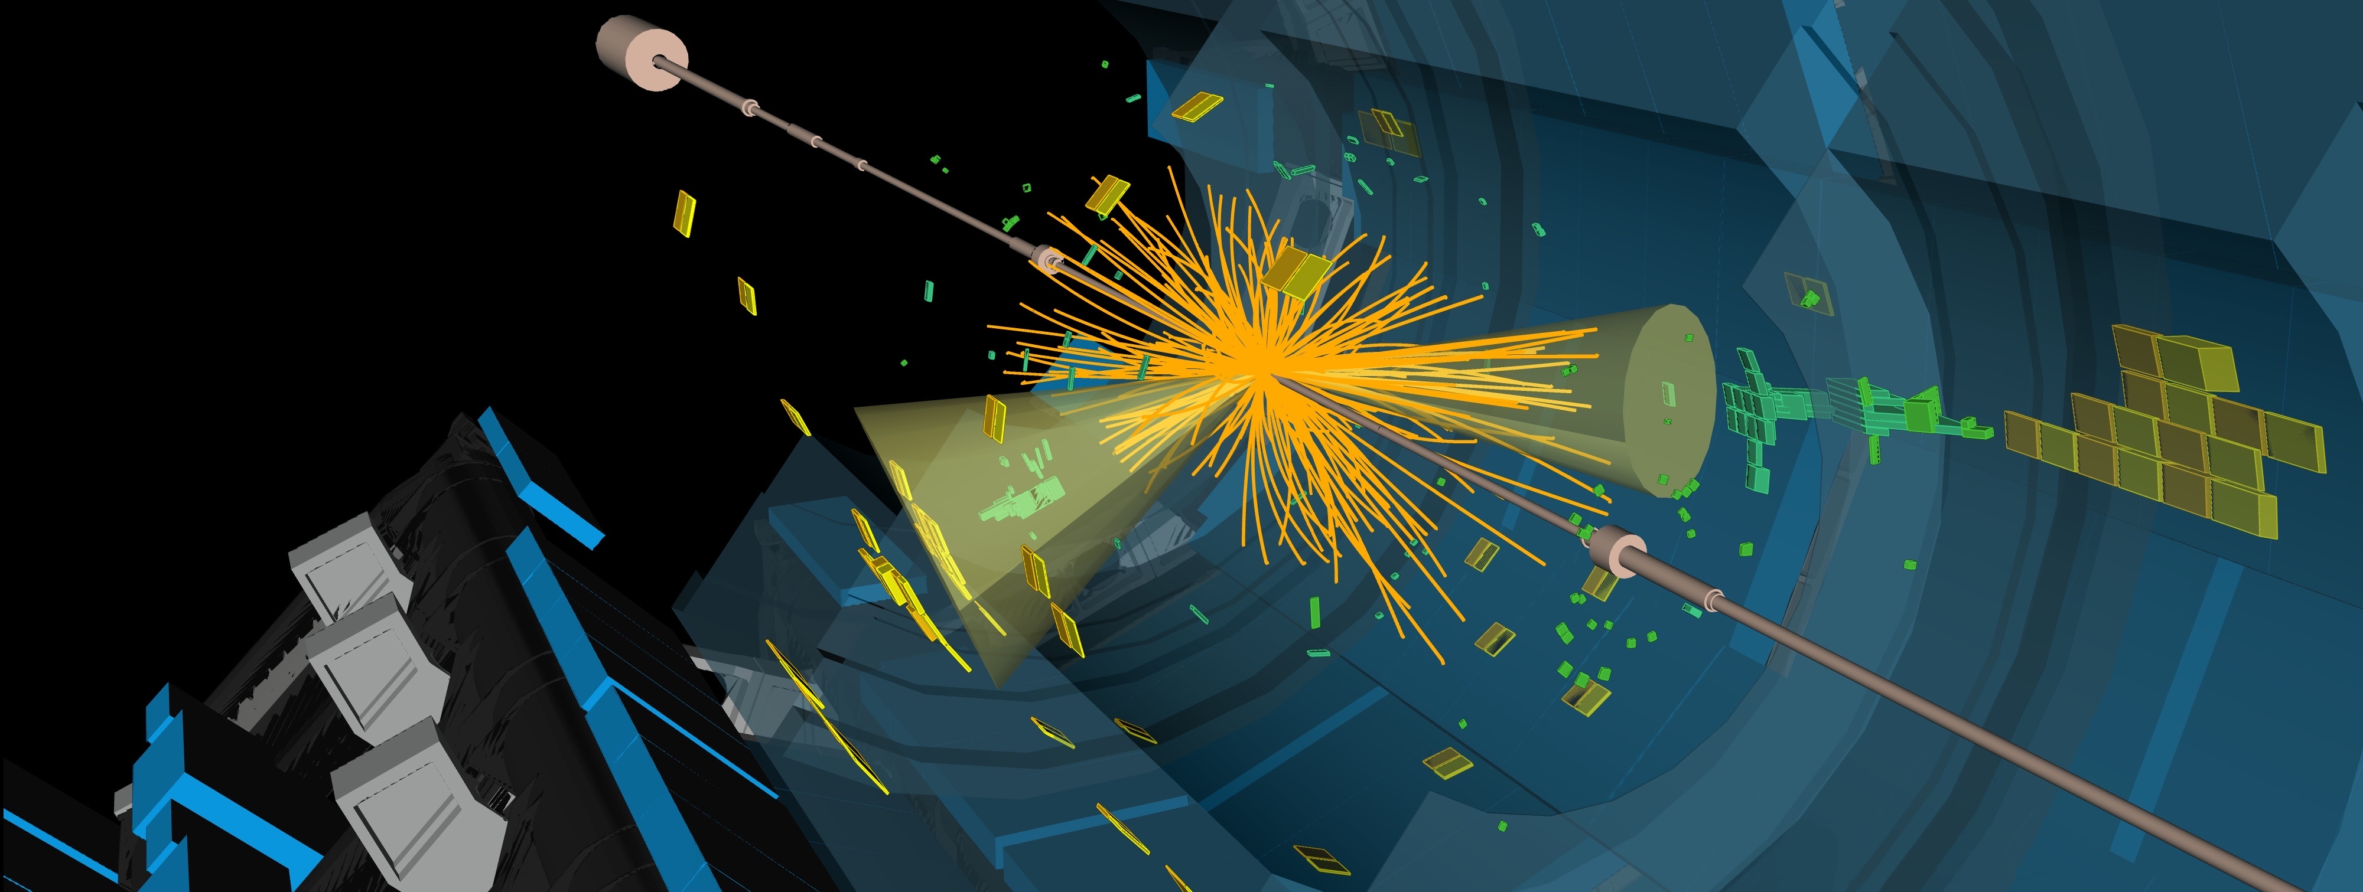
The LHC produces more than 1 billion particle collisions per second
The energy of the particles
in collision is converted into
new particles.
The detectors measure the energy, direction and charge of new
particles formed.
They are analogous to the 3D cameras taking 40 million pictures a second, of which 1000 are selected and recorded.
FICSA @ CERN
30 January 2025

Slide 13
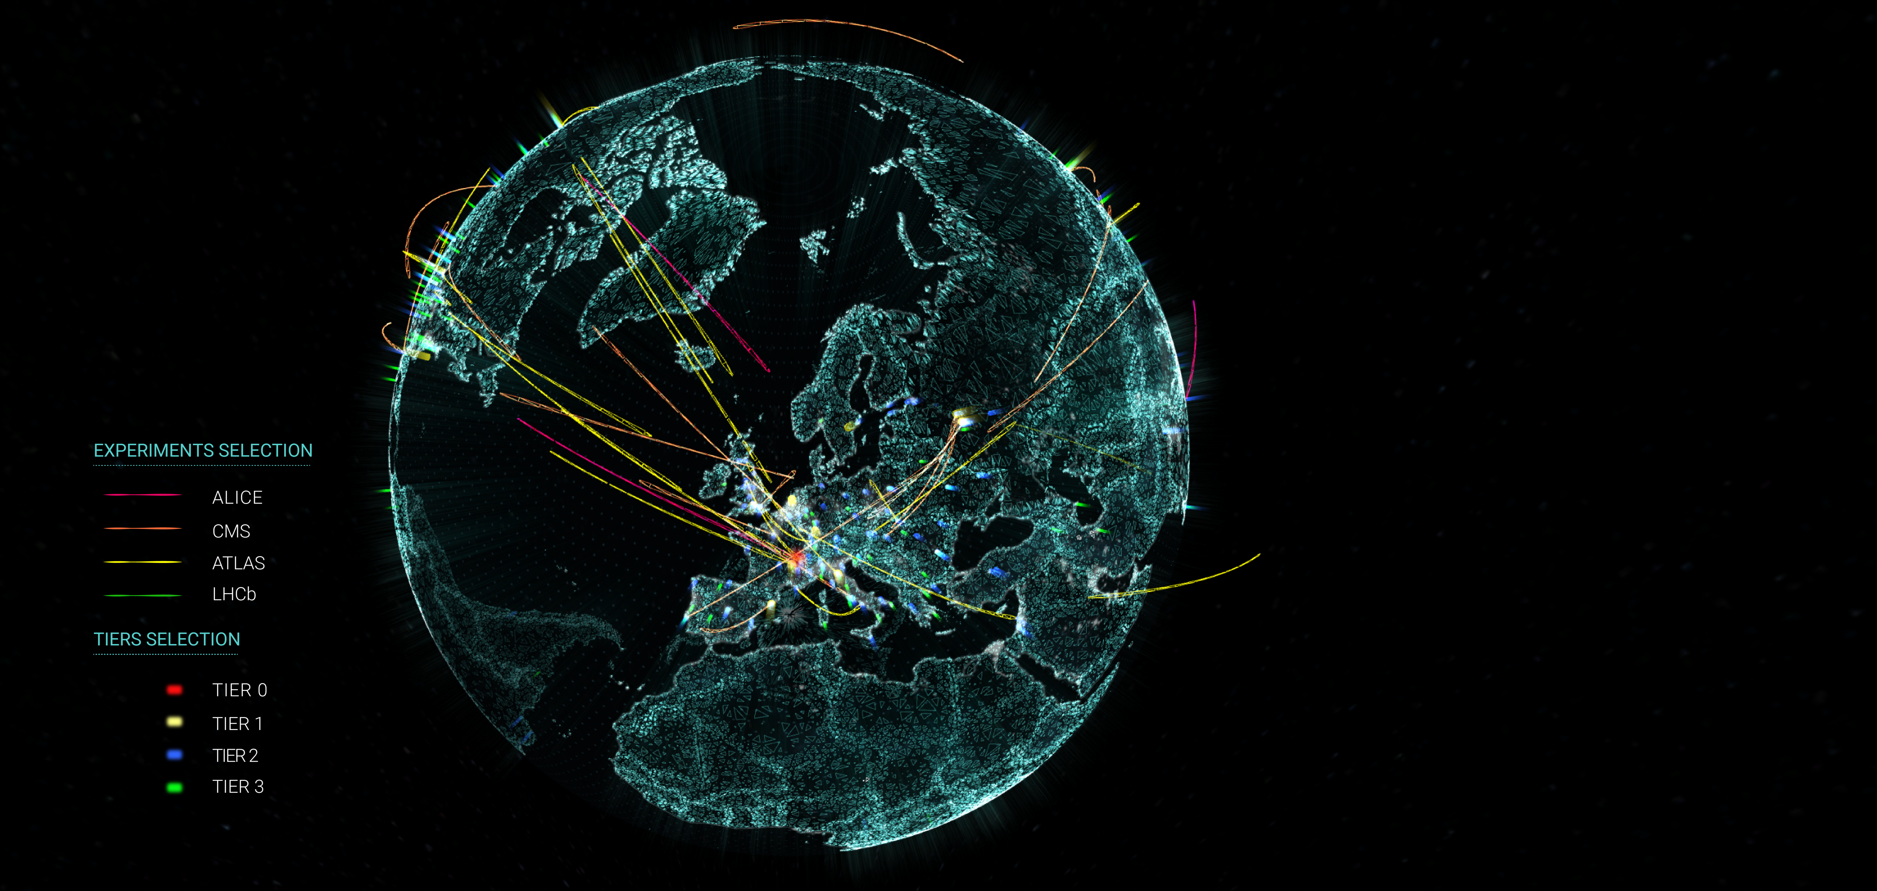

The Worldwide LHC Computing Grid (WLCG)
Stores, distributes, processes and analyses LHC experiments’ data.
1.4 million processing cores in 170 data centres
and more than 40 countries.
1500 Petabytes
of CERN data stored
world-wide.

Slide 14
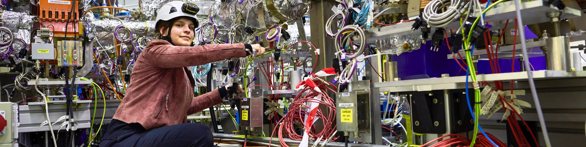
CERN has a diverse scientific programme
Nuclear Physics
(ISOLDE, n_TOF)
Antimatter Research
(Antiproton Decelerator)
Cosmic rays and cloud formation
(CLOUD)
Fixed-target experiments,
which include searches for rare phenomena
Contribution to the Long Baseline
Neutrino Facility in the USA (LBNF)
FICSA @ CERN
30 January 2025

Slide 15
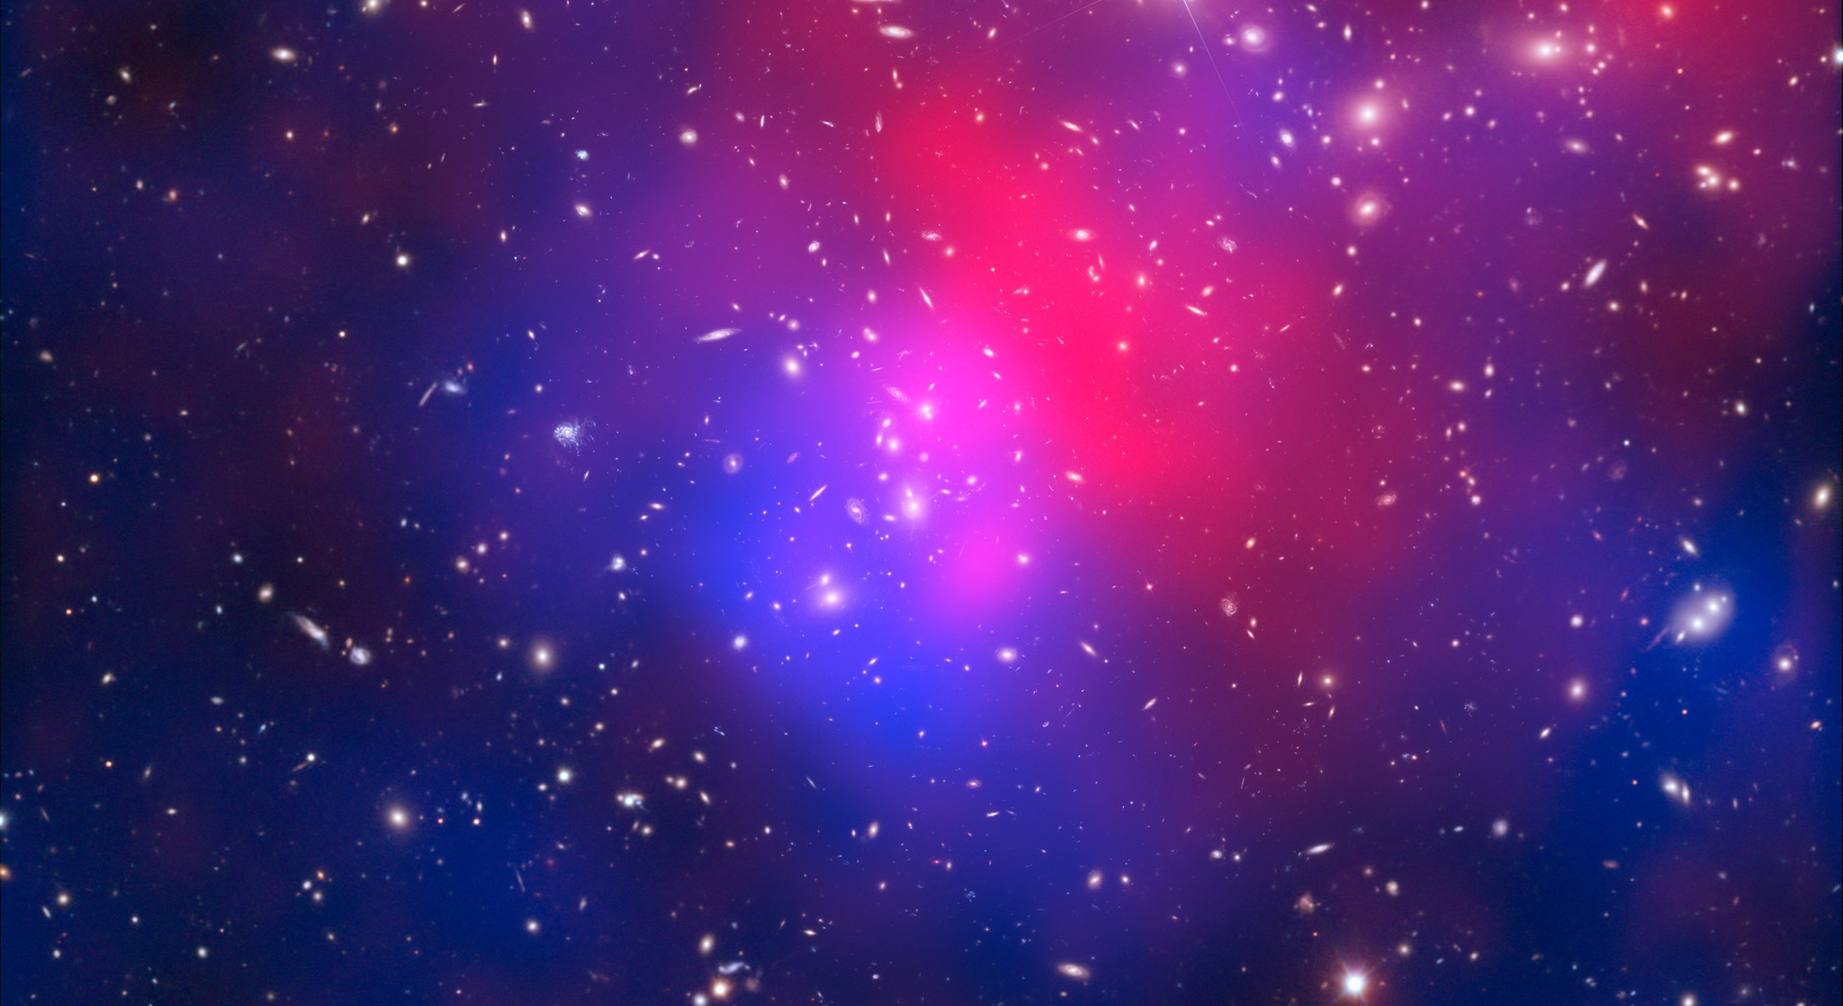
There are many unanswered questions in fundamental physics
Including
What is the unknown 95% of the mass
and energy
of the universe?
Is there only one Higgs boson, and does it behave exactly as expected?
Why is the universe made only of matter, with hardly any antimatter?
Why is gravity so weak compared to the other forces?

Slide 16
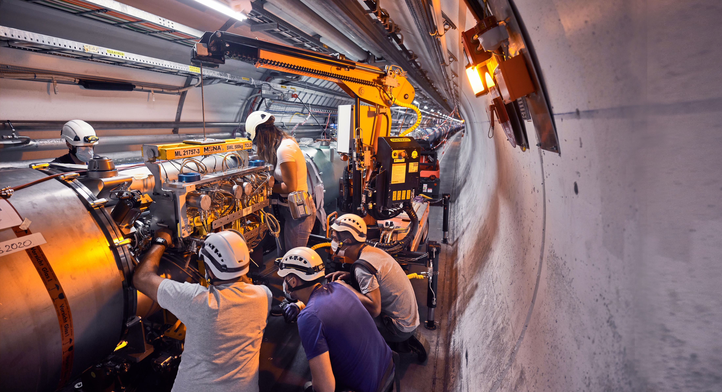
Upgrade to the
High-Luminosity LHC is under way
The HL-LHC will use new technologies to provide
10 times more collisions
than the LHC.
It will give access to rare phenomena, greater precision and discovery potential.
It will start operating in 2030, and run until 2041.

Slide 17
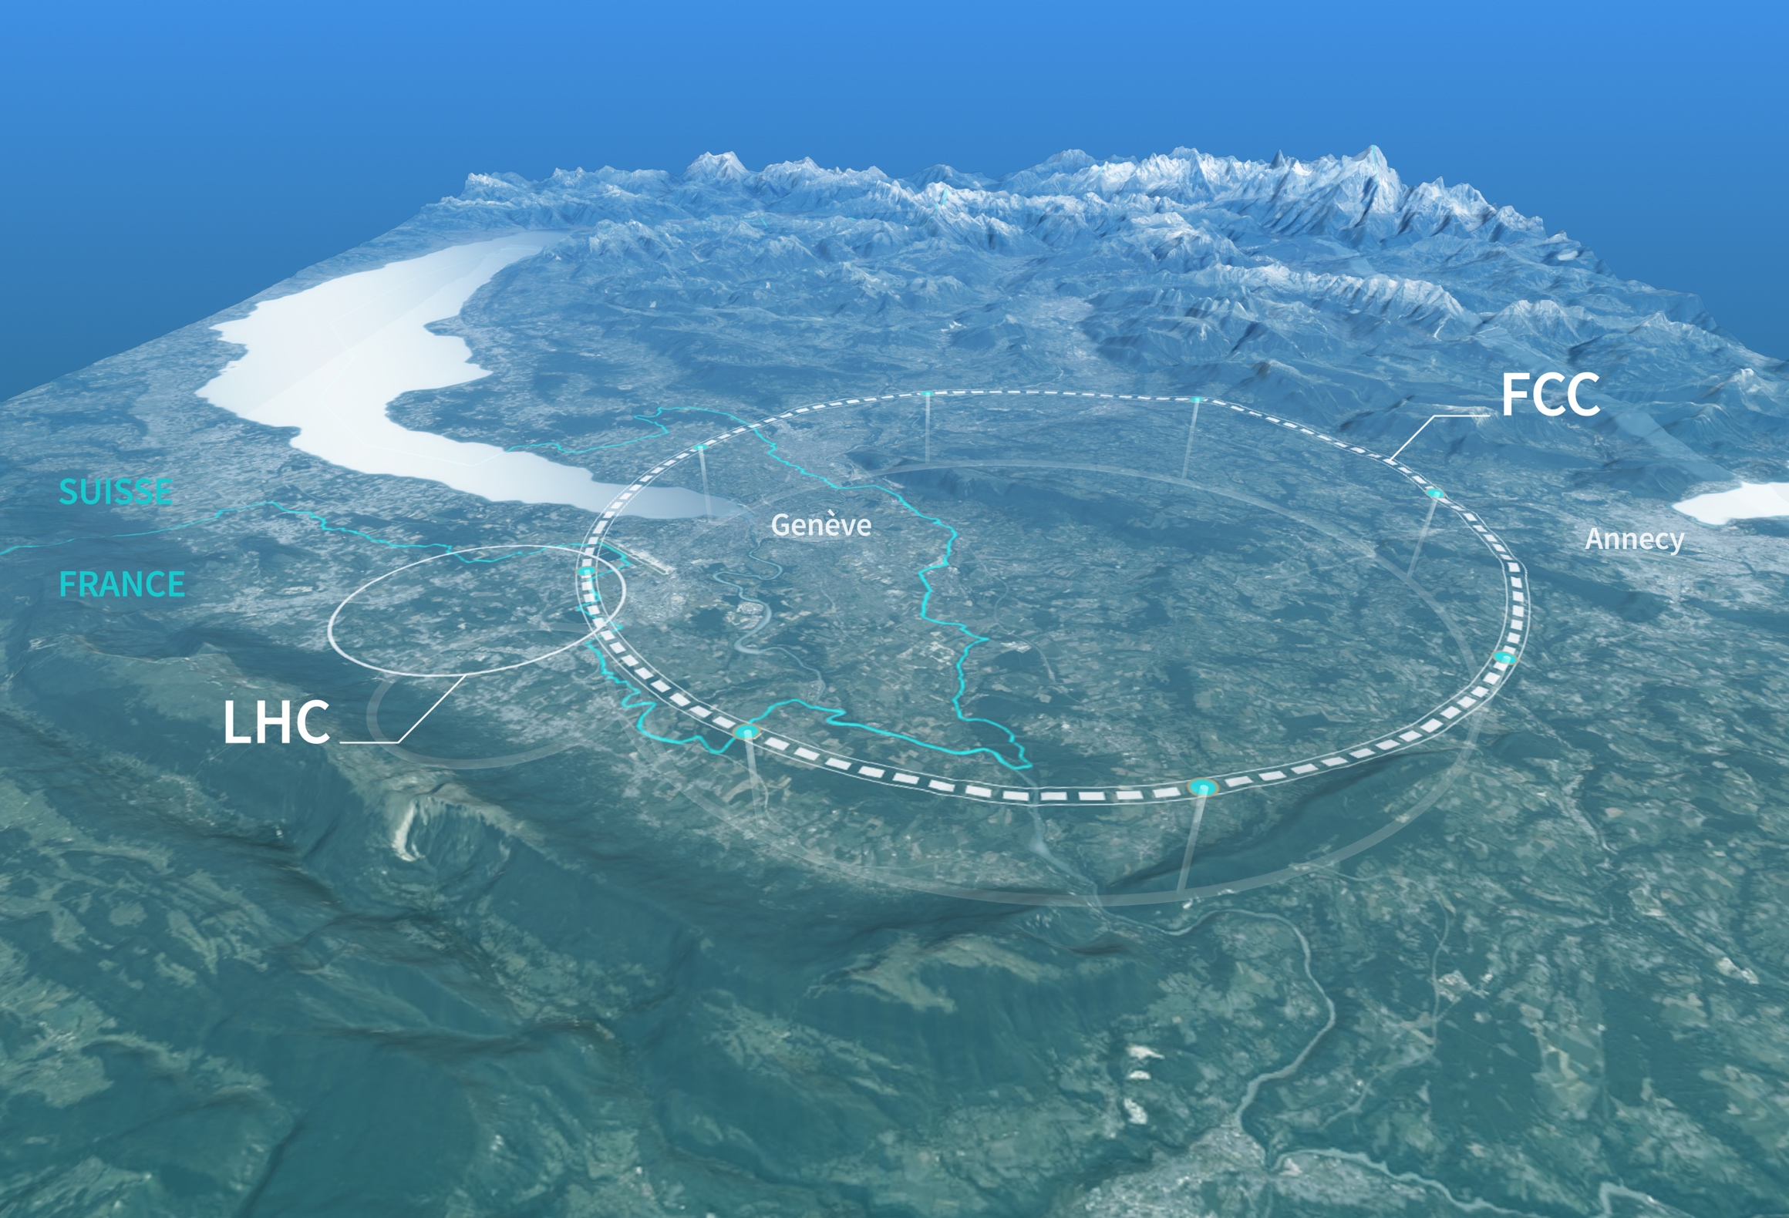
Preparing CERN’s future
Driven by the 2020 Update of the European Strategy for Particle Physics
Technical and financial feasibility study of a Future Circular Collider (Spring 2025)
Accelerator R&D to develop technologies for FCC and for alternative options
Detector and computing R&D
Maintain and expand a compelling scientific diversity programme
Continue to support other projects around
the world
FICSA @ CERN
30 January 2025

Slide 18

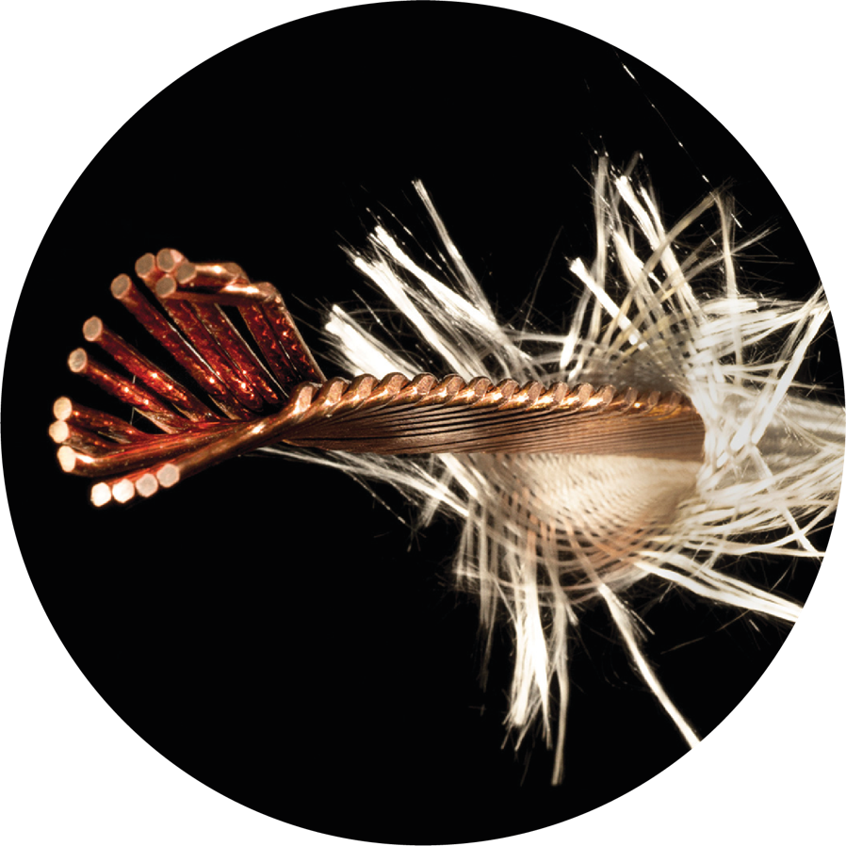
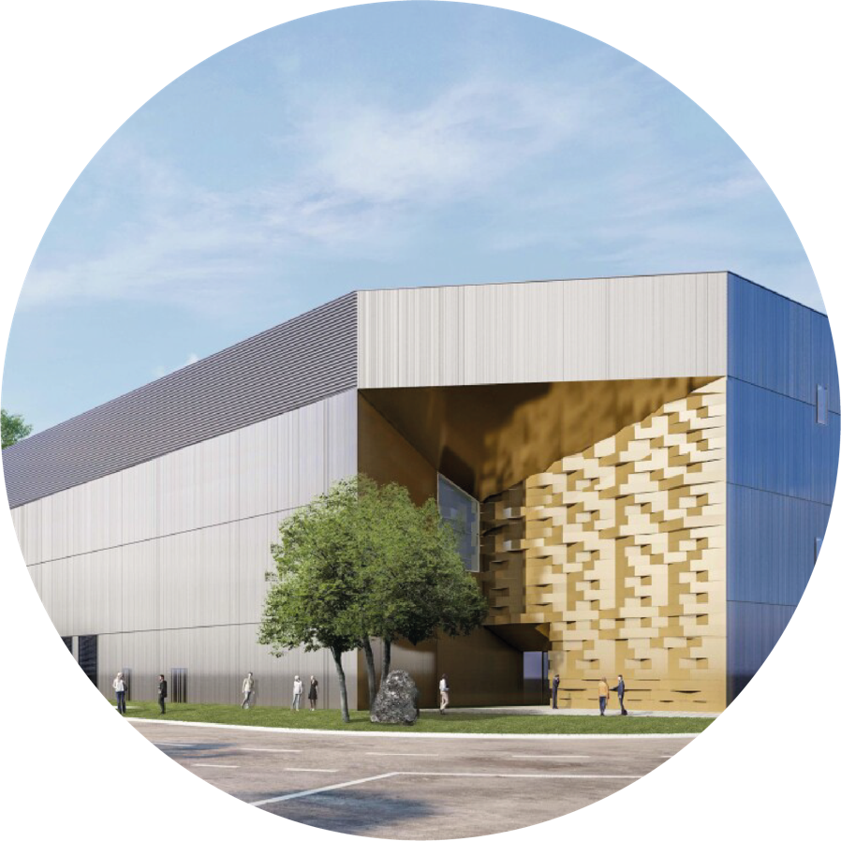
Committed to environmentally responsible and sustainable research
Minimize the impact of the laboratory’s activities on the environment with defined
priority actions
Identify and develop
CERN technologies that
would help mitigate society’s
impact on the environment
Energy:
Consume less, improve
efficiency, and recover more
FICSA @ CERN
30 January 2025

Slide 19
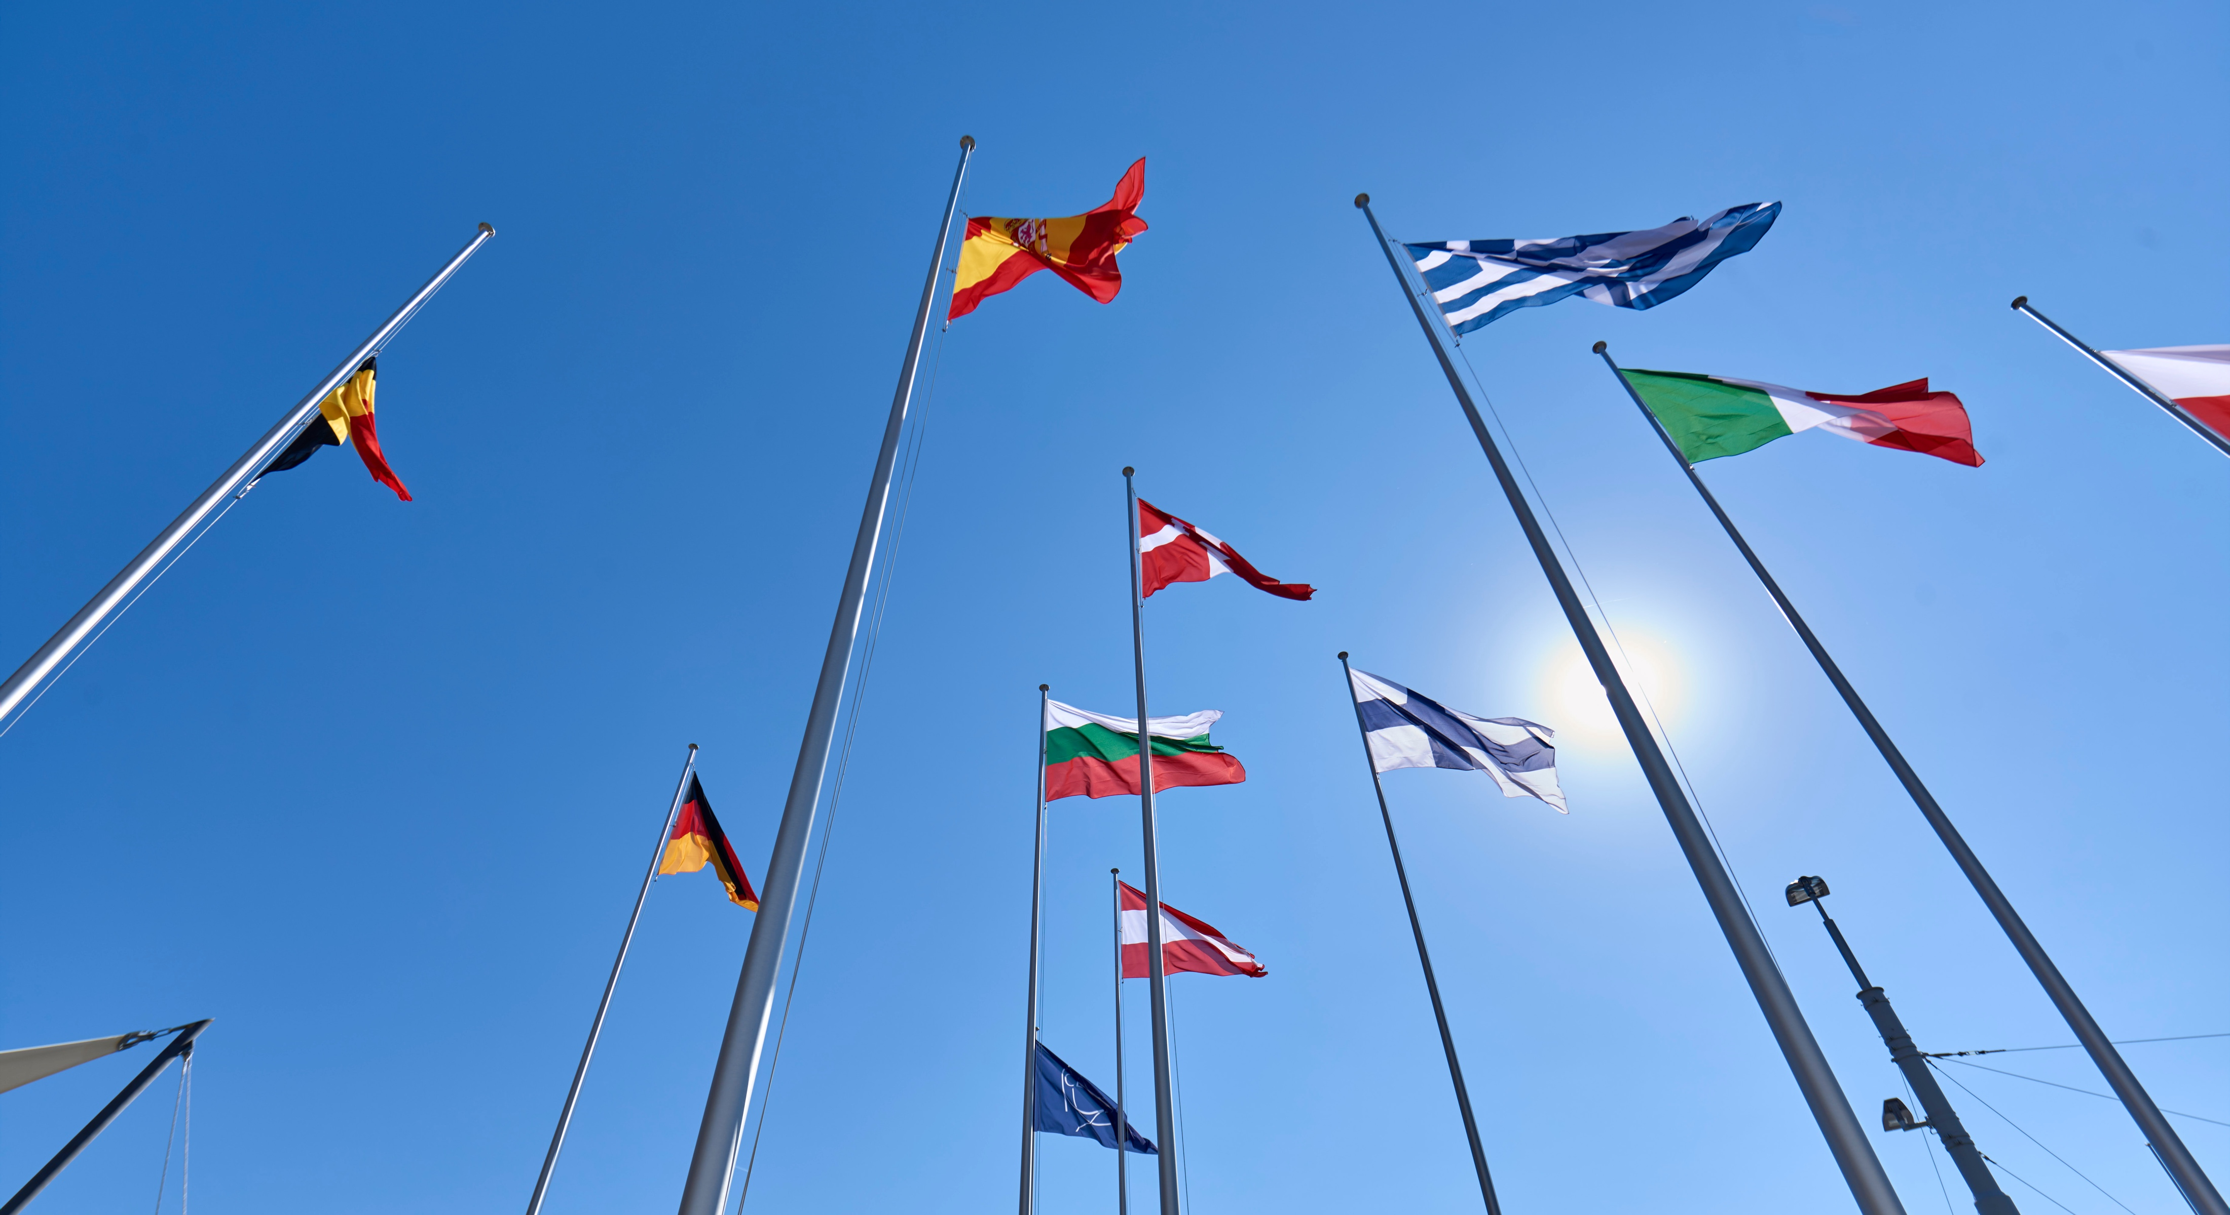
COLLABORATION

Slide 20
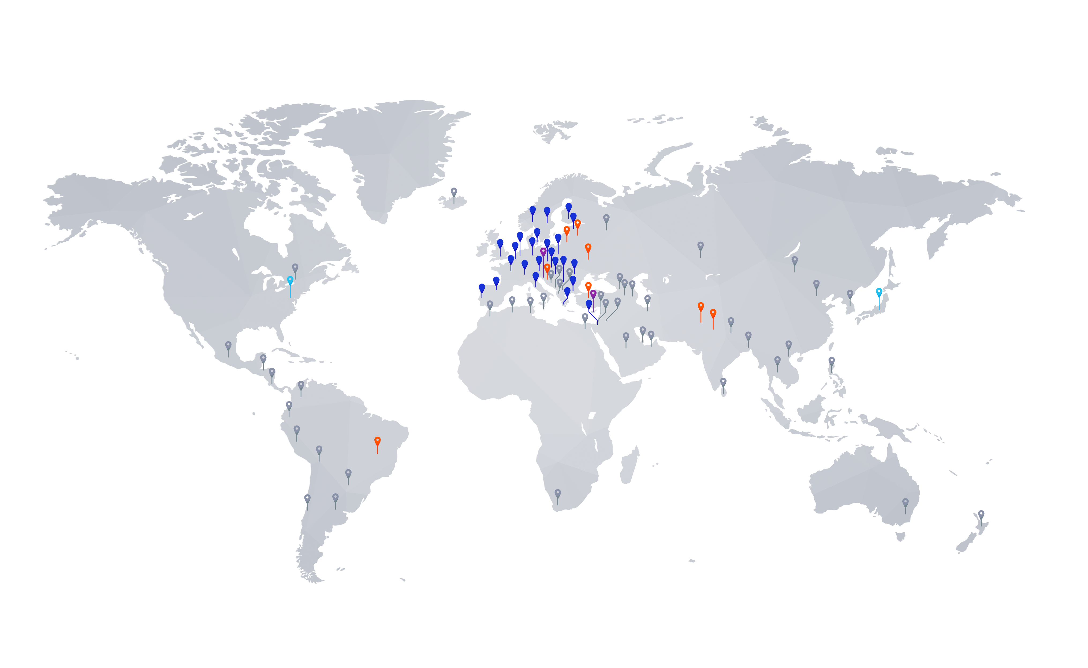
Science for peace
CERN was founded in 1954 with 12 European Member States
CERN’s annual budget
is 1200 MCHF (equivalent
to a medium-sized European university)
24 Member States
Austria – Belgium – Bulgaria – Czech Republic
Denmark – Estonia – Finland – France – Germany
Greece – Hungary – Israel – Italy – Netherlands
Norway – Poland – Portugal – Romania – Serbia
Slovakia – Spain – Sweden – Switzerland – United Kingdom
As of 31 December 2023
Employees:
2666 staff, 1002 graduates
Associates:
12 370 users, 1513 others
2 Associate Member States
in the pre-stage to Membership
Cyprus – Slovenia
8 Associate Member States
Brazil – Croatia – India – Latvia – Lithuania – Pakistan
Türkiye – Ukraine
4 Observers
Japan – USA – European Union – UNESCO
~ 50 Cooperation Agreements
Albania – Algeria – Argentina – Armenia – Australia – Azerbaijan – Bangladesh – Bolivia – Bosnia and Herzegovina
Canada – Chile – Colombia – Costa Rica – Ecuador – Egypt – Georgia – Honduras – Iceland – Iran – JINR – Jordan
Kazakhstan – Lebanon – Malta – Mexico – Mongolia – Montenegro – Morocco – Nepal – New Zealand
North Macedonia – Palestine – Paraguay – People's Republic of China – Peru – Philippines – Qatar – Republic of Korea
Saudi Arabia – Sri Lanka – South Africa – Thailand – Tunisia – United Arab Emirates – Uruguay – Vietnam
FICSA @ CERN
30 January 2025

Slide 21

A laboratory for people around the world
Distribution of all CERN Users by the country of their home institutes as of 31 December 2023
Geographical & cultural diversity
Users of 110 nationalities
23.7 % women
Member States (7467)
Austria 86 – Belgium 129 – Bulgaria 46 – Czech Republic 252
Denmark 47 – Estonia 29 – Finland 88 – France 842 – Germany 1296
Greece 112 – Hungary 80 – Israel 74 – Italy 1609 – Netherlands 167 Norway 77 – Poland 322 – Portugal 105 – Romania 113
Serbia 38 – Slovakia 67 – Spain 413 – Sweden 106
Switzerland 419 – United Kingdom 950
Associate Member States
in the pre-stage to Membership (40)
Cyprus 14 – Slovenia 26
Associate Member States (541)
Brazil 135 – Croatia 37 – India 145 – Latvia 21 – Lithuania 17 – Pakistan 30 Türkiye 129 – Ukraine 27
Observers (2226)
Japan 219 – United States of America 2007
Non-Member States /
Territories and International Scientific Organisations (1596)
Algeria 2 – Argentina 16 – Armenia 16 – Australia 26 – Azerbaijan 3 – Bahrain 3 – Canada 206 – Chile 45
Colombia 24 – Costa Rica 3 – Cuba 3 – Ecuador 4 – Egypt 24 – Georgia 34 – Hong Kong 15 – Iceland 3 – Indonesia 7 Iran 14 – Ireland 4 – JINR 293 – Jordan 3 – Kazakhstan 3 – Kuwait 2 Lebanon 7 – Madagascar 1 – Malaysia 4
Malta 1 – Mexico 56 – Montenegro 3 – Morocco 18 – New Zealand 2 Nigeria 2 – Oman 1 – Palestine 1
People's Republic of China 414 – Peru 3 – Philippines 1 – Republic of Korea 168 – Saudi Arabia 6 – South Africa 61
Sri Lanka 10 – Taiwan 52 – Thailand 17 – Tunisia 4 – United Arab Emirates 10 – Vietnam 1
FICSA @ CERN
30 January 2025

Slide 22
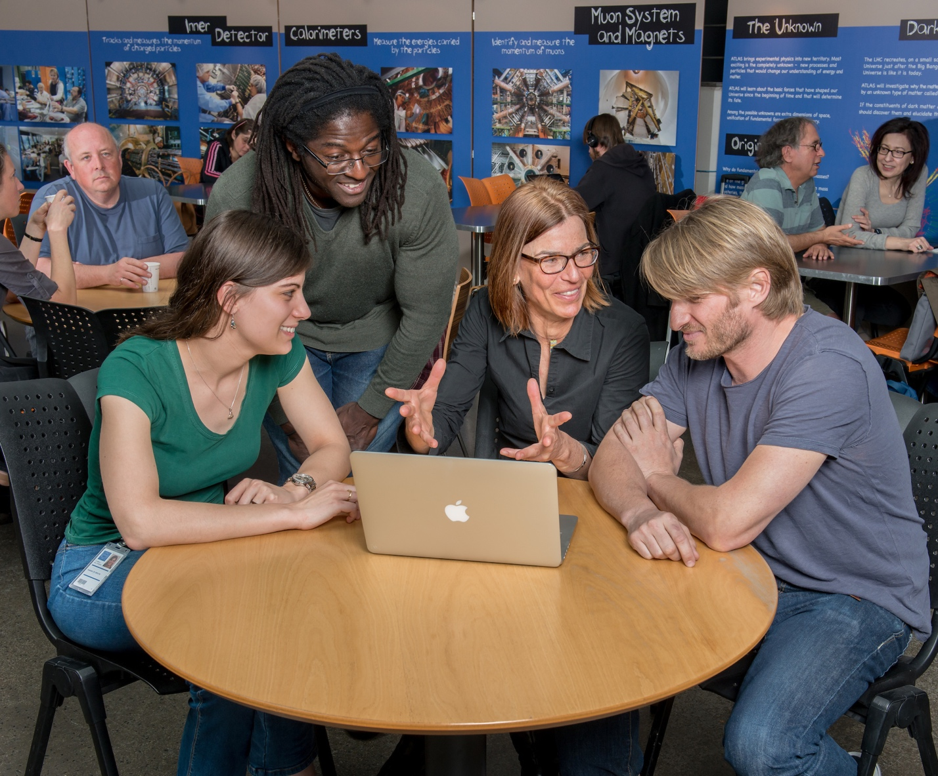
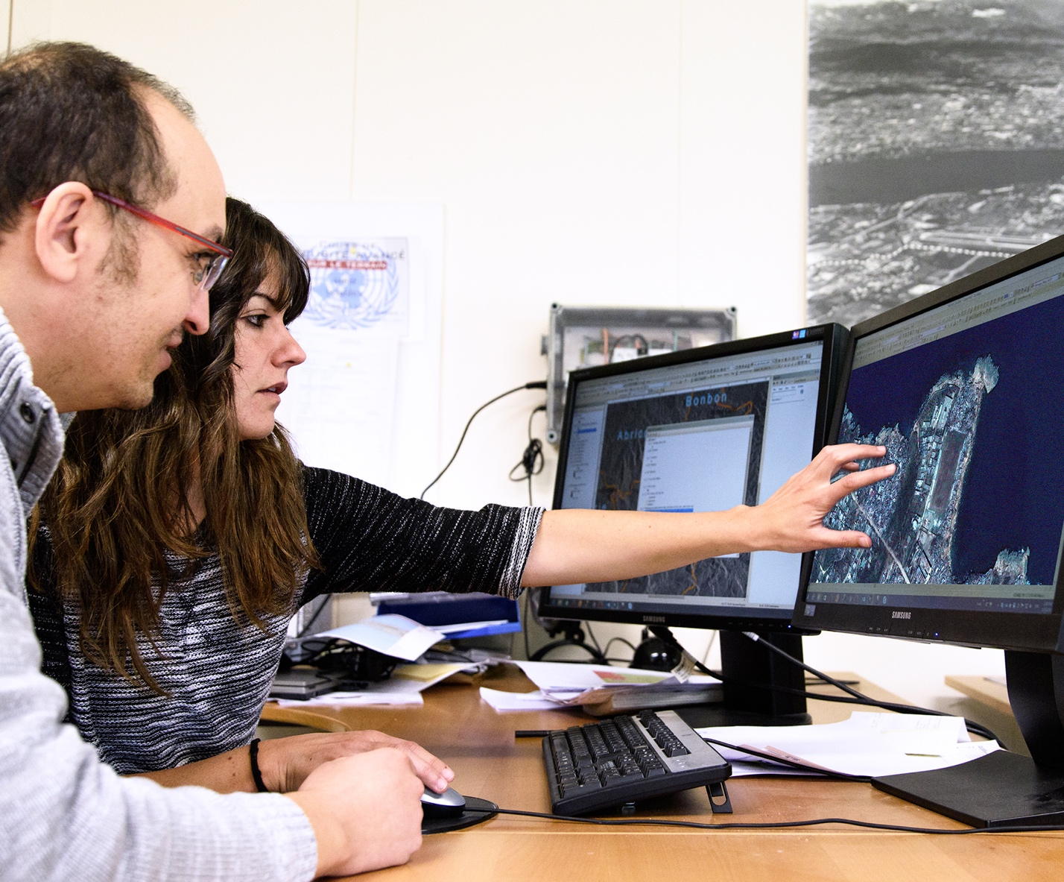
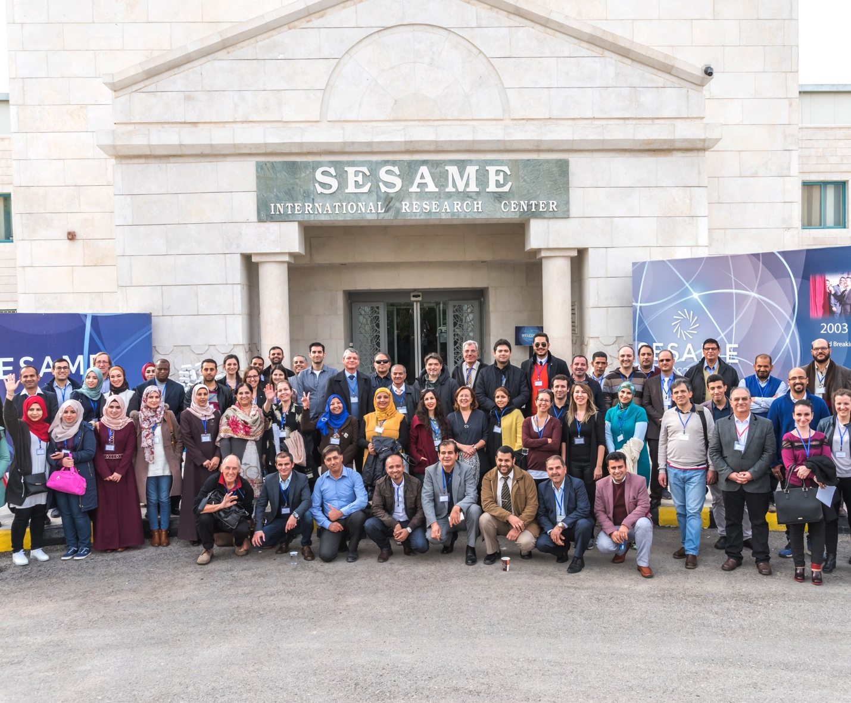
CERN is a model for open and inclusive collaboration
SESAME, a synchrotron light source
in Jordan, is modelled on CERN’s governance structure.
The LHC experiments are models of consensus building, competition and cooperation.
CERN provides the IT infrastructure for the satellite-analysis technology
used for emergency response.
FICSA @ CERN
30 January 2025

Slide 23
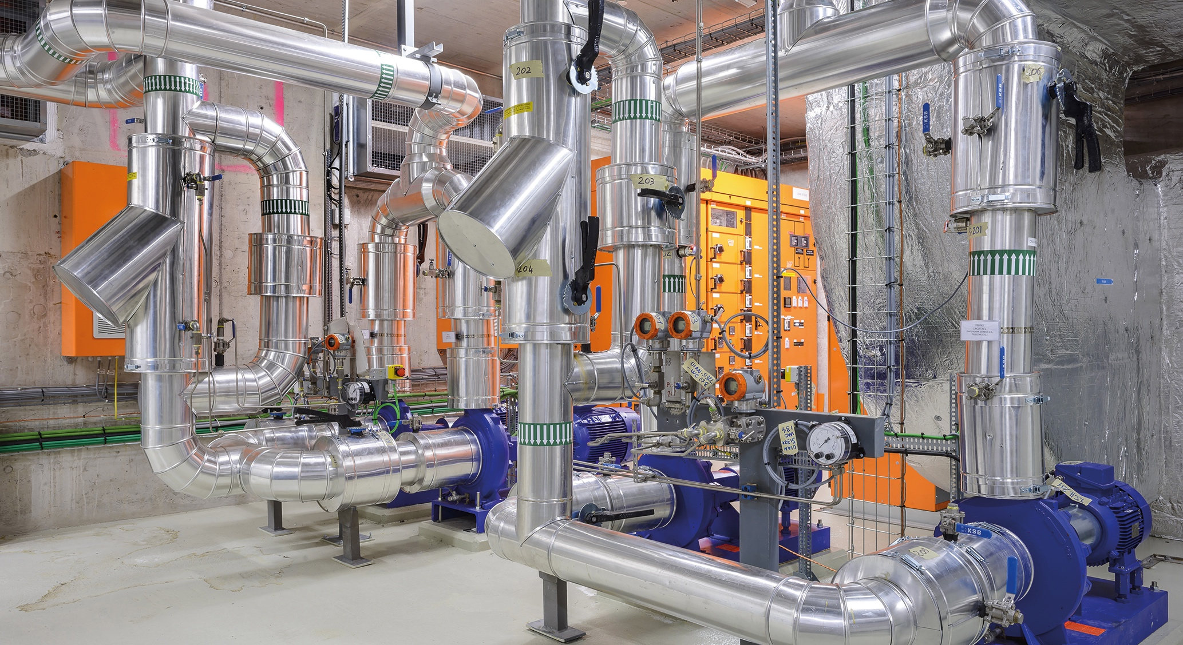
TECHNOLOGY & INNOVATION

Slide 24

CERN’s technological innovations have applications in many fields
CERN is the birthplace of the World Wide Web
And there are many more examples
Medical imaging, cancer therapy, material science, cultural heritage, aerospace, automotive, environment, health & safety, industrial processes.

Slide 25
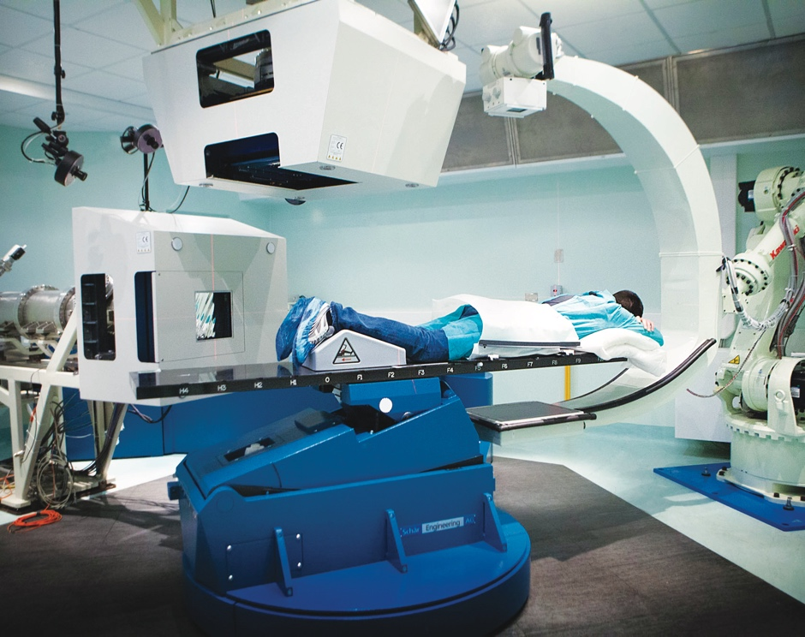
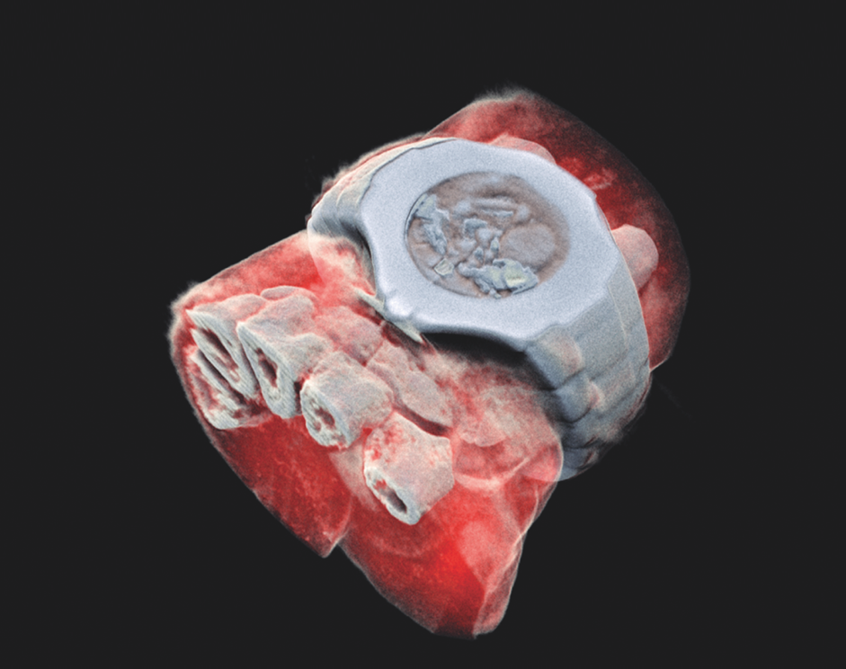
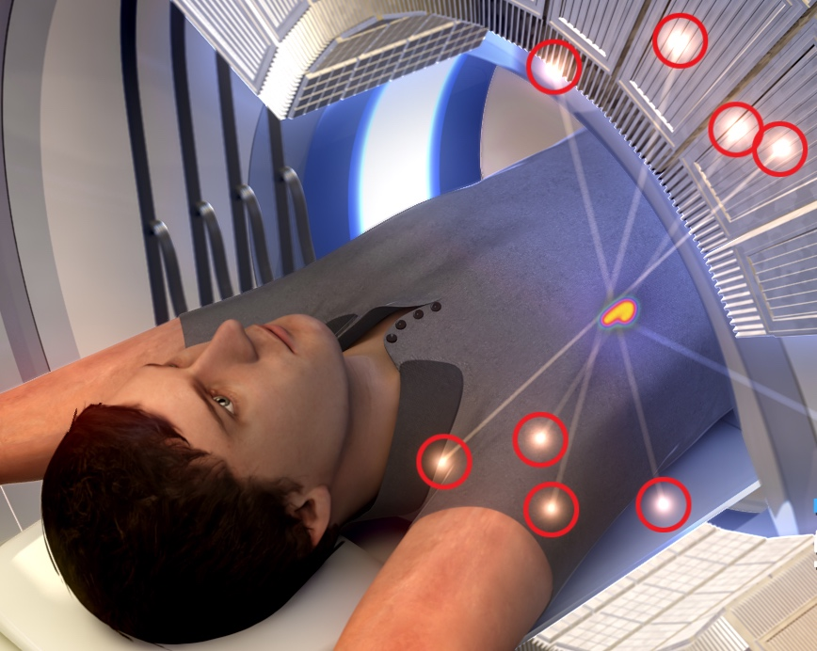
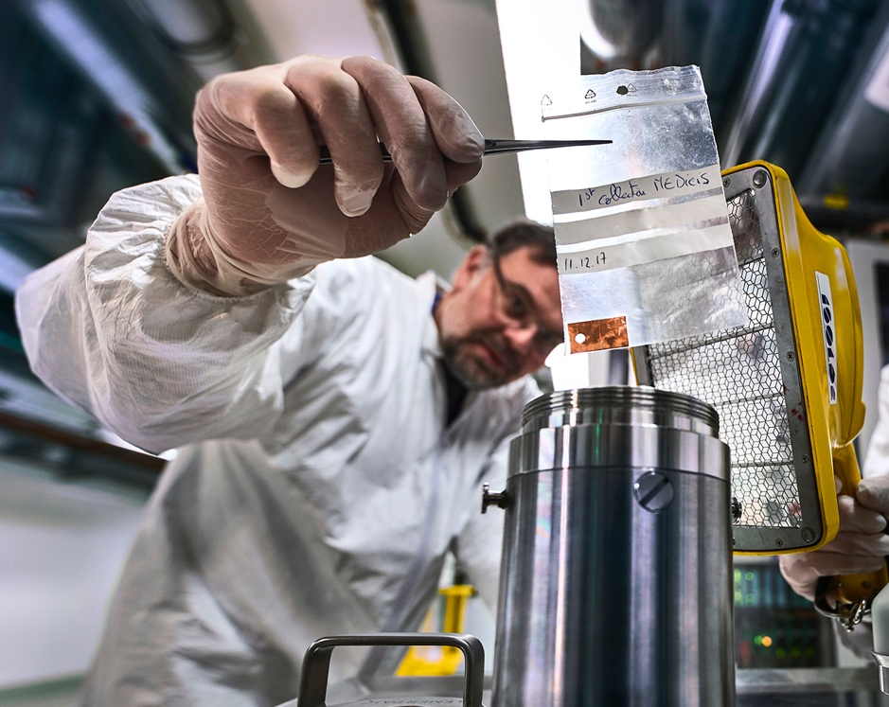
CERN’s technological innovations have important applications in medicine and healthcare
Technologies applied
at CERN are also used in PET, for medical imaging and diagnostics.
CERN produces innovative radioisotopes for nuclear medicine research.
© marsbioimaging
© CNAO
© ENVISION / ENLIGHT
Accelerator technologies are applied in cancer radiotherapy with protons, ions and electrons.
Pixel detector technologies are
used for high resolution
3D colour X-ray imaging.
FICSA @ CERN
30 January 2025

Slide 26
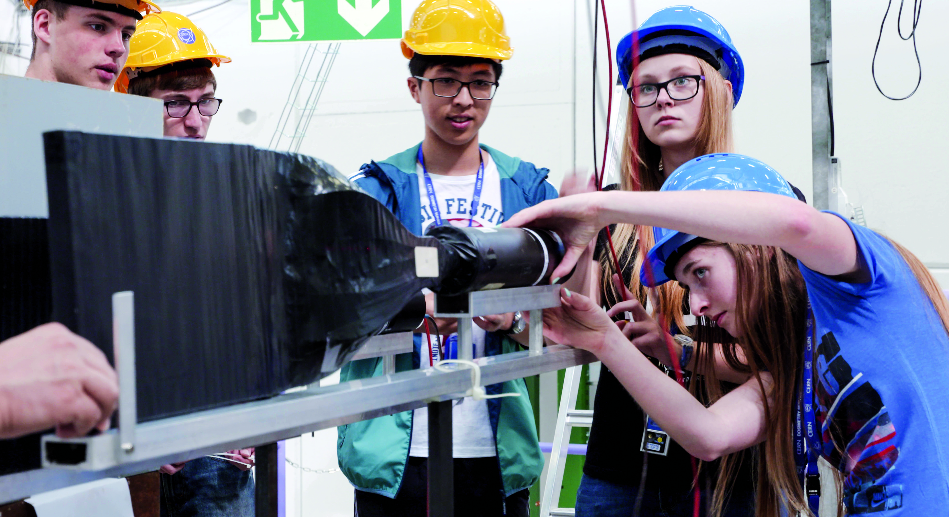
EDUCATION
& TRAINING

Slide 27
CERN opens a world of career opportunities
Number
of Persons
19%
Other fields, including
government organisations
27
45%
Industry
36%
Academia or Research
67
age
Age Distribution of Scientists working at CERN
Source: CERN Alumni survey (2014)
PhD and Technical students leaving CERN
FICSA @ CERN
30 January 2025

Slide 28
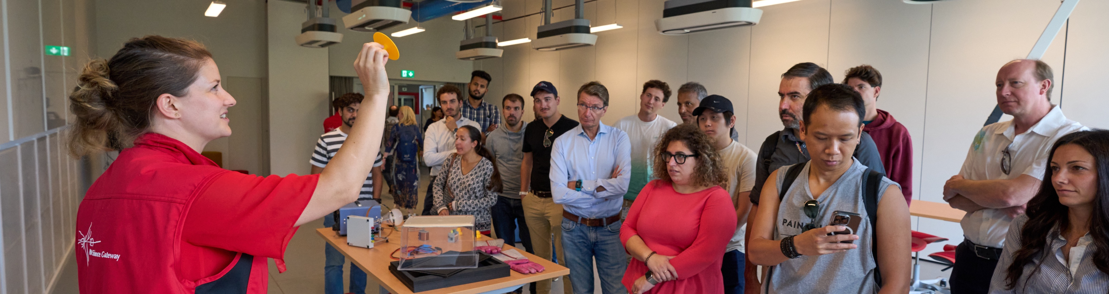
CERN’s training, education and outreach programmes
1002 graduates
(including Research Fellows)
3 000 PhD students
300 Undergraduate students in
Summer programmes
Numbers for Serbia
3 summer students during 2023
84 teachers in Teacher Programmes since 1998
9 teams in BL4S competition since 2014
> 15 000 teachers participating in dedicated programmes, since 1998
Around 150 000 visitors per year on guided tours of CERN,
from >50 countries
4.7M followers on social media, from around the globe
FICSA @ CERN
30 January 2025

Slide 29
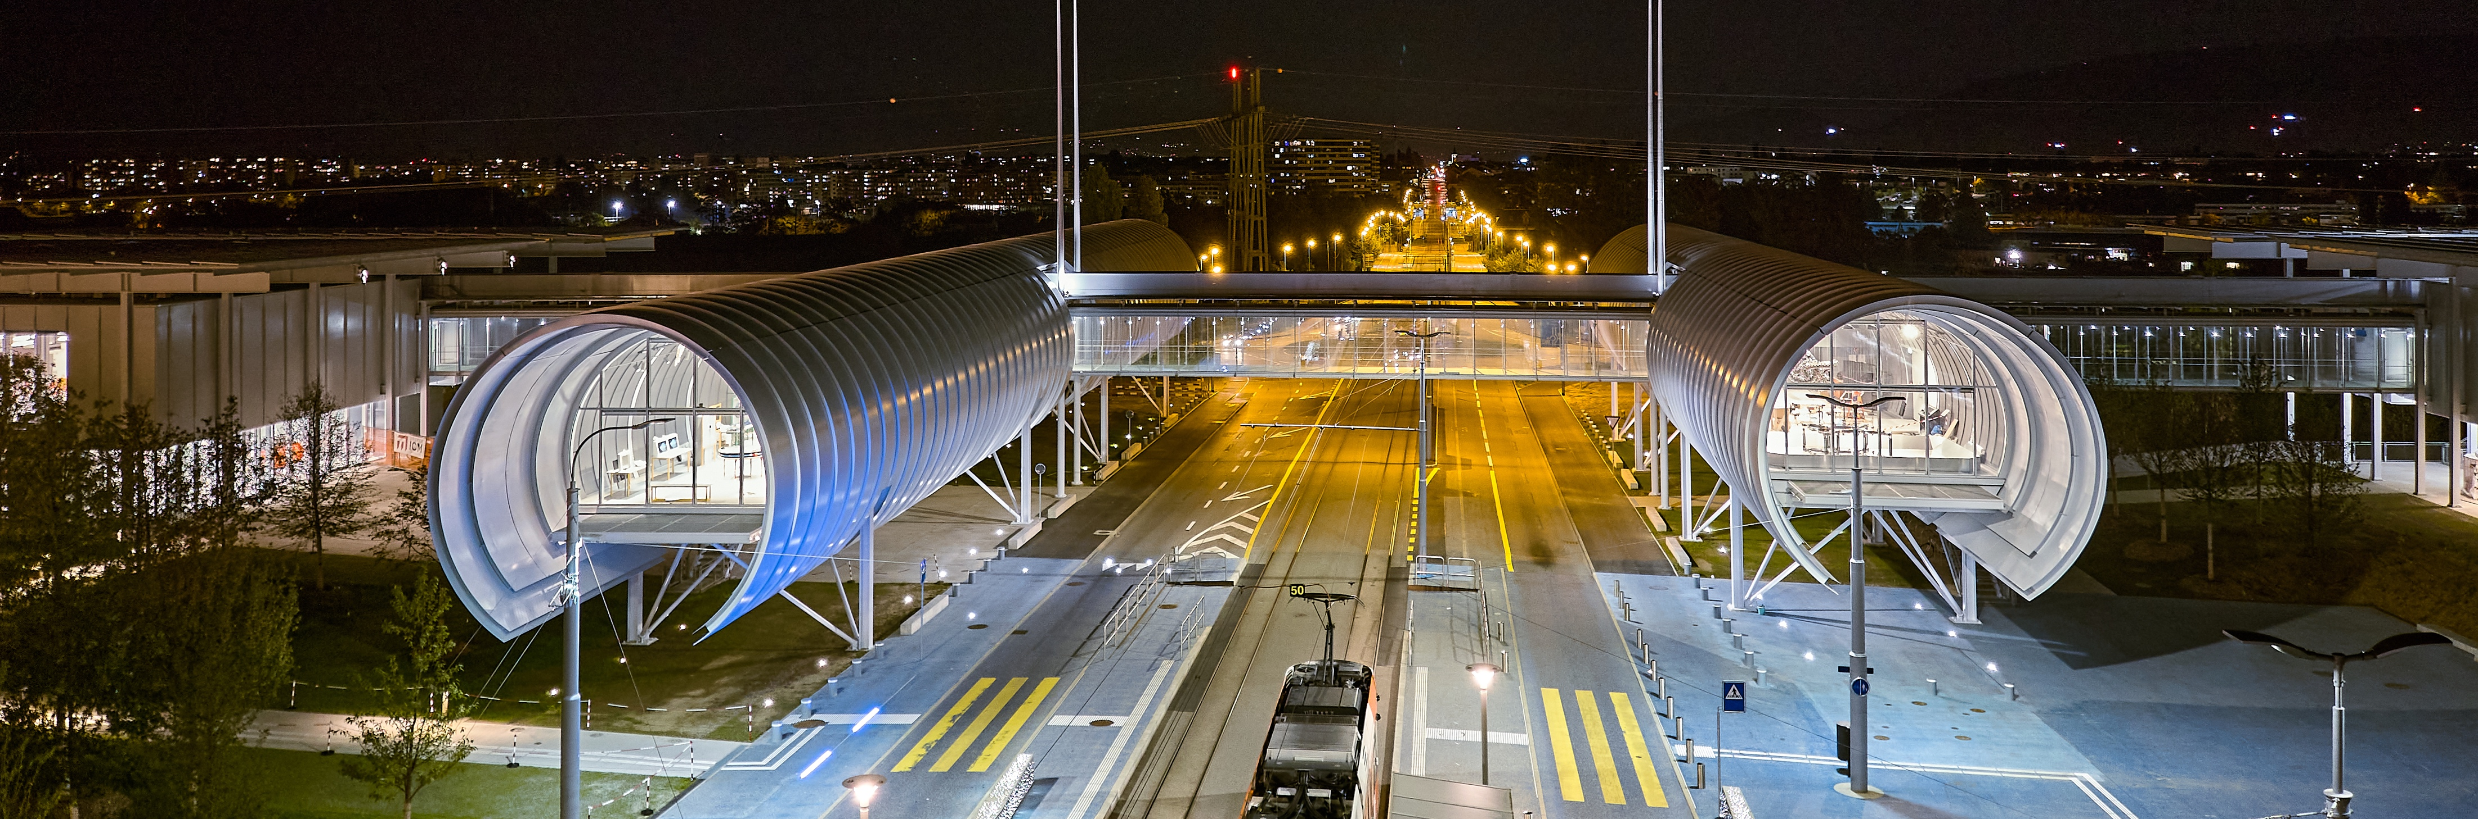
CERN Science Gateway
CERN’s new education and outreach centre for all
publics aged 5-plus.
Inaugurated
October 2023.
Number of visitors: >400 000
Immersive exhibitions, education labs, events
and shows.
FICSA @ CERN
30 January 2025

Slide 30
There are many unanswered questions
in fundamental physics
CERN will continue to play a crucial role
in the journey of exploration

