Slide 1



3.0
G. Watts (UW/Seattle)
For the ServiceX Team
Nov 1, 2024

Slide 2
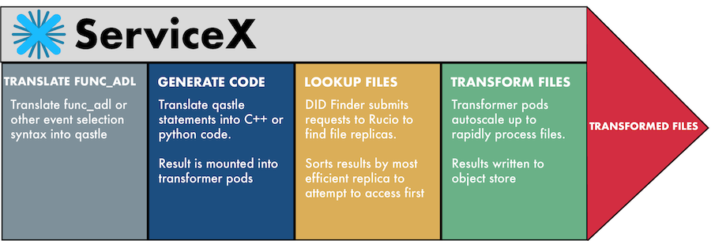
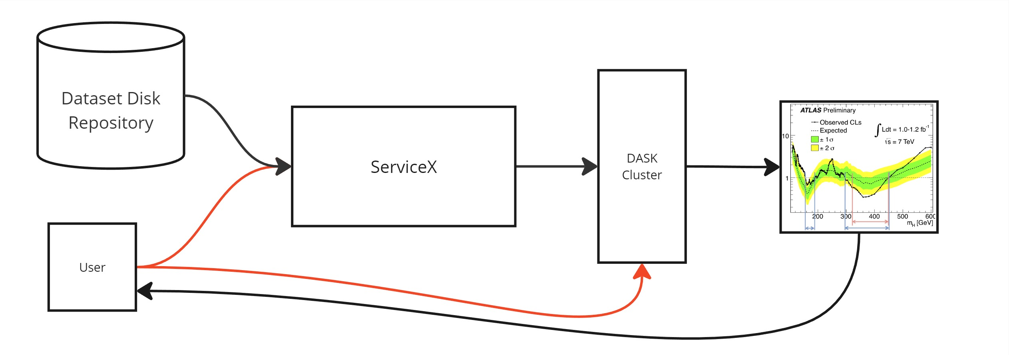
ServiceX Architecture Reminder
backend
frontend
Web API

Slide 3
Recent Developments in ServiceX
Backend Developments (ServiceX itself)
  1.4.1 (August 7th) -> 1.5.X (Sept 20th)
  Lessons from the IDAP 200 Gpbs test: reduce lost internal scaling messages, small updates to how we transform the data, lots of small stability improvements.
  New transformers/codegenerators to run plain-old-python
  The WebAPI did not change, however!
  Won’t really discuss further
Front End (Library to enable user interaction)
  3.0 released Sept 20th (after 5 months of development)
  Big (breaking) change in how the user interacts with ServiceX
  Pulled several ideas from the community into the central library (e.g. datasets)
  Queries can be coded with typed classes, dictionaries, or yaml text files now!
  DOCUMENTATION!!

Slide 4
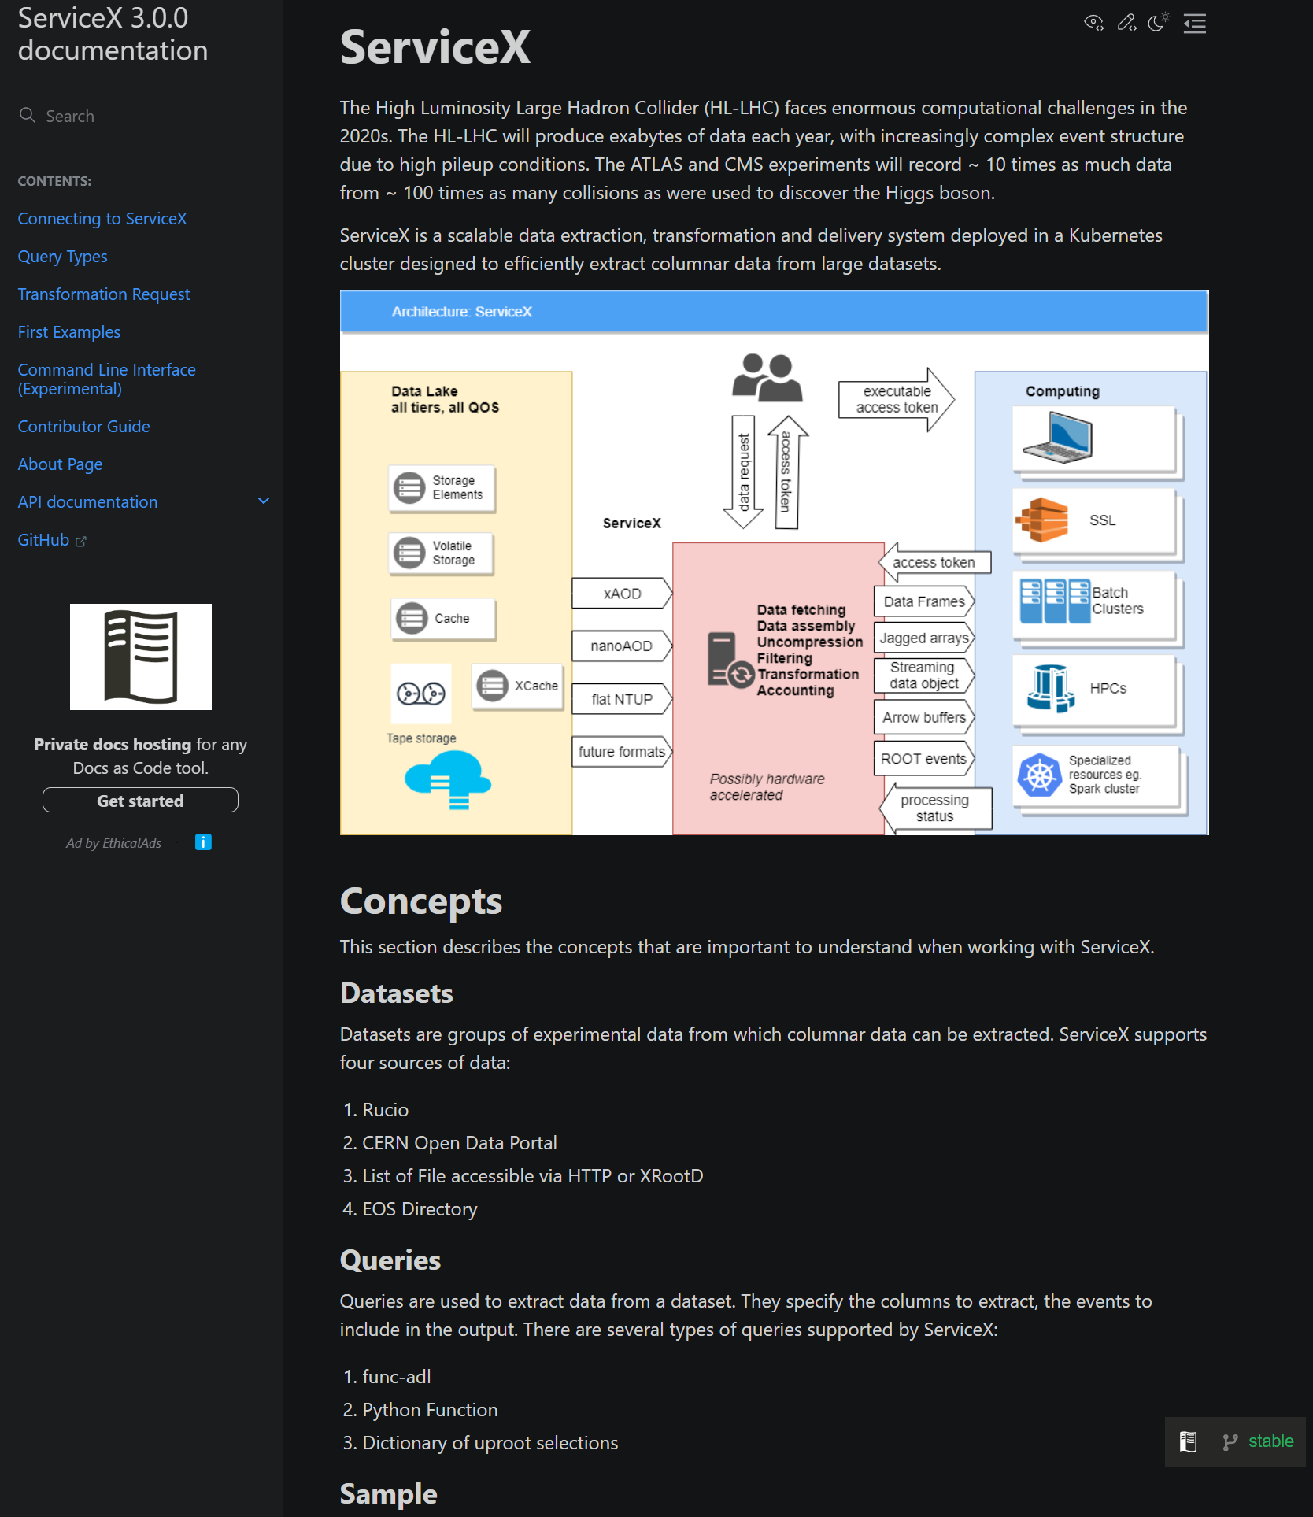
Getting Started: Help!
Find our new documentation on readthedocs:
ServiceX 3.0.0 documentation
Missing something? Spot an error?
Create an issue
Or… the source for the documentation is in the repo
Submit a MR

Slide 5
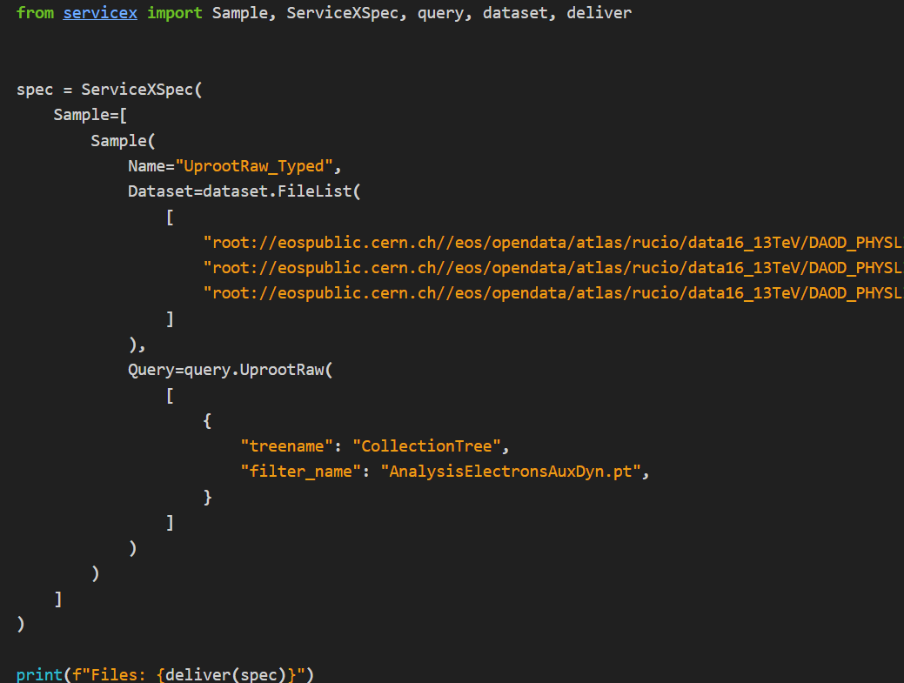
How does it work?
Data Source (FileList, Rucio, etc.)
Where to get the data from
Query
How to transform the data
Raw, func_adl, etc.

Slide 6
How does it work?
Sample
Consists of the data set and query together
Produces a set of files
Labeled with the Name

Slide 7
How does it work?
Samples
You can submit 1 or 100 samples at a time
Output will always be a dict of everything
All of these objects take lots of extra parameter that allow you to specify explicitly:
Code generator
Backend ServiceX location
Transformer image, etc.
The servicex.yaml file is still required!!

Slide 8
How does it work?
deliver changes the spec with the Samples into files.
There is an async version of this coming soon!
It will handle all interaction with the ServiceX backend via the WebAPI

Slide 9
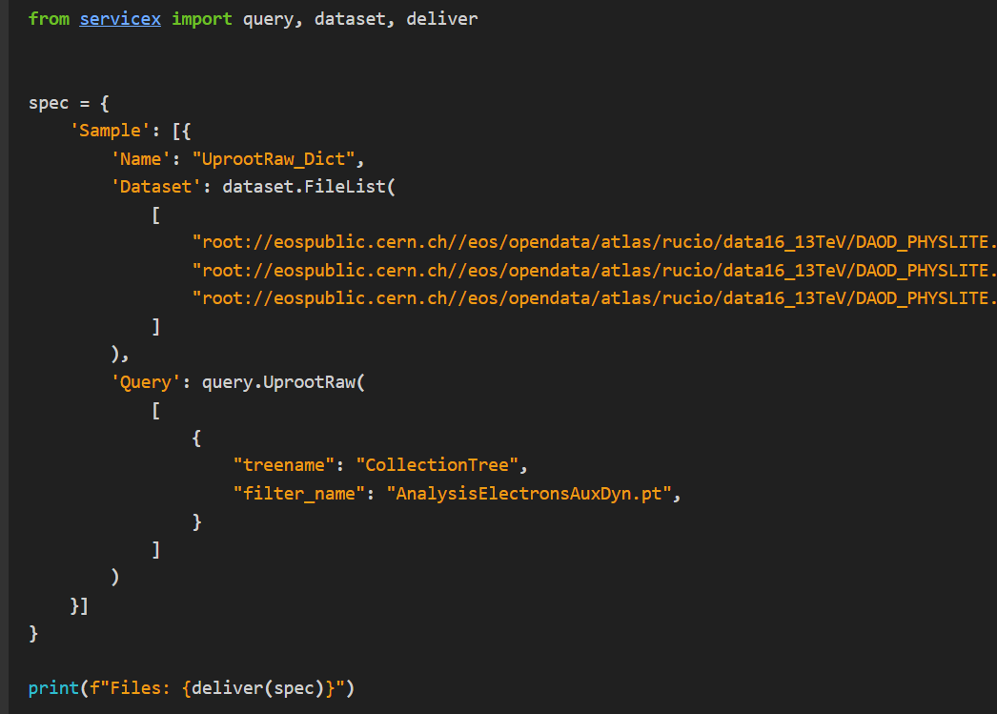
Using a Dictionary instead…
We expect:
Dictionary is the easiest to use for quick oneoffs
Typed classes will be used by libraries and frameworks
The YAML is attractive because it can be checked into git directly!
At its core, the frontend only uses the typed classes – everything is translated into that!

Slide 10
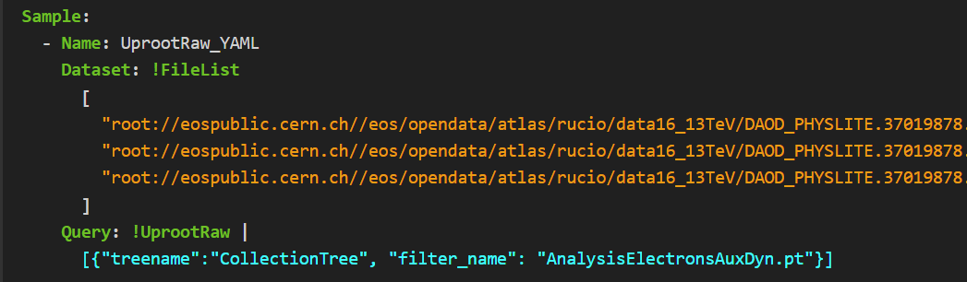
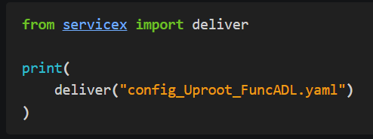
Using YAML
The YAML file itself:
Use in SX:
There is not yet a full text representation for all query languages!

Slide 11
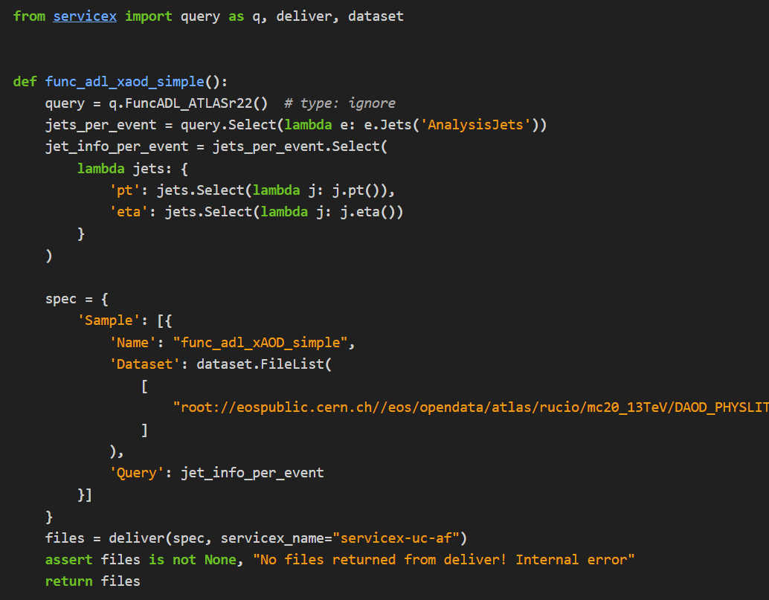
Other Queries: Func_ADL xAOD (Fully Typed)
Func_adl
ServiceX Spec and Delivery

Slide 12
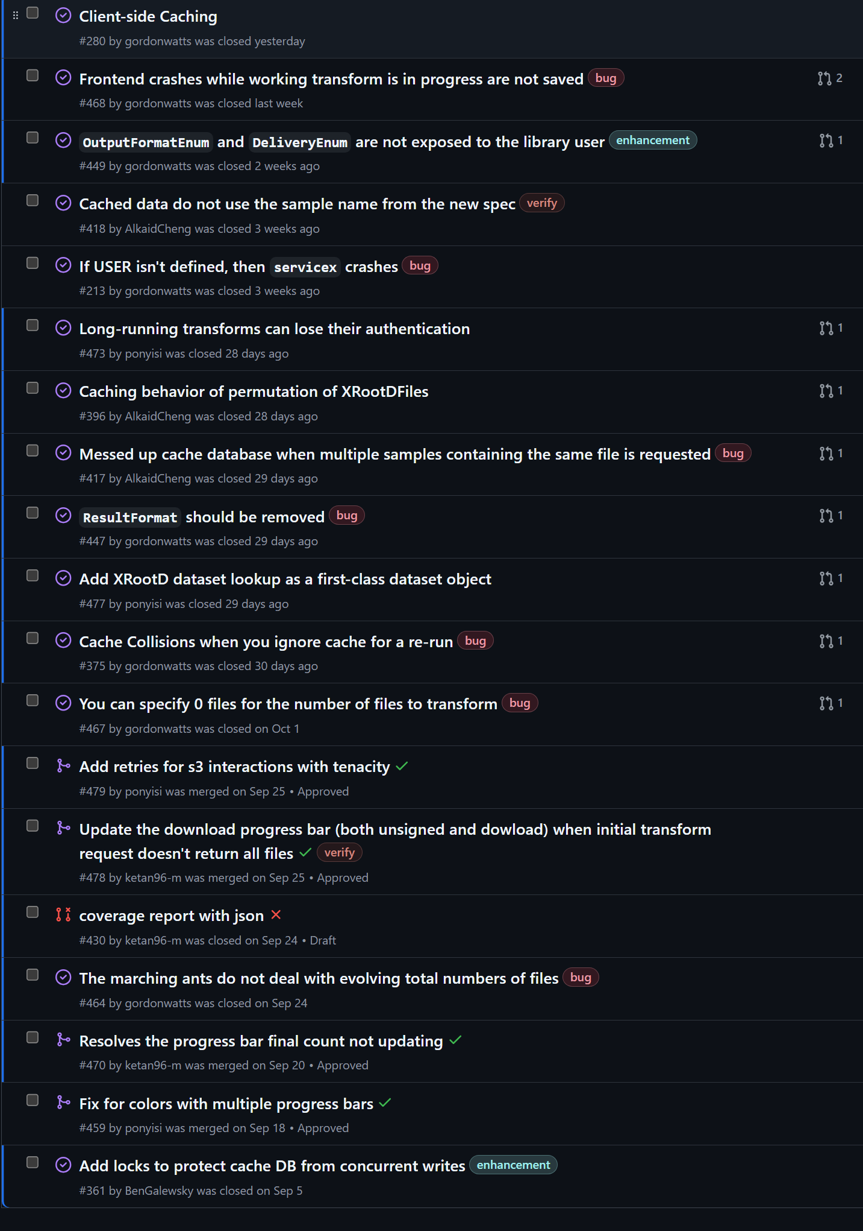
Status
ssl-hep/ServiceX_frontend: Client access library for ServiceX
The Analysis Grand Challenge and the IDAP 200 Gbps code has been converted to use 3.0
Being used in the wild as well (been out about 1.5 months).
However, there are some rough edges
  3.0.1’s branch already has a significant number of updates
  Will release “soon”
We also have a backlog of new features where we are planning for 3.1

Slide 13
Backup

Slide 14
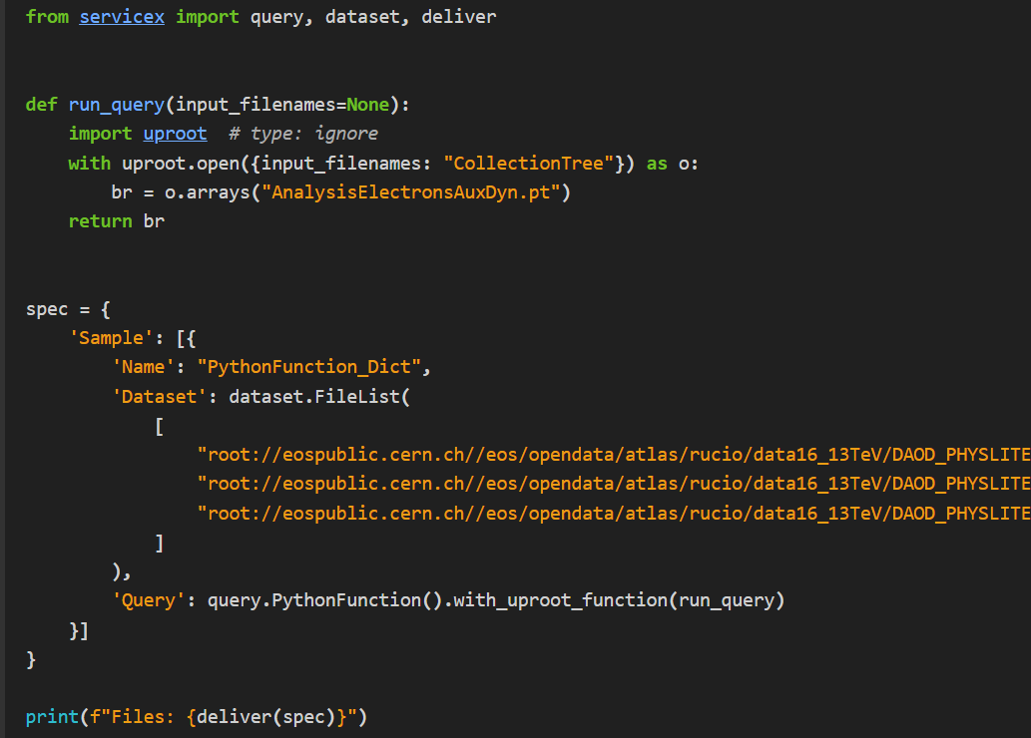
Full Python Function Transformer!!
Python Function
This allows one to extract non-ntuple-like objects from the file (e.g. cutflow, etc.)
ServiceX Spec and Delivery

