Slide 1
Dark Matter: Overview of Educational Resources
Julia Woithe | julia.woithe@cern.ch
Dark Matter: Online Seminar for Teachers 30 Oct 2024

Slide 2
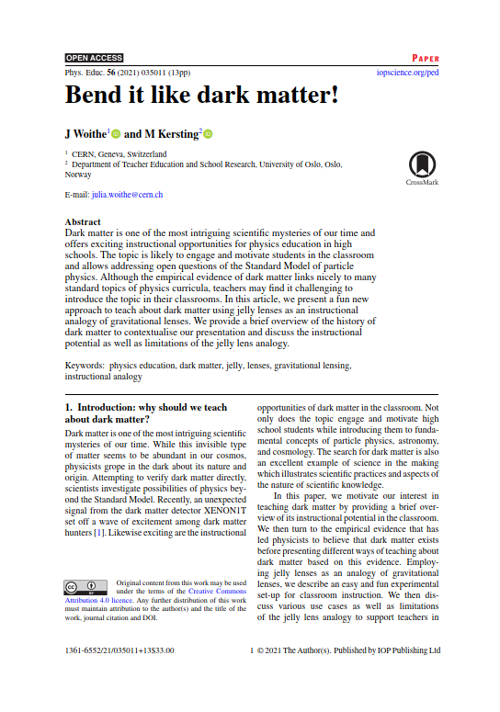
Why teach about dark matter?
One of the most intriguing scientific mysteries of our time
Excellent example of science in the making which illustrates scientific practices and aspects of the nature of scientific knowledge
Can link to standard physics curricula such as gravity, circular and orbital motion, and optics in addition to astronomy, particle physics and general relativity (Woithe & Kersting 2021)
High potential to promote students’ interest and curiosity irrespective of age, gender or nationality (Sjøberg & Schreiner 2010)

Slide 3
Overview of hands-on activities

Slide 4
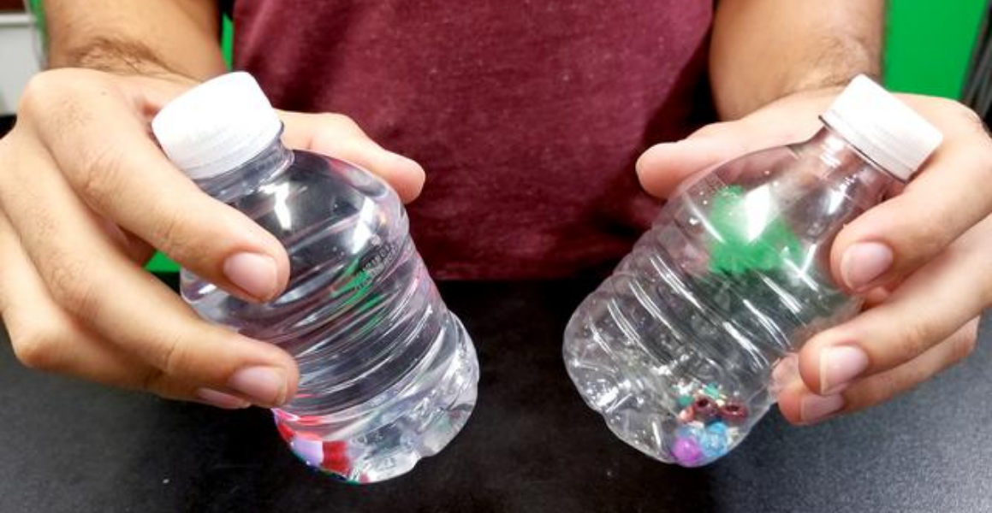
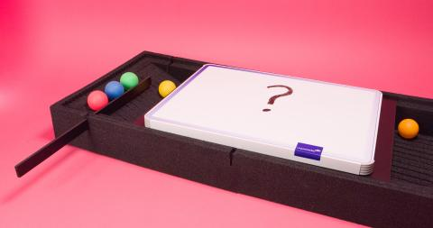
Something is missing & how to study the invisible
NASA JPL activity
Students make observations of two plastic bottles filled with small objects. One bottle is also filled with water. Although the water is invisible, students can observe the different masses of the two bottles.
CERN Science Gateway activity
Scattering boxes allow students to explore how balls interact with a hidden structure and develop a scientific model of an invisible obstacle.

Slide 5
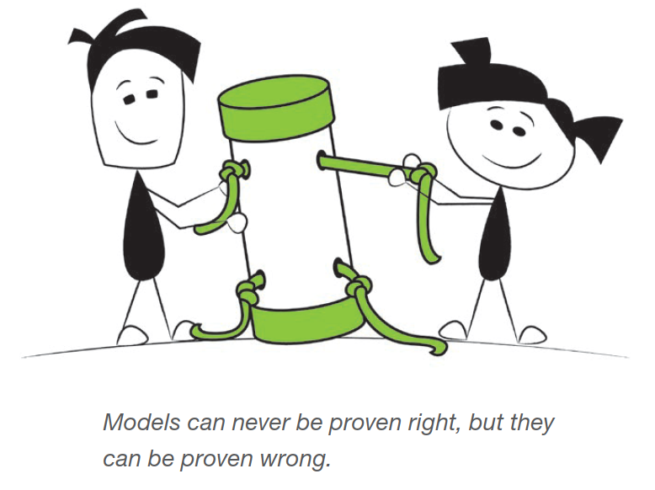
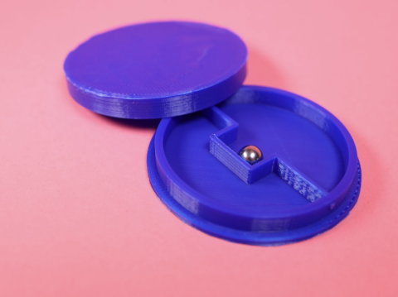
How to study the invisible: mystery tubes & boxes
Perimeter Institute extensive lesson plan: the process of science
Activities to practise being scientists and help students develop their curiosity, creativity, and communication and collaboration skills across many age levels and in any science class.
CERN education activity: mystery boxes
Experiment with mystery boxes with hidden internal structures to learn about different aspects of nature of science and scientific models. This activity can be linked to the discovery of the Higgs boson (Woithe et al. 2022)

Slide 6
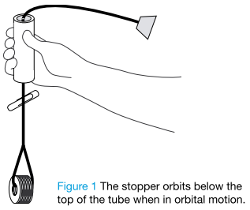
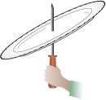
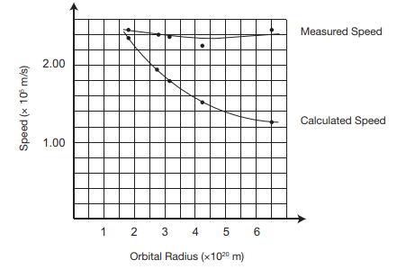

Something rotates weirdly
Perimeter Institute extensive lesson plan: the mystery of dark matter
DIY rotation apparatus to demonstrate that the rotational speed depends on the mass of the object that causes the centripetal acceleration, video with quiz, plot real astronomical data from a galaxy, calculate mass and compare with luminosity of stars, demo of grav. lensing.
Sanford Underground Research Facility lesson plan: dark matter
Build and study a weirdly spinning paper plate. Students infer the existence of extra hidden mass in the form of washers by observing the rotation behaviour.

Slide 7
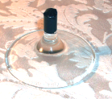
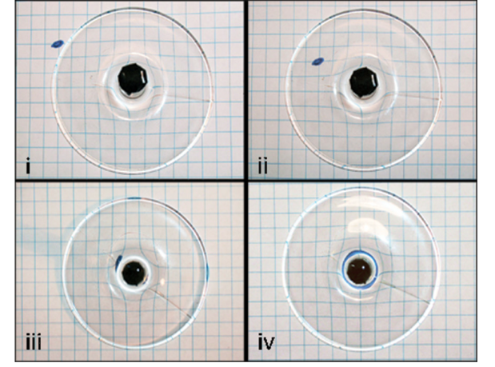
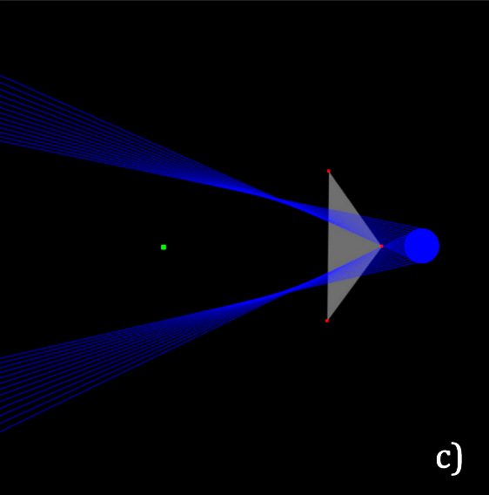
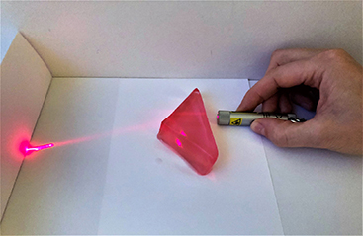
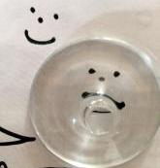
Gravitational lensing
Wine glass analogy
(e.g. Ros 2008, Huwe & Field 2015)
Use base of a wine glass to distort an image.
Jelly lenses (Woithe & Kersting 2021)
Gravitational lenses in 2 dimensions with home-made jelly lenses (simpler than wine glass), use simulations such as Ray Optics Simulation to compare observations with predictions.

Slide 8
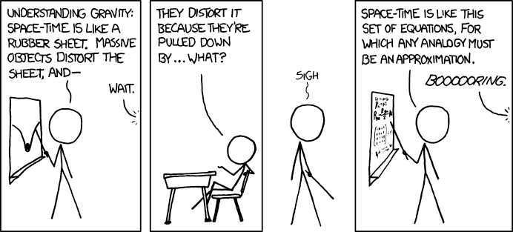
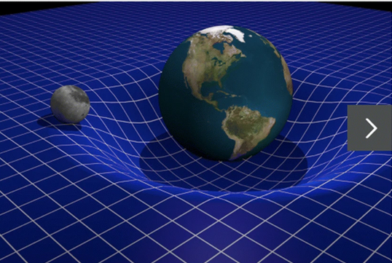
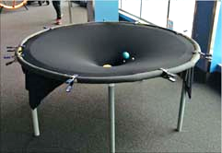
Curved spacetime
Rubber sheet analogy
To explain gravitational lensing, we need to introduce students to spacetime curvature. A popular analogy compares the distortion of spacetime to the distortion of a two-dimensional rubber sheet by massive objects (e.g. Kersting & Steier 2018, Ford et al. 2015)

Slide 9
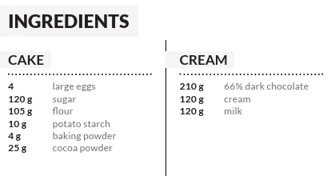
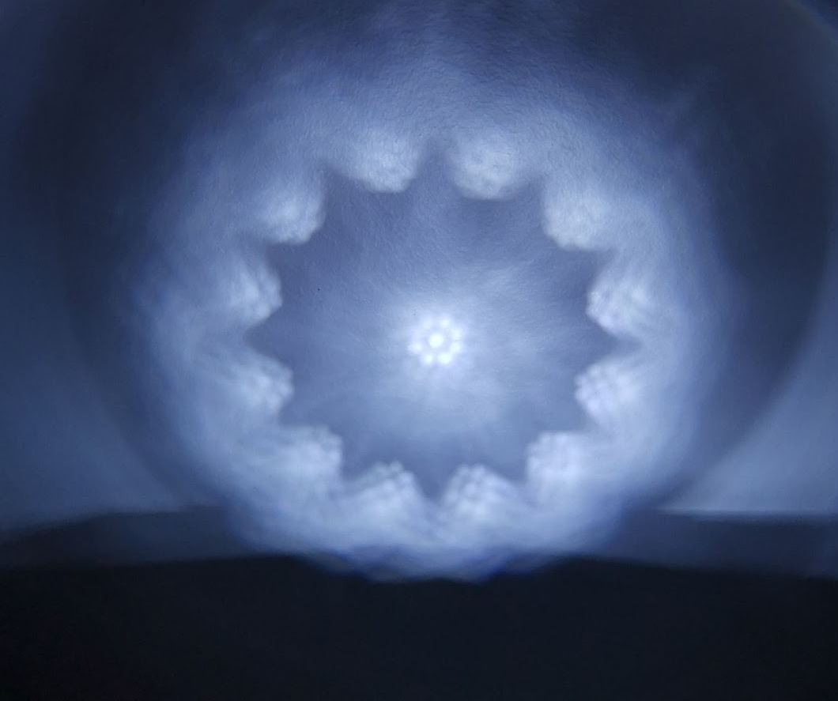
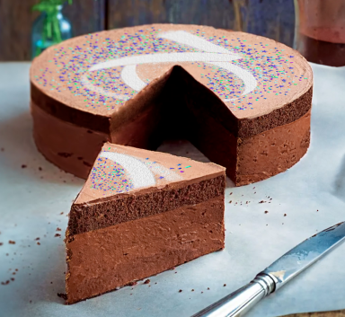
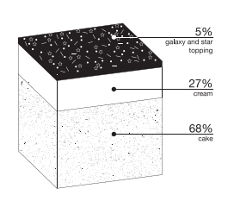
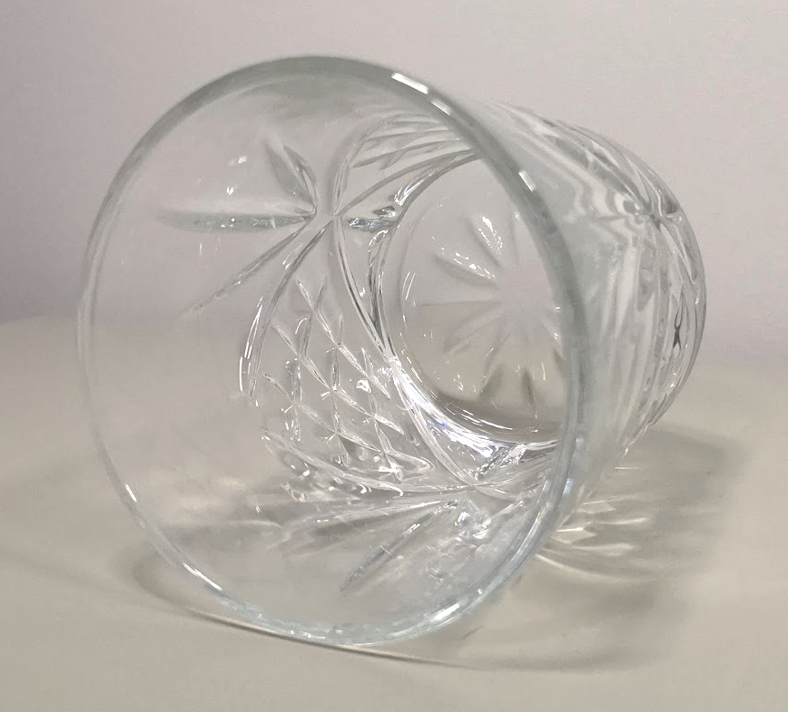
Science-art and bake activities
ARC Centre Activity: images of light
This science-art activity makes use of the refractive and reflective properties of materials to create unique and interesting photographs of light.
CERN Universe chocolate cake

Slide 10
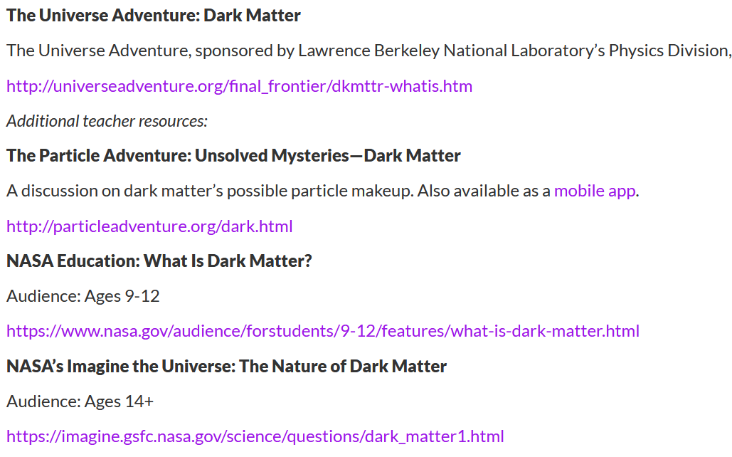
More resources including reading material & videos
https://www.interactions.org/dark-matter-day/educational-resources
(attention: no longer maintained)

Slide 11
Thanks a lot for your attention!
Let‘s discuss ☺

Slide 12
References
Sjøberg, S., & Schreiner, C. (2010). The ROSE project—overview and key findings
Woithe, J., & Kersting, M. (2021). Bend it like dark matter!. Physics Education, 56(3), 035011.
NASA Jet Propulsion Laboratory Educator Guide: How Do We See Dark Matter? | NASA/JPL Edu Website
CERN education activity: scattering boxes - seeing the invisible
Woithe, J., Boselli, M., Chatzidaki, P., Dahlkemper, M. N., Duggan, R., Durey, G., Herff, N., Kranjc Horvat, A., Molaro, D., Scheerer, G. W., Schmeling, S., Thill, P. T., Wiener, J. & Zoechling, S. (2022). Higgs in a box: investigating the nature of a scientific discovery. The Physics Educator, 4(4), 1-15
Sanford Underground Research Facility lesson plan
Perimeter Institute Perimeter Institute Website Dark Matter and Universal Gravitation
Ros R M 2008 Gravitational lenses in the classroom Phys. Educ. 43 506–14
Huwe P and Field S 2015 Modern gravitational lens cosmology for introductory physics and astronomy students Phys. Teach. 53 266–70
Rick Tu, Johnson Ray Optics Simulation Copyright 2018 Rick Tu, Johnson, licensed under the Apache License, Version 2.0
Kersting M and Steier R 2018 Understanding curved spacetime—the role of the rubber sheet analogy in learning general relativity Sci. Educ. 27 593–623
Ford J, Stang J and Anderson C 2015 Simulating gravity: dark matter and gravitational lensing in the classroom Phys. Teach. 53 557–60
ARC Centre Activity: Images of Light Science-Art activity
CERN Universe chocolate cake

