Slide 1
Initial Evaluations of Demonstrator Geometry,
2024
S. Fabbri, G. Scarantino, M. Statera, L. Bottura

Slide 2
Analysis of Desired Configuration (June 2024)
Notes:
A brief statement about the muon collider and the International Muon Collider Collaboration IMCC
at energies above ~ 1 TeV is potentially the most compact and power efficient lepton collider, and in the 10+ TeV energy range, the most promising facility overall with among other factors, the lowest cost range (Snowmass 2021 Report).
A 14 TeV MuC has similar discovery potential of a 100 TeV proton collider, such as the proposed FCC-hh
Muons are very attractive – not limited by synchrotron radiation like electrons! They are 200 times heavier, and 9 times less heavy than proton. Elementary particles! Clean physics!

Slide 3
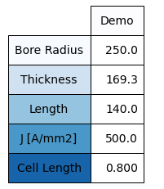
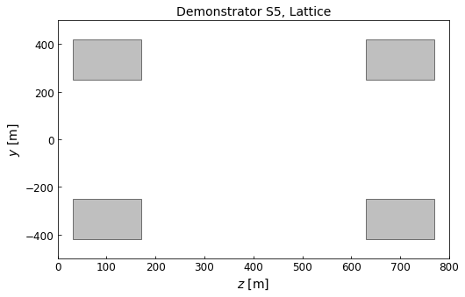
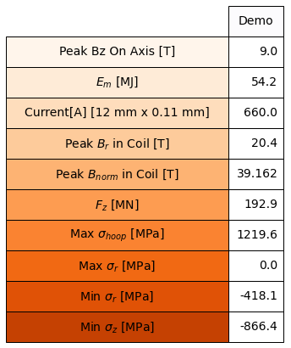
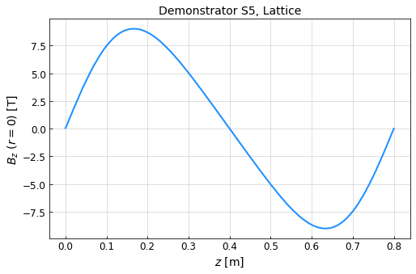
Demonstrator – Details and Results from COMSOL
Details
COMSOL Results (Lattice)
598.6 mm
B1 = 8.752
B2 = 1.2
B3 = 0.007
Values in PDF
B1 = 8.75
B2 = 1.25
B3 = 0.00
Notes:
A brief statement about the muon collider and the International Muon Collider Collaboration IMCC
at energies above ~ 1 TeV is potentially the most compact and power efficient lepton collider, and in the 10+ TeV energy range, the most promising facility overall with among other factors, the lowest cost range (Snowmass 2021 Report).
A 14 TeV MuC has similar discovery potential of a 100 TeV proton collider, such as the proposed FCC-hh
Muons are very attractive – not limited by synchrotron radiation like electrons! They are 200 times heavier, and 9 times less heavy than proton. Elementary particles! Clean physics!

Slide 4
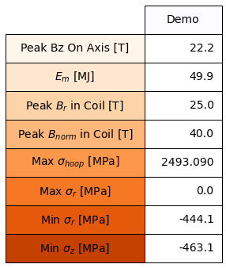
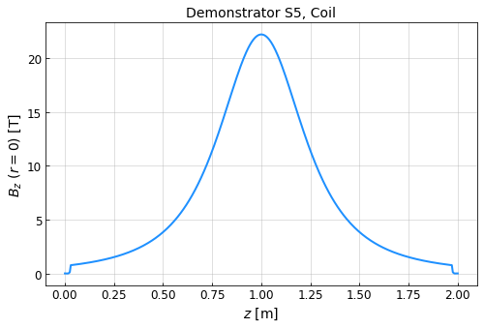
Demonstrator – Details and Results from COMSOL
Details
COMSOL Results (Single Coil)
598.6 mm
Notes:
A brief statement about the muon collider and the International Muon Collider Collaboration IMCC
at energies above ~ 1 TeV is potentially the most compact and power efficient lepton collider, and in the 10+ TeV energy range, the most promising facility overall with among other factors, the lowest cost range (Snowmass 2021 Report).
A 14 TeV MuC has similar discovery potential of a 100 TeV proton collider, such as the proposed FCC-hh
Muons are very attractive – not limited by synchrotron radiation like electrons! They are 200 times heavier, and 9 times less heavy than proton. Elementary particles! Clean physics!

Slide 5
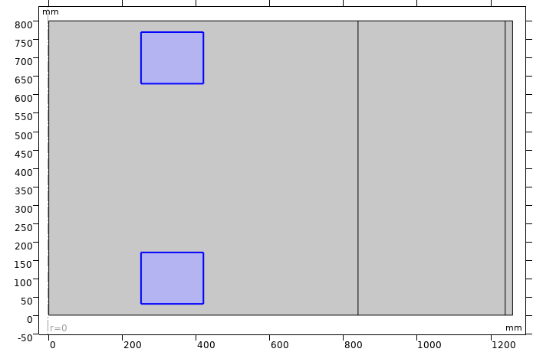
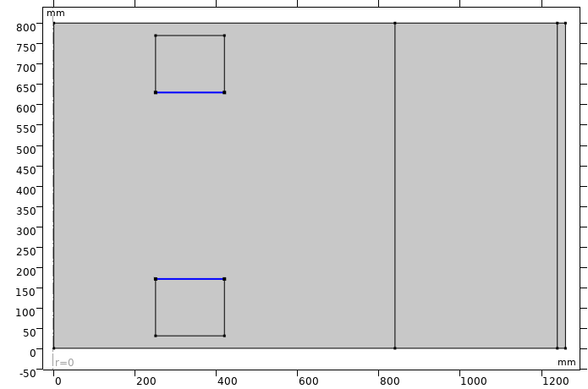
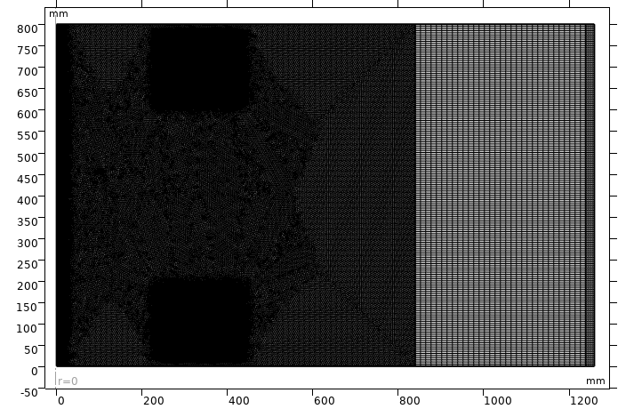
COMSOL Analysis – Reminder of Setup
Material: Copper
Roller Placement
Mesh
Notes:
A brief statement about the muon collider and the International Muon Collider Collaboration IMCC
at energies above ~ 1 TeV is potentially the most compact and power efficient lepton collider, and in the 10+ TeV energy range, the most promising facility overall with among other factors, the lowest cost range (Snowmass 2021 Report).
A 14 TeV MuC has similar discovery potential of a 100 TeV proton collider, such as the proposed FCC-hh
Muons are very attractive – not limited by synchrotron radiation like electrons! They are 200 times heavier, and 9 times less heavy than proton. Elementary particles! Clean physics!

Slide 6
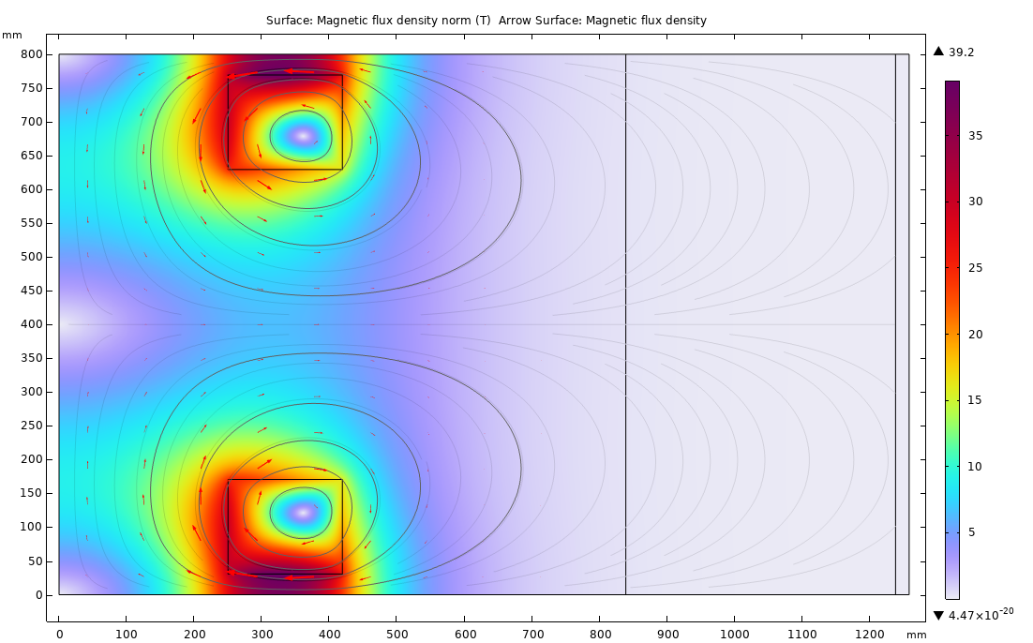
COMSOL Analysis – 2D Field
Notes:
A brief statement about the muon collider and the International Muon Collider Collaboration IMCC
at energies above ~ 1 TeV is potentially the most compact and power efficient lepton collider, and in the 10+ TeV energy range, the most promising facility overall with among other factors, the lowest cost range (Snowmass 2021 Report).
A 14 TeV MuC has similar discovery potential of a 100 TeV proton collider, such as the proposed FCC-hh
Muons are very attractive – not limited by synchrotron radiation like electrons! They are 200 times heavier, and 9 times less heavy than proton. Elementary particles! Clean physics!

Slide 7
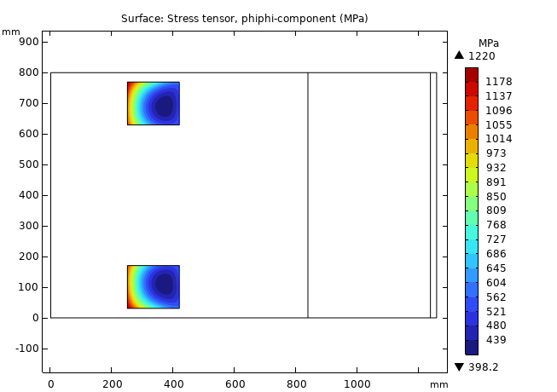
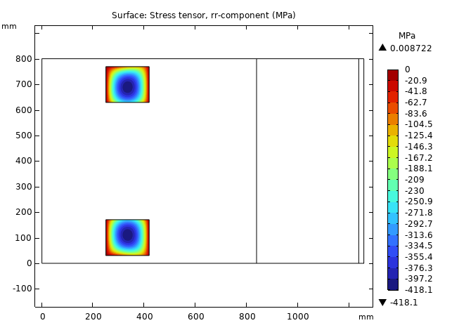
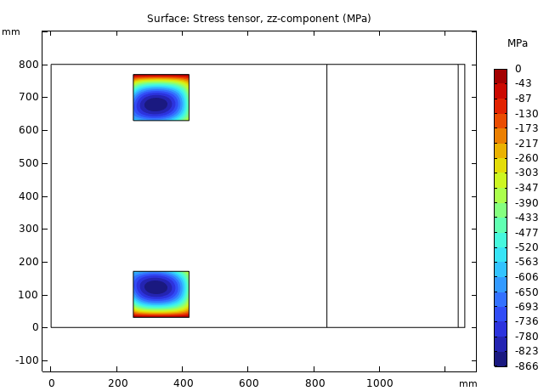
COMSOL Analysis – Mechanics
Hoop Stress
398 to 1220 Mpa
Radial Stress
0 to -418 MPa
Longitudinal Stress
0 to -866 MPa
Notes:
A brief statement about the muon collider and the International Muon Collider Collaboration IMCC
at energies above ~ 1 TeV is potentially the most compact and power efficient lepton collider, and in the 10+ TeV energy range, the most promising facility overall with among other factors, the lowest cost range (Snowmass 2021 Report).
A 14 TeV MuC has similar discovery potential of a 100 TeV proton collider, such as the proposed FCC-hh
Muons are very attractive – not limited by synchrotron radiation like electrons! They are 200 times heavier, and 9 times less heavy than proton. Elementary particles! Clean physics!

Slide 8
Analysis of Desired Configuration (June 2024)
Notes:
A brief statement about the muon collider and the International Muon Collider Collaboration IMCC
at energies above ~ 1 TeV is potentially the most compact and power efficient lepton collider, and in the 10+ TeV energy range, the most promising facility overall with among other factors, the lowest cost range (Snowmass 2021 Report).
A 14 TeV MuC has similar discovery potential of a 100 TeV proton collider, such as the proposed FCC-hh
Muons are very attractive – not limited by synchrotron radiation like electrons! They are 200 times heavier, and 9 times less heavy than proton. Elementary particles! Clean physics!

Slide 9
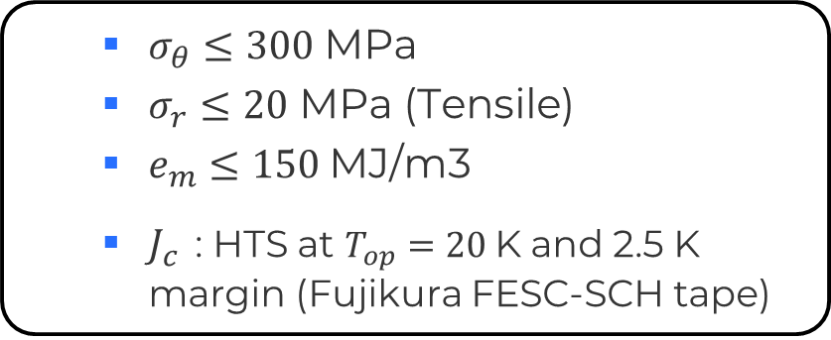
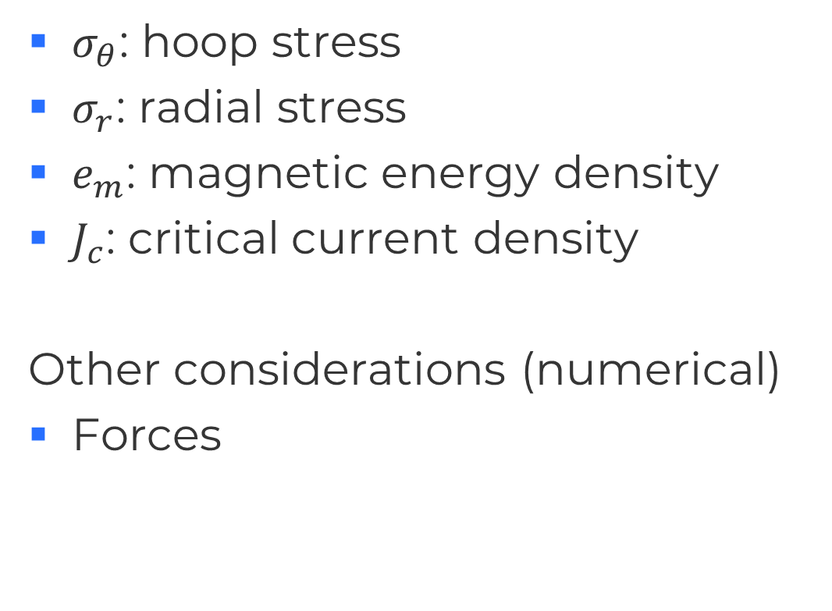
Guiding Design Parameters
Example limits
$σ_{θ}$: hoop stress
$σ_{r}$: radial stress
$e_{m}$: magnetic energy density
$J_{c}$: critical current density
Other considerations (numerical)
Forces
  $σ_{θ}≤300$MPa
  $σ_{r}≤20$ MPa (Tensile)
  $e_{m}$ $≤150$MJ/m3
  $J_{c}$ : HTS at $T_{op}=20$K and 2.5 K margin (Fujikura FESC-SCH tape)

Slide 10
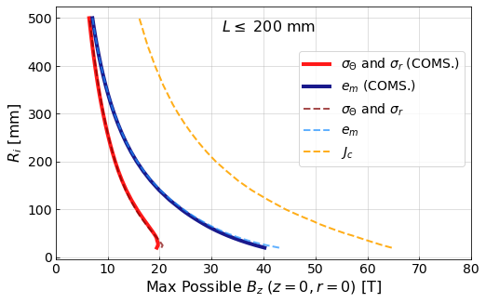
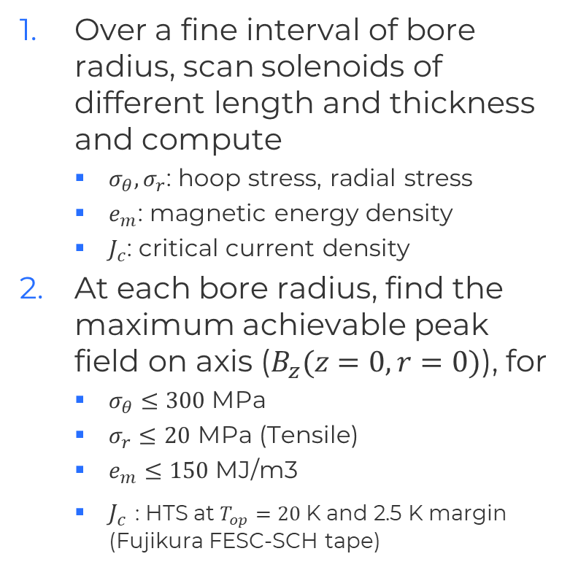

A-B Plot, Single Solenoid
Over a fine interval of bore radius, scan solenoids of different length and thickness and compute
  $σ_{θ}, σ_{r}$: hoop stress, radial stress
  $e_{m}$: magnetic energy density
  $J_{c}$: critical current density
At each bore radius, find the maximum achievable peak field on axis ($B_{z}(z=0,r=0)$), for
  $σ_{θ}≤300$MPa
  $σ_{r}≤20$ MPa (Tensile)
  $e_{m}$ $≤150$MJ/m3
  $J_{c}$ : HTS at $T_{op}=20$K and 2.5 K margin (Fujikura FESC-SCH tape)
$Th≤350$ mm
Given Coil
Solid Curves: COMSOL (COMSOL)
Dashed curves: Semi-analytic

Slide 11
A-B Plot, 2-4 Solenoids in a Lattice
COMING

Slide 12
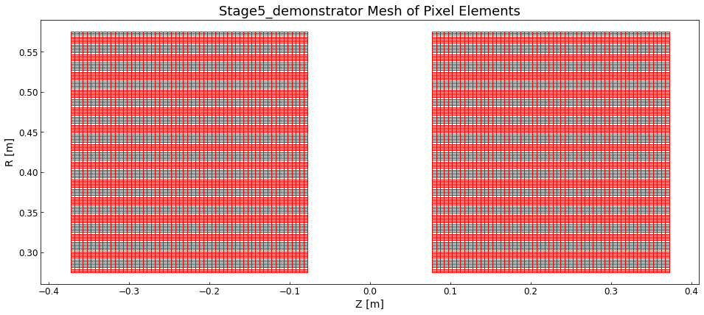
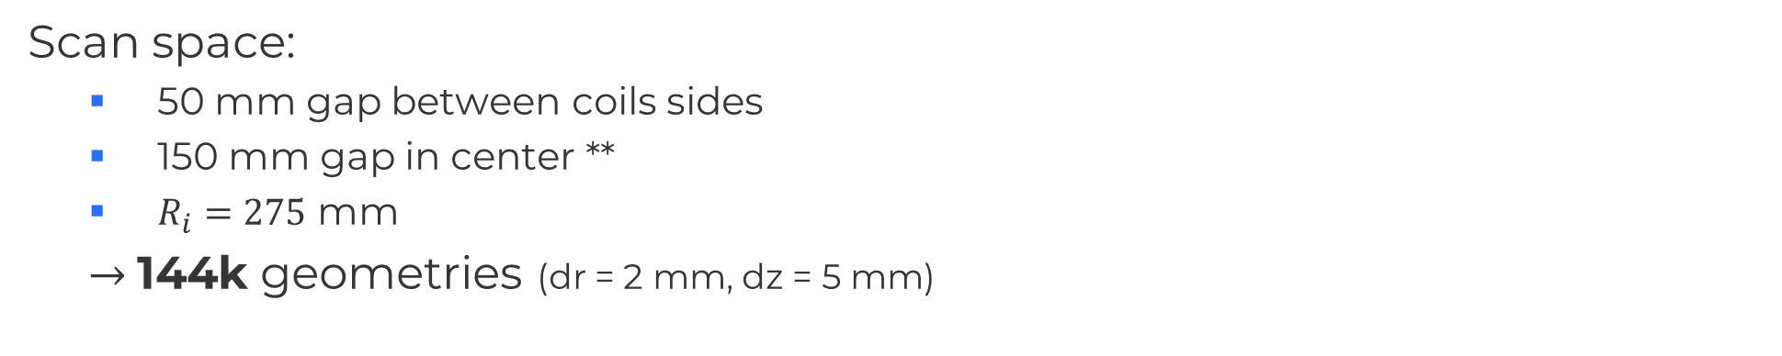

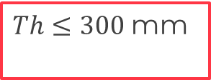


1. For the desired peak field, what harmonics are possible ($R_{i}=275$ mm, $L_{cell}=$0.8 m)
Scan space:
  50 mm gap between coils sides
  150 mm gap in center **
  $R_{i}=275$ mm
  $→$144k geometries (dr = 2 mm, dz = 5 mm)
$Th≤300$mm
L $≤300$mm
150 mm
25 mm
$R_{i}=275$mm

Slide 13
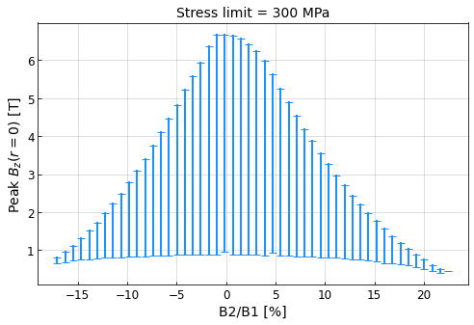
Numerical Scan of 2 Coils

Slide 14
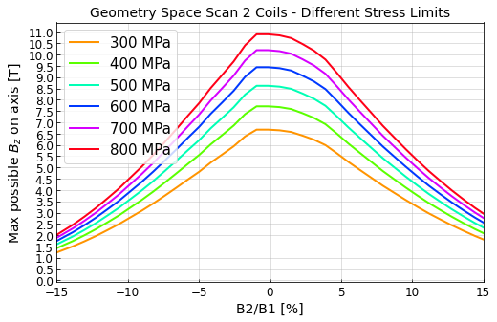
Numerical Scan of 2 Coils
Target

Slide 15
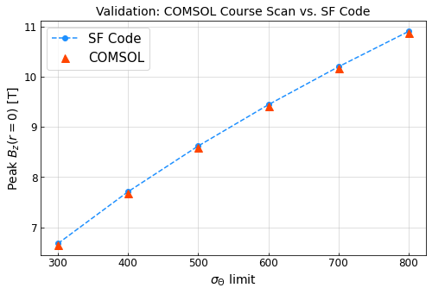
Numerical Scan of 2 Coils (peak possible field)
Target
[MPa]

Slide 16
Analysis – 4 Coils
Notes:
A brief statement about the muon collider and the International Muon Collider Collaboration IMCC
at energies above ~ 1 TeV is potentially the most compact and power efficient lepton collider, and in the 10+ TeV energy range, the most promising facility overall with among other factors, the lowest cost range (Snowmass 2021 Report).
A 14 TeV MuC has similar discovery potential of a 100 TeV proton collider, such as the proposed FCC-hh
Muons are very attractive – not limited by synchrotron radiation like electrons! They are 200 times heavier, and 9 times less heavy than proton. Elementary particles! Clean physics!

Slide 17
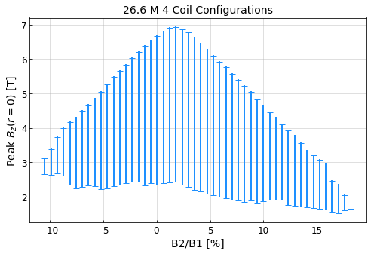
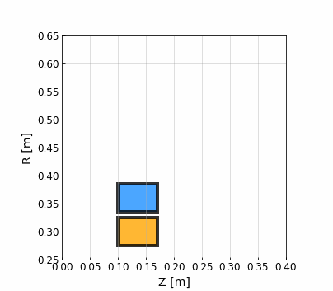
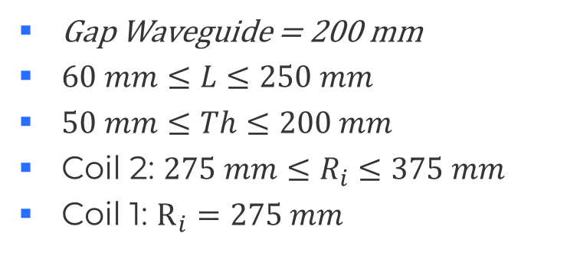
4 Coil Scan (gap between is 200 mm)
Gap Waveguide = 200 mm
$60 mm≤L≤250 mm$
$50 mm≤Th≤200 mm$
Coil 2: $275 mm≤R_{i}≤375 mm$
Coil 1: $R_{i}=275 mm$

Slide 18
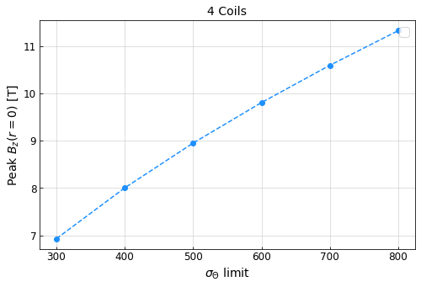
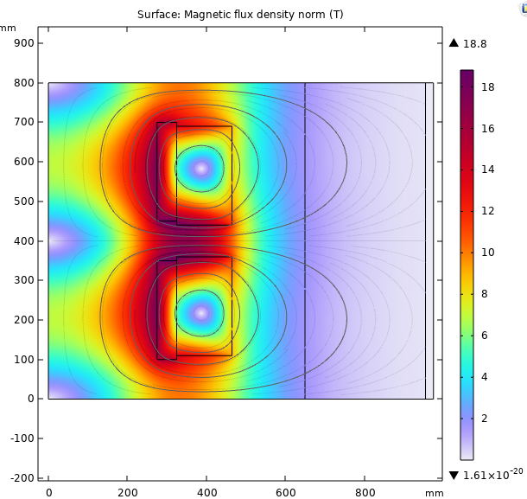

4 Coil Scan Conclusions (geometry creating highest field on axis)
$σ_{θ}=300$MPa in each coil
Target
z
r

Slide 19

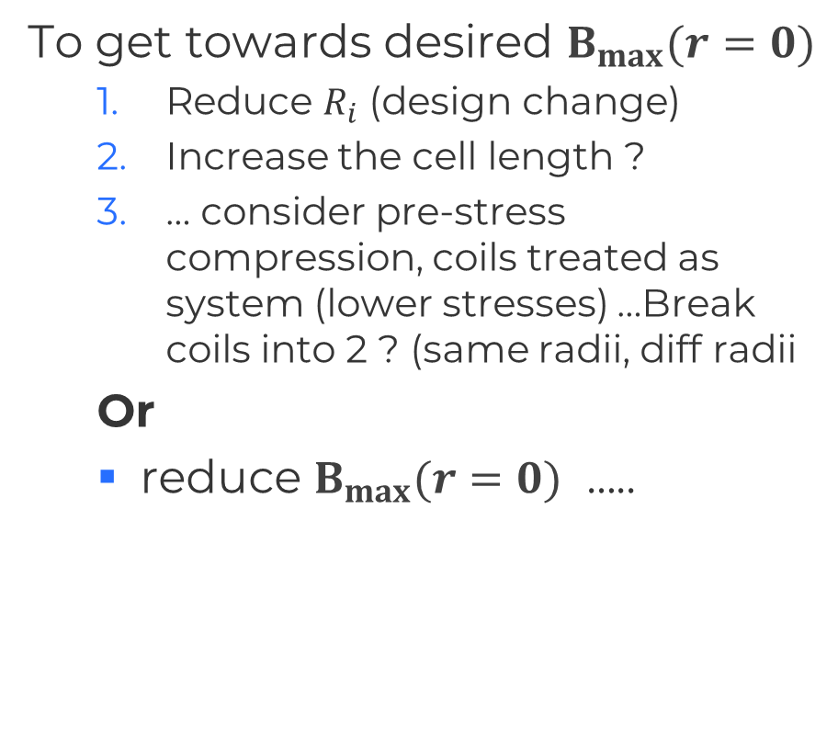


Next Steps
To get towards desired $B_{max}{(r=0)}$
  Reduce $R_{i}$ (design change)
  Increase the cell length ?
  … consider pre-stress compression, coils treated as system (lower stresses) …Break coils into 2 ? (same radii, diff radii
  Or
  reduce $B_{max}{(r=0)}$ …..
$$B_{max}{(r=0)}$$
$$R_{i}$$
$$L_{cell}$$

Slide 20
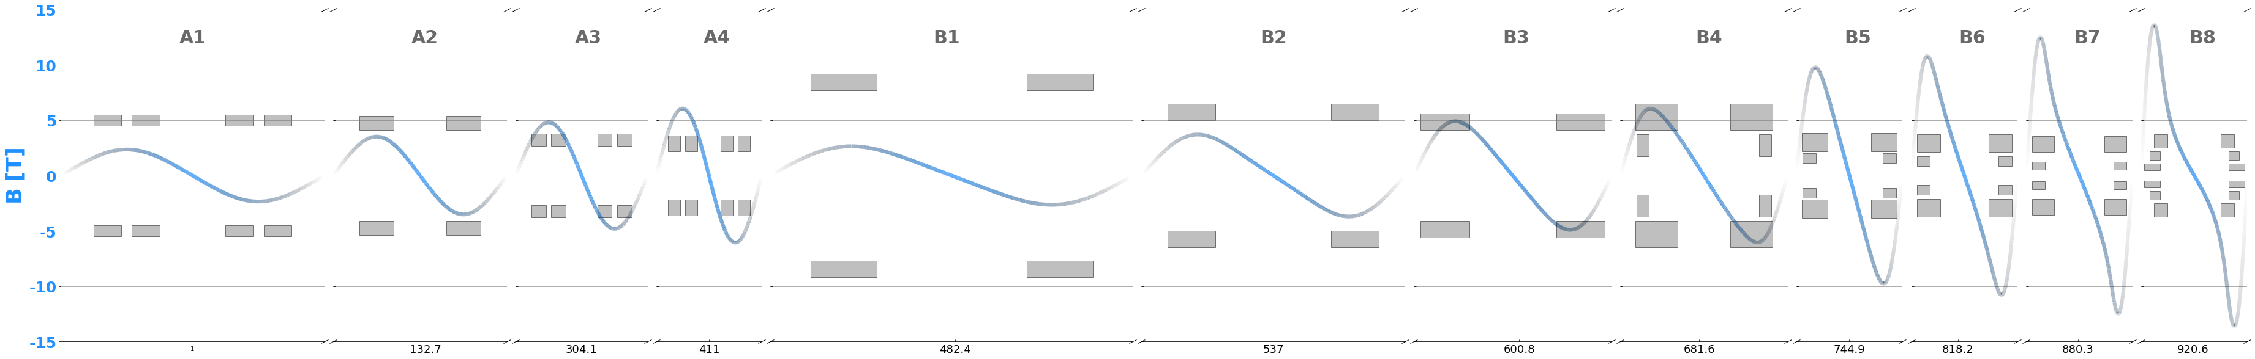
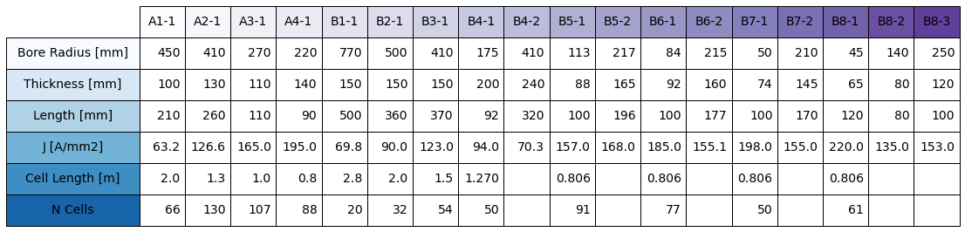
US-MAP Optics
Notes:
Power consumption of roughly 1 MW
Radiation heat load on coils ~4 kW
Local radiation dose of ~80 MGy (milligray)
A yearly peak DPA in the range of $10^{-3}$
Comparing the proposed HTS magnet design to the US MAP hybrid SC+NC design, the system's stored energy is reduced from approximately 3\,GJ to $\sim$1\,GJ, coil mass from about 200\,tons to around 100 tons, and wall-plug power consumption from around 12\,MW (dominated by the resistive insert), to approximately 1\,MW

Slide 21
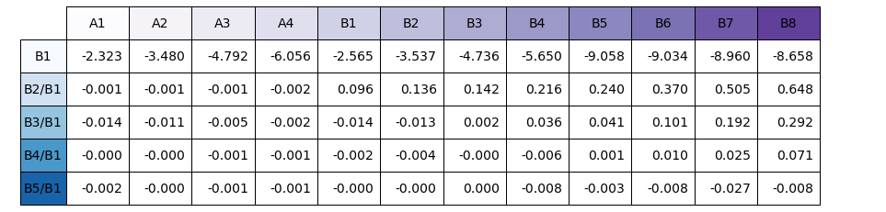
US MAP parameters

Slide 22
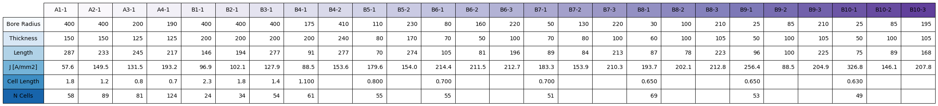
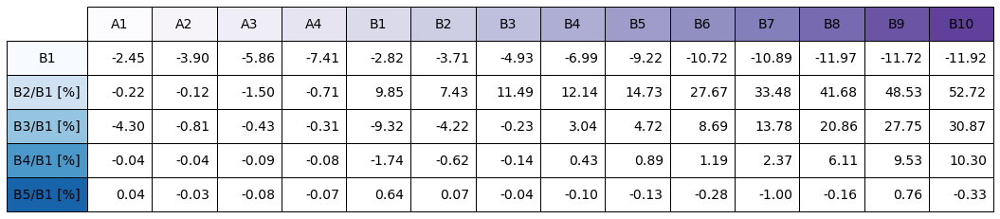
IMCC New Optics Version 2.0 June 2024
Total Number of Solenoids in 1 chain: 3054 | Total Length: 850.3 m
On axis field from 2.6 T to 17.9 T (in Lattice)
Notes:
Power consumption of roughly 1 MW
Radiation heat load on coils ~4 kW
Local radiation dose of ~80 MGy (milligray)
A yearly peak DPA in the range of $10^{-3}$
Comparing the proposed HTS magnet design to the US MAP hybrid SC+NC design, the system's stored energy is reduced from approximately 3\,GJ to $\sim$1\,GJ, coil mass from about 200\,tons to around 100 tons, and wall-plug power consumption from around 12\,MW (dominated by the resistive insert), to approximately 1\,MW

Slide 23
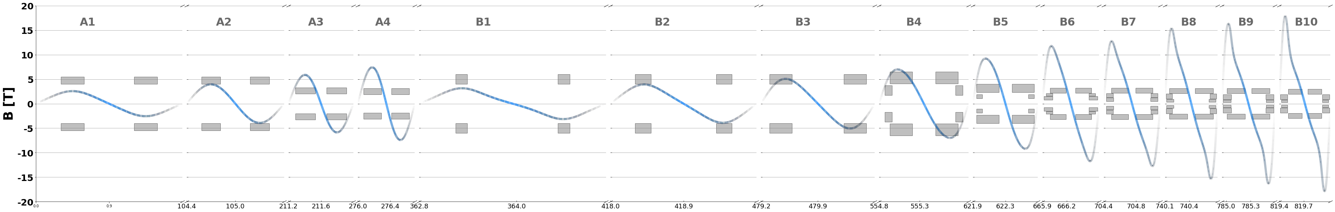
IMCC New Optics Version 2.0 June 2024
Total Number of Solenoids in 1 chain: 3054 | Total Length: 850.3 m
On axis field from 2.6 T to 17.9 T (in Lattice)
Notes:
Power consumption of roughly 1 MW
Radiation heat load on coils ~4 kW
Local radiation dose of ~80 MGy (milligray)
A yearly peak DPA in the range of $10^{-3}$
Comparing the proposed HTS magnet design to the US MAP hybrid SC+NC design, the system's stored energy is reduced from approximately 3\,GJ to $\sim$1\,GJ, coil mass from about 200\,tons to around 100 tons, and wall-plug power consumption from around 12\,MW (dominated by the resistive insert), to approximately 1\,MW

Slide 24
Progress in the Design of Magnets for a Muon Colliders, IPAC 2024 / S. Fabbri/ CERN

Slide 25
