Slide 1
Review and Update on RF cavity Design
Dario Giove
INFN-LASA –Milano
Thanks to Luigi Celona, Gino Sorbello, Davide Guarneri, Giorgio Mauro, Maria Rosaria Masullo, Guido Gentili (INFN- LNS, INFN-Na, Politecnico of Milan)

Slide 2
Ionization Channel Parameters
Within the two main sections, 6D rectilinear cooling and final cooling there are about 20 different types of cells with various geometry, length, gradients, magnetic field strength and frequency. In order to decide which one is the more interesting to be designed in details, one has to look not only at scientific considerations, but also to practical aspects that would ensure the maximum result for the investment to be done.
(25.4.2024 by Ruiu Zhu)

Slide 3
Terminology
Before to discuss the panorama of the open points related to RF and the activities carried out in the last year, a definition of the terminology that we will use in the discussions has been defined.
Cooling Cell
Cooling Module
Cooling Section
Absorber
RF Cell/Cavity
RF structure
Solenoid

Slide 4
RF Cavity and RF Structure Design
A decision on the type of RF structure that will have to integrated in the cell requires taking into
account a number of parameters that may be summarized as in the following:
the RF frequency
the required real estate gradient of the electric field in a cell vs. the peak gradient achievable in the RF structure
expected breakdown rate and eventual mitigation strategy, especially in the high magnetic field and high magnetic gradient they experience
specific materials and surface treatments for the cavity bodies.
the type of RF coupling from cell to cell in a RF structure
the space available to fit ancillaries (e.g. tuners, power couplers, cooling pipes etc…), considering the tight interference with the cryomagnetic system
the available or realistically feasible power sources
Most of the parameters being used for simulations of the entire cooling section are at the edge or beyond the present state-of-the-art, therefore require careful evaluation of the feasibility of the corresponding technological solution.

Slide 5
RF Frequency Range of Interest
The RF frequencies analyzed so far are the following:
704 MHz (the today reference MC frequency in the design)
1 GHz (power Klystron available from CLIC drive beam researches ideal for RF demonstrator structures test facility)
The interest for the 704 MHz frequency is due to the iris radius specification from BD and the availability of suitable power sources for RF cell tests.

Slide 6
Expected RF Breakdown Rate and Mitigation
Strategy in High Magnetic Fields
High voltage breakdown in both vacuum and gas has been studied extensively. The presence of a multi-tesla external magnetic field provided a new variable, however. As ionization cooling depends on RF cavities operating in such an environment, the performance of said cavities must be understood and characterized.
Early experiments focused on 805 MHz vacuum RF cavities.

Slide 7
RF E-field in High Magnetic Gradients Studies
A couple of interesting events (a special meeting and a workshop) took place in the past months

Slide 8
RF E-field in High Magnetic Gradients Studies

Slide 9
E-field in High Magnetic Gradients
Why we are proposing to carry out tests in a DC based environment ?
Simple setup with respect to a RF based one
Tests faster and more flexible
Study on materials and surface treatments
Additional input for further RF based experimental campaigns
Field levels of the order of 100 MV/m (over max. 0.1 mm gp)
Energy similar to the one involved in RF
UHV conditions
BD initial phenomena very similar
We already have a possible setup (magnet @ 1 T with a 120 mm bore and HV power supplies, radiation detectors, experience on data and image acquisition and competence in material treatments )
study of innovative materials to create electrodes to be tested with a high DC static field in the presence of a magnetic field of at least 1 T or higher
study of surface finishing, coating and cleaning techniques for the above materials
DC high static field test in the presence of a magnetic field of at least 1 T or higher

Slide 10
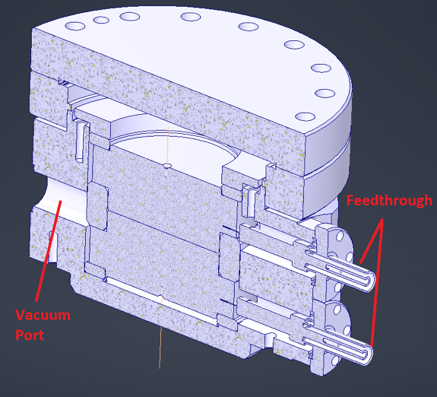
E-field in High Magnetic Gradients
The PVX-4110 pulse generator is a direct coupled, air cooled, solid state half-bridge (totem pole) design, offering equally fast pulse rise and fall times, low power dissipation, and virtually no over-shoot, undershoot or ringing. It has overcurrent detection and shutdown circuitry to protect the pulse generator from potential damage due to arcs and shorts in the load or interconnect cable.
Suitable to test different materials, surface finishing and treatments up to 50 MV/m

Slide 11
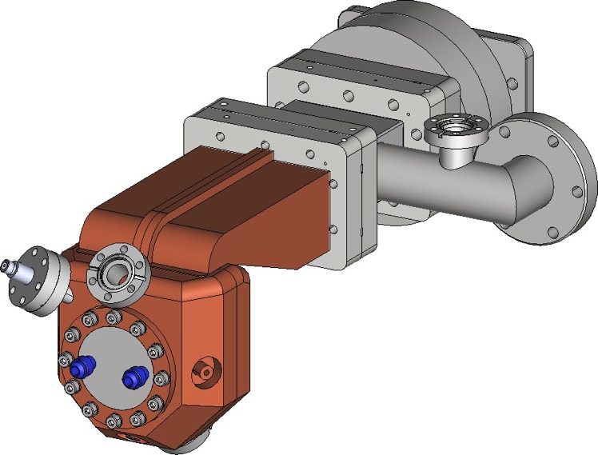
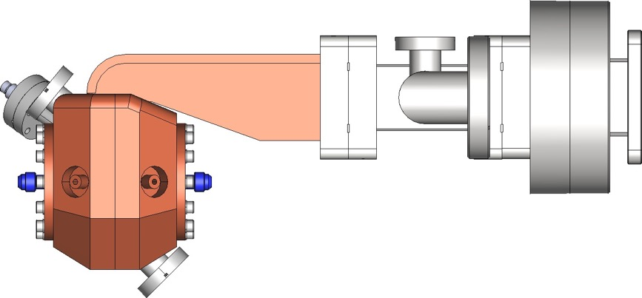
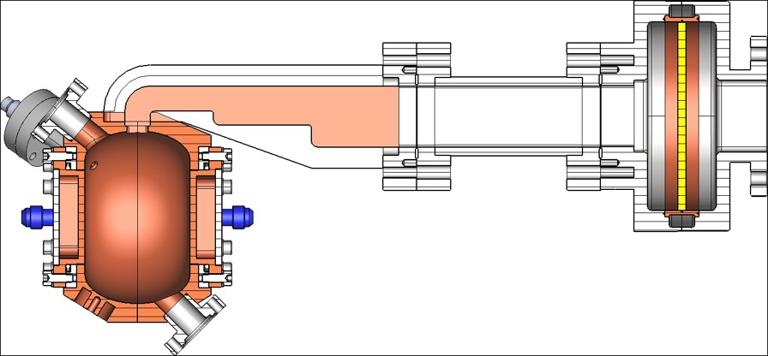
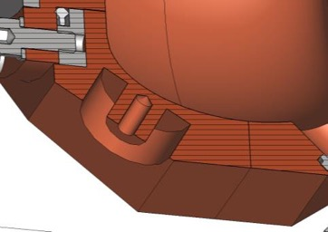
A 3 GHz Proposal for a INFN LASA Test Facility
364 mm
140 mm
170 mm
68 mm

Slide 12
ESPP-INFN New proposal in September 2024
Breakdown rate studies of normal conducting structures operating at electric fields > 30 MV/m up to 100 MV/m embedded in magnetic fields up to 10 T (mostly with E and B fields parallel to each other) represents one of the most exciting and relevant areas in the development of new proposals for accelerating machines.
The lack of experimental data and, as a consequence, the difficulties to develop and verify theoretical models of the involved phenomena must be addressed in a short period and this requires a significant effort involving an approach that will start from material science up to accelerator related advanced technologies.
The present proposal represents a unique opportunity in the area due to the possibility to take advantage in a short period of already existing testing facilities at LNF for RF power studies and the knowledge process under development at LASA related to the design of suitable magnet structures and RF cavities.

Slide 13
ESPP-INFN New proposal in September 2024
The proposal arises from a series of activities already underway for several years both at LNF and at LASA and for which it is necessary to make a qualitative leap in the related studies in order to continue to maintain an adequate level of leadership at a global level.
At LNF the development of RF structures operating in C and X band has achieved impressive results in the maximum electrical field sustained in the past years. The possibility to test in a devoted facility these structures resulted in the acquisition of a leading role in the international panorama.
At LASA the design of normal conducting cavities with frequencies ranging from 650 MHz up to 3 GHz has been carried out for different accelerator projects. The construction of full scale prototypes was carried out with Italian companies allowing the development and maintenance of adequate technologies. The completion of testing facilities underway allows to play a valuable role in projects such as the Muon Collider or ERL related components. The study, construction and technological developments related to high filed SC magnets represent the major activity underway at LASA.

Slide 14
ESPP-INFN New proposal in September 2024
Design, specify and build (internally or commissioning to a company) a SC magnet feeded by a cryocooler and with a useful bore of 120 mm to be used in the LNF TEX facility for testing C and X band structures about the breakdown rate obtainable. The magnet will provide up to 4 T of magnetic field over a length of 200 mm.
Design, specify and build (commissioning to a company) a couple of prototypes of single cells and power couplers running at 704 MHz and 1 GHz and aimed for the Muon Collider (MC) project. These components will be tested at low power in the RF laboratory under development at LASA within the previous ESPP funding.
Design, specify and build (commissioning to a company) a prototype of a full 3 RF cells element running at 704 MHz as the basic building block of the MC demonstrator structure. Carry out low power tests at LASA and high power RF tests in a laboratory to be identified.
Design and build a RF power coupler (up to few MW) for a 704 MHz and 1 GHz 3 RF cells structure.

Slide 15
ESPP-INFN New proposal in September 2024
Design, specify and develop a structure able to integrate a 7 T HTS based SC magnet with a full 3 RF cells elements as a prototype of the first cooling cell of the MC demonstrator structure.
Continue the technological developments underway at LASA and at LNL for the best materials and surface manipulation techniques to increase the breakdown rates and start studies that using the experimental results will allow to develop suitable theoretical studies of these phenomena.

Slide 16
RF cell @704 MHz INFN studies

Slide 17
3 cells RF preliminary structure

Slide 18
3 cells RF preliminary structure

Slide 19
3 cells RF preliminary structure

Slide 20
3 cells RF preliminary mechanical design
Copper weight: 180 kg
8 water channels
Max. external diameter: less than 500 mm

Slide 21
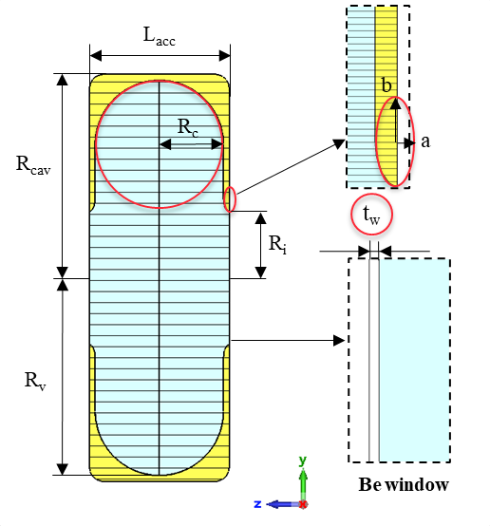
A 1 GHz Design
The availability of a high power Klystron from CLIC drive beam related activities recently suggested to perform a study of 1 GHz cavities powered by such a tube. The power available from this Klystron would be ideal to test a full RF structure.
The picture below shows the results obtained in preliminary computations with related set of parameters.
Size | [mm]
Lacc | 96.92
Rc | 44.94
Rv | 125.65
Ri | 45
a | 3.52
b | 7.74

Slide 22
A 1 GHz Design

Slide 23
Conclusions
RF studies related to the ionizing cooling channel for a MC are an exciting field of research with possible positive effects on other areas
Valuable progresses have been reached in RF cells and structures for the MC
Experimental activities are starting using partially available equipment
Design of more complex test stand for full power experiments at different frequencies and in high peak magnetic fields are in progress

Slide 24
Thanks for your attention !

