Slide 1



S5-like Demo Cell
Update on Solenoid Design
Mattia Castoldi, Lucio Rossi, Giuseppe Scarantino, Marco Statera
11/October/2024
MuCol-WP8 integration meeting

Slide 2
Outline
MuCol Deliverable Report D8.1 solenoid data
Study of the engineering limits of D8.1 configuration
Solenoids design optimization strategy
Minimum focusing strength error configuration analysis
Mechanical analyses: stand-alone and lattice operational modes
Reduced-current configuration analysis

Slide 3
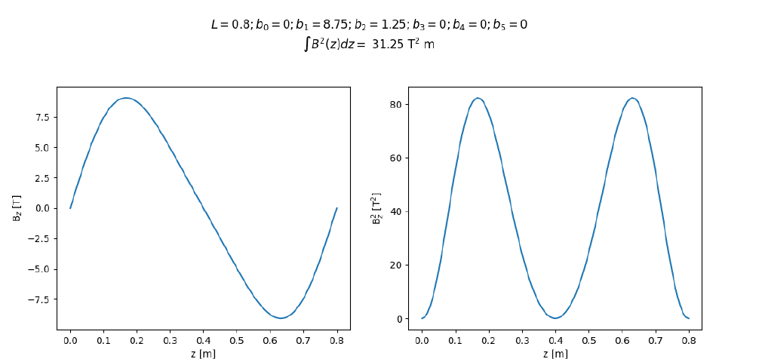


S5 demo cell analysis: MuCol Deliverable Report D8.1
Beam optic studies on S5 cell assumed ideal solenoids and dipoles.
Results presented in the Deliverable Report D8.1.
An engineering design of the stage magnets is needed.
$B_{z}$ field profile on axis
$B_{z}^{2}$profile on axis

Slide 4
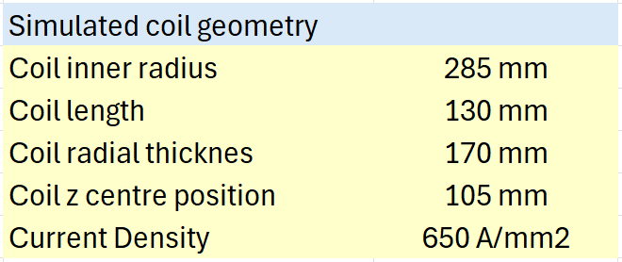
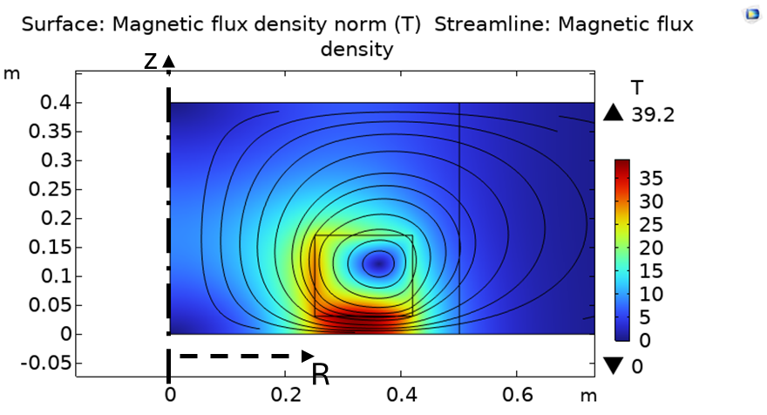
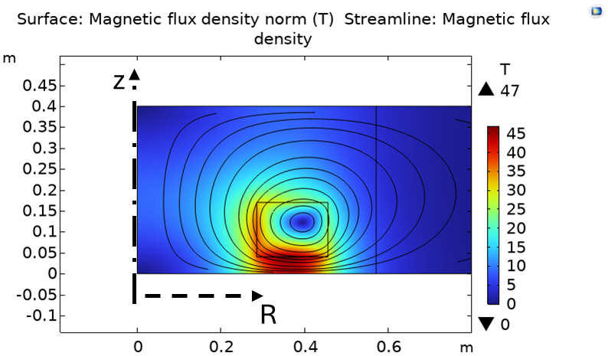
S5 demo cell: magnets design
Design for the target field required by the optics.
Magnets must be optimized starting from the proposed solenoid configuration.
Motivation: excessive peak field values on the coil section.
MuCol deliverable report D8.1 parameters
*Same solenoid shifted to larger radius, increasing current to keep same profile
Geometrical radial constraints not satisfied*.
(RF cavity aperture, cryostat thickness, dipole radial thickness)
Excessive field at the coil section!!

Slide 5
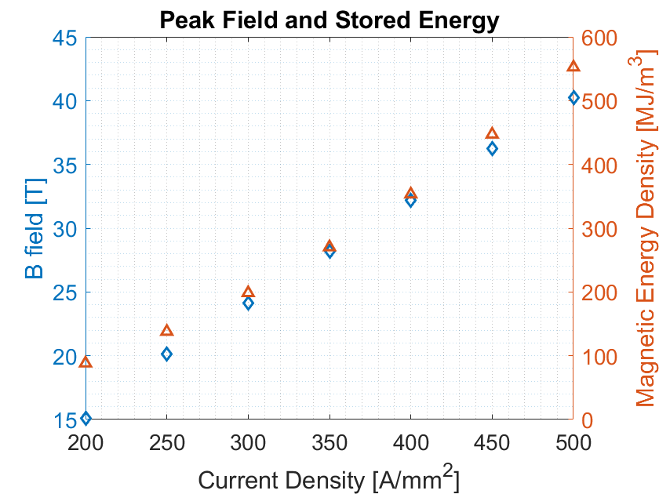
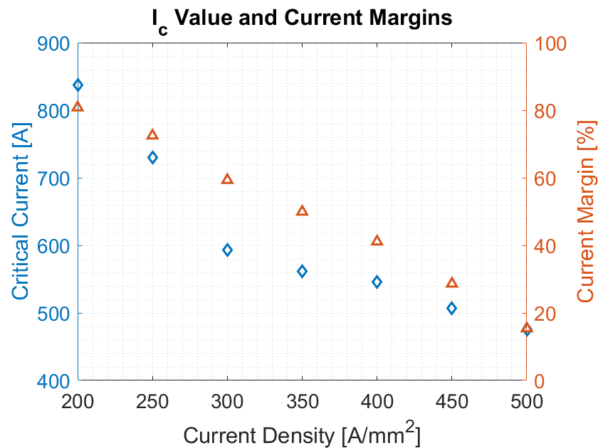
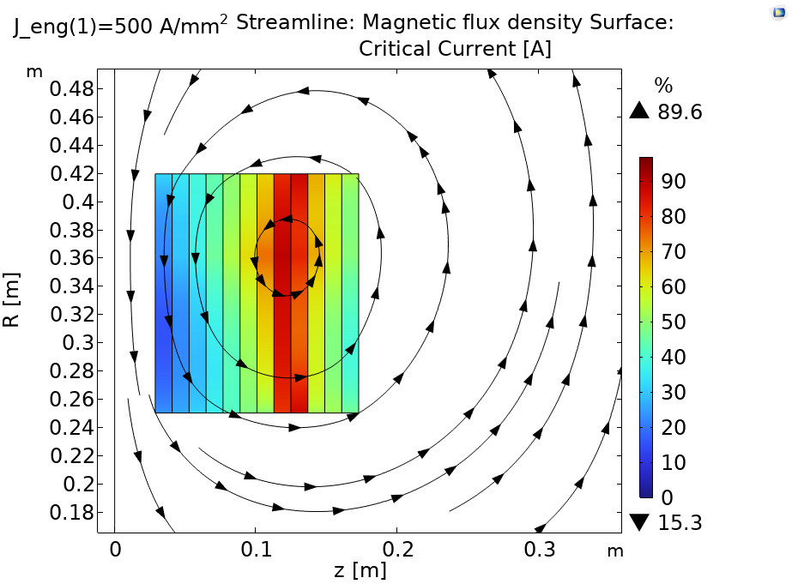
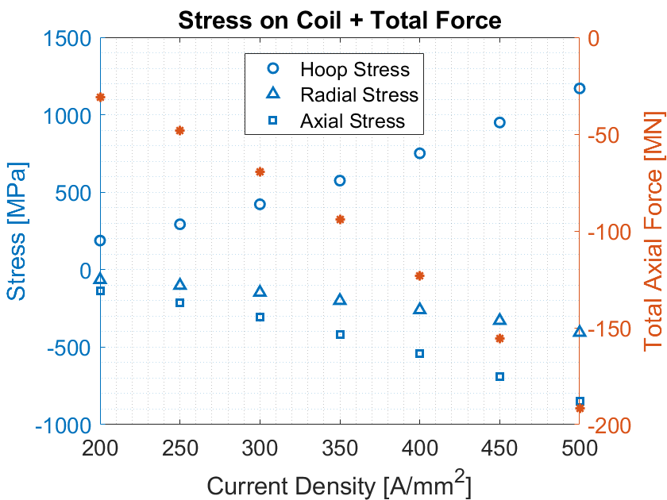
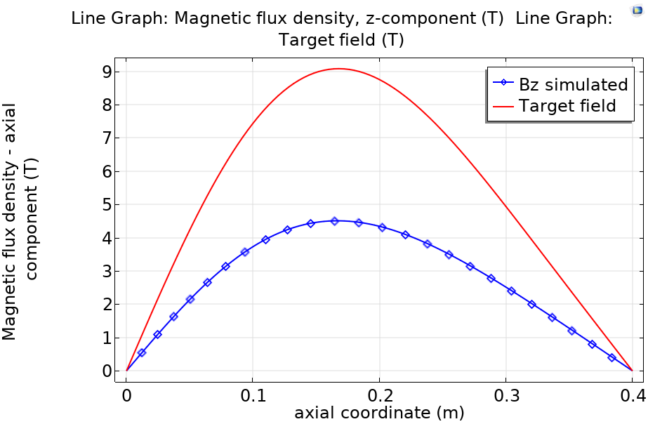
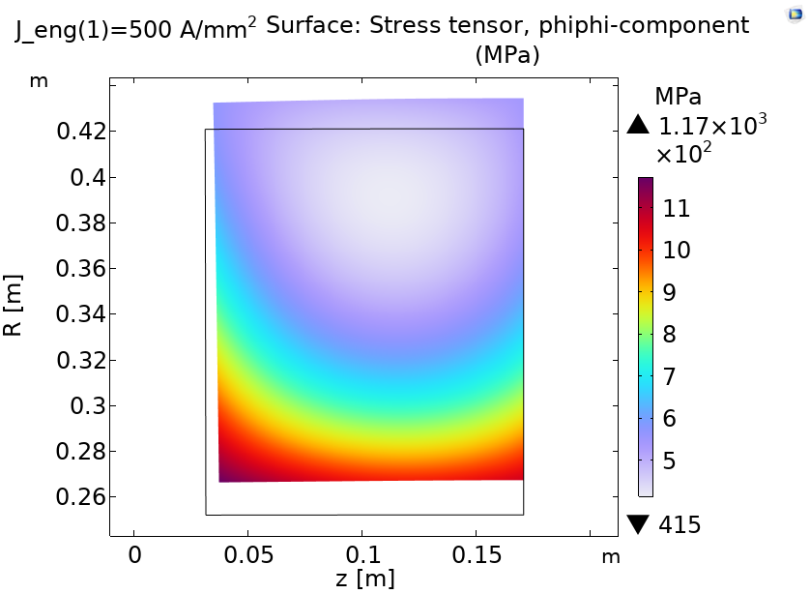
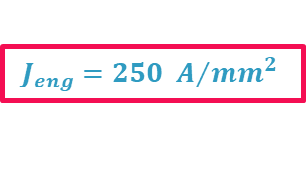
MuCol D8.1 Report configuration: excessive stresses
The engineering limits were investigated on the S5 cell solenoid parameters reported in the MuCol Deliverable Report D8.1.
Limit for a feasible solenoid design:
$$J_{eng}=250 A/{{mm}^{2}}$$
MuCol deliverable report D8.1 parameters
Minimum Current Margin: 15.3%
Max Hoop Stress: 1.2 GPa
Stresses are the limit!

Slide 6
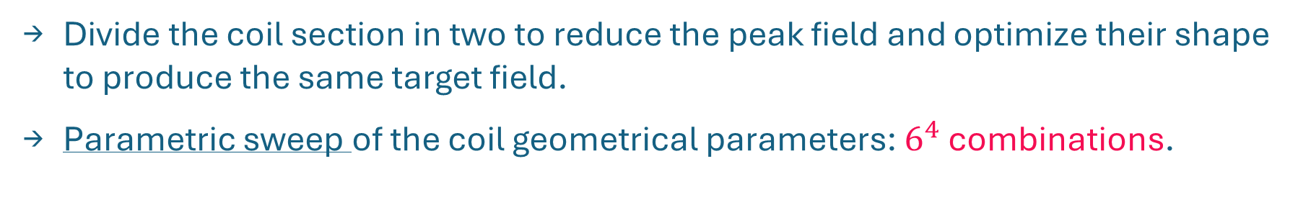
Solenoids optimization strategy: lattice configuration
Divide the coil section in two to reduce the peak field and optimize their shape to produce the same target field.
Parametric sweep of the coil geometrical parameters: $6^{4}$ combinations.
Coil scheme & geom. parameters considered:
2
t2
1
Begin of the cell
λ
t1
Cell mid-plane
w2
w1
Nota Bene:
Periodicity accounted in the stage modelling.
z
z1
Symmetry condition on the cell mid-plane

Slide 7
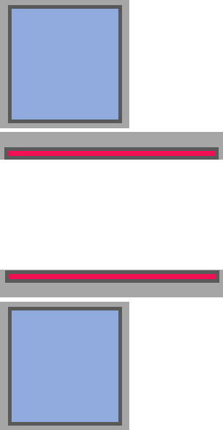
Constraints
Gap for thermal insulation and mechanics (coil-external boundary)
Constraints: ” “
Coil subdivision
Other constraint:
Aspect ratio of the coil section:
1/3 < wx/tx < 3
40 mm
Inner mechanics of the solenoid
Internal (minimum) radius solenoid
Coil
Dipole overall thickness
10 mm
275 mm
Dipole
15 mm
250 mm
220 mm
z
Inner radius of the dipole
Inner radius of the cryostat
(30 + 250 + 30) mm
Gap for waveguide
800 mm
Value updated to 200mm in WP8 meeting #22

Slide 8
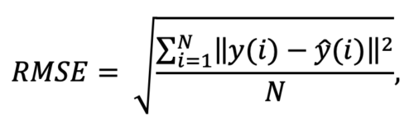
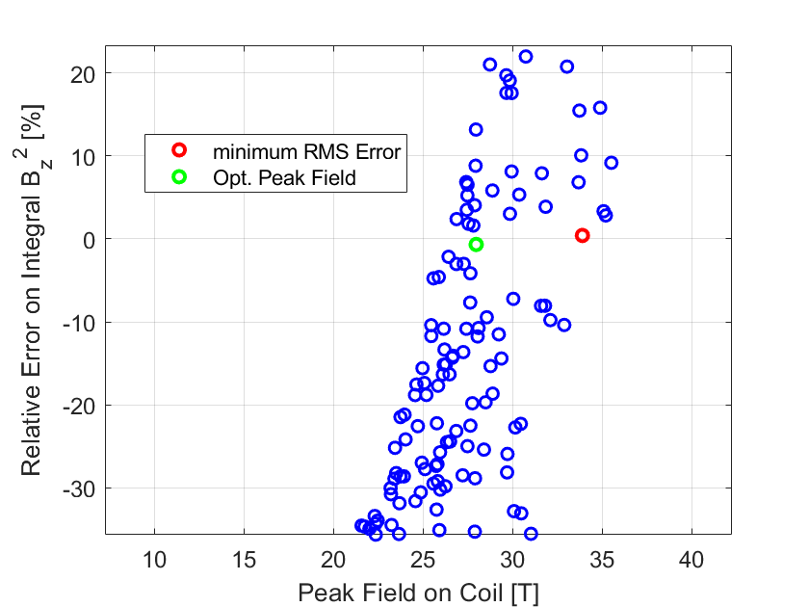
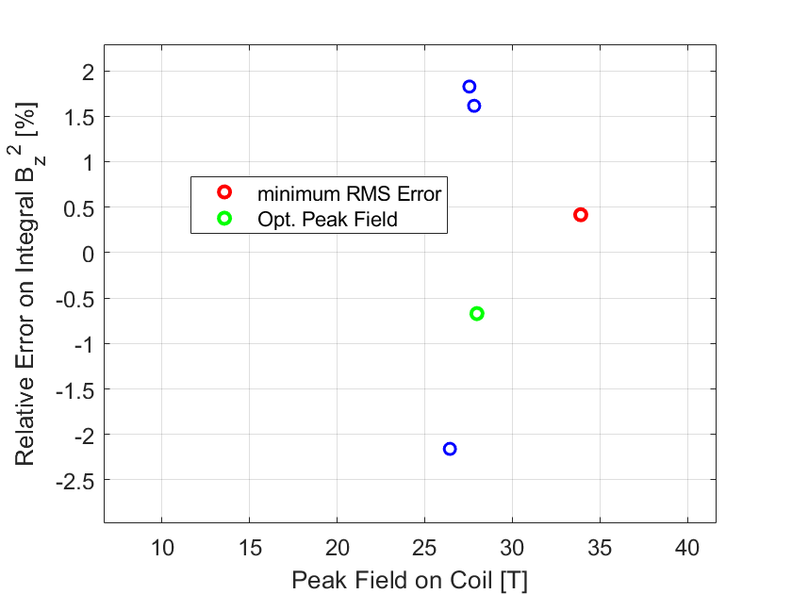
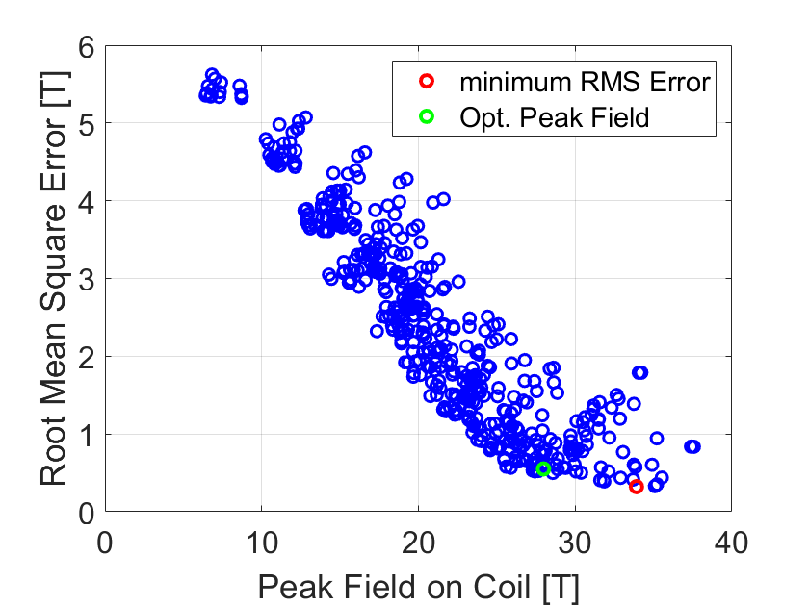
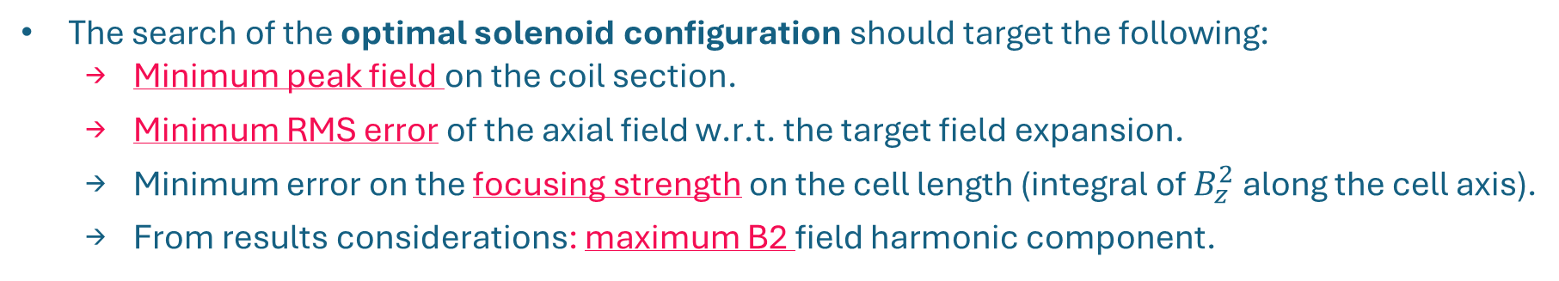
Optimization targets
The search of the optimal solenoid configuration should target the following:
  Minimum peak field on the coil section.
  Minimum RMS error of the axial field w.r.t. the target field expansion.
  Minimum error on the focusing strength on the cell length (integral of $B_{z}^{2}$ along the cell axis).
  From results considerations: maximum B2 field harmonic component.
2 configuration found:
Minimum RMSE.
Optimized: lower peak field.
Each point corresponds to a unique combination of the geometrical parameters
+1%
-1%
RMSE=0.325T
Focusing Strength error within 1%
RMSE=0.554T

Slide 9
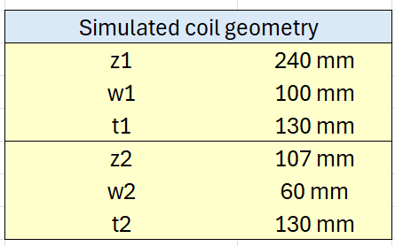
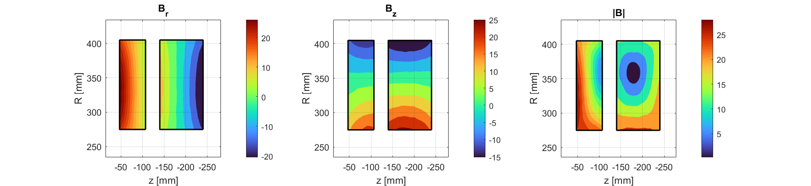
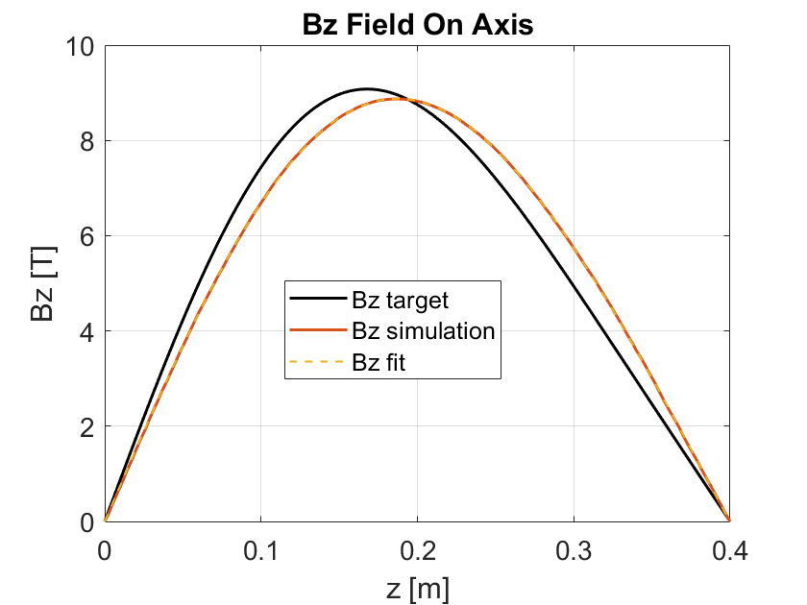
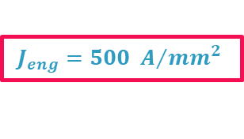
Results
$$J_{eng}=500 A/{{mm}^{2}}$$
Lower peak field configuration: RMSE = 0.554 T.
N.B:
6D stage lattice considered!
Peak field still high, but improved w.r.t. single coil stack (>40T)!
Computed field disaligned w.r.t. the target…
Coil Parameters
Current Margin [%] | 30.9
Minimum Critical current [A] | 582
Temperature Margin [K] | 27.2
Total magnetic energy in cell [MJ] | 47.4

Slide 10
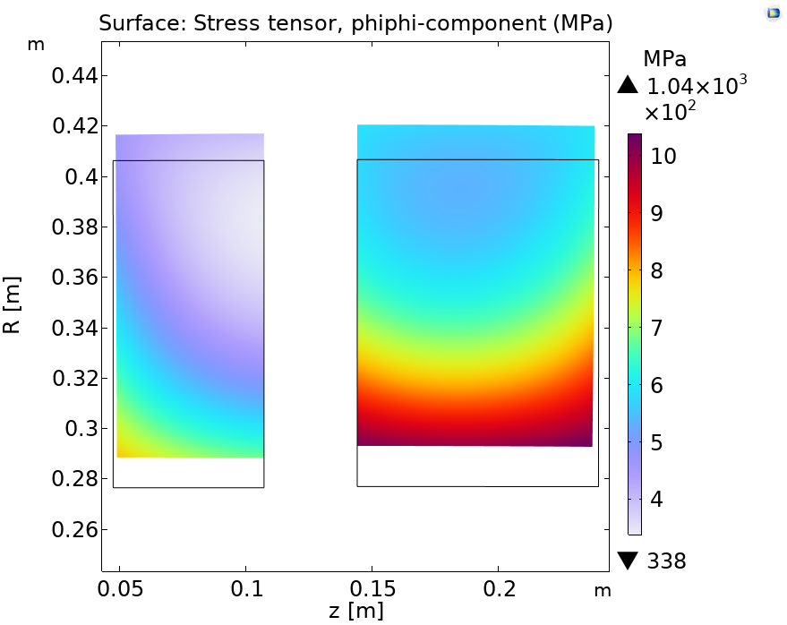
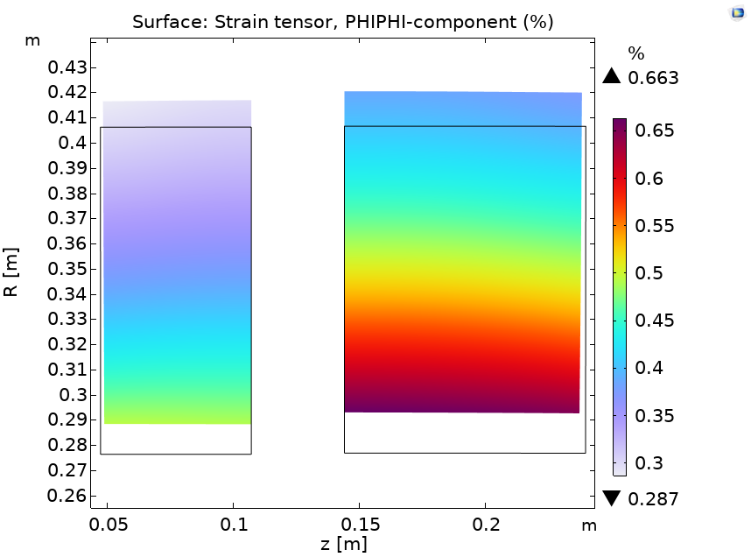
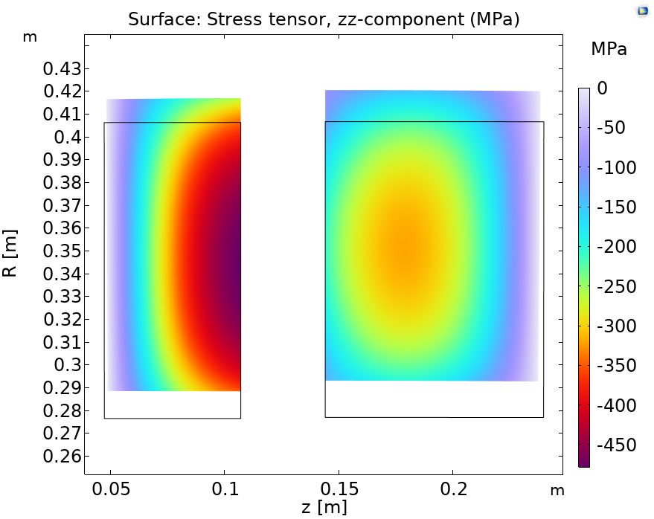
Mechanical Analysis: No prestress, no radial constraints
Mechanical analysis of the free-expanding coils.
Limiting hoop stress values!
Resulting force on the coils points towards the center of the cell (attractive force).
Hoop Stress [MPa]
Hoop Strain [%]
No radial constraints applied.
The coils are not self-sustaining
>> Limit value of 0.3 %
Coil B
Coil A
Axial Stress [MPa]
Coil Axial Forces:
Coil A: 47.5 MN
Coil B: -119 MN
Net Force:
-71.5 MN
N.B:
6D stage lattice considered!

Slide 11
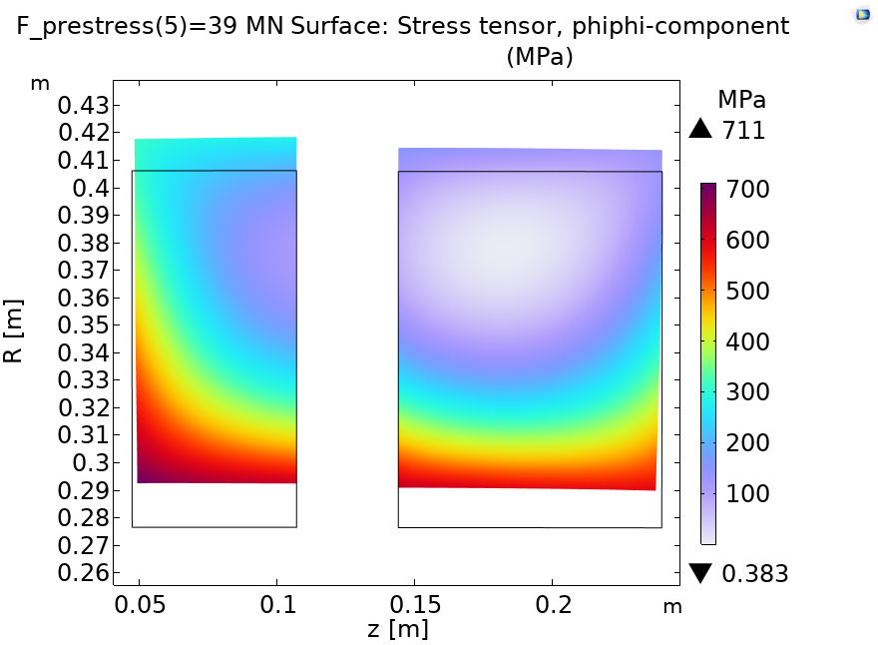
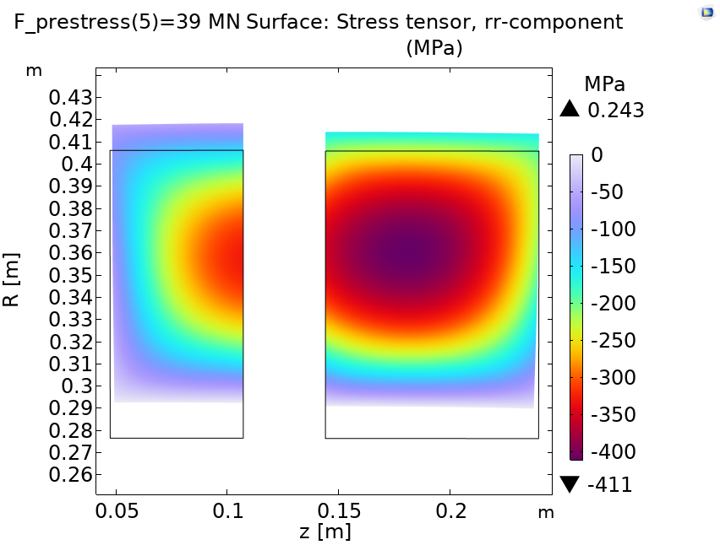
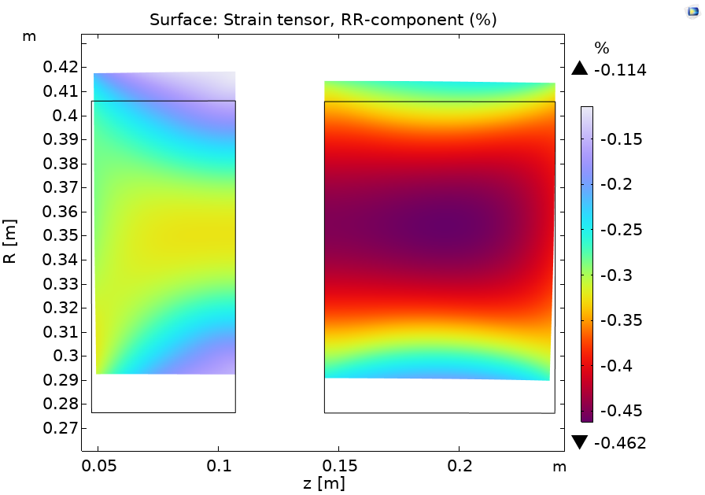
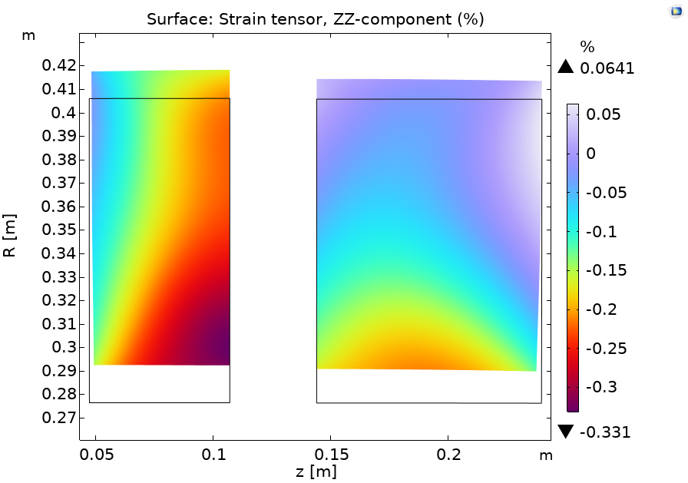
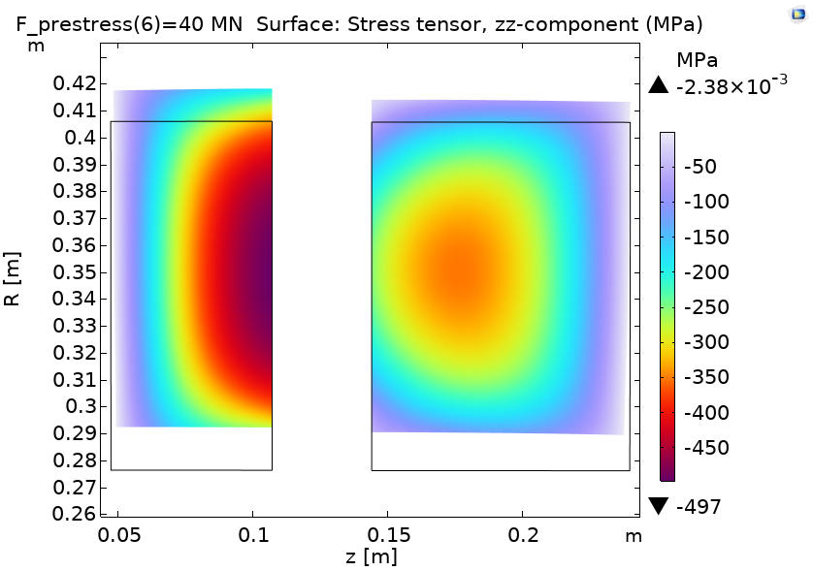
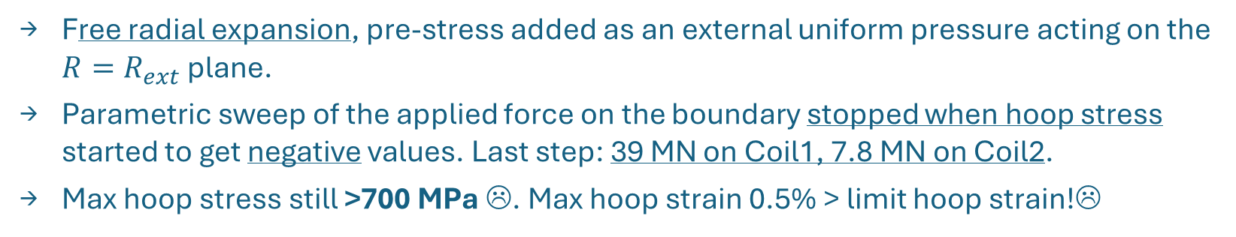
Prestress Study: Pressure on free boundary (I)
Free radial expansion, pre-stress added as an external uniform pressure acting on the $R=R_{ext}$ plane.
Parametric sweep of the applied force on the boundary stopped when hoop stress started to get negative values. Last step: 39 MN on Coil1, 7.8 MN on Coil2.
Max hoop stress still >700 MPa ☹. Max hoop strain 0.5% > limit hoop strain!☹
First approach: avoid negative hoop stress values!
39 MN
160 MPa
7.8 MN
51 MPa
N.B: 6D stage lattice considered!

Slide 12
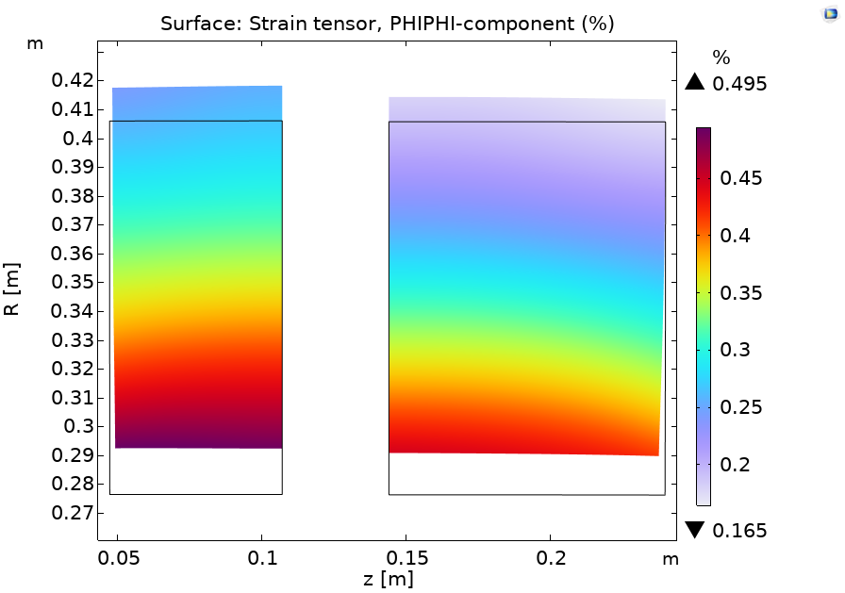
Prestress Study: Pressure on free boundary (I)
Free radial expansion, pre-stress added as an external uniform pressure acting on the $R=R_{ext}$ plane.
Parametric sweep of the applied force on the boundary stopped when hoop stress started to get negative values. Last step: 39 MN on Coil1, 7.8 MN on Coil2.
Max hoop stress still >700 MPa ☹. Max hoop strain 0.5% > limit hoop strain!☹
First approach: avoid negative hoop stress values!
Max hoop strain > 0.3 %...
N.B: 6D stage lattice considered!

Slide 13
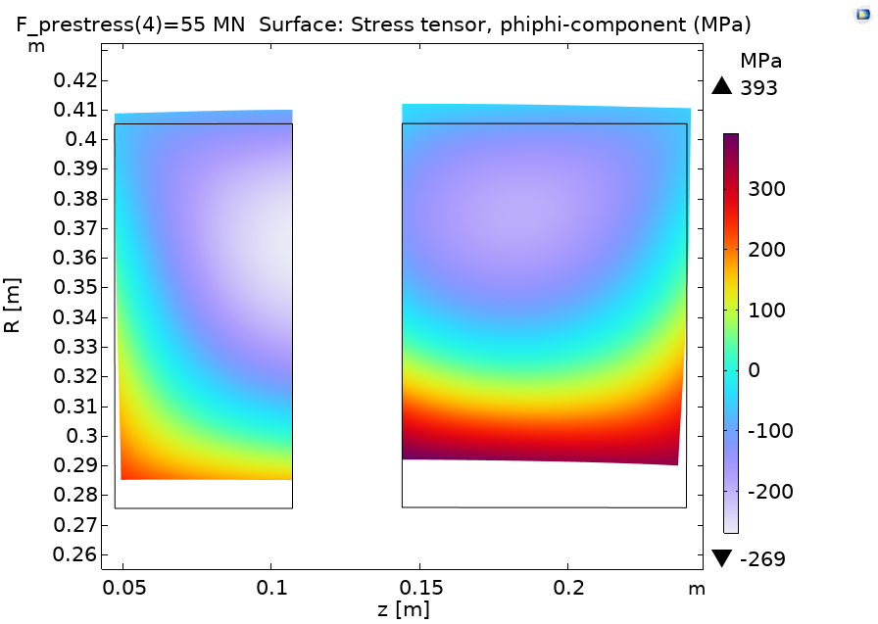
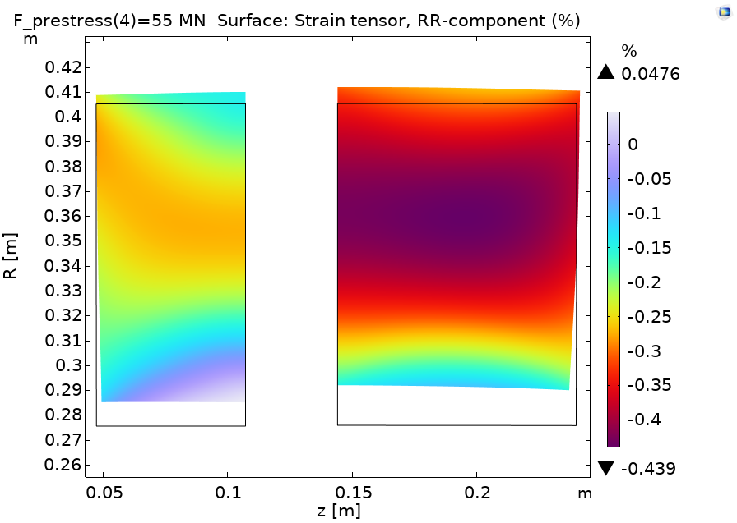
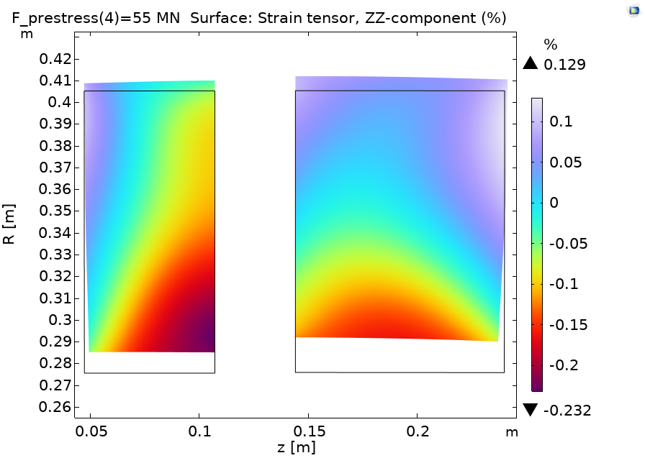
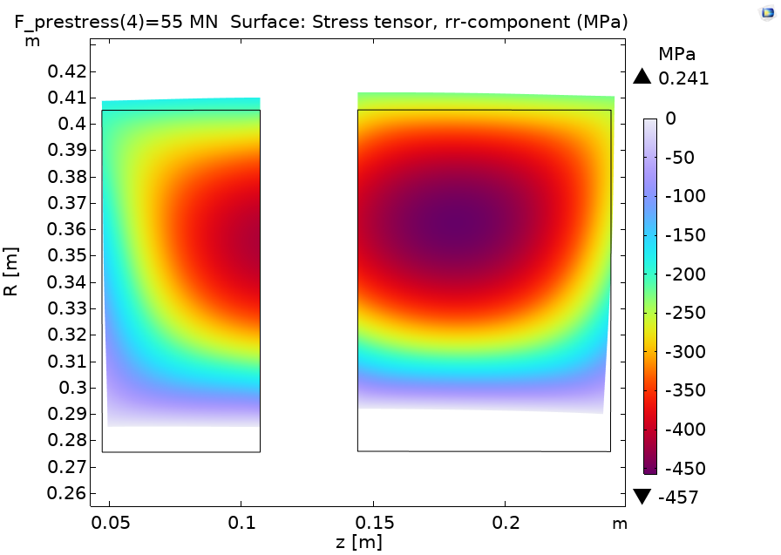
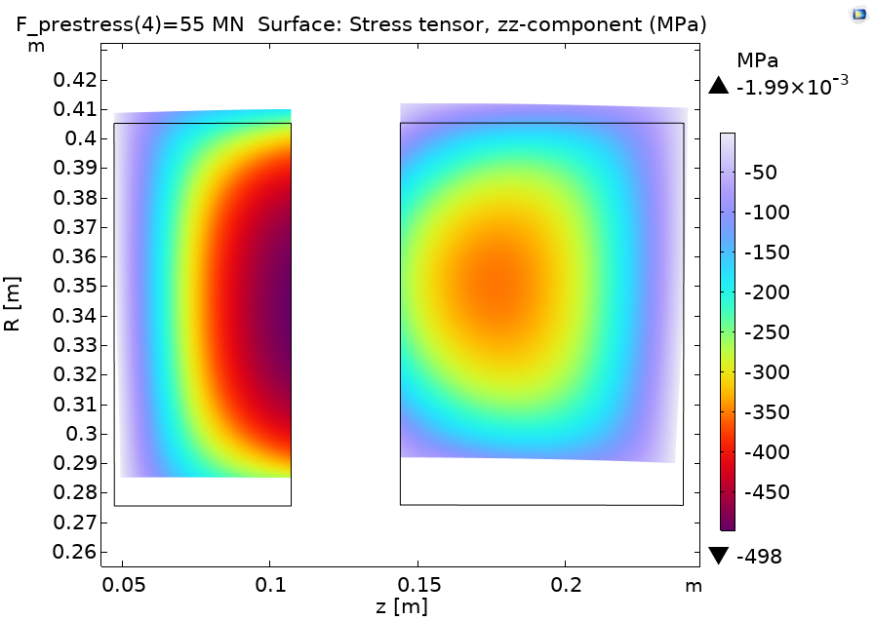
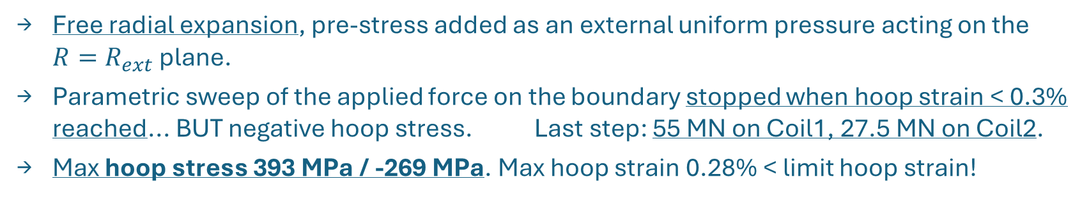
Prestress Study: Pressure on free boundary (II)
Free radial expansion, pre-stress added as an external uniform pressure acting on the $R=R_{ext}$ plane.
Parametric sweep of the applied force on the boundary stopped when hoop strain < 0.3% reached... BUT negative hoop stress. Last step: 55 MN on Coil1, 27.5 MN on Coil2.
Max hoop stress 393 MPa / -269 MPa. Max hoop strain 0.28% < limit hoop strain!
\
Approach: hoop strain < 0.3% !!
55 MN
225 MPa
27.5 MN
180 MPa
N.B: 6D stage lattice considered!

Slide 14
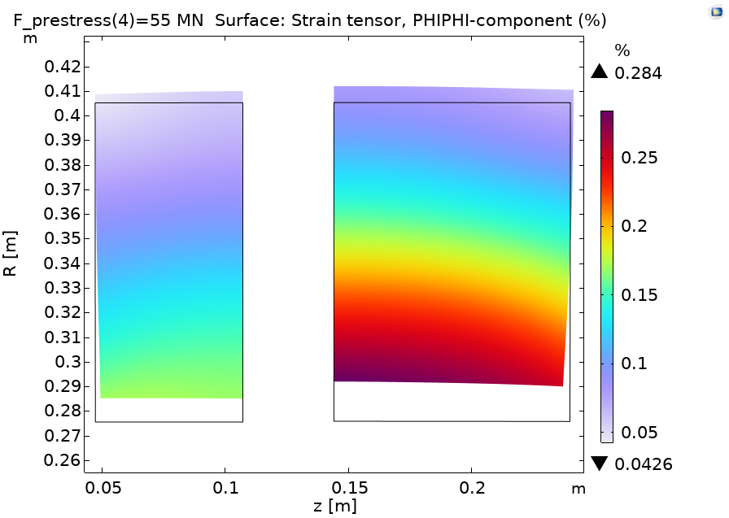
Prestress Study: Pressure on free boundary (II)
Free radial expansion, pre-stress added as an external uniform pressure acting on the $R=R_{ext}$ plane.
Parametric sweep of the applied force on the boundary stopped when hoop strain < 0.3% reached... BUT negative hoop stress. Last step: 55 MN on Coil1, 27.5 MN on Coil2.
Max hoop stress 393 MPa / -269 MPa. Max hoop strain 0.28% < limit hoop strain!
\
Approach: hoop strain < 0.3% !!
Max hoop strain < 0.3 % !!
N.B: 6D stage lattice considered!

Slide 15
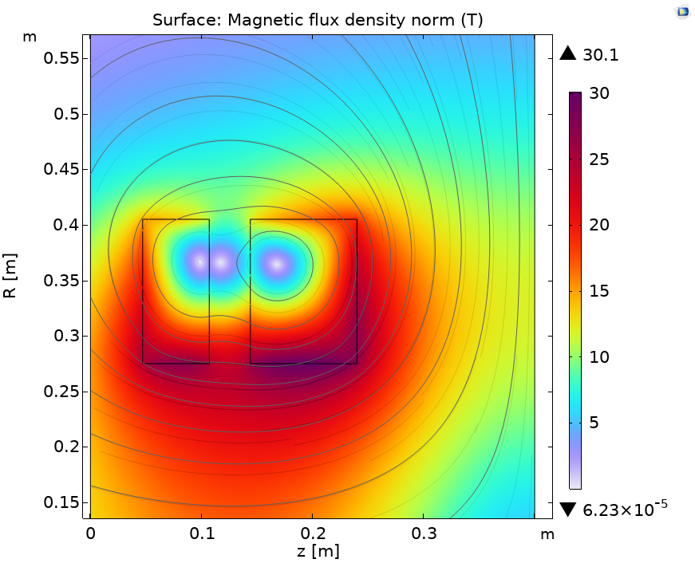
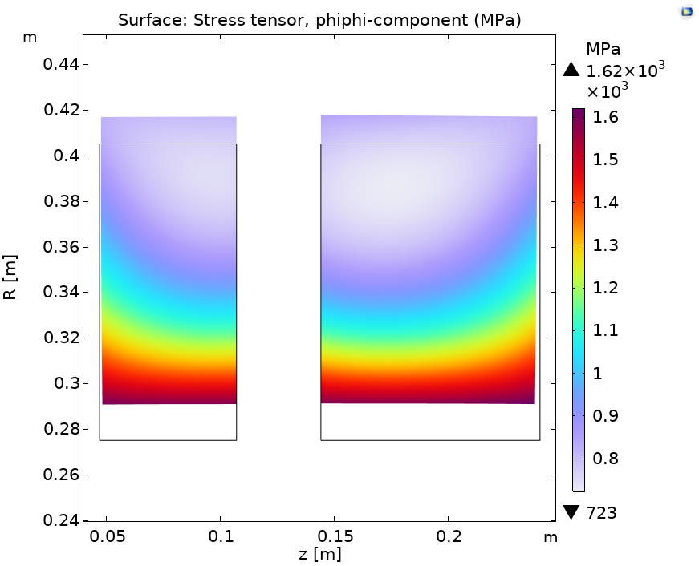
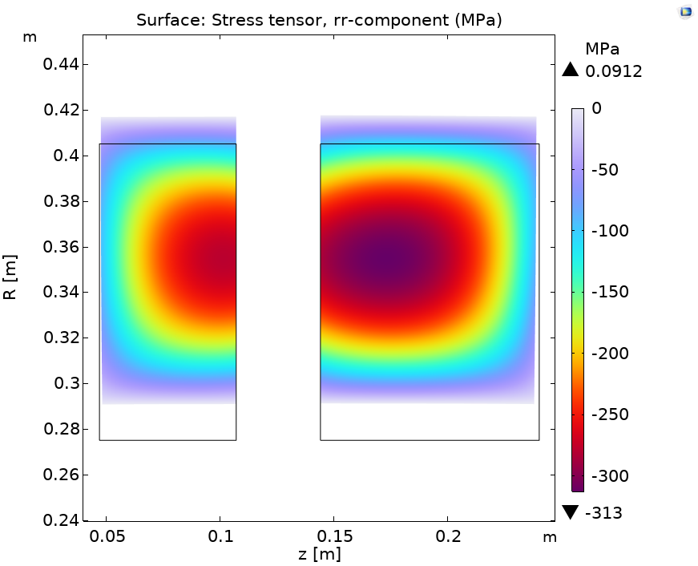
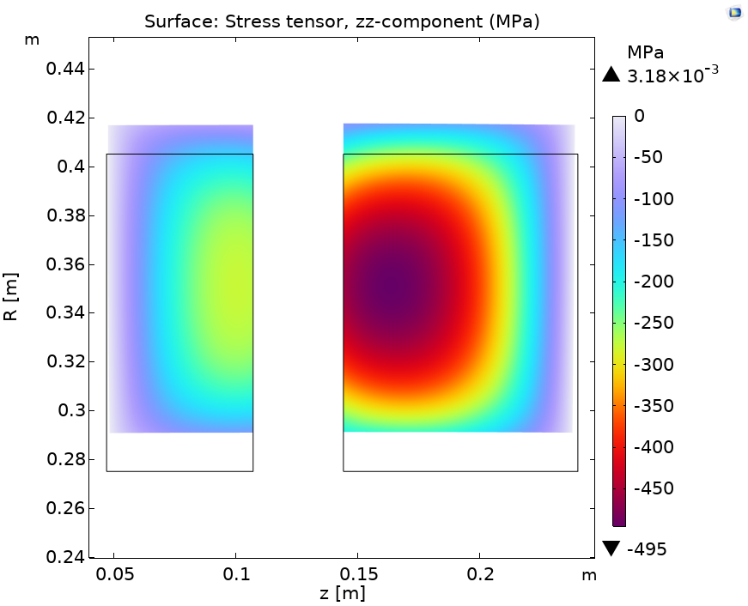
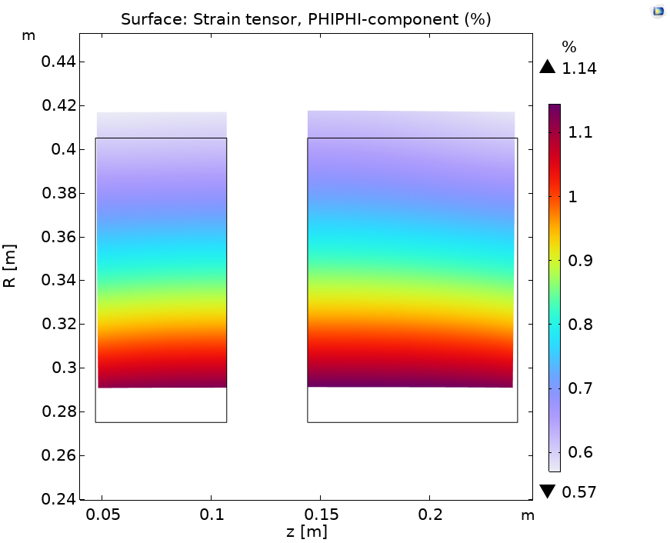
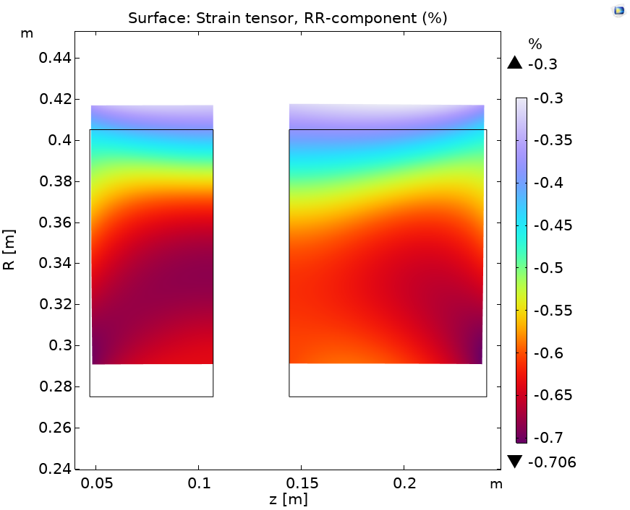
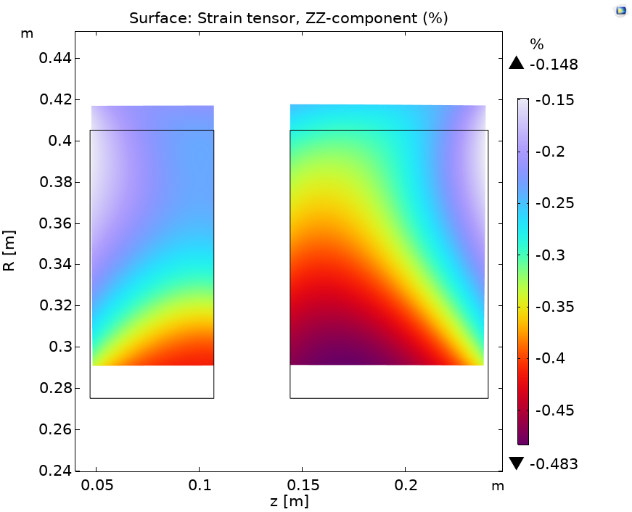
Mechanical Analysis:stand-alone demonstrator
Results for the stand-alone demonstrator stage.
This case is representative of the steady-state condition on an S5 stage following a fault shutdown on subsequent stages.
Peak field increased to 30 T
Test: no prestress, no radial constraints.
Applied prestress needs to be increased:
Apply 85 MN on Coil1 and 51 MN on Coil2 to have a peak hoop strain value of 0.29%. Still negative hoop stress regions.

Slide 16
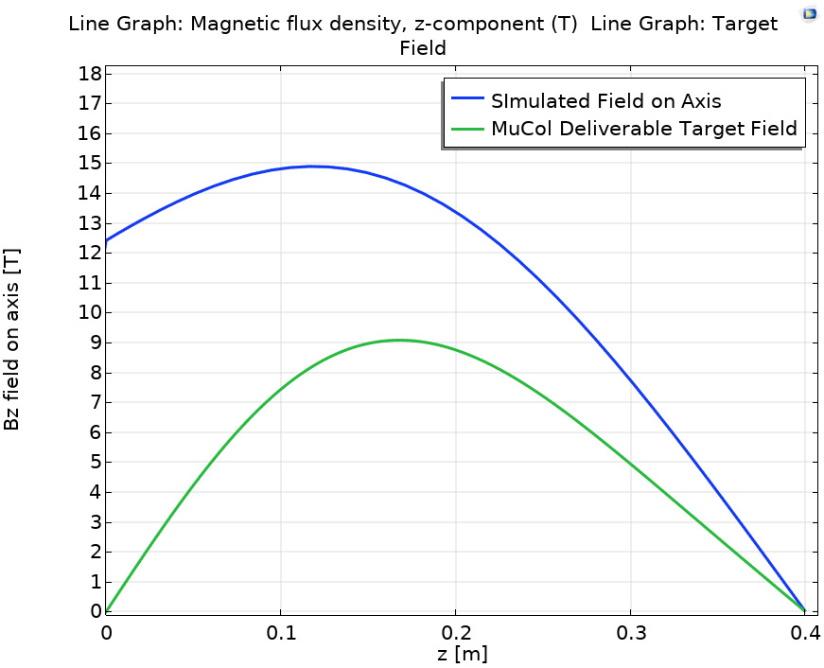
Mechanical Analysis:stand-alone demonstrator
Results for the stand-alone demonstrator stage.
This case is representative of the steady-state condition on an S5 stage following a fault shutdown on subsequent stages.
Test: no prestress, no radial constraints.
Applied prestress needs to be increased:
Apply 85 MN on Coil1 and 51 MN on Coil2 to have a peak hoop strain value of 0.29%. Still negative hoop stress regions.

Slide 17
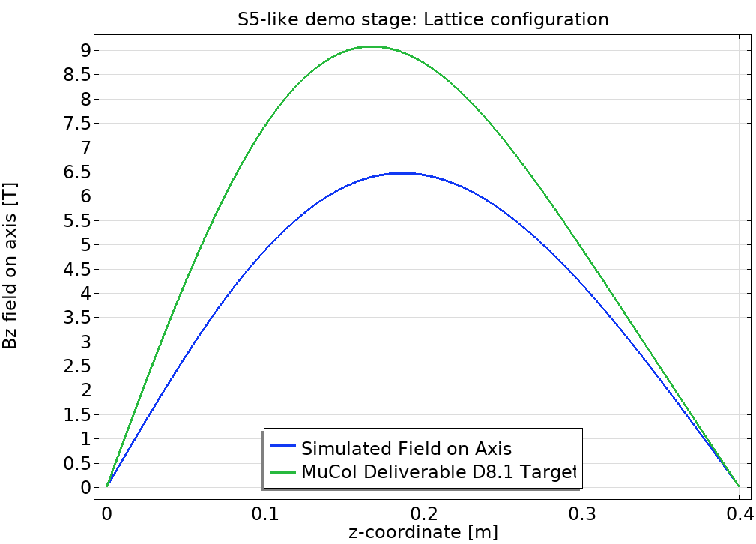
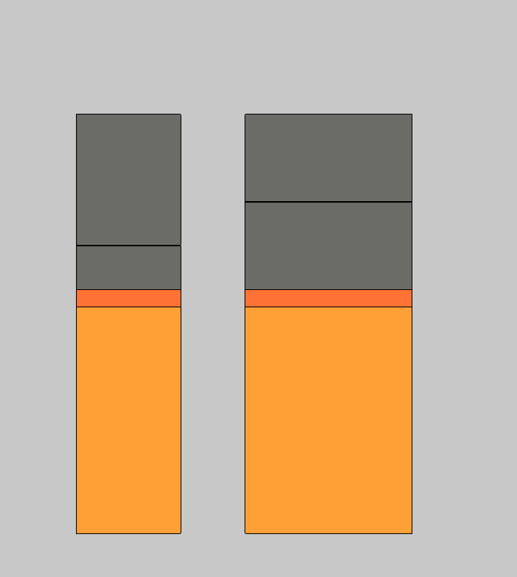
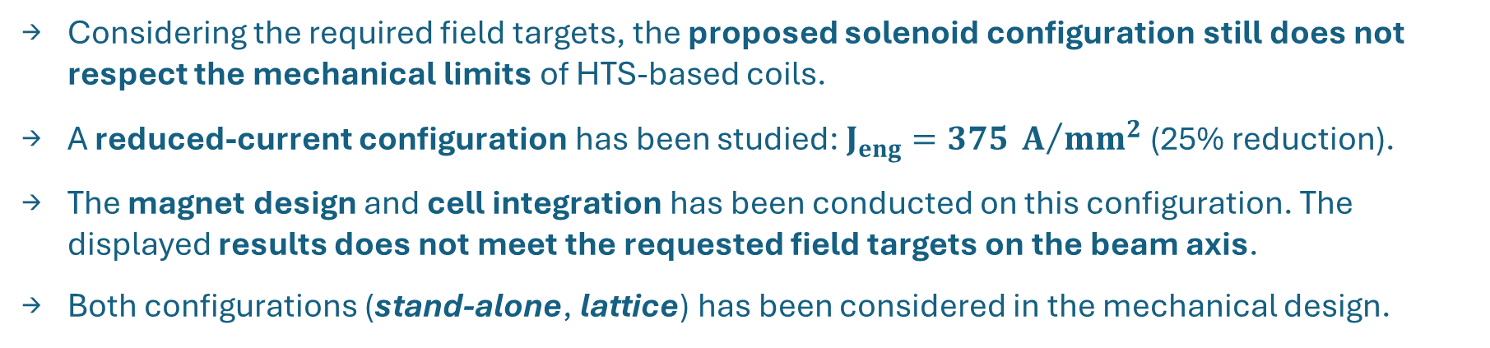
Reduced-current solenoid for first integration excercise
Considering the required field targets, the proposed solenoid configuration still does not respect the mechanical limits of HTS-based coils.
A reduced-current configuration has been studied: $J_{eng}=375 A/{{mm}^{2}}$ (25% reduction).
The magnet design and cell integration has been conducted on this configuration. The displayed results does not meet the requested field targets on the beam axis.
Both configurations (stand-alone, lattice) has been considered in the mechanical design.
SS restraining cylinders
Reduced peak field on axis: 6.5 T.
Cu collars
Coils
Two separated AISI 316LN steel restraining collars has been added: in case of stand-alone stage operation, the coil-structure deformation will be contained by the most external SS ring.
R
Z

Slide 18

Reduced-current solenoid for first integration excercise
Considering the required field targets, the proposed solenoid configuration still does not respect the mechanical limits of HTS-based coils.
A reduced-current configuration has been studied: $J_{eng}=375 A/{{mm}^{2}}$ (25% reduction).
The magnet design and cell integration has been conducted on this configuration. The displayed results does not meet the requested field targets on the beam axis.
Both configurations (stand-alone, lattice) has been considered in the mechanical design.
Reduced peak field on axis: 6.5 T.
Figures of Merit | Value
RMS difference [T] | 1.67
Reduction on Integral $B_{z}^{2}$ along the axis [%] | 47.03

Slide 19



Reduced-current solenoid design: lattice operation (I)
The mechanical design of the S5-like solenoids converged to a 25% reduced current configuration.
To limit the stresses in the solenoids in lattice operation, SS collars must be fit on the 10 mm Cu rings containing the coils. A 50 mm SS collar is needed for coil A, 25 mm SS collar for coil B.
A 0.8 mm interference between the two collars is required to contain the stresses in a self-sustaining coil configuration.
Coil stress components: lattice configuration
Coil B
Coil A
Stresses are within the mechanical limits!

Slide 20



Reduced-current solenoid design: lattice operation (II)
The Von Mises stress was assessed in the Cu collars and SS restraining rings.
The resulting stresses are compatible with the elastic limits of the materials considered.
The total radial displacement is needed to determine the radial gap with the external SS ring required for the stand-alone cell operation.
Cu collars
SS restraining rings
Total displacement
Stresses are within the mechanical limits!

Slide 21



Reduced-current design: stand-alone operation (I)
The load conditions in the stand-alone cell operation are remarkably different to the analyzed lattice configuration.
To limit the stresses in stand-alone operation, additional SS collars must be fit on the coils structure. Addittional 50 mm SS collar is needed for coil A, 75 mm SS collar for coil B.
A 0.8 mm interference between the two collars is assumed.
Coil stress components: lattice configuration
Coil B
Coil A
Stresses are within the mechanical limits!

Slide 22



Reduced-current design: stand-alone operation (II)
The Von Mises stress was assessed in the Cu collars and SS restraining rings.
The resulting stresses are compatible with the elastic limits of the materials considered.
The total radial displacement has been assessed on the structure.
Cu collars
SS restraining rings
Total displacement
Stresses are within the mechanical limits!

Slide 23



Reduced-current design: support structure design
The coil support structure has been designed to sustain the coil axial forces in the two configurations: stand-alone, lattice.
Thick AISI 316LN shell is needed to sustain the axial forces in normal out-of-cell direction.
Even in the reduced-current configuration, the mechanical design of the support structure is not trivial.
positive force (cell center)
Coil A
Coil B
negative force (outward cell direction)
z
Coil Axial Forces | Coil A/Coil B Value [MN] | Net Force Value [MN]
Lattice configuration | -27 / +67 | +50
Stand-alone configuration | -55 / +35 | -20
Stand-alone configuration: Von Mises Stress [Mpa]
Lattice configuration: Von Mises Stress [Mpa]

Slide 24

Summary and next steps
The magnet design for the S5-like demonstrator cell looks challenging, in particular from a mechanical point of view.
The search for an optimized solenoid configuration, respecting the required focusing strength, converged to the two-coil-subdivision configuration presented.
The mechanical limits of the materials constituting the assembly are not respected, thus a reduced-current configuration has been studied.
A 25% coil current reduction (from $500 A/{{mm}^{2}}$to $375 A/{{mm}^{2}}$) decrease the coil stresses within their mechanical limits: a collar and support structure design has been proposed.
The support structure design still presents criticalities to be solved, the stresses appear excessive, requiring 60 mm Inconel bolts and a thick shell (with associated increased cost and manufacturing complications…).
Further iterations are needed, both on the magnets design and on the cell integration study!

Slide 25
Thank you for your attention!

