Slide 1


Solar Energy Laboratory
(SEL)
Centre d’Excellence Régional pour la Maîtrise de l’Electricité (CERME)
ACP2025
ACP2025
Sept 18, 2025
Experimental investigation of thermoelectric cooler box using a passive temperature harmonization device.
M. Akilou ALLES
Thesis Advisor: M. KPELOU Pali, MC, University of Lome-Togo
collaborators : M. MANI K. Damgou, MC, University of Lome-Togo
collaborators : M. MOUZOU Essowè, MA, University of Lome-Togo
collaborators : M. N’WUITCHA Kokou ,P T, University of Lome-Togo

Slide 2
Outline
Context and Problem Statement
Objectives
Methodology
Experimental Results
Results and Discussion

Slide 3

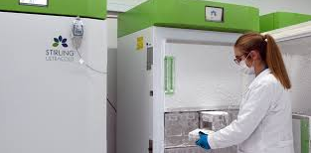
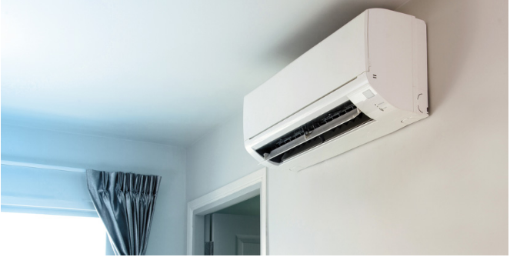
Context and Problem Statement
-organ preservation
-cryogenic treatments
-vaccine preservation
-Building air
conditionin
-Ice rinks
-LNG production
-Ground freezin……

Slide 4
Context and Problem Statement
Main methods of cold production
Naturally
Artificially
Glacier utilization
Thermoélectric Module (Peltier Effect )
Compression/Expansion
Others
High energy consumption, vibration, …
Refrigerant leak
( CFC ,HCFC)
-
Absence of refrigerants
-Absence of vibration
-Low power consumption
-Low maintenance
-Environmentally friendly
-Silent
-Good lifespan
-Reduced volume and mass…
Low efficiency
Depletion of fossil fuels
Significant CO₂ emission
Ozone layer depletion greenhouse effect …

Slide 5
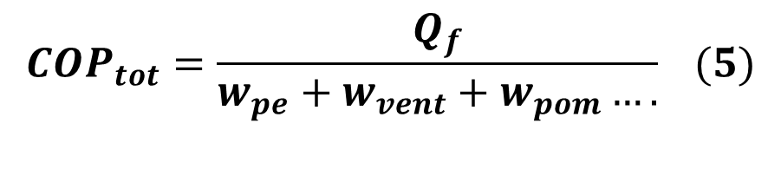
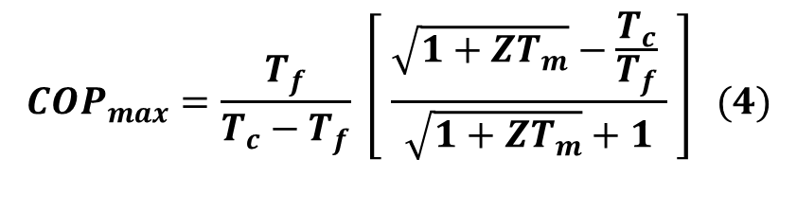
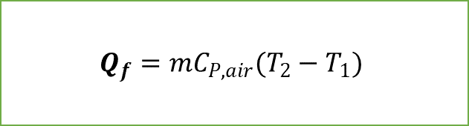
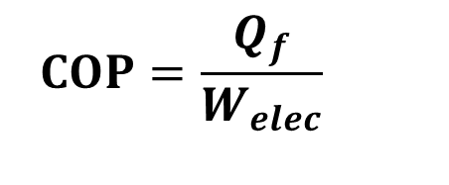
COP Calculation
$${COP}_{max}=\frac{T_{f}}{T_{c}−T_{f}} \left[ \frac{\sqrt{1+ZT_{m}}−\frac{T_{c}}{T_{f}} }{\sqrt{1+ZT_{m}}+1} \right] (4)$$
$$COP=\frac{Q_{f}}{W_{elec}}$$
$${COP}_{tot}=\frac{Q_{f}}{w_{pe}+w_{vent}+w_{pom}….} (5)$$
$$Q_{f}=mC_{P,air}(T_{2}−T_{1})$$

Slide 6
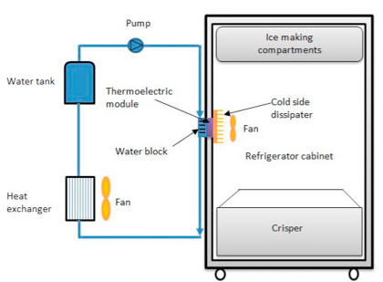
Cooling systems utilizing the Peltier effect
Mourat GöKçek et al

Slide 7
General objective
The objectives of this work are the optimization of the COP through cold dissipation and homogenization using passive devices.

Slide 8
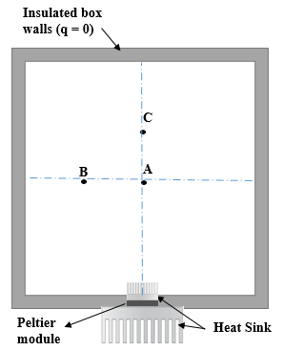
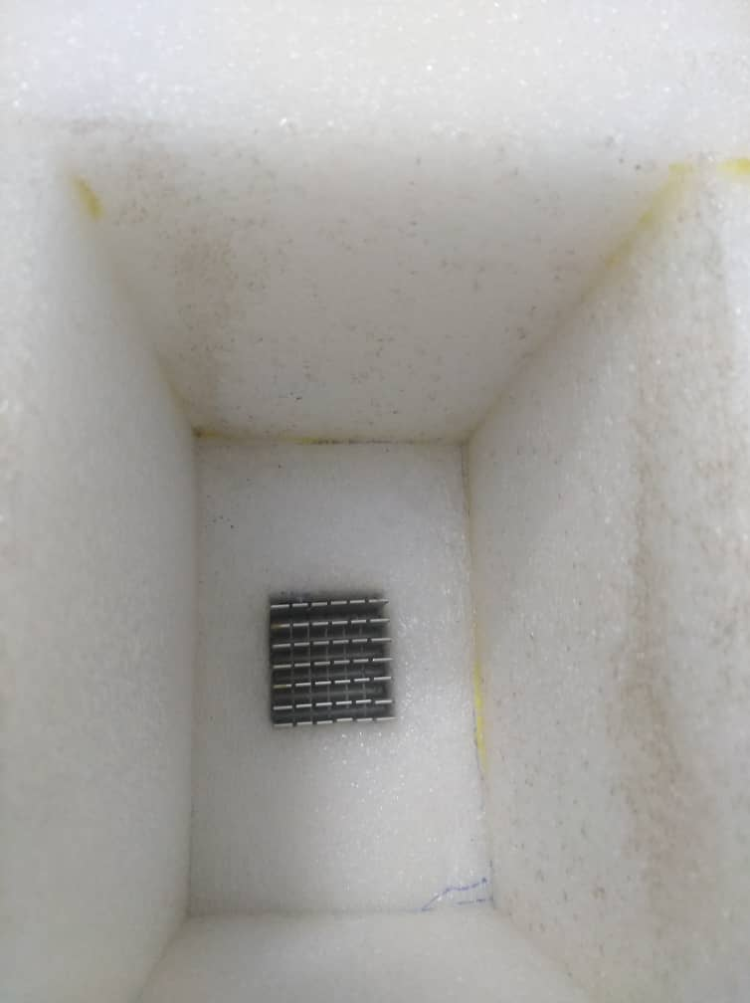
Methodology
a)
b)
Schematic view a) and picture b) of the box in module only mode.

Slide 9
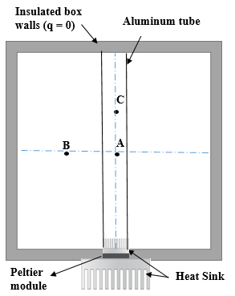
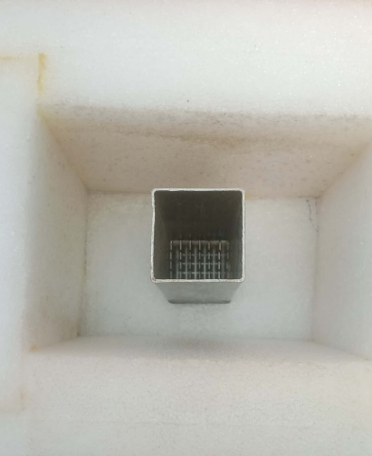
Methodology
.
b)
a)
Schematic view a) and picture b) of the box in aluminum tube mode.

Slide 10
Experimental results
a)
b)
Temperature of refrigerator boxes with respect to test time at two modes a) without tube b) with tube.

Slide 11
Results and Discussion
C)
B)
A)
Temperature of refrigerator boxes at points (A, B and C) with respect to test time at two modes (without tube, with tube).

Slide 12
Results and Discussion
Power consumption with respect to test time at two modes (without tube and with aluminum tube
COP values versus test time for two modes (without tube, with tube)

Slide 13
Results and Discussion
The results showed a significant temperature reduction:
with a 5°C drop outside the tube and a 10°C drop inside, creating two distinct thermal zones that improved localized cooling and temperature control.
While the COP values and overall cooling performance of this passive method were lower than those of active systems (such as fan and pump-driven methods), the findings highlight the potential of passive techniques as energy-efficient alternatives, especially in applications where minimizing power consumption is crucial
Current COP is estimated between 0.67 and 0.72%
(Riffat et al 2004)

Slide 14
THANK YOU FOR YOUR KIND ATTENTION

