Slide 1
Obed MANIRAGUHA
University of Rwanda
ASP2024 Alumna
Tel: +250788274906
Email: obdmnrgh7@gmail.com
STATISTICAL EVALUATION OF SOLAR INDICES USING PRINCIPAL COMPONENT ANALYSIS

Slide 2
SOLAR INDICES
SOLAR WIND
GEOMAGNETIC STORMS
INTRODUCTION &
MOTIVATION
RESEARCH PROBLEM AND OBJECTIVE
CONTENT
METHODOLOGY—PCA ANALYSIS
OBSERVATION & RESULTS DISCUSSION
RECOMMENDATION & IMPACT FOR AFRICA AND GLOBAL RELEVANCE

Slide 3
SOLAR INDICES
This theory refers to the study and analysis of various parameters that quantify the solar activity. They provide valuable information about the Sun’s behavior and are essential for understanding its impact on space weather and Earth’s climate. Sunspots are temporary phenomena on the Sun’s photosphere that indicate intense magnetic activity. They give out an index called sunspot number which is a measure of the overall solar activity.
Solar radio flux represents the amount of radio frequency energy emitted by the sun measured at various wavelengths.
Through solar indices mentioned above, we mitigate space weather impacts by implementing space weather models. All of these indices, are numerical values derived from observations of different solar phenomena, and they play a crucial role in solar physics, astrophysics and space sciences.

Slide 4
SOLAR WIND
The solar wind is a continuous stream of charged particles, primarily electrons and protons, released from the upper atmosphere of the Sun, known as the corona. The solar wind carries the Sun’s magnetic field into space, creating the heliosphere, a vast bubble that encompasses the solar system.
Variations in the solar wind can influence space weather, affecting satellite operations, communications, and even power grids. Studying the solar wind is crucial for understanding and mitigating its effects on our technology and environment.

Slide 5
GEOMAGNETIC STORMS
Geomagnetic storms are disturbances in Earth’s magnetosphere caused by the interaction between solar wind and the planet’s magnetic field. These storms are typically triggered by solar events such as coronal mass ejections (CMEs) or high-speed solar wind streams originating from coronal holes When these solar emissions reach Earth, they compress the magnetosphere and transfer energy into it, leading to enhanced currents and increased auroral activity..
These storms can disrupt satellite operations, navigation systems, and communication networks. They can also induce geomagnetic induced currents (GICs) in power lines, potentially damaging transformers and causing power outages. Additionally, geomagnetic storms create spectacular auroras, also known as the Northern and Southern Lights, visible at higher latitudes. Understanding and predicting geomagnetic storms is vital for protecting technology and infrastructure, as well as for advancing space weather forecasting.

Slide 6
Introduction and Motivation
Space weather, driven primarily by solar activity, affects satellite communication, GPS accuracy, power systems, and even aviation. This is especially critical in equatorial and developing regions like Africa, where infrastructure and early warning systems are still underdeveloped.
The core motivation behind this research is to improve the accuracy of space weather prediction models by identifying which solar index best represents ionospheric conditions, thereby minimizing forecasting errors.

Slide 7
Research Problem and Research Objective
Although many space weather models exist, they often use different solar indices arbitrarily, which leads to inconsistent and sometimes inaccurate predictions. For example, models using the Sunspot Number (SSN) or F10.7 flux have produced varied results, and no consensus exists on which is best.
To statistically evaluate five commonly used solar indices—SSN, F10.7, F10.781, R12, and F10.7p—and determine which is the most accurate for predicting Total Electron Content (TEC) during geomagnetic storm conditions.

Slide 8
Data Selection and Justification
We used data spanning from 1996 to 2020—a period covering multiple solar cycles—to ensure robustness. Here’s why we chose this data:
Solar indices (SSN, F10.7): Retrieved from internationally recognized agencies such as:
NOAA SWPC, SIDC/SILSO (for SSN)
NASA OMNIWeb (for F10.7 solar flux)
TEC Data: Derived from GPS satellite observations over equatorial Africa using GNSS receivers.
📌 Why TEC? TEC is a direct indicator of ionospheric activity. Since the ionosphere reflects radio signals and influences satellite communication, monitoring TEC is critical for evaluating space weather effects.

Slide 9
Methodology – PCA and Error Minimization
Principal Component Analysis
Error Minimization
We applied Principal Component Analysis (PCA) to the TEC data to reduce noise and focus on the most influential patterns:
PCA breaks down the TEC time series into principal components that capture the largest variations.
The first four PCs alone captured over 97.5% of the total variance, ensuring that we preserved almost all meaningful ionospheric information while minimizing computational complexity and noise.
To determine which solar index best predicted TEC, we compared reconstructed TEC (using each solar index) to actual observed TEC. We used the following evaluation metrics:
Mean Absolute Error (MAE): Measures the average prediction error. The smaller, the better.
Correlation Coefficient (R): Measures how well the model captures actual TEC trends.
Percentage Improvement (PI): Assesses the gain in accuracy over the base SSN model.
By applying the above metrics across 13 years of storm-time data, we ensured that our conclusions are statistically valid and not tied to specific events or short-term variability.

Slide 10
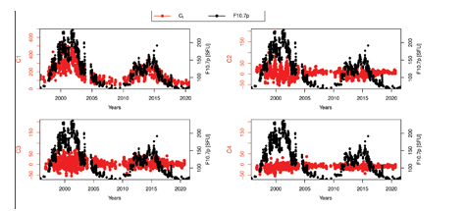
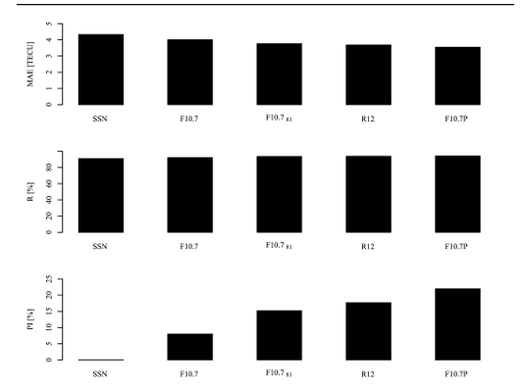

Slide 11
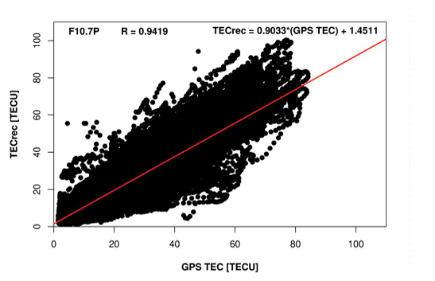
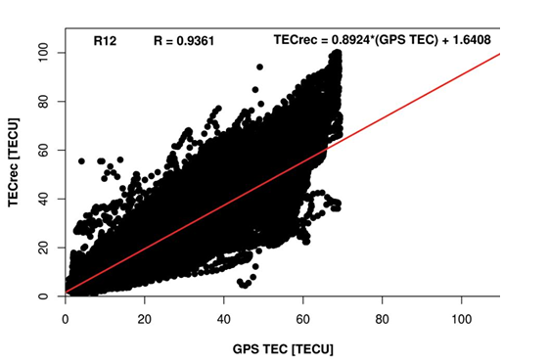
Results – Which Index Performed Best?
The F10.7p index showed the lowest MAE (3.55) and highest correlation (94.19%) with observed TEC, making it the best predictor.
R12, the 12-month smoothed sunspot number, also performed well, especially in capturing long-term trends.
Other indices like SSN and raw F10.7 were less accurate.
📌 The success of F10.7p lies in its hybrid nature—it combines real-time solar flux (F10.7) with a smoothed average (F10.7₈₁), balancing short-term and long-term variability

Slide 12
Impact for Africa and Global Relevance
Africa, especially equatorial countries like Rwanda, Kenya, Nigeria, and Uganda, experiences strong ionospheric variations.
Yet, Africa lacks many real-time ionospheric models tailored to its unique geophysical location.
This study provides a data-driven foundation to build region-specific space weather models, enhancing resilience for:
Aviation
Telecom and Satellite Services
Military and Civil Navigation Systems
Globally, our findings support more accurate modeling of ionospheric behavior, which is vital for timing systems, global positioning, and radio propagation.
By recommending a statistically validated solar proxy (F10.7p), this study contributes to standardizing space weather forecasting methods across the world.

Slide 13
. Conclusion and Recommendations
F10.7p is the most accurate solar index for modeling storm-time TEC and should be adopted in space weather forecasting tools.
For best results, we recommend a hybrid approach, combining F10.7p with R12, and updating models frequently with real-time data.
Policymakers, space weather agencies, and scientific institutions in Africa should invest in:
Regional TEC monitoring
Open-access ionospheric datasets
Capacity building in data-driven modeling

Slide 14
.!!!!!!!!!!!!!!!!!!!!!!!!!!!THANK YOU!!!!!!!!!!!!!!!!!!!!!

