Slide 1
AN IMPROVED SOLAR DECLINATION ANGLE FORMULA FOR ACCURATE DETERMINATION OF THE SUN’S POSITION FOR OPTIMUM ORIENTATION OF SOLAR PHOTOVOLTAIC MODULES
The 4th African Conference on Fundamental Physics (ACP2025)
14th -20th September
Mavyline Motari¹, Geoffrey Okeng’o¹, Robinson Ndegwa¹, Rana Liaqat Ali²
¹Dept. of Physics, University of Nairobi
²COMSATS University, Islamabad, Pakistan

Slide 2
Presentation Outline
Introduction
Related studies
Methodology
Results and Discussion
Conclusion
References
Acknowledgements

Slide 3
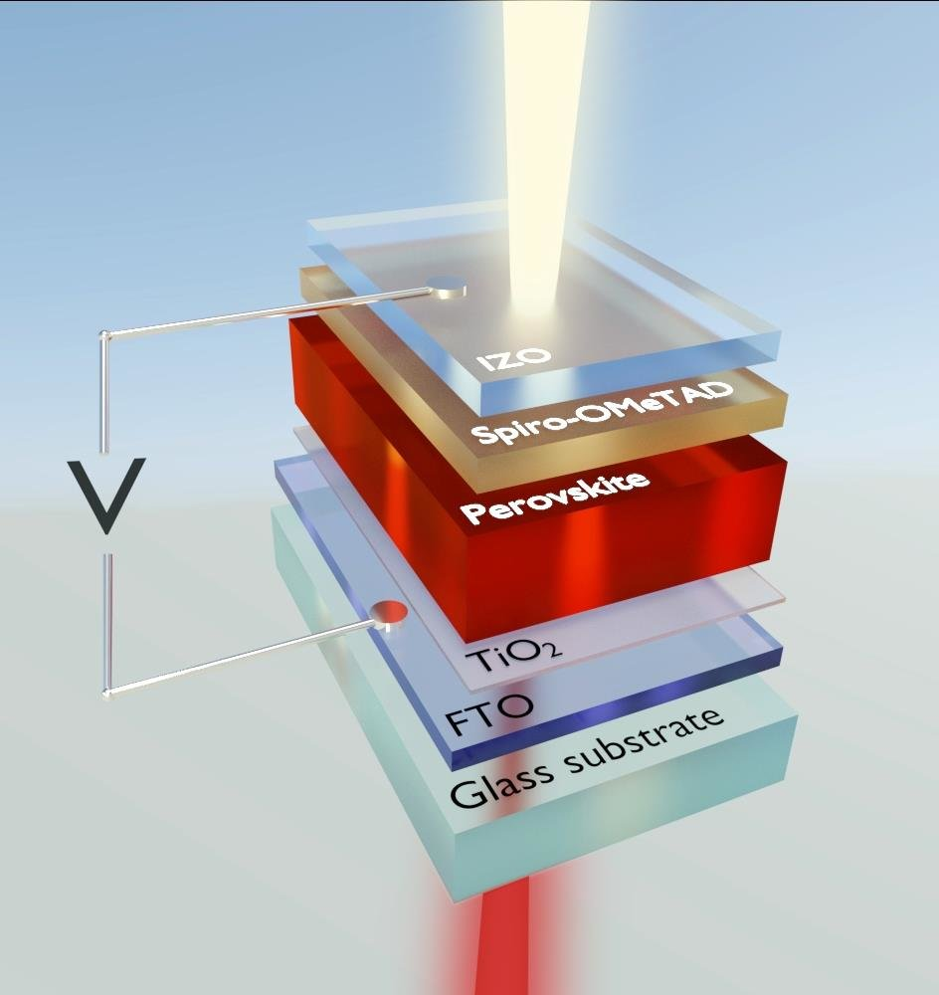
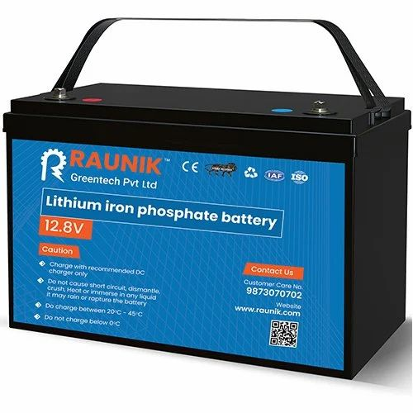
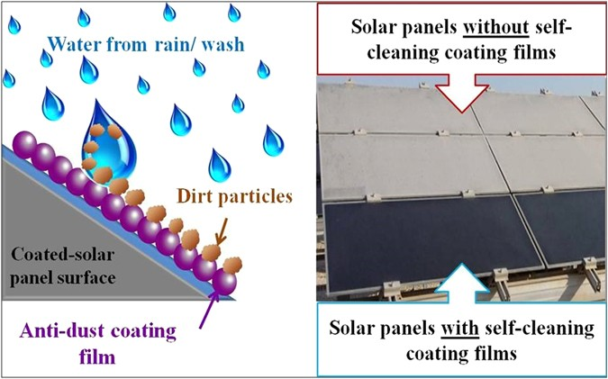
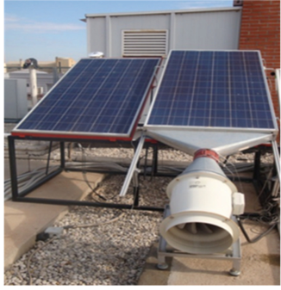
Introduction
Research into improvement of the energy output of a solar PV module at i) Solar cell level
ii) Battery/Storage
iii) Effect of external factors such as high cell operating temperature, orientation of panel, shading and dust accumulation on surface of the panel (Vidyanandan, 2017).

Slide 4
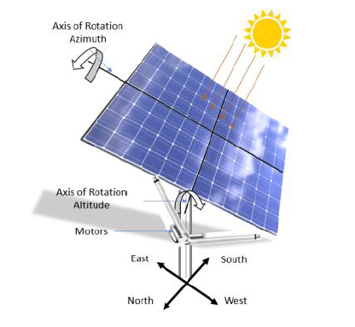
Introduction cont’.
The main aim of this study is to improve panel orientation through incorporation of a smart automated dual-axis tracker for maximized PV power output.
Figure 1: A Solar panel fitted with a dual-axis tracker (Ibrahimi et al. 2019).

Slide 5
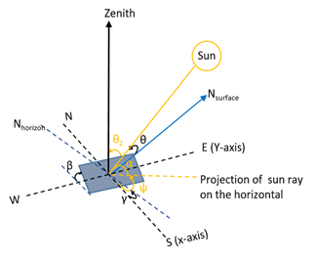
Introduction cont’.
Dual-axis trackers based on sun position algorithms make use of solar angles which include, the solar declination angle, solar elevation (α_{s}), zenith angle (θ_{z}) , solar azimuth angle (γ) and surface azimuth angle (γ_{s}) (Al-Naima,2011; Chen,2011).
The solar declination angle is key in calculation of the other solar angles
Figure 2: Solar angles relating the panel surface and the sun.

Slide 6
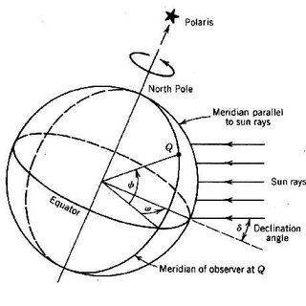
Solar declination angle
It is the angular position of the sun when it is on the local meridian with respect to the plane of the equator (Chen,2011).
It is attributed to the fact that the Earth is tilted on its axis of rotation around the sun varying from −23.45⁰ ≤ δ ≤ 23.45⁰ (Dufﬁe & Beckman, 2013; Karafil et al., 2015).
Figure 3: The Solar declination angle (Albarqoumi & Hussein 2010)

Slide 7
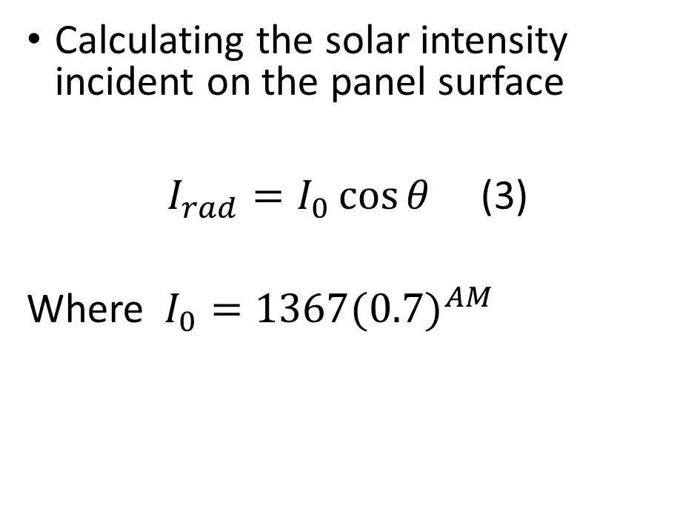
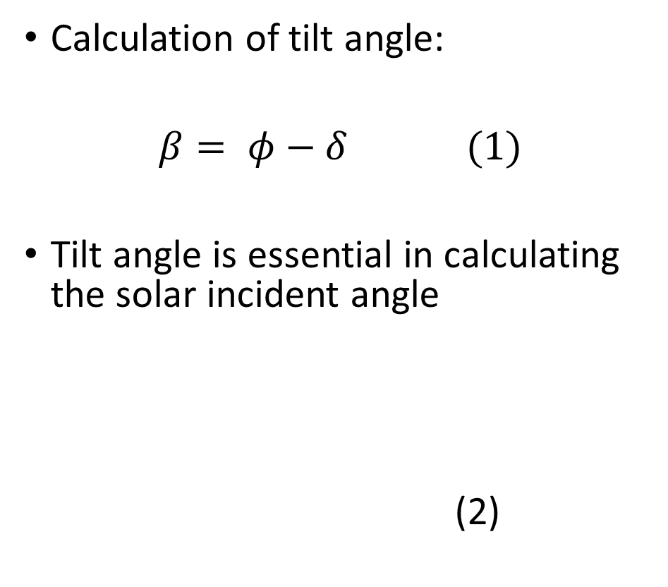
Solar Intensity
Calculation of tilt angle:
$β= φ−δ$ (1)
Tilt angle is essential in calculating the solar incident angle
(2)
Calculating the solar intensity incident on the panel surface
$I_{rad}=I_{0}\cos{θ}$ (3)
Where $I_{0}=1367{(0.7)}^{AM}$

Slide 8
Related studies
A comparison of five algorithms for computing the sun position for the years between 2010 to 2110. The errors ranged from 0.2⁰ to 0.0027⁰ with varying degree of complexity (Grena, 2012).
Algorithm by Reda and Andreas had higher accuracy than that by Ineichen (Melo et. al. 2018).
An improved sun position algorithm that yielded 6.38% more than algorithm used by Rizal (Loon & Daud, 2020).

Slide 9
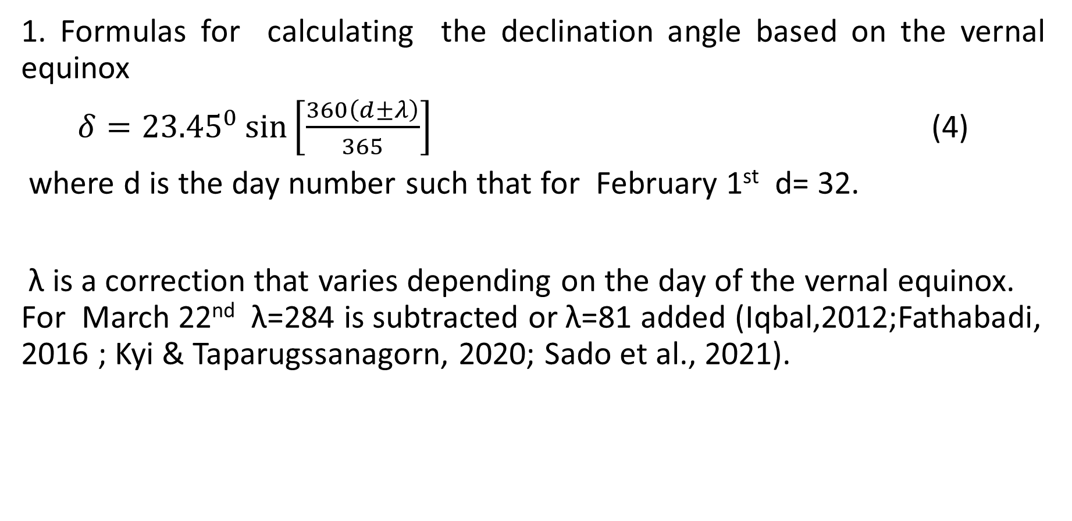
Methodology
1. Formulas for calculating the declination angle based on the vernal equinox
$δ={23.45}^{0}\sin\left[\frac{360\left(d±λ\right)}{365}\right]$ (4)
where d is the day number such that for February 1st d= 32.
λ is a correction that varies depending on the day of the vernal equinox. For March 22nd λ=284 is subtracted or λ=81 added (Iqbal,2012;Fathabadi, 2016 ; Kyi & Taparugssanagorn, 2020; Sado et al., 2021).
Notes:
using a sine approximation with an amplitude of 23.45⁰
March 23rd equinox λ=82 is subtracted;March 21st where λ=80 is subtracted

Slide 10
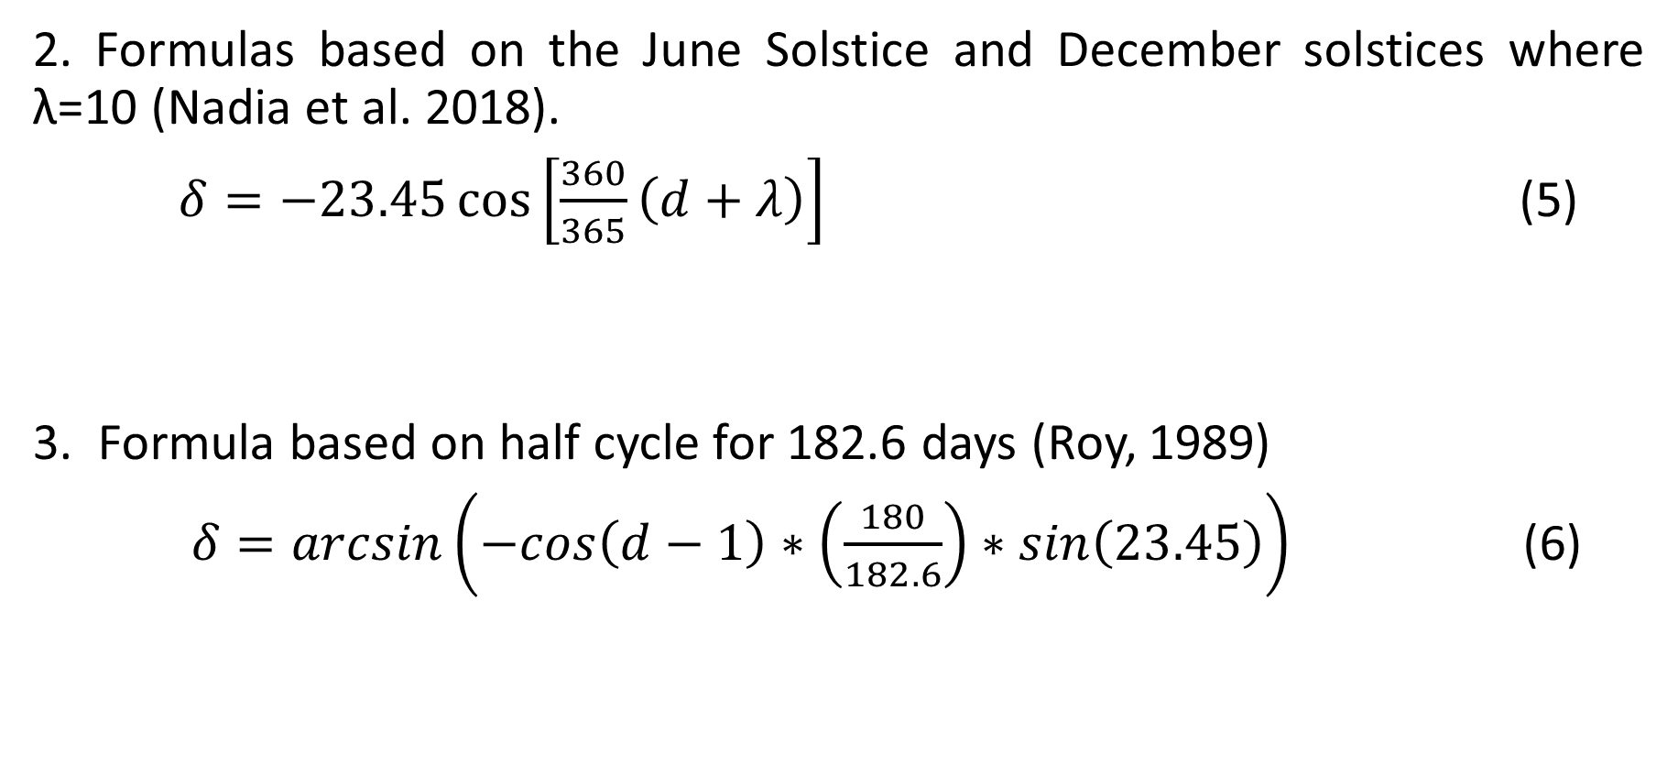
Methodology cont….
2. Formulas based on the June Solstice and December solstices where λ=10 (Nadia et al. 2018).
$δ=−23.45\cos\left[\frac{360}{365}\left(d+λ\right)\right]$ (5)
3. Formula based on half cycle for 182.6 days (Roy, 1989)
$δ=arcsin\left(−cos\left(d−1\right)∗\left(\frac{180}{182.6}\right)∗sin\left(23.45\right)\right)$ (6)

Slide 11
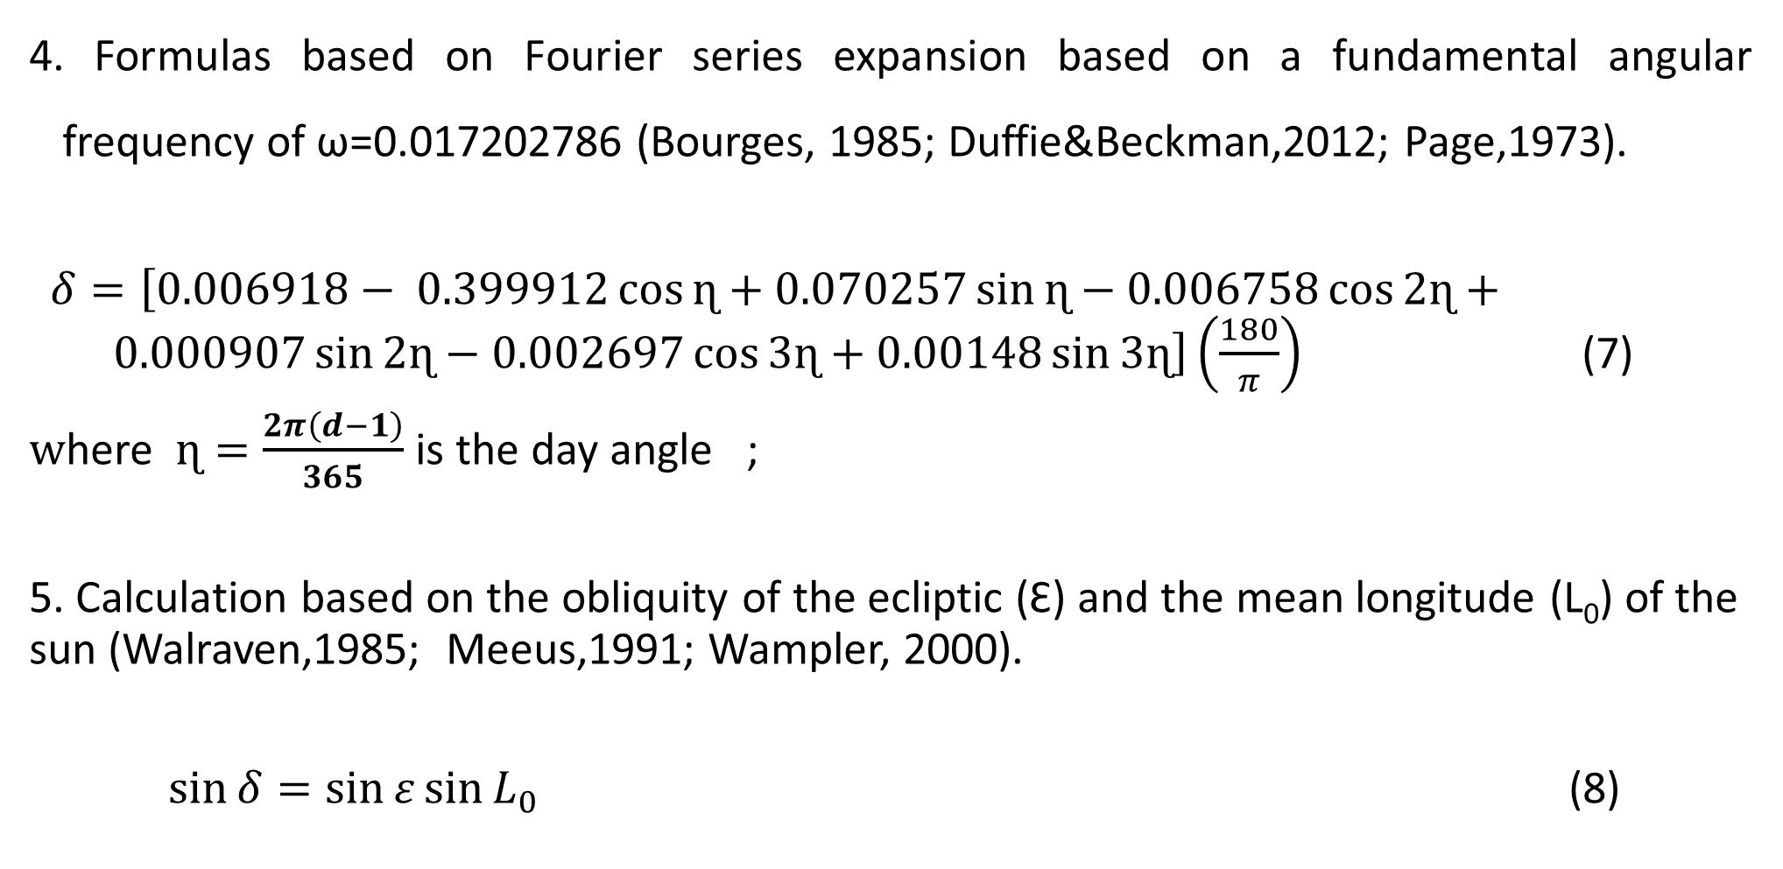
Methodology cont….
4. Formulas based on Fourier series expansion based on a fundamental angular frequency of ω=0.017202786 (Bourges, 1985; Duffie&Beckman,2012; Page,1973).
$δ=\left[0.006918− 0.399912\cos{ɳ+0.070257\sin{ɳ}−0.006758\cos{2ɳ}}+ 0.000907\sin{2ɳ−0.002697\cos{3ɳ+0.00148\sin{3ɳ}}}\right]\left(\frac{180}{π}\right)$ (7)
$w$here $ɳ=\frac{2π\left(d−1\right)}{365}$ is the day angle ;
5. Calculation based on the obliquity of the ecliptic (Ɛ) and the mean longitude (L₀) of the sun (Walraven,1985; Meeus,1991; Wampler, 2000).
$\sin{δ=\sin{ε\sin{L_{0}}}}$ (8)

Slide 12
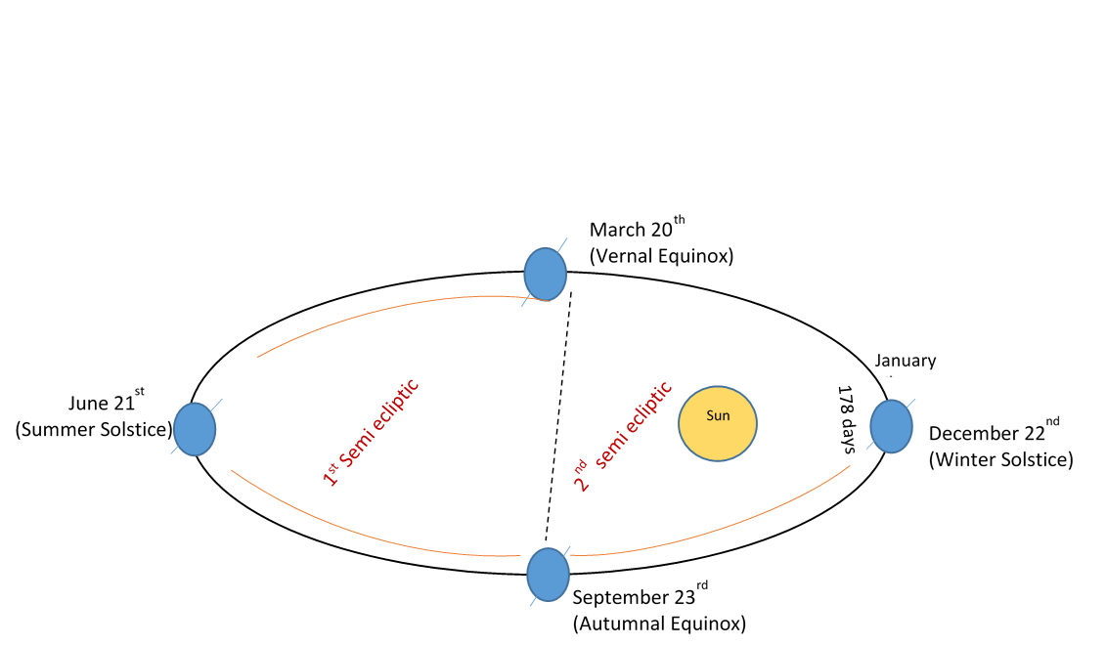
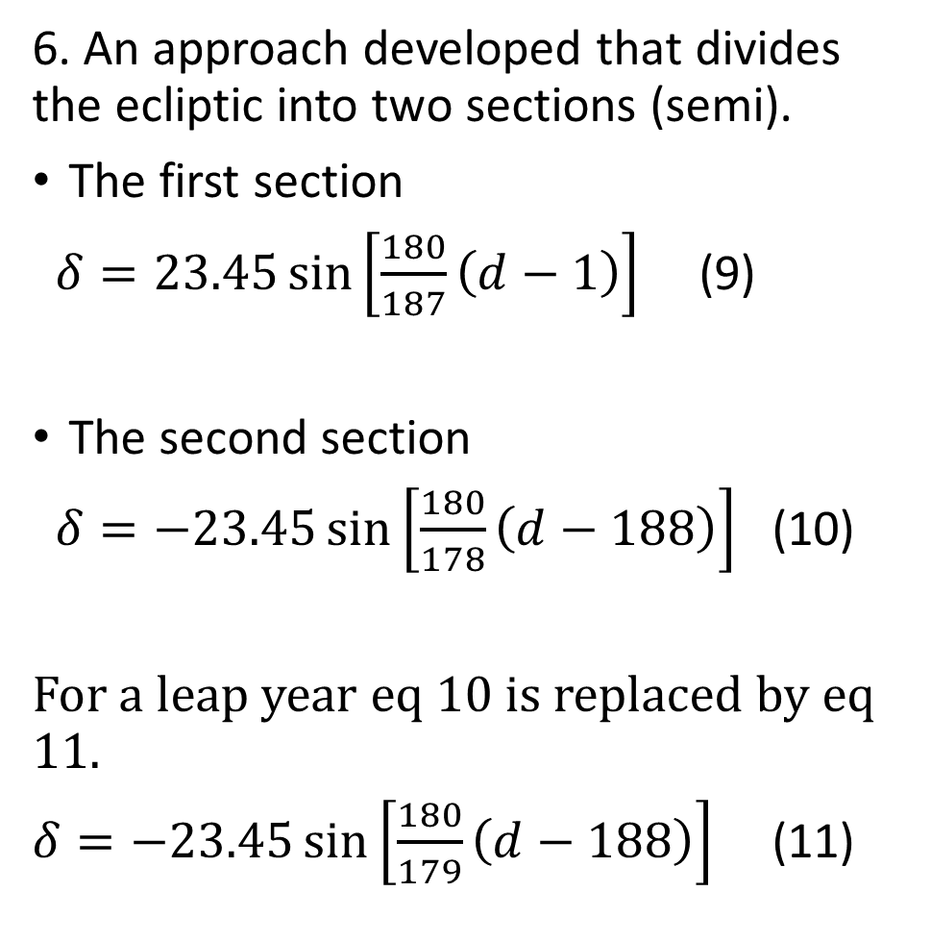
Methodology cont….
6. An approach developed that divides the ecliptic into two sections (semi).
The first section
$δ=23.45\sin\left[\frac{180}{187}\left(d−1\right)\right]$ (9)
The second section
$δ=−23.45\sin\left[\frac{180}{178}\left(d−188\right)\right]$ (10)
For a leap year eq 10 is replaced by eq 11.
$δ=−23.45\sin\left[\frac{180}{179}\left(d−188\right)\right]$ (11)
Figure 4:The two semi-ecliptic sections of the Earth’s orbit around the sun

Slide 13
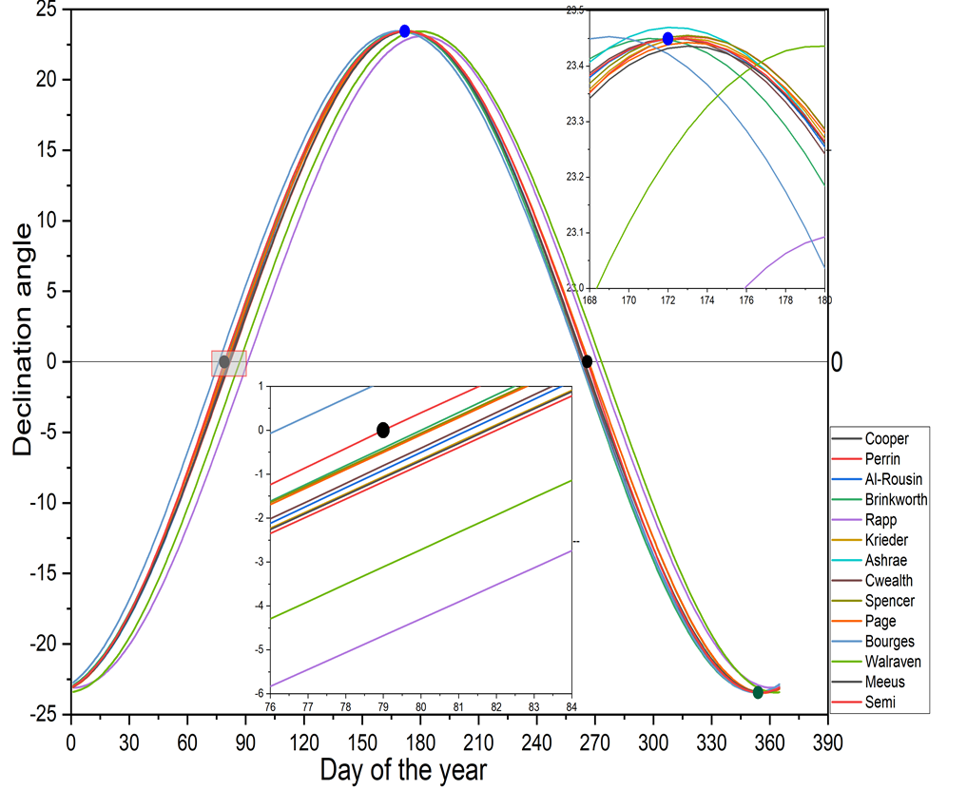
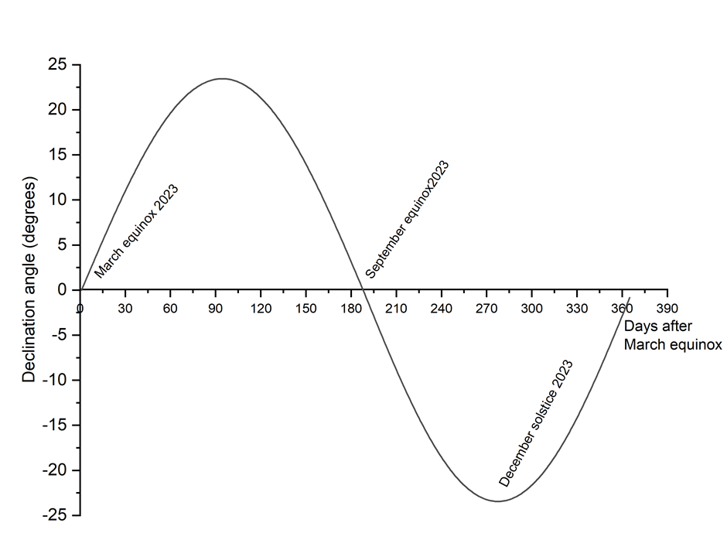
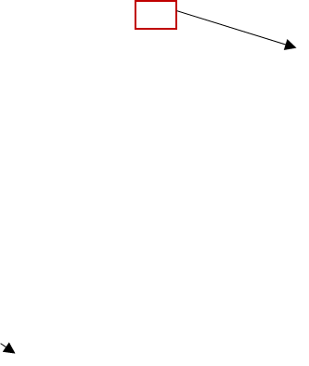
Results and Discussion
Figure 5 :Variation of declination angle as modelled by equation 6 and 7.
Figure 6 :The declination angle for a year was modelled using 14 equation

Slide 14
Results and Discussion
Figure 8: Errors in calculation of the declination angle around the equinoxes and solstices

Slide 15
Conclusion
From the formulas reviewed in this work, the Fourier series formula by Spencer had the least error for the prediction of the declination angle around the equinoxes and solstices.
The developed formula gave a good prediction for the declination angle for the equinoxes and solstices and can be developed further for use in a SPA.

Slide 16
References
Akram Abood. (2015). A comprehensive solar angles simulation and calculation using matlab. 6(4), 367–376.
AL-Rousan, N., Isa, N. A. M., & Desa, M. K. M. (2018). Advances in solar photovoltaic tracking systems: A review. Renewable and Sustainable Energy Reviews, 82, 2548–2569. https://doi.org/10.1016/j.rser.2017.09.077
Chen, J. (2011). Physics of Solar Energy. John Wiley & Sons.
Dufﬁe, J. A., & Beckman, W. A. (2013). Solar Engineering of Thermal Processes (Fourth). Wiley & sons.
Grena, R. (2012). Five new algorithms for the computation of sun position from 2010 to 2110. Solar Energy, 86(5), 1323–1337. https://doi.org/10.1016/j.solener.2012.01.024
Iqbal, M. (1983). An introduction to solar radiation. Academic Press.
Jean Meeus. (1998). Astronomical algorithms (Second). Willmann-Bell.

Slide 17
References
Kalogirou, S. (2009). Solar energy engineering: Processes and systems. Elsevier/Academic Press.
Kyi, S., & Taparugssanagorn, A. (2020). Wireless sensing for a solar power system. Digital Communications and Networks, 6(1), 51–57. https://doi.org/10.1016/j.dcan.2018.11.002
Makenzi, M., Muguthu, J., & Murimi, E. (2020). Maximization of site-specific solar photovoltaic energy generation through tilt angle and sun-hours optimization. Journal of Renewable Energy, \textbf 2020.
P. I Cooper. (1969). The absorption of Radiation in Solar Stills. Solar Energy, 12, 333–346
Roy, G. G., Rodrigo, M., & King, W. K. (1989a). A Note on Solar Declination and the Equation of Time. Architectural Science Review, 32(2), 43–51. https://doi.org/10.1080/00038628.1989.9696649

Slide 18
Acknowledgement
University of Nairobi and the Department of Physics fraternity.

Slide 19


