Slide 1




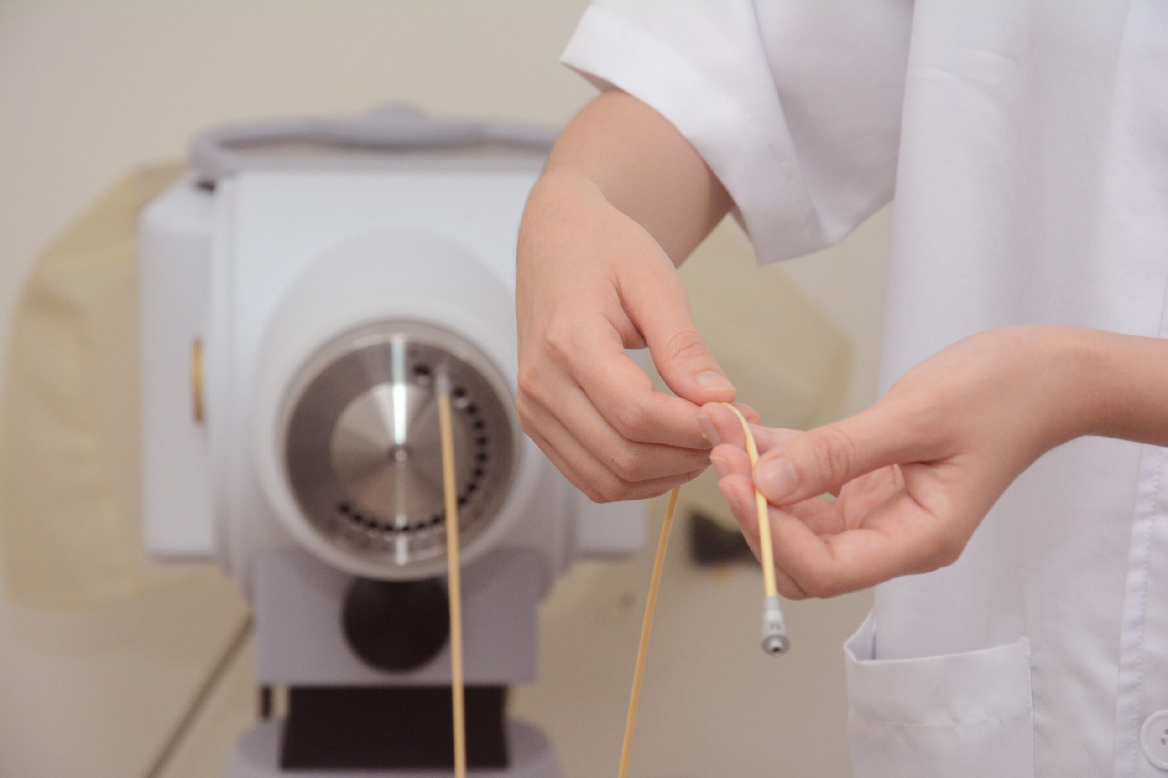
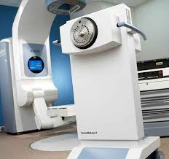

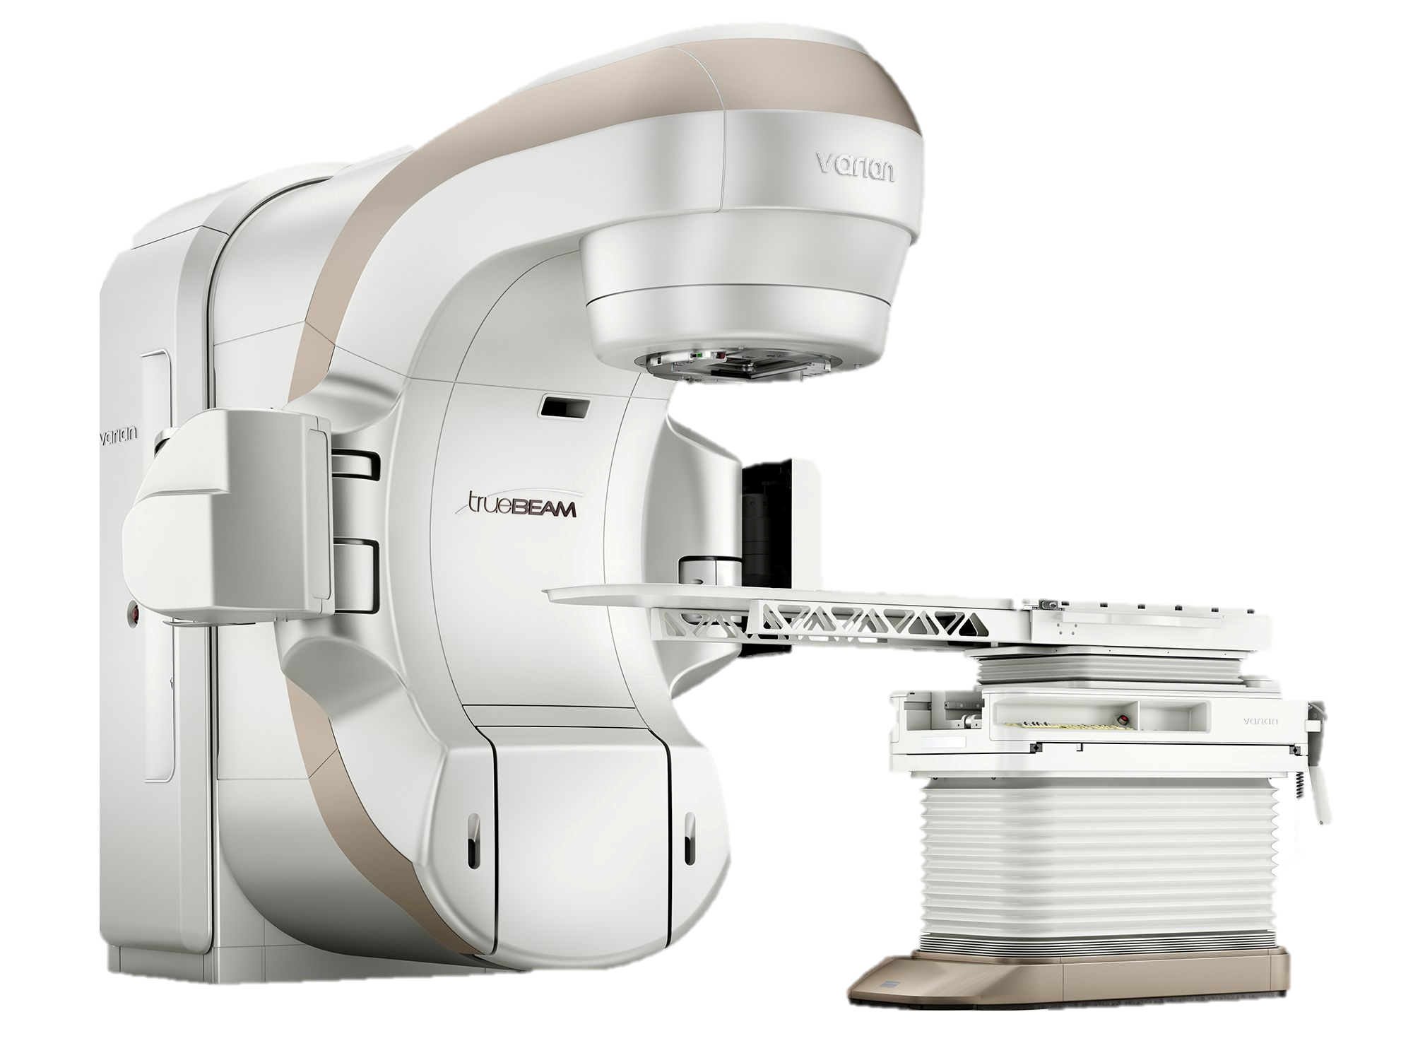
Evaluation of Treatment Planning System (TPS) Accuracy in Brachytherapy Using Analytical Dose Calculation Methods
The 4th African Conference of Fundamental Physics and Applications, ACP2025
Authors:
AZAIRI F.¹, GHASSOUN J.*¹ BECHCHAR R.¹ Kabrane S. ¹.
EPRA, Department of physics, Faculty of Sciences Semlalia PO Box: 2390, 40000 Marrakech, Morocco

Slide 2
Evaluation of Treatment Planning System (TPS) Accuracy in Brachytherapy Using Analytical Dose Calculation Methods
The 4th African Conference of Fundamental Physics and Applications, ACP2025
Authors:
AZAIRI F.¹, GHASSOUN J.*¹ BECHCHAR R.¹
EPRA, Department of physics, Faculty of Sciences Semlalia PO Box: 2390, 40000 Marrakech, Morocco

Slide 3

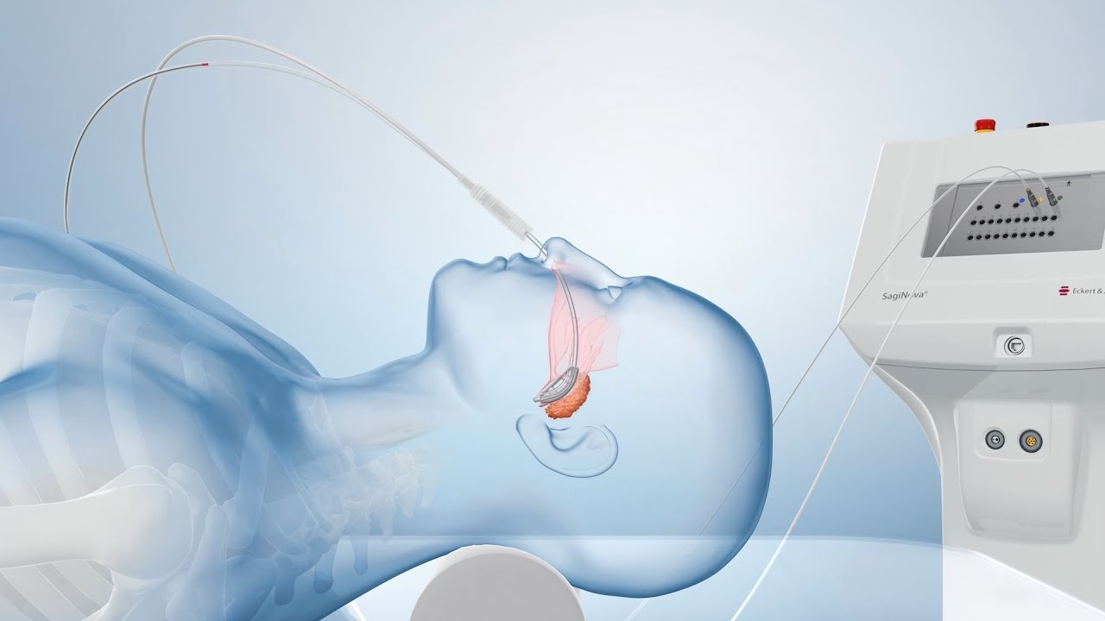
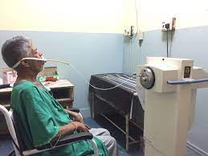
Brachytherapy is a form of internal radiotherapy in which sealed radioactive sources are placed inside or very close to the tumor, delivering a high radiation dose to the target while sparing surrounding healthy tissues (Gholami et al., 2016).

Slide 4
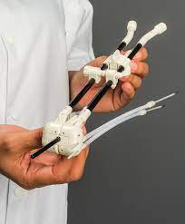
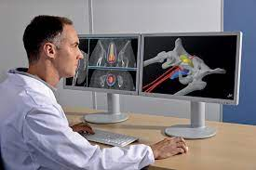
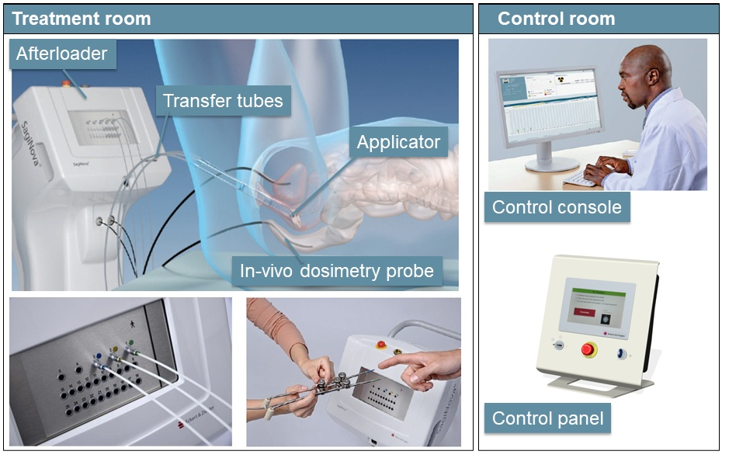
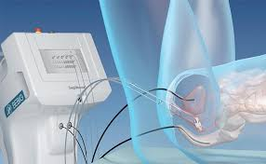
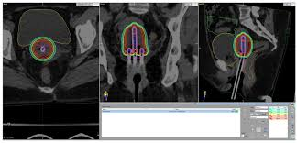
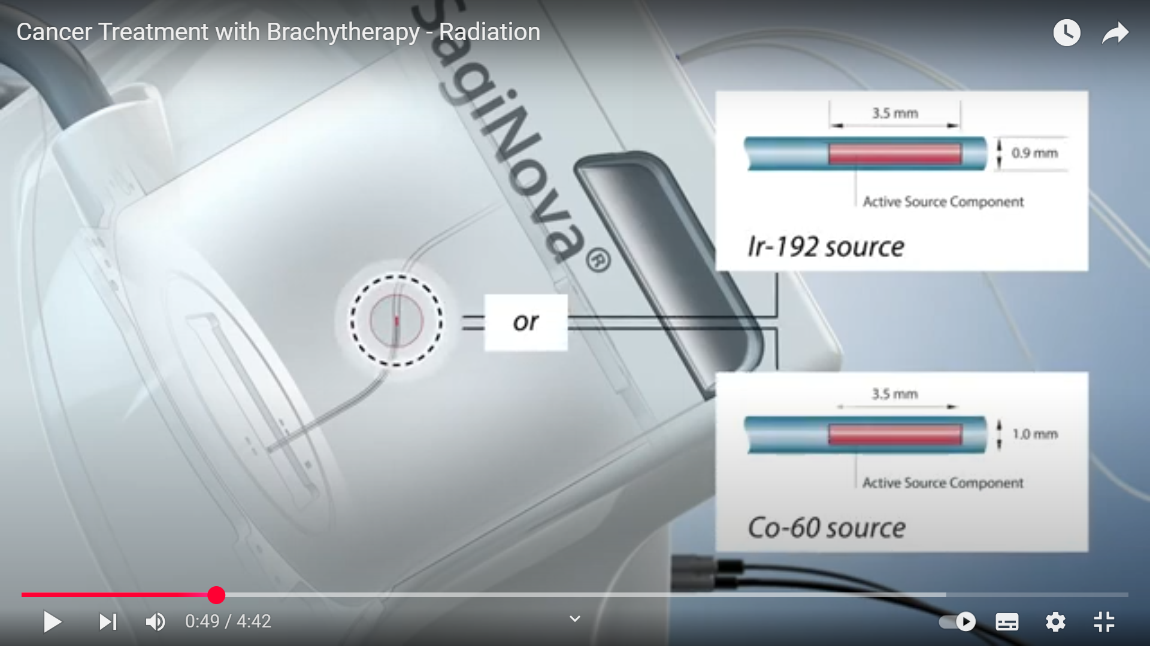
An afterloader is a device used in brachytherapy to remotely position and control radioactive sources within applicators placed in or near the treatment site.

Slide 5
Inside the afterloader, there is a radioactive source such as Ir-192 or Cobalt-60.

Slide 6
These channels connected to catheters serve as pathways that guide the radioactive source.

Slide 7
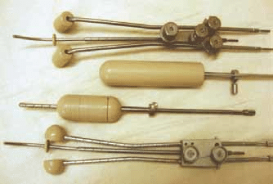
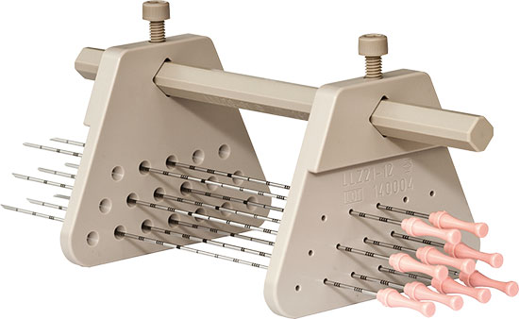
These catheters are connected to an applicator that is placed inside or in contact with the tumor, through which the source will deliver the prescribed treatment according to the protocol.

Slide 8
The treatment protocol is prepared in advance using a treatment planning system (TPS), which utilizes a dose calculation algorithm using the patient’s anatomical data obtained from a CT simulator.

Slide 9
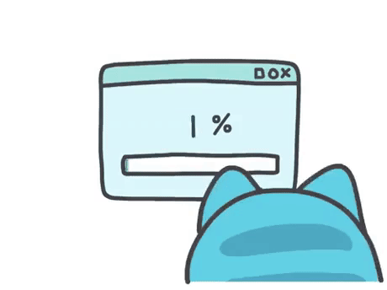




Brachytherapy is an indispensable modality for treating certain tumor types. Almost all commercial brachytherapy treatment planning systems (TPSs) were originally based on the AAPM TG-43 formalism, which is derived from dose calculations in a homogeneous water-equivalent medium and does not account for tissue heterogeneities, air cavities, or applicator attenuation.
This limitation, can introduce systematic errors. Such errors may result in underdosing the tumor, thereby reducing treatment effectiveness, or overdosing surrounding healthy tissues.
Therefore, independent verification of dose distributions is essential to ensure accurate and safe treatment delivery.
TPS dose
Delivered dose
This study aims to evaluate the accuracy of two analytical approaches, the Dose Kernel Method (DKM) and the Integral Sievert method, by comparing them with TPS dose distributions in a solid phantom we designed

Slide 10

MATERALS & METHODS

Slide 11
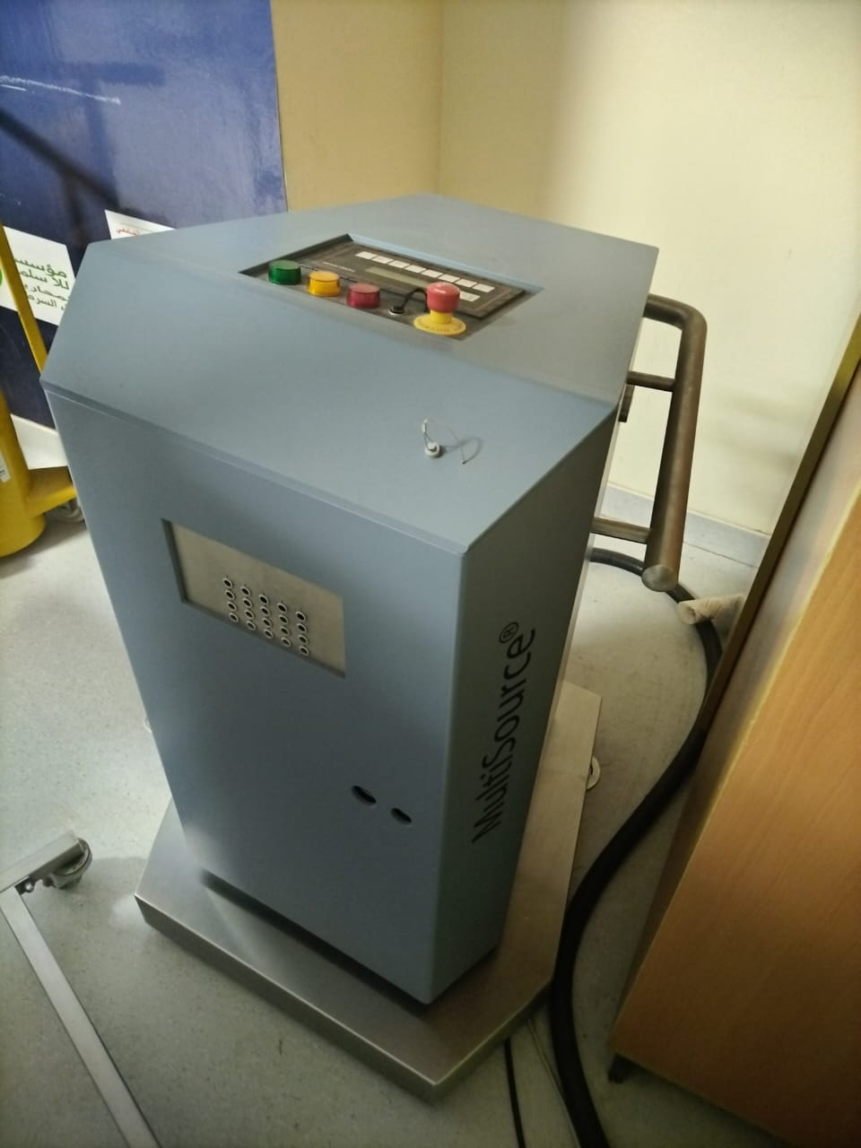
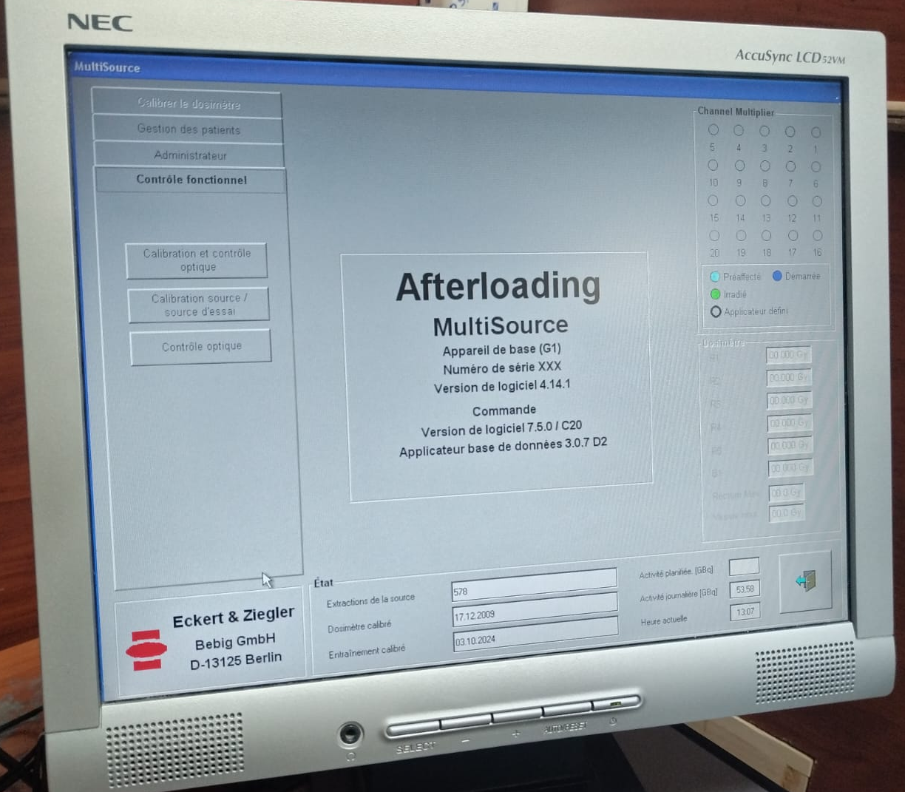
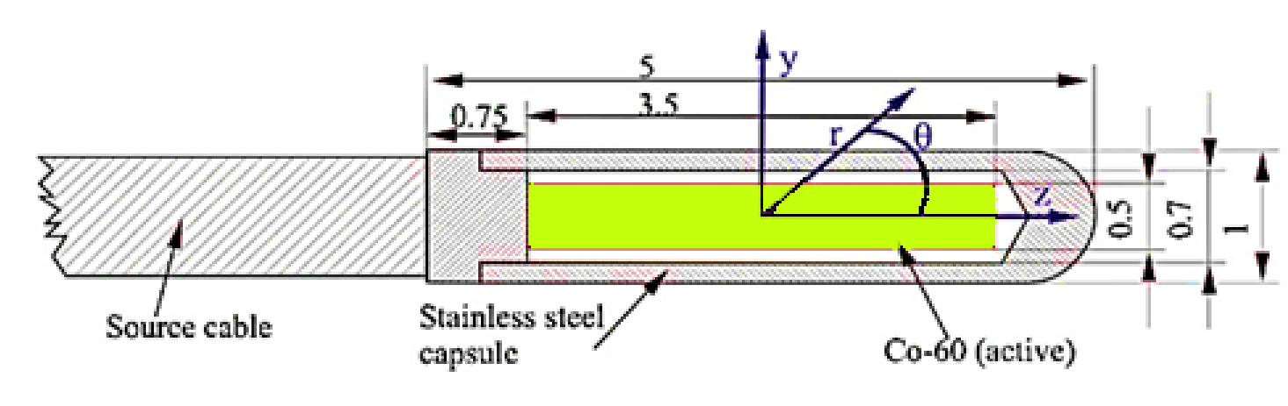
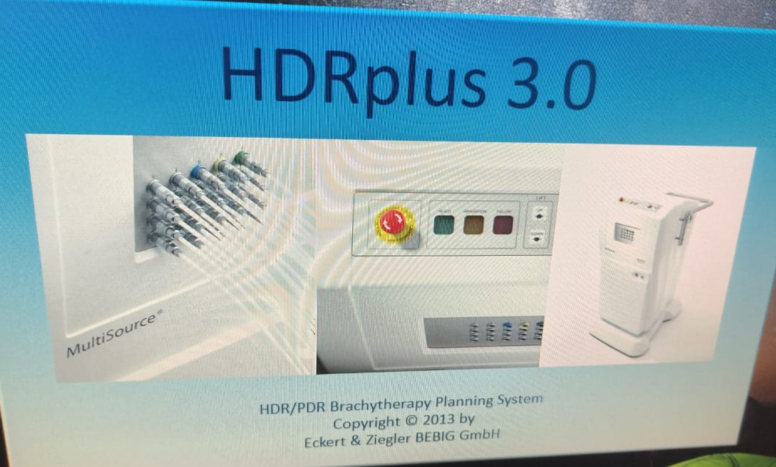
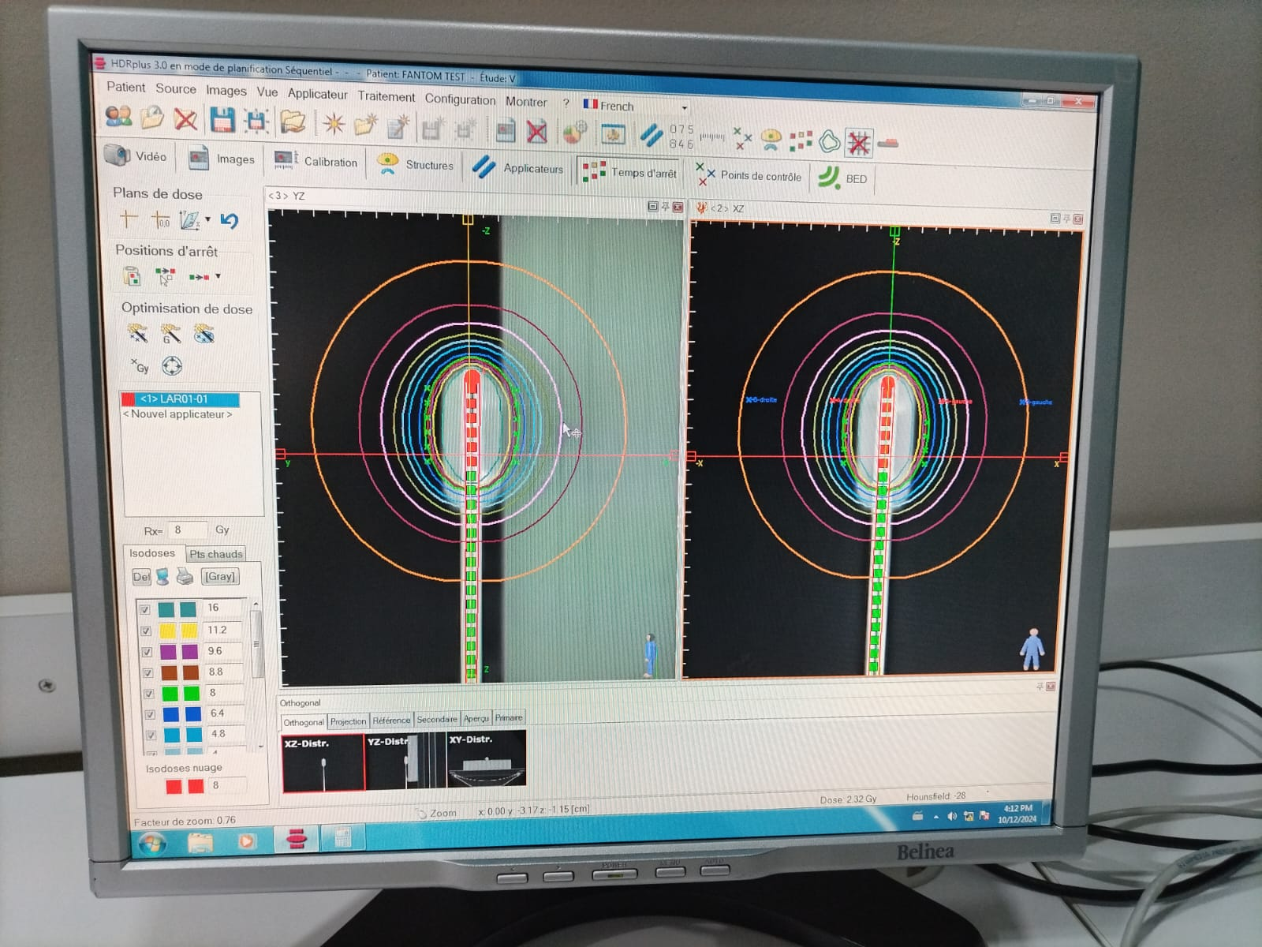
60Co HDR afterloading multisource software by Eckert & Ziegler
60Co BEBIG HDR A0.86 source geometry
60Co HDR Multisource afterloader by Eckert & Ziegler
TPS HDRplus version of 3.0

Slide 12
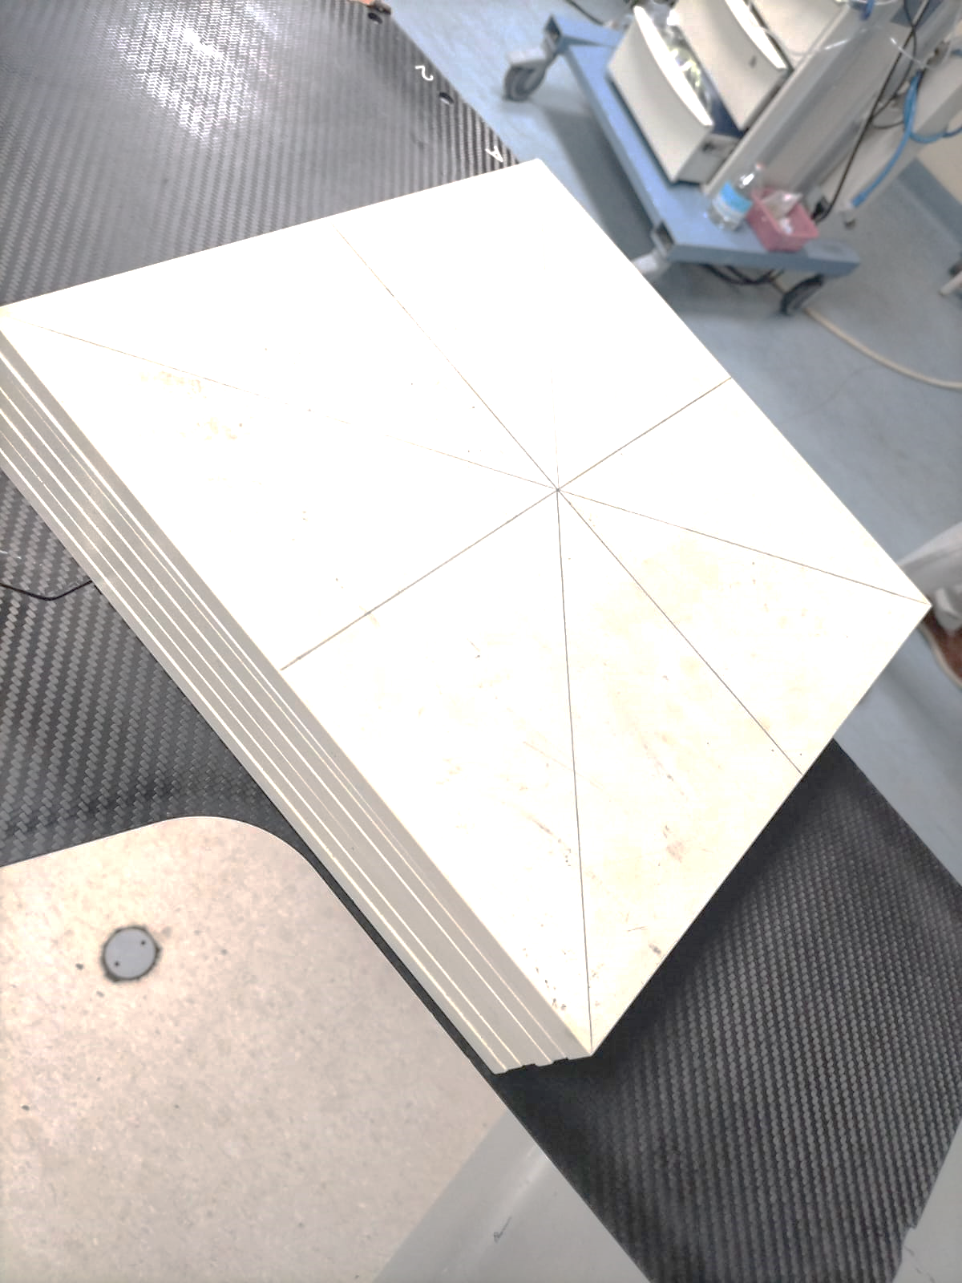
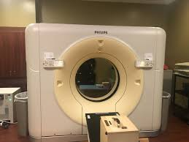
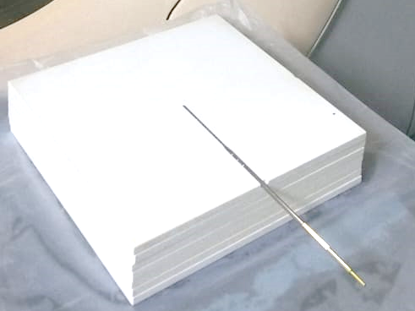
A solid SP34 phantom slab (density: 1.045g/cm³), made of 21 white polystyrene of type RW3
Simulator Scanner CT Bigbore of PHILIPS
LCT01-01 applicator

Slide 13
Preparation of the phantom
A cavity was precisely machined using an appropriate drilling tool by a qualified technician to accommodate the LCT01-01 applicator. The location of the applicator was chosen to ensure it remains parallel to the surface of the slab. The slab carrying the applicator was placed in the middle, corresponding to the 11th slab counting from top to bottom.

Slide 14
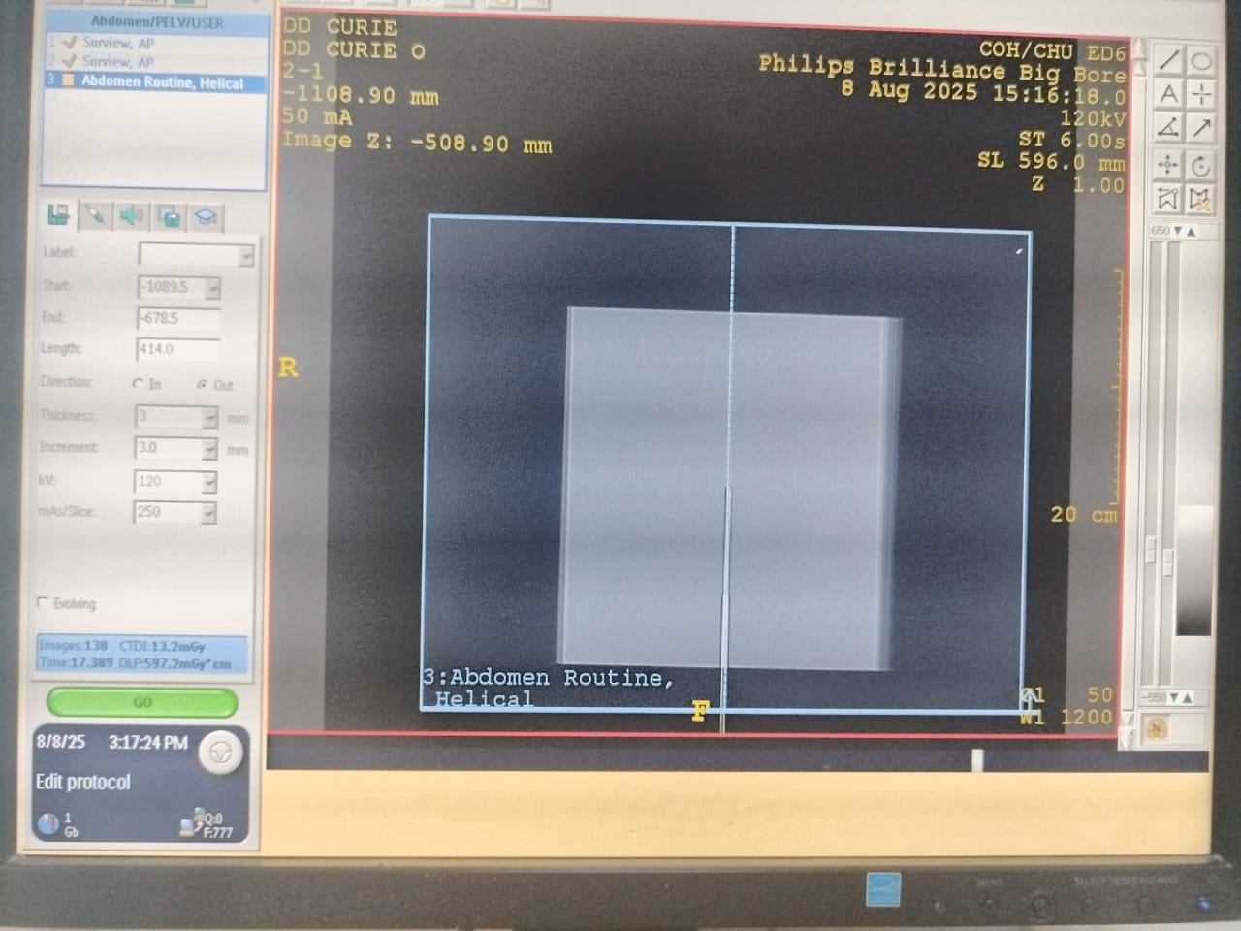
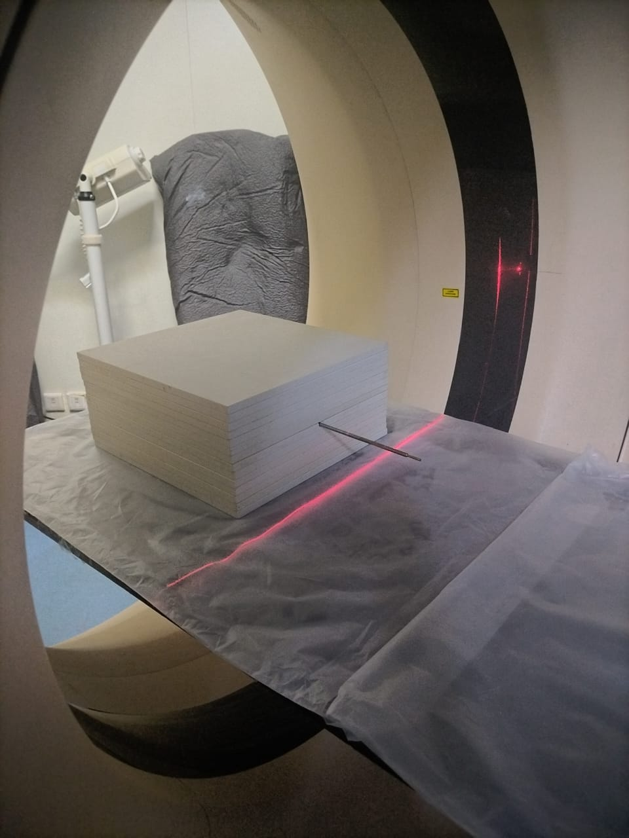
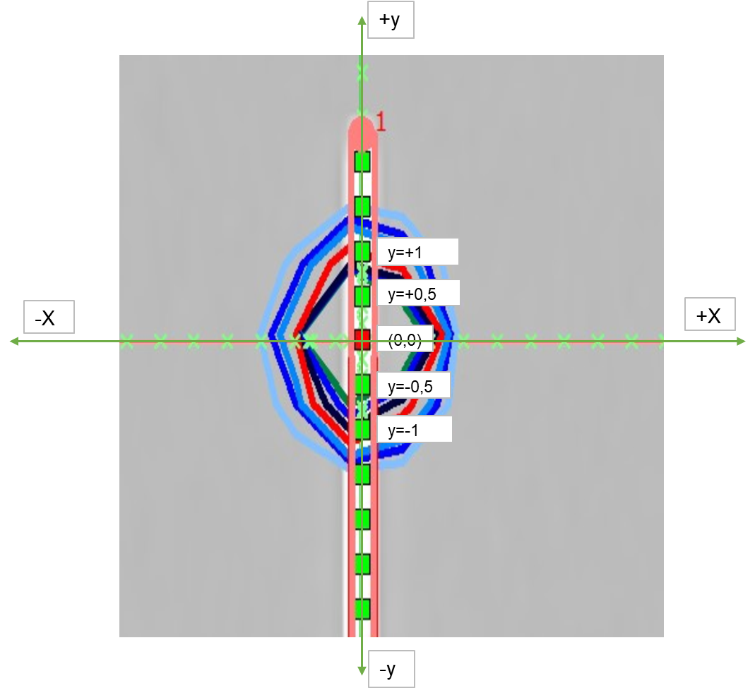
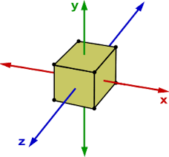
Step 1: The A-Solid SP34 phantom, composed of 21 slabs with the LCT01-01 applicator positioned at the center of the 11th slab, was scanned using a CT simulator. The scan was performed with a pelvis protocol and a slice thickness of 3 mm.
+Z
-Y
Step 2: The DICOM images of the scanned phantom were imported into the TPS to prepare 5 treatment plans. Each plan included a single dwell position of the source, as shown in the figure. The delivered doses were 2 Gy (100% at 1 cm).
+X
-X
+Y
-Z

Slide 15
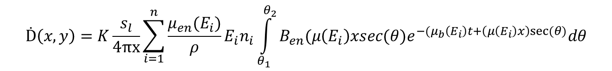



Integral Sievert and DKM analytic methods
Sievert Integral ( Dumenya et al. (2022) )
$$D=\frac{f_{med}.S_{k}.t_{dwell}}{L.x.\frac{\overline{W}}{e}}.e^{μ^{′}t}\int_{θ_{1}}^{θ_{2}}{e^{−μ^{′}.t.secθ}dθ}$$
$$r=\sqrt{x^{2}+y^{2}}$$
$$M_{poly}=A+Br+Cr^{2}+Dr^{3}$$
$$D_{corrected}=D ×M_{poly(r_{i})}$$
Dose kernel method by Bechchar et al.(Bechchar et al., 2019)
$$Ḋ\left(x,y\right)=K\frac{s_{l}}{4πx}\sum_{i=1}^{n}{\frac{μ_{en}(E_{i})}{ρ}E_{i}n_{i}\int_{θ_{1}}^{θ_{2}}{B_{en}(μ\left(E_{i}\right)xsec(θ)e^{−(μ_{b}\left(E_{i}\right)t+\left(μ\left(E_{i}\right)x\right)sec⁡(θ)}dθ}}$$

Slide 16


INTEGRAL SIEVERT
DKM
$f_{med}:$ roentgen-to- rad conversion factor
$S_{k}:$gamma emission rate per unit length (γ·cm⁻¹·s⁻¹)
$t_{dwell}$: the source dwell time (s).
L: half active length or length used in geometry (cm)
x: control points of dose calculation (cm)
μ’: the effective attenuation coefficient (cm⁻¹)
T : shield thickness (cm)
$θ_{1}$​ and $θ_{2}$​ represent the angular integration limits.
$\frac{\overline{W}}{e}$: the average work done per unit charge (cGy·kg/C)
t: capsule thickness (cm).
$M_{poly}$: Meisberger polynomial.
r = distance from the source to control point calculated using x and y values
A, B, C and D are constants or polynomial coefficients whose values are source dependent and for ⁶⁰Co.
K: constant used to convert energy from MeV/g to Gy.
$s_{l}$​: linear activity (Bq/cm).
x: control points of dose calculation (cm)
μen​(Ei​): linear absorption coefficient for each energy (cm⁻¹).
ρ: medium density (g/cm³).
$θ_{1}$​ and $θ_{2}$​ represent the angular integration limits.
$n_{i}$​: number of photons emitted with energy Ei​ per nuclear disintegration.
$E_{i}$​: energy emitted by the source (MeV).
μ(Ei​): linear attenuation coefficient for each energy (cm⁻¹).
$B_{en}(μ\left(E_{i}\right)xsec\left(θ\right))$ : energy absorption buildup factor.
$μ_{b}\left(E_{i}\right)$ : effective filtration coefficient (cm⁻¹).
t: capsule thickness (cm).

Slide 17
Validation
Validation of our IS calculation using MATLAB
Comparison
Comparison between published works and our calculation for IS and DKM in Water
Comparison /TPS Accuracy
IS against DKM in different Dwell positions solid phantom SP34
Notes:
Our study is structured around three main parts

Slide 18
RESULTS & DISCUSSION

Slide 19
Validation of our Intergal Sievert calculation
y=-1 |  |  |  | y=+1
x | Article sievert [1] | Article TPS [1] | Our calculation with data of article (Sv) | Article Calculation [1] | Article TPS [1] | Our calculation with data of article (Sv) | Deviation
 |  |  |  |  |  |  | Y=-1 | Y=+1
1 | 1.98 | 2.01 | 2.02 | 1.90 | 2.00 | 1.94 | 2% | 2%
2 | 0.79 | 0.79 | 0.80 | 0.76 | 0.78 | 0.77 | 1% | 1%
3 | 0.39 | 0.39 | 0.39 | 0.38 | 0.38 | 0.38 | 0% | 0%
4 | 0.23 | 0.23 | 0.23 | 0.22 | 0.22 | 0.22 | 0% | 0%
5 | 0.14 | 0.15 | 0.14 | 0.14 | 0.14 | 0.14 | 0% | 0%
6 | 0.10 | 0.10 | 0.10 | 0.10 | 0.10 | 0.10 | 0% | 0%
Table 1 : Comparison of dose values obtained with the Integral Sievert method for the source at y = ±1 cm, with those reported by Umenya et al. (2022) using IS and TPS in a water phantom for Co-60 A086
Our results are consistent with the calculated values reported by Umenya et al. (2022), with a small deviation of 2% observed at two points. This minor difference can be attributed to numerical rounding or interpolation in the MATLAB implementation. Overall, this confirms that our code accurately reproduces the reference calculations.

Slide 20
Comparison between our results with those published
x(cm) | Bhola et al. | Integral Sievert | DKM
1 | 0% | 1% | 2%
2 | 1% | 0% | 2%
3 | 2% | 0% | 1%
4 | 2% | 0% | 1%
5 | 2% | 1% | 1%
10 | 2% | 4% | 1%
Figure 1
Table 2
Figure 1: the absorbed dose along the x-axis for dwell position y = 0 in a water phantom (Cobalt-60 A086) was calculated using the IS and DKM. Results were compared with published values from Bhola et al. (analytical approch) and Reddy et al. (Monte Carlo, EGS), and deviations are shown in the table 2 .
The figure shows the four curves closely aligned, indicating good agreement between our calculations for both methods and the published results. A similar observation is seen in terms of deviations, which do not exceed 4% (tolerance < 5% according to the ICRU report).

Slide 21
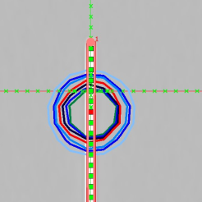
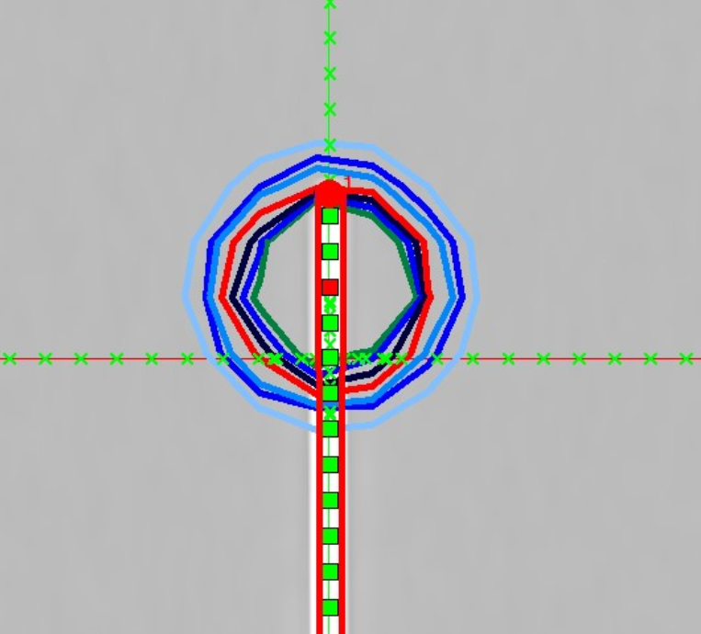

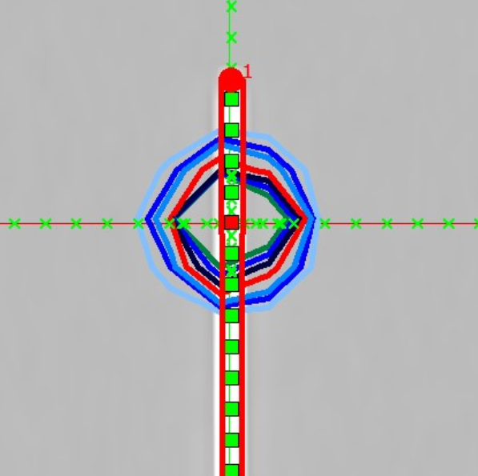
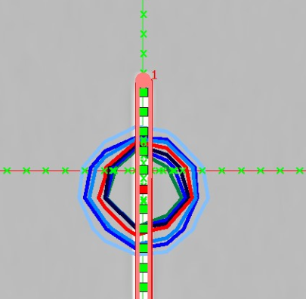
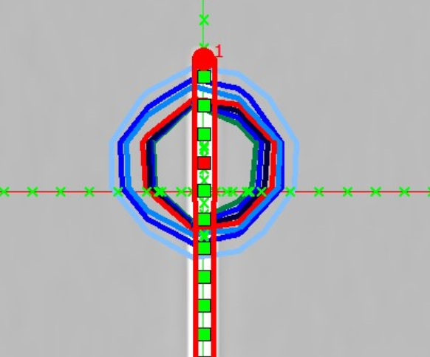
Y=-1
Y=1
Y=0
Y=-0,5
Y=+0,5

Slide 22
Figure 2
Each of these figures illustrate the dose calculated at control points (x) for five dwell positions using the Integral Sievert and Dose Kernel methods, compared to TPS in the SP34 solid phantom. All curves show good agreement with TPS at most control points; however, to analyze the results more precisely, a table of deviations was also calculated.

Slide 23
INTEGRAL SIEVERT |  |  |  |  |  | DKM
x | y=-1 | y=-0,5 | y=0 | y=0,5 | y=1 | y=-1 | y=-0,5 | y=0 | y=0,5 | y=1
0,2 | 3% | 2% | 9% | 3% | 2% | 1% | 0% | 8% | 1% | 2%
0,4 | 2% | 3% | 6% | 4% | 2% | 0% | 2% | 5% | 2% | 0%
0,5 | 2% | 3% | 5% | 4% | 2% | 0% | 2% | 4% | 3% | 1%
0,75 | 2% | 3% | 4% | 3% | 2% | 0% | 2% | 3% | 2% | 1%
0,8 | 2% | 3% | 3% | 3% | 2% | 1% | 2% | 2% | 2% | 1%
1 | 1% | 2% | 3% | 3% | 2% | 0% | 1% | 2% | 2% | 1%
1,5 | 2% | 2% | 2% | 2% | 1% | 1% | 1% | 1% | 1% | 0%
2 | 1% | 2% | 2% | 2% | 1% | 0% | 2% | 0% | 0% | 0%
2,5 | 0% | 0% | 0% | 3% | 2% | 2% | 0% | 0% | 0% | 0%
3 | 0% | 0% | 0% | 0% | 3% | 0% | 4% | 0% | 0% | 0%
3,5 | 0% | 0% | 6% | 0% | 0% | 0% | 0% | 0% | 0% | 0%
4 | 4% | 0% | 0% | 0% | 0% | 0% | 0% | 0% | 0% | 0%
4,5 | 0% | 0% | 0% | 0% | 0% | 0% | 0% | 0% | 9% | 0%
5 | 7% | 0% | 0% | 0% | 0% | 0% | 0% | 0% | 0% | 0%
5,5 | 0% | 0% | 0% | 13% | 0% | 0% | 0% | 0% | 0% | 0%
6 | 0% | 0% | 0% | 0% | 0% | 0% | 0% | 0% | 0% | 0%
6,5 | 11% | 0% | 0% | 0% | 0% | 0% | 0% | 0% | 0% | 0%
7 | 0% | 0% | 0% | 20% | 0% | 0% | 0% | 0% | 0% | 0%
8 | 17% | 0% | 0% | 0% | 0% | 0% | 17% | 0% | 0% | 0%
9 | 0% | 0% | 0% | 0% | 0% | 0% | 0% | 0% | 0% | 0%
10 | 0% | 0% | 0% | 0% | 0% | 0% | 0% | 0% | 0% | 0%
12 | 0% | 0% | 0% | 0% | 0% | 0% | 0% | 0% | 0% | 0%
14 | 0% | 0% | 0% | 0% | 0% | 0% | 0% | 0% | 0% | 0%
Table 3: Percentage deviation of calculated dose values from TPS reference doses, using the Integral Sievert (IS) and Dose Kernel Method (DKM) at different dwell positions.

Slide 24
Results and Discussion
Integral Sievert method
Deviations: 0–20%
106 points < 5%, 69 points < 2%
Largest deviation: 20% at 7 cm (y = 0.5 cm)
8 points > 5% tolerance
Dose Kernel Method (DKM)
Deviations: generally smaller
111 points < 5%, 94 points < 2%
Largest deviation: 17% at 8 cm
4 points > 5% tolerance

Slide 25
Results and Discussion
The DKM showed closer agreement with the TPS, with fewer points exceeding tolerance and smaller overall deviations. This is because the Dose Kernel Method (DKM) incorporates an appropriate buildup factor combined with the attenuation factor (B(µx)·exp(-µx)) (Bechchar et al., 2019). Furthermore, heterogeneity can also be taken into account in brachytherapy dose calculation by using two-region buildup factors, as reported in Bechchar et al.’s study.
In contrast, the Integral Sievert method showed additionnal discrepancies, particularly in some peripheral regions. As reported by Umenya et al. (2022), the Sievert approach introduces significant errors and tends to break down in extreme oblique directions.
Clinically, both methods performed acceptably specially in central regions (0.2–4 cm), but the DKM provides more reliable results for brachytherapy dose calculations.
Integral Sievert method
Deviations: 0–20%
106 points < 5%, 69 points < 2%
Largest deviation: 20% at 7 cm (y = 0.5 cm)
8 points > 5% tolerance
Dose Kernel Method (DKM)
Deviations: generally smaller
111 points < 5%, 94 points < 2%
Largest deviation: 17% at 8 cm
4 points > 5% tolerance

Slide 26
CONCLUSION
The Dose Kernel Method (DKM) showed the closest agreement with the TPS by more accurately modeling attenuation and buildup, which make it a valuable tool for independent dose verification and quality assurance in brachytherapy.

Slide 27
PERSPECTIVES
As we found that The DKM has proven to yield more accurate results in brachytherapy dose calculation., our work can be further extended through validation using Gafchromic film measurements, which is currently underway. This will allow us to assess both analytical methods and, in particular, verify the accuracy of our TPS calculations. In addition, heterogeneity can be considered in brachytherapy dose calculations by applying two-region buildup factors

Slide 28

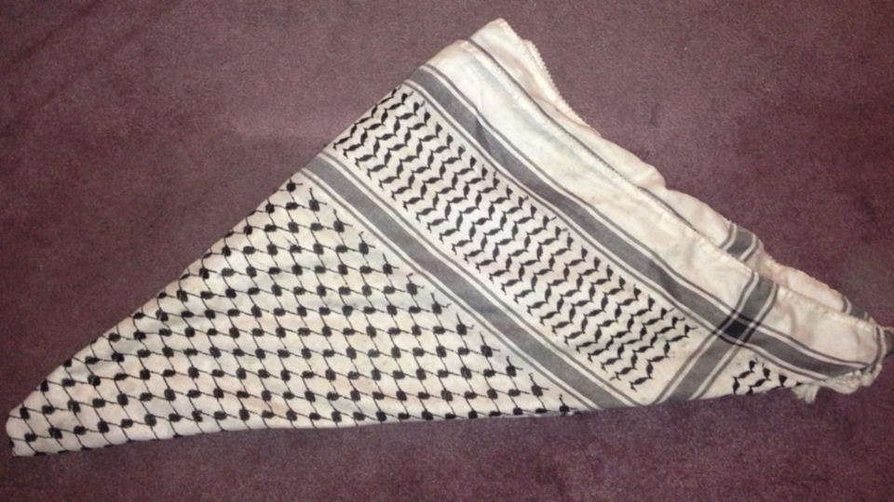
Thank you
THANK YOU

Slide 29
REFERENCES
[1] Dumenya, C., Hasford, F., Tagoe, S. N. A., Sasu, E., Pokoo-Aikins, M., Asamanyuah, B. B., & Amuasi, J. H. (2022). Implementation of the Sievert integral for the calculation of dose distribution around the BEBIG Co-60 high dose rate brachytherapy source. Polish Journal of Medical Physics and Engineering, 28(2), 71–80.
[2] Rivard, M. J., Coursey, B. M., DeWerd, L. A., Hanson, W. F., Huq, M. S., Ibbott, G. S., Mitch, M. G., Nath, R., & Williamson, J. F.
[3] Bechchar, R., Senhou, N., & Ghassoun, J. (2019). A fast and accurate analytical method for 2D dose distribution calculation around brachytherapy sources in various tissue-equivalent phantoms. International Journal of Radiation Research, 17(4), 531–540.
[4] Umenya, C. D., Asford, F. H., Nii, S., Agoe, A. T., & Sasu, E. (2022). Implementation of the Sievert integral for the calculation of dose distribution around the BEBIG Co-60 high dose rate brachytherapy source. Polish Journal of Medical Physics and Engineering, 28(2), 90–98.

Slide 30

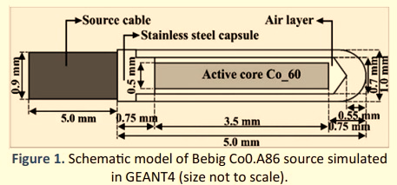
Parpoi de lapplicateur 0,25 mm
AIR = 0,5mm
Diametre total =2,5 mm

Slide 31
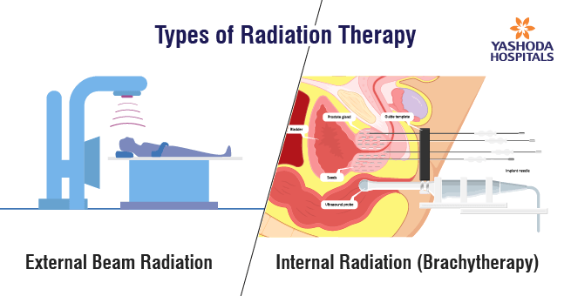
High Dose Rate (HDR) brachytherapy plays a crucial role in the radiotherapeutic management of cancer. When combined with external beam radiotherapy (EBRT), it has been shown to yield superior clinical outcomes compared to EBRT alone, particularly for localized cancers

