Slide 1

Istituto Nazionale di Fisica Nucleare
Muon beams for seismology: predicting earthquakes via active sensing of tectonic faults
M. Rossetti Conti
African Conference of Fundamental and Applied Physics 2025, 17 Sept 2025, Lomé, Togo
Notes:
Good afternoon, thanks for the kind introduction.
In this presentation I will show an innovative particle accelerator application to seismology we studied in the last two years.

Slide 2
Pillars of seismic risk prevention
2
Structural vulnerability reduction
→ Safer buildings & infrastructure
Emergency response planning
→ Prepared communities
Seismic hazard assessment
→ Informed decisions
Structural vulnerability reduction
Emergency response
planning
Seismic
risk prevention
Assessment
of seismic hazard
Integration of all three ensures effective seismic risk prevention
Notes:
Before starting it is important to state that seismic risk prevention is based on 3 pillars…

Slide 3
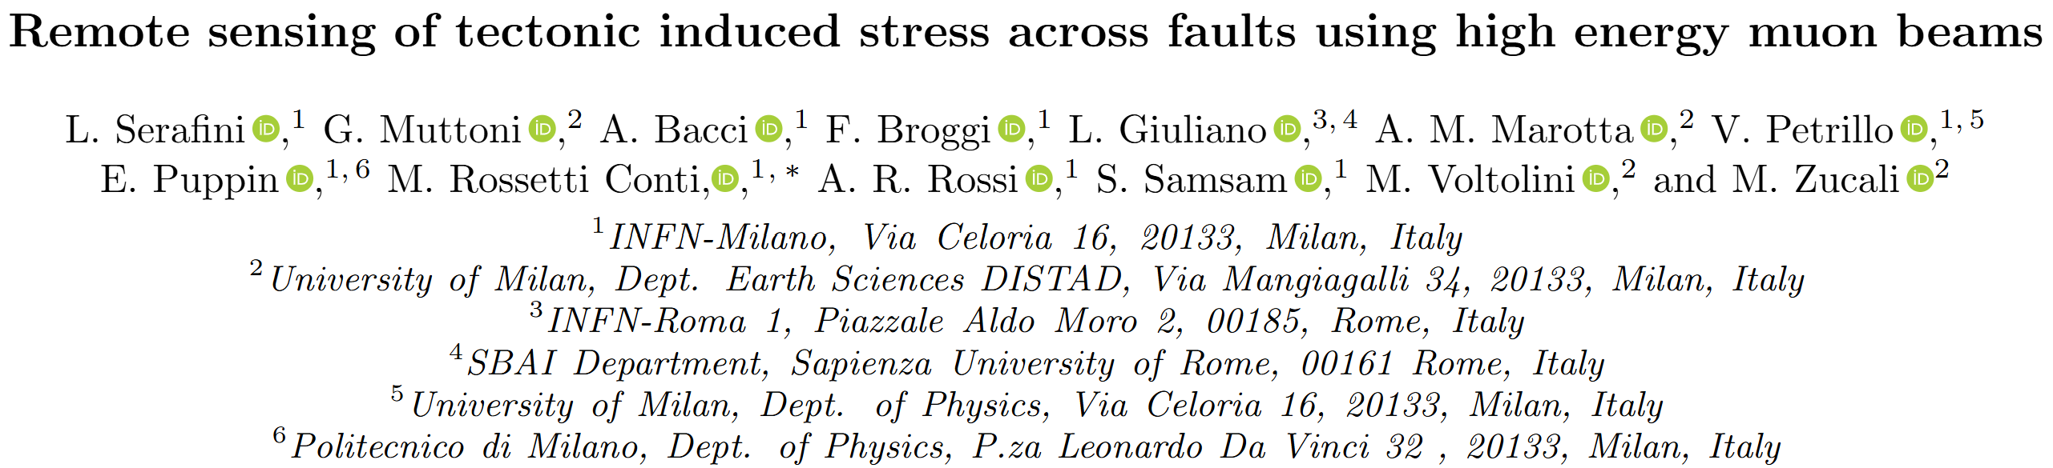
The technique
3
E R M E S
Earthquake Reconnaissance via Muon beam Evolution in Silicon dioxide
The goal: monitoring tectonic stress building-up across seismic faults.
ACCEPTED
PRResearch (8 Sep 2025)

Slide 4
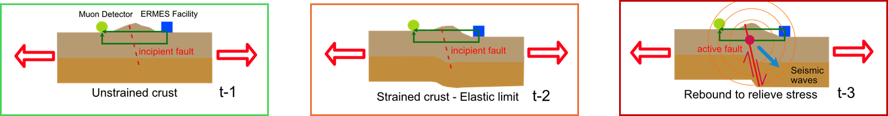
Quartz whispers, muons listen
4
Tectonic stress
Tectonic stress
Courtesy of M. Zucali and G. Muttoni
The physics:
Stress generates an electric field inside piezoelectric materials such as quartz.
Charged particles can be deflected by these fields and transport information about pressure level.
Framework:
Muons are best candidates for this task (can be produced in accelerators and travel long distances in SiO₂)
Technique appliable up to about 10 km dept.
Notes:
In this simplified scheme we see the area close to an incipient fault where the ERMES facility can be located
Earthquakes are triggered once the pressure exceeds the elasto-plastic rupture limit.

Slide 5
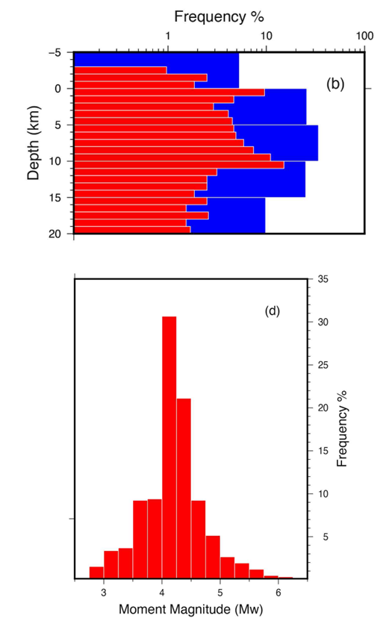
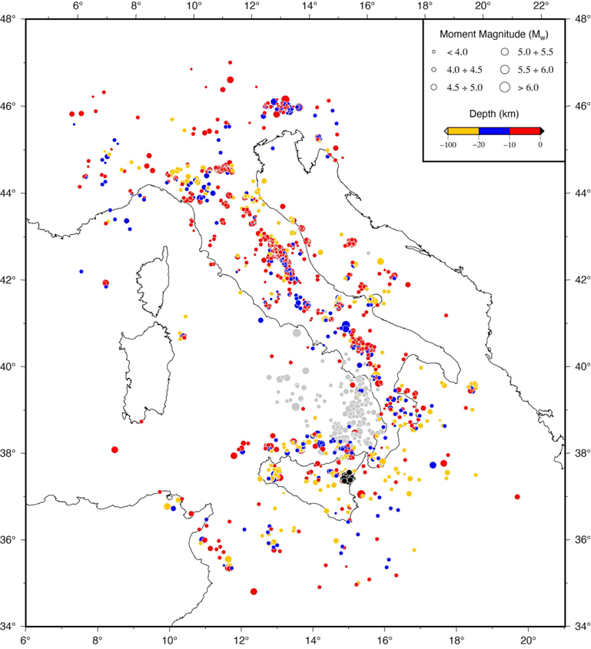
Shallow quakes are common
5
Italian area – earthquake data (1918-2020)
55% of the events occurred at depth below 10 km.
70% of these had momentum magnitude > 4.
Courtesy of A. M. Marotta

Slide 6
MuAEGIS
Modeling muon transport and beam dynamics in stressed quartz-rich rocks

Slide 7

The code
7
ERMES needed a simulator to study charged particle interactions in long crystalline rock sections.
MonteCarlo codes for particle tracking through matter (FLUKA, GEANT4) don’t simulate piezoelectricity.
So we developed our own:
Muon Underground Active Earthquake Genesis Investigation Software
Objective: quantify the modifications on muon beam dynamics in presence of stress induced electric fields.
Developed in python with support for multiprocessing.
MuAEGIS have an internal beam generator but accepts also external beam distributions.
Simulates key effects of beam-rock interaction.

Slide 8
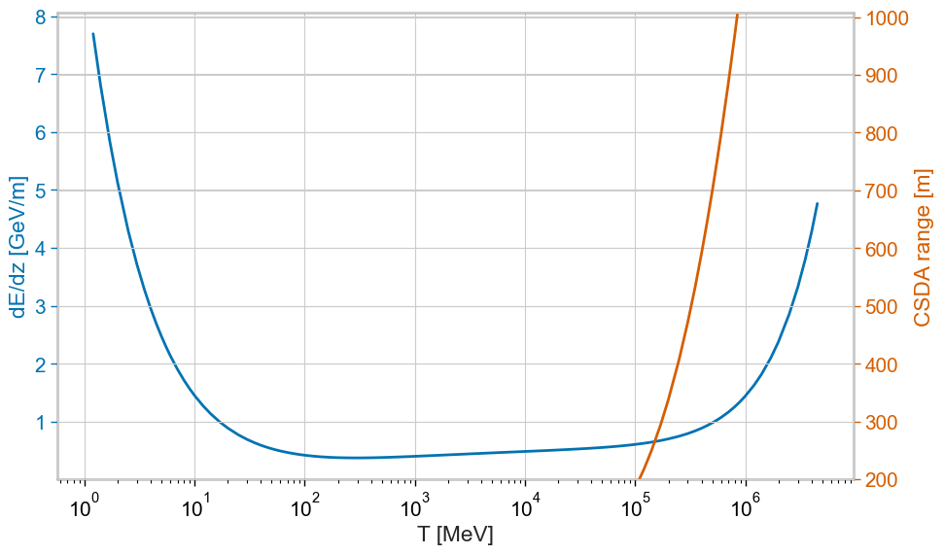
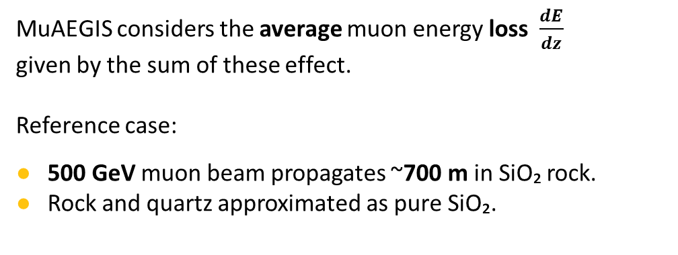
1 - Energy loss
8
More mechanisms play a role in the muon energy loss:
Ionization.
Radiation losses:
Bremsstrahlung.
Pair production.
Photonuclear excitation.
Muons in SiO₂
MuAEGIS considers the average muon energy loss $\frac{dE}{dz}$
given by the sum of these effect.
Reference case:
500 GeV muon beam propagates ~700 m in SiO₂ rock.
Rock and quartz approximated as pure SiO₂.

Slide 9
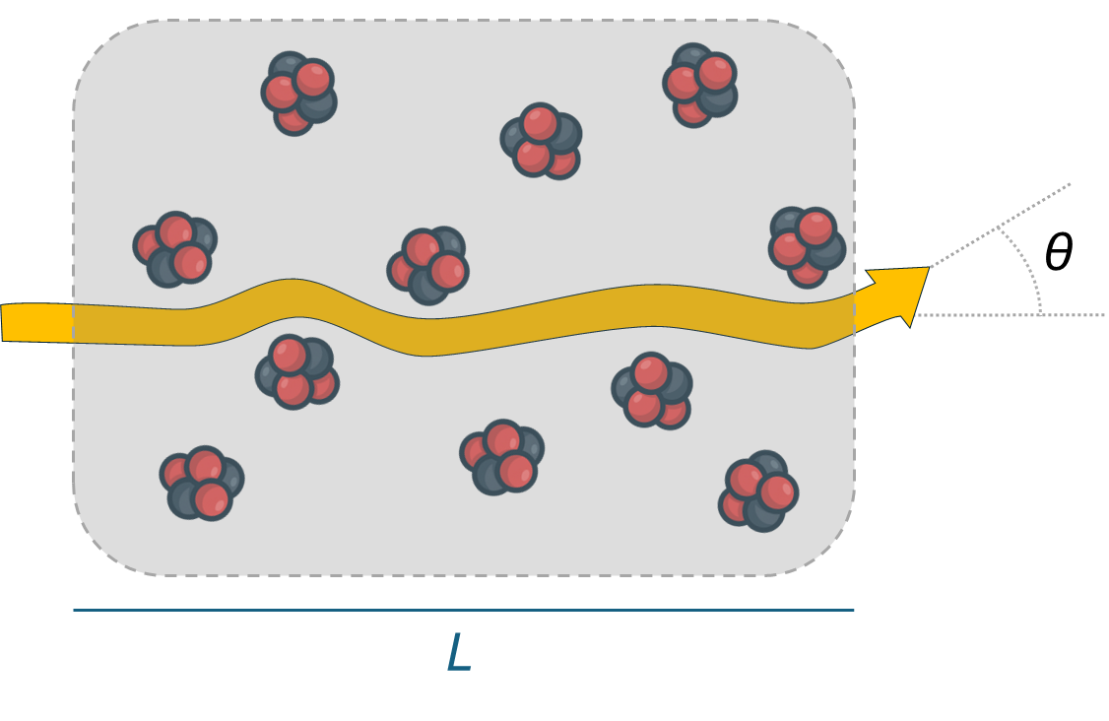
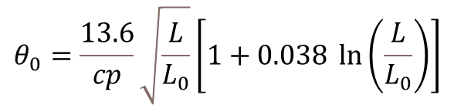
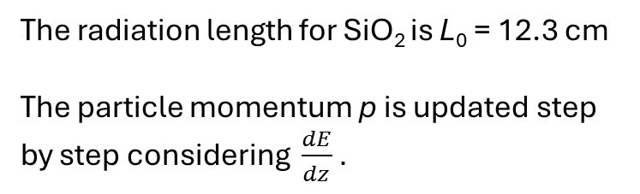
2 - MCS
9
Multiple Coulomb Scattering (MCS) is the main transverse effect causing stochastic deflection by an angle ϑ.
Molière theory: for relativistic particles, angle ϑ follows a normal distribution with σ = 𝜃₀ .
The radiation length for SiO₂ is L₀ = 12.3 cm
The particle momentum p is updated step by step considering $\frac{dE}{dz}$.

Slide 10
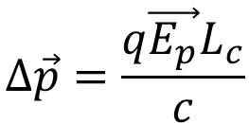

3 - PRW
10
Piezoelectric Random Walk (PRW): second effect on beam
transverse plane.
- - - - -
E_{p}
E_{p} = 20 MV/m for P = 400 MPa (= 4 kbar)
L_{c} up to few cm
+ + + + +
Crystals and E_{p} are randomly oriented over 4π.
Transverse momentum evolves as 2D random walk
Notes:
spiegare il random walk

Slide 11
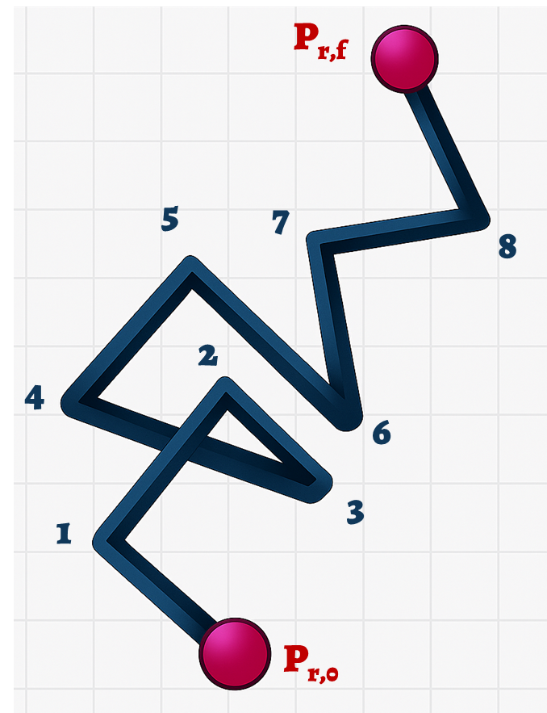
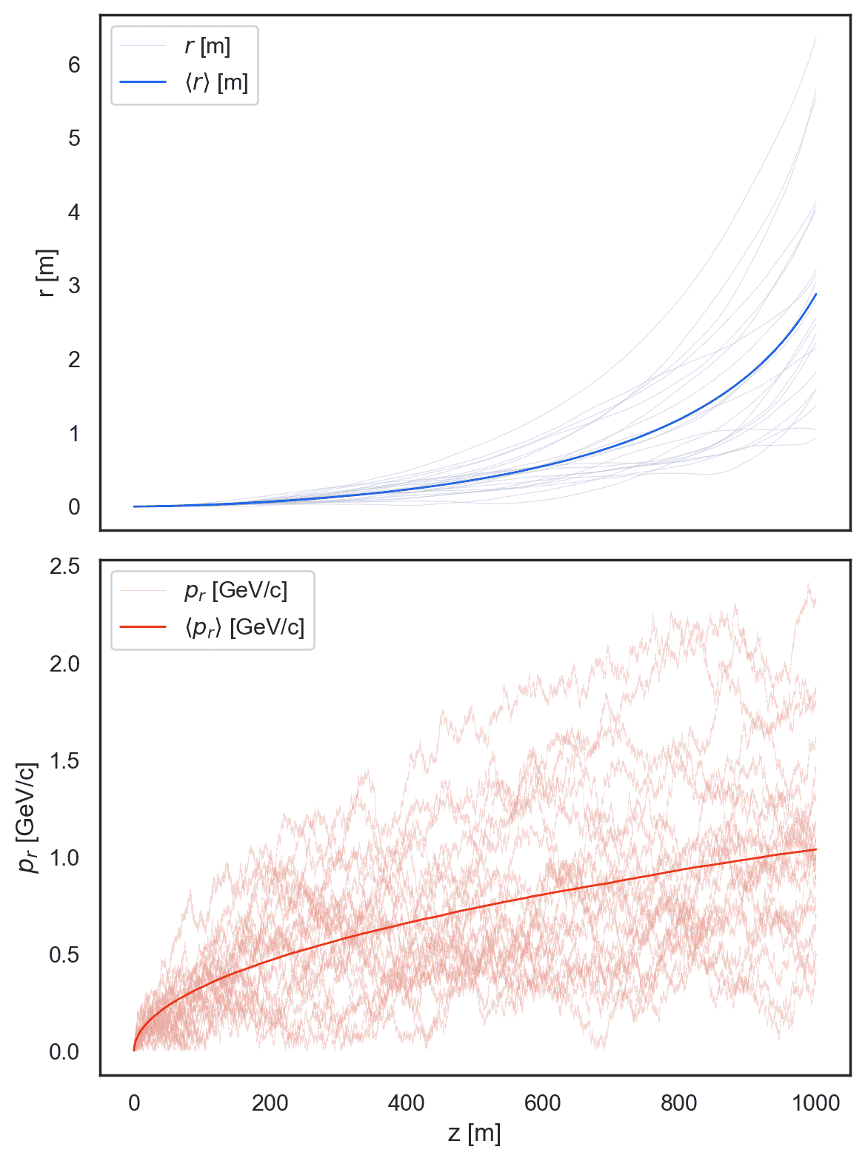
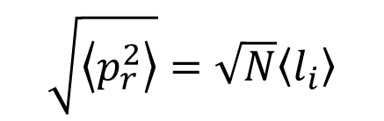
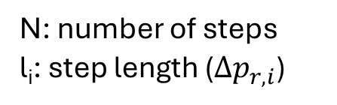
2D random walk
11
PRW and MCS affect transverse momentum like a 2D random walk.
Each momentum step has a random direction. Each particle follows a unique transverse path, but the bunch evolves with averaged, ordered behavior:
N: number of steps
l_{i}: step length ($∆p_{r,i}$)
Visual example:
20,000 muons through 1 km of ground Periodic layers: 1 cm rock / 1 cm quartz (20 tracks shown)

Slide 12
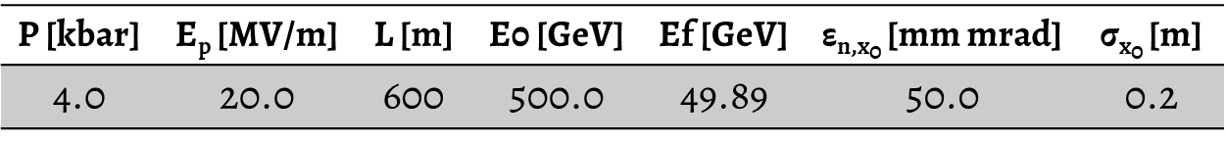
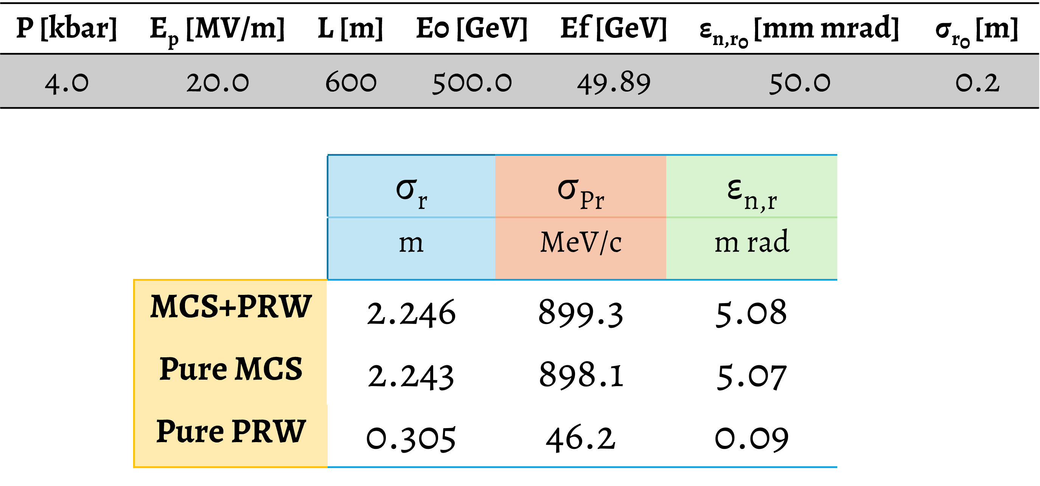
Reference case
12
We simulate ${10}^{6}$ muons into 600 m of ground -- Periodic layers: 1 cm rock / 2 cm quartz

Slide 13
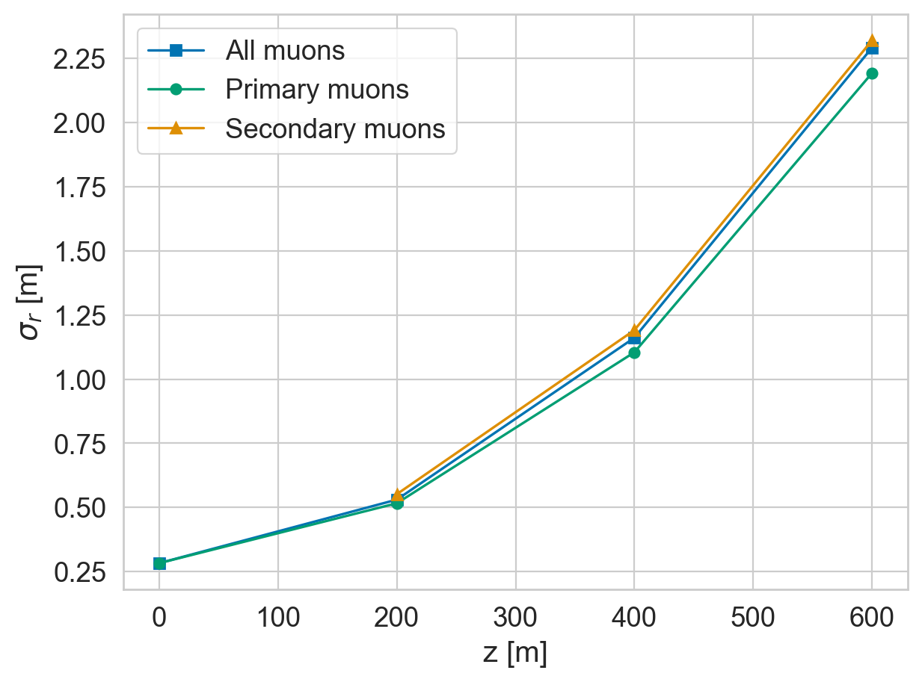
Great benchmark
13
Same case simulated with FLUKA for comparison. Additional effects observed, but overall good agreement.
FLUKA – envelope
MuAEGIS: 2.243 m (+2%)

Slide 14
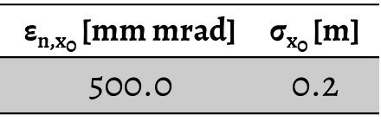

Quality is not mandatory
14
What happens with a higher emittance (10x) beam?
The final beam dimension is not impacted. High quality muons are not necessary!

Slide 15
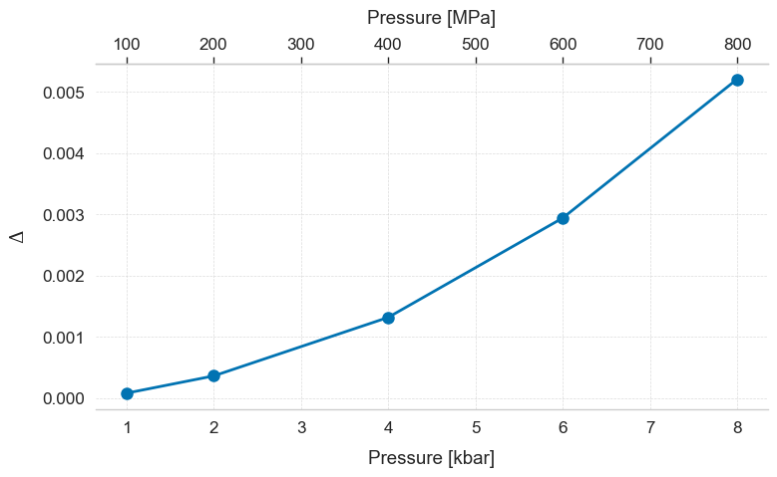
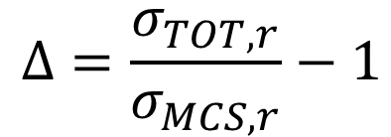
We can see the build-up
15
We simulated beam envelope enhancement (∆) under varying quartz pressures observing non-linear evolution.

Slide 16
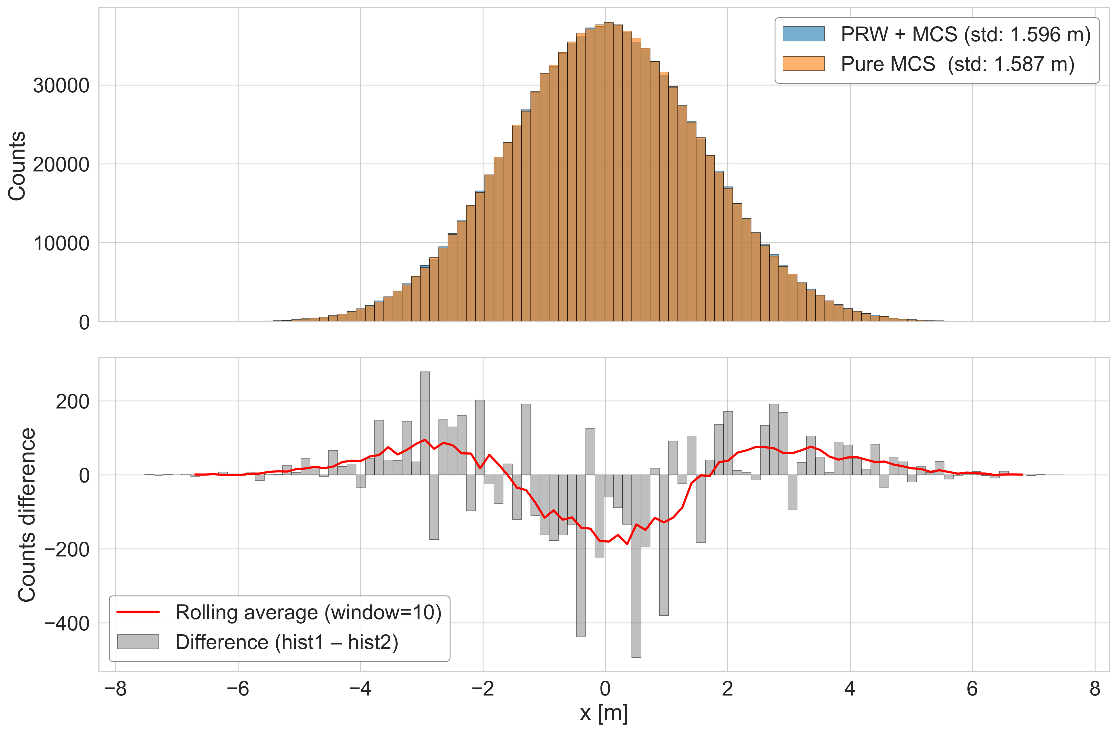
How to see the effect
16
Effect observed by comparing muon distribution on detector plane with ideal case (no pressure/quartz).

Slide 17
Proof of principle experiments

Slide 18
2 experiments
18
Purpose:
Demonstrate core concepts of the ERMES technique.
Validate theoretical predictions and numerical simulations.
Crucial for assessing feasibility and future implementation.
PoP-1: Single Quartz Crystals
Objective: Characterize direct piezoelectric response.
Measurement: Detectable, deterministic beam centroid deflection (e.g., mm-scale).
Method: Tens-MeV hundreds-MeV electron beams through a stressed crystal.
PoP-2: Meter-Thick Granite Slabs
Objective: Investigate Piezoelectric Random Walk (PRW).
Measurement: Detectable enhancement of the muon beam spot size (parameter Δ).
Method: GeV-class muon beams through granite under significant pressure.

Slide 19
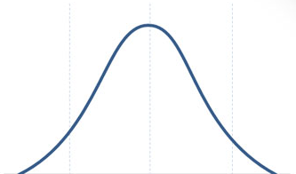
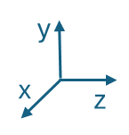

e⁻ beam through a quartz crystal
19
ASTRA particle tracking code is an ad hoc tool for this kind of test
1) It has a very smart way to import full 3D maps user defined (5 & 20 MV/m meshed “piezo volumes”). 2) It is perfect for realistic Start-to-End simulations, from the Gun up to the final screen.
We considered electron beams (generated by ASTRA generator @ 20 & 150 MeV): - I) a quartz crystal (1 cm x 1 cm x 1 cm) with 150 MeV – 5 & 20 MV/m of piezo - II) a quartz crystal (1 cm x 1 cm x 0.5 cm) with 20 MeV – 5 & 20 MV/m of piezo
The sketch
e⁻ beam from Linac T = 150 MeV – 20 MeV ε_{x,n} =1 µm σ_{x}= 200 µm
Pressure up to generate 20 MV/m field into the crystal
Upon exiting face, e⁻ tracking stops, stochastic angular broadening MCS is applied, and tracking restarts up to the screen
$$20\frac{MV}{m}$$
E_{y}
1 m @150 MeV
0.6 m @ 20 MeV
Screen
Full-3D map dx, dy, dz mesh size ~ 300 µm
Courtesy of A. Bacci
Notes:
È tutto un monocristallo. Abbiamo fatto un programma in python per costruire una mappa di campo 3D compatibile con ASTRA

Slide 20
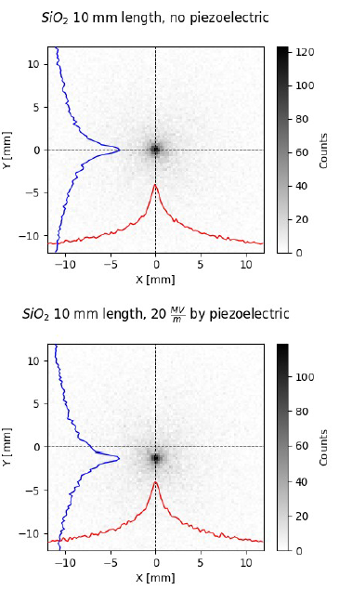
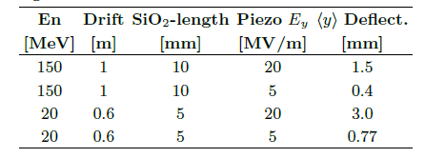
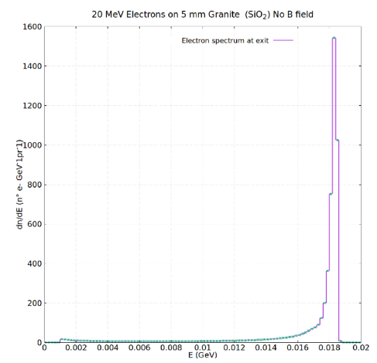
20 & 150 MeV e⁻ beam @ screen
20
The beam shows a significant visible shift on the target!
Considering other value as in the following Tab:
No pressure
Shifts are amplified at lower energy and reduced with lower field.
60 kpart @ 150 MeV
Active pressure
@20 MeV beam deceleration is less the 10%.
Courtesy of A. Bacci

Slide 21
Wrap-up
21
ERMES is a novel technique for earthquake forecasting. It aims to actively monitor the temporal evolution of tectonic stress in seismic fault zones
MuAEGIS: a lightweight, stochastic simulation tool modeling relativistic muon transport through stressed piezoelectric rock.
Piezoelectric-induced deflections become increasingly significant at high pressures, perturbing the transverse beam profile despite MCS dominance.
Final beam parameters are largely independent of initial quality — easing ERMES design constraints.
Next Steps
PoP-1: Quartz crystal tests with electron beams → validating pressure-field coupling. We are investigating the possibility to run the experiment in Rome at Sapienza university.
Extend MuAEGIS to include:
Stress profile along muons path
Coherent piezoelectric effects
Stress-induced rock magnetization

Slide 22
Thanks!
Any questions ?

Slide 23
Credits
Special thanks to all the people who made and released these resources for free:
Presentation template inspired by SlidesCarnival
Icons from Flaticon

Slide 24
How to produce the muon beam?
A compact solution with plasma

Slide 25



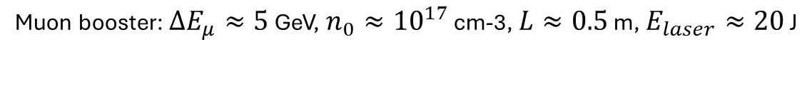
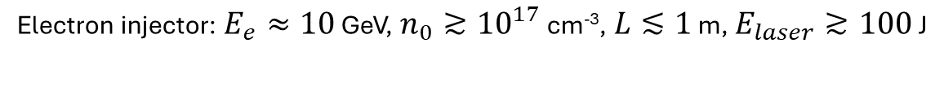

Concept of a plasma muon accelerator
25
500 GeV muons
$L≈3$ m
$L≈1$ m
$$×100$$
$L≈100$ m
Electron injector: $E_{e}≈10$ GeV, $n_{0}≳{10}^{17}$ cm⁻³, $L≲1$ m, $E_{laser}≳100$ J
Sparse considerations:
No high brightness required
Low charge muon bunches O(10pC), so no significant beam loading
Efficiency in transport is most important
Positive muons lost along transport
Solid target
Capture and matching (plasma lenses and scrapers)
Muon booster: $ΔE_{μ}≈5$ GeV, $n_{0}≈{10}^{17}$ cm-3, $L≈0.5$ m, $E_{laser}≈20$ J
Intra-booster optics (plasma lenses)
Final focusing (plasma lenses)

Slide 26
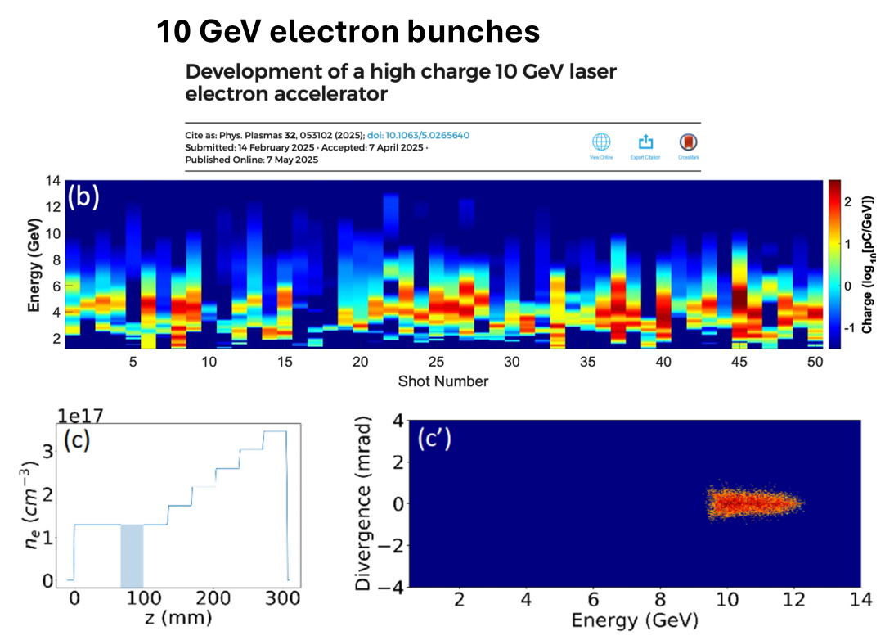
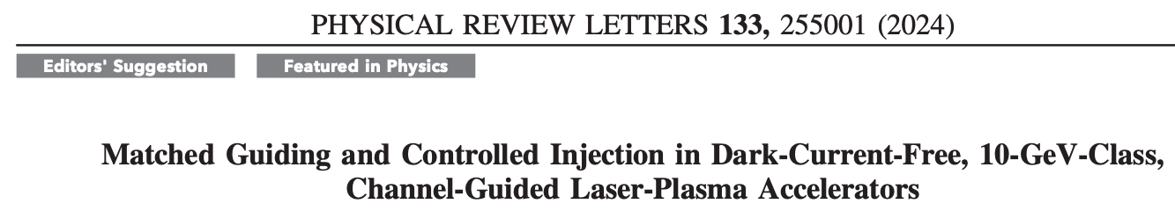
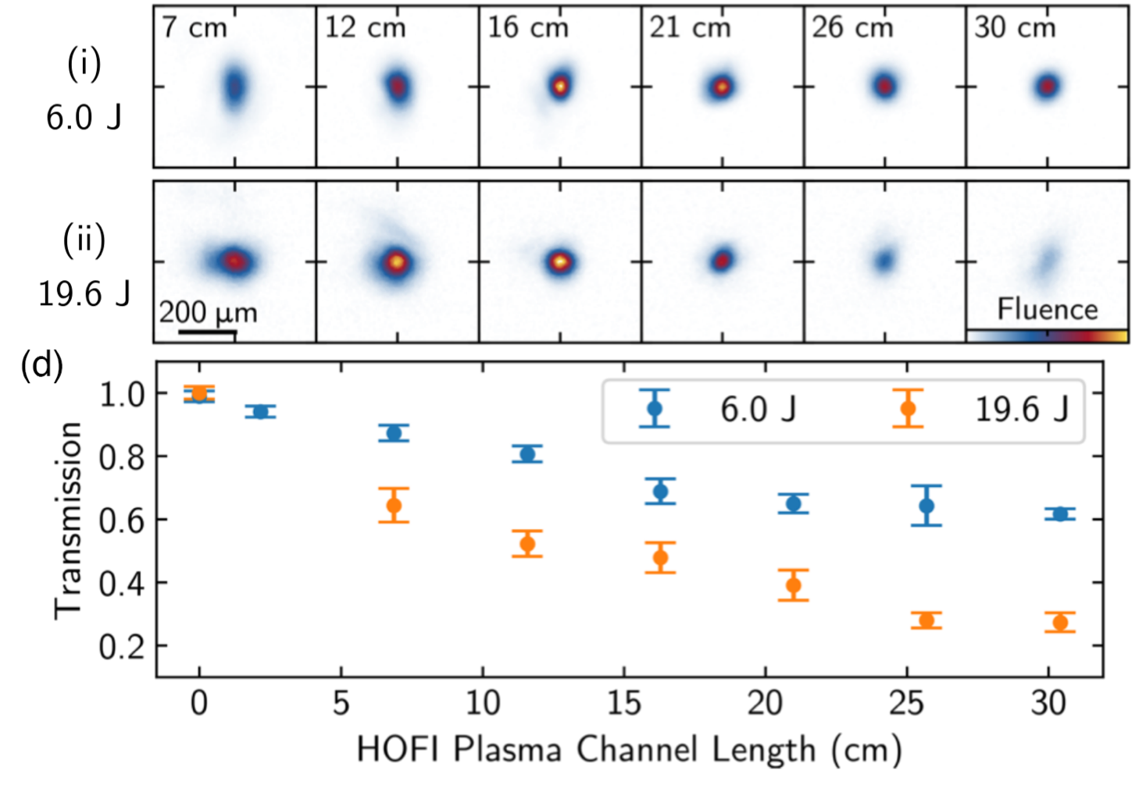
Electron injector
26
Petawatt lasers with $E≳100$ J and rep rate of few Hz available
Meter long plasma target
HOFI: hydrodynamic expansion of optical field-ionized plasma
Still missing: high charge bunches
Notes:
Il plasma è scaldato dal lase oltre che generato, il calore lo fa espandere e si crea il profile trasverso richiesto per il guiding. È una iniezione interna di elettroni controllata si pensa che passando a bolle più grandi si possa salire di carica evitando beam loading, si può anche salire con la non linearità della bolla con a_0 Maggiore.

Slide 27
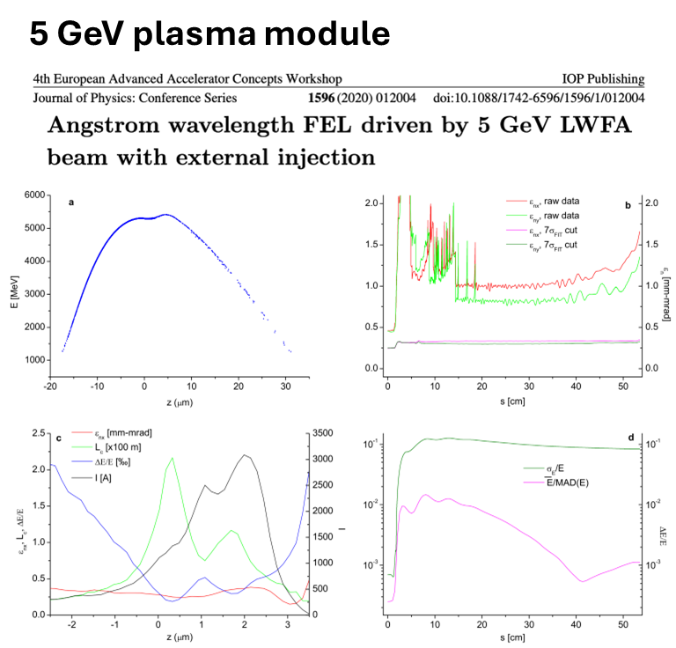
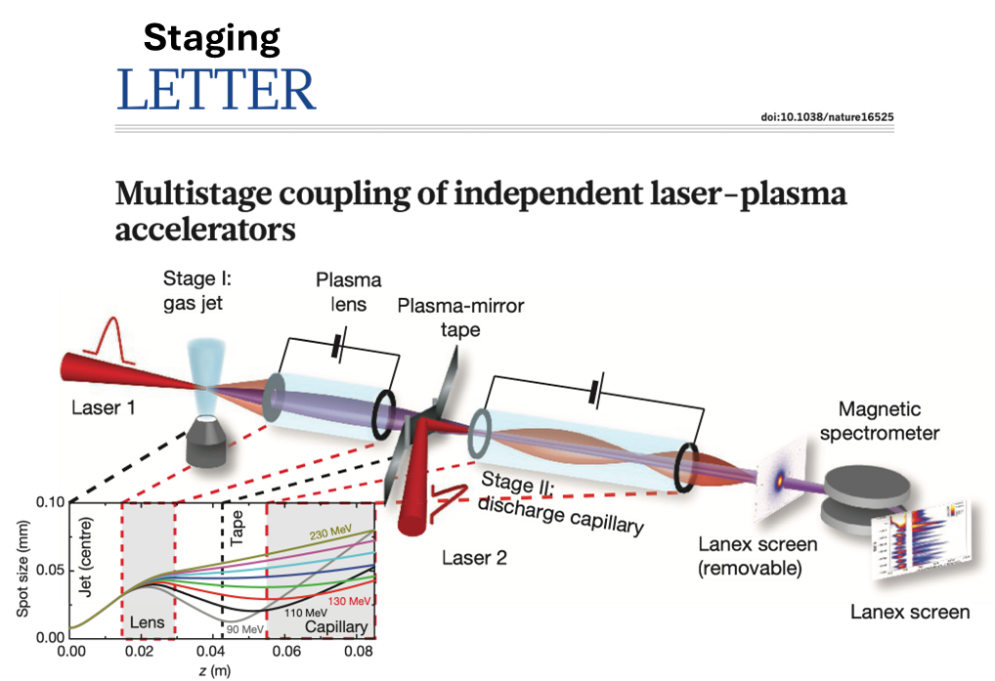
Muon booster
27
Terawatt lasers with $E≲20$ J and rep rate of $≳10$ Hz available
Notes:
Studio numerico della parte plasma del booster. 0.5 m Qua c’era anche uno sforzo per mantenere alta qualità di fascio che a noi non serve. Inoltre la dinamica trasversa dei muoni è più lenta e questo aiuta la gestione delle oscillazioni di betatrone. esistono studi di staging a livello di POP. Esistono anche progetti (SPARTA project [29] di ERMES)

Slide 28
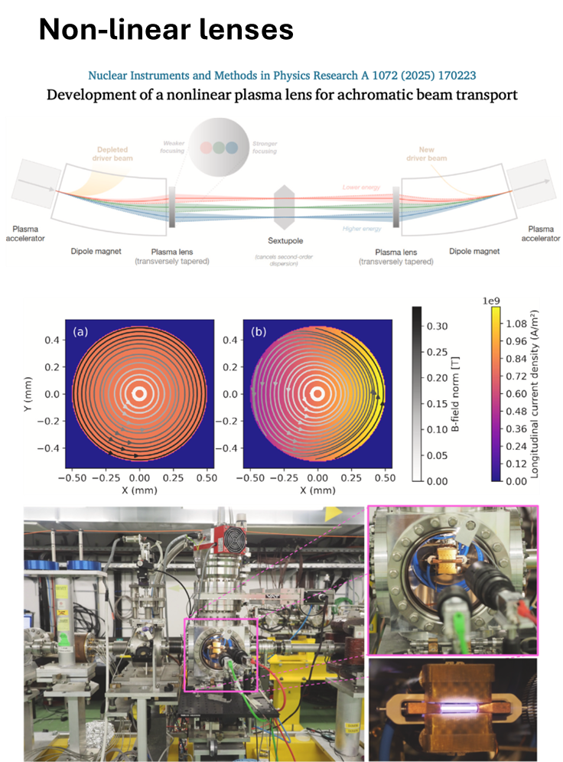
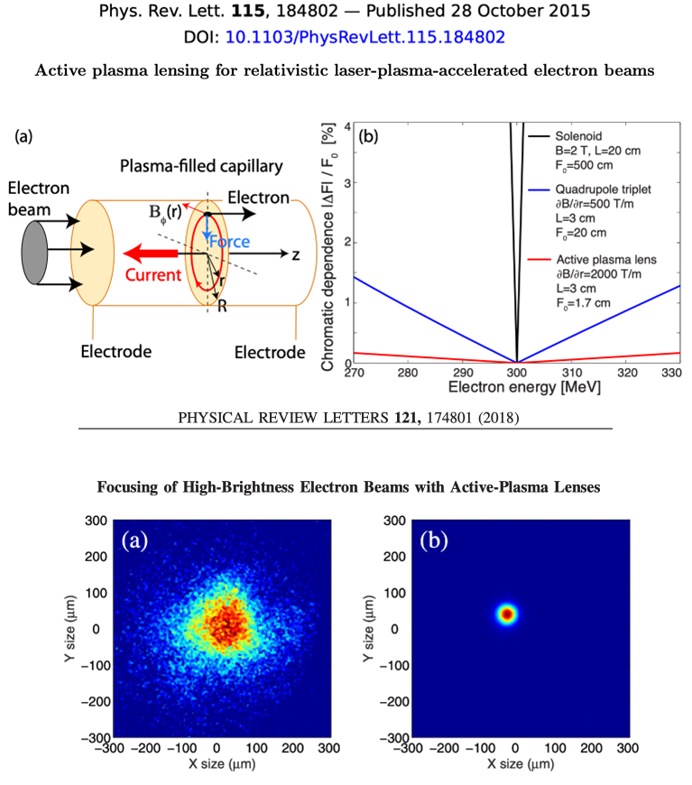
Plasma lenses
28
Actively investigated
Notes:
L’ottica per restare compatti. Lenti al plasma. Lente attiva di Berkely Sotto test a EuPRAXIA
Lenti non lineari per ottimizzare I trasporti senza perdite.

