Slide 1

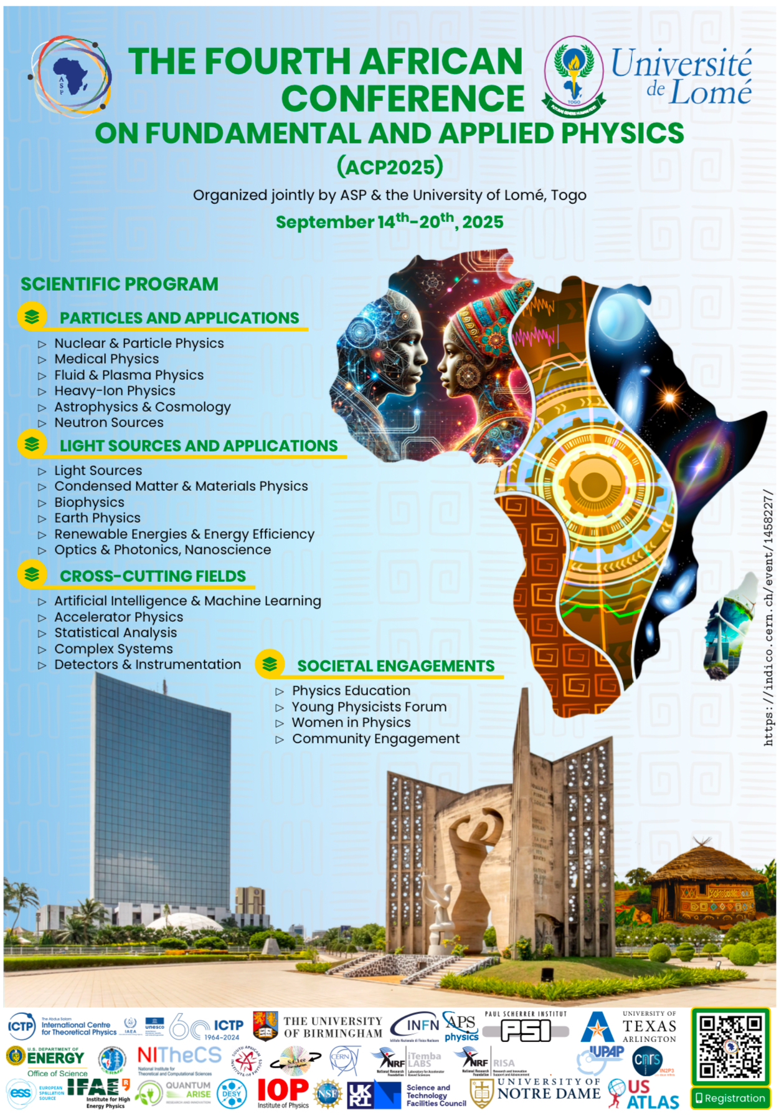

The fourth African Conference of Fundamental and Applied Physics, (ACP2025)
14-20 September, 2025, University of Lomé, Togo
Numerical analysis of non-Newtonian EMHD blood flow through overlapping time-variant stenosis artery: Effect of hematocrit viscosity
Issa EL GLILI*, Hafsa AKKAOUI, Youness FOUKHARI, Abdelmajid SAIDI, Mohamed DRIOUICH & Mohamed SAMMOUDA
Laboratory of Research in Physics and Engineering Sciences, Polydisciplinary faculty, Sultan Moulay Slimane University, Beni Mellal, Morocco
*Speaker email: issa.elglilifpb@usms.ac.ma

Slide 2
plan :
1
INTRODUCTION
2
MATHEMATICAL FORMULATION
3
NUMERICAL METHOD h
4
RESULTS AND DISCUSSION
5
CONCLUSION

Slide 3

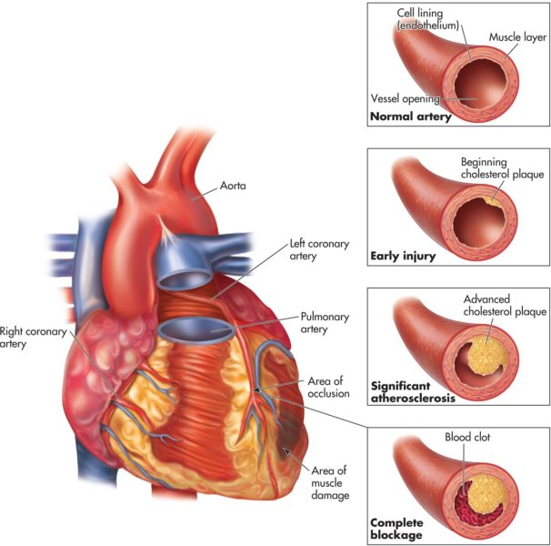
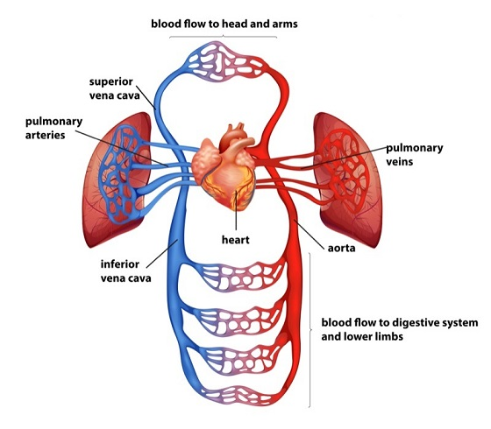
INTRODUCTION
Arteries are the routes by which oxygenated blood is transported from the heart to the body's tissues. However, various factors can affect blood flow in these arteries, including the presence of stenoses, which are pathological narrowings of the blood vessels. Today, we're going to explore how these stenoses affect blood flow in the arteries and the associated consequences.

Slide 4
INTRODUCTION
Applications of Gold nanoparticles in biomedical fields
Controlled Drugs delivery
Diagnosis
Biomedical imaging
Cancer treatment
Inert nature
Stability
Non-cytotoxicity
Compatibility

Slide 5
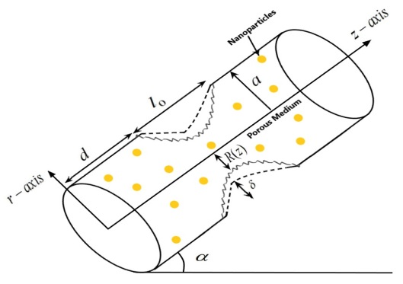
2
MATHEMATICAL FORMULATION
The current study examines the pulsatile two-dimensional flow model of blood through an artery with stenosis in the presence of gold nanoparticles.
Incompressible, non-Newtonian fluid
Unsteady and pulsatile flow.
The Casson model was used to characterize the rheology of blood
For the irregular stenosis,
For the composite stenosis,
(a)
(b)
Figure 1: Schematic problem of the artery with (a) composite and (b) irregular stenoses

Slide 6
2
MATHEMATICAL FORMULATION
Dimensional formulation
Continuity equation
Momentum equation
Energy equation

Slide 7
2
MATHEMATICAL FORMULATION
Dimensionless formulation
Boundary conditions
Thermophysical propriety of nanofluids
Flow rate
Resistance to flow

Slide 8
2
3
NUMERICAL METHOD h
There are several numerical methods:
Finite element
Finite volume
Numerical methods
Spectrale
Finite Difference

Slide 9
2
3
NUMERICAL METHOD h
Validation
(a)
(b)
Fig. 2. Graph comparison for (a) non-dimensional velocity profile (b) non-dimensional temperature profile.

Slide 10
2
3
4
RESULTS AND DISCUSSION
Axial velocity
(a)
(b)
Fig. 3. Velocity profiles for variation of (a) hematocrit parameter (b) Casson fluid parameter.

Slide 11
2
3
4
RESULTS AND DISCUSSION
Temperature profile
(a)
(b)
Fig. 4. Temperature profiles for variation of (a) Brinkman number (b) volume fraction of nanoparticles.

Slide 12
2
3
4
5
CONCLUSIONj
In conclusion, our study provides several important insights into the behavior of blood flow through stenosed arteries. We found that:
Enhancing the hematocrit dependent viscosity parameter reduce the blood velocity.
As the volume fraction of nanoparticles and Brinkman number increase, the temperature profile rises.
Increasing the stenosis height parameter increase the flow resistance.

Slide 13
Thank you for your attention

