Slide 1

USING DNA ORIGAMI TO ORGANIZE MATTER AT THE NANOSCALE
UNIVERSITY OF CAPE COAST
Prof. George Amoako*
Department of Physics, University of Cape Coast
Cape Coast, Ghana
gamoako@ucc.edu.gh
+233505300062
*Corresponding author

Slide 2
OUTLINE
Introduction
DNA Origami
Some structures
DNA Origami Mediated Assembly of Ordered Gold Nanoparticles
Some applications of DNA origami in diﬀerent ﬁelds
Conclusion

Slide 3
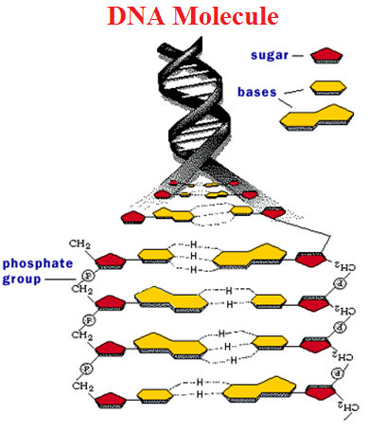
WHAT IS DNA?
DNA: Stands for Deoxyribonucleic Acid
Contains the genetic instructions of living organisms
Polymer of nucleotides, with backbones of sugars and phosphate groups joined by ester bonds.
A base is attached to each sugar.
The sequence of bases encodes information.
http://upload.wikimedia.org/wikipedia/commons/4/43/Deoxyribose.png
Figure 1

Slide 4
DNA NAOTECHNOLOGY
The field of DNA nanotechnology takes this molecule out of its biological context and uses its information to assemble structural motifs and then to connect them together.
DNA has the properties of a polymer and as such can be used as a structural material.

Slide 5
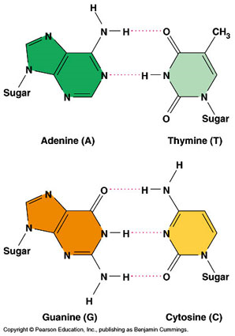
WATSON–CRICK BASE PAIRING
The DNA double helix is stabilized by Hydrogen Bonds between the bases.
The Four Bases are adenine (A), cytosine (C), guanine (G) and thymine (T).
Each type of base on one strand forms a bond with just one type of base on the other strand. This is called complementary base pairing.
A bonds only with T; and C bonds only with G.
The two strands of DNA in a double helix can be pulled apart by high temperature.
Figure 2

Slide 6
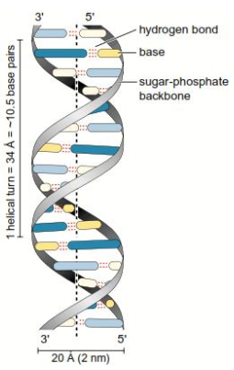
DNA: Always synthesized in the 5'-to-3' direction
Meaning:
It consists of two oppositely running long polymers as shown in Figure 3, whose units are termed as nucleotides (nt).
Nucleotides are added only to the 3' end of the growing strand.
When sequences are being written, start from the
5’ end to the 3’ end.
Figure 3

Slide 7
Using DNA to Design Nanostructures
DNA Origami
Origami: (A Contraction of the Japanese words ‘ori’ meaning ‘folding’ and ‘kami’ meaning ‘paper’) is the traditional Japanese art of folding paper into recognizable or functional forms.
Very Important to Note
Size of the origami structure generated is dependent on the size of the paper.
Idea will be transferred to the DNA to generate objects or structures.

Slide 8

Figure 4
https://www.manualidadeson.com/en/9-easy-origami-to-get-started.html

Slide 9
Pioneering Work in DNA origami
DNA origami was pioneered by Paul W. K. Rothemund in 2006.
He used as his scaffold the circular genomic DNA from the virus M13mp18 which is single-stranded and 7249 nucleotides (nt) long.

Slide 10
DNA origami deals with the nanoscale folding of DNA to construct DNA objects which could be arbitrary two or three dimensional.
Size of the origami structure generated is dependent on the scaffold length.
Tradeoffs in the formation of origami structures: the more complex the structure, the longer the assembly time and the lower the yield.

Slide 11
The Folding Process in Simple Terms
It entails taking a long single-stranded ‘scaffold’ DNA backbone molecule of several thousand bases long and forcing it to adopt close-packed bundles of B-form DNA double-helical domains using several short, single-stranded ‘staple’ nucleotides.
The use of a long scaffold strand in DNA origami alleviates the problem of stoichiometry, as the short staple strands can be applied in excess and can be used as synthesized without additional purification.

Slide 12
caDNAno
Use caDNAno, an open source software based on the Adobe AIR platform for the design of three-dimensional DNA origami nanostructures.
Design process can be likened to sculpture from a porous crystalline block.
caDNAno has two platforms on which DNA origami designs can be generated:
The honeycomb-pleat-based and
The square-based lattices.
Castro, C. E. et al. A primer to scaffolded DNA origami NATURE METHODS 8, 221-229 (2011).

Slide 13
Assembly of a target (imagine whatever shape you want to design) three-dimensional shape using the caDNAno honeycomb-pleat-based strategy can be conceived as laying down the scaffold strand into an array of antiparallel helices.
Initial geometrical parameters assigned to the double helix are:
2.0 nm diameter,
0.34 nm/base-pair rise, and
34.3⁰/base-pair average twist which comes down to 21 base pairs/2 turns.

Slide 14
Roller structure
Figure 5. Design Scheme. (a) Cross sectional view of the ‘roller’ in the honeycomb caDNAno lattice. (b). Front view JPEG image of the ‘roller’ DNA origami. The red and yellow sections form the continuous single-layer nanotube and the gray area forms the surrounding multi-layer. The light blue in the structure is the M13mp18 scaffold DNA. Red, yellow, gray etc. are staple DNA strands. (c). Schematic drawing of the folding of the roller origami structure through hybridization of scaffold and staple strands. Amoako, G., Zhou, M., Ye, R., Zhuang, L., Yang, X., & Shen, Z. (2013). 3D DNA origami designed with caDNAno, Chinese Science Bulletin, 58, 3019-3022.

Slide 15
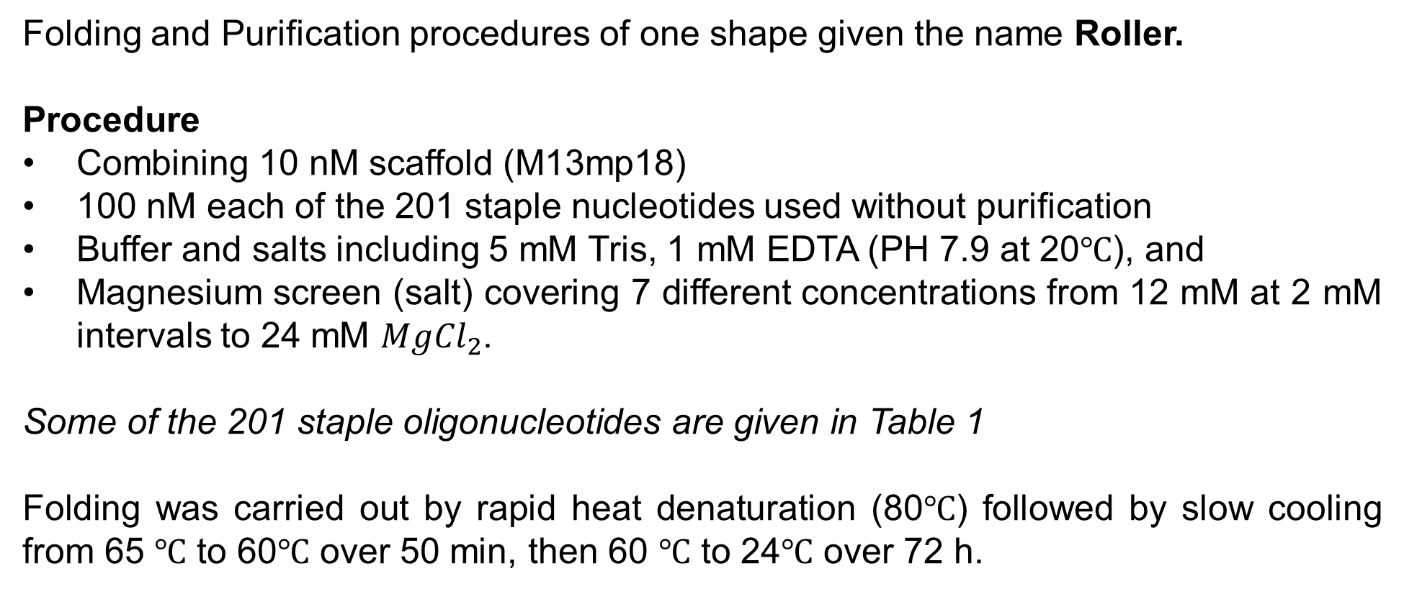
Folding and Purification
Folding and Purification procedures of one shape given the name Roller.
Procedure
Combining 10 nM scaffold (M13mp18)
100 nM each of the 201 staple nucleotides used without purification
Buffer and salts including 5 mM Tris, 1 mM EDTA (PH 7.9 at 20℃), and
Magnesium screen (salt) covering 7 different concentrations from 12 mM at 2 mM intervals to 24 mM ${MgCl}_{2}$.
Some of the 201 staple oligonucleotides are given in Table 1
Folding was carried out by rapid heat denaturation (80℃) followed by slow cooling from 65 ℃ to 60℃ over 50 min, then 60 ℃ to 24℃ over 72 h.

Slide 16
Roller structure
Table 1: Some Generated staple Sequences
A1 | AATAATAAGACCACAAGAATTGAGTT | 26
A2 | AACCCTCTTGAAAGGAATTGAAGTAACAATTCCTGCAGT | 39
A3 | CTCAAATAGCACGCTAATATC | 21
A4 | CTATCAACACTAACAACTAATTATT | 25
A5 | GTTGGCAAAAACAAAGAAACC | 21
A6 | ATCTGTTATTAATTTTAAAAGTTTGGGAAGGTAAC | 35
A7 | GAACTTAGGAGATCTAAAGAAGCCCCAAAGTCAGAG | 36
A8 | AAAGATTGTTAGAAATTGCGTAGATTTTCAG | 31
A9 | CAACTCGAGATTAGGGGCGAAAAGCAGAGAATTAACTGA | 39
A10 | ACCAGAAGGAGCCGGGAGAAACAA | 24
A11 | CATGGAATTATCATCATTTATCATTTTGCGGTCAACAGAATC | 42
A12 | TAACGGATTCGCCTGATTGTTAATTAATTTTCCCTTAG | 38
A13 | AATCCTTGAAAACATAGCGTTAATGGTTTGA | 31
A14 | TTGTCGCTACTTTGAAAGTACCTTTTA | 27
A15 | ATTTCATCTTCTGACCTAAATATAGC | 26
A16 | TTAGTTAAGAAGAGATAA | 18
A17 | CAAGAATCATAATTACTAGAAAAAAACGCG | 30
A18 | AGAAAACTATCAAAATAAATCA | 22
A19 | AATACCGACCGTTATAAAGTACCG | 24
A20 | GTTAAATTTCGAGCACGACGACAAT | 25
A21 | ACAAAAGGTAAAGTAATTCACCGCACTCATCGAGAACA | 38
A22 | TCAACAATAGAAACCAATCAAAGGCTTA | 28
A23 | CGGAACGCGCTAACAACGCCAACA | 24
A24 | AGCAAGCCGTTTTTATTTTAACGCTATACAAAAAGATA | 38

Slide 17
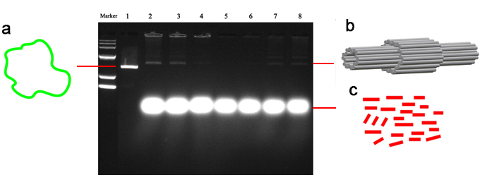
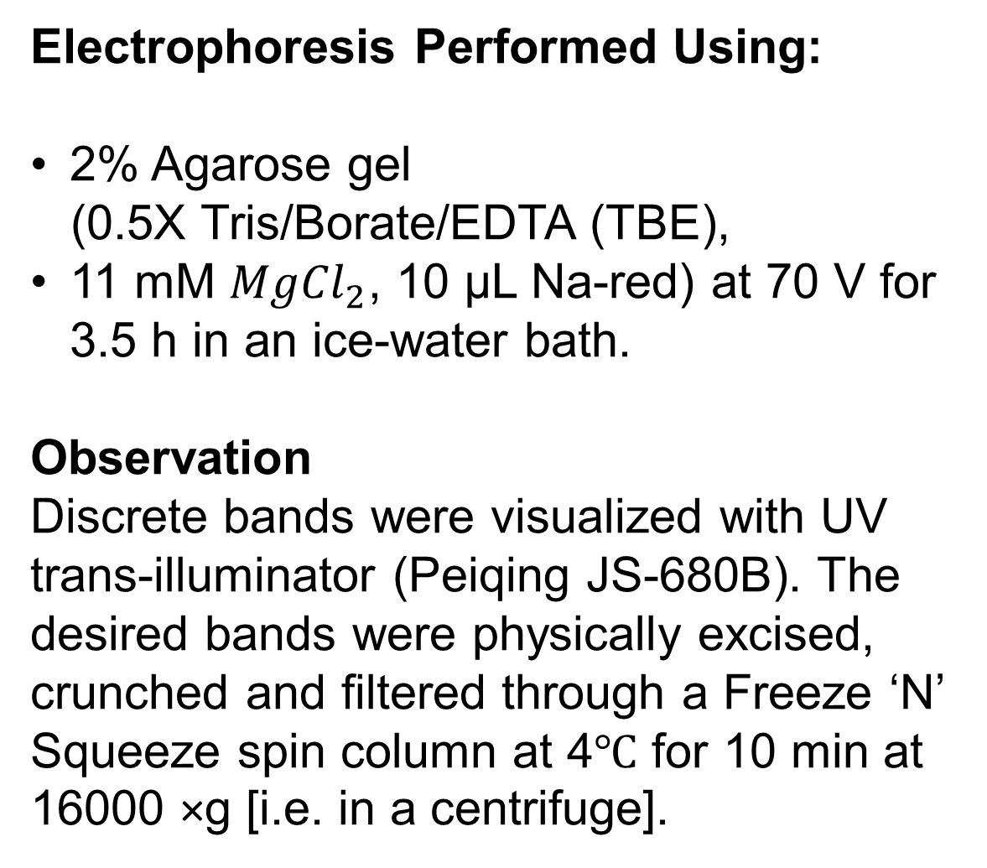
Electrophoresis Performed Using:
2% Agarose gel
(0.5X Tris/Borate/EDTA (TBE),
11 mM ${MgCl}_{2}$, 10 µL Na-red) at 70 V for 3.5 h in an ice-water bath.
Observation
Discrete bands were visualized with UV trans-illuminator (Peiqing JS-680B). The desired bands were physically excised, crunched and filtered through a Freeze ‘N’ Squeeze spin column at 4℃ for 10 min at 16000 ×g [i.e. in a centrifuge].
Figure 6. 2% Agarose gel electrophoresis. (a) Lane 1 contains the M13mp18 scaffold. (b) The leading bands of lanes 2-8 were excised and purified for our objects. (c) The bands showing excess staples. Amoako, G., Zhou, M., Ye, R., Zhuang, L., Yang, X., & Shen, Z. (2013). 3D DNA origami designed with caDNAno, Chinese Science Bulletin, 58, 3019-3022.

Slide 18
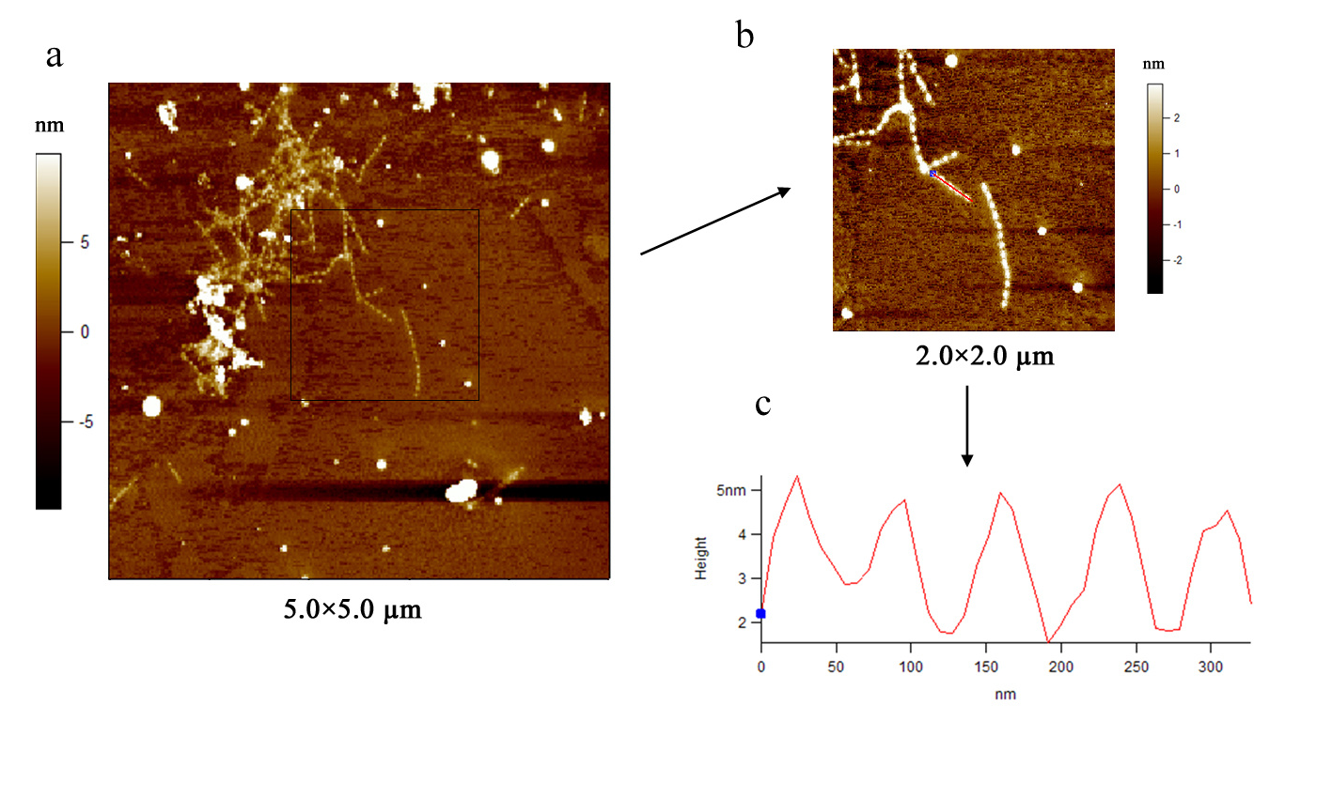
Figure 7. AFM images (a) A 5×5 µm² image of our structure. The clearly formed ‘roller’ are stacked together and can be clearly seen in the image. (b) A closer look of the structures formed as indicated with a square in (a) also showing the stacking. (c) Height profile of a section of the sample indicated in (b) with the red line from the blue point to the base. The profile shows that the heights of the hollow single- and middle multi-layer are respectively ~3nm and ~5nm. The distance between the two vertices shows the length of our object (~75), which is consistent with our design model. Amoako, G., Zhou, M., Ye, R., Zhuang, L., Yang, X., & Shen, Z. (2013). 3D DNA origami designed with caDNAno, Chinese Science Bulletin, 58, 3019-3022.

Slide 19
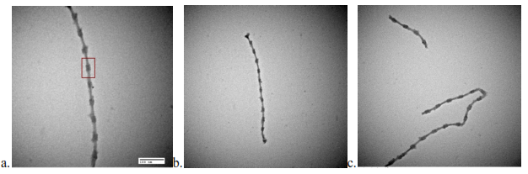
Figure 8. TEM image of the 3D origami roller structure. (a) Shown within the red rectangle is the ‘roller’ structure. (b, c) Several roller structures multimerized together The image shows the stacking of several of the structures together. All the TEM images have a scale of 100 nm. Amoako, G., Zhou, M., Ye, R., Zhuang, L., Yang, X., & Shen, Z. (2013). 3D DNA origami designed with caDNAno, Chinese Science Bulletin, 58, 3019-3022.

Slide 20
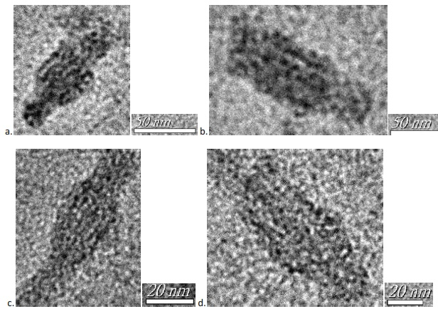
Figure 9. TEM images of monomeric 3D roller structure. (a-b) 50 nm resolved images of the origami roller structure. (c-d) 20 nm resolved image showing the clearly formed structure.

Slide 21
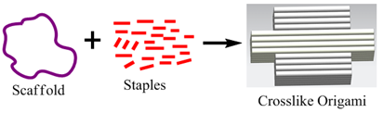
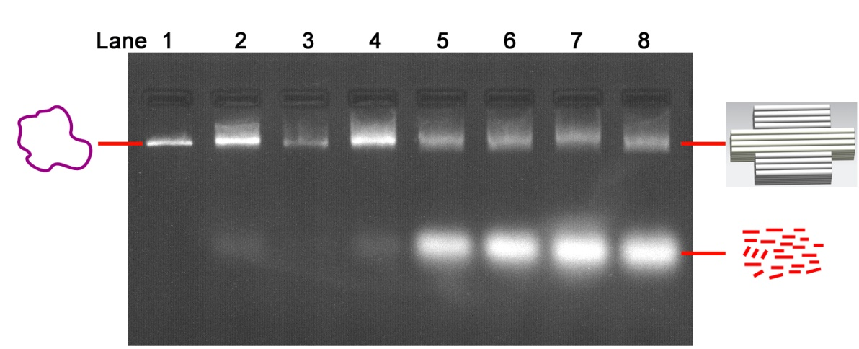
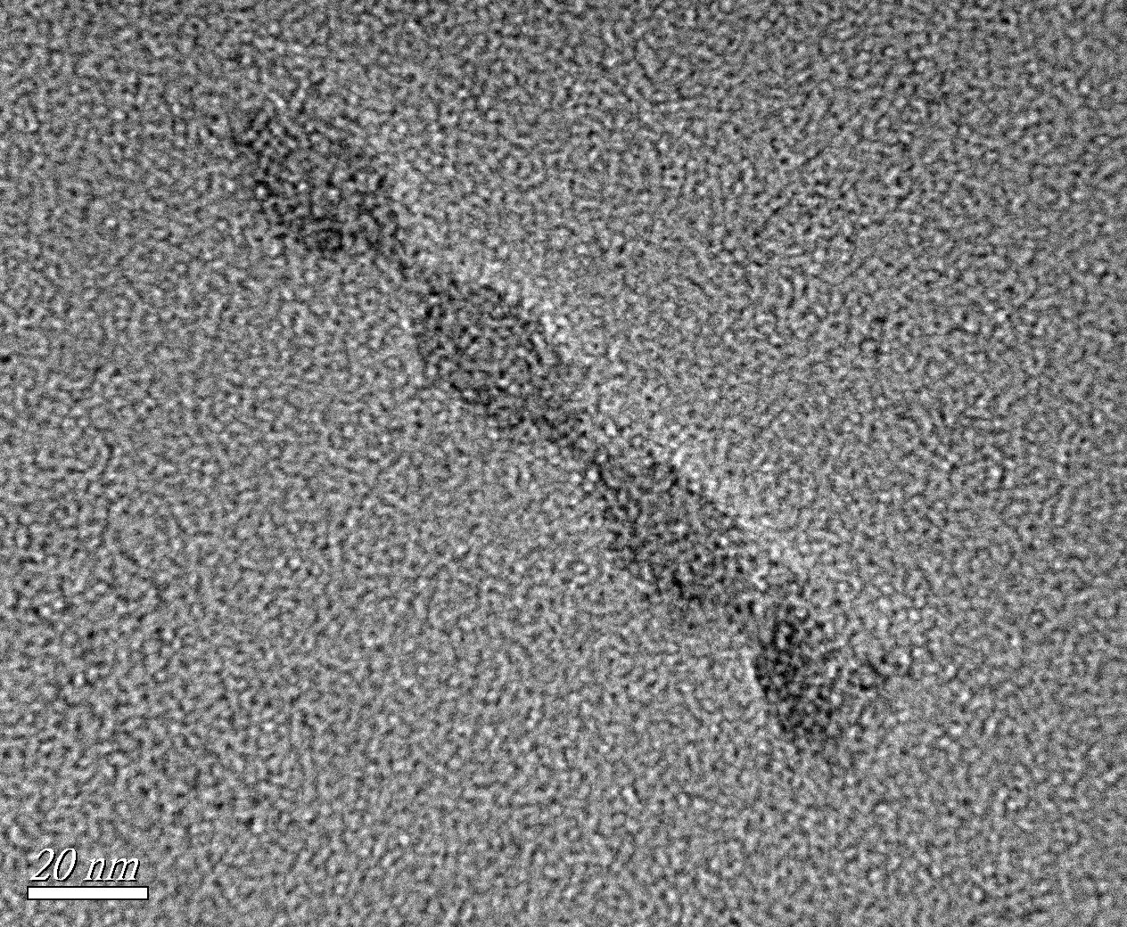
CROSS-LIKE STRUCTURE
Figure 14: Design scheme of the DNA origami cross-like structure.
Figure 11: (a) 2% agarose gel electrophoresis of the samples in the magnesium screen. i) Lane 1 contains M13mp18, ii) lanes 2 to 8 containe respectively solutions from 12 to 24 mM Magnesium salts. The leading bands of lanes 2-8 were excised and purified for our objects and iii) the bands showing excess staples.
Figure 10: TEM image of the 3D DNA origami
cross-like structure with the scale bar indicated.

Slide 22
Assembly of Nanoparticles into Arrays (why?)
The ability and precision to assemble nanoparticles into arrays, networks, and circuits in a precise and controlled manner is critical to the fabrication of a variety of nanodevices.
These nanometer sized networks of metal/semiconductor islands/quantum dots may exhibit a variety of quantum phenomena with applications including:
optical devices,
nanometer-sized sensor devices, and
quantum information science and technology.

Slide 23
Question:
How to fabricate these nanodevices with the precise dimensions to perform the intended functions.
Use of Top-down Approaches:
Use of particle-based and e-beam lithographic methods, but they lack the required resolution.
Scanning probe microscopy used in making molecular devices, but slow and not suitable for mass production.
Self-assembled monolayers,
Block copolymer template lithography and electro-deposition techniques have been demonstrated.

Slide 24
Limitations
Such approaches have limitations on particle size and/or the resulting arrays.
Search for New Techniques
Search by scientists to deal with problems with top-down approaches.
One solution: DNA scaffolding
DNA scaffolding, a bottom-up self-assembly method for arranging nanometer scale components with a theoretical precision of 0.34 nm.
Which is the separation between base pairs in a B-form double-stranded DNA helix.

Slide 25
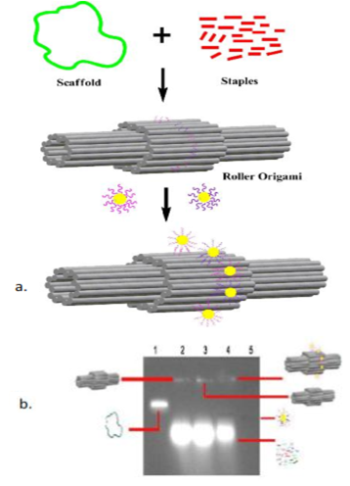
DNA Origami Mediated Assembly of Ordered Gold Nanoparticles
Figure 12: Assembly steps of DNA origami metalized C-structure. (a) A schematic drawing depicting the assembling process of the 5nm Au nanoparticles to form the C-shape on the DNA origami.
(b) Gel-red stained agarose gel electrophoresis of assembled origami and origami/AuNP products
Monothiol modified DNA combined with phosphine stabilized AuNPs
Amoako, G., Ye, R., Zhuang, L., Yang, X., Shen, Z., & Zhou, M. (2013). DNA Origami Site-Specific Arrangement of Gold Nanoparticles, NANO: Brief Reports and Reviews, 8, 1350064 - 1350075.

Slide 26
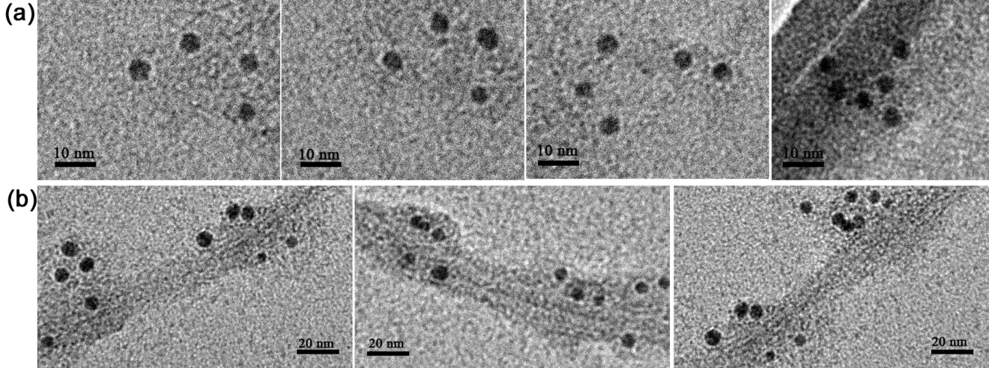
Figure 13: TEM images of the C-shaped AuNP assemblies. (a) The non-negative-stain TEM image; (b) uranyl acetate-stained image of the structure formed on DNA origami roller structure.
Amoako, G., Ye, R., Zhuang, L., Yang, X., Shen, Z., & Zhou, M. (2013). DNA Origami Site-Specific Arrangement of Gold Nanoparticles, NANO: Brief Reports and Reviews, 8, 1350064 - 1350075.

Slide 27
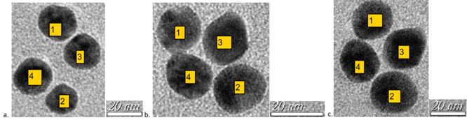
Purification with Gel Red Stained 0.6% Agarose Gel Electrophoresis
Figure 14: TEM images of 15 nm AuNP assemblies at the bottom of the DNA origami cross-like structure. (a-c) cross section of the four 15 nm AuNPs structure formed.
Amoako, G., Zhou, M., Eghan, M. J., & Sackey, S. S. (2018). DNA origami as a tool to design asymmetric gold nanostructures. Journal of Materials Science Research, 7 (1), 1- 8.

Slide 28
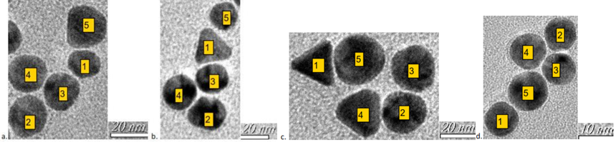
Figure 15. TEM images of 15 and 10 nm AuNP assemblies using the DNA origami cross-like structure.
Amoako, G., Zhou, M., Eghan, M. J., & Sackey, S. S. (2018). DNA origami as a tool to design asymmetric gold nanostructures. Journal of Materials Science Research, 7 (1), 1- 8.

Slide 29
Some applications of DNA origami in diﬀerent ﬁelds.
Biomaterial science:
Materials that have been designed to interface with biological systems, for the treatment, augmentation, or replacement of biological functions.
Nanomedicine:
Nanomedicine is the development of nanoscale (1–100nm) or nanostructured objects/nano-robots/skin patches and their use in medicine for diagnostic and therapeutic purposes based on the use of their structure, which has unique medical effects.

Slide 30
Nanorobotics:
The emerging field of science and technology that deals with the design, development and control of robots at the nanoscale.
Molecular computation:
DNA computing is an emerging branch of unconventional computing which uses DNA, biochemistry, and molecular biology hardware, instead of the traditional electronic computing.

Slide 31
Concluding Remarks
A lot is happening in this field and we need not be left behind. We should be up and doing.

