Slide 1


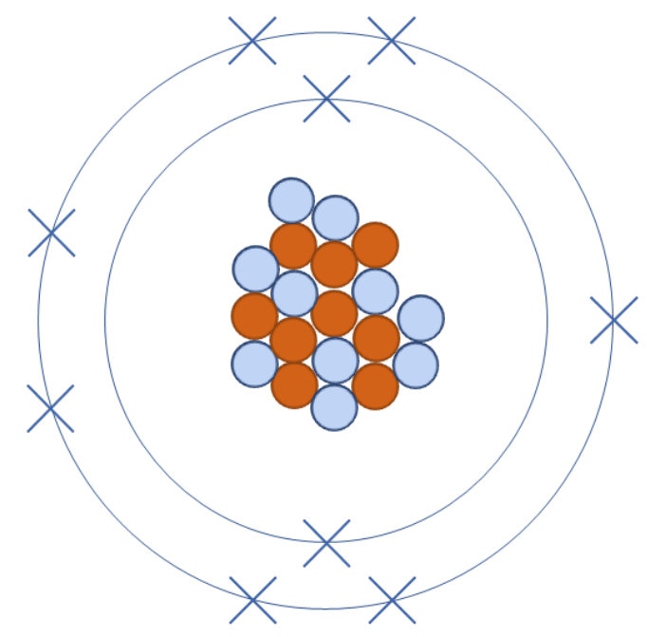


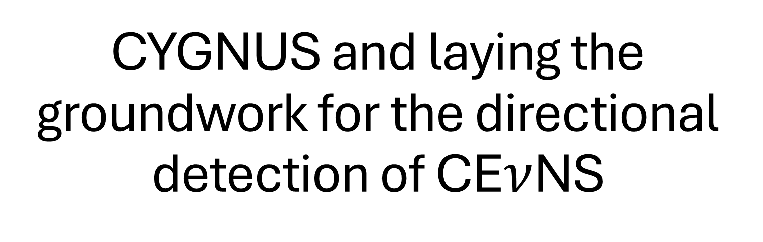
CYGNUS and laying the groundwork for the directional detection of CE$ν$NS
Michael Litke
$$ν$$
$$ν$$

Slide 2


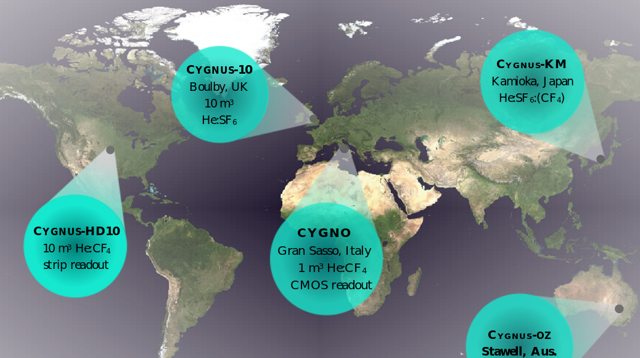


















Long term CYGNUS Vision: Multi-site Galactic Recoil Observatory with directional sensitivity to WIMPs and neutrinos
https://arxiv.org/abs/2008.12587
CYGNUS-KM
Kamioka, Japan
He:SF₆(CF₄)
Strip readout
CYGNUS-UK
Boulby, UK
He:SF₆
GEM+wire
readout
CYGNUS-US
SURF, USA
He:CF₄:X
Strip readout
CYGNO/INITIUM
Gran Sasso, Italy
HeCF₄(SF₆)
sCMOS+PMT
readout
CYGNUS-Oz
Stawell, Australia
R&D leading to 1-10 m³

Slide 3
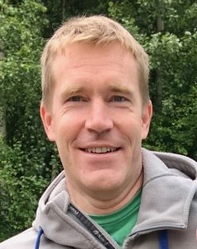
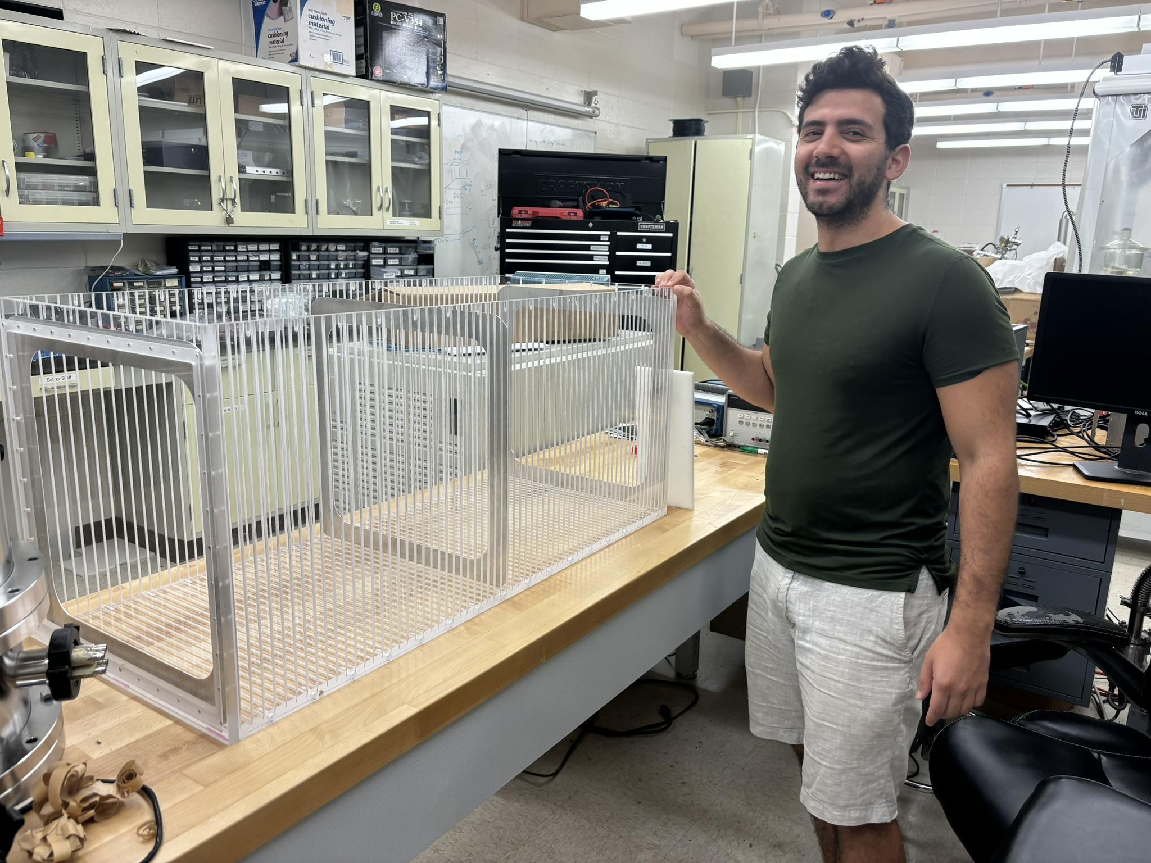

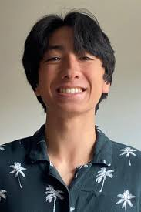
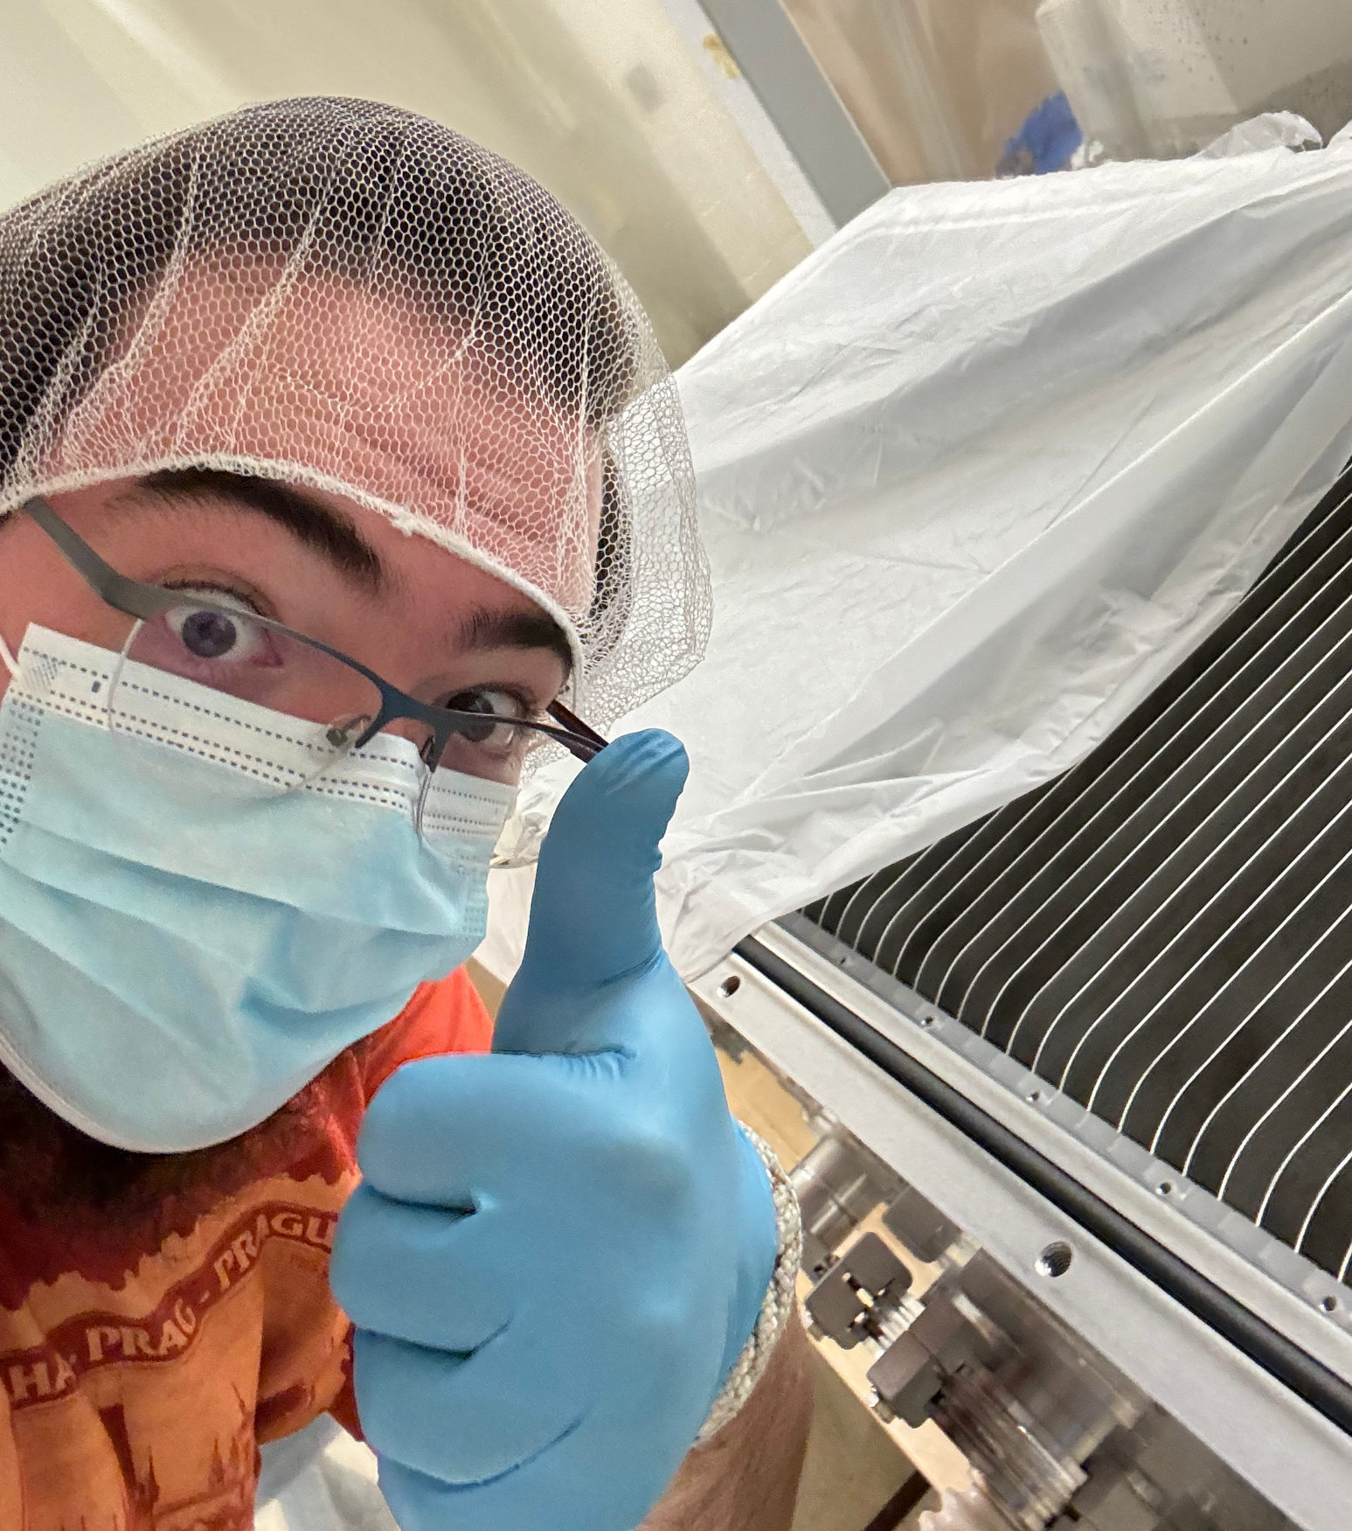
CYGNUS Hawaii
Prof Sven Vahsen
Dr Majd Ghrear (former PhD student)
Michael Litke current (PhD Student)
Aleczander Paul (current PhD student)
Gage Wettlaufer (former undergrad)

Slide 4
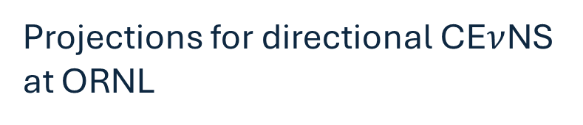

Directional Recoil Detection
Introduction and background
Motivation for CE$ν$NS and DM
CYGNUS gas TPCs
CYGNUS Hawaii work
CYGNUS at Oak Ridge
Projections for directional CE$ν$NS at ORNL

Slide 5
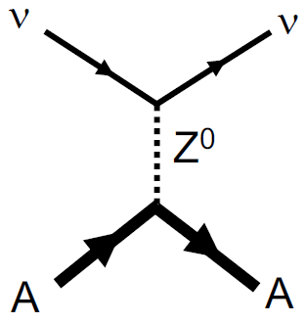
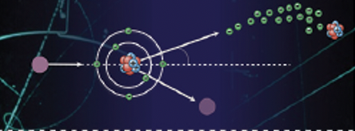
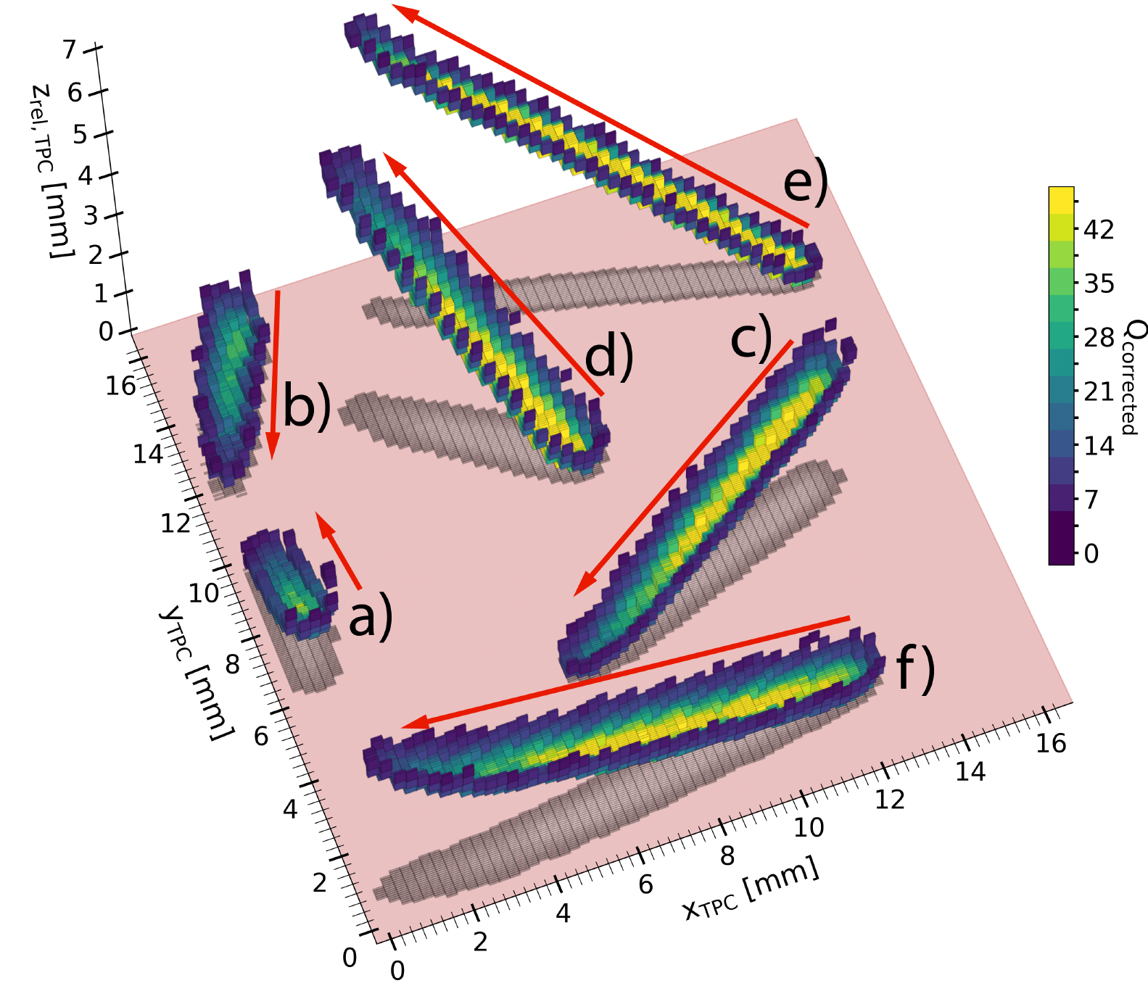
What is directional recoil detection?
When a particle scatters off one of the nuclei in our target gas this produces a recoil track
The track can be used to identify the transferred momentum vector

Slide 6
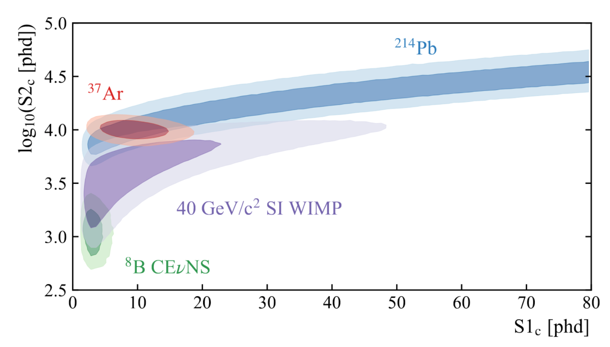
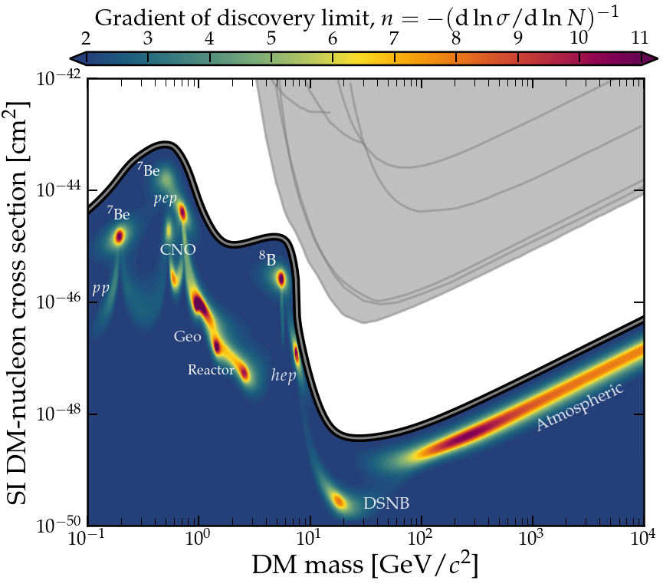
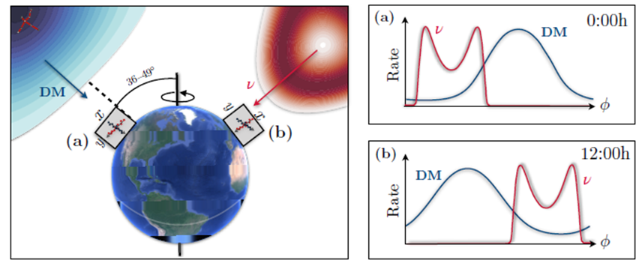
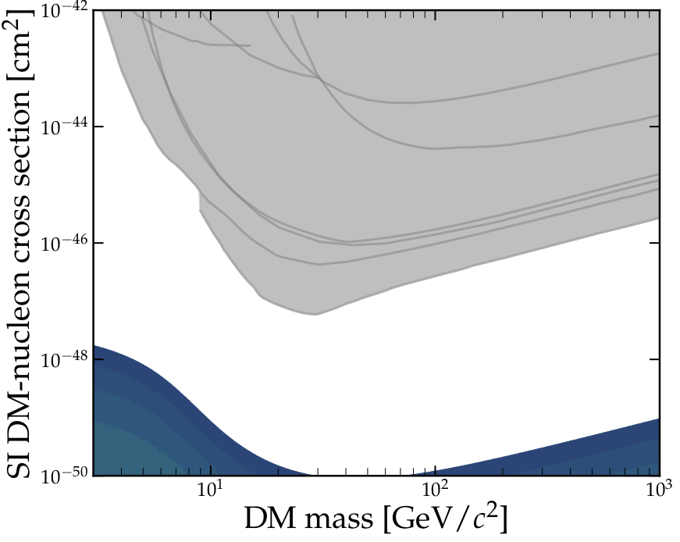
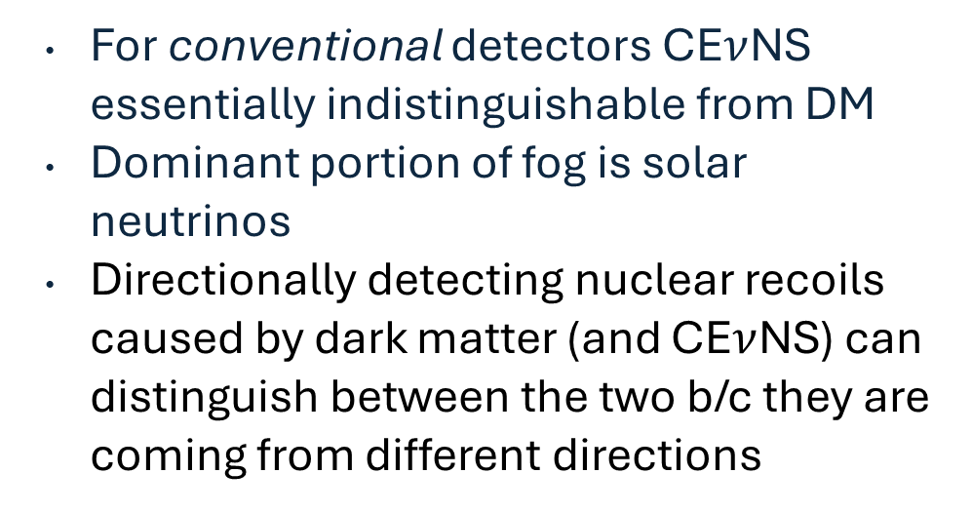
Overcoming the Neutrino Fog
For conventional detectors CE$ν$NS essentially indistinguishable from DM
Dominant portion of fog is solar neutrinos
Directionally detecting nuclear recoils caused by dark matter (and CE$ν$NS) can distinguish between the two b/c they are coming from different directions
[LZ Collaboration 2201.0285]
Ciaran A. J. O’Hare
Vahsen et al. [arXiv:2102.04596]
6

Slide 7
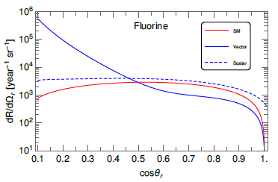

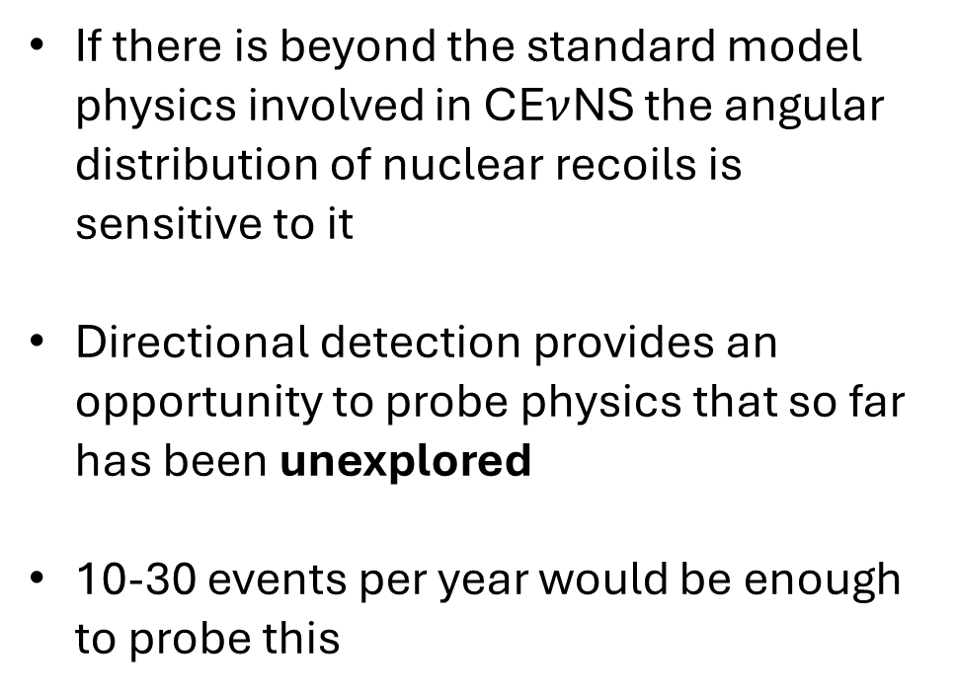
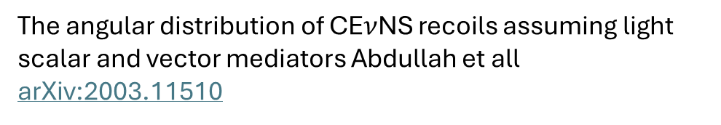
Potential BSM physics probed by directionality of CE$ν$NS
If there is beyond the standard model physics involved in CE$ν$NS the angular distribution of nuclear recoils is sensitive to it
Directional detection provides an opportunity to probe physics that so far has been unexplored
10-30 events per year would be enough to probe this
The angular distribution of CE$ν$NS recoils assuming light scalar and vector mediators Abdullah et all arXiv:2003.11510

Slide 8
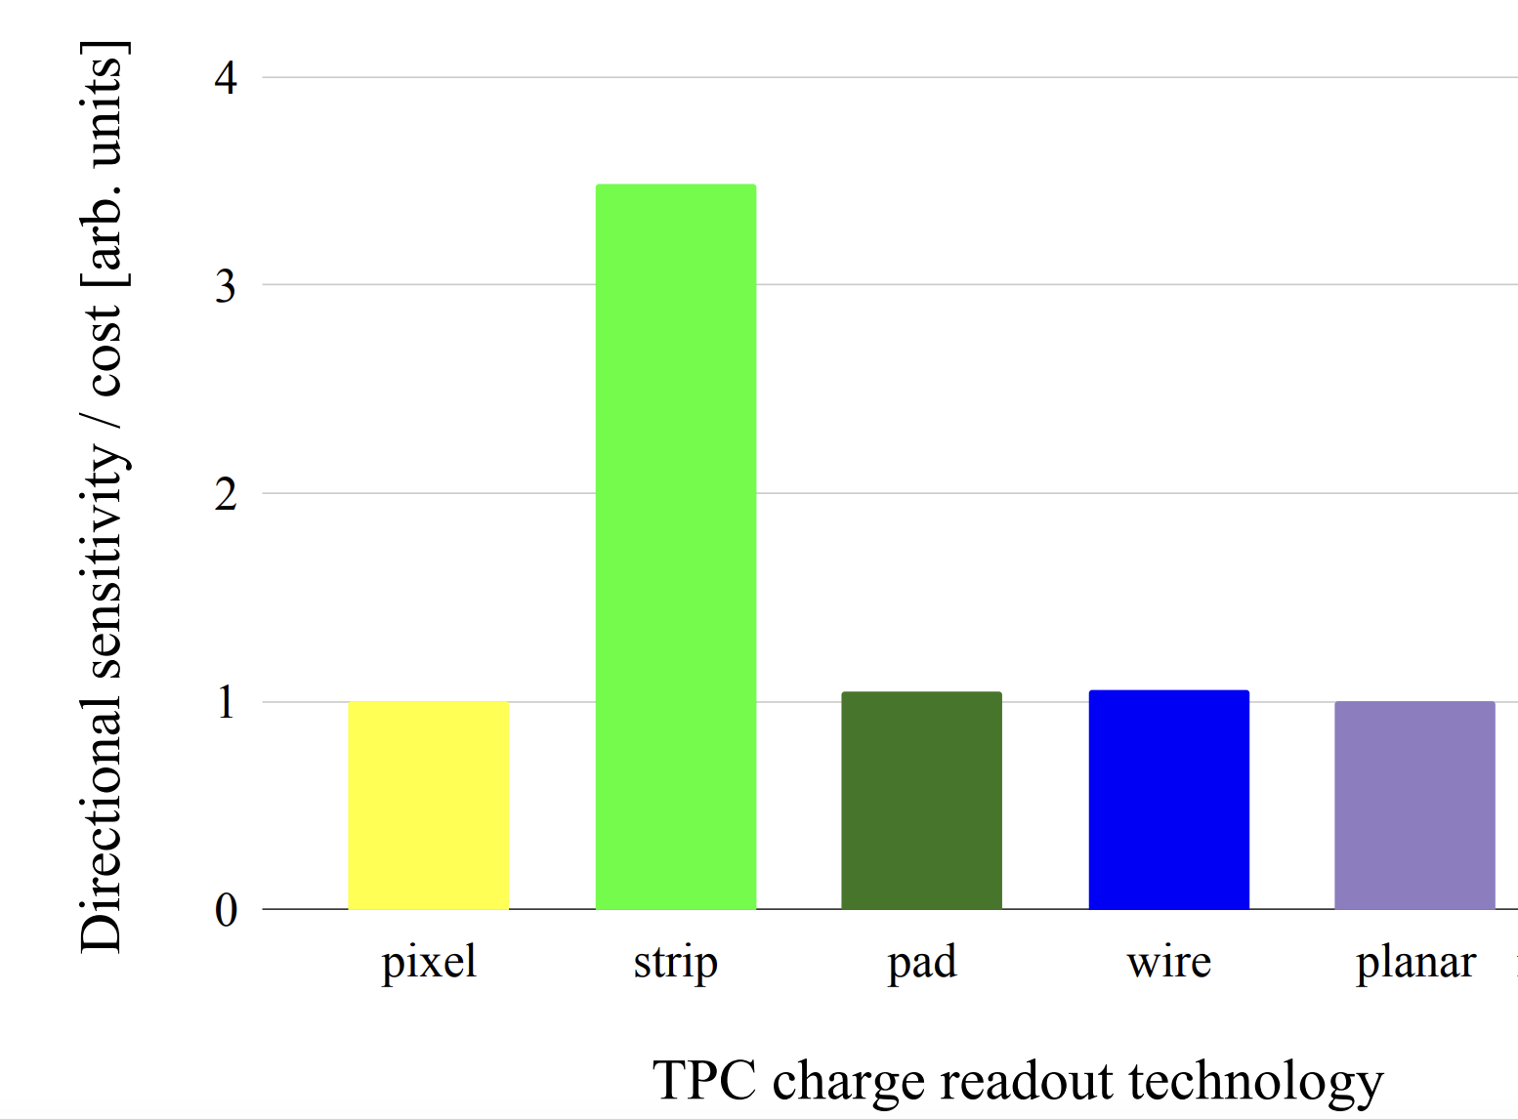
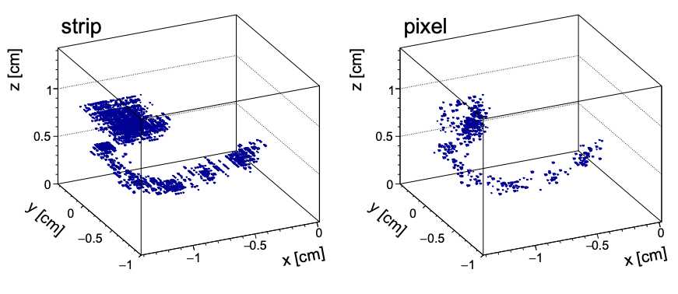
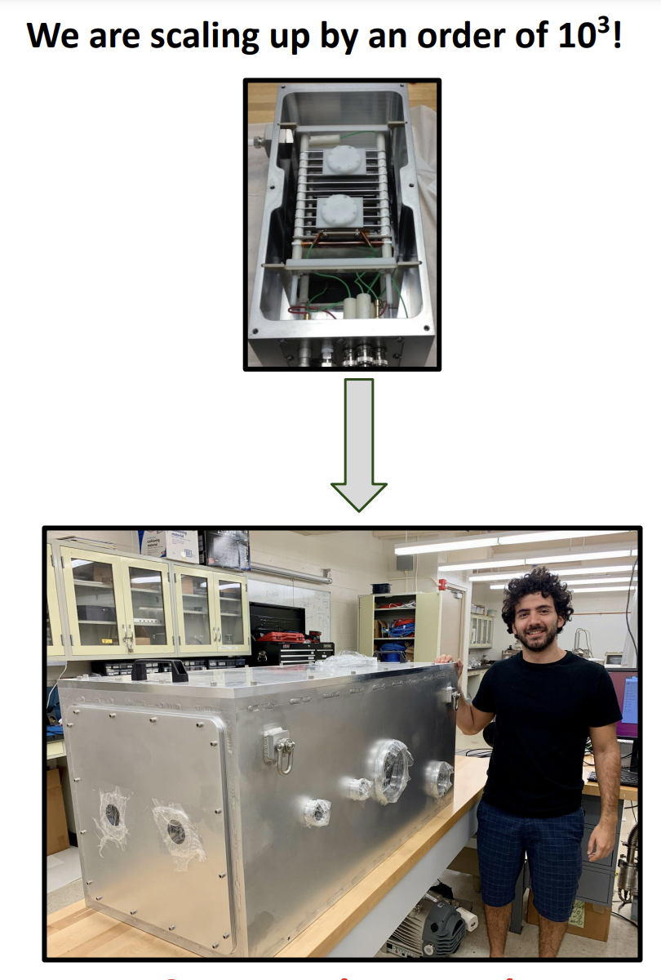
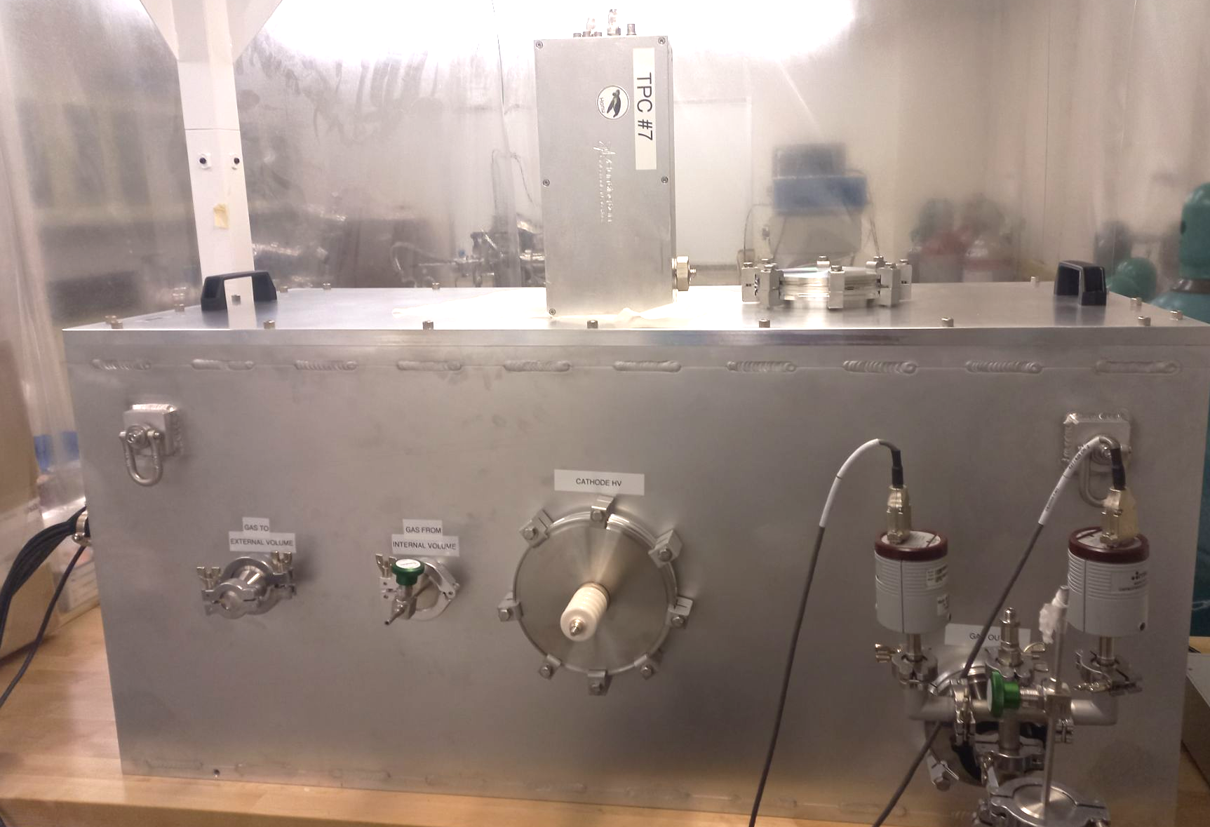
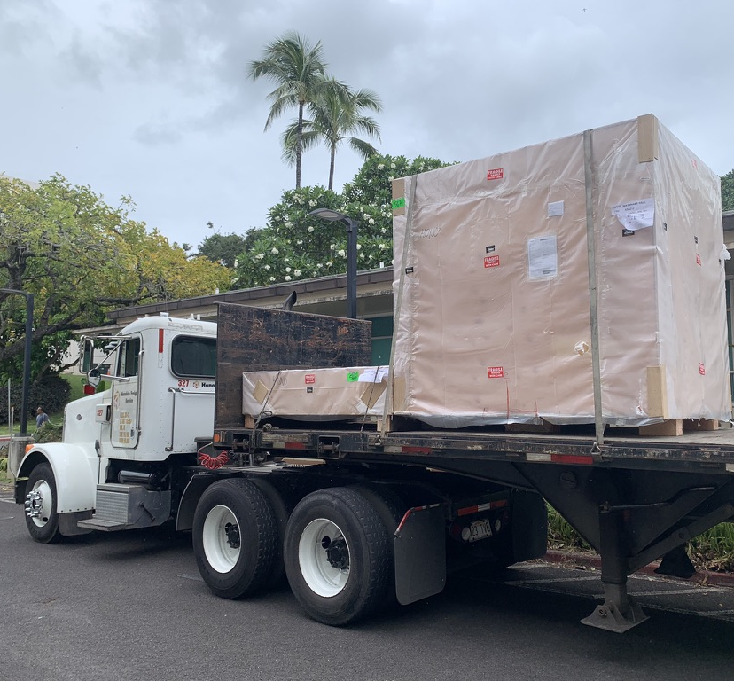
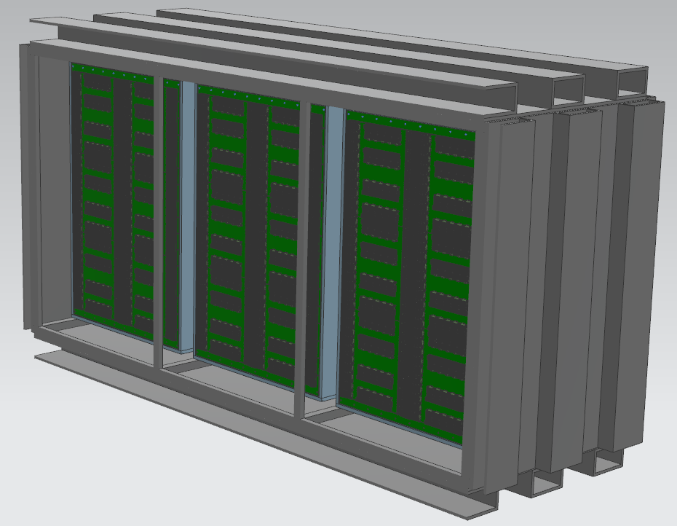


Scalable Directional Detectors
Detailed simulation of readout technologies [Vahsen et al. 2008.12587]
Best Raw Performance
Best directional WIMP sensitivity / unit cost
40 cm³
1$m^{3}$
x1000
x25
x10
40 L
10$m^{3}$

Slide 9
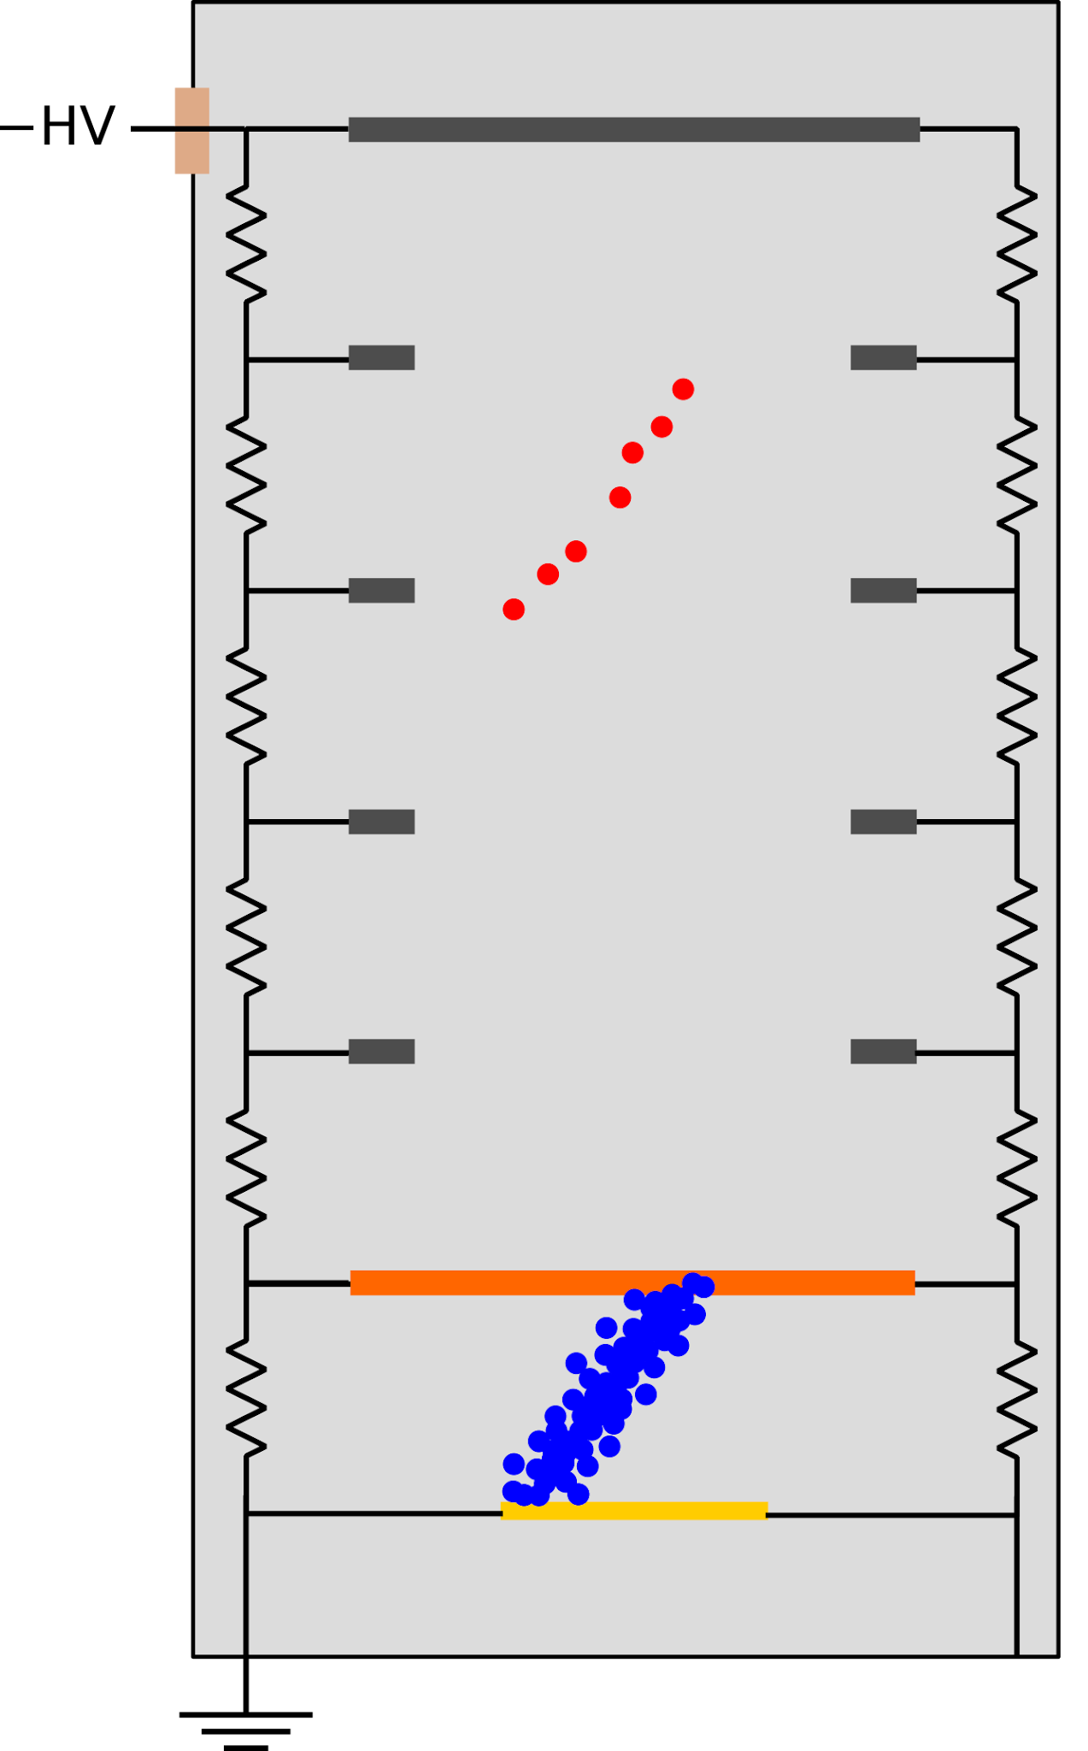
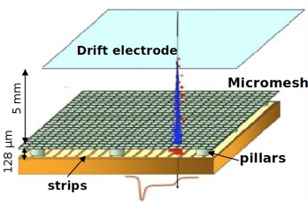
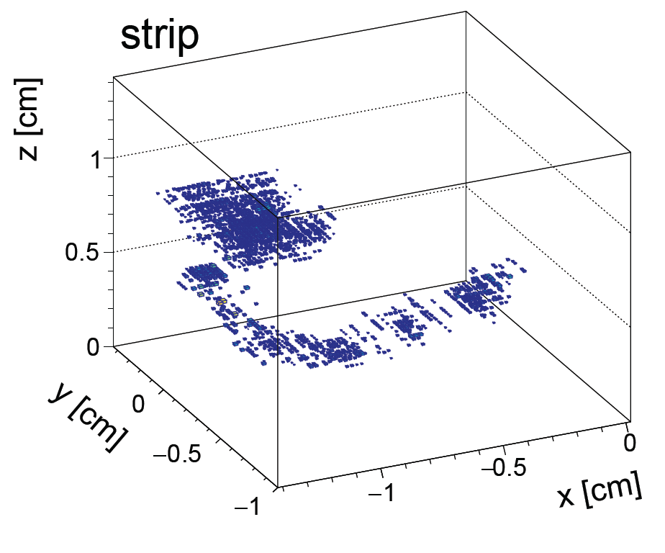
Brief explanation of our Micromegas Gas TPCs
Sequence of events in a single detection:
  Target gas held in a uniform electric field
  Incoming particle generates some ionization
  Charge cloud drifts into high field region, is amplified
    Diffuses as it drifts
  The amplified charge reaches readout strips and generates a signal
Regions are separated by a woven wire mesh (the mesh is called a micromegas: Micro-mesh gaseous structure)

Slide 10
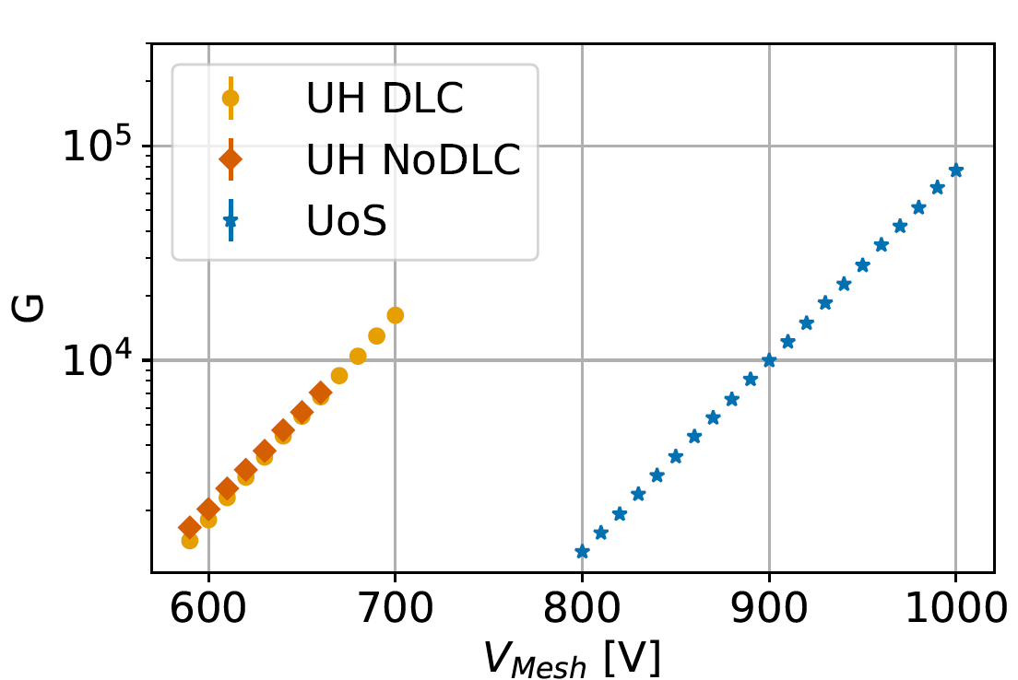
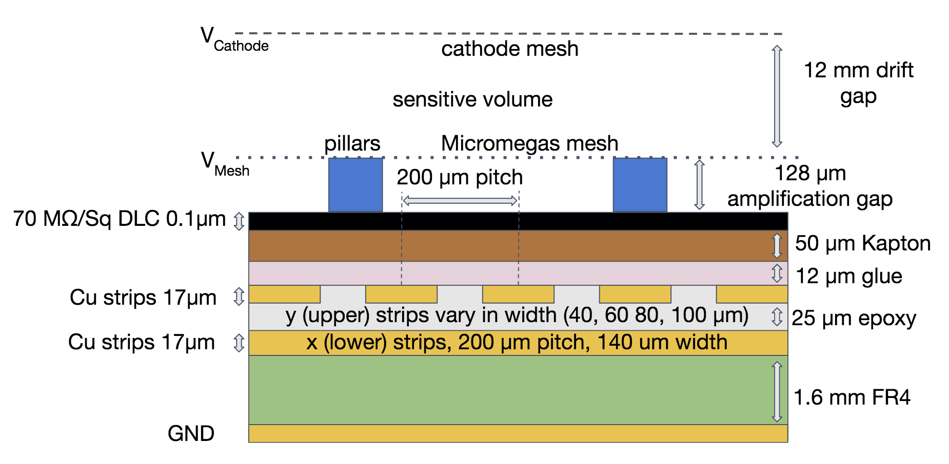
Scalable Readouts
Ghrear et al 2410.00048
Paper highlights:
Two independent readout techniques
Compares 9 readouts with varying upper strip width, DLC layer, amp. gap
Compare gain, energy resolution, charge sharing
Develops algorithm for 3D reconstruction with digitized strip readouts
Finds and explains effect where digitized strip readouts suppress observed diffusion

Slide 11
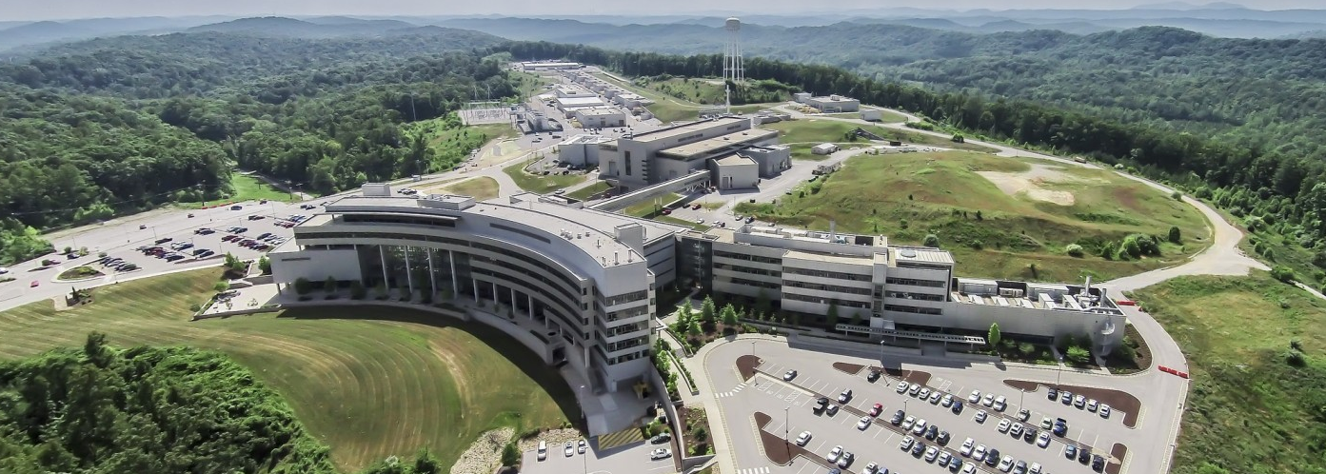
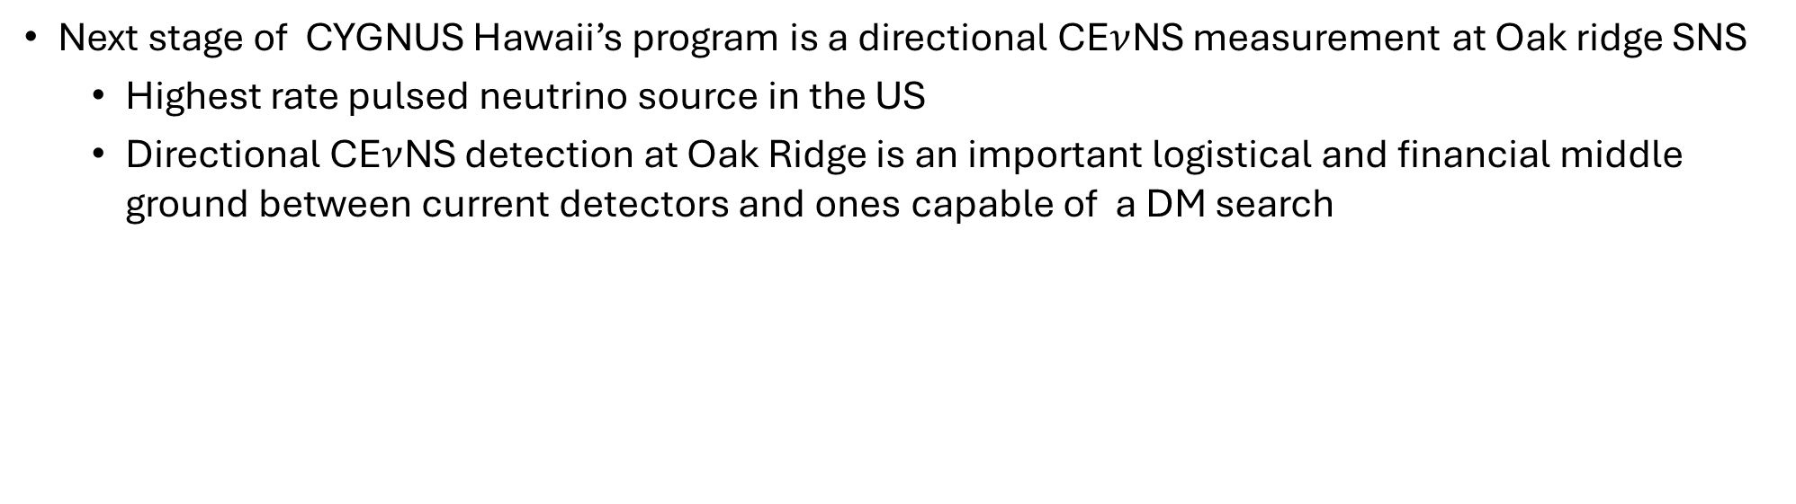
CYGNUS at Oak Ridge
Next stage of CYGNUS Hawaii’s program is a directional CE$ν$NS measurement at Oak ridge SNS
  Highest rate pulsed neutrino source in the US
  Directional CE$ν$NS detection at Oak Ridge is an important logistical and financial middle ground between current detectors and ones capable of a DM search

Slide 12
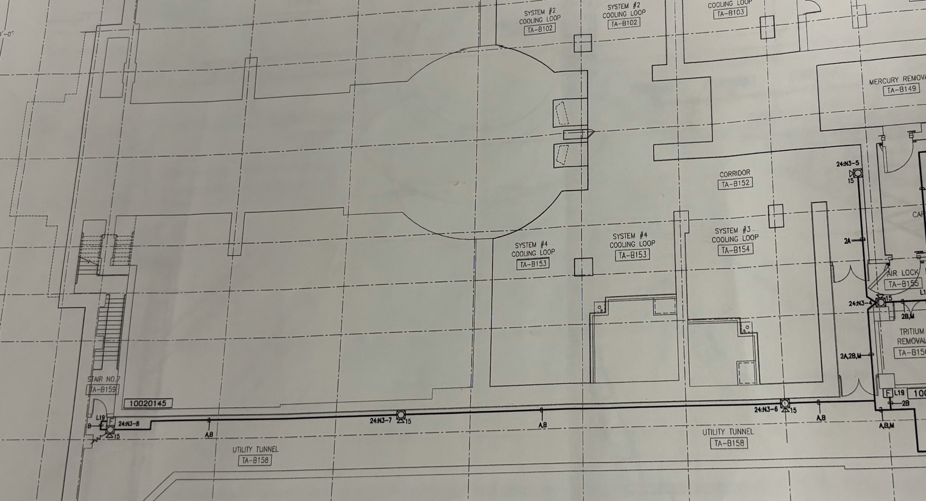
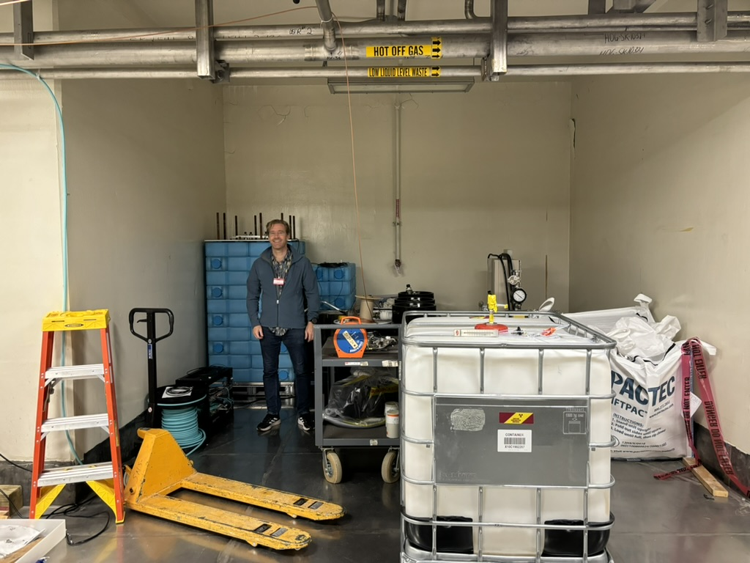
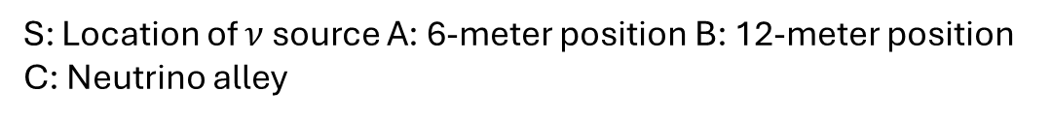
Site selection at SNS
A
B
S
C
S: Location of $ν$ source A: 6-meter position B: 12-meter position C: Neutrino alley
Prof Vahsen standing in position B
Neutrino alley not suitable for low pressure GAS TPC, new site is needed
Neutron background measurements at A&B using BEAST TPCs and 40L planned for next year. Looking at background and possible shielding

Slide 13
Picking and optimizing a new gas
Currently using a 70:30 He:C02 mix picked for neutron detection in the BEAST TPCs & 40L detector.
  Helium has a low neutron number, so we looked at how CF4 would perform over a year.
Pressure is proportional to events and inversely proportional to directionality, so we have to optimize pressure to get most directional events possible

Slide 14

Inputs and assumptions for the performance estimate
There are 4 inputs to estimating the number of directional events
  A measure of directionality (next slide)
  Electron transport and recoil track length properties of CF4 (obtained from the work done by DM-TPC and CYGNUS NEWAGE in arXiv:0905.2549 and arXiv:2101.09921 respectively)
  Double differential rate $\frac{d^{2}σ}{dE_{r}dΩ_{r}}$ of CE$ν$NS events (my calculation is ~50% lower than the literature [arXiv:2003.11510], so this estimate is conservative)
Assuming $1.58×{10}^{23}$POT per year at SNS (old number) at the 12-meter position with a 1 cubic meter detector running CF4 taking data for a year

Slide 15
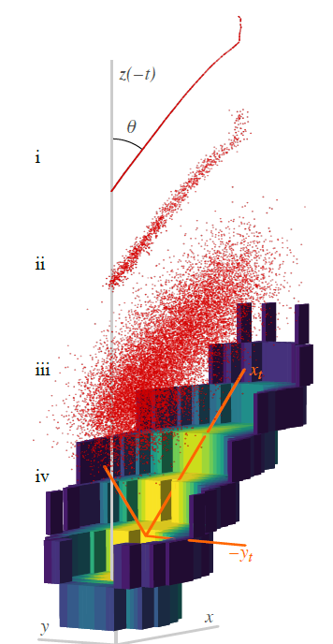
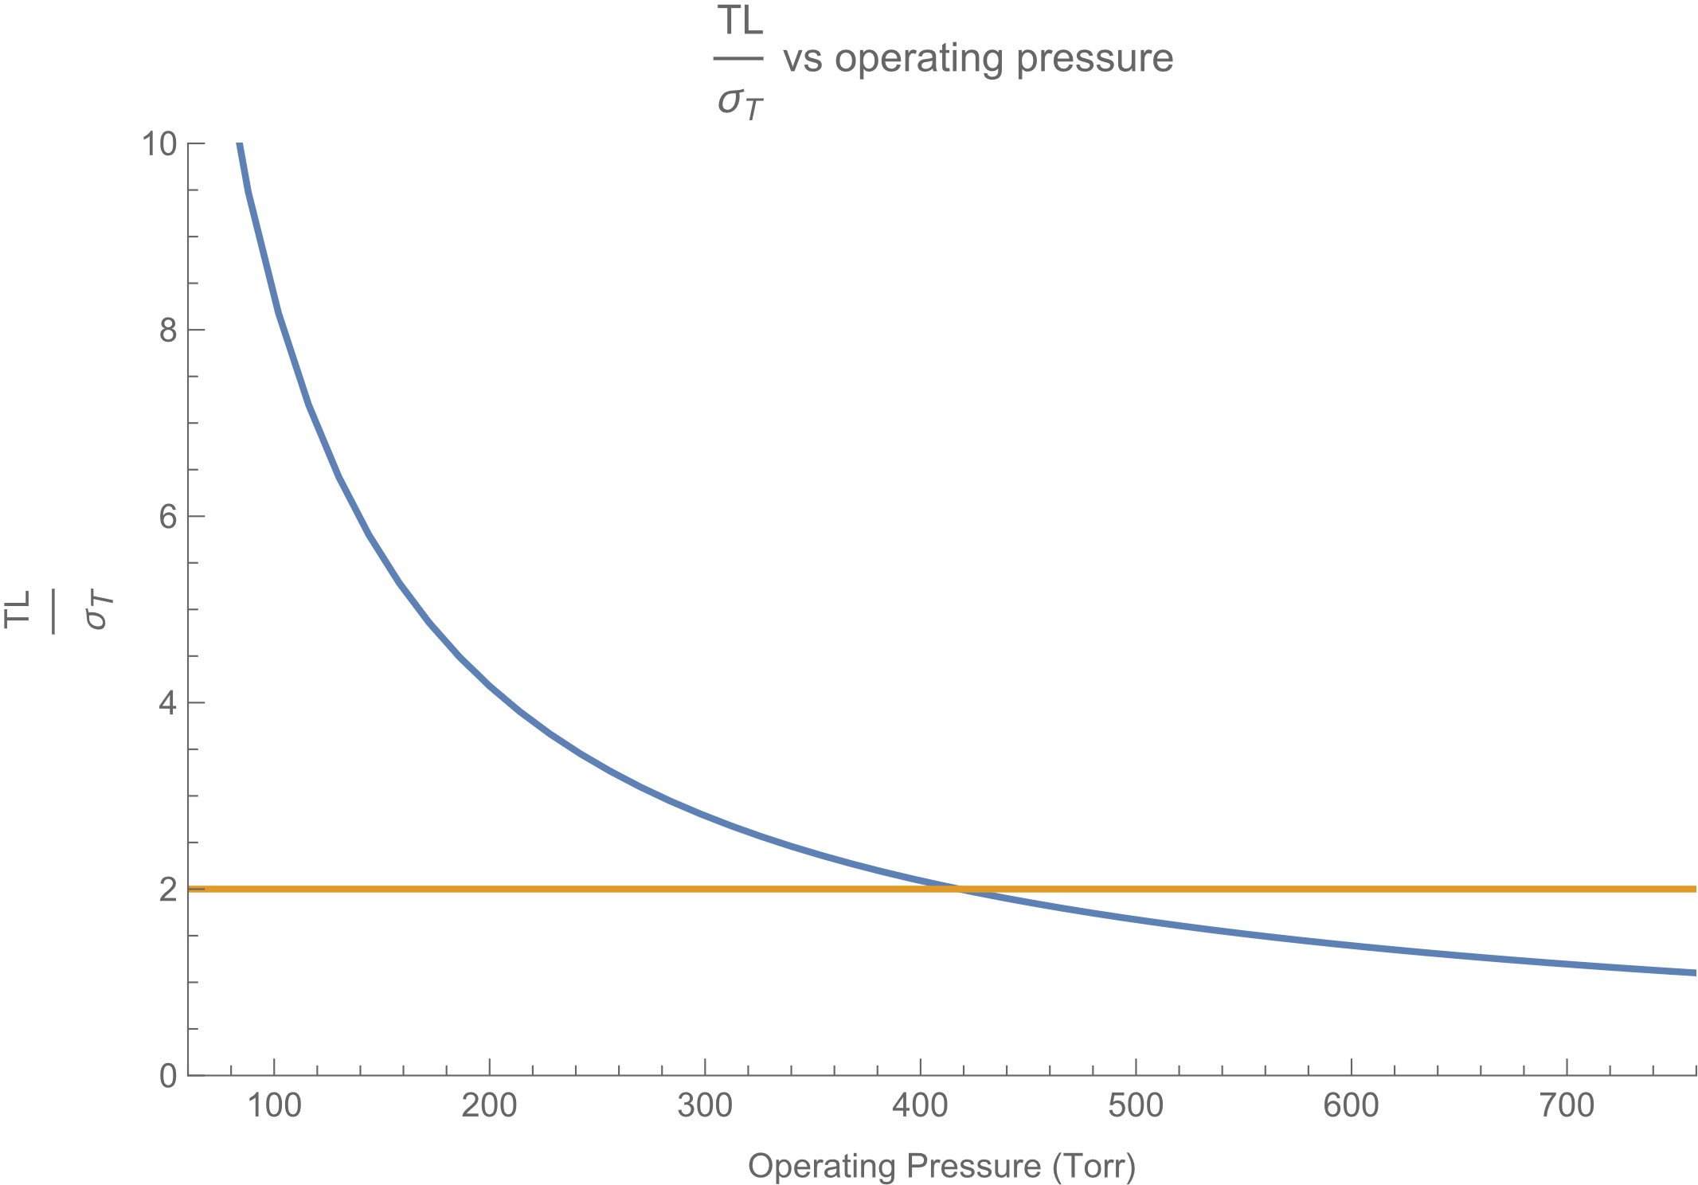
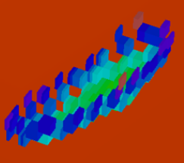
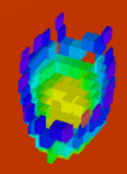
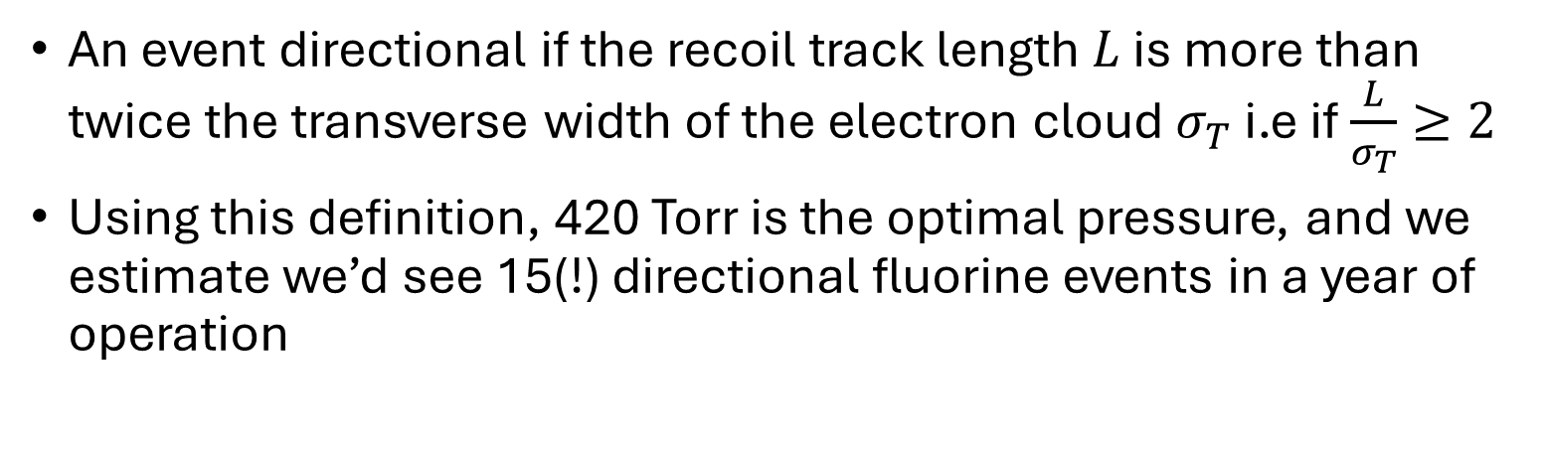


Directionality and Performance estimate
An event directional if the recoil track length $L$ is more than twice the transverse width of the electron cloud $σ_{T}$ i.e if $\frac{L}{σ_{T}}≥2$
Using this definition, 420 Torr is the optimal pressure, and we estimate we’d see 15(!) directional fluorine events in a year of operation
Image from: arXiv:2106.15829
Reconstructions of two nuclear recoils. One directional by this standard and the other not
$$L$$
$$2σ_{T}$$

Slide 16
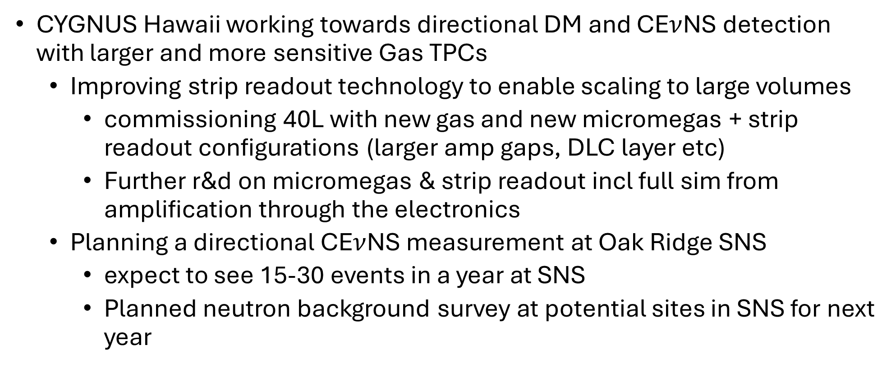
Summary & plans
CYGNUS Hawaii working towards directional DM and CE$ν$NS detection with larger and more sensitive Gas TPCs
  Improving strip readout technology to enable scaling to large volumes
    commissioning 40L with new gas and new micromegas + strip readout configurations (larger amp gaps, DLC layer etc)
    Further r&d on micromegas & strip readout incl full sim from amplification through the electronics
  Planning a directional CE$ν$NS measurement at Oak Ridge SNS
    expect to see 15-30 events in a year at SNS
    Planned neutron background survey at potential sites in SNS for next year

Slide 17
Backup

Slide 18
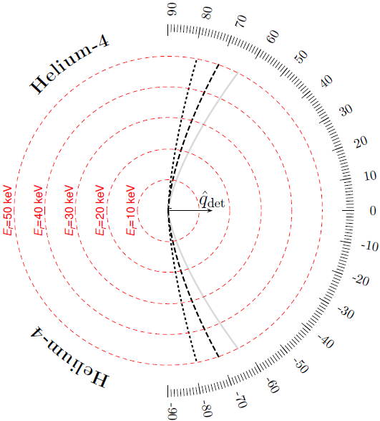

Assessing and optimizing detector performance
There are 5 things we need to calculate to assess and optimize the performance of a hypothetical detector
  Differential rate $\frac{dR}{dE}$ of CE$ν$NS events
  Angular distribution $\frac{dR}{dΩ_{r}}$ of CE$ν$NS events
  A measure of directionality
  Total number of directional CE$ν$NS events
  The best operating pressure for a given gas
The first 2 can be derived from the double differential cross section: $\frac{d^{2}σ}{dE_{r}dΩ_{r}}=\frac{1}{2π}\frac{dσ}{dE_{r}}δ(cos\left(θ_{r}\right)−\frac{E_{ν}+m_{N}}{E_{ν}}\sqrt{\frac{E_{r}}{2m_{N}}})$
The directionality can be calculated based on event parameters and gas properties, which we can use to calculate the best operating pressure
Allowed recoil angles for a He-4 at SNS (dotted black curve) [arXiv:2003.11510]

Slide 19
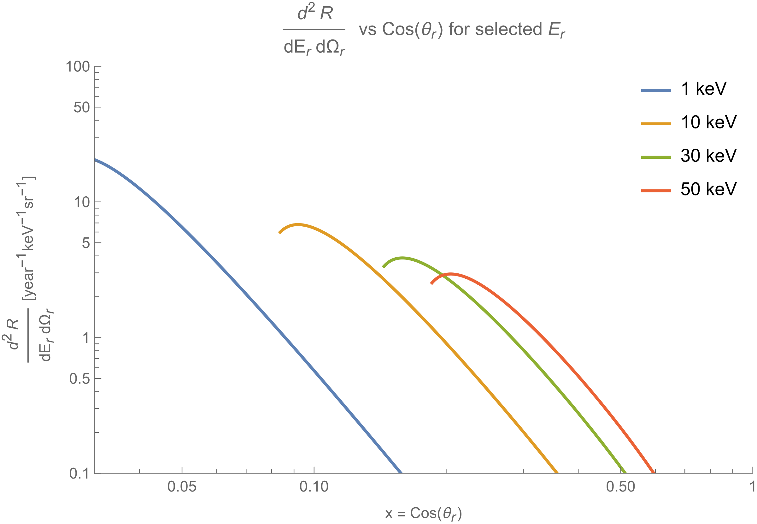
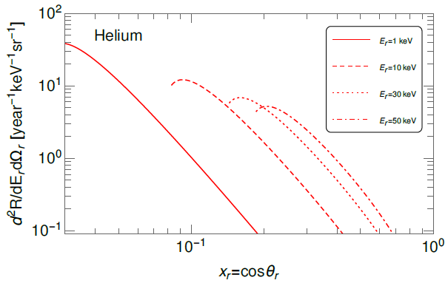
Comparing calculations to the literature: $\frac{d^{2}R}{dE_{r}dΩ_{r}}$
My calculations
Plot from arXiv:2003.11510
Projections made assuming 164kg He 20m from source (the values used in the paper)
Discrepancy is only about 50% (1keV line intersects at ~40keV in paper, and at ~20keV in my calculation) This means any estimates made with current calculations are conservative

Slide 20
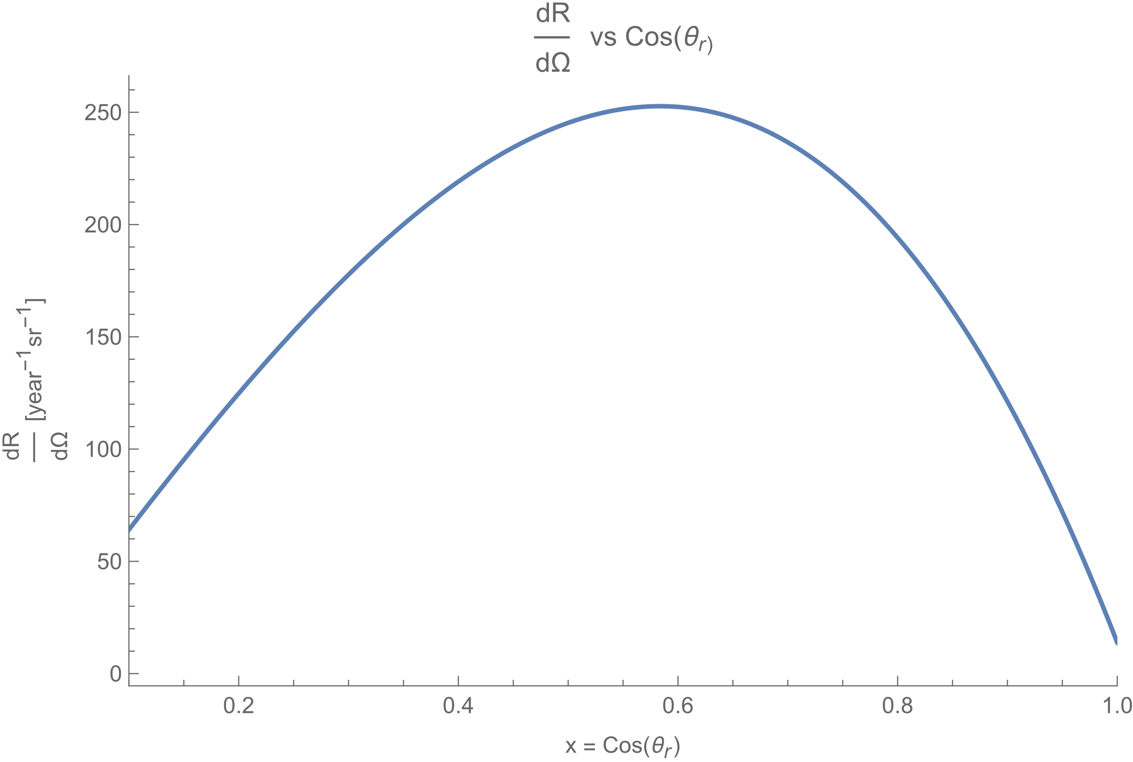
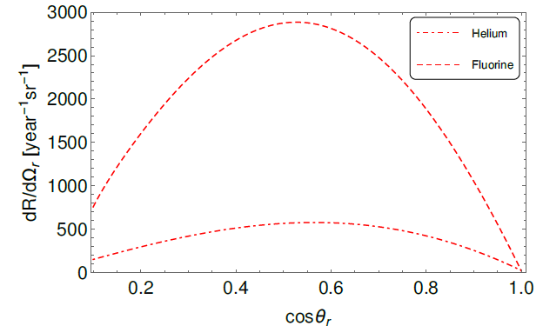
Comparing calculations to the literature:$\frac{dR}{dΩ_{r}}$
My calculations
Plot from arXiv:2003.11510
As with the double differential, overall disagreement is about 50% but the shape agrees

Slide 21
Transverse width
Caldwell et al. measured the transport properties of electrons in CF4 in [arXiv:0905.2549]. They report that the observed transverse width of the electron cloud as a function of the drift length is: $σ^{2}\left(z\right)=σ_{0}^{2}+2(\frac{D}{μ})(\frac{z}{E})$
  $σ_{0}$ is the resolution of the readout plane$, 2(\frac{D}{μ})(\frac{z}{E})$ accounts for the diffusion of the electrons as they drift. $\frac{D}{μ}$ is related to the electron energy, z is the drift length E is the field strength
  Based on data from the DM-TPC team, $\frac{D}{μ}\left(p,E\right)=2.51∗{10}^{15}∗\frac{E}{ρ_{n}}+.019volts$

Slide 22
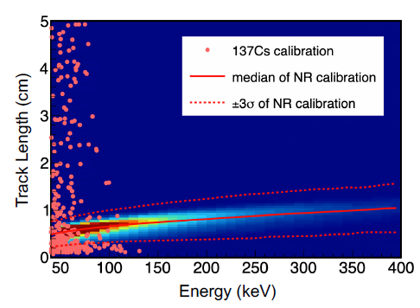
Recoil track length
The CYGNUS NEWAGE group in Japan measured the recoil track length of nuclear recoils in cf4 at 75 torr
Track length scales as $\frac{1}{p}$, so we multiply their curve by $\frac{75 torr}{p}$ to get $L(E_{r},p)$
Image from arXiv:2101.09921

Slide 23
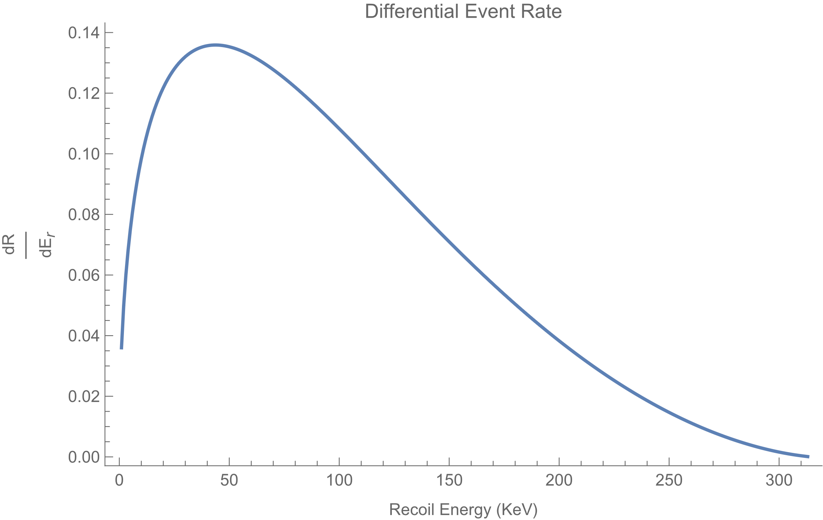
Picking a threshold and finding the optimal pressure
Differential event rate distribution peaks at near 50kev so we get bulk of events >50kev
Crosses 2 at about 420 torr (for an assumed drift length of the worst case of 50cm)
At 420 Torr, we expect 15 (!) fluorine recoil events above 50KeV in a year of run time at the 12-meter position with a 1 cubic meter detector

