Slide 1
CERN RTD positions on LMQXFA01
R. Bossert, F. Nobrega, S. Feher, L. Martin, T. Strauss
9/12/24

Slide 2
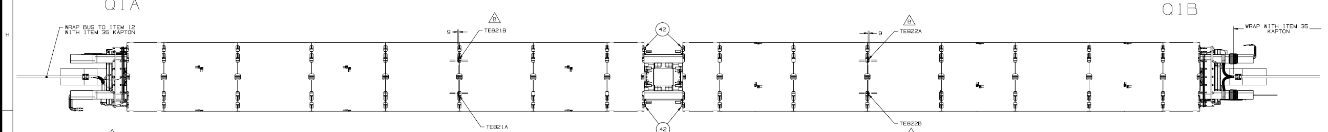
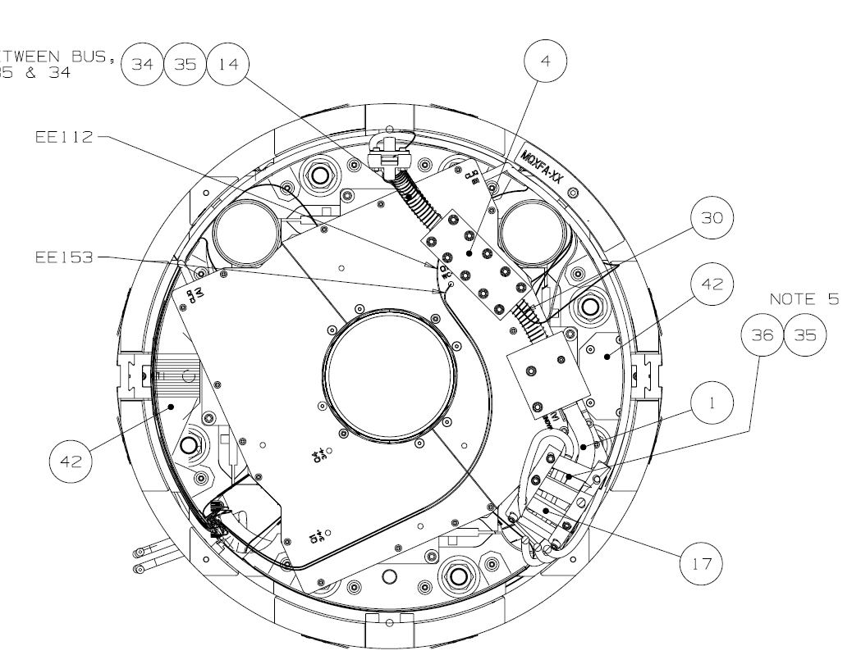
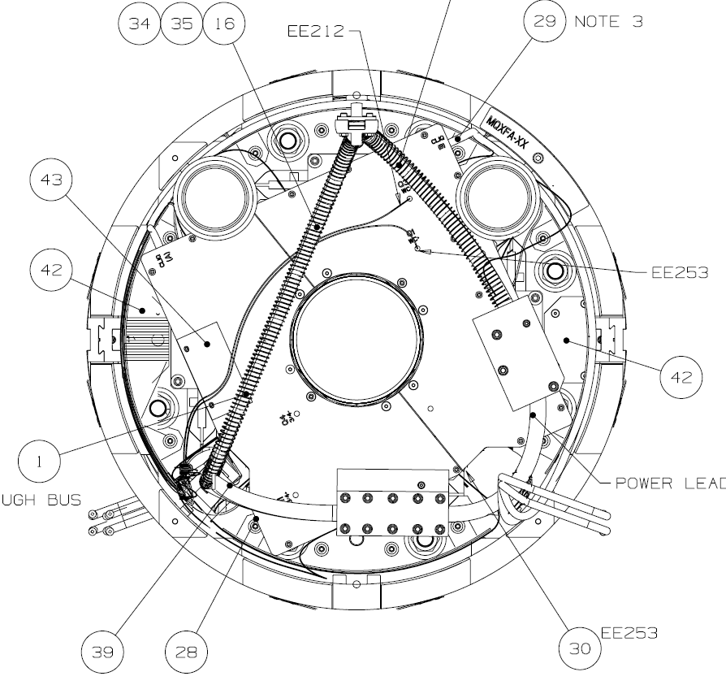
Plan view (view from above) with CERN desired layout of Q1/Q3
A
TE821A
TE822A
Lead side
B
Q1a/Q3a
Q1b/Q3b
A
Lead side/Bus side
TE821B
TE822B
Bus side
B
Through Bus
Looking into Qa from connection end
Looking into Qb from connection end
(View A-A)
(View B-B)
TE821A
TE821B
TE822B
TE822A
Through Bus
Through Bus

Slide 3
As we believe installed on CA01
Thermometer Labels and identifying numbers from traveler
Consistent with CERN Schematic
CERN RTD Designations
 |  |  | From CERN Thermometer Traveler
CA01 Wire Label Ref. resistance vs last measured resistance |  | Serial number from Anthony | CERN Part Identifier | Other Identification
TE821B 57.24 Ω | Qa Bus 58.051 Ω | CX_LS_20677 | HCQITESCXT-CR029420 | CX_LS_20677
TE821A 54.04 Ω | Qa no Bus 54.899 Ω | CX_LS_20707 | HCQITESCXT-CR029670 | CX_LS_20707
TE822B 56.87 Ω | Qb Bus 57.877 Ω | CX_LS_X20695 | HCQITESCXT-CR029580 | CX_LS_X20695
TE822A 56.90 Ω | Qb no Bus 57.814 Ω | CX_LS_X20667 | HCQITESCXT-CR029360 | CX_LS_X20667

Slide 4
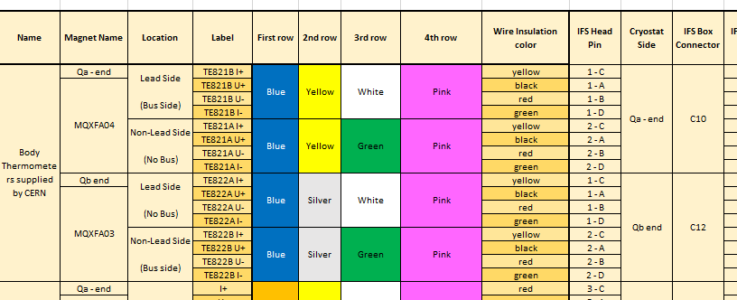
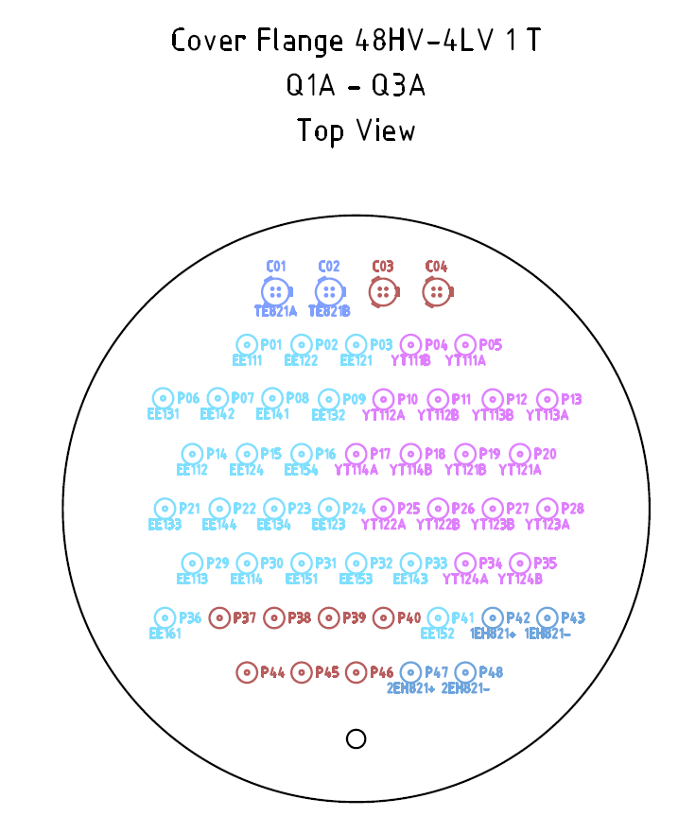
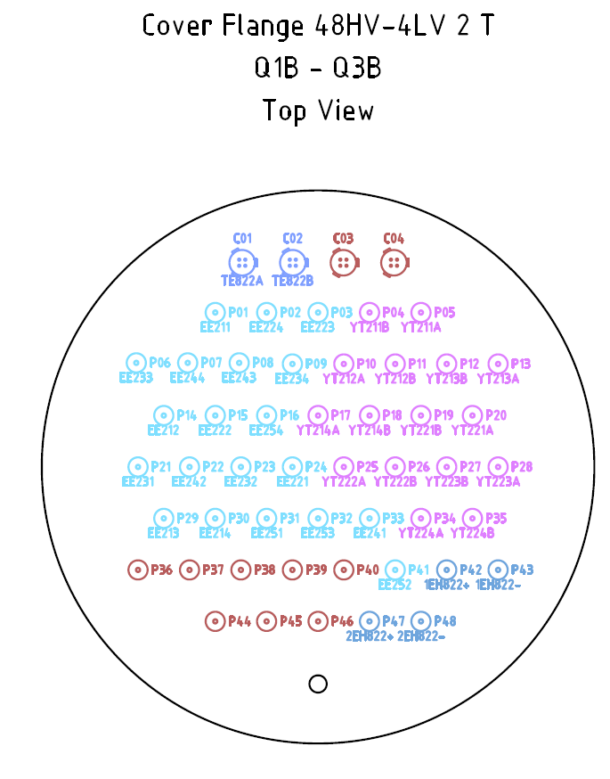
The big BUT:
We found one problem when the spreadsheet was created, it should be an issue on the Qa end for CA01. We noticed that in the assignment we mixed up the Pin1 TE821A & Pin 2 TE821B assignment.

Slide 5
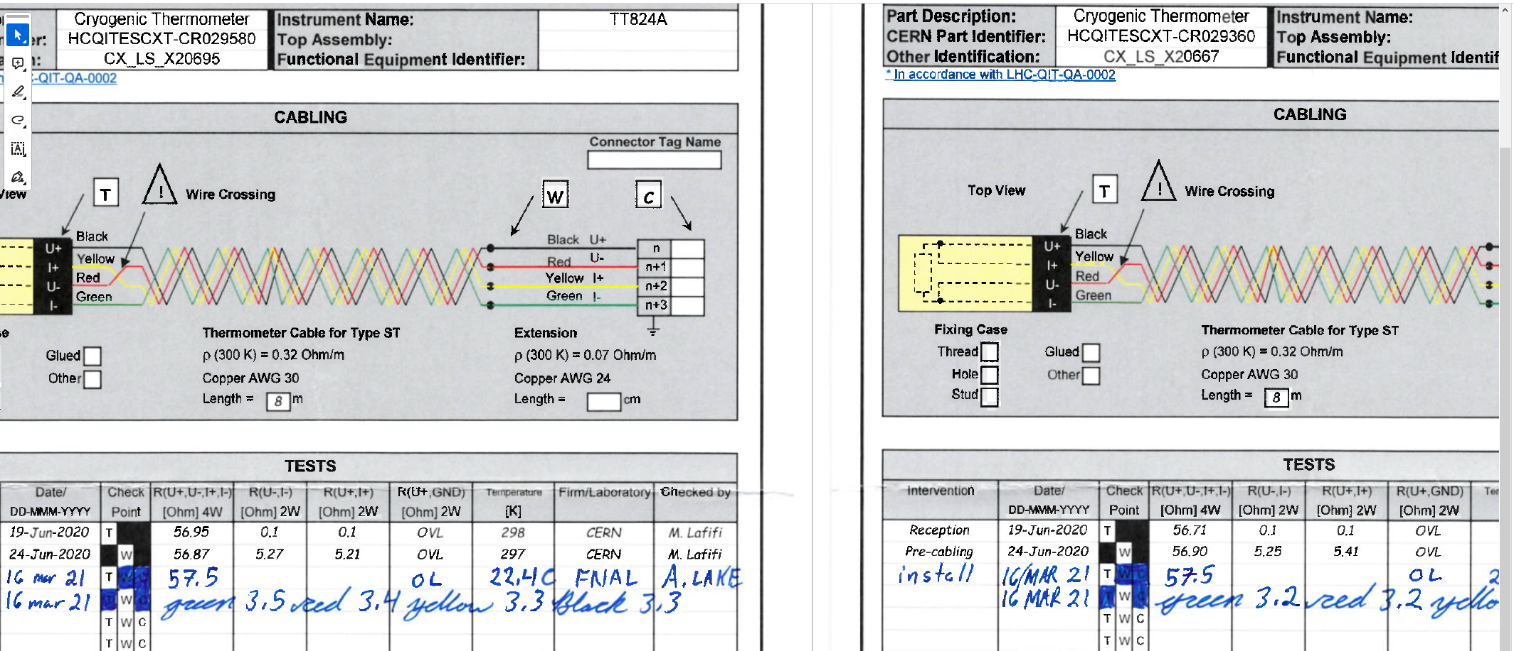
We also note that there is an indication the sensor on the Qb end are swapped, they are really close in value and on the CERN sheet moved opposite in value.
We can see from our cold data a small offset between the two values

Slide 6
We might have the CERNOX location on the assembly wiring reversed from the expectation to CERN
We implement edchanges for CM & CA assembly to prevent this in the future (excl. CA02, which is completed and from data shows the first issue persisted)

Slide 7
Backup Slide

Slide 8
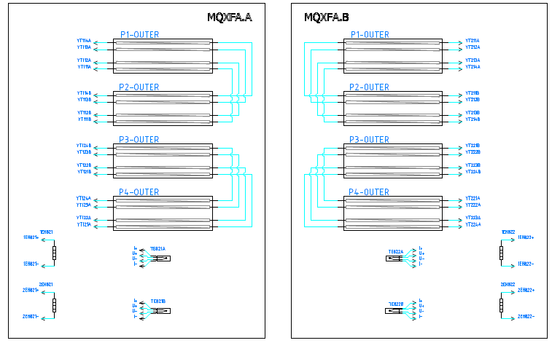
CERN Schematic showing RTD positions in plan view (updated in 2022, past CM01 assembly)
TE821A
TE822A
TE821B
TE822B
TE821B = CX_LS_X20707
TE822B = CX_LS_X20667
TE821A = CX_LS_X20677
TE822A = CX_LS_X20695

Slide 9
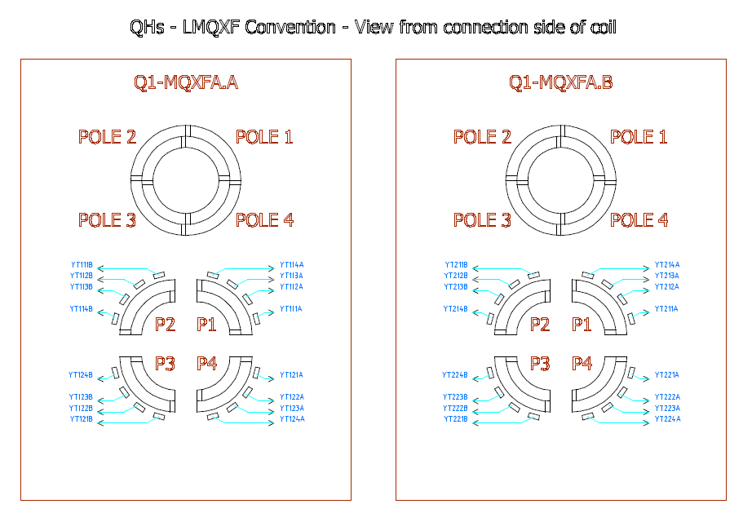
CERN Schematic showing RTD positions in end views
TE821A
TE821B
TE822B
TE822A

