Slide 1
Attempt to measure field change during MQXFA17 ‘spike’ event.
19Sep2024
J. DiMarco, P. Joshi, F. Kurian, V. Teotia

Slide 2
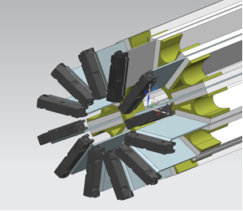
The full-length ‘Theta Quench Antennas’ (TQA) were switched from DQBuck with amplifiers to UnBucked (UB) configuration in May2024
TQA are 12 radial, full-length PCB-like, antennas having dipole and quadrupole bucking
These were re-configured to be ‘UnBucked’ in order to have sensitivity to dipole and quadrupole field changes
Thanks to the BNL technical team for their great support doing this work!

Slide 3
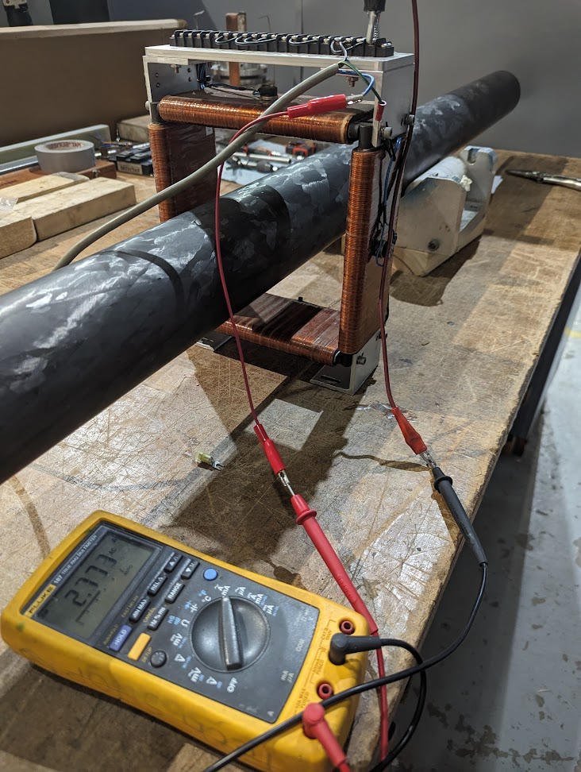
The UB TQA were tested with short (90mm), dipole magnet cycled with 60Hz current.
The field from the magnet was measured to be ~ 8mT, magnetic length ~ 0.23m
➔ TQA sees ~1.85 mTm integrated field change.

Slide 4
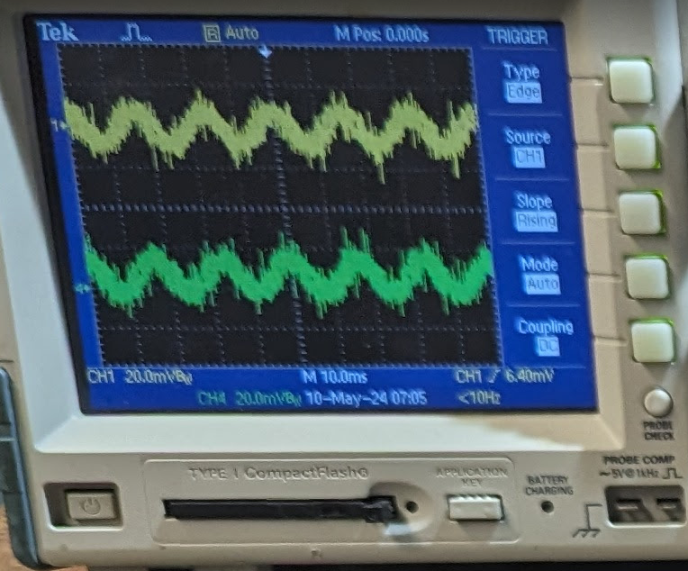
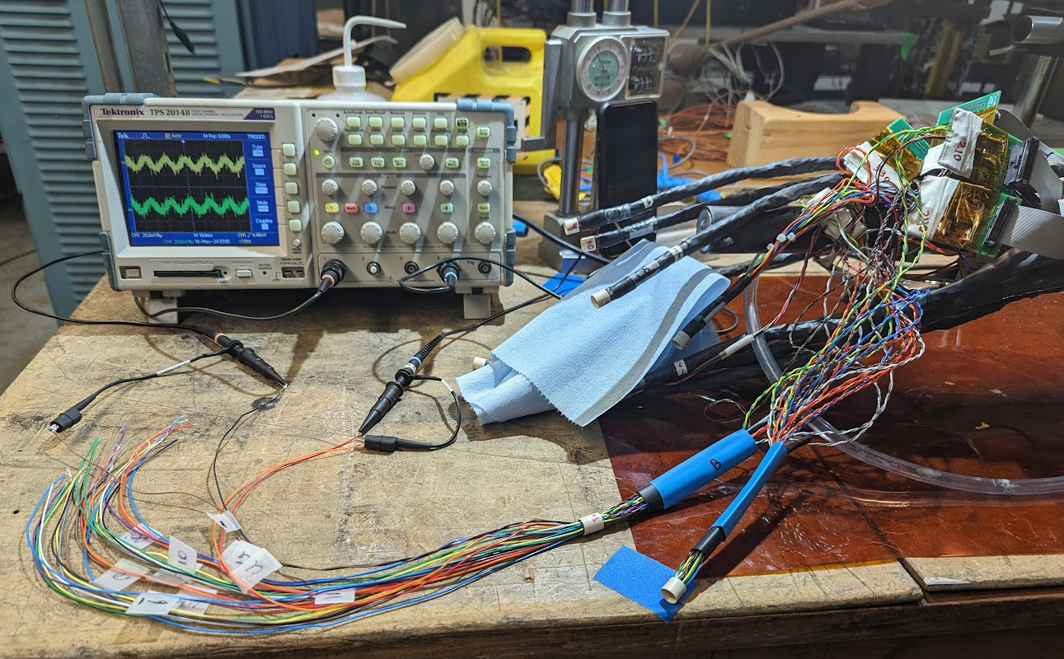
Scope signal on TQA is ~15mV P-P for the AC 1.85 mTm field change of the small dipole.➔ measured integrated voltage signal from scope is ~4e-5 Vs.
To compare with what is expected from TQA, the UB quench antenna has sensitivity of about 0.015 m^2, so 1.85 mTm integrated field change should give about 3e-5 Vs signal on the quench antenna.
➔ Agrees roughly with expected

Slide 5
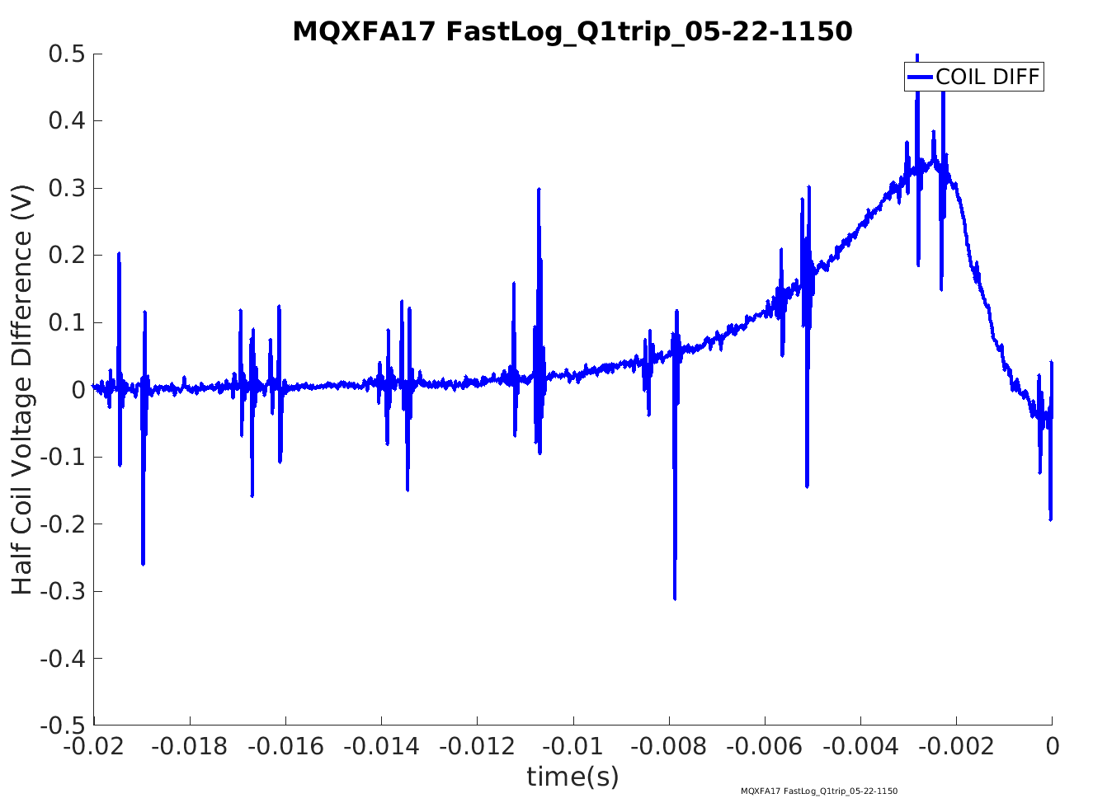

Slide 6
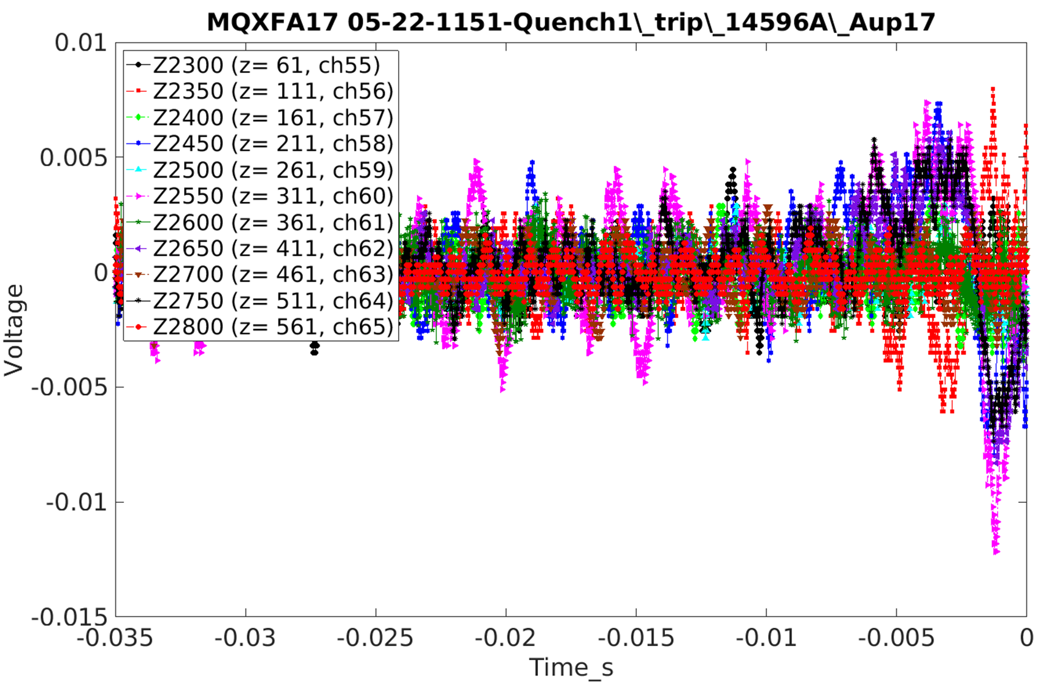
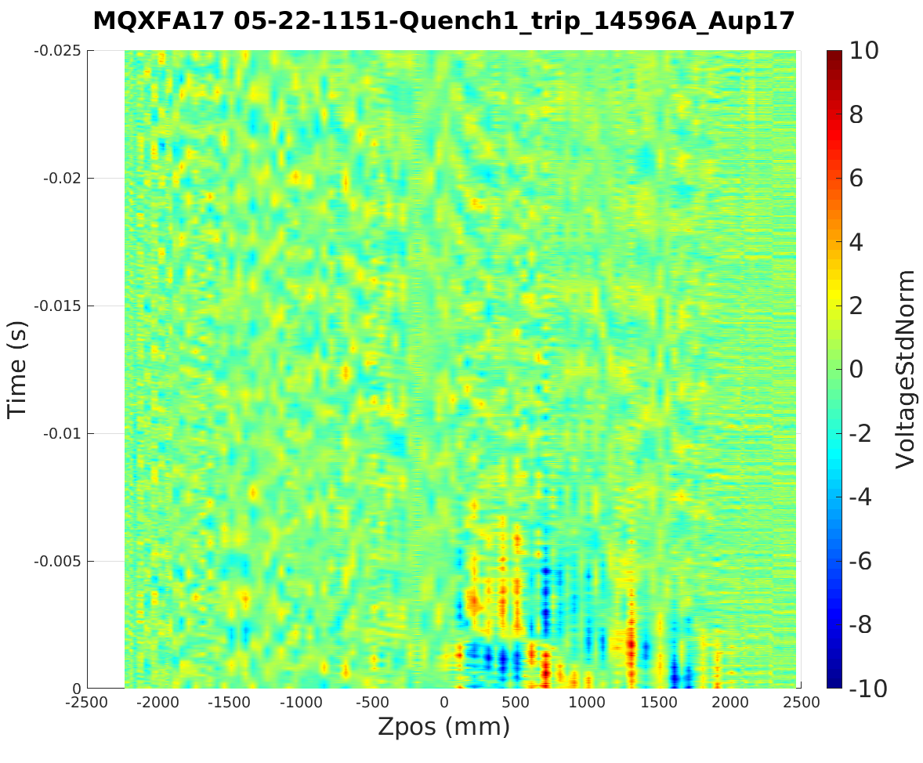
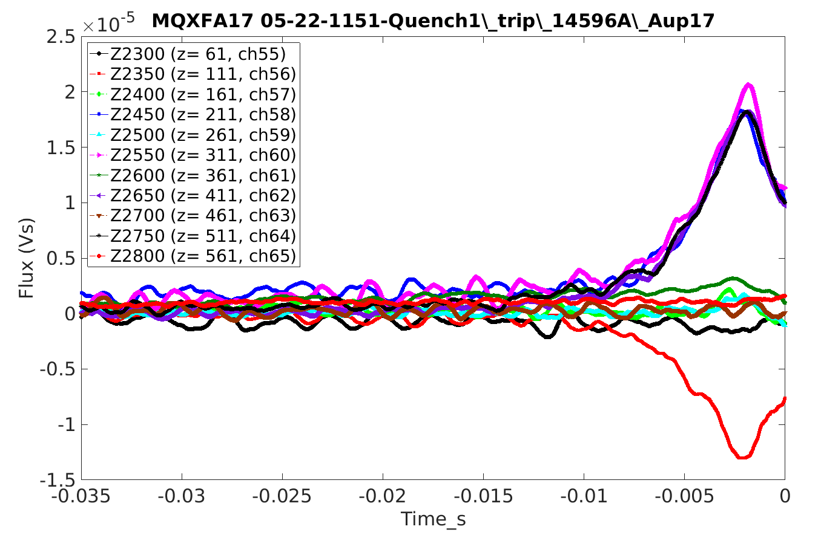
MQXFA17 first trip/quench had a ‘current spike’ event.
Voltage
The body quench antennas, which buck dipole and quad have high sensitivity and clearly saw the event.

Slide 7
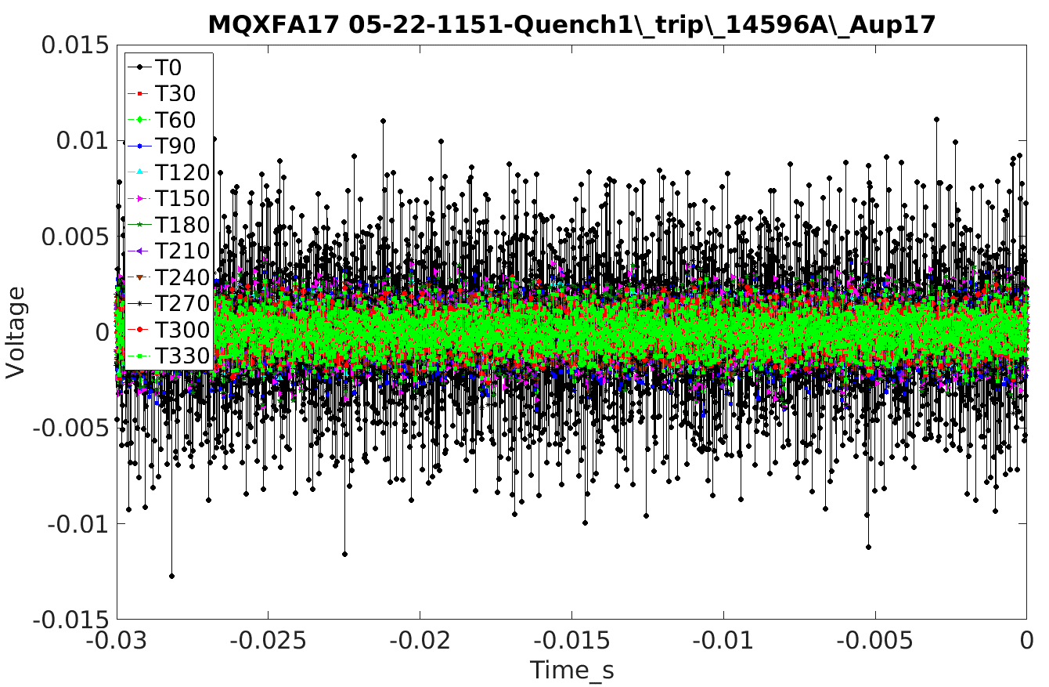
Voltage signals on TQA during spike event

Slide 8
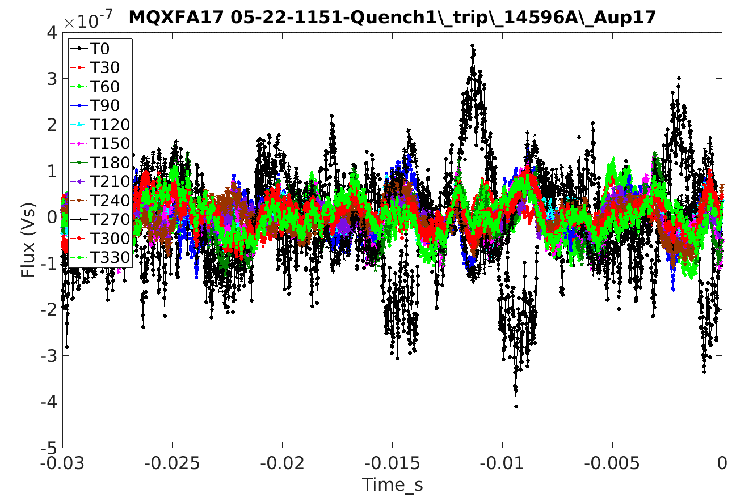
TQA flux signals do not seem to see anything at the level above 1e-6 Vs
Some small flux changes probably are being seen here
These larger changes (still <1e-6) do not involve multiple angles, so are probably not from ‘main field’ changes

Slide 9
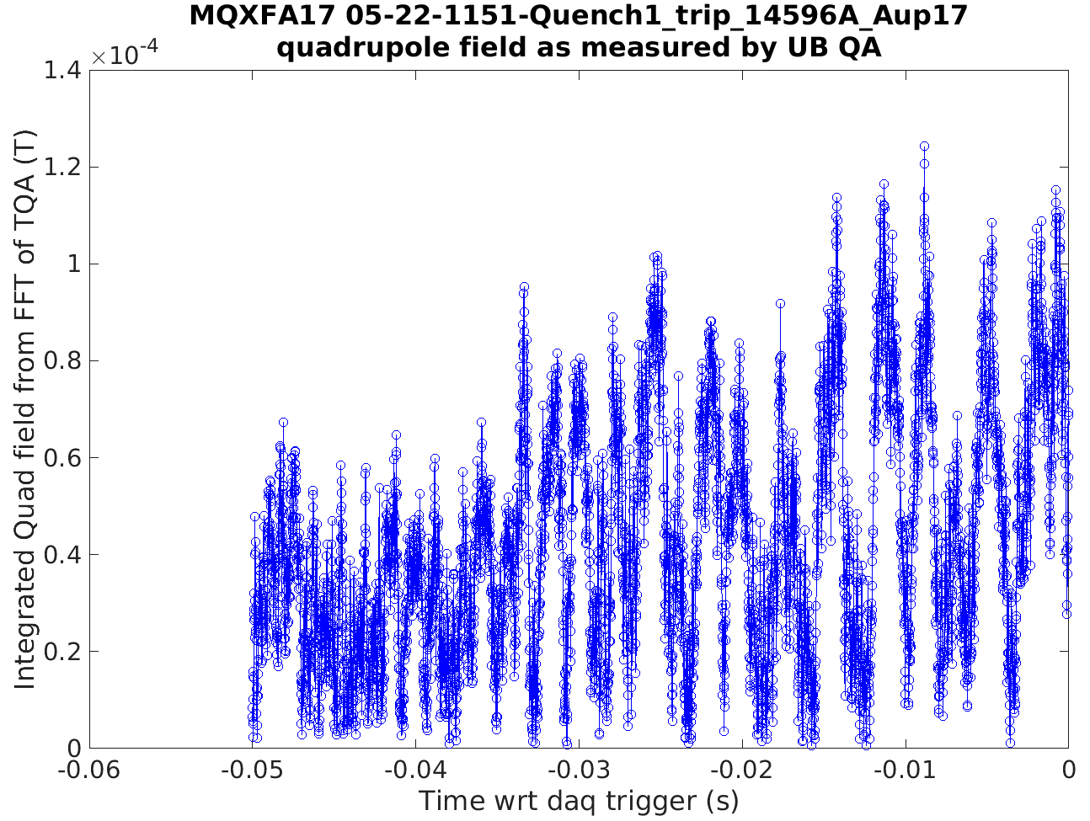
Quadrupole field component determined from TQA flux changes vs time. (Note that the integrated main quadrupole field is ~ 25T at the TQA radius)

Slide 10
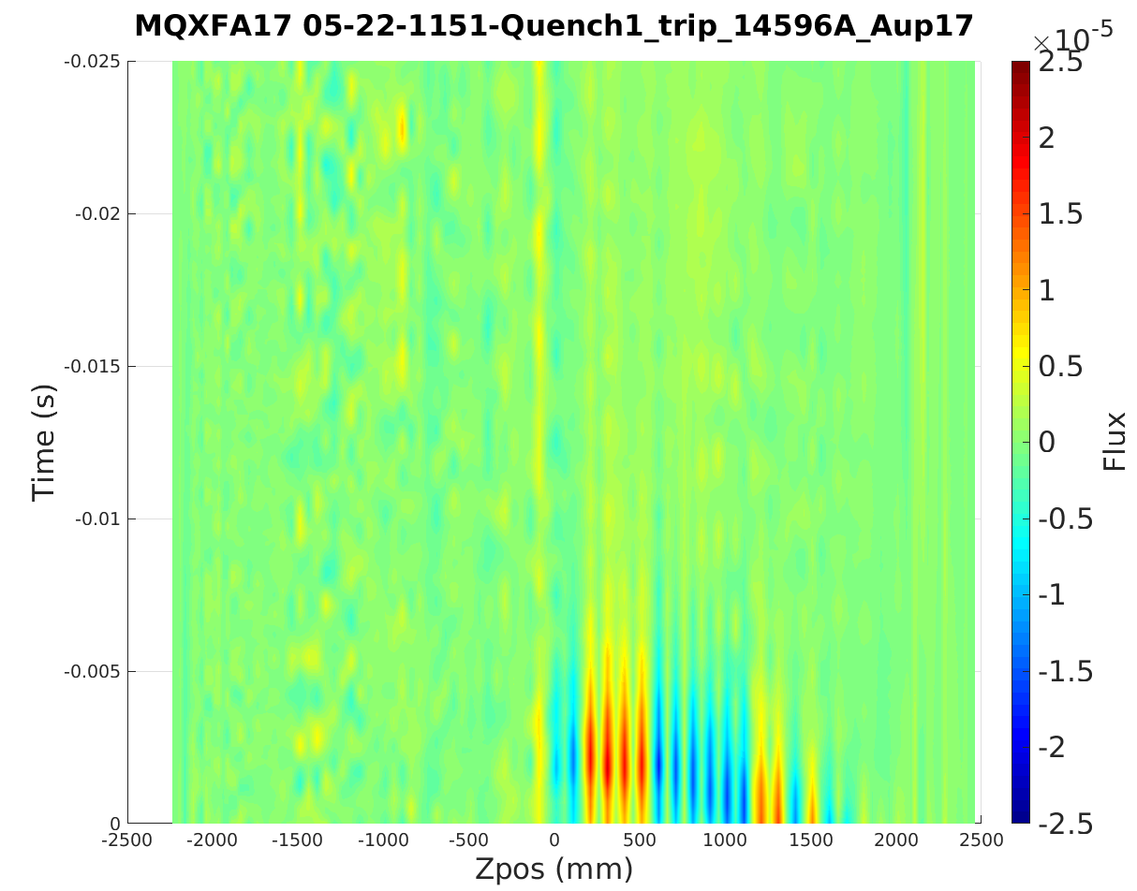
Perhaps in terms of integral field, flux changes are cancelling axially (?)

Slide 11
Summary/Conclusion:
The azimuthal full-length quench antennas (Theta Quench Antennas (TQA)) were reconfigured to be sensitive to dipole and quadrupole fields.
The reconfigured TQA were tested with a small AC magnetic field to assess their sensitivity – they could clearly see integrated field changes on the order of 1.85e-3 Tm, resulting in TQA signals of about 5e-5 Vs.
TQA signals during quench show < 1e-6 Vs flux change during the quench with a ‘spike event’, and so no large change in field seemed to accompany this event.
The integrated quadrupole field changes during the spike event were measured to be < 2.5e-4 T, compared to the main field integral of ~25 T, which would be a negligible perturbation to the field.
Additional slides➔

Slide 13
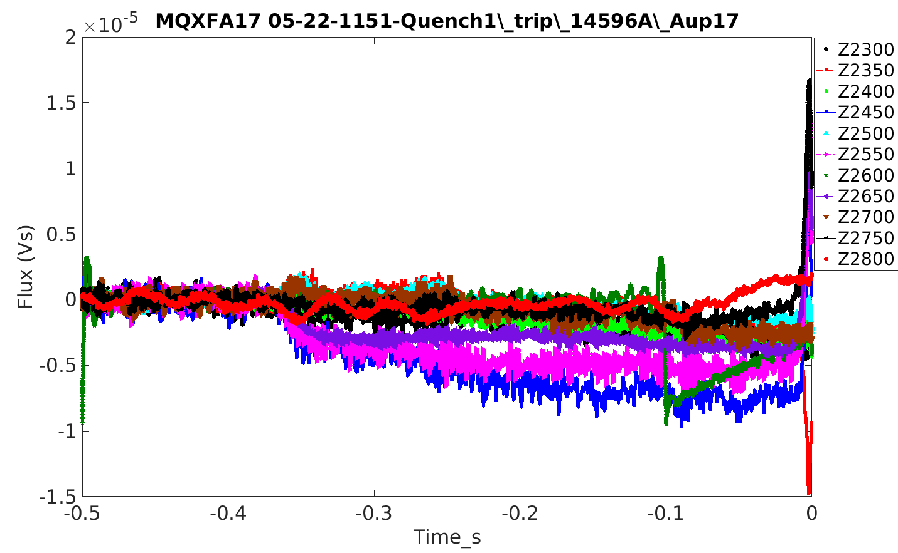
Flux transition (over ~ 3ms) that slowly ‘recovers’
Flux ‘shift’ in channels over about 30ms) that later see ‘spike’ (as if the later spike is part of a redistribution back to previous level )

Slide 14
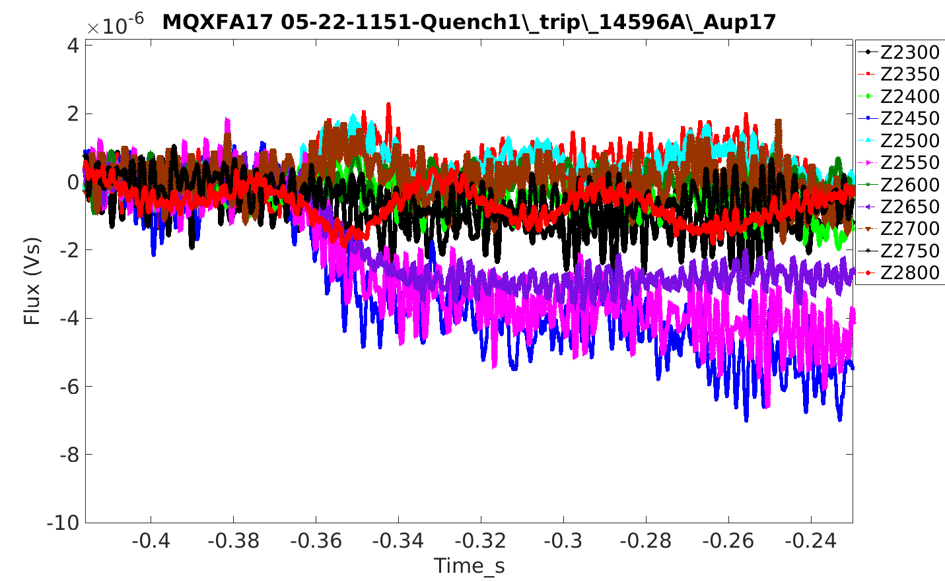

Slide 15
