Slide 1


AD/ELENA FACILITY
TELMAX exp area
Welcome test beam users !
TEst Line for Machine Antimatter and eXperiments

Slide 2
TELMAX main goals
New TELMAX exp area shall be used as a
test beamline (few weeks stay) :
  For machine equipment tests (RF setup, OP operation modes, instrumentation, vacuum…)
  By existing / new collaborations to test new equipment using standard or new beam structures
Already 2 collaborations expressed interest:
  PAX collaboration (antiProtonic Atom X-ray Spectroscopy) – First test Oct 2024, Spring 2025
  ASACUSA emulsion detector - Nov 2024 ?

Slide 3
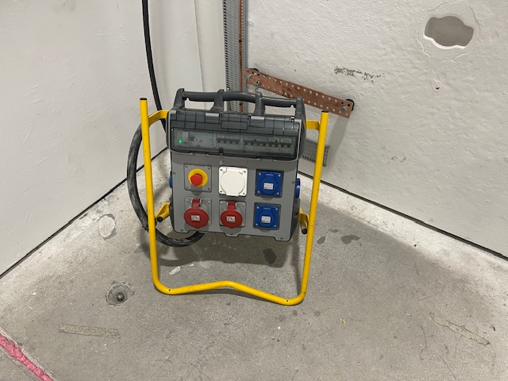
Current status
Shielding wall enclosure is complete
Electrical distribution is complete, including sockets, earth bar, AUL (not commissioned yet) – work site power supply installed
Access safety system operational
2 racks installed for exp setup usage
DSO tests complete
Beam permit validated
First beam observed on SEM below interface vacuum valve
Successful test of micro-bunches extraction

Slide 4
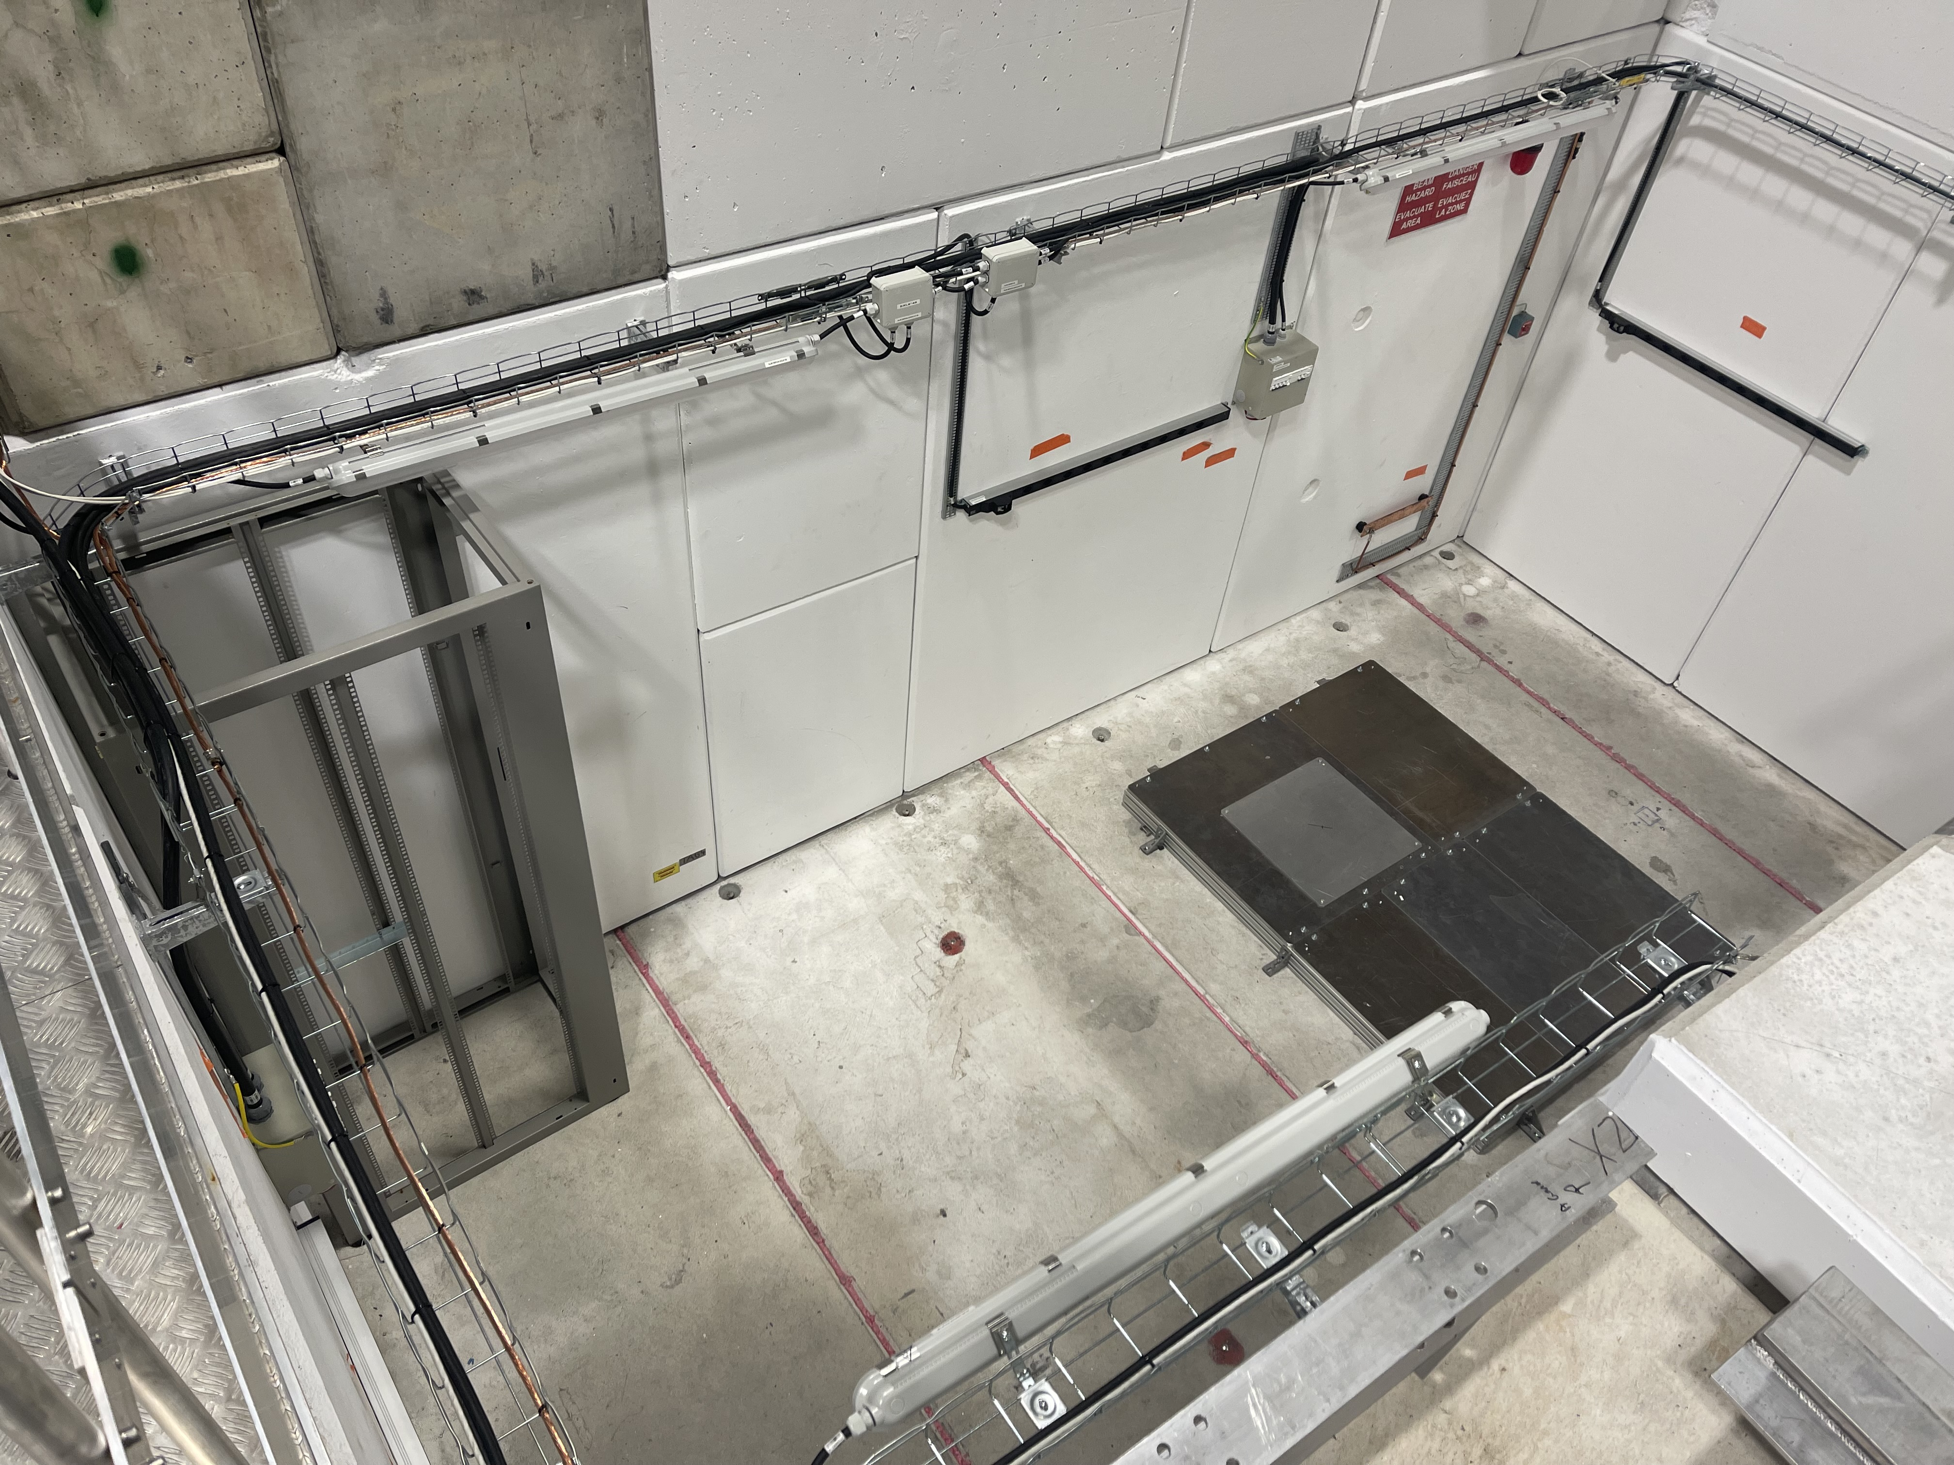
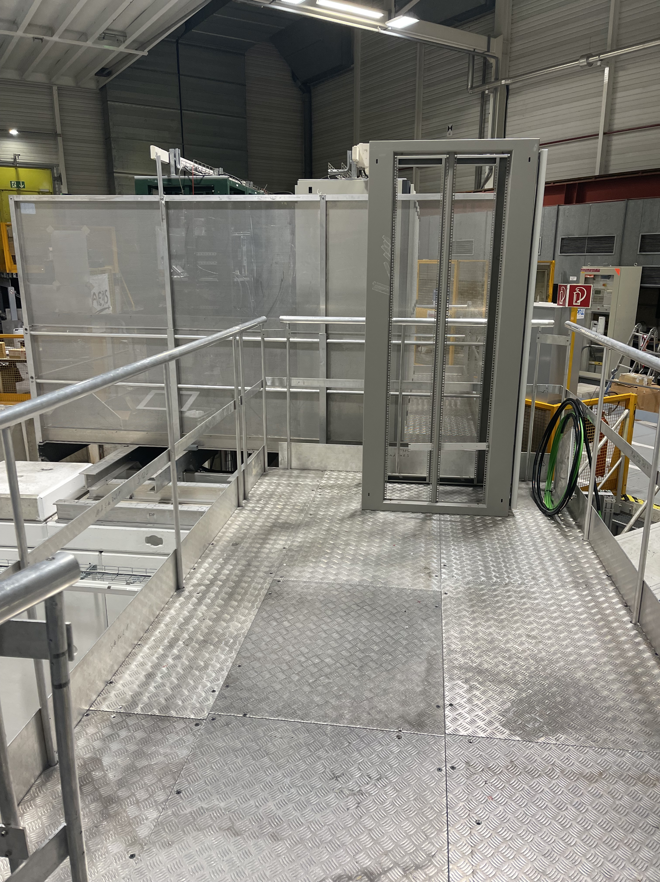
TELMAX exp area status
Rack
for experiment
TELMAX
Eaxp Area
Power
sockets
Rack
for experiment
Earth
bar
Cooling
water
Beam arrives
here
Opt fibre
To PUMA
CR
lighting
Platform accessible
during run

Slide 5
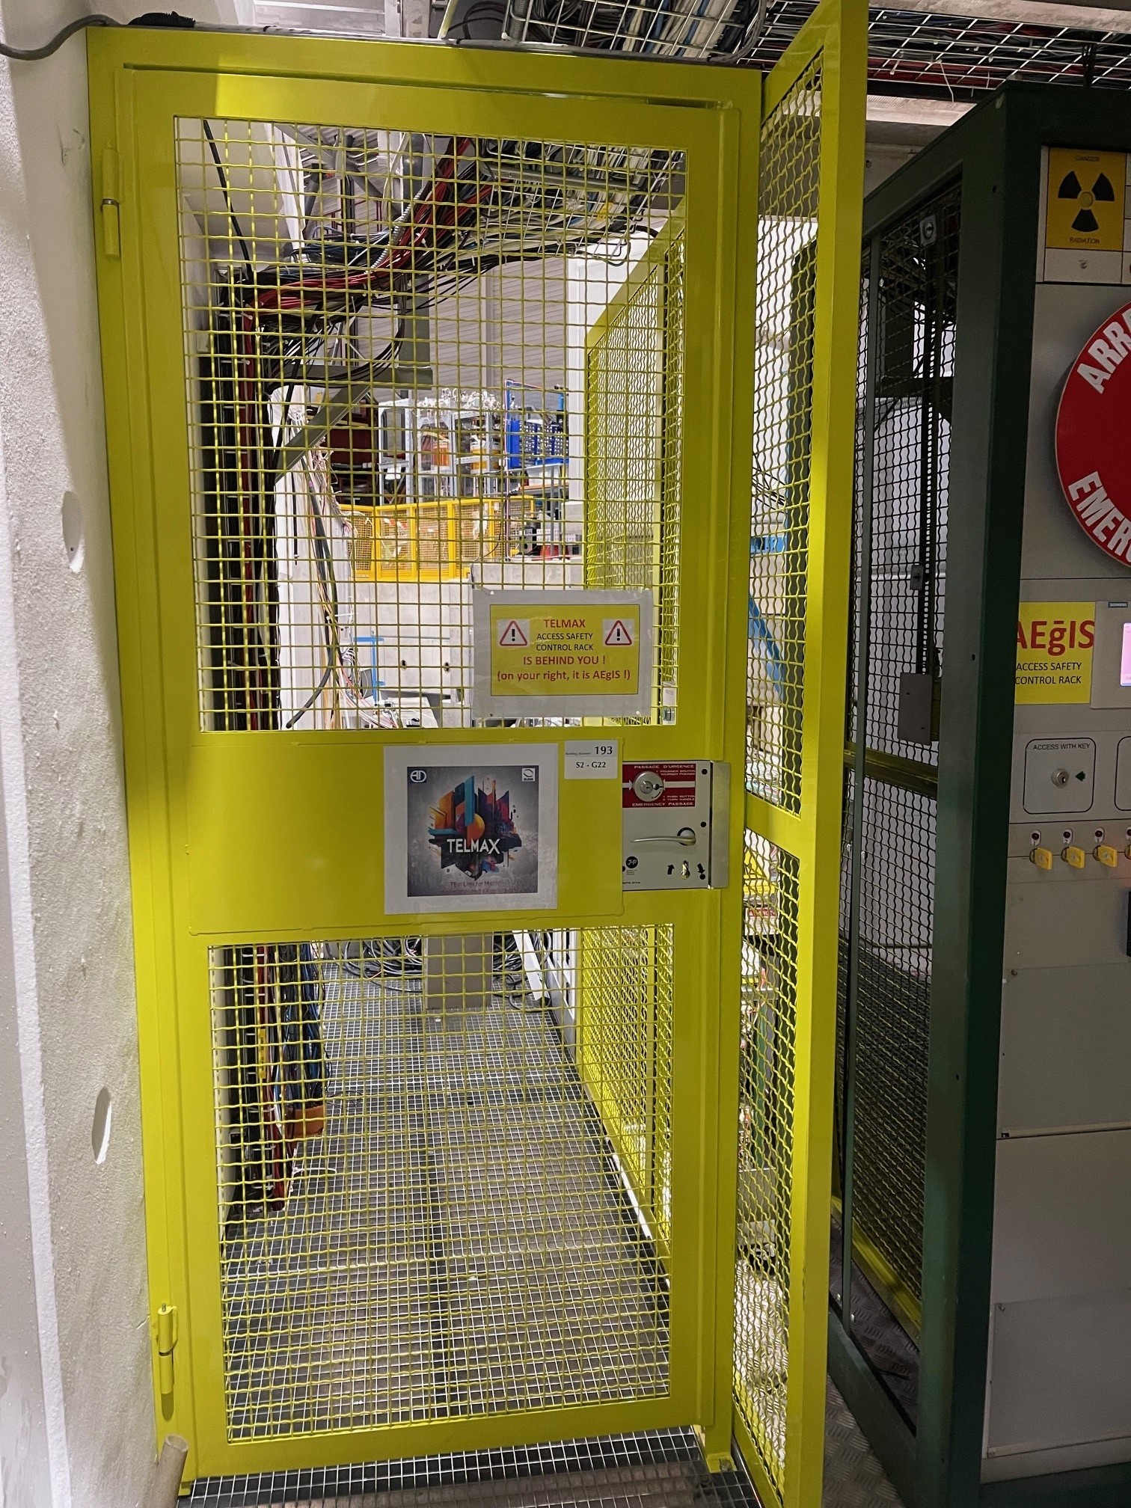
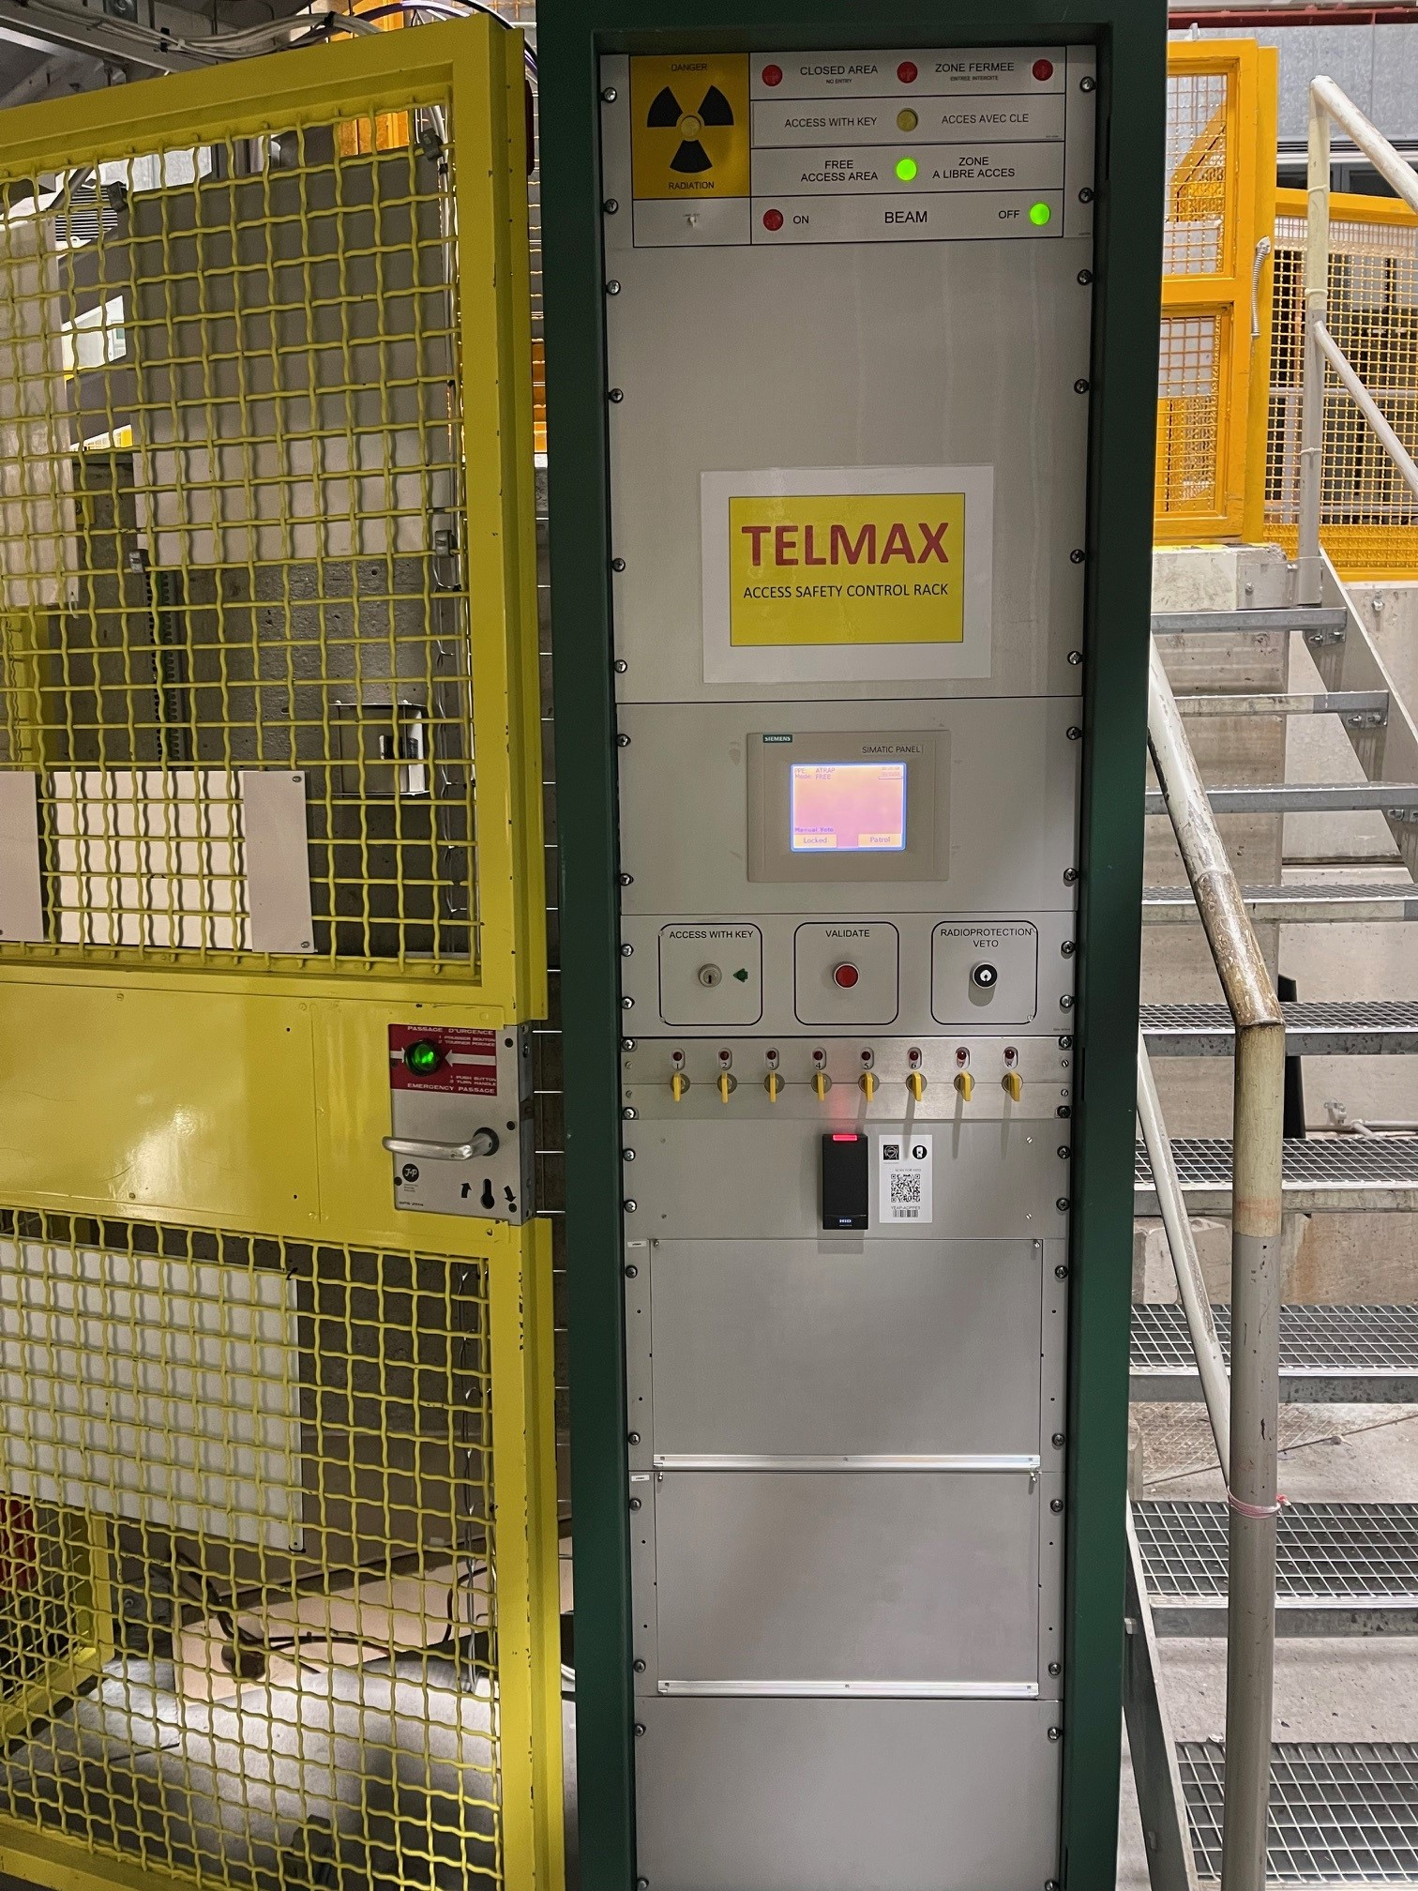
Access safety system

Slide 6
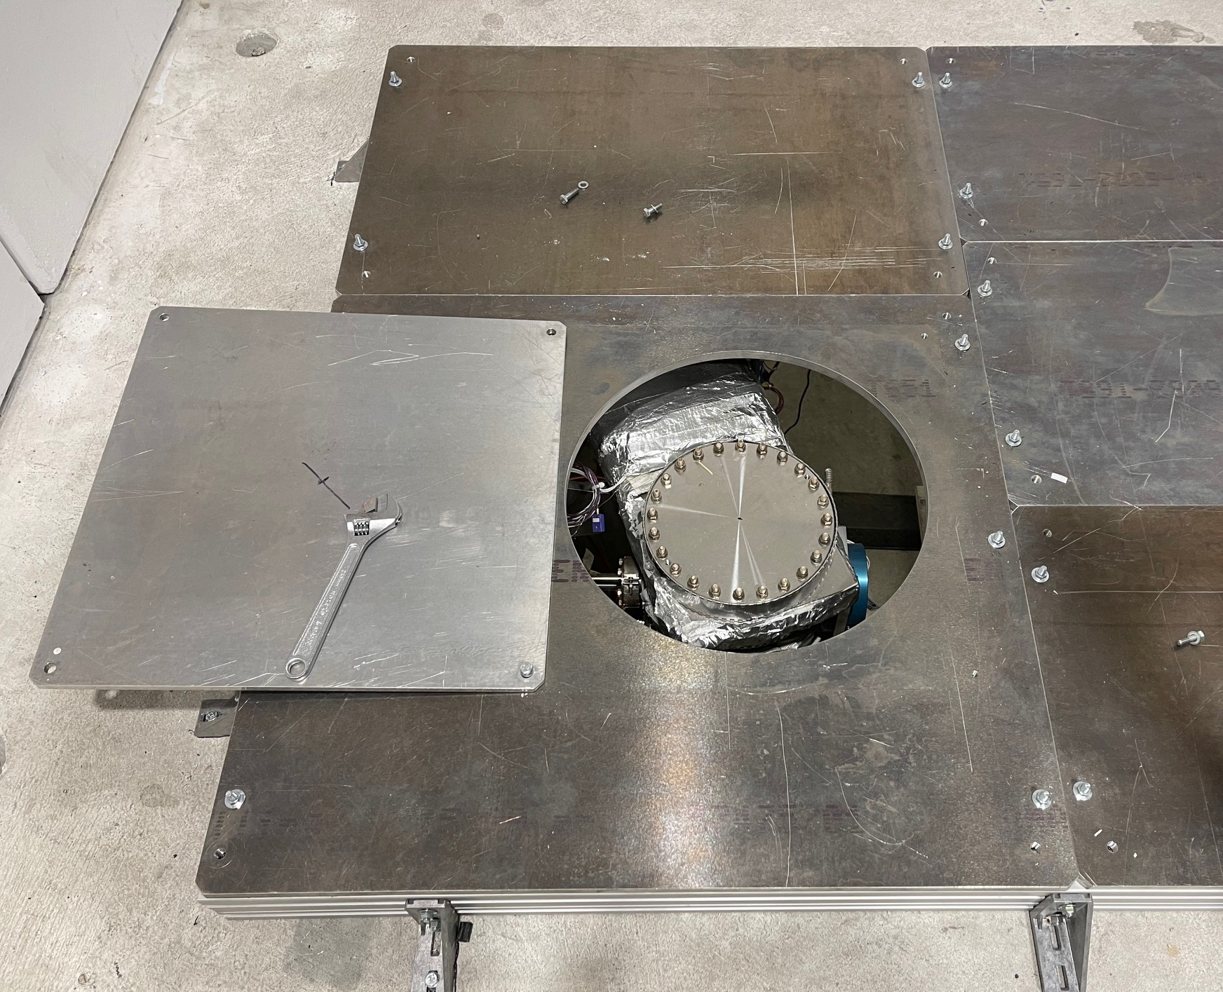
ELENA interface gate valve
CF100
To be added soon
CF200
Requirements:
-Vacuum at least low 10⁻⁹ mbar
-Automatic shut-off valve on turbo pump in case of power loss (available from CERN store)

Slide 7
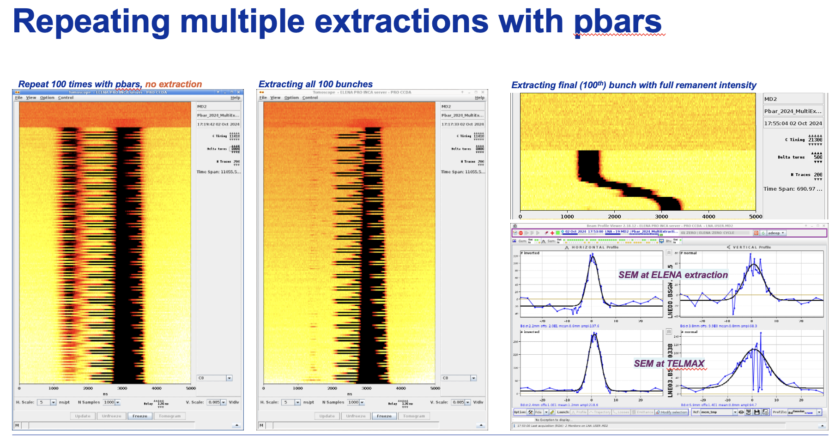
Possibility of «Micro bunches» extraction
Courtesy: Davide Gamba

Slide 8
Needed to satisfied in by users
TELMAX beam time request to be filled-in and discussed with Physics Coordinators (B. Holzer)
https://ps-sps-users.web.cern.ch/request/details/115/overview/
ISIEC safety form to be filled and discussed with safety coordinator (J. Devine)
https://ep-th-safety.web.cern.ch/isiec-safety-clearance
Subscribe CERN e-group PS-SPS-users
https://e-groups.cern.ch/e-groups/Egroup.do?egroupId=10092727
Present experiment, report results at PS-SPS user meeting
Safety inspection with safety coordinator before beam permit is granted

Slide 9
To be improved in the near future
Demineralized water installation is pending (date TBC by CV) – meanwhile provisional pipes from STEP
Compressed air pipe to be extended (already in the zone)
Networks will be installed during YETS (RJ45 ethernet sockets , timing, BTV signal)
Optical fibres arrive in rack on platform, connected to PUMA control room, to be adapted by users
The LNE03 line currently ends vertically in the Exp Area: eventually to be bent horizontally (LS3)
Optics and vacuum layout to be adapted

Slide 10
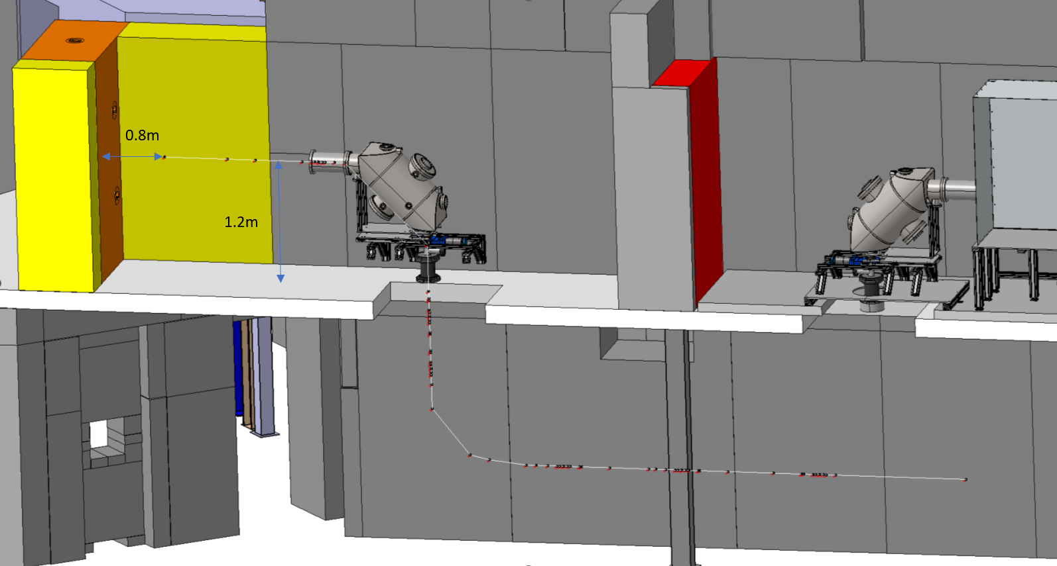
Future horizontal beam setup
Same technology as STEP
MPI has agreed to produce a 90°deflector, details TBC
New vacuum equipment to be installed is described in the ECR : EDMS 2975107
Additional ZQNA + SEM
Can be installed or removed “easily”
Tell us what you need !
To be installed during LS3

