Slide 1
AIDAinnova successor
Possible contribution from the DRDC and similar bodies
Thomas Bergauer
12 September 2024

Slide 2
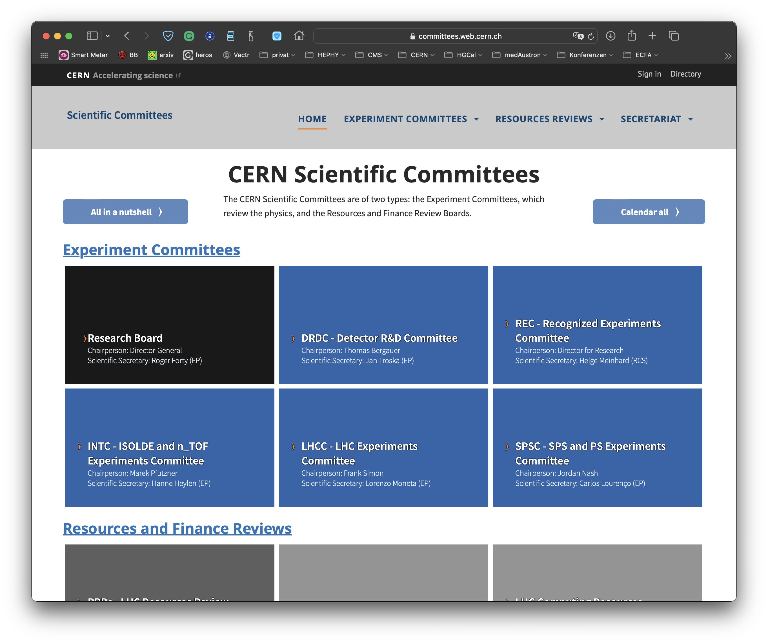
DRD Committee (DRDC) at CERN
Detector R&D Committee is a new committee on the same level as SPSC and LHCC
  Established autumn 2023 following ECFA Detector Roadmap Process
  http://committees.web.cern.ch/drdc
Mandate of DRDC:
  Reviews DRD proposals and suggests recommendations to CERN Research Board
  Requests annual status reports of running DRD collaborations and conducts reviews of their progress

Slide 3
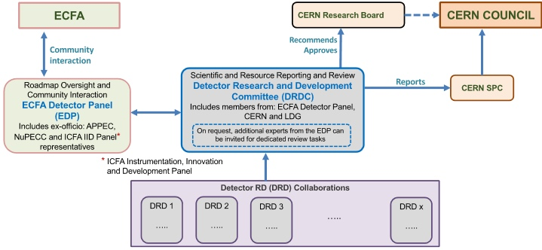
Roadmap implementation plan
Approved by CERN SPC and Council in fall 2022 (CERN/SPC/1190 ; CERN/3679)
CERN will host DRD collaborations
  Interaction between DRD collaborations and committees through DRDC
  Interface to ECFA via ECFA Detector panel EDP: https://ecfa-dp.desy.de
Distinction between reviewing body (DRDC) and advising body (EDP)
ECFA Detector Panel (EDP) interfaces to ECFA
  Organizes “DRD managers forum”
  provides input to the next Strategy update

Slide 4
Committee Members
ECFA Detector Panel (EDP):
Detector R&D Committee (DRDC):
Co-chairs: Felix Sefkow (DESY), Didier Contardo (Lyon)
Scientific secretary: Jens Dopke (STFC RAL)
Gaseous Detectors: Silvia Dalla Torre (Torino)
Liquid Detectors: Inés Gil Botella (CIEMAT)
Solid State Detectors: Susanne Kuehn (CERN)
PID & Photon Detectors: Roger Forty (CERN)
Quantum and emerging Technologies.: Steven Hoekstra (Groningen)
Calorimetry: Laurent Serin (IJCLab)
Mechanics and Integration: Jens Dopke (STFC RAL)
Electronics: Valerio Re (Bergamo)
Ex Officio: ECFA Chair (Paris Sphicas), ICFA Detector Panel (Ian Shipsey), DRDC chair (Thomas Bergauer)
APPEC & NuPECC observers
Thomas Bergauer (HEPHY Vienna)
Jan Troska (CERN, Scientific Secretary)
Stan Bentvelsen (NIKHEF)
Shikma Bressler (Weizmann)
Dimitry Budker (Mainz)
Roger Forty (CERN)
Claudia Gemme (INFN and U. Genoa)
Inés Gil Botella (CIEMAT)
Petra Merkel (Fermilab)
Mark Pesaresi (Imperial College)
Laurent Serin (IJCLab)
Ex-officio: F. Sefkow, D. Contardo (EDP)
Names in bold in both committees

Slide 5
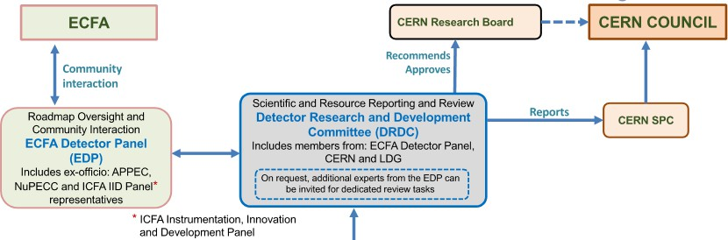
DRD collaborations
DRD1 ✓ Gaseous Detector M. Titov E. Oliveri | DRD2 ✓ Liquid Detector R. Guenette G. Fiorillo | DRD3 ✓ Solid State Detector G. Kramberger G. Pellegrini |  | DRD4 ✓ Photon det. and PID M.Fiorini G. Wilkinson | DRD5 ✓ | DRD6 ✓ Calorimetry R. Poeschl R. Ferrari | DRD7 ✓ | DRD8 ✓ Mechanics and Integration B. Schmidt A. Mussgiller
 |  |  |  |  | Quantum, emerging techno. M. Demarteau M. Doser |  | Electronics on-detector processing F. Simon F. Vasey
Approved by CERN RB*, ✓ DRD8 LoI submitted to DRDC, proposal aims end-2024

Slide 6
Summary
First step for the AIDAinnova successor project would be to form a proposal preparation team in an inclusive way
We should seek participants for it from
  DRDC
  EDP (ECFA Detector Panel),
  DRD Collaborations
For the new EU Call need to be two ESFRI infrastructures involved. Detailed composition depends on this as well
  From HORIZON-INFRA-2025-01-TECH-02 call: consortia must include at least two different research infrastructures, each of them being an ESFRI infrastructure, a European Research Infrastructure Consortium (ERIC) or another research infrastructure that is an international European research organization.

Slide 7
Possible ESFRI/ERIC
ELI ERIC includes two laser facilities in Czech Republic and in Hungary
CERIC-ERIC: synchrotron light for life sciences, nanoscience and nanotechnology, cultural heritage, environment and materials sciences.
CTA: Cherenkov Telescope Array
ELT: Extremely Large Telescope
ESRF: European Synchrotron Radiation Facility Extremely Brilliant Source
ESS: European Spallation Source
FAIR: Facility for Antiproton and Ion Research
SKAO: Square Kilometre Array Observatory

