Slide 1

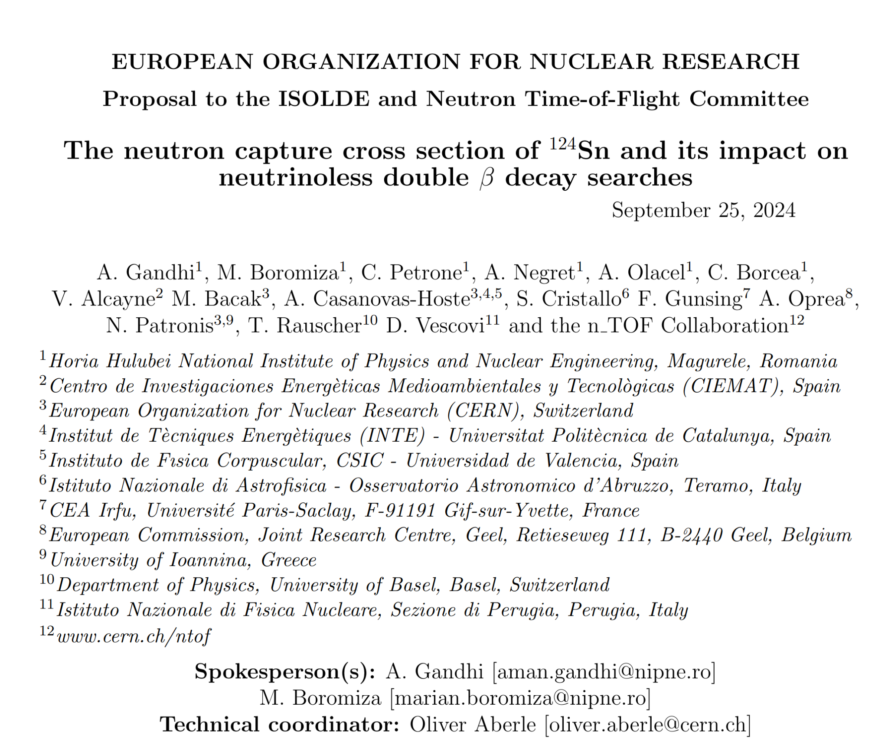
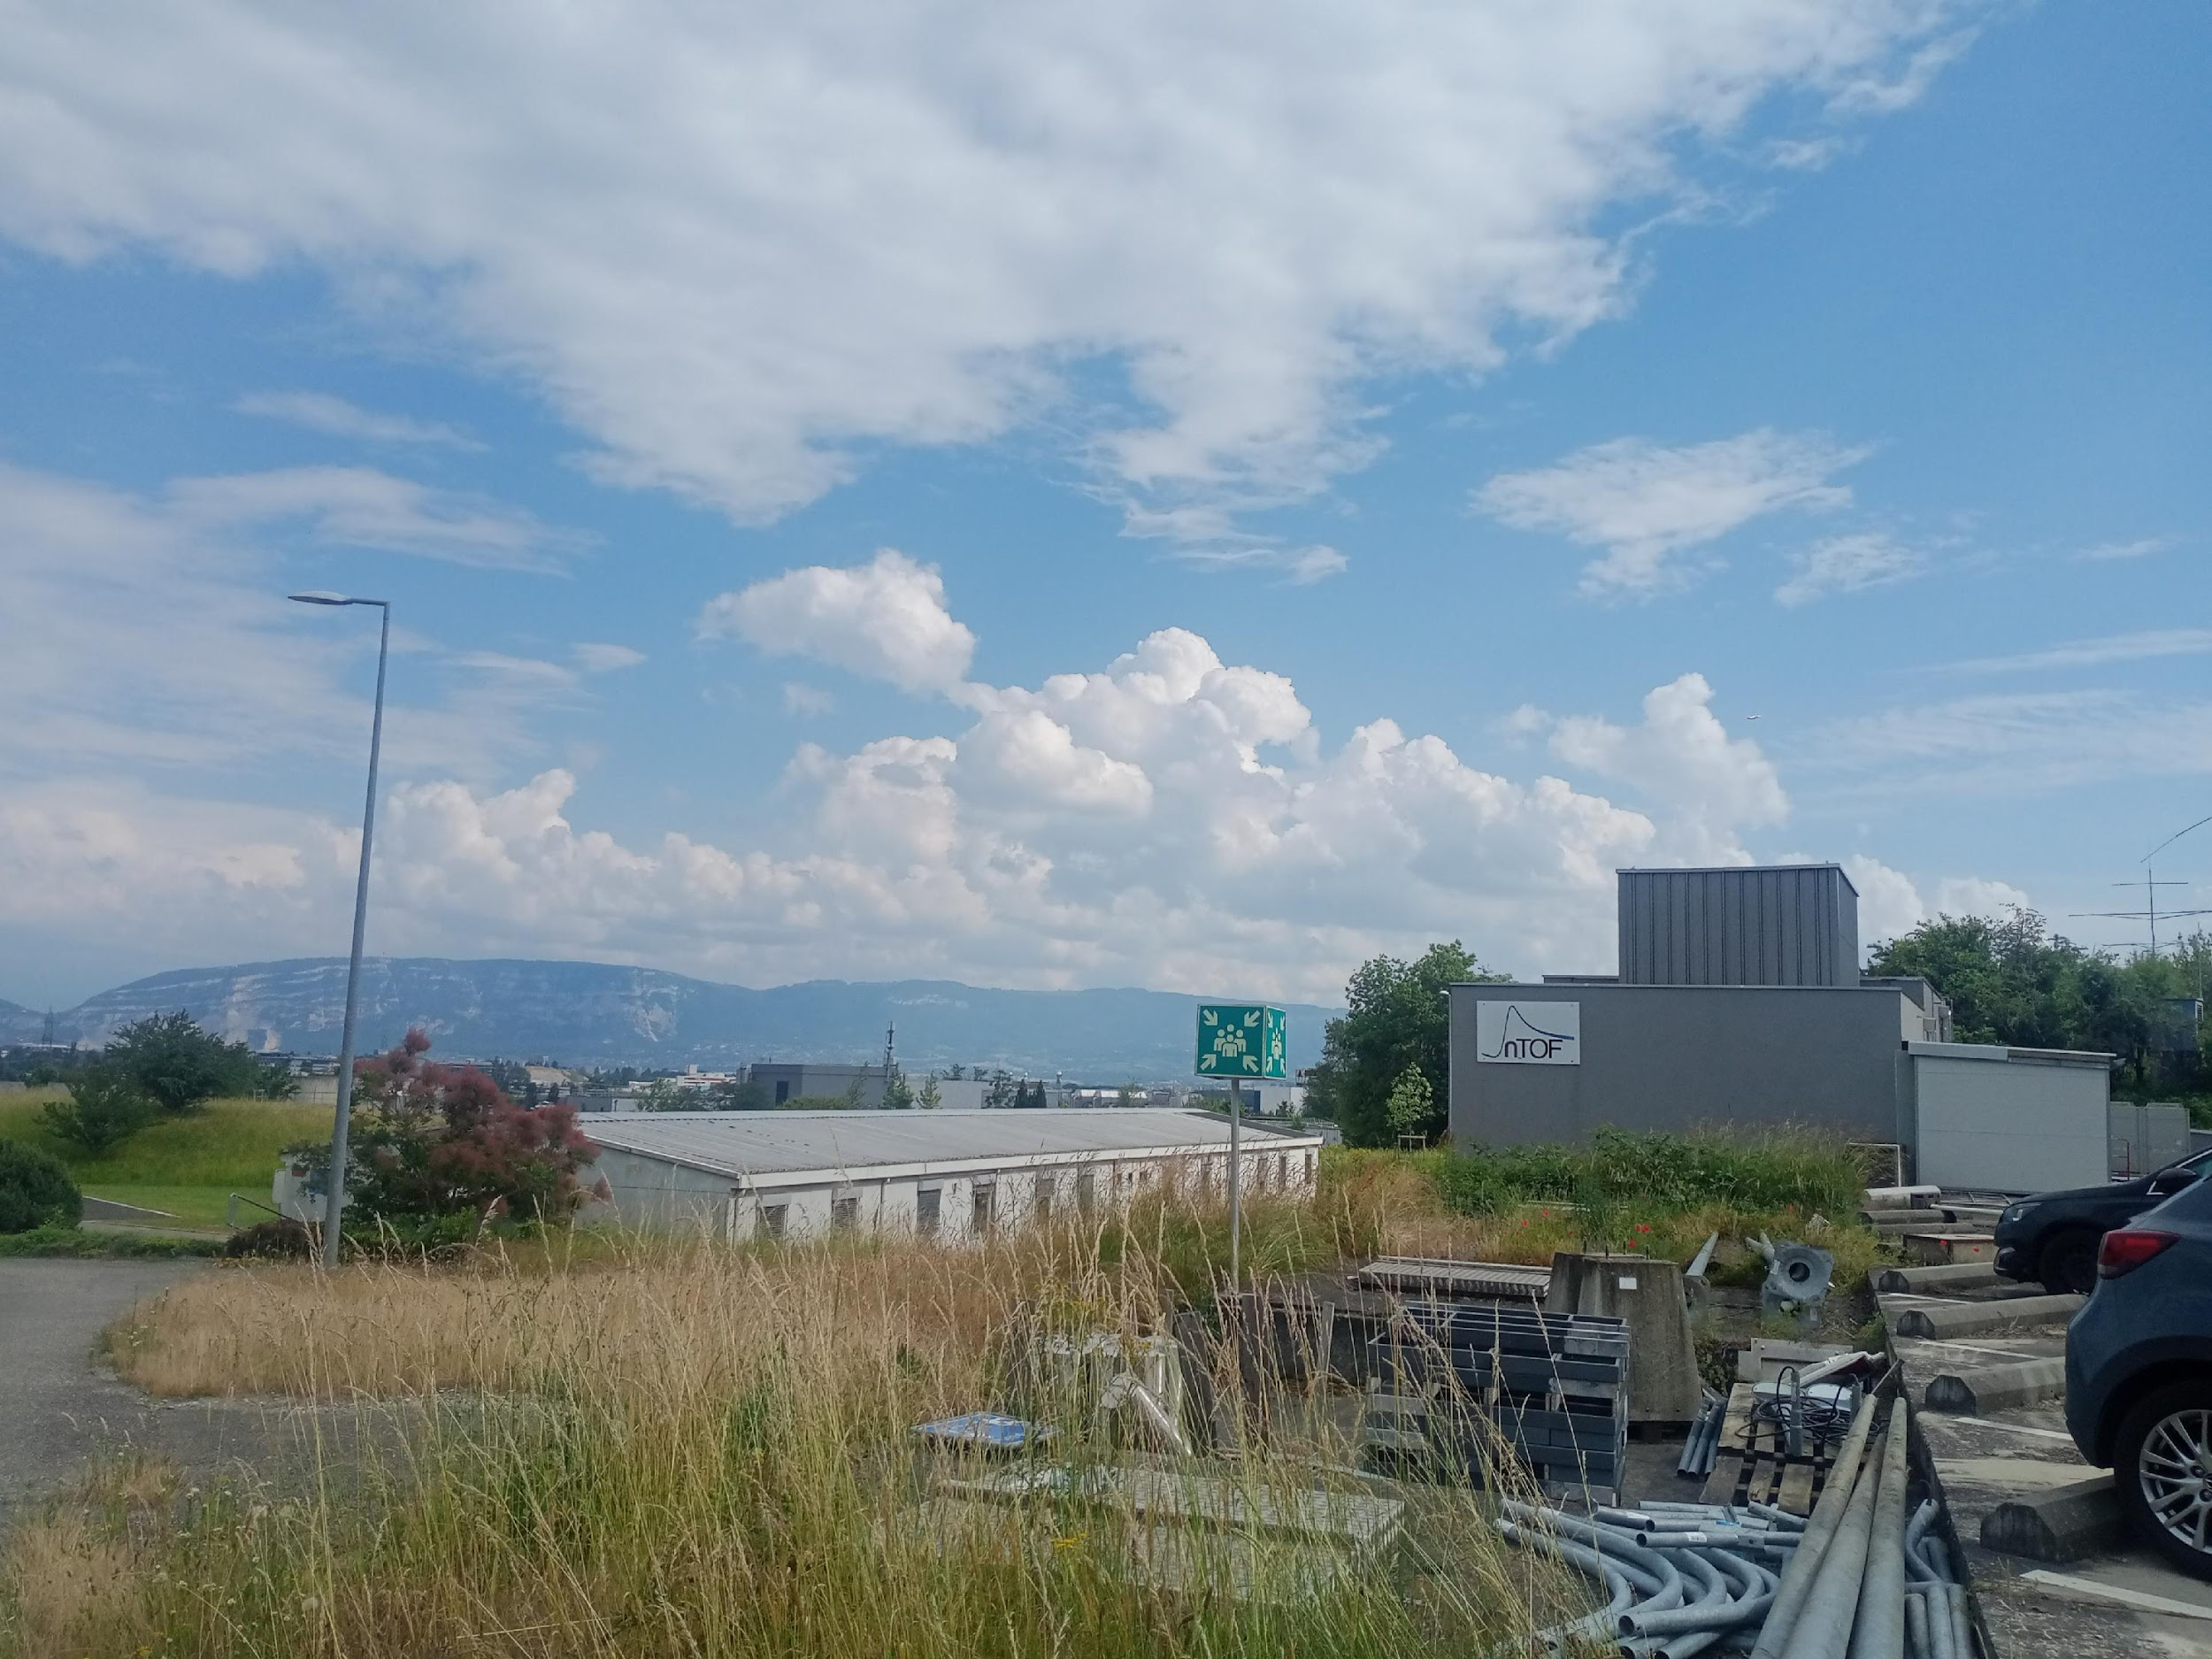


The neutron capture cross section of ¹²⁴Sn and its impact on neutrinoless double β decay searches
Horia Hulubei National Institute for R&D
in Physics and Nuclear Engineering
Marian Boromiza and Aman Gandhi
IFIN-HH, Romania (n_TOF@CERN group)
Horia Hulubei National Institute for R&D
in Physics and Nuclear Engineering

Slide 2
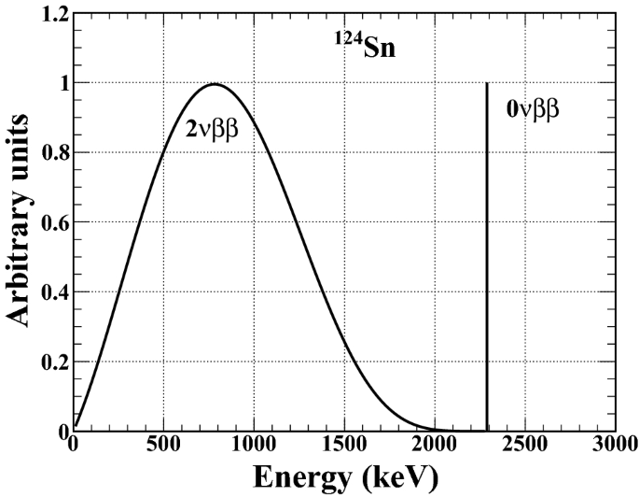
Motivation A
Why do we need ¹²⁴Sn(n,γ) cross section data?
Background assessment of 0νββ decay searches
A few groups around the world search for the 0νββ of ¹²⁴Sn ----> ¹²⁴Te:
¹²⁴Sn is one of the promising 0νββ candidates
They measure the 0νββ decay peak which is at an energy equal to the Q-value of the reaction: 2292.7(4) keV
Golden channel: decay rate <-> direct access to neutrino mass & CP violating Majorana phases (can not be probed by ν oscillations experiments)
0νββ is a second order weak interaction process and the event rates are very low (T_{1/2} > 10¹⁷ y)*
They are extremely sensitive to background signals which can mimic the signal of interest -> neutron-induced background in the Q-value region*
India
South Korea
In progress
Done
Lab: Indian Neutrino Observatory (INO)
and TATA institute
Lab: YangYang Underground Laboratory (Y2L)-2009
Detector: Sn cryogenic superconducting bolometer (TIN.TIN -The India based TIN detector)
Detector : tin-loaded liquid scintillator for an active source-detector technique
Nanal, Vandana.EPJ Web of Conferences, EDP Sciences 66 (2014)
Hwang, M. J., et al., Astroparticle Physics 31.6 (2009): 412-416.
Singh, M.K., et al. Indian J Phys 94, 1263–1270 (2020).
*Dawson, J., et al., Physical Review C 78.3 (2008): 035503
*Gupta, G., et al., Applied Radiation and Isotopes 158 (2020): 108923

Slide 3
Motivation A
Background assessment of 0νββ decay experiments
Background: Neutrons
Cosmic ray-induced neutrons
Rocks (^{nat}Th, ^{nat}U) -> spontaneous fission neutrons
-> (α,n)-induced neutrons

Slide 4
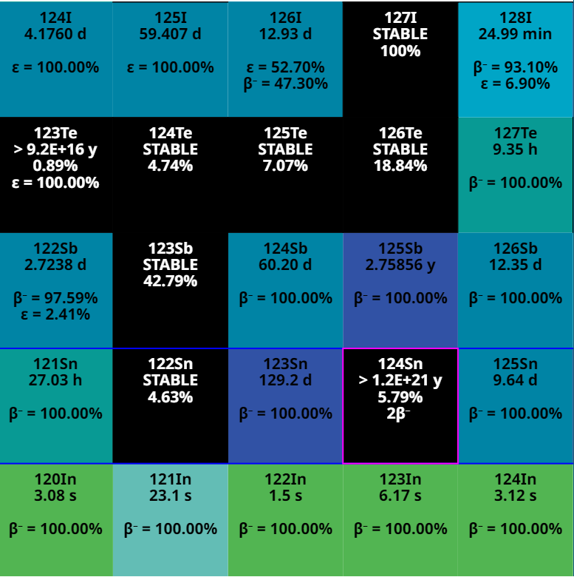
Motivation A
Background assessment of 0νββ decay experiments
ISSUE: γ rays following neutron capture on ¹²⁴Sn can mimic the 0νββ decay signal!!!
Literature* shows that, after activating a ¹²⁴Sn sample with a neutron thermal flux and measuring the delayed γ following neutron capture and subsequent β⁻ decays with a HPGe detector, a strong summing peak of 2288.2 keV has been seen*
Also, a (worrying) 30% simulation vs. experiment difference was observed*
52
β⁻
protons
2β⁻
β⁻
Q_{0νββ}= 2292.7 keV
50
(n,γ)
S_{n}(¹²⁵Sn) = 5733.50(20) keV
*Gupta, G., et al., Applied Radiation and Isotopes 158 (2020): 108923
*Gupta, G., et al., Applied Radiation and Isotopes 158 (2020): 108923
72
neutrons
74

Slide 5
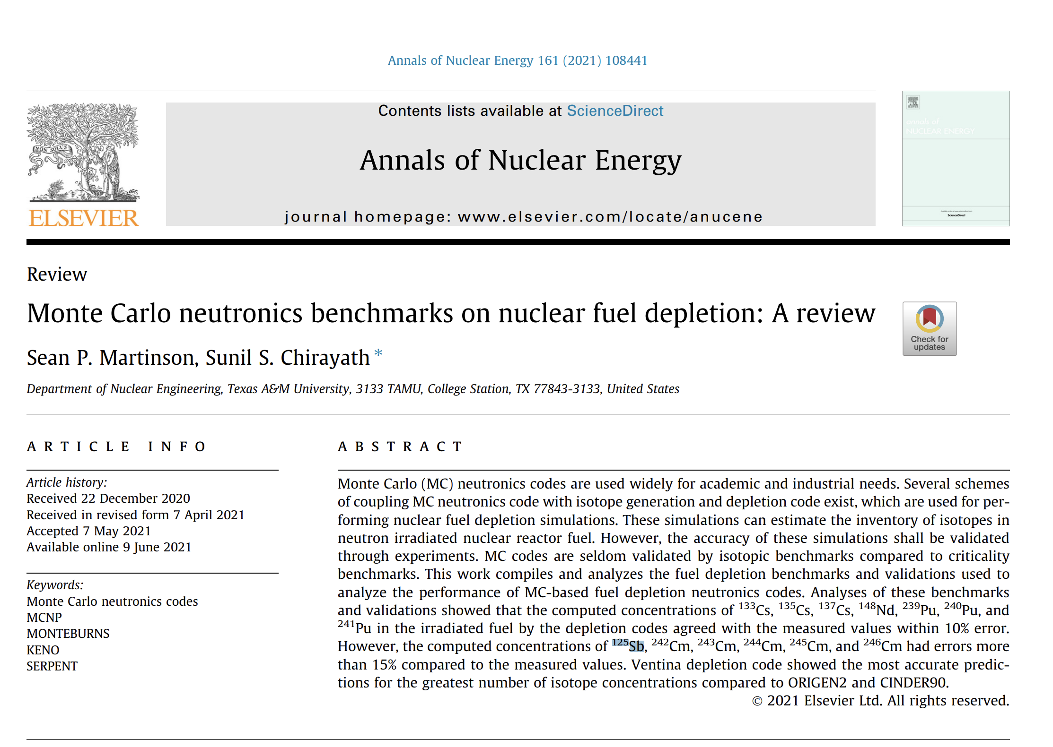
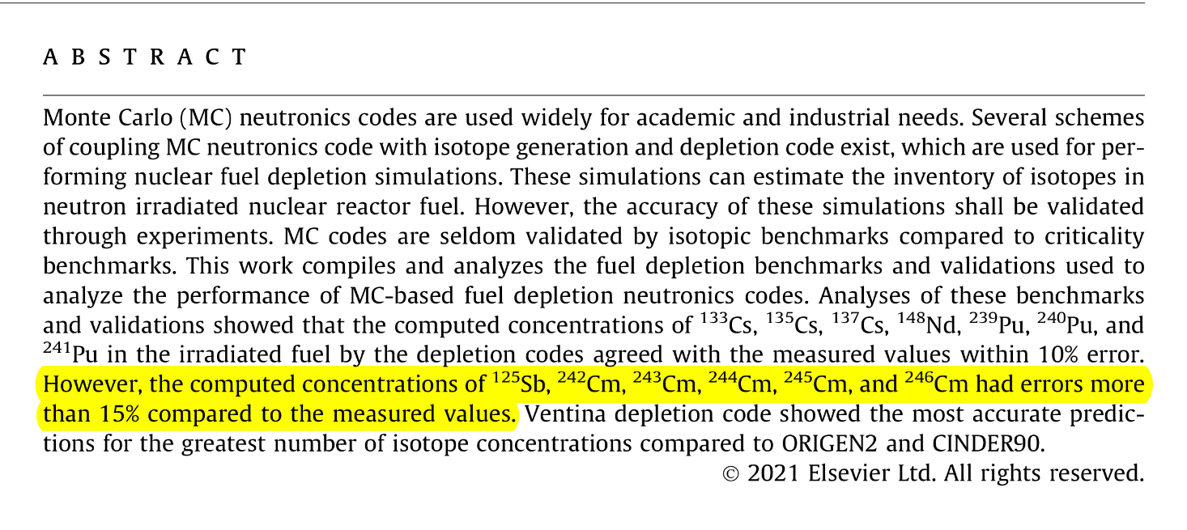
Motivation B
Problem in reactor fuel depletion calculations for ¹²⁵Sb:
Why do we need ¹²⁴Sn(n,γ) cross section data?

Slide 6
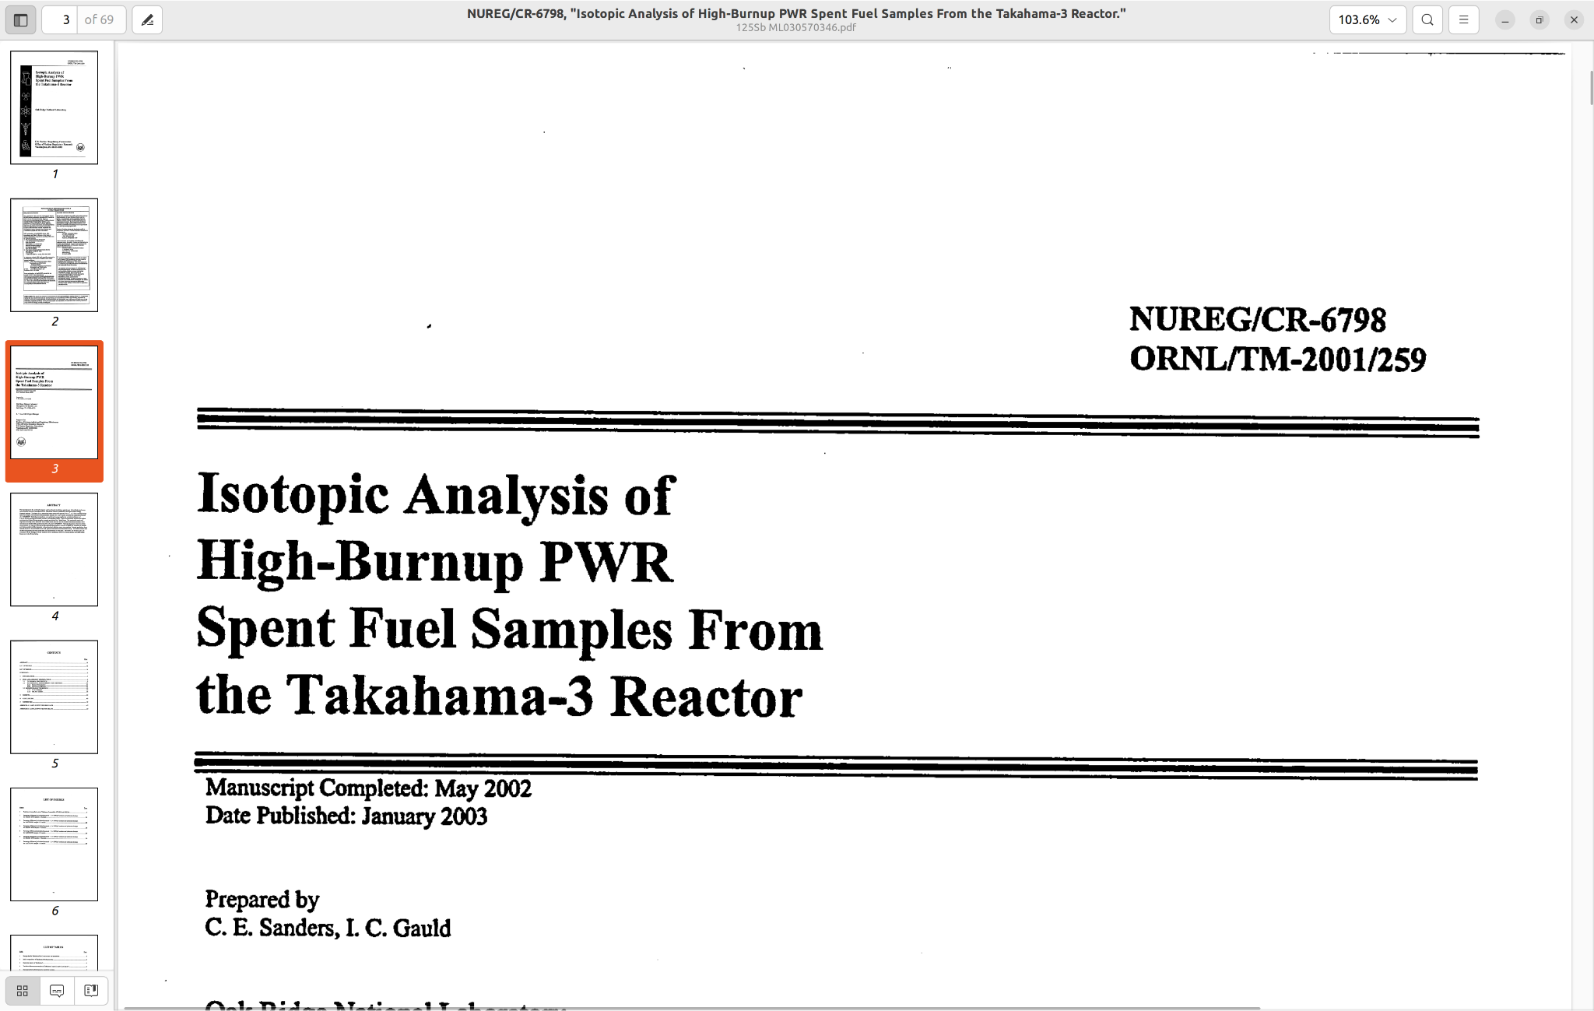
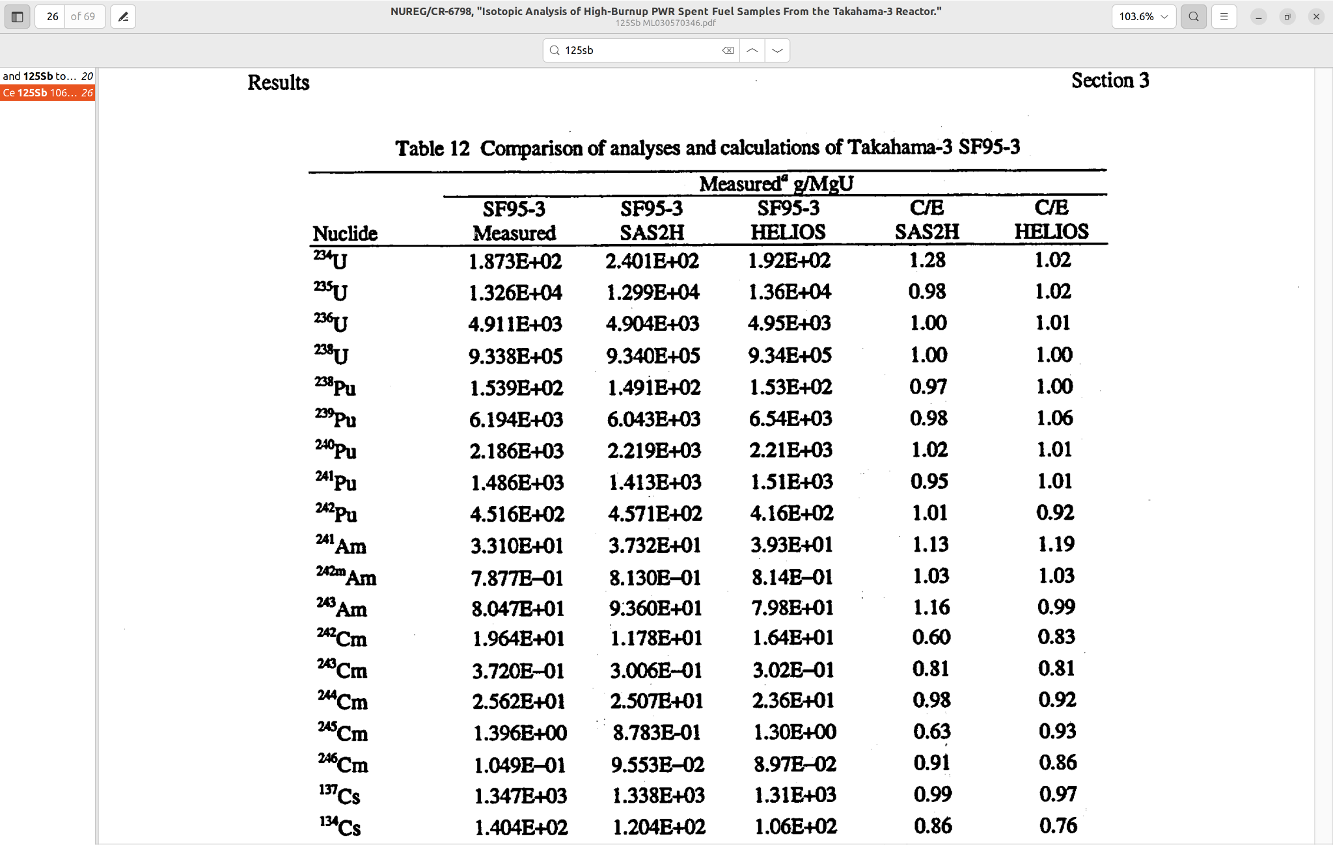
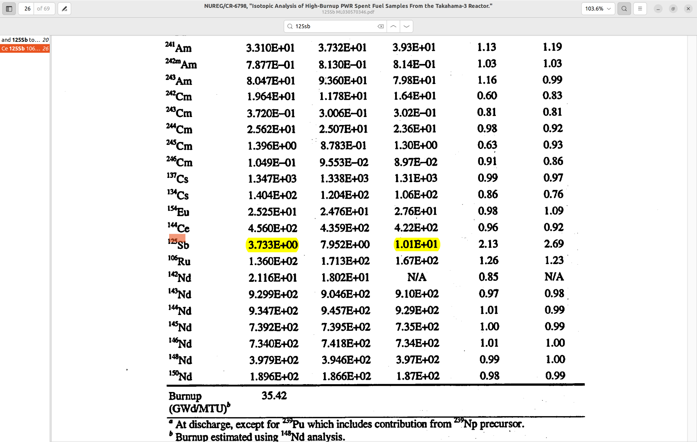
Motivation B

Slide 7
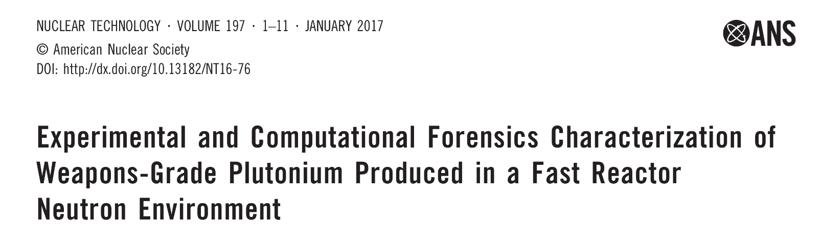
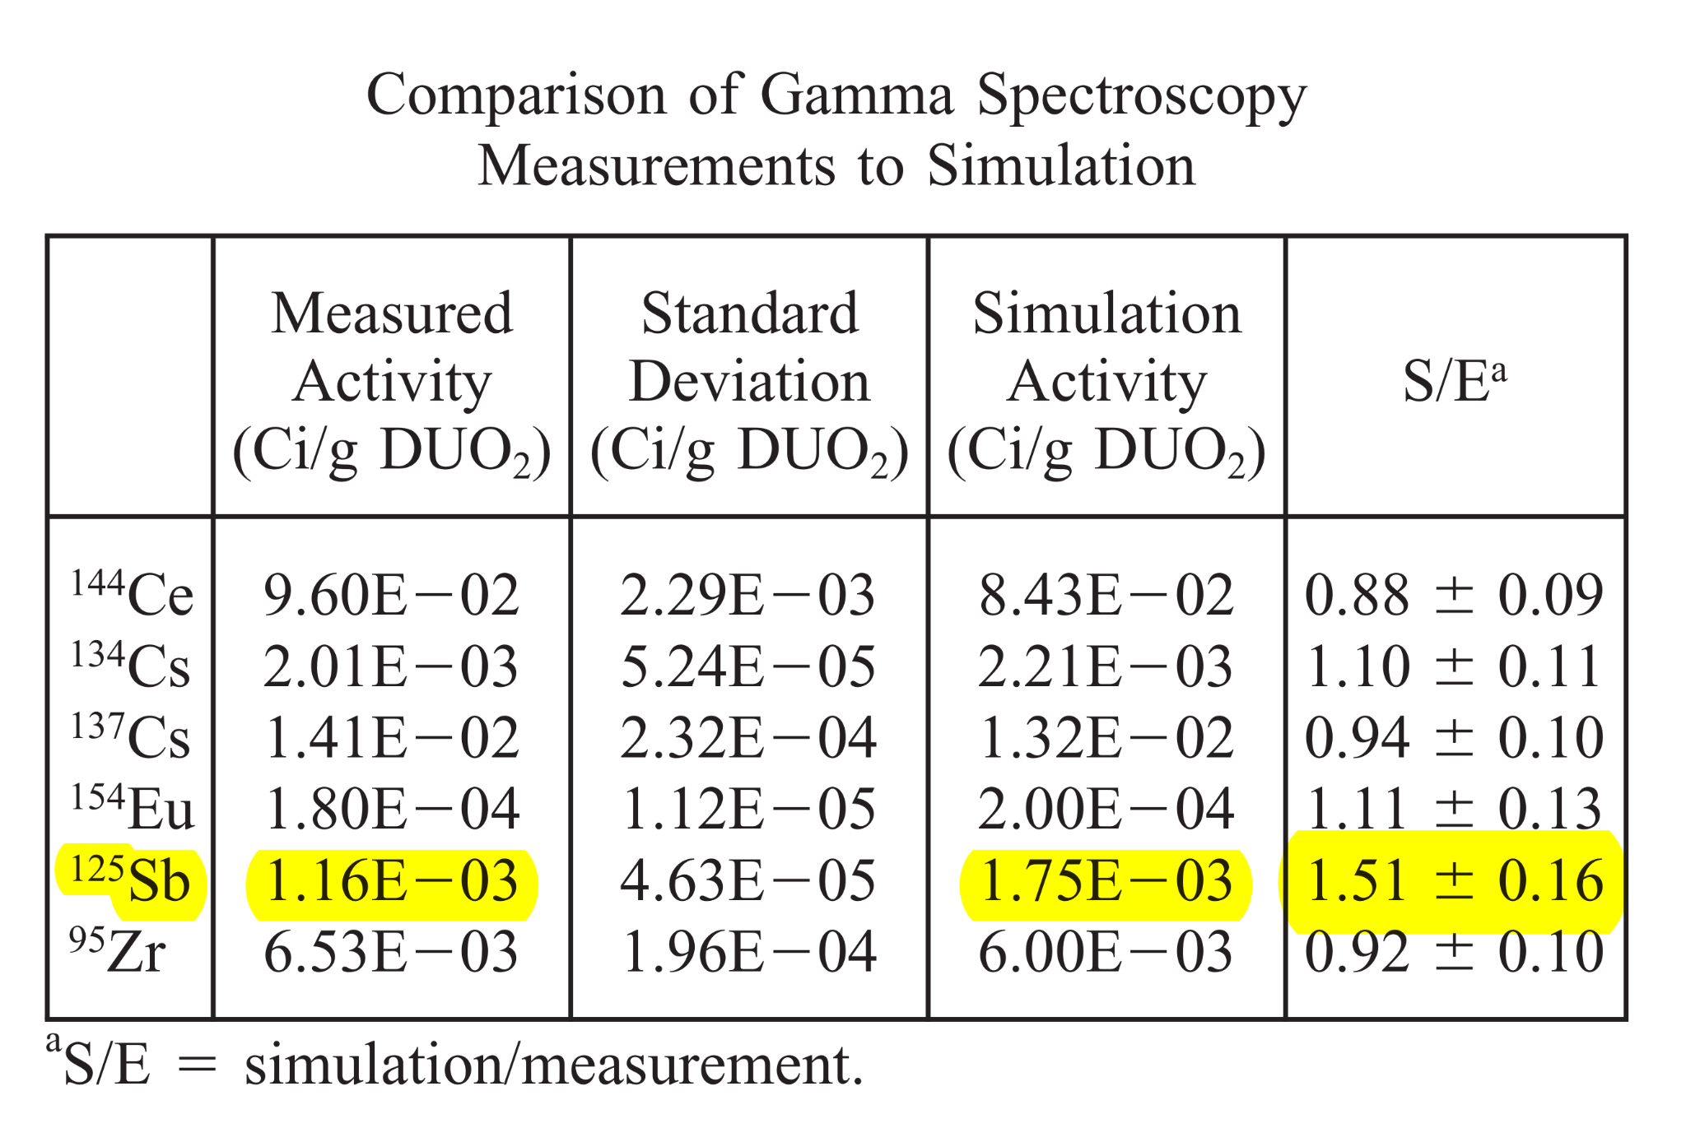
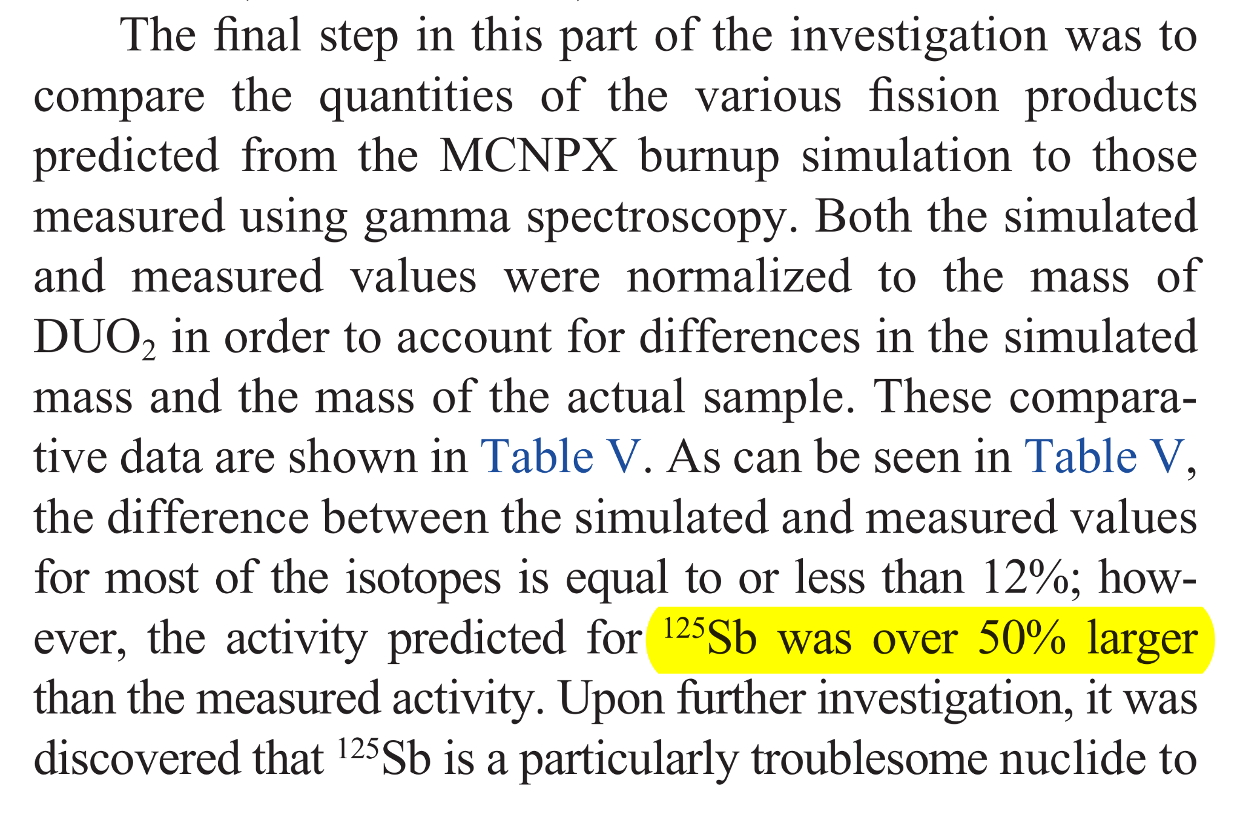
Motivation B

Slide 8
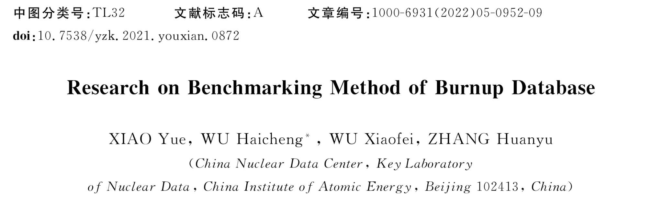
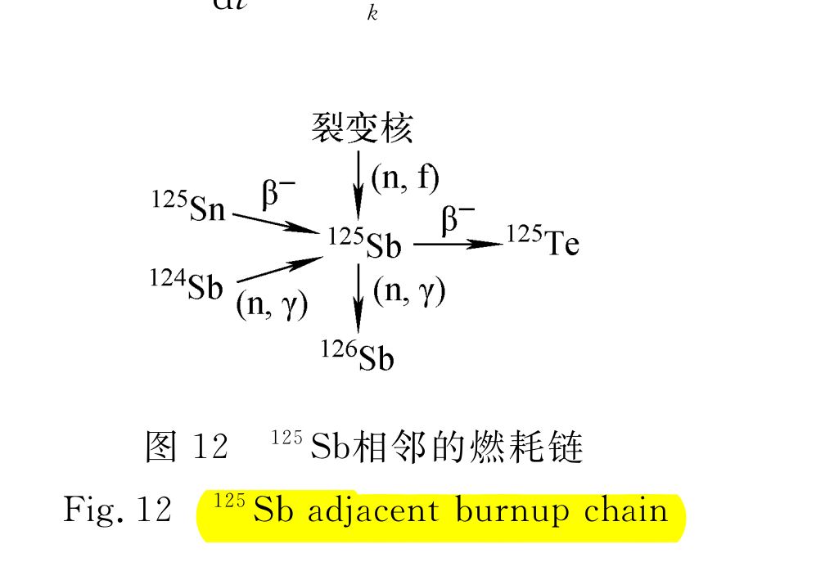
Motivation B
¹²⁴Sn(n,γ)
Fission nucleus
Figure: Burnup chain adjacent to 125Sb

Slide 9
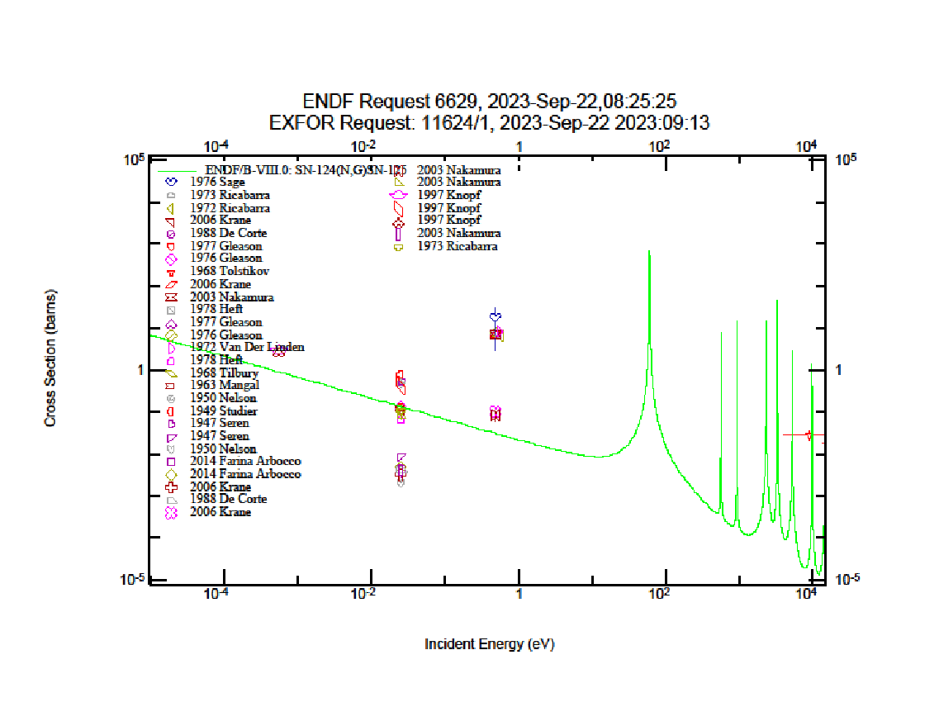
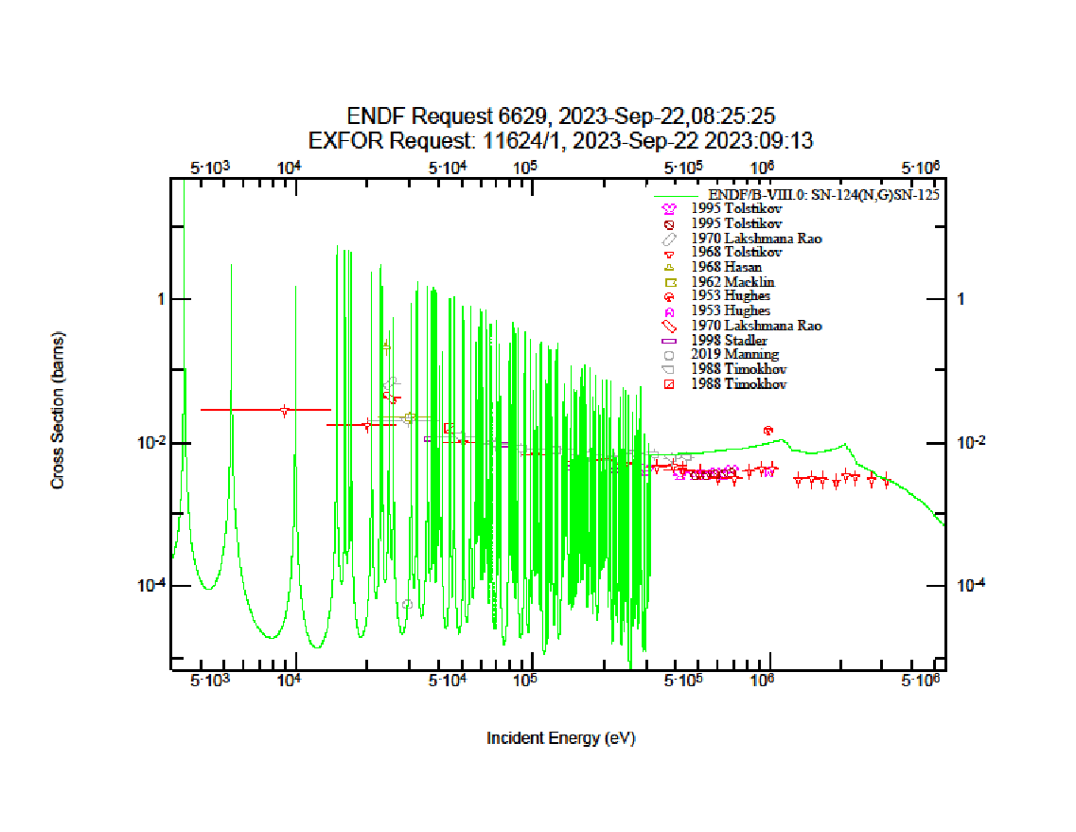
Present status of ¹²⁴Sn(n,γ) cross section data
(n,γ)
HPGe-based measurement
A. Kimura et al., EPJ Web of Conferences 146, 11031 (2017) in ANNRI at MLF/J-PARC (ND2016 proceedings)

Slide 10
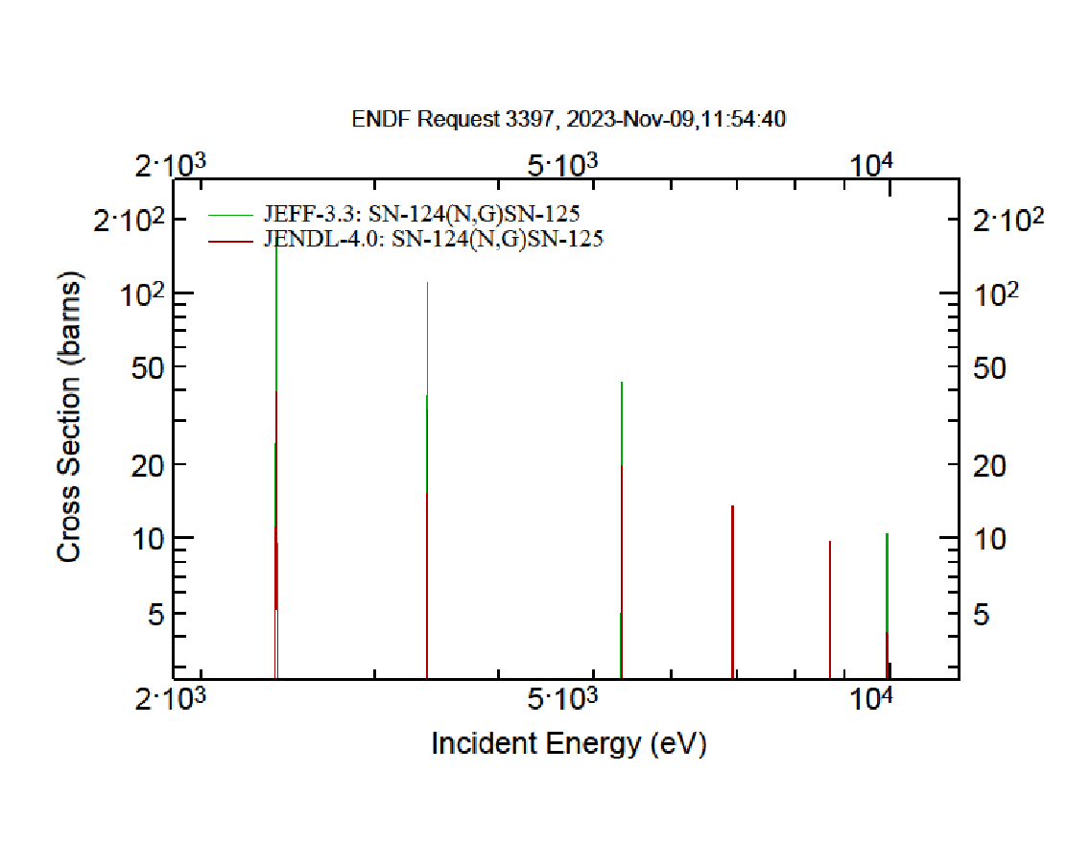
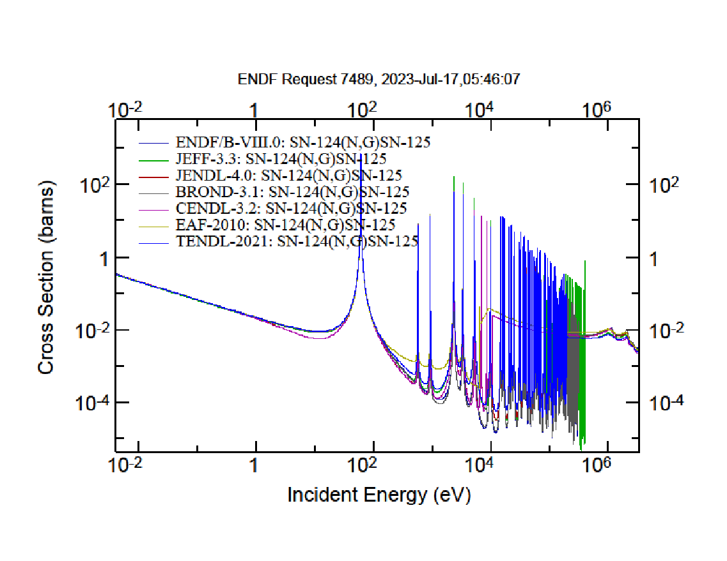
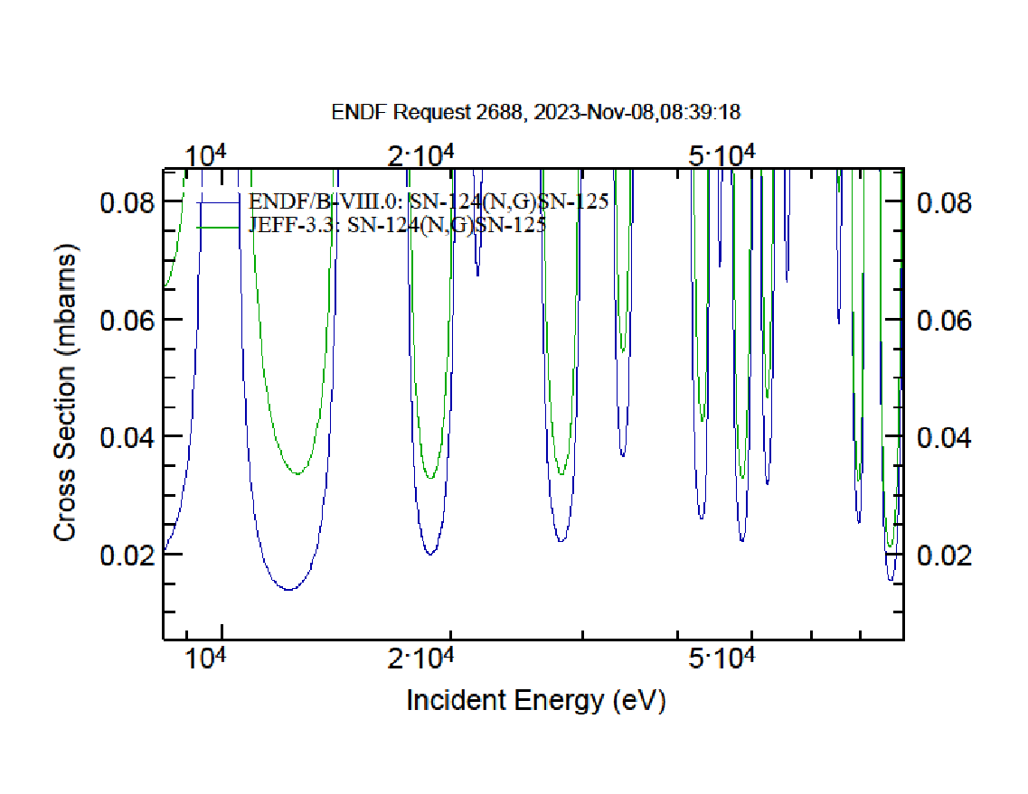
Present status of ¹²⁴Sn(n,γ) cross section data
?
100%

Slide 11
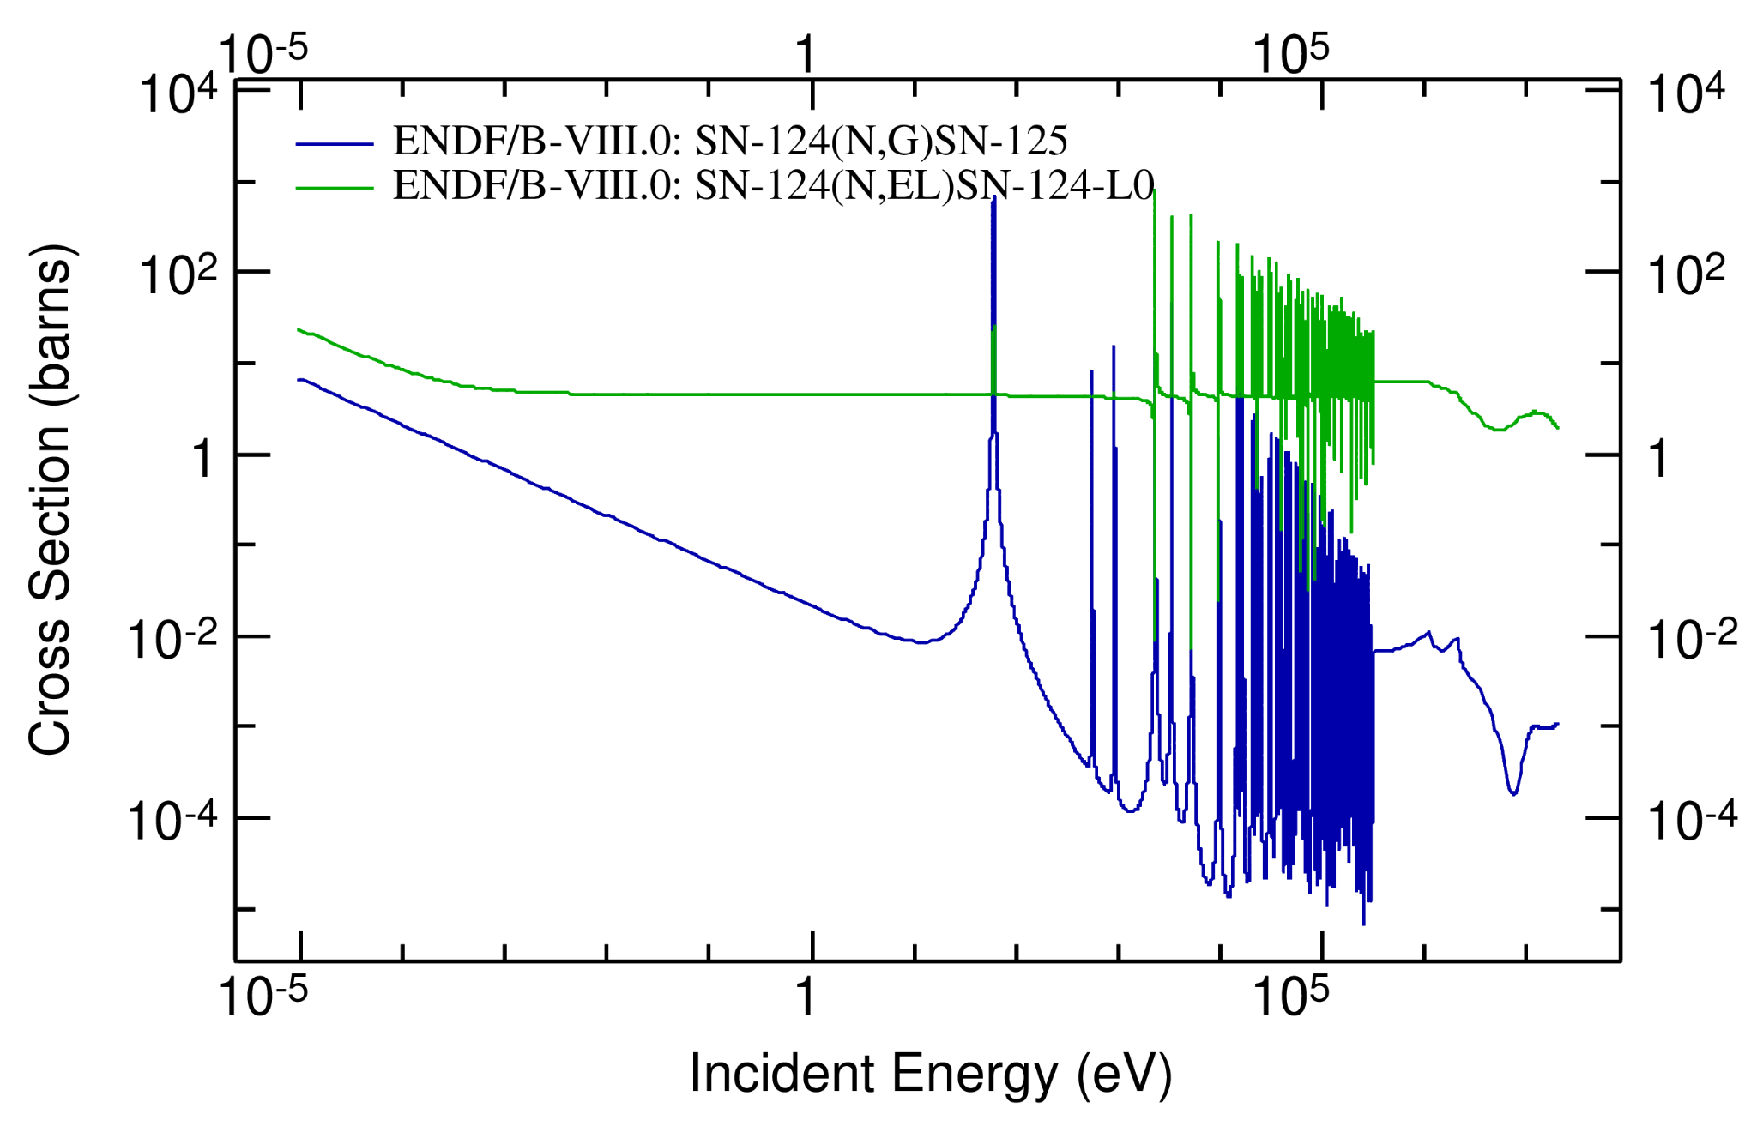
Experimental Details and Difficulties
Elastic to capture ratio -> very unfavorable!!!

Slide 12
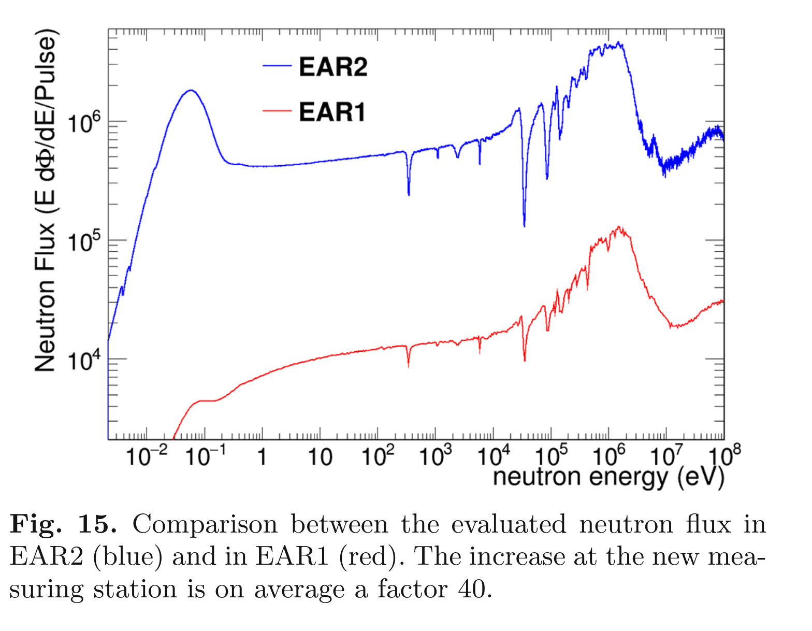
Experimental Details and Difficulties
Elastic to capture ratio -> very unfavorable!!!
Neutron energy resolution is not paramount -> AVERAGE CROSS SECTION (above 20 keV)
Table: Average distance in-between resonances against energy resolution at EAR1 versus EAR2
Neutron Energy range | No. of resonances (ENDF/B-VIII.0) | Avg. distance between Capture Resonances | Energy resolution in EAR1 * | Energy resolution in EAR2 *
50 eV-10 keV | 7 | 1200 eV | 10 eV | 200 eV
10-100 keV | 67 | 1300 eV | 300 eV | 3000 eV
100-200 keV | 68 | 1500 eV | 800 eV | -
200-314 keV | 47 | 2400 eV | 1200 eV | -
Goal: resolve resonances up to 15-20 keV
*Guerrero, C., et al. The European Physical Journal A 49 (2013): 1-15.
*Lerendegui-Marco, J., et al. The European Physical Journal A 52 (2016): 1-10.

Slide 13
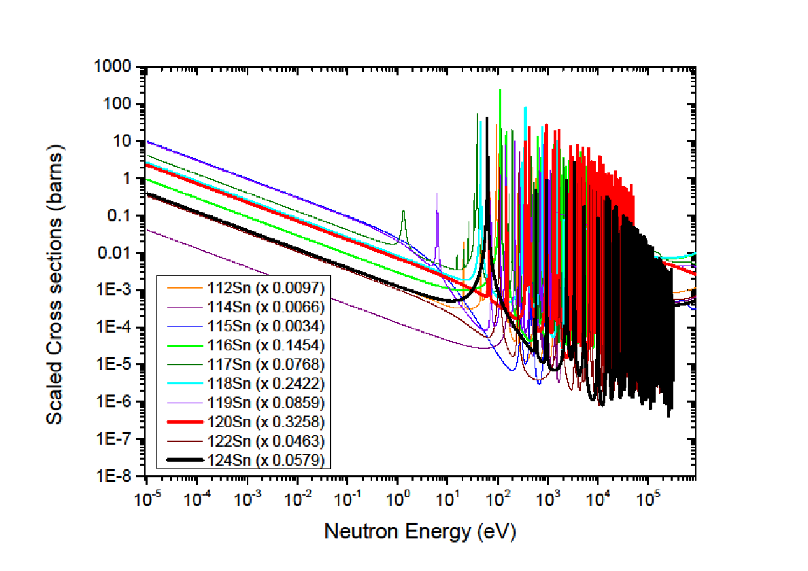
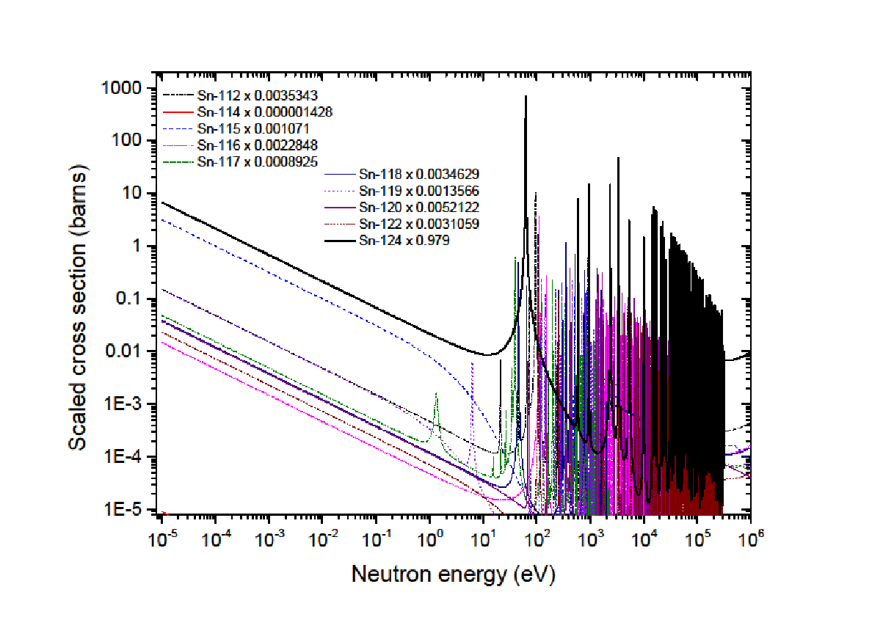
Experimental Details and Difficulties
Enriched sample -> paramount!
Enriched ¹²⁴Sn
^{nat}Sn
Comparison of ¹²⁴Sn resonances (in black) with the resonances from other Sn isotopes (cross section data from ENDF/B-VIII.0)
Scaled cross section associated to the other tin isotopes (scaled by the abundances of the ¹²⁴Sn enriched sample we plan to use)

Slide 14
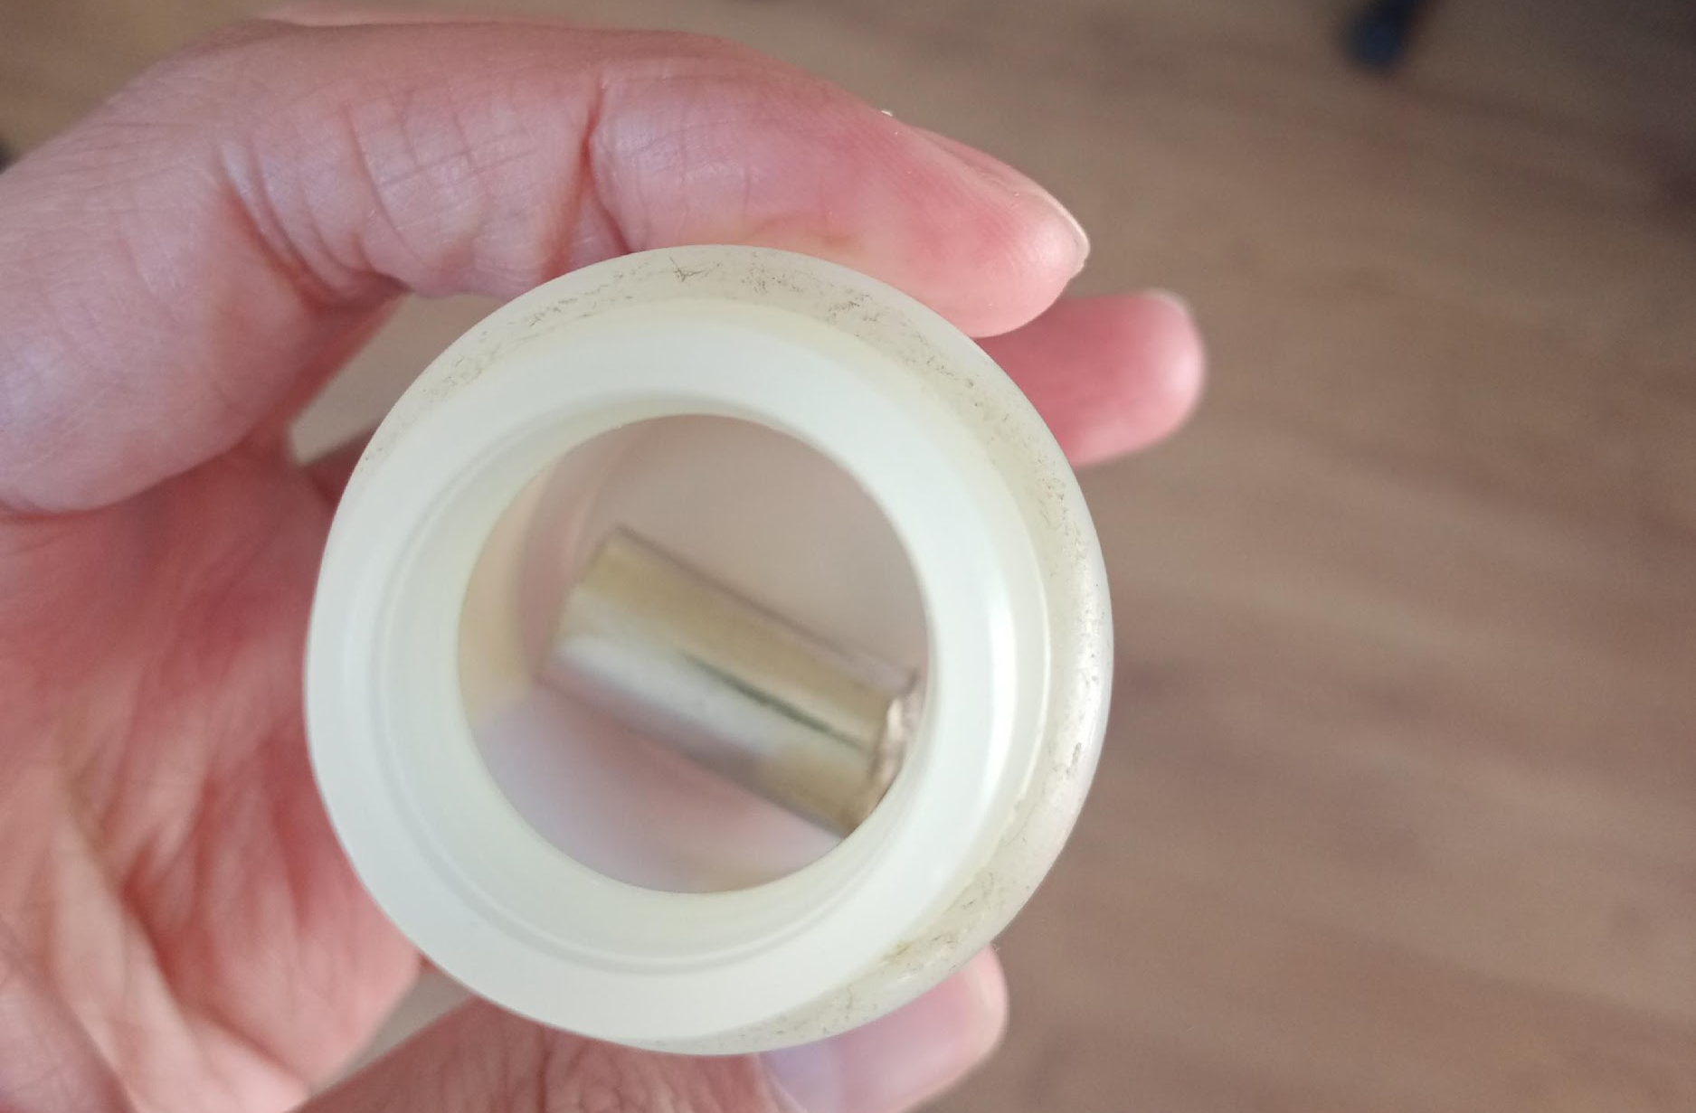
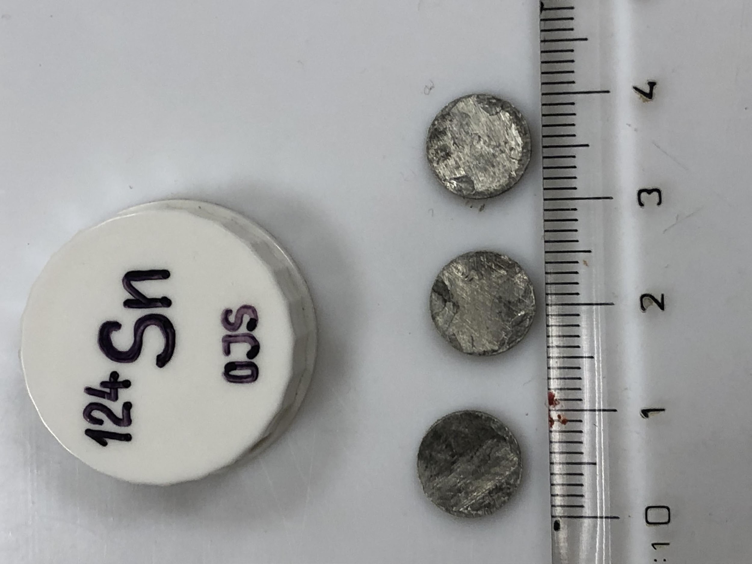
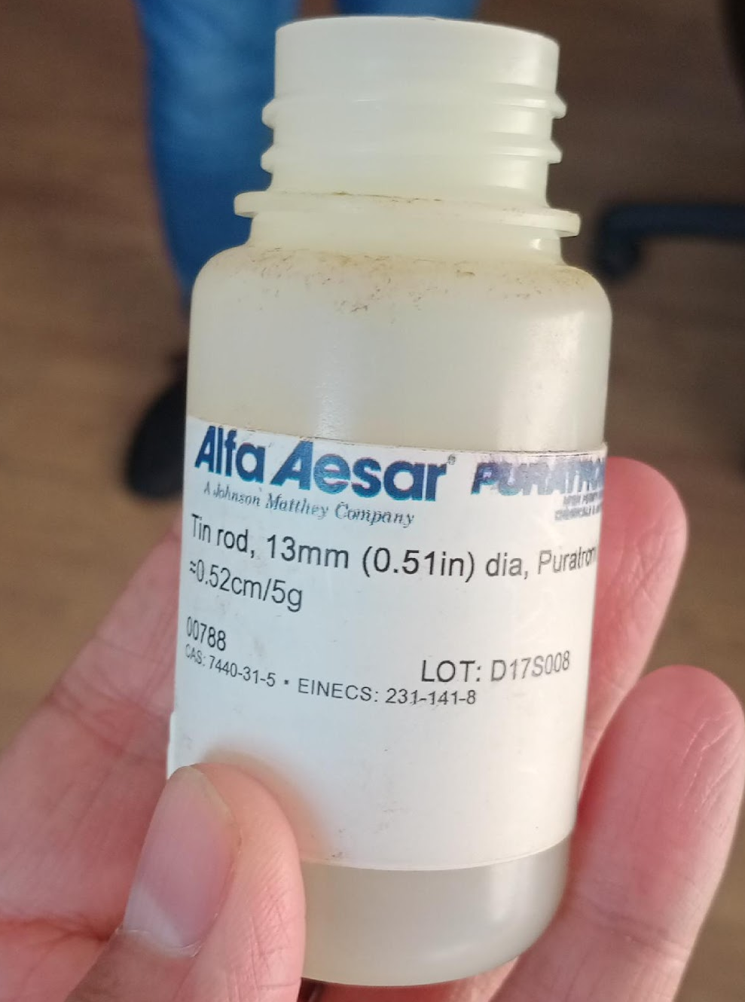
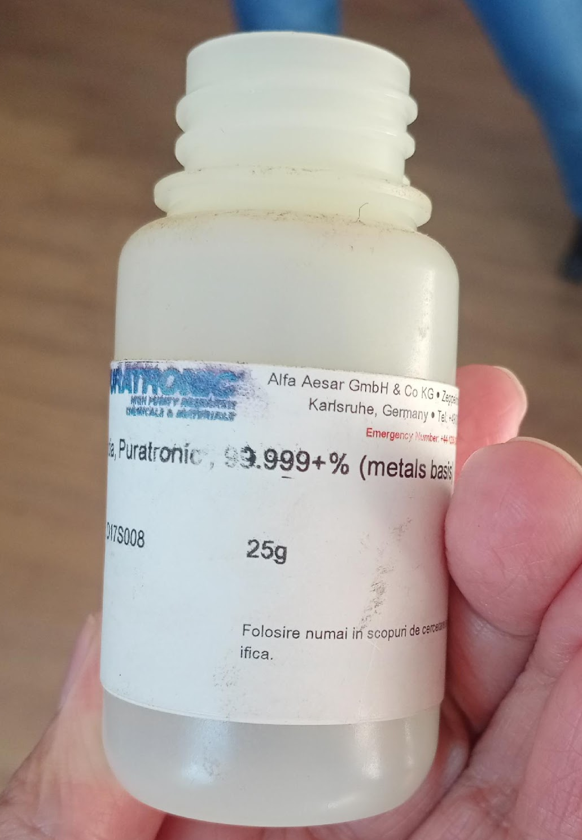
Experimental Details and Difficulties
^{Sample(s) Details}
^{3 disks (1 g each)}
^{97.9% enrichment}
^{10 mm diameter}
^{1.8 mm thickness}
^{nat}Sn
^{25 g (natural Tin rod)}
^{99.999% Purity}
^{13 mm diameter}
Available @ Nuclear Physics Institute
Czech Academy of Sciences (I. Tomandl, F. Marek)
Available @ IFIN-HH Target lab

Slide 15
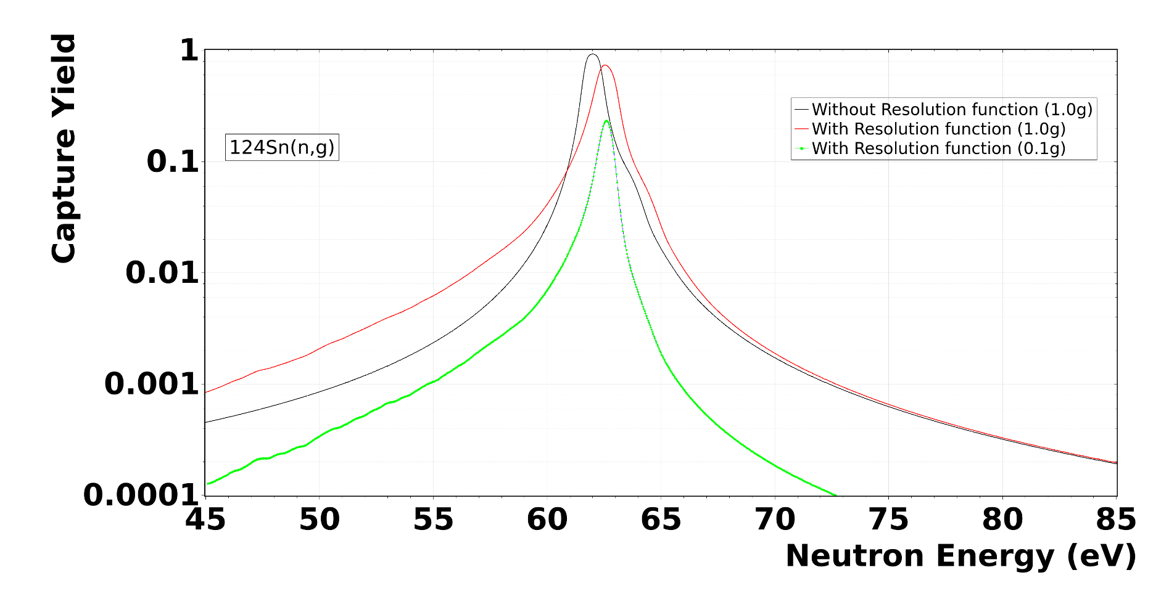
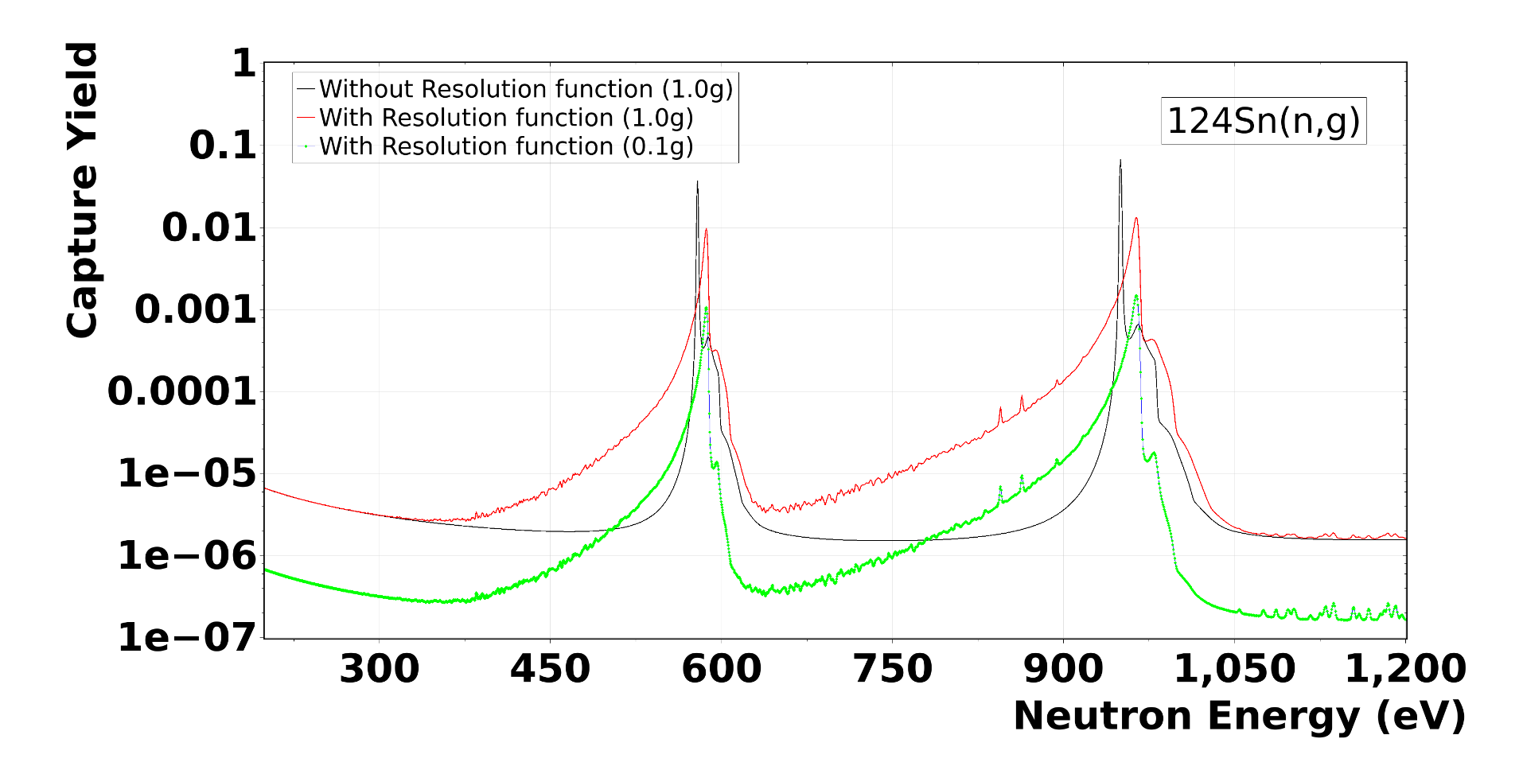
Experimental Details and Difficulties [EAR2]
Resolution function and multiple scattering -> SAMMY-based calculations
In EAR2 : 1.0 g sample (0.00618 at/b)
In EAR2 : 0.1 g sample (0.000618 at/b)

Slide 16
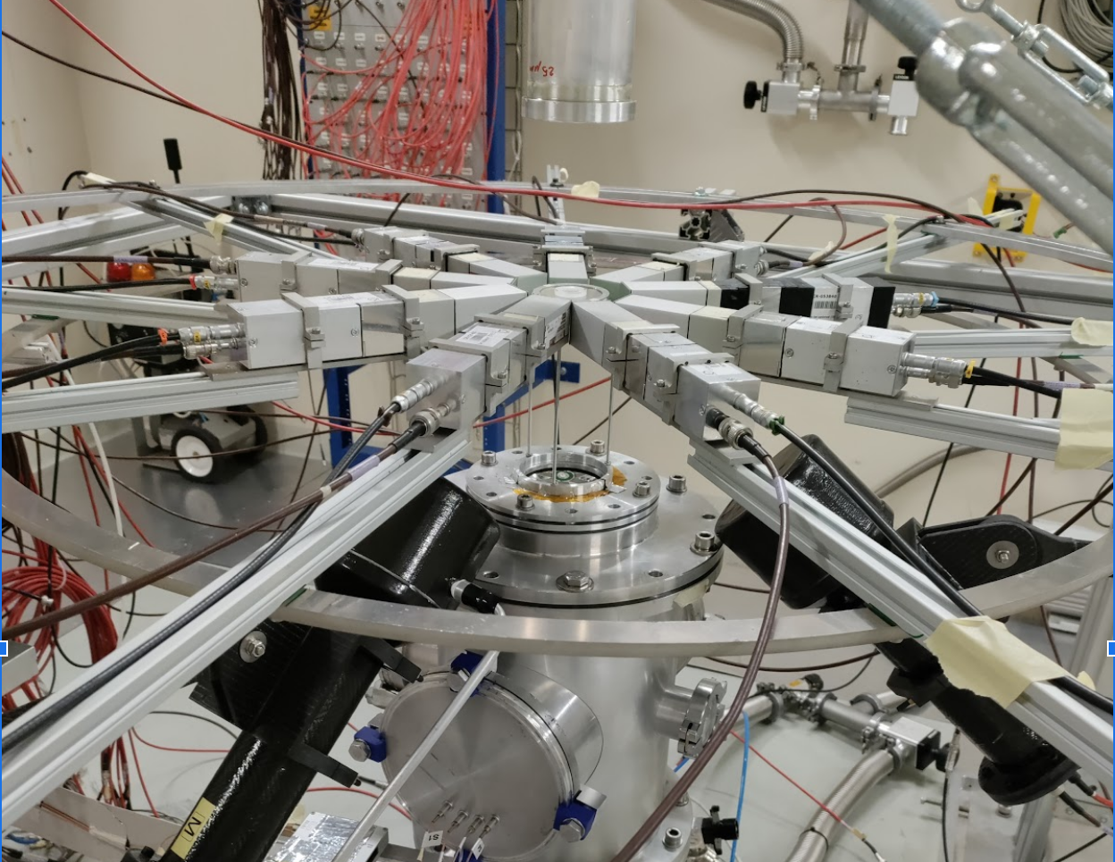
Experimental Details [EAR2]
How will we measure?
Setup of 9 sTED detectors
Measure from thermal to highest reachable energy by these detectors in EAR2
Use an enriched sample: 97.9% of ¹²⁴Sn
Thin-thick approach:
      Up to 15-20 keV-> thick (1.0 g)
      Average xs above 20 keV-> thick (3.0 g)
      First resonance -> thin (0.1 g)
Ancillary: also irradiate ^{nat}Sn, ¹⁹⁷Au, ^{nat}C, ^{nat}Pb samples + Empty
The 9 sTED’s setup used in EAR2 for the ²⁰⁹Bi(n,γ) campaign

Slide 17
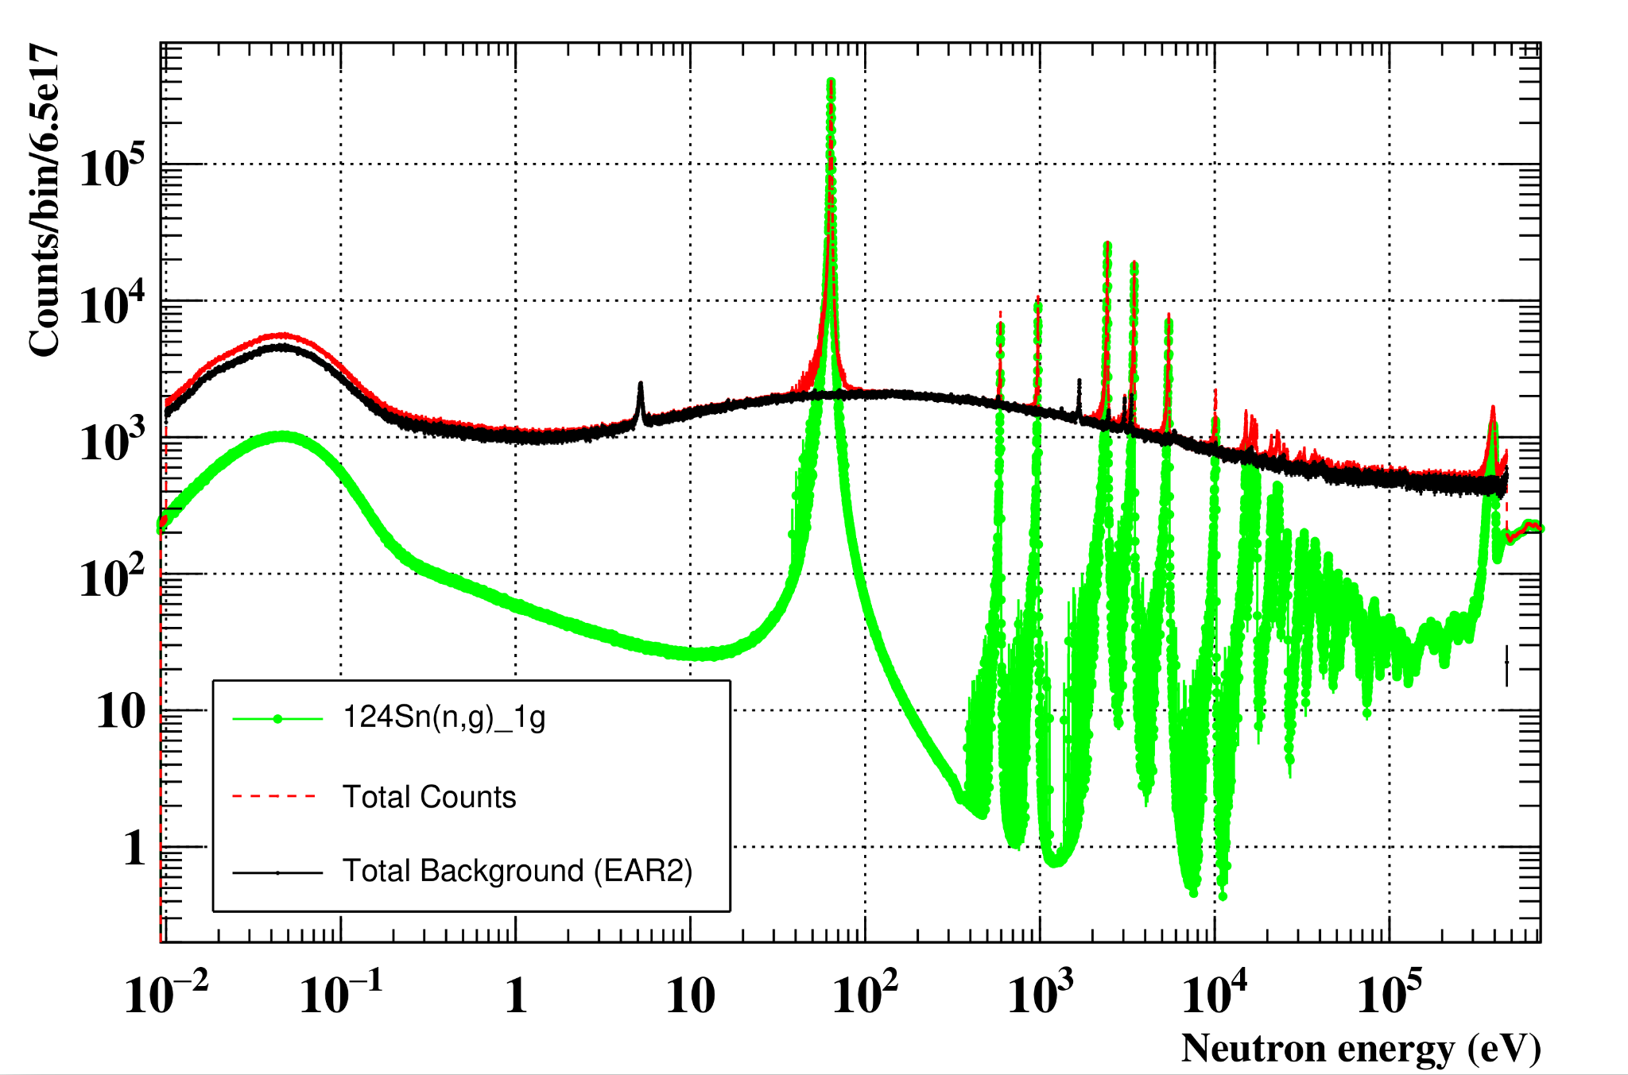
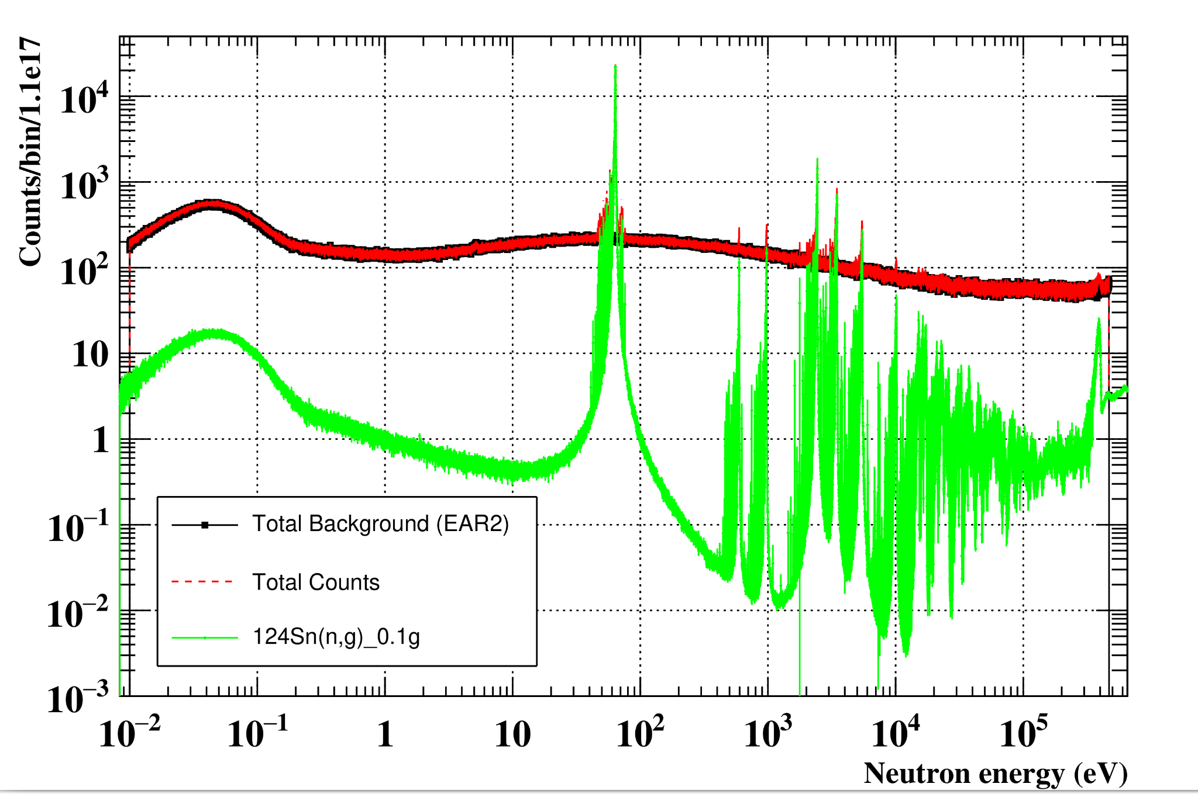
Proton Request [EAR2]
Counts estimation:
1.0 g sample, 0.00618 at/b (10 mm-diameter)
0.1 g sample, 0.000618 at/b (10 mm-diameter)
Eff-4.5% (9 sTEDs), JEFF-3.3
Eff-4.5% (9 sTEDs), JEFF-3.3
6.5e17 protons
2000 bpd
1.1e17 protons
2000 bpd
Total background = empty+in-beam 𝛾+elastic
Total Counts = 124Sn(n,g)_0.1/1g + total background

Slide 18
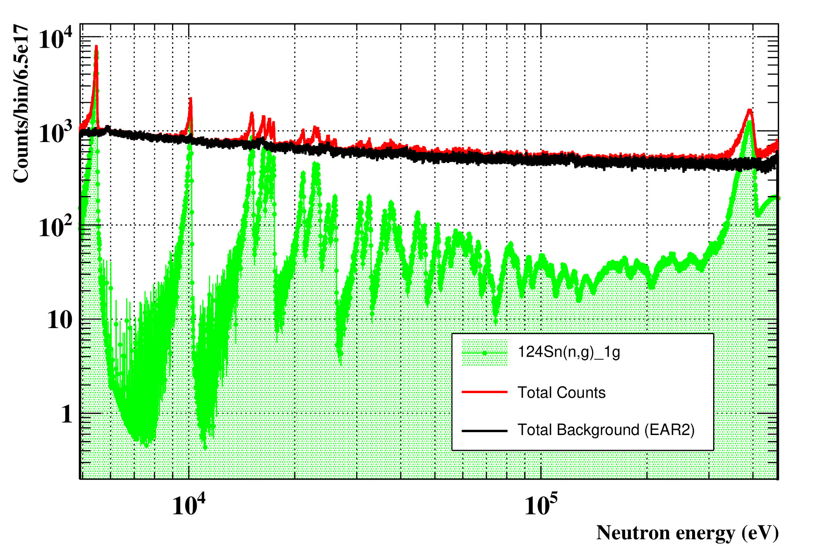
Proton Request [EAR2]
Counts estimation:
Eff-4.5% (9 sTEDs), JEFF-3.3
1.0 g sample, 0.00618 at/b (10 mm-diameter)
6.5e17 protons
(2000 bpd)

Slide 19
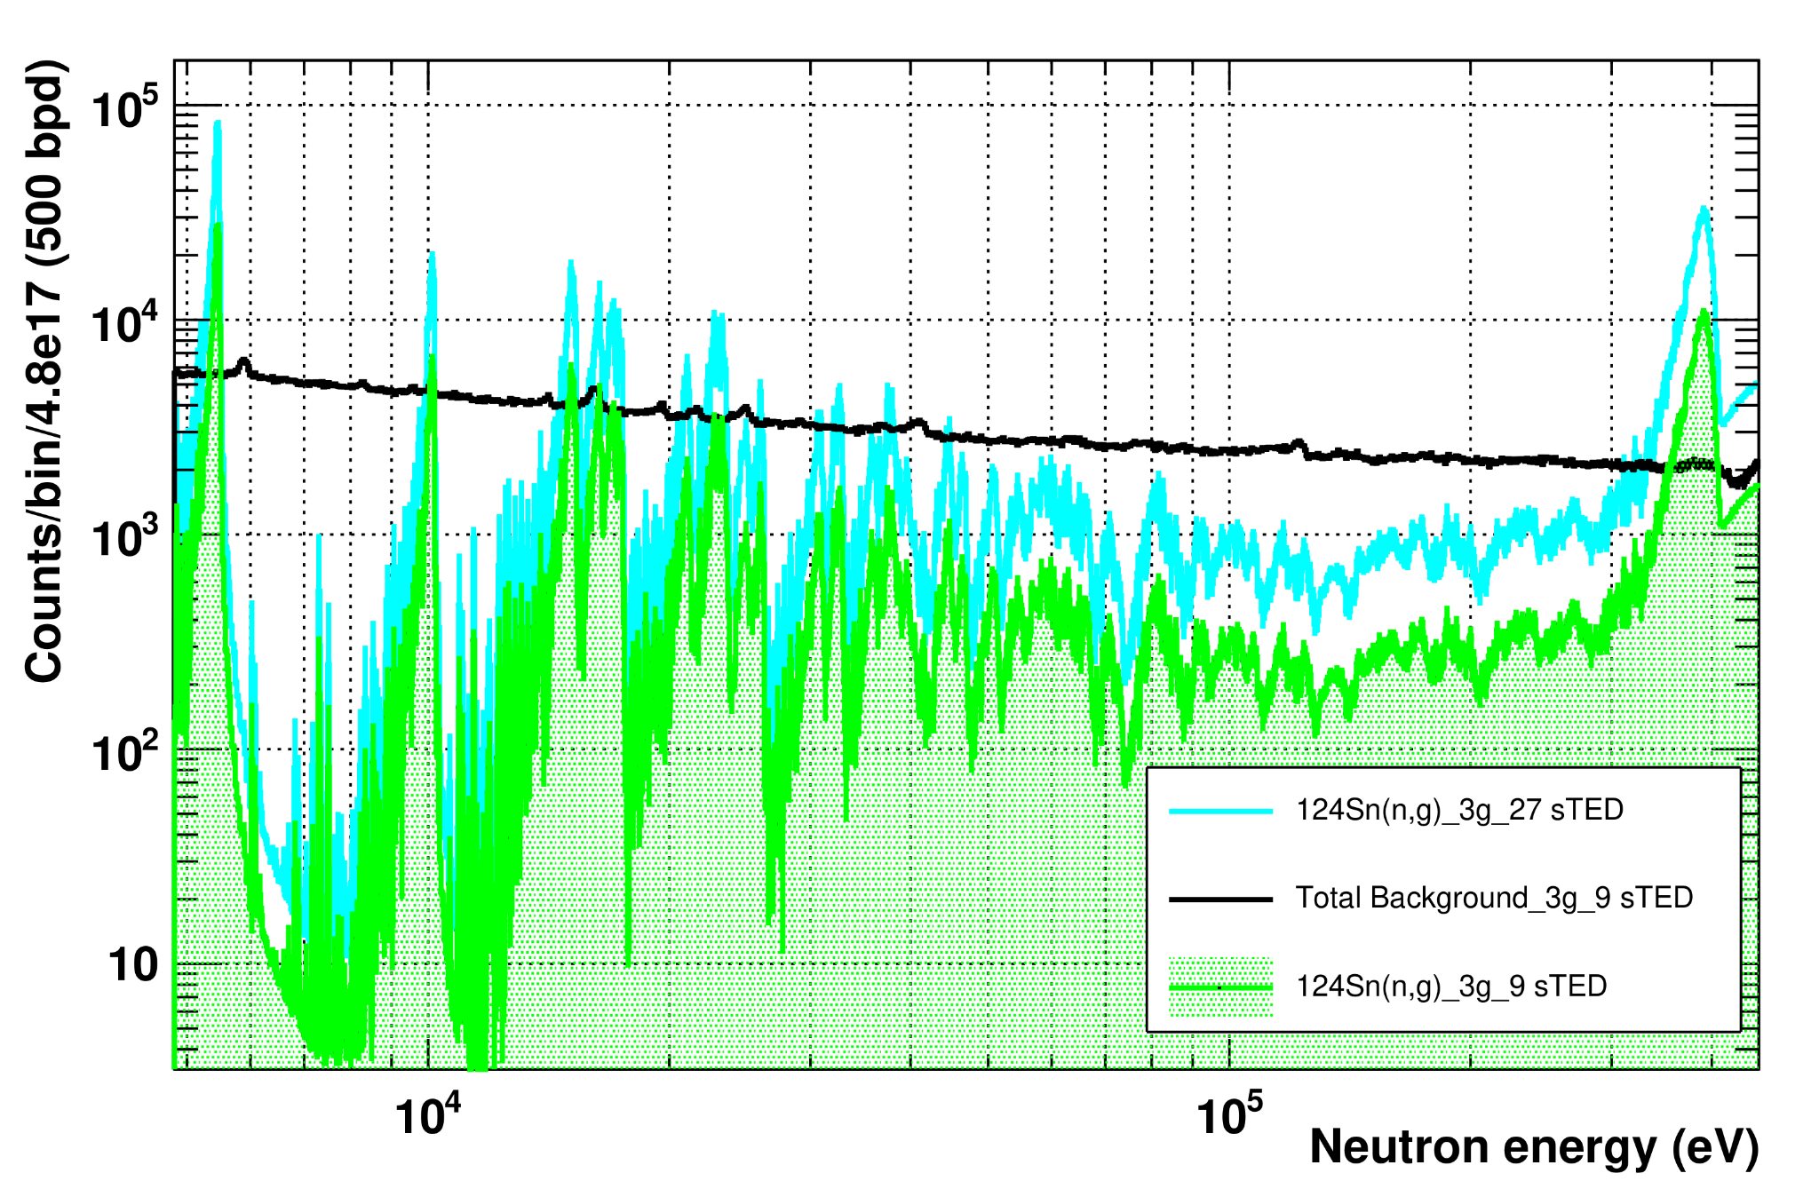
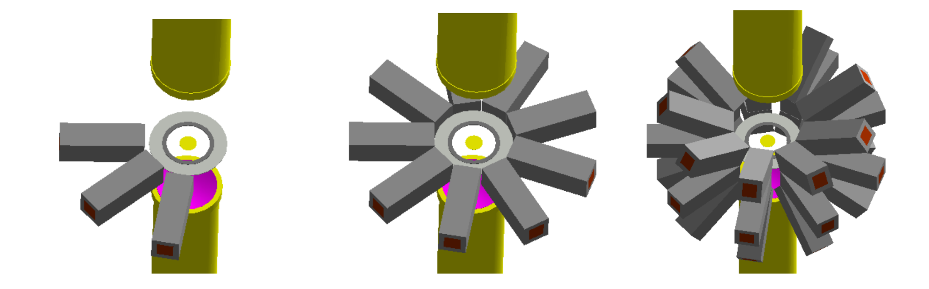
Proton Request [EAR2]
Counts estimation:
3.0 g sample, 0.01856 at/b (10 mm-diameter)
4.8e17 protons
(500 bpd)
Eff-4.5%, JEFF-3.3 [9 sTEDs]
Eff-13.5%, JEFF-3.3 [27 sTEDs]

Slide 20
Proton Request [EAR2]
For ¹²⁴Sn (1 g sample) -> 6.5x10¹⁷ protons
For ¹²⁴Sn (0.1 g sample) -> 1.1x10¹⁷ protons
For ¹²⁴Sn (3 g sample) -> 4.8x10¹⁷ protons
For ^{nat}Sn -> 1.1x10¹⁷ protons
Ancillary: normalisation (¹⁹⁷Au) + background estimation (^{nat}Pb, ^{nat}C, Empty) -> 6.5x10¹⁷ protons
In total: 2.0x10¹⁸ protons

Slide 21
Summary
Motivation:
A: Neutrinoless double β decay searches
B: Nuclear fuel depletion calculations: ¹²⁵Sb problem
Proton request
Sample | Protons
¹²⁴Sn (1 g) | 6.5x10¹⁷
¹²⁴Sn (0.1 g) | 1.1x10¹⁷
¹²⁴Sn (3.0 g) | 4.8x10¹⁷
^{nat}Sn | 1.1x10¹⁷
^{nat}C, ^{nat}Pb, ¹⁹⁷Au + Empty | 6.5x10¹⁷
Total | 2.0x10¹⁸
Status of data:
No ToF neutron capture data exist to map out first resonances below 10 keV, questionable resonances…
Experiment goals:
To provide for the first time reliable, low uncertainty neutron capture ToF data from thermal to 15-20 keV -> resonance parameters for the most intense resonances
Possibly average cross section above 20 keV
To better quantify the neutron-induced background for neutrinoless double β decay (0νββ) searches
Optimistically, to at least partially clarify the differences between various evaluations -> improve on ¹²⁵Sb problem
Impact:

Slide 22

Thanks
Do you have any questions?
https://www.nipne.ro/proiecte/pn3/ntof/
https://www.nipne.ro/
Contact Us
Address: Str. Reactorului no.30, P.O.BOX MG-6, Bucharest - Magurele, ROMANIA
Phone: +(4021) 404.23.00
Fax: +(4021) 457.44.40

