Slide 1
Laser spectroscopy of neutron-rich Ni with PI-LIST
Spokespersons:
Jordan Reilly (CERN)
Michail Athanasakis-Kaklamanakis (Imperial College London)

Slide 2
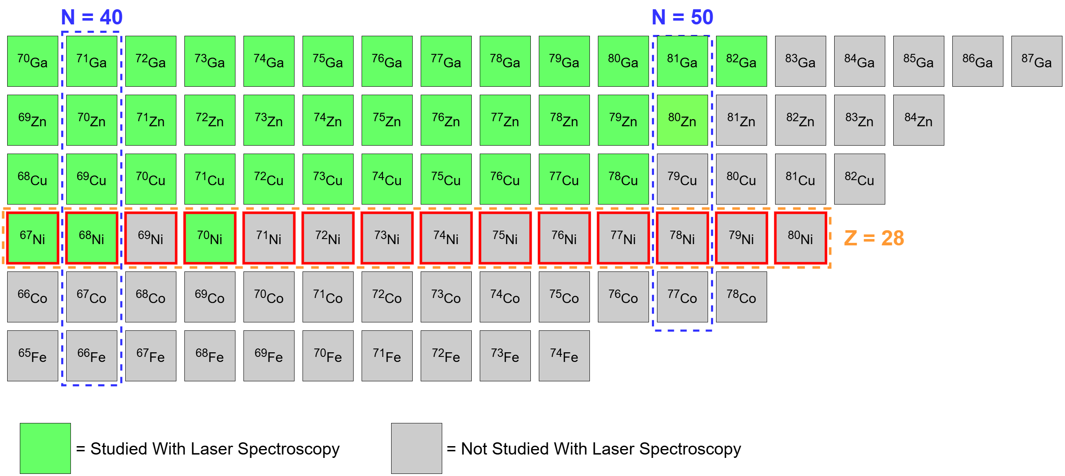
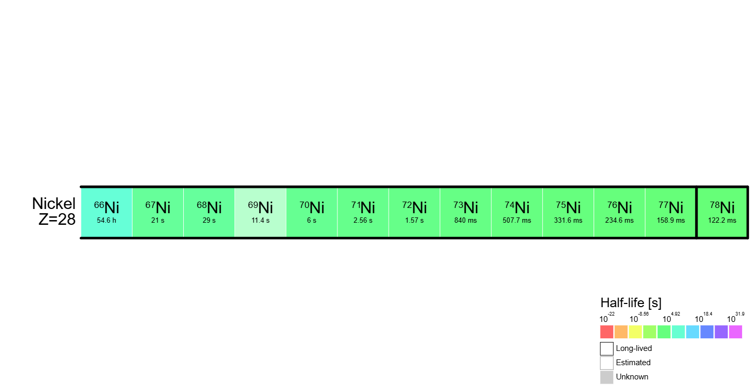
Introduction
Closed proton shell (Z = 28)
Z > 28 extensively studied with laser spectroscopy
^{54-68,70}Ni studied previously
Expand online PI-LIST into the medium-mass region
Ni spans across N = 40 & 50!

Slide 3
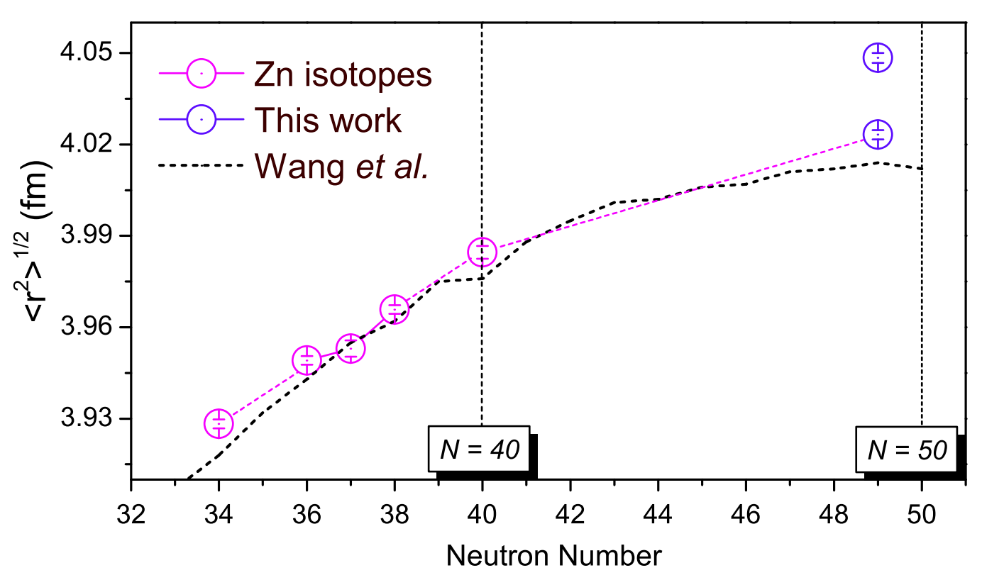
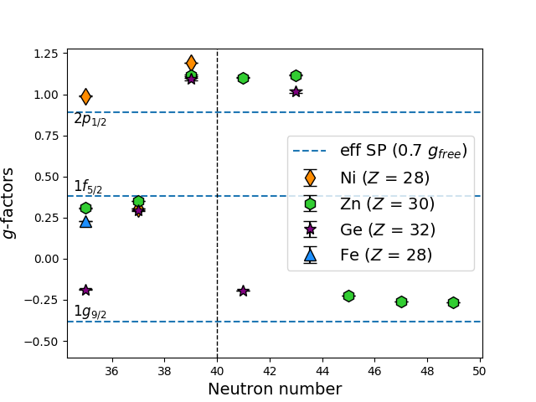
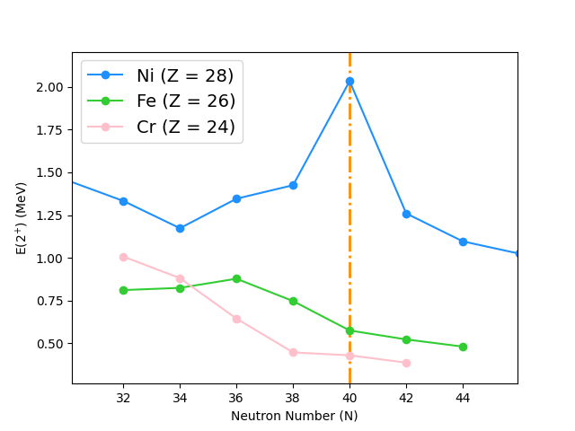
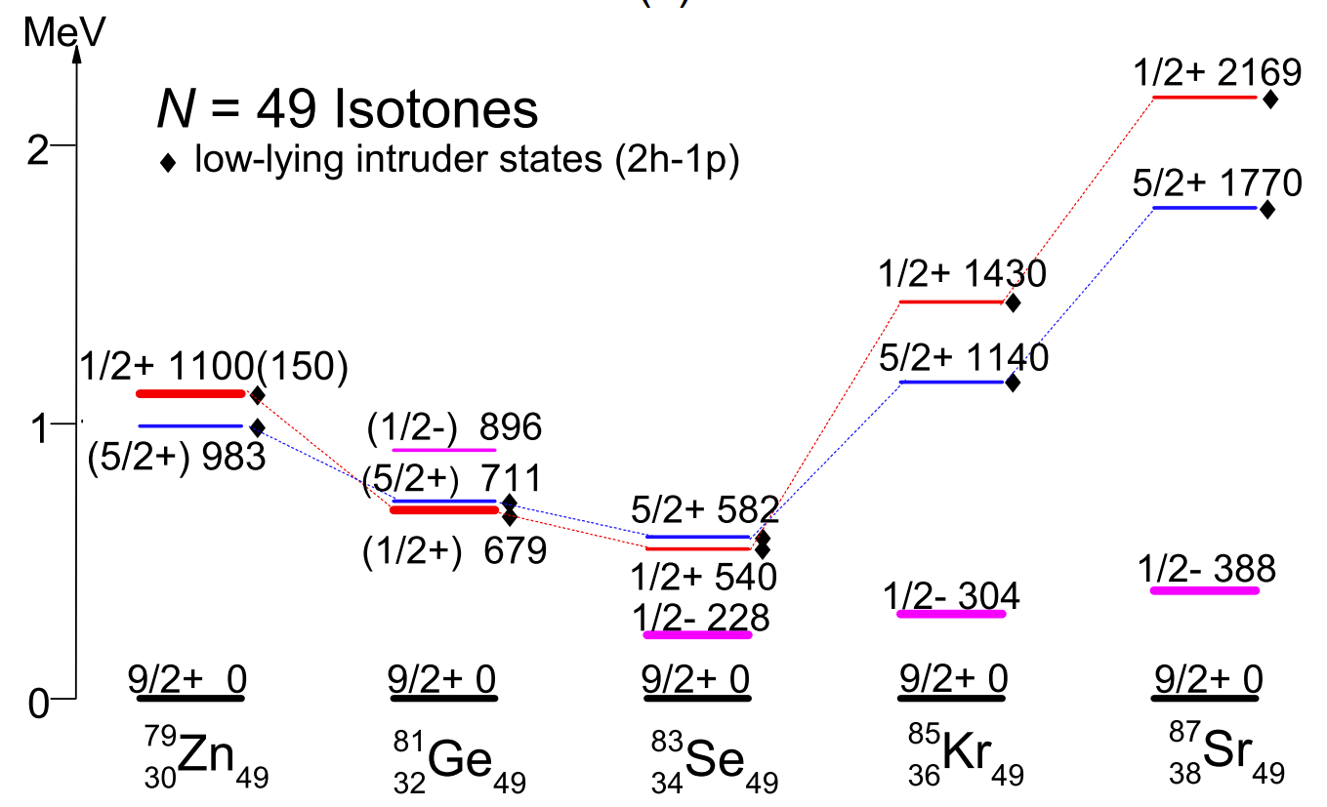
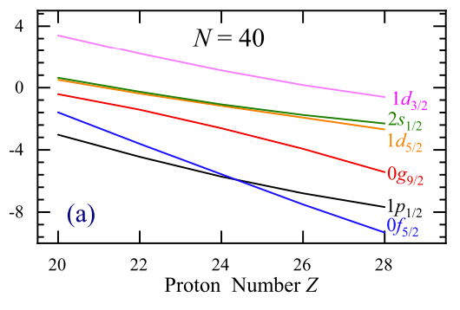
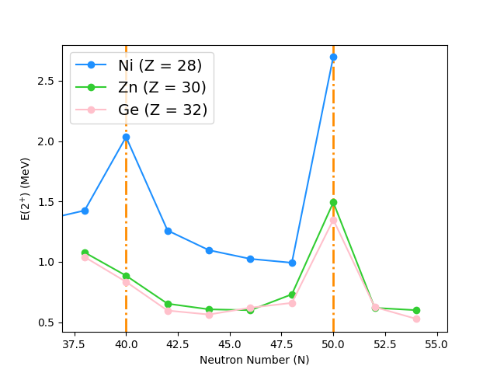
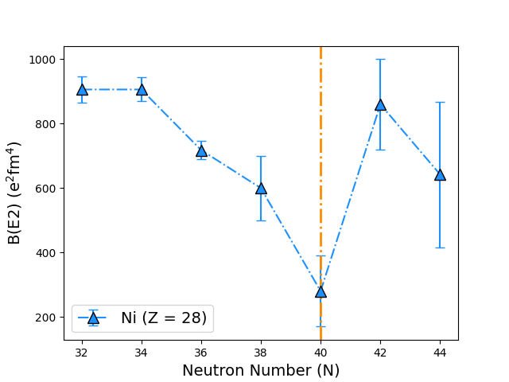
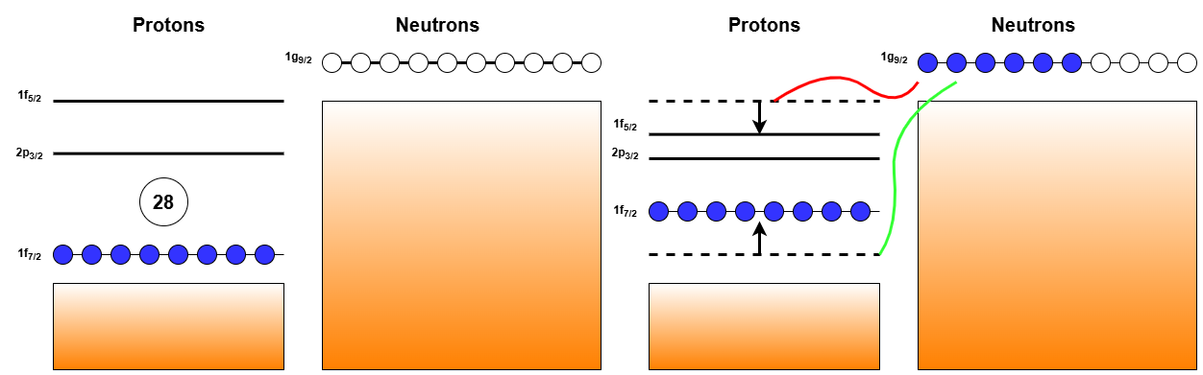
Isomeric states and mid-shell configuration mixing
N = 40 Island of Inversion
Ideal testing ground for developing and refining nuclear theories!
Region rich with nuclear structure changes!
Shape Coexistence near ⁷⁸Ni
Doubly magic nature of ⁷⁸Ni
Z = 28 Weakening & Enhanced Collectivity

Slide 4
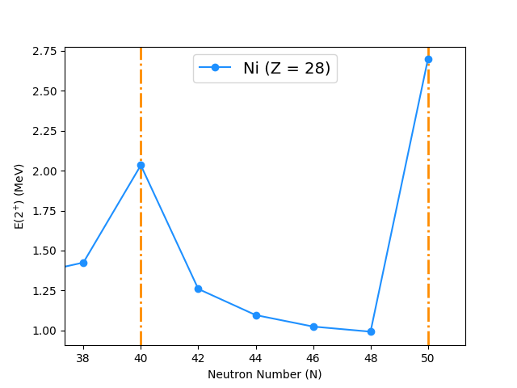
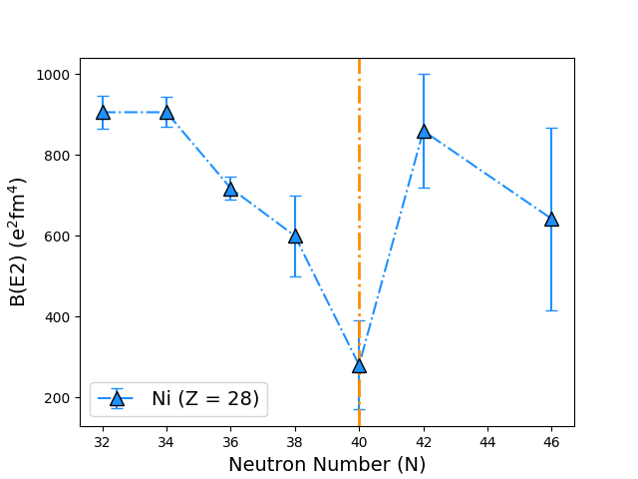

Motivation: possible weakening?
[1] N. Aoi et al., Enhanced collectivity in 74ni. Physics Letters B,692(5):302–306, September 2010.
[2] O. Perru et al., Enhanced core polarization in 70Ni and 74Zn.Phys. Rev. Lett., 96:232501, Jun 2006.
[3] T. Marchi et al., Quadrupole transition strength in the 74Ni nucleus and core polarization effects in the neutron-rich Ni isotopes. Phys. Rev. Lett., 113:182501, Oct 2014.
Decreasing trend of E(2⁺) between N = 40-50
Possible indicator of Z = 28 weakening as neutrons populate $g_{9/2}$
Enhancement in collectivity in ⁷⁴Ni reported in [1]
Increase in B(E2) between N = 40-42 [2]
Prolate deformation in ⁷⁴Ni
$μ, Q_{s}, {δ\left\langle r^{2}\right\rangle }^{A, A^{′}}$ measurements crucial in mid-shell region to understand development of collectivity

Slide 5

Motivation: N = 40 Island of inversion
E(2⁺) indicate re-emergence of N = 40 sub-shell closure in Ni
⁶⁴Cr marks the heart of the IoI, 4 protons from Ni [2]
As ${π1f}_{7/2}$ is populated, N = 40 energy gap narrows
Promotes np-nh excitations, causing intruder-dominated configurations
Reflected in ${δ\left\langle r^{2}\right\rangle }^{A, A^{′}}$, $Q_{s}$ and $μ$
To conclusively exclude Ni from N = 40 IoI, ${δ\left\langle r^{2}\right\rangle }^{A, A^{′}}$, $μ$ and $Q_{s}$ are required
[1] J.G. Li. Merging of the island of inversion at n=40 and n=50. Physics Letters B,840:137893, 2023.
[2] L. Lalanne et al., ⁶¹Cr as a door-way to the n = 40 island of inversion, 2024.
Fig from [1]

Slide 6
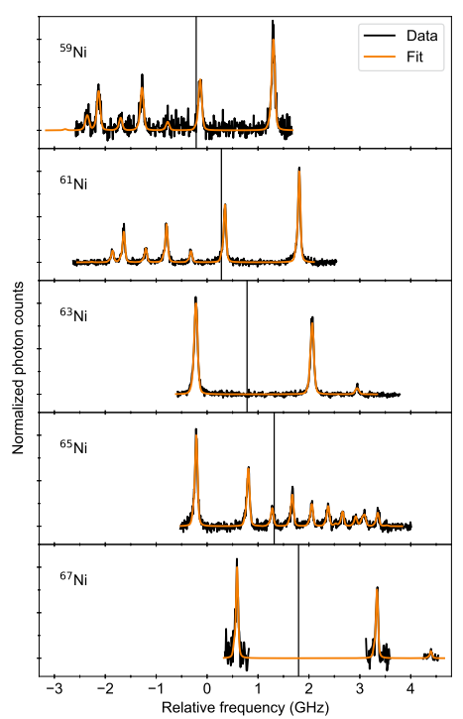
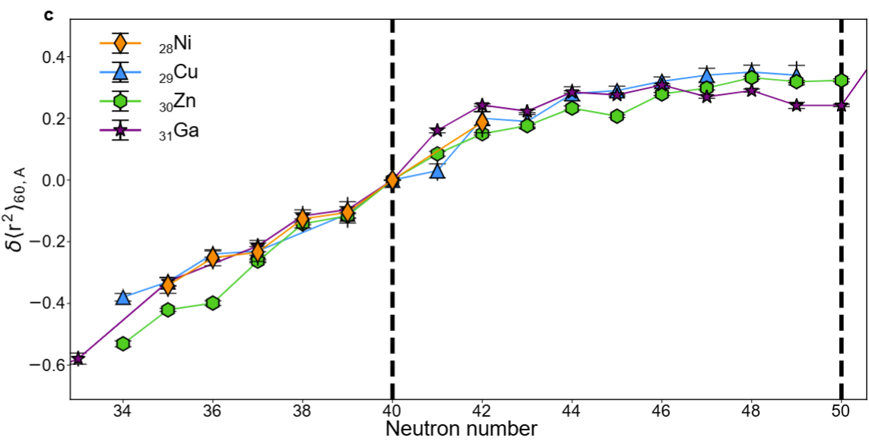
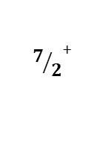
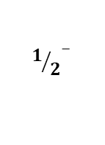

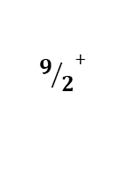
Previous measurements
[1] P. Muller et al., electromagnetic moments of the odd-mass nickel isotopes 59-67ni. Physics Letters B, 854:138737, 2024.
[2] S. Malbrunot-Ettenauer et al., nuclear charge radii of the nickel isotopes 58−68,70Ni. Phys. Rev. Lett., 128:022502, Jan 2022.
[3] C. Wraith et al., Evolution of nuclear structure in neutron-rich odd-Zn isotopes and isomers. Physics Letters B, 771:385–391, 2017.
Fig from [1]
$${1/2}^{−}$$
$${1/2}^{−}$$
Laser spectroscopy of Ni previously performed @ COLLAPS [1, 2]
${δ\left\langle r^{2}\right\rangle }^{A, A^{′}}$ measured for ^{58-68,70}Ni [2]
$μ$ and $Q_{s}$ measured up to ⁶⁷Ni [1]
Neighbouring elements also studied: Fe, Zn, Ge
Zn deviates from the expected $1g_{9/2}$ SP g-factor at N = 41, 43 [3]
Neutron hole in the $2p_{1/2}$ orbital at N = 41, 43
Conventional shell filling resumes at N = 49 in Zn
$${7/2}^{+}$$
$${7/2}^{+}$$
$${9/2}^{+}$$

Slide 7
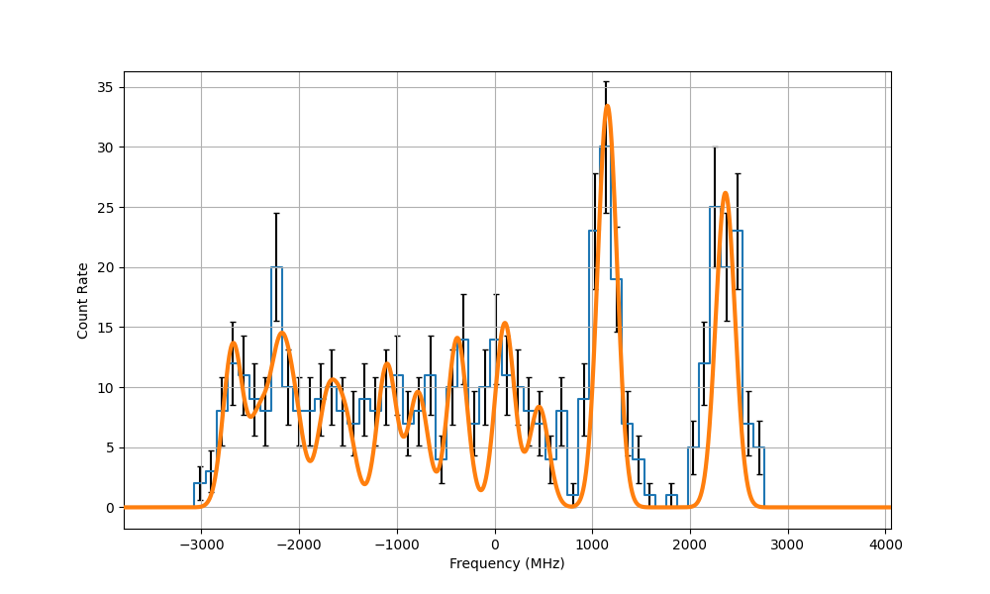
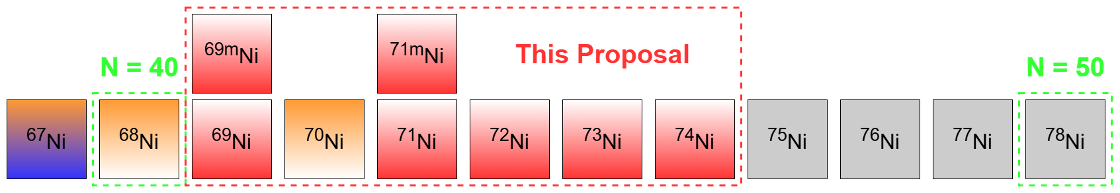
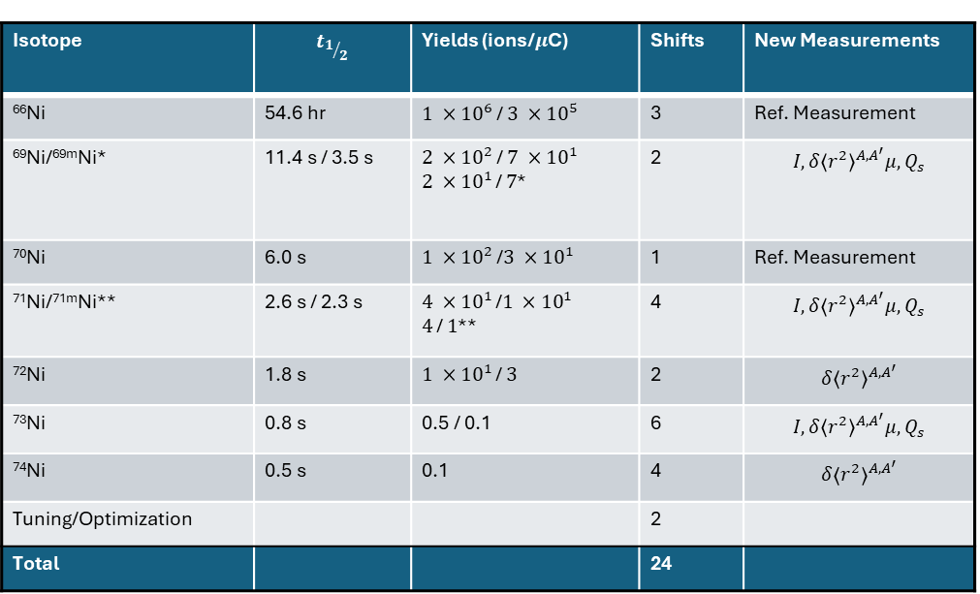

Proposal
Simulated ⁷³Ni!
24 shifts for high-resolution laser spectroscopy on ⁶⁹⁻⁷⁴Ni
Lightest mass used online for PI-LIST
Confirm tentative spins ($I^{π}$) of ^{69,71,73}Ni
Confirm level ordering of I = 9/2, 1/2 in ^{69,71}Ni with laser spectroscopy
Benchmark PI-LIST against lit. values for ⁷⁰Ni
Extend ${δ\left\langle r^{2}\right\rangle }^{A, A^{′}}$ up to N = 46
Extend $μ$ and $Q_{s}$ up to N = 45
Simultaneous decay data on ⁷⁴Ni at IDS
Reaffirm mass measurements of ⁷⁴Ni at ISOLTRAP
Isotope | $$t_{1/2}$$ | Yields (ions/$μ$C) | Shifts | New Measurements
⁶⁶Ni | 54.6 hr | $1 ×{10}^{6}$ / $3 ×{10}^{5}$ | 3 | Ref. Measurement
⁶⁹Ni/^{69m}Ni* | 11.4 s / 3.5 s | $2 ×{10}^{2}$ / $7 ×{10}^{1}$ $2 ×{10}^{1}$ / $7$* | 2 | $${I, δ\left\langle r^{2}\right\rangle }^{A, A^{′}}μ\text{,} Q_{s}$$
⁷⁰Ni | 6.0 s | $1 ×{10}^{2}$ /$3 ×{10}^{1}$ | 1 | Ref. Measurement
⁷¹Ni/^{71m}Ni** | 2.6 s / 2.3 s | $4 ×{10}^{1}$ /$1 ×{10}^{1}$ $4$ / $1$** | 4 | $${I, δ\left\langle r^{2}\right\rangle }^{A, A^{′}}μ\text{,} Q_{s}$$
⁷²Ni | 1.8 s | $1 ×{10}^{1}$ / $3$ | 2 | $${δ\left\langle r^{2}\right\rangle }^{A, A^{′}}$$
⁷³Ni | 0.8 s | 0.5 / 0.1 | 6 | $${I, δ\left\langle r^{2}\right\rangle }^{A, A^{′}}μ\text{,} Q_{s}$$
⁷⁴Ni | 0.5 s | 0.1 | 4 | $${δ\left\langle r^{2}\right\rangle }^{A, A^{′}}$$
Tuning/Optimization |  |  | 2
Total |  |  | 24

Slide 8
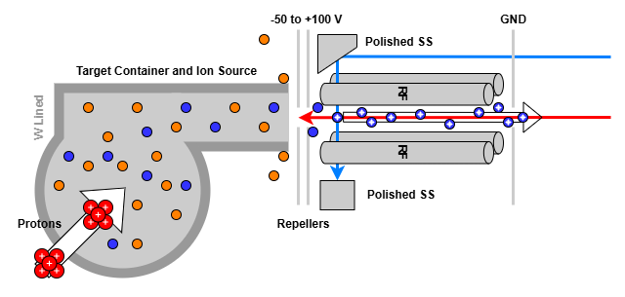
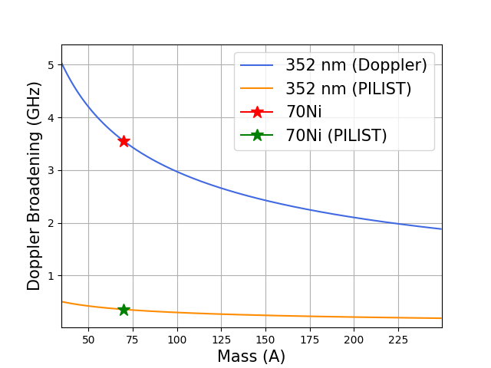
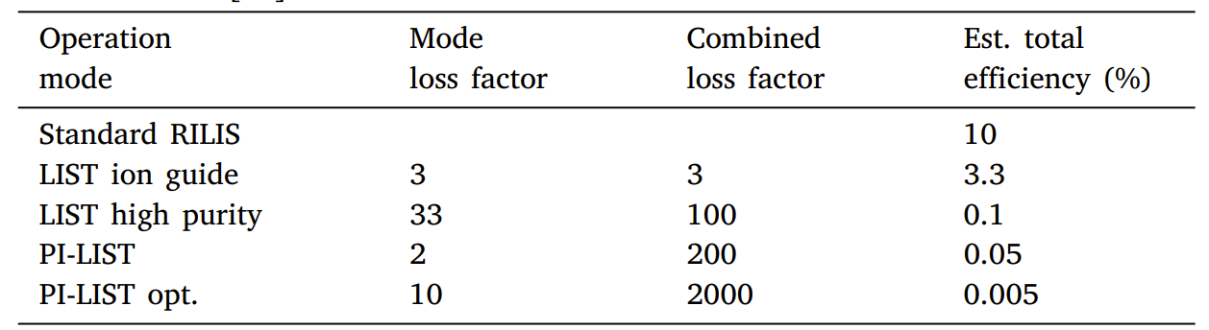
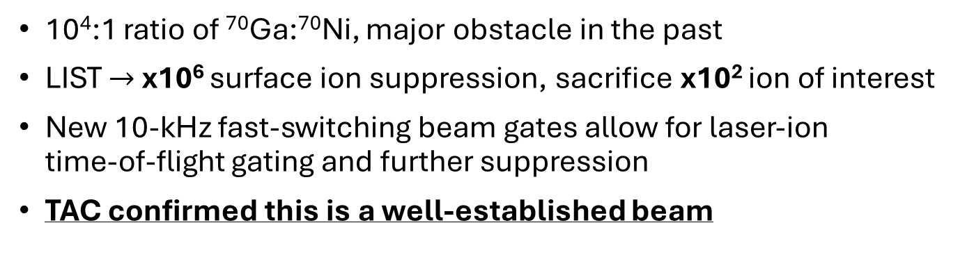
Technical Details:
PI-LIST
10⁴:1 ratio of ⁷⁰Ga:⁷⁰Ni, major obstacle in the past
LIST $→$ x10⁶ surface ion suppression, sacrifice x10² ion of interest
New 10-kHz fast-switching beam gates allow for laser-ion
time-of-flight gating and further suppression
TAC confirmed this is a well-established beam
Tab from [1]
[1] R. Heinke et al., high-resolution in-source laser spectroscopy in perpendicular geometry: Development and application of the pi-list. Hyperfine Interactions, 238, 12 2016.

Slide 9
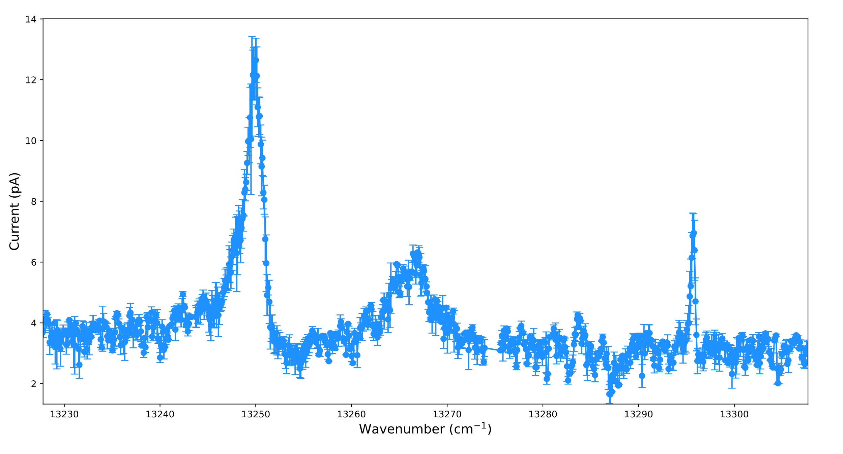
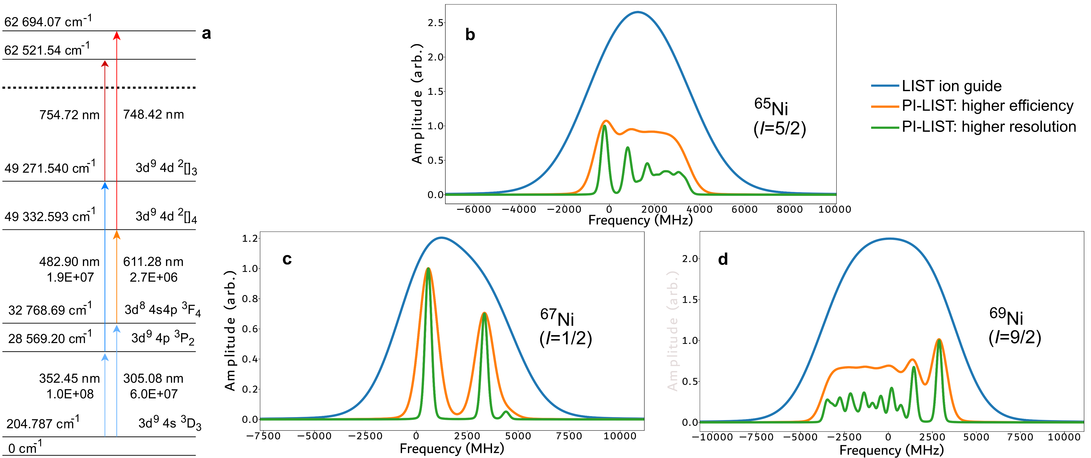
Technical Details: Laser Ionization Scheme
New autoionizing states found in Ni!
Measured in Oct!
Even-A isotopes can be converted back to “higher production” mode or even Ion guide collinear LIST mode
This comes with a sacrifice in resolution
Spectroscopy transition with known HFS parameters
New laser ionization scheme is at least as efficient as the production scheme
1st step used previously in laser spectroscopy at ISOLDE

Slide 10
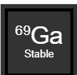
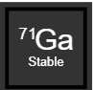
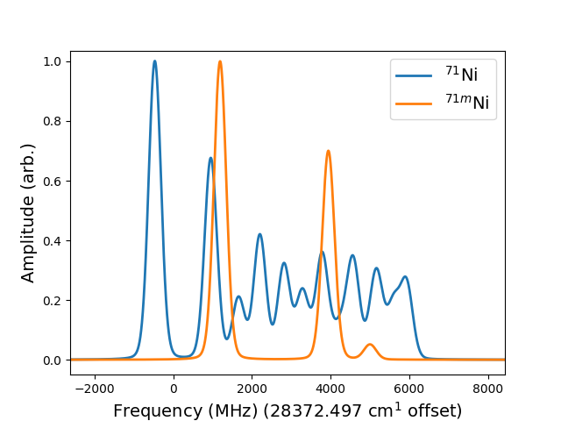
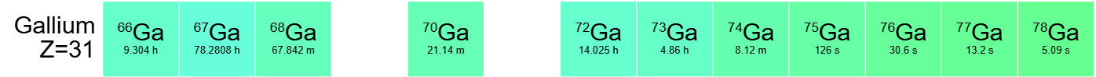
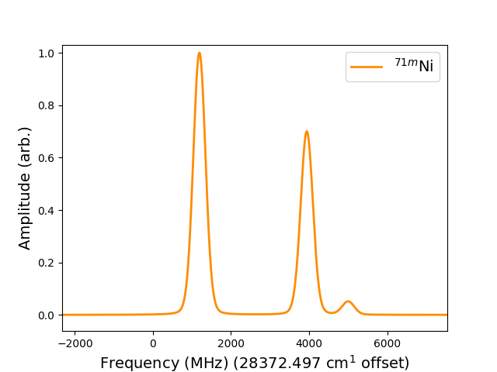
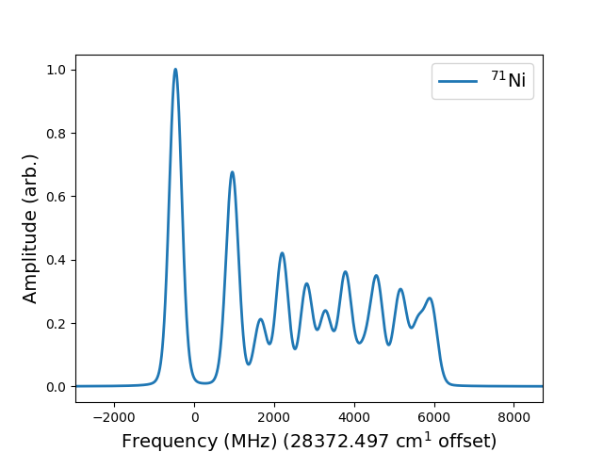


Technical Details:
IDS and ISOLTRAP
Isomer & G.S. Separation in a single scan!
IDS: main element of detection
$t_{1/2}$ (Ga) >> $t_{1/2}$(Ni), mostly filtered by tape movement
Decay data on ^{69m, 71m}Ni is sparse
No decay data available for A$≥$⁷⁴Ni
Mass measurements of ^{74,75}Ni @ IGISOL (2022) – Reaffirm values
Ion detection with ISOLTRAP MR-ToF
Revert to high-production collinear LIST for decay or mass measurements
Well-established method due to strong RILIS + IDS + ISOLTRAP technique!
$γ −$ Gating
Instant Switching between high production and high resolution!
PI-LIST
Higher resolution
Spectroscopy Laser
Shutters
Collinear LIST
Higher production
PBS Cube

Slide 11

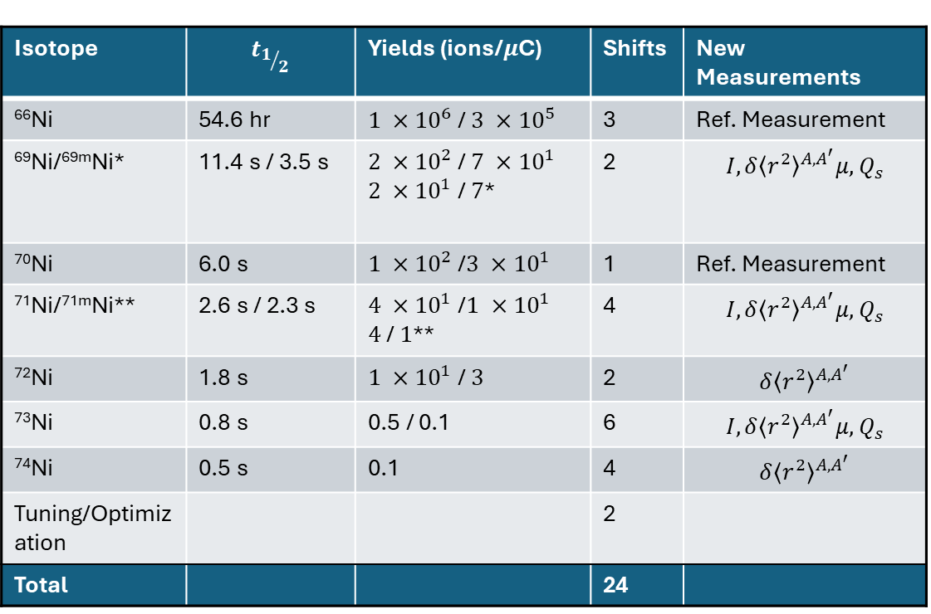
Conclusion
Isotope | $$t_{1/2}$$ | Yields (ions/$μ$C) | Shifts | New Measurements
⁶⁶Ni | 54.6 hr | $1 ×{10}^{6}$ / $3 ×{10}^{5}$ | 3 | Ref. Measurement
⁶⁹Ni/^{69m}Ni* | 11.4 s / 3.5 s | $2 ×{10}^{2}$ / $7 ×{10}^{1}$ $2 ×{10}^{1}$ / $7$* | 2 | $${I, δ\left\langle r^{2}\right\rangle }^{A, A^{′}}μ\text{,} Q_{s}$$
⁷⁰Ni | 6.0 s | $1 ×{10}^{2}$ /$3 ×{10}^{1}$ | 1 | Ref. Measurement
⁷¹Ni/^{71m}Ni** | 2.6 s / 2.3 s | $4 ×{10}^{1}$ /$1 ×{10}^{1}$ $4$ / $1$** | 4 | $${I, δ\left\langle r^{2}\right\rangle }^{A, A^{′}}μ\text{,} Q_{s}$$
⁷²Ni | 1.8 s | $1 ×{10}^{1}$ / $3$ | 2 | $${δ\left\langle r^{2}\right\rangle }^{A, A^{′}}$$
⁷³Ni | 0.8 s | 0.5 / 0.1 | 6 | $${I, δ\left\langle r^{2}\right\rangle }^{A, A^{′}}μ\text{,} Q_{s}$$
⁷⁴Ni | 0.5 s | 0.1 | 4 | $${δ\left\langle r^{2}\right\rangle }^{A, A^{′}}$$
Tuning/Optimization |  |  | 2
Total |  |  | 24
The Z = 28, N = 40-50 region is rich with nuclear structure
High-resolution laser spectroscopy performed with PI-LIST + IDS
LIST is the ideal candidate to overcome the overwhelming Ga contamination
New measurements on $μ$, $Q_{s}$, ${δ\left\langle r^{2}\right\rangle }^{A,A^{′}}$ and $I$ on ^{69, 71-74}Ni and ^{69m, 71m}Ni.
Measurement that will help clarify the evolution of nuclear structure leading to ⁷⁸Ni
Free additional decay spectroscopy data on ⁷⁴Ni
Instant switching between higher-resolution and higher-efficiency
Lightest online medium mass measurements using PI-LIST, opening doors for other medium-mass elements

Slide 12
Thank you!
Questions?
J. R. Reilly¹, M. Athanasakis-Kaklamanakis², M. Araszkiewicz³, K. Chrysalidis¹,A. Ajayakumar¹, A. N. Andreyev⁴, M. Au¹, C. Bernerd¹, J. G. Cubiss^{4,5}, L. M. Fraile⁶, M. J. G. Borge⁷, P. Garczynski³, G. Georgiev⁸, P. F. Giesel⁹, R. de Groote¹⁰,R. Grzywacz¹¹, R. Heinke^{12,1}, M. Karny³, A. Koszorus¹⁰, R. Kuczma³, L. Lalanne¹³, D. Lange¹⁴, K. M. Lynch¹², D. McElroy¹², M. M lynarczyk³, L. Nies¹, F. Nowacki¹³,B. Olaizola⁷, S. Rothe¹, C. Schweiger¹⁴, A. I. Sison⁶, K. Solak³, K. Stoychev¹⁵,R. Taniuchi⁴, B. van den Borne¹⁰, P. Wakuluk³, J. Warbinek¹⁶, J. Wessolek^{1,12}, J. Wilson⁴, S. Zajda³
¹Systems Department, CERN, CH-1211 Geneva 23, Switzerland
²Centre for Cold Matter, Imperial College London, SW7 2AZ London, United Kingdom
³Faculty of Physics, University of Warsaw, PL 00-681 Warsaw, Poland
⁴School of Physics, Engineering and Technology, University of York, York, YO10 5DD, UnitedKingdom
⁵School of Physics and Astronomy, University of Edinburgh, Edinburgh, EH9 3FD, United King-dom
⁶Grupo de Fısica Nuclear & IPARCOS, Universidad Complutense de Madrid, Madrid, Spain
⁷Instituto de Estructura de la Materia, CSIC, E-28006 Madrid, Spain
⁸IJCLab, IN2P3/CNRS, and Universite Paris-Saclay, F-91405 Orsay Campus, France
⁹Institut fur Physik, Universitat Greifswald, D-17487 Greifswald, Germany
¹⁰KU Leuven, Instituut voor Kern- en Stralingsfysica, B-3001 Leuven, Belgium
¹¹Department of Physics and Astronomy, University of Tennessee, Knoxville, Tennessee 37996,USA
¹²School of Physics and Astronomy, The University of Manchester, Manchester M13 9PL,United Kingdom
¹³Universit´e de Strasbourg, CNRS, IPHC UMR 7178, F-67000 Strasbourg, France
¹⁴Max-Planck-Institut fur Kernphysik, 69117 Heidelberg, Germany
¹⁵Department of Physics, University of Guelph, Guelph, Ontario N1G2W1, Canada
¹⁶Experimental Physics Department, CERN, CH-1211 Geneva 23, Switzerland

Slide 13

Conclusion
Isotope | $$t_{1/2}$$ | Yields (ions/$μ$C) | Shifts | New Measurements
⁶⁶Ni | 54.6 hr | $1 ×{10}^{6}$ / $3 ×{10}^{5}$ | 3 | Ref. Measurement
⁶⁹Ni/^{69m}Ni* | 11.4 s / 3.5 s | $2 ×{10}^{2}$ / $7 ×{10}^{1}$ $2 ×{10}^{1}$ / $7$* | 2 | $${I, δ\left\langle r^{2}\right\rangle }^{A, A^{′}}μ\text{,} Q_{s}$$
⁷⁰Ni | 6.0 s | $1 ×{10}^{2}$ /$3 ×{10}^{1}$ | 1 | Ref. Measurement
⁷¹Ni/^{71m}Ni** | 2.6 s / 2.3 s | $4 ×{10}^{1}$ /$1 ×{10}^{1}$ $4$ / $1$** | 4 | $${I, δ\left\langle r^{2}\right\rangle }^{A, A^{′}}μ\text{,} Q_{s}$$
⁷²Ni | 1.8 s | $1 ×{10}^{1}$ / $3$ | 2 | $${δ\left\langle r^{2}\right\rangle }^{A, A^{′}}$$
⁷³Ni | 0.8 s | 0.5 / 0.1 | 6 | $${I, δ\left\langle r^{2}\right\rangle }^{A, A^{′}}μ\text{,} Q_{s}$$
⁷⁴Ni | 0.5 s | 0.1 | 4 | $${δ\left\langle r^{2}\right\rangle }^{A, A^{′}}$$
Tuning/Optimization |  |  | 2
Total |  |  | 24
The Z = 28, N = 40-50 region is rich with nuclear structure
High-resolution laser spectroscopy performed with PI-LIST + IDS
LIST is the ideal candidate to overcome the overwhelming Ga contamination
New measurements on $μ$, $Q_{s}$, ${δ\left\langle r^{2}\right\rangle }^{A,A^{′}}$ and $I$ on ^{69, 71-74}Ni and ^{69m, 71m}Ni.
Measurement that will help clarify the evolution of nuclear structure leading to ⁷⁸Ni
Free additional decay spectroscopy data on ⁷⁴Ni
Lightest online medium mass measurements using PI-LIST, opening doors for other medium-mass elements

Slide 14
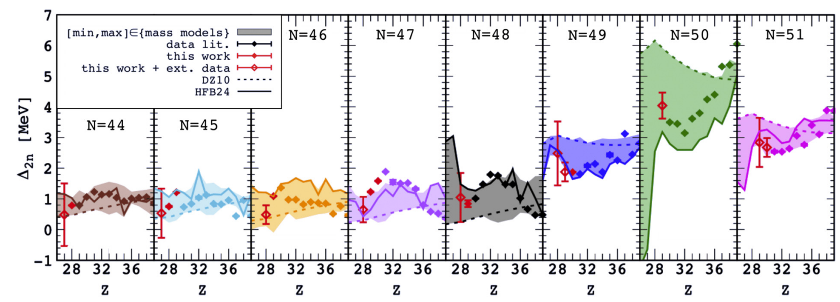
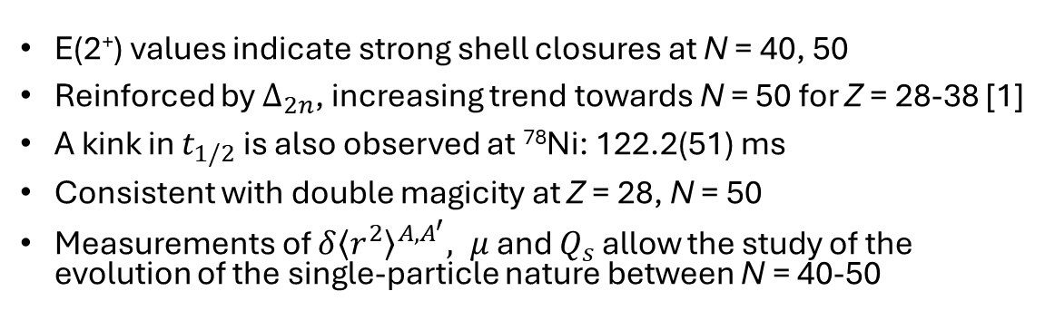
Back-up:
Doubly magic ⁷⁸Ni
[1] S. Giraud Mass measurements towards doubly magic 78ni: Hydrodynamics versus nuclear mass contribution in core-collapse supernovae. Physics Letters B, 833:137309, 07 2022.
2.6 MeV!
E(2⁺) values indicate strong shell closures at N = 40, 50
Reinforced by $∆_{2n}$, increasing trend towards N = 50 for Z = 28-38 [1]
A kink in $t_{1/2}$ is also observed at ⁷⁸Ni: 122.2(51) ms
Consistent with double magicity at Z = 28, N = 50
Measurements of ${δ\left\langle r^{2}\right\rangle }^{A, A^{′}}, μ$ and $Q_{s}$ allow the study of the evolution of the single-particle nature between N = 40-50

Slide 15
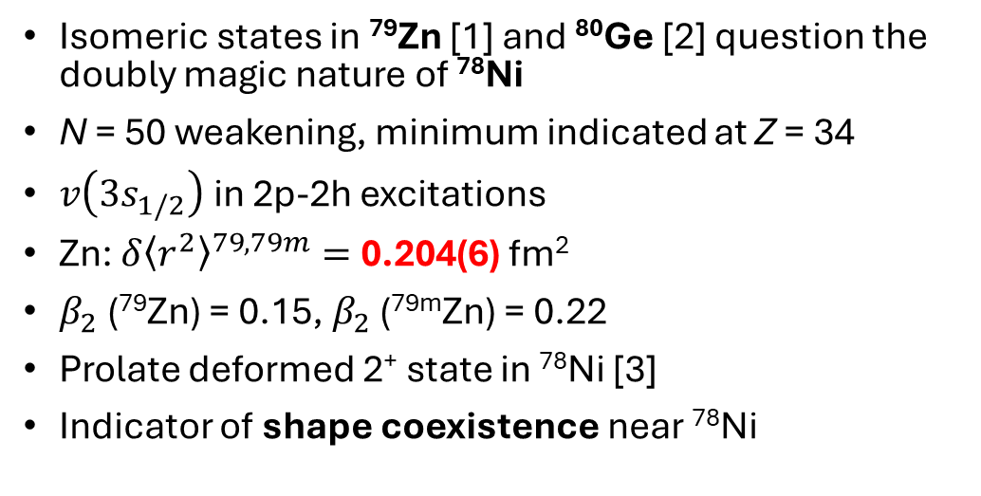
Back-up:
Shape Coexistence near ⁷⁸Ni
Isomeric states in ⁷⁹Zn [1] and ⁸⁰Ge [2] question the doubly magic nature of ⁷⁸Ni
N = 50 weakening, minimum indicated at Z = 34
$v\left(3s_{1/2}\right)$ in 2p-2h excitations
Zn: ${δ\left\langle r^{2}\right\rangle }^{79, 79m}=$ 0.204(6) fm²
$β_{2}$ (⁷⁹Zn) = 0.15, $β_{2}$ (^{79m}Zn) = 0.22
Prolate deformed 2⁺ state in ⁷⁸Ni [3]
Indicator of shape coexistence near ⁷⁸Ni
[1] X. F. Yang Isomer Shift andMagnetic Moment of the Long-Lived 1/2+ Isomer in 3079Zn49: Signature of ShapeCoexistence near 78Ni. Physical Review Letters, 116(18):182502, 5 2016.
[2] A. Gottardo irst Evidence of Shape Coexistence in the Ni 78 Region:Intruder 02+ State in Ge 80. Physical Review Letters, 116(18), 5 2016.
[3] R. Taniuchi et al., ⁷⁸Ni revealed as a doubly magic stronghold against nuclear deformation. Nature, 569(7754):53–58, 5 2019.
Notes:
Combine 3 and 4 ad reduce, move to back up

Slide 16
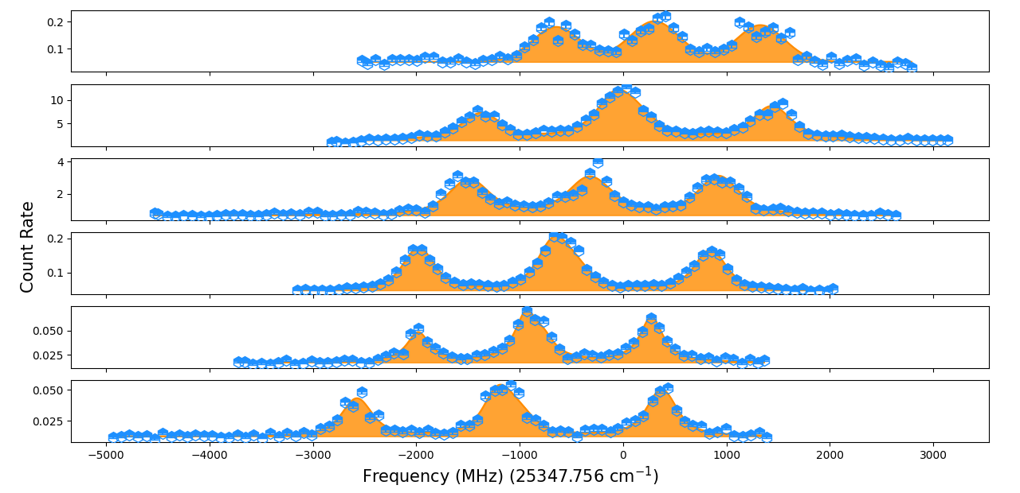
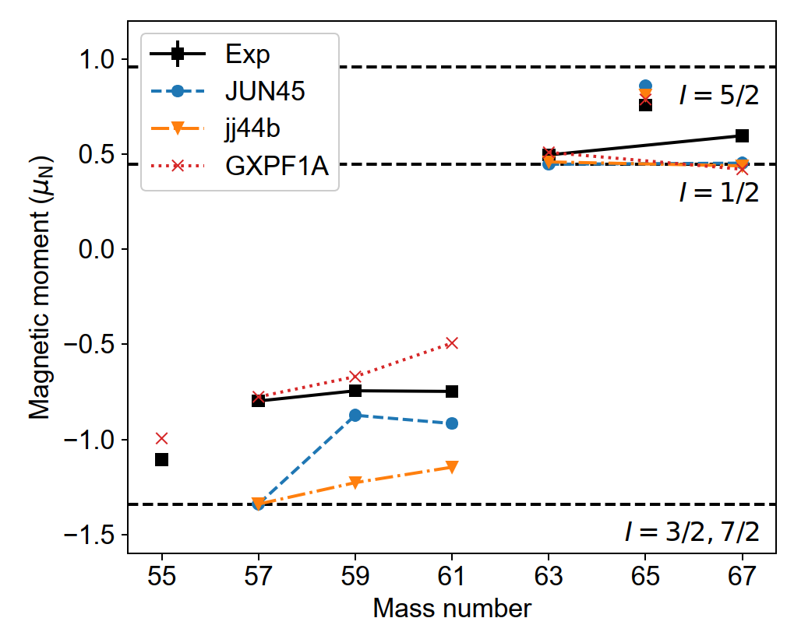
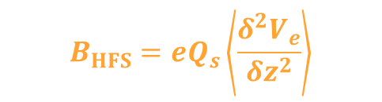
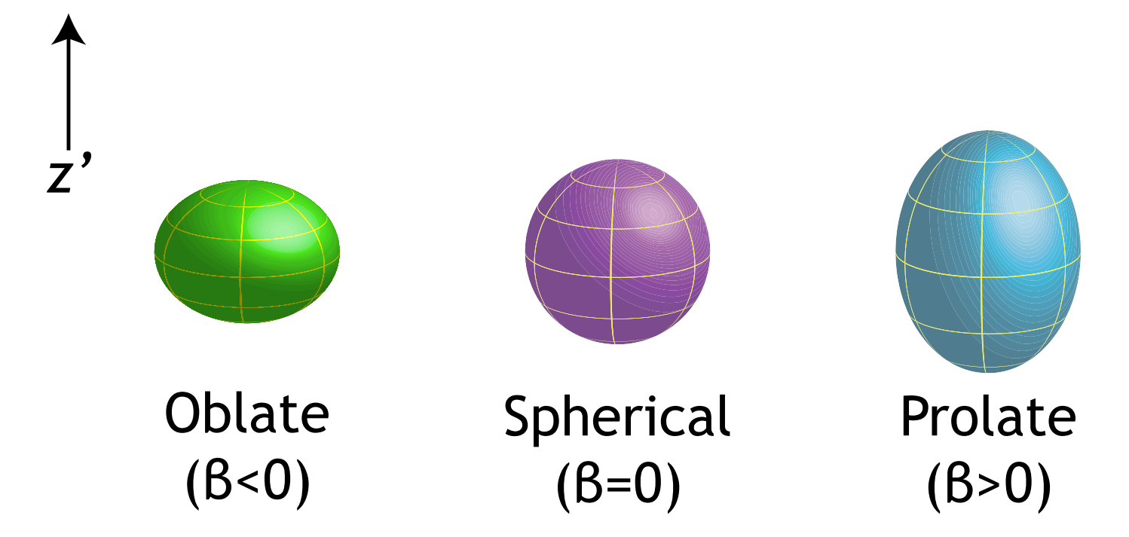



Back-up: Laser Spectroscopy
Laser spectroscopy provides access to:
Nuclear spin ($I$)
Magnetic dipole moment ($μ$)
Electric quadrupole moment ($Q_{s}$)
Change in mean-square charge radii (${δ\left\langle r^{2}\right\rangle }^{A,A^{′}}$)
$$A_{HFS}= \frac{μ B_{e}(0)}{IJ}$$
$$B_{HFS}=eQ_{s}\left\langle \frac{δ^{2}V_{e}}{{δz}^{2}}\right\rangle$$
$${δv}^{A, A^{′}}=F{δ\left\langle r^{2}\right\rangle }^{A,A^{′}}+ μ^{A, A^{′}}M$$

Slide 17
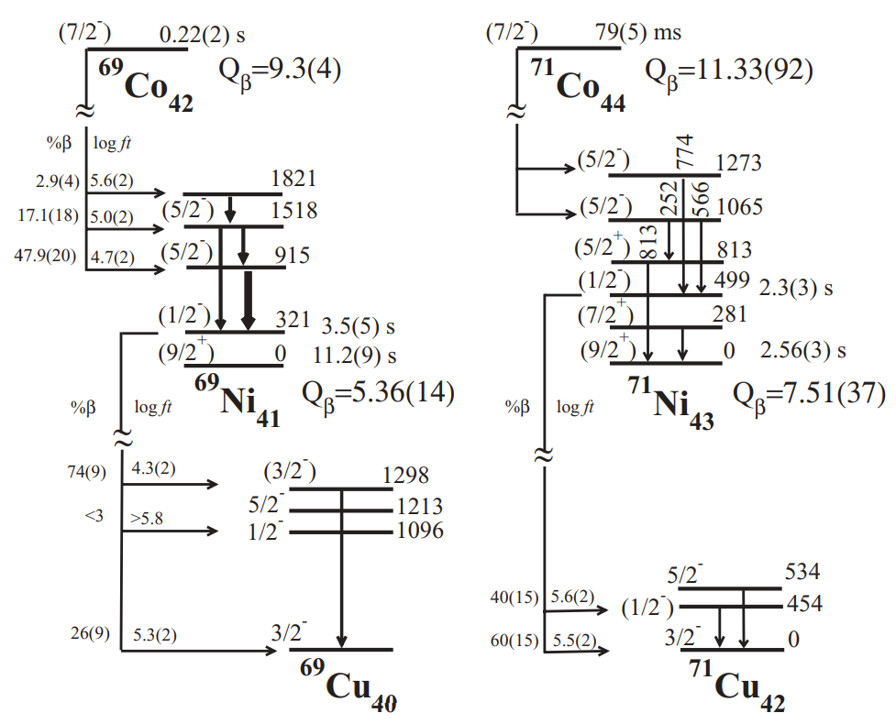

Back-up: ^{69m}Ni and ^{71m}Ni
Discovery of ^{69m, 71m}Ni
Decay paths in Cu populate states with varying characteristics
1298 keV transition in ⁶⁹Cu has a B(E2) value of 1.4 W.u
454 keV transition in ⁷⁰Cu has a B(E2) value of 20.4(22)
Increasing population of the $g_{9/2}$ orbital
${δ\left\langle r^{2}\right\rangle }^{A,A^{′}}$ and $μ$ would provide insight into the level of deformation compared to G.S. and make critical information about the configuration mixing

Slide 18



Back-up: ${9/2}^{−}$ and ${1/2}^{−}$level inversion
Occupation across the Z = 28 closure corresponds to an enhancement in the charge radii
$I$(^{71, 73}Zn) = ${1/2}^{−}$
$I$(^{71m}Zn) = ${9/2}^{−}$
Fig from [1]
[1] L. Xie et al., Nuclear charge radii of 62-80zn and their dependence on cross-shell protonexcitations. Physics Letters B, 797:134805, 2019.

Slide 19


Back-up Slides
LEFT: ⁶⁹Ni
RIGHT: ^{69m}Ni

Slide 20


Back-up Slides
LEFT: ⁷¹Ni
RIGHT: ^{71m}Ni

Slide 21


Back-up Slides
COLLAPS $μ$ values

Slide 22


Back-up Slides
Efficiency
$γ$ – efficiency curve from recent Hg (Oct 2024) run at IDS
Energy (keV)

Slide 23
Back-up Slides
Simulated Spectrum

