Slide 1
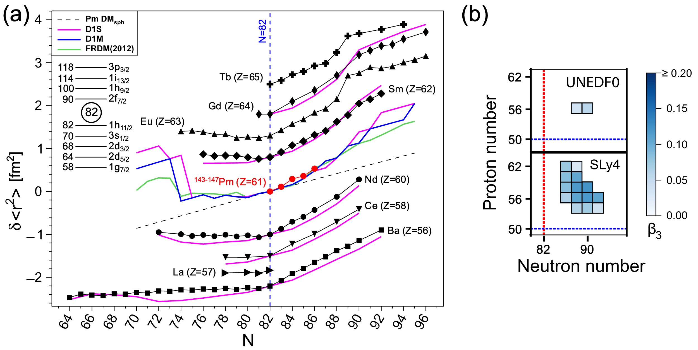
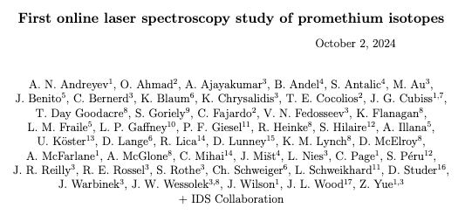
First online laser spectroscopy study of promethium isotopes

Slide 2
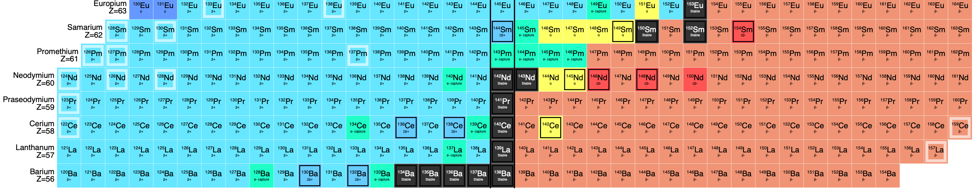
Why Pm?
Lanthanides are interesting region influenced by shell and subshell closures
Pm is one of the least known isotopic chains of the lanthanides
Nuclear spin & moments across the chain largely unknown or uncertain
Magnetic and quadrupole moments only known for long-lived ^{143-149,151}Pm
Q and µ for crucial isotopes (e.g. ¹⁵¹Pm (N = 90)) measured but with large uncertainties
N-deficient Eu, Sm, Nd show strong deviation from sphericity → what happens with Pm?
Two regions of deformation (N<76 and N>88) expected for Pm with different pattern of shape transition
possible to study with (high resolution) laser spectroscopy!

Slide 3
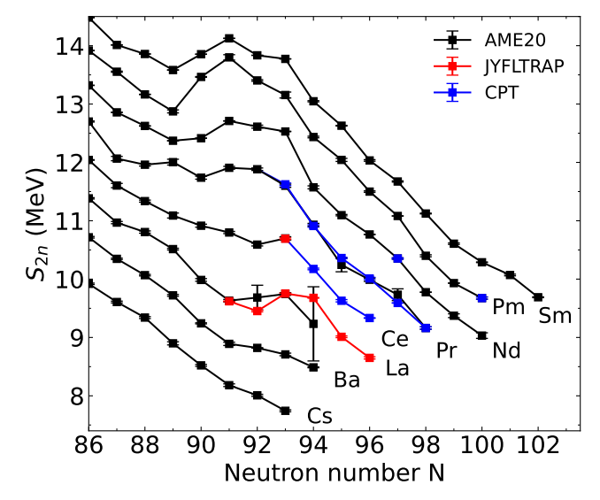
Physics case(s) – n-rich N > 85 (¹⁴⁶⁻¹⁵³Pm)
1.) N = 90 shape transition:
transition between spherical and deformed shapes has observed Z dependence (presumably due to p-subshell closure Z = 64)
Pm isotopes lie directly on the border between smooth, weak transitions observed for Z = 56, 58 and 60, and a larger jump-like change for Z = 62 − 67
HFB calculations with D1S perform well for the trend predictions
Benchmark theory with measurements
FRDM calculations predict a “smoother” transition
S_{2n} values for Pm isotope show a large “jump” at N=90
Indicative of sudden structural change in ground state
→ investigate what Q, µ and δ⟨r²⟩ look like
Jaries et al., arXiv:240806221v1 (2024)

Slide 4
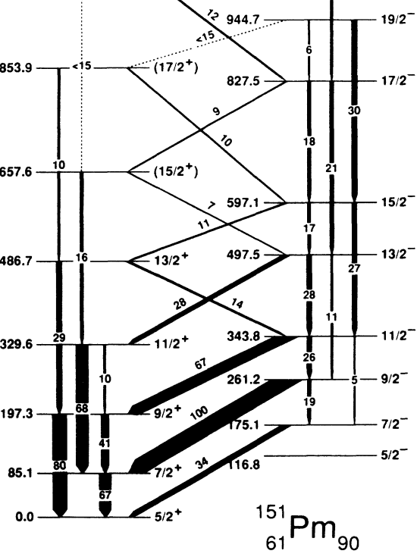
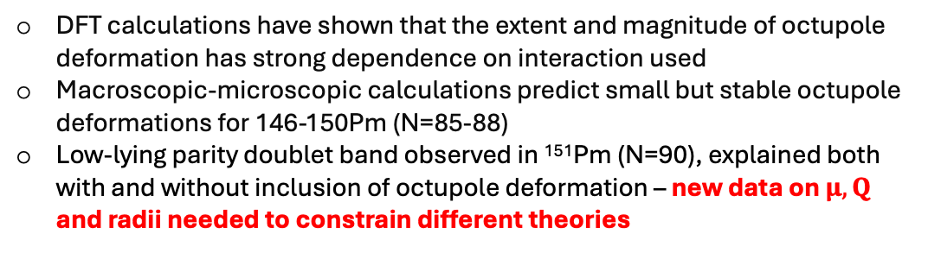
Physics case(s) – n-rich N > 85 (¹⁴⁶⁻¹⁵³Pm)
2.) Octupole collectivity
Typical experimental signatures: near- degenerate, parity-doublet rotational bands, enhanced transition strengths [B(E3)s and B(E1)s]
Complementary evidence can be found in μ and δ⟨r²⟩ values:
e.g. inverted odd-even staggering and mixing of states with different intrinsic parities
DFT calculations have shown that the extent and magnitude of octupole deformation has strong dependence on interaction used
Macroscopic-microscopic calculations predict small but stable octupole deformations for 146-150Pm (N=85-88)
Low-lying parity doublet band observed in ¹⁵¹Pm (N=90), explained both with and without inclusion of octupole deformation – new data on $μ, Q$ and radii needed to constrain different theories
Vermeer et al. Phys. Rev. C 42, R1183(R) 1990

Slide 5
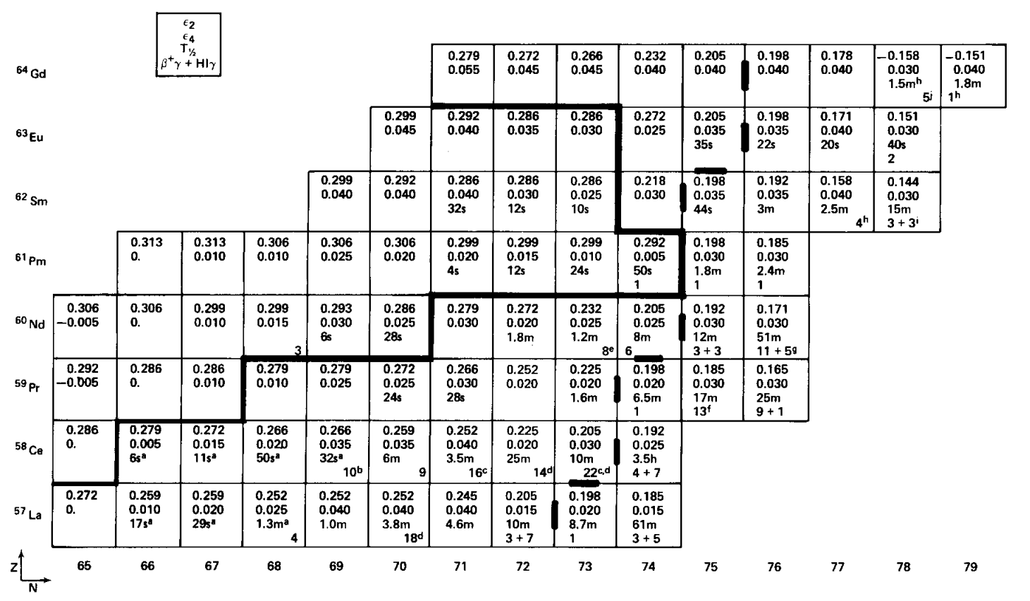
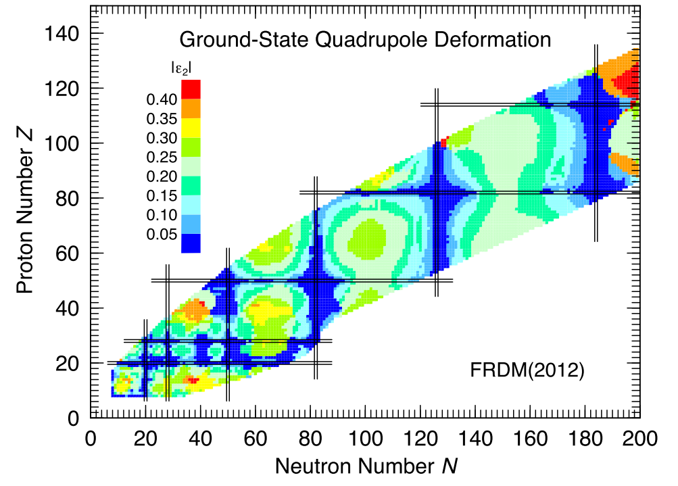
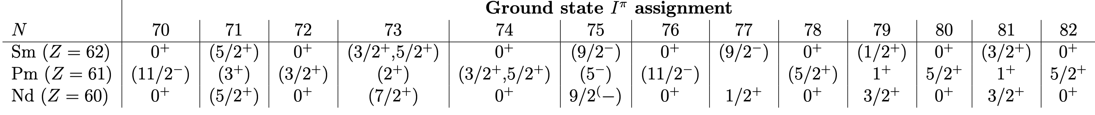
Physics case(s) – n-deficient isotopes N < 75
1.) N<75 shape transition:
long-standing predictions for strongly-deformed region in the very light lanthanide isotopes BUT: modern FRDM and HFB codes also predict a dramatic shape transition
Leander, Möller, Phys.Lett.110(1) (1982)
Möller et al., ADT 109-110 (2015)
deformed shell model calculations indicate large and sudden jump in deformation close to proton drip line (strongly pronounced in N = 74 and 75 in the Pm chain)
available δ⟨r2⟩ and Q data (Sm, Eu, Nd isotopes) limited to moderately deformed cases with observed smooth onset of deformation
2.) Triaxiality
nuclei with A = 130 − 140 are known for exhibiting properties associated with triaxial degrees of freedom (e.g. Ce & Sm)
ground state I^{π}, μ and Q values are sensitive to the degree of triaxiality
present I^{π} assignments for the neutron-deficient Pm isotopes are uncertain: primarily based on either systematics from neighbouring nuclei, or β- decay feeding patterns to states in Nd daughters
I^{π} = 3/2⁺
I^{π} = 5/2⁺
I^{π} = 7/2⁺
Compare character of shape transitions for both regions in Pm

Slide 6
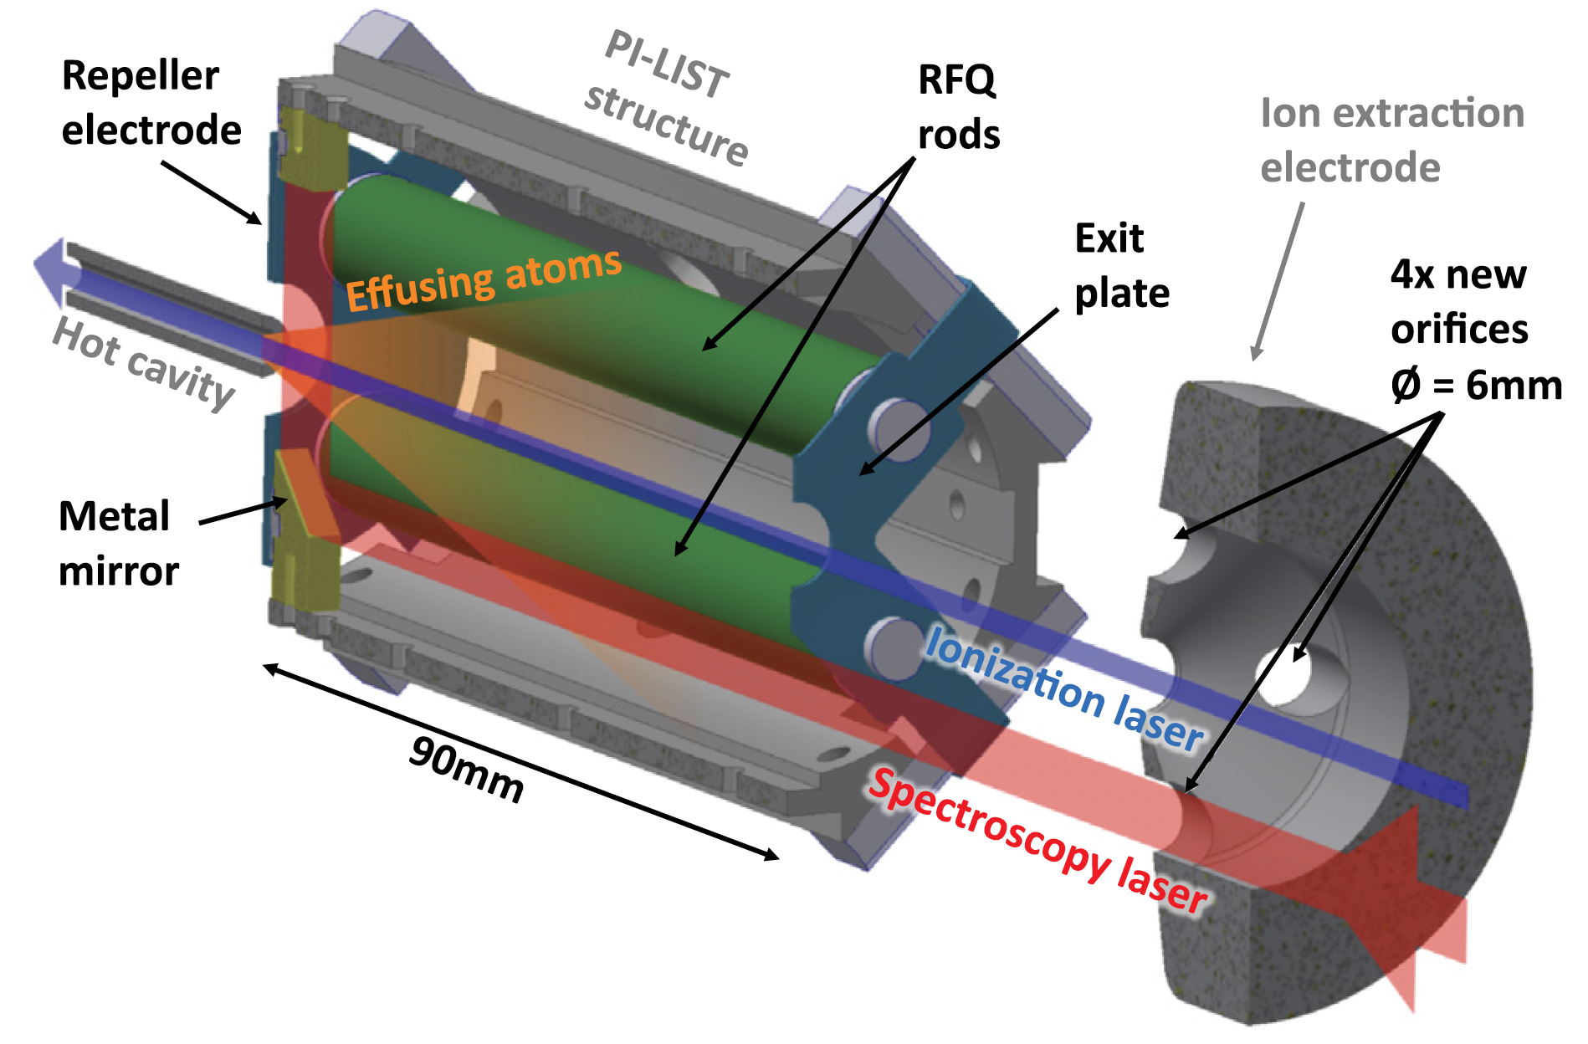
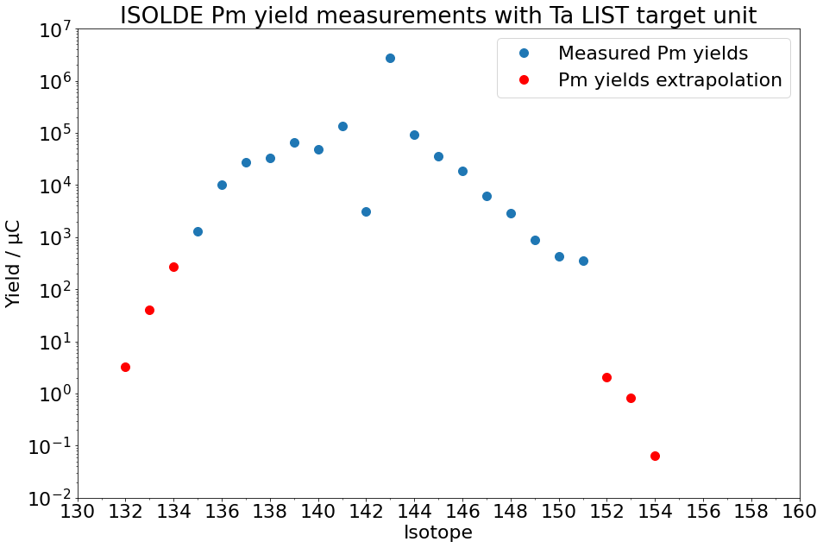
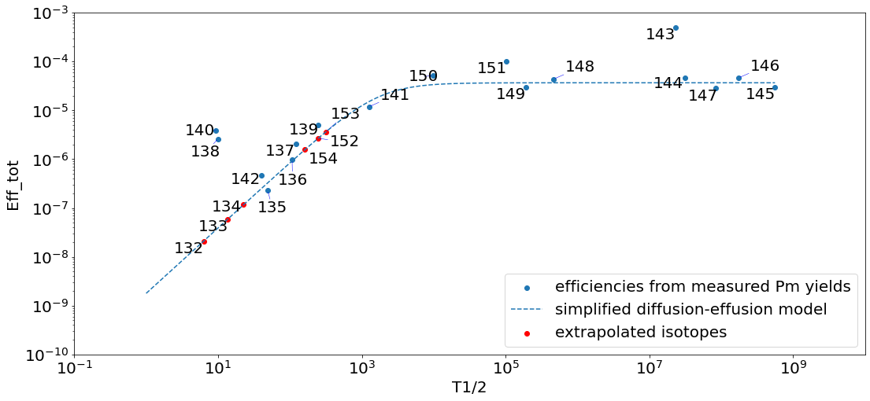
Production
https://doi.org/10.1016/j.nimb.2023.04.057
Best method to decrease the isobaric contamination using a LIST → suppress surface ions and laser ionize outside the hot cavity
Detection with Farday cups and MagneToF (time structure and laser on/off for element identification)
During LOI246 (“Yield measurements for lanthanide elements with Ta-foil target and a LIST ion source”) yields for 3 lanthanides were measured: Dy, Pm, Tm
Measured yields and extrapolation with diffusion-effusion model for Tm has been validated in 2024
we expect Pm extrapolation to be reliable
Possible deterioration of Ta-foils not seen as hindrance for any of the proposed isotopes: Release of Pm is slow (~5min) → only problematic for short-lived isotopes which can be measured at the start of the run

Slide 7
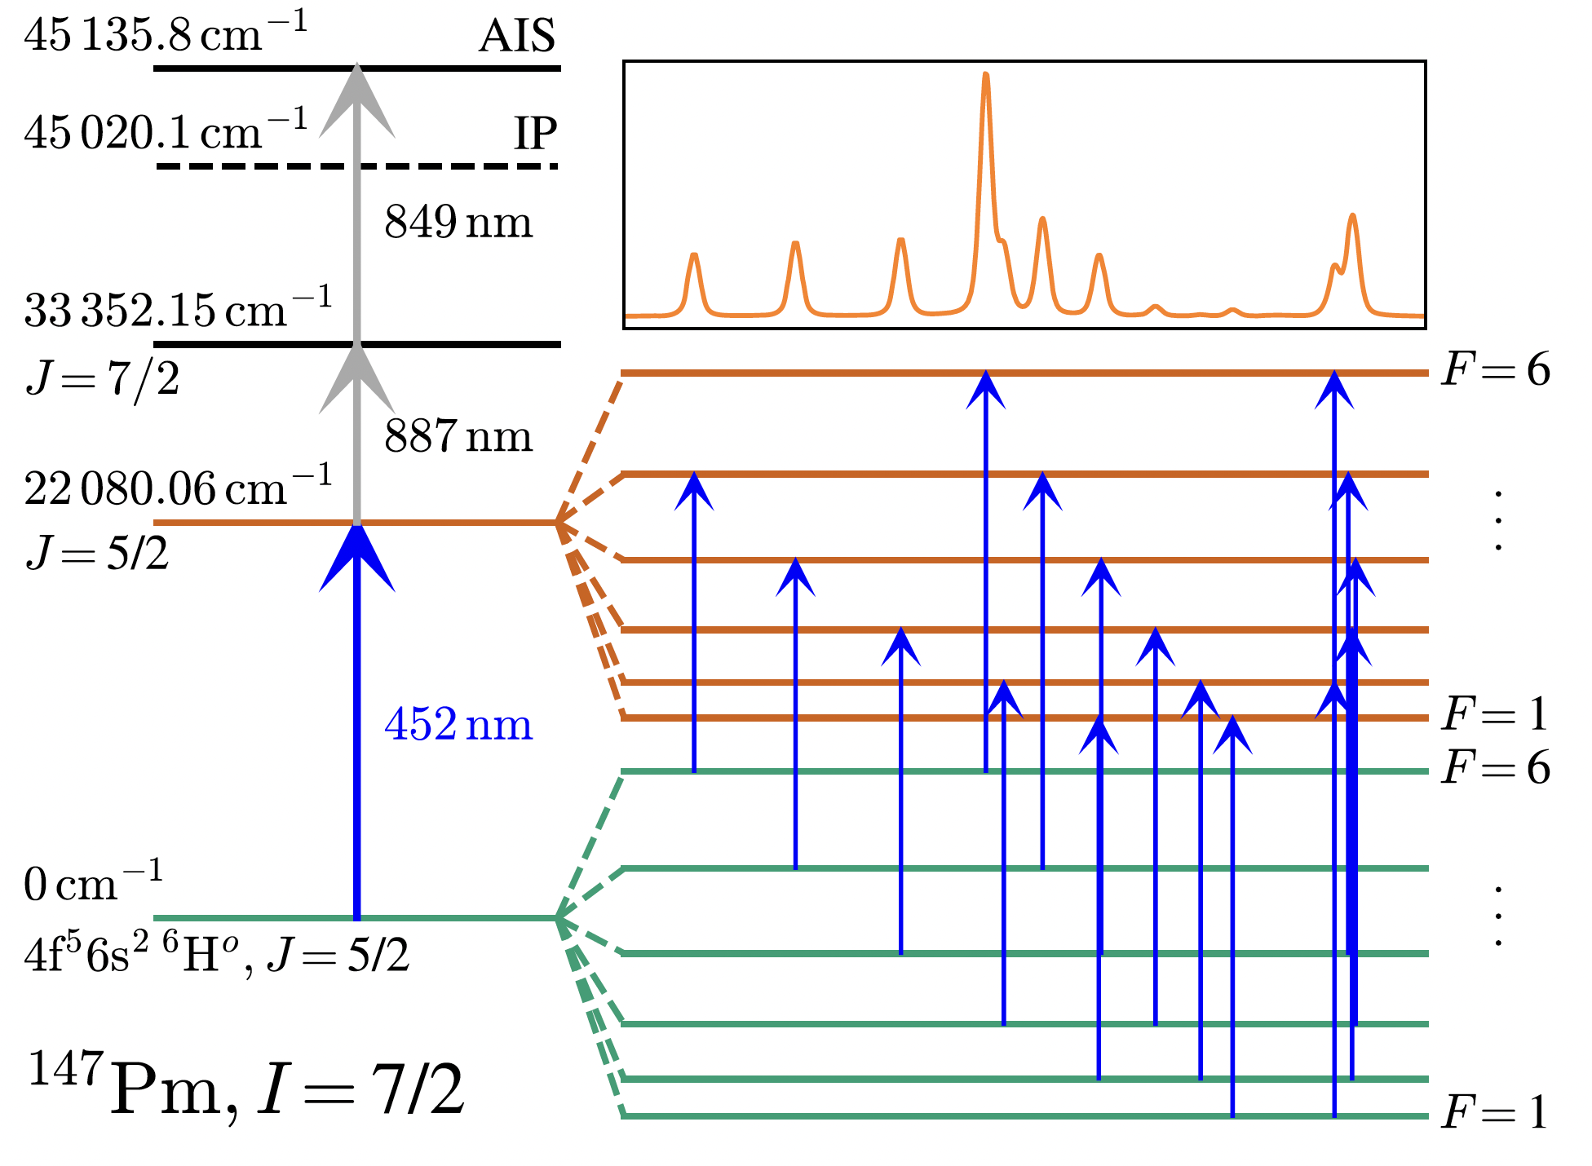
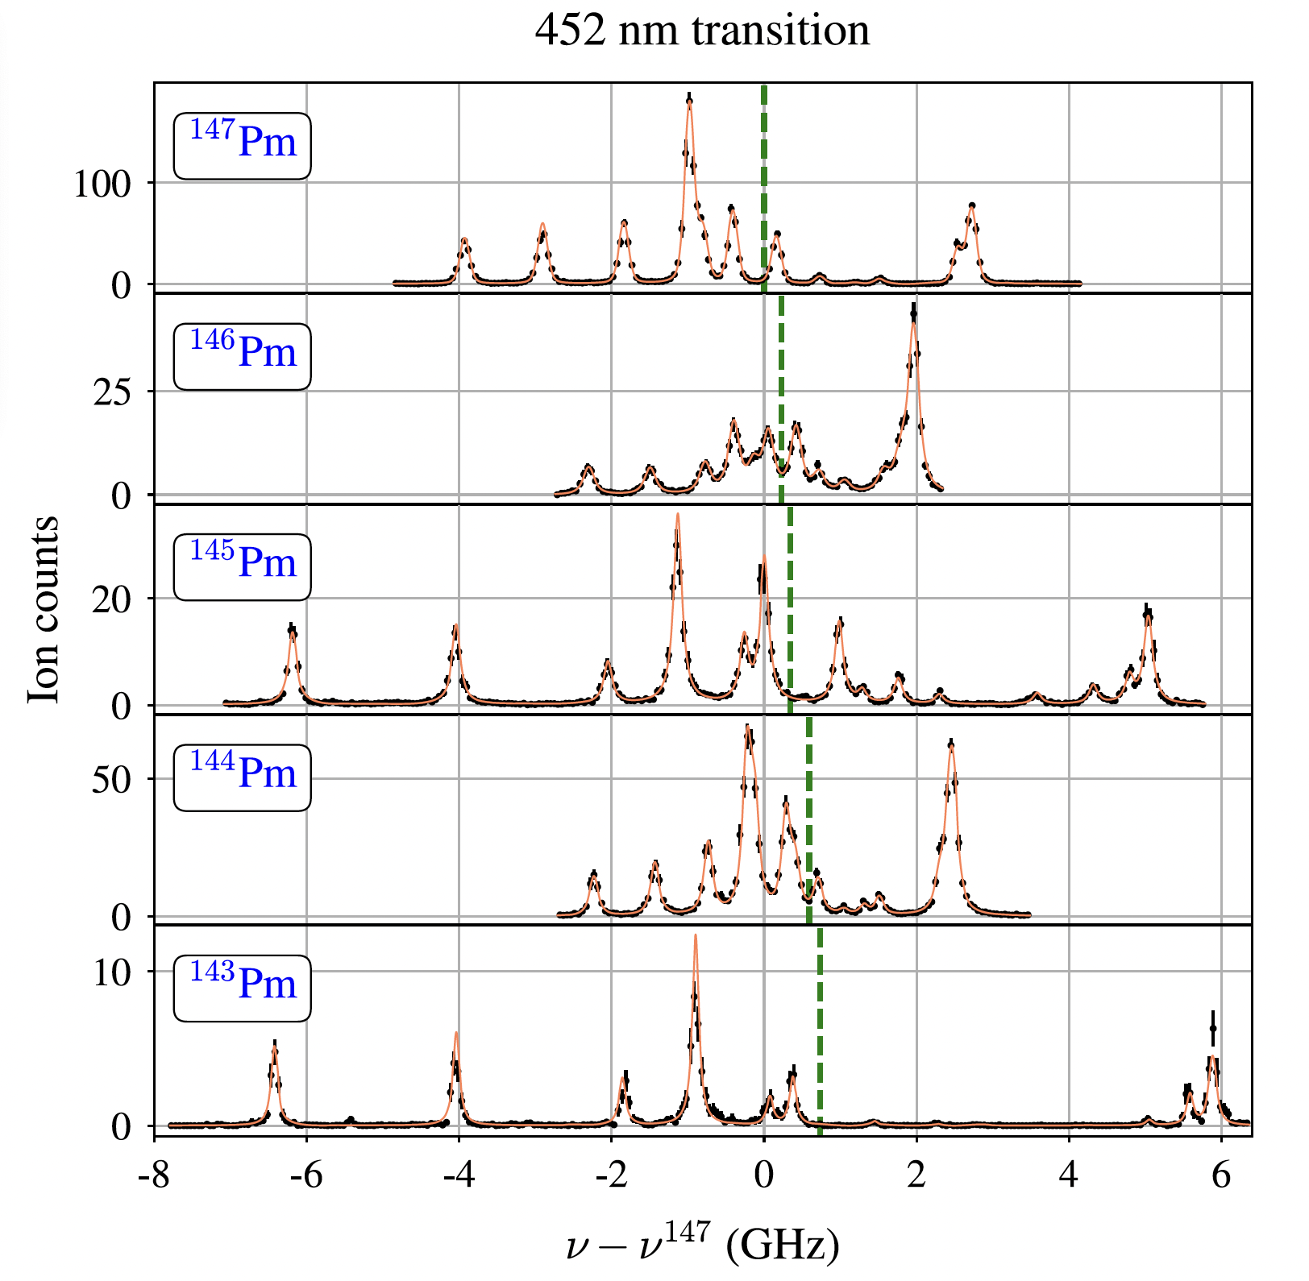
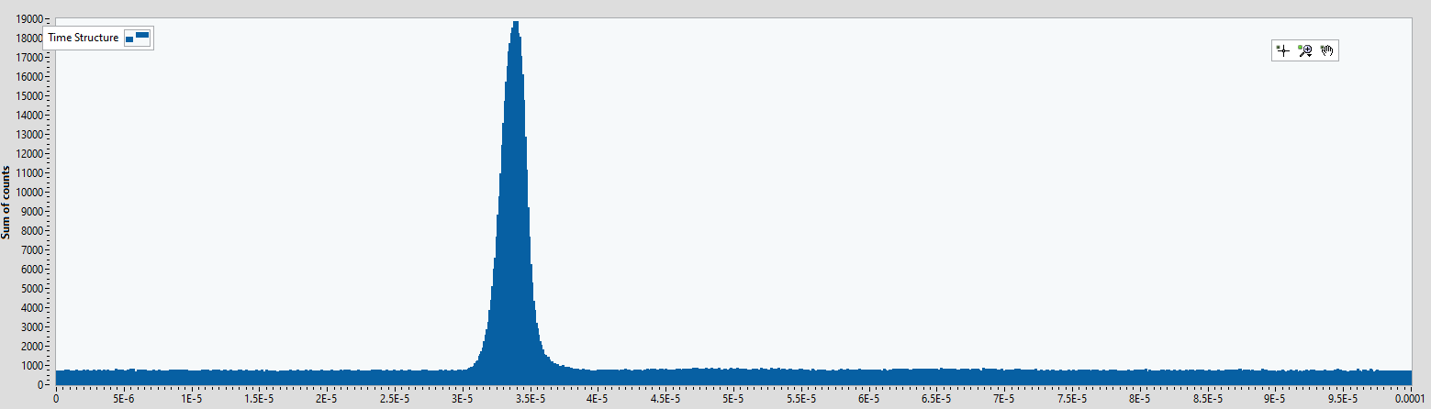
Laser spectroscopy
D. Studer et al, Eur. Phys. J. A (2020) 56:69
Laser spectroscopy is well established for IS and HFS measurements
extraction of nuclear parameters
¹³²⁻¹⁵³Pm HFS and IS using same technique as applied in standard in-source laser spectroscopy runs (IDS, ISOLTRAP & RILIS collab)
Choice of detection according to purity of the beam and presence of known isomers
Known laser scheme(s) from D. Studer et al.
¹⁴⁵Pm laser ion time structure in PI-LIST geometry → Clean & strong signal

Slide 8
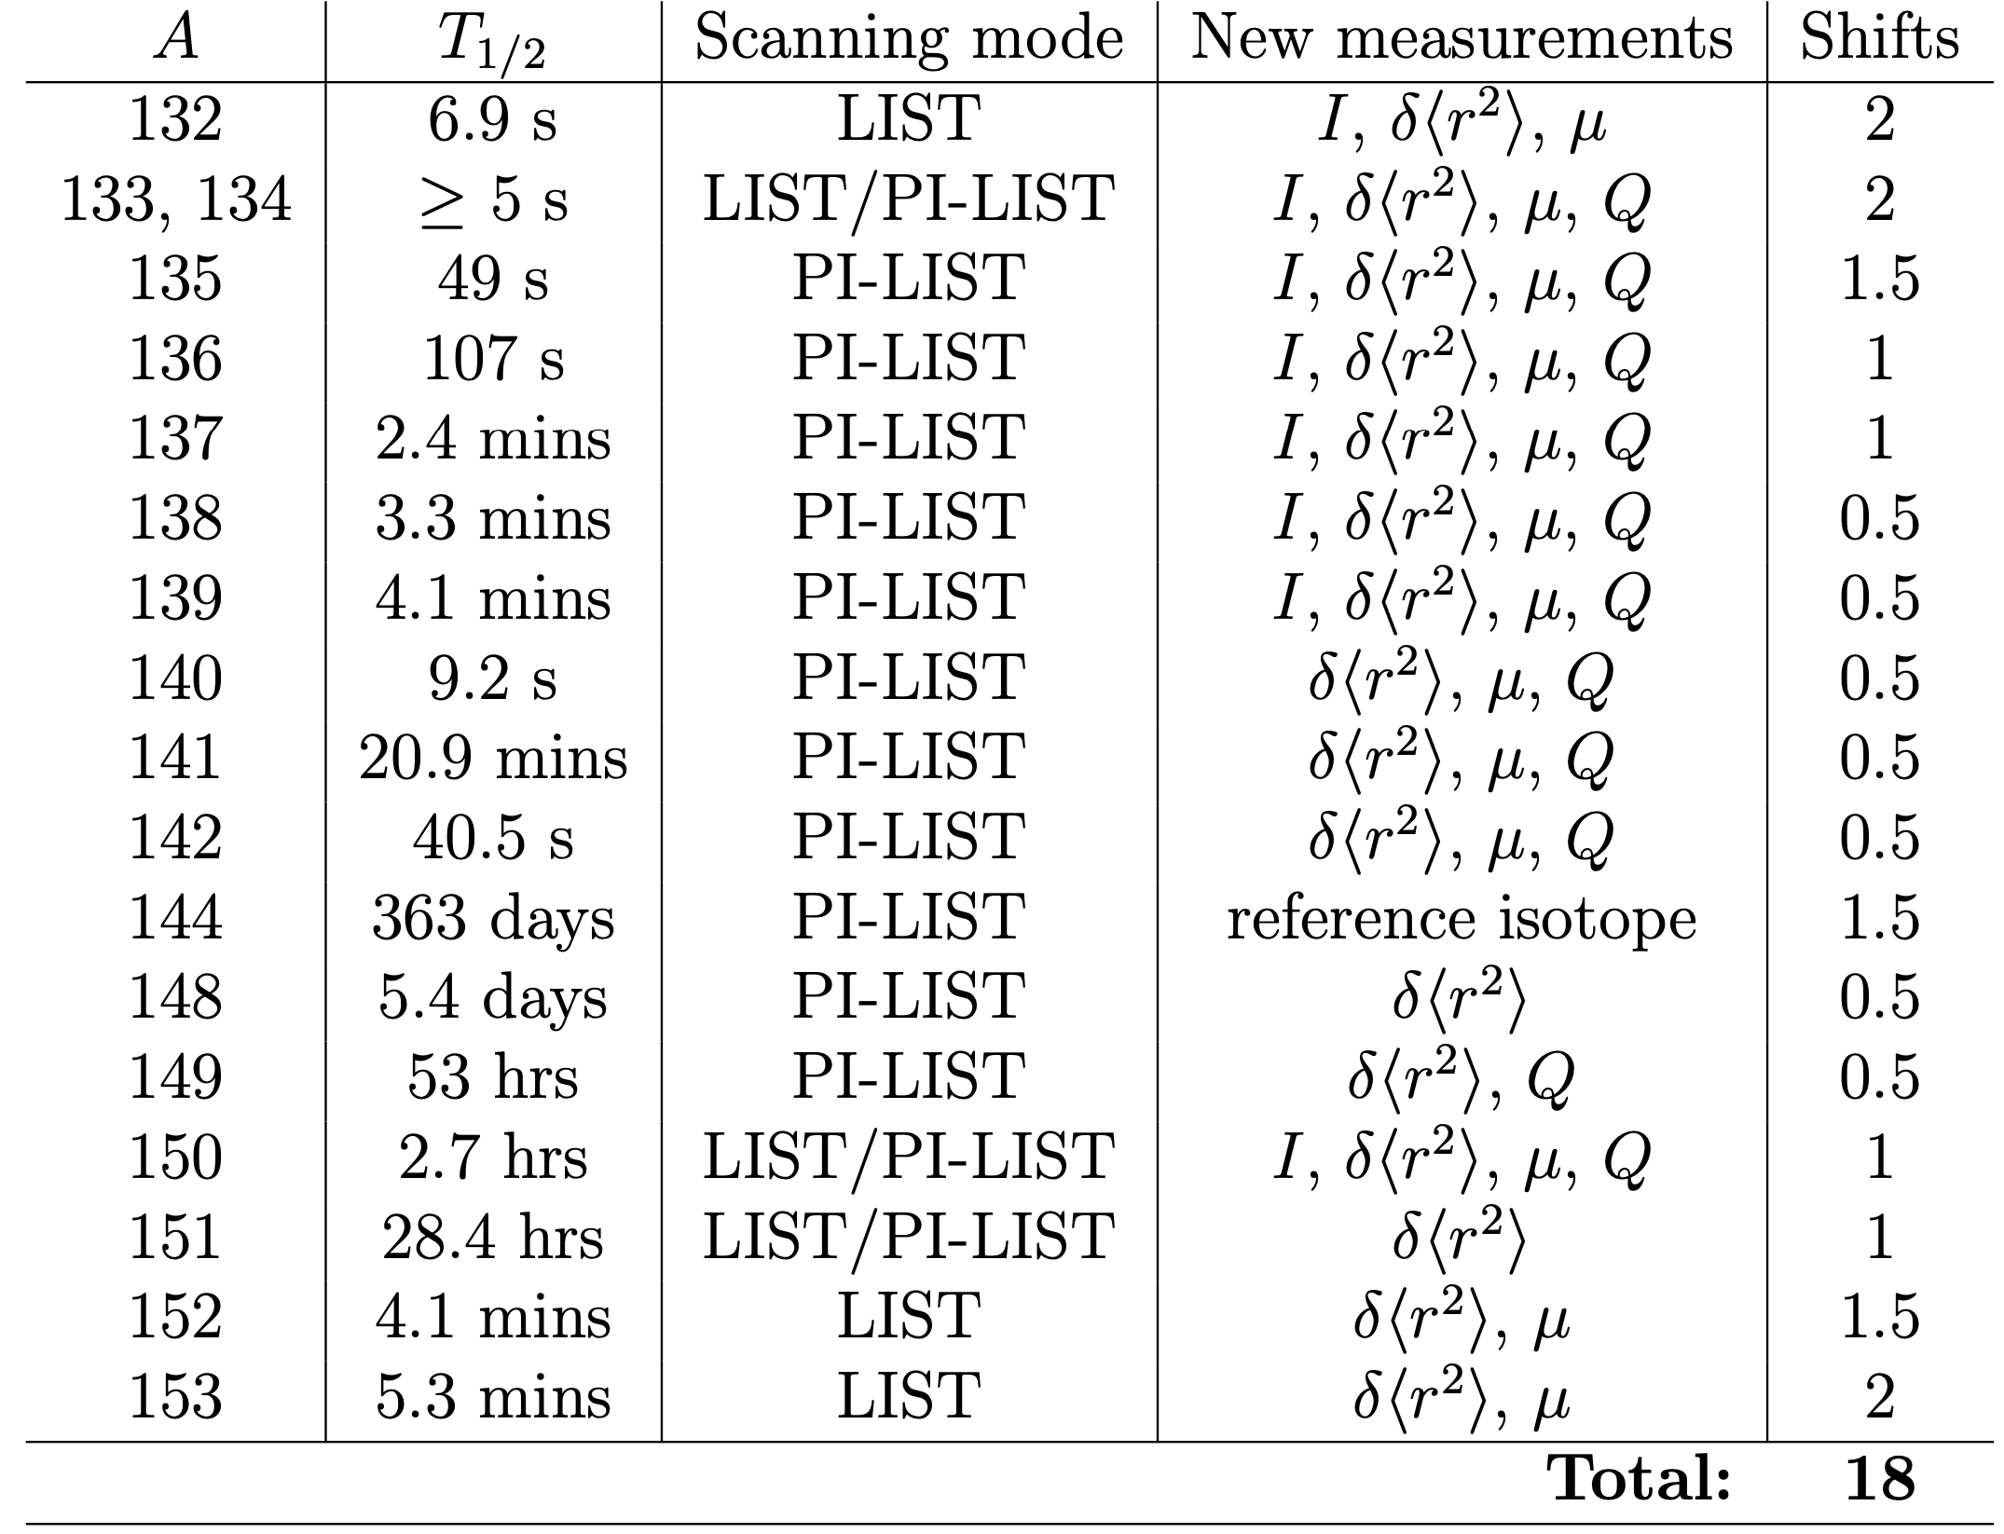
Summary
Pm is one of the least studied lanthanides
Many fundamental properties are not yet known
Measured yields from LOI246 known and used to determine feasibility of HFS scans with PI-LIST
Longstanding predictions for shape transitions both in N-rich and -deficient isotopes
Benchmark theory by measuring the trends
Atomic theory support: in contact with theory who are willing to perform calculations for the transitions we will scan
Nuclear theory support: Paris-Saclay+Brussels group have agreed to make dedicated calculations in support of experimental work
Jaries et al., arXiv:240806221v1 (2024)

Slide 9
Backup slides

Slide 10
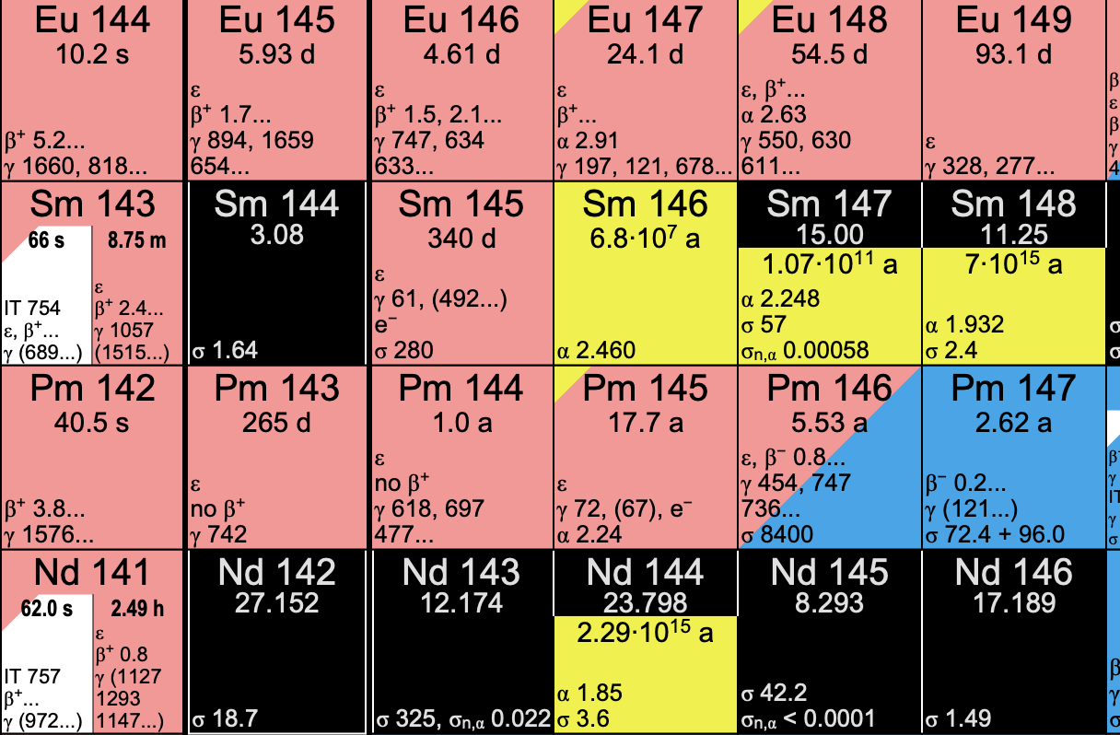
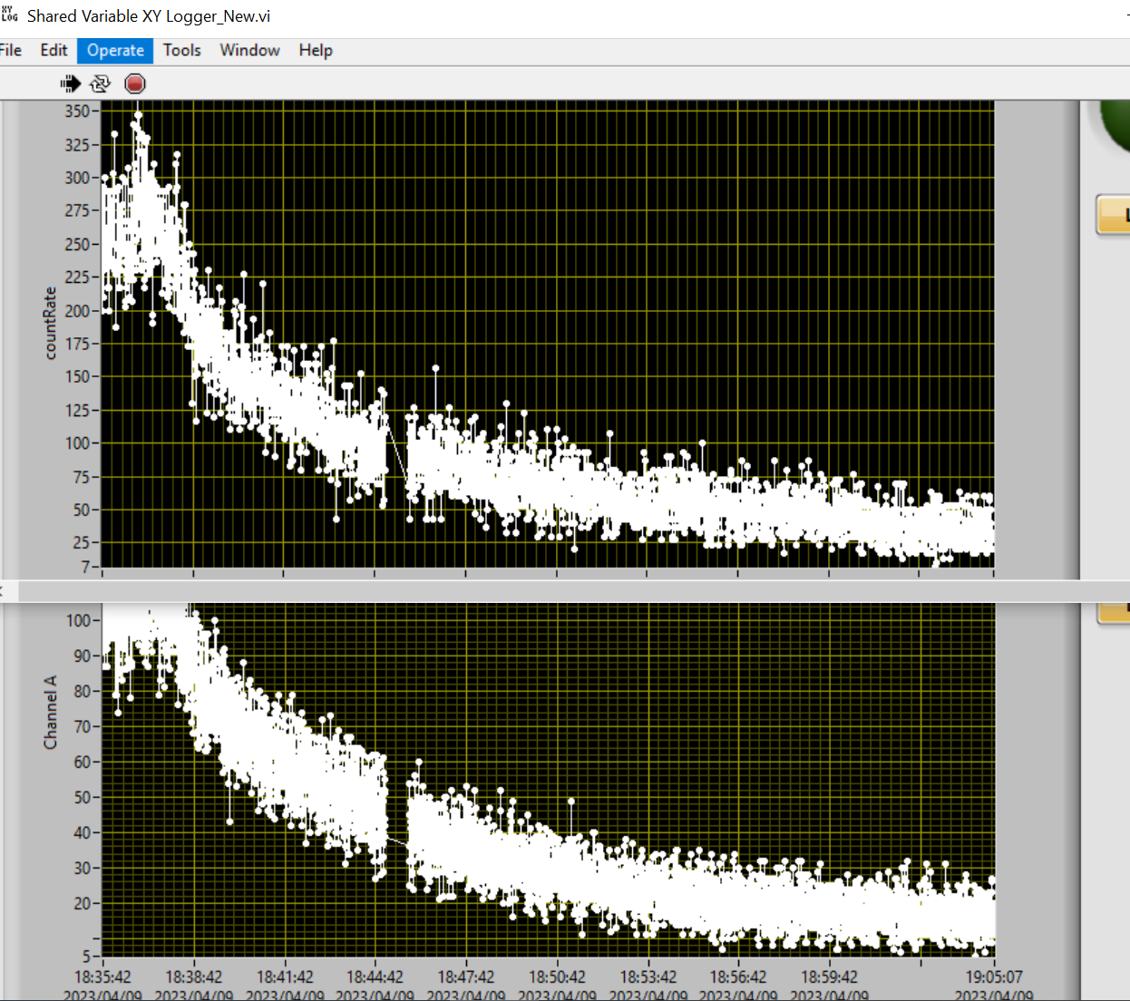
release

