Slide 1
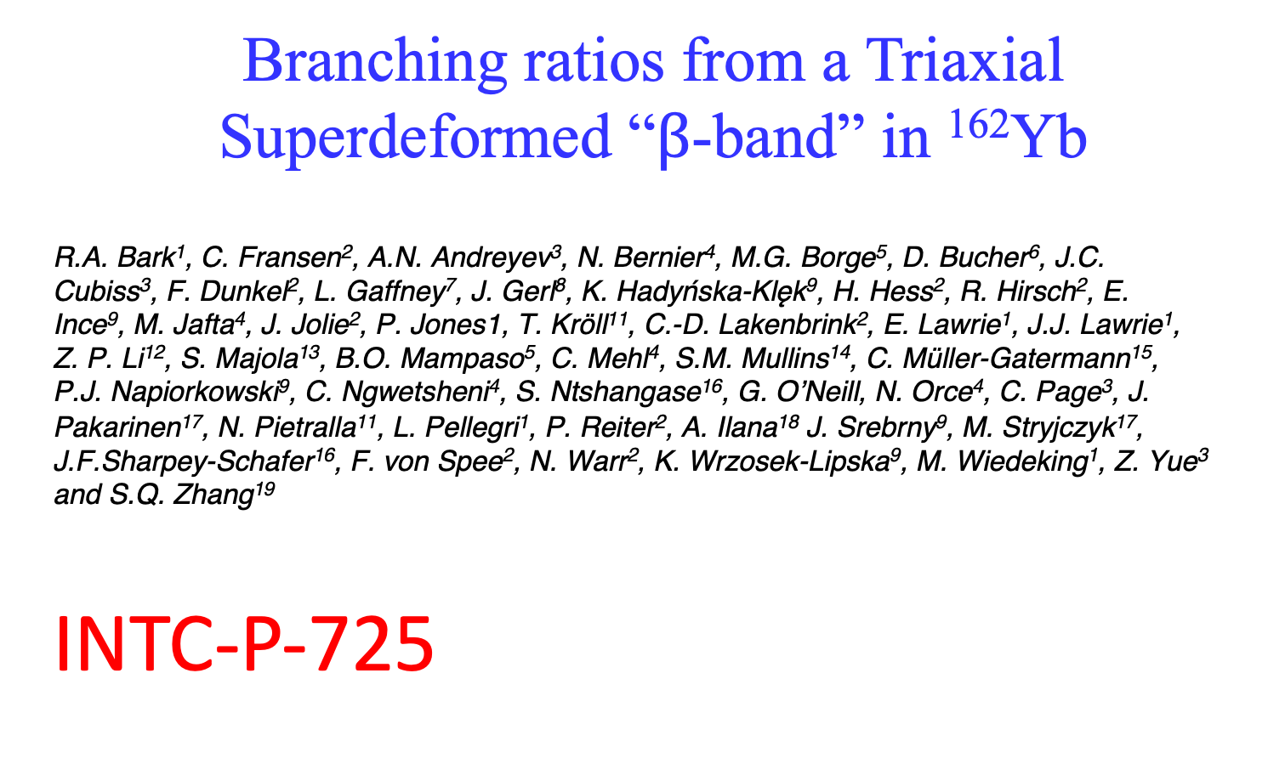
Branching ratios from a Triaxial Superdeformed “$β$-band” in ¹⁶²Yb
R.A. Bark¹, C. Fransen², A.N. Andreyev³, N. Bernier⁴, M.G. Borge⁵, D. Bucher⁶, J.C.
Cubiss³, F. Dunkel², L. Gaffney⁷, J. Gerl⁸, K. Hadyńska-Klęk⁹, H. Hess², R. Hirsch², E.
Ince⁹, M. Jafta⁴, J. Jolie², P. Jones1, T. Kröll¹¹, C.-D. Lakenbrink², E. Lawrie¹, J.J. Lawrie¹,
Z. P. Li¹², S. Majola¹³, B.O. Mampaso⁵, C. Mehl⁴, S.M. Mullins¹⁴, C. Müller-Gatermann¹⁵,
P.J. Napiorkowski⁹, C. Ngwetsheni⁴, S. Ntshangase¹⁶, G. O’Neill, N. Orce⁴, C. Page³, J.
Pakarinen¹⁷, N. Pietralla¹¹, L. Pellegri¹, P. Reiter², A. Ilana¹⁸ J. Srebrny⁹, M. Stryjczyk¹⁷, J.F.Sharpey-Schafer¹⁶, F. von Spee², N. Warr², K. Wrzosek-Lipska⁹, M. Wiedeking¹, Z. Yue³
and S.Q. Zhang¹⁹
INTC-P-725

Slide 2
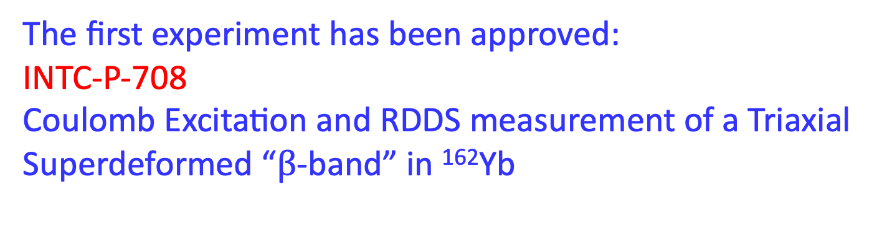
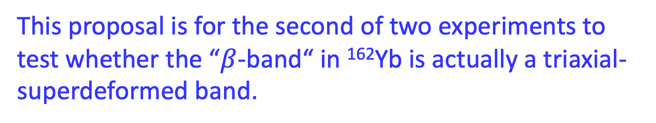
This proposal is for the second of two experiments to test whether the “$β$-band“ in ¹⁶²Yb is actually a triaxial-superdeformed band.
The first experiment has been approved:
INTC-P-708
Coulomb Excitation and RDDS measurement of a Triaxial Superdeformed “$β$-band” in ¹⁶²Yb

Slide 3
Physics Motivation:
Studying the origin of 0₂⁺ bands in mass 160 region
β vibrations?
shape coexistence?
“pairing isomers” – “second vacuum”?
X(5)….?

Slide 4
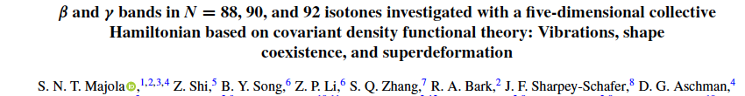
Energy Systematics
ground band
β band
γ band
0₃⁺ band
S-band
γ-band almost always parallel to ground band
β-band not always
parallel, especially in
Er and Yb nuclei
N=90
N=88
N=92

Slide 5
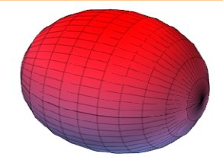
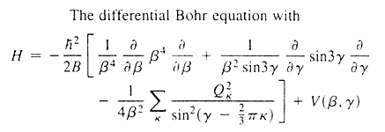
The vibrating nucleus
Vibrating Liquid drop
The Bohr Hamiltonian
T_{vib}
T_{rot}

Slide 6
In reality:
Complicated Potential Energy Surfaces
The Bohr Hamiltonian
T_{vib}
T_{rot}

Slide 7

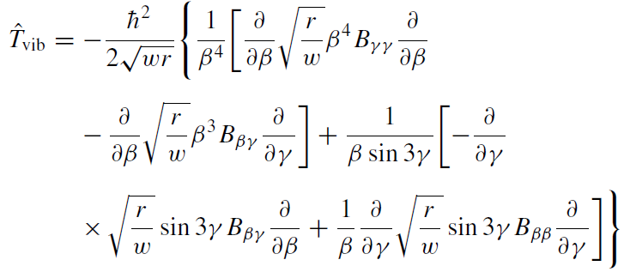
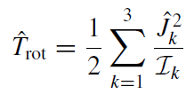
Re-cast Bohr Hamiltonian: 5 Dimensional Collective
Hamiltonian
Need to determine I’s, B’s
T. Niksic et al PRC 79, 034303 (2009)
Z.P. Li et al., PRC 79, 054301 (2009)

Slide 8
N=92
Calculated Energies
(lines) compared to experiment (points)
ground band
β band
γ band
0₃⁺ band

Slide 9
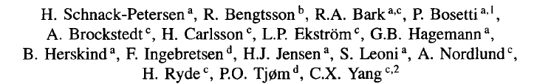
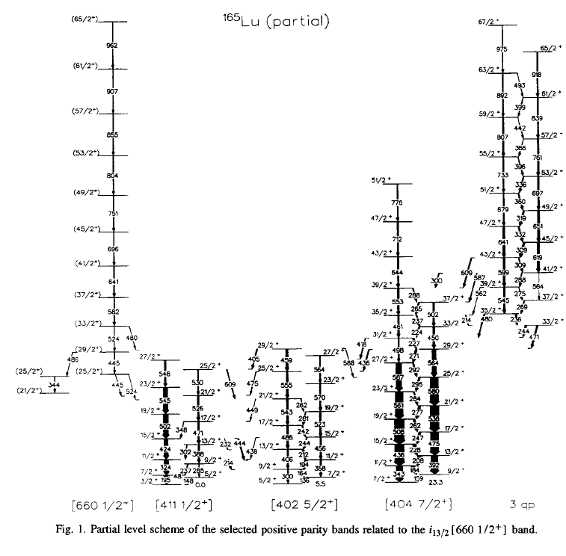
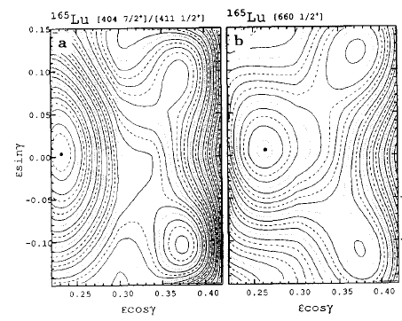

Slide 10
In-band
B(E2)s
ground
band
(theory)
ground
band (exp)
0₂⁺
band
(theory)
0₂⁺
band (exp)

Slide 11
Branching Ratios β-band
β-band B(E2) branching ratios: out/in
I
in
out
I-2
β
I-2
g

Slide 13
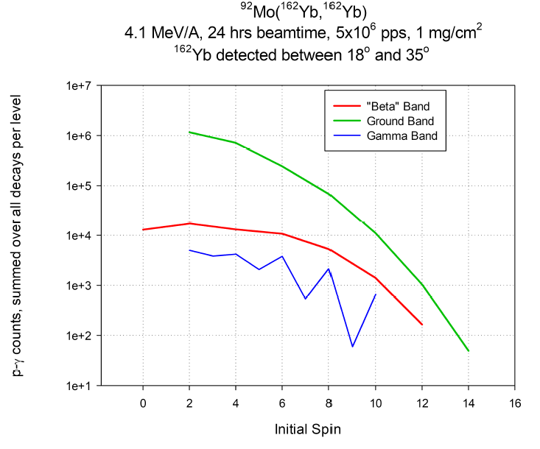
GOSIA Calculation: Coulomb Excitation of ¹⁶²Yb

Slide 14
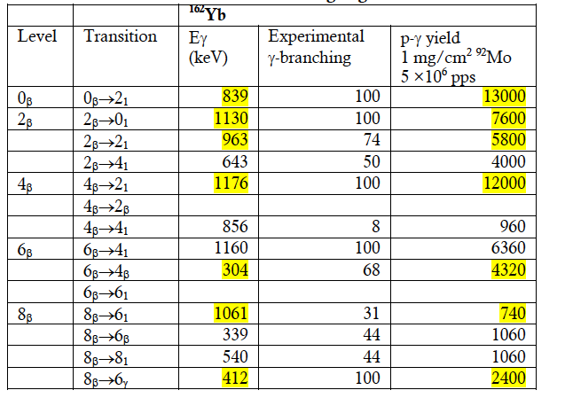


Statistics: Coulomb Excitation of ¹⁶²Yb “β -band”
Calculated branching ratios:
$$P_{γ}∝E_{γ}^{5}B(E2)$$

Slide 15
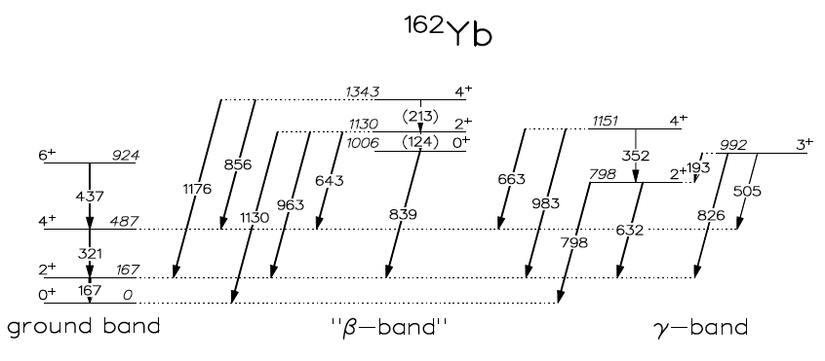
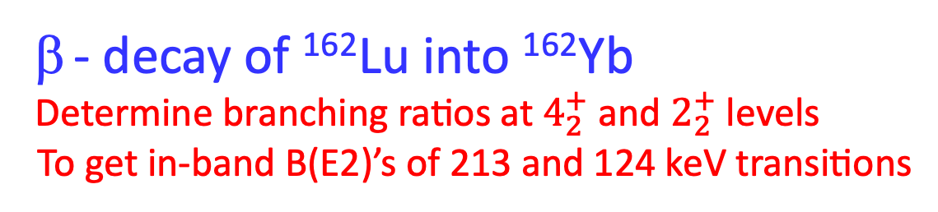
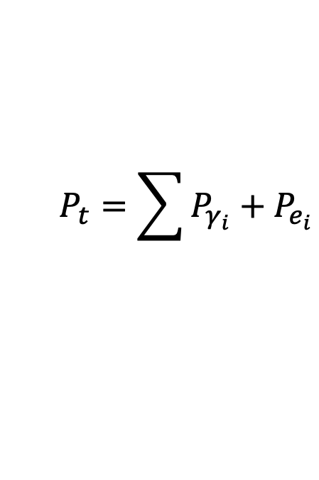



- decay of ¹⁶²Lu into ¹⁶²Yb
Determine branching ratios at $4_{2}^{+}$ and $2_{2}^{+}$ levels
To get in-band B(E2)’s of 213 and 124 keV transitions
$$P_{γ}∝E_{γ}^{5}B(E2)$$
$$B\left(E2\right)∝Q_{t}^{2}$$
$$Q_{t}∝β+0.36β^{2}$$
$$P_{t}=\sum{P_{γ_{i}}+P_{e_{i}}}$$
Easily seen in Coulomb Excitation
Too weak to be populated in Coulomb Excitation
McCutchan 2004

Slide 16
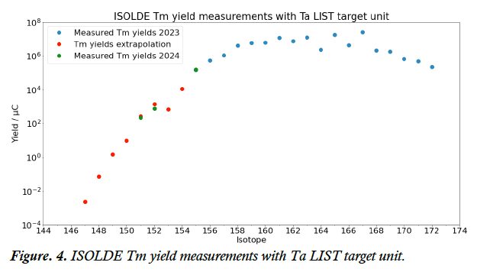

Success of experiment depends on ¹⁶²Lu beam intensity.
LoI 268 was approved to determine yields of ¹⁶²Lu
Ran together with LoI 278 in which Tm yields were measured
Unfortunately, target “failed” before Lu yields were measured
By then Tm yields had dropped a factor of 10. The measured yield of ¹⁶²Lu was
~ 5e3 pps/ C
Implies ~ 10⁵ pps is possible
$$μ$$

Slide 17
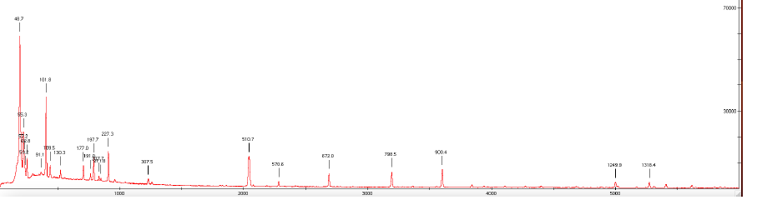
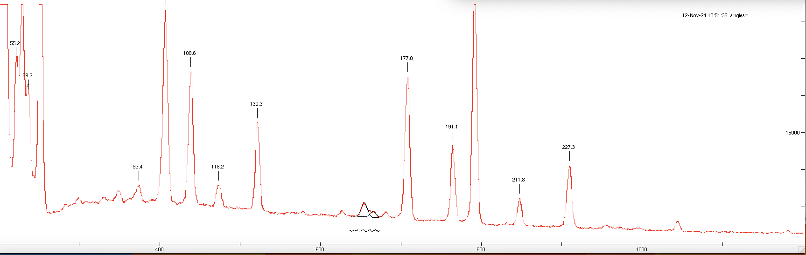
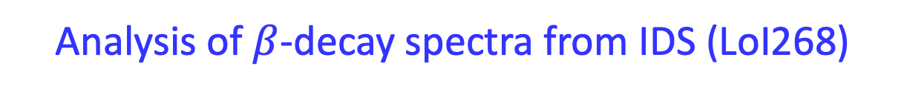
Analysis of $β$-decay spectra from IDS (LoI268)
¹⁶²Tm beam 18 minutes
¹⁶²Er
¹⁶²Er
¹⁶²Er
¹⁶²Er
¹⁶²Er
¹⁶²Er
¹⁶²Er
Again conclude ¹⁶²Lu beam is 2 orders of magnitude weaker than ¹⁶²Tm beam
¹⁶²Lu beam 38 minutes
¹⁶²Yb

Slide 18
Look for 124 and 213 in coincidence mode
Assuming 10⁵ pps and using intensities of McCutchan 2004 &
calculated branching ratios, Majola (2019), 12 clovers :
Estimated number of coincidence counts in 9 shifts
213 11000 +/-400
125 2300 +/-400

Slide 19
TAC question: What if beam is only 10⁴ pps?
(Sintering of the target happened after 2-3 days of operation)
Reduce counts by a factor of 10:
Peak Bkgd. (Bkgd)^{1/2} %uncert.
213 1100 7500 +/- 90 10%
125 230 7500 +/- 90 40%
Conclude only 213 intensity will be obtained.
But remember 9 shifts = 3 days of operation

Slide 20
Summary of beamtime request ¹⁶²Lu decay
9 shifts
12 clovers
SPEDE

Slide 21
Thank You
16th International Symposium on Capture Gamma-Ray Spectroscopy and Related Topics (CGS16)
18-22 September 2017
Shanghai Jiao Tong University

