Slide 1
our results for an electrical coupling
A 3-cell cavity with a length of 187,8 mm
with a frequency close to 704 mHz

Slide 2
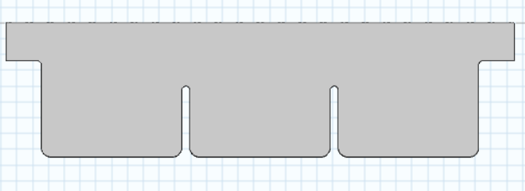
Cavity geometry
3 cells cavity with an electrical/conductive coupling:
Aluminium iris
Rw_ext
Rw_int
Lcell (or βλ/2)
(187,8 mm)
L_tube
(40 mm)
Rv
Copper wall
Lacc = 3* Lcell (187,8 mm)
And to establish a correct electric field flatness, we played with the radii of the separation between cells (Rw_int ) and the iris at the ends of the cavity (Rw_ext).

Slide 3
Our procedure
More precisely, for a given Rw_int (and vise versa), we increased Rw_ext (and vise versa), and modified Rv to stay close to 704 MHz.
We followed this procedure for Rw_int (and vise versa), set at 60 mm and then 80 mm.
(Hereafter, the presentation of Carlelo Barbagello and Alexeij Grudiev on particules accelerators, in Nashville, and the presentation of cooling cell conceptual design in 2024:
- They are the main reason of our choice of iris radii size).

Slide 4
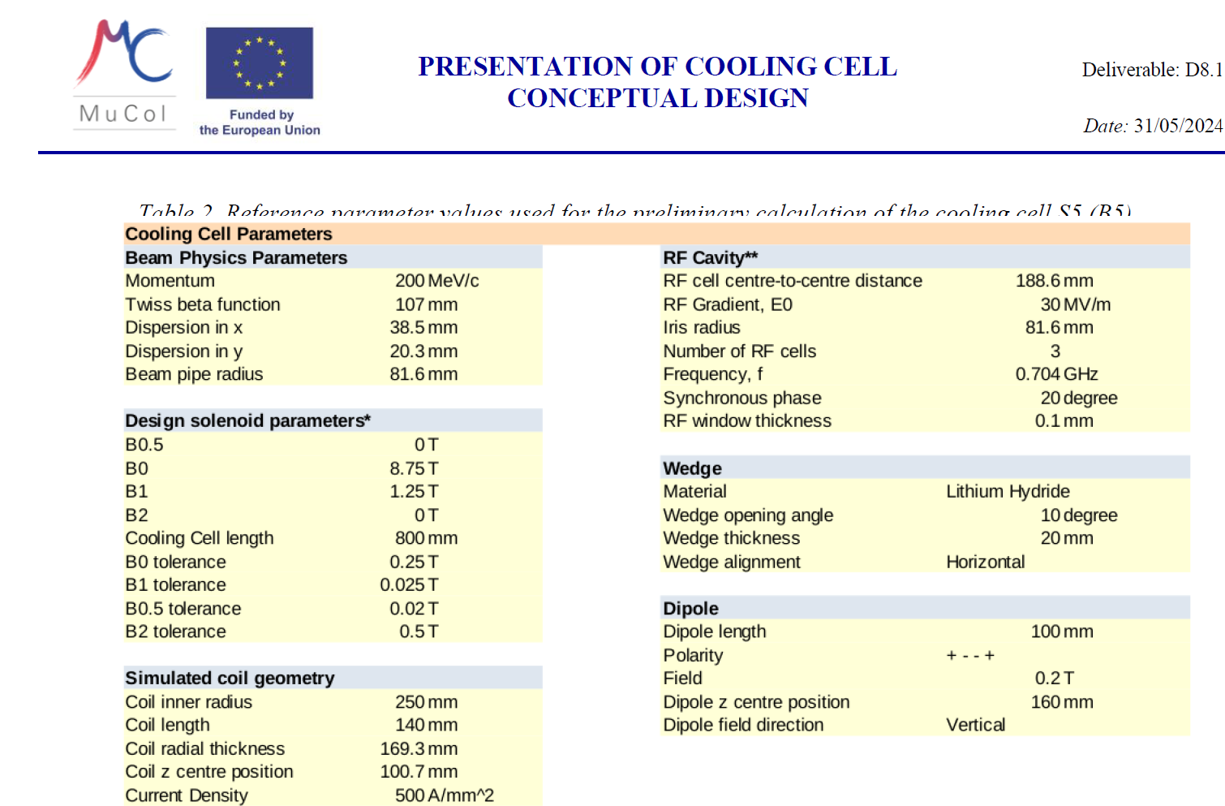
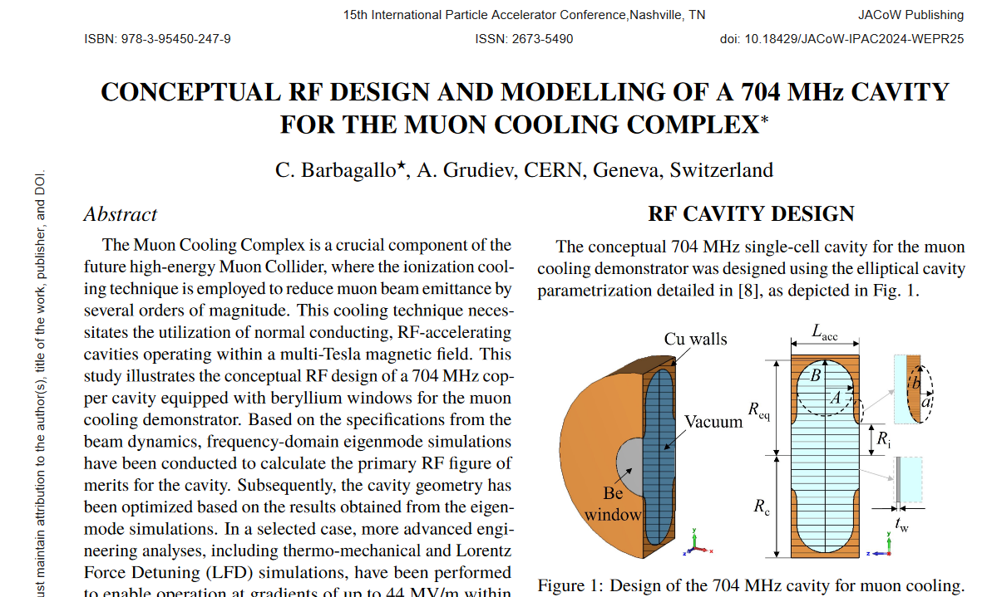
Presentations explaining our choice for
R = 60 mm (cf Carmelo Barbagallo, Alexej Grudiev)
R = 80 mm (cf Cooling cell conceptual design)

Slide 5
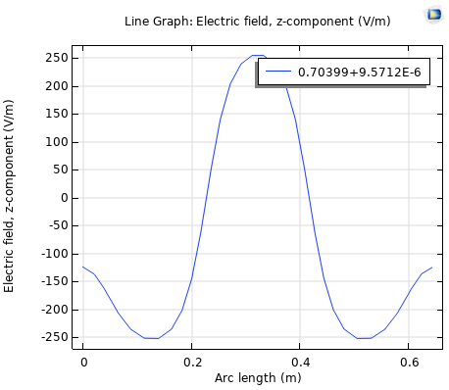
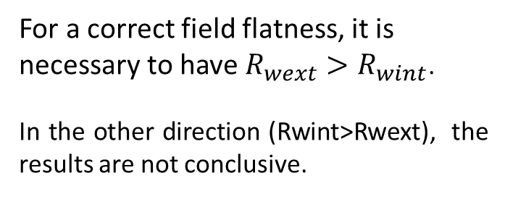


Our results
For a correct field flatness, it is necessary to have $R_{wext}>R_{wint}$.
In the other direction (Rwint>Rwext), the results are not conclusive.
Additional information
Ezmax
Z, propagation axis
Ezmin
And the cases to be studied in more detail appears to be :
$R_{wext}=78 mm$
$$R_{wint}=60 mm$$
$R_{wext}=122 mm$
$$R_{wint}=80 mm$$

Slide 6
Our results
Rwint = 60 mm $\frac{R_{wext}}{R_{wint}}=1,3$
Rwint = 80 mm $\frac{R_{wext}}{R_{wint}}=1,5$
It seems that with Rwint at 60 mm, R/Q is greater and Emax (on the Cu wall) lower (even though we should look into this to find a way of lowering it further).
For Rwint > Rwext, the results only confirm our choice.

Slide 7
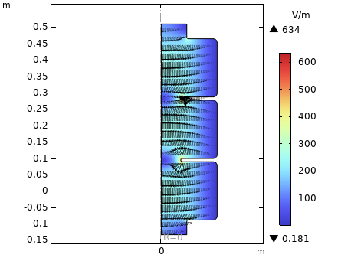
Our results
Electric field norm (V/m) in the cavity and its direction
Electric field (V/m)
0
axis of electric field propagation
Eigenfrequency (MHz) | L_tube (m) | Cavity radius (m) | window radius inside (m) | window radius (m) | R/Q (Ω) | Quality factor | Emax/Eacc
703.99 | 0.04 | 0.17067 | 0.06 | 0.078 | 286.07 | 36777 | 4.702

Slide 8
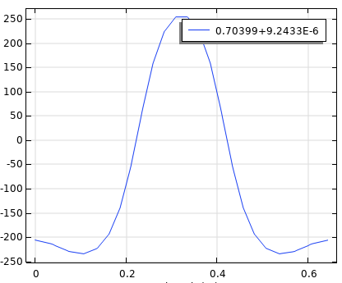
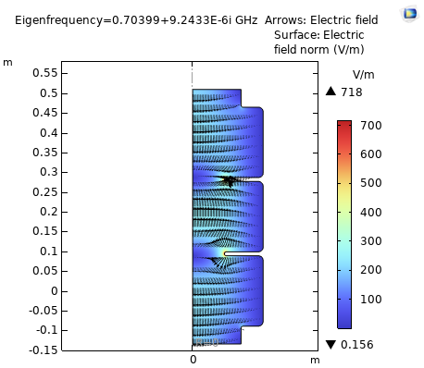
Our results
Electric field norm (V/m) in the cavity and its direction
Electric field (V/m)
0
axis of electric field propagation
Eigenfrequency (MHz) | L_tube (m) | Cavity radius (m) | window radius inside (m) | window radius (m) | R/Q (Ω) | Quality factor | Emax/Eacc
703.99 | 0.04 | 0.17779 | 0.08 | 0.122 | 209.69 | 38081 | 6.021

Slide 9
Conclusion / continued
If (80,122) offers more space for the beam, (60,78) may offer more advantages.
It would be interesting to see what happens if we soften the edges a little more (on the Epeak). We want to reduce it to minimize the breakdown rate.
Other parameters can be optimized for best results.
The cavity can be made more convex to increase R/Q, for example. Or the cells can be slightly spaced from one another…

