Slide 1
Preparation for MuCol
P1 reporting to the EU
Laura Gina Dalla Palma (CERN External Grants) & Cloé Levointurier-Vajda (CERN EU Office)
22 October 2024
Notes:
Sabrina

Slide 2
Content
Definition and objectives of a periodic reporting
MuCol P1 reporting timeline: overview
How to prepare for the technical reporting
The EU review
Concluding remarks
Notes:
Sabrina – mettre a jour titres et ordre

Slide 3
Definition and objectives of a periodic reporting

Slide 4
Objectives of a periodic reporting
What is a periodic reporting?
A report submitted by the Coordinator on behalf of the Consortium
to the Funding Agency (the REA: European Research Executive Agency) for review
at the end of a reporting period
including both technical & financial information about the activities performed during the period
and leading to a payment release
Objectives for the Funding Agency
To monitor the project implementation (progress towards the achievement of the project objectives, deliverables, milestones, …)
To identify possible deviations, delays, issues or shortcomings
To support the Consortium concerning future work (until the end of the project)
Objectives for the Consortium
To receive payment for the costs incurred during the reporting period
To acknowledge the main achievements and raise attention on possible issues and mitigation solutions

Slide 5
Composition of a periodic report
Periodic report = Technical Part A + Technical Part B + Financial Part
Technical Parts
The Technical Report consists of 2 parts:
Technical Part A contains structured tables with project information
  Part A is generated by the IT system. It is based on the information which are entered (mostly by the Coordinator) into the EC Portal, through the Continuous Reporting module, and the Periodic Reporting module.
Technical Part B is a narrative description of the work carried out during the reporting period
  Part B needs to be uploaded as PDF on the EC Portal.
  No page limit for this narrative description, but it should be concise and readable.
  Any duplication should be avoided (e.g.: no copy-paste from deliverable report in the Part B, since Deliverables are in Part A).
Financial Part
The Financial Report is generated by the IT system on the basis of the financial information entered into the Periodic Reporting module (mostly the individual Financial Statements (Annex 4 to the GA) for each Beneficiary).

Slide 6
MuCol P1 reporting timeline: overview

Slide 7
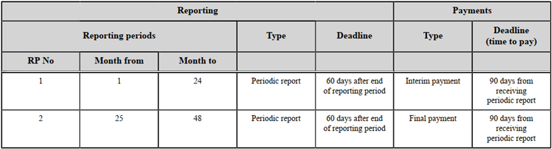
Background information
MuCol is 48 months duration: from M1 (March 2023) to M48 (February 2027)
MuCol is divided into 2 reporting periods
P1 (M1-M24) from the start date to the end of February 2025
P2 (M25-M48) from March 2025 to the end date
Grant Agreement inputs about periodic reporting
See the GA Data Sheet,
and article 21 (& Art. 22
for payments)
2 months after end of the
period to submit the report
For P1 report, the
deadline is end of
M26 = April 2025

Slide 8
P1 reporting timeline
P1 report accepted & interim payment from EC to Coord
~~M30?
End of P1
P1 report submission
P1 review meeting
~ during M27
End date
M48
Start date
M24
M26
M1
M2
RP1
RP2
P1 reporting preparation
= 2 months
End of P1
= M24 = 28/02/2025
P1 report EU review & consortium revision/answers
= from ~2 months to …
P1 report submission deadline
= M26 = 30/04/2025

Slide 9
How to prepare for the technical reporting

Slide 10
General template for Part A (1/2)
The template & instructions are accessible on the EC Portal, in the “Reference Documents”: Periodic report (HE)
Pages 6 to 28 are focused on Part A and relevant for MuCol. Pages 27 to 32 are not applicable for MuCol.
The following items are part of Part A:
Project summary
  Will be published through CORDIS and possibly other communication channels: do not include confidential information
Researchers involved in the project
  No need to fill if the corresponding tab in the Continuous reporting have been updated recently
List of critical risks (foreseen and unforeseen)
Results
  e.g: Scientific discovery, model, theory // Method, material, technology, design (new or improved) // Event (conference, seminar, workshop) // Learning and training (learning modules, curricula) // New or improved infrastructures or facilities // …
Results ownership list (optional at P1 reporting, mandatory for the final reporting)

Slide 11
General template for Part A (2/2)
Publications (more efficient if Zenodo is up-to-date)
Datasets
Intellectual Property Rights (e.g : Patent / Trademark / Registered design / Utility model / Other)
Standards
Other results (e.g: Software / Workflow / Protocol / Prototype / Other)
Dissemination and communication activities
Impact
Specific and targeted instructions/templates and timeline for Part A are yet to be announced

Slide 12
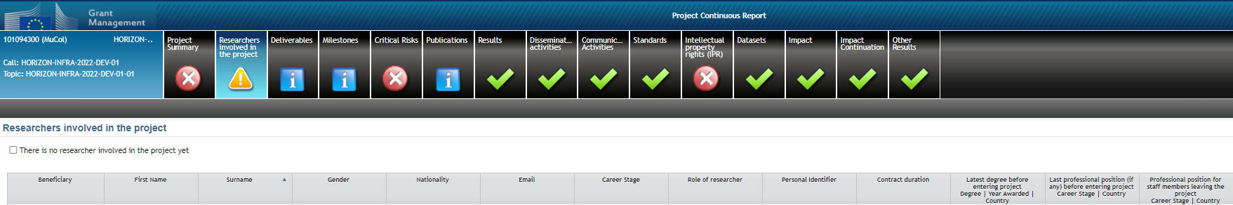
The Continuous Reporting as preparation for Part A
The module is accessible during the whole project duration
CERN (as Coordinator) is responsible to enter the data in the IT system for all tabs
CERN will collect inputs from relevant WPs, Task leaders & consortium bodies.
Exceptions:
  the “Researchers involved in the project” tab can be filled by each Beneficiary
  The Publications can be uploaded on Zenodo by CERN Muon Secretariat (the EC Portal IT system is synchronised with Zenodo) → keep in mind to inform when a new publication is to be uploaded!

Slide 13
General template for Part B
Based on the general template for Technical Part B, it is recommended to follow this structure for MuCol P1 Technical Part B:
Explanation of the work carried out and overview of the progress
  Overview of the project results
  Objectives
  Explanation of the work carried out per WP
    WP1
    WP2
    …
  Impact
  Update of the plan for exploitation and dissemination of results (if applicable)
Open science
Deviations from Annex 1 and Annex 2
  Tasks/objectives
  Use of resources

Slide 14
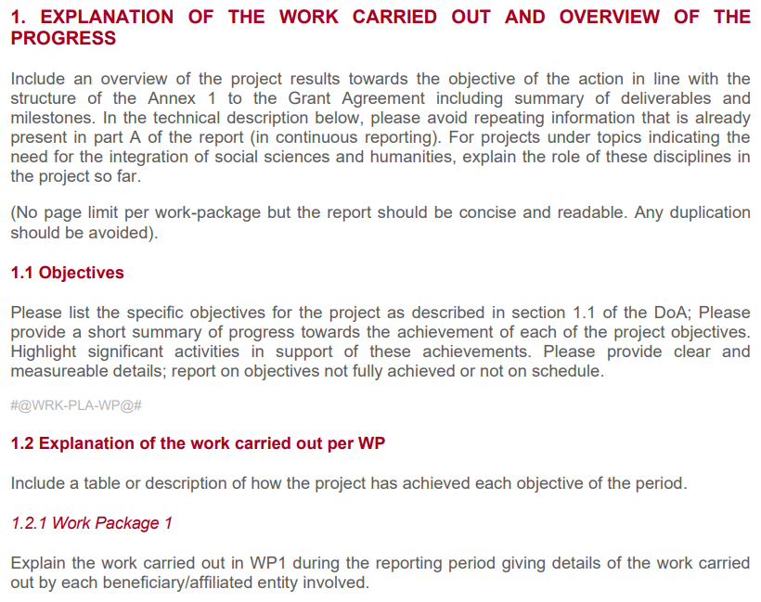
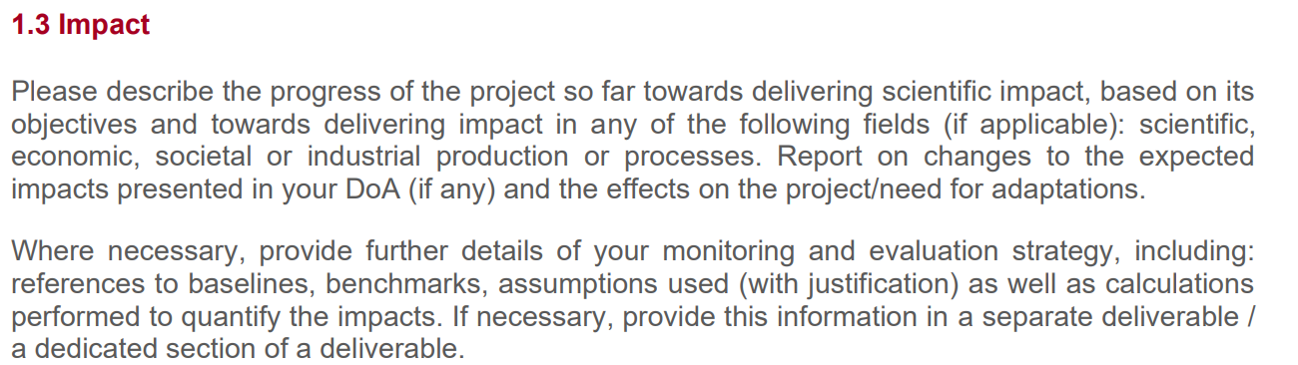
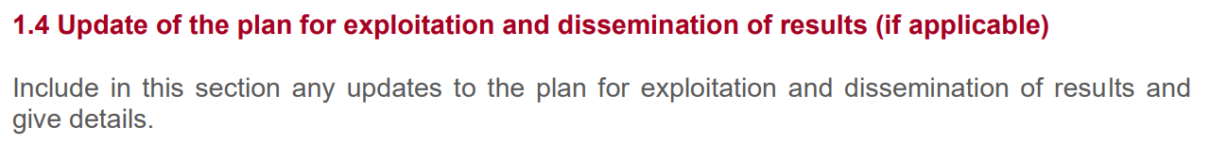
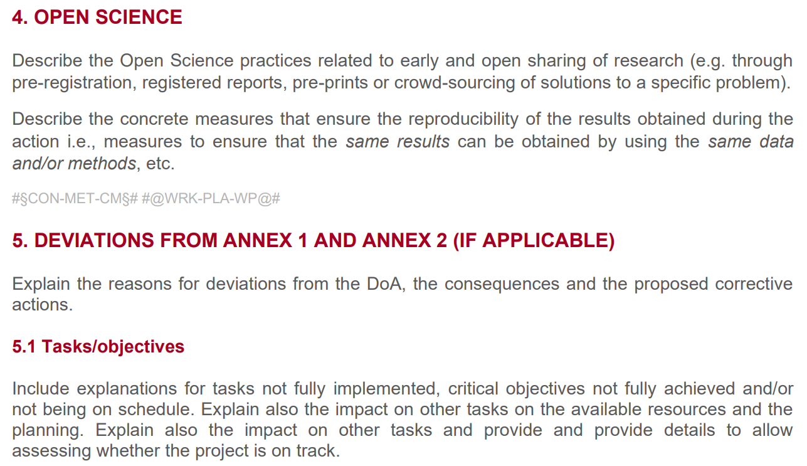
General instructions for Part B
All instructions are included in the template, accessible on the EC Portal, in the “Reference Documents”: Periodic report (HE)

Slide 15
Tentative timeline for Technical reporting Part B
The March 2025 month will be busy with EUSPP strategy document submission, leading to limited availabilities of Management team and WP & Task leaders for the drafting of the Technical report
The Technical report should be approved by MuCol Governing Board before submission
The Technical report submission deadline is end of April 2025 (so is the Easter… ~20th of April)
Consequently, MuCol consortium should anticipate as much as possible the preparation of mandatory documents.
The table in the next slides includes the following acronyms:
GB: Governing Board
MC: Management Committee (includes a CERN representative, the SL, the Deputy SL, the TL, all the WP leaders)
SL: Study Leader → Daniel Schulte
TL: Technical Leader → Roberto Losito
WP: Work Package
AC: Advisory Committee
FO: CERN Financial Officer
MCS: Muon Collider Secretariat

Slide 16
Tentative timeline for Technical reporting Part B
When | Who | What
~Nov. 2024 | TL, MCS | Customised template distribution to MC
Nov. 2024 – Jan. 2025 | MC, Task leaders, … | Filling the template and sending it back to TL and MCS Note that all activities & achievements until 28/02/2025 should be also included → see #6 below
Early Feb. | TL and SL | Distribution of the assembled document for review to MC and AC
February | MC, AC | Reviewing and commenting of the document, raising questions or asking for clarifications, advising on improvements… and send the annotated document to TL and MCS
Late Feb. | TL | Distribution of the annotated assembled document for review to MC
March | WP/Task leaders, … | Revision according to the comments, and inclusion of the latest activities performed until 28/02/2025 and sending back the document to TL and MCS
Early April | MCS, TL and SL | Restricted distribution of the document for final editing
Until ~Apr. 24th | SL, DSL, TL, FO | Final review and edits, and inclusion of the justifications for financial deviations
~Apr. 25th | TL or SL or MCS | Distribution of the final Technical Report Part B for GB approval
Until Apr. 29th | GB | Approval of the final Technical Report Part B by the GB
April the 30th | TL, MCS | Submission of the approved final Technical Report Part B
#1
#2
#3
#4
#5
#6
#7
#8
#9
#10
#11

Slide 17
The EU review

Slide 18
Reminder: P1 reporting timeline
End of P1
P1 report submission
P1 review meeting
~ during M27
End date
M48
Start date
M24
M26
M1
M2
RP1
RP2
P1 reporting preparation
= 2 months
End of P1
= M24 = 28/02/2025
P1 report EU review & consortium revision/answers
= from ~2 months to …
P1 report submission deadline
= M26 = 30/04/2025

Slide 19
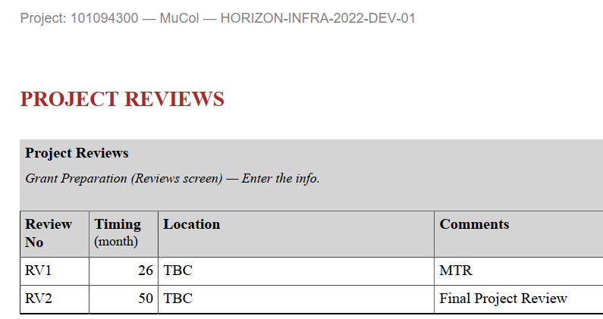
The P1 review (meeting)
A mid-term review (MTR) is announced in MuCol GA.
Review is performed by the Project Officer and the
appointed external reviewer(s).
The name(s) of the appointed external reviewer(s) will be
communicated on the EC Portal and CERN has ~7 days
to react if needed to object to the expert(s) on the grounds
of commercial confidentiality, and to explain the reasons why.
The PO and the ER will review:
the full P1 report submitted, including
all Milestones with a due date in P1,
and all Deliverables with a due date in P1.
There will most probably be a review meeting in addition to the review process.
The review meeting can be fully on-line, or hybrid: CERN will discuss with the PO if the meeting is confirmed.
Usually 1-day meeting, or a (packed) half-day meeting, with a general overview of the progress achieved during P1, followed by a presentation for each WP, and Q&A after each session for the PO & reviewer(s) can ask for any clarification, if needed.

Slide 20
The outcome of P1 review
The PO & ER will prepare a Review report and either accept or reject the P1 report.
If the P1 report is rejected, a Suspension of Payment Deadline Letter specifies the updates to be done, and the deadline for resubmission of the revised P1 report.
If the P1 report is accepted, a Payment Letter specifies the interim payment amounts to be paid by the Funding Agency to the Coordinator
  Then, it is the Coordinator responsibility to distribute the interim payment to the relevant Beneficiaries
The Review report is very instructive and includes recommendations from the expert(s) for the remaining time of the project.
For P2 technical report Part B (due in M50), an additional section will be needed compared to P1 one: “Follow up of recommendations and comments from previous review”.

Slide 21
Concluding remarks

Slide 22
Anticipate
Identify key players in the technical report preparation – Part A and Part B may require inputs from different persons!
The Financial part is specific and managed by Financial Officers / EU Offices in each institute (Beneficiaries only) however it is a long process as well.
Technical & Financial colleagues should study the templates beforehand and ask questions if something is not clear – Less experienced partners are encouraged to identify themselves to the Coordinator for benefiting from a specific support or guidance if needed.
Be on time & play your part
The preparation of such periodic reporting includes a lot of persons
Minor delay by 1 person / entity may create major delay in the whole process
The deadline will come quicker than what you think
Think of the bright side
Once the P1 reporting process will be over, you will receive a very instructive Review report … and interim payment for costs incurred during P1!

Slide 23
Thank you for your attention
Any questions?

