Slide 1
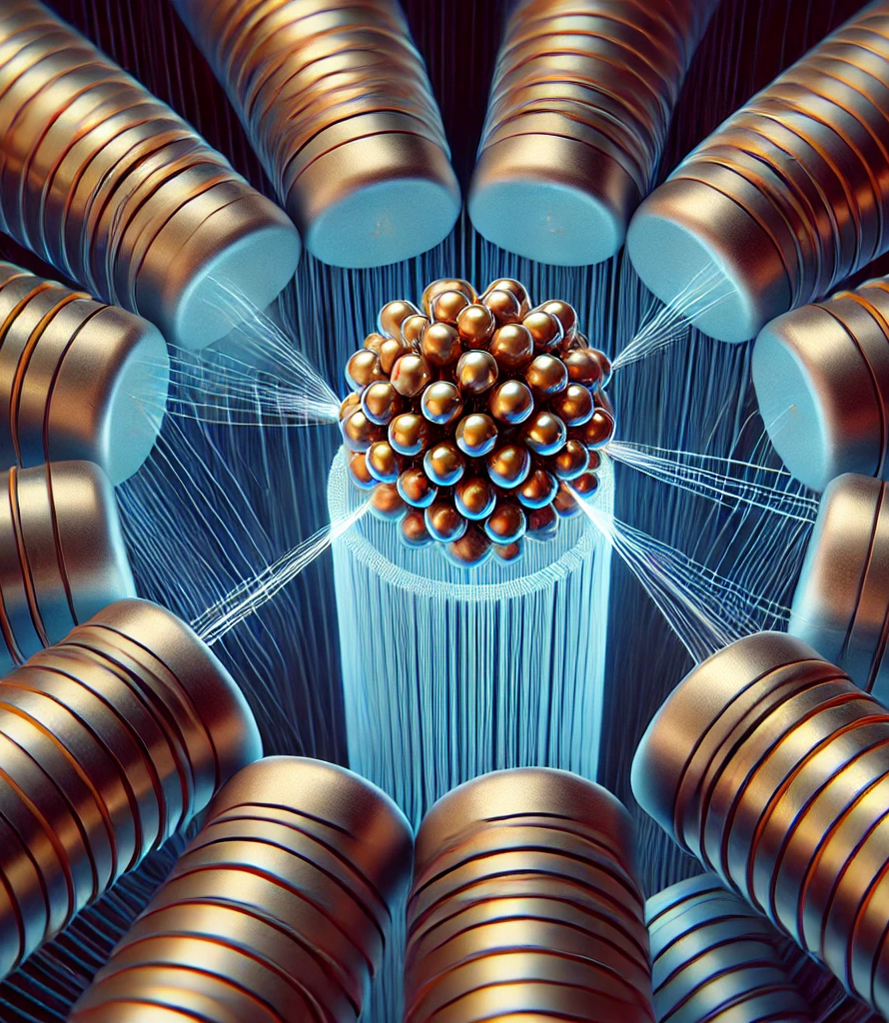
β-IP corrections in the Ion Run
T. Persson
On behalf of the OMC-team

Slide 2
β IP from K-mod
Global β-beat and dispersion look fine throughout the cycle
After the global corrections
  β from K-mod was NOT included due to first issues with acquisition and then with software
IP1 and IP5 are almost spot on
  Want minimum change
Large waist shift in particular in beam 2
  -> ALICE would receive less luminosity
IP2
Plane | β IP
B1H | 0.55
B1V | 0.57
B2H | 0.62
B2V | 0.54

Slide 3
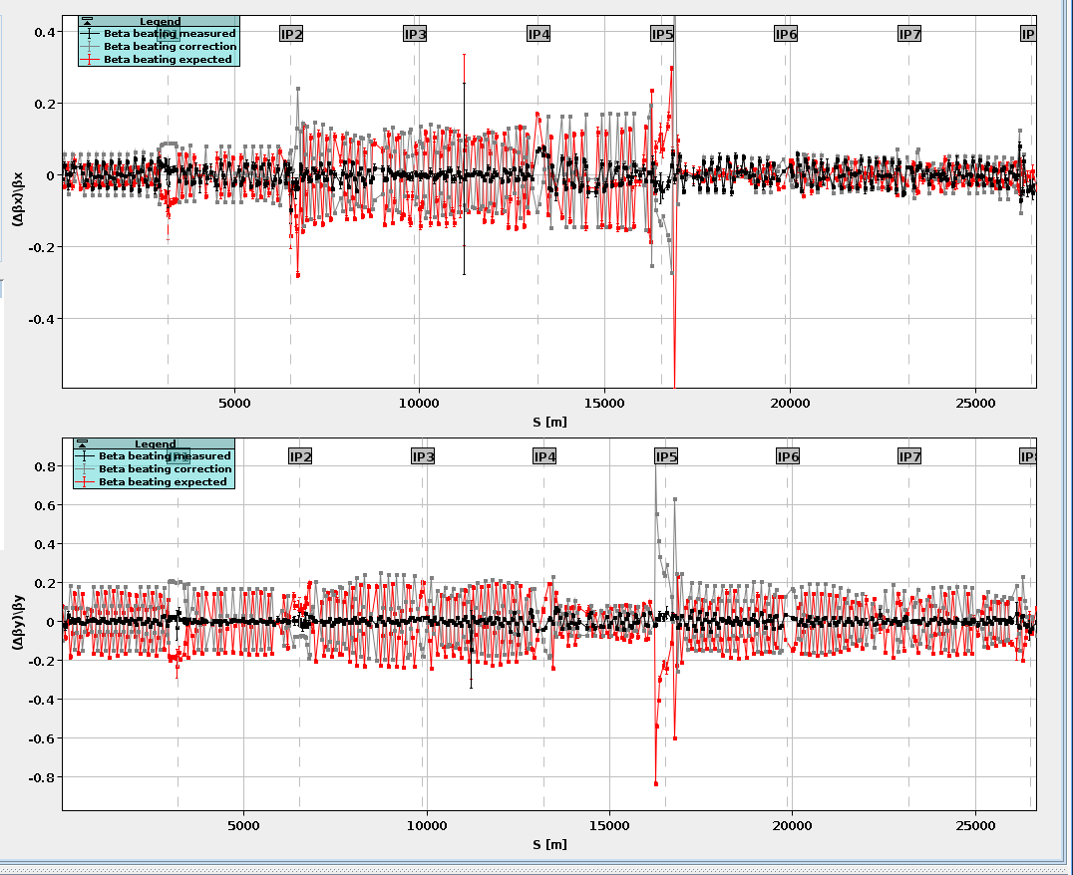
Finding a global correction
Could NOT find a correction that both :
  C onserved the β-beat globally
  Corrected the β* in IP
Worked for beam 1 but not beam 2

Slide 4
Global correction using
Made a global matching in MAD-X that matches both beams
Input:
  Only data from K-modulation, propagated to the Q1 BPMs
Uses (only IP2):
  Triplet magnets
  All individuals powered to from Q4-Q10 (both beams)
Constraints:
  Match the Q1 BPMs (3m tolerance)
  Alfx=dx=0 at the IP
  Betx_IP1=Bety_IP5=0.5, alfx=0, alfy=0 (here one could have taken a closer point but in the end I tried both and didn’t change)

Slide 5
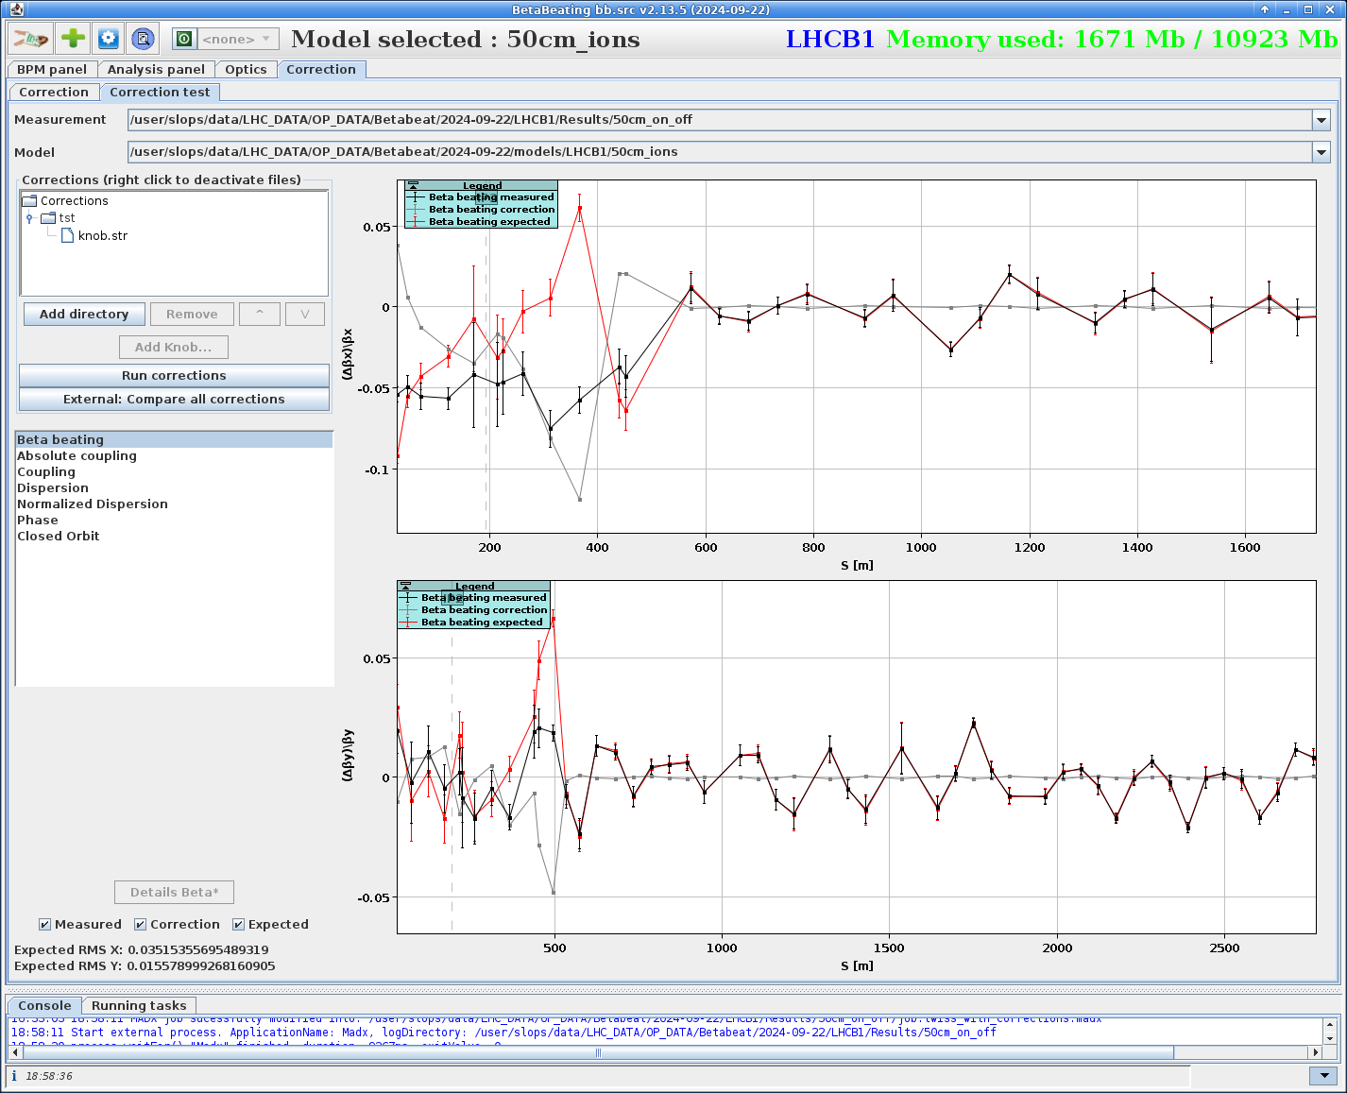
Beam 1
Some local β-beat is expected to be introduced but in the range of a peak 6-7%

Slide 6
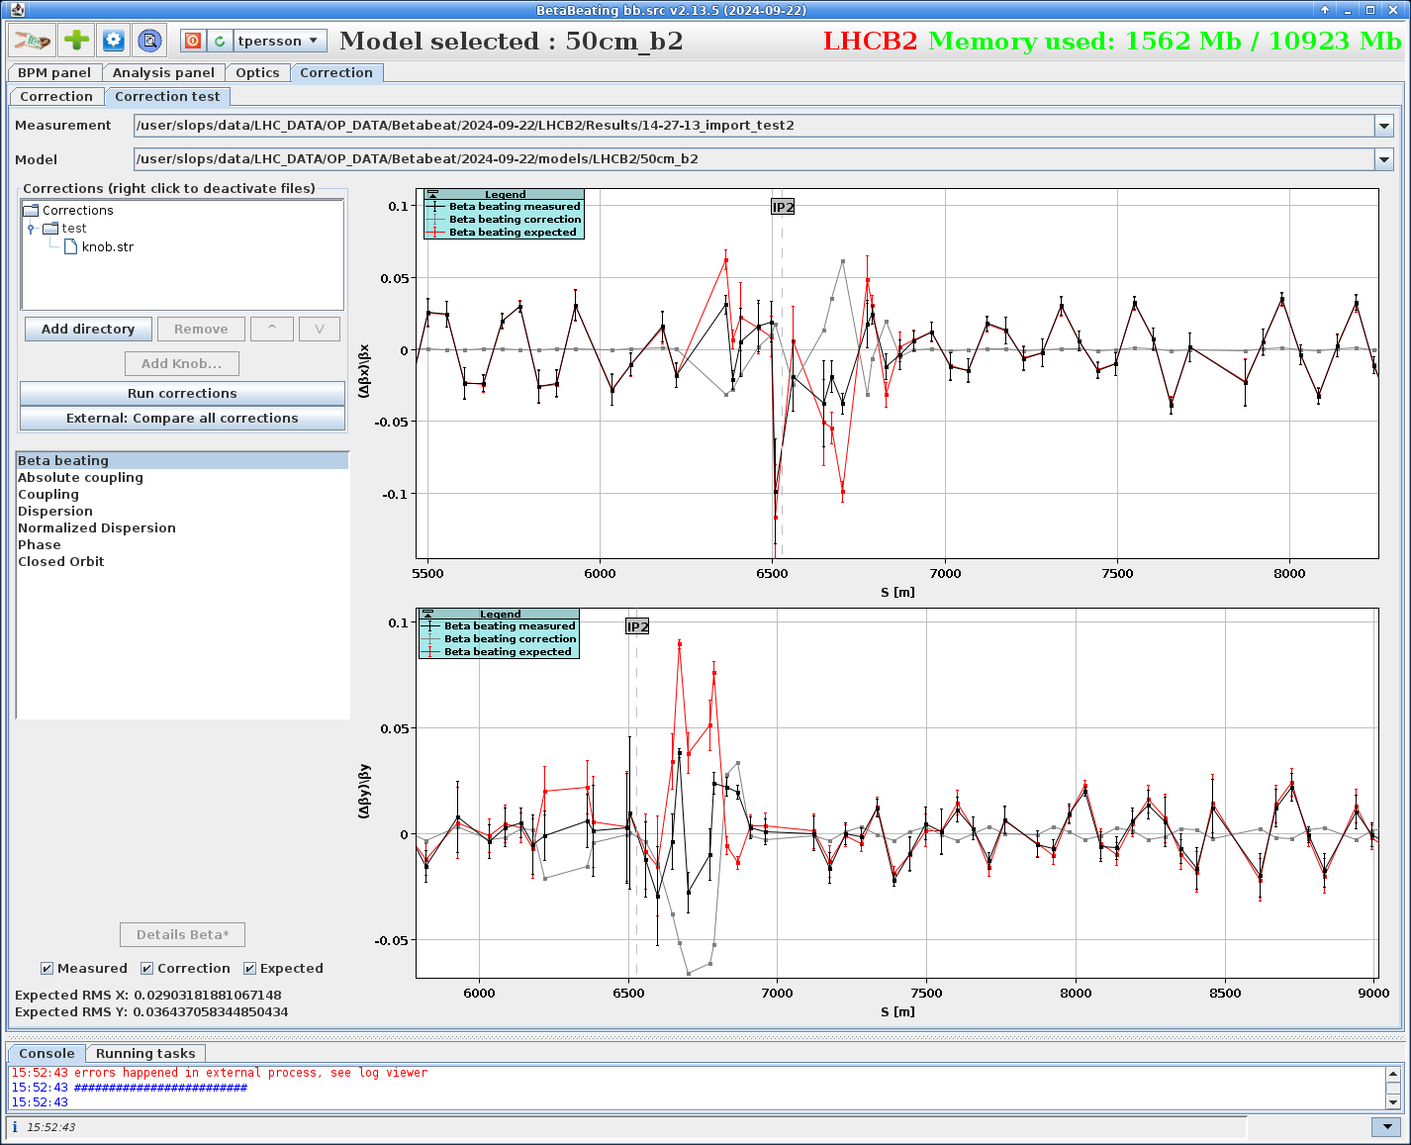
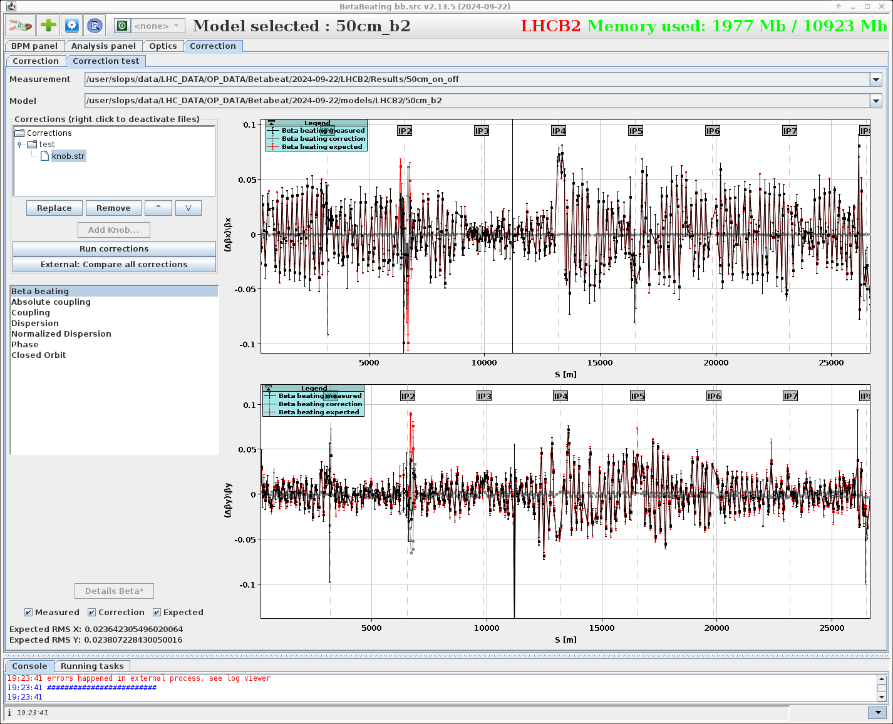
Beam 2
A bit stronger for beam 2 but still below 10% β-beat
The β IP2 is predicted to be ~50cm after corrections

Slide 7
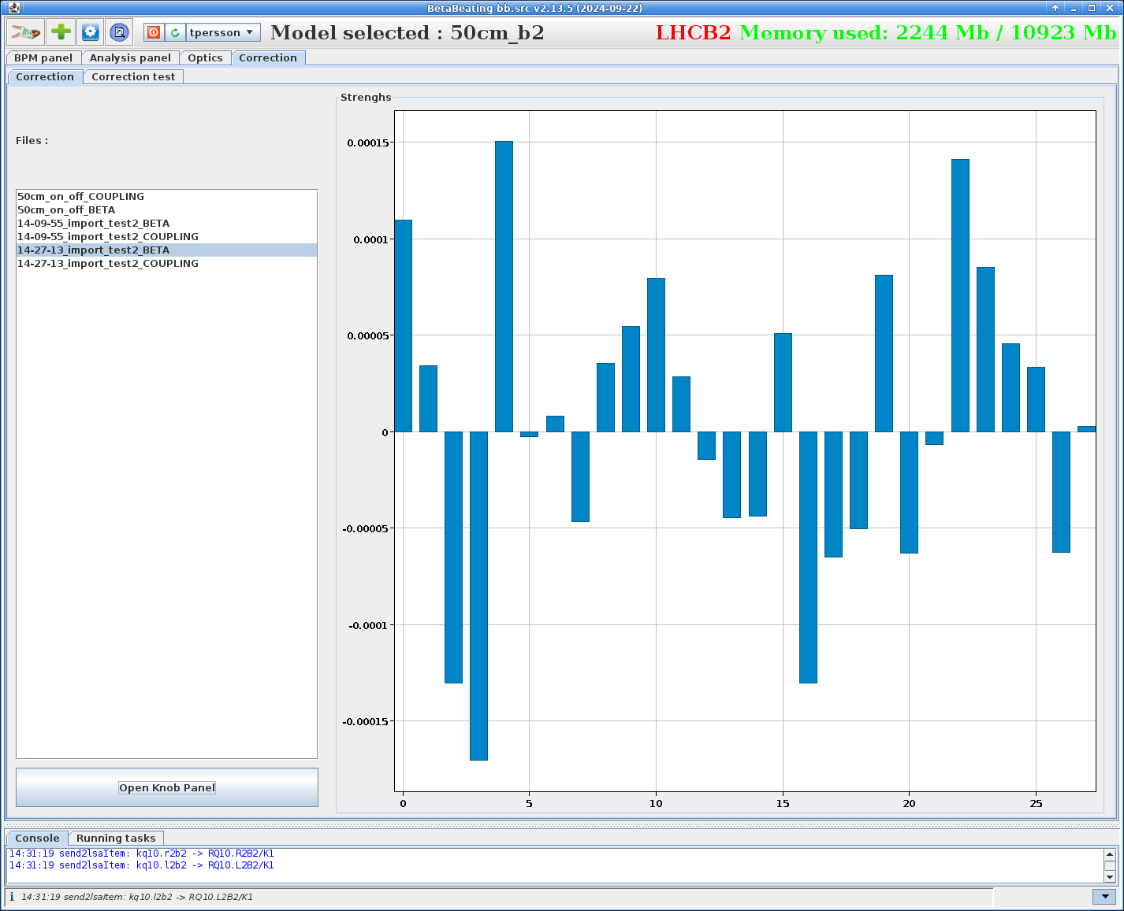
Strength of correction
All corrections less than 2e-5

Slide 8
The triplet corrections
Magnet | Local | New regional | Local+Regional
Q1.L2 | -1.155E-5 | 1.09E-6 | -1.05E-05
Q2.L2 | -3.1E-6 | 1.04E-5 | 7.30E-06
Q3.L2 | -2.0E-5 | -1.04E-5 | -3.04E-05
Q1.R2 | -2.91E-5 | -7.05E-6 | -3.62E-05
Q2.R2 | 1.9E-5 | 1.95E-5 | 3.85E-05
Q3.R2 | 1.1E-5 | -1.95E-5 | -8.50E-06
I was hoping it would reduce the correction strength but in fact it increases them

Slide 9
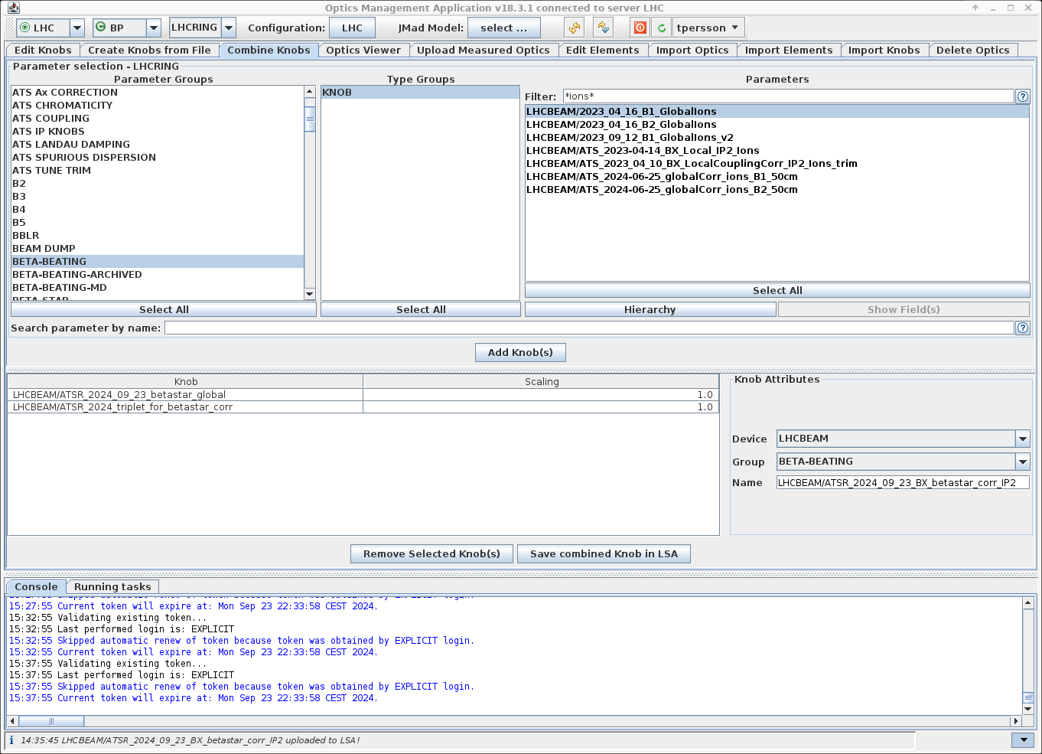
Combining knobs
Tool by Michi allows to combine several knobs into one
Used it to combine the triplet with the individual ones
Maybe we should use this more in the future?
  Creating temporarily knobs and then move them away and use combined knows

Slide 10
What is left in terms of optics commissioning in 2024?
Ions
  Implement these corrections and re-measure, already 70% of the correction fixes almost all the waist shift
  Re-check the b3 correction
Pp-ref
  Re-measure the ramp after the new corrections included
Measure more MO circuits if there is an opportunity

