Slide 2
Falcon D coil tooling
technical meeting
CERN/INFN Collaboration,
TE MSC SMT A. Foussat,
EN.MME L. Gentini, P Schneider, 25th September 24

Slide 3
Agenda items
#ID | Agenda items | duration
1 | Introduction, objectives | 10 mins , CERN
2 | Falcon D-I tooling specifications, specific functionalities and scope | 20 mins, ASG, INFN
3 | CAD tooling models, Manufacture drawings list, detail assembly drawings of key tooling | 30 mins, ASG
4 | Outcome of ASG tooling fabrication order, NC, as-built tooling reporting, commissioning status and plan | 35 mins, ASG
5 | Status of FALCON D-C CAD design at CERN, | 30 mins, CERN DO
6 | List of pending activities on CAD design, production drawings | 20 mins, CERN DO
7 | Specifications of CERN Falcon D tooling, specific development features, discussion | 25 mins CERN, DO, all
8 | Requirement for an exchange of CAD Falcon D tooling manufacturing models and drawings, discussion | 15 mins CERN, DO, all
9 | AOB, discussion | 15 mins
https://indico.cern.ch/event/1459212/
- -
-
-
DO
- l
- ….

Slide 4
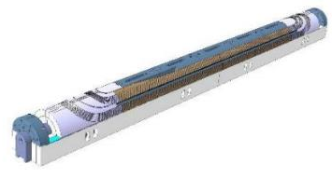
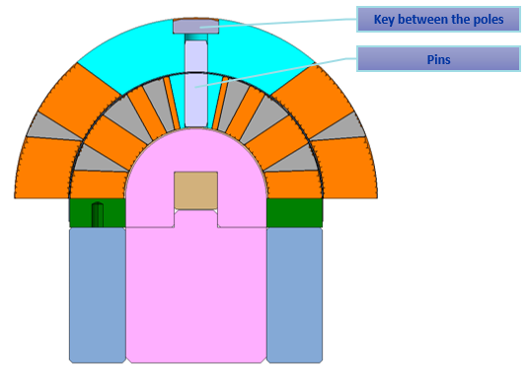
Introduction,
In the context of HFM program, it has been required since June 2024 to align the FALCOND dipole 12T coils design of both WP3.1 at CERN and WP3.2 at INFN in order to enhance the synergy, share the technical information and put in common some efforts.
It is proposed to reach a design for coils tooling between WPs as close as possible to minimise risk, strengthen exchanges, effective troubleshooting. Initial conceptual design shared by CERN in 2022, now in production completion at ASG by end 2024.
25th September 2024: Collaboration meeting on ASG INFN CERN Falcon tooling
MSC/SMT A Foussat

Slide 5
Objectives
The objectives of this meeting is to discuss between INFN, CERN and ASG what is the status of both coils tooling advancement, to inform about specific features, get advices on current design.
  INFN Falcon D coil toolings are procured by ASG since 2023 based on coil wound from Nb3Sn (RRP 162/169) 40 x 1.0mm φ strands. Completion planned for Q4-2024.
  CERN Falcon D tooling is under CAD design based on old coil using QXF cable, (September 2024 status) – Coming design update to be carried out.
To discuss the specific features of FalconD CERN coils, to exchange with CERN experts. To further decide either to discard from previous baseline or to kept some of the items allowing to test structure variant.
To decide with INFN team on the way to receive @ CERN the exchanged CAD models and drawings.
This meeting does not cover magnet assembly tooling.

Slide 6
Timeline
It is of interest for the CERN Falcon D project and the collaboration that the tooling is timely delivered for both projects to be on phase. One needs to assess risk on the tooling design and way to implement mitigations.
Falcon D CERN tooling procurement target dates :
ID | Equipments | Start MS | Start Procurement | Delivery
P1 | Winding mandrel + curing tooling | Nov 2024 | Feb 2025 | June 2025
P2 | Heat treatment mould and impregnation mould | Jan 2025 | Mar 2025 | Sept 2025
P3 | Assembly tooling aperture, pads, yoking ( not covered by this meeting ) | May 2025 | June 2025 | March 2026

Slide 7
CAD QA files exchange
CERN asks INFN to receive the 12T FalconD coil complete design QA information ( CAD model and drawings) for traceability.
Archive of the Falcon coil tooling 3D manufacturing models and CAD tooling drawings. ( next slide list).
CERN to prioritise the preparation of CAD tender drawings. This allows to focus on the specific machine interfaces ( winding, heat treatment and impregnation molds).
Access to the common tooling CAD design minimises the time for the creation of CERN CAD tooling models and drawings.

Slide 8
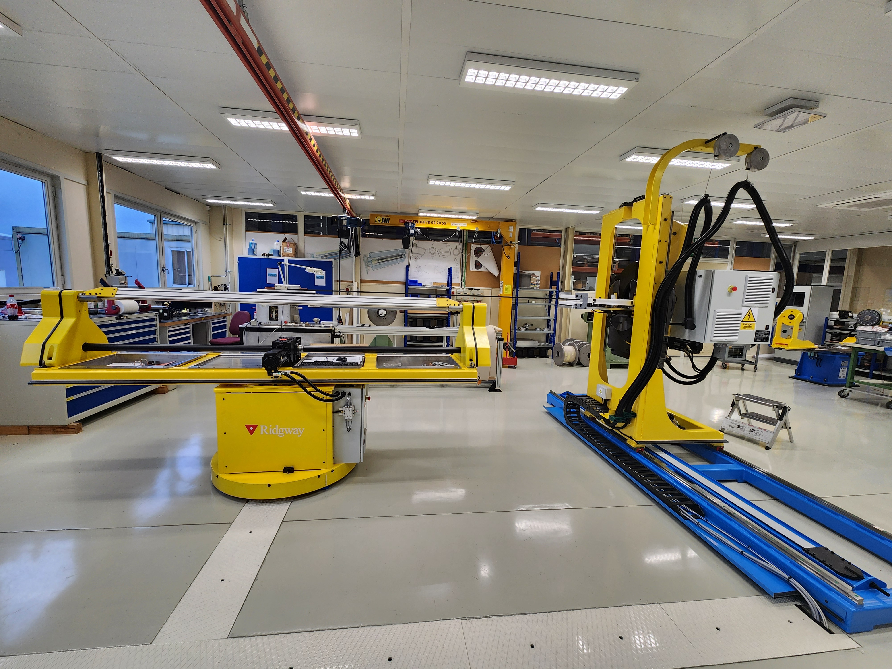
CAD Falcon D common tooling list
1st batch | 2nd batch
Spool handling Spool-stock holder Winding Mandrel 1st layer winding cores 2nd layer winding cores 1st layer Containment shields 2nd layer Containment shields tested Electrical exits support/locking tool Layer Jump containment/locking tool Interlayer insulation curing mould Heating & Control System ** 1st layer pressing and curing strips 2nd layer pressing and curing strips 1st layer protection tiles 2nd layer protection tiles 1st layer pressing and curing counter mould 2nd layer pressing and curing counter mould Handling coil tooling (927 interfaces) | Coil Heat Treatment Mold Impregnation Mold Support tool and tinning for electrical outlets
More than 200 drawings…
Newly commissioned winding machine at CERN 927

Slide 9
Specifications of CERN FalconD tooling, specific development features
FALCON D CERN tooling specifications drawings will include all common features with tooling designed by INFN. Specific features on CERN tool design.
  Winding mandrel: Interfaces of winding mandrel onto the new 927 winding tool to be confirmed, set clamping tools ( rotating mandrel unlike travelling reel at ASG).
  Tooling risk mitigation: Common base plate between winding and heat treatment to minimize the coils handling is implemented in Falcon D ASG tooling ( see Luca Gentini’s slides). Proposed to keep the feature
  Coil layers: New individual supporting bars of individual layers in case of separated layers requirement. Design is done but as WP3.2 does not include it and coil cos-theta interlayer splice is not mature, it is not considered as a priority. ( need further prototyping). Evaluation only on mechanical mock up of structural impact from separated layers
  Collar poles: As there are ongoing options study of the B&K structure design w/o detachable poles. CERN FalconD coil tooling would like to keep tooling capability of the separate poles, ( possibly impregnated). The impregnation mold should consider both poles options.

Slide 10
Summary
Proposed way forward to check Falcon D tooling CAD models and drawings from INFN, to minimize redundant tool design completion work at CERN due to the re-design of coil cross section.
Design update of Falcon D CERN tooling targets to keep most of common features and focus on a few open functionalities like collar poles.
Proposed postponed feature of the separate layers fabrication.
Production target timeline was discussed, some PRR shall be organized for each batch.
CAD catia exchange request by CERN to be discussed in detail.
Follow up meeting on 11 st October at ASG.

