Slide 1
Story size: Page format is 16:9 (1920x1080p)
Be aware:
Mobile can be implemented. In this case, design should be reviewed and adapted accordingly. To the current stand, responsive design cannot be generated using Storyline 3.
1/4 of
page size
EXPERIMENT SAFETY OFFICER
EXSO
EDMS No. xxxxxxx

Slide 2

Objectives
By the end of this course, you will be able to:
Understand the role and responsibilities of the Experiment Safety Officer (EXSO).
Integrate safety aspects throughout the life cycle of an experiment.
Gain insight into the organizational structure at CERN and the EP Safety procedure.
Get familiar with specific hazards present in the Experiment(s)

Slide 3

Experiment Safety Officer
Experiments at CERN
Experiments at CERN
Role of the EXSO
Safety validation process
Experiment Safety File

Slide 4
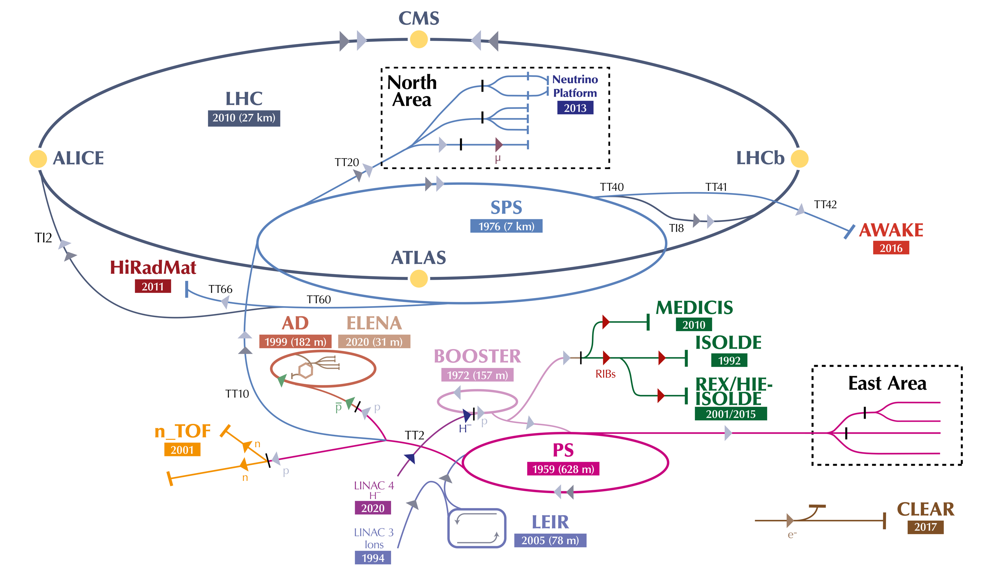
Experiments at CERN
Depending on the size, time of operation, and safety implications, Experiments at CERN are divided into three categories:
  Small Experiments
  Small Experiments
  Medium Experiments
  Medium Experiments
  Large Experiments
  Large Experiments

Slide 5
Experiments at CERN
Depending on the size, time of operation, and safety implications, Experiments at CERN are divided into three categories:
  Small Experiments
  Medium Experiments
  Medium Experiments
  Large Experiments
Such experiments usually have:
  No permanent installation at CERN
  An operation time of < 3 weeks
  No major safety hazards
Safety validation process: EDMS 2522660
Around 150 small Experiments per year, inspected by the EP Safety Office
No official EXSO is nominated (but Safety contact is present)
Such experiments usually have:
  Permanent installations at CERN
  Recurrent operation time during the year
  Specific safety implications
Includes permanent facilities hosting different (temporary or not) Experiments
Safety validation process: EDMS 1884757
Around 35 of these Experiments or Facilities, for whichan officially nominated EXSO is present!
4 large Experiments on the LHC ring: ATLAS, CMS, ALICE, LHCb
Each of those has its own Safety Office within the collaboration, guided by the LEXGLIMOS
Own safety processes (in some cases, connected with the ones of the EP Safety Office)
The term “Experiment” will hereafter represent Medium Experiments.
Notes:
Animated on click

Slide 6

Experiment Safety Officer
Role of the EXSO
Experiments at CERN
Role of the EXSO
Safety validation process
Experiment Safety File

Slide 7
Role of the EXSO
Organisational Chart – Experiments
EP Department Head
Responsibility line
Interaction line
EP DSO
Experiment Technical Coordinator/Spokesperson/Project Leader
Management
of the Experiment
HSE Unit
EP Safety Correspondent
EXSO
Activity Responsible
Team members
Team members
Team members
Other Safety Officers
(TSO, FGSO, ESO, RSO, CSO, LSO…)
Notes:
DSO = Department Safety Officer (mandate at GSI-SO-1)
The EP Safety Office is a team supporting the EP Department about safety matters.
Within the team, there are Safety Specialized Officers in different fields (mandate at GSI-SO-6), available to support you and verify your work, as:
Electrical Safety Officer (ESO)
Flammable Gas Safety Officer (FGSO)
Laser Safety Officer (LSO)
Radiation Safety Officer (RSO)
…
Visit the EP Safety Office website to discover their contacts and specific procedures. ep-th-safety.web.cern.ch

Slide 8
Role of the EXSO
EP DSO- Safety Office
EP Department Head
Responsibility line
Interaction line
EP Safety Office
Provides support to the EP Department in safety matters; organises a yearly meeting with all EXSOs to discuss news and feedback.
EP Safety Correspondent
Nominated by EP DSO, supports the EXSO in fulfilling their mandate and can answer their doubts in matters of safety.
EP DSO
Experiment Technical Coordinator/Spokesperson/Project Leader
Management
of the Experiment
HSE Unit
EP Safety Correspondent
EXSO
Activity Responsible
EP Safety Office
Team members
Team members
Team members
Other Safety Officers
(TSO, FGSO, ESO, RSO, CSO, LSO…)
Notes:
Within all the EP activities followed by the EP Safety Office, there are the Experiments. For each of those, an EP Safety Office is nominaated
DSO = Department Safety Officer (mandate at GIS-SO-1)
The EP Safety Office is a team supporting the EP Department about safety matters.
Within the team, there are safety officers specialized in different fields, available to support you and verify your work, as:
Electrical Safety Officer (ESO)
Flammable Gas Safety Officer (FGSO)
Laser Safety Officer (LSO)
…
Visit the EP Safety Office website to discover their contacts and specific procedures. ep-th-safety.web.cern.ch
Visit the EP Safety Office website to discover their contacts and specific procedures.

Slide 9
Role of the EXSO
Why does it exist?
EXSO
EXperiment Safety Officer
is an official CERN role with specific mandate, detailed in GSI-SO-5.
comes from the need to have a Safety Officer within the Experiment, to support the Experiment’ hierarchy in fulfilling their responsibility in matters of safety.
the responsibility of the safety implications related to the installation, commissioning, operation and dismounting of an Experiment, remains within the Experiment’s hierarchy.
It is mandatory for each Experiment at CERN to have an EXSO + one (or more) Deputy EXSO (recommended).
Notes:
Instructions: Click on the GSI and scroll it with the EXSOs.

Slide 10

Role of the EXSO
Main tasks
1
Open GSI-SO-5 (EXSO – Experiment Safety Officer)
Study the file
Identify:
2
3
Mission
Limits
Network
Resources
Notes:
Instructions:
Participants to study the GSI-SO-5 (5-7 min)
Two options:
Tasks (mission, network, limits, resources) are divided between groups of 2-3 and presented to the class (3 min each)
Tasks are reviewed and completed altogether one by one – see slide’s animation (PREFERRED OPTION – because of limited info on limits, network, and resources in the GSI)

Slide 11
Role of the EXSO
Main tasks
Mission
Limits
Network
Safety Link between CERN and the Experiment, ensuring all safety aspects are covered.
Ensuring compliance and training of Experiment collaborators.
Overseeing safety of all equipment and ensuring risk assessments and safety measures are in place.
Keeping Safety Files up to date
Promoting ongoing safety improvements, challenging outdated practices.
Ensuring the Experiment obtains safety approval before operation.
Performing any other safety duties assigned.
Collaborating with Safety Officers and services.
Reporting to DSO.
Expertise in specific matters of Safety - Specific Safety background not required
Responsibility - is not transferable and remains within the hierarchical line.
Availability of resources depends on the Experiment’s management.
Departmental Safety Officer (DSO)
Other Safety Officers and Safety Support Officers
HSE Unit
  Occupational Health and Safety (OHS)
  Medical Service
  Fire and Rescue Service
Resources
Authority
Budget
Training
Information
Notes:
From the GSI-SO-5 --- The EXSO shall in particular:
keep himself/herself and his/her DSO informed regarding all aspects of Safety within the Experiment; The EXSO is the safety link between the CERN and the Experiment. It is part of their role to make sure that all safety aspects of the Experiments have been managed..
propose and monitor the implementation of appropriate measures for all persons participating in his/her Experiment and present on the CERN site to receive information on and comply with the CERN Safety Policy, the CERN Safety Rules and best practices; It is part of the EXSO role to make sure all collaborators of the Experiment are aware and compliant with the safety measures in place. In addition, the EXSO also makes sure everyone is aware about the needed trainings to access/perform a certain activity.
propose and monitor the implementation of appropriate measures to ensure the compliance of Installations, activities and projects under the responsibility of the Experiment with the CERN Safety Rules and best practices; It is part of the role of the EXSO to make sure that all equipment/installation of the Experiment are safe for usage. It is part of the EXSO role to make sure that risk assessments regarding a certain activity or installation exist and that the related safety measures are implemented (i.e. mechanical calculations of structures exist and are verified, needed safety systems are operational, collective safety measures are in place - as barriers -, operational procedures are in place)
oversee the establishment and updating of Safety Files; The EXSO is the Safety File editor of the Experiment. All documents related to the Experiment and, in particular, to its safety aspects, have to be uploaded on an EDMS Safety File, which is an ”alive” folder, evolving with the life of the Experiment. This task can be delegated to another figure within the Experiment collaboration.
contribute to the improvement of Safety in the Experiment; One of the pillars of safety is continuous improvement. Part of the role of an EXSO is to improve the “I have always did it like this and nothing ever happened” kind of answers!
support the Experiment in obtaining Safety clearance in accordance with the applicable CERN Safety Rules; It is part of the role of the EXSO to make sure that the Experiment starts the commissioning/operation phase only after having received an official Safety Clearance (details in the next slides!).
execute any other Safety tasks as may be assigned to him by the Department Head, via the DSO, or a CERN Safety Rule.
collaborate with other Safety Officers and Safety Support Officers, as well as with the HSE Unit, the Medical Service and the Fire and Rescue Service, as required. - The Safety Officer with whom you will interact the most is your EP Safety Correspondent. However, interactions will other Safety Officers will be needed (i.e. always collaborate with the TSO - Territorial Safety Officer - of the building hosting your Experiment).
The EXSO shall act on behalf of and report to the DSO (Department Safety Officer) concerned. … via your EP Safety Correspondent!

Slide 12
Role of the EXSO
Knowledge and means
Knowledge
Training
Concerning the Installations, activities and projects under the responsibility of the Experiment.
Hazards, risks generated by the Experiment and about the compensatory measures in place
Provide/create (with the help of its Experiment collaboration) documentation (list of hazards, installation and operational procedures, risk assessments, etc.), which are verified by the EP Safety Correspondent and/or by HSE specialists
It is not asked for the EXSO to have a specific safety background or to be an expert in Safety.
Trainings:
  Safety Officers CORE training (mandatory)
  This EXSO training (mandatory)
  SST (Sauveteur Secouriste du Travail – Workplace First Aider) training (optional)
  Any additional safety training related to your Experiment’s needs and assessment. Your EP Safety Correspondent will help you identify the needed ones!
The EP Safety Correspondent supports you in performing this!
Notes:
KNOWLEDGE
The EXSO shall be knowledgeable in matters of Safety concerning the Installations, activities and projects under the responsibility of the Experiment and shall have successfully completed the required training, if any.
The EXSO shall be knowledgeable about all hazards and risks generated by the Experiment and about the compensatory measures in place.
The EXSO shall be able to provide/create (with the help of its Experiment collaboration) documentation like list of hazards, installation and operational procedures, risk assessments, etc.
It is not asked to the EXSO to have a specific safety background or to be an expert in safety.
Safety related documentation created by the EXSO will be verified by the EP Safety Correspondent and/or by HSE specialists.
MEANS
The EXSO shall be given the necessary authority and means, including training, information and resources, to fulfil his obligations.
Trainings:
The Safety Officers CORE training you have already followed
This specific EXSO training
The SST (Sauveteur Secouriste du Travail – Workplace First Aider) training (volunteer based)
Any additional safety training related to your Experiment’s needs.
Your EP Safety Correspondent will help you identifying the needed ones!

Slide 13
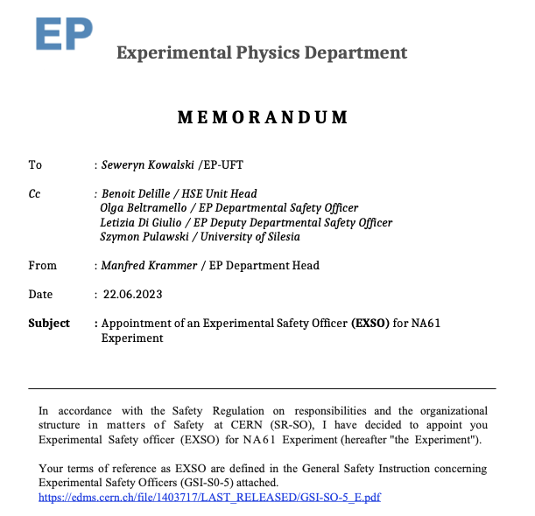
Role of the EXSO
Appointment
Appointment of the EXSO
EXSO is appointed by the Head of the Department hosting the Experiment in consultation with the DSO or home institution. The appointment is made in writing.
Notes:
The EXSO shall be appointed by the Head of the Department hosting the Experiment concerned from among Members of the Personnel, in consultation with the DSO and, if the EXSO is an associated Member of the Personnel, in consultation with his home institution.
Each appointment shall be made in writing.

Slide 14
Role of the EXSO
Wrap up
In general, the following should be part of the recurrent tasks for the EXSO:
Learn about the activities ongoing in the Experiment
Identify any new safety elements in the Experiment
Make sure the Safety File is always up to date
Introduce yourself to staff as their primary safety contact
Communicate to the EP Safety Correspondent or other Safety Officers about safety issues in your experiment
Promote safety within your Experiment
Intervene in case of an immediate danger
Make sure incident reports are filed
…

Slide 15

Experiment Safety Officer
Safety Validation Process
Experiments at CERN
Role of the EXSO
Safety validation process
Experiment Safety File

Slide 16






Safety Validation Process
Process Phases
For a new/upgraded Experiment, the main phases of this process are:
Safety declaration of the Experiment (or of its upgrade)
Delivery of the main safety requirements for operation
EP Safety Validation Process
Delivery of Safety Permit
Safety organization for worksite activities (dismounting/installation/modification)
Guidelines
EDMS 1884757
Delivery of EP Safety Clearance
Implementation of safety requirements for operation
It is a live process, following the entire lifecycle of an Experiment!
Notes:
A specific document describes the Experiments safety validation process: EDMS 1884757
For a new/upgraded Experiment, the main phases of this process are:
Safety declaration of the Experiment (or of its upgrade) at early stage
Delivery of the main safety requirements for operation
Safety organization for worksite activities (dismounting/installation/modification)
Implementation of safety requirements
Delivery of Safety Permit (if any)
Delivery of EP Safety Clearance
The entire process is followed by the Project Leader/Technical Coordinator (management of the Experiment) with the support of the EXSO, and the help of the EP Safety Correspondent
This EP process can be interconnected with the HSE PESS (Project and Experiments Safety Support) process

Slide 17




Safety Validation Process
HSE PESS process
This EP process can be interconnected with the HSE PESS (Project and Experiments Safety Support) process
Depending on the safety implications of the Experiment, HSE Unit might follow more closely the “project”. In this case, a PESS Correspondent is assigned
Initial Enquiry
Launch Safety Discussion
Project Safety Requirements
Project
Acceptance Report
Safety Authorisation
Initial conversation with PESS coordination member to determine the applicable level of service
Preliminary hazard identification, facilitated by the PESS Correspondent
Summary of requirements and recommendations given by HSE Specialists
Summary of the inspections and checks performed, with any outstanding actions identified
If required, for projects defined as liable to have Major Safety Implications
LSD
Regulatory
Framework
PSR
PAR
Safety Authorisation

Slide 18
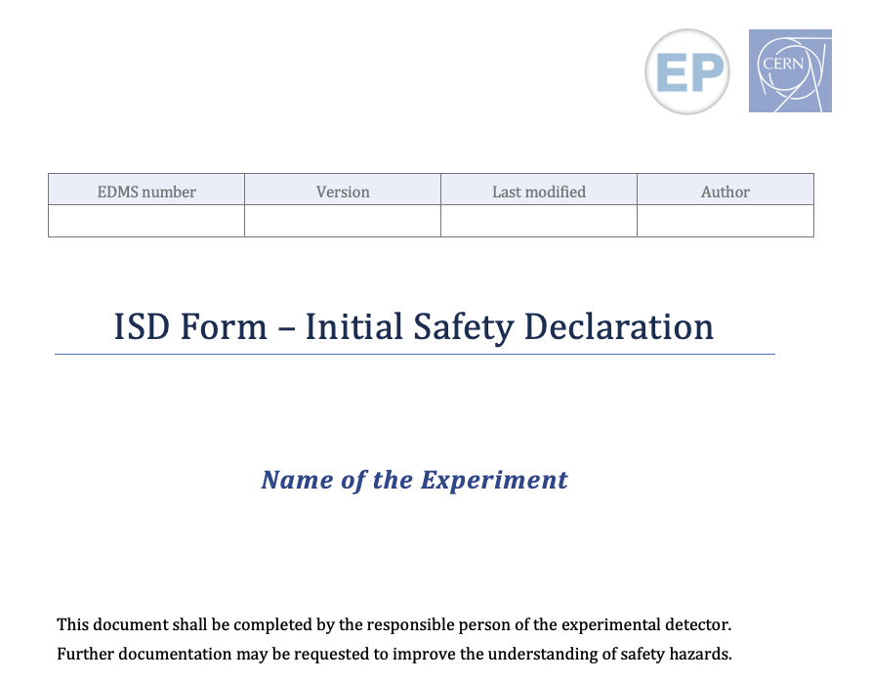
Safety Validation Process
Safety declaration of the Experiment
Safety declaration of the Experiment (or of its upgrade)
The declaration is done via the ISD (Initial Safety Declaration) form, containing:
  Description of the Experiment
  Estimated schedule
  Preliminary hazards identification
The ISD is reviewed by the EP Safety Office and distributed to HSE to confirm if the project will be followed by PESS.
At this stage, an EP Safety Correspondent is assigned to the Experiment.
Some Experiments might still have the information above in the form of an ISIEC (Initial Safety Information on Experiments at CERN) document (older template).
The EXSO (if already appointed) should support the Experiment’s hierarchy in the creation of this document
The EP Safety Correspondent reviews this document with the Experiment, making sure all hazards have been identified
Notes:
The safety declaration is done (as early as possible) via the ISD (Initial Safety Declaration) form, containing:
Description of the Experiment (safety related)
Estimated schedule (if applicable)
Preliminary hazards identification
The ISD is reviewed by the EP Safety Office and distributed to HSE to confirm if the project will be followed by PESS (if that is the case, an LSD – Launch Safety Discussion document is created)
At this stage, an EP Safety Correspondent is assigned to the Experiment
Some Experiments might still have the information above in the form of an ISIEC (Initial Safety Information on Experiments at CERN) document (older template)

Slide 19

Safety Validation Process
Delivery of the main safety requirements
Delivery of the main safety requirements for operation
Considering the hazards declared in the ISD, the related safety requirements are given, as:
    Specific regulatory requirements to be followed
    Needed engineering documentation and risk assessments
    Operational procedures and trainings requirements
    Technical safety inspections and tests to be performed
    …
These requirements are discussed with the Experiment and can be revised during its lifecycle
Where can you find the list of requirements?
    If the Experiment is followed by PESS, in the HSE Project Safety Requirements (PSR) form (delivered by the PESS Correspondent)
    If not, in the EP Memorandum of Safety Requirements (delivered by the EP Safety Correspondent/DSO)
The EP Safety Correspondent supports the EXSO in fulfilling the safety requirements given

Slide 20
Safety Validation Process
Safety organization for worksite activities
Safety organization for worksite activities (dismounting/installation/modification)
Safety declaration of the Experiment (or of its upgrade)
This phase will be detailed in the next module of the training, which will cover:
    Roles and responsibilities for worksite activities
    IMPACT tool
    What is a VIC
    The CERN EROS team
    …

Slide 21

Safety Validation Process
Operation Safety
Implementation of safety requirements for operation
1. The given safety requirements shall be fulfilled:
    All required engineering documentation, risk assessments and operational procedures verified by the EP Safety Correspondent and the HSE specialist and approved by the Experiments hierarchy
    All needed control measures implemented
    All safety inspections performed; all remarks solved
    Trainings followed by the required personnel
    …
    2. Once all requirements have been fulfilled, a final safety visit on site is organized (e.g. EXSO, EP Safety Correspondent)
    3. If no blocking remarks are found, the green light is given to start operation:
  EP Memorandum of Safety Clearance. Operations can start after the reception of this document!
  And (if PESS), HSE Project Safety Acceptance (PSA) + HSE Safety Authorization, in case of major safety implication (case-by-case, declared by HSE)
Depending on hazards present, access conditions, etc. for some of the Experiments it is requested to have dedicated online/classroom courses, specific Experiment based. If needed, contact the EP Safety Correspondent for support on the creation of this training!
Notes:
The operational safety aspects of the Experiment are usually treated before or during the installation phase (to avoid delay for operations)
Depending on hazards present, access conditions, etc. for some of the Experiments it is requested to have dedicated online/classroom courses, specific Experiment based. If needed, contact the EP Safety Correspondent for support on the creation of this training!

Slide 22
Safety Validation Process
Delivery of EP Safety Clearance
Delivery of EP Safety Clearance
Operations can start after the reception of this document.
The delivery of the EP Memorandum of Safety Clearance is based on:
    The content of the Experiment Safety File at the moment of the delivery
    The status of the Experiment during the final safety visit on site
Renewal: A new EP Memorandum of Safety Clearance might be needed in the following cases:
    “Significant” upgrade of the Experiment (case-by-case, to be checked with EP Safety Correspondent)
    Additional detector/equipment bringing new hazards
    Periodical renewal (i.e. after a YETS or LS)
Independent from the renewal of the EP Safety Clearance, general and electrical safety inspection of the premises with the EP Safety Correspondent is mandatory before the start of operations, after every YETS.
New ISD form
Always keep your EP Safety Correspondent aware of all changes!

Slide 23
Safety Validation Process
Safety Permit
Delivery of Safety Permit
It is a specific permission to carry on with a certain operation or commissioning activity and it is composed of a list of controls, which are signed by the corresponded responsible persons (via EDMS)
One Experiment could have multiple Safety Permits, depending on the hazards present
Safety Permit could be needed at different stages of the safety process
A specific document describes the Safety Permits:
EDMS 1536514
The need for a specific Safety Permit will be communicated well in advance by the EP Safety Correspondent.
Notes:
Examples:
Beam Permit, for a beam line/Experiment
Source Permit, for the usage of a particular source
Cool-down Permit, for a specific cryogenic installation
…
One Experiment could have multiple Safety Permits, depending on the hazards present
To be noted that a Safety Permit could be needed at different stages of the safety process, depending on when you will need to carry on the operation/activity linked to the permit

Slide 24
Safety Validation Process
Activity

Slide 25
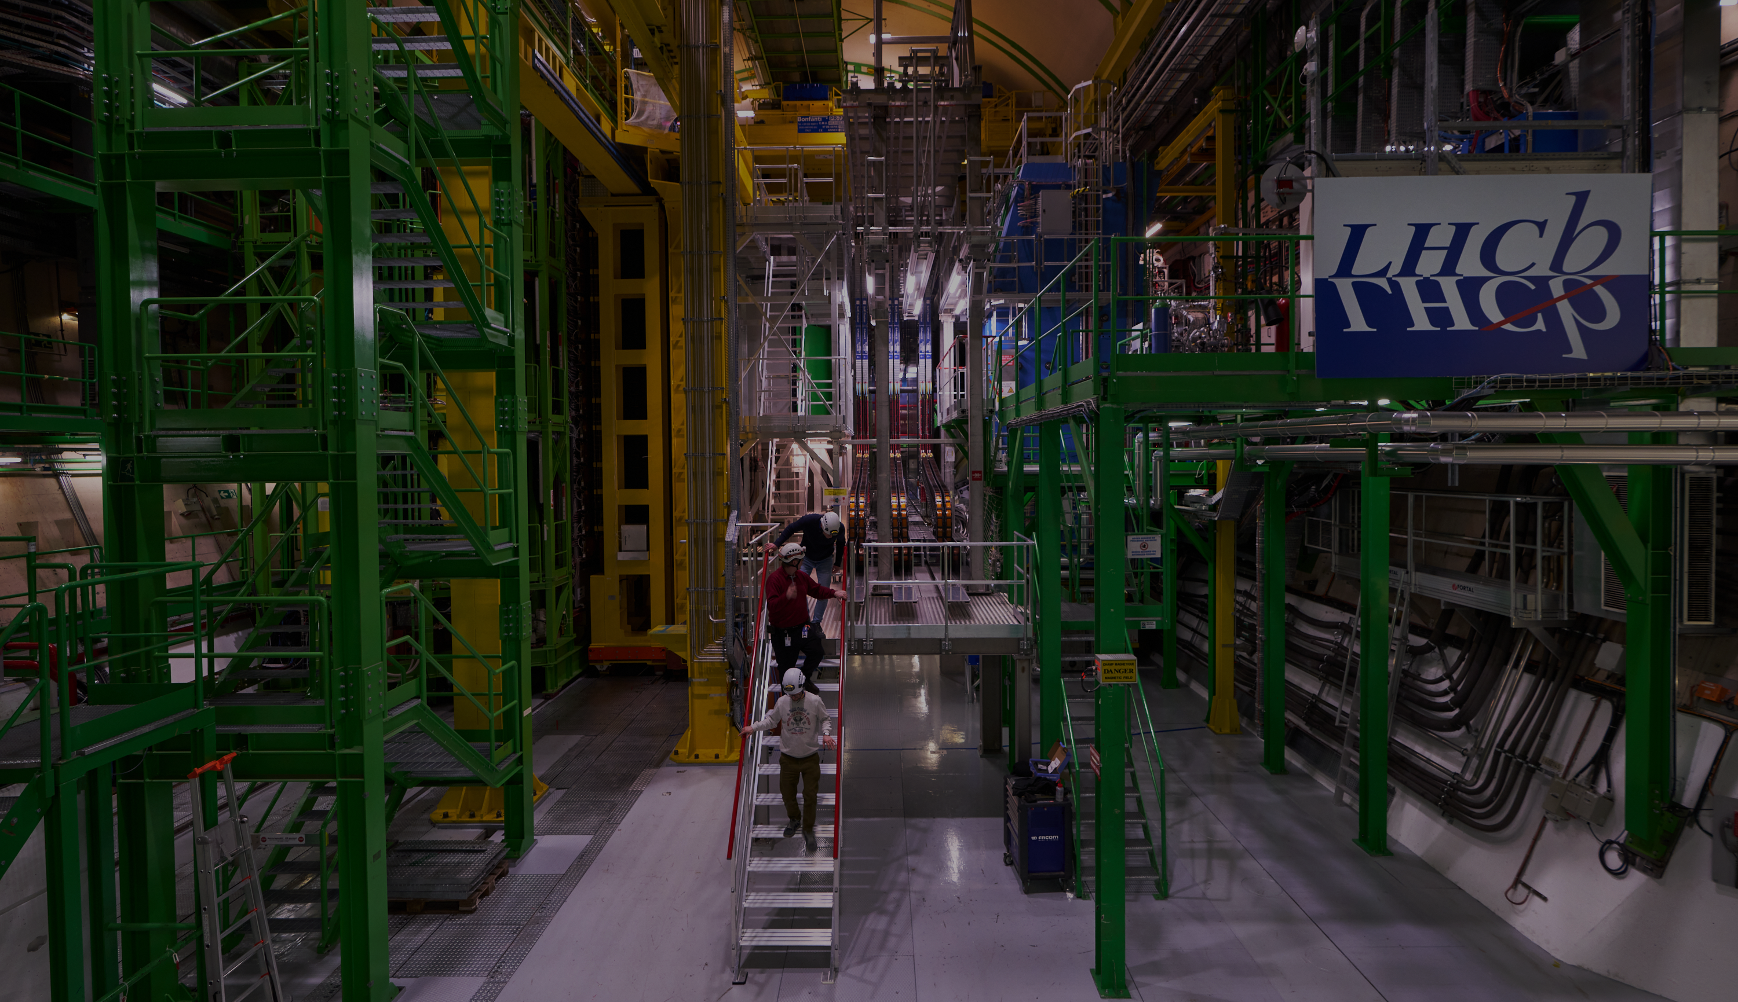
Experiment Safety Officer
Experiment Safety File
Experiments at CERN
Role of the EXSO
Safety validation process
Experiment Safety File

Slide 26




Experiment Safety File
Introduction
Experiment Safety File
A set of documents aiming to demonstrate that a certain Experiment is designed, installed and operated according to CERN safety principles.
The EXSO is the Safety File editor for their Experiment. The EP Safety Correspondent can provide support to the editorial work.
The official repository for the Safety File is EDMS. Safety file has a specific EDMS folder structure, which, upon request from the Host States, can be “translated” into specific documents.
Is alive and continuously updated during the lifecycle of the Experiment with relevant documents.
EDMS = Engineering and Equipment Data Management Service
edms.cern.ch
Notes:
Following the CERN Safety File Management documents (EDMS 1177755 - https://edms.cern.ch/document/1177755/4.0 and 785546 - https://edms.cern.ch/document/785546/4.0), the official repository for the Safety File is EDMS.

Slide 27
Experiment Safety File
Structure
Following the CERN Safety File Management, the Safety File is composed of four parts:
  Descriptive
  Demonstrative
  Maintenance and Operation
  Record and Monitoring (REM)
To be noted that also different structures for the Experiment Safety File are accepted (i.e. ISO45001)!
Experiment X Safety File
Notes:
Instructions:
The trainer clicks on the button and familiarizes participants with the Safety File structure and documents (10-15 min)
Descriptive:
This part is composed of all documents/information that provide a description of the Experiment in terms of safety.
The ISD - Initial Safety Declaration (or the ISIEC - Initial Safety Information on Experiments at CERN, if the Experiment was operational before 2020) document is part of this section.
If PESS, also the LSD – Launch Safety Discussion is found here.
Demonstrative
This part “shall make the demonstration that all hazards and risks are identified, that all risks are assessed and that appropriate mitigation measures are taken.”
In the Safety File EDMS structure, this part can be divided into sub-folders (i.e. by risk or by subsystem of the Experiment).
Usual documents part of this section are: mechanical calculations and related HSE specialist verification, risk assessments, drawings, CE certificates, etc.
Maintenance and operation
This part is composed of all safety relevant procedures, needed for the maintenance and operation of the Experiment.
In this section there are usually: emergency procedures, shifters procedures, specific operational procedures to cover certain activities within the Experiment, etc.
Record and Monitoring (REM)
This part is a repository for documents providing evidence that safety procedures have been applied
In this section there are usually: safety clearances, safety permits, incident reports, safety and inspection reports, etc.
The safety procedures related to installation activities (i.e. PPSPSs, Work Package, tasks sheets) can be stored in a dedicated folder in this section of the Safety File.

Slide 28
Experiment Safety File
Case study
Open Experiment X Safety File:
Review Safety File, its structure AND read the guidelines
Present a case study
1
https://edms.cern.ch/project/CERN-0000257244
2
3
Notes:
Instructions:
Participants get familiar with the Safety file on their own (10 min)
Participants are divided into groups (2-3 ppl)
A case study is given (10-15 min prep) (e.g. “A new laser room is to be installed in your experiment, prepare a plan consisting of tasks to be completed regarding the Safety File update”)
10 min presentation by each group followed by a short debrief

Slide 30
Safety Validation Process
EP Safety Process
For a new/upgraded Experiment, the main phases of this process are:
Safety declaration of the Experiment (or of its upgrade)
Delivery of the main safety requirements for operation
It is a live process, following the entire lifecycle of an Experiment!
Safety organization for worksite activities (dismounting/installation/modification)
Experiments safety validation process guidelines
EDMS 1884757
Implementation of safety requirements for operation
Delivery of EP Safety Clearance
Delivery of Safety Permit
Notes:
A specific document describes the Experiments safety validation process: EDMS 1884757
For a new/upgraded Experiment, the main phases of this process are:
Safety declaration of the Experiment (or of its upgrade) at early stage
Delivery of the main safety requirements for operation
Safety organization for worksite activities (dismounting/installation/modification)
Implementation of safety requirements
Delivery of Safety Permit (if any)
Delivery of EP Safety Clearance
The entire process is followed by the Project Leader/Technical Coordinator (management of the Experiment) with the support of the EXSO, and the help of the EP Safety Correspondent
This EP process can be interconnected with the HSE PESS (Project and Experiments Safety Support) process

