Slide 1
Story size: Page format is 16:9 (1920x1080p)
Be aware:
Mobile can be implemented. In this case, design should be reviewed and adapted accordingly. To the current stand, responsive design cannot be generated using Storyline 3.
1/4 of
page size
EXPERIMENT SAFETY OFFICER
EXSO
EDMS No. xxxxxxx

Slide 2

Objectives
By the end of this course, you will be able to:
Understand the role and responsibilities of the Experiment Safety Officer (EXSO).
Integrate safety aspects throughout the life cycle of an experiment.
Gain insight into the organizational structure at CERN and the EP Safety procedure.
Get familiar with specific hazards present in the Experiment(s)
2

Slide 3

EXperiment Safety Officer
Specific Hazards
Specific Hazards
Extended
Functions

Slide 4

Specific Hazards
Introduction
Mission
Training
EXSO: Awareness of all hazards generated by the Experiment, support their declaration and follow-up for compliance with the CERN Safety Rules
Experiment: Responsibility to have control measures in place for each hazard to reduce the risk to an acceptable level
Highly recommended that EXSOs follow the safety training related to the hazards present in their Experiment, as described in the next pages
Support
EP Safety Correspondent
Specialised Safety Officers (SSOs) within the EP Safety Office (full list available on the EP Safety Office website)
HSE specialists
4

Slide 5

Specific Hazards
Radiation Protection
Hazard and risks
Specifics
Resources
Panel signs
Buffer Zone (TREC point, temporary storage, waste container, vacuum cleaners)
TREC (TRaceability of Equipment at CERN) computer point
Patrol – occurs before sending the beam to a certain line to ensure that nobody is present in the area
  Specific patrol procedure for Experiment: start/validate patrol, path followed
  Patrol requirements: only trained personnel (with ADamS access right)
  Training given by BE-EA physicists
RP training (on LMS):
  “Radiation Protection – Awareness”, mandatory for everyone on CERN site
  “Radiation Protection – Supervised Area”, mandatory for entering Supervised Areas
  “Radiation Protection – Controlled Area”, mandatory for entering Controlled Areas
  Additional RP training, specific for a certain zone
  Support Network
  Radiation Protection Officer (RPO)
  EP Radiation Safety Officer (RSO)
  Radiation Protection Expert (RPE)
  CERN Safety Rules
The majority of the experiments are installed within Classified Radiation Areas
5
Notes:
The classification at CERN is based on the effective dose a person is liable to receive during their stay in the area, in normal working conditions. Reference document is the CERN Area Classification (S3/GSI1): EDMS 810149
PATROL
The Experiments concerned have a specific patrol procedure containing:
How to start/validate the patrol
The path to be followed inside the beam area, with the position of the patrol search boxes
Only trained personnel (with the correspondent ADaMs access right) can patrol a certain area:
The Experiment usually has trained personnel within their collaboration
The patrol training is usually given by the BE-EA physicists – contact them for any question on this subject!
Resources:
Every beam facility has a reference Radiation Protection Officer (RPO) – the list can be found here https://espace.cern.ch/RP-LHC/DivDocs/RP-AS-Contacts-LastUpdate.pdf. Make sure you know the contact of the RPO related to your Experiment!
In the EP Safety Office it is present a Radiation Safety Officer (RSO), available to be contacted in case of need. The updated list of EP Safety Officers contacts can be found on the EP Safety Office website https://ep-th-safety.web.cern.ch/team
Some Experiments have the internal support of the Radiation Protection Expert (RPE), a person within the collaboration, who is qualified to perform operational RP tasks (i.e. perform dose measurements, give advice to ensure effective protection of individuals)

Slide 6
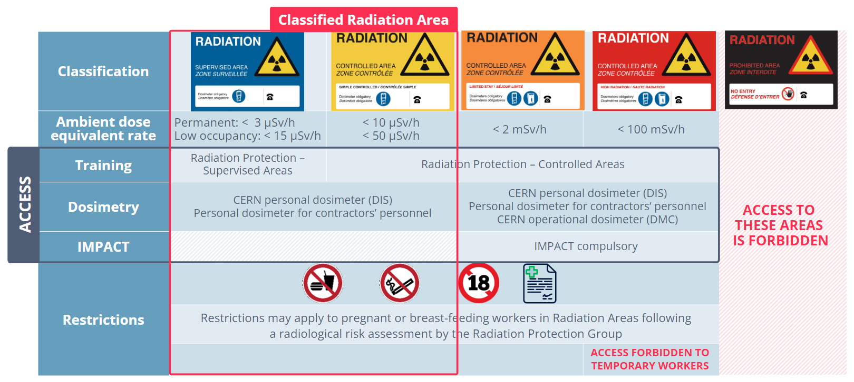
Specific Hazards
Radiation Protection – Area Classification
Usually, Experiments are placed within this area
6

Slide 7

Specific Hazards
Chemical Safety
Hazard and risks
Specifics
Resources
SDS (Safety Data Sheet, provided by the supplier): for each chemical product used in the Experiment - uploaded on the Safety File.
Attire: closed-toe shoes, long trousers and sleeves (or lab coat), protective gloves and safety glasses must be worn when handling chemical products
CERES platform (CERN Chemical Register for Environment, Health and Safety)
Storage (according to the CERN Safety Guideline SG-C-1-0-1): clearly labelled and stored in original containers in a chemical cabinet and returned there after use.
Training (on LMS):
Chemical Safety – Awareness (mandatory or users handling chemicals OR working in an area where chemical hazards exist).
Additional training if necessary
  Support Network
  Chemical Safety Officer (ChSO)
  HSE specialists
  CERN Safety Rules
  SR-C “Chemical Agents”
  GSI-C-1 “Prevention and Protection Measures”
A variety of hazards related to chemical safety are present within different Experiments
7
Notes:
Safety Measures: Use the CERES Help page if you need or contact the EP Safety Office!
Resources:
Training: Additional trainings might be necessary, depending on the chemical used (outcome of specific risk assessment)
For the CERN Stores Catalogue, the SCEM code of chemical hazard pictograms belong to the group 55.50 (https://edh.cern.ch/edhcat/Browser?command=searchItems&argument=&top=&objid=$$EDH84764biib&showAdvanced=&scem=50.55&keywords=)
Poisonous substances, even at small doses, can pose a serious health risk, in the short or long term, and may even result in death.

Slide 8

Specific Hazards
Chemical Safety - Lead
Hazard and risks
Specifics
Resources
Lead shall be used only as shielding; any other use is discouraged
Bricks in degraded state are not to be used (can be sold and new ones purchased via the EP Safety Office)
If manipulation of degraded bricks is needed (i.e. time constraint; special shape), specific training and PPEs are to be delivered to the workers. Contact your EP Safety Correspondent for details!
Correct storage and handling
HSE Guideline
EP Lead Safety Procedure
Lead bricks in a degraded state
(ruined protection layer, oxidized)
Lead
Presents health risks (i.e. headaches, nausea, damage to kidneys, cancer), which can be developed after long exposure to lead, through:
  Inhalation of lead dust or fumes
  Ingestion of lead dust
8
Notes:
Lead bricks are often found in Experiments in a degraded state: ruined protection layer, oxidized. Bricks in this condition might expose the workers to the health risk above

Slide 9

Specific Hazards
Chemical Safety – Waste Management
Hazard and risks
Specifics
Resources
The chemical product owner is solely responsible for their chemical products from purchase, during use and until they have been correctly disposed of.
For the disposal of gas bottles, a practical guide made by the HSE Unit is available
The ADR agreement is applicable for transport on or between the CERN sites
Training (on LMS):
“Transport of Chemical Products and Chemical Waste” (for all waste)
“Transport of Chemicals in Limited Quantities (LQ)” (for small quantities, quantity limit defined in the ADR regulations for the transport of dangerous goods)
  Support Network
  SCE Department - gestion-des-déchets-chimiques@cern.ch
  HSE Department - safety-chemistry@cern.ch
Waste Management
9
Notes:
The chemical product owner is solely responsible for their chemical products from purchase, during use and until they have been correctly disposed of. This includes the empty containers. Additional users should be informed of correct use by the product owner
The online training must have been followed before asking for support!

Slide 10

Specific Hazards
Flammable Gas Safety
Hazard and risks
Specifics
Resources
Procedure:
  The Experiment creates a descriptive document (incl. procedures and flow diagrams), which is sent to the FGSO.
  The FGSO completes (with HSE Expert):
    Safety Form C-2-0-1 (Explosion Risk Assessment)
    Safety Form C-2-0-2 (Hazardous area classification – ATEX Zones)
  After the FGSO’s green light, Experiment completes the Safety Form C-2-0-3 (Declaration of the use of Flammable Gas)
Training (on LMS):
  “ATEX Accreditation - Level 1”
  “ATEX Accreditation - Level 2”
  Support Network
  Flammable Gas Safety Officer (FGSO)
  HSE specialists
  Support webpage
  CERN Safety Rules
  GSI-C-2 “Explosive atmospheres”
  SG-C-2-0-1 “Explosion protection measures”
  SG-C-2-0-2 “Identification and prevention of explosion hazards”
When flammable substances are mixed with air, they can create an explosive atmosphere
(ATEX = ATmosphere EXplosive)
10
Notes:
Safety Measures:
Resources:

Slide 11

Specific Hazards
Cryogenic Safety
Hazard and risks
Specifics
Resources
A risk assessment might be required for handling or operations with cryogens
Portable and fixed ODH detectors are available via CERN services
Training (on LMS):
  “Cryogenic Safety – Awareness”
  “Cryogenic Safety – Fundamentals”
  Support Network
  Cryogenics Safety Officer (CSO)
  HSE specialists
  CERN Safety Rules
  GSI-M-4 “Cryogenic Equipment”
  SG-M-4-0-1 “Cryogenic equipment”
  Support webpage
A gas is defined as cryogenic if it can be liquified at or below 123 K at atmospheric conditions
Main cryogenic hazards:
  Cold surfaces and vapor → burns
  Oxygen Deficiency Hazard (ODH) → asphyxia
  Pressure release → damage to people and equipment
11
Notes:
Safety Measures:
Resources:

Slide 12

Specific Hazards
Electrical Safety
Hazard and risks
Specifics
Resources
  Experiment’s collaborators - trained for the electrical activities that they will have to perform
Training (on LMS):
  “Electrical Safety – Working in EP Experiments” (4h) – highly recommended
  Electrical Safety
  Support Network
  Electrical Safety Officer (ESO)
  HSE specialists
  electrical-safety-specialist@cern.ch
  Safety Rules
Electrical hazards are present in every Experiment
12
Notes:
Electrical risks are present in every Experiment – it is highly recommended for EXSOs to enroll to the classroom training “Electrical Safety – Working in EP Experiments” (4h) and advertise this training within the collaboration
Experiment’s collaborators shall be trained for the electrical activities that they will have to perform
The EP Electrical Safety Officer (ESO) is present to support you in the tasks above (contact on the EP Safety Office website), together with the HSE specialists, reachable on the contact electrical-safety-specialist@cern.ch

Slide 13


Specific Hazards
Electrical Safety - Trainings
15 min
½ day
3 days
Course/Activity | Electrical Safety Awareness (online) | Working in EP Experiments (classroom) | Habilitation Electrique (hybrid)
Access to CERN site, plug & unplug equipment | Mandatory | N/A | N/A
Design experiment distribution
Secure plugs for work on modular equipment
Measurements based on written procedure
Measurements without a written procedure
Lock-out, other tasks
13

Slide 14

Specific Hazards
Laser Safety
Hazard and risks
Specifics
Resources
  Lasers (class 3B and above) must be registered at CERN (NIRREG Database) and follow specific CERN Safety Rules
  Designated Laser Area (DLA) established for each laser installation with a nominated responsible (LSSO)
  Safety visits with the EP Laser Safety Officer (LSO)
  Laser Safety File (template here)
Training (on LMS):
  "LSSO" Classroom training
  “Laser - User” Online training
  Support Network
  EP Laser Safety Officer (LSO)
  Laser Safety Support Officer (LSSO – mandate in GSI-SO-14)
  Safety Rules
Risks related to laser beam can range from mild skin burns to irreversible injury of skin or eyes
14
Notes:
Risks related to laser beam can range from mild skin burns to irreversible injury to skin or eyes
For this reason, all lasers of class 3B and above must be registered at CERN (NIRREG Database) and follow specific CERN Safety Rules
For each laser installation, a specific Designated Laser Area (DLA) must be established
For each DLA, a responsible person must be nominated, with the role Laser Safety Support Officer (LSSO – mandate in GSI-SO-14), and appropriately trained
The training available regarding laser safety are:
"LSSO" Classroom training
“Laser - User” Online training
Safety visits with the EP Laser Safety Officer (LSO) are to be organized and a specific Safety File to be created (template here)

Slide 15
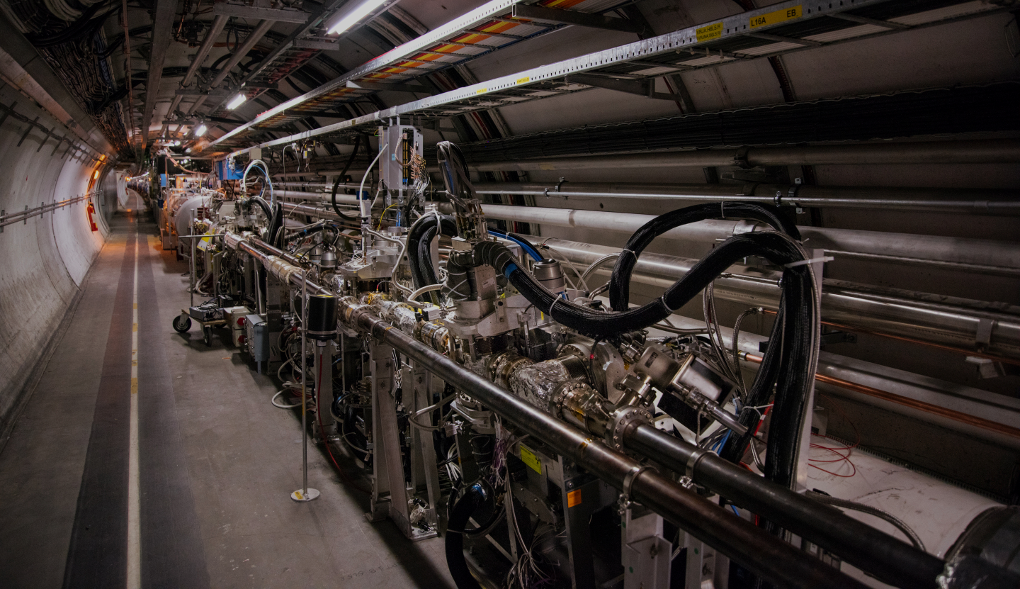
EXperiment Safety Officer
Extended Functions
Specific Hazards
Extended Functions

Slide 16
Extended Functions
Safety in laboratories and mechanical workshops
Different Experiments usually have a certain number of related laboratories and mechanical workshops
Part of the role of an EXSO is to be aware about the existence of these areas and make sure at least one responsible person exists for each. The EXSO should put in contact the responsible person with the EP Safety Correspondent
The responsible person, with the support of the EP Safety Correspondent, will proceed with the needed safety assessment of the infrastructure/activities done in the laboratory or workshop
Mechanical Workshop
Experiment (experimental area)
Laboratory 1
Laboratory 2
16

Slide 17
Extended Functions
Safety in laboratories and mechanical workshops
Laboratories
Workshops
Possibility of multiple activities occurring in parallel
Conformity to CERN Safety Rules: general infrastructure and different test set-up/activities carried on
Activity responsible shall be present for each activity or set-up
The EXSO and the activity responsible ensure that the information about the certain activity/set-up is transmitted to the EP Safety Corresponded and that no undeclared activities are performed
Declaration: each set-up or activity (or group of activities) fill the template ”Description and Hazard identification for EP Set-up/Laboratory”, where also the operational procedures are specified
A mechanical workshop is defined from the moment at least one fixed mechanical machine/tool is present
Workshop Supervisor must be officially nominated (and ideally, a Deputy). A specific CERN rule describes the mandate of this role: GSI-SO-12. They shall ensure that (not exhaustive list):
  machines conform to CERN Safety Rules and maintained in good state
  the Safety File of their workshop is up to date
  operators are provided with operating instructions of machines
  operators are briefed on safety measures implemented (i.e. presence AUL – Arret d’Urgence Local, first aid cabinet, chemical cabinet)
  …
17

Slide 18



Extended Functions
Emergency Preparedness
Emergency Guides
Planned Evacuations
Fire Safety
Emergency Guides (EG) - assigned to support the collaborators in case of emergency evacuation. The number of EGs depends on the size of the installation, the collaborators’ turnover, etc.
The EXSO should support in finding the EGs of the Experiment (and, ideally, be one!)
The building where your Experiment is placed could be subject to a planned evacuation
The EXSO should collaborate with the planned evacuation organizer.
EXSO could conduct periodical inspections for unused flammable materials and the placement of fire extinguishers.
Promote "Fire Extinguisher" training.
E-learning “Emergency evacuation “ is mandatory for everyone accessing the CERN site.
Classroom course “First Aid - Life-Saving Actions (1st responder)” is highly recommended.”
18
Notes:
Mandatory for everyone accessing the CERN site is the e-learning “Emergency evacuation”
Emergency Guides:
Each Experiment should have a certain number of Emergency Guides, to support the collaborators present at the experimental installation in case of emergency evacuation
The number of needed guides could depend on the size of the experimental installation, the collaborators turn over, etc. The EXSO should support in finding the Emergency Guides of the Experiment (and, ideally, be one!)
Planned Evacuations:
Periodically, the building where your Experiment is placed could be subject to a planned evacuation
The EXSO should collaborate with the planned evacuation organizer (i.e. by providing information about possible evacuation scenario or the period when the majority of the activities are on going)
Fire Safety:
EXSO could perform periodical inspections of their Experiments to check that no unused flammable material is stored (i.e. carton, wood), the fire extinguisher are at their correct placement
Encourage your collaborators to enroll in the “Fire Extinguisher” training!

