Slide 1
Reconstructions, Performances, and Systematics in ARCA
V. Kulikovskiy, M. de Jong
on behalf of the KM3NeT collaboration

Slide 2
Reconstructions, Performances, and Systematics in ARCA
Which data is actually reconstructed?
  PMT + redout basics,
  DAQ, filtering/triggering, event sample preparation.
Reconstructions and forecast for ARCA115 performance.
KM3-230213 event and uncertainties for ARCA21 data.

Slide 3

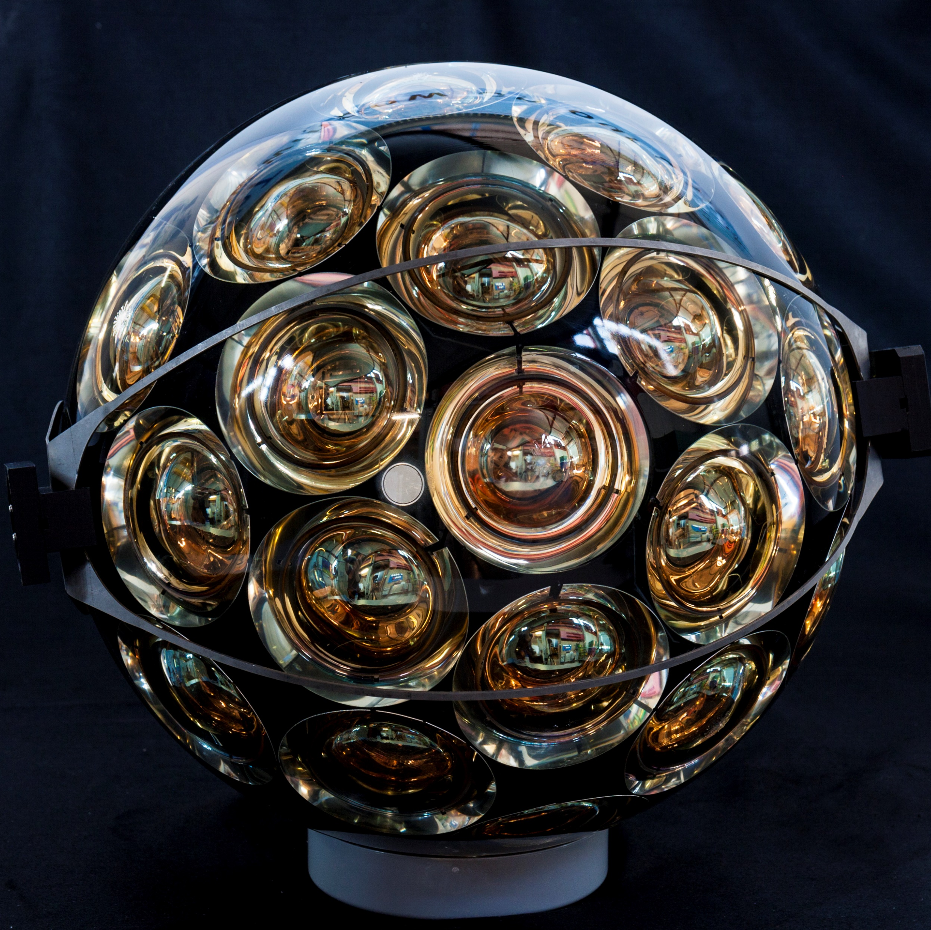
KM3NeT neutrino telescope
cosmic ray
chromatic
dispersion
2 km
light absorption
intensity
1 km
light
scattering
radioactivity
1 km
arrival time [ns]
atmospheric muon
cosmic neutrino

Slide 4
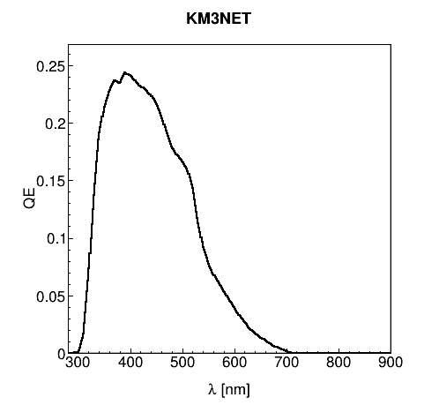
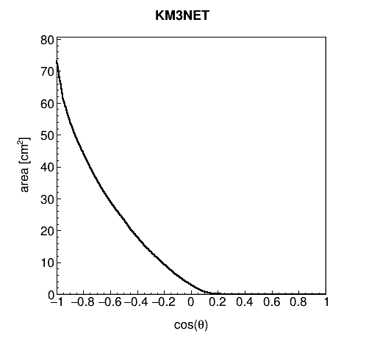
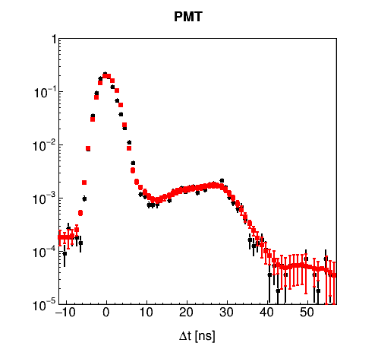
Light detection
a posteriori correction
QE (wl)
Area (theta)
Transit Time

Slide 5

Data processing (3/3)
Event
  cluster of hits: threshold 1/3p.e., Transit Time (TT), Time Over Threshold (ToT)
    normal: cluster of causally related L2 hits
    mixed: cluster of one L2 hit with causally related L0 hits
Note that
  different triggers can be applied to the same data $→$ trigger mask
  same event can be triggered multiple times $→$ number of overlays
  cluster algorithm is known in literature as “clique” $→$ useful in analysis
  you can trigger on anything (incl. external signals) $→$ augment science scope

Slide 6
Event data
trigger(s)
snapshot
{Snapshot hits,
{Triggered hits}
, Snapshot hits}
{ hit }
T_{min} - ΔT
T_{min}
T_{max}
T_{max} + ΔT
time
snapshot¶ = All raw data between [T_{min} - ΔT, T_{max} + ΔT]
¶ ΔT = nD/c (where D corresponds to size of detector)

Slide 7

Start value problem
$$5D=3D⊗2D$$
position-time
direction
wave front
$$R$$
$$\left({\overline{x}}_{i},t_{i}\right)$$
linear fit $\left(x_{0}\text{,} y_{0}\text{,} t_{0}\right)$
scan $\left(θ\text{, }φ\right)$
$$θ_{C}$$
$$z→$$
$${\overline{t}}_{j}^{2}−{\overline{t}}_{i}^{2}−2\left({\overline{t}}_{j}^{ }−{\overline{t}}_{i}^{ }\right) {\overline{t}}_{0}^{ } =$$
$$x_{j}^{2}−x_{i}^{2}−\left(x_{j}^{ }−x_{i}^{ }\right) x_{0} +$$
$$\left({\overline{x}}_{0},t_{0}\right)$$
$$y_{j}^{2}−y_{i}^{2}−\left(y_{j}^{ }−y_{i}^{ }\right) y_{0}$$
$${ct}_{i} ≅ ct_{0}+∆z+R\tan{θ_{C}}$$
$${\overline{t}}_{i}^{ }≡\frac{ct_{i}}{\tan{θ_{C}}}−\frac{z_{i}}{\tan{θ_{C}}}$$
$${\overline{t}}_{0}^{ }≡\frac{ct_{0}}{\tan{θ_{C}}}$$

Slide 8
Linear fit
$$y=Hθ$$
1 (0) solution
$\left(n×1\right)$ $\left(n×k\right)$ $\left(k×1\right)$
Statistical Methods in Data Analysis, W.J. Metzger, HEN-343

Slide 9

Reconstruction (3/3)
Model parameters
  orthogonalisation (following rotation of primary axis to z-axis)
    muon trajectory $\left(x_{0},y_{0},t_{0},T_{x},T_{y}[,E [,B_{y}]]\right)$ → M. De Jong
    shower $\left(x_{0},y_{0},z_{0},t_{0},T_{x},T_{y}[,E [,B_{y}]]\right)$ → A. Domi; J. Seneca, T. van Eden?
PDF
  contains as-much-as-possible knowledge of the detector response to particles
    Cherenkov light production
    light absorption, scattering and dispersion
    PMT QE, angular acceptance and TTS
    electronics (discriminator, TDC, etc.)
    background rates, high-rate veto, etc.

Slide 10
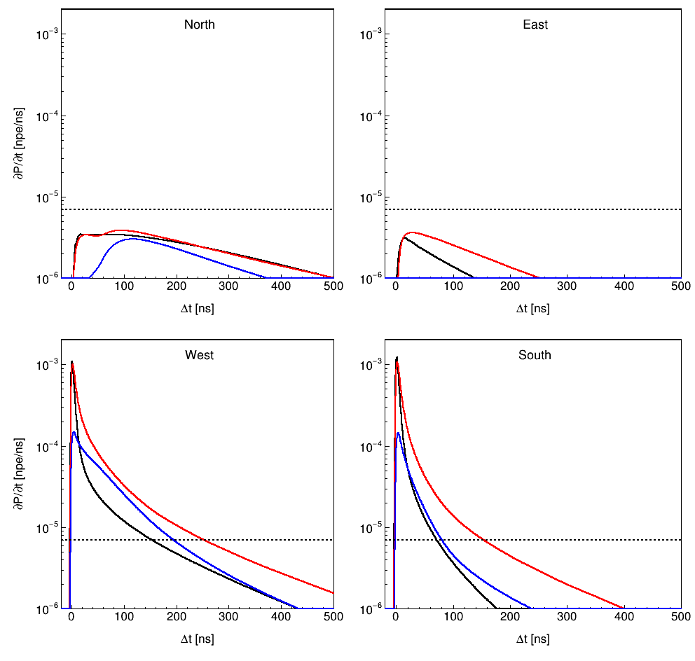
PDF of Cherenkov light
N
North
East
W
E
wave front
$$R$$
S
$$θ_{C}$$
West
South
– muon
– dE/dx
– δ-rays

Slide 11
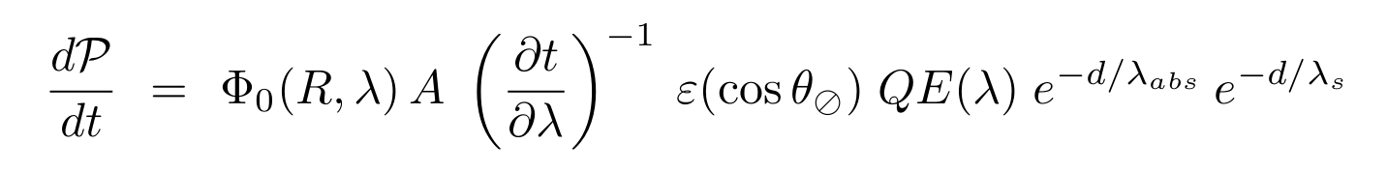
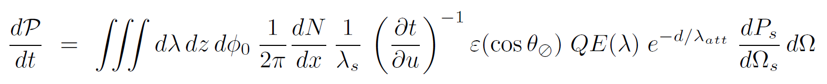
PDF of Cherenkov light
PDF can be calculated from first principles when [effective] scattering length is much larger than absorption length (see documentation)
$$\frac{1}{R}∝$$
$$∝\frac{1}{R}$$
$$\frac{∂N_{s}}{∂u}$$
$$\frac{1}{1−\cos{θ_{s}}}$$

Slide 12
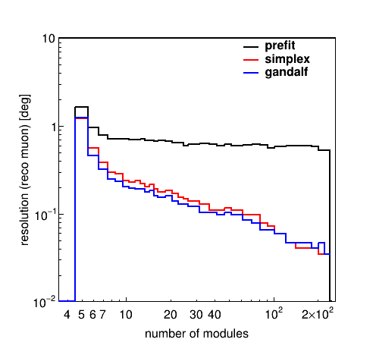
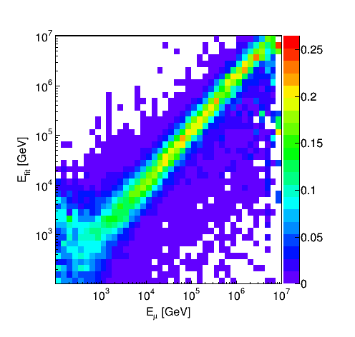
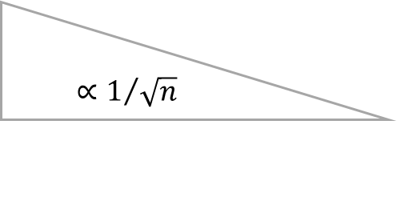

Final fit (3/3)
best of $N$
$$∝1/{\sqrt{n}}$$

Slide 13
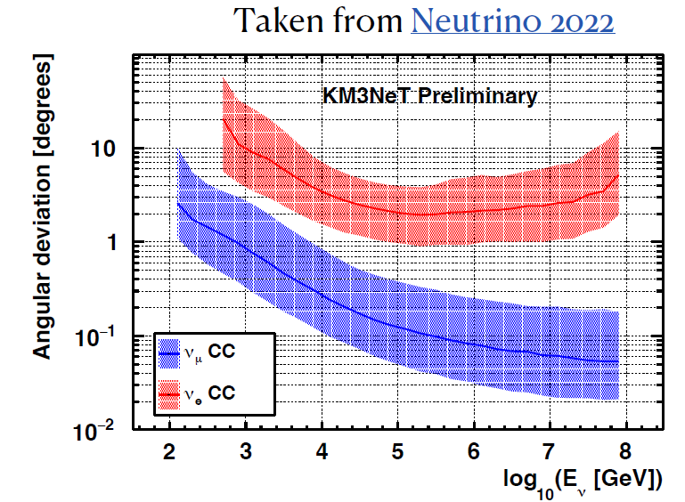
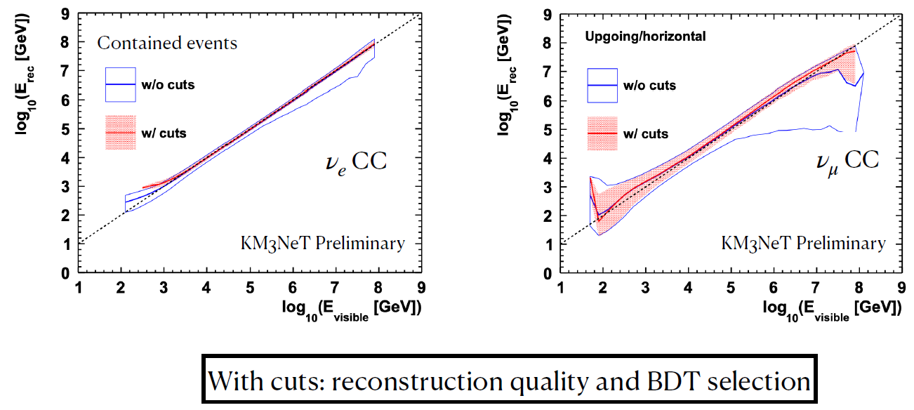
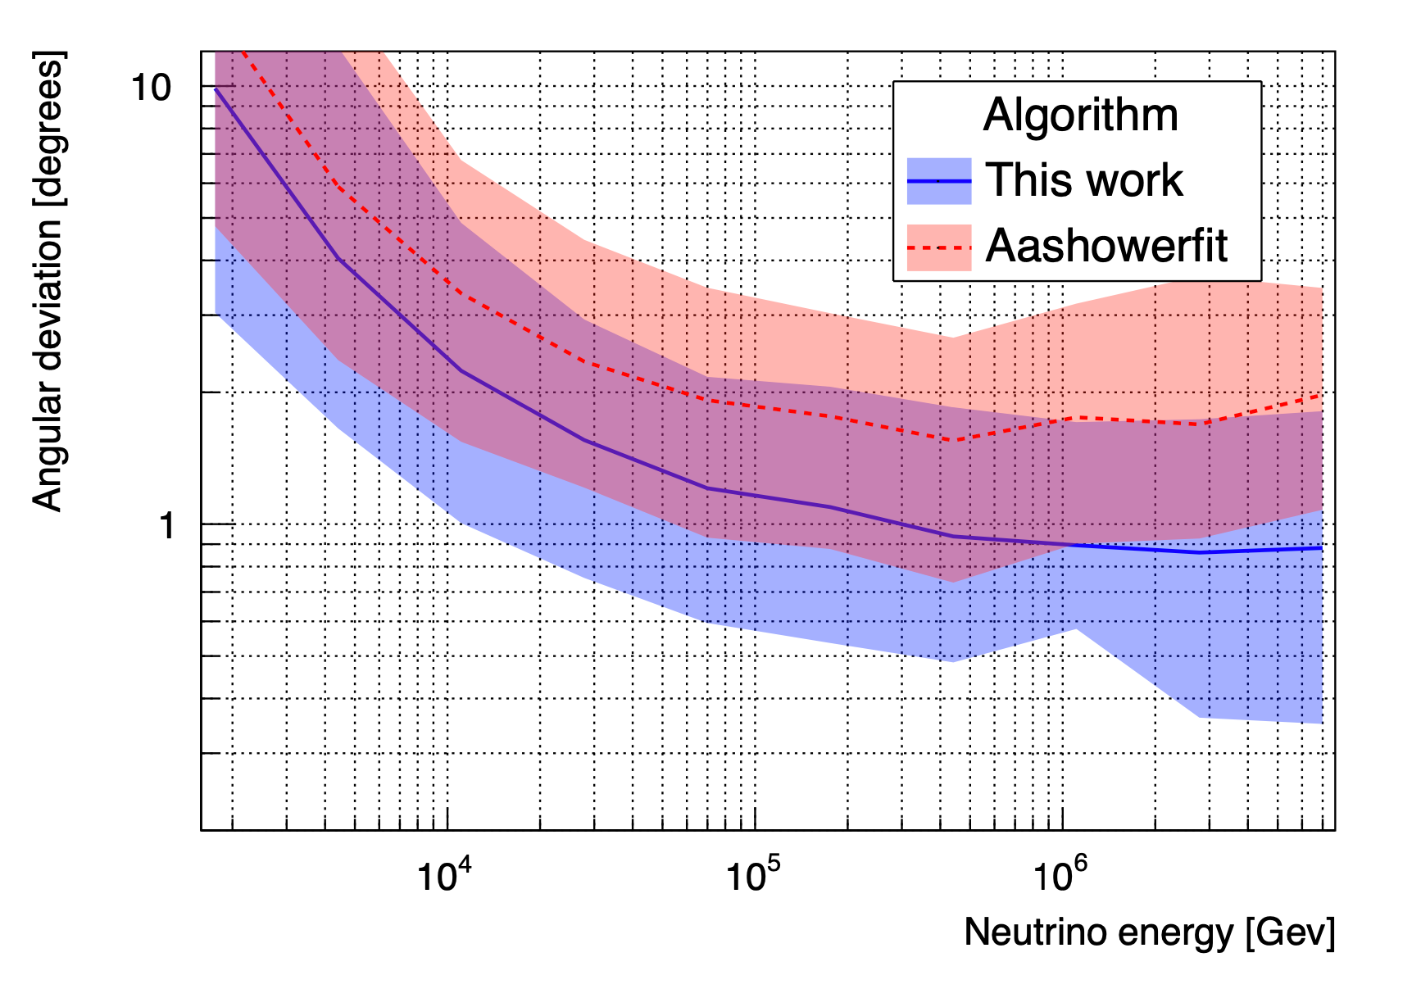
Angular resolution once completed
Neutrino 2022
Median angular resolution reaches
  0.06º for tracks
  2º for cascades (improved: <1 º)
arXiv:2205.02641

Slide 14
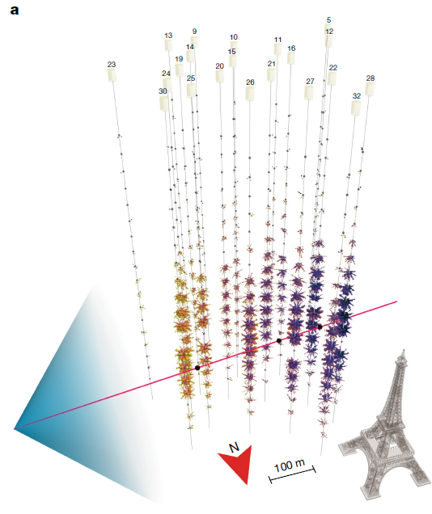
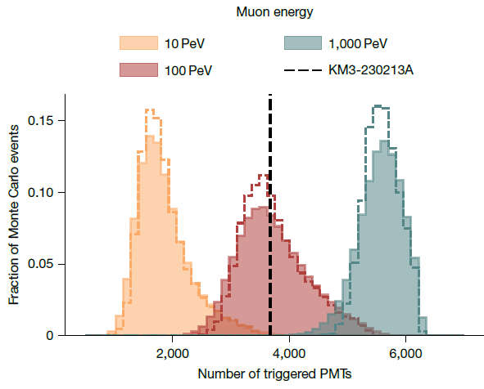
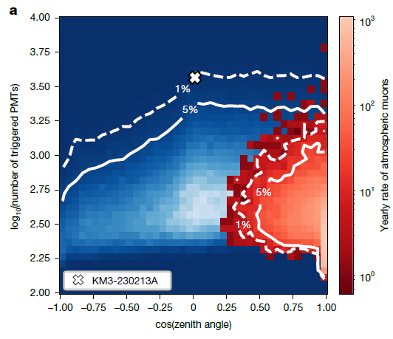
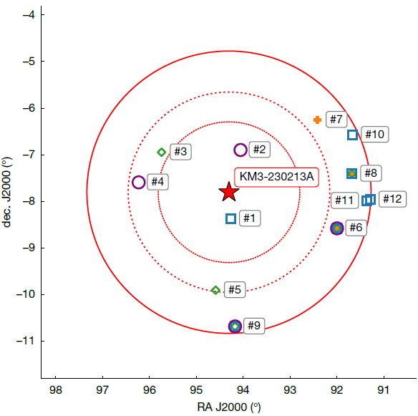
KM3-230213A
Exceptional even seen in ARCA21 data.
  Near-horisontal (near-horizontal, originating 0.6° above the horizon).
  Muon track reconstruction log-likelihood ratio of 1,415.2, which is the highest value observed in the 21-line ARCA data
  Estimated muon (neutrino) energy is 120⁺¹¹⁰₋₆₀ PeV (220 PeV)

Slide 15
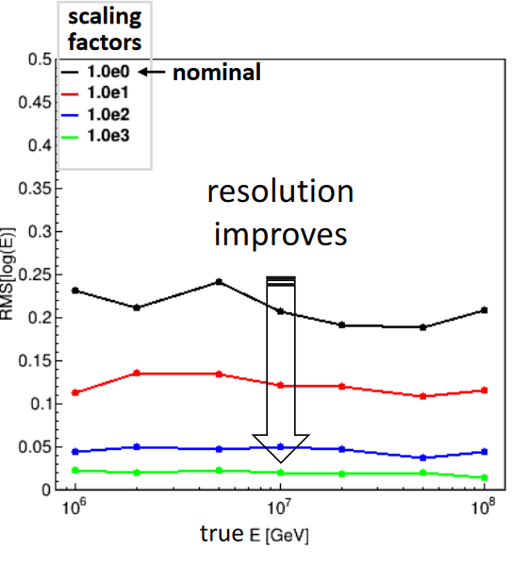
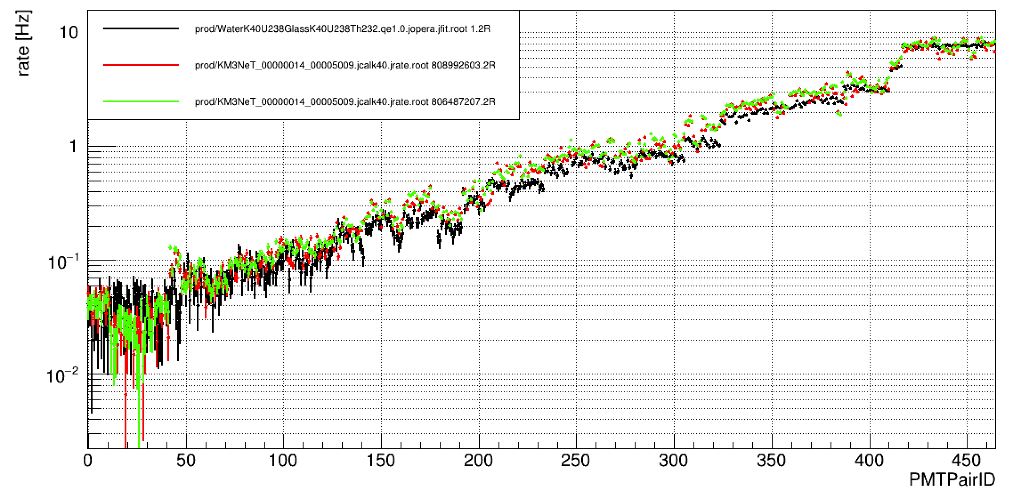
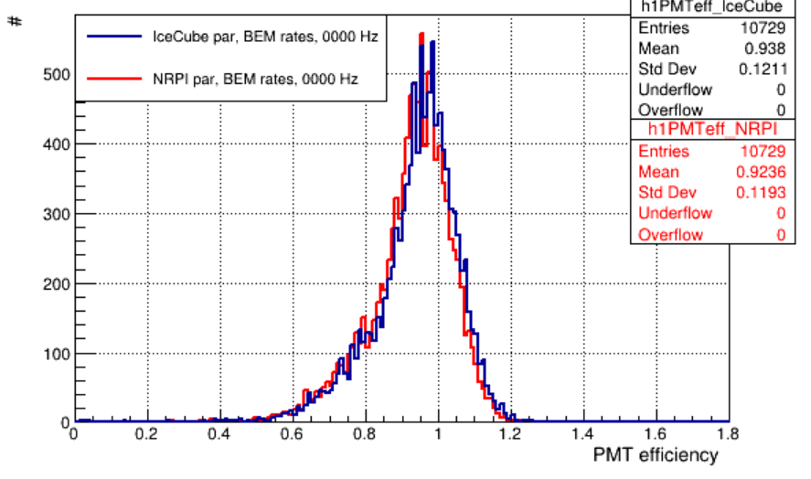
KM3-230213A
Test: Reduce interaction length and
energy loss of each process (M. De Jong)
Estimated muon (neutrino) energy is 120⁺¹¹⁰₋₆₀ PeV (220 PeV)
  log10(E) = 2.08±0.3, dominated by the stochastic nature of the energy losses.
  Scattering of light does not influence the energy estimate by more than several percent.
  The optical module efficiency has a <10% level effect on this estimation.
    Improved radioactive decays model is in progress + publishing.
  Light absorption:
    +10% (−10%) modification of the absorption length yields a
    −0.21 (+0.25) shift in the logarithm of the estimated energy.
    Work is ongoing: monitoring with nanobeacons (LED on each DOM), laser emitter (sea floor), atmospheric muons.
with vs w/o systematics.
Simulation and data agrees very well for each PMT pair.
New glass radioactivity measurements shift efficiencies by 1% (IEAP CTU/UNI-PRA, SURO)

Slide 16
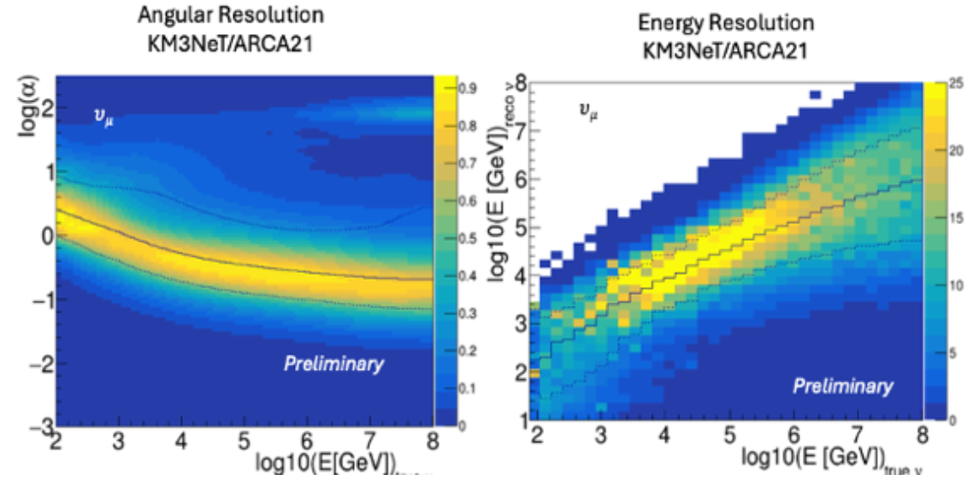
KM3-230213A
At 100 PeV, 50% (90%) of the muons are reconstructed within 0.12° (0.28°).
The absolute pointing uncertainty R(68%) = 1.5°is mostly due to uncertainty absolute orientation of the detector
Absolute orientation from the emitter positions (~10 m uncertainty measurement during marine operations).
  uncertainty of 1° on rotations of the detector around each of the three axes.
Deficit of atmospheric muons due to the Moon. 335 days of data, 3.2σ
  The largest significance was found for the nominal orientation. The corresponding uncertainty is evaluated by means of simulations to 0.24°.
Measured depths by the acoustic system shows aligned to within 1°. (comparison with bathymetry data).
Goal: reaching <1-m accuracy in each direction for emitters position + extra data for the Moon shadow analysis. Reaching systematics below reconstruction uncertainties. Re-calibration of already collected data is possible.
RICAP2024
ARCA115 forecast

Slide 17
Summary
Robust data taking and filtering. Scalability for the full detector.
Fast and precise reconstructions: easier case study due to uniformity of the water and light propagation.
Track direction reconstruction with sub-degree precision already with currently deployed detector.
  Absolute positioning to be improved and the work is in progress.
Track energy reconstruction is already dominated by irreducible stochastic nature of energy losses. Calorimetric measurements at VHE-UHE energies is not feasible.
  More detailed water absorption measurement and monitoring is in preparation.
  PMT efficiency calibration and monitoring is unique for multi-PMT design.
There are currently deployed 33 DUs in ARCA and new campaign is planned this summer together with new absolute positioning measurements.

