Slide 1



ATLAS RPC FOAM TECHNIQUE
STUDIES
Report
presenter: Ahmet Renklİoğlu
On behalf of atlas rpc R&D team
23.09.2024

Slide 2
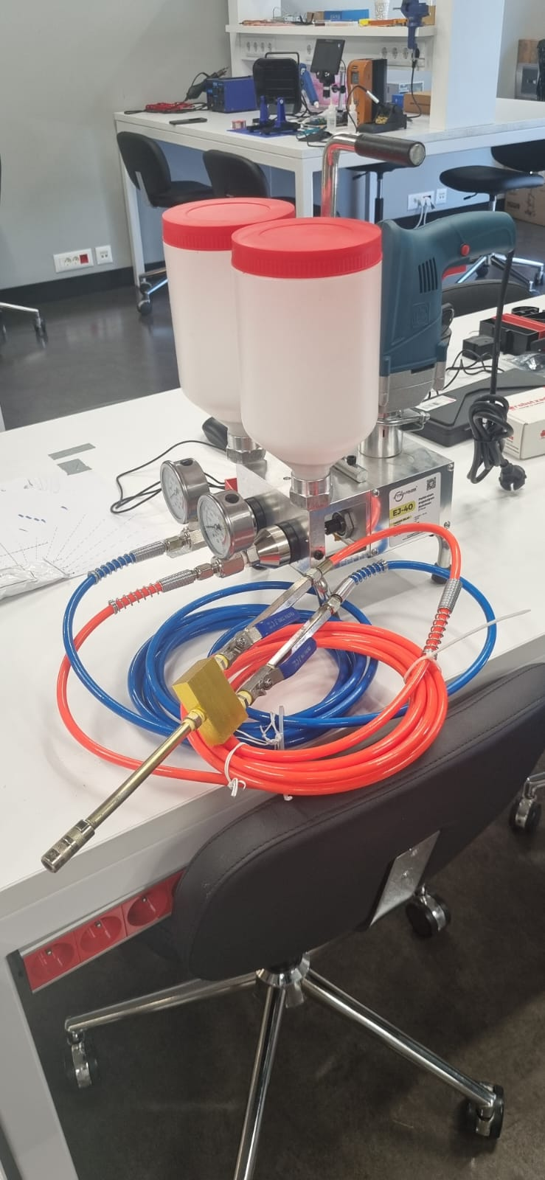
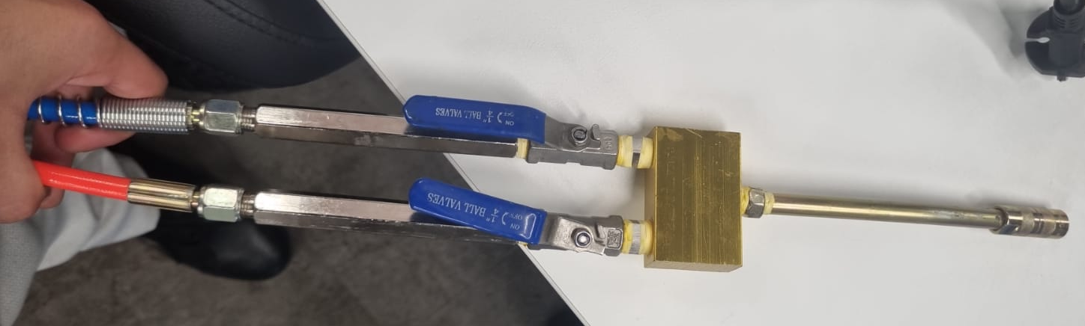
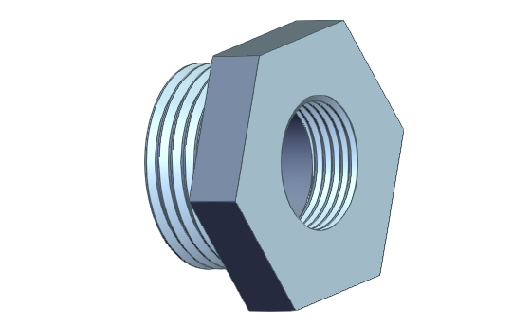
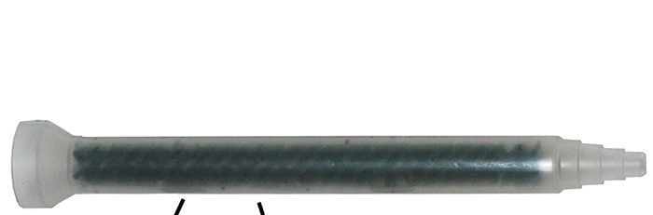
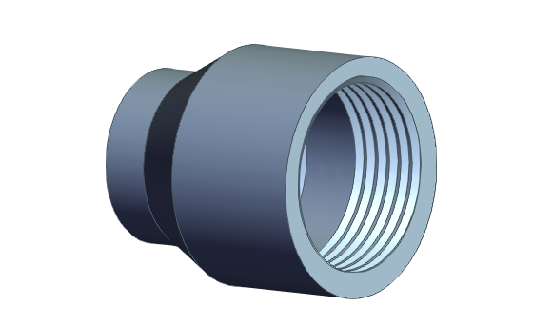
Connectıng the statıc mıxer to EJ-40
EJ-40 was carefully tested. The first tests were promising.
In order to ensure that the foam we obtain exhibits the desired properties, it is absolutely essential to use a static mixer!
We first designed a 3D Connector between static mixer and the tip of EJ-40.
  We printed the design using PLA+ filaments; however, during testing, we observed that the threads of this connector melted, leading to leaks.
  Subsequently, we selected aluminum as the material and ordered the necessary part. However, the order has not yet arrived.
  Currently, we are both waiting for the aluminum part to arrive and working on another connector design that we will print using PETG filaments.
23.09.2024

Slide 3

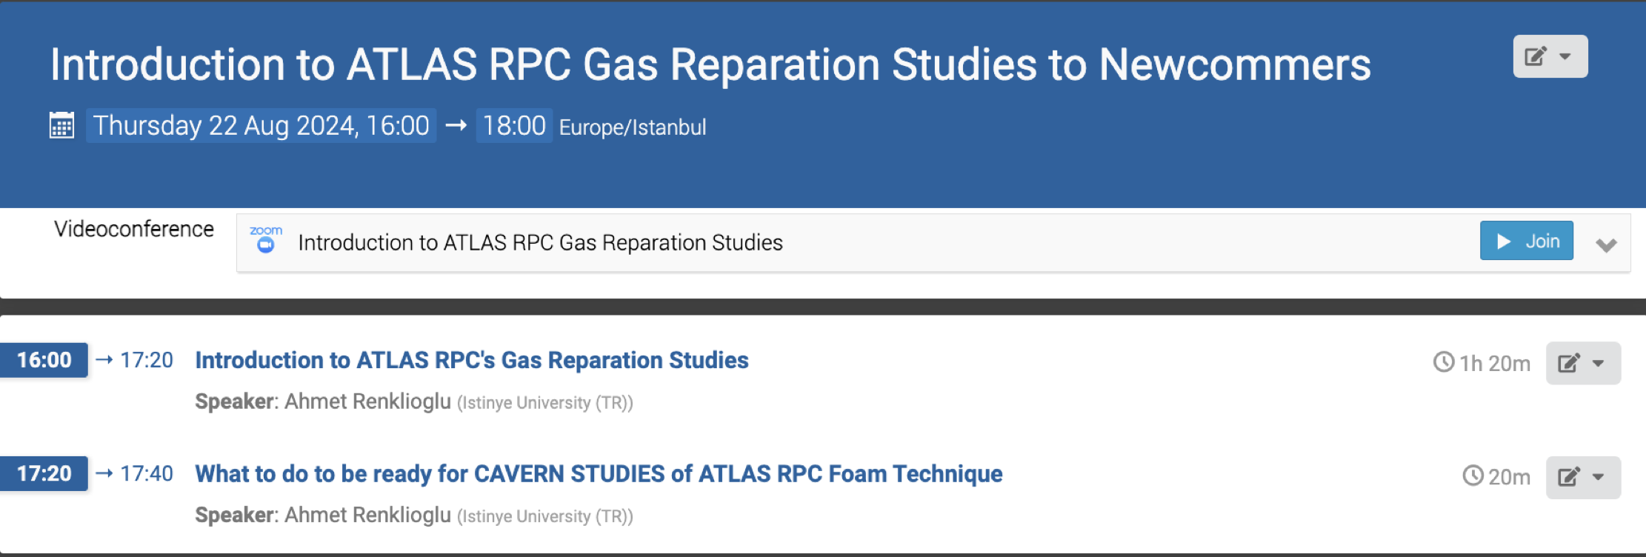
New engineers who will work in the ATLAS Cavern have been trained
New engineers who will work in the ATLAS Cavern have been trained
Hilal Koç - hilal.koc@cern.ch , Electrics and Electronics Engineer, Computer Engineering Master Student
Tuğrul Göl - tugrul.gol@cern.ch, Electrics and Electronics Engineer, Computer Engineering Master Student
  1 Theoretical Orientation Presentation
    Technical Information about ATLAS Cavern and ATLAS RPC Gas System
    The details of the technique
    Working Conditions and Challenges
  1 Hands-On Session in Laboratory for the Injection Step. (4 Hours training)
  Weekly Training
Name | Experience | YETS 24/25
Ahmet Renklioğlu | 3 YETS | 6 Weeks
Orhan Seyrek | 2 YETS | 12 Weeks
Taha Batuhan İlhan | 2 YETS | 12 Weeks
Aydın Özbey | 3 YETS | -
Tuğrul Gök | 0 YETS | 12 Weeks
Hilal Koç | 0 YETS | 12 Weeks
Amine İclal Akın | 0 YETS + R&D Studies | 5 Weeks
Elif Tuğ | 0 YETS + R%D Studies | 5 Weeks
23.09.2024

Slide 4
Summary of avalıbılıtıes for Yets 24/25
Name | Experience | YETS 24/25
Ahmet Renklioğlu | 3 YETS | 4 Weeks
Aydın Özbey | 3 YETS | -
Orhan Seyrek | 2 YETS | 12 Weeks
Taha Batuhan İlhan | 2 YETS | 12 Weeks
Tuğrul Gök | 0 YETS | 12 Weeks
Hilal Koç | 0 YETS | 12 Weeks
Amine İclal Akın | 0 YETS + R&D Studies | 4 Weeks
Elif Tuğ | 0 YETS + R%D Studies | 4 Weeks

Slide 5
ATLAS RPC FOAM TECHNIQUE
R&D STUDIES UNTIL NEXT YETS24/25
Thank You
ATLAS RPC Gas Repair Meeting
23.09.2024

