Slide 1
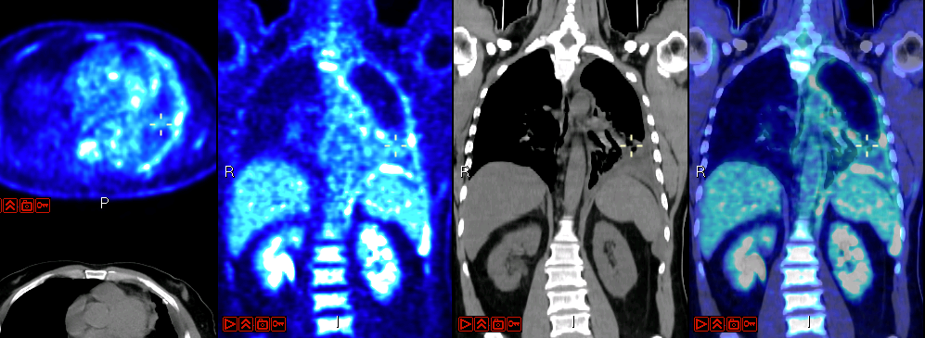

CERN-MEDICIS ANNIVERSARY – DECEMBER 11, 2024
Relevance of MEDICIS for nuclear medicine
Prof. John Prior, PhD MD
Nuclear Medicine and Molecular Imaging, Lausanne University Hospital

Slide 2

MARIE SKŁODOWSKA-CURIE ACTIONS
Innovative Training Networks : H2020
“MEDICIS-produced radioisotope beams for medicine”

Slide 3
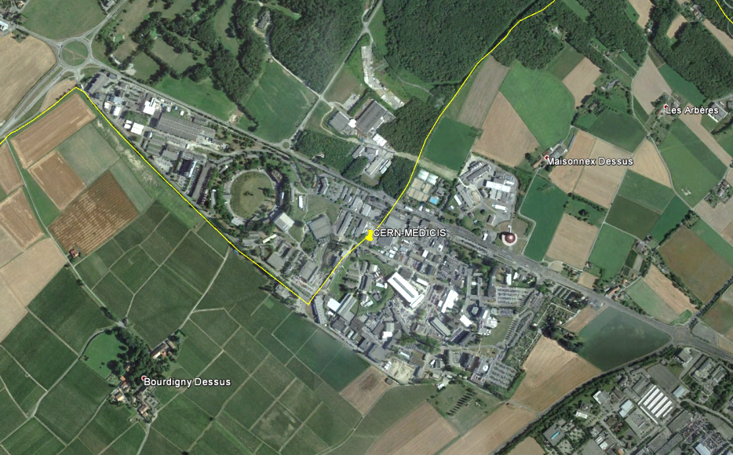


MEDICIS : linked to ISOLDE
ISOLDE
CERN site Meyrin

Slide 4
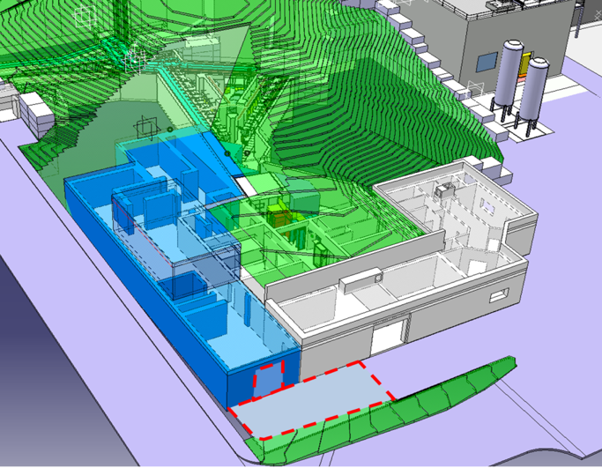
CERN-MEDICIS
First worldwide facility dedicated to mass-separated radioisotope beams for medical applications

Slide 5





CERN-MEDICIS
World-unique facility for novel radioisotopes: CERN-MEDICIS

Slide 6
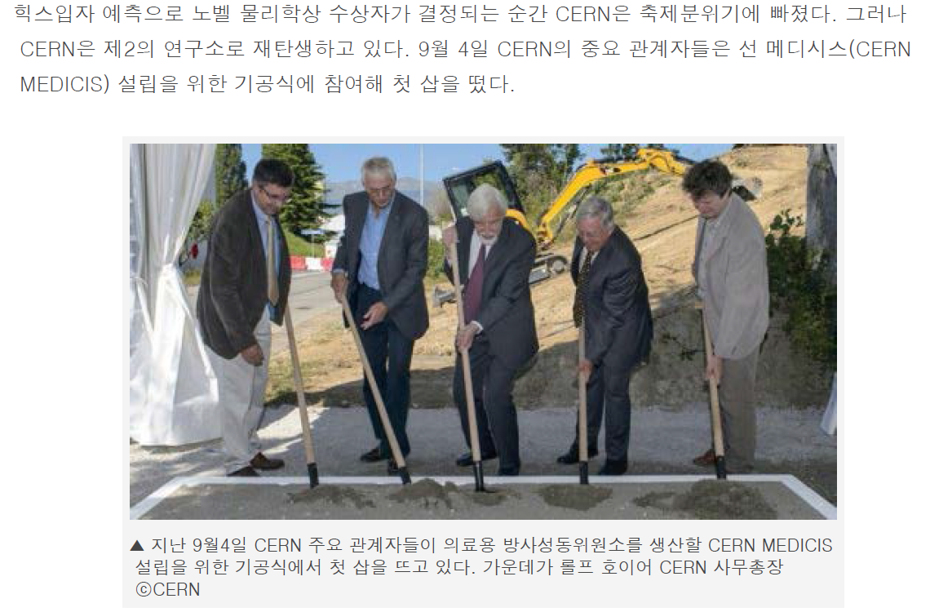
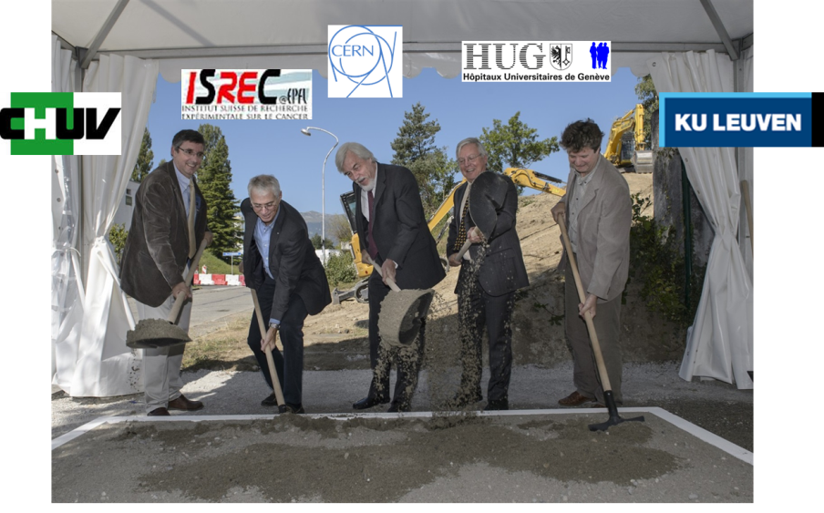
Ground breaking ceremony 4.9.2013
9 | 10 | 11 | 12 | 1 | 2 | 3 | 4 | 5 | 6 | 7 | 8 | 9 | 10 | 11 | 12 | 1 | 2 | 3 | 4 | 5 | 6 | 7 | 8 | 9 | 10 | 11 | 12 | 1 | 2 | 3 | 4 | 5 | 6 | 7
2013 |  |  |  | 2014 |  |  |  |  |  |  |  |  |  |  |  | 2015 |  |  |  |  |  |  |  |  |  |  |  | 2016

Slide 7
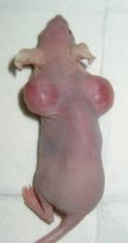
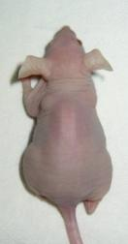
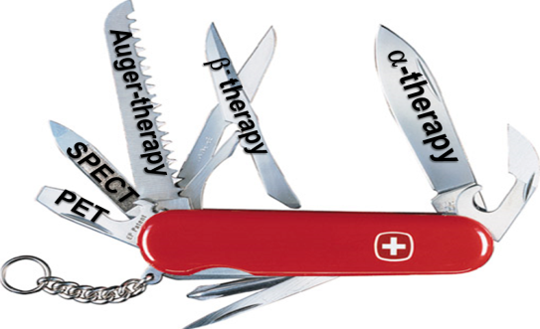

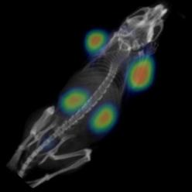






Terbium: Swiss Army Knife of Nuclear Medicine
¹⁴⁹Tb-therapy
¹⁵²Tb-PET
¹⁶¹Tb-therapy
& SPECT
¹⁵⁵Tb-SPECT
Müller et al., JNM 2012

Slide 8
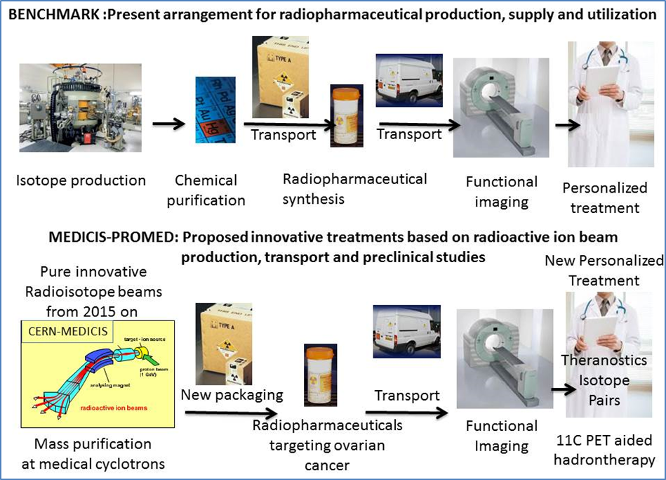
In 2015 CERN-MEDICIS became the first worldwide facility dedicated to mass-separated radioisotope beams for medical applications.
Its network, consisting of university hospitals, hadron therapy centers and isotope distribution entrepreneurial companies across France, Italy and Switzerland, is leading the field of oncological research, imaging and personalized treatments.
It will act as the seed for the extended MEDICIS-PROMED network and train a new generation of entrepreneurial scientists to develop systems for new personalized treatments throughout Europe.
(T. Stora, 2014)

Slide 9
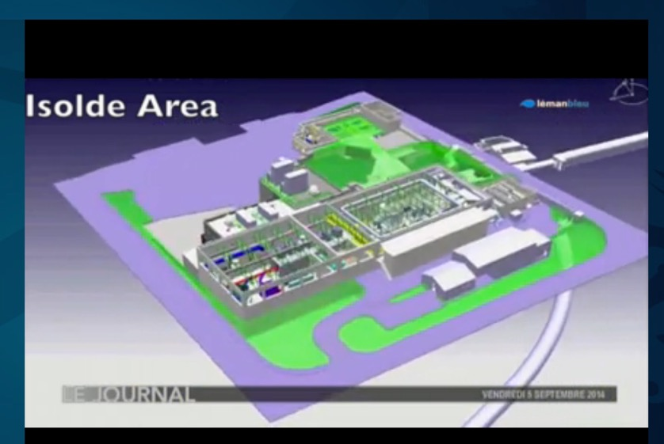
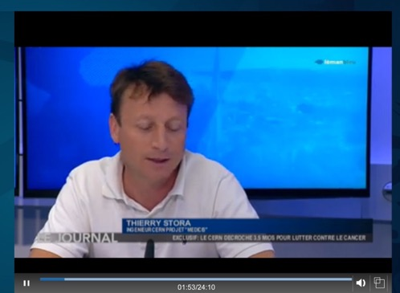

H2020: Marie Curie ITN – € 3.9 mio.
For training 15 PhD within CERN–MEDICIS
CERN-CHUV-HUG-EPFL

Slide 10
MEDICIS Journey
2nd Collaboration Board
4th Collaboration Board
5th Collaboration Board
2014
2019
2020
2018
Medicis Day
https://indico.cern.ch/event/342013/
https://indico.cern.ch/event/882074/
2024
6th Collaboration Board (TODAY!)

Slide 11
Potentials of Theranostics

Slide 12
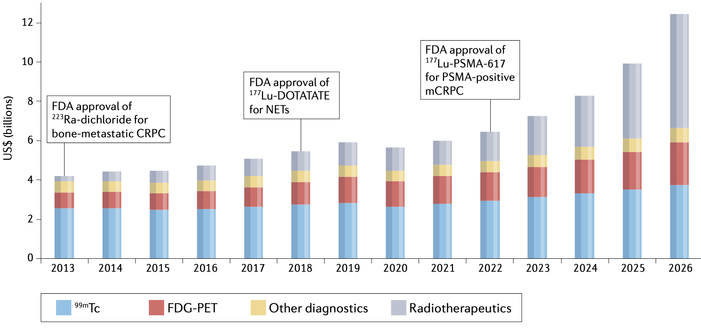
Predicted Nuclear Medicine Market 2013–26
Bodei et al. Nat Rev Clin Oncol 19, 534–550 (2022).

Slide 13
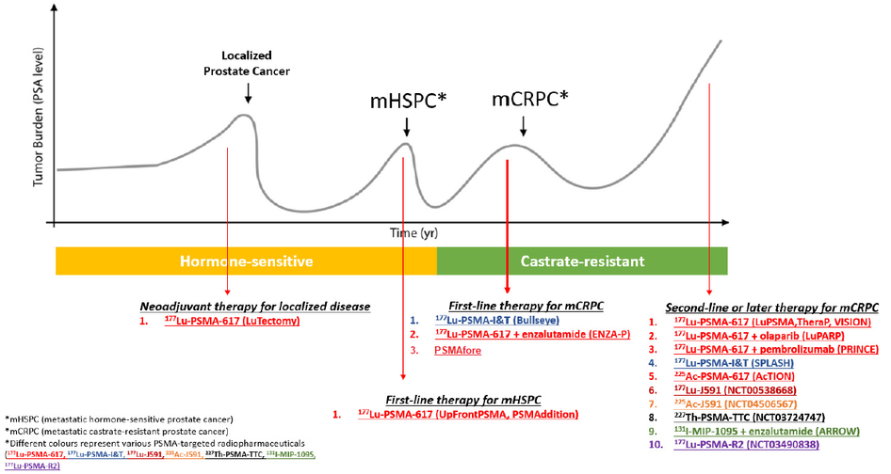
PSMA Theranostics Clinical Trials
Poor prognosis of metastatic prostate cancer
17 theranostics clinical trials (as of 2021)
Zhang,et al. Cancers 2021, 13, 4023.

Slide 14
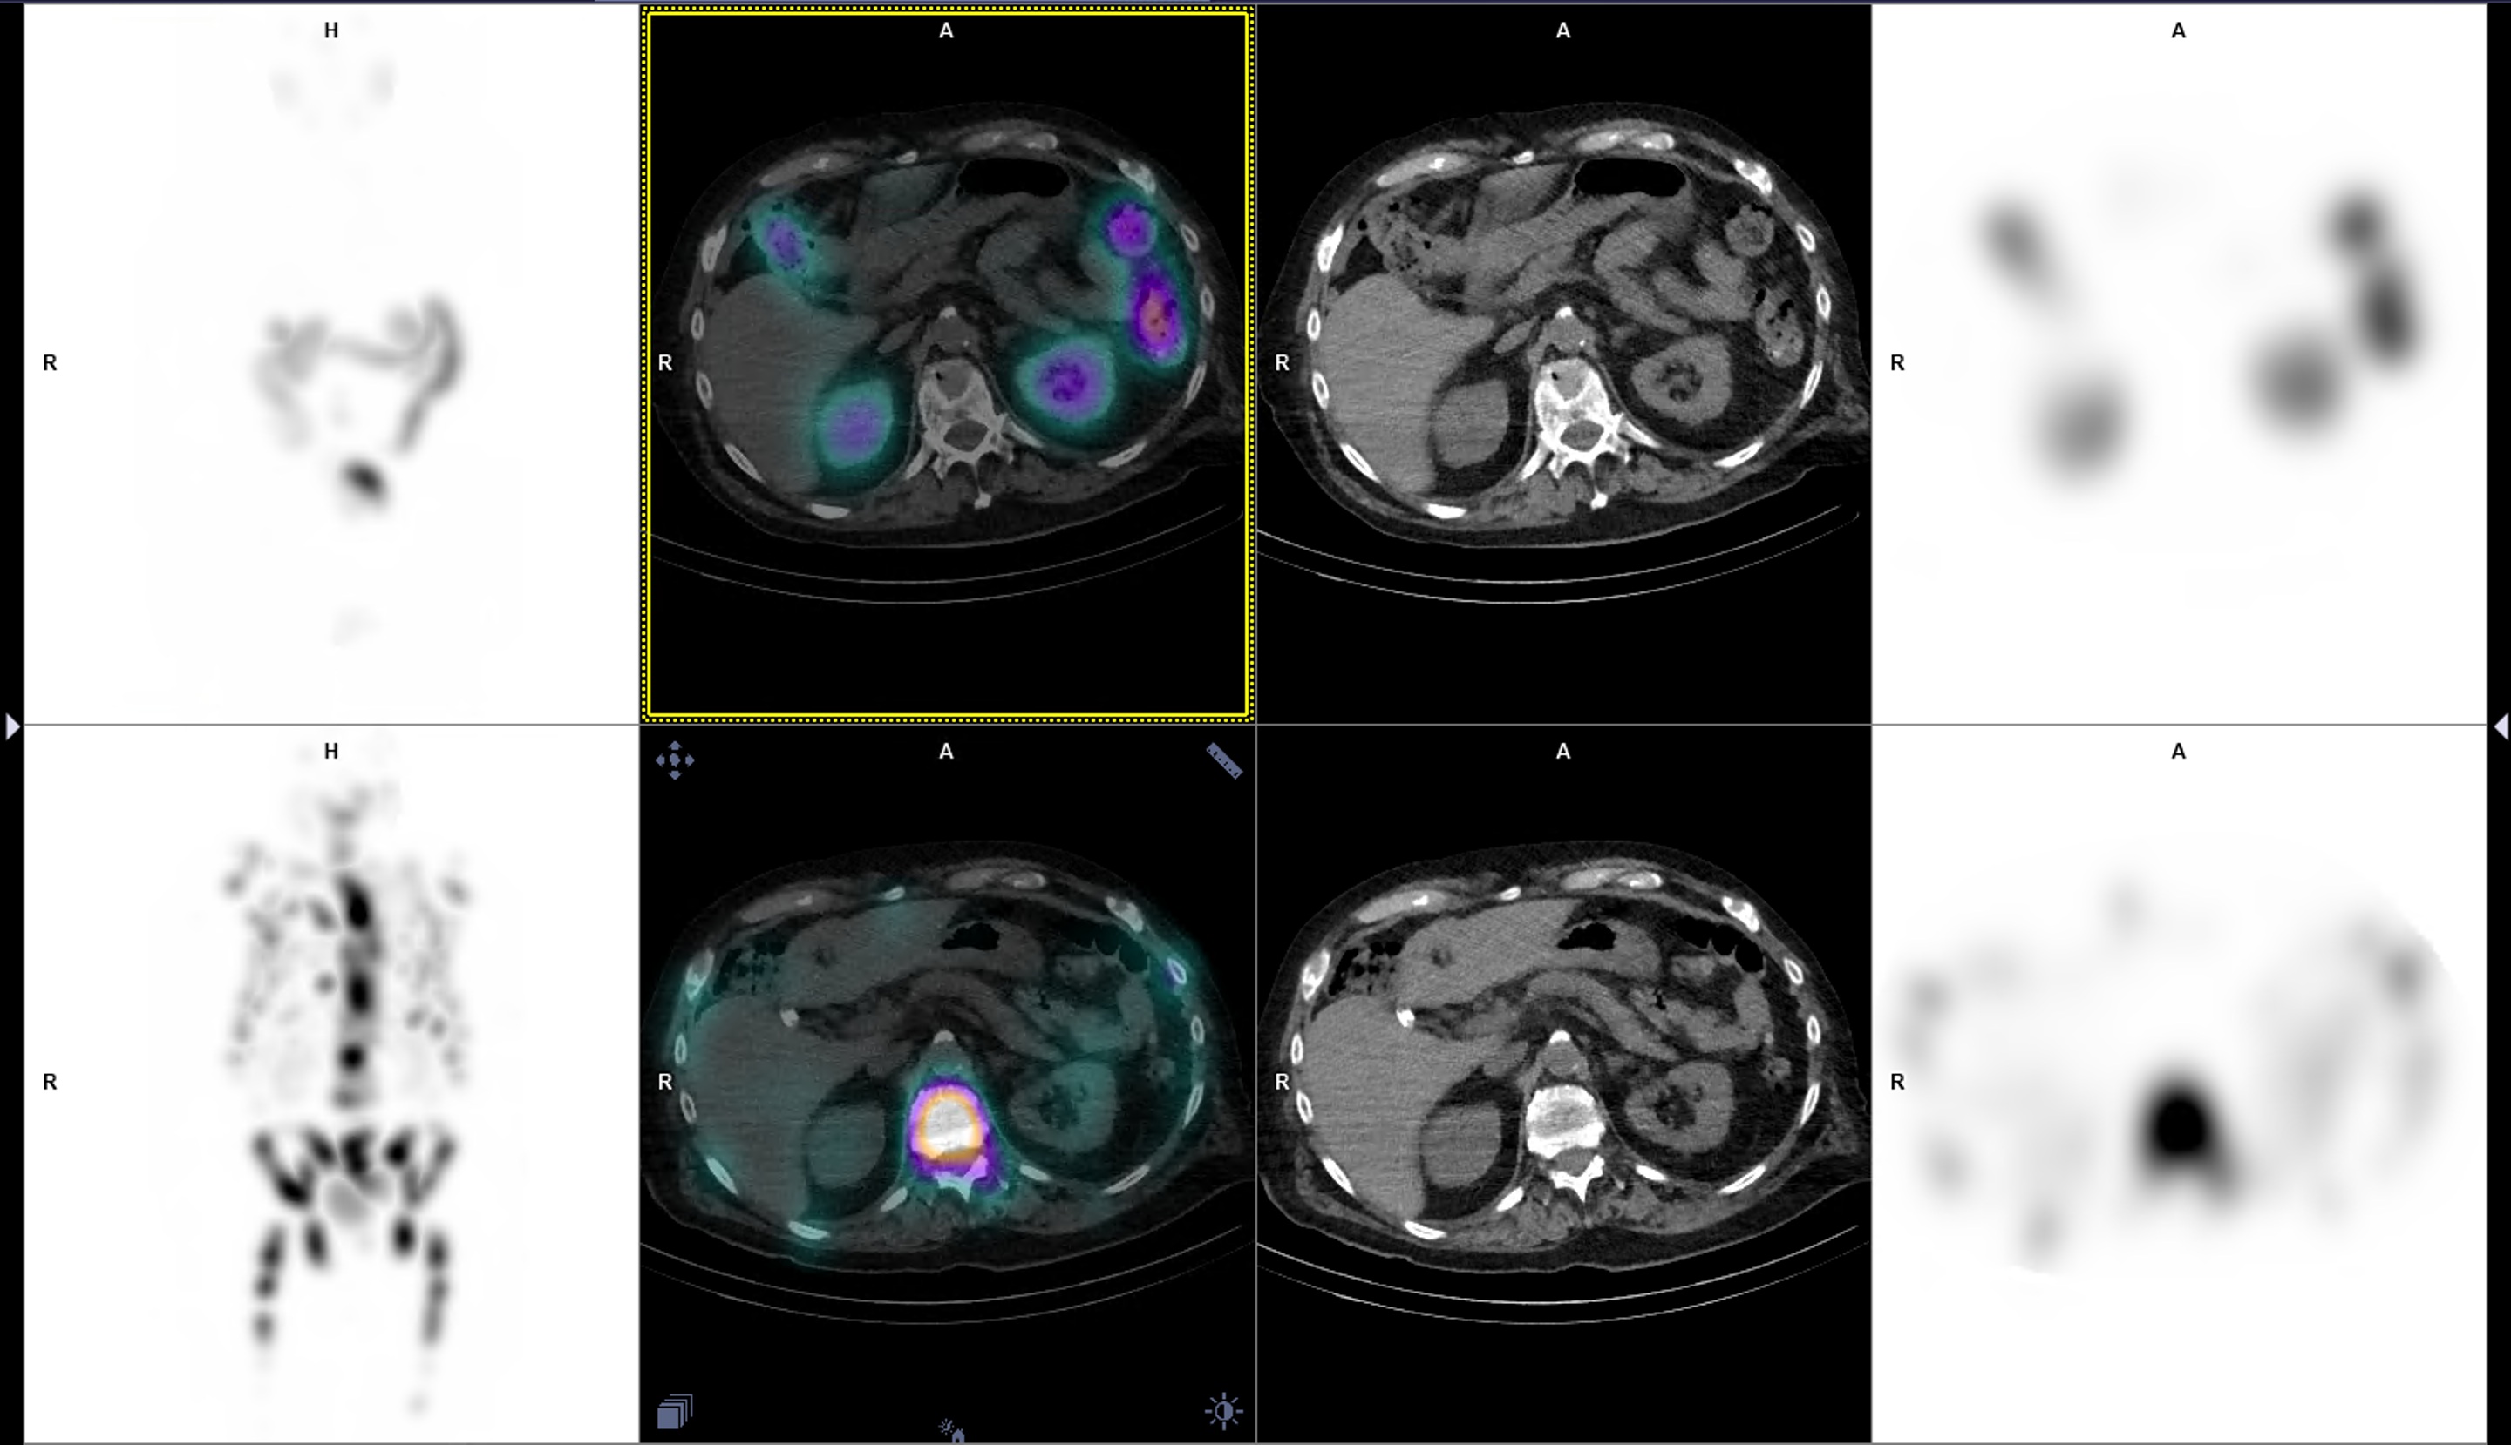
Theranostics (Lu-177-based)
Therapy 2
PSA 6 µg/L
Therapy 1
PSA 212 µg/L
82-y-old man with hormonoresistant prostate cancer

Slide 15
Mass separation of ²²⁵Ac from ²²⁷Ac and from irradiated Th targets to support Targeted Alpha Therapy
Proposal MED024
CERN MEDICIS Collaboration Board IV
18 September 2019

Slide 16
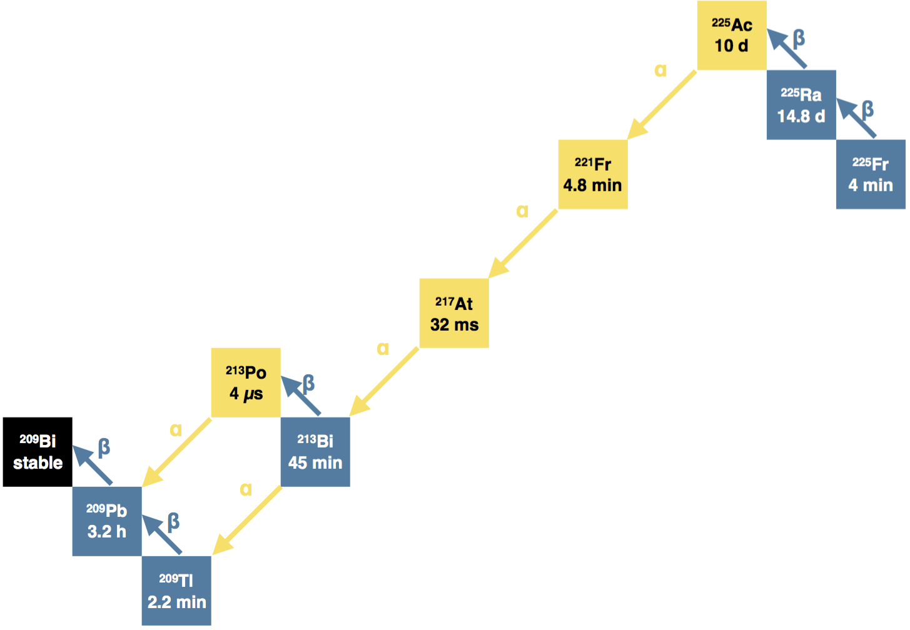
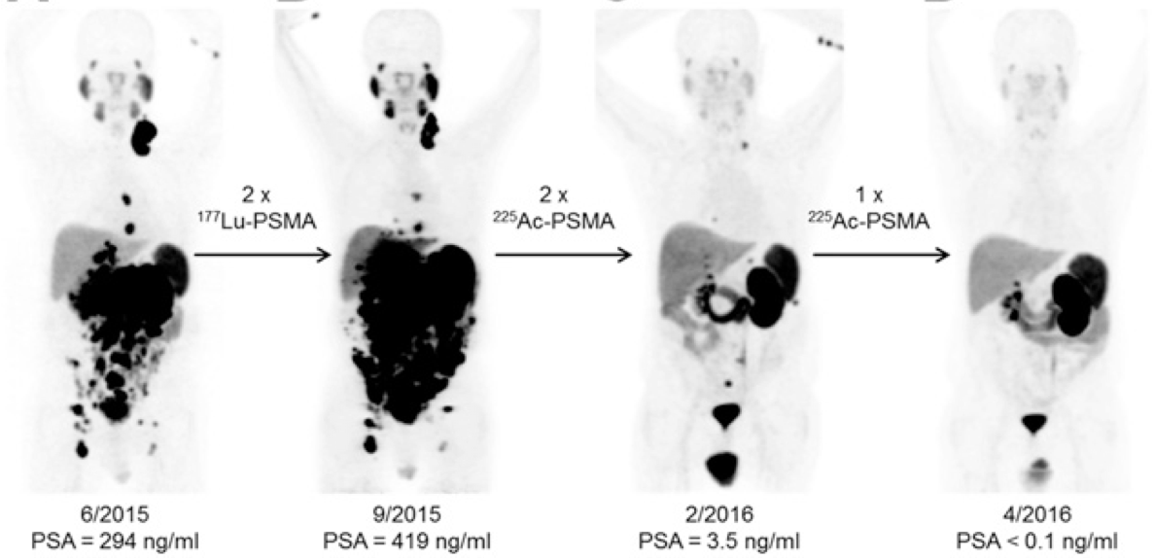
²²⁵Ac for medical application
Direct use as an α emitter
  4 α particles in close succession
  T_{1/2} ~ 10 days
As a generator for ²¹³Bi
  100% α emission
  T_{1/2} ~ 45 min
Can be combined with ⁶⁸Ga for theranostics applications
C. Kratochwil et al, The Journal of Nuclear Medicine 57 (2016) 1941-1944

Slide 17
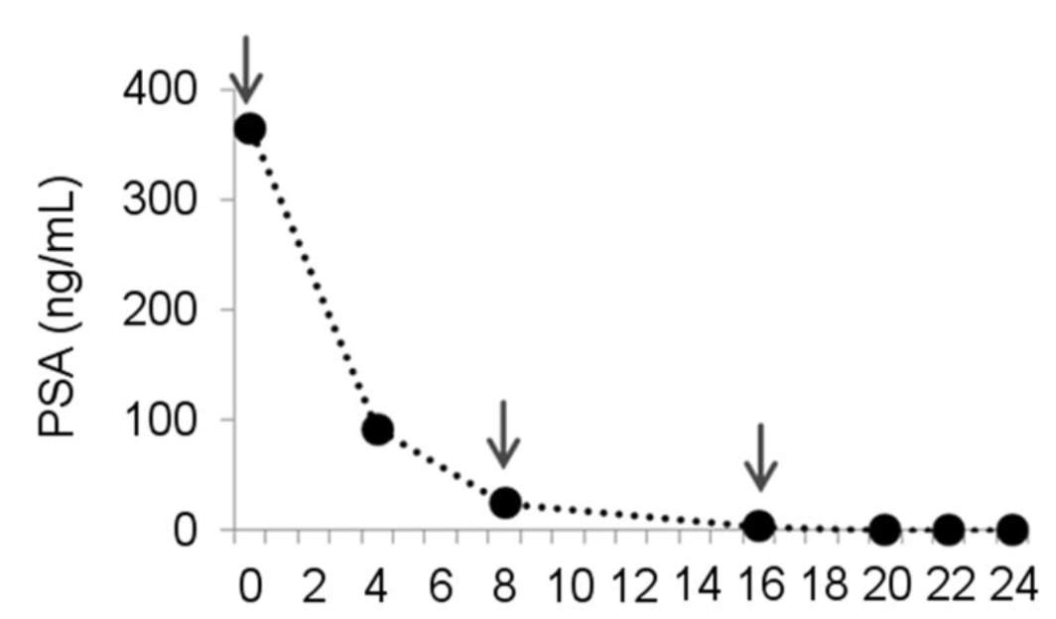
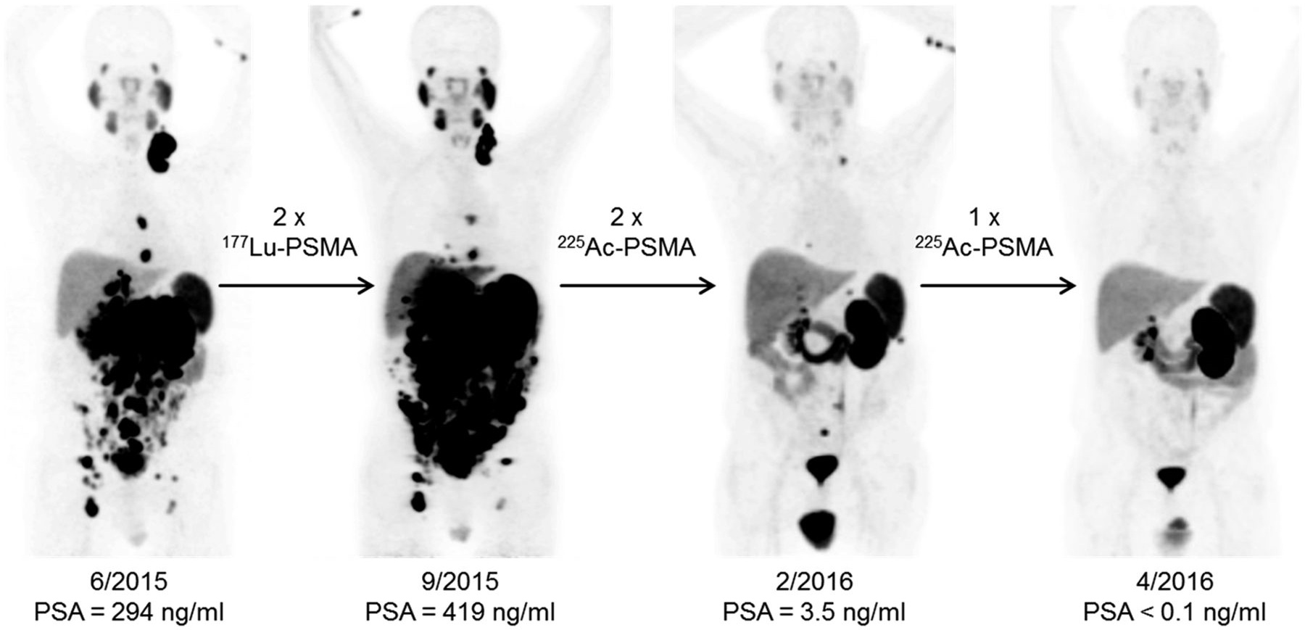
²²⁵Ac-PSMA
Kratochwil et al, JNM 2016

Slide 18
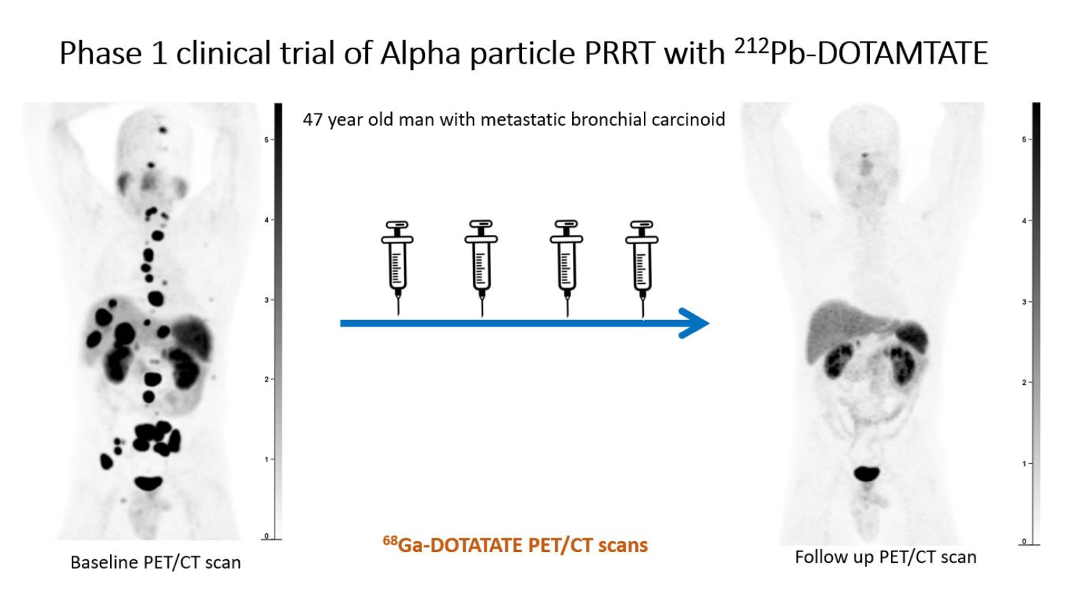
²¹²Pb-DOTAMTATE
Delpassand et al JNM 2022

Slide 19
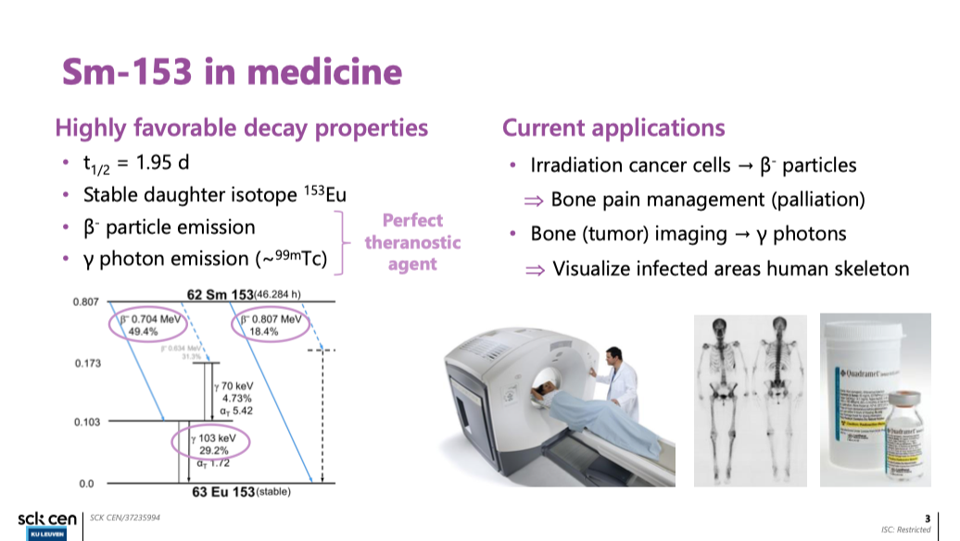
Cocolios et van de Voorde et Oms

Slide 20
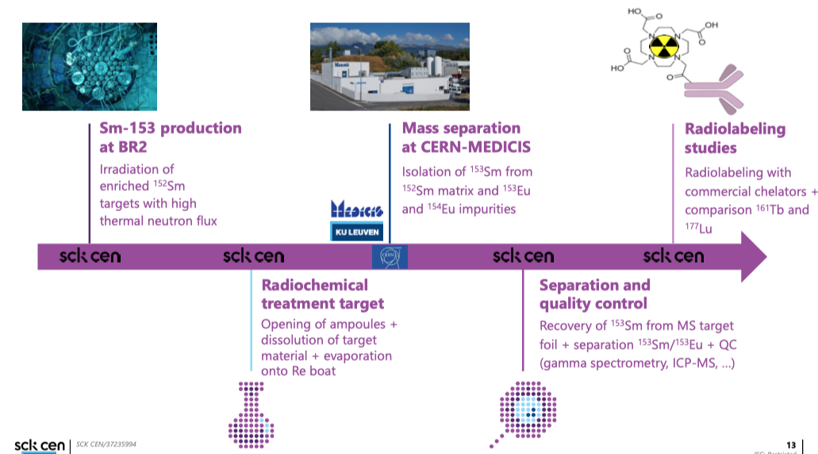

Slide 21
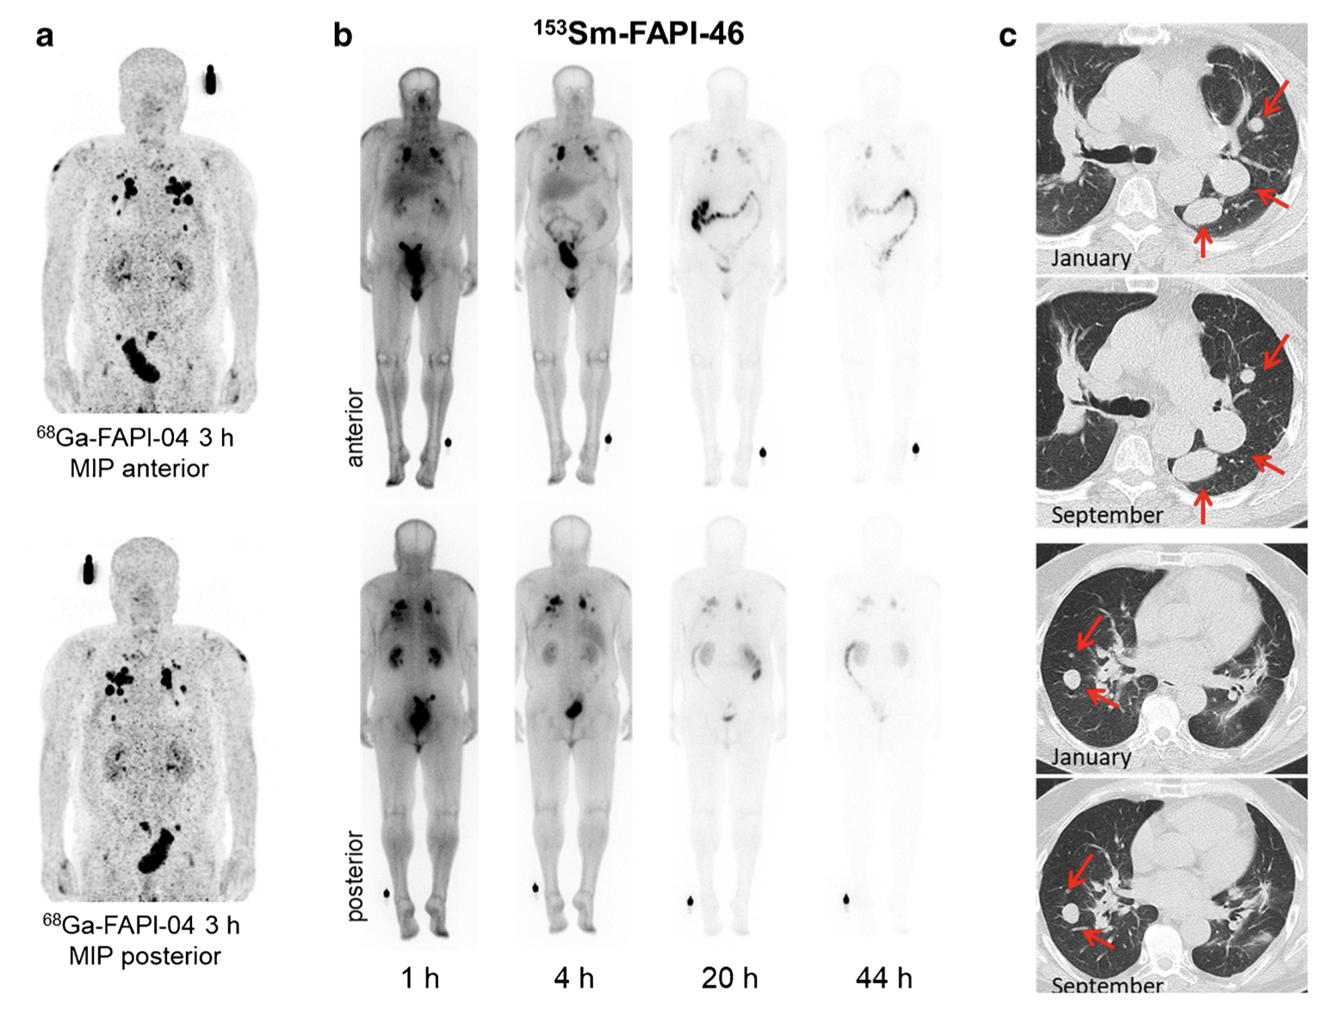
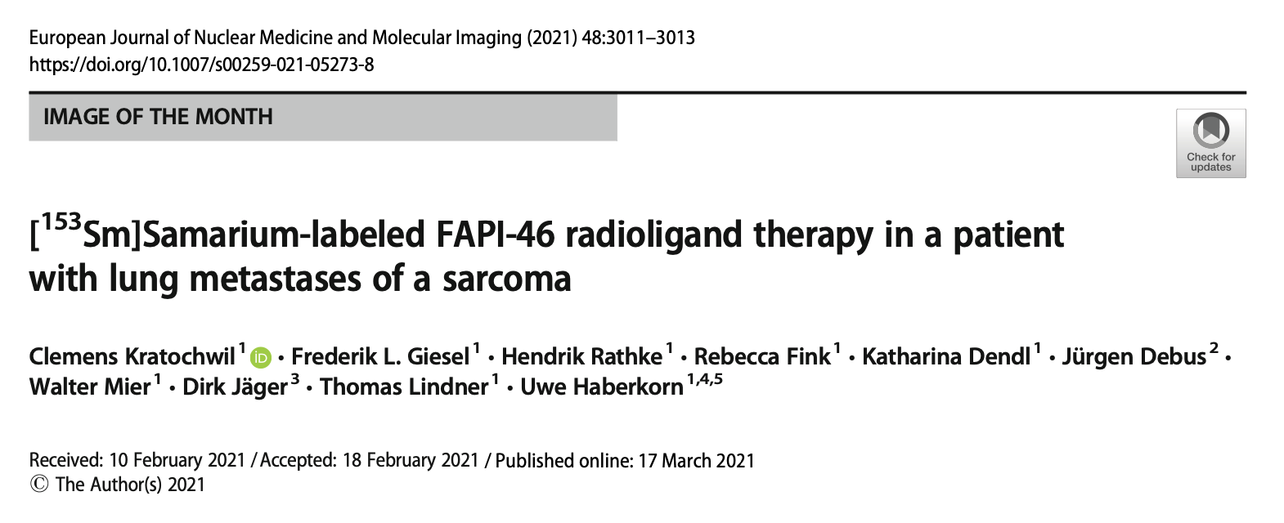
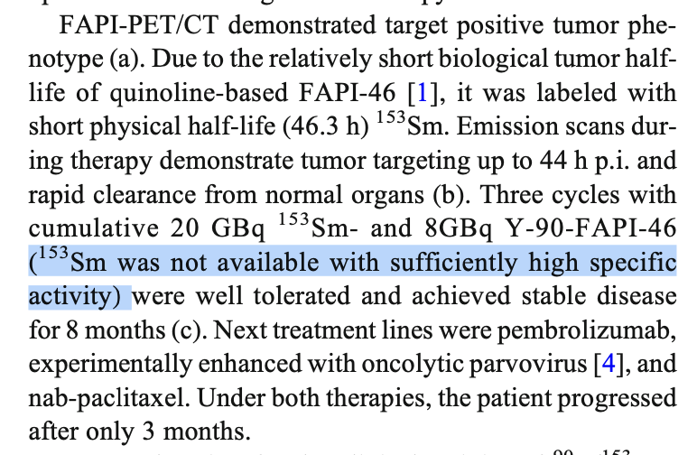
¹⁵³SM-FAPI-46 RADIOLIGAND THERAPY WITH HIGH-MOLAR ACTIVITY ¹⁵³SM
progression of lung metastatic, fibrous spindle cell soft tissue sarcoma

Slide 22
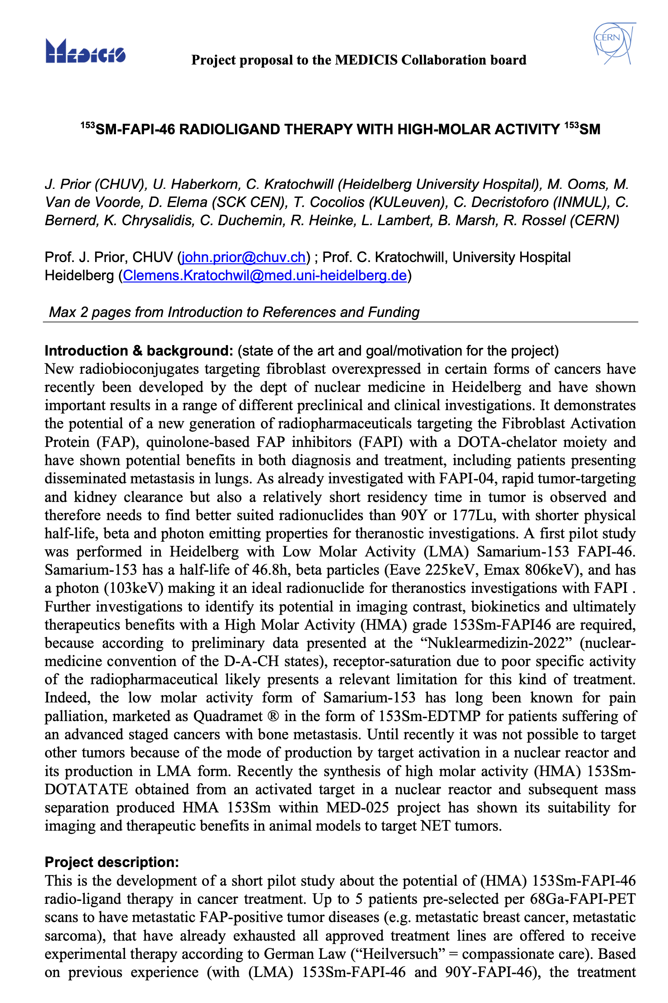
¹⁵³SM-FAPI-46 RADIOLIGAND THERAPY WITH HIGH-MOLAR ACTIVITY ¹⁵³SM
POTENTIAL STUDY
Investigate the potential of (HMA) ¹⁵³Sm-FAPI-46 radioligand therapy in cancer treatment
Up to 5 patients pre-selected per ⁶⁸Ga-FAPI-PET scans to have metastatic FAP-positive tumor diseases (e.g., metastatic breast cancer, metastatic sarcoma)
  With already exhausted all approved treatment lines
  Will be offered to receive experimental therapy according to German Law (“Heilversuch” = compassionate care)

Slide 23
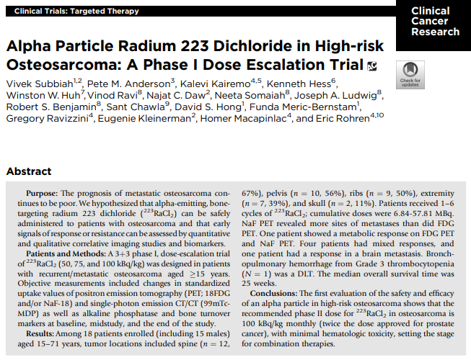
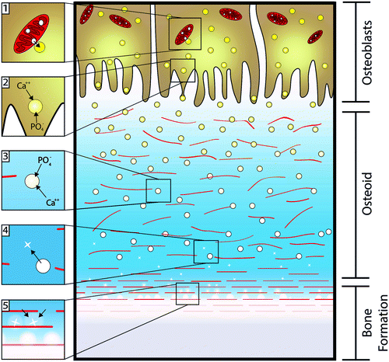
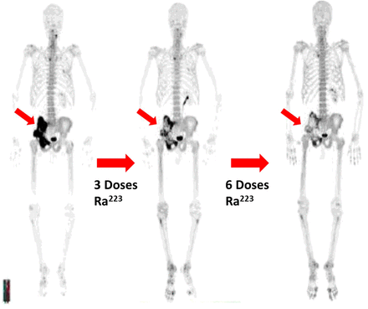
Rational:
¹²⁸Ba/¹²⁸Cs enters the bone matrix as a surrogate of Ca²⁺ like ²²³Ra and ⁸⁹Sr
It is metabolized, concentrated secreted through the matrix vesicles by the osteoblast
Figure 3.NaF PET–CT in a patient with pelvic osteosarcoma showing decrease in NaF with subsequent doses of ²²³RaCl₂.
Kyungsup Shin, Timothy Acri, Sean Geary, and Aliasger K. Salem.Tissue Engineering Part A.Oct 2017.1169-1180

Slide 24
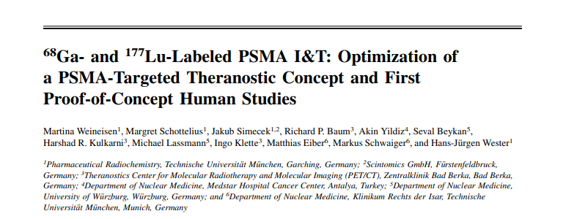
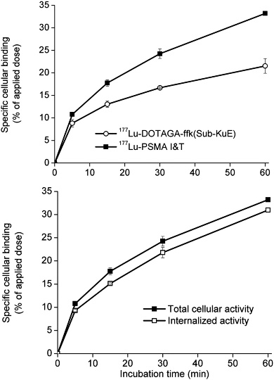
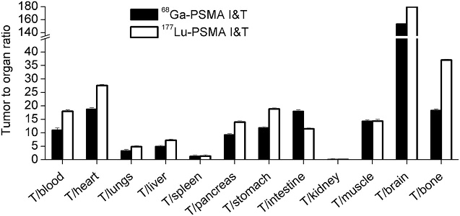
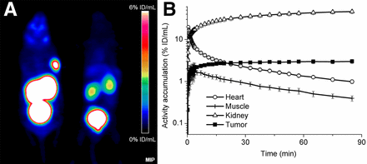
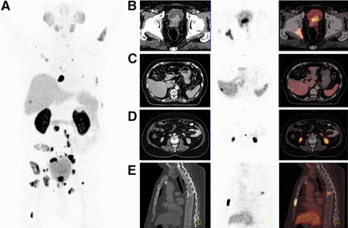
Rational:
The PSMA-I&T theranostic tracer is currently used to diagnose (⁶⁸Ga-PSMA-I&T) and treat (¹⁷⁷Lu-PSMA-I&T) patients with prostate cancer
As Lutetium, Cerium belongs to the lanthanides, and chelation by DOTAGA-PSMA-I&T can be achieved following already established protocols
The ¹³⁴Ce/¹³⁴La in vivo generator will be used to be conjugated to DOTAGA-PSMA-I&T (PSMA-I&T) to target cancer cells expressing PSMA

Slide 25
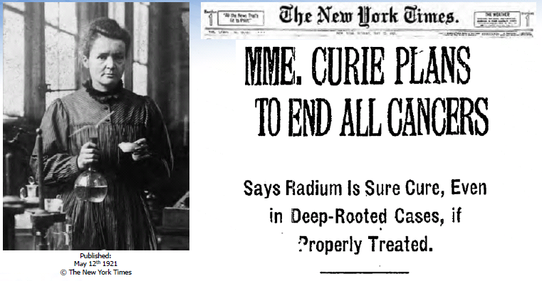
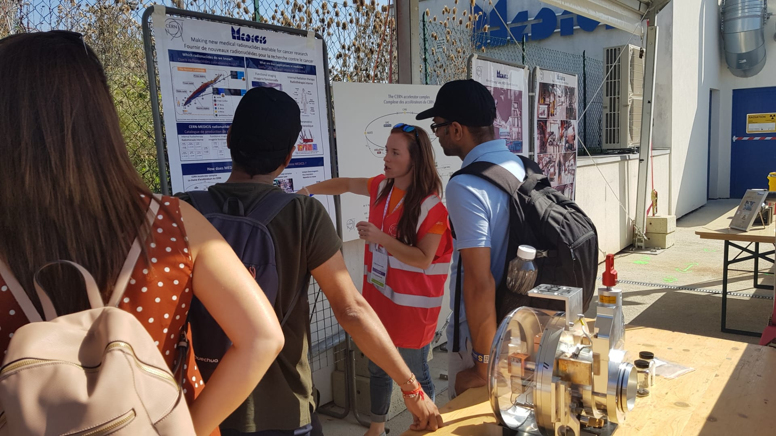
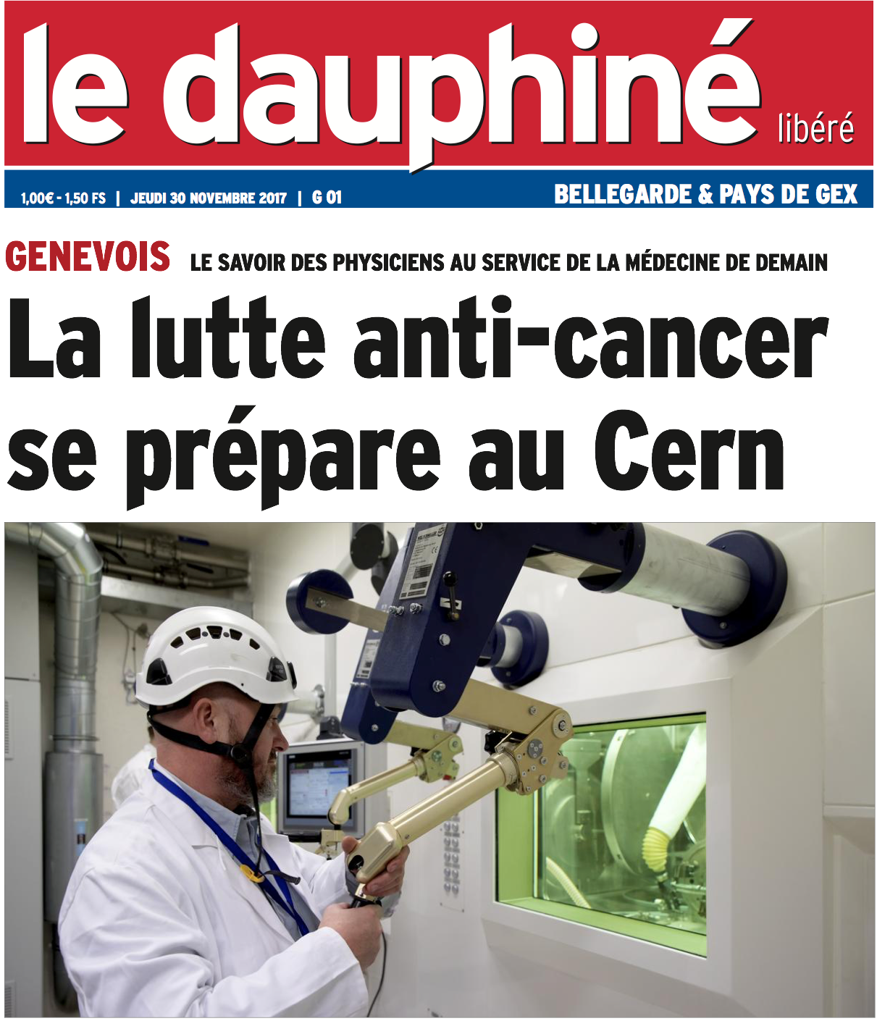
Stora et al.
New treatments in nuclear medicine : a large and “recent” interest in Europe
€, $
Physics & Chemistry Nobel Prizes
AAA bought by Novartis for
3.8 Bi$ in 2017 (¹⁷⁷Lu-based drug)
Time
Economics, Innovators
European Commission
ENER/17/NUCL/SI2.755660
(2018)
Accelerator Labs Worldwide
(eg PSI, TRIUMF )
Helene Langevin-Joliot at MEDICIS,
professor in nuclear physics,
grand-daughter of Marie Curie (2017)
Finally Monsieur et Madame tout le monde
CERN open days 2019 – MEDICIS press release 2017

Slide 26

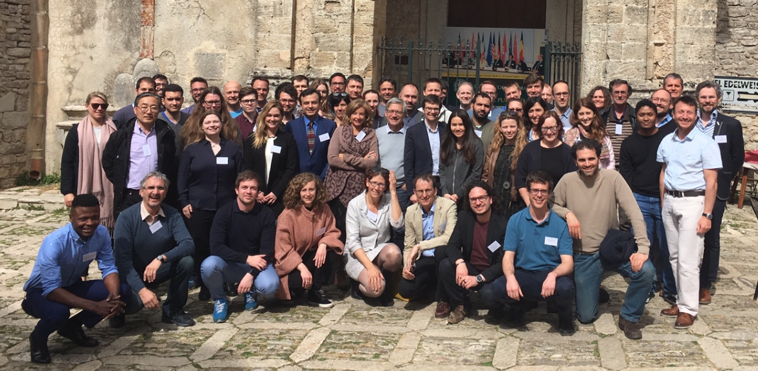
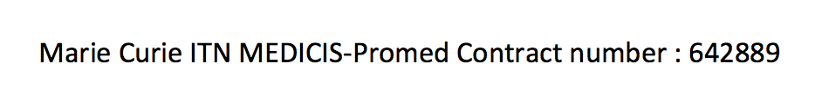
Towards an integration at the European level:
Some Historical background
NuPECC miniworkshop
at CERN in 2017
PRISM(AS-M)AP
joint ECFA-NuPECC-ApPEC meeting,
France 2019
2015-2019
Idea of INFRA 1st mentioned at the EURISOL-DF Town meeting in INFN-Pisa – Apr 2018
2 “dedicated meetings”, many many phone calls, Emails, meetings, even some lunches

Slide 27

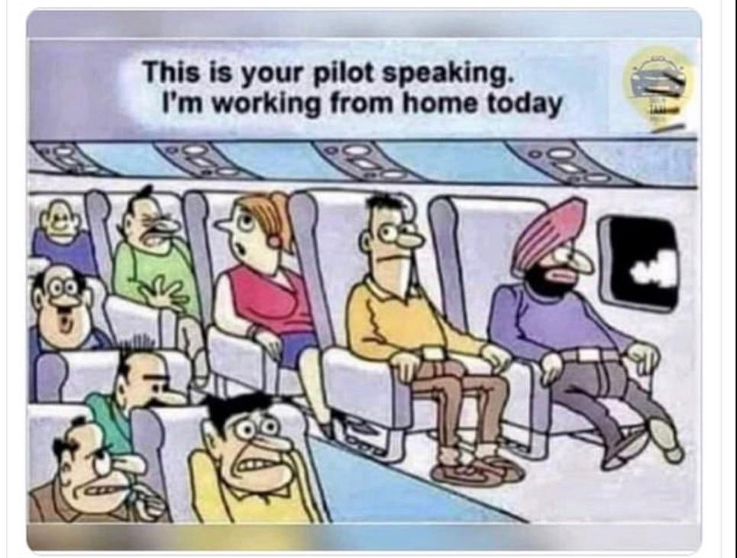
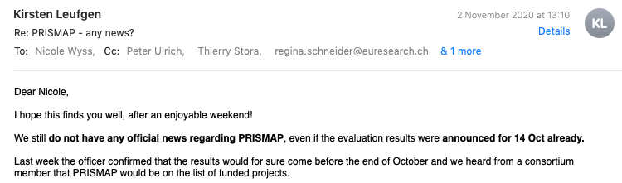
PRISMAP – The European medical isotope programme
Submitted to the INFRA-2-2020 Call
In full of the COVID outbreak …
Open key national and regional research infrastructures to all European researchers
https://medicis.cern/prismap-european-medical-isotope-programme
“Writing team” : K. Leufgen (Sciprom), T. Cocolios, F. Haddad, U. Koester, M. Lassman, J. Prior, CERN Colleagues, T.S, …

Slide 28
