Slide 1
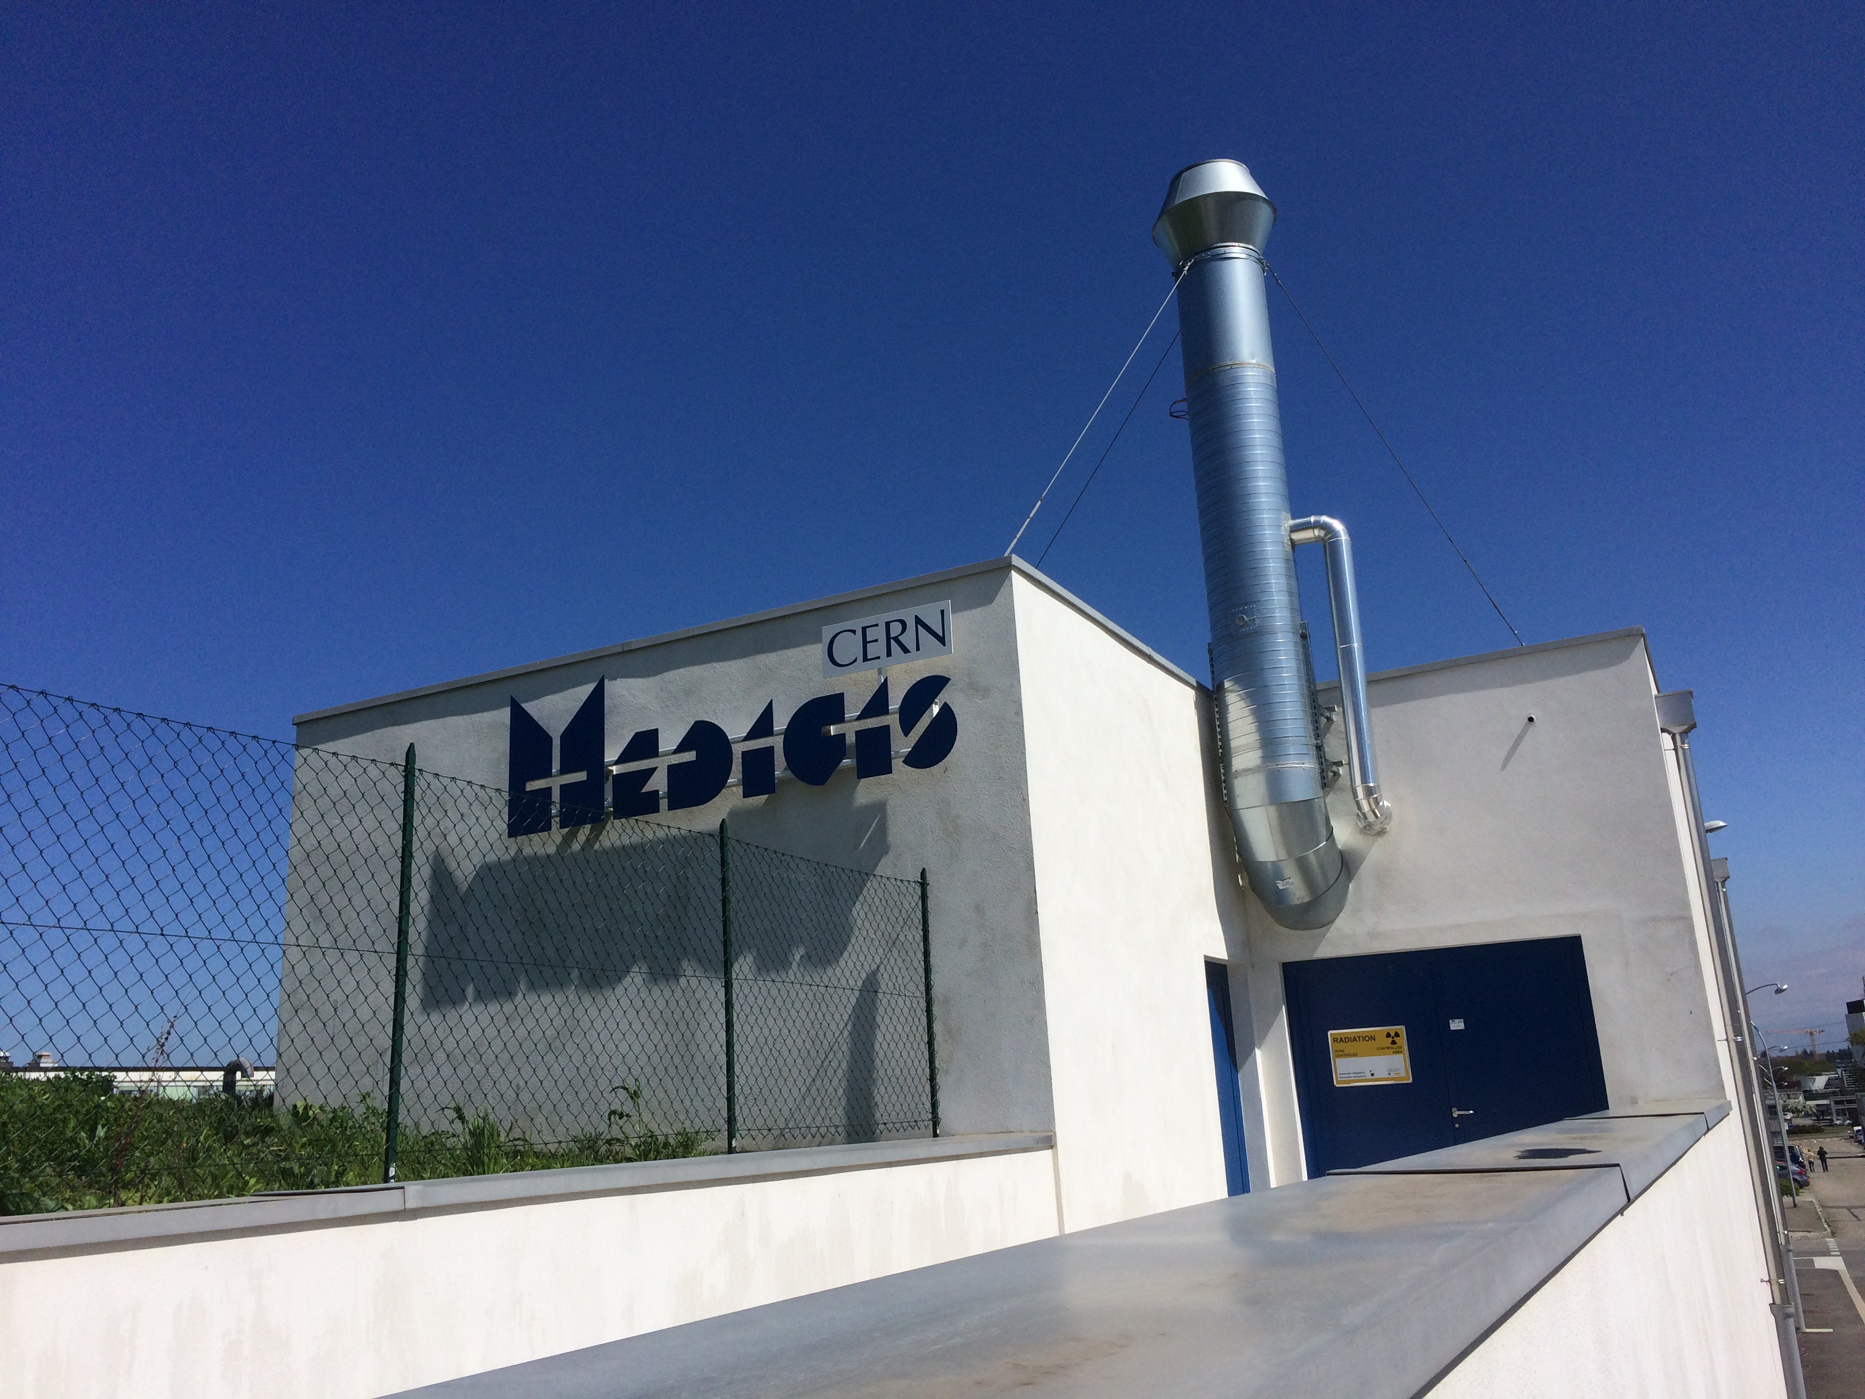

Nuclear physics
Back to the ROOTs

Slide 2
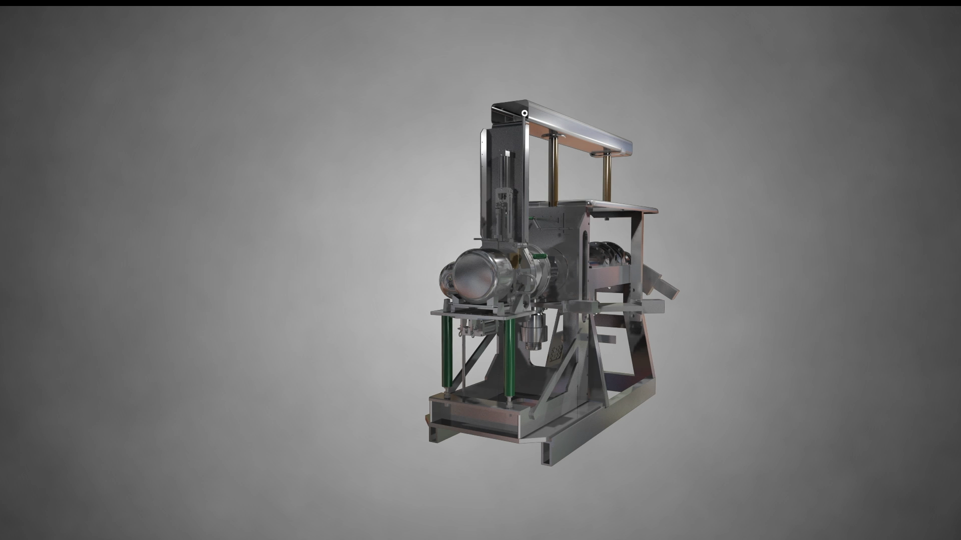

Slide 3
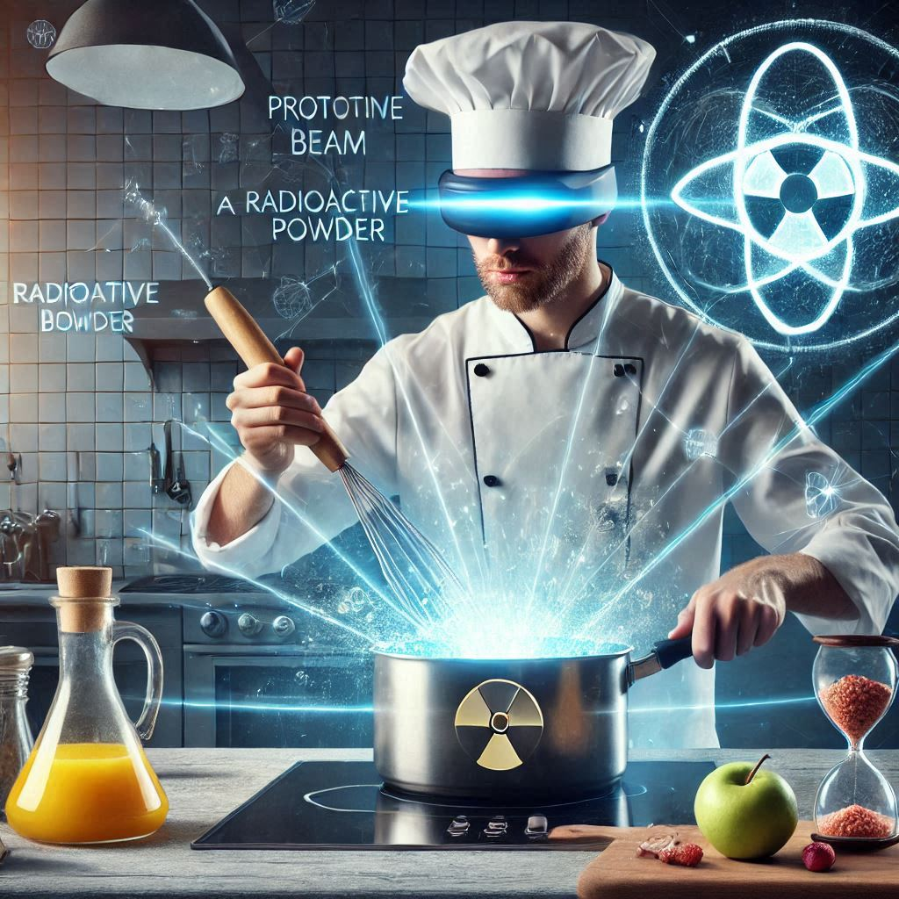
The ISOL recipe
Mix the ingredients
Cook on high temperature (~2000ºC)
Serve

Slide 4
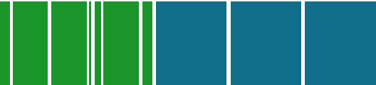
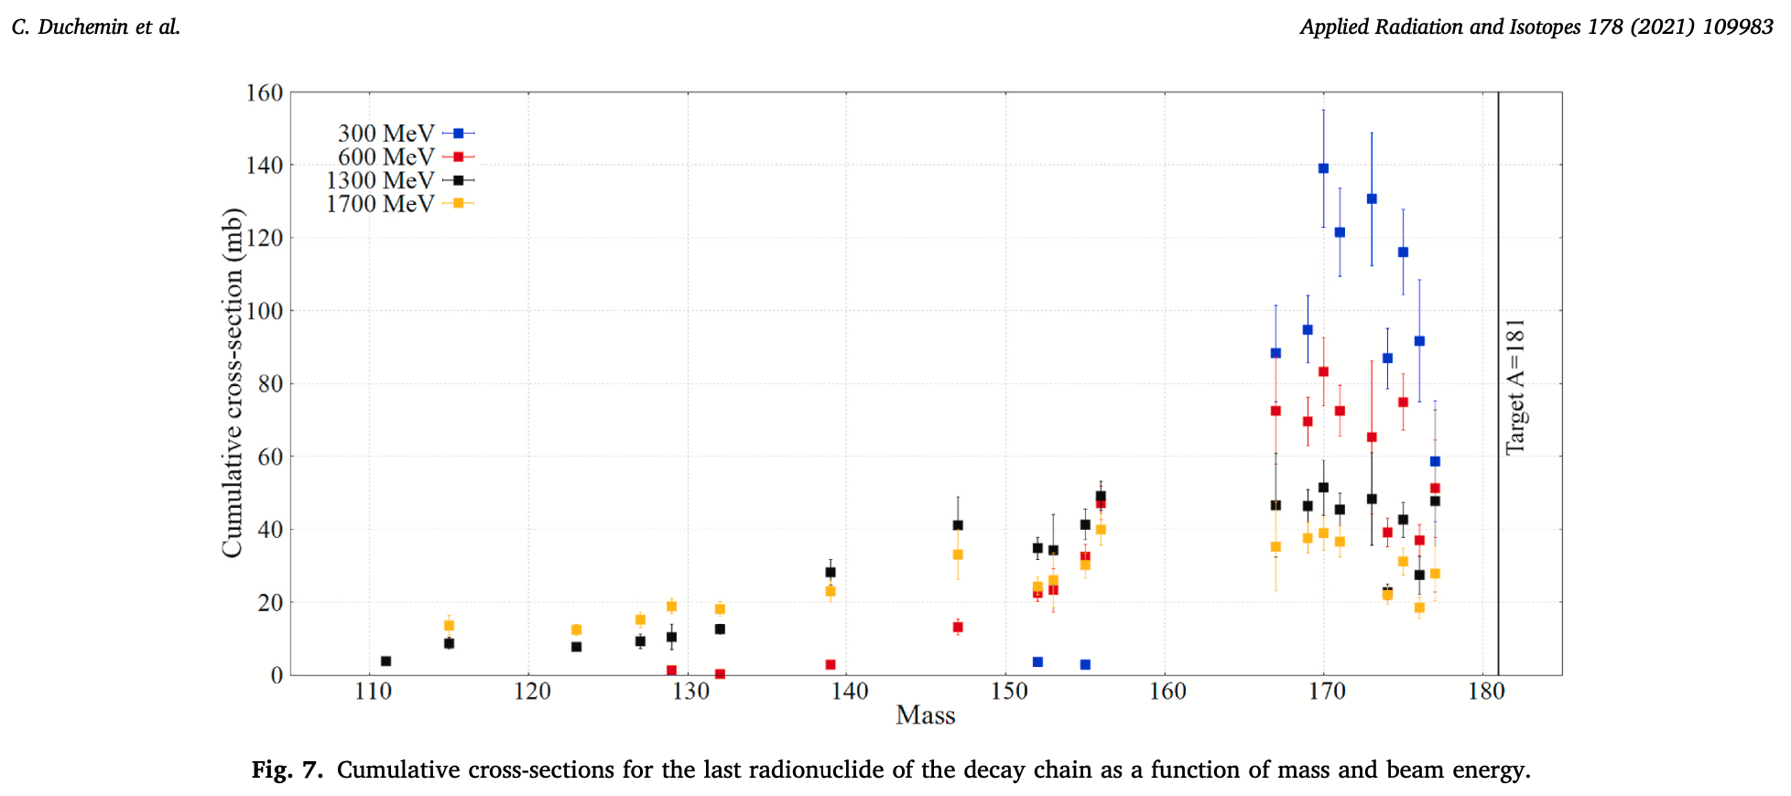
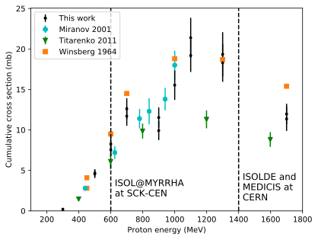
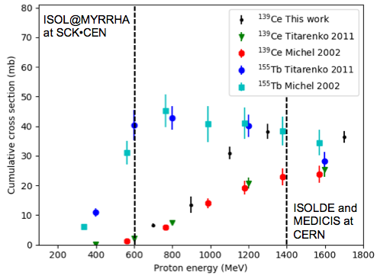
Back to start: nuclear cross sections
It all starts with the nuclear reaction and its cross sections.
Ta
Al
¹⁴⁹Tb
¹⁵⁵Tb
H. Verhoeven et al., NIMB 463 (2020) 327-329.
C. Duchemin et al., Frontiers in Medicine 8 (2021) 625561.
C. Duchemin et al., Applied Radiation & Isotopes 178 (2021) 109983.

Slide 5
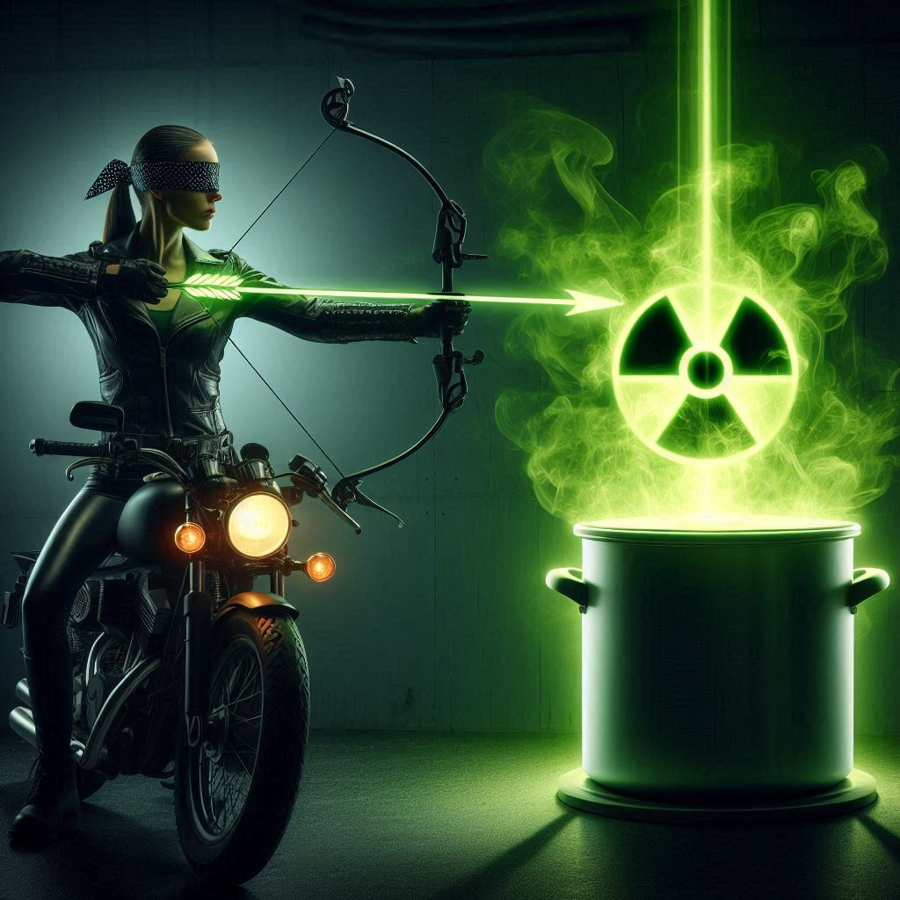
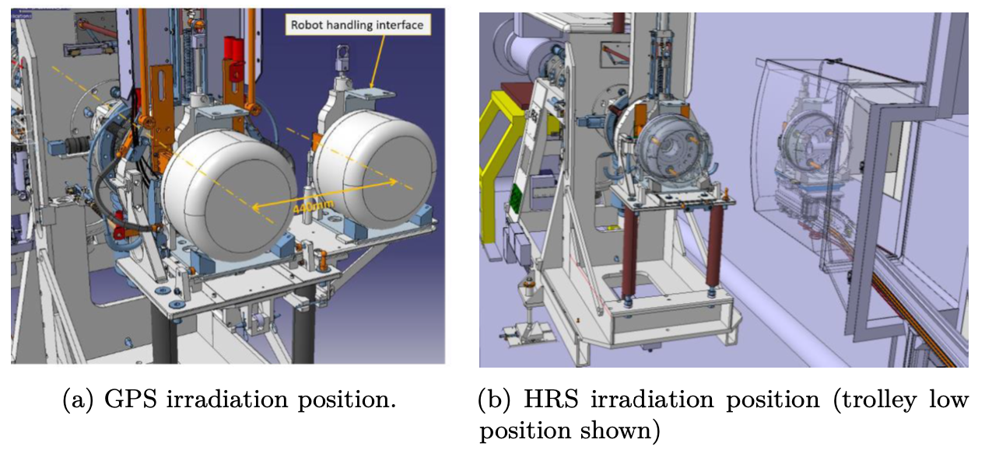
Shooting on target…
It is all in the aim...

Slide 6
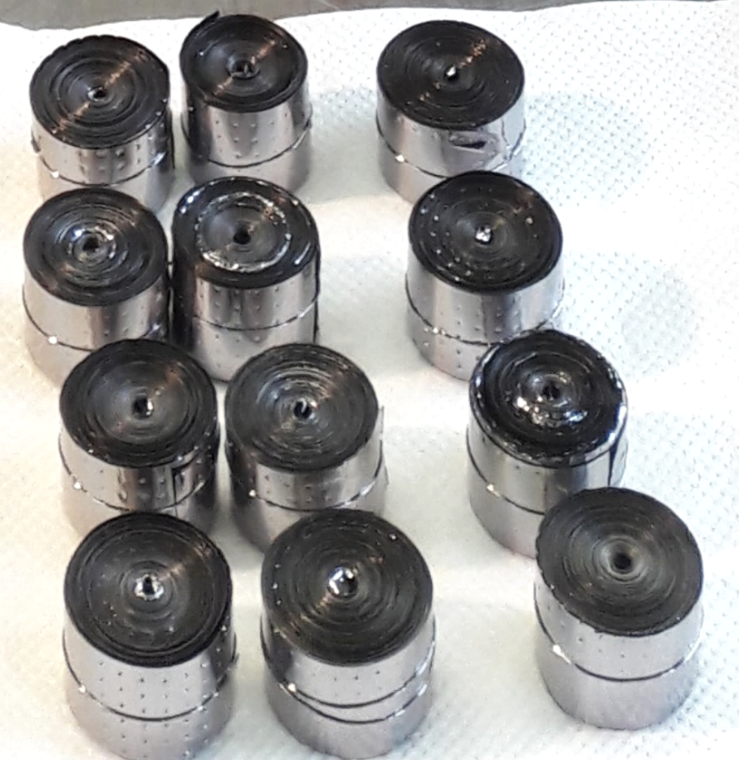
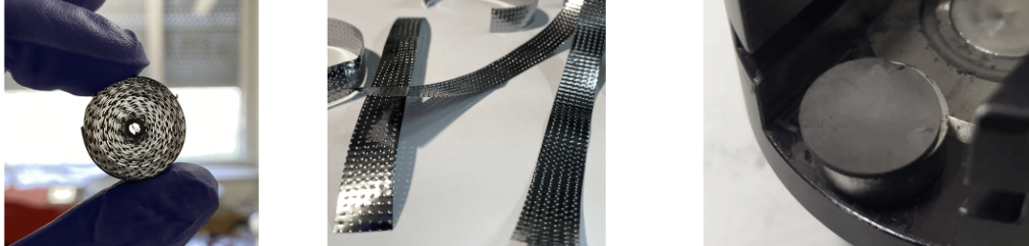
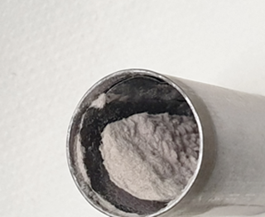
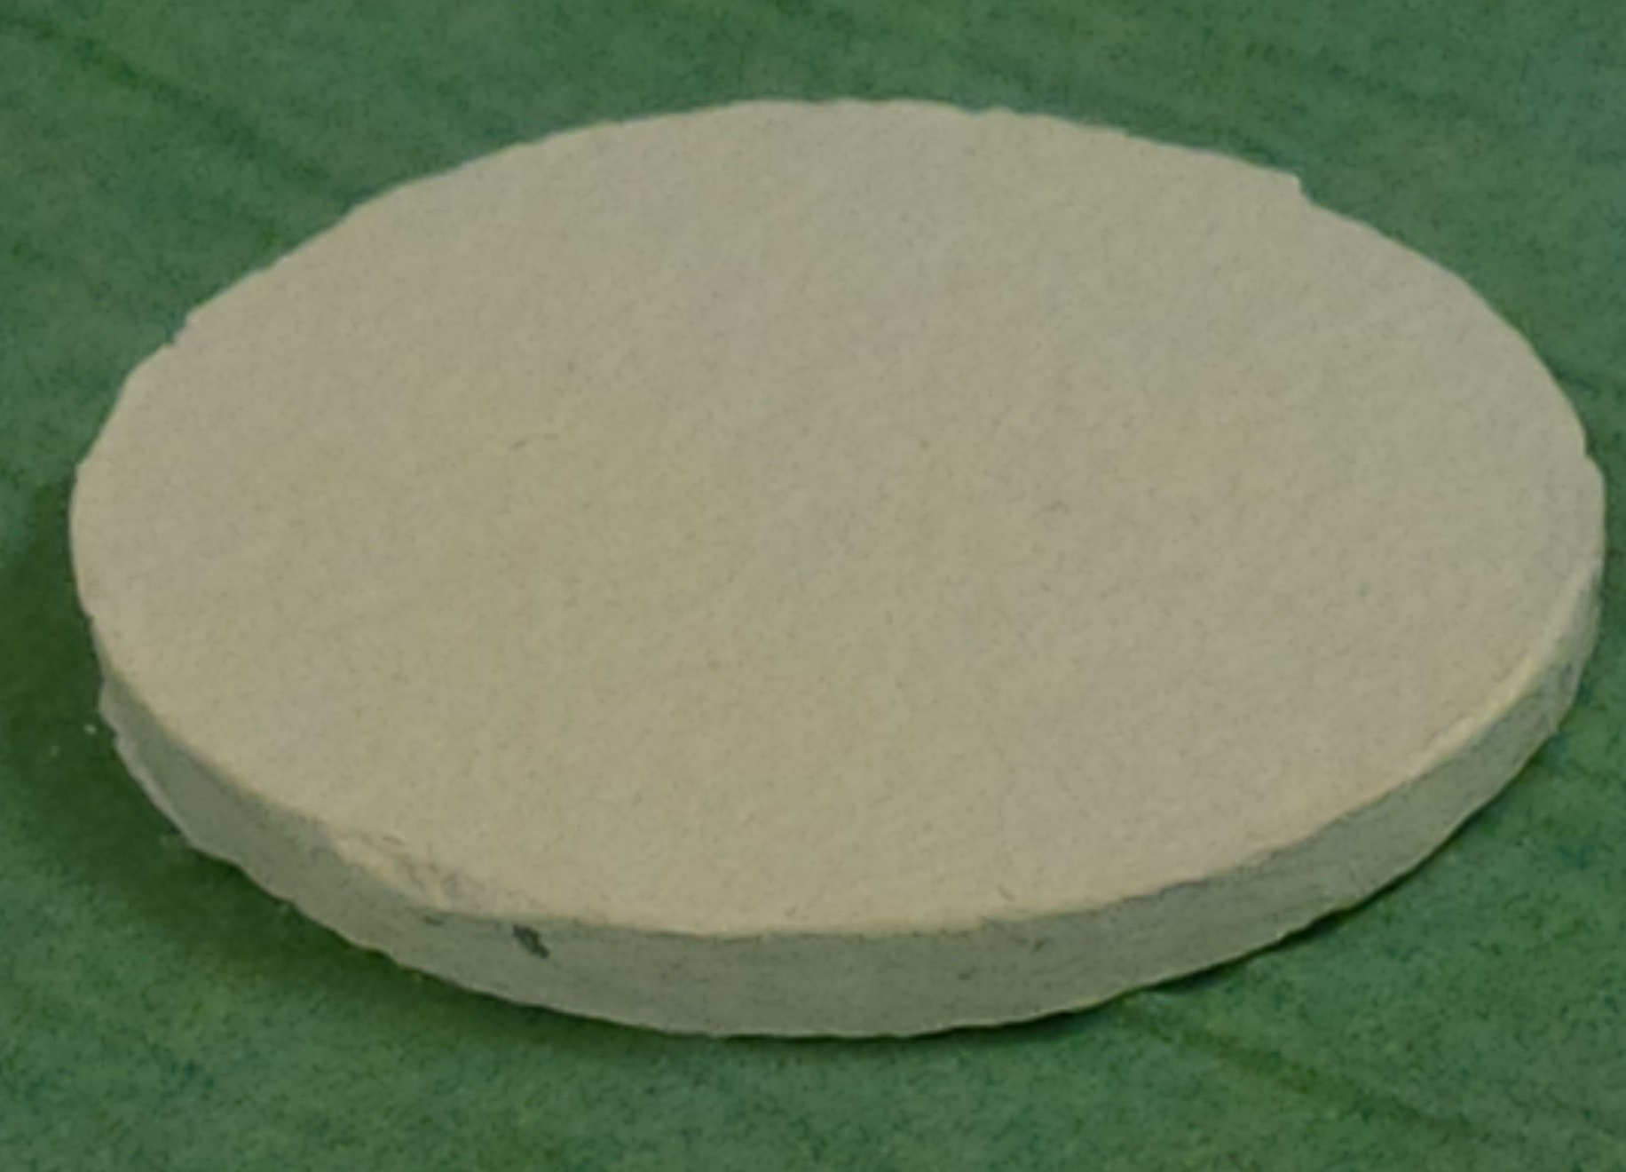
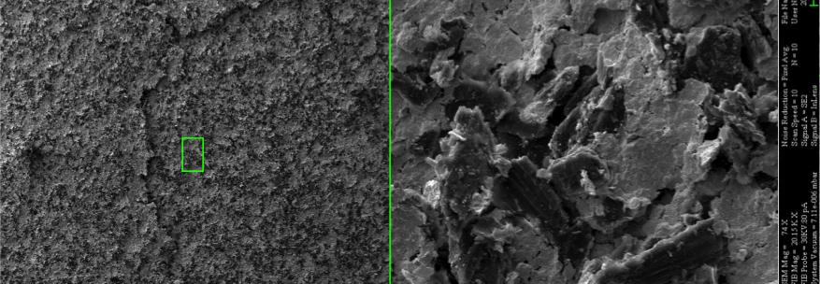
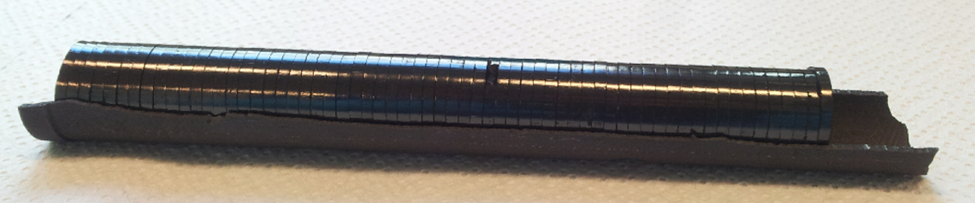
Next ingredient: the target
ISOLDE has a big pantry of targets where we can ‘shop’, but we can also make something new…

Slide 7
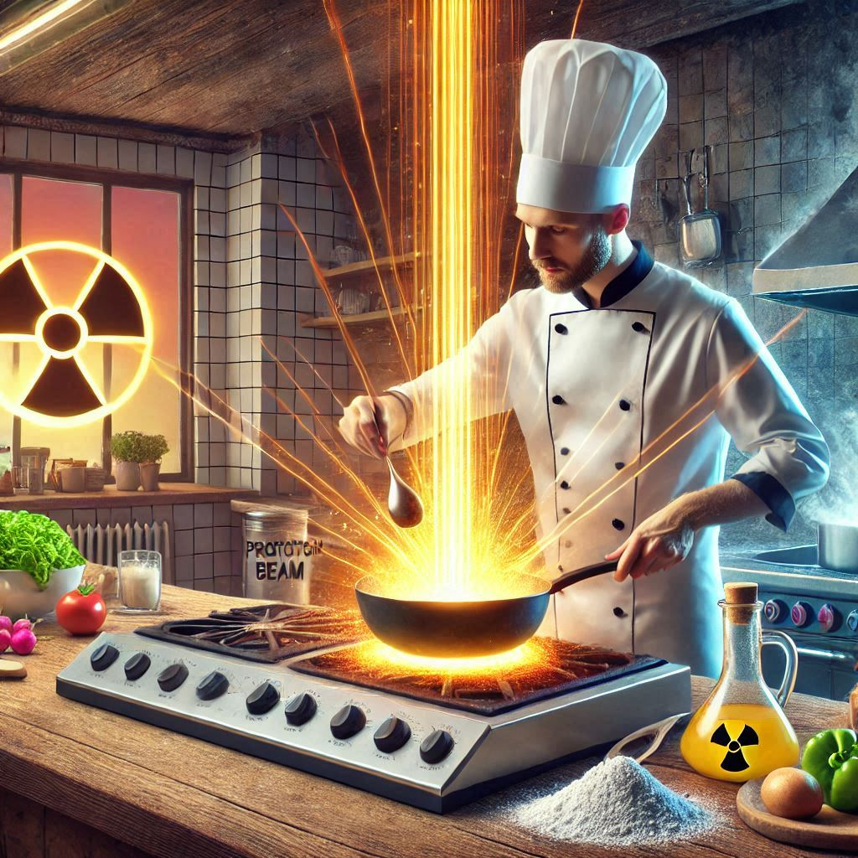
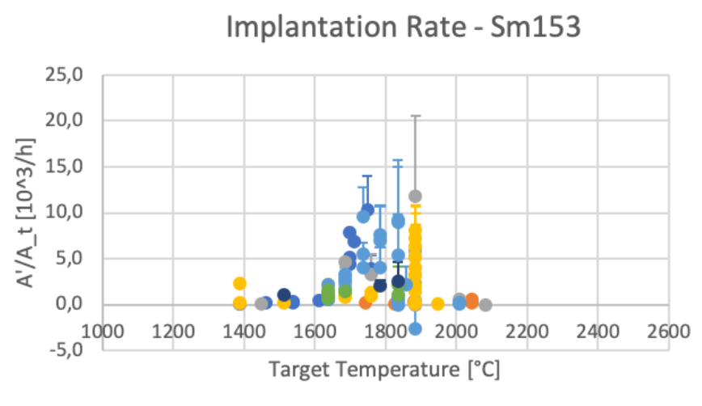
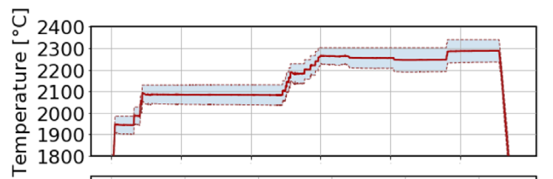
Releasing all the flavours at high T
From the target material to the ion source, there are two steps: diffusion & effusion
It is full of chemistry and weird stuff: true cooking skills are required.
From sublimating Sm to AcO ceramics, we have faced many forms of unexpected!
Well Ac from ThO₂
No Ac from ThO₂
M. Van de Voorde et al., Frontiers in Medicine 8 (2021) 675521.
J.D. Johnson et al., Scientific Reports 13 (2023) 1347.

Slide 8
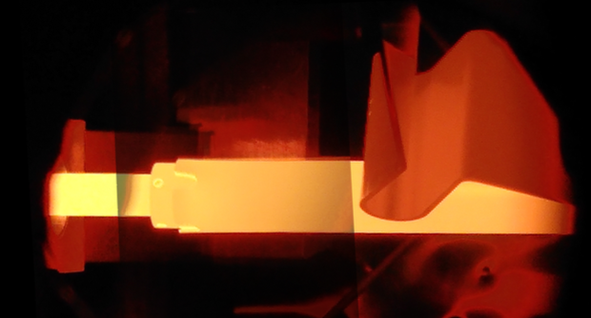
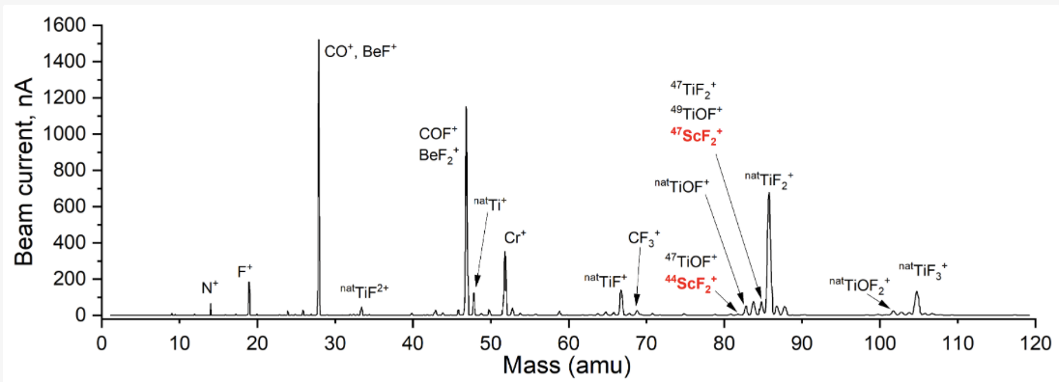
Shooting it away: the ion source
Electron impact
Laser ionisation
Surface ionisation
Tb-II
411 nm
406 nm
Scheme A
Scheme B
433 nm
406 nm
462 cm⁻¹
0 cm⁻¹
Tb-I
28% @ 2000°C
19% @ 2000°C
E. Mamis et al., Pharmaceuticals 17 (2024) 390.

Slide 9
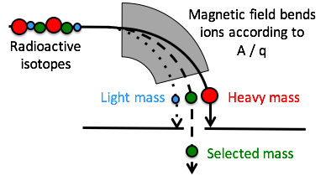
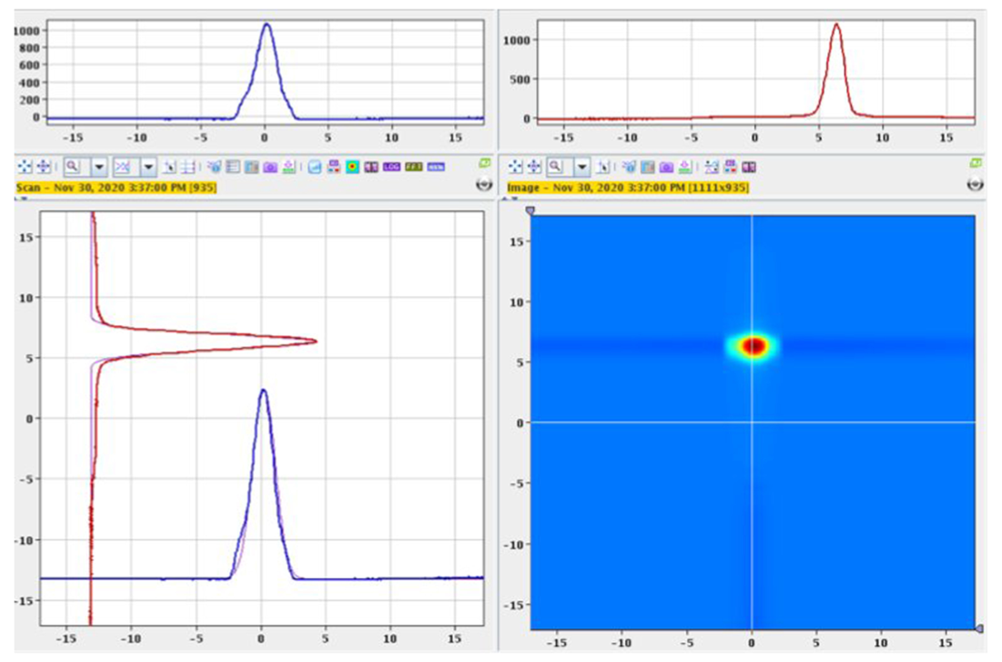
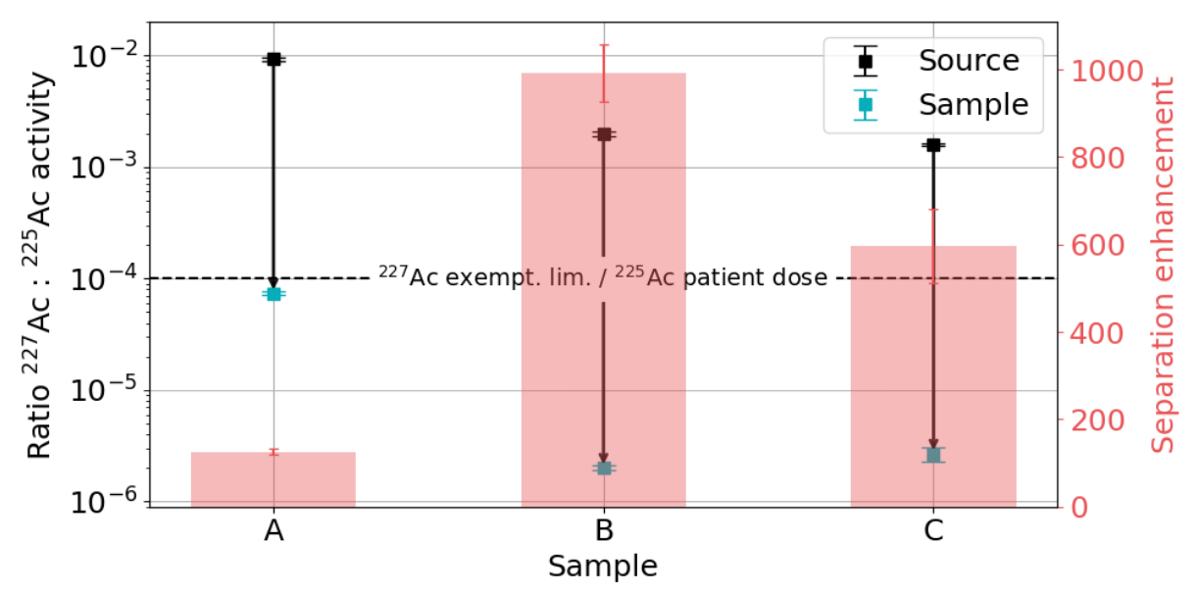
Pick & choose: mass separation
M. Van de Voorde et al., Frontiers in Medicine 8 (2021) 675521.
J.D. Johnson, PhD thesis, KU Leuven (2024).

Slide 10
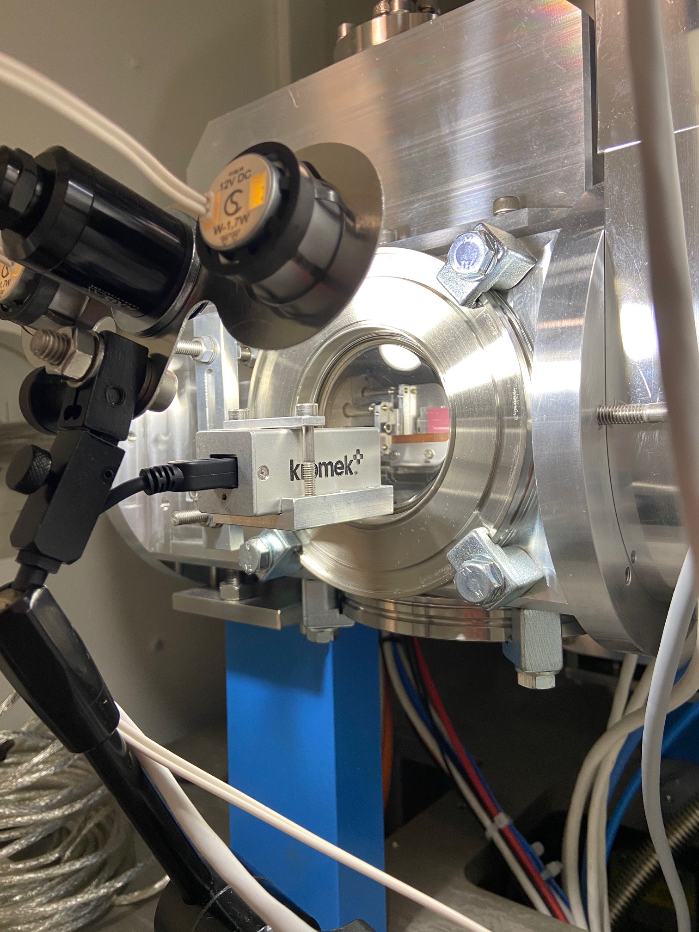
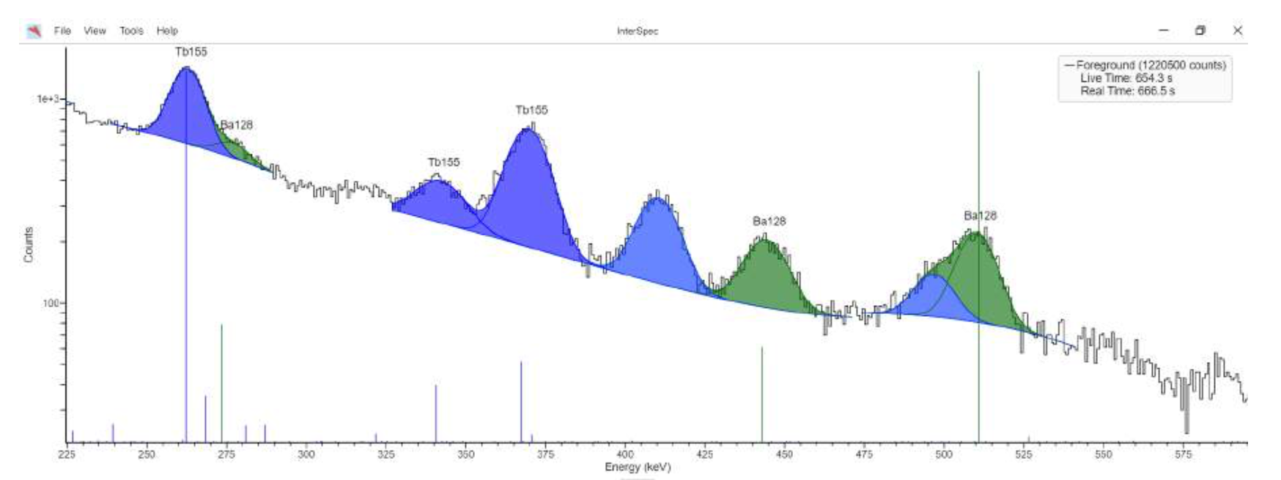
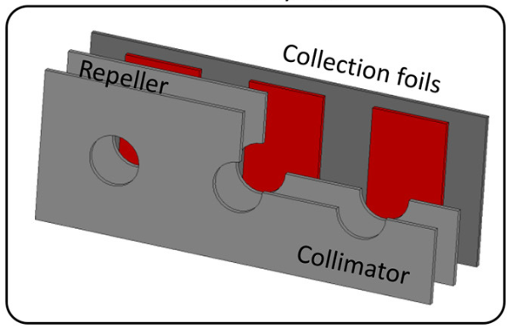
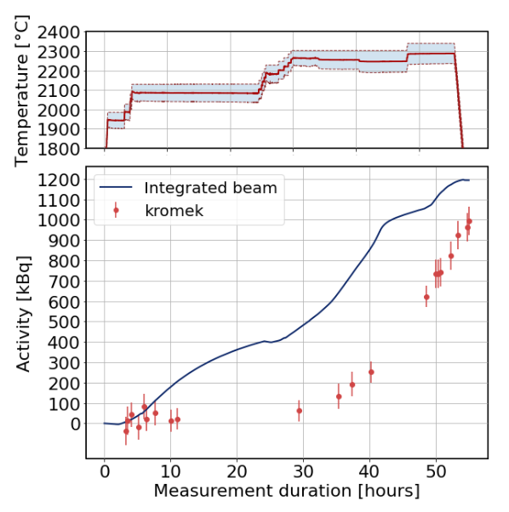
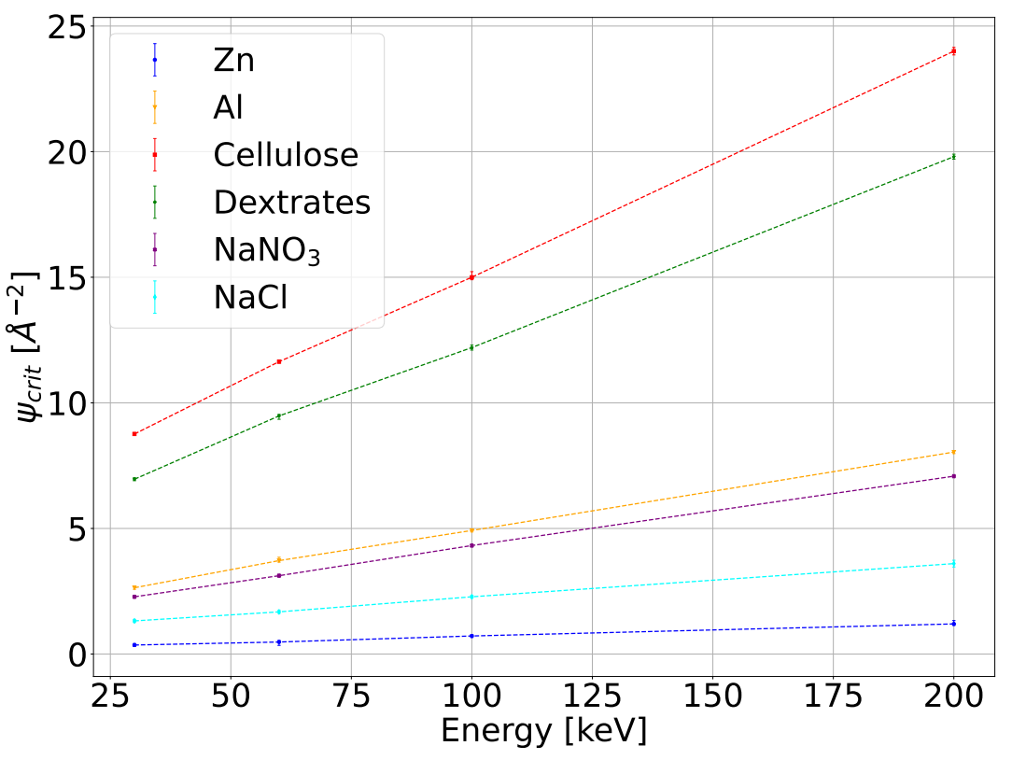
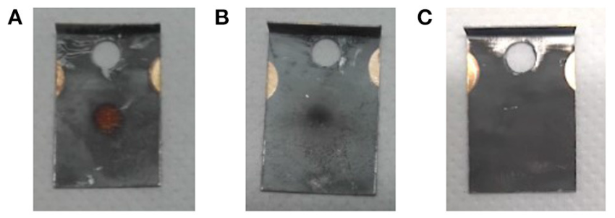
Ready to serve?
Implantation is not trivial!
R. Heinke et al., Frontiers in Medicine 8 (2021) 712374.
J.D. Johnson et al., Scientific Reports 13 (2023) 1347.

Slide 11
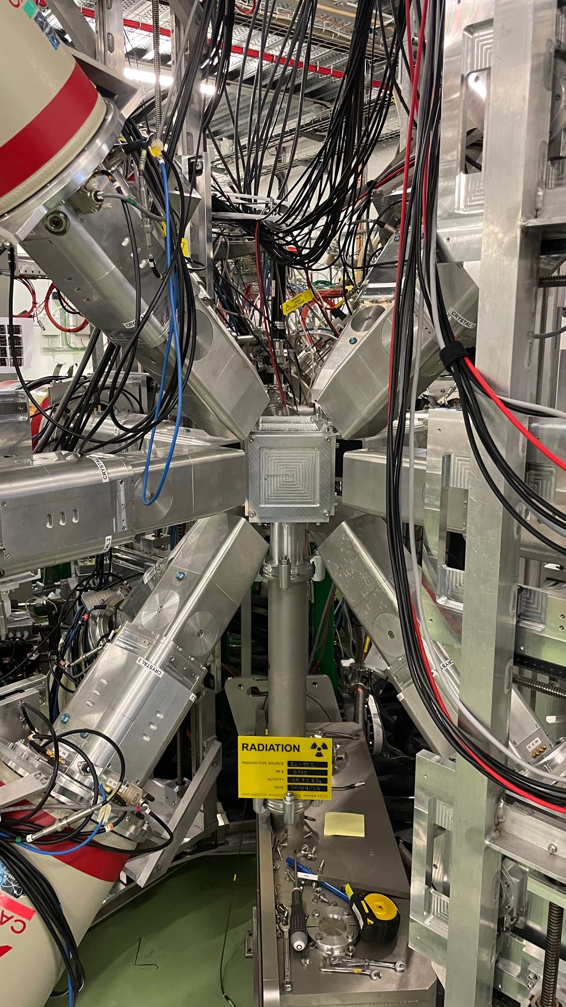
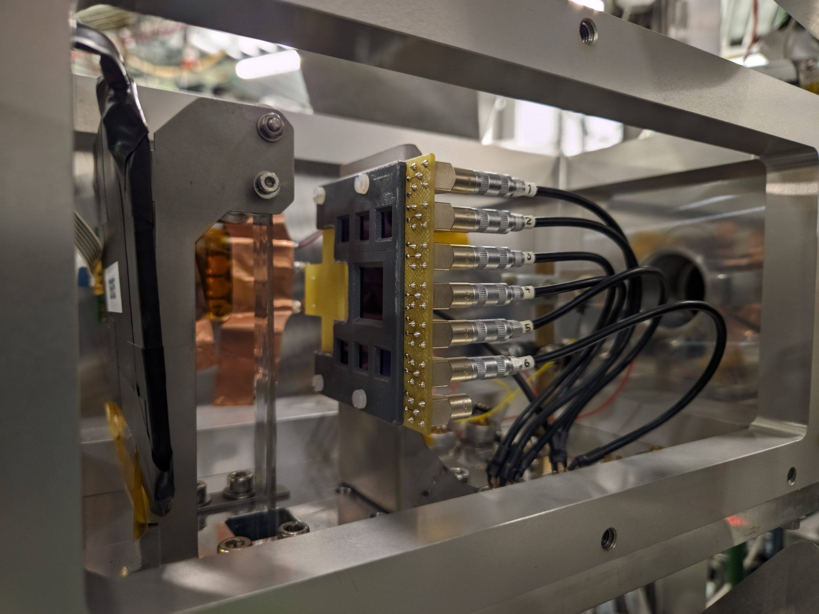
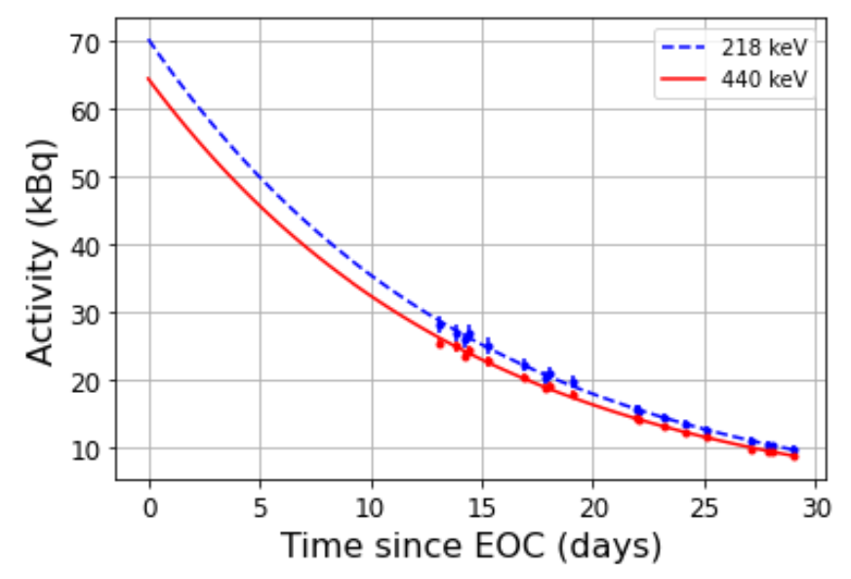
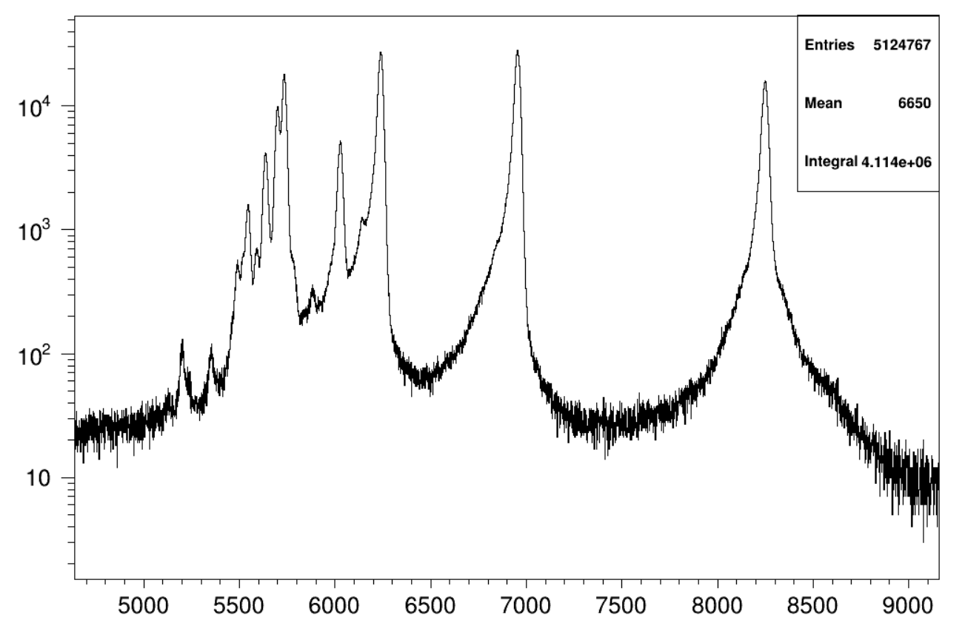
And what do we have here?
The nuclear data on many of these medical radionuclides are actually insufficiently known for use in clinical settings!

Slide 12
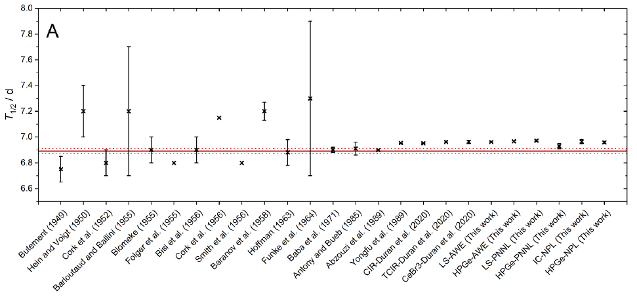
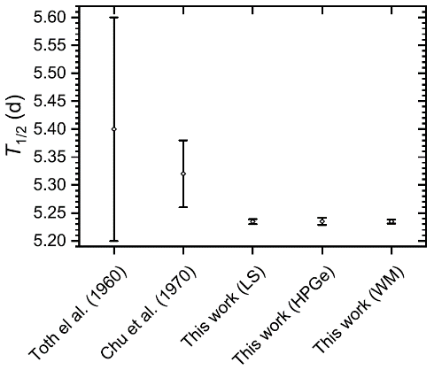
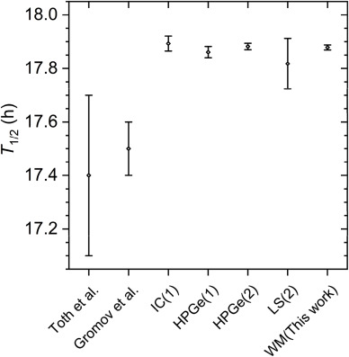
And what do we have here?
The nuclear data on many of these medical radionuclides are actually insufficiently known for use in clinical settings!
¹⁶¹Tb
¹⁵⁵Tb
¹⁵²Tb
S. Collins et al., Applied Radiation and Isotopes 182 (2022) 110140.
S. Collins et al., Applied Radiation and Isotopes 190 (2022) 110480.
S. Collins et al., Applied Radiation and Isotopes 202 (2023) 111044.

Slide 13
