Slide 1



„high-specific-activity“
¹⁵³Sm-FAPI-46
Dr. Clemens Kratochwil
clemens.kratochwil@med.uni-heidelberg.de
University Hospital Heidelberg, Department of Nuclear Medicine, Im Neuenheimer Feld 400, 69120 Heidelberg, Germany

Slide 2
Program
Background on “thera(g)nostics” and “targeted radio-ligand therapy”
  Dosimetry
  Pharmacokinetics of shuttle-molecule and physical characteristics of radio-label
Where do we stand? Own work with radio-labeled FAPI-46
  Why high-specific activity ¹⁵³Sm-FAPI-46?
  Challenges of Sm-153

Slide 3
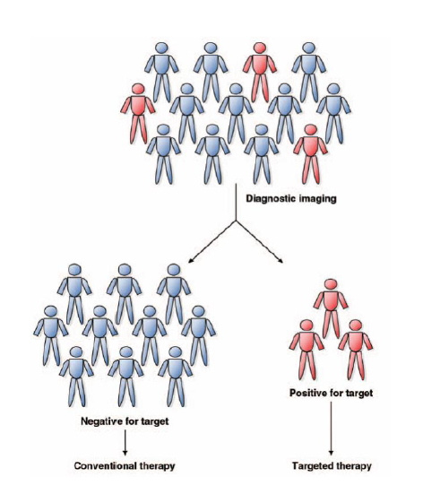
Thera(g)nostics: similar ligand for targeted therapy and diagnostics imaging
Tracer dose of a therapeutic radionuclide with
co-emission of gamma photons (e.g. radioiodine-test)
Identical molecule but different isotope (I-123, I-131)
Shuttle-molecule tagged with a chelator that can be
labeled with various diagnostic and therapeutic radio-metals (e.g. Ga-68, Lu-177, Tb-161, Ac-225)
Surrogate imaging using an (often faster) ligand
binding to the identical target molecule
D.Y. Lee, AJR 1997
Notes:
Previously known as nuclear medicine

Slide 4
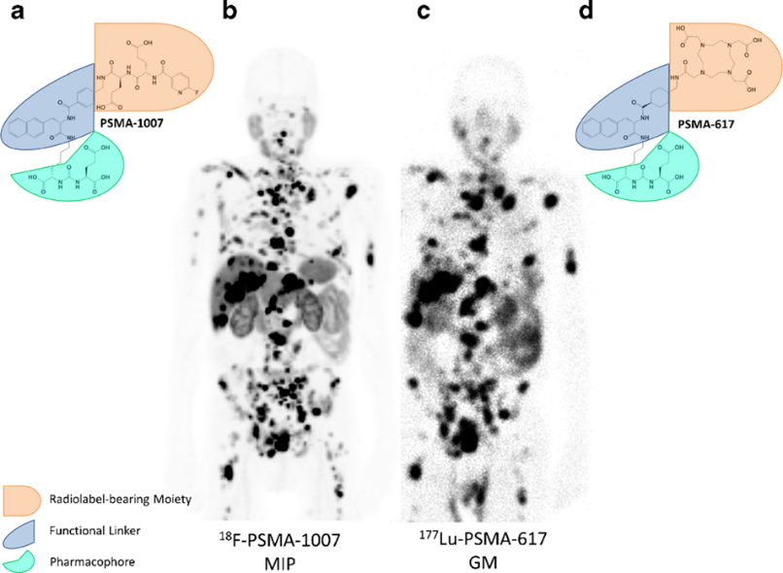
Thera(g)nostics: similar ligand for targeted therapy and diagnostics imaging
D.Y. Lee, AJR 1997
Giesel FL, Kratochwil C, et al. EJMMI 2016

Slide 5
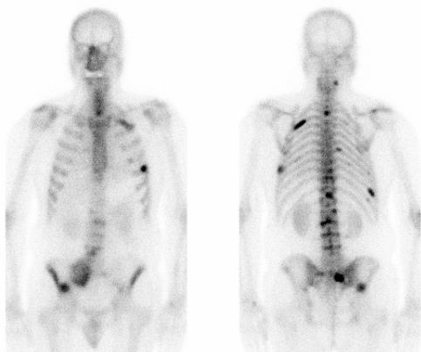
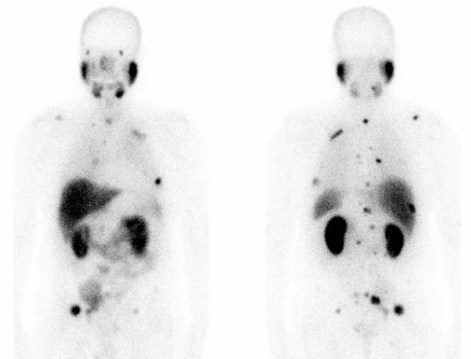
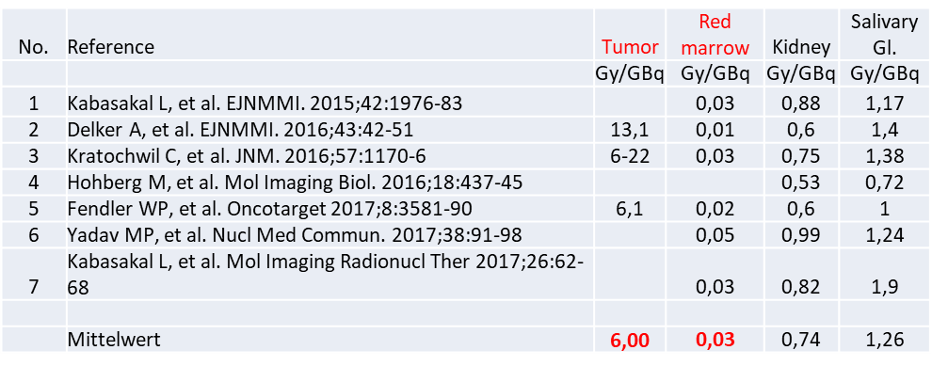
Thera(g)nostics: Diagnostic imaging as surrogate for treatment dosimetry?
No. | Reference | Tumor |  | Osteogenic cells | Red marrow
 |  | Gy / GBq |  | Gy / MBq | Gy / GBq
1 | Andreou M et al. JoPhysics 2011 | 22 |  | 6,8 | 1,5
Bone-Seekers:
Tumor to Red Marrow 15 : 1
PSMA-RLT:
Tumor to Red Marrow 150 : 1
No. | Reference | Tumor |  | Osteogenic cells | Red marrow
 |  | Gy / MBq |  | Gy / MBq | Gy / MBq
1 | Pacilio M et al. EJNMMI 1/2016 | 2 |  | 1,15 | 0,14
2 | Murray I et al. EJNMMI 6/2017 | 0,3-2,2 |  | 1,15 | 0,14
¹⁵³Sm-EDTMP, ²²³RaCl₂
¹⁷⁷Lu-PSMA-617

Slide 6
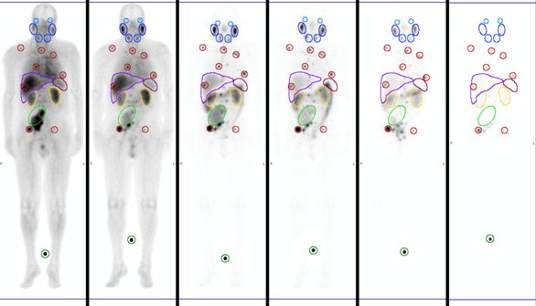
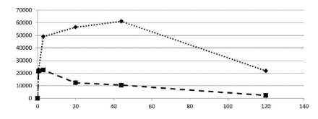
A magic bullet would have perfect tumor vs. normal-organ dosimetry
Serial imaging and blood sampling
Segmentation of organs and tumors.
TAC fitting. Integration of number of decays
in target volume.
Segmentation of target mass per CT
OLINDA calculates organ und tumor (Sphere model) absorbed dose [Gy]
Dose-limiting organs:
Red-marrow: 1-3 Gy
Kidneys: 23-30 Gy
Tumor: > 80 Gy needed

Slide 7
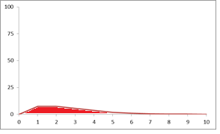
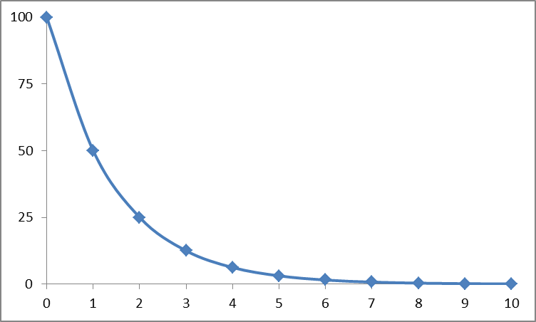
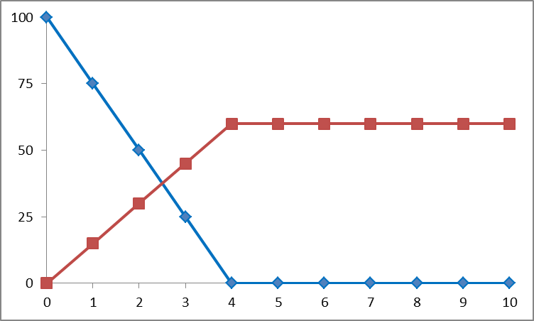
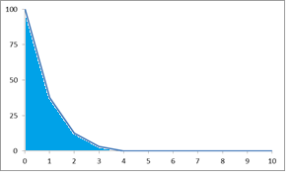
Radiopharmacology: Understanding the basics
Physical half-life Pharmacokinetics
Tumor absorbed dose
Blood / marrow dose

Slide 8
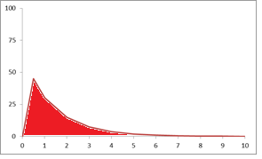
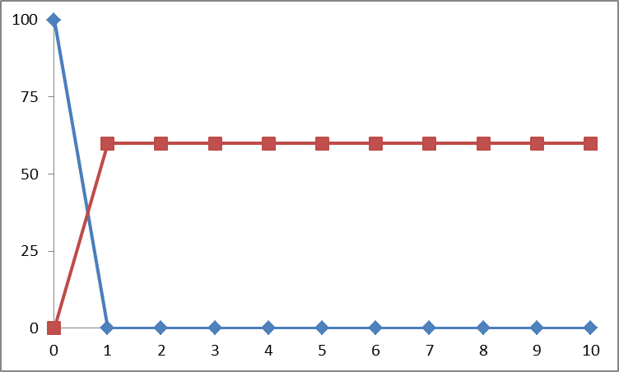
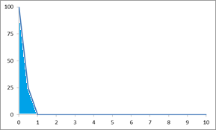
Radiopharmacology: Understanding the basics
Physical half-life Pharmacokinetics
Tumor absorbed dose
Blood / marrow dose

Slide 9
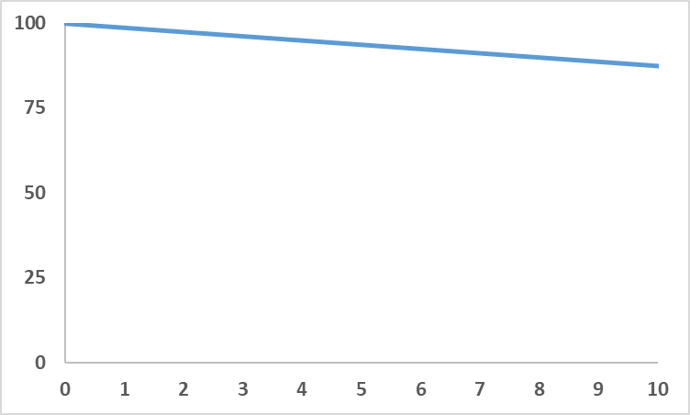
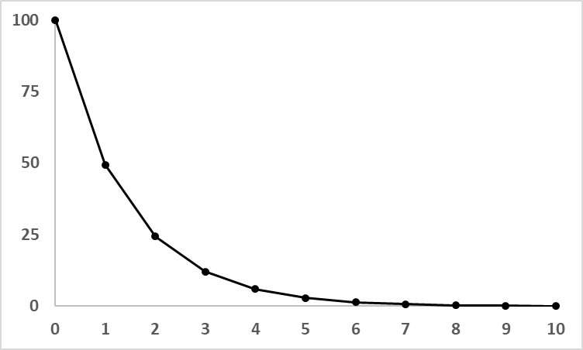
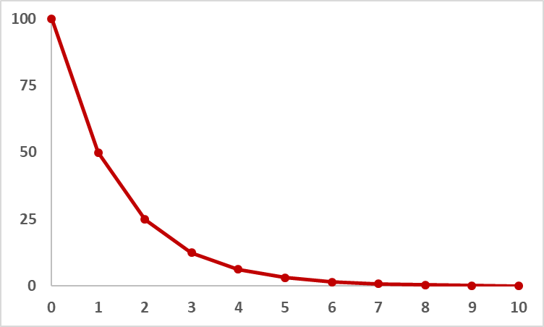
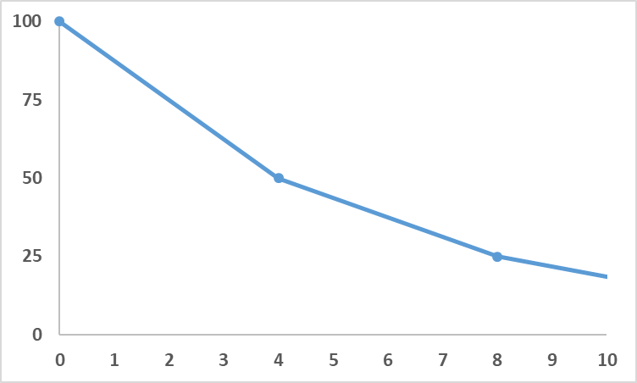
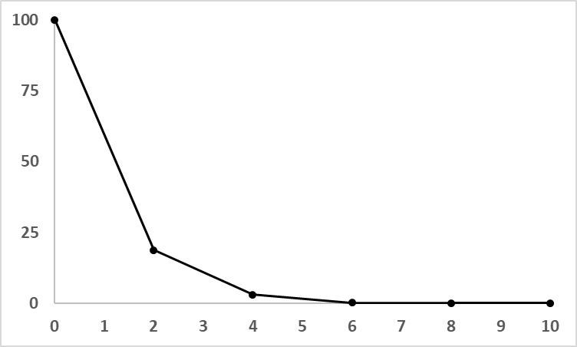
Radiopharmacology: Understanding the basics
HWZ_{phys} = 40x HWZ_{biol}
Tumor absorbed dose
Biological half-life (tumor)
HWZ_{phys} = 4x HWZ_{biol}
Tumor absorbed dose

Slide 10
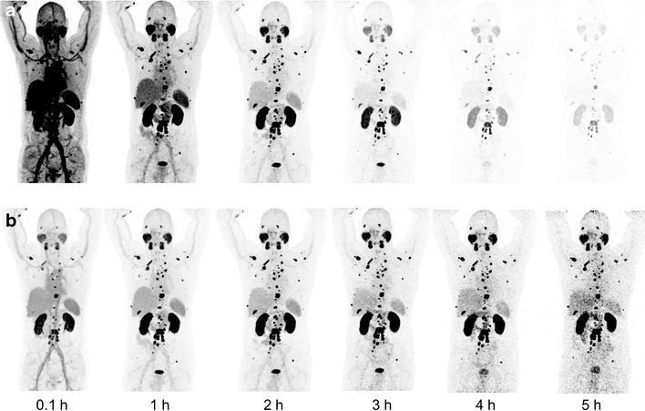
Radiopharmacology: Understanding the basics
a) ²¹³Bi-PSMA617 (HL 47 min) vs. b) ²²⁵Ac-PSMA617 (HL 9.9 d)
(quantitatively correct reconstructed images normalized to 2h p.i.)
Kratochwil, EJNM 2018

Slide 11
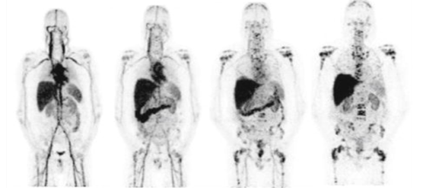
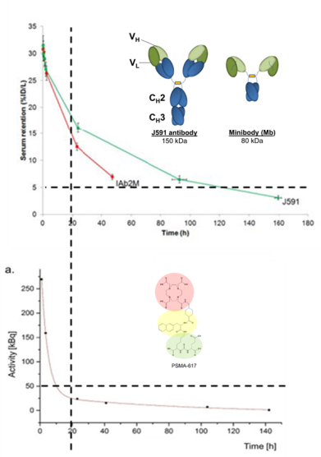
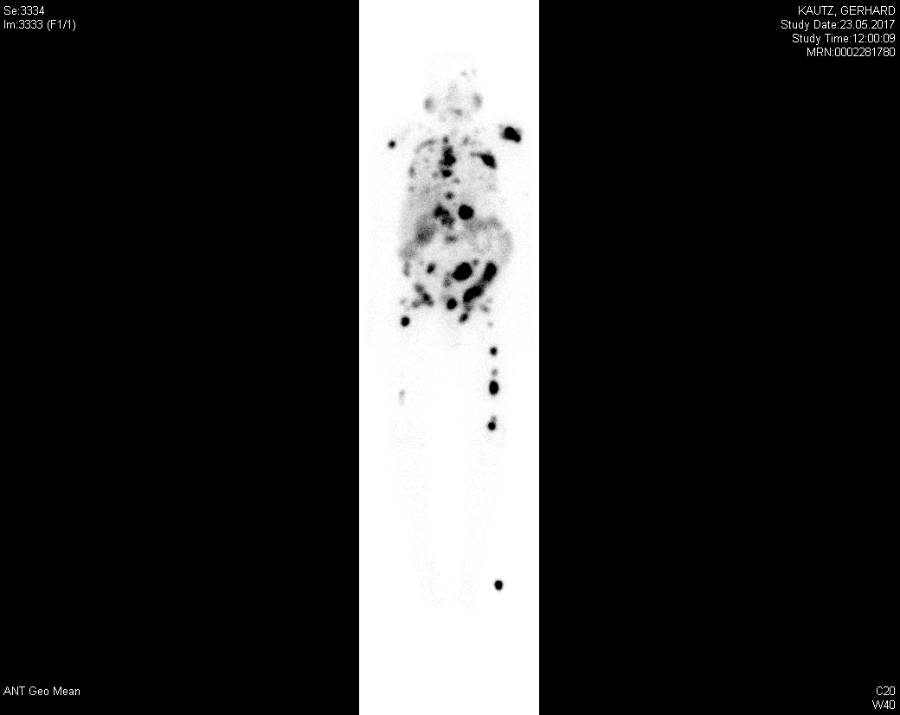
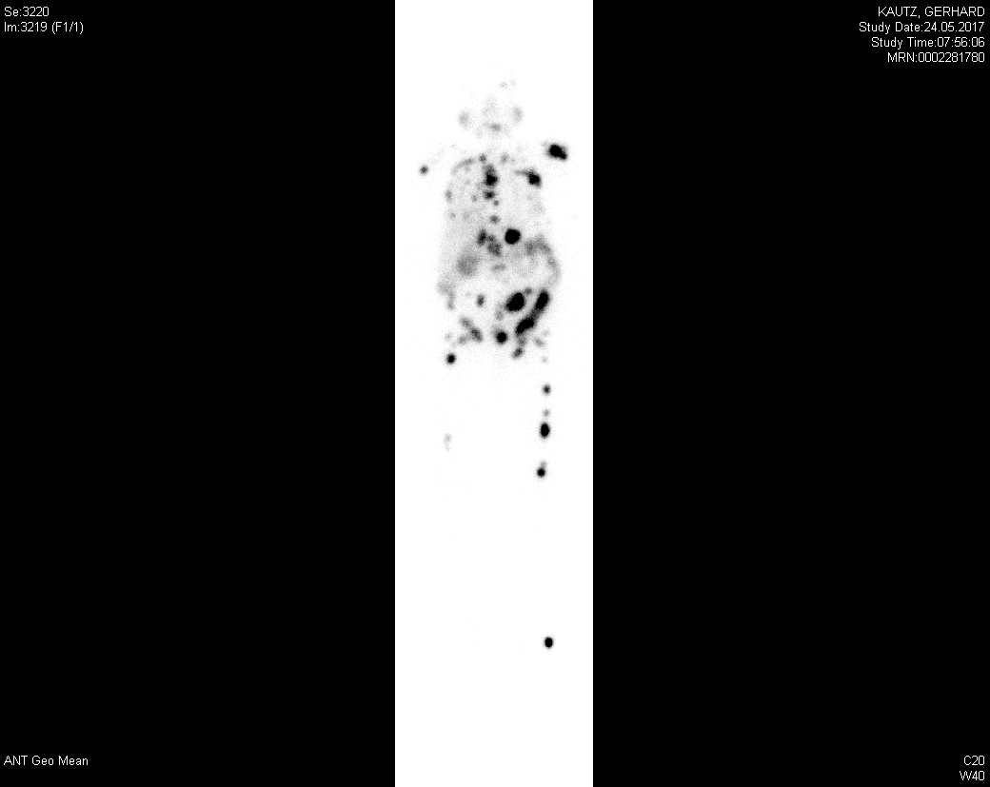
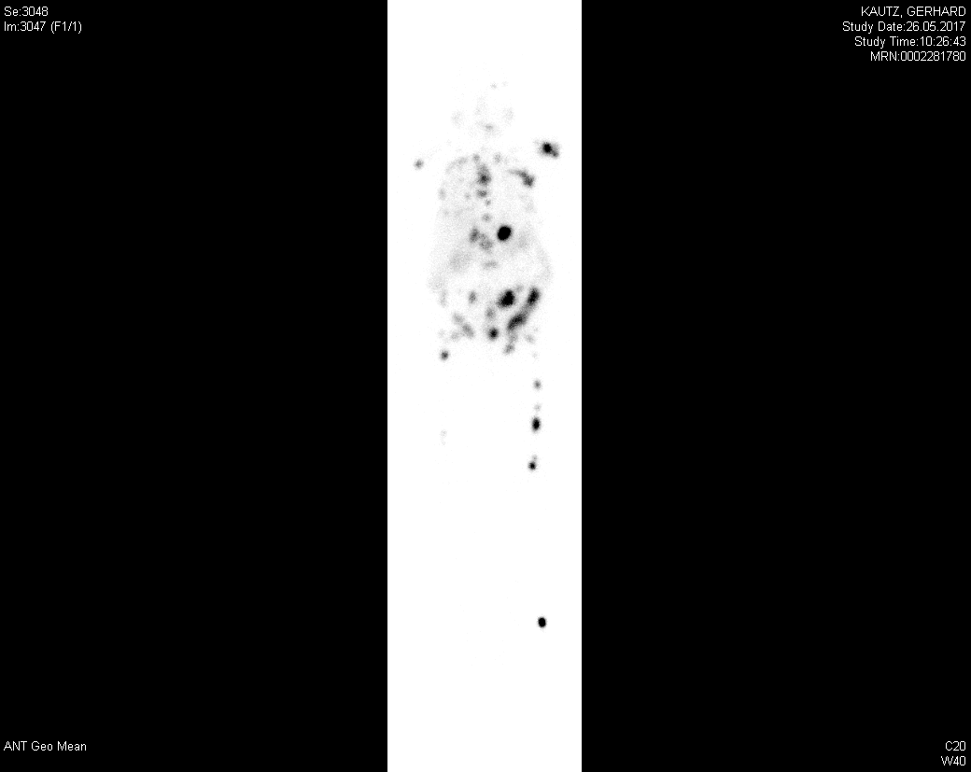
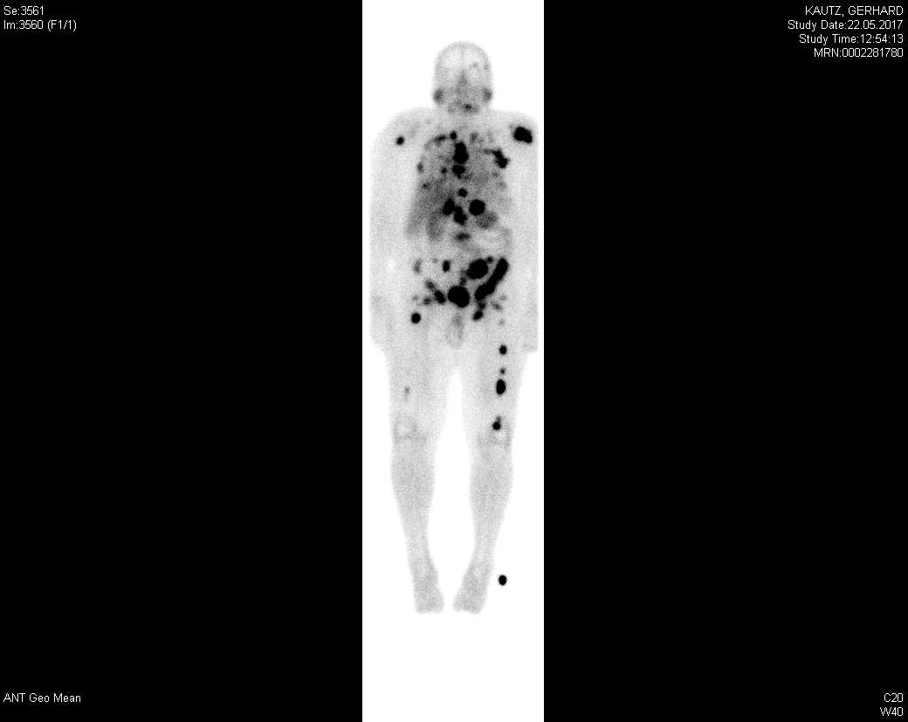
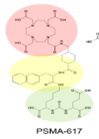
Radio-Ligand-Therapy ≠ Radio-Immuno-Therapy 2.0
Pandit-Taskar, et al. JNM, 2016
hu591
PSMA-617
Day 1
Day 2
Day 4
Day 8
1 kDa
1-4h p.i. 24h p.i. 48h p.i. 96h p.i.

Slide 12
Radio-Ligand-Therapy ≠ Radio-Immuno-Therapy 2.0
Pandit-Taskar, et al. JNM, 2016
IAB2M
PSMA-617
1-4h p.i.
24h p.i.
48-72h p.i.
96-120h p.i.
1 kDa
1-4h p.i. 24h p.i. 48h p.i. 96h p.i.

Slide 13
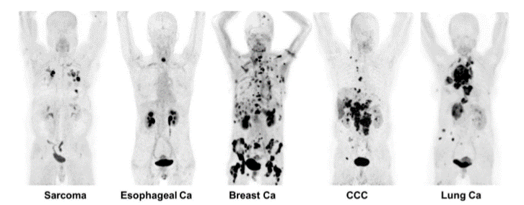
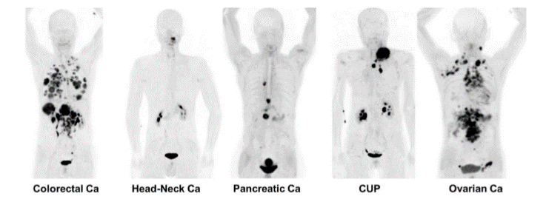
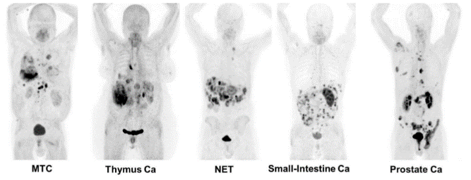
How to construct a magic bullet – FAPI-46
Multi tumor targeting molecule
Tumor specific, high uptake (SUV >10)
Large extra-cellular domain
Ligand-induced internalization
Post-Proline-Cleaving-Protease Inhibitor
Rapid kinetics of low-molecular-weight ligand
Universal DOTA-Chelator
⁶⁸Ga-FAPI-04 PET/CT 1 h p.i.
Image of the year SNMMI / JNM 2019

Slide 14
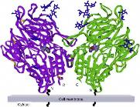
How to construct a magic bullet – FAPI-46
Multi tumor targeting molecule
Tumor specific, high uptake (SUV >10)
Large extra-cellular domain
Ligand-induced internalization
Post-Proline-Cleaving-Protease Inhibitor
Rapid kinetics of low-molecular-weight ligand
Universal DOTA-Chelator
⁶⁸Ga-FAPI-04 PET/CT 1 h p.i.
Image of the year SNMMI / JNM 2019

Slide 15
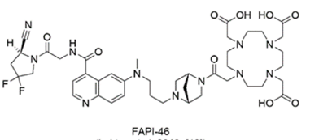
How to construct a magic bullet – FAPI-46
Multi tumor targeting molecule
Tumor specific, high uptake (SUV >10)
Large extra-cellular domain
Ligand-induced internalization
Post-Proline-Cleaving-Protease Inhibitor
Rapid kinetics of low-molecular-weight ligand
Universal DOTA-Chelator
⁶⁸Ga-FAPI-04 PET/CT 1 h p.i.
Image of the year SNMMI / JNM 2019

Slide 16
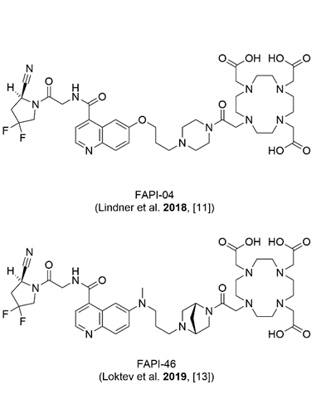
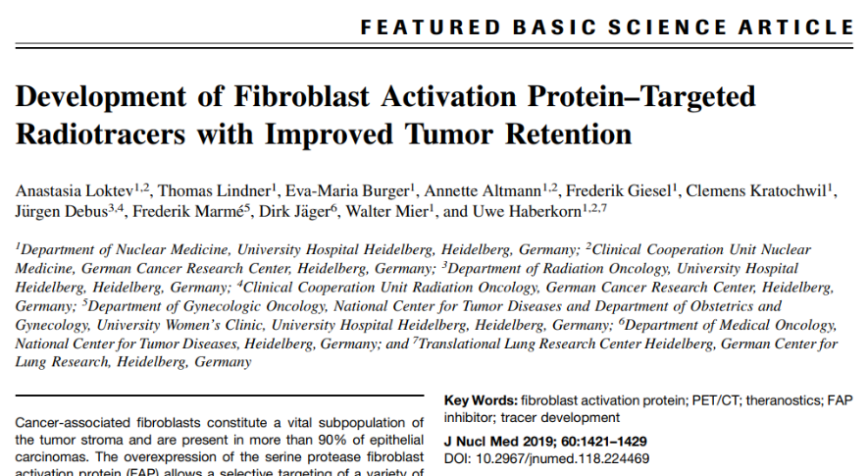
FAPI-46 – Optimization of PK

Slide 17
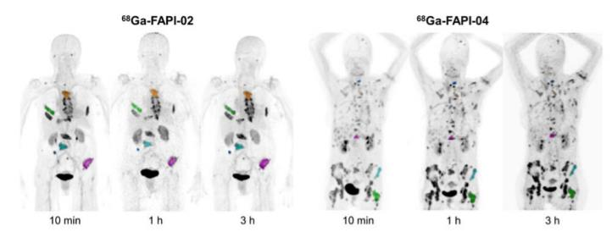


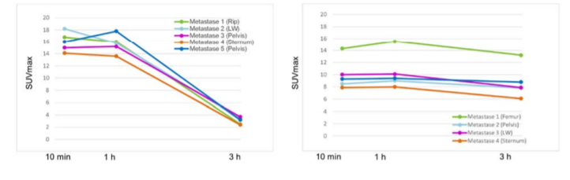
FAPI-46 – Optimization of PK
Very short tumor retention time
(FAPI-02: ~ 2h,
FAPI-04: ~8h,
FAPI-46: ~16h)

Slide 18
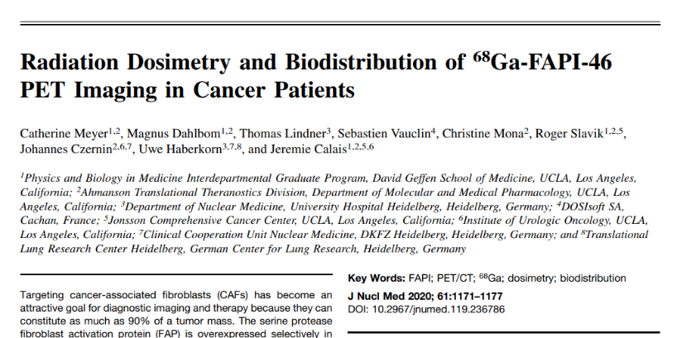
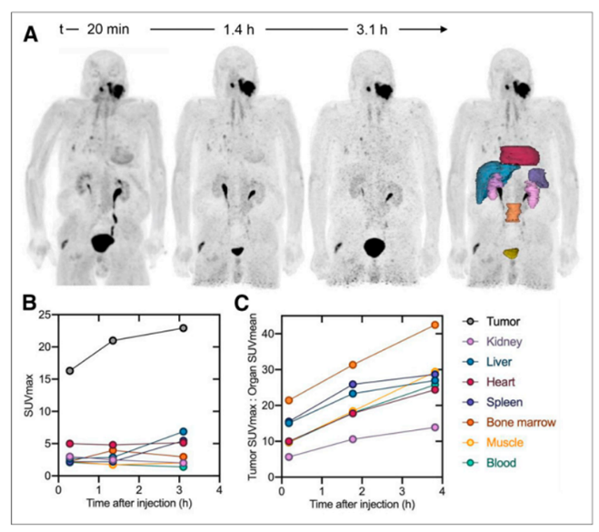
FAPI-46 – Optimization of PK

Slide 19
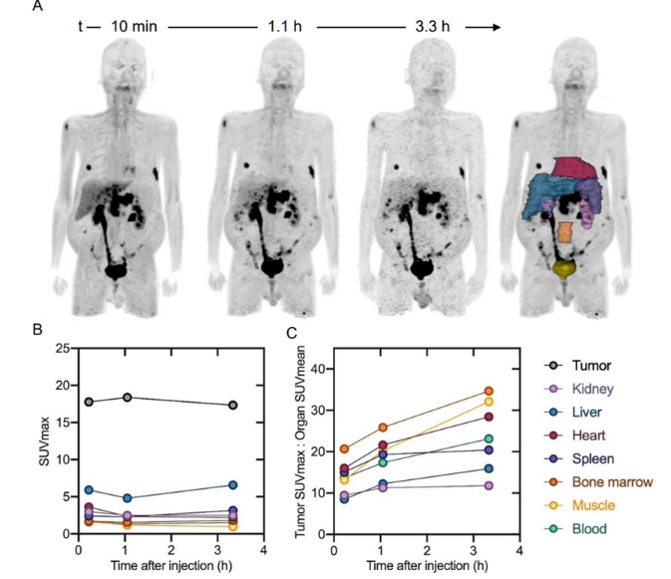
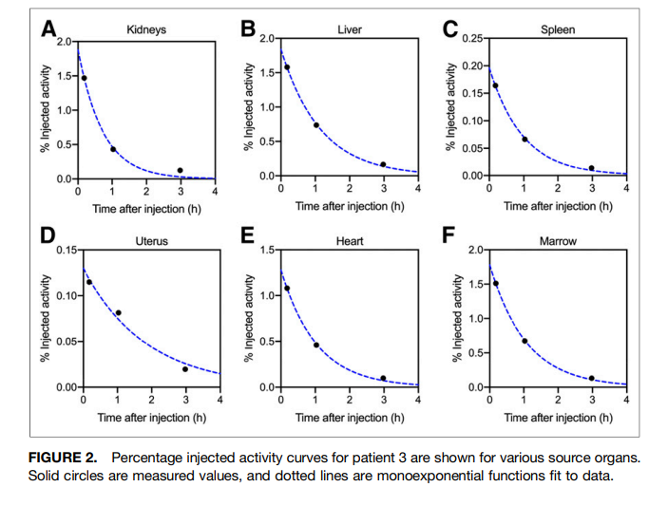
FAPI-46 – Optimization of PK

Slide 20
FAPI-46 – Optimization of PK
FAPI-46 HL_{biol}(Tu): 16 h FAPI-46 HL_{biol}(KM,Nieren): 2 h
Nuclide | HL_{phys} | HL_{eff} (Tu) | HL_{eff} (KM, Ni)
Re-188 | 16 h | 8,0 h | 1,8 h
Sm-153 | 46 h | 12,4 h | 1,9 h
Y-90 | 64 h | 12,8 h | 1,9 h
Lu-177 | 161 h | 14,5 h | 2,0 h

Slide 21
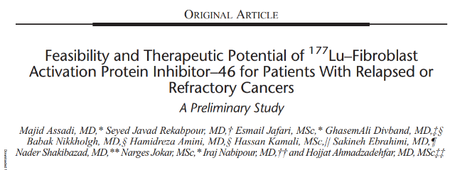
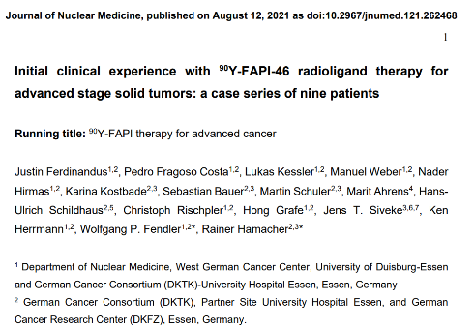
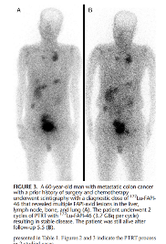
Dosimetry of ⁹⁰Y/¹⁷⁷Lu-FAPI-46
0.03 Gy/GBq red-marrow
0.89 Gy/GBq kidneys
0.04 Gy/GBq red-marrow
0.52 Gy/GBq kidneys
1.28 Gy/GBq tumor/metastasen

Slide 22
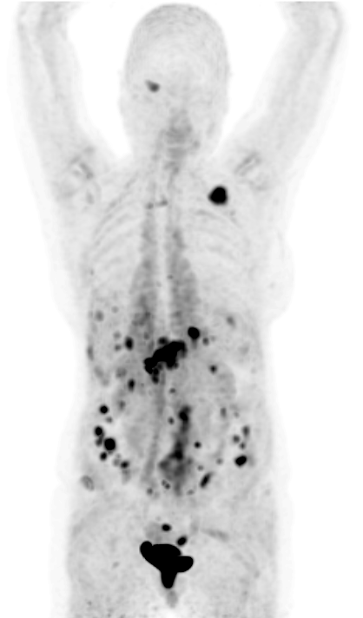
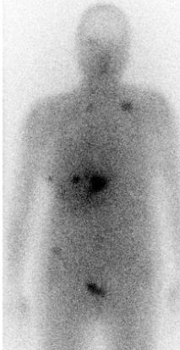
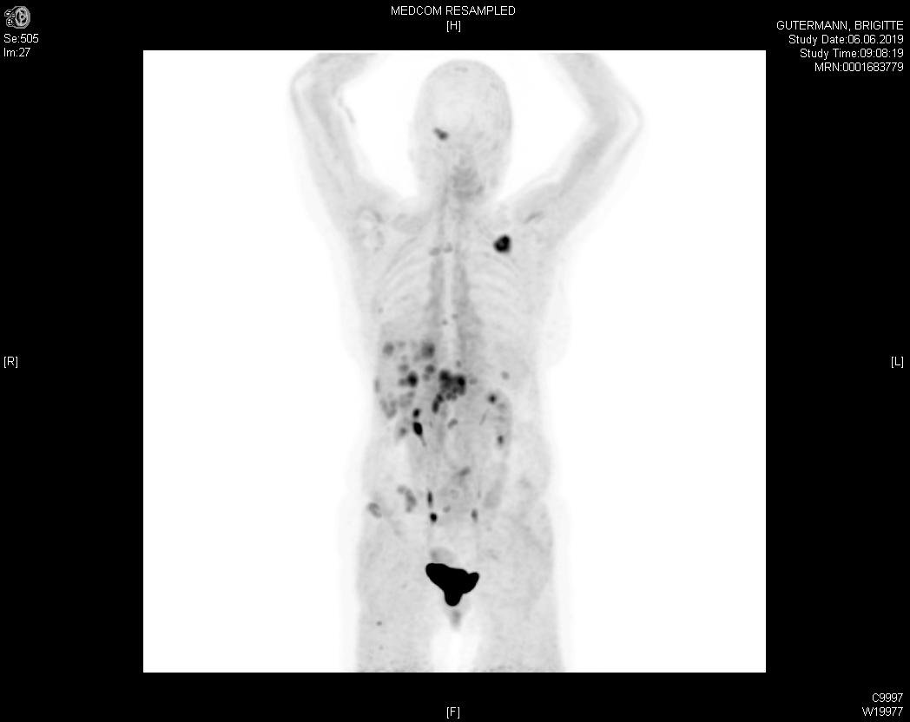
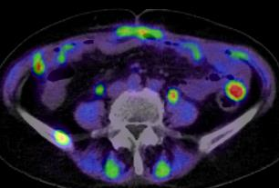
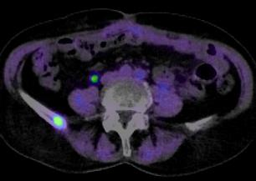
⁹⁰Y-FAPI-46 – Case from Heidelberg
A
B
C
D
baseline
E
post Tx
Baseline PET/CT
⁶⁸Ga-FAPI-04
7,4 GBq
⁹⁰Y-FAPI-46
Week-6 PET/CT
⁶⁸Ga-FAPI-04

Slide 23
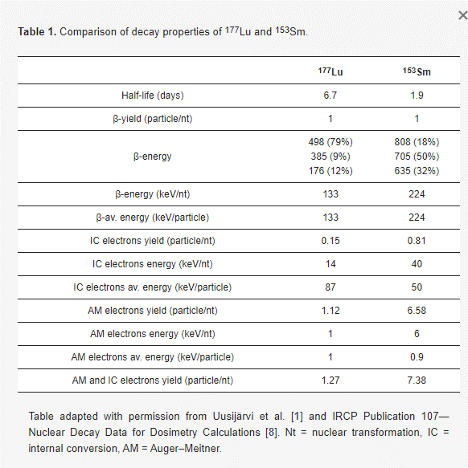
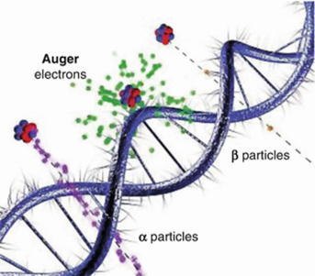
Theoretical advantage of ¹⁵³Sm-FAPI-46
In addition to its more favorable half-life (dose-rate benefit over Lu-177), Sm-153 benefits from higher co-emission of IC- and Auger electrons.
Vermeulen K, Van de Voorde M, et al Pharmaceutics 2022

Slide 24


¹⁵³Sm-FAPI-46 – Case from Heidelberg

Slide 25


¹⁵³Sm-FAPI-46 – Case from Heidelberg

Slide 26

¹⁵³Sm-FAPI-46 – the issue of “specific activity”
TUMOR SECIFIC UPTAKE: TARGET NUMBERS
RECEPTOR NUMBER
typical example:
10 g tumor ≙ 10¹⁰ cells
10⁵ receptors per cell
patient: 10¹⁵ binding sites
TRACER NUMBER
86 mg Doxorubicin ≙ 10²⁰ molecules
3.5 mg Vinchristin ≙ 10¹⁸ molecules
270 mg Kadcyla ≙ 3 x 10¹⁷ molecules
6 GBq ¹⁷⁷Lu ≙ 5 ×10¹⁵ atoms
20 MBq ²²⁵Ac ≙ 10¹⁴ atoms

Slide 27
¹⁵³Sm-FAPI-46 – the issue of “specific activity”
Sm-152 (stable) > 99 %
Sm-153 (active) < 1 %

Slide 28


¹⁵³Sm-FAPI-46 – the issue of “specific activity”
Limitations of reactor produced ¹⁵³Sm:
Eu-152 and Eu-154 impurities
(half-life > 8 y)

Slide 29


¹⁵³Sm-FAPI-46 – the issue of “specific activity”
Limitations of reactor produced ¹⁵³Sm:
Eu-152 and Eu-154 impurities
(half-life > 8 y)
Sm-152 : Sm-153 is 120 : 1

Slide 30
¹⁵³Sm-FAPI-46 – the issue of “specific activity”
Limitations of reactor produced ¹⁵³Sm:
Eu-152 and Eu-154 impurities
(half-life > 8 y)
Sm-152 : Sm-153 is 120 : 1
These issues have already been eliminated by mass separation (CERN-MEDICIS):
(135 GBq/ml -> 1.87 TBq/ml (max. 16.4 TBq/ml)

Slide 31

¹⁵³Sm-FAPI-46 – the issue of “specific activity”
Eu-153 (stable)
Sm-153 (active)
Time dependent
(logistic challenge)

Slide 32


Current development: Chemical separation of Sm-153 / Eu-153

Slide 33
Summary
FAP is a very promising target for radioligand therapy of multiple tumor entities.
Physical half-life of Sm-153 (1.9d = 46h) presents a perfect match for the pharmacokinetics of the FAPI-46 shuttle molecule.
Issues of (c.a.) low specific activity Sm-152 / Sm-153 and long half-life Eu-152 an Eu-154 impurities after reactor production have been solved by MEDICIS.
“In-growth” of Eu-153 by beta-decay of Sm-153 is still an issue that cannot be solved with mass separation. Chemical separation is challenging but improving.
Saturation of tumor binding sites allows for approx. 250 µg of FAPI-46 precursor (estimated from n=1 Heidelberg patient). Yet, 1000 µg precursor was needed for labeling of test-activity HSA Sm-153.
Future factor-4 improvement in labeling-efficacy appears very reasonable.

Slide 34

(HSA) ¹⁵³Sm-FAPI-46
Thanks to all my collaborators…
… and for your excellent questions…
… and the fruitful discussion!

