Slide 1


Overview of the LHC performance in Run 3
Major LHC events and performance in 2023 and 2024
Prospects for 2025 & 2026
Status of HL-LHC preparation
Reyes Alemany Fernandez, CERN
Beams department – Accelerator and Beam Physics group

Slide 2
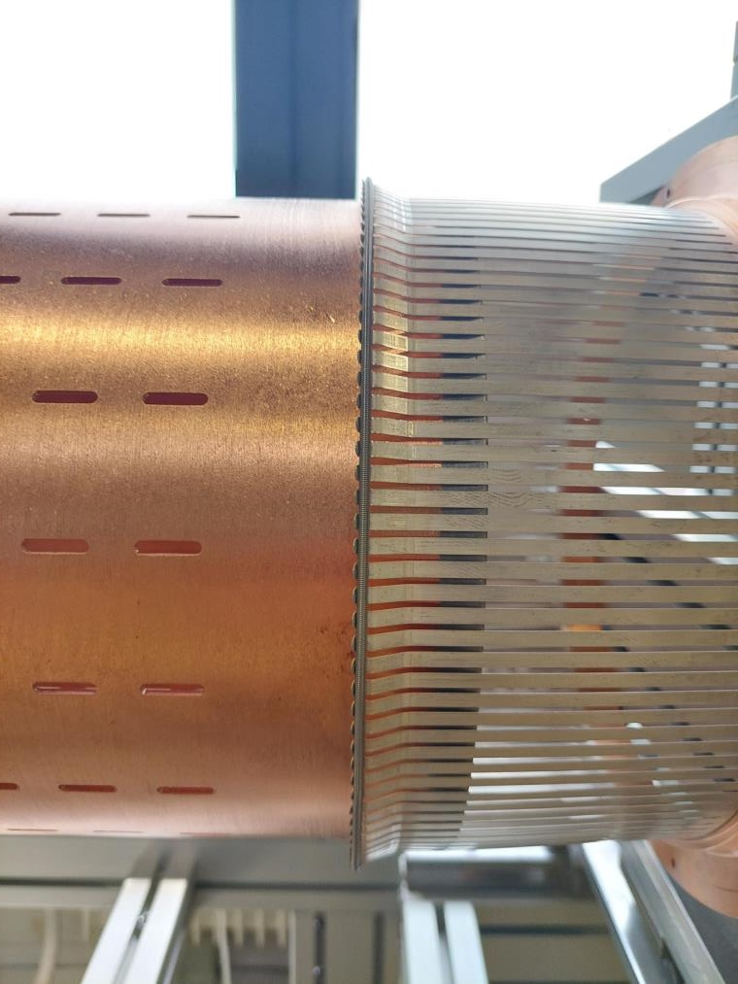
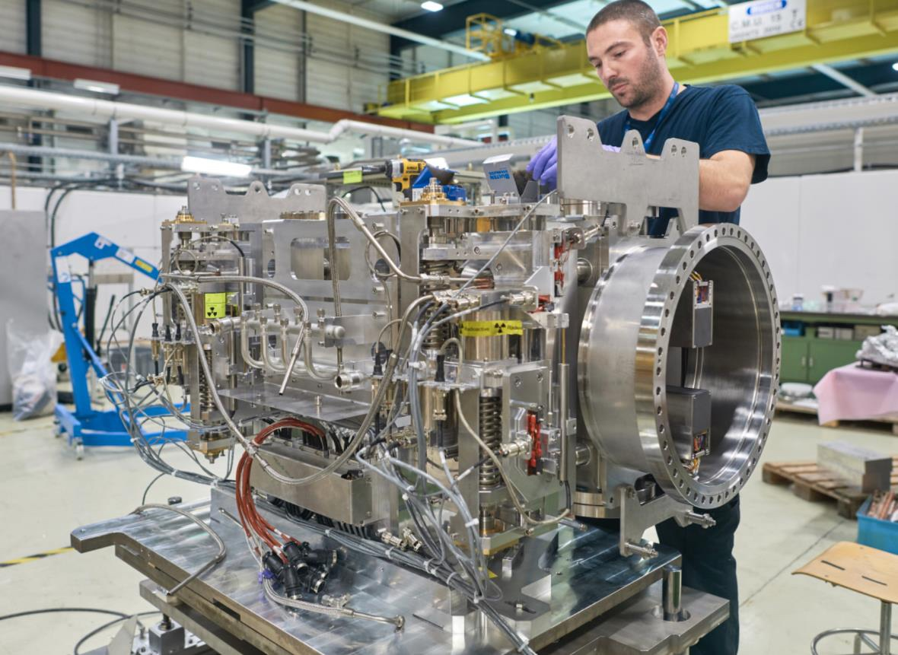
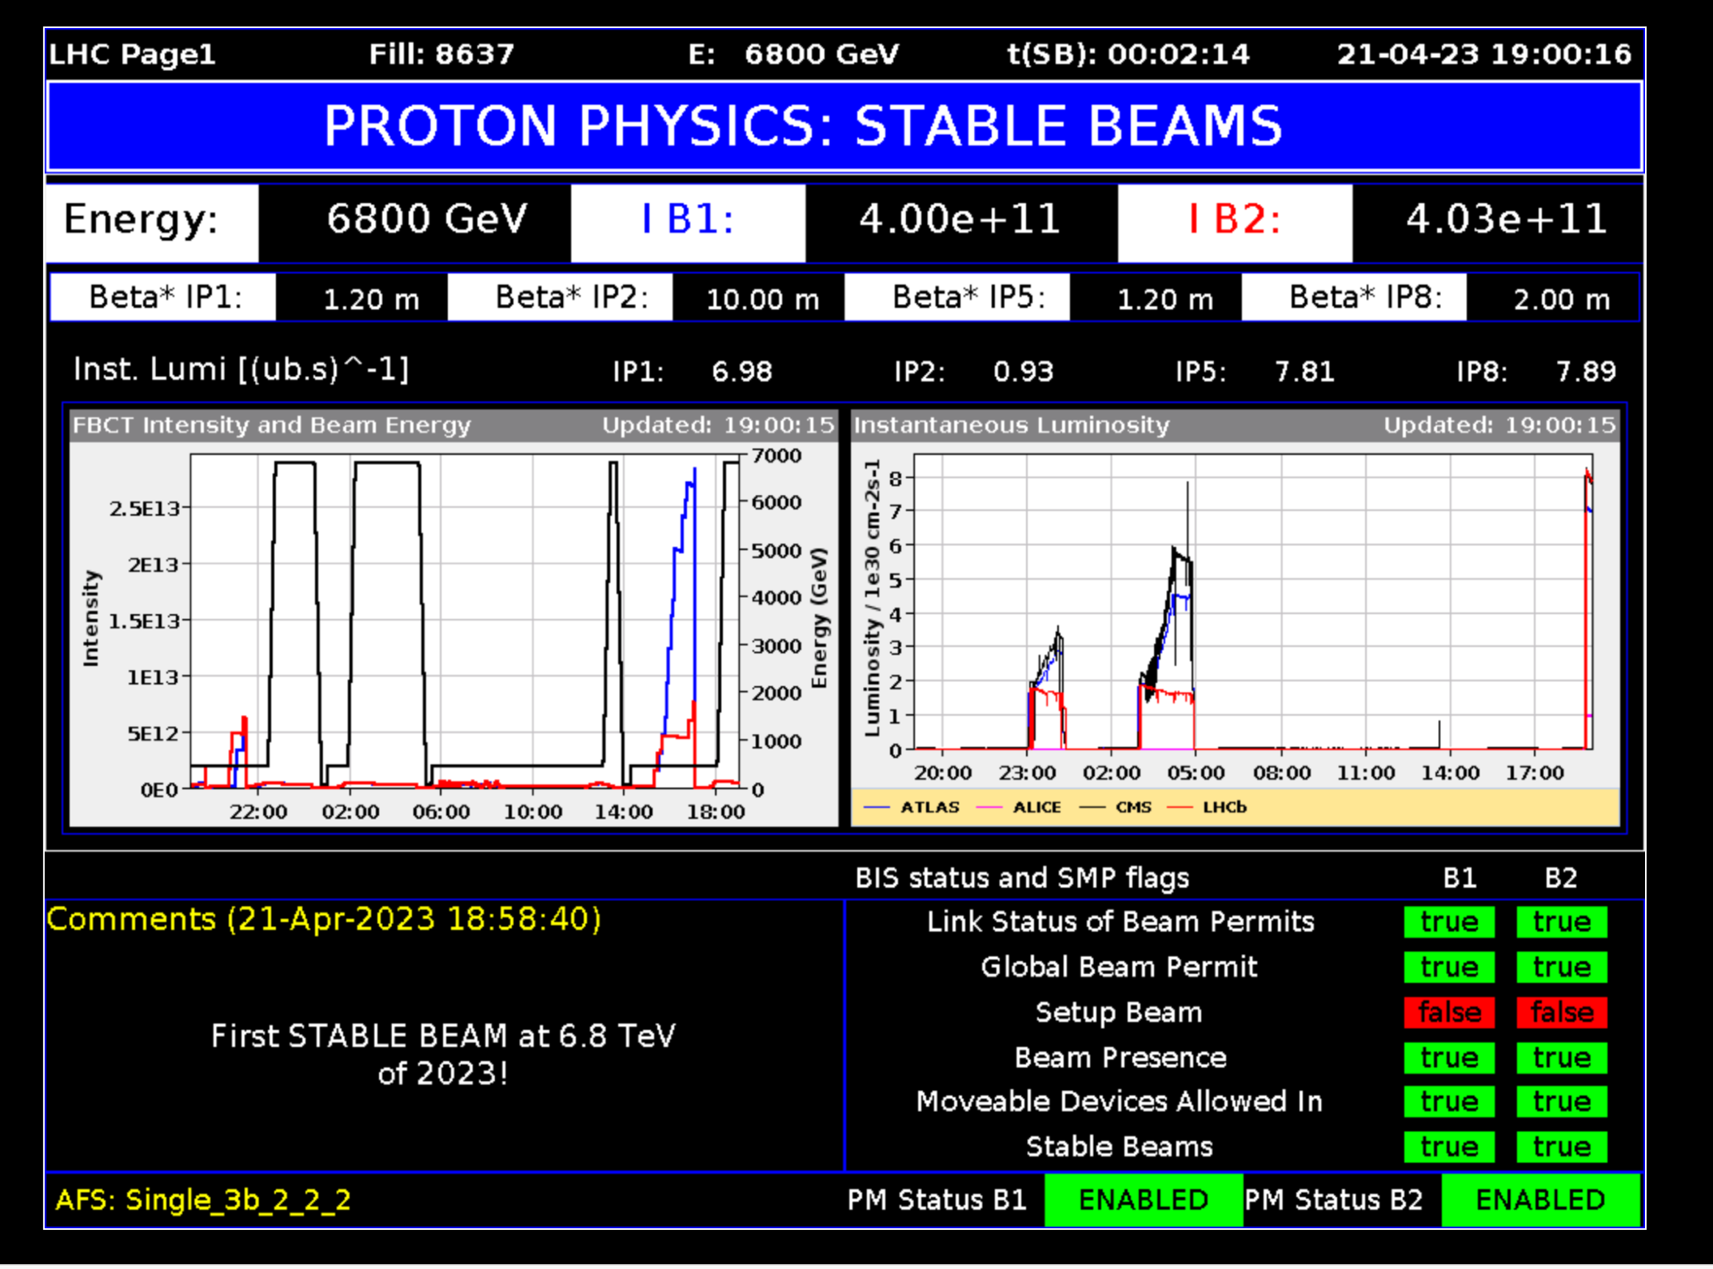
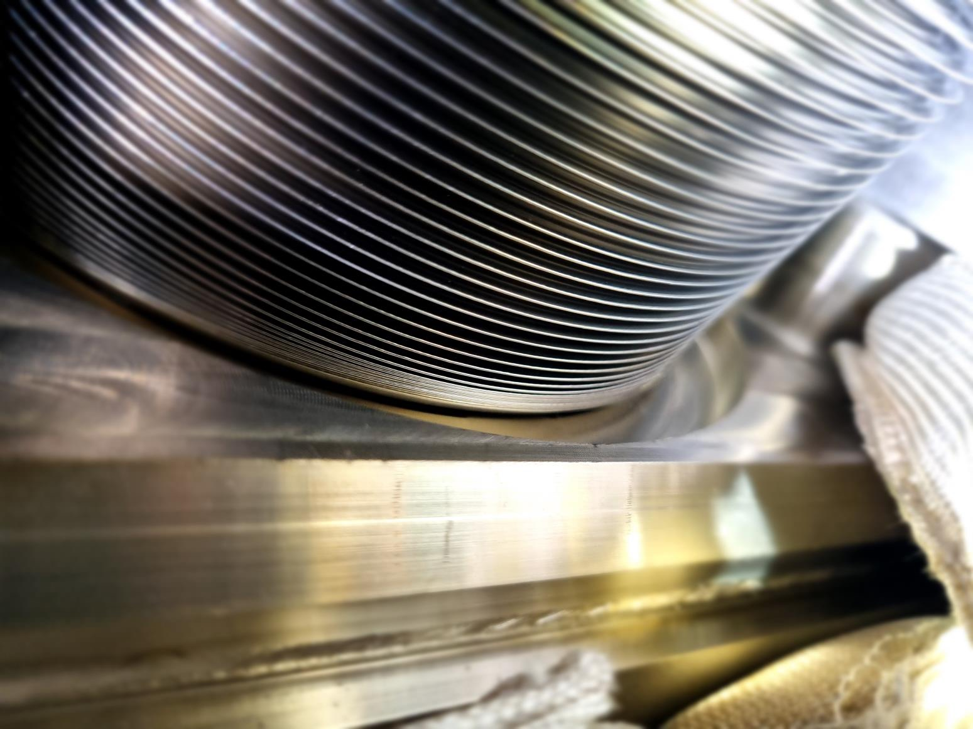
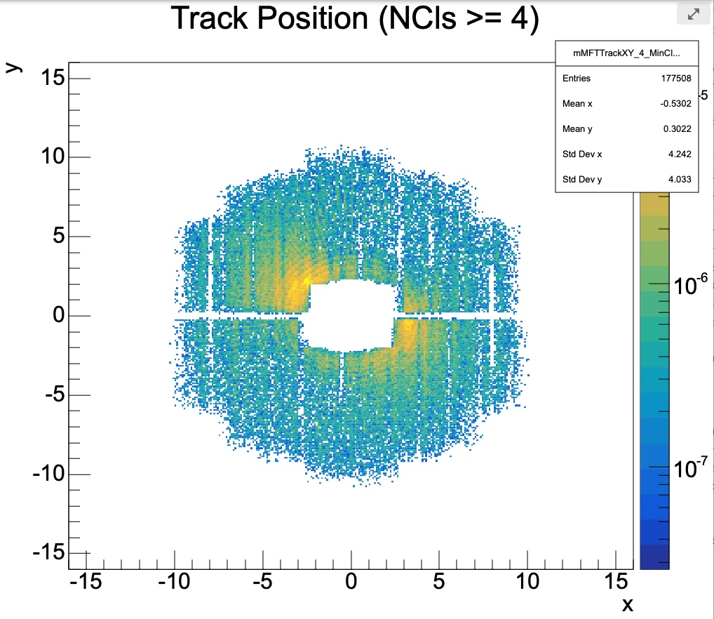
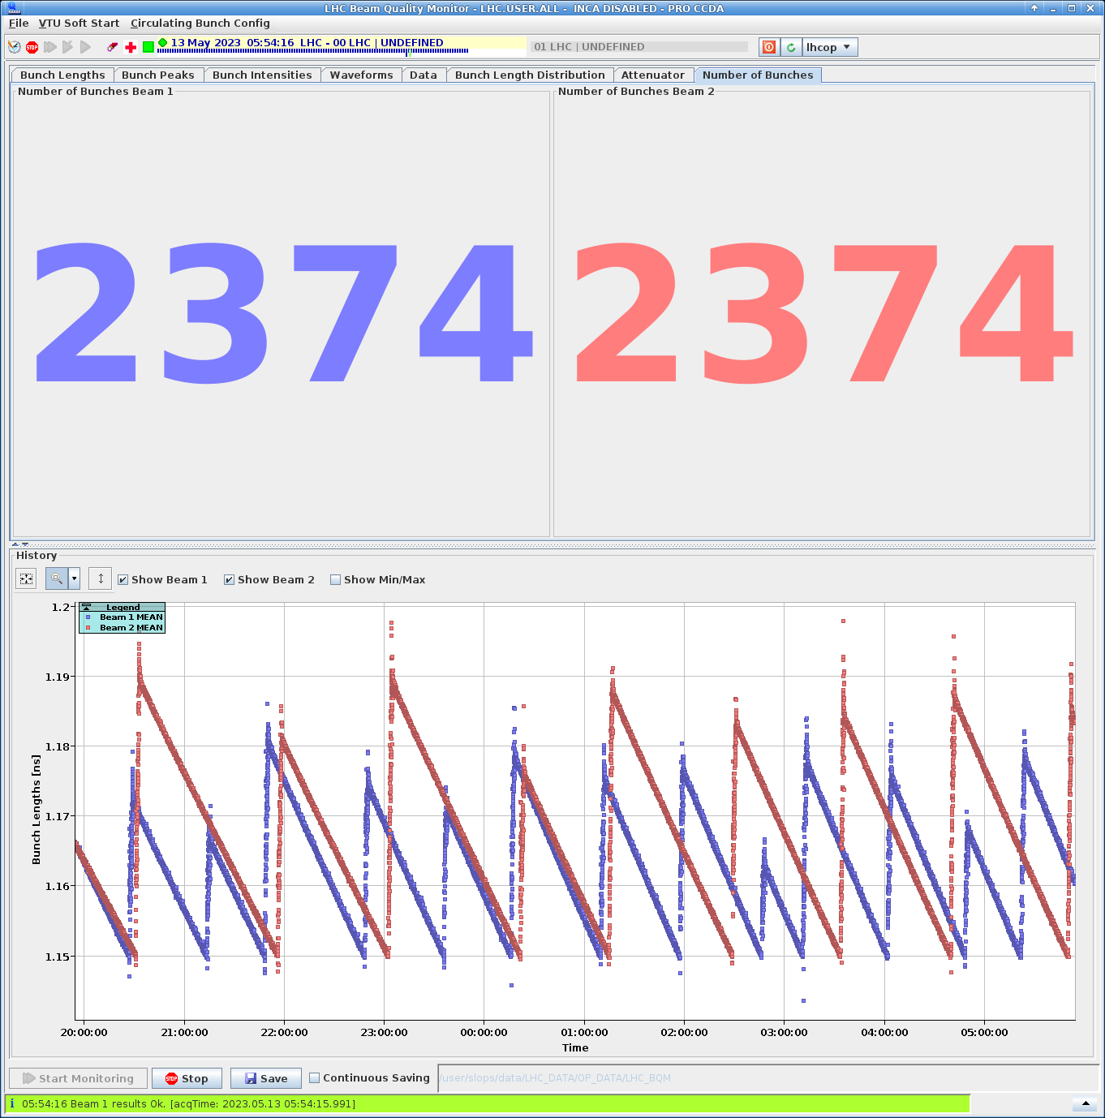
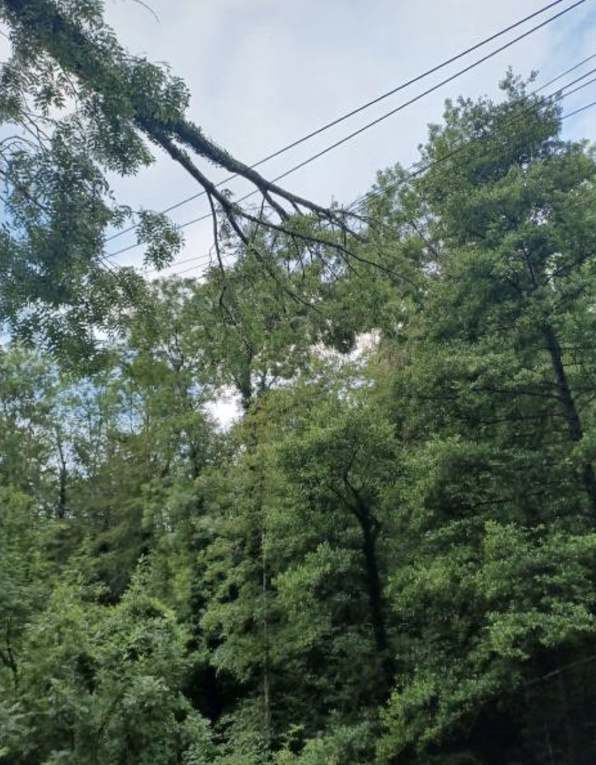
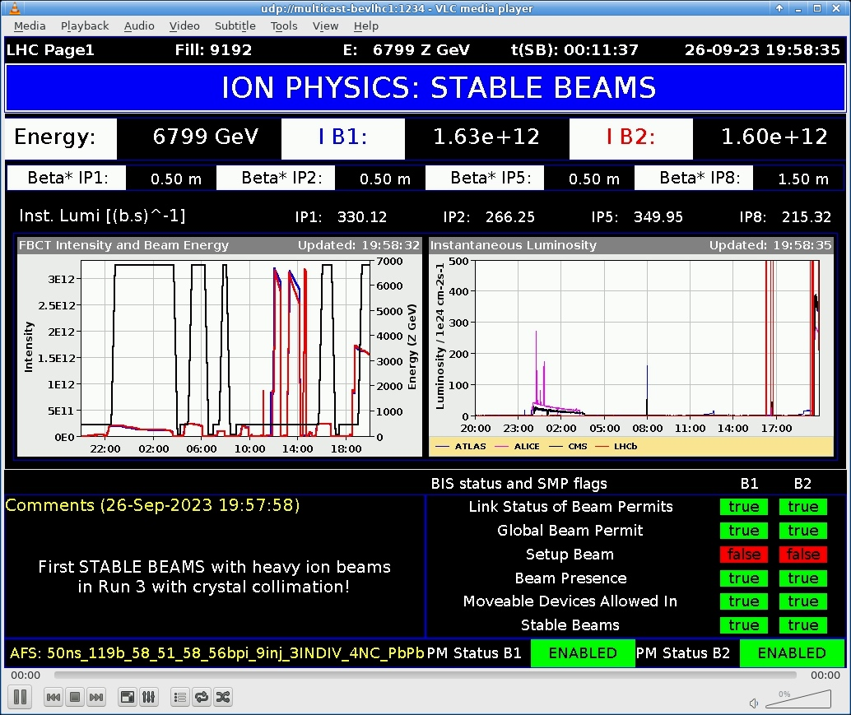
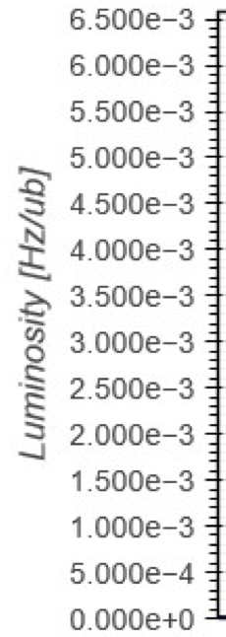
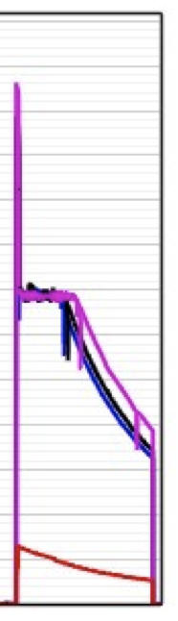
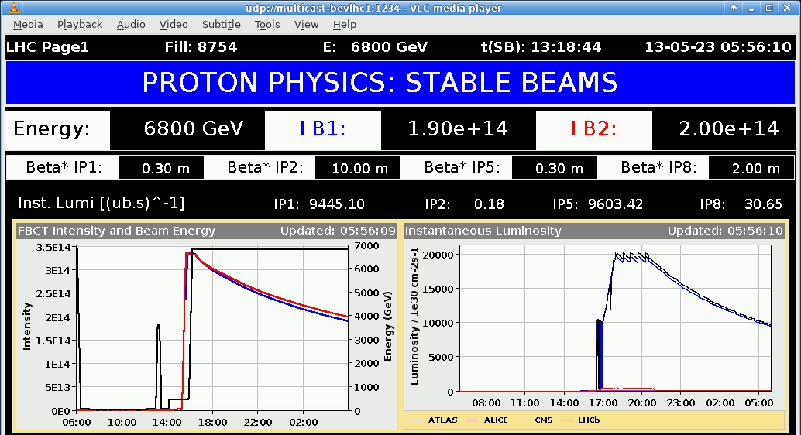
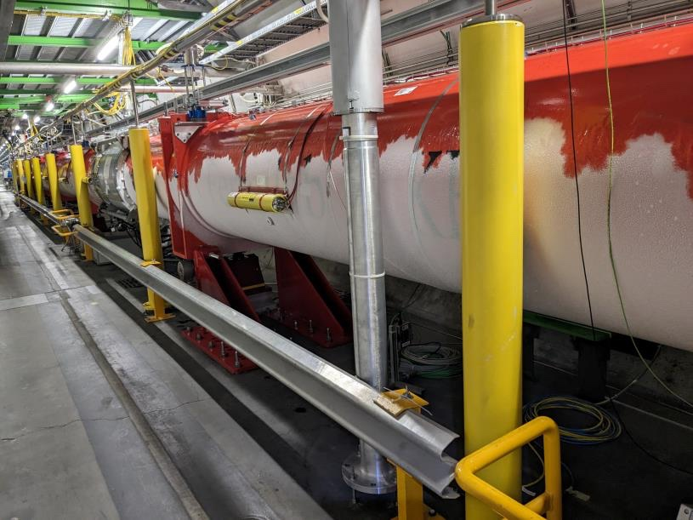
LHC in 2023
25.05.2023
RF finger module issue.
Intensity limited to 1.6x10¹¹ p+/b
31.08.2023 (B)
08.09.2023 (A)
2 x injection protection device (TDIS) vacuum leak.
Stop p+ operation!
21.04.2023
1st stable beam of 2023
End Sep – Early Oct
ALICE background issue followed by studies and solution
~4 days downtime
Mar-Apr
Jun-Jul
May
Aug-Sep
Oct-Nov
17.07.2023
Fallen tree in VD causing power glitch, magnet quench, and leaking bellow between cold mass and insulation vacuum
October
Beam loss induced SEU causing trips, quenches, etc.
Studies, Lumi levelling
12.05.2023
1st collisions 2374 bunches
~50 days of downtime
26.09.2023:
1st stable Pb ion beam

Slide 3
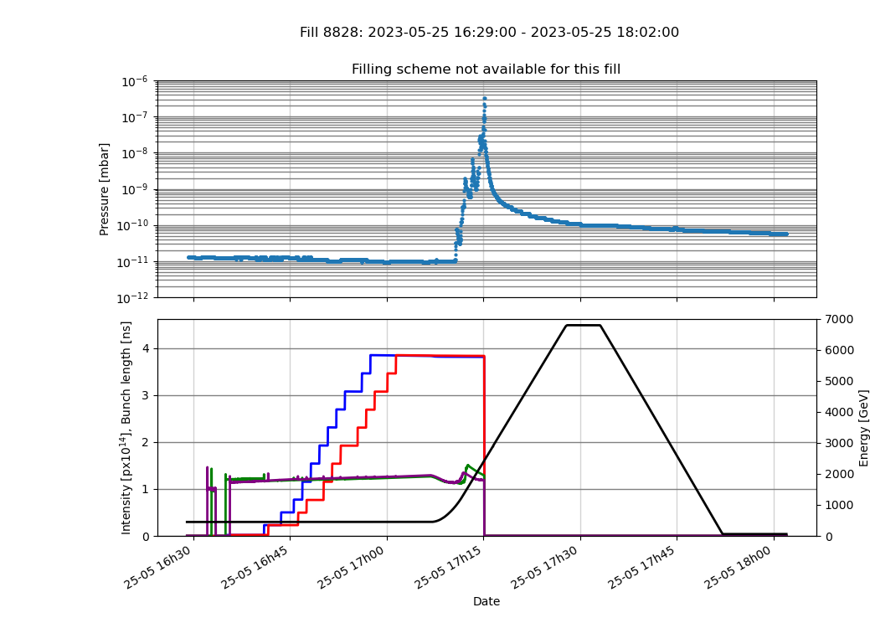
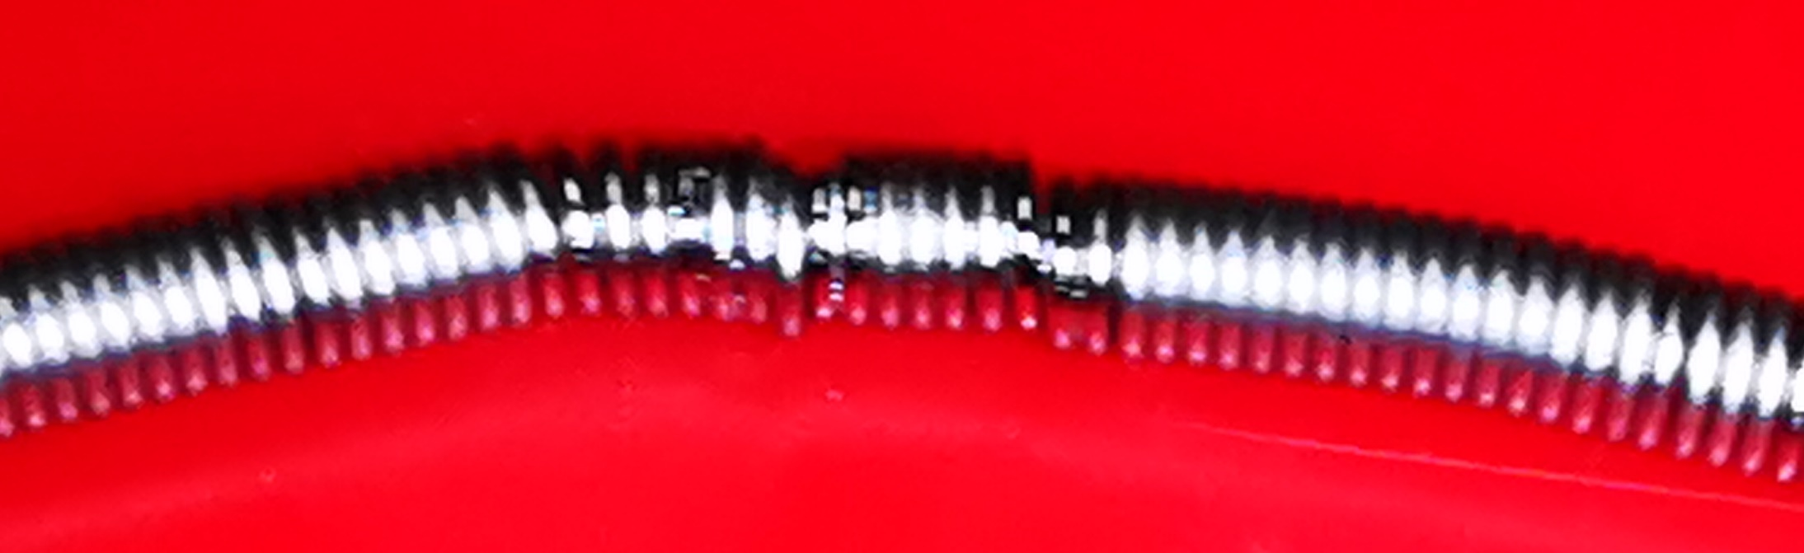

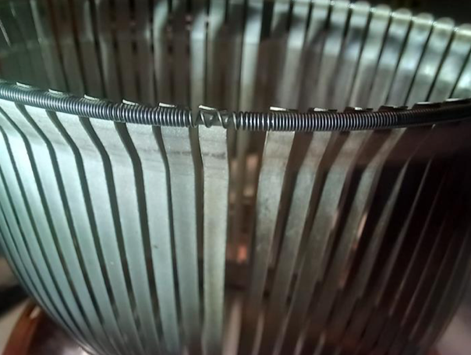
LHC RF Finger Module Issue
25.05.2023
Visual inspection ➔ annealed/plasticized spring on the 212 mm vacuum module due to localized temperature increase to more than 500°C
10⁻⁷
RF fingers
Vacuum pressure
Pressure (mb)
10⁻¹¹
VGI.628.4L1.X.PR
Signs of overheating
Beam intensity
Beam energy
Bunch length
2023: Pressure spikes within the vacuum sector A4L1 during the fill ID 8828 (1.63⋅10¹¹ p/b – 2358 bunches) ➔ beam dumped during the ramp (BLM)
Spring is damaged where RF fingers separation is non-conform
~ 4 days of downtime for repair
Total number of modules present in LHC = 1819
Inspections in 2023 of 212 mm type revealed 8 degraded modules
Full replacement in 2023 not possible
Replacement strategy staged in YETS23-24 (47/71) and YETS24-25
Mitigation for 2023 & 2024:
Bunch intensity limited to 1.6⋅10¹¹ p+
Bunch length kept above 1.2 ns
YETS: Year End Technical Stop

Slide 4

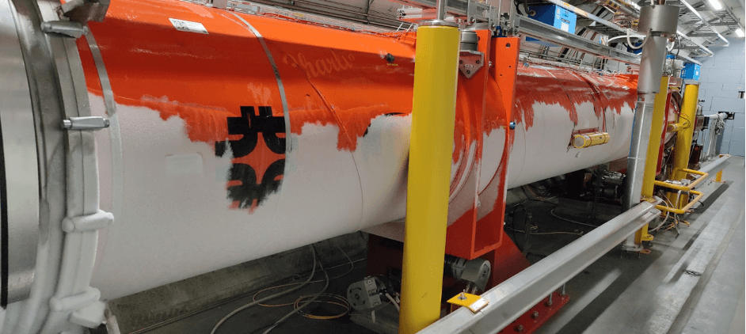
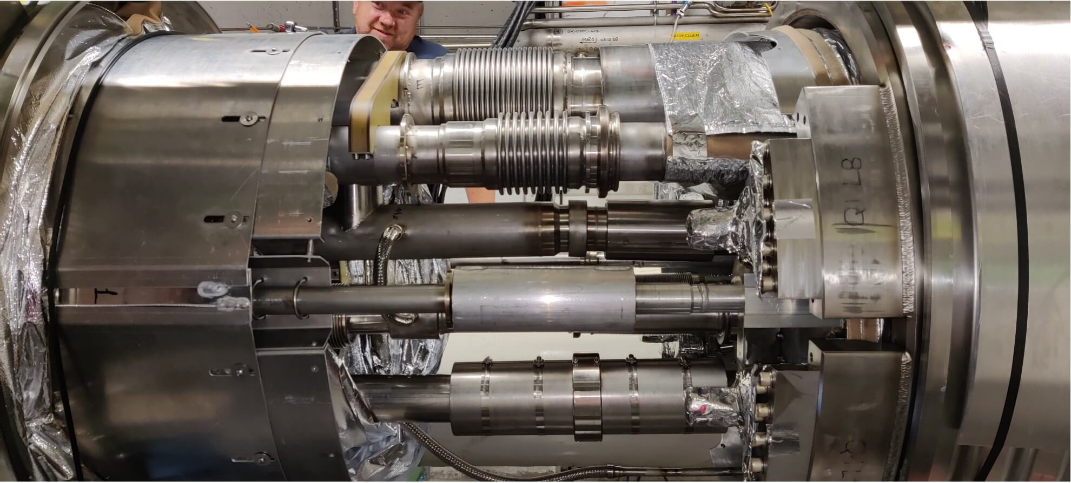
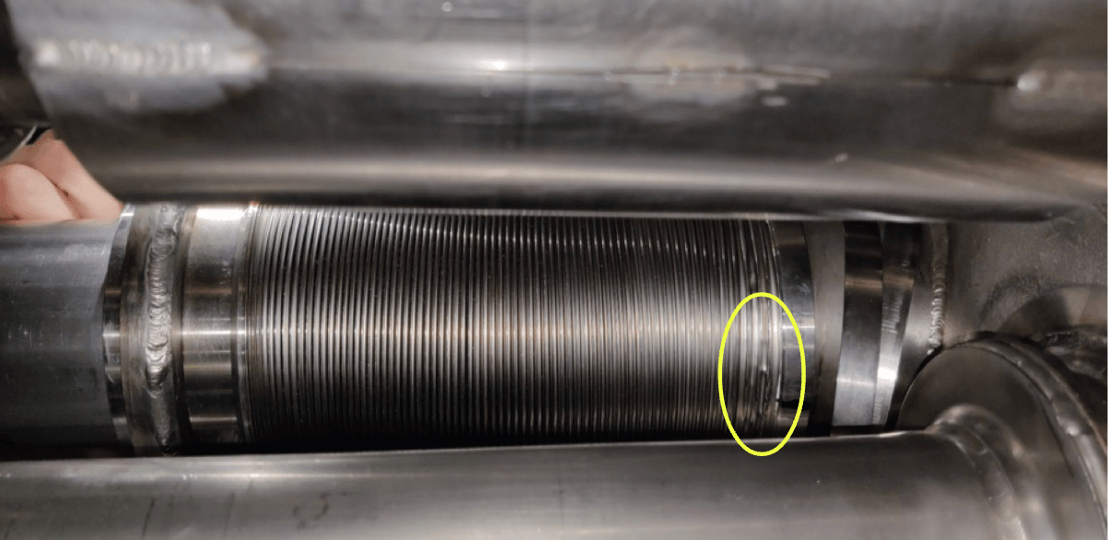
LHC Inner Triplet (IT) Bellow Leak
17.07.2023
IT.L8
Magnet Quench due to electrical perturbation
  ‘Normal’ high pressures in the He lines during the magnet quench created a small hole (1 mm²) in an edge
  welded bellow (non-conform) with major consequences (vacuum vessel pressure degraded and below reparation)
Quick repair in-situ with partial cryogenic warm-up
~50 days of downtime
Similar events possible on triplets and mainly in Q1-Q2 interconnection until LS3
Inspection not possible without warm-up
But warm-up poses a significant risk due to a thermal cycle of irradiated triplets
Consolidation of IP2 and IP8 IT proposed in LS3
(IP1 and IP5 replaced by HL-LHC upgrade)

Slide 5
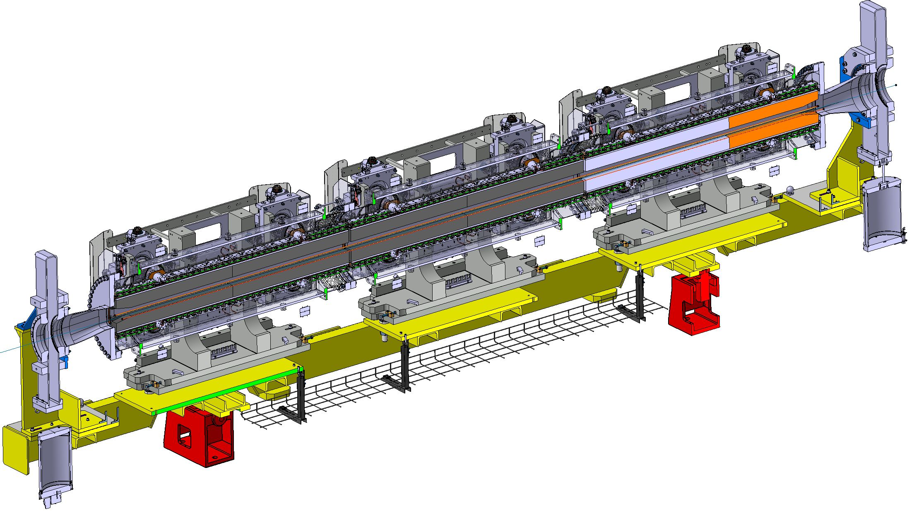
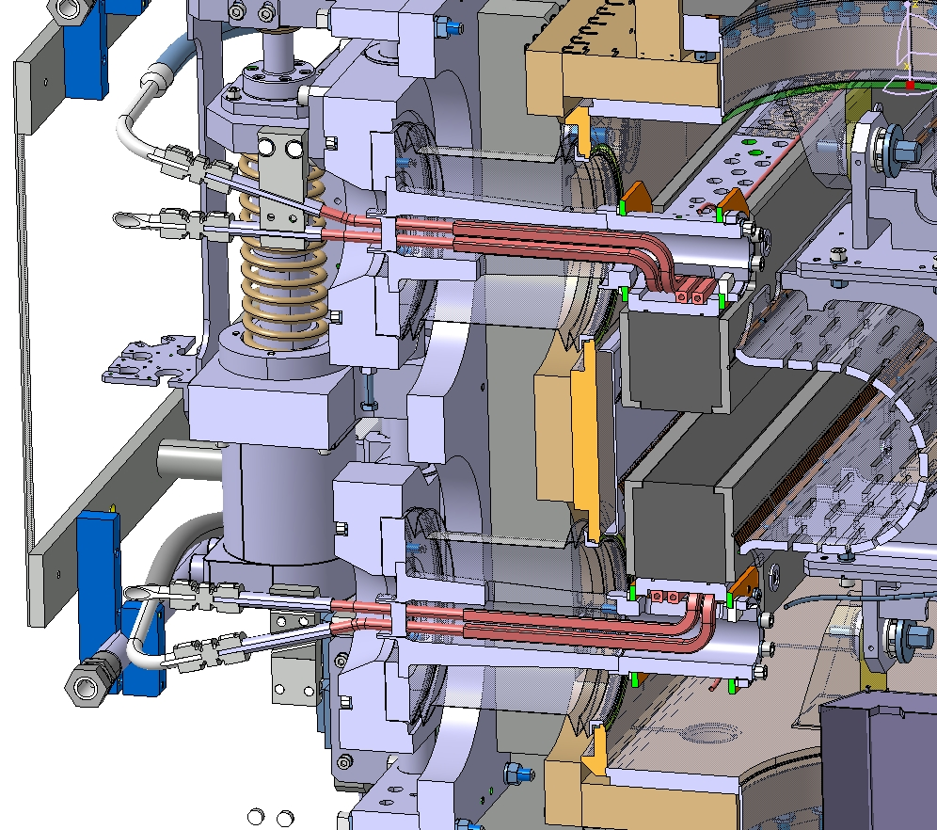
LHC TDIS (Target Dump Injection Segment)
Machine protection devices used during injection – regularly moving in and out
  Located in front of IP2 (ALICE) for beam 1 and IP8 (LHCb) for beam 2
  Each TDIS contains 3 modules with 12 edge welded bellows per TDIS
Two leaks appeared on separate bellows of the same TDIS (IP8) within 1 week
  Both varnished and blocked in out position
Root cause: misspecification of the bellow, causing wear-out after 2-3 years
Intensity per injection severely limited
➔ End of high-intensity p+ physics
Ion run extended
p-p reference run moved to 2024
31.08.2023 (B)
08.09.2023 (A)
Module C
Module B
Mitigation:
Both TDIS replaced by (non-conform) spares during YETS23-24 (expected life-cycle covers the year of operation)
YETS24-25 replace by conform spares (based on refurbished TDIS with new bellows)
Module A
beam
Bellows
(E)YETS: (Extended) Year End Technical Stop

Slide 6
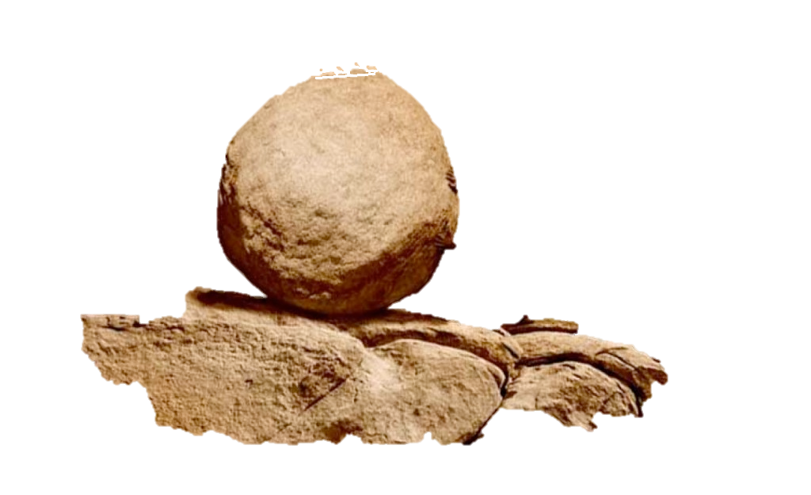



Other limitations in Run 3 that require LHC parameters and configuration optimization
LIMITATIONS
Electron cloud and cryogenics load
➔ limits bunch pattern
Radiation to inner triplets
➔ change of optics

Slide 7
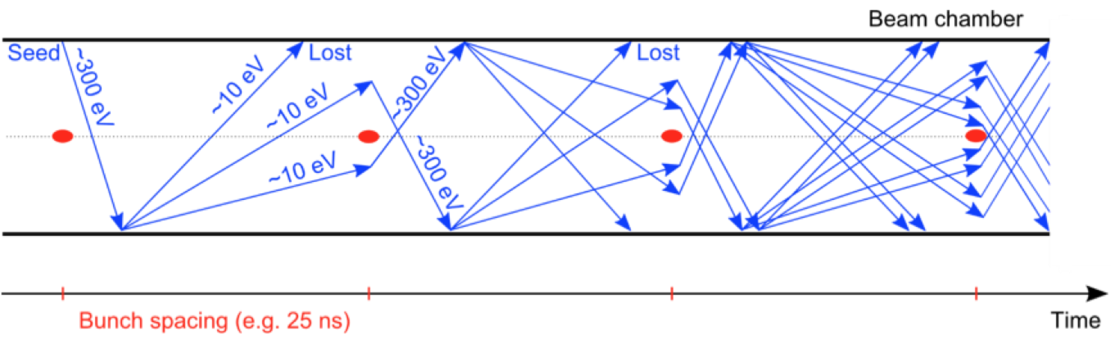
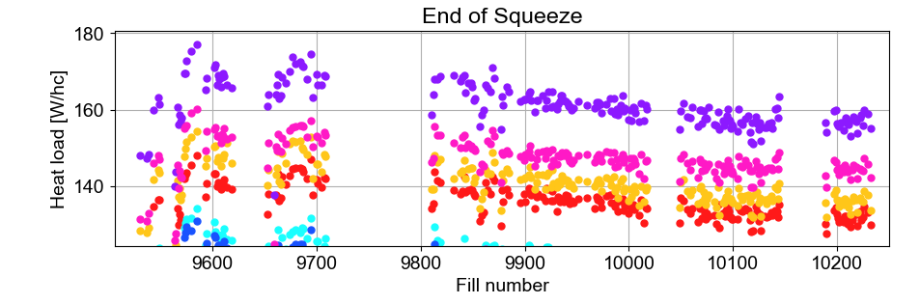
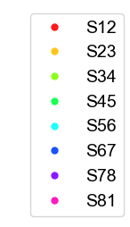
Electron cloud and cryogenics load
e- accelerated by the intense e.m. field of the next p+ bunch
Heat load ➔ at the limit of cryogenic system
Pressure rise
Beam instabilities
Emittance growth
Synchrotron radiation
SEY > 1!!
Cascade effect
LHC sector
The additional 10% scrubbing leaves room to increase the number of bunches and bunch intensity:
  2400 bunches with 1.8e11 p+/b with trains of 4-5x36b in reach
Heat load evolution in 2024
SEY: Secondary Emission Yield
SEY: Secondary Electron Yield
hc: LHC half-cell ~53 m
~10% heat load reduction between Apr & Sep!
Under the eﬀect of the cloud itself, conditioning of the copper surface of the LHC beam pipes is expected, decreasing thus the SEY of the surface. Such a process seems therefore to be hindered in some parts of the LHC ring.

Slide 8
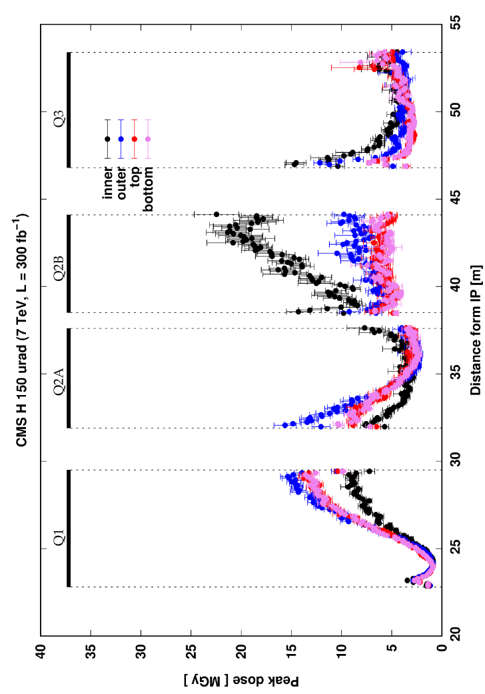
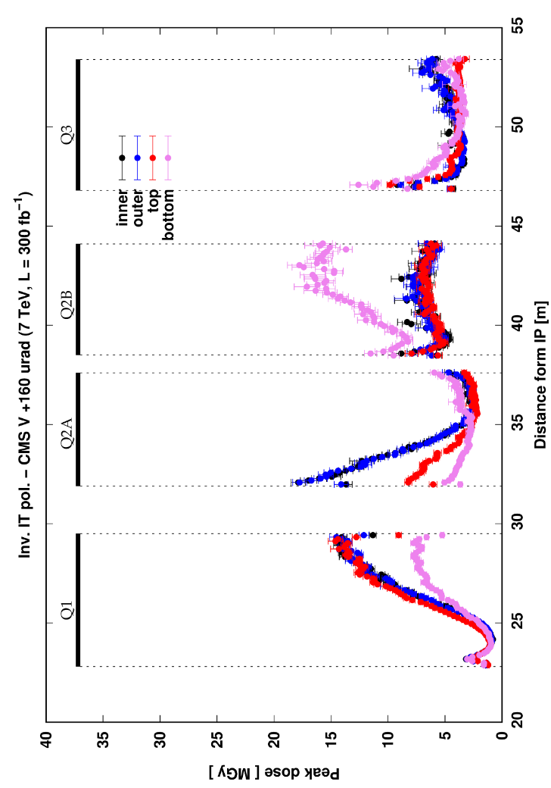
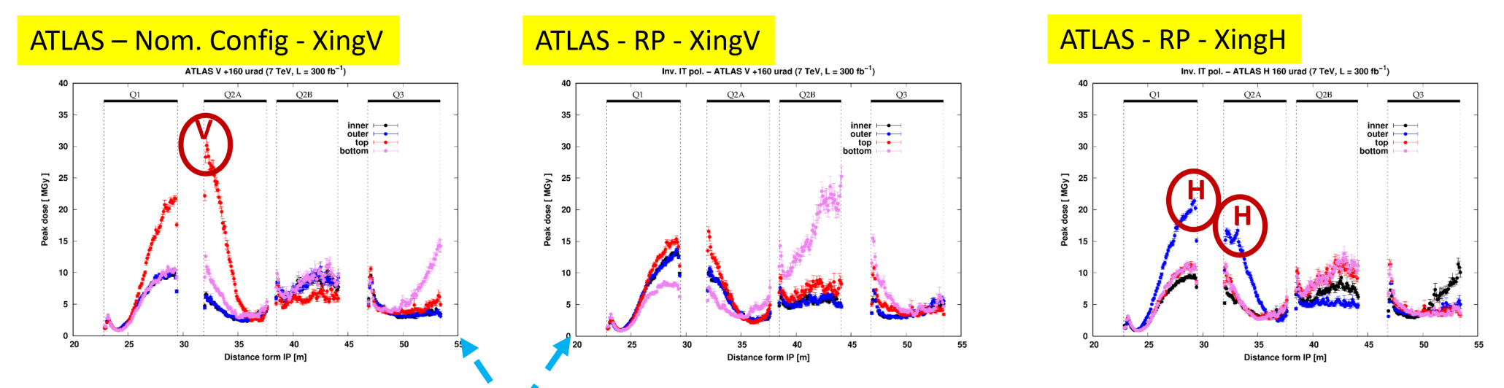
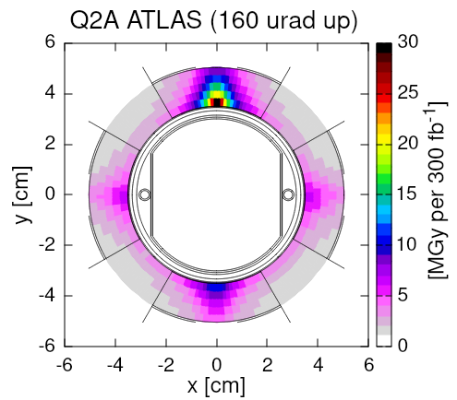
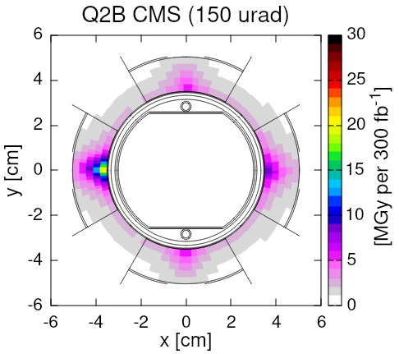
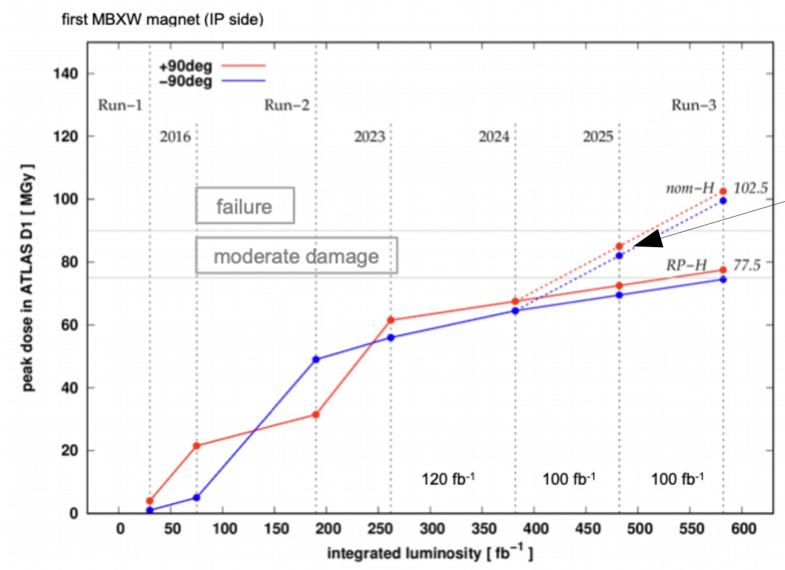
Ensuring the Longevity of the IT until LS3
IT R1
The problem: collision debris (mainly pions) capture in the IT
The consequence: reduced lifetime of magnets ➔ change needed before LS3
The mitigation: from nominal (FDF) to Reverse Polarity (DFD) optics
p-p @√s=14 TeV
85 mb inel xs
Mitigation applied in 2024 in IP1
Mitigation in 2025: IP5 RP-V, IP1 Nom-V, Xang rot IP1&5)
40
IR1: Nom-V
IR5: Nom-H
IR5: RP-V
IR1: RP-H
30
Peak dose (MGy)
20
20
30
40
50
Distance from IP (m)
Exchange with spare should be considered for the YETS25-26
Main drawback: risk of radiation damage for the first module of D1 of both sides of IP1
140
Moderate risk for 2025:
Replacement of a spare →7 weeks of work in the tunnel
Possibility to run with the first D1 module disconnected (~1 shift of work in the tunnel), increasing the strength of the remaining 5 modules (per IP side) and the MCBHX3
Run 1
Run 2
120
Failure
100
80
Peak dose IP D1 (MGy)
Moderate damage
60
Run 3
40
IT: Inner Triplet
IR: Insertion Region, IP: Interaction Point
RP: Reverted Polarity
20
D1: separation dipole
FDF: Focusing Defocusing Focusing
DFD: Defocusing Focusing Defocusing
Integrated lumi (fb⁻¹)

Slide 9
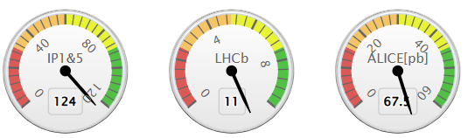
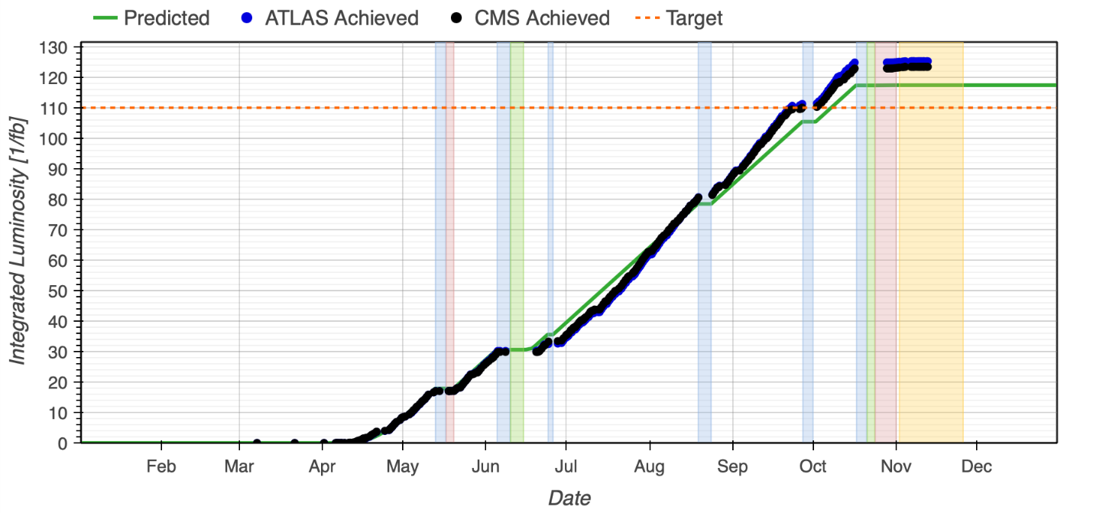
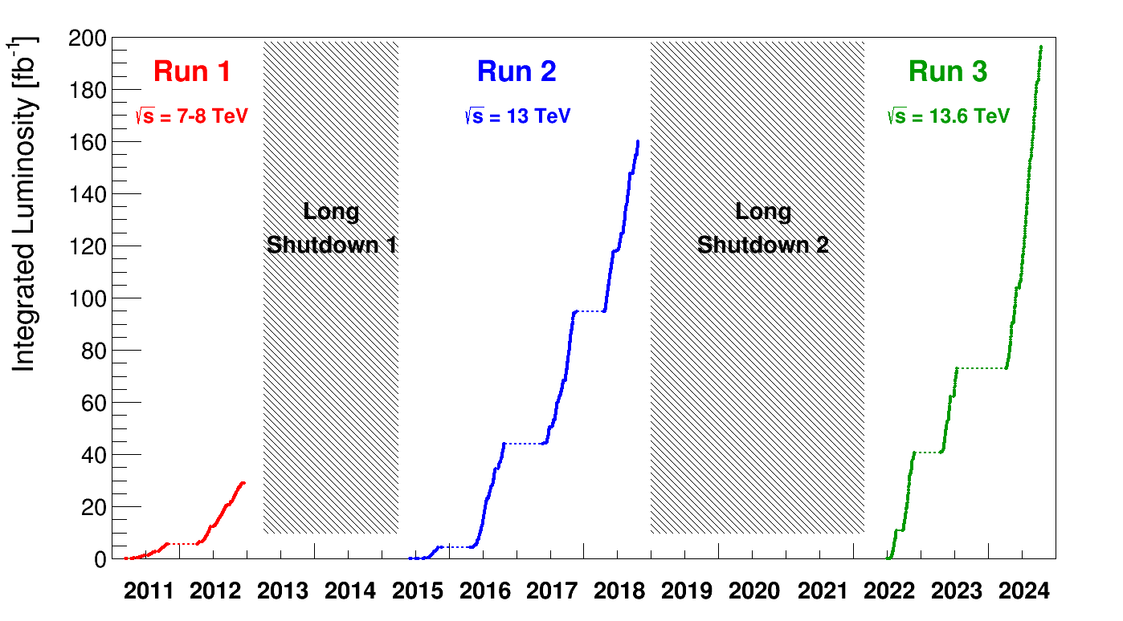
2023 & 2024 LHC Performance
2023 summary:
  p+ period best availability 76%, stable beams for physics 52%
  Many long-term faults ➔ target 75 fb⁻¹/exp not reached
2024 summary:
  Highest production rate ever - up to 1.5 fb⁻¹/24h
  Peak luminosity at ~2.1x10³⁴ cm⁻¹s⁻¹
    Limited by cryogenic cooling capacity in the IT
2024

Slide 10
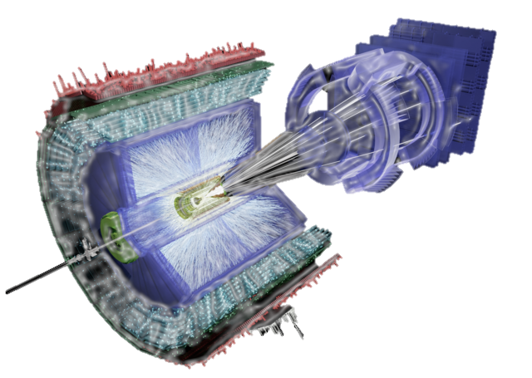
The 2023 & 2024 ion runs

Slide 11
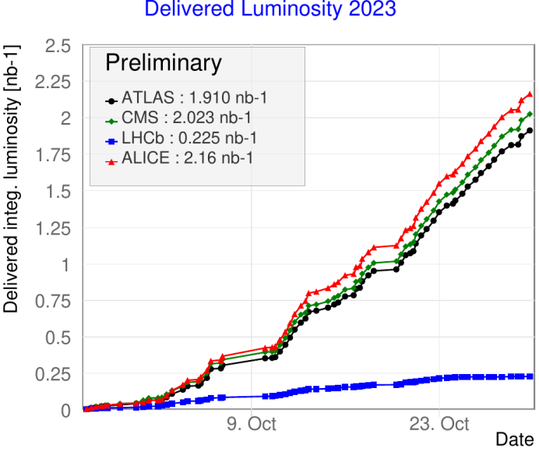
2023 LHC Lead Ion Run Performance
Ion run relied on several new concepts all successfully used in operation
  Slip-stacked 50 ns beams from injectors to provide higher intensity
  Crystal collimation to handle higher intensity without quenches
  TCLD collimators (HL-LHC equipment) & BFPP bump in IR2 to allow full luminosity for ALICE
  BFPP bump in IR8 to allow higher LHCb luminosity
Several problems encountered
  Background in ALICE experiment – mitigated in 2023
  High beam losses in the ramp – mitigated in 2024
  Beam losses due to 10 Hz orbit oscillation – culprit found and fixed!
  Single-event upsets on quench protection system – mitigated in 2024
TCLD: Target Collimator Long Dispersion suppressor in IR7
BFPP: Bunch Free Pair Production
IR: Insertion Region

Slide 12
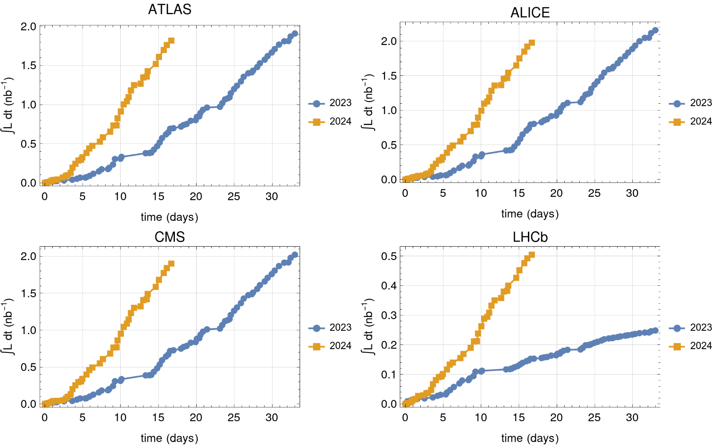
2024 LHC Ion Run Performance
2024 Production
  ALICE, ATLAS, CMS: average 1.9 nb⁻¹
  LHCb: doubled 2023 production in half the time ➔ achieved!
2024
2023
Excellent injectors performance:
Higher bunch intensities than LIU target
Higher transmission efficiencies than before
Experiments’ expectations for the full Run 3
  ATLAS/CMS/ALICE
    5.35 nb⁻¹ for full Run3
  LHCb
    1 nb⁻¹ but strong request for higher target (x2)
IP1,2,5: Remains 1.45 nb⁻¹ to be collected in 2025&2026
LIU: LHC Injectors Upgrade

Slide 13
2025 & 2026 schedules
18.09.2024 Research Board approved the update of Run3/LS3/Run4 schedule:
  Short YETS25-26 (08.12.2025 to 23.02.2026)
  Run LHC until end of June 2026 with Heavy Ion run taking place in June
  End of LHC Run 3 date on Monday 29th June 2026 (SPS North Area physics continues)
Run 3
LHC LS3^{(*)}
LHC Run 4
2025 scheduled (approved)
2026 scheduled (info)
138 days of p+ physics
2 days of Vdm
25 days Pb run end of 2025
NO pp ref run
O-O and p-O collisions last week of June
66 days of p+ physics
2 days of Vdm
25 days Pb run in June (PbPb or pPb)
NO pp ref run
(*) LS3 Injectors is shorter
YETS: Year End Technical Stop
Vdm: Van der Meer scan for luminosity calibration

Slide 14
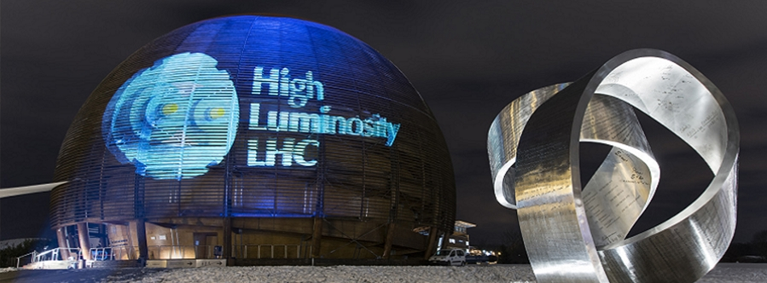
Status of HL-LHC preparation

Slide 15
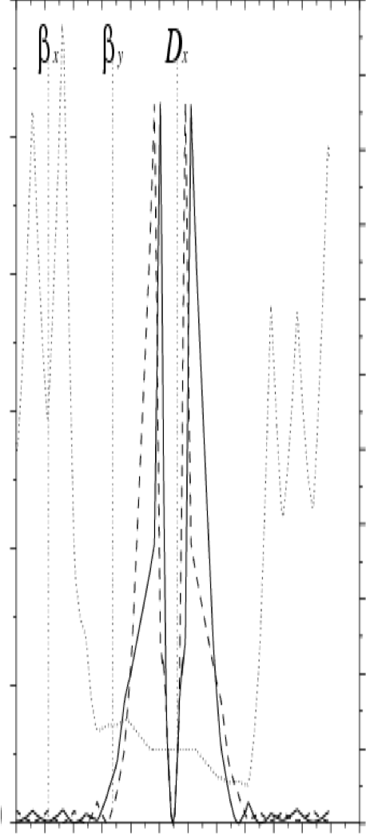

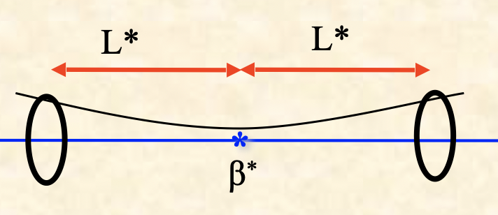
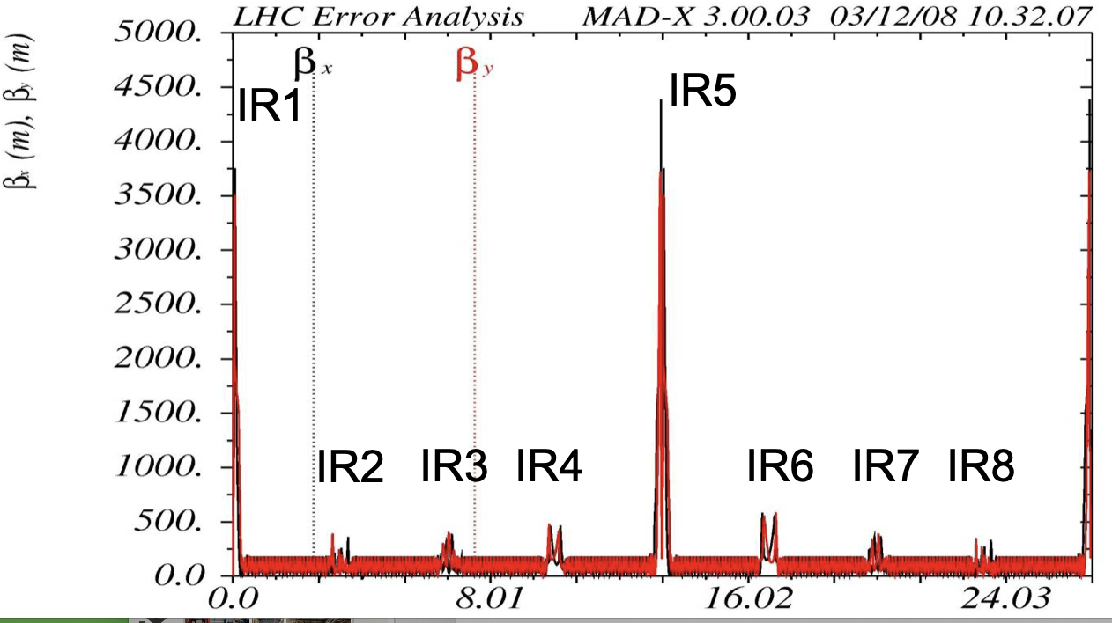

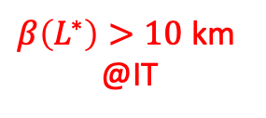
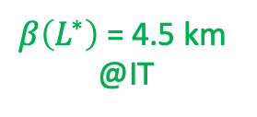

HL-LHC parameters
$β\left(L^{∗}\right)>10$ km
@IT
10 km
2.3·10¹¹ p+/bunch
2.1 μm ℇ^{n}x,y
25 ns bunch spacing
β*= 0.15 m (β*= 0.5 m @LHC)
Virtual peak lumi with crab 1.7·10³⁵ cm⁻²s⁻¹
LHC p+ Lumi Levelled @ 5·10³⁴ cm⁻²s⁻¹
Pile up = 131
LHC Injectors Upgrade
High gradient magnets:
Stronger focusing
Large aperture
Only possible with new technology
LHC
5 km
$β\left(L^{∗}\right)$= 4.5 km
@IT
HL-LHC
IT
IP
$$β\left(L^{∗}\right)=β^{∗}+\frac{L^{∗2}}{β^{∗}}$$
$$σ_{x,y}=\sqrt{ε_{x,y}∙β_{x,y}}$$
27 km
IT: Inner Triplet
IP: Interaction Point

Slide 16
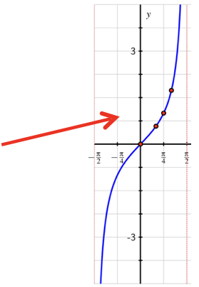
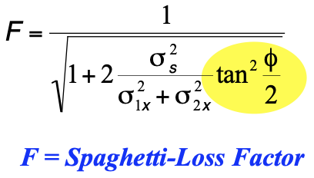
HL-LHC parameters
But, larger beam size at the IT ➔ larger crossing angle to avoid beam-beam interactions (need of large aperture)
Crossing angle = φ
Lumi = Lumi_{ideal} * Spaghetti-Loss Factor
IP
Lumi_{ideal} = f(N_{b}↑,I_{b}↑,ε↓,β*↓)
LHC ➔ φ/2 = 285 µrad ➔ F ~ 85%
HL-LHC ➔ φ/2 = 590 µrad ➔ F ~ 30%
If Spaghetti-Loss Factor is not cured ➔
Crab-cavities are the solution

Slide 17
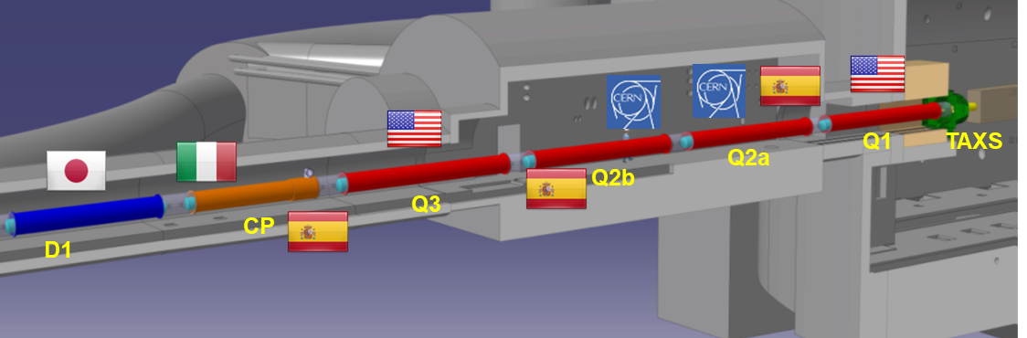
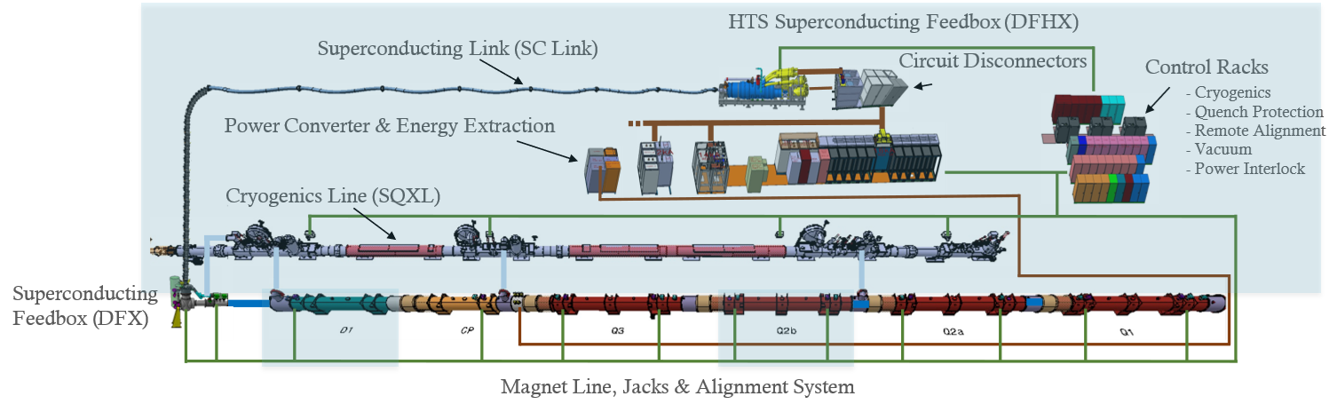
Magnets Nb₃Sn
Good progress across all key technologies
US and CERN magnet production well underway
Inner Triplet String testbed taking shape
  Infrastructure in place and magnets starting to be installed
LHC NbTi ➔12 kA
HL-LHC Nb₃Sn ➔ 16.5 kA (ultimate 17.5 kA)
The IT String will deliver the first complete experience of installing and operating the IT zone
The Inner Triplet String Testbed – focus for 2025

Slide 18
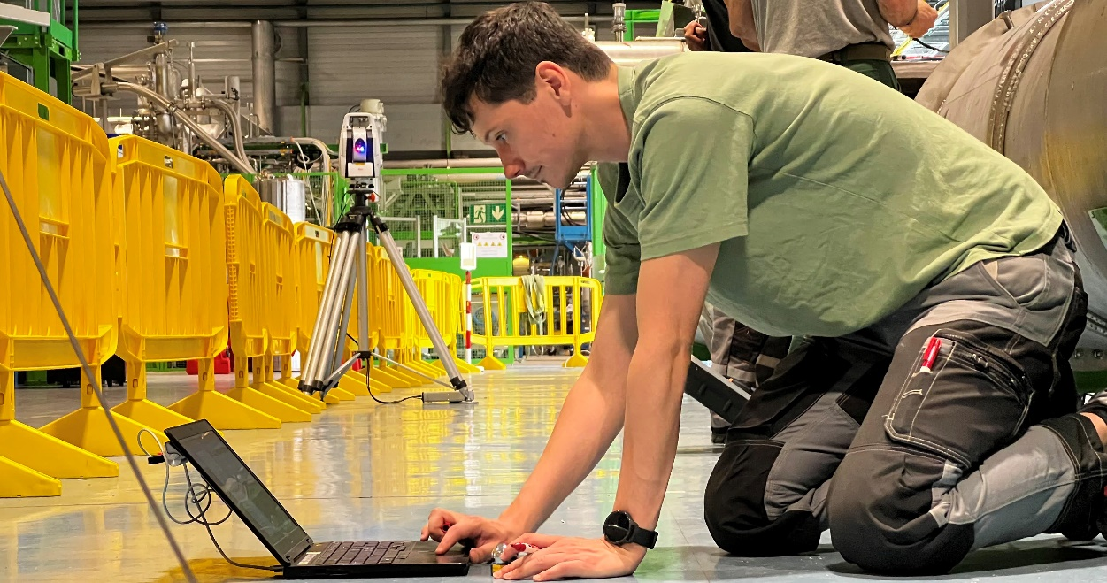
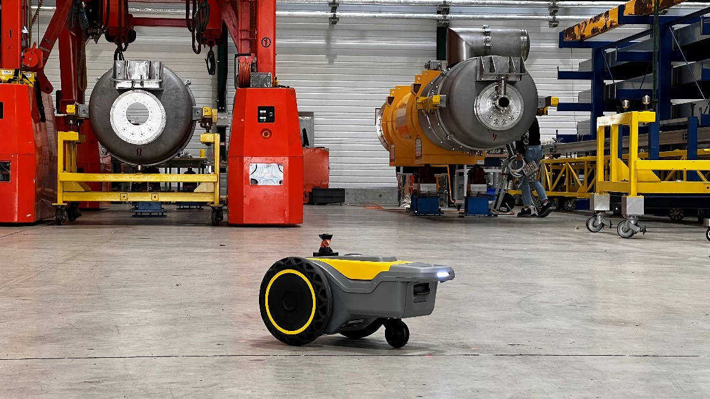
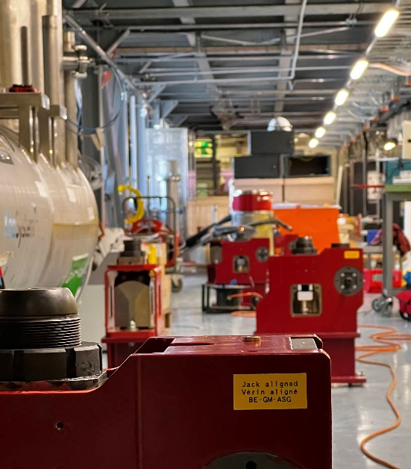

Preparing for the Inner Triplet String Test
Tracing on the floor:
  Beamlines, pillars, jumpers, beam pts, jacks, anchors, …
  Robotic solutions for tracing to reduce time
Magnet support jacks - installation and alignment
First magnets aligned
  Q2a and D1 in place and aligned in Nov 2024
IT STRING tracing
Tracing robotic solutions testing
IT STRING jack alignment
IT STRING – D1 placed and aligned

Slide 19


MgB₂ superconducting link
The flexible, double-wall, corrugated cryostat:
19 MgB₂ SC cables in a single assembly, twisted together to form a compact bundle
Can transfer altogether a DC current of about 120 kA at ~20 K
Nb₃Sn quadrupoles
NbTi correctors
SC D1
The first Cold Powering System for the HL-LHC Triplets has been successfully validated: cryogenic, electrical and mechanical performance all met design parameters
Today in an advanced phase of series production
SC: Super Conducting
D1: separation dipole

Slide 20





Crab Cavities
Increasing the number of collisions in the HL-LHC
Delays in RFD cavities jeopardizes completion of RFD cryomodules in-time for LS3 installation
Mitigation strategy being worked on
5 DQW cryomodules (Europe)
5 RFD cryomodules (North America)

Slide 21




Civil Engineering Complete
Point 1
Point 5

Slide 22

Updated Schedule for HL-LHC

Slide 23
Conclusions

Slide 24


Slide 25


Slide 26
Spares

Slide 27

Setting the scene
2015 - 2018
2021 - 2026
≥ 2030
LS2
RUN 3
LS3
RUN 4
RUN 2
LIU &
1st phase of HL-LHC
LIU & 1st phase of HL-LHC commissioning
and exploitation
HL-LHC upgrades
installation
HL-LHC commissioning
and exploitation
Injectors RUN 2 achieved parameters ^{SPS ejection}:
1.2·10¹¹ p+/bunch
2.6 μm ℇ^{n}_{x,y}
25 ns bunch spacing
- New Linac 4 @160 MeV H-
- Booster injection @160 MeV and extraction @2 GeV
- PS injection @2GeV, RF system upgrade, etc
- SPS RF system upgrade, etc
SPS ejection
Integrated LHC luminosity
~140 nb⁻¹ @6.5 TeV
(per high lumi experiment)
LHC 2024 operation
3 x 36 bunches BCMS
1.6·10¹¹ p+/bunch
Integrated lumi
~125 nb⁻¹ @6.8 TeV
(per high lumi experiment)
2.45·10¹¹ p+/bunch
1.66 μm ℇ^{n}_{x,y}
Injectors LIU targets ^{SPS ejection}
2.3·10¹¹ p+/bunch
2.1 μm ℇ^{n}x,y
25 ns bunch spacing
LHC p+ Lumi Levelled
@ 5·10³⁴ cm⁻²s⁻¹
ℇ^{n}_{x,y} : normalized transverse emittance
LIU: LHC Injectors Upgrade
Achieved in MD, not yet operational

Slide 28











LHC in 2024
Stable Lumi Production
Summer period
BCMS beams May
First injection: 8th March (3 days early)
110 nb⁻¹
1.9 nb⁻¹ Target
Normalized emittance
Average lumi (nb⁻¹)
1200 bunches
on 14th April
(10 days early)
2.0 µm
Record ion Run
H (mm)
Apr
May
Jul
Oct
Apr
Jun
Sep
Aug
Dec
Date
May
Nov
V (mm)
Beyond the 110 fb⁻¹ target
Beam position around the 27 km
Mar-Apr
Jun-Jul
May
Aug-Sep
Oct-Nov
Very stable physics production
Reverse Polarity optics
commissioned (~ +1 week)
First Stable Beams @6.8 TeV
5th April (3 days early)
Operating with 1.6⋅10¹¹ p+/bunch
Bunch length control/target
Limit RF module heating risk
Delivered int lumi (pb⁻¹)
Bunch length (ns)
30 Oct
1 Nov
3 Nov
5’
pp reference run
28th Oct – 2nd Nov
Integrated lumi over expectations
LHCb VELO closed for the 1st time
Time
BCMS: Batch Compression and (bunch) Merging and (bunch) Splitting

Slide 29

RF burst disk
02.04.2023
Trigger event ➔ power cut in point 4 following a wrong manipulation after issue with compensator
Afterwards: well-known chain of events:
  the RF cavities are automatically isolated from the He input and output lines,
  consequently the cryomodule pressure increases due to the static heat loads
  the safety valves open and maintain the pressure around 1.9 bar
Unfortunately, two of the new burst disks installed during YETS22-23 did not withstand the pressure and opened
A test campaign on the spare disks confirmed that likely these two disks were outliers
Mitigation to reduce the risk:
Installation of fast depressurizing valves to back up the warm recovery line
Similar events may still happen given small pressure margin between opening of safety valve and burst disk, which is necessary to able to protect the RF cavities against major events, for which the bust disks were foreseen

Slide 30



LHC in 2024
Dealing with Limitations – RF Finger Modules
Operating in 2024 with known weak modules
  47 of 71 replaced in YETS23-24
  Remaining modules to be replaced YETS24-25
Beam induced power depends on bunch intensity and bunch length
  Bunch intensity limited to 1.6⋅10¹¹ p+ in 2024
    Run 3 max = 1.8 ⋅ 10¹¹ p+/b
  Bunch length control throughout the cycle
Bunch length B1 (ns)
Bunch length B2 (ns)
3.3 min
Time from start of acceleration (s)
Time from start of acceleration (s)
(E)YETS: (Extended) Year End Technical Stop

Slide 31



Performance optimization
36 bunches
18 bunches
Move to BCMS Beams
  Filling scheme based on 3x36b patterns imposed by heat load limitation
  from electron cloud
  Intensity limited to 1.6⋅10¹¹ p+/bunch by RF fingers
  Emittance: could be improved with BCMS
Optimised BCMS since May
  Higher bunch brightness
    Smaller emittance beneficial for reducing losses at injection
9 bunches
Time along PS cycle
3 bunches
6 bunches
BCMS Beam for the LHC in the PS
BCMS: Batch Compression and (bunch) Merging and (bunch) Splitting
BCMS
Instantaneous lumi (Hz/µb)
Stable beams
Normalized emittance (µm rad)
Apr
May
Jun
Jul
Aug
Sep
Oct
Time (s)

Slide 32

Outlook for the LHC in 2025
2025 Schedule
  2025 luminosity target will be comparable to 2024
  (target 110 nb⁻¹)
  Short Oxygen run mid-year and Pb Ion Run to end the year
Ensuring longevity of the IT Magnets
  Full reversed polarity gives best outlook but would stop any forward physics
  Compromise is flipping the crossing plane with nominal powering in IR1 and reversed polarity in IR5
    Good background conditions for FASER and SND
    PPS rotated to allow data taking to continue
  Several magnets still reach estimated limits if 2025 and 2026 are good production years
Moving to Flat Optics
  Recovers luminosity loss due to limitation of aperture in triplet with flipped crossing plane
IT: Inner Triplet
FASER: Forward Search Experiment (close to IP1)
SND: Scattering and Neutrino Detector (close to IP1)
PPS: Precision Proton Spectrometer (close to IP5)

Slide 33

Beam screen heat load forecast @HL-LHC era
The LHC cryogenic capacity is limited and cannot be easily increased
Money, surface/underground available space, energy…
From Run 4, heat loads applied to cryogenics will significantly increase
LHC intensities ↑↑ ➔ Sync. Rad + Image Current + e-cloud ↑↑
HL-LHC prediction in S78
for 5x48b @ 2.3e11 ppb & 7 TeV
➔ 280 W/hc > Cryo limit [225 W/hc]
Cryo Limit expected for Run4
Objective after Beam Screen (BS) treatment
Fill #8471 in 2022
(measured 5x36b)
The proposed mitigation strategy is :
“Treat” in situ a fraction of BS around the LHC to reduce the e-clouds
This treatment must be done in LS3
Simulations without considering any BS treatment and fitting the current heat load measurements in 2022 for 5x36b
“Treat”: remove CuO + increase surface carbon concentration + surface passivation on 100 selected half-cells
2.3
Under the eﬀect of the cloud itself, conditioning of the copper surface of the LHC beam pipes is expected, decreasing thus the SEY of the surface. Such a process seems therefore to be hindered in some parts of the LHC ring.

Slide 34

Key ingredients for the HL-LHC upgrade
A technologically “intense” upgrade project
New IT quadrupoles, Nb3Sn
Civil engineering
Crab Cavities
Crystal collimation
Low impedance collimators
  Superconducting links
Injection and dump upgrades
…
1
2
2
3
4
5
6

Slide 35



Preparing the Collider-Experiment Interface
Protecting the machine from collision debris
  Moving into the production phase for both the TAXS (secondary particle absorber) the TAXN (neutral particle absorber)
  Mock-up area heavily used to train and test
    Very soon house full setups of both ATLAS and CMS

Slide 36


LHC layout & beam production

Slide 37


Slide 38


Slide 39

Other limitations in Run 3 that require LHC parameters and configuration optimization
LIMITATIONS
Besides: RF fingers modules
➔ limits bunch intensity and bunch length
Electron cloud and cryogenics load
➔ limits bunch pattern
Radiation to inner triplets
➔ change of optics

