Slide 1


Multiplicity distributions and quantum entanglement
Epiphany Conference, Krakow, 2025
Sandor Lokos (IFJ PAN)
Supported by Miniatura 7,
NSC, Poland 2023/07/X/ST2/00652

Slide 2
Why is it interesting?
Very simple observable
  Bookkeeping positive integers
Historical data available
  Even in exotic systems, even from the 80s
Good input for Monte Carlo generators
  They often miss to reproduce the data
Contains many information
  Althought they are hidden or cannot be disentangled
Recently conjectured connection to quantum entanglement
  Active theoretical field, detailed data required
“The confinement of coloured quarks inside a hadrons provides perhaps the most dramatic example of quantum entanglement that exists in nature.”
Phys. Rev. Lett.,124,6

Slide 3
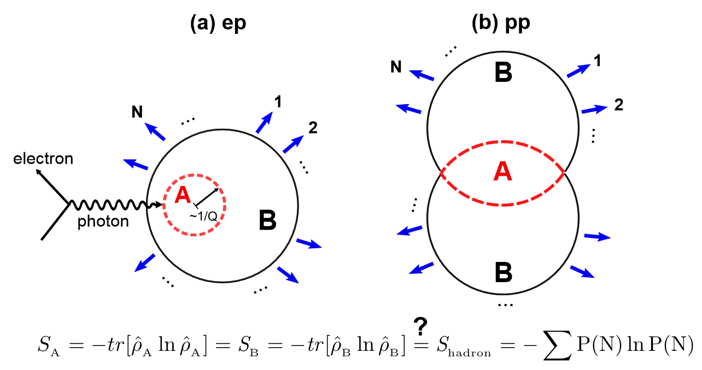
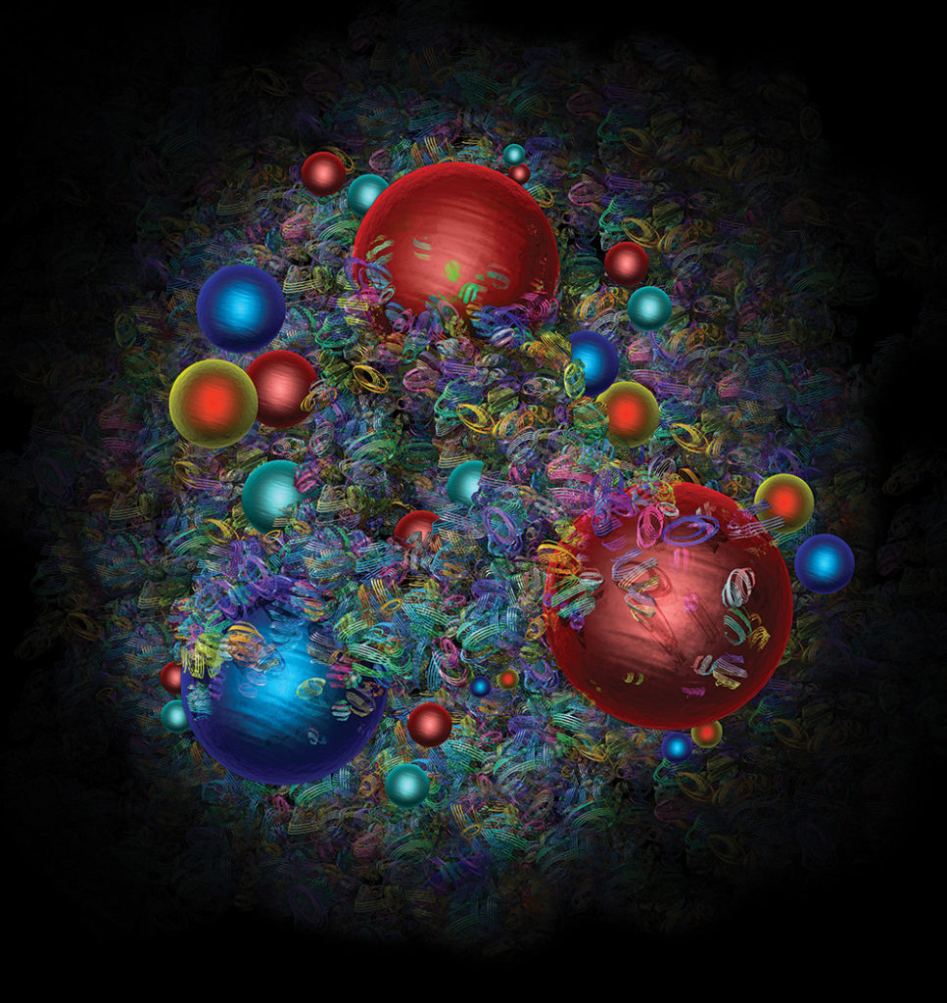
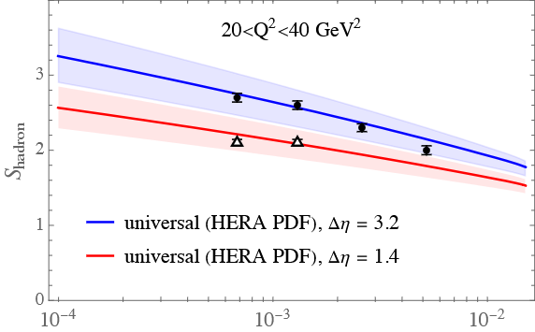
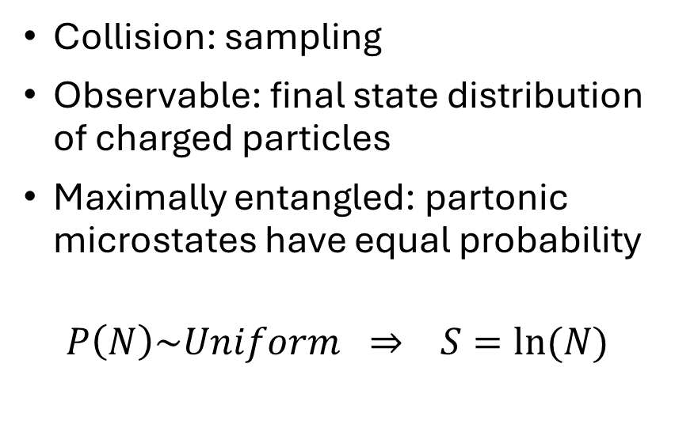
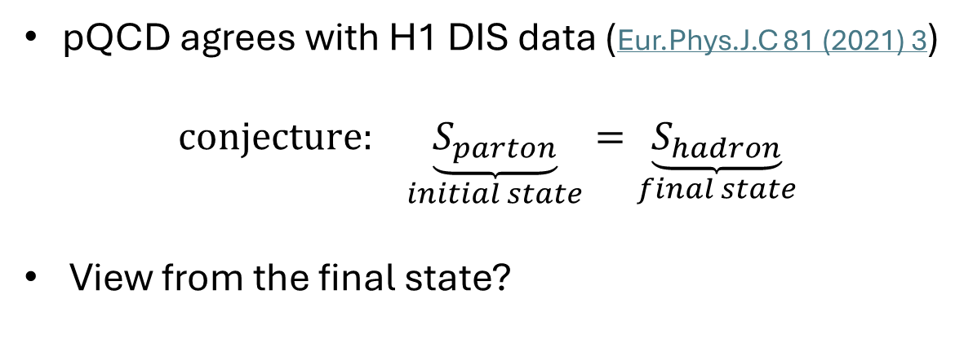
Initial state entanglement
Collision: sampling
Observable: final state distribution of charged particles
Maximally entangled: partonic microstates have equal probability
$$P\left(N\right)\sim Uniform ⇒ S=ln⁡(N)$$
Phys. Rev. Lett.,124,6
pQCD agrees with H1 DIS data (Eur.Phys.J.C 81 (2021) 3)
$$conjecture: \underset{initial state}{\underbrace{S_{parton}}}=\underset{final state}{\underbrace{S_{hadron}}}$$
View from the final state?
Eur.Phys.J.C 82 (2022) 12, 1147
and K. Kutak presentation 15.01.

Slide 4
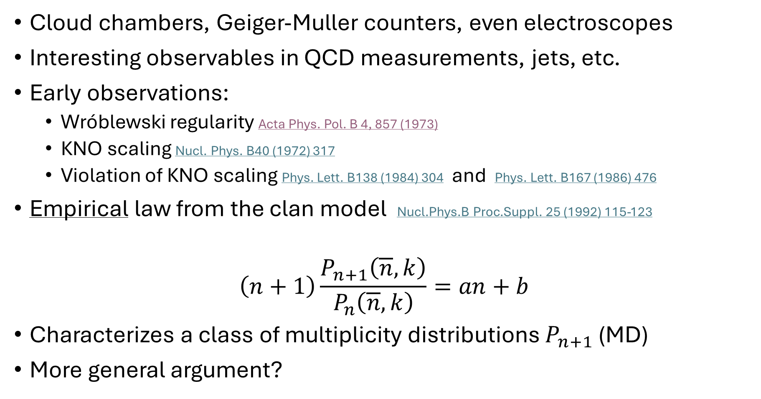
History
Cloud chambers, Geiger-Muller counters, even electroscopes
Interesting observables in QCD measurements, jets, etc.
Early observations:
  Wróblewski regularity Acta Phys. Pol. B 4, 857 (1973)
  KNO scaling Nucl. Phys. B40 (1972) 317
  Violation of KNO scaling Phys. Lett. B138 (1984) 304 and Phys. Lett. B167 (1986) 476
Empirical law from the clan model Nucl.Phys.B Proc.Suppl. 25 (1992) 115-123
$$\left(n+1\right)\frac{P_{n+1}\left(\overline{n},k\right)}{P_{n}\left(\overline{n},k\right)}=an+b$$
Characterizes a class of multiplicity distributions $P_{n+1}$ (MD)
More general argument?

Slide 5

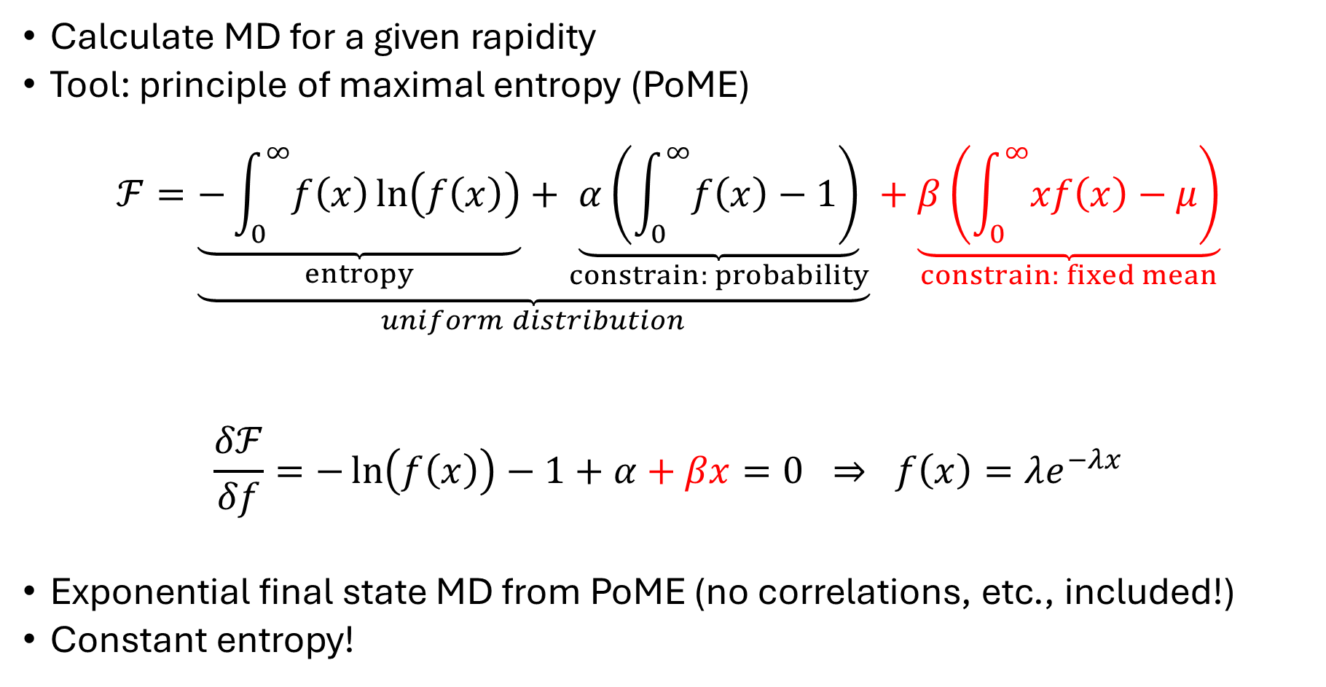
Derivation from maximal entropy principle
Calculate MD for a given rapidity
Tool: principle of maximal entropy (PoME)
$$ℱ=\underset{uniform distribution}{\underbrace{\underset{entropy}{\underbrace{−\int_{0}^{∞}{f\left(x\right)\ln\left(f\left(x\right)\right)}}}+\underset{constrain: probability}{\underbrace{α\left(\int_{0}^{∞}{f\left(x\right)}−1\right)}}}}+\underset{constrain: fixed mean}{\underbrace{β\left(\int_{0}^{∞}{xf\left(x\right)}−μ\right)}}$$
$$\frac{δℱ}{δf}=−\ln\left(f\left(x\right)\right)−1+α+βx=0 ⇒ f\left(x\right)=λe^{−λx}$$
Exponential final state MD from PoME (no correlations, etc., included!)
Constant entropy!
$$β=−λ$$
$$e^{α−1}=λ$$

Slide 6
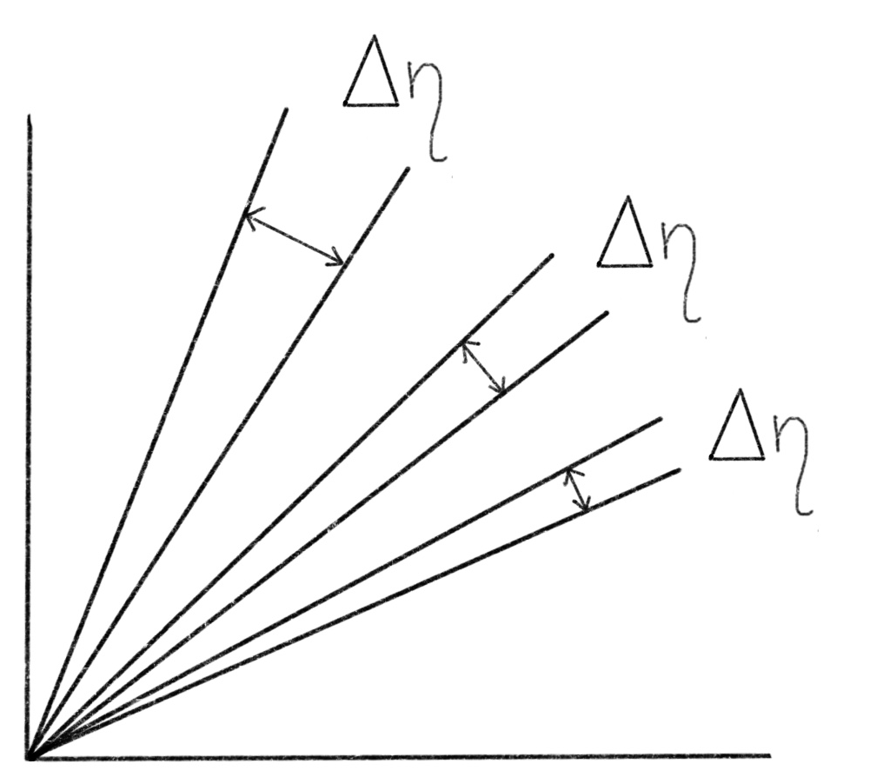
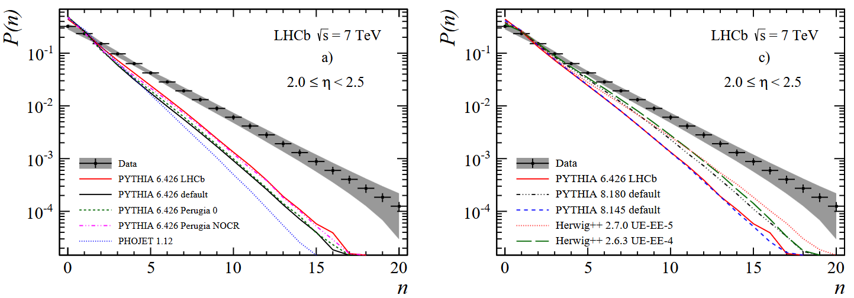

Experimental confirmation
LHCb data from $2≤η<2.5$ to $4≤η<4.5$
Moving rapidity window!
Models reproduce the shape
Illustration: Anita Czinder
LHCb, Eur. Phys. J. C (2014) 74

Slide 7
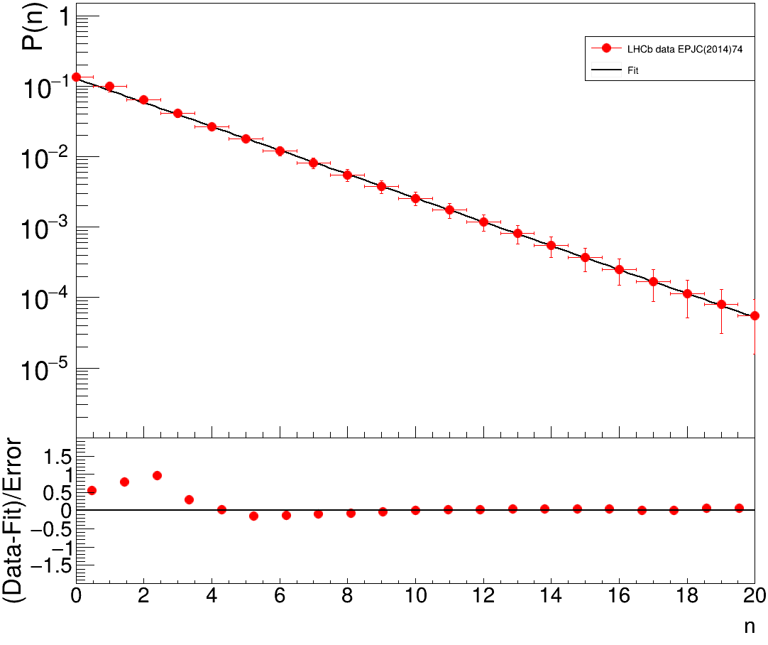
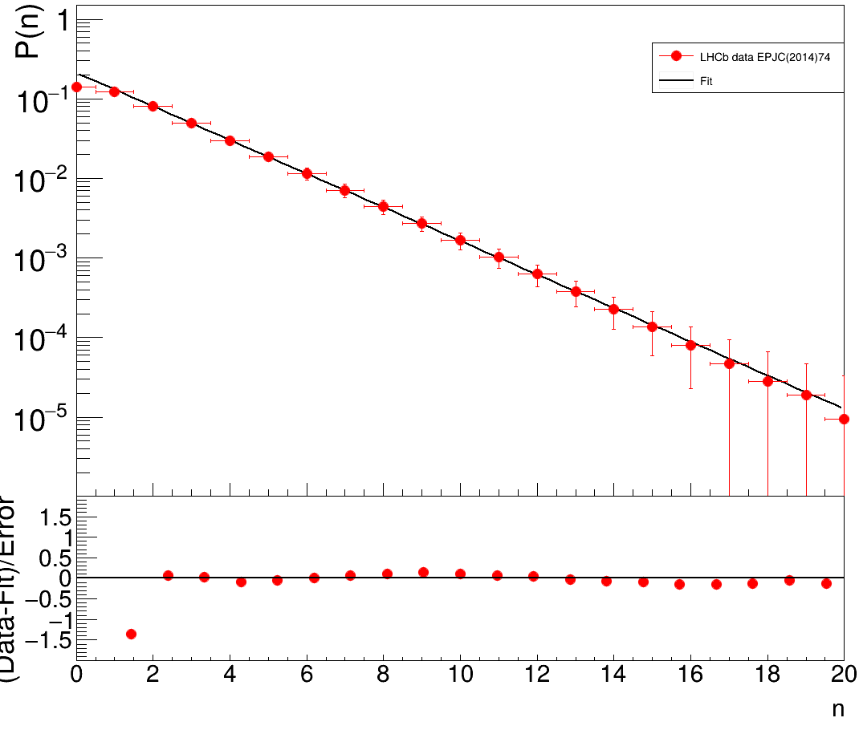
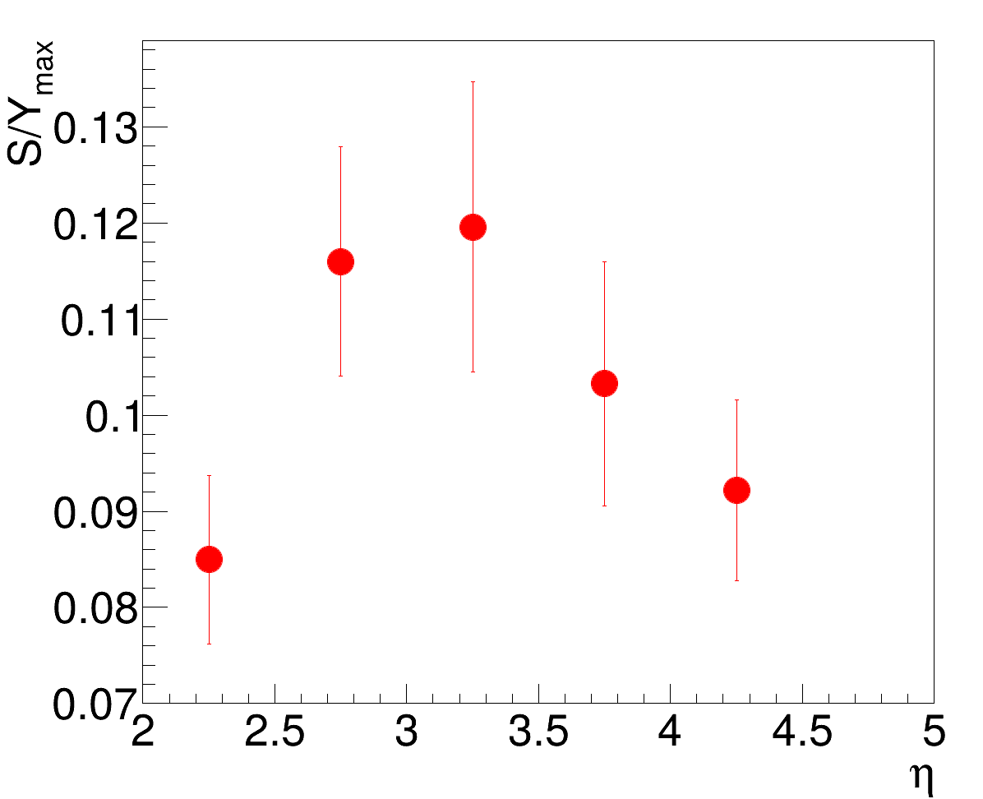


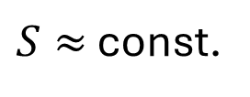



Experimental confirmation
LHCb data from $2≤η<2.5$ to $4≤η<4.5$
Own fits with stat and syst uncert combined
$$2≤η<2.5$$
$$4≤η<4.5$$
Illustration: Anita Czinder
Work in progress
$$λ=0.48±0.02$$
LHCb, Eur. Phys. J. C (2014) 74
$$λ=0.63±0.02$$
$S≈$ const.

Slide 8
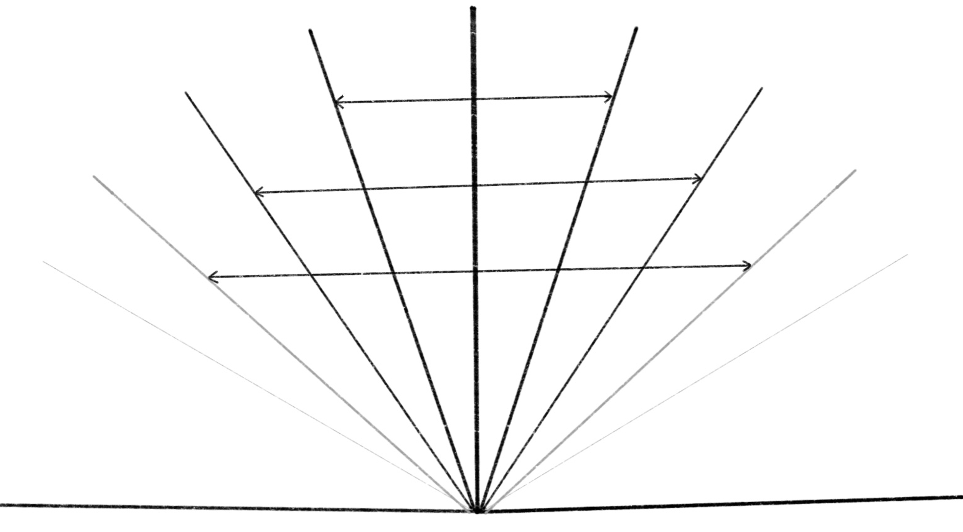

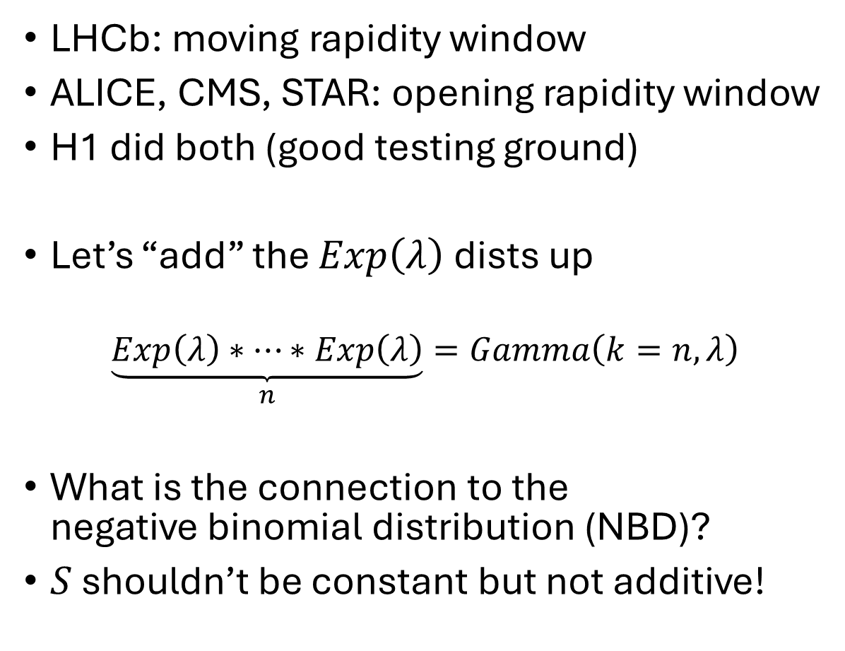
Extension to larger rapidity ranges
LHCb: moving rapidity window
ALICE, CMS, STAR: opening rapidity window
H1 did both (good testing ground)
Let’s “add” the $Exp\left(λ\right)$ dists up
$$\underset{n}{\underbrace{Exp\left(λ\right)∗…∗Exp\left(λ\right)}}=Gamma\left(k=n,λ\right)$$
What is the connection to the
negative binomial distribution (NBD)?
$S$ shouldn’t be constant but not additive!
convolution
$$⇓$$
Illustrations: Anita Czinder

Slide 9
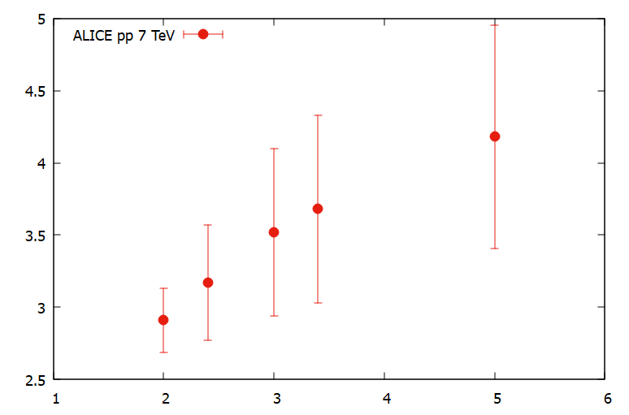
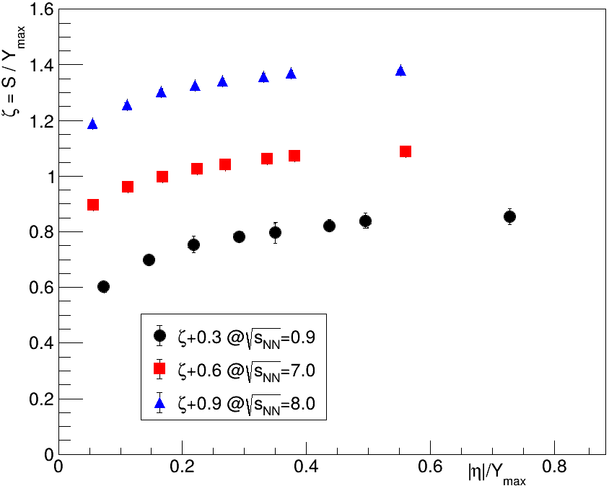
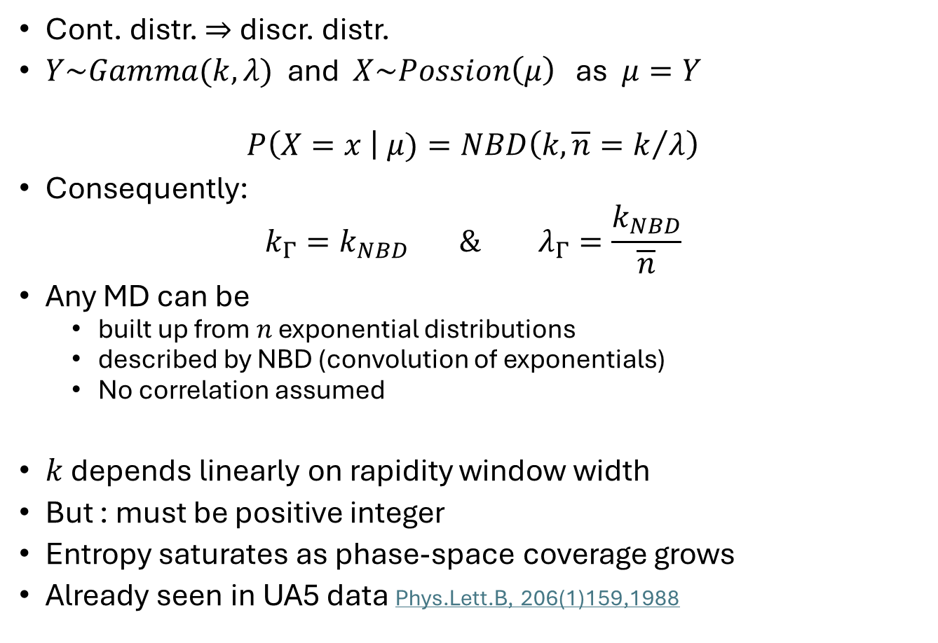


Poisson-Gamma mixture or Poisson transformation
ALICE, Eur.Phys.J.C 77 (2017) 12
Cont. distr. $⇒$ discr. distr.
$Y\sim Gamma(k,λ)$ and $X\sim Possion\left(μ\right)$ as $μ=Y$
$$P\left(X=x \right| μ)=NBD\left(k,{\overline{n}=k}/λ\right)$$
Consequently:
$$k_{Γ}=k_{NBD} \& λ_{Γ}=\frac{k_{NBD}}{\overline{n}}$$
Any MD can be
  built up from $n$ exponential distributions
  described by NBD (convolution of exponentials)
  No correlation assumed
$k$ depends linearly on rapidity window width
But : must be positive integer
Entropy saturates as phase-space coverage grows
Already seen in UA5 data Phys.Lett.B, 206(1)159,1988
$$k$$
$$|η|$$

Slide 10
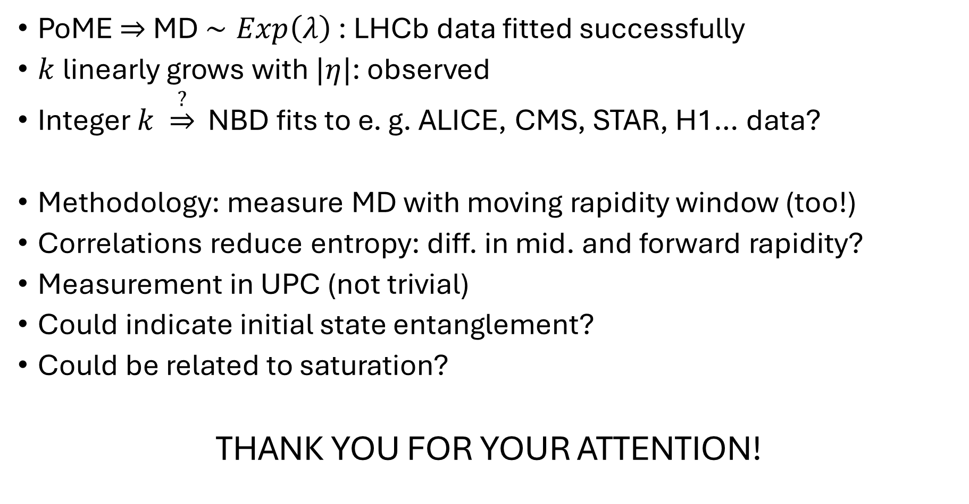
Conclusion and outlook
PoME $⇒$ MD $∼Exp\left(λ\right)$ : LHCb data fitted successfully
$k$ linearly grows with $|η|$: observed
Integer $k \underset{⇒}{?}$ NBD fits to e. g. ALICE, CMS, STAR, H1… data?
Methodology: measure MD with moving rapidity window (too!)
Correlations reduce entropy: diff. in mid. and forward rapidity?
Measurement in UPC (not trivial)
Could indicate initial state entanglement?
Could be related to saturation?
THANK YOU FOR YOUR ATTENTION!

Slide 11
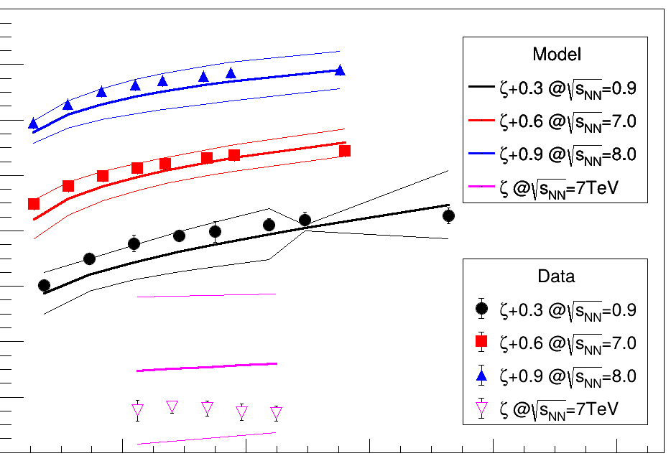
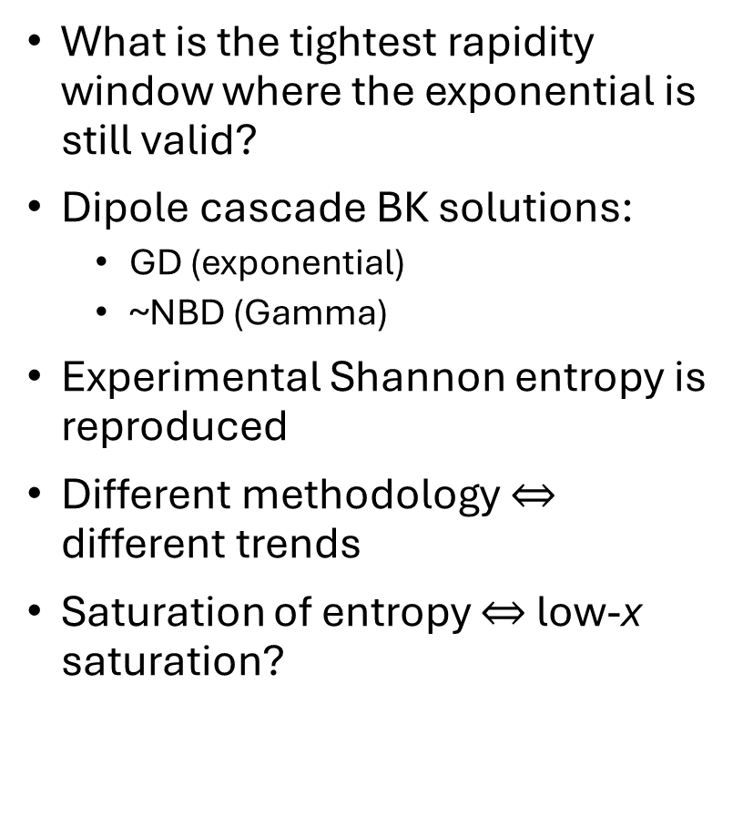
Connection to saturation
What is the tightest rapidity window where the exponential is still valid?
Dipole cascade BK solutions:
  GD (exponential)
  ~NBD (Gamma)
Experimental Shannon entropy is reproduced
Different methodology $⇔$ different trends
Saturation of entropy $⇔$ low-x saturation?
Work in progress

