Slide 1
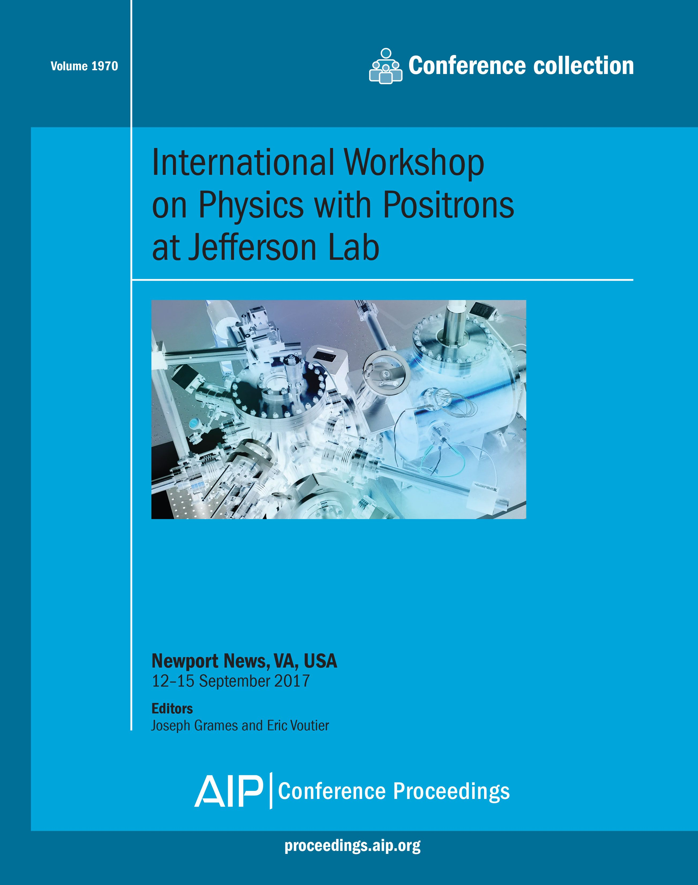
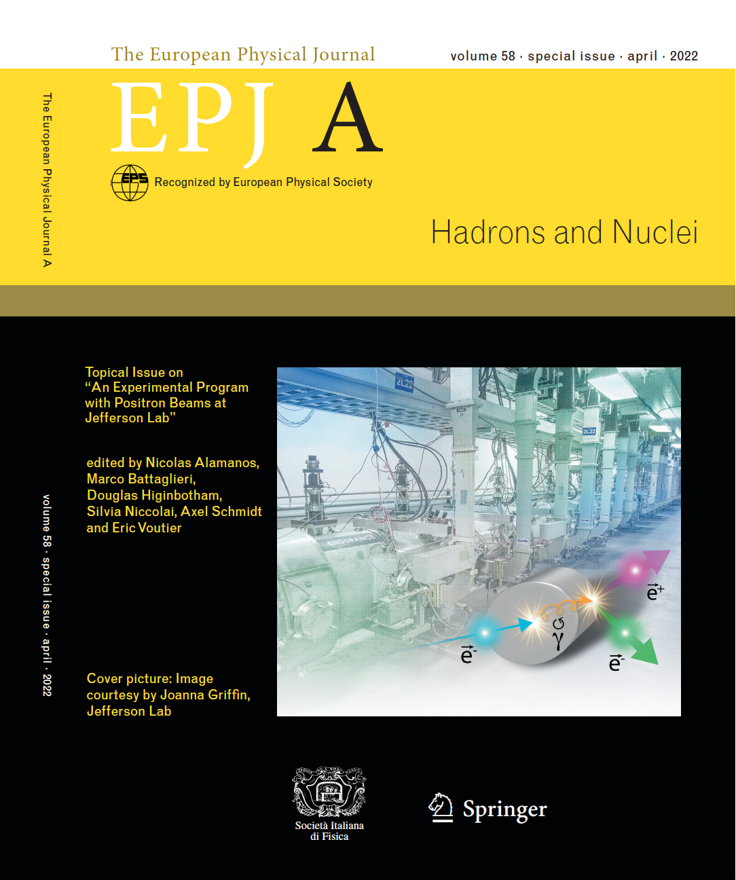
The Jefferson Lab Positron Beam Program
Ce⁺BAF
Eric Voutier and the Jefferson Lab Positron Working Group
Université Paris-Saclay, CNRS/IN2P3/IJCLab, Orsay, France
(Jefferson Lab Positron Working Group) A. Accardi et al. EPJ A 57 (2021) 261
Production and Structure of Matter and Antimatter at High Energies (PAW’25)
June 1st-4th, 2025

Slide 2
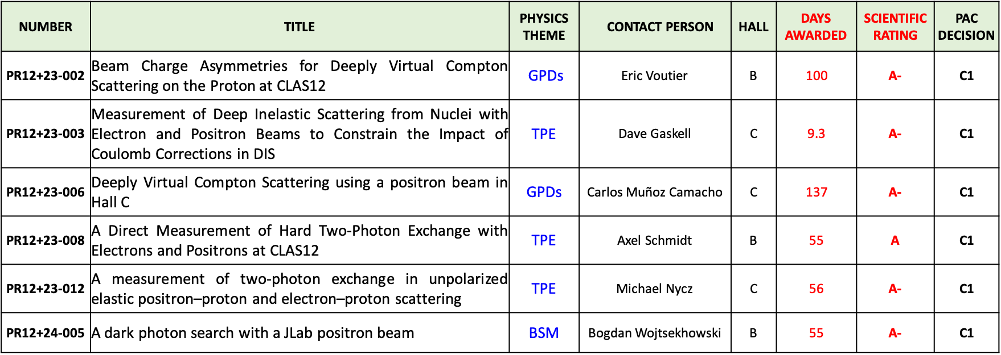
JLab Positron Working Group
E. Voutier
The Positron Experimental Program at JLab represents today 6 approved proposals (C1) covering the 3 pillars of the JLab Positron White Paper and representing 412 days of single hall running.
MPE
C1 = Conditionally Approved with Technical Review by the Lab
Subscribe to the JLab Positron Working Group mailing list pwg@jlab.org
2/24
June 4th, 2025

Slide 3

JLab Positron Working Group
E. Voutier
3 new Proposals have been submitted to the coming JLab PAC53 (July 2025).
n-TPE
Measurement of two-photon exchange contribution in electron-neutron and positron-neutron elastic scattering
S. Alsalmi, P. Blunden, P. Datta, E. Fuchey
MPE in eN
Energy dependence of dispersive effects in unpolarized inclusive elastic electron/positron-nucleus scattering
A. Afanasev, J. Arrington, P. Gueye
  T(M)PE in (SI)DIS
Multi-photon effects in inclusive and semi-inclusive deep inelastic scattering
G. Gaskell, T. Hague, M. Nycz
4 Letters-of-Intent are still under developments for additional proposals.
p-GPs – LOI12+23-001
Measurement of the generalized polarizabilities of the proton with positron and polarized electron beams
N. Sparveris
Axial form factor – LOI12+23-002
The axial form factor of the nucleon from weak capture of positrons
D. Dutta
  Dark Bhabha – LOI12+23-005
A hopefully amplitude-level search for a Dark Photon in Bhabha scattering
D. Mack
TPE in polarization transfer – LOI12+23-008
Polarization transfer in positron-proton elastic scattering
A. Puckett, J.C. Bernauer, A. Schmidt
3/24
June 4th, 2025

Slide 4

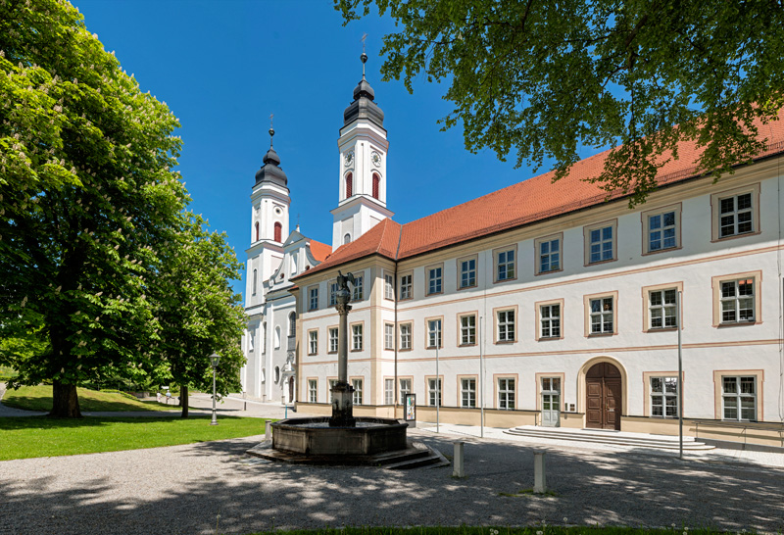
Outline
E. Voutier
Two-photon exchange
Multi-photon exchange
Generalized parton distributions
Test of the Standard Model
Ce⁺BAF
Summary
4/24
June 4th, 2025

Slide 5
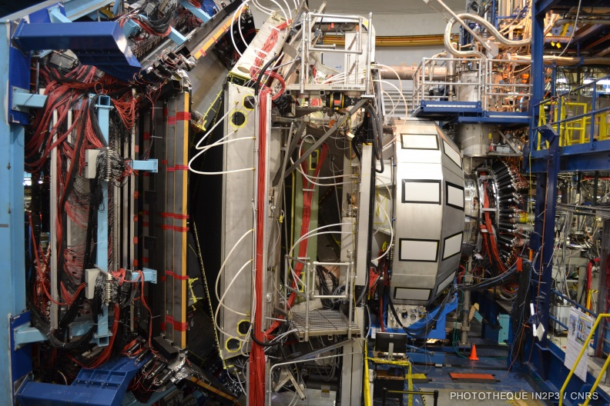
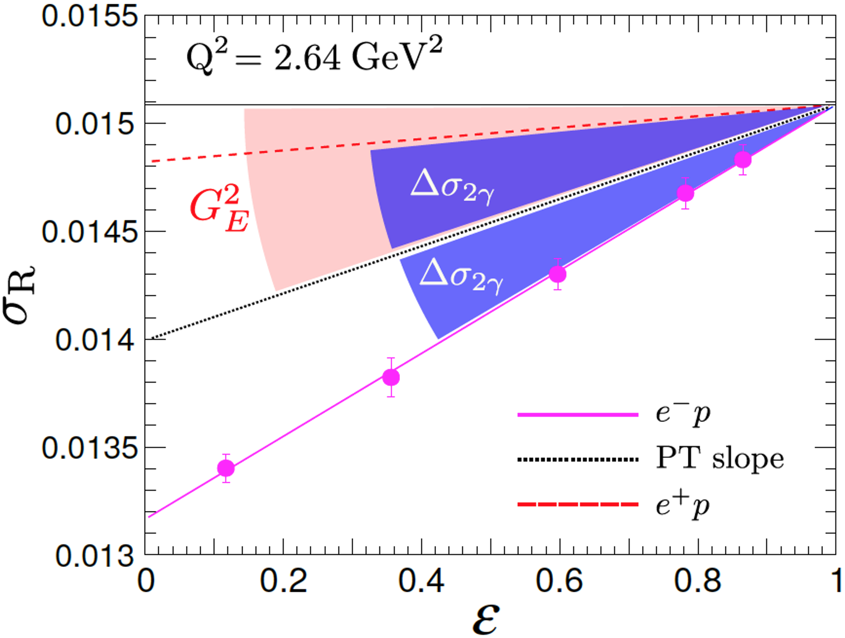
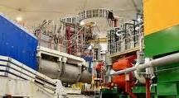


Two-Photon Exchange
E. Voutier
Elastic Scattering
J.C. Bernauer et al. EPJA 57 (2021) 144 J. Arrington, M. Yurov, EPJ A 57 (2021) 319
Measurements of polarization transfer observables in electron elastic scattering off protons question the validity of the 1γ exchange approximation (OPE) of the electromagnetic interaction.
Interaction mechanisms beyond the Born approximation may reconciliate cross section and polarization measurements of the proton electric form factor (G_{E}).
$$R_{2γ}=\frac{σ_{e^{+}}}{σ_{e^{−}}}≈1+δ_{2γ}$$
$$σ_{R}=G_{M}\left(G_{M}±{∆′}_{σ_{2γ}}\right)+\frac{ε}{τ}G_{E}\left(G_{E}±∆_{σ_{2γ}}\right)$$
PR12+23-008 A. Schmidt et al.
PR12+23-012 M. Nycz et al.
5/24
June 4th, 2025

Slide 6
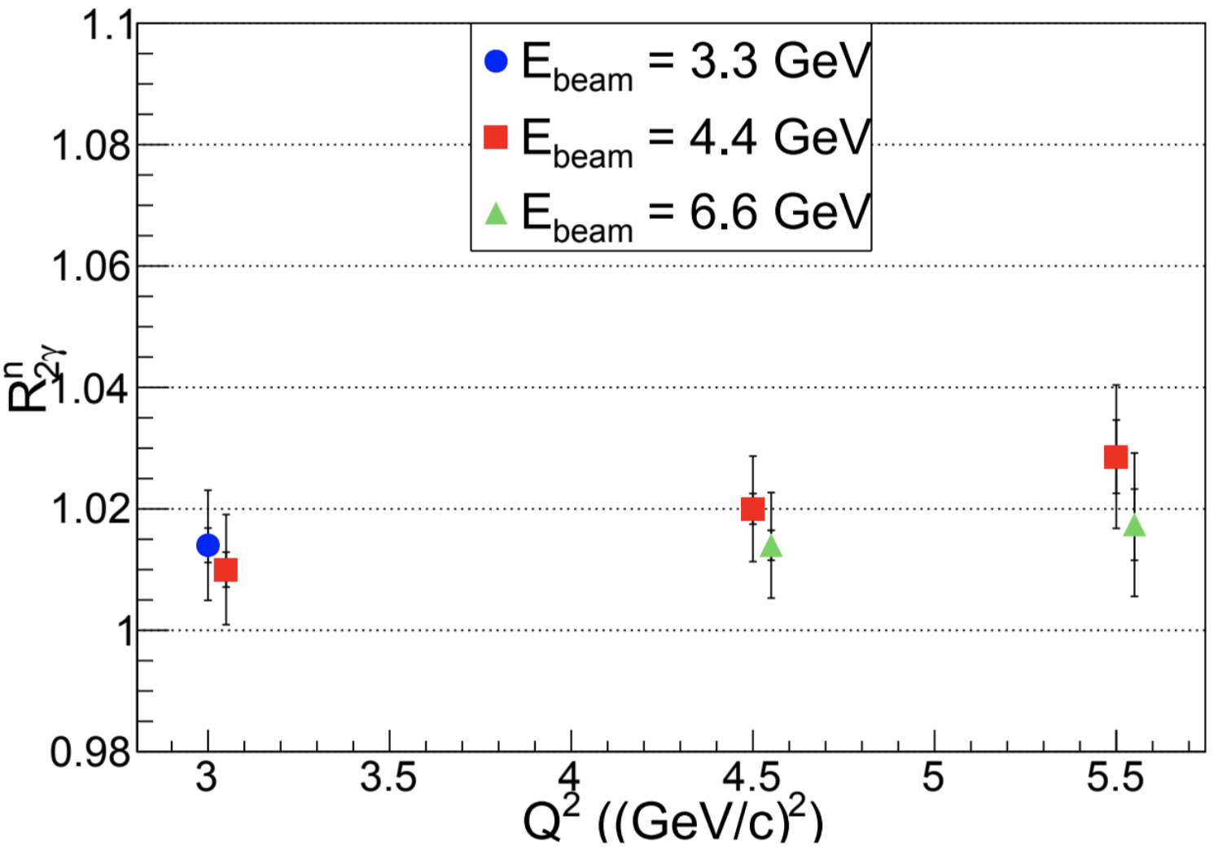
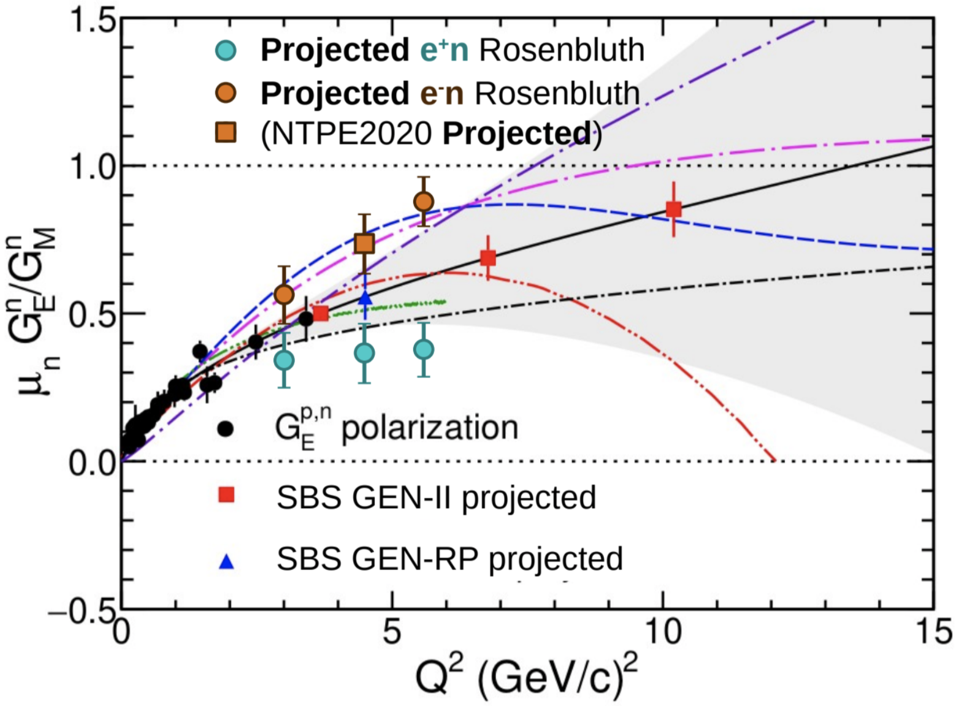
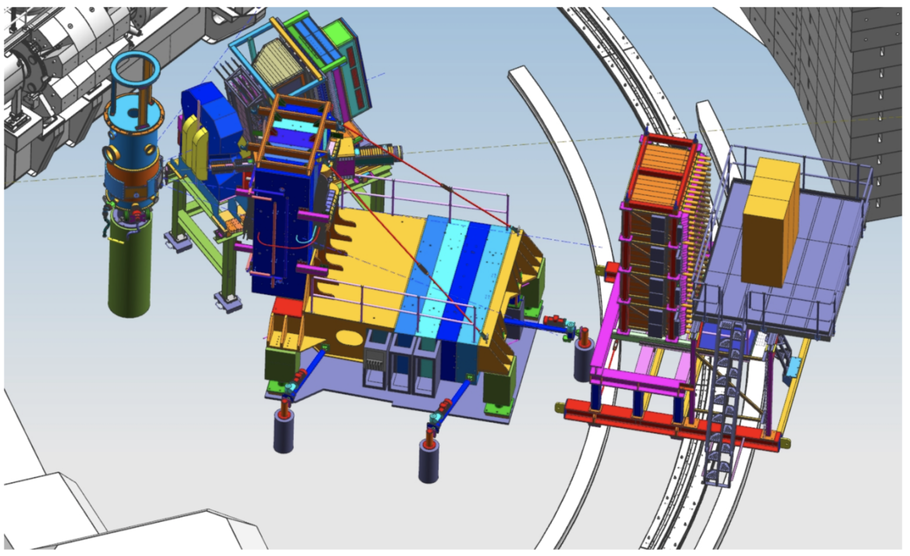
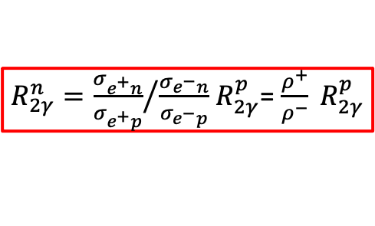
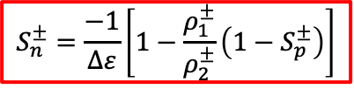
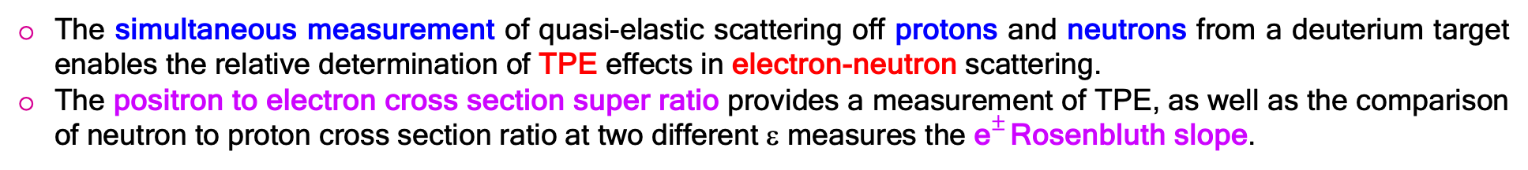
Two-Photon Exchange
E. Voutier
Quasi-Elastic Scattering
E. Fuchey et al. Proposal to PAC53 (2025)
The simultaneous measurement of quasi-elastic scattering off protons and neutrons from a deuterium target enables the relative determination of TPE effects in electron-neutron scattering.
The positron to electron cross section super ratio provides a measurement of TPE, as well as the comparison of neutron to proton cross section ratio at two different ε measures the e$±$Rosenbluth slope.
$R_{2γ}^{n}={\frac{σ_{e^{+}n}}{σ_{e^{+}p}}}/{\frac{σ_{e^{−}n}}{σ_{e^{−}p}}}{ R}_{2γ}^{p}$= $\frac{ρ^{+}}{ρ^{−}} R_{2γ}^{p}$
$$S_{n}^{±}=\frac{−1}{Δε}\left[1−\frac{ρ_{1}^{±}}{ρ_{2}^{±}}\left(1−S_{p}^{±}\right)\right]$$
Bigbite + Super Bigbite Spectrometer
6/24
June 4th, 2025

Slide 7
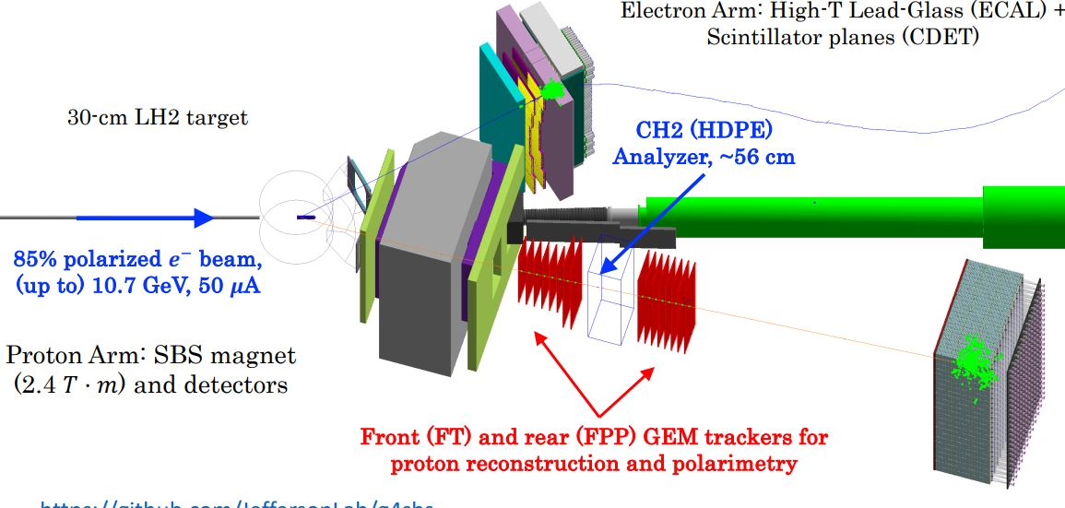
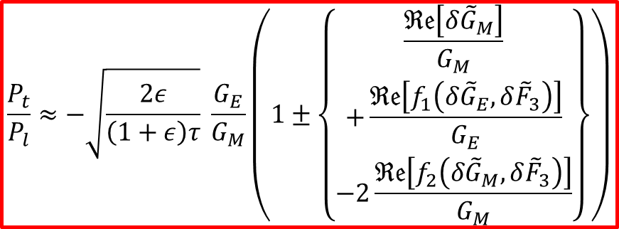
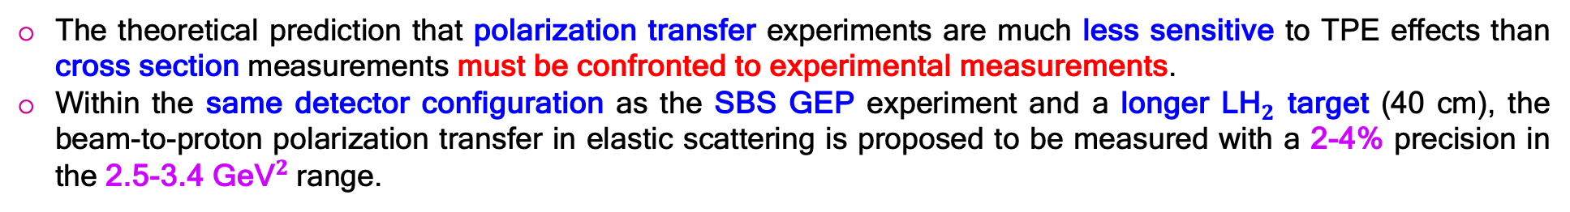

Two-Photon Exchange
E. Voutier
Polarization Transfer
A.J.R. Puckett, J.C. Bernauer, A. Schmidt EPJ A 57 (2021) 188 A.J.R. Puckett, J.C. Bernauer, A. Schmidt et al. LOI12+23-008
The theoretical prediction that polarization transfer experiments are much less sensitive to TPE effects than cross section measurements must be confronted to experimental measurements.
Within the same detector configuration as the SBS GEP experiment and a longer L${\text{H}}_{2}$ target (40 cm), the beam-to-proton polarization transfer in elastic scattering is proposed to be measured with a 2-4% precision in the 2.5-3.4 ${\text{GeV}}^{2}$range.
$$\frac{P_{t}}{P_{l}}≈−\sqrt{\frac{2ε}{\left(1+ε\right)τ}} \frac{G_{E}}{G_{M}}\left(1±\left\{\begin{aligned}\frac{ℜ𝔢\left[δ{\tilde{G}}_{M}\right]}{G_{M}} \\ +\frac{ℜ𝔢\left[f_{1}\left(δ{\tilde{G}}_{E},δ{\tilde{F}}_{3}\right)\right]}{G_{E}} \\ −2\frac{ℜ𝔢\left[f_{2}\left(δ{\tilde{G}}_{M},δ{\tilde{F}}_{3}\right)\right]}{G_{M}}\end{aligned}\right\}\right)$$
40 cm LH2 target
60% polarized ${\text{e}}^{+}$ beam
2.2-4.4 GeV, 50 nA
SBS magnet
2.4 T.m
7/24
June 4th, 2025

Slide 8
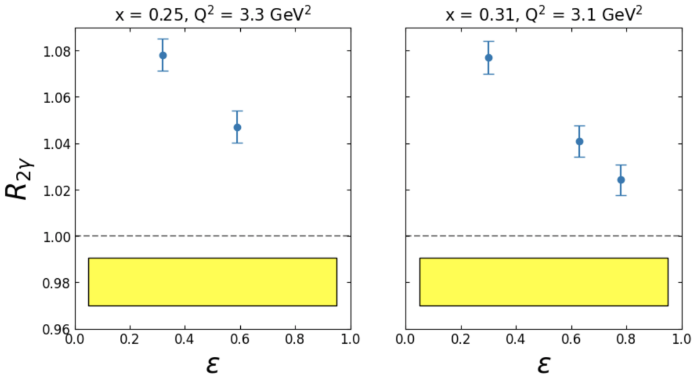
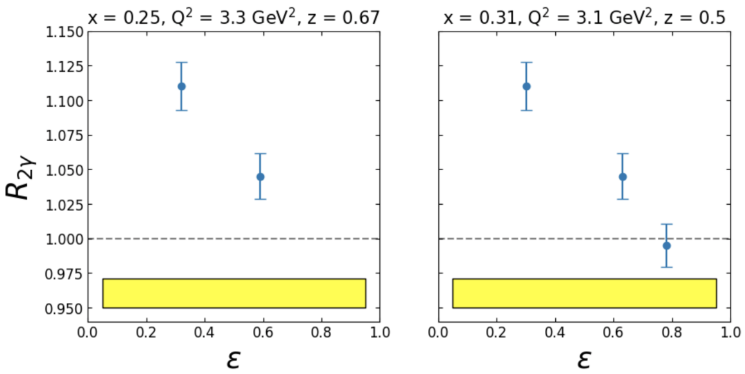

Two-Photon Exchange
E. Voutier
DIS & SIDIS
T. Hague et al. Proposal to PAC53 (2025)
There are contradictory evidences of possible TPE effects in DIS from HERMES and JLab measurements of the target-normal single spin asymmetry.
Significant TPE effects in SIDIS have recently been predicted
while no measurement is available.
$$R_{2γ}=\frac{σ_{e^{+}}}{σ_{e^{−}}}≈1+δ_{2γ}$$
H(e,e’)X projections
H(e,e’π⁺)X projections
(HERMES Collaboration) A. Airapetian et al. PLB 628 (2010) 351 J. Katich et al. PRL 113 (2014) 022502 S. Lee, A. Afanasev, arXix:2504.17123
8/24
June 4th, 2025

Slide 9
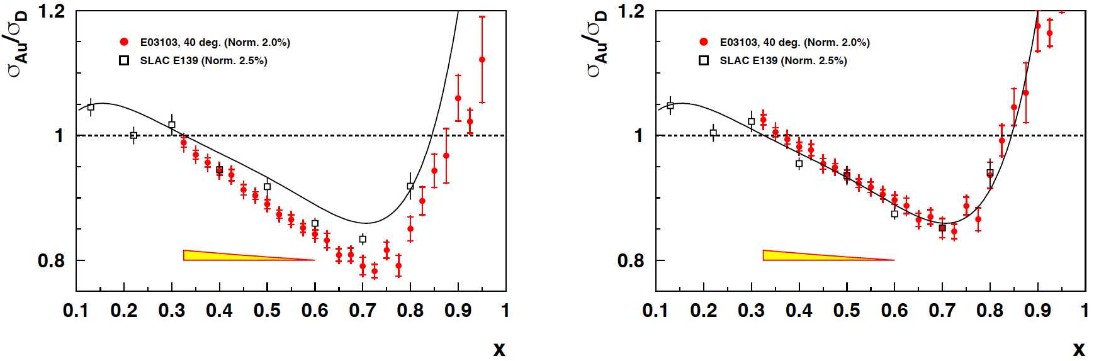
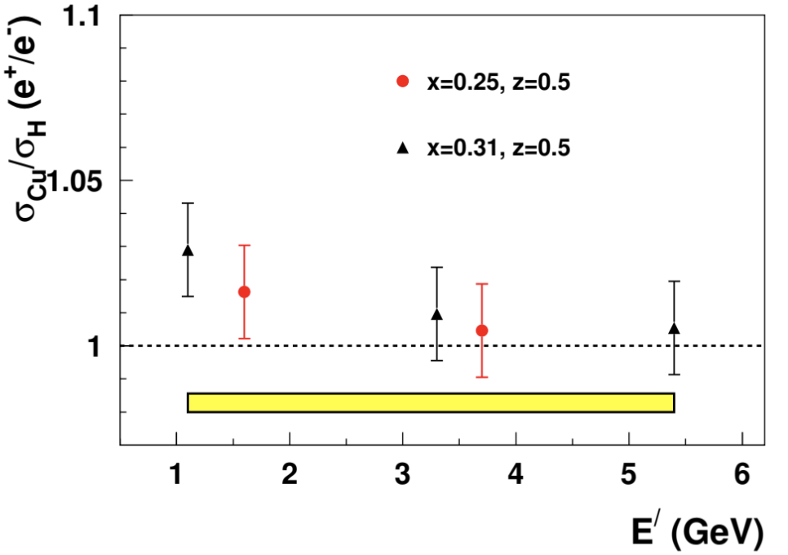
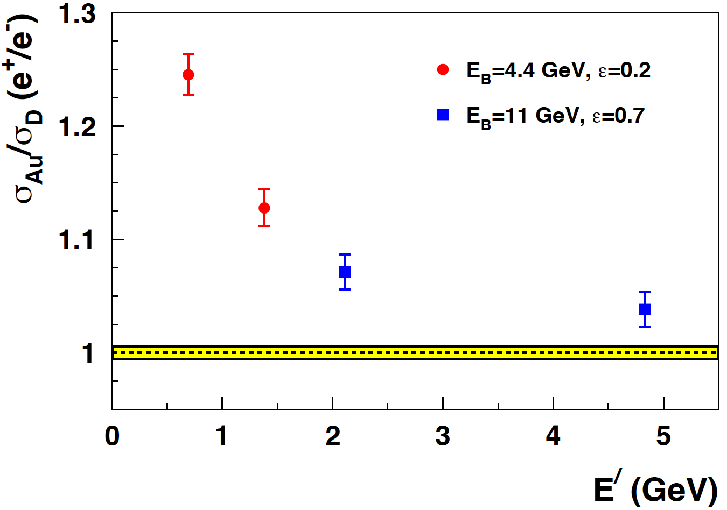
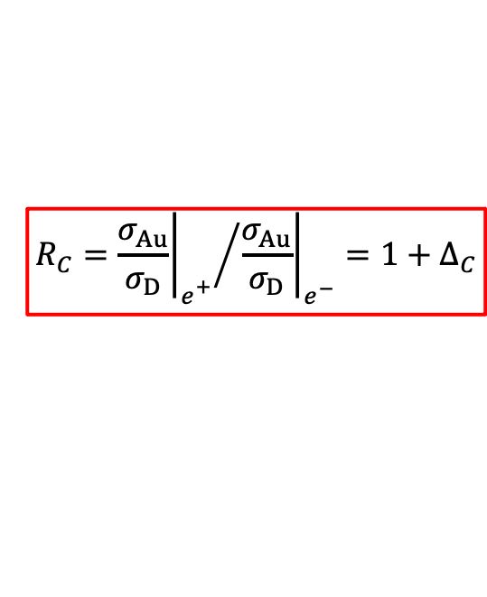
Multi-Photon Exchange
E. Voutier
Coulomb Corrections in (SI)DIS
T. Hague et al. Proposal to PAC53 (2025)
Coulomb Corrections are at work when dealing with the understanding of the nuclear dependency of physics phenoma: the EMC effect in DIS, the nuclear dependence of σ_{L}/σ_{T} in SIDIS...
Prescriptions have been derived in the quasi-elastic domain of which application to DIS and SIDIS regimes must be experimentally confirmed.
$$R_{C}={{\left.\frac{σ_{Au}}{σ_{D}}\right|}_{e_{}^{+}}}/{{\left.\frac{σ_{Au}}{σ_{D}}\right|}_{e^{−}}}=1+∆_{C}$$
H(e,e’π⁺)X SIDIS Projections
PR12+23-003 D. Gaskell et al.
9/24
June 4th, 2025

Slide 10
Multi-Photon Exchange
E. Voutier
Coulomb Corrections in (SI)DIS
T. Hague et al. Proposal to PAC53 (2025)
Coulomb Corrections are at work when dealing with the understanding of the nuclear dependency of physics phenoma: the EMC effect in DIS, the nuclear dependence of σ_{L}/σ_{T} in SIDIS...
Prescriptions have been derived in the quasi-elastic domain of which application to DIS and SIDIS regimes must be experimentally confirmed.
$$R_{C}={{\left.\frac{σ_{Au}}{σ_{D}}\right|}_{e_{}^{+}}}/{{\left.\frac{σ_{Au}}{σ_{D}}\right|}_{e^{−}}}=1+∆_{C}$$
H(e,e’π⁺)X SIDIS Projections
Impact of Coulomb corrections on
JLab Hall C EMC data, as determined from
the Improved Effective Momentum Approximation.
PR12+23-003 D. Gaskell et al.
9/24
June 4th, 2025

Slide 11
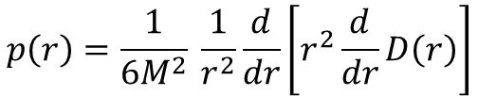
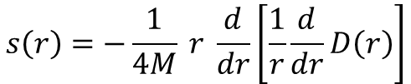
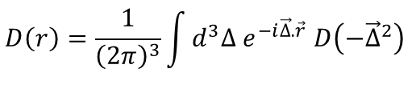
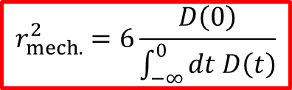
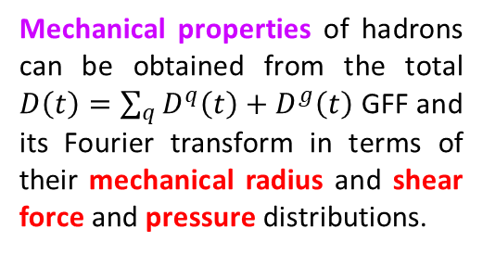
Generalized Parton Distributions
E. Voutier
Gravitational Form Factors
V.D. Burkert, L. Elouadrhiri, F.-X. Girod, C. Lorcé, P.E. Shanahan RMP 95 (2023) 041002
Experimental access to the Gravitational Form Factors (GFFs) of hadrons is the novel quest of the understanding of nucleon structure and dynamics.
GFFs may be probed indirectly in various exclusive processes: (Double) Deeply Virtual Compton Scattering, Time-Like Compton Scattering, Meson Production, J/Ψ production at threshold...
$\left\langle p′ | {\hat{T}}_{μν}^{q} | p\right\rangle =\overline{u}\left(p^{′},\vec{s}′\right) \left[M_{2}^{ q}\left(t\right) \frac{P_{μ}P_{ν}}{M}+J^{q}\left(t\right) \frac{i\left(P_{μ}σ_{να}+P_{ν}σ_{μα}\right)Δ^{α}}{2M}+D^{q}\left(t\right) \frac{Δ_{μ}Δ_{ν}−g_{μν}Δ^{2}}{4M}\right]u\left(p,\vec{s}\right)$
Mass/energy distribution
Angular momentum distribution
Forces & pressure distribution
Mechanical properties of hadrons can be obtained from the total $D\left(t\right)=\sum_{q}{D^{q}\left(t\right)}+D^{g}\left(t\right)$ GFF and its Fourier transform in terms of their mechanical radius and shear force and pressure distributions.
$$s\left(r\right)=−\frac{1}{4M} r \frac{d}{dr}\left[\frac{1}{r}\frac{d}{dr}D\left(r\right)\right]$$
$$D\left(r\right)=\frac{1}{{\left(2π\right)}^{3}}\int{d^{3}∆ e^{−i\vec{∆}.\vec{r}} D\left(−{\vec{∆}}^{2}\right)}$$
$$p\left(r\right)=\frac{1}{6M^{2}} \frac{1}{r^{2}}\frac{d}{dr}\left[r^{2}\frac{d}{dr}D\left(r\right)\right]$$
$$r_{mech.}^{2}=6\frac{D\left(0\right)}{\int_{−∞}^{0}{dt D\left(t\right)}}$$
10/24
June 4th, 2025

Slide 12
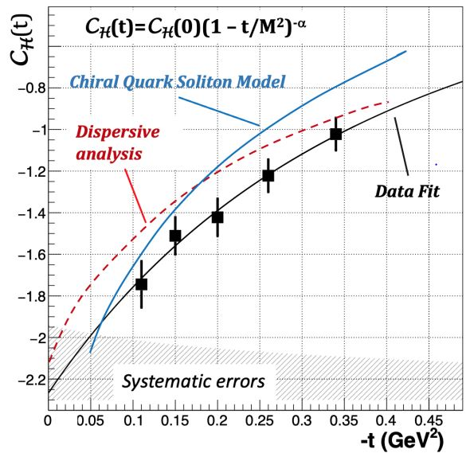
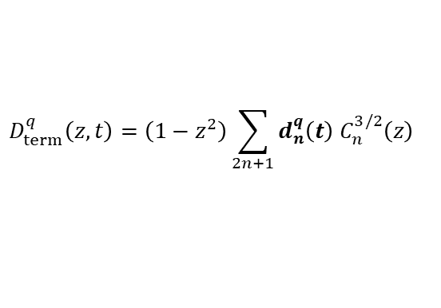
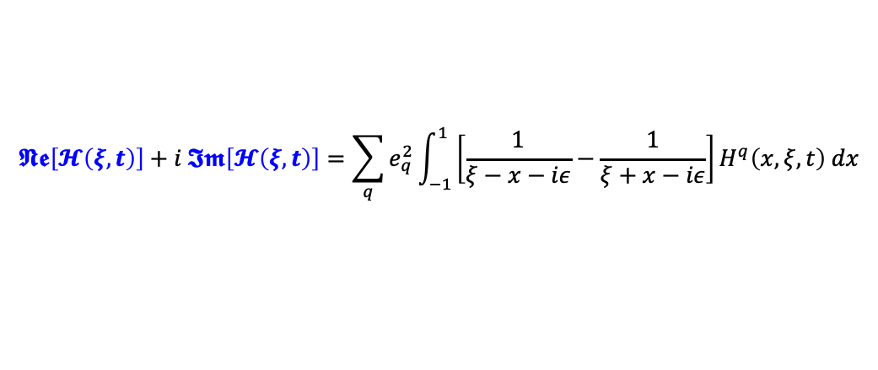

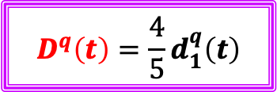
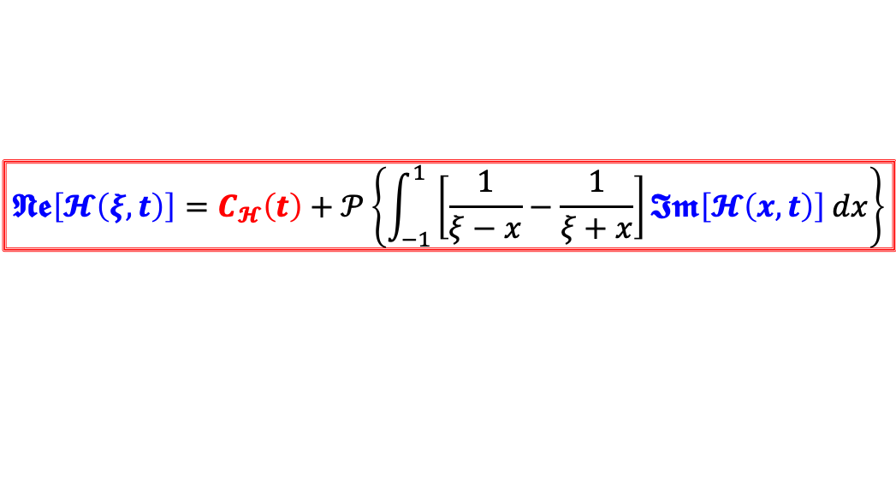
Generalized Parton Distributions
E. Voutier
Experimental Access to D(t)
V.D. Burkert, L. Elouadrhiri, F.-X. Girod, Nature 557 (2018) 39
GPDs are accessed through Compton Form Factors (CFFs) which real and imaginary parts are related by a fixed-t dispersion relation.
$$𝕹𝖊\left[𝓗\left(ξ,t\right)\right]+i 𝕴𝖒\left[𝓗\left(ξ,t\right)\right]=\sum_{q}{e_{q}^{2}}\int_{−1}^{1}{\left[\frac{1}{ξ−x−iε}−\frac{1}{ξ+x−iε}\right]H^{q}\left(x,ξ,t\right) dx}$$
V.D. Burkert et al. RMP 95 (2023) 041002
$$𝕹𝖊\left[𝓗\left(ξ,t\right)\right]=C_{𝓗}\left(t\right)+𝒫\left\{\int_{−1}^{1}{\left[\frac{1}{ξ−x}−\frac{1}{ξ+x}\right]𝕴𝖒\left[𝓗\left(x,t\right)\right] dx}\right\}$$
LO
Beam Charge Asymmetry
Beam Spin Asymmetry
$$C_{ℋ}\left(t\right)=2\sum_{q}{e_{q}^{2}}\int_{−1}^{1}{\frac{D_{term}^{q}\left(z,t\right)}{1−z}} dz$$
$$D_{term}^{q}\left(z,t\right)=\left(1−z^{2}\right)\sum_{2n+1}{d_{n}^{q}\left(t\right) C_{n}^{3/2}\left(z\right)}$$
$$D^{q}\left(t\right)=\frac{4}{5}d_{1}^{q}\left(t\right)$$
11/24
June 4th, 2025

Slide 13
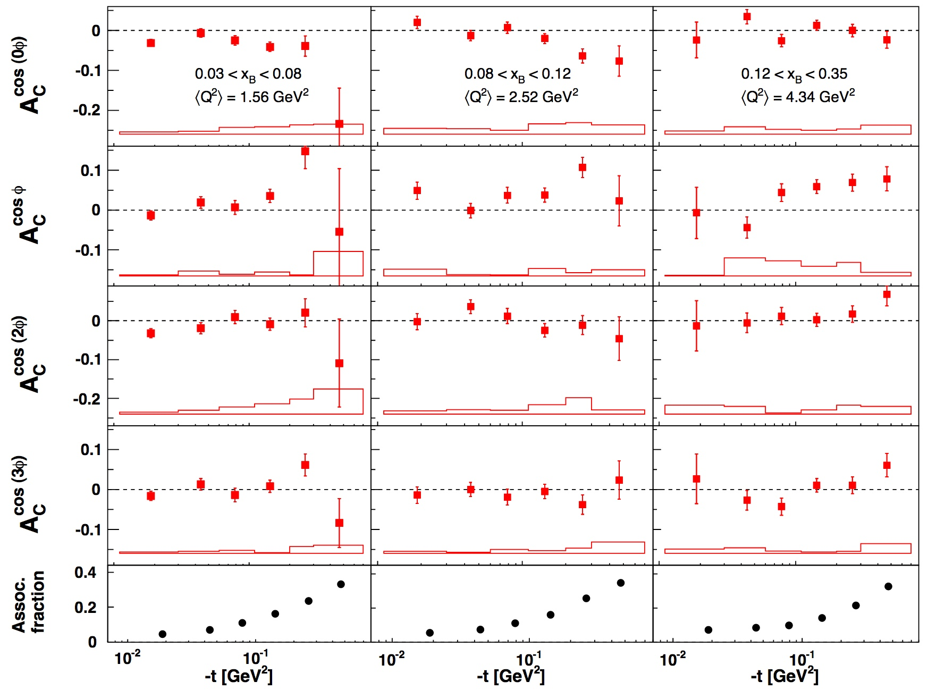
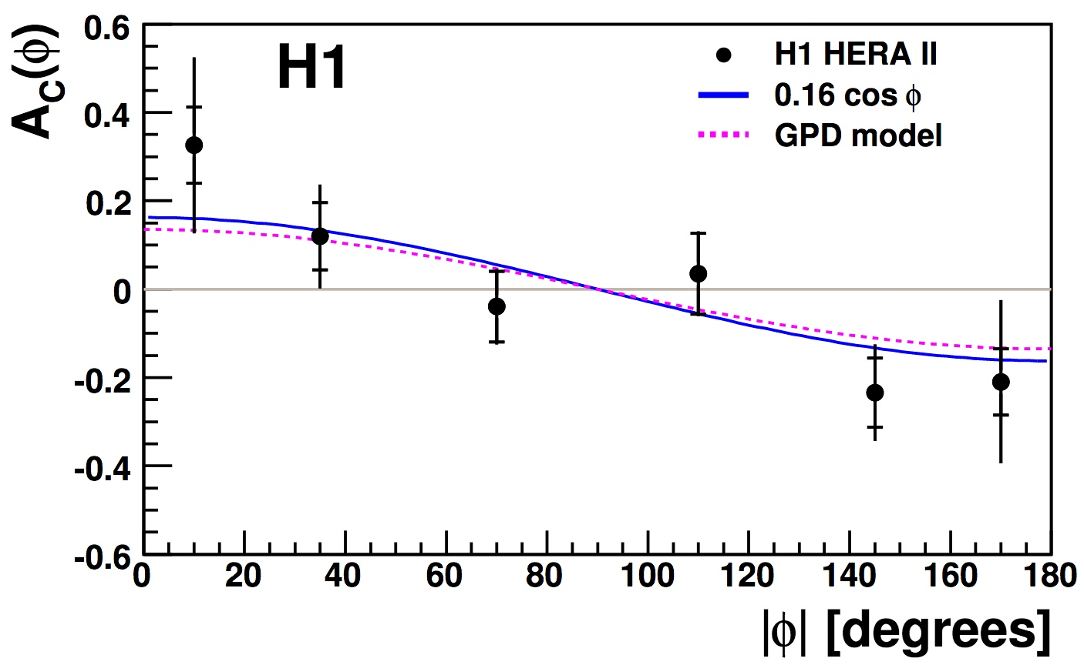
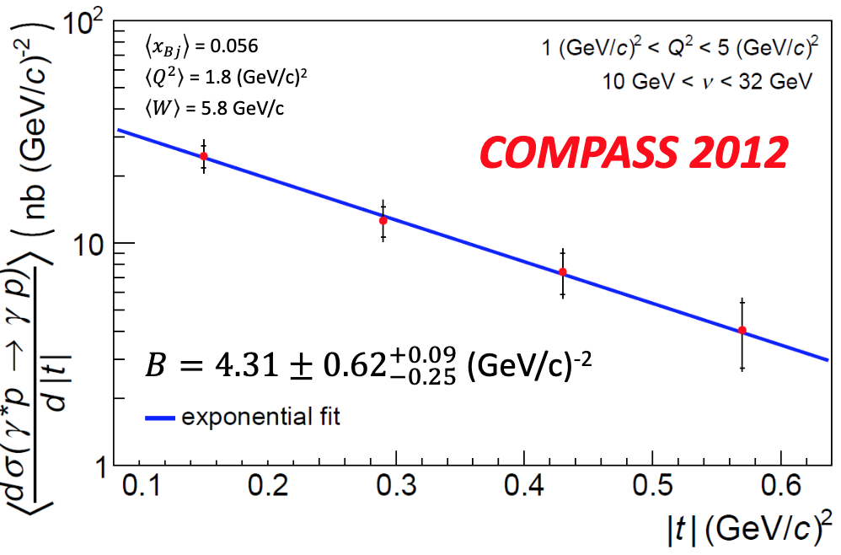

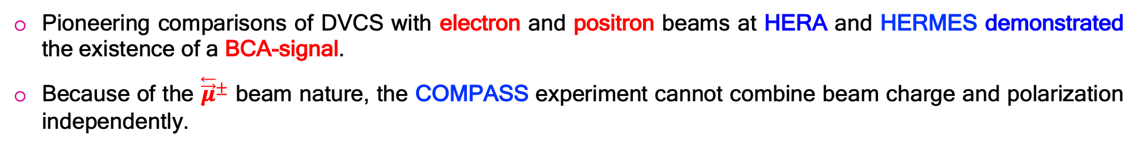
Generalized Parton Distributions
E. Voutier
Charge Asymmetries
Pioneering comparisons of DVCS with electron and positron beams at HERA and HERMES demonstrated the existence of a BCA-signal.
Because of the ${\overset{⃖}{\vec{μ}}}^{±}$ beam nature, the COMPASS experiment cannot combine beam charge and polarization independently.
$${Σσ}_{∓P}^{±}=2\left({d^{5}σ}_{BH}+{d^{5}σ}_{DVCS}{− Pd^{5}\tilde{σ}}_{INT}\right)$$
(H1 Collaboration) F.D. Aaron et al. PLB 681 (2009) 391 (HERMES Collaboration) A. Airapetian et al. JHEP 06 (2008) 066 – 11 (2009) 083 – 07 (2012) 032
(COMPASS Collaboration) R. Akhunzyanov et al. PLB 793 (2019) 188
12/24
June 4th, 2025

Slide 14
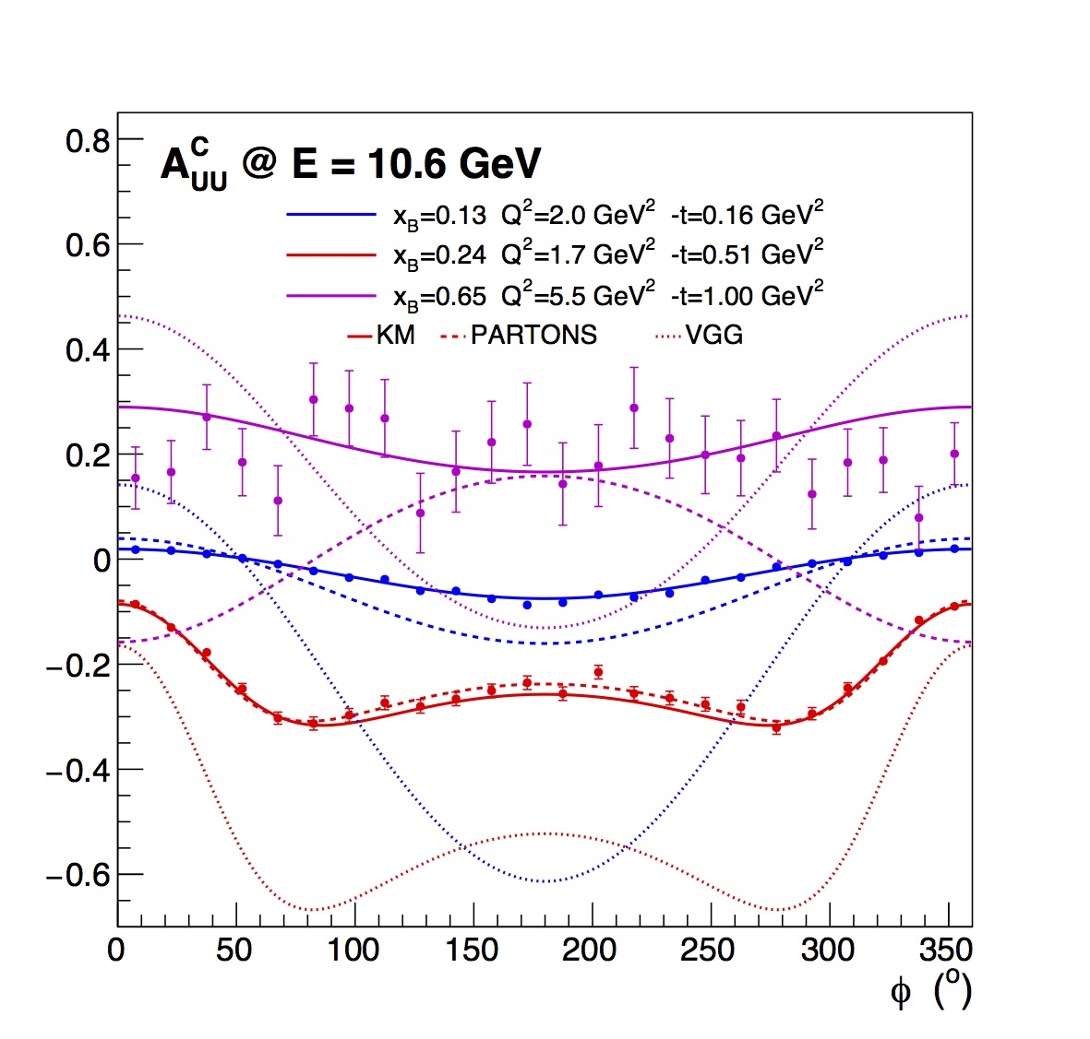
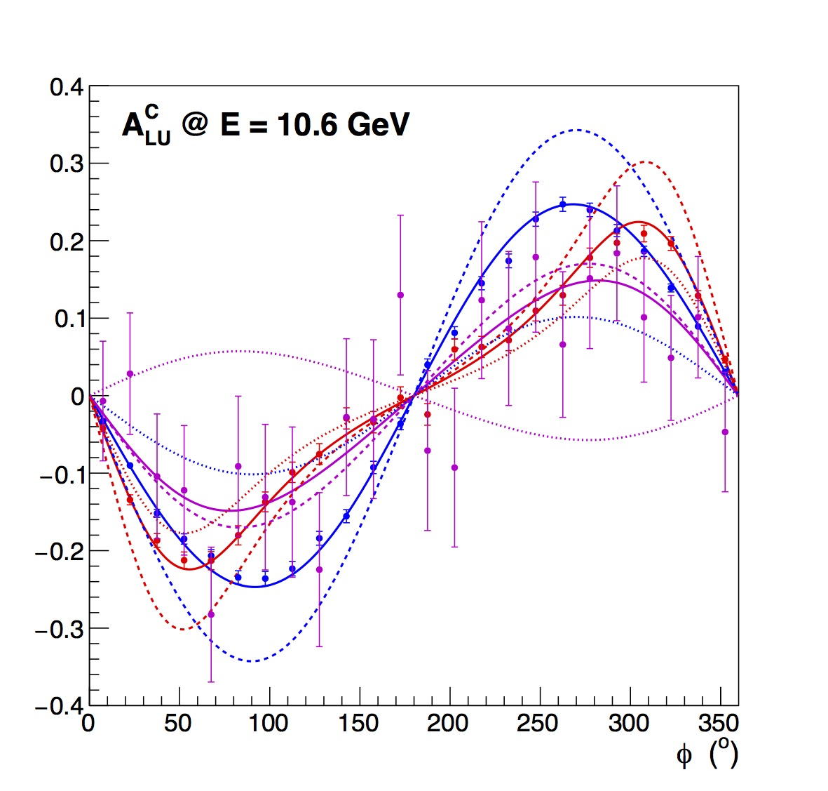
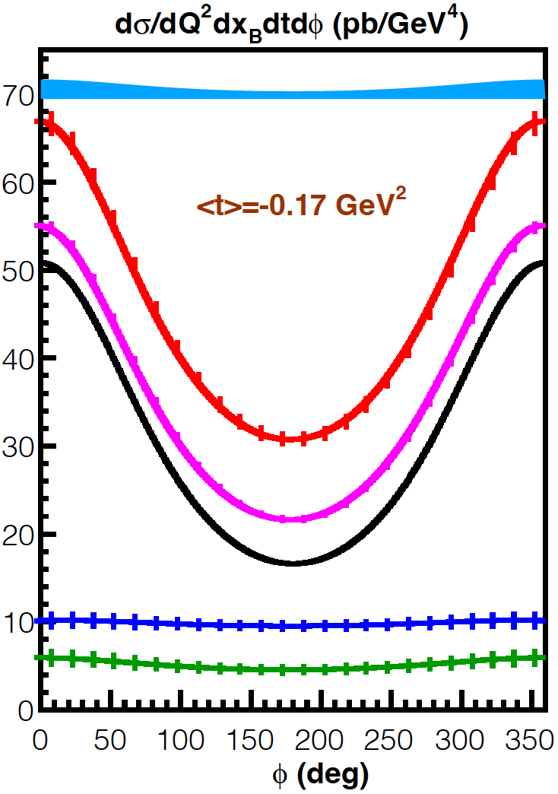
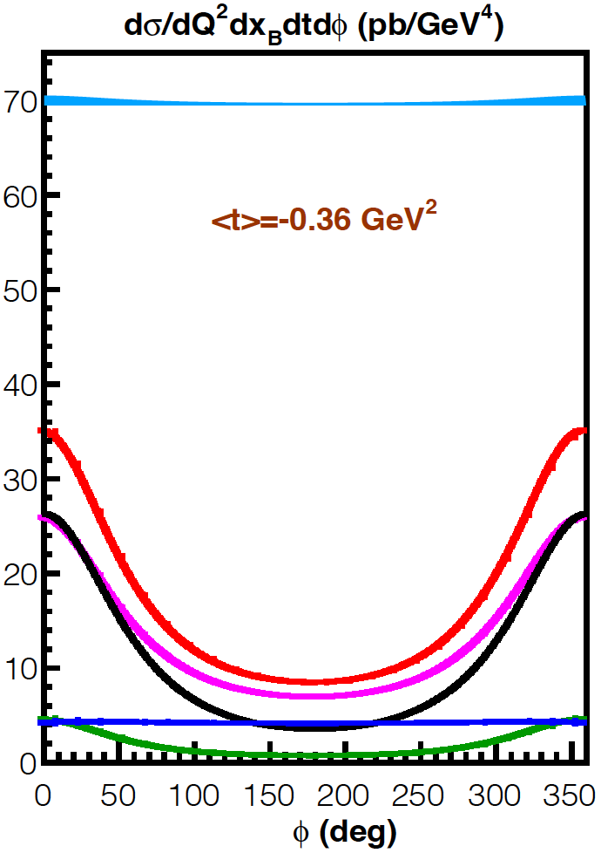
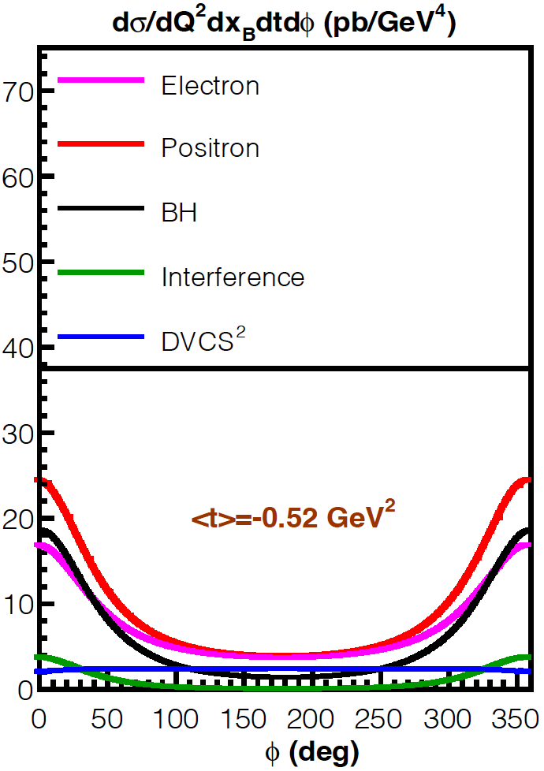
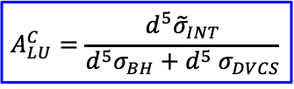
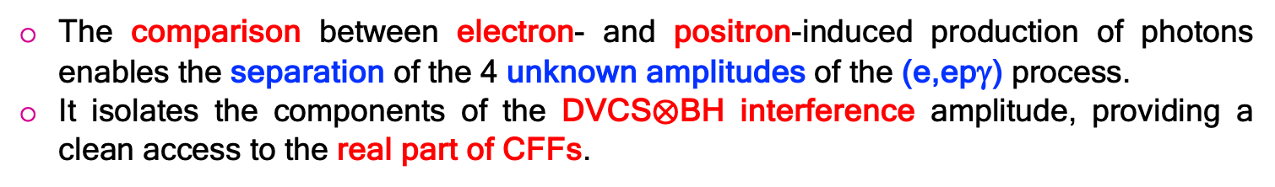


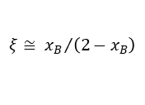

Generalized Parton Distributions
DVCS off Protons
A. Afanasev et al. EPJ A 57 (2021) 300 V.D. Burkert et al. EPJ A 57 (2021) 186
$$\left(Q^{2},x_{B}\right)$$
The comparison between electron- and positron-induced production of photons enables the separation of the 4 unknown amplitudes of the (e,epγ) process.
It isolates the components of the DVCS$⨂$BH interference amplitude, providing a clean access to the real part of CFFs.
$$ξ≅ {x_{B}}/{\left(2−x_{B}\right)}$$
GPDs
$${d^{5}σ}_{00}^{±}={d^{5}σ}_{BH}+{d^{5}σ}_{DVCS}∓{d^{5}σ}_{INT}$$
$$A_{UU}^{C}=\frac{d^{5}σ_{INT}}{{d^{5}σ}_{BH}+{d^{5}σ}_{DVCS}}$$
$$A_{LU}^{C}=\frac{d^{5}{\tilde{σ}}_{INT}}{{d^{5}σ}_{BH}+{d^{5} σ}_{DVCS}}$$
x_{B} = 0.36 Q² = 4.0 GeV²
PR12+23-006 C. Muñoz Camacho et al.
PR12+23-002 E. Voutier et al.
13/24
June 4th, 2025

Slide 15

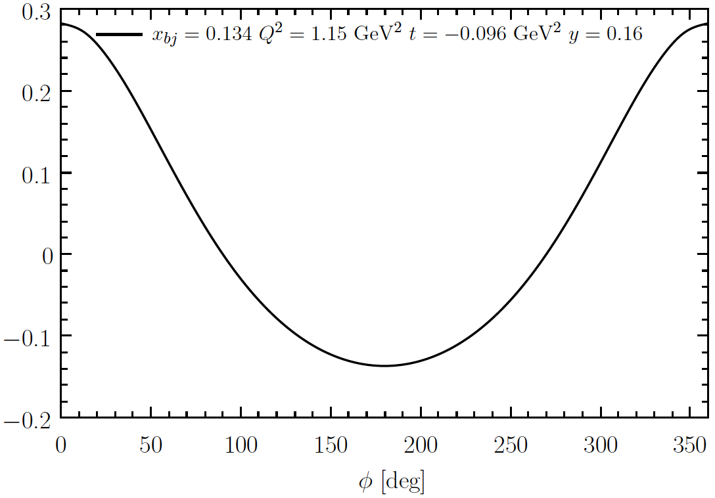
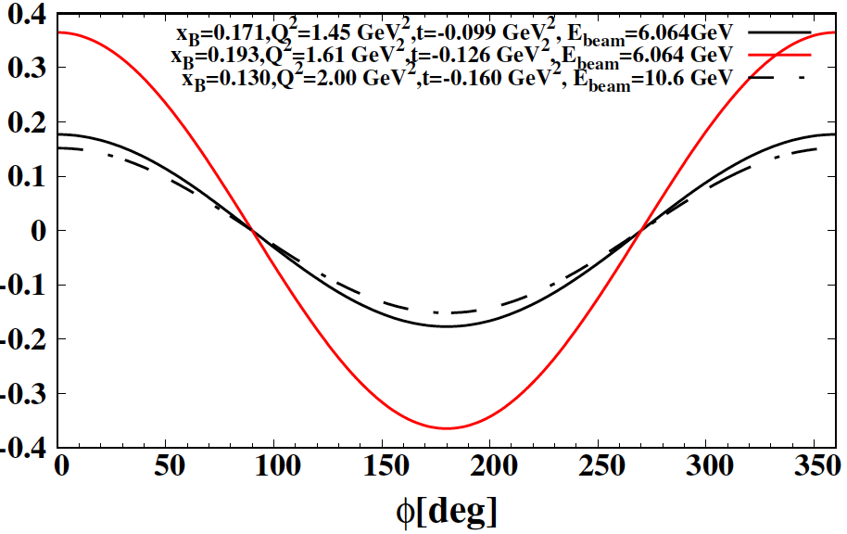
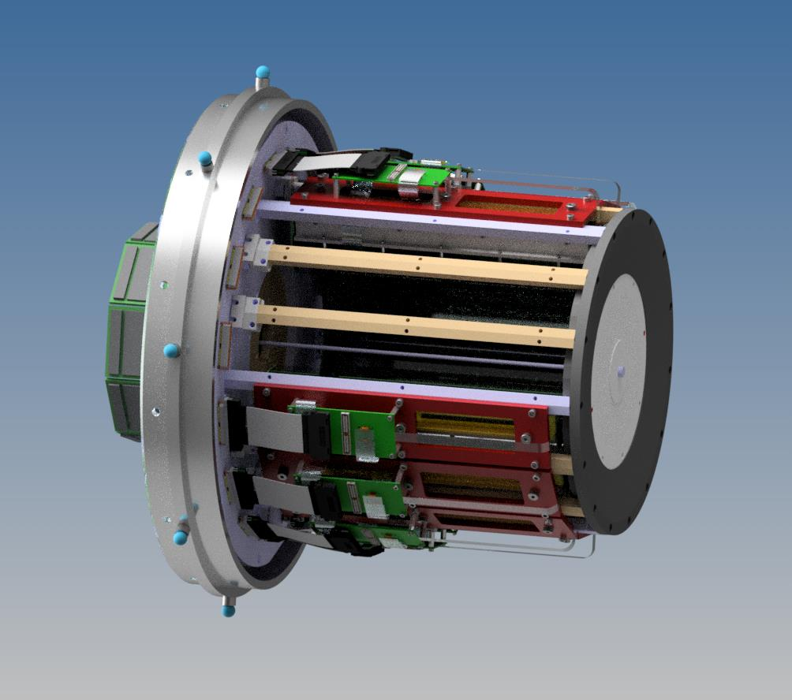

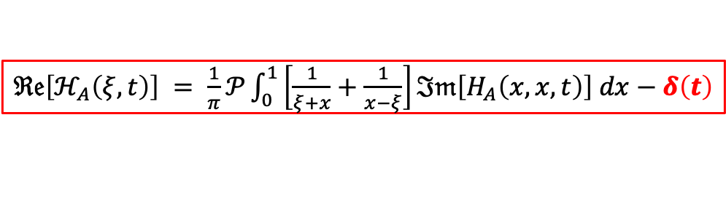
Generalized Parton Distributions
E. Voutier
DVCS off Nuclei
S. Niccolai et al. EPJ A 57 (2021) 226 S. Fucini et al. EPJ A 57 (2021) 273
The real part of the Compton Form Factor E_{n}, of importance for the neutron GFFs and for flavor separation is hardly experimentally constrained without Beam Charge Asymmetry data.
DVCS off nuclei is an exciting tool to access nuclei GFFs and image the nuclear force using a recoil detector (ALERT) a large acceptance spectrometer (CLAS12) and high-energy electron and positron beams.
$$A_{UU}^{C}∝\frac{1}{F_{2}}ℜ𝔢\left[ξ{\tilde{H}}_{n}−\frac{t}{4M^{2}}E_{n}\right]$$
$ℜ𝔢\left[ℋ_{A}\left(ξ,t\right)\right] = \frac{1}{π}𝒫\int_{0}^{1}{\left[\frac{1}{ξ+x}+\frac{1}{x−ξ}\right]ℑ𝔪\left[H_{A}\left(x,x,t\right)\right] dx}−δ\left(t\right)$
e⁺ and e⁻ beams
e⁻ beam only
e⁺ and e⁻ beams
e⁻ beam only
³He
⁴He
14/24
June 4th, 2025

Slide 16
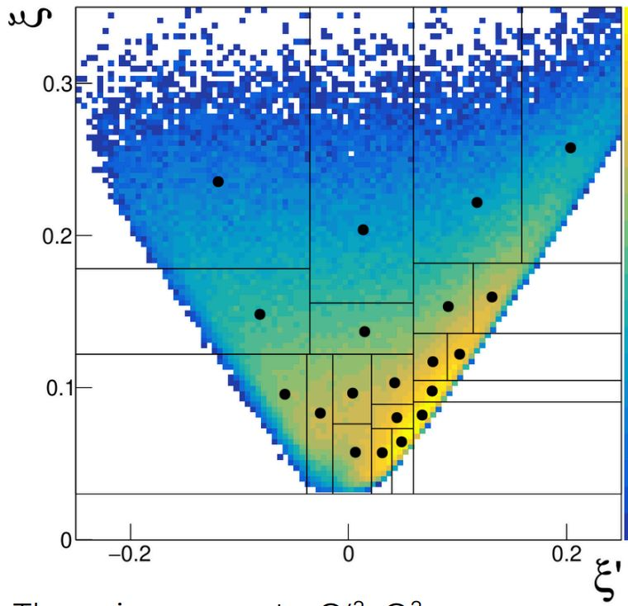
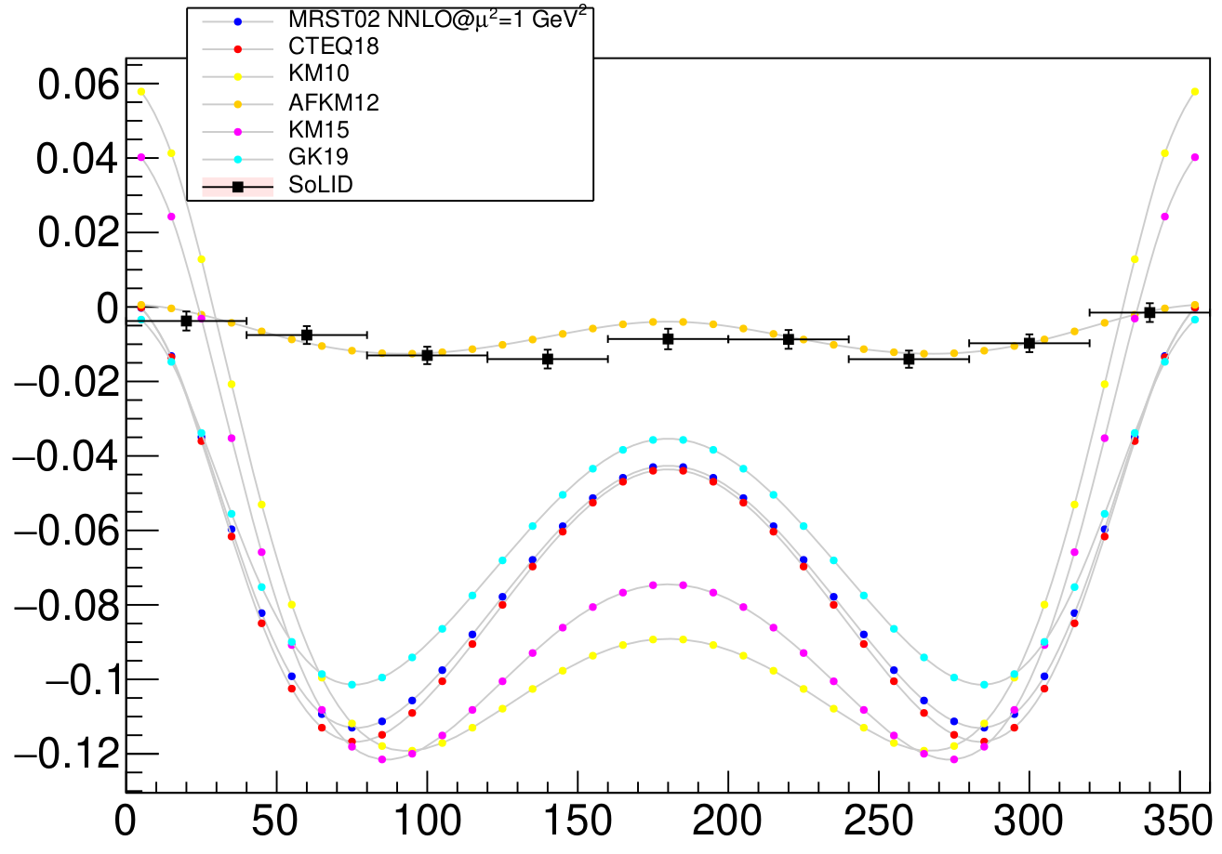


Generalized Parton Distributions
E. Voutier
Double DVCS
S. Zhao et al. EPJ A 57 (2021) 240 K. Deja et al. PRD 107 (2023) 094035 J.S. Alvarado et al. arXiv:2502.02346
The virtuality of the final photon in the DDVCS process enables uncorrelated exploration of the CFF phase-space, which is inaccessible to DVCS and TCS.
The SoLID spectrometer complemented with a muon detector (SoLIDμ) allows to access GPDs at $ξ′≠ξ$ and the real part of DDVCS CFFs for which no dispersion relation has been established.
$$A_{UU}^{C}$$
DVCS limit
TCS limit
Beam Charge Asymmetry
SoLIDμ kinematic coverage
M. Guidal, M. Vanderhaeghen, PRL 90 (2003) 012001
A.V. Belitsky, D. Müller PRL 90 (2003) 022001; PRD 68 (2003) 116005
15/24
June 4th, 2025

Slide 17




Test of the Standard Model
E. Voutier
Dark Photon Search
B. Wojtsekhowski, P. Achenbach, A. Gasparian, N. Liyanage, B. Raydo, W. Xiong et al. PR12+24-005 (2024)
Based on the PRad-II detector setup, a sensitive search for the $A^{′}$-boson in the 15-90 MeV mass range will be performed in the $e^{+}e^{−}$–annihilation.
The kinematic correlation between the energy $E_{γ}$ and the angle $θ_{γ}$ of the produced photon allows to determine the $A^{′}$-mass.
$$M_{A^{′}}^{2}=2m_{e}^{2}+2 m_{e}\left(E_{+}−E_{γ}\right)−4 E_{+}E_{γ}{\left[\sin\left(\frac{θ_{γ}}{2}\right)\right]}^{2}$$
PR12+24-005 B. Wojtsekhowski et al.
16/24
June 4th, 2025

Slide 18



Test of the Standard Model
E. Voutier
Dark Bhabha
D. Mack @ HP2030, Orsay (2024)
As a pure QED process, the interpretabilty of Bhabha scattering offers the possibilty to search for a Beyond Standard Model (BSM) signal by looking at deviations from QED predictions from the interference between QED and BSM amplitudes.
Adding transverse polarization, either beam or/and target, provides access to never measured double spin observables testing high order QED effects and potentially interested for BSM signal search.
A_{TU} : might be used to test higher order QED effects or to search for the imaginary part of light scalar or tensor novel amplitudes.
A_{TT’} : optimally sensitive to the real part of light scalar or tensor novel amplitudes.
A_{LT} : not particularly sensitive to new (pseudo) scalar interactions but A_{LT}+A_{TL} might be.
1%
Within a naive modelling of A’-production with a 10⁻³ coupling magnitude, the variation of the cross section would produce a characteristic signal.
17/24
June 4th, 2025

Slide 19







Test of the Standard Model
E. Voutier
Atoms as Accelerators
F. Arias_Aragon, L. Darmé, G. Grilli di Cortona, E. Nardi, arXiv:2407.15941
The Hadronic Vacuum Polarization (HVP) is the leading theoretical uncertainty in the determination of ${\left(\text{g}\text{−2}\right)}_{μ}$.
Serious disagreements on $σ_{had}$ exist among different experiments as well as between data driven and lattice QCD results for HVP.
Taking advantage of the relativistic motion of inner atomic shells electrons of high Z materials,
the $e^{+}e^{−}⟶π^{+}π^{−}$ cross section can be measured at C${\text{e}}^{\text{+}}$BAF
over a s-range of interest for the determination of ${\left(\text{g}\text{−2}\right)}_{μ}$.
$$a_{μ}^{HVP}=\int_{s_{th.}}{ds σ_{had}\left(s\right)} K\left(s\right)$$
$$s_{±}=s_{0}±2 E_{e^{+}}\left\langle p_{nl}^{z}\right\rangle −{\left\langle p_{nl}\right\rangle }^{2}$$
C${\text{e}}^{+}$BAF
$$2m_{e}\left(E_{e^{+}}+m_{e}\right)$$
Atom acceleration effects have already been observed in Møller polarimetry.
L.G. Levchuk, NIM A 345 (1994) 496
18/24
June 4th, 2025

Slide 20













Ce⁺BAF
E. Voutier
Working Group
Contact grames@jlab.org for joining the group
T. Abe, J. Benesch, A. Bogacz, M. Bruker, L. Cardman, J. Conway, S. Covrig, P. Degtiarenko, Y. Enomoto,
S. Gessner, P. Ghoshal, S. Gopinath, J. Grames, J. Gubeli, C. Gulliford, S. Habet, G. Hays, C. Hernández-García,
D. Higinbotham, A. Hofler, R. Kazimi, M. Kohl, M. Kostin, V.O. Kostroun, F. Lin, V. Lizarraga-Rubio, K. Malher,
Y. Morikawa, S. Nagaitsev, E. Nanni, S. Ogur, G. Palacios-Serrano, N. Raut, B. Rimmer, Y. Roblin, A. Seryi,
K. Smolenski, M. Spata, M. Stutzman, R. Suleiman, A. Sy, N. Taylor, D. Turner, A. Ushakov, C. Valerio-Lizarraga, E. Voutier, H. Wang, S. Wang, M. Yamamoto, S. Zhang, V. Ziemann, Y. Zhang
(Ce⁺BAF Working Group) J. Grames et al. JACoW IPAC2023 (2023) MOPL152
S. Habet et al. JACoW IPAC2022 (2022) 457 R. Kazimi et al. JACoW IPAC2023 (2023) WEPA035 A. Sy et al. JACoW IPAC2023 (2023) MOPM081
Ushakov et al. JACoW IPAC2023 (2023) WEPM120
S. Wang et al. JACoW IPAC2024 (2024) MOPC51 M.W. Bruker et al. JACoW IPAC2024 (2024) MOPC52 A. Sy et al. JACoW IPAC2024 (2024) MOPC53
A. Ushakov et al. JACoW IPAC2024 (2024) MOPC54 T. Lengler et al. JACoW IPAC2024 (2024) TUPC81
19/24
June 4th, 2025

Slide 21


Ce⁺BAF
E. Voutier
e⁺ @ LERF
J. Grames @ Positron Working Group Workshop, Newport News (2025)
The critical risk areas (mA polarized e⁻ source, high power target, capture cavities) are currently investigated.
Within the 2 coming years, a 10 MeV high power test bench will be available at LERF (Low Energy Recirculation Facility).
e⁻ source : JLab LDRD – FY25-26
Solid target : DOE FY24 R&D for Next Generation Nuclear Physics Accelerator Facilities – FY25-26
Liquid target : (GaInSn) DOE SBIR Phase 2 – FY25-26
Cavities : DOE HEP Advanced Positron Concepts, US-Japan Coll. (SLAC/JLab/KEK) – FY25-26
Target Test Area
To CEBAF
Ce⁺BAF White Paper
within 12-18 months
20/24
June 4th, 2025

Slide 22



Ce⁺BAF
E. Voutier
e⁺ @ CEBAF
J. Grames et al. IPAC’23 (2023) MOPL152
LERF
CEBAF Polarized
Electron Injector
123 MeV e⁺ Beam
Injected to NL
North Linac
West Arc
New e⁺ Injector
at LERF
East Arc
123 MeV e⁺
New Beamline
to CEBAF Tunnel
South Linac
New Transport Line
along SL and West Arc
21/24
June 4th, 2025

Slide 23
Ce⁺BAF
E. Voutier
CEBAF / Ce⁺BAF / JLab22
D. Higinbotham @ HP2030, Orsay (2024)
Considering a notional DOE budget profile, Ce⁺BAF construction may potentially start early 2030s.
Activities | Fiscal Year
 | 24 | 25 | 26 | 27 | 28 | 29 | 30 | 31 | 32 | 33 | 34 | 35 | 36 | 37 | 38 | 39 | 40 | 41 | 42
Moller Project and Experiment
SoLID
Positron Source (R&D)
CEBAF Upgrade preCDR/preplan
Positron Project (potential)
Positron Physics
22 GeV Development (R&D)
22 GeV Project (potential)
EIC Project (partner with BNL)
CEBAF Up
22/24
June 4th, 2025

Slide 24
Summary & Outlook
E. Voutier
A unique experimental program with polarized and unpolarized positron beams at Jefferson Lab develops addressing :
- Two- and Multi-Photon Exchange effects in electromagnetic processes (elastic, DIS, SIDIS…);
- Generalized Parton Distributions of hadronic systems (proton, neutron, nuclei…) for the determination of GFFs;
- Tests of the Standard Model using novel reaction channels.
The Ce⁺BAF R&D program is currently addressing the critical risk areas with the development of prototypes and test benches at LERF.
There are strong opportunities for an experimental physics program at LERF with electron and positron beams which could start as early as within 3 years.
Subscribe to the JLab Positron Working Group mailing list pwg@jlab.org
23/24
June 4th, 2025

Slide 25

Summary & Outlook
E. Voutier
Physics @ LERF
at very low beam energies
I_{e} < 10 mA P_{e} > 80% T_{e} < 10 MeV
I_{p} < 10 nA P_{p} < 60% T_{p} < 10 MeV
Nuclear physics
Nuclear astrophysics
Atomic physics
Material Science
Test of the Standard Model
Physics @ LERF
at low beam energies
I_{e} < 1 mA P_{e} > 80% T_{e} < 150 MeV
I_{p} > 50 nA P_{p} > 60% T_{p} < 123 MeV
I_{p} > 1 μA P_{p} < 10% T_{p} < 123 MeV
D. Cassidy (University College London) | J. Grames (Jefferson Lab)
D. Higinbotham (Jefferson Lab) | K. Jordan (Jefferson Lab)
T. Kutz (Universität Mainz) | A. Schmidt (George Washington University)
F. Selim (Arizona State University) | E. Voutier (Université Paris-Saclay)
International Workshop on Low Energy e$±$ Physics at Jefferson Lab
(MeVPhy@JLab)
Newport News, November, 3rd-7th, 2025
Keep posted !
24/24
June 4th, 2025

Slide 27



Multi-Photon Exchange
E. Voutier
Dispersive Effects in eA Scattering
P. Gueye et al. Proposal to PAC53 (2025) P. Gueye et al. EPJ A 56 (2020) 126
Virtual excitations of the nucleus contribute significantly to eA cross section and are energy dependent.
The comparison between e⁻A and e⁺A cross sections selects the real part of the dispersive amplitude while measurements in the minima region of the nuclear form factor also access the imaginary part.
G. Rawitscher PR 151 (1966) 846
$${\left|ℳ_{Stat.}+ℳ_{Disp.}\right|}^{2}= {\left(αZ\right)}^{2}{\left[F\left(q^{2}\right)\right]}^{2}+2{\left(αZ\right)}^{3}\left[F\left(q^{2}\right) 𝕽𝖊\left\{G\left(q^{2}\right)\right\}\right]+ {\left(αZ\right)}^{4}\left[{\left(𝕽𝖊\left\{G\left(q^{2}\right)\right\}\right)}^{2}+{\left(𝕴𝖒\left\{G\left(q^{2}\right)\right\}\right)}^{2}\right]$$
June 4th, 2025

Slide 28





Generalized Parton Distributions
E. Voutier
Deeply Virtual Compton Scattering
M. Diehl at the CLAS12 European Workshop, Genova, February 25-28, 2009
CFF = Compton Form Factors
$∝$ to the real part
of a CFF linear combination
$∝$ to the imaginary part
of a CFF linear combination
$${d^{5}σ}_{P0}^{e}={d^{5}σ}_{BH}+{d^{5}σ}_{DVCS}+P{ d}^{5}{\tilde{σ}}_{DVCS}−e \left[{d^{5}σ}_{INT}{+ P{ d}^{5}\tilde{σ}}_{INT}\right]$$
$∝$ to the real part
of a CFF bilinear combination
$∝$ to the imaginary part
of a CFF bilinear combination
$${d^{5}σ}_{PS}^{e}={d^{5}σ}_{P0}^{e}+S \left[{{P d}^{5}∆σ}_{BH}+\left({{Pd}^{5}∆σ}_{DVCS}+{ d}^{5}∆{\tilde{σ}}_{DVCS}\right)−e\left(P{d^{5}∆σ}_{INT}{+{ d}^{5}∆\tilde{σ}}_{INT}\right) \right]$$
Polarized electrons and positrons allow to separate the
unknown amplitudes of the cross section for electro-production of photons.
June 4th, 2025

