Slide 1
Challenges for Kaon Spectroscopy
Bernhard Ketzer
for the AMBER Collaboration
Production and Structure of Matter and Antimatter at High Energies
PAW 2025
Kloster Irsee
04 June 2025

Slide 2

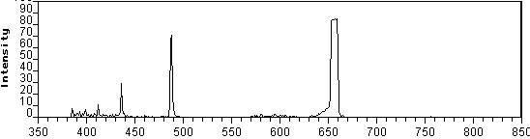
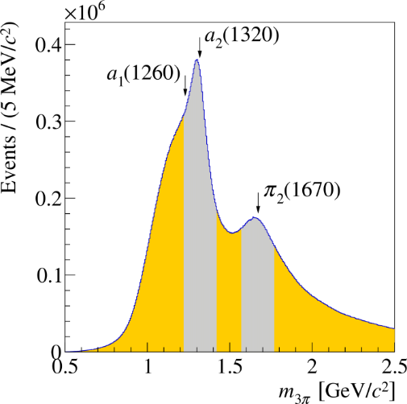



Why Spectroscopy?
Atom
$$3$$
$$2$$
e
p
$$n=1$$
Hadron
u

Slide 3

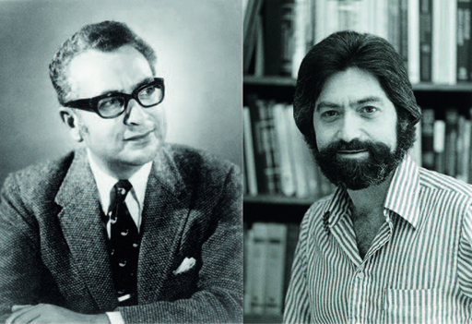

















Exotic Mesons
=
+
$$q$$
$$q$$
+
$$\overline{q}$$
$$π, σ$$
$$\overline{q}$$
+
+
+ ...
$$q$$
$$\overline{q}$$
$$ρ,ω$$
$$q$$
$$\overline{q}$$
$$\overline{q}$$
$$\overline{q}$$
$$q$$
$$q$$
$${\left(q\overline{q}\right)}_{0}$$
$${\left(qq\right)}_{8}{\left(\overline{q}\overline{q}\right)}_{8}$$
$${\left(q\overline{q}\right)}_{0}{\left(q\overline{q}\right)}_{0}$$
$${\left(q\overline{q}\right)}_{8}g$$
$${\left(gg\right)}_{0}$$
Tetraquark
Molecule
Hybrid
Glueball
Where are they?
How to identify them?
Crypto-exotic:
  supernumerary, unexpected properties
  comparison with lattice, models
Flavor-exotic:
Spin-exotic:
$$a_{1}\left(1420\right), X, Y,Z$$
$$T_{cc}$$
$$π_{1}$$

Slide 4
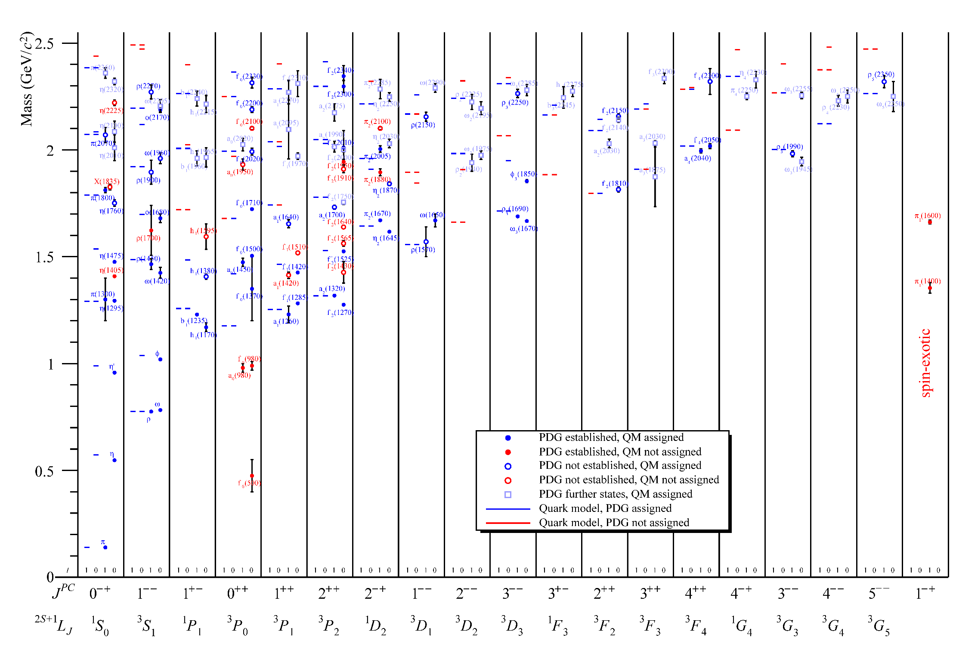
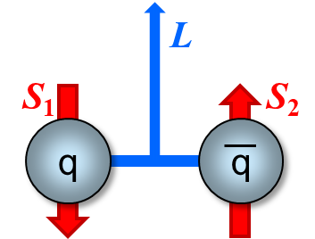
Light-Meson Spectrum
[B. Ketzer et al., Prog. Part. Nucl. Phys. 113, 103755 (2020)]
Relativistic Quark Model: [D. Ebert et al., Phys. Rev. D 79, 114029 (2009)]

Slide 5
Light-Meson Spectrum
[B. Ketzer et al., Prog. Part. Nucl. Phys. 113, 103755 (2020)]
Relativistic Quark Model: [D. Ebert et al., Phys. Rev. D 79, 114029 (2009)]

Slide 6
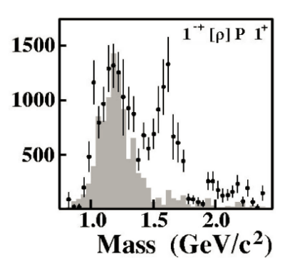
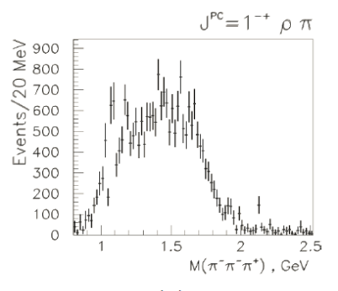
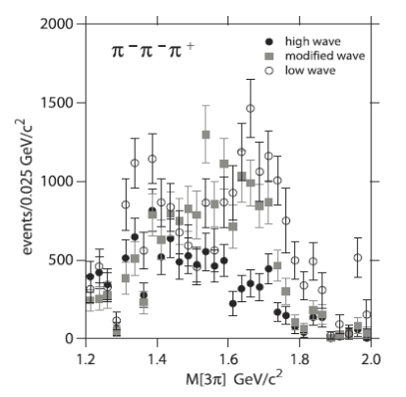
The $π_{1}$ Saga
1970 – 1980’s: early phenomenology
1995 – 2010: early data
[BNL E852, Adams et al., Phys. Rev. Lett. 81, 5760 (1998)]
[Crystal Barrel, Abele et al., Phys. Lett. B 446, 349 (1999)]
[VES, Zaitsev, Nucl.Phys. 830 A675, 155C (2000)]
[BNL E852, Dzierba et al., Phys. Rev. D 73, 072001 (2006)]
[BNL E852, Ivanov et al., Phys. Rev. Lett. 86, 9377 (2011)]

Slide 7
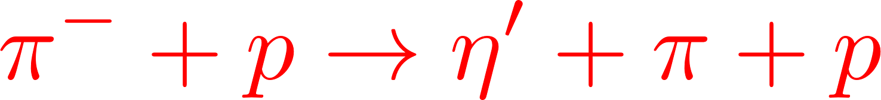



Two low-mass $π_{1}$ Mesons?
P-wave $ηπ$ channel
P-wave $η′π$ channel
Data from
Data from
Model based on S-matrix theory
Analyticity
Unitarity
[A. Rodas, BK, et al. (JPAC), Phys. Rev. Lett. 122, 042002 (2019)]

Slide 8
Two Low-mass $π_{1}$ Mesons?
P-wave $ηπ$ channel
P-wave $η′π$ channel
Data from
Data from
[A. Rodas, BK, et al. (JPAC), Phys. Rev. Lett. 122, 042002 (2019)]

Slide 9
Two Low-Mass $π_{1}$ Mesons?
P-wave $ηπ$ channel
P-wave $η′π$ channel
Data from
Data from
only a single pole needed to describe both peaks
consistent with π₁(1600)
First coupled-channel extraction of resonance pole of a hybrid candidate
Later confirmed by [B. Kopf et al., Eur. Phys. J. C 12, 1056 (2021)], also including $\overline{p}p$ and $ππ$ scattering data
[A. Rodas, BK, et al. (JPAC), Phys. Rev. Lett. 122, 042002 (2019)]

Slide 10

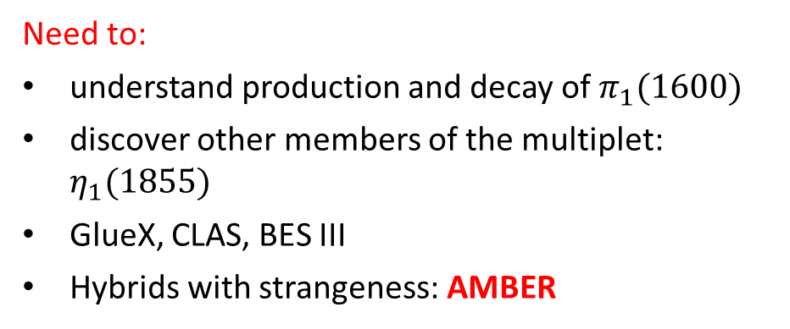
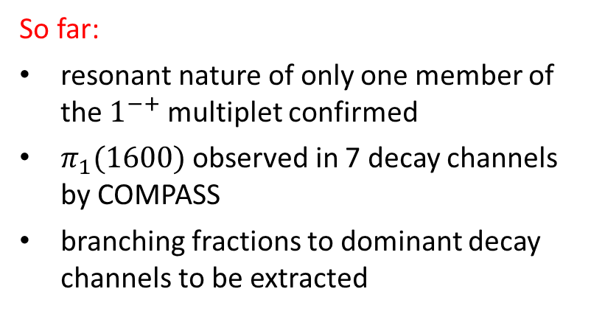
Hybrid $π_{1}$ Multiplet
So far:
resonant nature of only one member of the $1^{−+}$ multiplet confirmed
$π_{1}(1600)$ observed in 7 decay channels by COMPASS
branching fractions to dominant decay channels to be extracted
Need to:
understand production and decay of $π_{1}(1600)$
discover other members of the multiplet: $η_{1}(1855)$
GlueX, CLAS, BES III
Hybrids with strangeness: AMBER
https://arxiv.org/abs/2202.00623

Slide 11
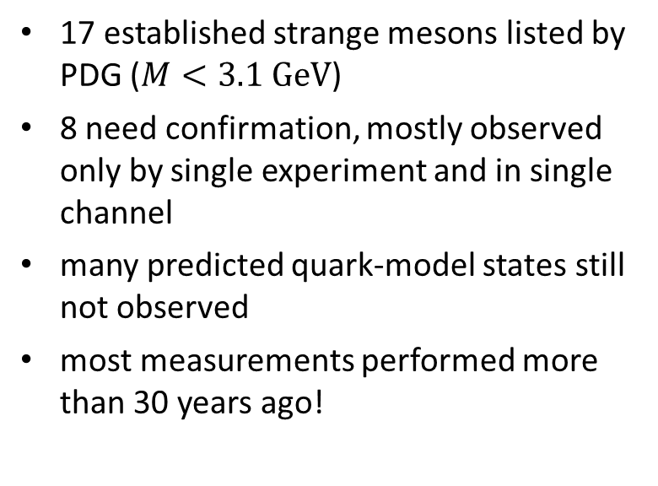
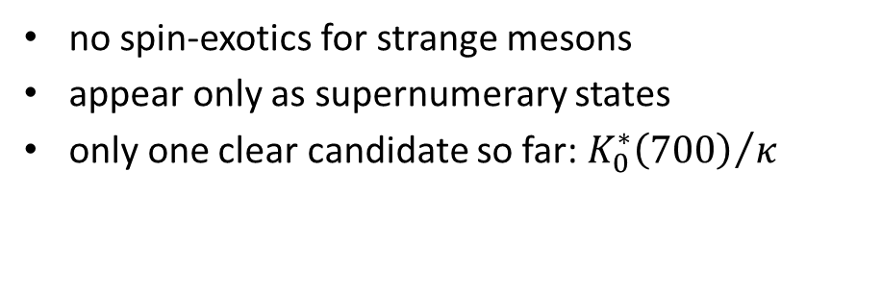
Strange Meson Spectrum
17 established strange mesons listed by PDG ($M<3.1 GeV$)
8 need confirmation, mostly observed only by single experiment and in single channel
many predicted quark-model states still not observed
most measurements performed more than 30 years ago!
no spin-exotics for strange mesons
appear only as supernumerary states
only one clear candidate so far: ${K_{0}^{∗}\left(700\right)}/κ$
More data needed on strange meson spectrum
bridge the gap between light and heavy hadrons
input to other fields, e.g. CP violation, BSM

Slide 12
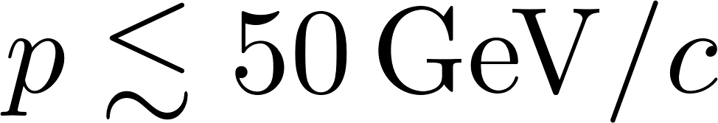
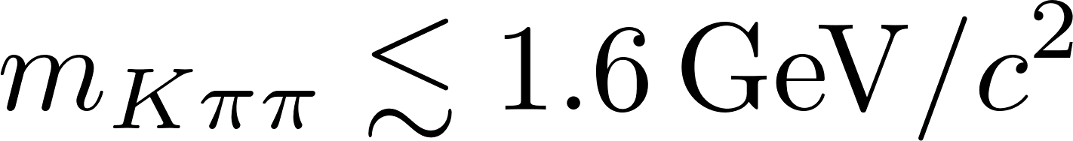
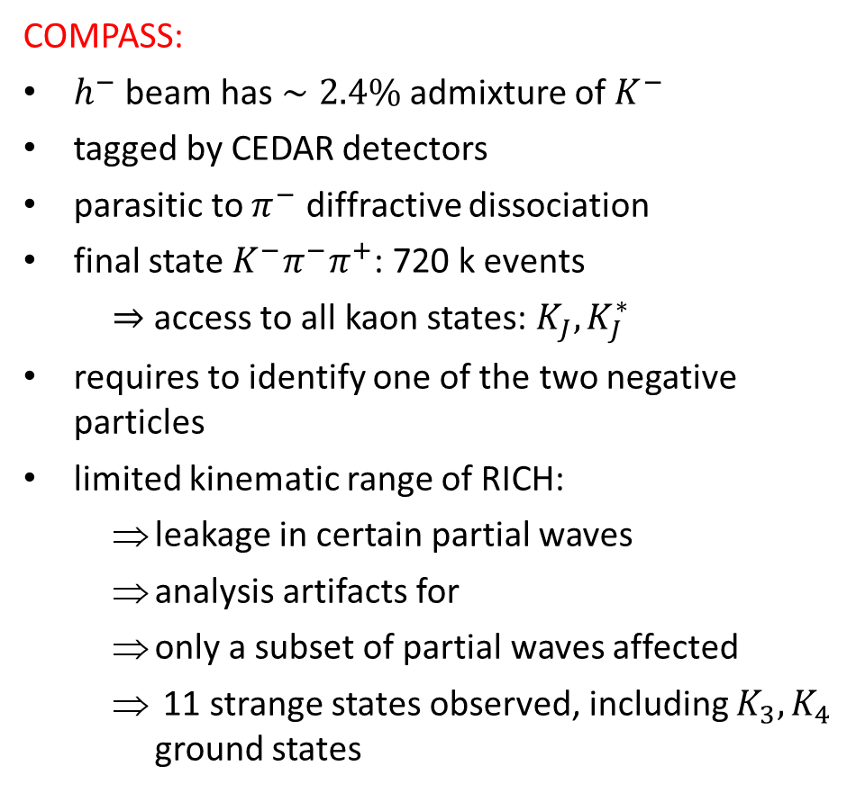
Strange Meson spectrum
COMPASS:
$h^{−}$ beam has $∼2.4\%$ admixture of $K^{−}$
tagged by CEDAR detectors
parasitic to $π^{−}$ diffractive dissociation
final state $K^{−}π^{−}π^{+}$: 720 k events
  ⇒ access to all kaon states: $K_{J}, K_{J}^{∗}$
requires to identify one of the two negative particles
limited kinematic range of RICH:
  leakage in certain partial waves
  analysis artifacts for
  only a subset of partial waves affected
  11 strange states observed, including $K_{3}, K_{4}$ ground states
[COMPASS, arXiv:2504.09470]

Slide 13
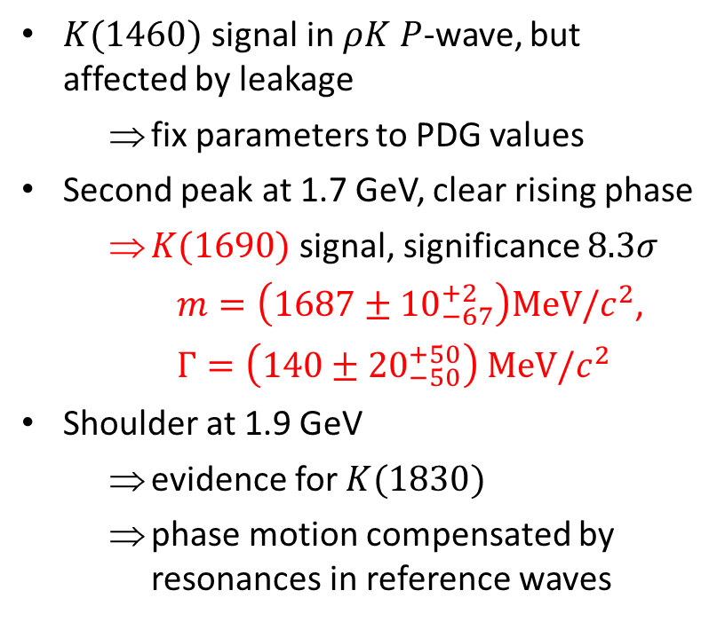
A New Krypto-exotic State with $J^{P}=0^{−}$
$K(1460)$ signal in $ρK$ $P$-wave, but affected by leakage
  fix parameters to PDG values
Second peak at 1.7 GeV, clear rising phase
  $K(1690)$ signal, significance $8.3σ$
  $m=\left(1687±{10}_{−67}^{+2}\right)MeV/c^{2}$,
  $Γ=\left(140±{20}_{−50}^{+50}\right) MeV/c^{2}$
Shoulder at 1.9 GeV
  evidence for $K(1830)$
  phase motion compensated by resonances in reference waves
3 excited K from single analysis, QM predicts only 2
K(1690) candidate for supernumerary state
[COMPASS, arXiv:2504.09470]

Slide 14
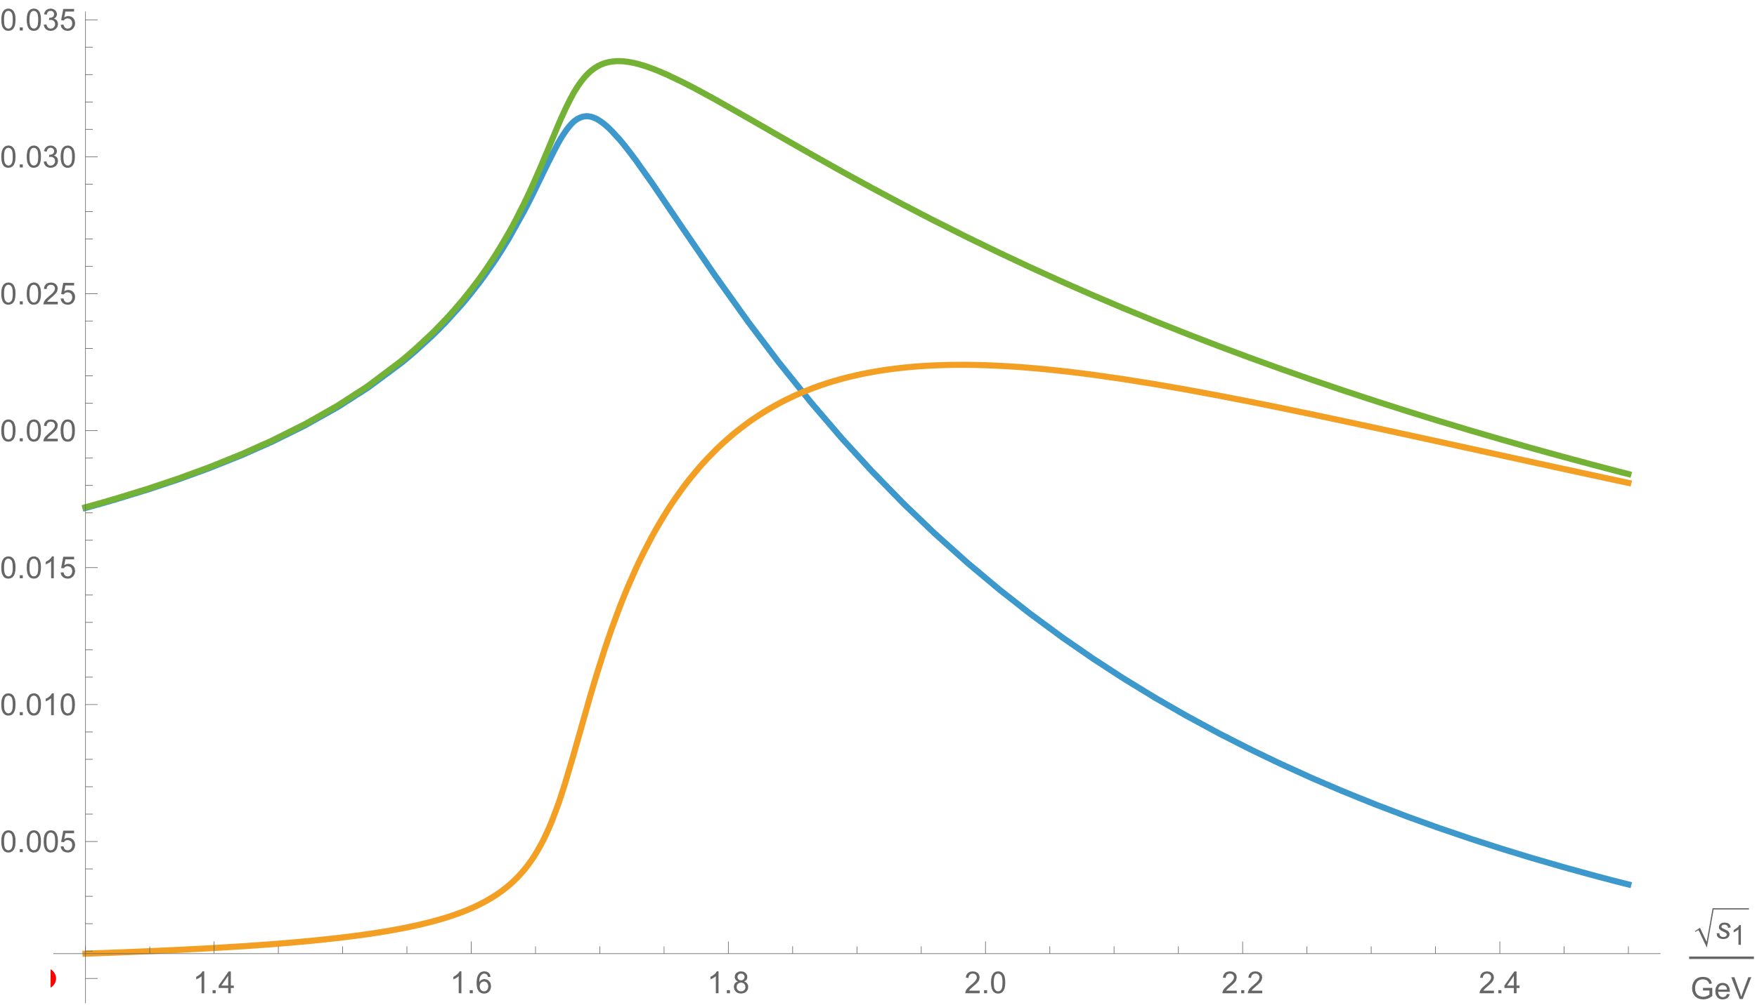
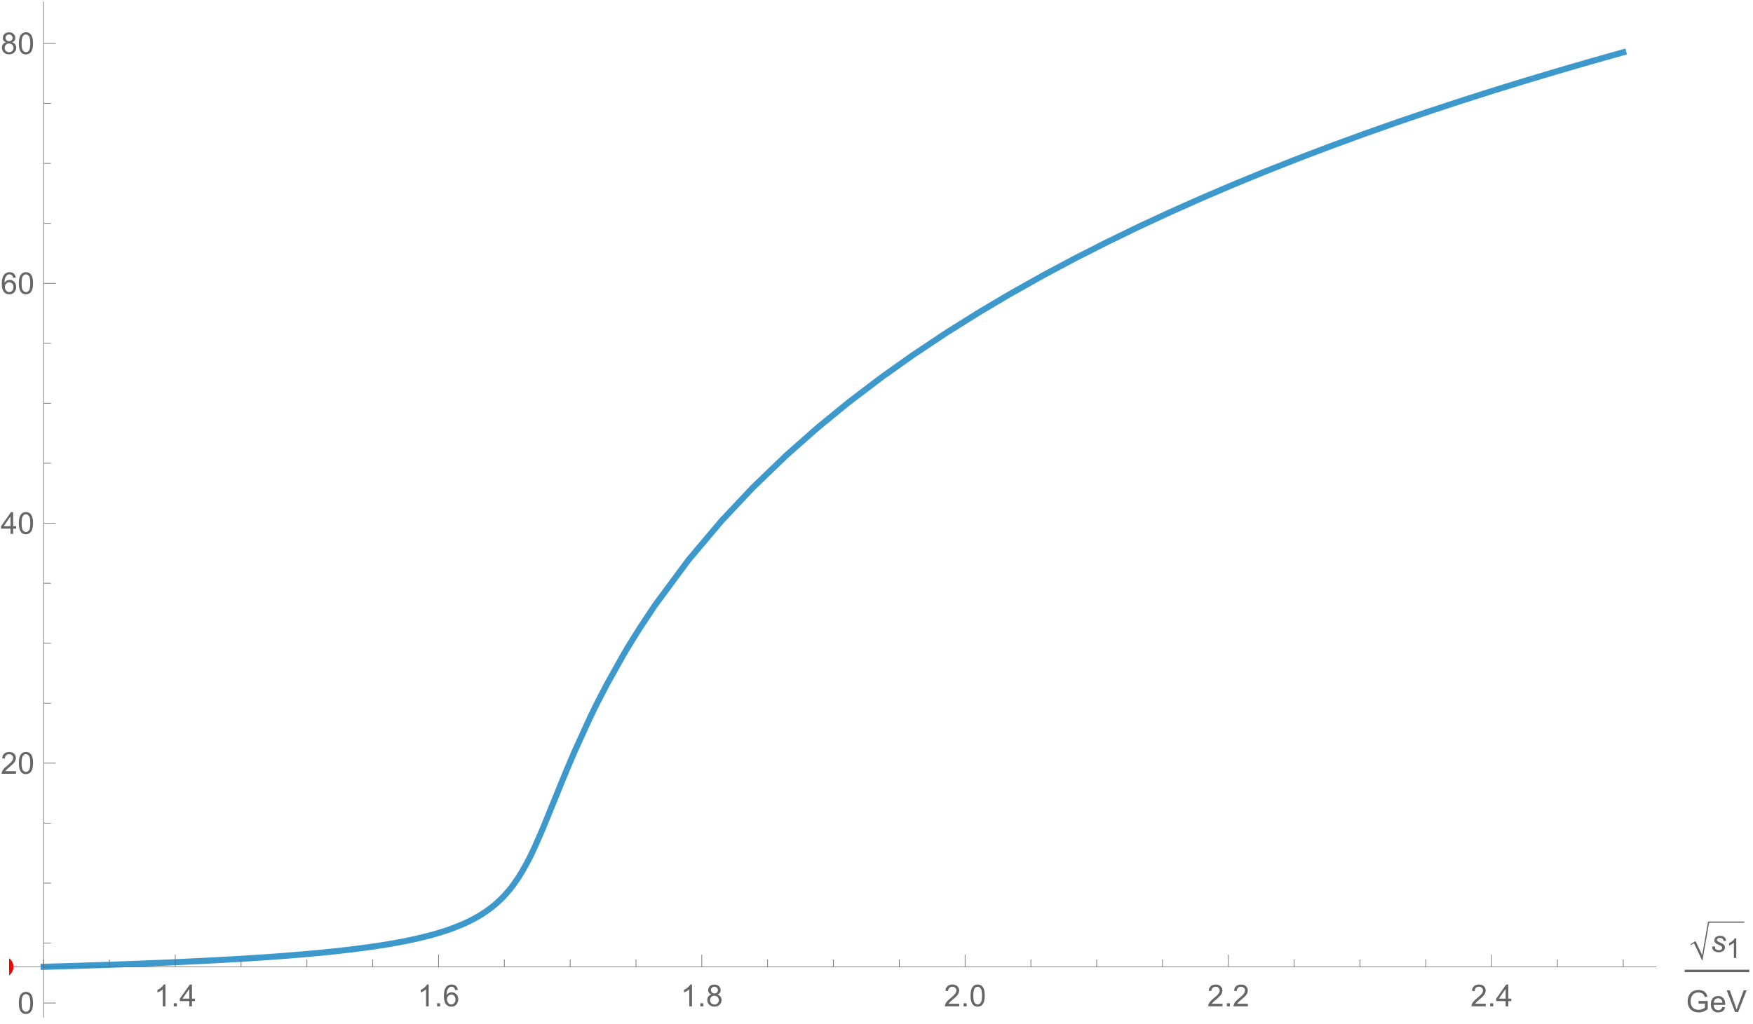










A New Krypto-exotic State with $J^{P}=0^{−}$
$$Abs ℳ$$
$$Im ℳ$$
$$Re ℳ$$
ongoing analysis
$$Arg ℳ$$
$$K^{0}/K^{−}$$
$$K^{−}$$
$$K^{∗−}$$
$$K^{∗−}$$
$$π^{0}$$
Triangle singularity (?)
$$ω(792)$$
[M. Wagner, priv. comm.]
$$ρ(770)$$

Slide 15
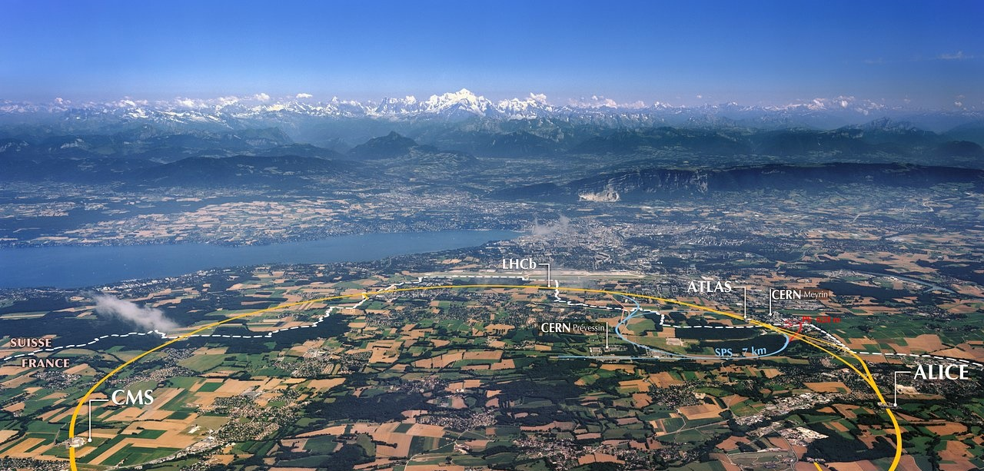
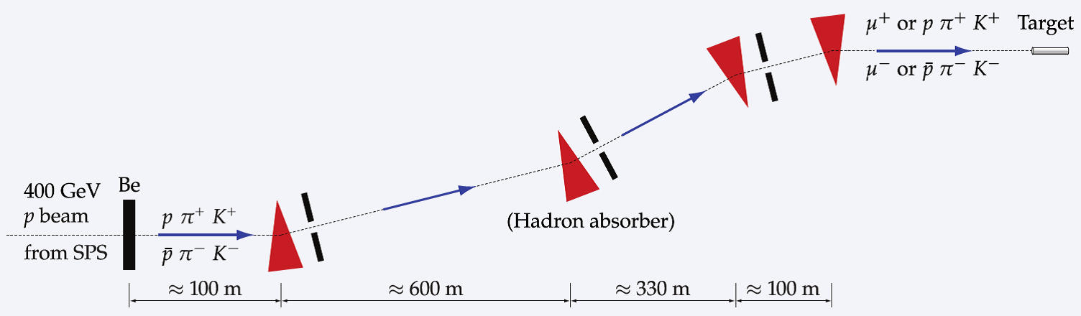
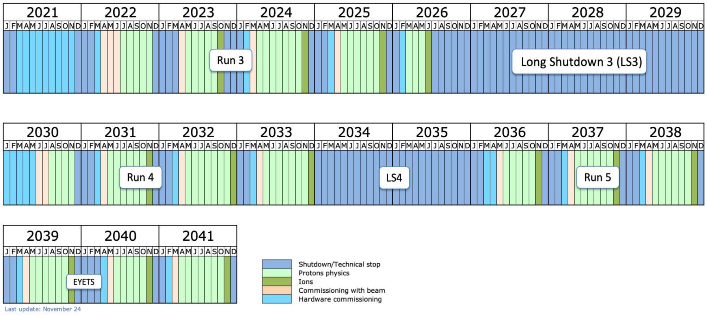
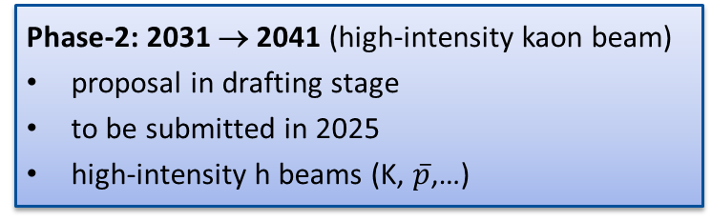
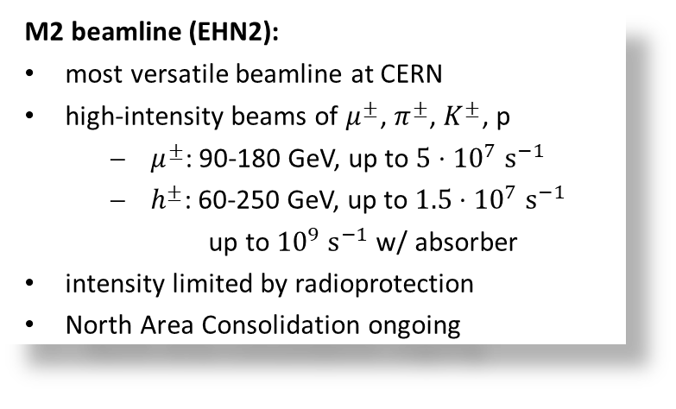
AMBER @ CERN SPS
M2 beamline (EHN2):
most versatile beamline at CERN
high-intensity beams of $μ^{±}$, $π^{±}$, $K^{±}$, p
  $μ^{±}$: 90-180 GeV, up to $5⋅{10}^{7} s^{−1}$
  $h^{±}$: 60-250 GeV, up to $1.5⋅{10}^{7} s^{−1}$
  up to ${10}^{9} s^{−1}$ w/ absorber
intensity limited by radioprotection
North Area Consolidation ongoing
Phase-1: 2023 → 2031 (conventional beams)
approved by CERN RB in 2020
conventional h/μ beams
Phase-2: 2031 → 2041 (high-intensity kaon beam)
proposal in drafting stage
to be submitted in 2025
high-intensity h beams (K, $\overline{p}$,…)

Slide 16
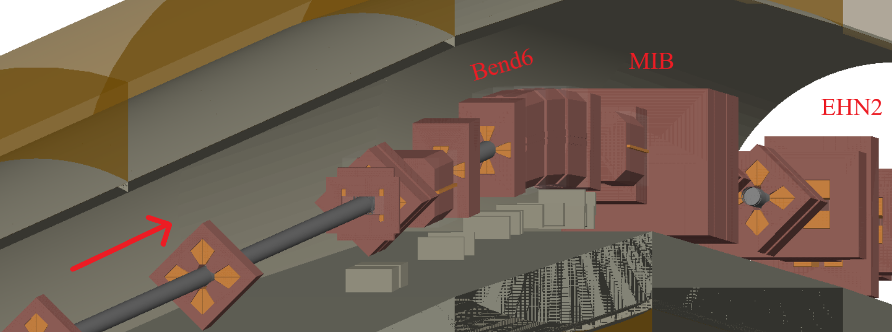
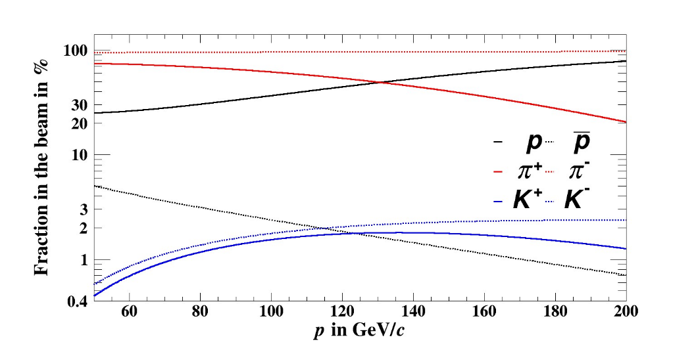
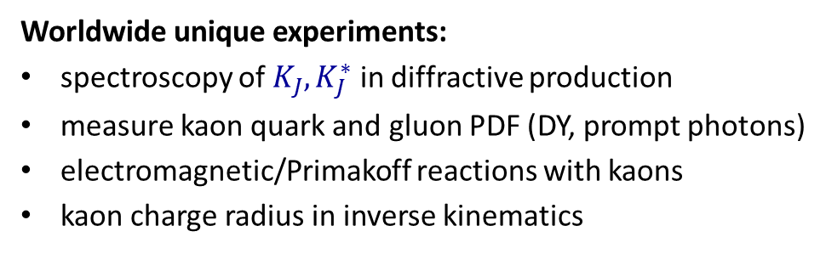
High-Intensity Kaon Beam for Phase-2
Worldwide unique experiments:
spectroscopy of $K_{J}, K_{J}^{∗}$ in diffractive production
measure kaon quark and gluon PDF (DY, prompt photons)
electromagnetic/Primakoff reactions with kaons
kaon charge radius in inverse kinematics
Requirements:
Highest possible intensity of K in secondary beam
complete beam-line vacuum: remove 100m air sections, except XTAX (5m), replace wire chambers by SciFi (XBPF)
improve transport: reduce beam divergence at CEDARs
High-efficiency / high-purity beam particle identification
  reduce beam momentum, choose positive polarity
Atherton parameterization

Slide 17
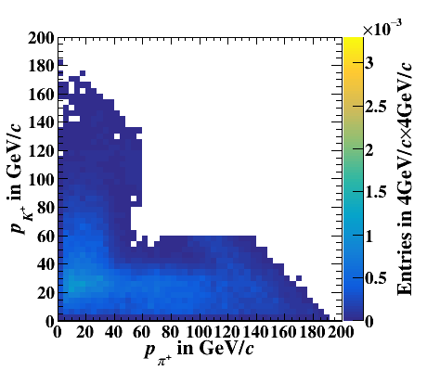
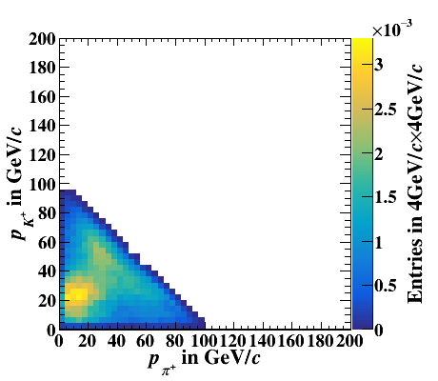


High-Intensity Kaon Beam for Phase-2
Worldwide unique experiments:
spectroscopy of $K_{J}, K_{J}^{∗}$ in diffractive production
measure kaon quark and gluon PDF (DY, prompt photons)
electromagnetic/Primakoff reactions with kaons
kaon charge radius in inverse kinematics
$$190 GeV/c$$
Requirements:
Highest possible intensity of K in secondary beam
complete beam-line vacuum: remove 100m air sections, except XTAX (5m), replace wire chambers by SciFi (XBPF)
improve transport: reduce beam divergence at CEDARs
$$100 GeV/c$$
High-efficiency / high-purity beam particle identification
  reduce beam momentum, choose positive polarity
Close acceptance hole in final-state PID
  ⇒ reduce beam momentum, extend RICH acceptance

Slide 18
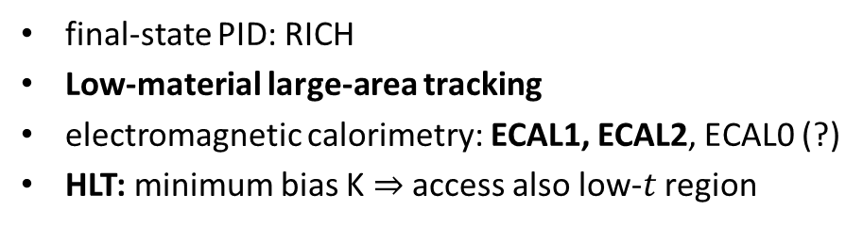

AMBER Experimental Setup for Spectroscopy
Beam: $π$, K, (e)
Target region: program-specific
Spectrometer: common for all measurements
beam line upgrade for high-intensity K beam
Target: 40 cm lH
Recoil Proton Detector
Beam + vertex tracking
final-state PID: RICH
Low-material large-area tracking
electromagnetic calorimetry: ECAL1, ECAL2, ECAL0 (?)
HLT: minimum bias K $⇒$ access also low-$t$ region

Slide 19

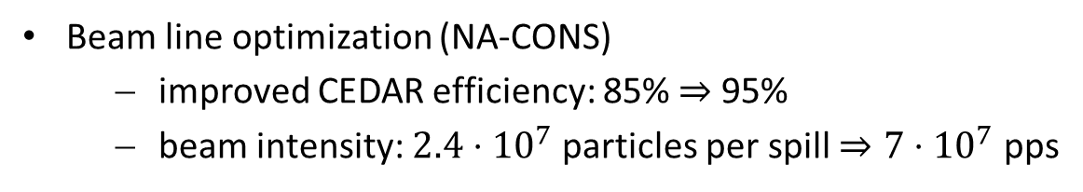

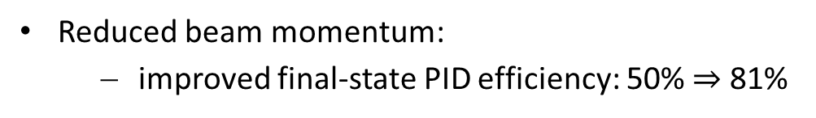
Projections (Preliminary)
Goal: record 20 M $K^{+}π^{−}π^{−}$ events
Beam line optimization (NA-CONS)
  improved CEDAR efficiency: 85% $⇒$ 95%
  beam intensity: $2.4⋅{10}^{7}$ particles per spill $⇒7⋅{10}^{7}$ pps
Reduced beam momentum:
  improved final-state PID efficiency: 50% $⇒$ 81%
Luminosity for K with 40cm lH2 target: $ℒ=1.24⋅{10}^{30} cm^{−2}spi{ll}^{−1}$
$⇒200$ days á 3000 spills (4.8 s) per day
Cross section for diffractive production of $Kππ$: $σ_{Kππ}=250 μb$
⇒ we can record 20 M $K^{+}π^{−}π^{−}$ events in about 2 yrs

Slide 20
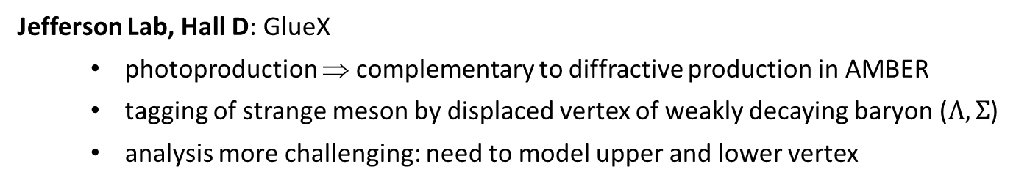
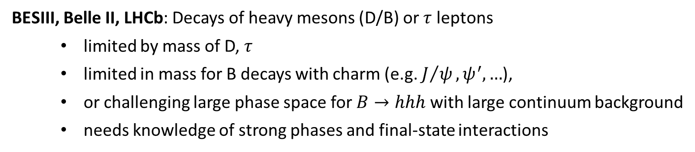
Worldwide Competition
BESIII, Belle II, LHCb: Decays of heavy mesons (D/B) or $τ$ leptons
  limited by mass of D, $τ$
  limited in mass for B decays with charm (e.g. $J/ψ, ψ^{′}, …$),
  or challenging large phase space for $B→hhh$ with large continuum background
  needs knowledge of strong phases and final-state interactions
Jefferson Lab, Hall D: GlueX
  photoproduction ⇒ complementary to diffractive production in AMBER
  tagging of strange meson by displaced vertex of weakly decaying baryon ($Λ, Σ$)
  analysis more challenging: need to model upper and lower vertex

Slide 21
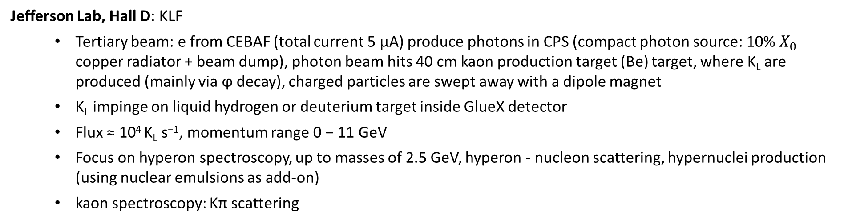
Worldwide Competition
Jefferson Lab, Hall D: KLF
  Tertiary beam: e from CEBAF (total current 5 μA) produce photons in CPS (compact photon source: 10% $X_{0}$ copper radiator + beam dump), photon beam hits 40 cm kaon production target (Be) target, where K_{L} are produced (mainly via ϕ decay), charged particles are swept away with a dipole magnet
  K_{L} impinge on liquid hydrogen or deuterium target inside GlueX detector
  Flux ≈ 10⁴ K_{L} s⁻¹, momentum range 0 − 11 GeV
  Focus on hyperon spectroscopy, up to masses of 2.5 GeV, hyperon - nucleon scattering, hypernuclei production (using nuclear emulsions as add-on)
  kaon spectroscopy: Kπ scattering
[M. Amaryan, https://arxiv.org/abs/2008.08215]

Slide 22
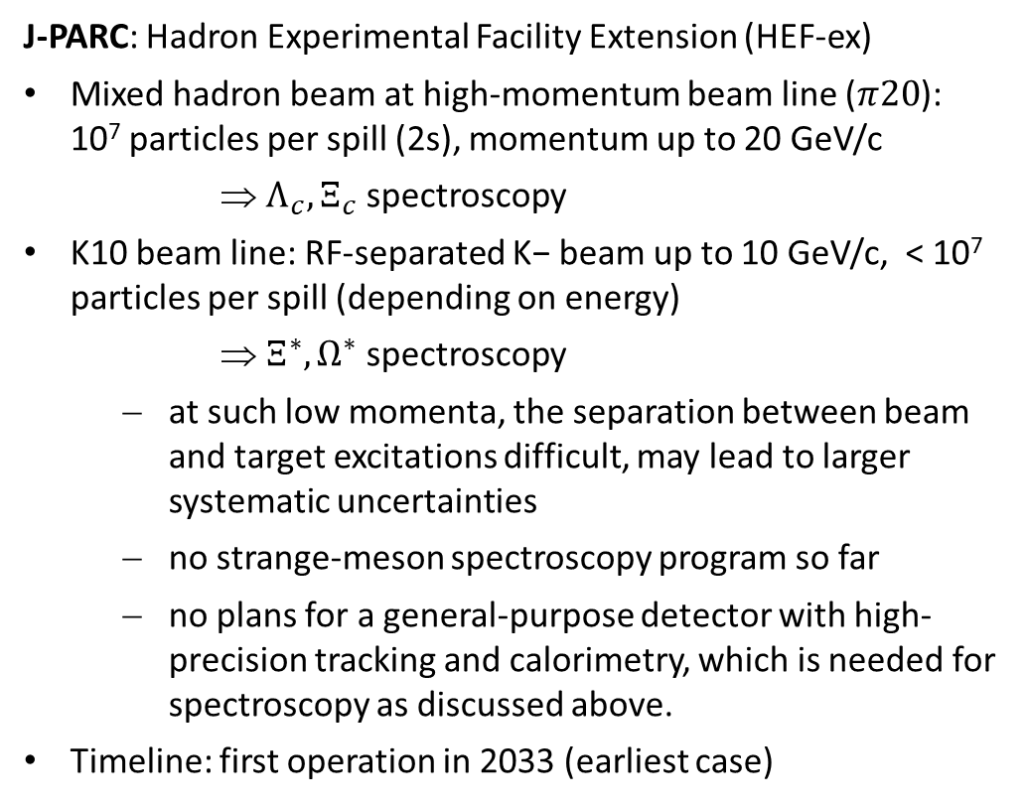
Worldwide Competition
J-PARC: Hadron Experimental Facility Extension (HEF-ex)
Mixed hadron beam at high-momentum beam line ($π20$): 10⁷ particles per spill (2s), momentum up to 20 GeV/c
⇒ $Λ_{c}, Ξ_{c}$ spectroscopy
K10 beam line: RF-separated K− beam up to 10 GeV/c, < 10⁷ particles per spill (depending on energy)
⇒ $Ξ^{∗}, Ω^{∗}$ spectroscopy
  at such low momenta, the separation between beam and target excitations difficult, may lead to larger systematic uncertainties
  no strange-meson spectroscopy program so far
  no plans for a general-purpose detector with high-precision tracking and calorimetry, which is needed for spectroscopy as discussed above.
Timeline: first operation in 2033 (earliest case)
[Hitoshi Takahashi, HADRON 2025, Osaka, Japan]

Slide 23
Conclusions
NA66/AMBER is a new and unique facility at CERN dedicated to study fundamental questions related to the emergence of hadron properties from QCD with high-energy hadron and muon beams
Phase-1: started in 2023
Phase-2: measurements with high-intensity hadron/K beam
  Comprehensive program to strange meson spectroscopy
  Analysis tools are in our hands, expect further progress
  Re-write strange meson section of PDG
  Kaon and pion gluon PDFs, Primakoff reactions, charge radii
Opportunities for cooperation:
  Important contributions to instrumentation & software: tracking, calorimetry, PID, DAQ, reconstruction
  Shaping physics program for Phase-2

