Slide 1

Rucio WebUI
My internship report
Notes:
First of all, I would like to thank you all for giving me the opportunity to present my work today. My name is Viktoriia. I am an undergraduate student from Ukraine with major in software engineering and experience in full-stack development. During my 3 month internship here, I have been working on the new generation of the web user interface for the Rucio communities.
I hope to prove myself as a worthy addition to the contributors as I would like to continue helping enhance the WebUI even after my internship concludes. I’m looking forward to working more closely with the rest of the team and am eager to receive any feedback or suggestions you may have.
[Here I thank you :)]

Slide 2
01
Defining issues

Slide 3
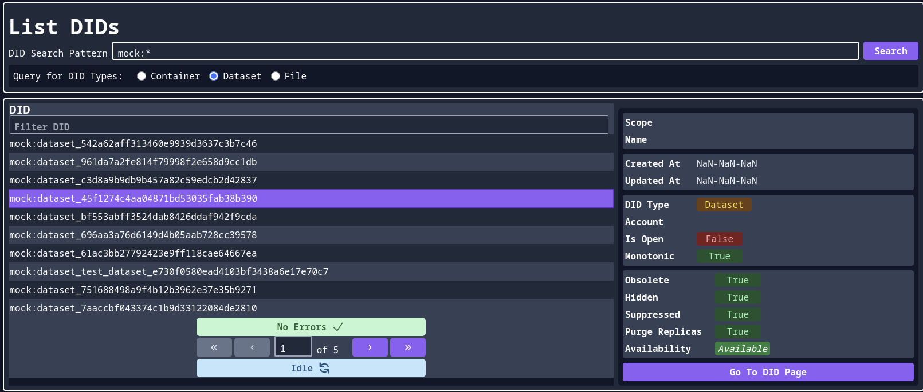
DIDs undefined details
Notes:
First and foremost, some of the UI components weren’t properly connected to the API endpoints. This lead to several features not being functional.
For example, details could not be viewed for the DIDs, as some of the properties came out undefined.

Slide 4
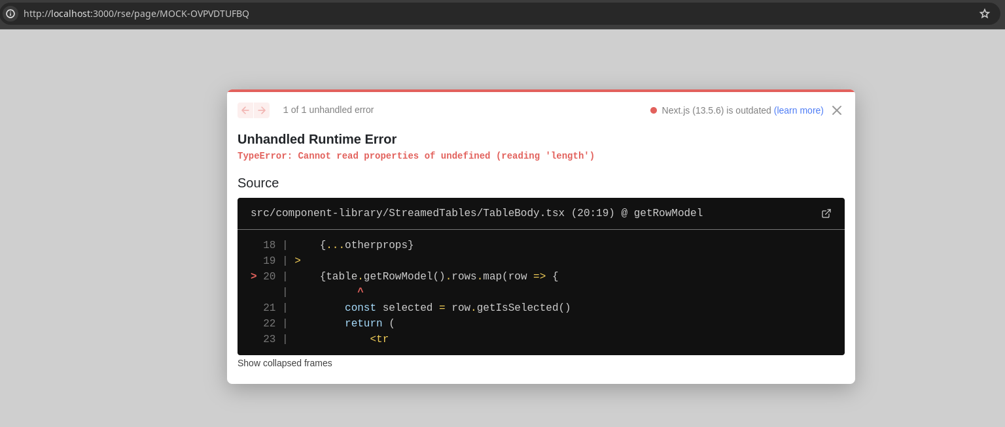
RSEs details loading error
Notes:
Certain pages couldn’t be loaded because of errors, such as the details of RSEs

Slide 5
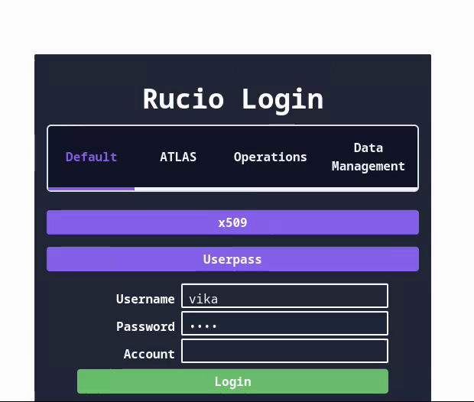
Login failing for identities with multiple accounts
Notes:
Identities with multiple accounts couldn’t log in without specifiying the account, as picking them from a list wasn’t implemented yet.

Slide 6
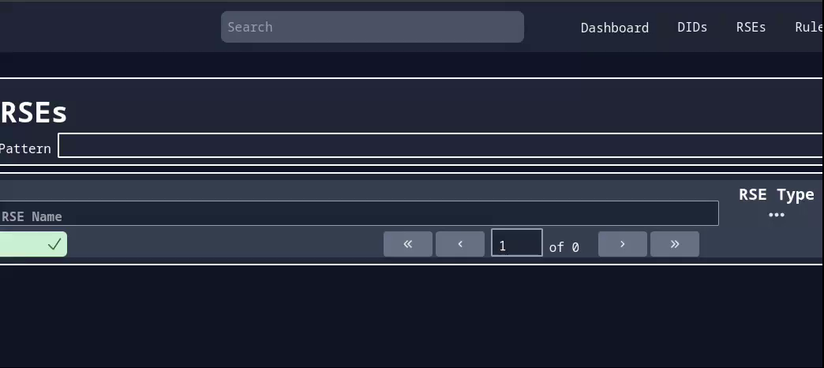
Searchbar not functioning
Notes:
The same was the case with the searchbar, which didn’t lead to any endpoints and didn’t implement smart resolution of the query

Slide 7
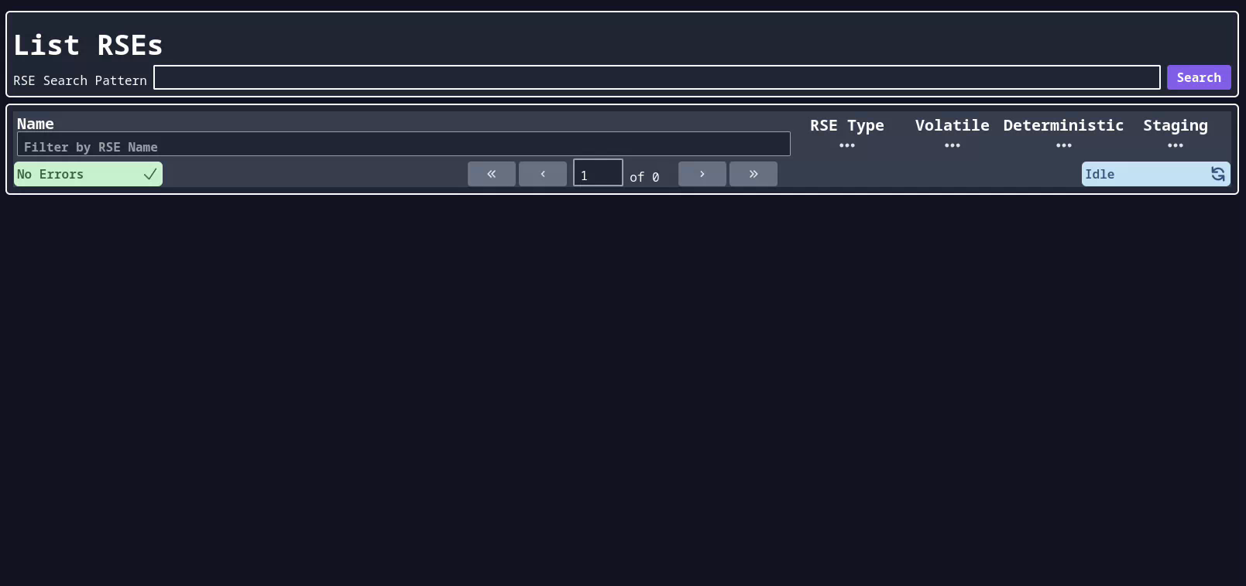
Streaming constraints
Notes:
Secondly, there were huge constraints to the streaming speed. Besides that, some entries produced errors, which indicated some issue with parsing data chunks.

Slide 8
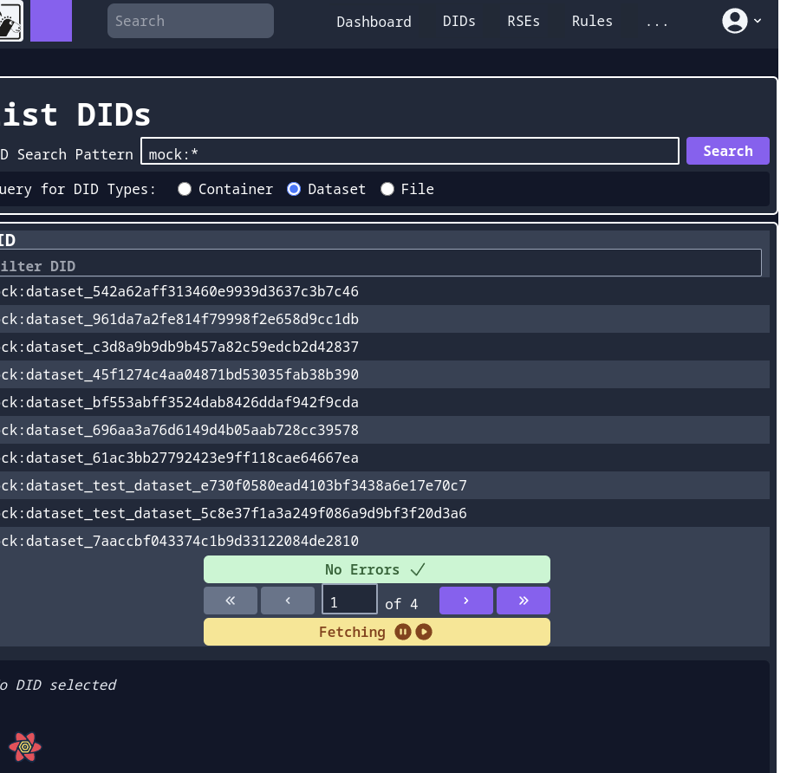
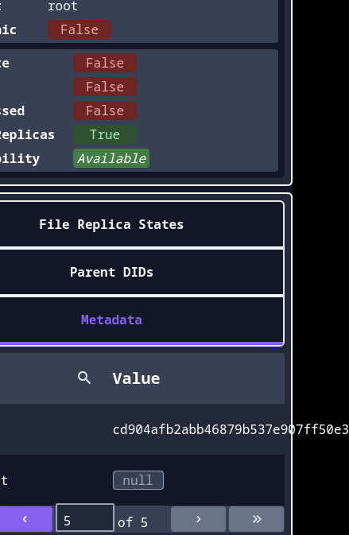
Responsiveness issues
Notes:
Thirdly, some problems were evident with page responsiveness and display of certain values. Some elements of the interface were prone to overflowing.
Finally, when I first started working on the code, I noticed there were areas that could benefit from some refactoring to improve maintainability and scalability. I know every project has room to grow, and the foundation that was already in place gave me a great starting point to build on.

Slide 9
02
My contribution

Slide 10
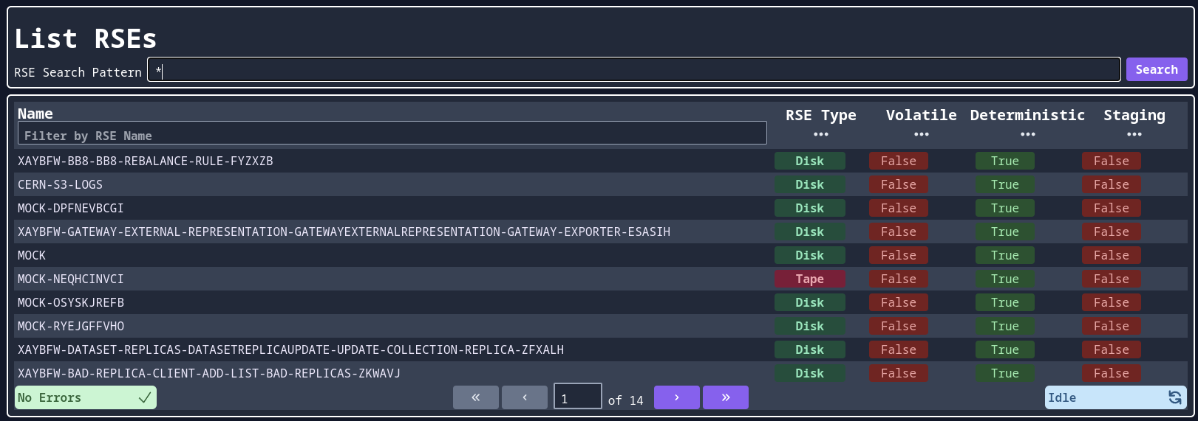
Parsing issue
Notes:
I started with fixing all of the failing features and removing mocks where possible.
Firstly, I found a root of the parsing errors and missing entities during streaming. A change in handlng chunks got rid of this issue.

Slide 11
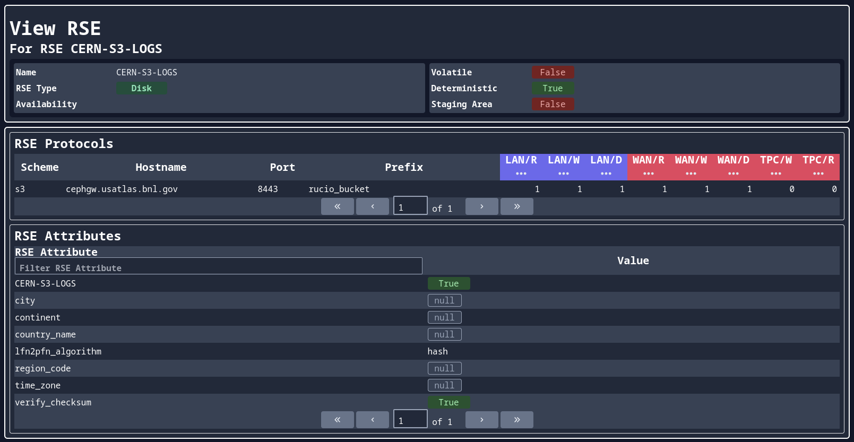
Functional RSEs details
Notes:
The errors on the detailed view of the RSEs were handled. This page got populated with real data instead of mocks.

Slide 12
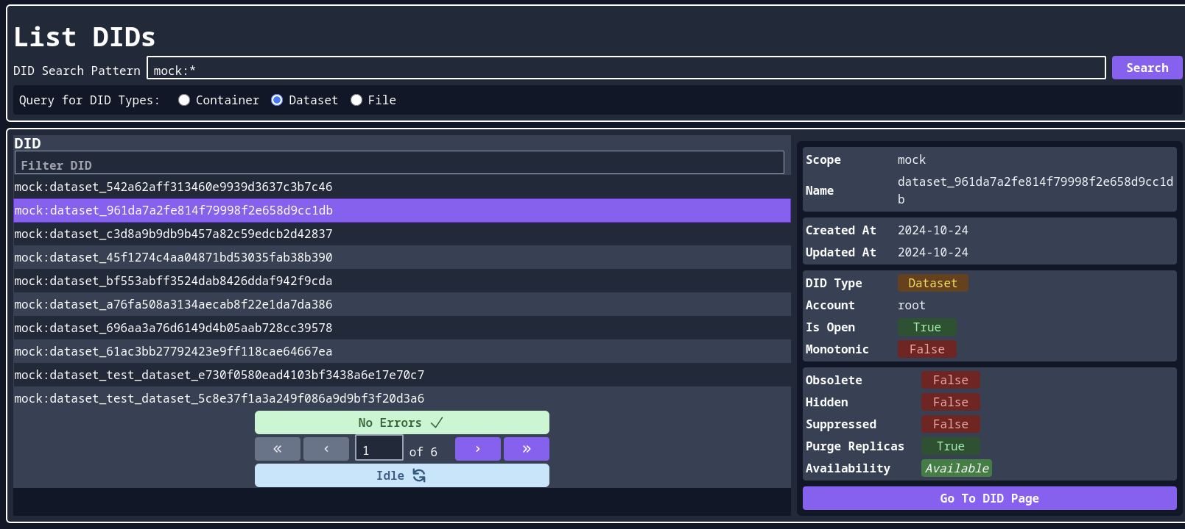
Functional DIDs details
Notes:
Same fixes for the communication with endpoints were applied to DIDs. This made viewing the details possible.

Slide 13
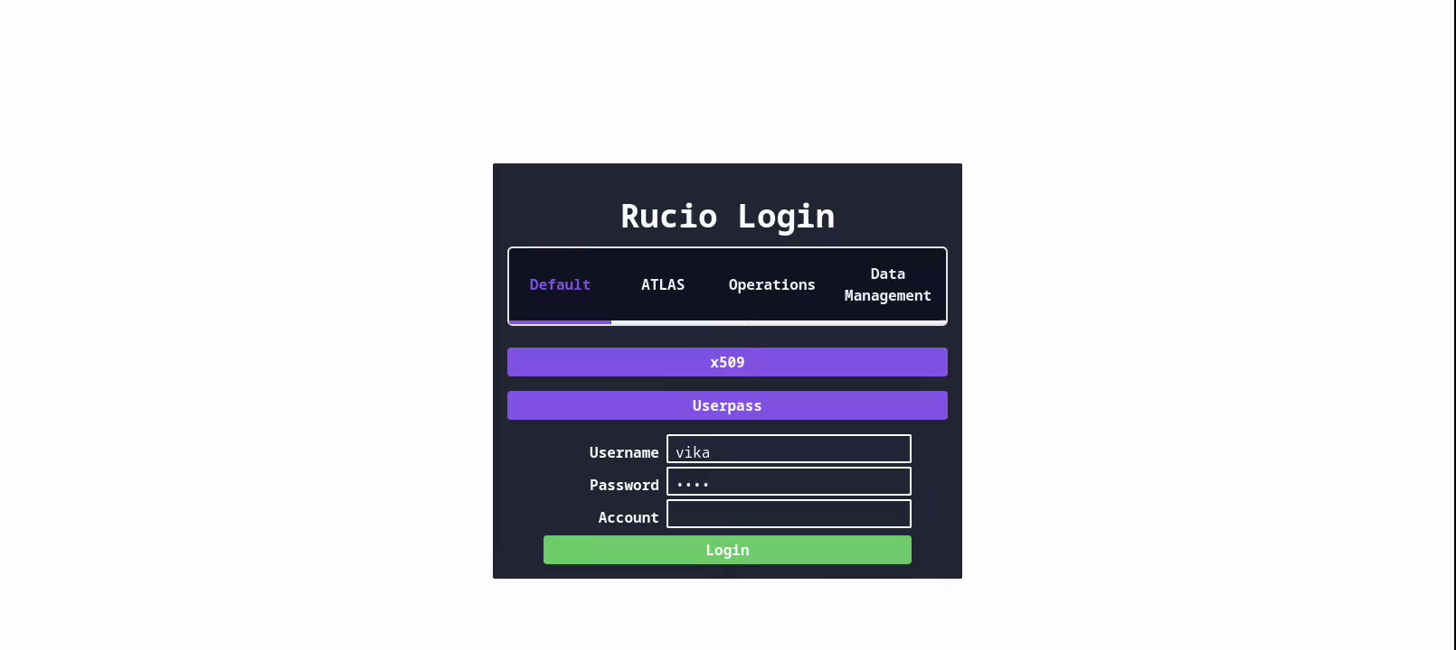
Login with account choice
Notes:
Identities with multiple accounts became able to view a popup with a list to choose from.
Along with this, I addressed issues regarding caching on the framework and ensured proper logout and account switching.

Slide 14
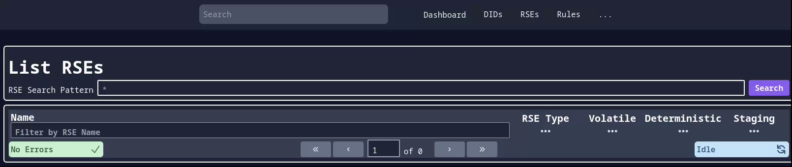
Smart searchbar
Notes:
The searchbar was connected to the endpoints, had interaction with arrows implemented, and smart resolution of the query type implemented.

Slide 15
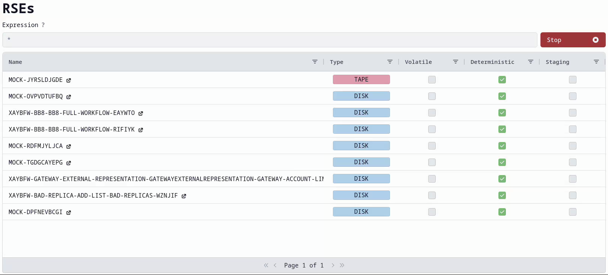
Streaming optimization
Notes:
From here on, after discussions with Mayank, I started building the UI components from scratch to ensure their reliability and maintainability. The present unit tests had to be temporarily replaced with setups for manual testing in Storybooks, covering more cases. There is a plan to incorporate automation soon.
Using the mechanisms under the current streaming mechanism, I began building a more robust version from scratch. My idea was to start extremely small and evaluate the performance after each little change. The first version presented streaming on the main thread of the browser and was extensively covered by unit tests. Then, after thorough evaluation, it became evident that rapid streaming may cause intense lagging with this approach.
So I returned to the web worker idea, changed the method of thread communication and state management. This led to an exciting increase in performance and much more reliable updates of the state.

Slide 16
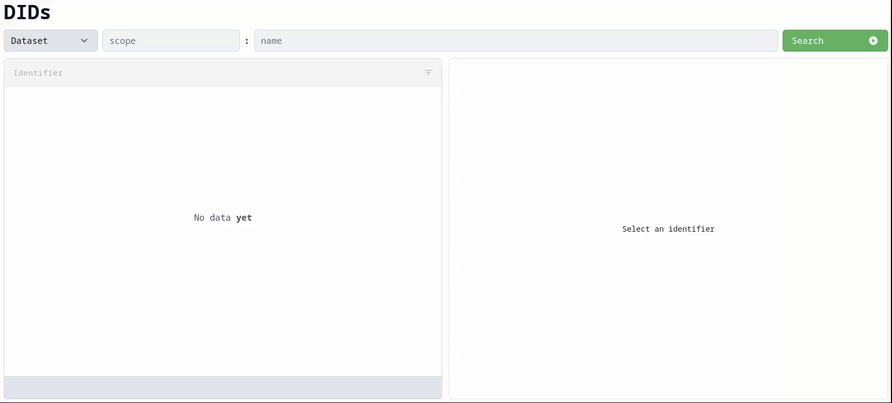
Streaming optimization
Notes:
From here on, after discussions with Mayank, I started building the UI components from scratch to ensure their reliability and maintainability. The present unit tests had to be temporarily replaced with setups for manual testing in Storybooks, covering more cases. There is a plan to incorporate automation soon.
Using the mechanisms under the current streaming mechanism, I began building a more robust version from scratch. My idea was to start extremely small and evaluate the performance after each little change. The first version presented streaming on the main thread of the browser and was extensively covered by unit tests. Then, after thorough evaluation, it became evident that rapid streaming may cause intense lagging with this approach.
So I returned to the web worker idea, changed the method of thread communication and state management. This led to an exciting increase in performance and much more reliable updates of the state.
To handle large amounts of data without lagging, throttling was set in place with adjustable properties. The default ones were chosen for optimal performance.

Slide 17
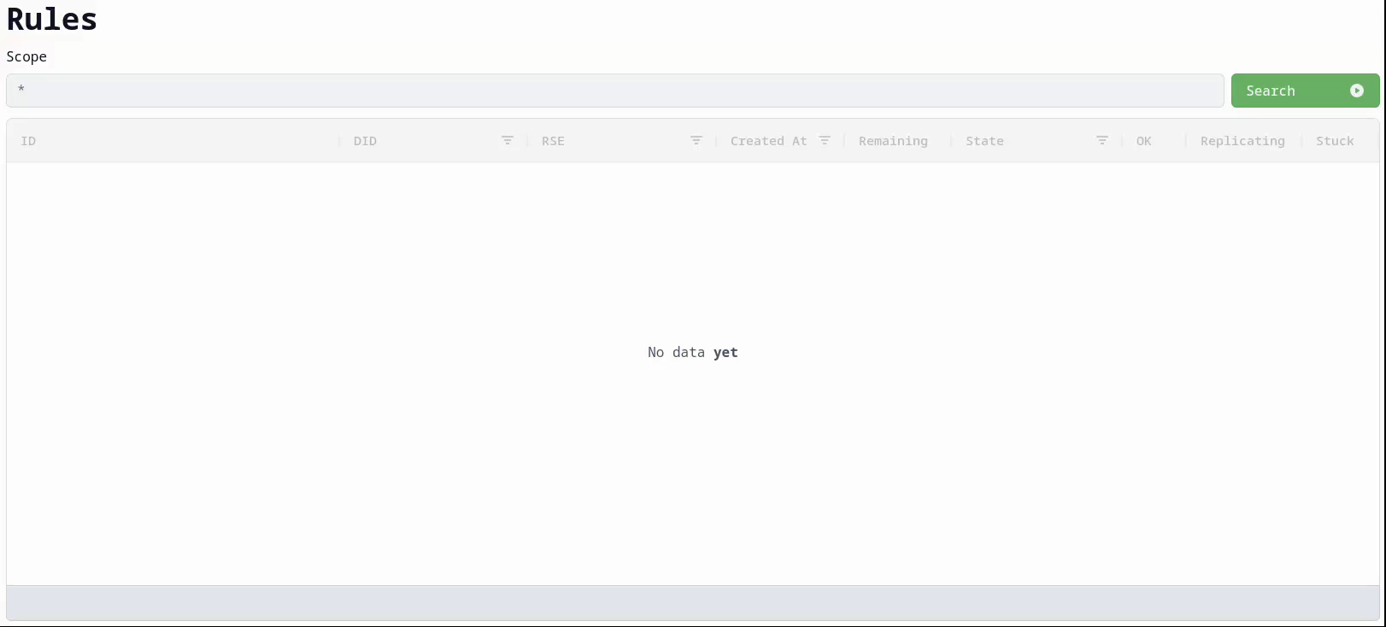
Streaming optimization
Notes:
From here on, after discussions with Mayank, I started building the UI components from scratch to ensure their reliability and maintainability. The present unit tests had to be temporarily replaced with setups for manual testing in Storybooks, covering more cases. There is a plan to incorporate automation soon.
Using the mechanisms under the current streaming mechanism, I began building a more robust version from scratch. My idea was to start extremely small and evaluate the performance after each little change. The first version presented streaming on the main thread of the browser and was extensively covered by unit tests. Then, after thorough evaluation, it became evident that rapid streaming may cause intense lagging with this approach.
So I returned to the web worker idea, changed the method of thread communication and state management. This led to an exciting increase in performance and much more reliable updates of the state.
To handle large amounts of data without lagging, throttling was set in place with adjustable properties. The default ones were chosen for optimal performance.

Slide 18
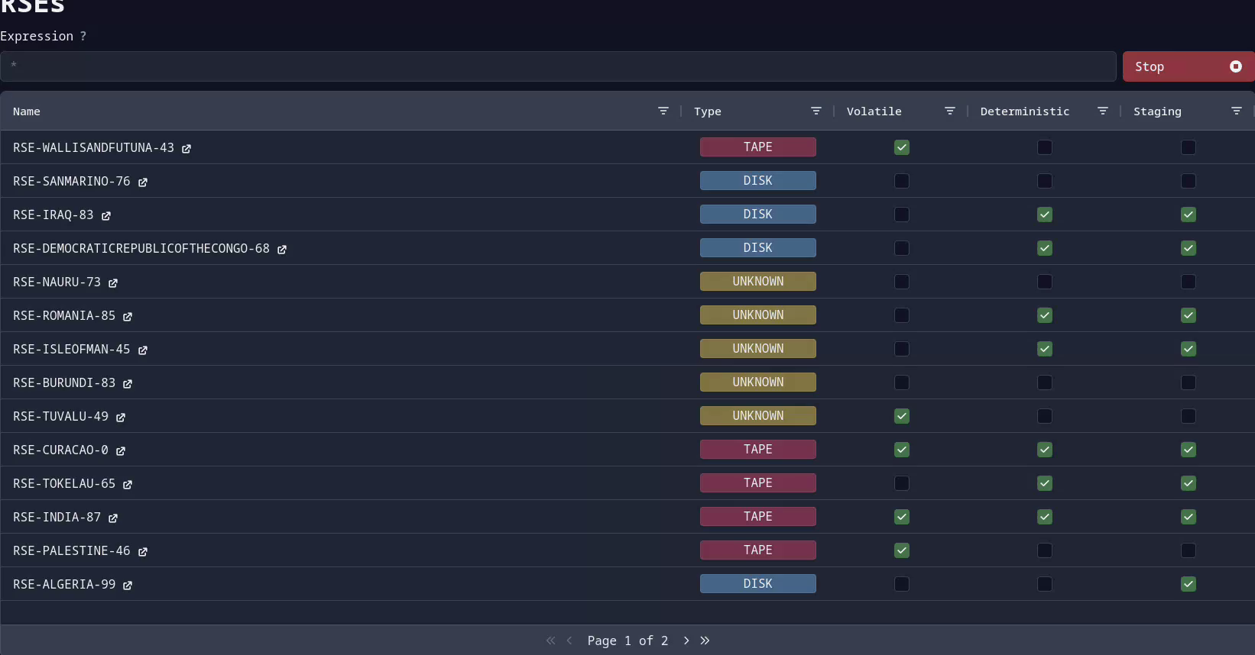
Loading 100k entries
Notes:
At max, I tested the performance with 1 million entries using a mock server, and, even though the performance wasn’t optimal, there was no blocking to the UI thread. The storybooks contain a 100,000 entries example, which performs extremely well. This is still a matter of testing and improvement, but the current streaming mechanism might be enough for a regular user.
So, the main list pages of the application all got reworked.

Slide 19
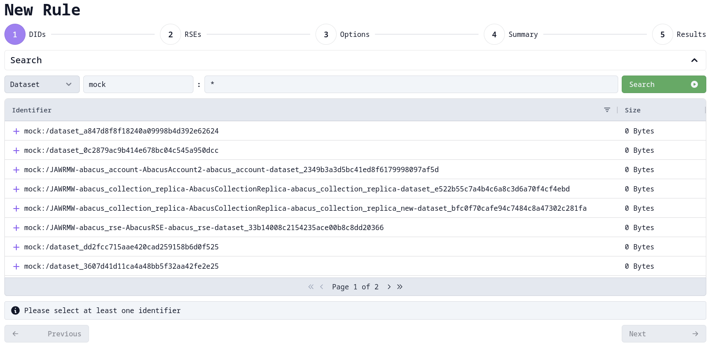
Rule creation
Notes:
The rule creation was made fully functional, with the new streaming mechanism in place and all the steps reworked. It is currently connected to the rucio server and contains all the features of the old UI. Some changes are coming which will make it adjustible for all the Rucio communities.

Slide 20
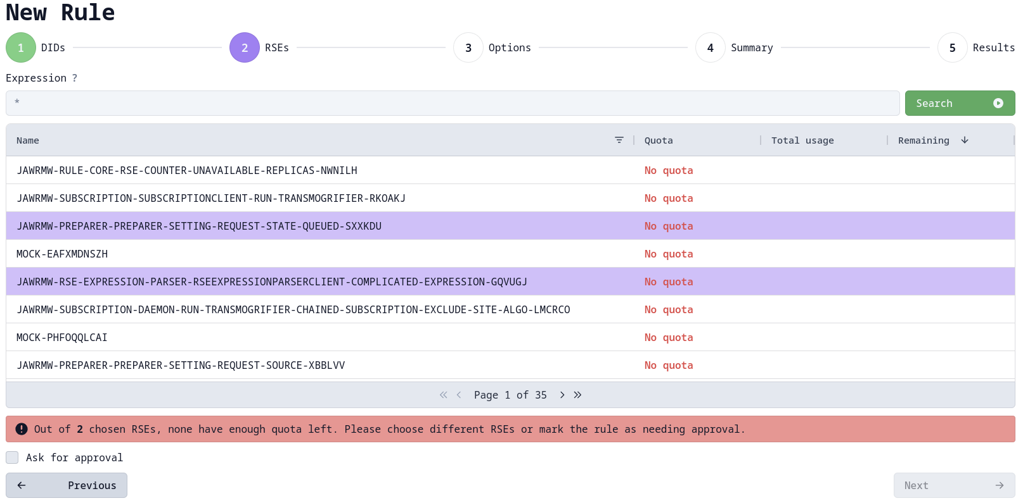
Rule creation
Notes:
The rule creation was made fully functional, with the new streaming mechanism in place and all the steps reworked. It is currently connected to the rucio server and contains all the features of the old UI. Some changes are coming which will make it adjustible for all the Rucio communities.

Slide 21
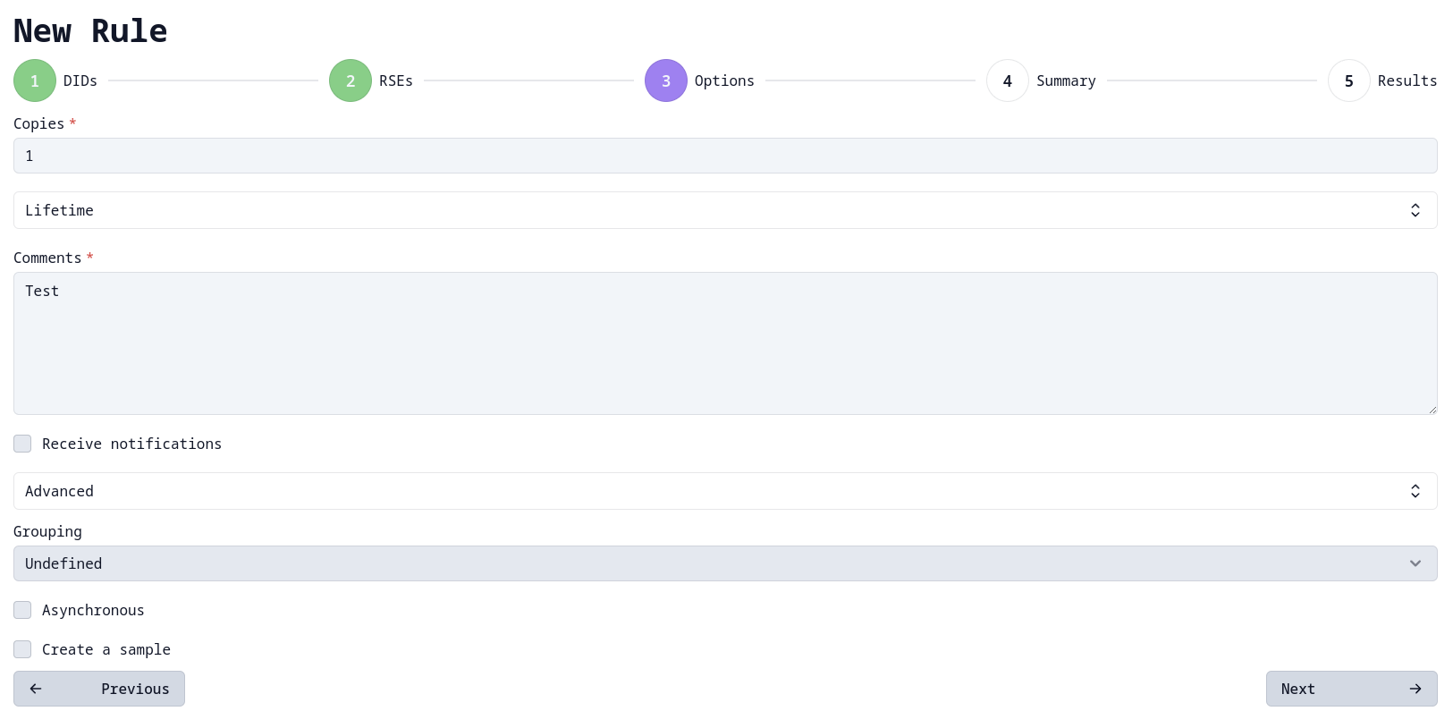
Rule creation
Notes:
The rule creation was made fully functional, with the new streaming mechanism in place and all the steps reworked. It is currently connected to the rucio server and contains all the features of the old UI. Some changes are coming which will make it adjustible for all the Rucio communities.

Slide 22
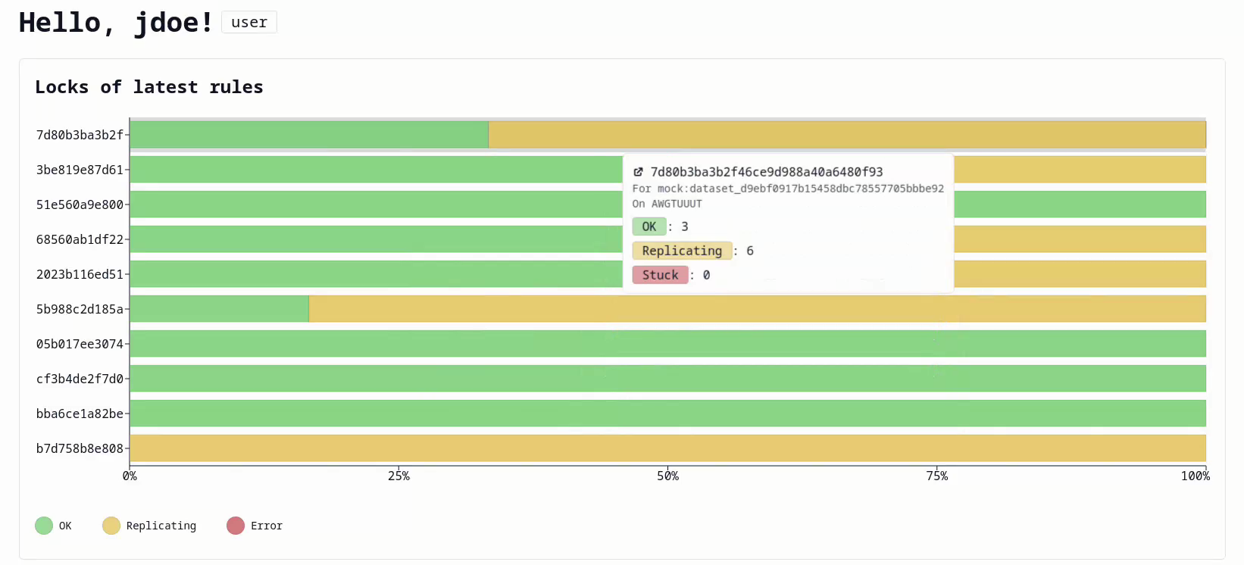
Dashboard
Notes:
Last but not least is the Dashboard, which displays charts with real data. Currently two widgets are implemented – the latest rules and top used RSEs.

Slide 23
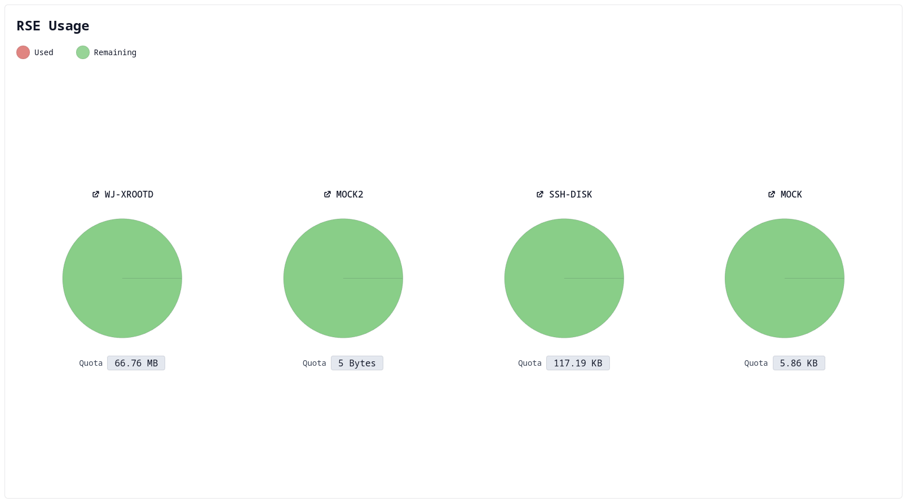
Dashboard
Notes:
Last but not least is the Dashboard, which displays charts with real data. Currently two widgets are implemented – the latest rules and top used RSEs.

Slide 24
03
What’s next?

Slide 25
- Extensive test coverage
- Reworking the rest of the views (coming soon!)
- Adjusting for different Rucio communities
- Adjusting for different browsers
- Refining the visual integrity
- Focusing on client/server component architecture for performance benefits
Notes:
Moreover, the current third-party implementation of the table doesn’t seem to perform perfectly well at all cases. My (very ambitious) thesis will focus on developing a solution for tabular display of huge sets of data. It will sure give me ideas for optimizing the this user interface!

Slide 26
Thank you!
Notes:
Thank you all for taking the time to listen to my presentation today. Please feel free to reach out if you have any questions or suggestions.

