Slide 1
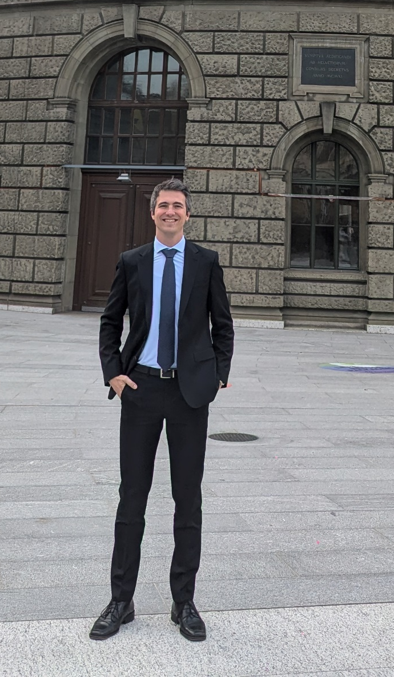
Self Introduction
Lukas Breitwieser
SFT Group Meeting
December 2, 2024

Slide 2
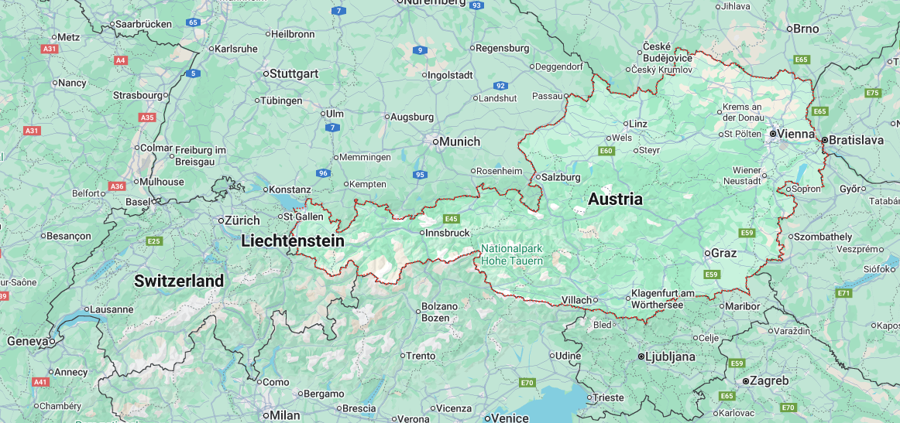

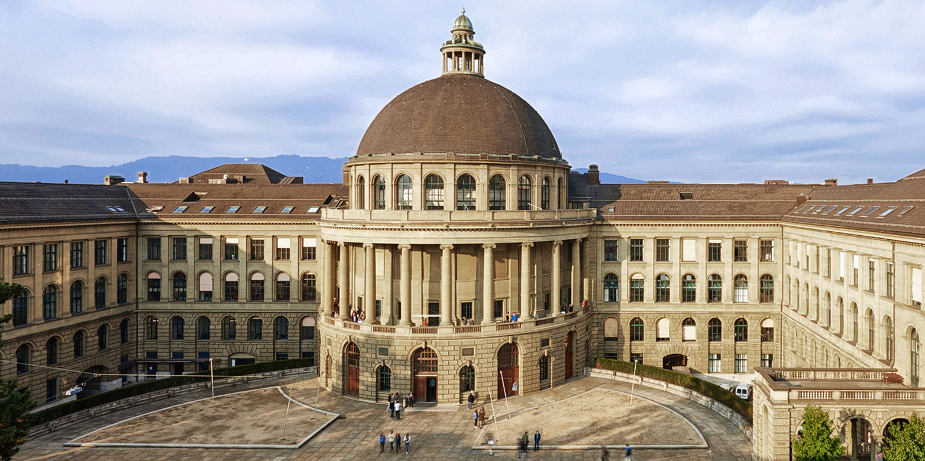
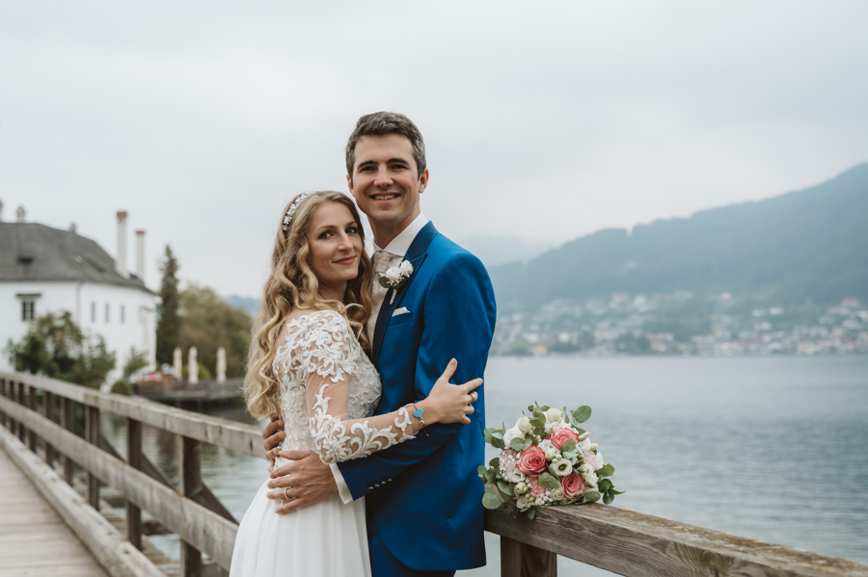
About Me
I am from Austria
Studied
  Medicine (did not complete)
  Master in Software Engineering and
  Business Management
Joined CERN openlab (IT) as a summer student in 2015
  and never left
  Agent-Based Simulation: BioDynaMo
PhD in CS at ETH Zurich
  BioDynaMo project
  Parallel, distributed, high-performance, and heterogeneous computing; computational biology/X
Joined SFT as a guest
Met my wife indirectly through CERN/SFT
Hobbies
  Road biking, running, swimming, skiing, hiking,
  and would like to try wing foiling

Slide 3
BioDynaMo in a Nutshell
We address two key issues of agent-based modeling
inflexible software design
low performance
by designing an agent-based simulation platform from the ground up to be high-performance, scalable, and modular
1
thereby enabling
larger and more complex simulations
faster iterative development
more extensive parameter exploration
2
significantly improving adoption
Notes:
In summary,
CLICK We address two key issues of agent-based modeling:
Which are Inflexible design and low performance
CLICK by designing …
CLICK thereby enabling
CLICK and

Slide 4
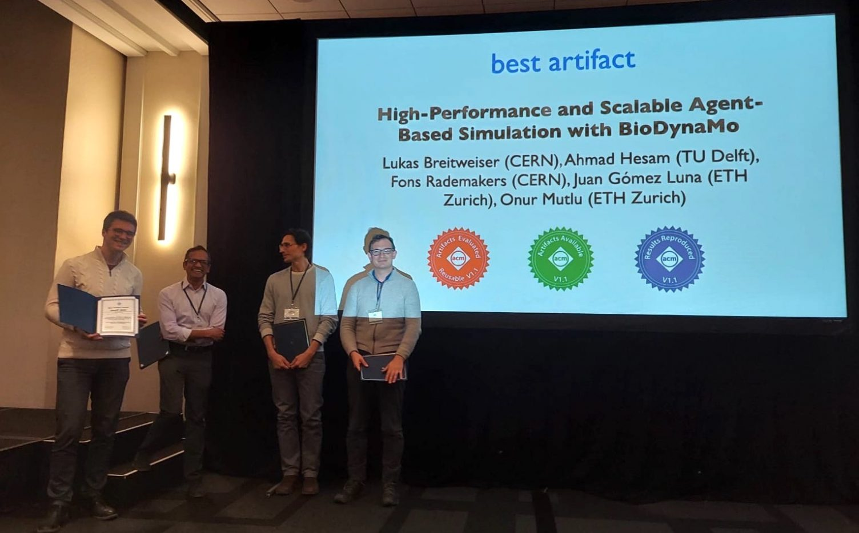
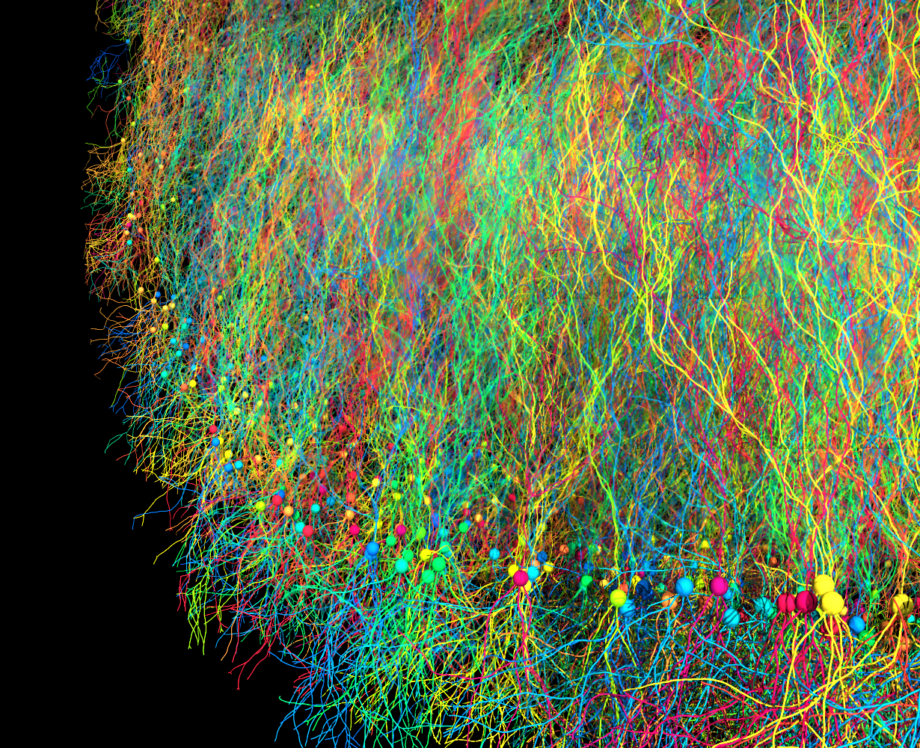
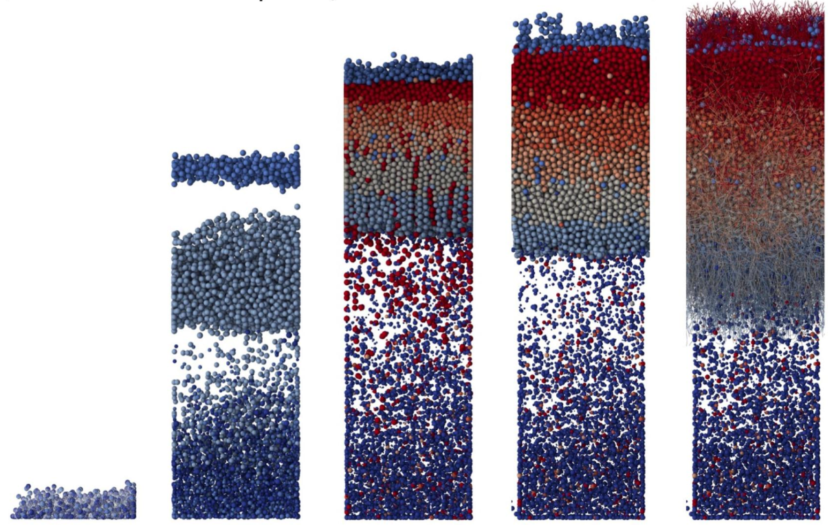
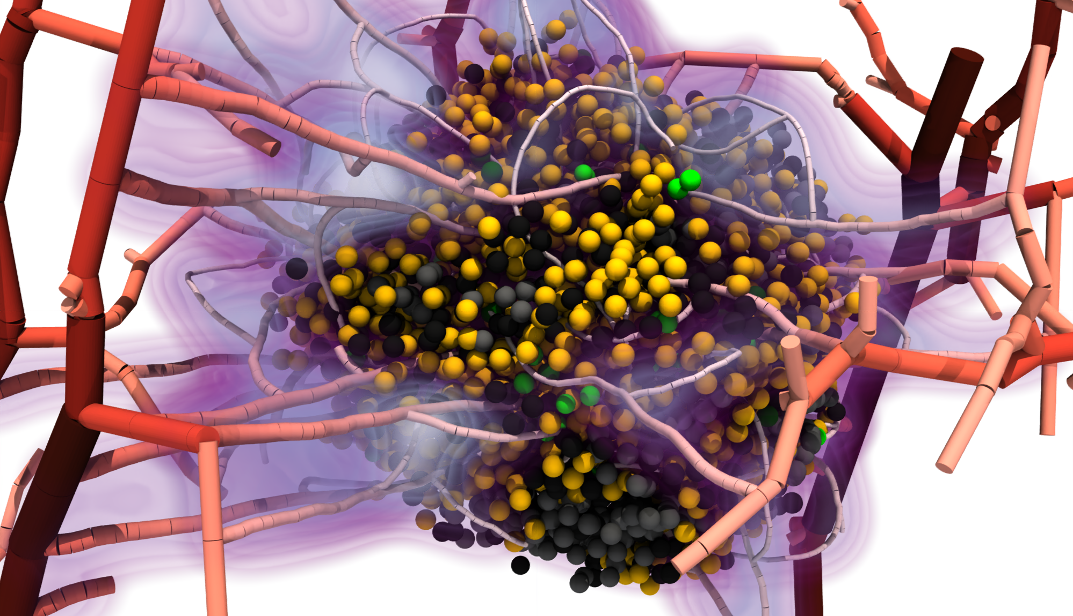
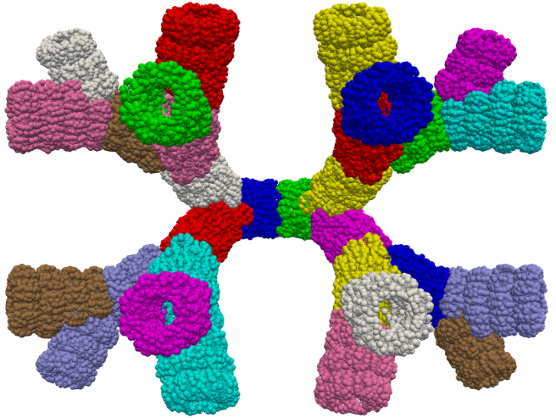
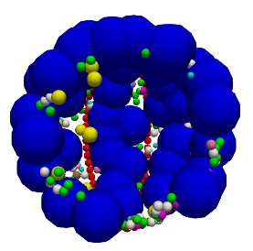
BioDynaMo Results
500 billion
agents
on 84096 CPU cores
Alveolus
References: https://doi.org/10.1145/3572848.3577480, https://doi.org/10.1093/bioinformatics/btab649,
https://doi.org/10.1080/15384047.2024.2344600, https://doi.org/10.1016/j.cma.2023.116566,
https://www.nature.com/articles/s43856-024-00442-w

Slide 5

My Future Contributions in SFT
Contract: 2 year Quest
Supervisor: Jonas Rembser
Tasks:
EP R&D: GPU Histogramming
Enabling CUDA support for ROOT’s cling version
Universal Histogram Interface
…

Slide 6




Thank You and Let’s Connect …
Lukas.Breitwieser@cern.ch
32/RC-13
https://linkedin.com/in/LukasBreitwieser
… and go for an early lunch together

