Slide 1
Other FCC Science Applications & FCC-ee booster as a light source
Frank Zimmermann, 24 September 2024

Slide 2
History: studies of other FCC science applications
14 May 2013 brainstorming meeting on LHC as a light source organized by Herman Winick.
Attendees: Yunhai Cai, Alan Fisher, Bob Hettel, Claudio Pellegrini, Tom Rabedeau, John Seeman, Jim Sebek, Gennady Stupakov, Kai Tian. “Herman Winick Winick called this meeting after having discussions with Albert Hofmann and Frank Zimmermann, who pointed out that LHC provided soft x-ray beams that might exceed the performance of existing electron storage ring light sources, and that this might be extended to harder x-rays from future proton rings”; Followed by discussion on HE-LHC, VHE-LHC (FCC-hh) & TLEP (FCC-ee) as light sources.
Brainstorming in July 2020 on R1 outside terasse (covid!): Michael Benedikt, Sara Casalbuoni (EU-XFEL, remote), Michael Doser, Frank Zimmermann; identified 7 applications: 1.1 FCC-LS : The world’s most powerful light source for very hard X-rays 1.2 FCC-CBS: 3-5 orders of magnitude more flux and higher photon energy than ELI-NP; 2.1 Positron source for material research; 2.2 Testbed for LEMMA muon collider; 2.3 Plasma acceleration of positrons; 2.4 Non-perturbative QED Experiments – proving the boiling of the QED vacuum ; 2.5 Positronium-based GeV photon source – a speculative proposal ; Documented in M. Benedikt, F. Zimmermann, M. Doser, S. Casalbuoni: 10.5281/zenodo.7675663
Other FCC Science Initiative (also in view of ESU), kick off brainstorm 23 August 2024. In person: Gianluigi Arduini, Hannes Bartosik, Michael Benedikt, Christoph Grojean, Patrick Janot, Yannis Papaphilippou, Guy Wilkinson, Frank Zimmermann; Remote: Emanuele Bagnaschi , Giovanni Cantatore, Sara Casalbuoni, David d’Enterria, Armin Ilg, Richard Jacobsson, Joerg Jaeckel, Witek Krasny, Sakura Pascarelli, Benjamin Rienäcker, Ivo Schulthess, Alessandro Variola, Matthew Wing; https://indico.cern.ch/event/1442918/
Recent communications: Atoosa Meseck on Compton source; Marco Calviani & Charlotte Duchemin on use of beamstrahlung photons and on radionuclide production Witek Krasny – comprehensive notes from, and comments on, the kickoff meeting

Slide 3
Proposed next steps
4 working groups
photon science (light source, CBS)
- S. Casalbuoni, F. Zimmermann, + ?
HEP applications (QED, dark sector, )
- G. Arduini + ?
e⁺ applications (surface science, Ps BEC, 511 keV X-ray laser )
- B. Rienäcker, M. Doser
4) neutron science (based on the e- linac) and radionuclide production
(based on the beamstrahlung photons)
- M. Calviani (tbc)
in person status & wrap-up meeting at CERN, 28+29 Nov. 2024

Slide 4
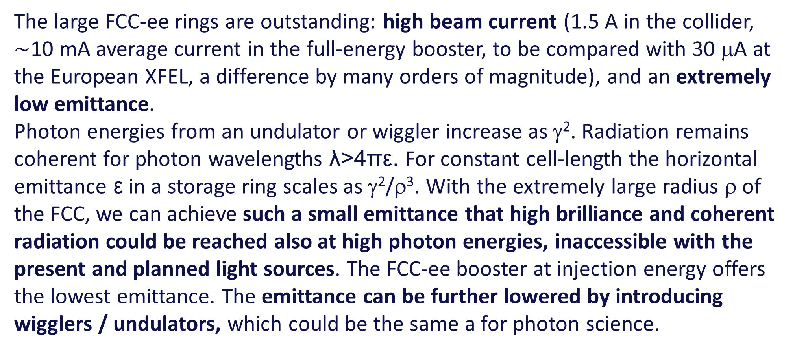
Photon Science: FCC-LS – motivation
The large FCC-ee rings are outstanding: high beam current (1.5 A in the collider, $\sim$10 mA average current in the full-energy booster, to be compared with 30 μA at the European XFEL, a difference by many orders of magnitude), and an extremely low emittance.
Photon energies from an undulator or wiggler increase as γ². Radiation remains coherent for photon wavelengths λ>4πε. For constant cell-length the horizontal emittance ε in a storage ring scales as γ²/ρ³. With the extremely large radius ρ of the FCC, we can achieve such a small emittance that high brilliance and coherent radiation could be reached also at high photon energies, inaccessible with the present and planned light sources. The FCC-ee booster at injection energy offers the lowest emittance. The emittance can be further lowered by introducing wigglers / undulators, which could be the same a for photon science.

Slide 5
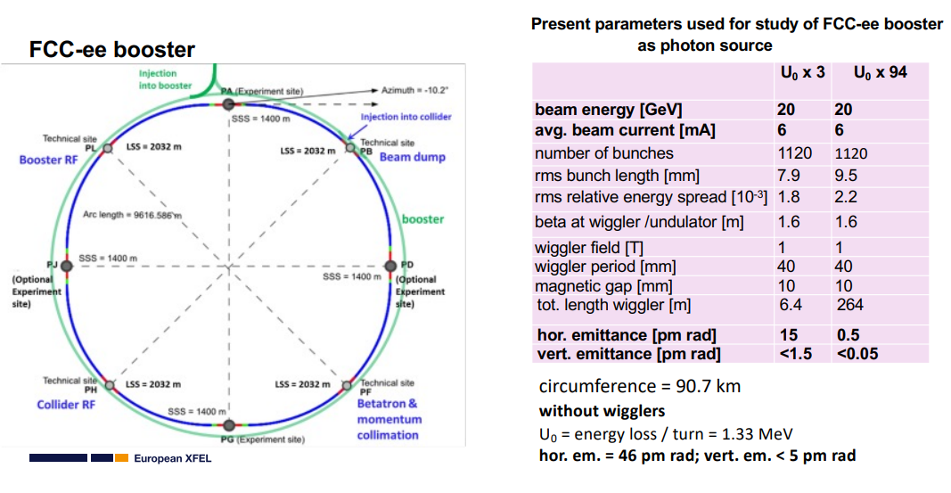
Photon Science: FCC-LS – Opportunities with the booster
to be revised
S. Casalbuoni

Slide 6
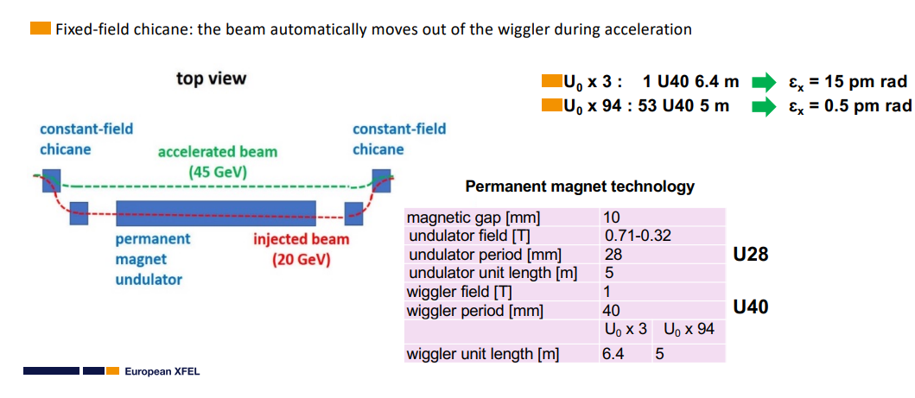
Using the FCC-ee Booster ring as a Photon Source
to be revised
S. Casalbuoni

Slide 7
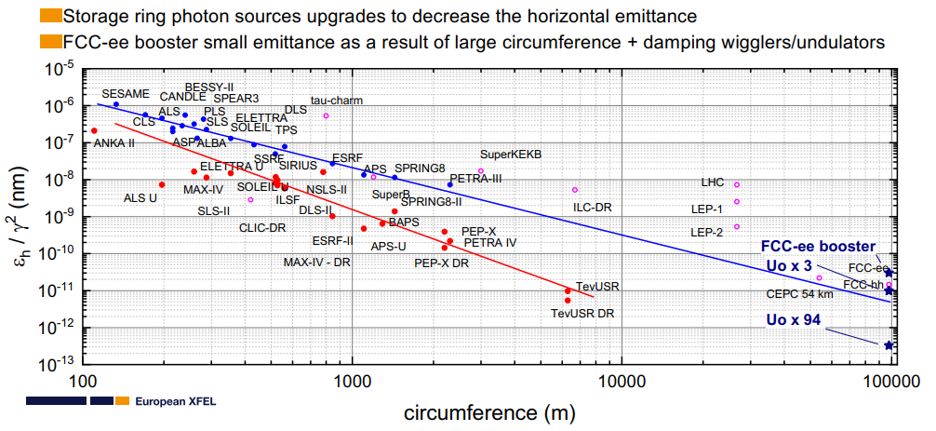
Horizontal emittance versus circumference
S. Casalbuoni

Slide 8
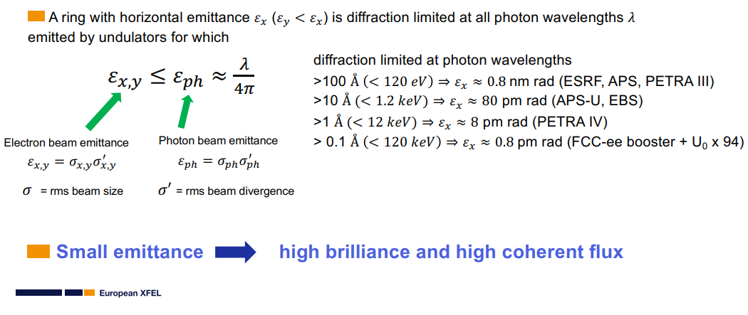
Diffraction limited storage ring (DLSR)
S. Casalbuoni

Slide 9
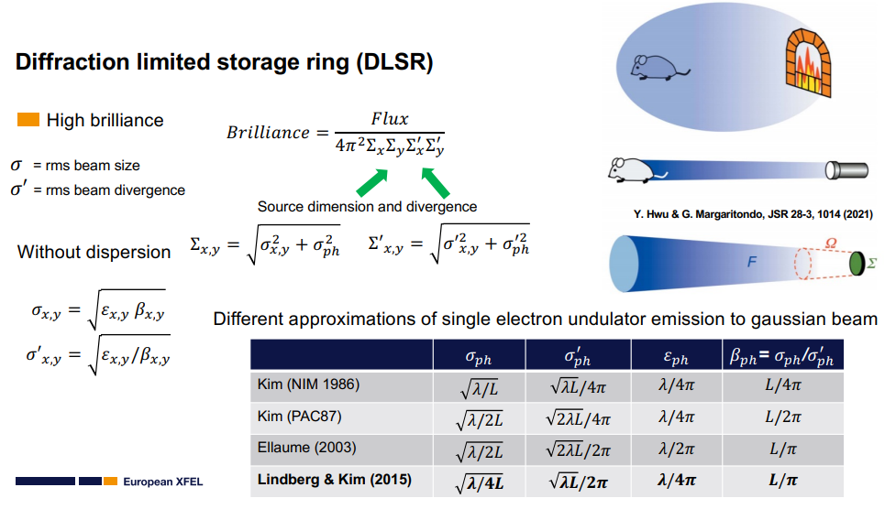
Diffraction limit
S. Casalbuoni

Slide 10
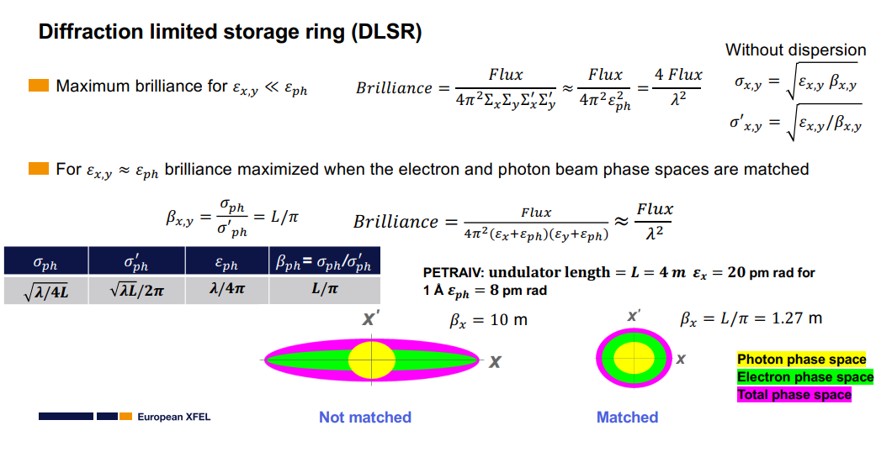
Diffraction limit – matching e⁻ and photon beams
S. Casalbuoni

Slide 11
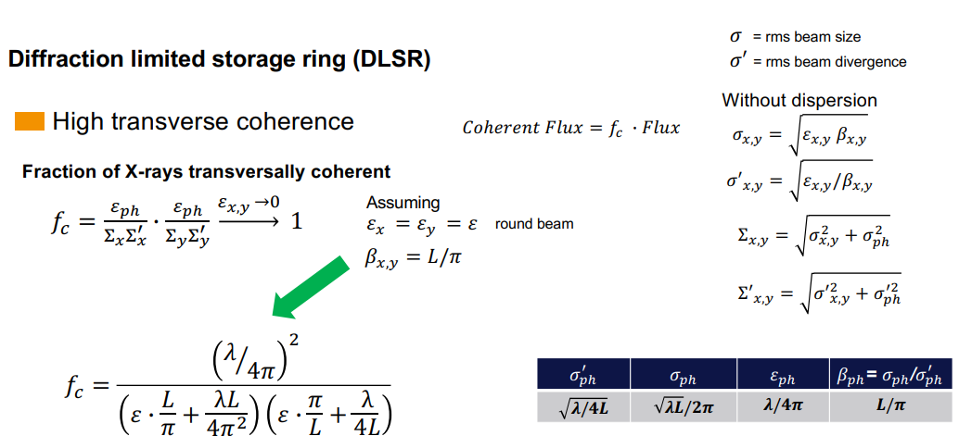
Diffraction limited radiation: High transverse coherence
to be revised
S. Casalbuoni

Slide 12
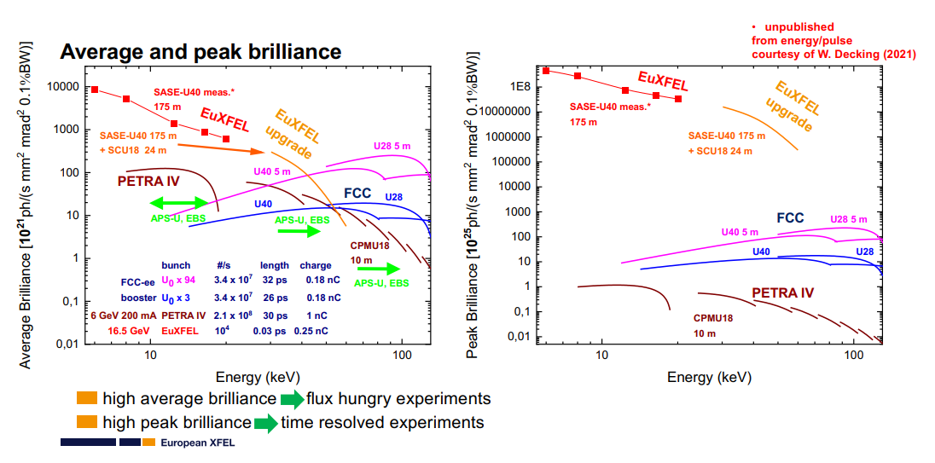
Average and peak brilliance
to be revised
S. Casalbuoni

Slide 13
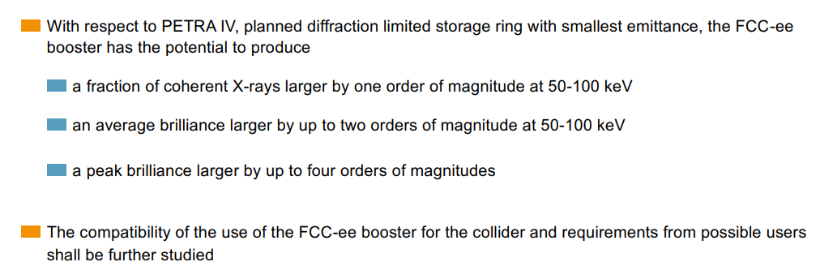
FCC-LS | preliminary conclusions for coherent 50-100 keV photons
S. Casalbuoni

Slide 14
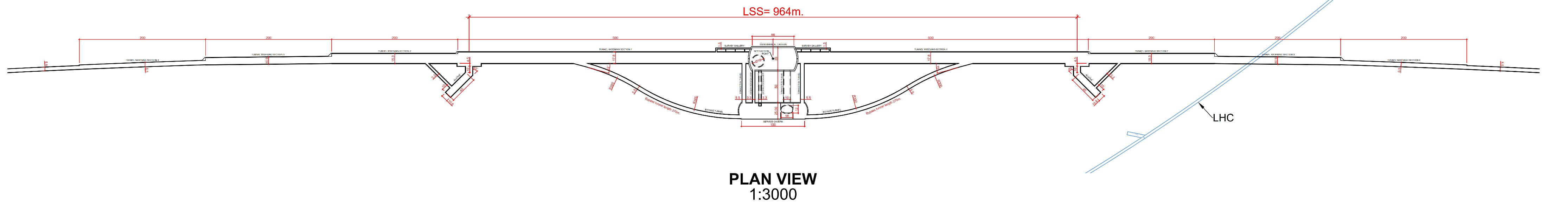
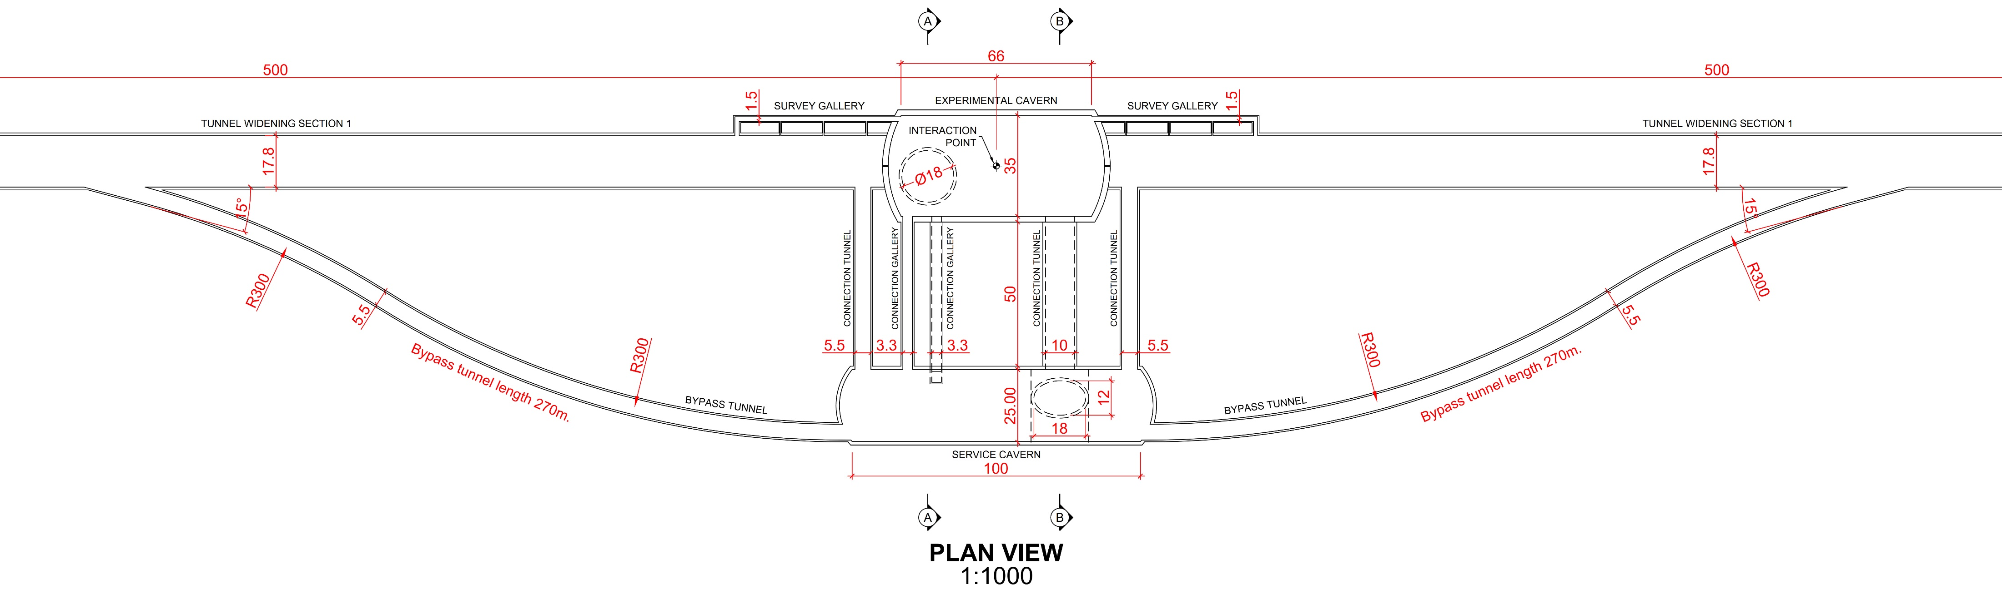
How & where can we integrate the FCC photon beam lines ?
Option: around the four e⁺e⁻ collision points
booster is separated to bypass the experimental detector
large underground infrastructure for FCC-hh
wide tunnel
to be studied
T. Watson

Slide 15
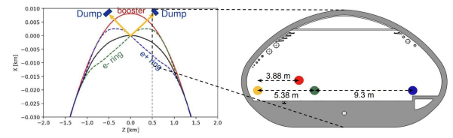
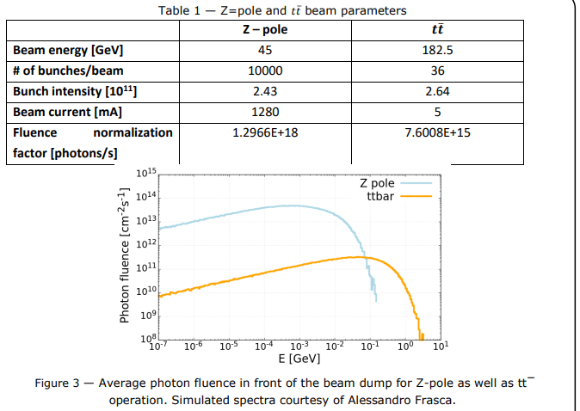
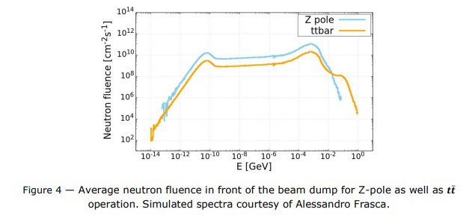
FCC-BS | beamstrahlung photon source
A. Frasca
C. Duchemin, M. Calviani

Slide 16
References
M. Altarelli et al. (Eds.), XFEL: The European X-Ray Free-Electron Laser.Technical Design Report, Preprint DESY 2006-097, DESY, Hamburg, 2006 (see also http://xfel.desy.de).
E.A. Schneidmiller and M.V. Yurkov,”Photon Beam Properties at the European XFEL”, DESY-11-152; TESLA-FEL 2011-01
C. G. Schroer et al., PETRA IV Conceptual Design Report, https://bib-pubdb1.desy.de/record/426140/files/DESY-PETRAIV-Conceptual-Design-Report.pdf
T. Tanaka and H. Kitamura, “SPECTRA: a synchrotron radiation calculation code”, Journal of Synchrotron Radiation 8, 1221 (2001)
F. Burkart et al., “LUXE — A QED Experiment at the European XFEL,” 10th Int. Particle Accelerator Conf. IPAC2019, Melbourne, Australia JACoW Publishing ISBN: 978-3-95450-208-0 doi:10.18429/JACoW-IPAC2019-TUPRB008
C. Hugenschmidt, Positrons in Surface Physics (2016), https://arxiv.org/pdf/1611.04430
M. Benedikt, S. Casalbuoni, M. Doser, F. Zimmermann, First thoughts on the synergetic use of the FCC-ee collider and its injector complex for photon science and other applications, 10.5281/zenodo.7675663.
S. Casalbuoni and F. Zimmermann, FCC-ee booster as ultimate storage ring photon source, FCC Week 2021
R. Aleksan, A. Apyan, Y. Papaphilippou, F. Zimmermann, Scenarios for Circular Gamma-Gamma Higgs Factories, Proc. IPAC2015, Richmond (2015) 2156

