Slide 1
Wigglers and undulators in the real booster, impact on emittance, possible changes 24 September 2024
A. Chance (CEA)

Slide 2
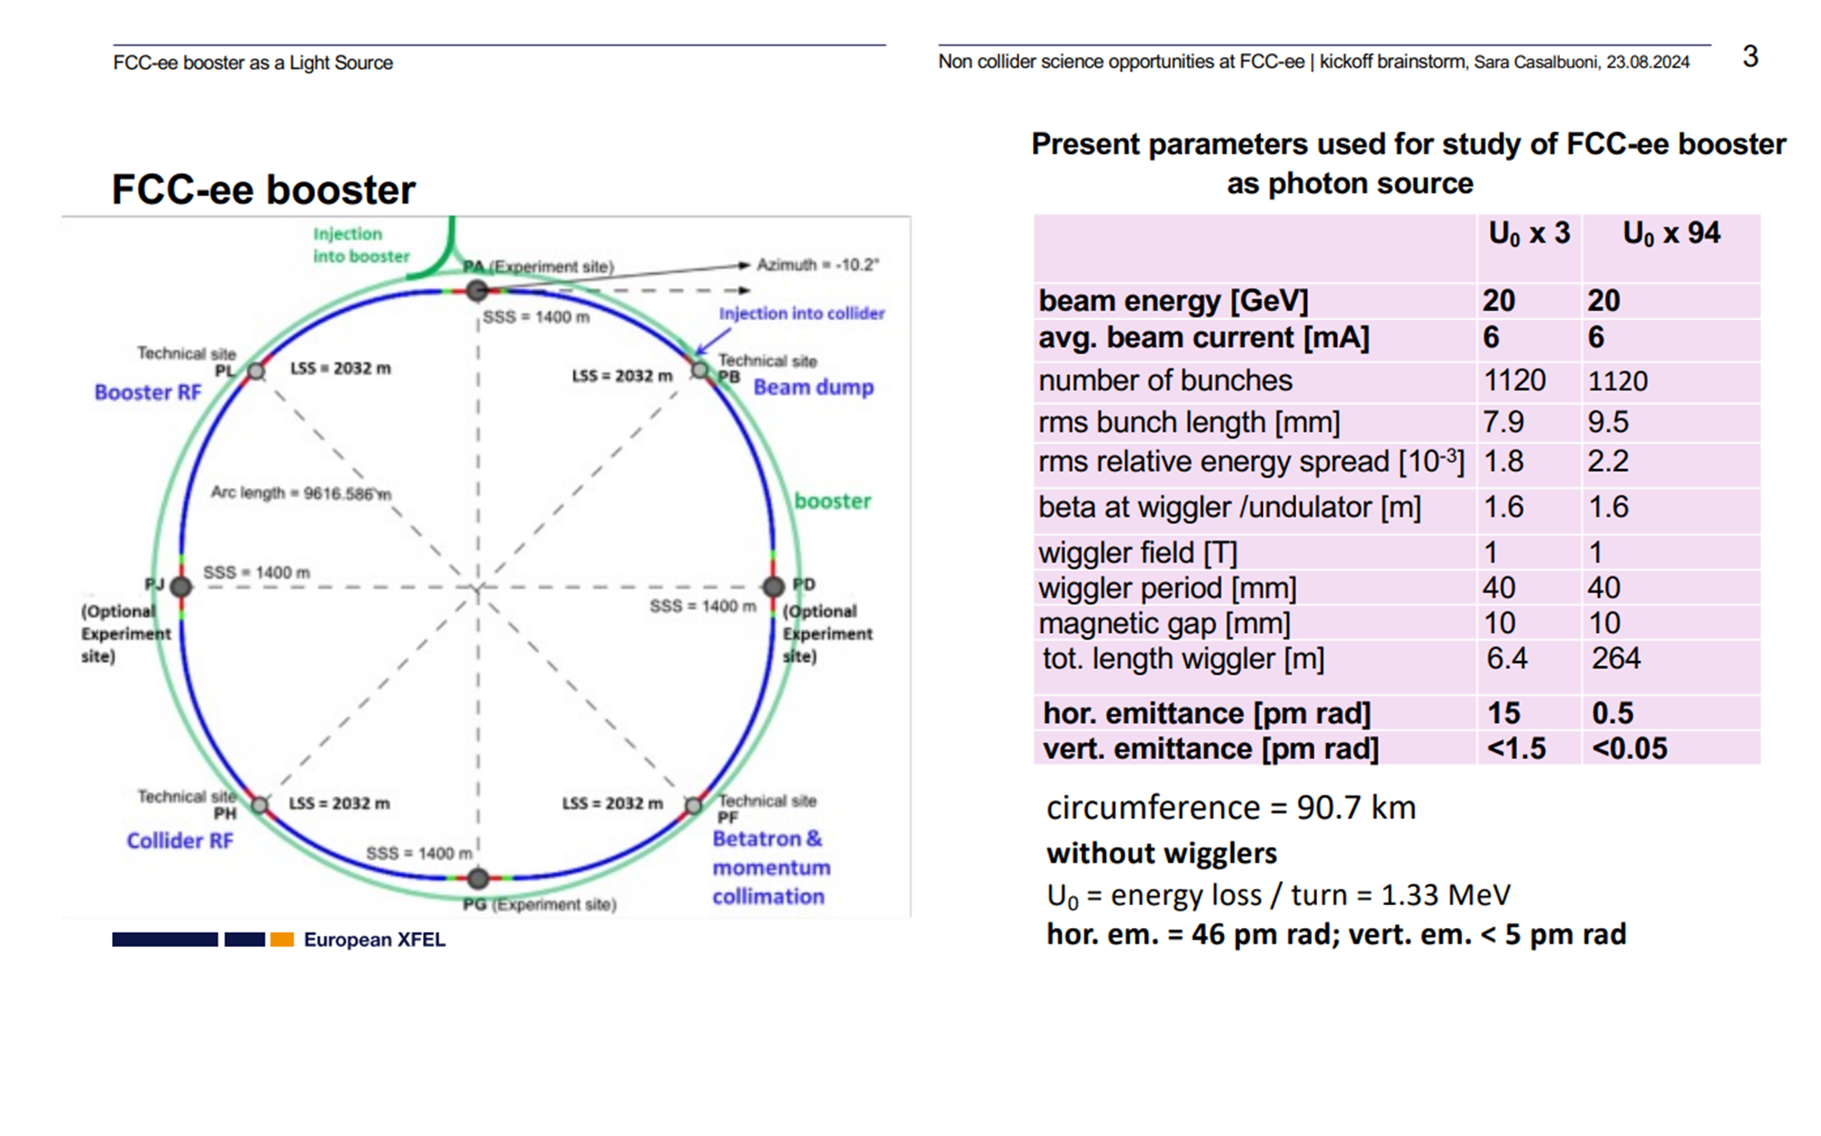
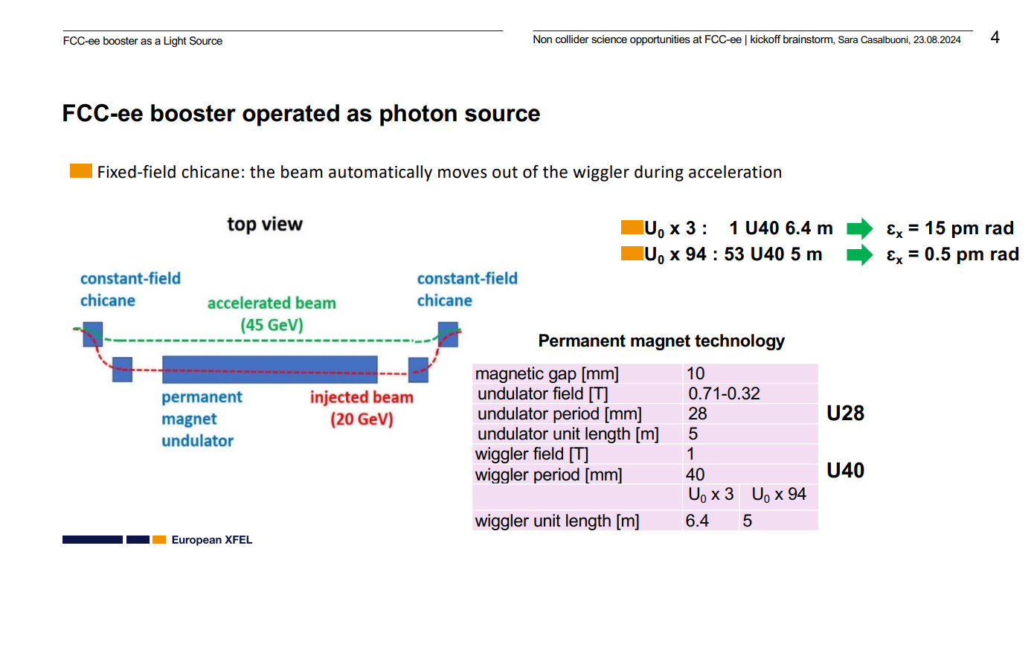
Reminder: proposal of Sara Casalbuoni

Slide 3
First reactions
The insertion PA is dispersive (needs for dipoles to follow the layout in the outer side).
If needs to go to a dispersionless insertion:
Go to the inner side (modification of the booster layout and of the optics).
Use strong dipoles in this region to have an additional straight section (more SR radiation for the operation).
Additional insertions dedicated to the undulators.
Use of the insertion PB for instance.
For the operation, what is the allowed radiated power (especially with U0 x 94)?
Difficult to operate in top-up injection + light source.

Slide 4
First simulations
In Mad-X (and X-Suite) there is no dedicated element to simulate an undulator.
Needs to use RBEND but that is not ideal (difficult to reproduce a sinus-like field, the reference trajectory is not the good one, etc…). If going to a light source in the booster, good to develop a dedicated element.
For the simulations, I have used RBEND + a « non-physical element » between the RBENDs to cancel the vertical edge-effect (otherwise, the beam is not stable anymore)!
Something goes wrong with IBS (see slides after). Needs to benchmark the simulation. Some developments are ongoing with Xsuite. Necessary to benchmark.

Slide 5
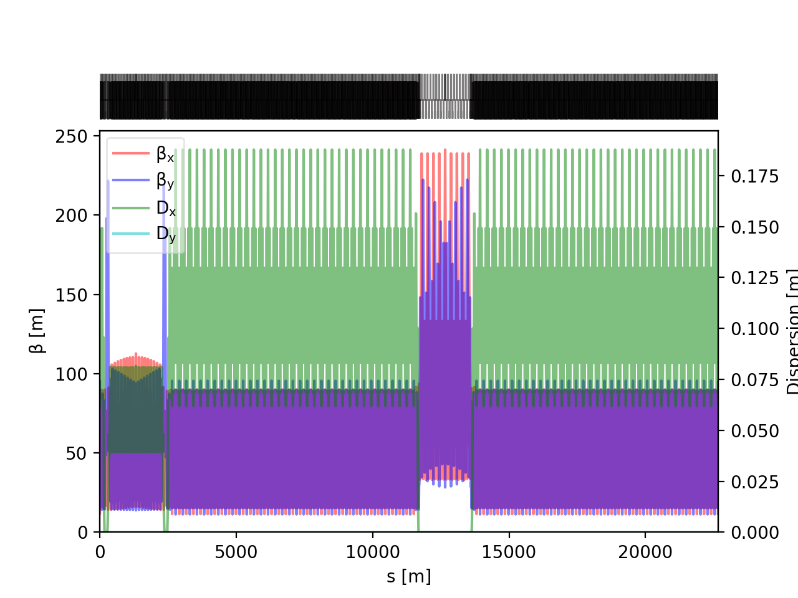
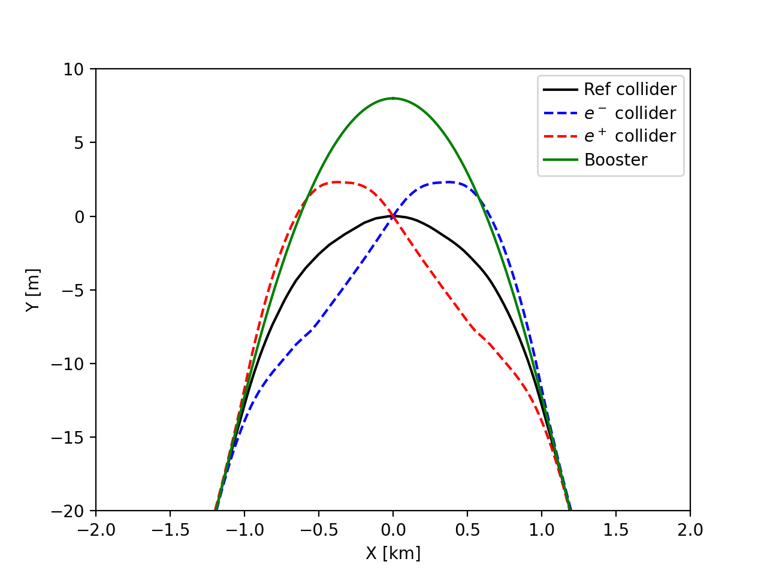
Booster optics: ¼ of the booster

Slide 6
EMIT NO IBS
Damping partition numbers 0.99998999 1.00000000 2.00001002
U0 x1
Damping constants [1/s] 0.11055577E+00 0.11055687E+00 0.22111486E+00
Damping times [s] 0.90452087E+01 0.90451182E+01 0.45225364E+01
Emittances [pi micro m] 0.16939732E-04 0.41765664E-31 0.10289553E+00
U0 x3
Damping constants [1/s] 0.37709960E+00 0.37710060E+00 0.75423265E+00
Damping times [s] 0.26518193E+01 0.26518123E+01 0.13258508E+01
Emittances [pi micro m] 0.15131226E-04 0.33518399E-29 0.12218801E+02
U0 x94
FAILS. TO BE INVESTIGATED. NEEDS TO UPDATE THE RF VOLTAGE.

Slide 7
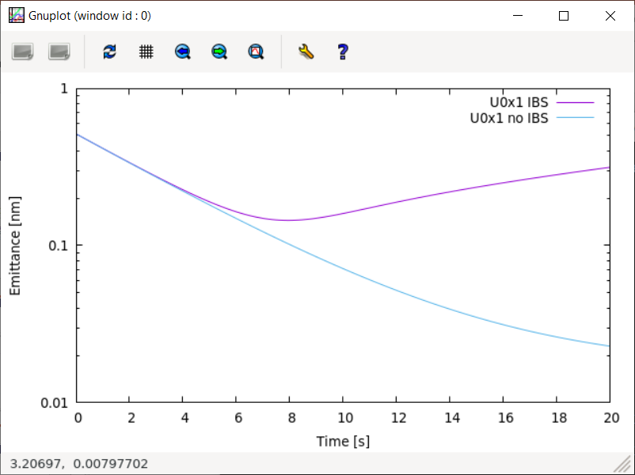
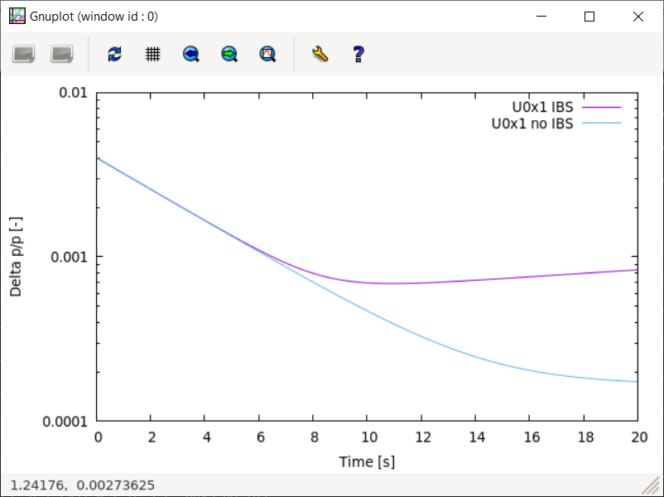
Emittance U0x1

Slide 8
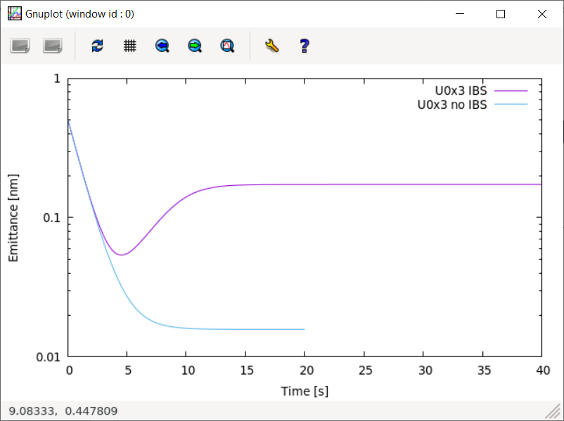
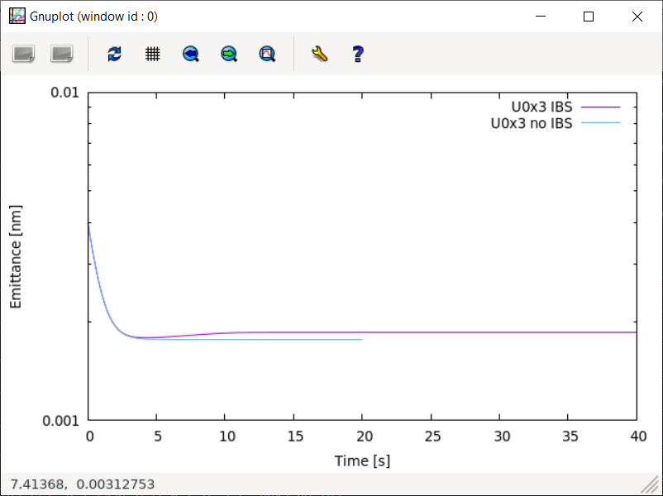
Emittance U0x3

Slide 9
Thank you

