Slide 1



Identity, Authentication, Authorization
Thematic CSC – Security
Tom Dack – STFC UKRI
Notes:
The abstract pattern can be removed or repositioned if required. Be careful to ‘Send to Back’ so that it does not obscure any important information.

Slide 2




Who am I?
I currently wear multiple Authentication and Authorization hats…
Group Leader for the STFC Federating Services Group, responsible for the Identity and Access Management service for the U.K. IRIS Collaboration
Current Authorization Working Group Chair for the WLCG
Leading Identity Management Community of Practice within the Square Kilometre Array Observatory’s Science Regional Centre Network project
Working to ensure that all these communities (and others!) can interoperate
Questions? Feel free to contact at:
thomas.dack@stfc.ac.uk
Notes:
Please replace photo of presenter with a portrait of your own. 1) Send the geometric shape overlay to the back – Right-Click > Send to Back > Send to Back. 2) Replace image – use the guides provided to correctly position it. 3) Send your portrait to the back so that the geometric overlay re-appears over the portrait.

Slide 3


Agenda
1 Introduction to Identity, Authentication, Authorization
…and why does it matter anyway
2 AuthN & AuthZ For Distributed Research
3 AuthN & AuthZ Technologies:
3 .1 Certificates
3 .2 SAML
3 .3 OAuth & OIDC Tokens
Image © STFC Alan Ford
4 …but which is “best”?
Notes:
To replace photo with one of your own. 1) Send the geometric shape overlay to the back – Right-Click > Send to Back > Send to Back. 2) Replace image – use the guides provided to correctly position it. 3) Send your image to the back so that the geometric overlay re-appears over the image. Remember to delete the image credit if using your own image.

Slide 4
Take Aways
What is the difference between Authentication and Authorization
How the global research community is connected through shared use of digital identities, and an understanding of why this is important for research
An understanding of some of the different tools and methods involved
If you are developing a service that needs authentication or authorization, come back and look at this!

Slide 5
Introduction to
Identity,
Authentication, and Authorization,
…and why does it matter anyway

Slide 6
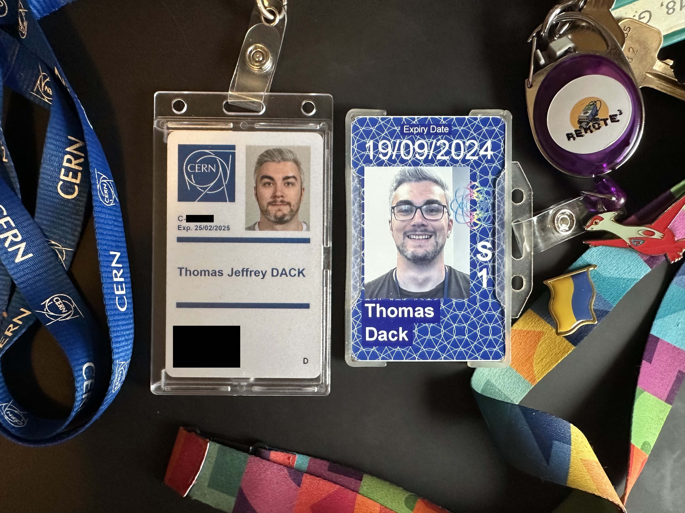
What’s an Identity?
Identity is…
Concept of you as an individual – a collection of information that describes you.
Clear in “real life” but may be fuzzy – especially online.
At any time, your identity may be unified or may be split into personas
  e.g. work and home email accounts, or two different site passes for different organisations

Slide 7
Online Identity - Then
Traditionally a user would need to create a new ”identity” to use for every new service or account they used online
Lots of accounts, scattered through every site a user has ever signed up for
This results in many username and password pairs, which in turn leads to bad security practices
  Credentials are reused for “simplicity”, or simply forgotten and lost

Slide 8
Online Identity - Now
In more modern applications, the process is evolving
Increased importance of account credibility
  Processes and systems in place to show that an associated identity is verified
Increased adoption of single sign-on mechanisms, using a unified identity
  Log-in with Social IDs, such as Facebook, Google, ORCID
Can grant authorised access based on an identity’s attributes
  Home institute, email address, etc

Slide 9

Authentication & Authorization
Or, Not letting everyone in
Letting everyone access everything is often a bad idea
Though this is not always true – the level of access control required involves considering the risks
In the context of research, we probably don’t want anyone and everyone online being able to get in…

Slide 10


Authentication & Authorization: Controlling Access
Controlling access depends on:
Verifying a user’s access to an account or identity – authentication (AuthN)
Knowing that a user is allowed to do what they want to do – authorization (AuthZ)
These processes are usually combined, as key processes in a community’s Authentication and Authorization Infrastructure - AAI
SIDE NOTE:
AuthoriZation - 🇺🇸 & 🇨🇦
AuthoriSation - 🇬🇧 & the rest of the English-speaking world
I will have typed AuthoriZe, for consistency (and less Microsoft Rage) except in occurrences where it is a named term or attribute
… also I use the Americanised shorthand, AuthZ

Slide 11
What makes AAI important for research?
A couple of key concepts underpin the use of identity in research:
Confidentiality
Traceability
Suspension
Attribution

Slide 12

What makes AAI important for research?
A couple of key concepts underpin this:
Confidentiality
Traceability
Suspension
Attribution
Confidentiality
Whilst final research outputs are public, maintaining confidentiality before this point is important
Particularly important for fields handling personal and medical data
Notes:
Sure the final product may be openly available but, whilst the information is in draft, confidentiality matters. Even between some WLCG experiments there is an intentional level of segregation between work.

Slide 13

What makes AAI important for research?
A couple of key concepts underpin this:
Confidentiality
Traceability
Suspension
Attribution
Traceability
If something goes wrong – accidentally or maliciously – service owners need to be able to trace where this happened
Knowing which account caused an issues is important for both support or suspension
Notes:
When something goes wrong, we need to be able to trace the usage. Equally, if something goes brilliantly, we want to understand who deserves credit! For example, a job that seg faults, where does it come from? Can we contact the person and get them to understand? Provenance of user/data

Slide 14

What makes AAI important for research?
A couple of key concepts underpin this:
Confidentiality
Traceability
Suspension
Attribution
Suspension
Processes to suspend an individual user account in case of compromise or malicious activity
Avoids downtime caused by stopping an entire service or resource, by isolating the problematic identity
Notes:
What if a user’s identity is compromised? Can we isolate that identity and suspend it? Otherwise, do we have to suspend an entire Virtual Organisation, or a service?

Slide 15
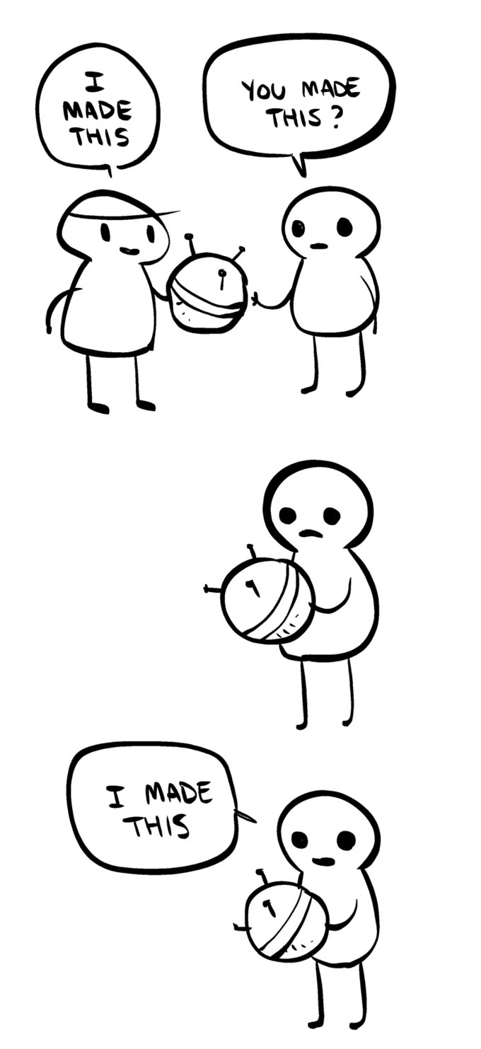

What makes AAI important for research?
A couple of key concepts underpin this:
Confidentiality
Traceability
Suspension
Attribution
Attribution
A single central identity provides a mechanism through which research can be attributed
This helps to avoid problems arising from Identity changes – name changes from marriage, gender transition, etc
ORCID is an example of this – life-long identifiers for researchers, which can be attached to publications, grant requests, etc
Tumblr – The Internet by Nedroid / January 30th, 2013
Not come across ORCID?
Visit https://blog.inspirehep.net/2015/04/what-is-orcid-and-how-can-it-help-you/
and https://home.cern/cern-people/updates/2018/01/get-yourself-orcid

Slide 16
AuthN & AuthZ
For Distributed Research

Slide 17
AuthN & AuthZ for Distributed Research
Providing global access to computing resources – not easy!
Global user community, with many members
Distributed single infrastructure
Not guaranteed that users know each other
Not guaranteed that users will ever meet
Need a system for provisioning access, to be trusted across the research infrastructure

Slide 18
Not guaranteed that users know each other
Who can you trust to know the users, in order to authenticate them?
Many options, including:
The Infrastructure
The Experimental Group or Research Community
The Home Organisations
A trusted Third Party
In most cases, a user’s Home Organisation may have the most current information – especially if their access is a function of their affiliation.
Something you trust to know users is an
Identity Provider (IdP)
Notes:
Or, potentially, a trusted 3rd party like a government, bank or organisation specialised in identity vetting

Slide 19
Not guaranteed that users will ever meet
But! A user’s Experimental Group or Research Community will likely be better placed to tell you other things about the user…
Which group the user belongs to
What roles (permissions) they should have
  what are they authorised to do
  Are they a user, an admin, a super-user, etc?
The status of a user’s policy acceptance – e.g. whether they have accepted the latest acceptable usage policy
Notes:
Or, potentially, a trusted 3rd party like a government, bank or organisation specialised in identity vetting

Slide 20



Putting the Pieces Together…
In distributed computing, we need to work with both Identity Providers and Research Communities to obtain the information needed to make access control decisions.
But to do that, we need methods to communicate this info…
Identity
Provider
Research
Community
Authentication
Authorization
Research
Service

Slide 21
How does it work?
There are multiple possibilities, we’ll focus on the three most widely used methods for distributed authentication
Certificates
SAML
  XML bundles
OAuth2
  Tokens

Slide 22
AuthN & AuthZ
Technologies:
Certificates

Slide 23
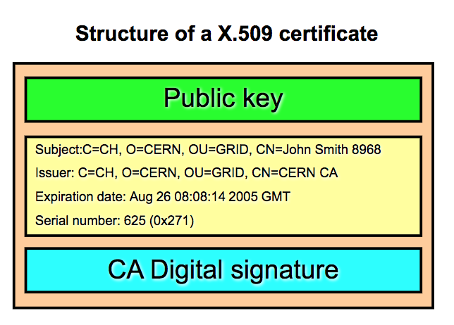
What is a Certificate…
A Certificate is…
A digital identity, representing an entity
  could be a service/website, a machine, or a human individual
Signed by a Certificate Authority (CA)
  Self-signed certificates do exist but are not useful for situations requiring assured authentication.
  Signed by taking a hash of the certificate, which is then encrypted with the CA’s private key
Long lived – typically within research applications, a certificate will last a year
User keeps an accompanying private key and password
http://slideplayer.com/slide/10176602/

Slide 24

Certificates for Research
Certificates have been used for research since the early 2000s
  X509 is the form of certificate used
Certificate Authorities (CAs) regulated by the Interoperable Global Trust Federation (IGTF)
  Signed by CA IF they can validate the identity
Authentication = Certificates
Authorization = Certificate Extensions
Notes:
In research communities we have been using certificates for authentication for a long time, since the early 2000s. One of the original challenges was how to make sure that the certificate authorities were well behaved and checked the identity of the people to whom they issued certificates. This is where a group called the IGTF was created, they agreed a set of rules and policies for the certificate authorities and only those certificate authorities that were part of IGTF would be trusted by research infrastructures.

Slide 25
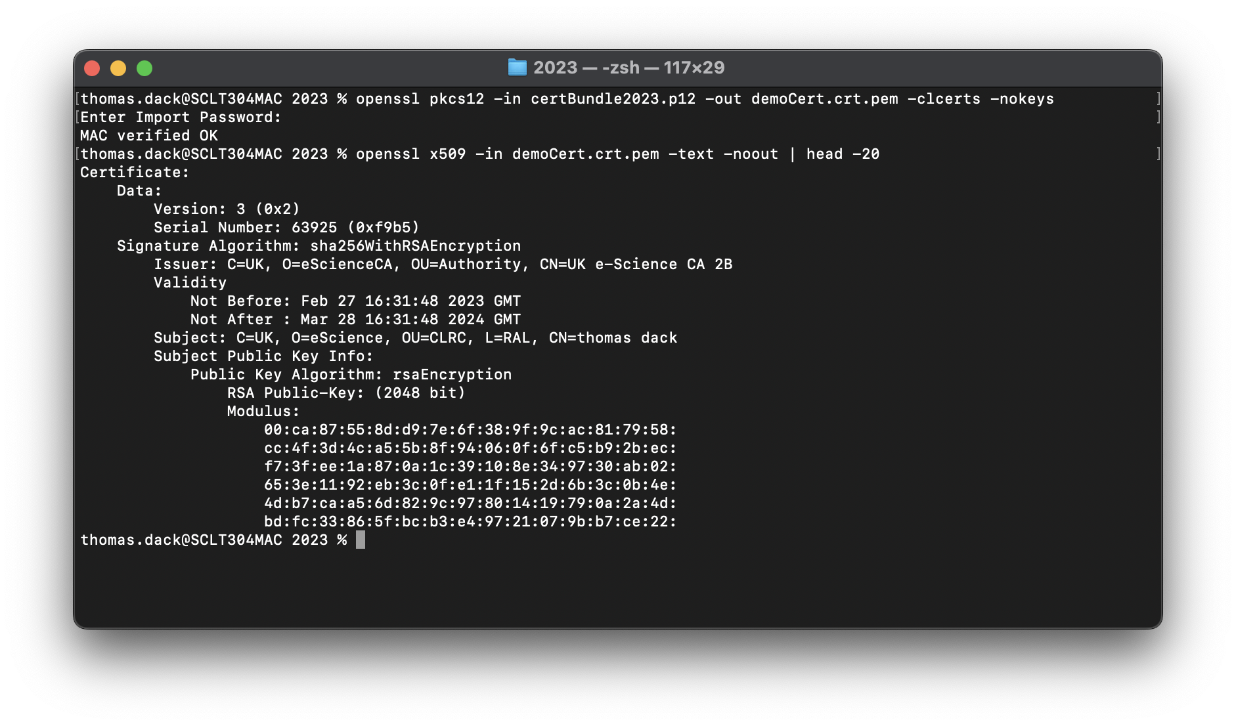
Taking a peek inside…
Here, I have downloaded my “certificate bundle” from the UK Certificate Authority – this contains the certificate and a private key, protected by a password
The first command extracts the certificate from the bundle
The second uses the OpenSSL tool to look inside – you can see information about the issuer, the UK CA, and the subject, me
Notes:
In research communities we have been using certificates for authentication for a long time, since the early 2000s. One of the original challenges was how to make sure that the certificate authorities were well behaved and checked the identity of the people to whom they issued certificates. This is where a group called the IGTF was created, they agreed a set of rules and policies for the certificate authorities and only those certificate authorities that were part of IGTF would be trusted by research infrastructures.

Slide 26
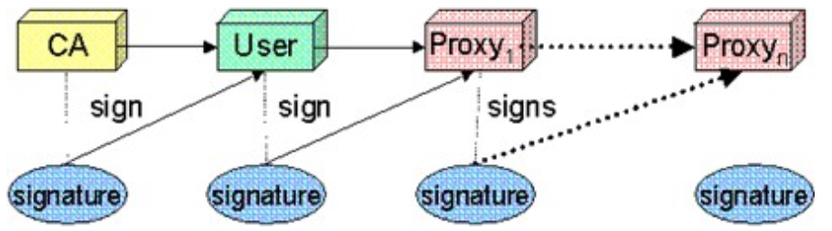
Proxy Certificates
In most certificate-based AAI, the original user certificate is not used for job submission – instead, a proxy is generated.
The user certificate is used to generate and sign a
  Proxy Certificate
    Identity of the user
    Short lived
    Expiration time
  with corresponding Private key
    No password
    Readable only by the user
The proxy and its private key can be used together to generate new proxies
http://slideplayer.com/slide/10176602/
Why Generate a Proxy Certificate and not send the original?
We use proxies because:
they have a shorter lifetime. If they are compromised the damage is limited. In addition, the private key of a certificate is protected by a password known only to the user - it’s critical that that information remain private and so the user private key can’t be used for signing by a system.
By giving a proxy to a service, that service can keep regenerating the proxy and acting like you. You don’t want to give them all of your rights, just the one relevant for that particular service
Notes:
We want proxies because
they have a shorter life time. If they are compromised the damage is limited. In addition, the private key of a certificate is protected by a password known only to the user - it’s critical that that information remain private and so the user private key can’t be used for signing by a system.
By giving a proxy to a service, that service can keep regenerating the proxy and acting like you. You don’t want to give them all of your rights, just the one relevant for that particular service

Slide 27
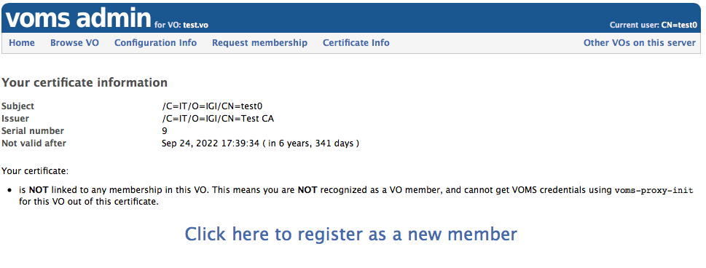
The WLCG Example: VOMS Proxy Certificates
That was just for Authentication - we now need a way to add authorization
Taking WLCG as an example:
Authorization rules are (were!) stored in the Virtual Organisation Management System (VOMS)
A Virtual Organisation is an experiment or research community in our context.
Who has registered with, and is known to, VOMS?
Grid Proxy = Short lived certificate to be used for authentication to grid services
VOMS Extension = Virtual Organisation specific information, e.g. role and capability
VOMS Proxy = Grid Proxy + VOMS Extension
Notes:
We’re already getting quite deep here, you can see how complicated it is to set up this distributed authentication system. On top of that we need to add the authorization.
For science such as WLCG, authorization rules are stored in the Virtual Organisation Management System (VOMS). A Virtual Organisation is effectively an experiment in our context. Who has registered with VOMS? Probably all the physicists.
The authorization can be added to a proxy certificate in the form of an extension.

Slide 28

Putting the pieces together… Certificates
Good Bits
Well established technology, services are set up to accept certificates
Same credential valid for web and non-web
Bad Bits
Security impact if compromised (and frequently compromised)
Not user friendly & Mobility issues
Aging out of usage in favour of more modern solutions
Identity
Provider
Research
Community
Authentication
(Certificate)
Authorization
(Proxy)
Research
Service

Slide 29
AuthN & AuthZ Technologies:
SAML

Slide 30
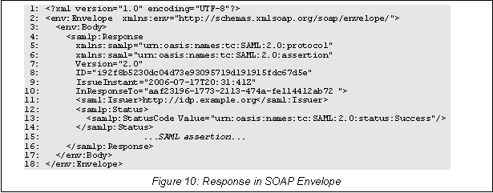
Security Assertion Markup Language
Facilitates Single-Sign-On implementations
Historically used by the Research and Education sector
Mostly limited to web services
Authentication assertions sent as XML packets
  Can be encrypted or not
  Contain user attributes,
  can contain authorization
  information
http://docs.oasis-open.org/security/saml/Post2.0/sstc-saml-tech-overview-2.0.html

Slide 31
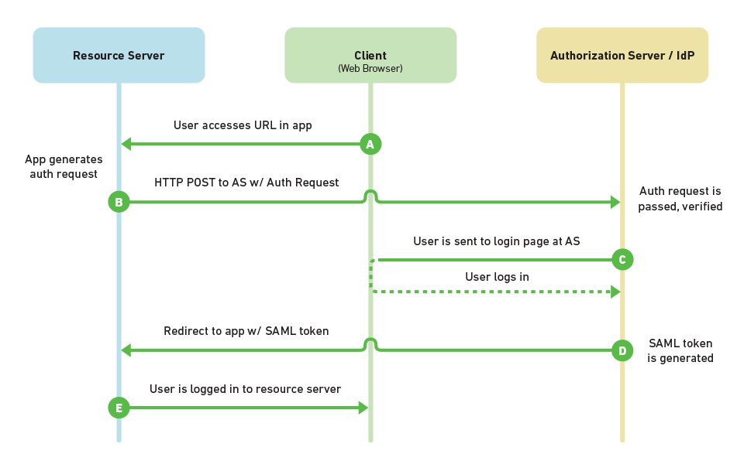
SAML Protocol
Client
  User on their browser
Resource Server
  A website requiring authentication
Authorization server/IdP
  Home Organisation
https://www.mutuallyhuman.com/blog/2013/05/09/choosing-an-sso-strategy-saml-vs-oauth2/

Slide 32
SAML Trust Federations
A group of Service Providers and Identity Providers that have agreed to work together.
Federation metadata collects XML descriptions of each organisation, along with their certificate
Federation metadata is signed by the Federation and distributed to all members
Everyone has access to everyone’s certificates, issued by a trusted source

Slide 33
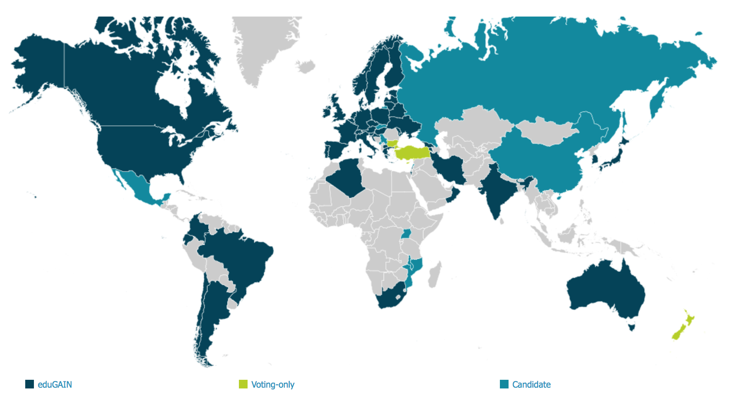
Federation of Federations: Interfederation
The big example: eduGAIN
“The eduGAIN service interconnects identity federations around the world, simplifying access to content, services and resources for the global research and education community. eduGAIN enables the trustworthy exchange of information related to identity, authentication and authorization (AAI).​ ”
https://technical.edugain.org/

Slide 34
Putting the pieces together… SAML
Good Bits
Mature, scalable federations
Secure protocol
Bad Bits
Only natively works for web services
Significant implementation effort
Identity
Provider
Research
Community
Authentication
(SAML Token)
Authorization
Typically a second call takes place to get research authorization
Research
Service

Slide 35
AuthN & AuthZ Technologies:
OAuth & OIDC Tokens

Slide 36
OAuth and OIDC Tokens
There are a few components in a “token” flow. Key to this, a token is…
typically a JSON Web Token
  “JWTs are an open, industry standard RFC 7519 method for representing claims securely between two parties.” https://jwt.io/introduction/
  Tokens are encoded strings of data, issued by an issuer with which the client (receiver) has a trusted relationship.
In this context, JWTs are used to communicate authentication and authorization information using the OAuth 2.0 and OIDC protocols
OAuth 2.0 | OIDC
Open Authorization | Open ID Connect

Slide 37

Oauth 2.0 – the Access Token
An open standard for access delegation, and most often used for allowing users to grant a website access to their information on another website, without giving them their password
  Examples include signing into a third-party website using your Google, GitHub, or Orcid account
An access token is provided to the third party, from whichever service is acting as the Authorization Server, which it can then use to retrieve a protected resource
Want to know more about OAuth after the lecture?
https://oauth.net/

Slide 38






Oauth 2.0 – Terminology
Protected Resource
  The identity or data which is to be shared
  eg: your email address, or the ability to post to a Social Media profile
Resource Owner
  The user who owns the Protected Resource
  eg: you!
Client
  The application that wants access on behalf of the Resource Owner
  eg: the website you want to register with using your Google identity
Authorization Server
  The application which knows the Resource Owner, and where the Resource Owner already has an account
  eg: The Google, Facebook, Orcids of the world
Resource Server
  Where the Protected Resource lives, and what the Client wants to use
  eg: the API from which the Client can access the Protected Resource
Owner
Client
AuthZ
Resc

Slide 39
Oauth 2.0 – Terminology
Protected Resource
  The identity or data which is to be shared
  eg: your email address, or the ability to post to your Twitter
Resource Owner
  The user who owns the Protected Resource
  eg: you!
Client
  The application that wants access on behalf of the Resource Owner
  eg: the website you want to register with using your Google identity
Authorization Server
  The application which knows the Resource Owner, and where the Resource Owner already has an account
  eg: The Google, Twitters, Orcids of the world
Resource Server
  Where the Protected Resource lives, and what the Client wants to use
  eg: the API from which the Client can access the Protected Resource
A quick aside…
OAuth 2.0 defines two types of clients:
Confidential and Public Clients
Confidential applications can hold credentials with which they use to authenticate themselves to the AuthZ Server in a secure way. They require a trusted backend server to store the secret(s).
eg – a web application with a secure backend
Public clients cannot hold credentials securely.
eg – a native desktop or mobile application, or a JavaScript-based client-side web application (single-page app)
Owner
Client
AuthZ
Resc

Slide 40

OAuth 2.0 – How things work
Client
AuthZ
Server
Authorization Request
Owner Authorization
Client
Owner
Authorization Grant
AuthZ
Access Token Request w AuthZ Grant
Owner
Access Token
Resource
Server
Resource Request with Access Token
Resc
Protected Resource

Slide 41
OAuth 2.0 – How things work
Client
AuthZ
Server
Authorization Request
Owner Authorization
Client
Owner
Authorization Grant
AuthZ
Access Token Request w AuthZ Grant
Owner
Access Token
Authorization Grant?
Multiple types, the method through which a token is obtained.
NON EXAMINABLE: details in Supplement Slides!
Resource
Server
Resource Request with Access Token
Resc
Protected Resource
Notes:
There are several different Authorisaton Grants which can be issued, and different scenarios will call for different grants.
Authorization Code – the most typical, where a code issued which is exchanged for a token
Client Credentials – for a client to authenticate and get information about itself
Device Code – such as when you authenticate to a SmartTV
Refresh Token – for allowing the client to obtain a new token when the first expires.
More information can be found in the supplement slides – non examinable!

Slide 42
Oauth 2.0 – the Access Token
OAuth is an Authorization flow – does not have a method for user Authentication
Enter…
OpenID Connect: OIDC

Slide 43

OIDC: The ID Token
OpenID Connect (OIDC) is an identity layer on top of the base OAuth 2.0 protocol
OIDC provides the ability for app and web developers to authenticate users without the need to directly store credential sets
OIDC enables the Authorization Server to act as an Identity Provider (IdP). An OAuth 2.0 Authorization Server implementing OIDC is also referred to as an OpenID Provider (OPs).
A client which uses an OP for authentication is a Relying Party (RPs).
OIDC identifies a set of personal attributes that can be exchanged between Identity Providers and the apps that use them, and includes an approval step so that users can consent (or deny) the sharing of this information
Want to know more about OIDC after the lecture
https://openid.net/connect/

Slide 44
OIDC: The ID Token
In OAuth flows involving a user, the user will authenticate with the Authorization Server before providing consent for the server to release information to the client. OpenID Connect utilises this process to authenticate to the client
The Token Endpoint will provide two separate tokens: a standard OAuth Access Token, and the OIDC ID Token.
The ID Token will contain information about the user pertaining to what the client has requested
When the client receives the ID Token, it may then read off requested claims

Slide 45
OIDC: Requesting Info with Scopes
When the client makes its token request, it must use Scopes to specify which privileges – Claims – are being requested in the token
In OAuth 2.0, Scopes correspond to what resources are available when a protected resource is accessed
In OIDC, Scopes correspond to the specific sets of information to be made available as Claim Values
  Claims are Key/Value pairs of user information
  A Scope is a Grouping of Claims.
    e.g. the email scope gives the email and email_verified claims
OIDC defines a set of standard Scopes (and Claims) but does allow additional Scope values to be defined and used – see the supplement slides for examples!

Slide 46
An Example Token Request
https://example.com/oauth/auth? ➡️ The Token Endpoint Address
response_type=code ➡️ Authorization Grant requested
&scope=openid%20profile%20email ➡️ The Scopes Requested
&client_id=EXAMPLE_CLIENTID ➡️ Unique ID of the Client
&redirect_uri=EXAMPLE_REDIRECT_URI ➡️ The URL at the client where the token should be returned

Slide 47
OIDC: Default Token Claims
as defined by OIDC Core
Claim | Summary
iss | REQUIRED: Issuer identifier for who issued the response. This is a case sensitive URL
sub | REQUIRED: Subject identifier. A locally unique identifier which must never be reassigned, this identifies the user within the issuer. A case sensitive string ≤ 255 ASCII characters in length
aud | REQUIRED: Audiences that this token is intended for, using the Client ID as its identifying value.
exp | REQUIRED: Expiration time for the token, after which it MUST NOT be used for processing.
iat | REQUIRED: Time at which the JWT was issued
auth_time | Time when end-user authentication occurred. If a max_age request is made or auth_time is requested as an essential claim, this is REQUIRED – otherwise it is OPTIONAL
{ "iss":
"https://server.example.com",
"sub": ”24400320",
"aud": "s6BhdRkqt3”,
"exp": 1311281970,
"iat": 1311280970,
"auth_time": 1311280969”
}

Slide 48
OIDC: Standard Identity Claims
as defined by OIDC Core
Claim | Summary
name | The end-user’s full name, including all name parts. given_name, family_name, middle_name and nickname may also be used.
preferred_username | A shorthand name by which the user wishes to be referred to by at the RP. This MAY be any valid JSON string – including special characters such as @, /, or whitespace. The RP MUST NOT rely on this value being unique.
email | End-User's preferred e-mail address. Its value MUST conform to the RFC 5322 addr-spec syntax. The RP MUST NOT rely upon this value being unique.
phone_number | End-user’s preferred telephone number.
address | End-User's preferred postal address.
profile | URL of the End-User's profile page. The contents of this Web page SHOULD be about the End-User.
... And others | picture, website, email_verified, gender, birthdate, zoneinfo, locale, phone_number_verified, updated_at

Slide 49
OIDC: Additional Claims
The OpenID Connect Core specification only defines the previous small set of claims as standard
However, OP’s MAY provide additional claims about the End-User
A typical example includes groups, a list of groups the user is registered with at the OP
Any additional Claim will need to have a corresponding Scope, to allow it to be requested
  Alternatively, extra claims could be included within the profile scope (not claim!) – this is how the OP to be used within the exercises provides its groups claim
Scope | Summary
profile | OPTIONAL. This scope value requests access to the End-User's default profile Claims, which are: name, family_name, given_name, middle_name, nickname, preferred_username, profile, picture, website, gender, birthdate, zoneinfo, locale, and updated_at.
See supplement slides for other scopes!

Slide 50
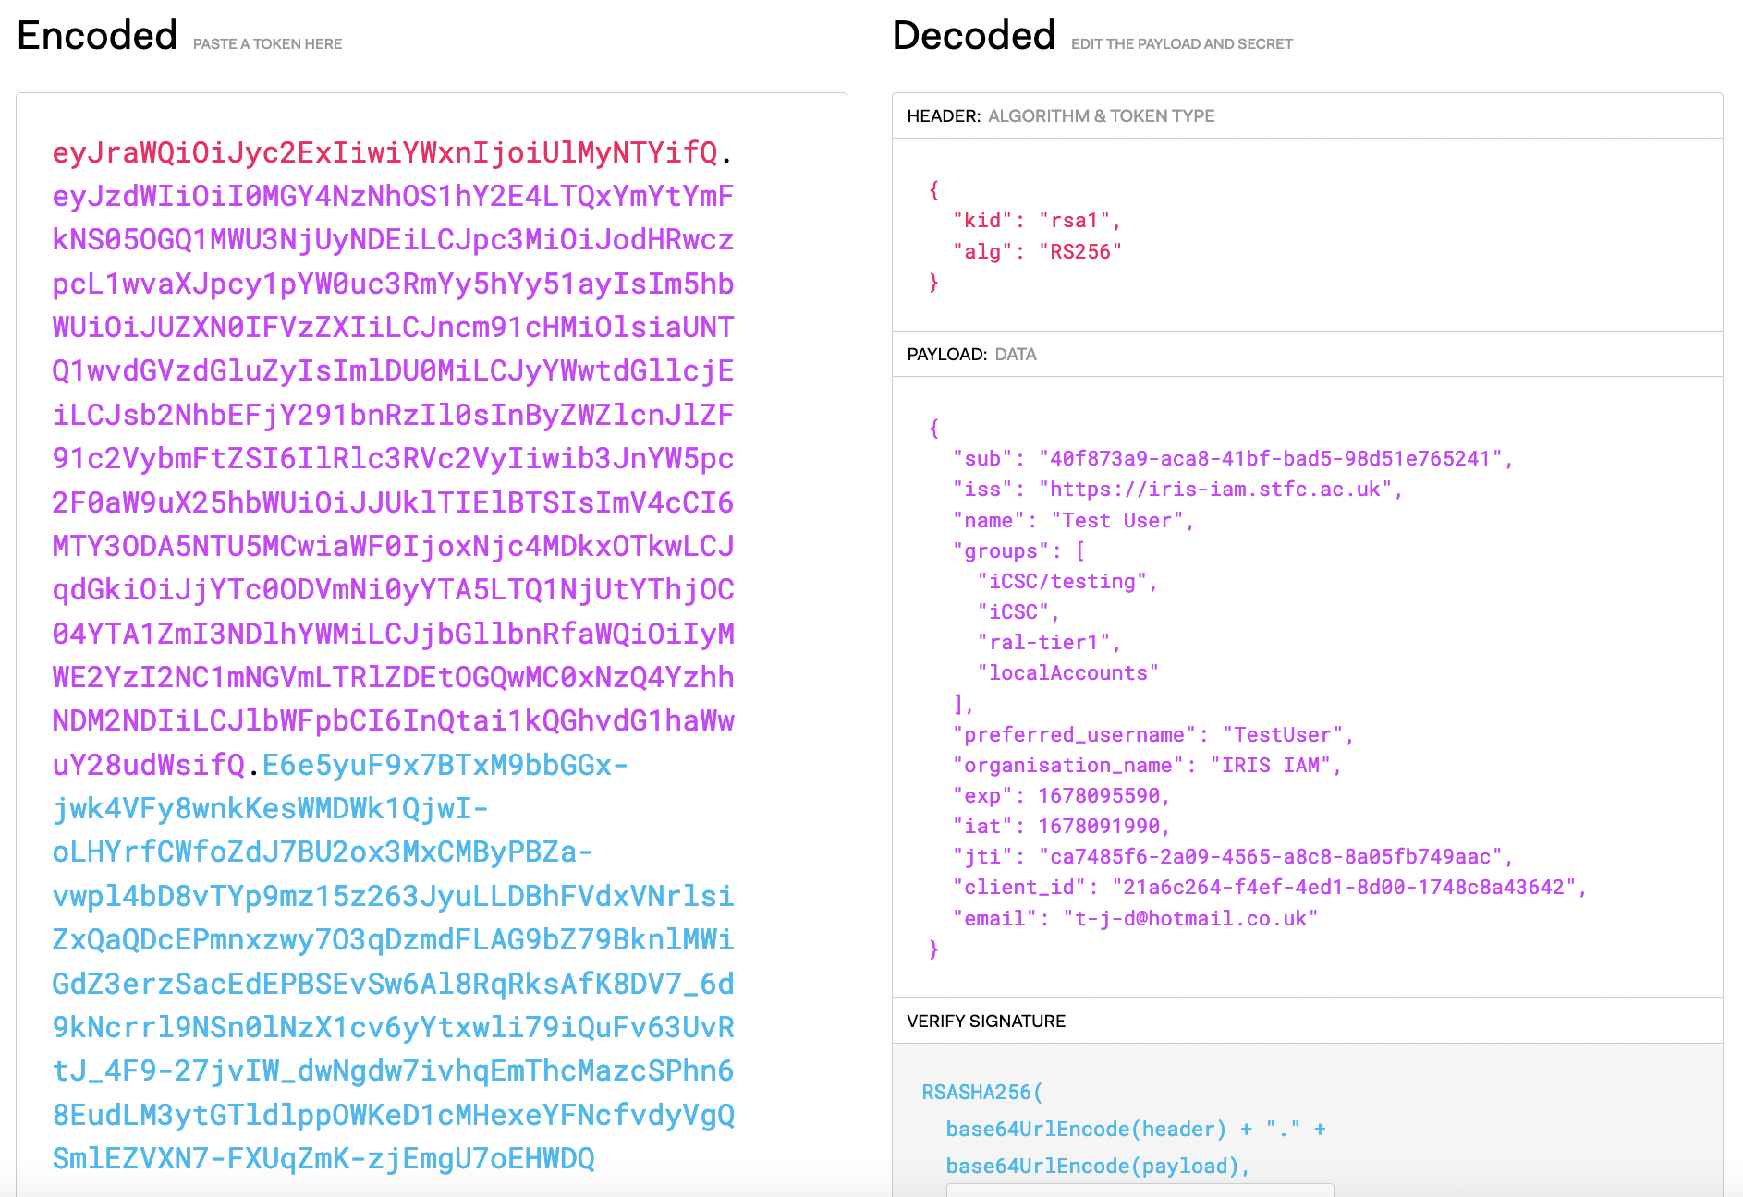
OIDC: Putting this together…
The token is three Base64-URL strings separated by dots that can be easily passed in HTML and HTTP environments
Handy token decoding taken from: https://jwt.io/
Check it out for more info on JWTs or when using them yourself!
🙂

Slide 51
OIDC: Putting this together…

Slide 52
OIDC: Putting this together…
🙂

Slide 53
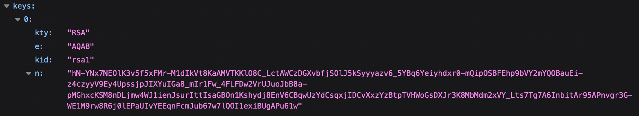
OIDC: Putting this together…
JWK signing key published at a URL at the OP, such as:
https://wlcg.cloud.cnaf.infn.it/jwk
The specific URL is detailed in the OP metadata, found at:
.well-known/openid-configuration
For Example:
https://wlcg.cloud.cnaf.infn.it/.well-known/openid-configuration

Slide 54
OIDC: UserInfo Endpoint
The ID token is not the only way for a RP to get information about a user – it can also make a request to the Ops UserInfo endpoint
A UserInfo Request is made by the client using either a HTTP GET or HTTP POST. The Access Token previously obtained from an OIDC Authentication request MUST be included as a Bearer Token
The OIDC Core recommendation is that the request uses the HTTP GET method, with the Access Token sent using the Authorization header field
A non-normative example of a UserInfo Request:
GET /userinfo HTTP/1.1
Host: server.example.com Authorization: Bearer SlAV32hkKG
NOT EXAMINABLE

Slide 55
Putting the pieces together… OAuth & OIDC
In many deployments, the Identity Provider and Research Community are combined as the “Token Issuer”
Good Bits
Tokens widely accepted
“Easy” to implement
Works for non-web
Bad Bits
Current identity federation status immature
Identity
Provider
Research
Community
Authentication
(OIDC)
Authorization
(OAuth)
Research
Service

Slide 56
… but which is “best”?

Slide 57
A recap
We have looked at 3 different technologies for distributed AAI
 | Certificates | SAML | OAuth2
Web? | Yes | Yes | Yes
Command Line? | Yes | No | Yes
Advantage? | Established | Scalable | Widely accepted
Disadvantage? | Security & Usability | Usability, Non-web | Scalability
Example | Grid Certificates | Your Home Organization, via eduGAIN | ORCID, Github

Slide 58
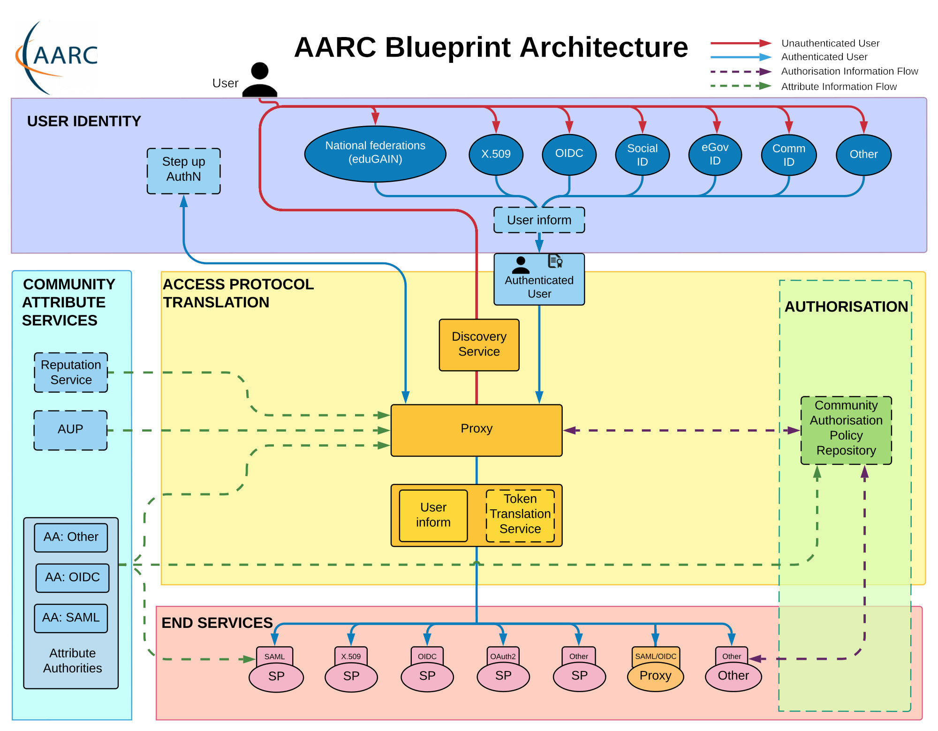
Perhaps a combination of multiple…
Identity
Provider
Identity
Provider
Identity
Provider
Authentication via SAML Identity Federations
Research
Community
Authorization managed by the experiment/research community using OAuth/OIDC
For a more in-depth example, see the AARC Blueprint in the supplement slides
Research
Service

Slide 59
A note on incident response…
Identity management, authentication, and authorization all form key tools within Incident Response – see Barbara’s lecture for more!
Taking some examples on how different implementations interact…
WLCG Certificate Federation
Common security policies
Central suspension mechanism (Argus)
Infrastructure CSIRT (Computer Security Incident Response Team)
Very mature setup with international participation in trust initiatives (IGTF)
SAML Federations
Established Security Framework, Sirtfi
No central suspension mechanism
No central operational security or incident response capability
Still a long way to go before Research Communities trust them to the same extent
WLCG OAuth2 Token Issuers
Suspension possible experiment wide
Procedures a work in progress as the infrastructure develops – see the supplement slides for more info!
NOT EXAMINABLE

Slide 60
Take Aways
What is the difference between Authentication and Authorization
How the global research community is connected through shared use of digital identities and understanding of why this is important for research
An understanding of some of the different tools and methods involved

Slide 61




Notes:
The abstract pattern can be removed or repositioned if required. Be careful to ‘Send to Back’ so that it does not obscure any important information.

Slide 62






Science and Technology Facilities Council
@STFC_matters
Science and Technology Facilities Council
Notes:
The abstract pattern can be removed or repositioned if required. Be careful to ‘Send to Back’ so that it does not obscure any important information.

Slide 63
Supplementary Slides
All Non-Examinable Content
1 OAuth Authorization Grant Types
2 OIDC Scope Examples
3 Towards Tokens for the WLCG
Notes:
To replace photo with one of your own. 1) Send the geometric shape overlay to the back – Right-Click > Send to Back > Send to Back. 2) Replace image – use the guides provided to correctly position it. 3) Send your image to the back so that the geometric overlay re-appears over the image. Remember to delete the image credit if using your own image.

Slide 64
OAuth Authorization Grant Types
NOT EXAMINABLE

Slide 65
OAuth 2.0 – Authorization Grants
The OAuth 2.0 framework specifies several different methods through which a Client can verify itself to the Authorization Server - these are known as Authorization Grants
  Authorization Code
  PKCE
  Client Credentials
  Device Code
  Refresh Token
Key Authorization Grant Concepts
Redirect URL – a URL at the client which the AuthZ server will deliver an issued token to
ClientID – the “username” of the client
ClientSecret – the “password” of the client
NOT EXAMINABLE

Slide 66
OAuth 2.0 – Authorization Grants
The OAuth 2.0 framework specifies several different methods through which a Client can verify itself to the Authorization Server - these are known as Authorization Grants
  Authorization Code
  PKCE
  Client Credentials
  Device Code
  Refresh Token
Authorization Code
Used by both confidential and public clients
An authorization code is exchanged for an access token
When the user returns to the client via the Redirect URL, the Authorization Code is extracted from the URL and used to obtain the Access Token
NOT EXAMINABLE

Slide 67
OAuth 2.0 – Authorization Grants
The OAuth 2.0 framework specifies several different methods through which a Client can verify itself to the Authorization Server - these are known as Authorization Grants
  Authorization Code
  PKCE
  Client Credentials
  Device Code
  Refresh Token
https://example.com/oauth/auth?
response_type=code
&scope=EXAMPLE_REQUESTED_SCOPES
&client_id=EXAMPLE_CLIENTID
&redirect_uri=EXAMPLE_REDIRECT_URI
Authorization Code
Used by both confidential and public clients
An authorization code is exchanged for an access token
When the user returns to the client via the Redirect URL, the Authorization Code is extracted from the URL and used to obtain the Access Token
NOT EXAMINABLE

Slide 68
OAuth 2.0 – Authorization Grants
The OAuth 2.0 framework specifies several different methods through which a Client can verify itself to the Authorization Server - these are known as Authorization Grants
  Authorization Code
  PKCE
  Client Credentials
  Device Code
  Refresh Token
curl --header "Authorization: Basic EXAMPLE_SECRET"
--data "grant_type=authorization_code&code=EXAMPLE_CODE"
--request POST https://example.com/oauth/token
Authorization Code
Used by both confidential and public clients
An Authorization code is exchanged for an access token
When the user returns to the client via the Redirect URL, the Authorization Code is extracted from the URL and used to obtain the Access Token
NOT EXAMINABLE

Slide 69
OAuth 2.0 – Authorization Grants
The OAuth 2.0 framework specifies several different methods through which a Client can verify itself to the Authorization Server - these are known as Authorization Grants
  Authorization Code
  PKCE
  Client Credentials
  Device Code
  Refresh Token
PKCE: Proof Key for Code Exchange
An extension to Authorization Code, which aims to prevent Cross Site Request Forgery (CSRF) and Authorization code injection attacks
Not a replacement for a ClientSecret, and therefore does not enable treating a Public Client as Confidential
NOT EXAMINABLE
Notes:
Code challenge and method sent with AuthZ request
Code verifier sent with AuthZ Code to the Token endpoint

Slide 70
OAuth 2.0 – Authorization Grants
The OAuth 2.0 framework specifies several different methods through which a Client can verify itself to the Authorization Server - these are known as Authorization Grants
  Authorization Code
  PKCE
  Client Credentials
  Device Code
  Refresh Token
Client Credentials
Must ONLY be used by Confidential Clients
The Client authenticates itself directly with the Authorization Server, for example using it’s ClientID and ClientSecret pair or with an public/private key pair
As Client Authentication is used as the Authorization grant, no further AuthZ is required
Often used for a client to obtain information about itself
NOT EXAMINABLE
Notes:
Code challenge and method sent with AuthZ request
Code verifier sent with AuthZ Code to the Token endpoint

Slide 71
OAuth 2.0 – Authorization Grants
The OAuth 2.0 framework specifies several different methods through which a Client can verify itself to the Authorization Server - these are known as Authorization Grants
  Authorization Code
  PKCE
  Client Credentials
  Device Code
  Refresh Token
curl --request POST \
--url 'https://EXAMPLE/oauth/token’ \
--header 'content-type: application/x-www-form-urlencoded’ \
--data grant_type=client_credentials \
--data client_id=EXAMPLE_CLIENT_ID \
--data client_secret=EXAMPLE_CLIENT_SECRET \
--data audience=EXAMPLE_AUDIENCE
Client Credentials
Must ONLY be used by Confidential Clients
The Client authenticates itself directly with the Authorization Server, for example using it’s ClientID and ClientSecret pair or with an public/private key pair
As Client Authentication is used as the Authorization grant, no further AuthZ is required
Often used for a client to obtain information about itself
NOT EXAMINABLE
Notes:
Code challenge and method sent with AuthZ request
Code verifier sent with AuthZ Code to the Token endpoint

Slide 72
OAuth 2.0 – Authorization Grants
The OAuth 2.0 framework specifies several different methods through which a Client can verify itself to the Authorization Server - these are known as Authorization Grants
  Authorization Code
  PKCE
  Client Credentials
  Device Code
  Refresh Token
Device Code
This flow is intended for use by browserless or input constrained clients – such as command line
The user is directed to visit a URL at the AuthZ Server in a separate browser, along with a user code to identify the device
The original device continuously polls the AuthZ server with the generated device code until the user completes the interaction, the code expires, or another error occurs
NOT EXAMINABLE

Slide 73
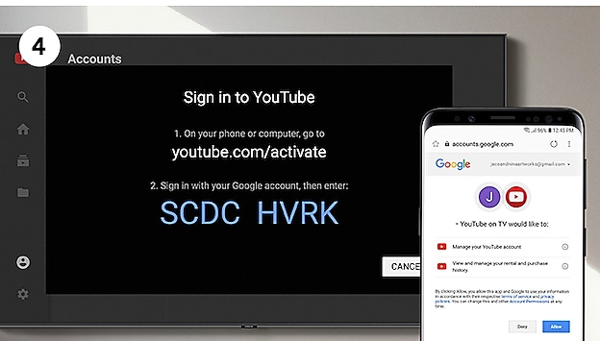
OAuth 2.0 – Authorization Grants
The OAuth 2.0 framework specifies several different methods through which a Client can verify itself to the Authorization Server - these are known as Authorization Grants
  Authorization Code
  PKCE
  Client Credentials
  Device Code
  Refresh Token
Device Code
This flow is intended for use by browserless or input constrained clients – such as command line
The user is directed to visit a URL at the AuthZ Server in a separate browser, along with a user code to identify the device
The original device continuously polls the AuthZ server with the generated device code until the user completes the interaction, the code expires, or another error occurs
NOT EXAMINABLE

Slide 74
OAuth 2.0 – Authorization Grants
The OAuth 2.0 framework specifies several different methods through which a Client can verify itself to the Authorization Server - these are known as Authorization Grants
  Authorization Code
  PKCE
  Client Credentials
  Device Code
  Refresh Token
Refresh Token
This is a mechanism for allowing a client to get a new Access Token after an initial one has expired, without further user interaction
Not a replacement for a ClientSecret, and therefore does not enable treating a Public Client as Confidential
NOT EXAMINABLE

Slide 75
OAuth 2.0 – Authorization Grants
To get a Refresh token, the client needs to request the scope:
scope=offline_access&
curl --request POST \
--url 'https://{yourDomain}/oauth/token’ \
--header 'authorization: Basic {yourApplicationCredentials}’ \
--header 'content-type: application/x-www-form-urlencoded’ \
--data grant_type=refresh_token \
--data 'client_id={yourClientId}’ \
--data 'refresh_token={yourRefreshToken}
The OAuth 2.0 framework specifies several different methods through which a Client can verify itself to the Authorization Server - these are known as Authorization Grants
  Authorization Code
  PKCE
  Client Credentials
  Device Code
  Refresh Token
Refresh Token
This is a mechanism for allowing a client to get a new Access Token after an initial one has expired, without further user interaction
Not a replacement for a ClientSecret, and therefore does not enable treating a Public Client as Confidential
NOT EXAMINABLE

Slide 76
OIDC Scope Examples
NOT EXAMINABLE

Slide 77
OIDC: Default Scopes
as defined by OIDC Core
Scope | Summary
openid | REQUIRED. Informs the Authorization Server that the Client is making an OpenID Connect request. If the openid scope value is not present, the behaviour is entirely unspecified.
profile | OPTIONAL. This scope value requests access to the End-User's default profile Claims, which are: name, family_name, given_name, middle_name, nickname, preferred_username, profile, picture, website, gender, birthdate, zoneinfo, locale, and updated_at.
email | OPTIONAL. This scope value requests access to the email and email_verified Claims.
address | OPTIONAL. This scope value requests access to the address Claim
phone | OPTIONAL. This scope value requests access to the phone_number and phone_number_verified Claims.
offline_access | OPTIONAL. This scope value requests that an OAuth 2.0 Refresh Token be issued that can be used to obtain an Access Token that grants access to the End-User's UserInfo Endpoint even when the End-User is not present (not logged in).
NOT EXAMINABLE

Slide 78
Towards Tokens
For the WLCG
NOT EXAMINABLE

Slide 79
Transition to Tokens - Motivations
OAuth and OIDC protocols have been adopted by a wide range of software and systems, thanks to their prevalence in industry – in particular within the social identity space
  This prevalence enables developers to utilise developed libraries, and facilitates integration and interoperability
Certificates, whilst established within WLCG, are not familiar outside this context - and are often viewed as unintuitive. Conversely, Token-based flows are becoming increasingly commonplace, and can lead to a better user experience as a result
NOT EXAMINABLE

Slide 80
Token Authentication and Authorization Infrastructure
In the planned WLCG infrastructure, there will be an OP per VO, which users may access using their CERN Account
This model unifies the IdP and Research community, with both being represented by the Token Issuer
The Infrastructure design has been informed by the AARC Blueprint architecture - a set of software building blocks that can be used to implement federated access management solutions for international research collaborations
NOT EXAMINABLE

Slide 81
The AARC Blueprint
NOT EXAMINABLE

Slide 82
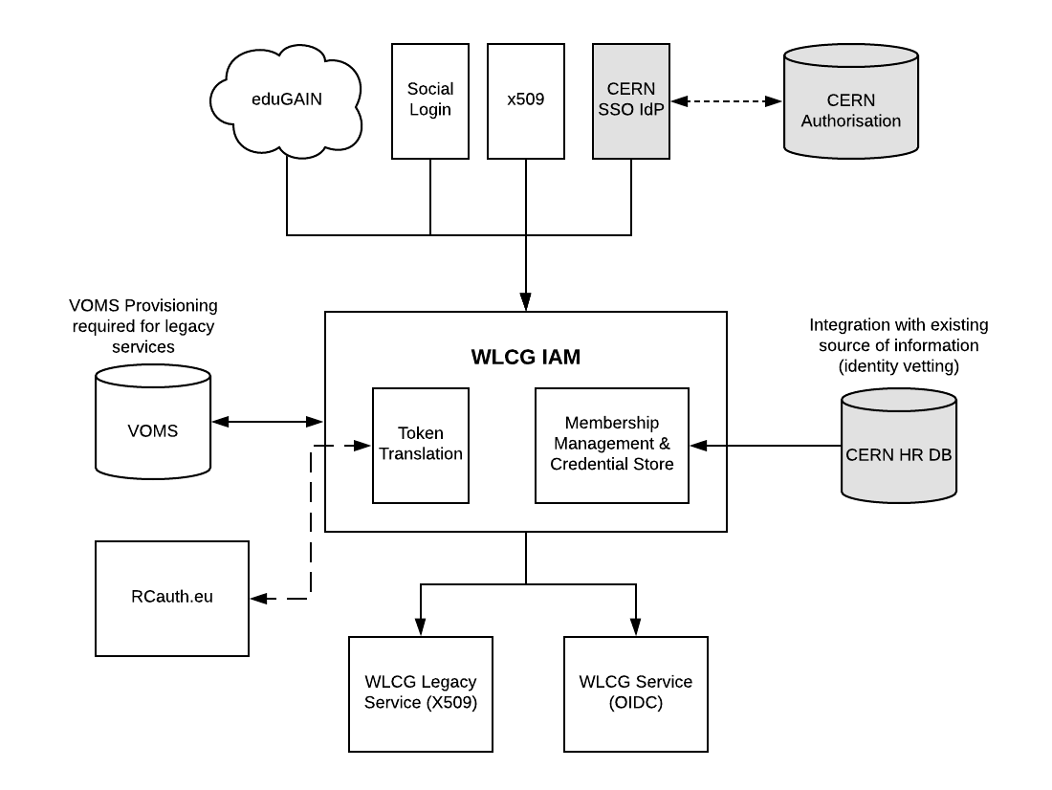
WLCG Token Infrastructure Design
NOT EXAMINABLE

Slide 83
WLCG Token Infrastructure Design
NOT EXAMINABLE

Slide 84
WLCG Token Infrastructure Design
CERN Person ID is checked against CERN HR DB. Affiliation with Virtual Organisation (experiment) is verified, as well as end dates.
If the check is OK, the membership
is approved.
CERN SSO releases:
● Name,
● Email,
● CERN Person ID (indicates
HR has performed ID check),
● CERN Kerberos Principal
● ...
Currently all researchers have
CERN accounts but aim is to work
towards removing this need in
future
NOT EXAMINABLE

Slide 85
WLCG Token Infrastructure Design
RCAuth integration possible
to generate short lived X.509 certs for backwards compatibility
Groups imported from VOMS
NOT EXAMINABLE

Slide 86
WLCG Token Schema
In order to serve authorization information a VO, the WLCG token schema definies extra claims – wlcg.groups for Group-based authorization and scopes for Capability-based authorization
wlcg.groups semantics are equivalent to existing VOMS groups, and will be initially imported directly from VOMS
  Eg: /atlas/production
scopes is used to provide capability to a specific token, rather than permanent authorization to a user
  Format $AUTHZ:$PATH where $PATH is mandatory (may be ‘/’ for *)
  Eg: storage.read:/atlas
For more details, you can see the published schema: https://zenodo.org/record/3460258#.Y-YqUxPMLVs
NOT EXAMINABLE

