Slide 1



Digital Forensics:
Essentials and Data Acquisition
Thematic CERN School of Computing, 2025
Daniel Kouřil
kouril@cesnet.cz

Slide 2
Digital Forensics
Methods to collect, preserve and analyze digital artifacts and evidence
Three main phases
  Acquiring the primary data
  Analysis and evaluation (establishing the evidence)
  Reporting
The first phase is most crucial
  Must make sure the data is complete, authentic and its integrity can be checked
  The other phases can be repeated/corrected/scrutinized any time

Slide 3
Examples of investigations
Burst of a ransomware campaign, a self-propagating worm exploiting a zero-day vulnerability in the operating system. After it is executed, the worm blocks access to the data on the disk and asks for ransom.
Micro Enterprise
  Can data be recovered?
  Have data been modified, tempered with?
Large Organization
  How the attack is spreading and how to spot it?
  Have any sensitive data leaked?
Law Enforcement
  Is it possible to identify the attacker?
  Is the determined evidence admissible?

Slide 4
Digital Evidence
Evidence is determined based on acquired artifacts
  Digital artifacts are data
Can be literally anything
  Files on the storage, memory contents, metadata
  Computer isn’t the only source of data
Data is digital
  Potentially hard to get
  Easy to distort

Slide 5
Today’s focus
We focus on system administrators who want to secure forensically sound data
  Not aiming at acting in “hostile environment” (like LEA, etc.)
  The environment is supposed to be known and cooperative (mostly)
    Architecture details can be (easily) established
    System passwords and keys are known / available, etc.
We focus on demonstrating principles using common tools

Slide 6
Data Acquisition

Slide 7
Basic principles
Common principles
  The collected data should be:
    complete (for subsequent analysis)
    accurate (not altered)
  “We want to get the most evidence we can with the least amount of alteration”
Every investigation should be scoped (questions formulated, at least internally)
Only start the acquisition process if you’re authorized!
Prepare in advance
The quality of the data and the soundness of the acquisition process determines the utility of the evidence

Slide 8
Risks of low quality of evidence
If the evidence is incomplete, it cannot yield relevant outcome
If the acquisition process doesn’t guarantee the integrity and authenticity of the data, results can be disputed
  Never know when the data will need to be defended, e.g. an internal process with an employee can end up in court
If you don’t know what to do, do not interact with the system at all
  No commands typed, no programs started, no new logins, …

Slide 9
Getting data from computer

Slide 10
Machine is switched off
The off-line approach is straightforward
  The only evidence is on permanent storage
  The device can be dismounted and processed outside the computer
    Works for virtual machines as well
Or the computer can be booted from a trusted media
  The computer must never boot other than trusted OS (e.g. USB), esp. the OS installed in the host!

Slide 11
Never boot the machine OS
Windows 10 changes or creates a lot of system files, e.g.:
/Windows/System32/LogFiles/WMI/NetCore.etl
/Windows/System32/LogFiles/WMI/NtfsLog.etl
/Windows/System32/LogFiles/WMI/Wifi.etl
/Windows/System32/LogFiles/WMI/RtBackup/EtwRTEventLog-Application.etl
/Windows/System32/LogFiles/WMI/LwtNetLog.etl
/Windows/System32/LogFiles/WMI/Microsoft-Windows-Rdp-Graphics-RdpIdd-Trace.etl
/Windows/System32/WDI/LogFiles/WdiContextLog.etl.001
/hiberfil.sys
/pagefile.sys
/swapfile.sys
/Program Files/AMD/atikmdag_dce.log
/Windows/System32/LogFiles/WMI/RtBackup/EtwRTUBPM.etl
/Windows/debug/PASSWD.LOG
/Windows/bootstat.dat
/Windows/System32/SleepStudy/UserNotPresentSession.etl
/Windows/ServiceProfiles/NetworkService/NTUSER.DAT{fd9a35da-49fe-11e9-aa2c-248a07783950}.TxR.blf
/Windows/ServiceProfiles/NetworkService/NTUSER.DAT{fd9a35da-49fe-11e9-aa2c-248a07783950}.TxR.0.regtrans-ms
/ProgramData/Microsoft/Windows Defender/Support/MpWppTracing-20201023-170636-00000003-ffffffff.bin
/ProgramData/Microsoft/Windows Defender/Scans/History/Results/Resource/{4862B78F-8B86-4B07-B4CB-254796EFB69D}
/ProgramData/Microsoft/Windows/AppRepository/Packages/Microsoft.Windows.StartMenuExperienceHost_10.0.18362.449_neutral_neutral_cw5n1h2txyewy/ActivationStore.dat
/Windows/System32/winevt/Logs/Microsoft-Windows-LiveId%4Operational.evtx

Slide 12
What if the computer is turned on?
Never shutdown the computer from the system
  Files get changed during the process (similarly to the booting process)
If you want to proceed with off-line approach, pull the power plug
  But think twice before you do

Slide 13
Why (not) to pull the power plug?
If you pull the plug
  you don’t risk any change of the evidence
  you immediately stop any malicious activities
There is a big disadvantage, though
  information may be lost immediately by virtue of the volatility of digital data
  The contents of RAM is lost when power is off, couldn’t be recovered
  Examples:
    Data is lost – a mail being composed
    Crucial information that never hits disk (encryption keys, passwords)
    System structures – list of running processes, open connections

Slide 14
Live capture
Accessing a live, running system and collecting volatile information
Data capture should follow the order of volatility
  Data is volatile (either frequently changing and/or available only for a limited time)
  There are different levels
  Most volatile data needs to be captured first
    e.g., list of open connections is more volatile than disk contents

Slide 15
Things to remember during live capture
Minimize all activities on the system
  (every action leaves/modifies traces)
A running system persistently modifies itself even without investigation activities
  keeps producing logs, performing SW updates, …
Remember the capturing is always mediated by the system that is being investigated
  Don’t trust the programs on the system
  Be prepared the collected information might be distorted/hidden
    Imagine a kernel rootkit hiding certain processes or connections

Slide 16
Perils of live acquisition
Inherently a thin line between investigation and acquisition
  The system needs to be investigated to establish potential sources of evidence
It’s important to document the process
  E.g., using video/image records, a log of performed actions, etc.
  In serious investigations work in a pair (investigating + documenting steps)

Slide 17
Handling primary data

Slide 18
Managing captured data
Integrity protection and authenticity is necessary
  Cryptographic hashes with them
Store primary data as read-only and perform analysis on copies of the data
  Data might be large, you’ll need a double space (to store and analyse)
After the analysis is done, data needs to be archived

Slide 19
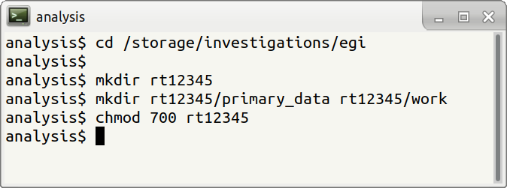

Slide 20
Acquiring evidence from storage systems

Slide 21
Strategies
Byte-stream copies
  Source is a whole disk or a volume
  Target is either image file or another disk
  Copies are exact (byte) replicas of the original
Logical (sparse) acquisition
  Capturing only specific files
  Takes less time and space
  Omits some information
Acquisition of contents metadata
  Quick, with minimal space requirements
  Reasonable notion of the whole system
  Inherently misses information from content

Slide 22
Acquisition in virtual environment
No need to manipulate with HW devices
  Snapshots or disk copies can be obtained easily
It can be obtained from a device or can be retrieved from a storage “manager”
  Virtualization, containers
  Different formats are used
    Must be converted to be usable by common tools

Slide 23
Performing full byte-stream copy

Slide 24
Full byte copy
The image is exact copy of the source
  It is a continuous byte stream stored in a single file
Error handling
  The source might fail to read some parts of the media
  The acquisition tool has to handle errors properly, e.g. to fill in failing sectors with zeros (and report the problem)
    If a sector was skipped, the addresses would change, making it difficult to reconstruct partitions, file systems data etc.

Slide 25
Mirroring
Connect the source media to a computer and mirror the device directly
  Where write blocker cannot/should not be used
  Also usable for other media (USB sticks, memory cards, non-removable storage)
You can consider to use the existing computer but make sure it boots a trusted OS
Decide whether to image a whole disk or a particular partition
  Depends on the goals of investigation and expected sources of evidence

Slide 26
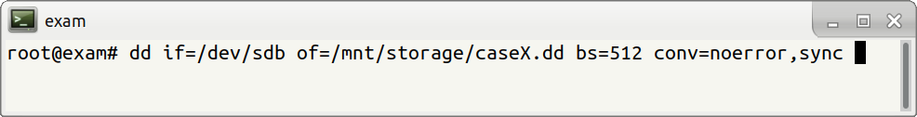
Imaging using dd
dd is a common tool to transfer data between two endpoints (files)
if refers to the source device (/dev/sdb)
of refers to the target (external device)
bs block size (the amount of data to read at once)
conv=noerror,sync makes sure the processing doesn’t stop error and failing blocks are filled with 0’s

Slide 27


Slide 28
