Slide 1

OT Cybersecurity
Protecting Critical Industrial Systems
Nowshaba Jeelani Wani,
University College Cork

Slide 2
Nowshaba Jeelani Wani
University College Cork, J&J Medtech (Depuy Synthes).
Masters in Applied Mathematics and Physics: Moscow Institute of physics and technology.
B.Tech, Computer Science and Engineering: University of Kashmir
PhD Research: Cybersecurity for Operational Technologies: Intrusion Detection in Industrial Control Systems

Slide 3
Definition of Operational Technology (OT)
Operational Technology (OT) encompasses the hardware and software systems that detect or cause changes through direct monitoring and control of physical devices, processes, and events in various industrial environments. OT systems are essential for the functioning of critical infrastructure, ensuring that processes such as manufacturing, transportation, and utilities operate efficiently and safely.

Slide 4
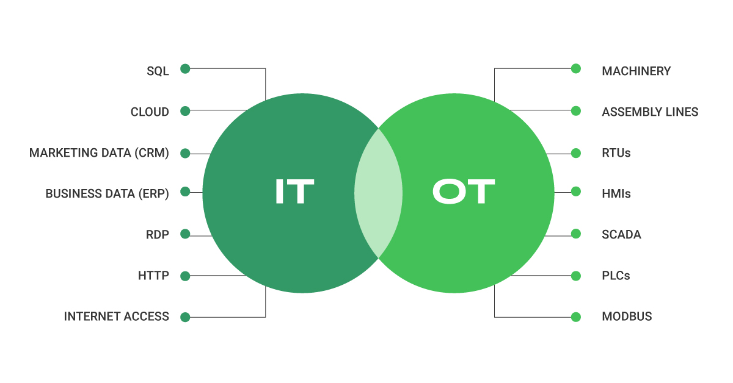
Difference between OT and IT:

Slide 5
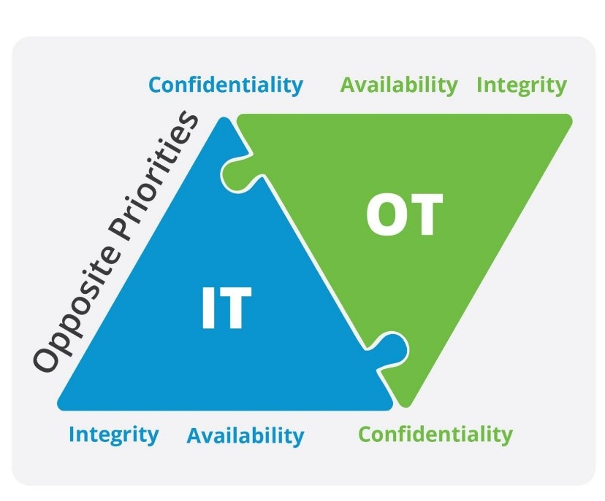
Difference of Priorities In OT and IT security:

Slide 6
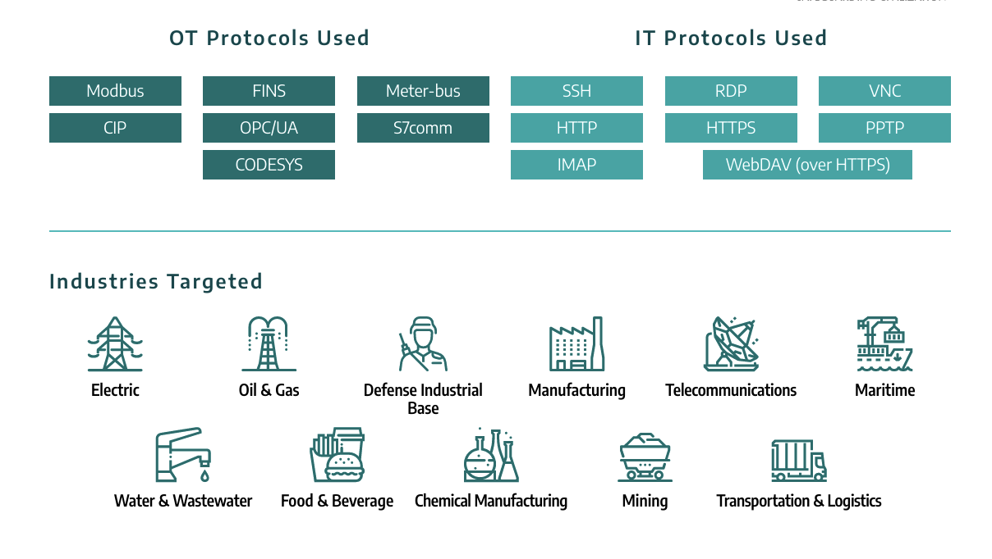

Slide 7
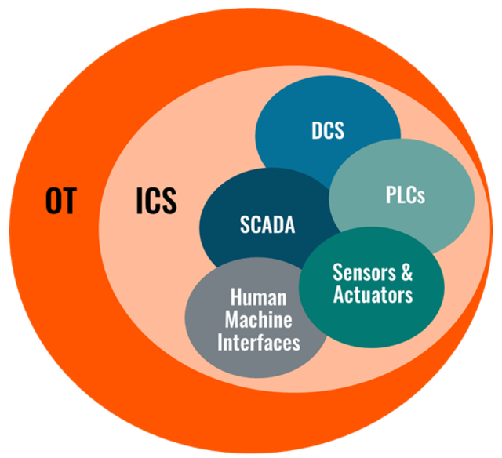
Role of Industrial Control Systems (ICS)
Industrial Control Systems (ICS) are a subset of OT that includes various control systems used in industrial production such as SCADA (Supervisory Control and Data Acquisition), PLC (Programmable Logic Controller), and DCS (Distributed Control System). These systems are designed for monitoring and controlling physical processes in real-time, often requiring high levels of reliability and availability to maintain operational safety and performance.

Slide 8
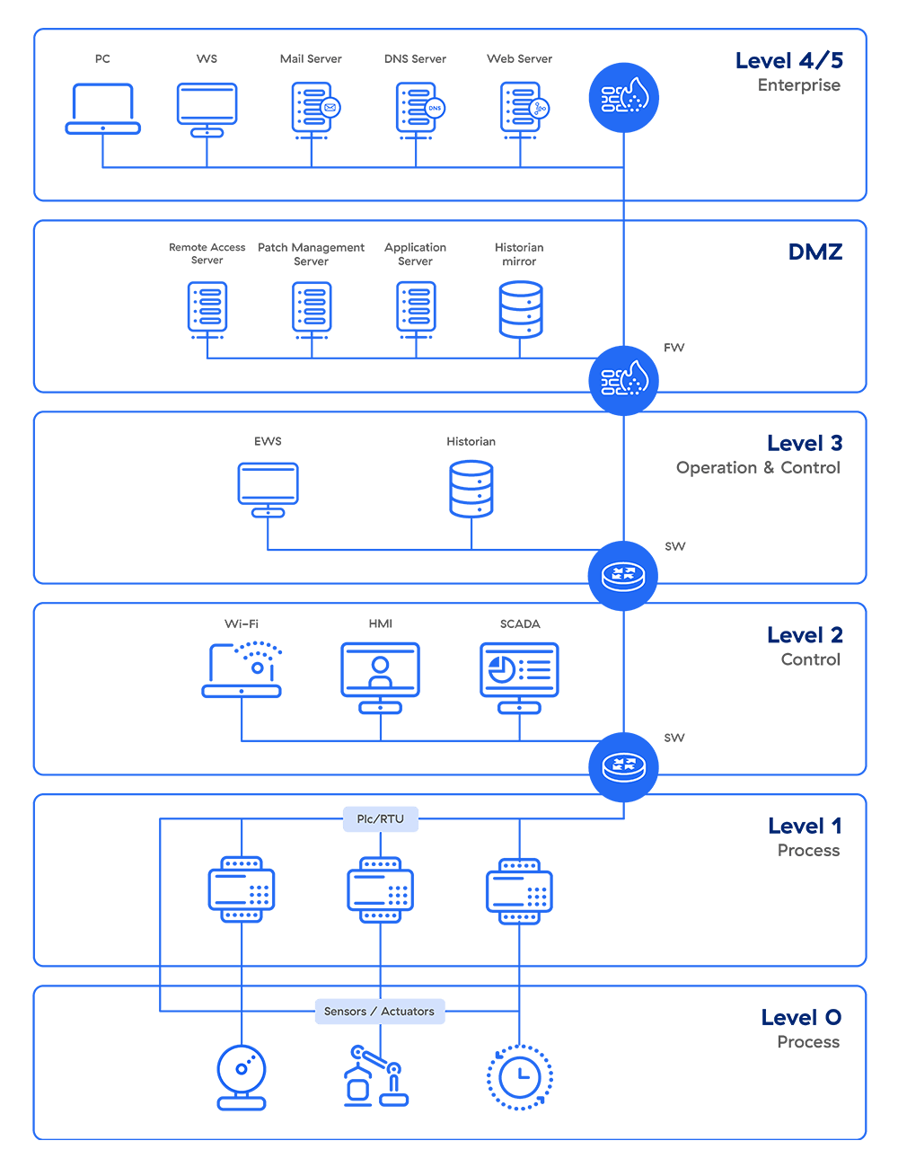
Security of Industrial Control Systems (ICS)

Slide 9
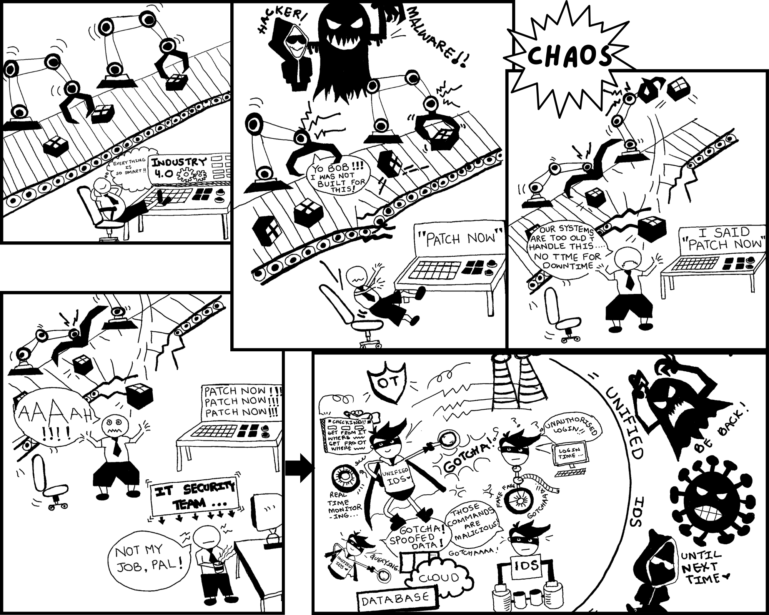

Slide 10
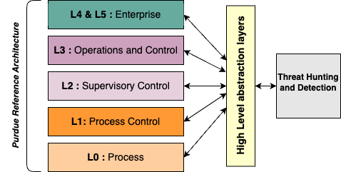

Slide 11
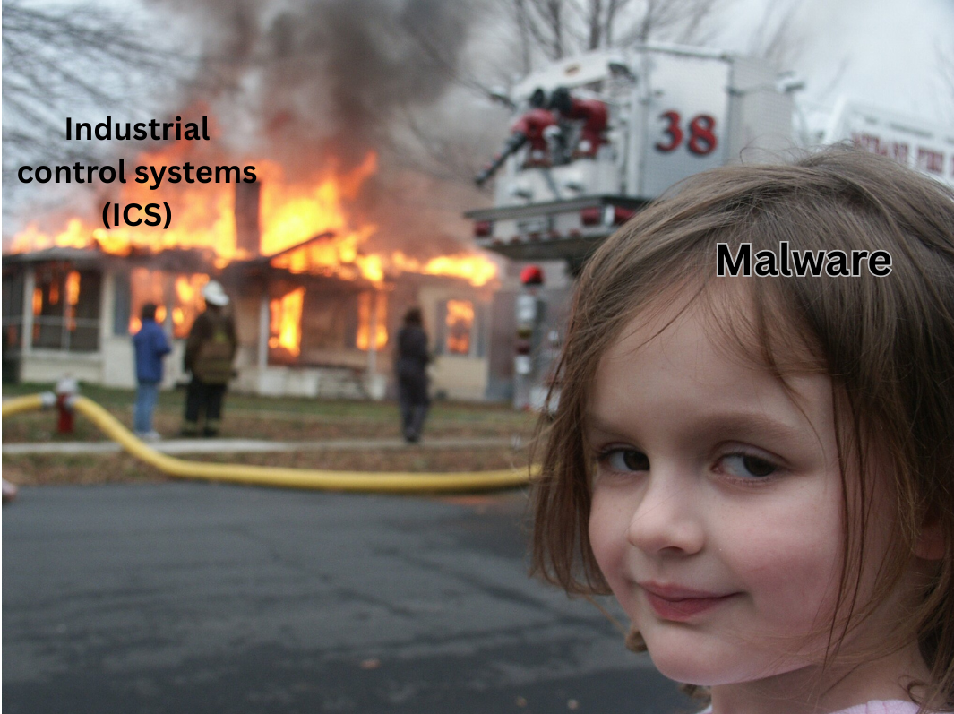


Slide 12
Thank you!
Any questions?

